Slide 1

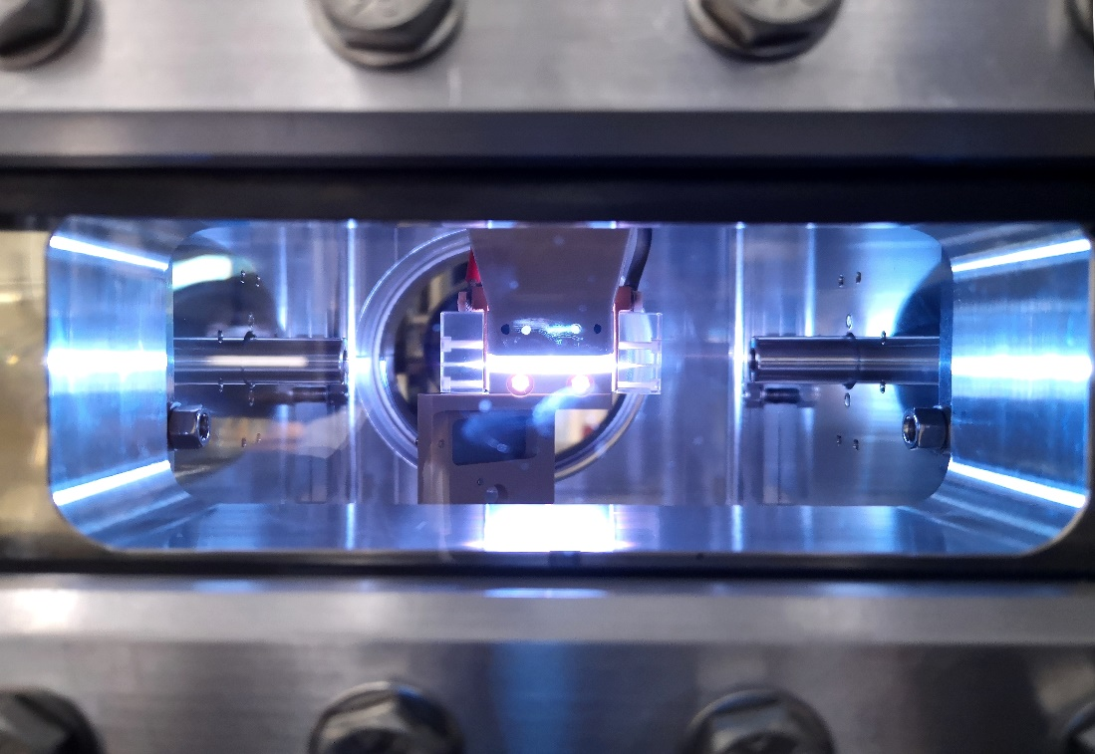


First SASE and Seeded FEL Lasing
based on a beam-driven wakefield accelerator
Angelo Biagioni
On behalf of the SPARC_LAB collaboration

Slide 2


Outline
  Plasma acceleration experiments at SPARC_LAB test facility
  Plasma accelerating structure
  Plasma-acceleration experiments by using particle-driven technique
  Proof-of-principle experiments demonstrating the first lasing of a FEL driven by a PWFA
        SASE
        Seeded
  EuPRAXIA@SPARC_LAB design study
2/28

Slide 3

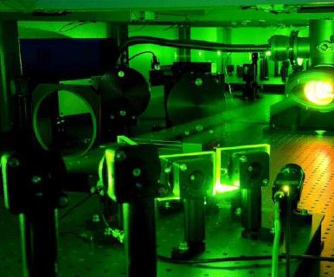
Plasma-based experiments at SPARC_LAB test facility
High-power laser
Energy | 6 J
Duration | 25 fs
Wavelength | 800 nm
Bandwidth | 60/80 nm
Spot@focus | 10 um
Peak power | 250 TW
Contrast ratio | 10¹⁰
Laser-driven plasma
acceleration
EuPraxia Betatron
Source
Particle-driven plasma acceleration
Angelo.Biagioni@lnf.infn.it ▪ INFN-LNF
3/28

Slide 4

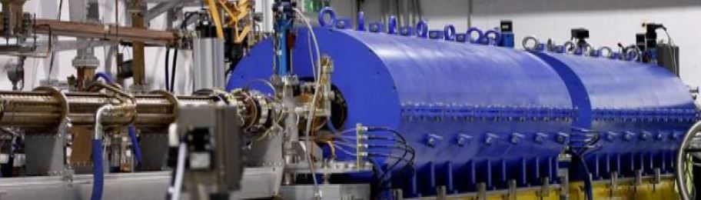
Plasma-based experiments at SPARC_LAB test facility
HB photo injector
Two S-band and one C-band accelerating structures able to produce up to 170 MeV bunch energy
Bunch length around tens of fs
Emittance less than 1 µm
4/28

Slide 5
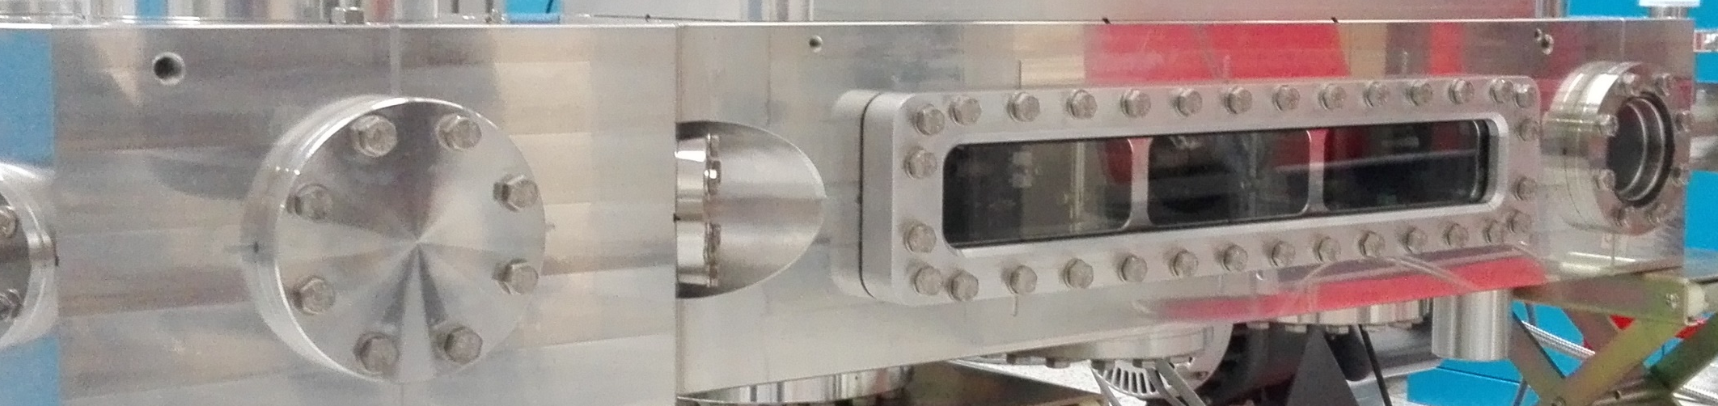
Plasma-based experiments at SPARC_LAB test facility
Plasma accelerating structure
3D-printed plasma sources (plastic)
3cmx2mm capillary
Plasma densities 10¹⁶ – 10¹⁷ cm⁻³
5/28

Slide 6
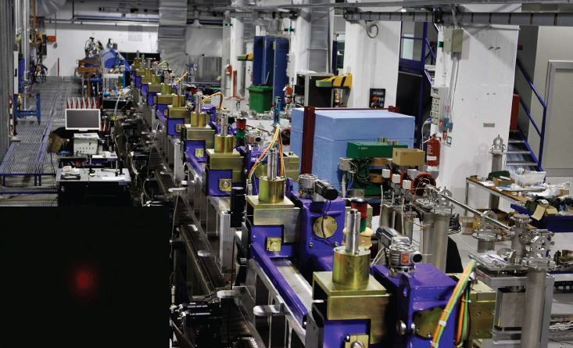
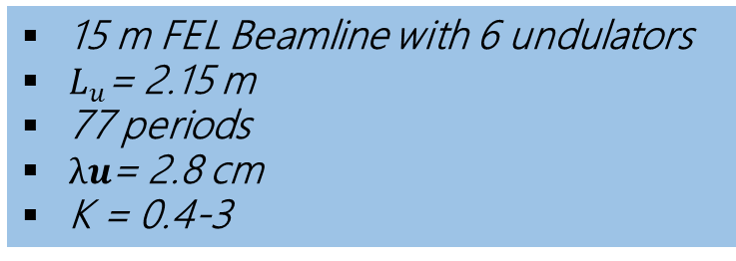
Plasma-based experiments at SPARC_LAB test facility
Free Electron Laser
15 m FEL Beamline with 6 undulators
$L_{u}$= 2.15 m
77 periods
$λu$= 2.8 cm
K = 0.4-3
Pompili, R., et al. Free-electron lasing with compact beam-driven plasma wakefield accelerator.
Nature 605, 659–662 (2022).
Angelo.Biagioni@lnf.infn.it ▪ INFN-LNF
6/28

Slide 7
Outline
  Plasma acceleration experiments at SPARC_LAB test facility
  Plasma accelerating structure
  Plasma-acceleration experiments by using particle-driven technique
  Proof-of-principle experiments demonstrating the first lasing of a FEL driven by a PWFA
        SASE
        Seeded
  Plasma accelerating structure
7/28

Slide 8
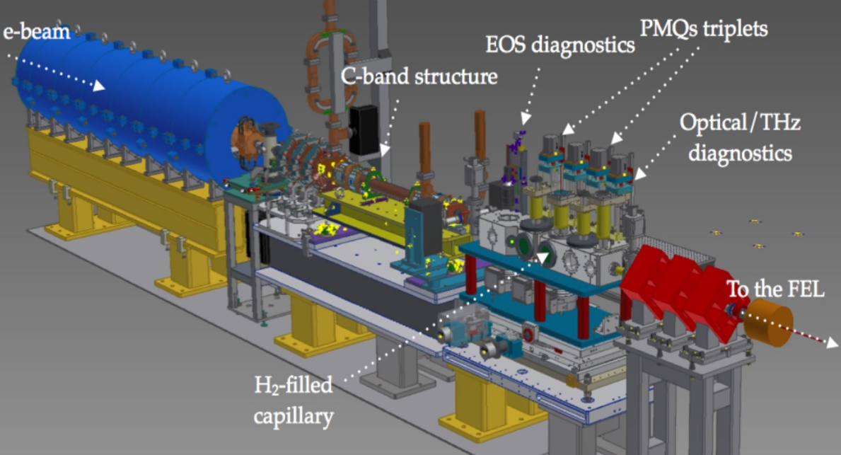
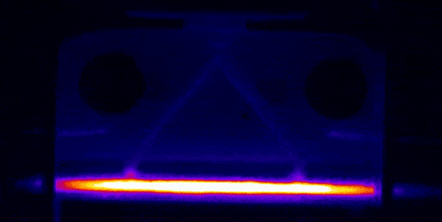

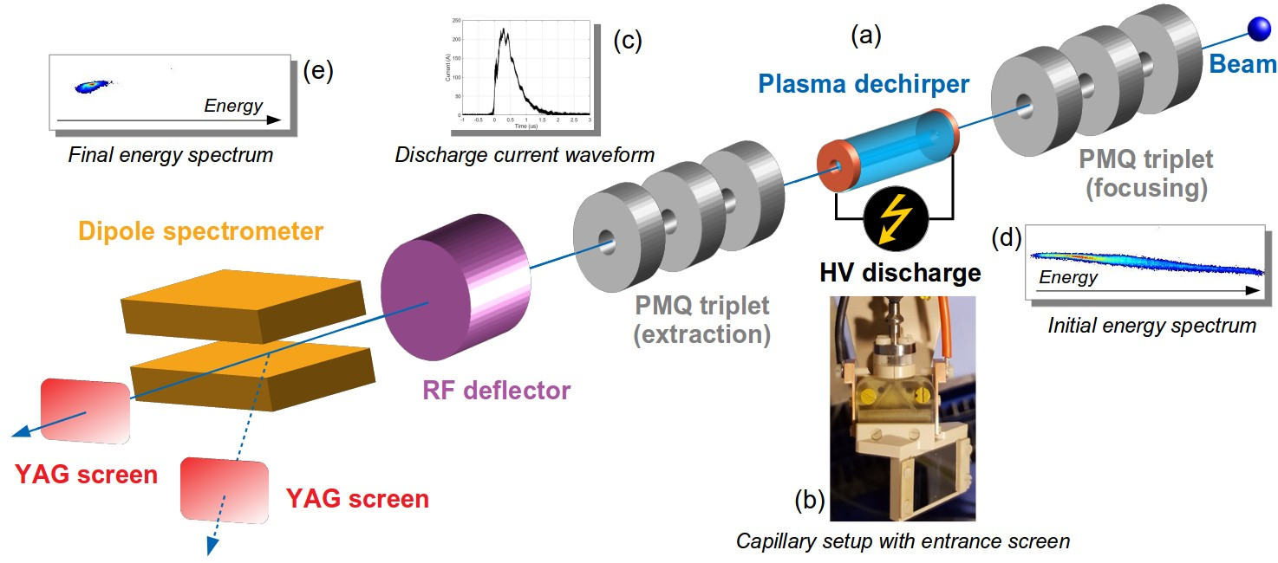
Plasma accelerating structures: Gas-filled capillary discharges
Biagioni A., et al., JINST 11.08
(2016): C08003
Capillary
SPARC_lab linear accelerator
8/28

Slide 9
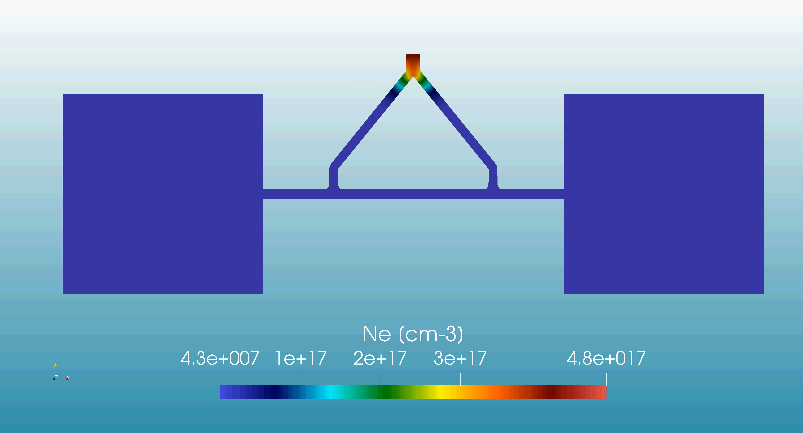
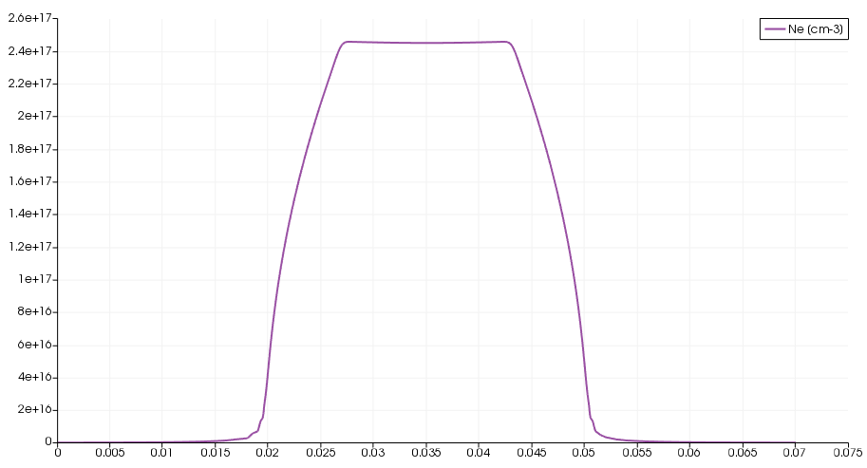
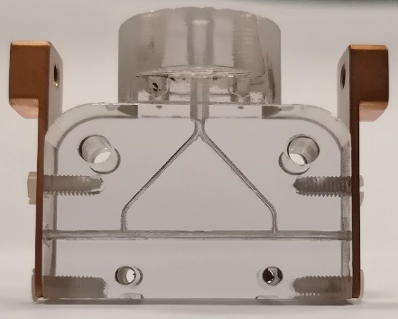
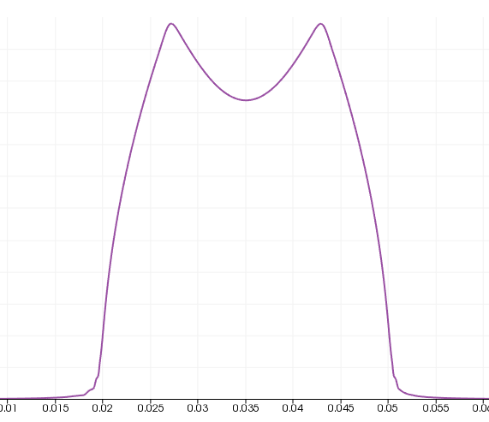
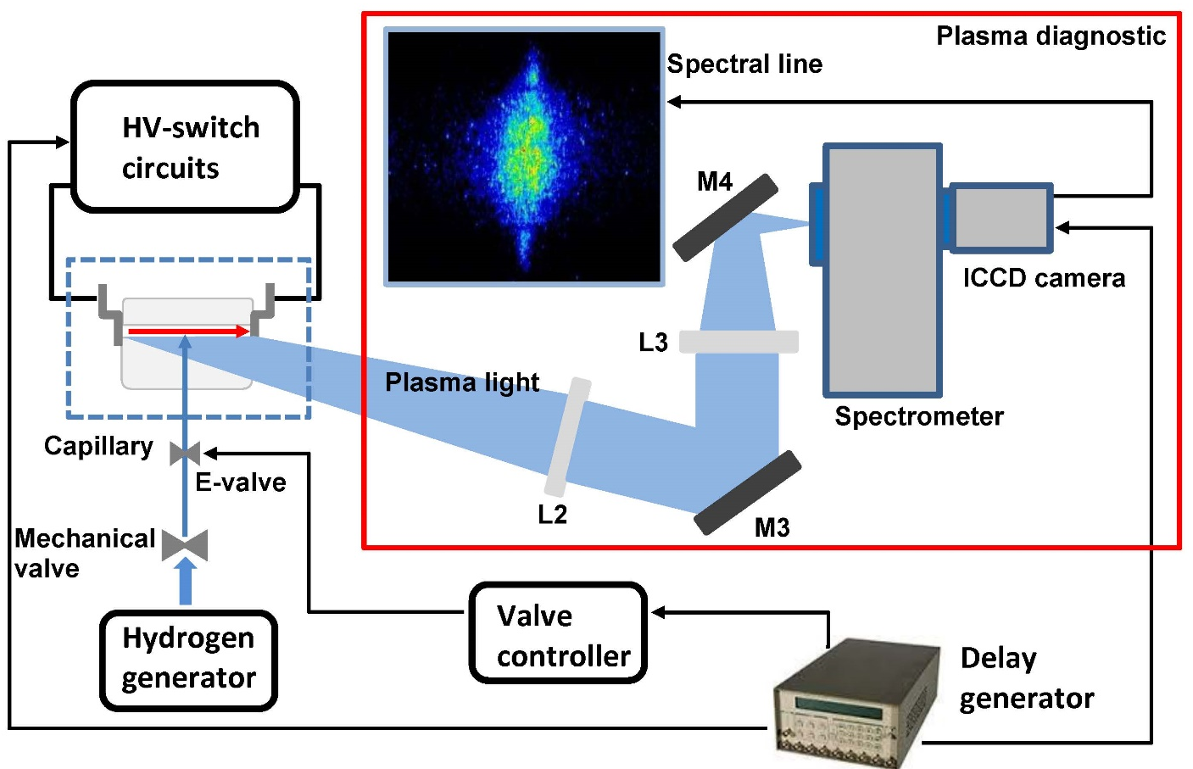
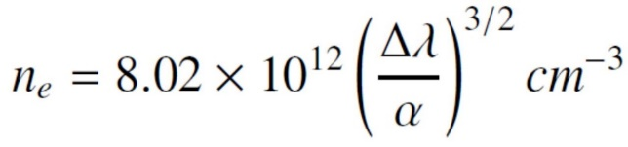
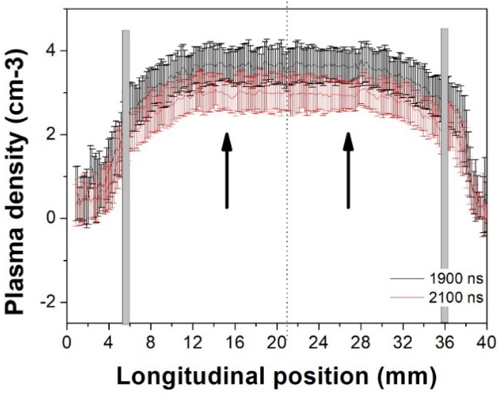
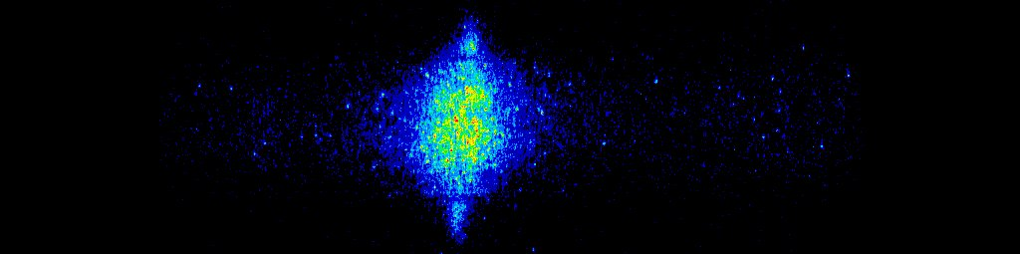
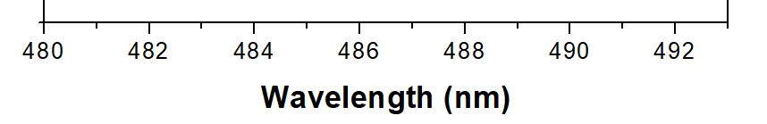
Plasma accelerating structures: Gas-filled capillary discharges
OpenFOAM code
for neutral gas distribution
2.5E17
0 – 5 ms
1 ms
0-5 ms
Electrode
4.5 ms
HV pulse
Gas inlets
6E16
Plasma channel
2E16
By applying the HV pulse...
Density profile
9/28

Slide 10
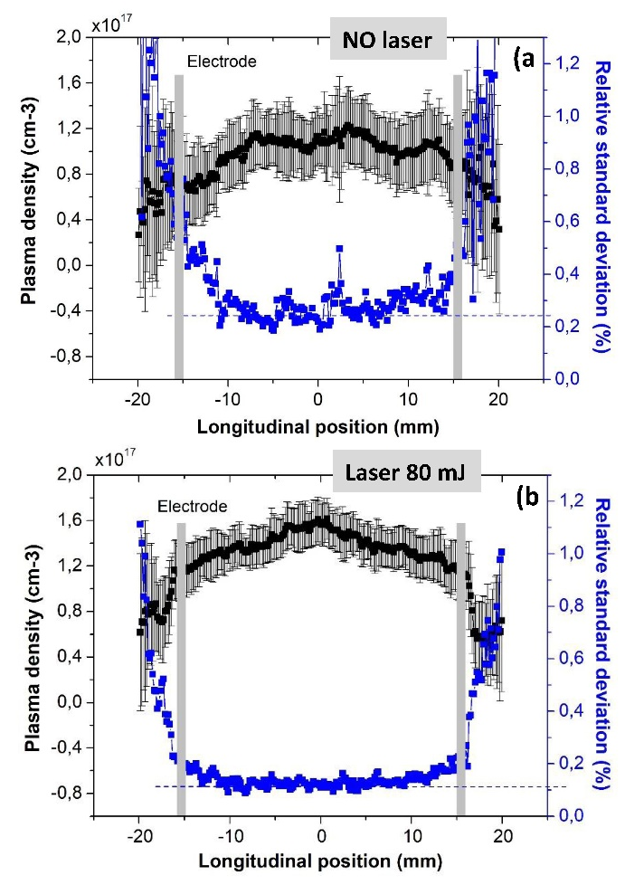
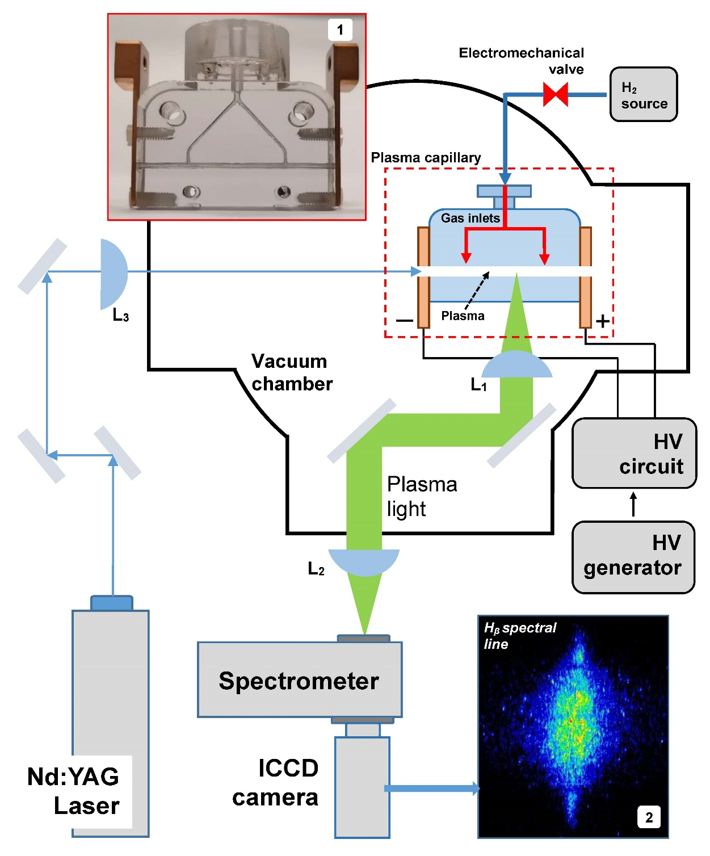
Plasma accelerating structures: Gas-filled capillary discharges
There are two main sources of jitter
  Plasma density fluctuations (to reduce this jitter source, we pre-ionize the Hydrogen gas with an external laser (100 uJ, 2mm diameter laser pulse reaches the negative electrode hole around 400 ns before the discharge trigger).
  Driver-witness separation jitter in a beam-driven plasma is limited by RF sync
Laser 100 uJ
Biagioni A., et al. "Gas-ﬁlled capillary-discharge stabilization for plasma-based accelerators by means of a laser pulse.“ Plasma Physics and Controlled Fusion (2021). 63(11) 115013
M. Galletti, et al.: "Advanced Stabilization Methods of Plasma Devices for Plasma-Based Acceleration." Symmetry 2022, 14(3), 450.
10/28

Slide 11
Outline
  Plasma acceleration experiments at SPARC_LAB test facility
  Plasma accelerating structure
  Plasma-acceleration experiments by using particle-driven technique
  Proof-of-principle experiments demonstrating the first lasing of a FEL driven by a PWFA
        SASE
        Seeded
  Plasma-acceleration experiments by using particle-driven technique
11/28

Slide 12
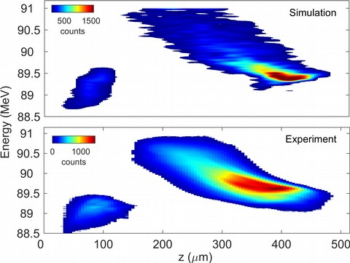
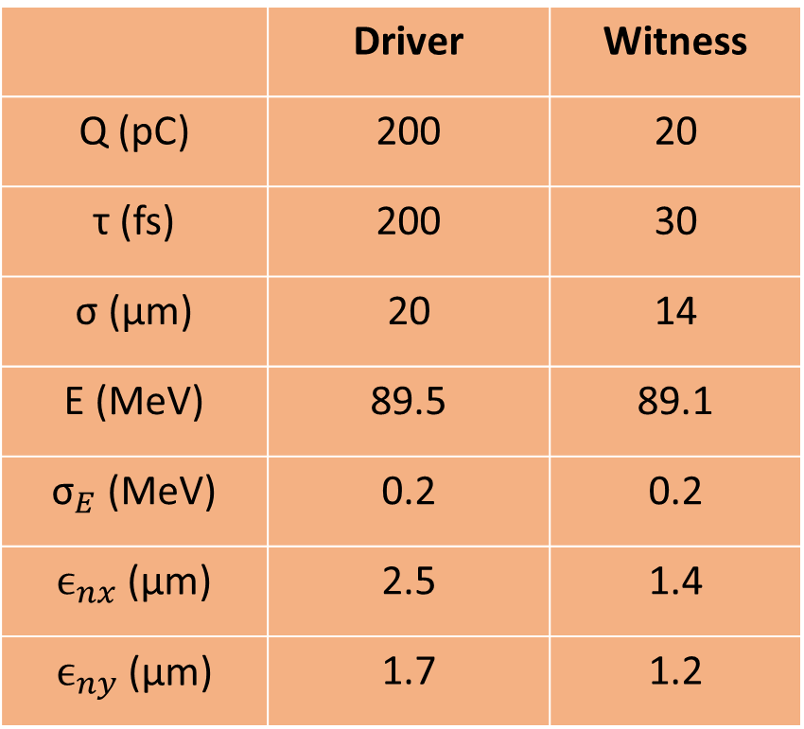
Plasma-acceleraiton experiments - Beam configuration @ the plasma entrance
Two-bunches configuration with a time-separation of approximately 1 ps
 | Driver | Witness
Q (pC) | 200 | 20
τ (fs) | 200 | 30
σ (μm) | 20 | 14
E (MeV) | 89.5 | 89.1
${\text{σ}}_{E}$ (MeV) | 0.2 | 0.2
$ϵ_{nx}$ (μm) | 2.5 | 1.4
$ϵ_{ny}$ (μm) | 1.7 | 1.2
D
D
W
Nearly the same energy with plasma OFF
Angelo.Biagioni@lnf.infn.it ▪ INFN-LNF
12/28

Slide 13
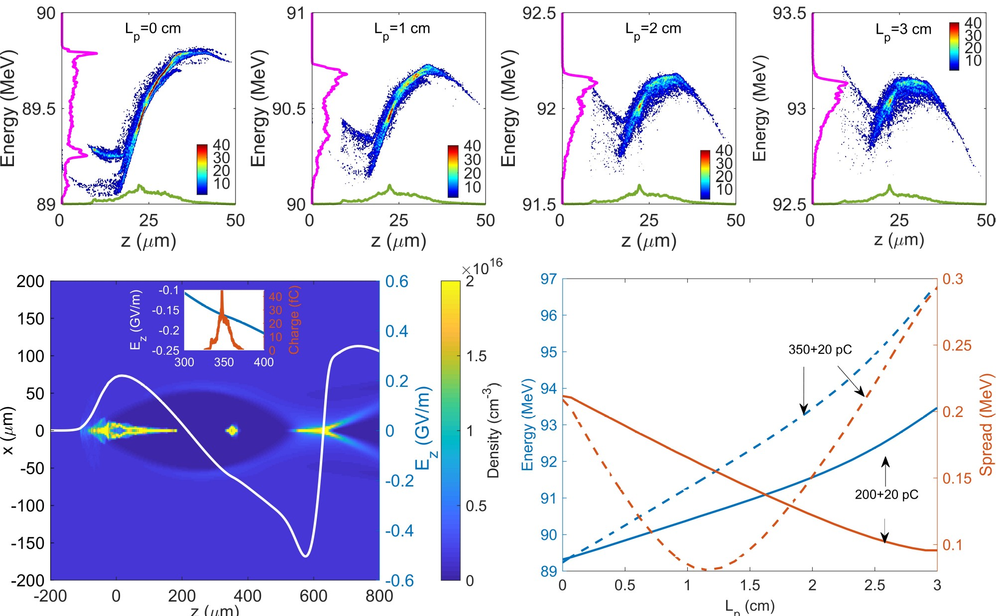
Plasma-acceleraiton experiments - Assisted beam-loading technique
Pre-chirp to compensate wakefield slope
By setting a positive energy chirp on the witness bunch, we compensate the chirp imprinted in the acceleration stage, resulting in an ultralow energy spread that is even lower than the spread at the plasma entrance
The witness relative energy spread goes from 0.2% to 0.1% after 3 cm long plasma device
W
D
Angelo.Biagioni@lnf.infn.it ▪ INFN-LNF
13/28

Slide 14
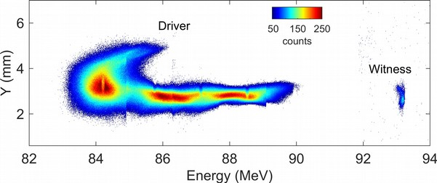
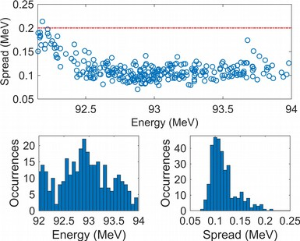
First Plasma acceleration results
4 MeV acceleration in 3 cm plasma capillary with 200 pC driver/20 pC witness
  2x10¹⁵ cm-3 plasma density
  ~130 MV/m accelerating gradient
Demonstration of energy spread compensation
  Total projected spread from 0.2 MeV to 0.12 MeV
Initial energy
Pompili, R., et al. "Energy spread minimization in a beam-driven plasma wakefield accelerator." Nature Physics 17.4 (2021): 499-503.
14/28

Slide 15
Outline
  Plasma acceleration experiments at SPARC_LAB test facility
  Plasma accelerating structure
  Plasma-acceleration experiments by using particle-driven technique
  Proof-of-principle experiments demonstrating the first lasing of a FEL driven by a PWFA
        SASE
        Seeded
  Proof-of-principle experiments demonstrating the first lasing of a FEL driven by a PWFA
15/28

Slide 16
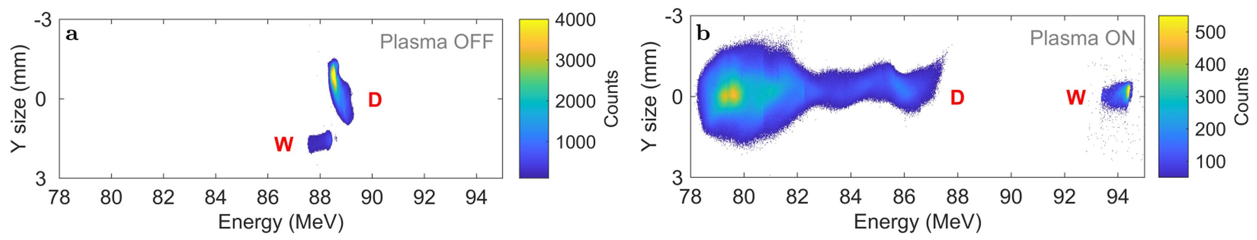
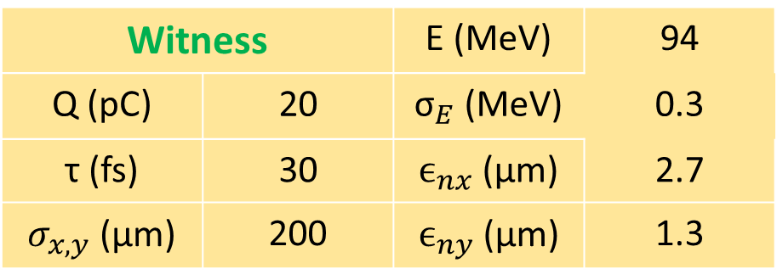

SASE FEL driven by PWFA – Beam configuration
Plasma density set to 2x10¹⁵ cm⁻³
Accelerated witness (~200 MV/m acceleration gradient)
Driver decelerated by almost 10 MeV
transverse mismatch
that is 3x the ideal one
$σ_{eq}= {\left(\frac{β_{eq} ε}{γ}\right)}^{0.5}$ $≅5 μm$
Witness | Witness | E (MeV) | 94
Q (pC) | 20 | ${\text{σ}}_{E}$ (MeV) | 0.3
τ (fs) | 30 | $ϵ_{nx}$ (μm) | 2.7
$σ_{x,y}$ (μm) | 200 | $ϵ_{ny}$ (μm) | 1.3
16/28

Slide 17
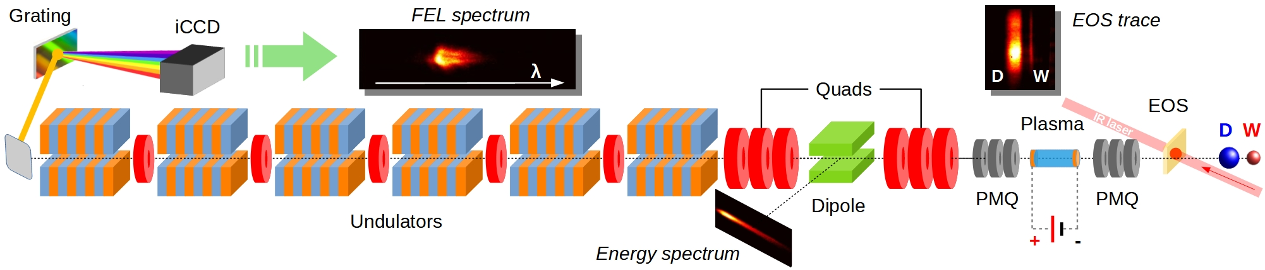
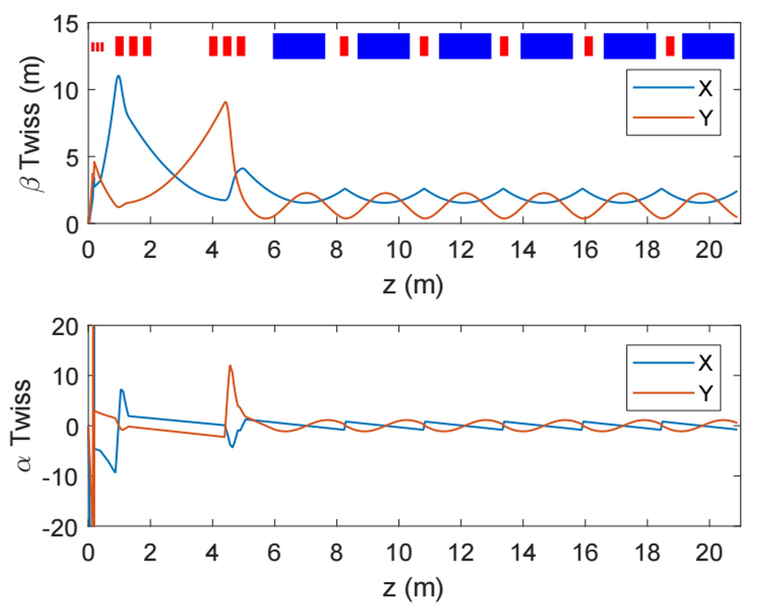
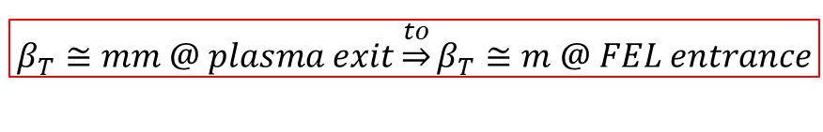
SASE FEL driven by PWFA – Beam transport
  PMQs triplet catches the beam and removes the high divergence.
  The 6 m FODO (6 e.m. quads) stage sets the required Twiss parameters to optimize the FEL performance.
  Low energy beams so UNDs are transport elements (vertical focusing).
  Optimal transport is ensured by 5 short e.m. quads allowing horizontal focus
$$β_{T}≅mm @ plasma exit\underset{⇒}{to}β_{T}≅m @ FEL entrance$$
Angelo.Biagioni@lnf.infn.it ▪ INFN-LNF
17/28

Slide 18
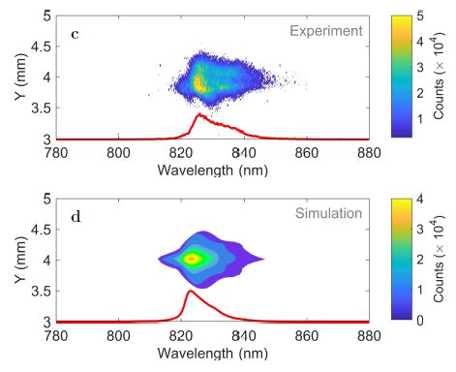
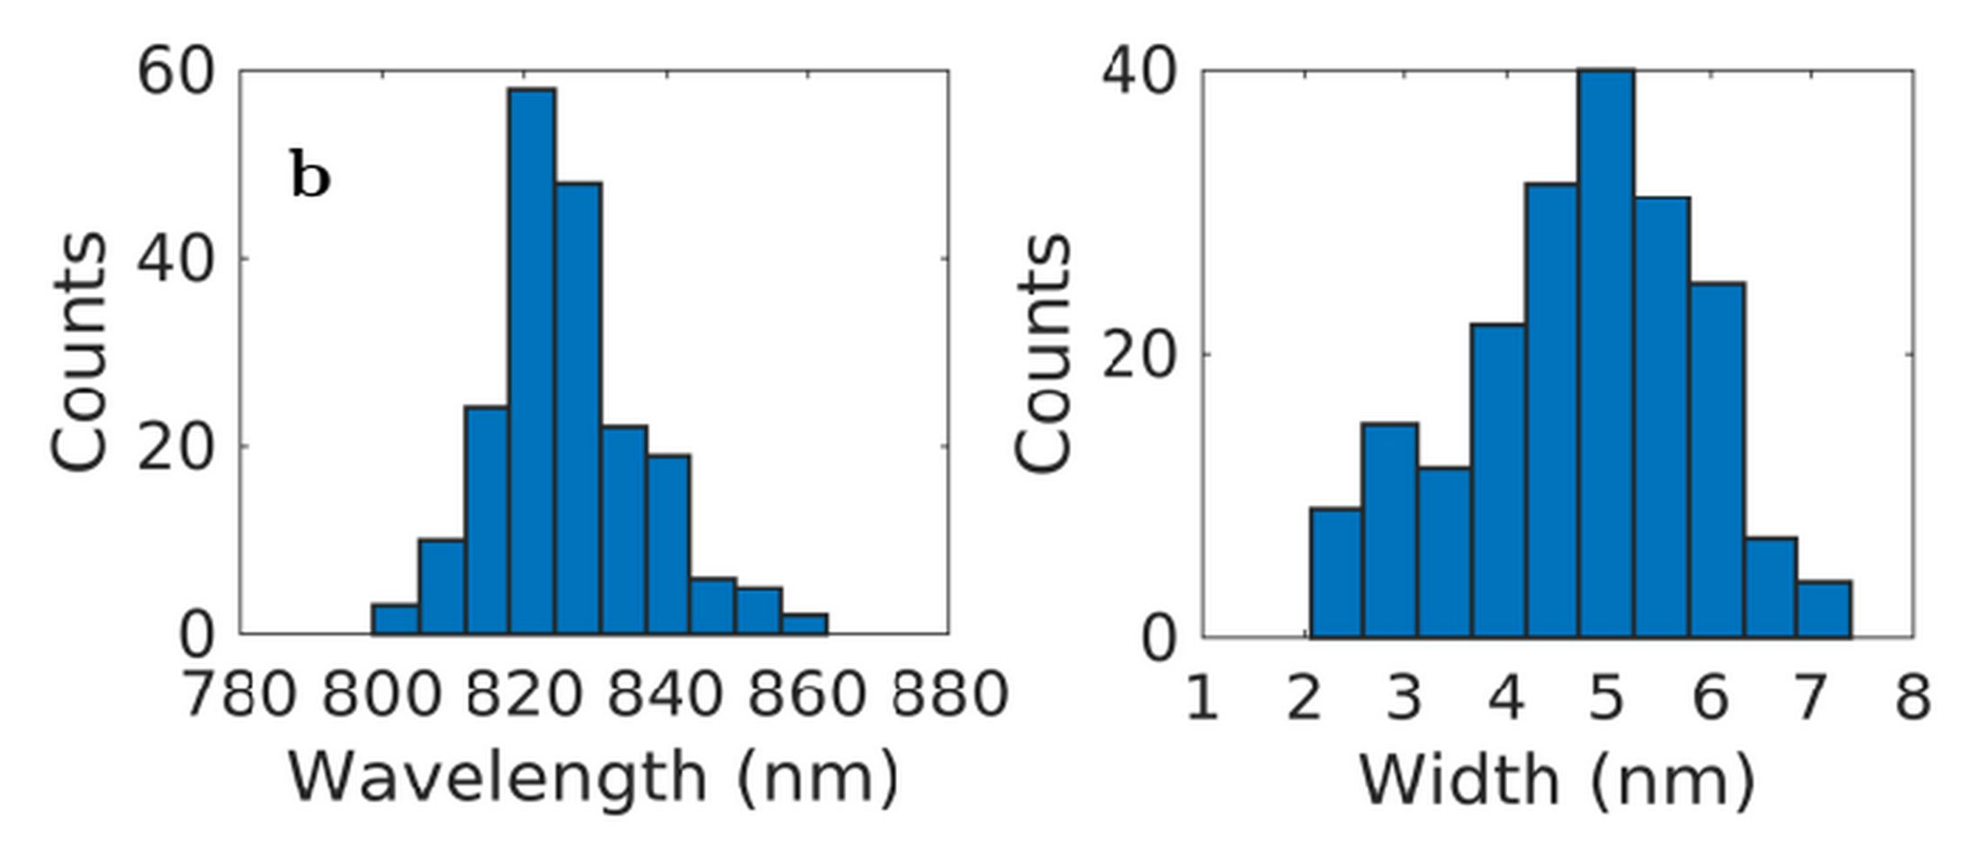
SASE FEL driven by PWFA – Radiation spectrum
2D traces of single shot spectra retrieved from experiment and simulation
Histograms of 200 consecutive experimental
spectra reporting the central wavelength and
Width of the radiation.
SASE FEL single-shot spectrum
  30% shot-to-shot reproducibility
  Centered @827 nm with 5 nm BW
  Pulse energy up to 30 nJ
18/28

Slide 19
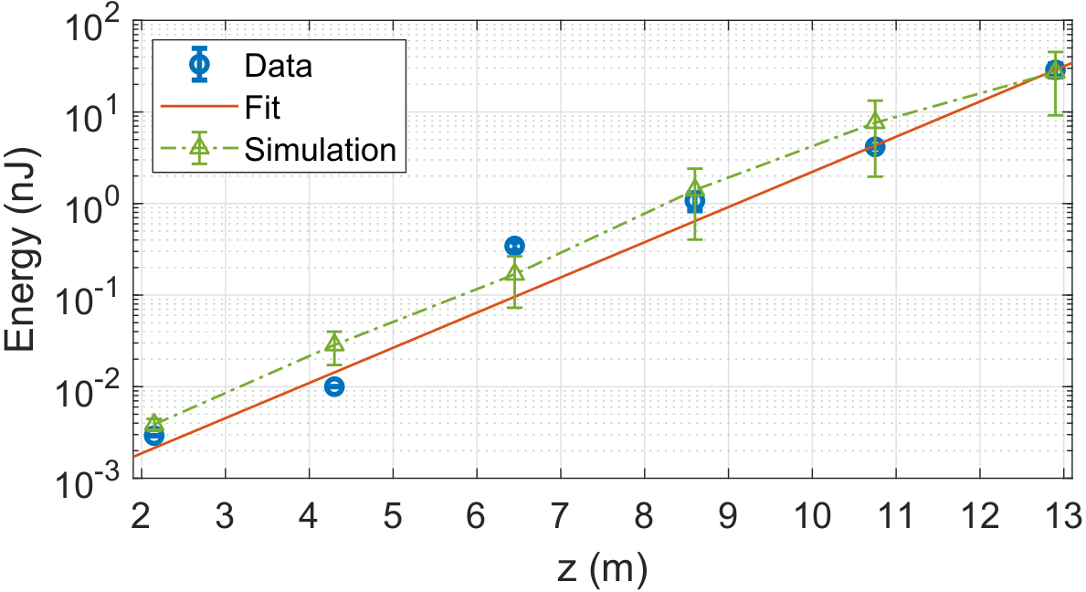
SASE FEL driven by PWFA – exponential gain
Exponential growth of the amplified light. Energy gain of the FEL radiation along the six undulators measured with the photo-diodes.
~30 nJ
R. Pompili, et al. “Free-electron lasing with compact beam-driven
plasma wakefield accelerator.” Nature 605, 659–662 (2022).
Lg = 1.1 ± 0.1 m
SASE FEL radiation @827 nm
Pulse energy increased 4 order of magnitude throughout the UNDs stage.
17% pulse energy RMS fluctuations over 30% of successful shot
19/28

Slide 20
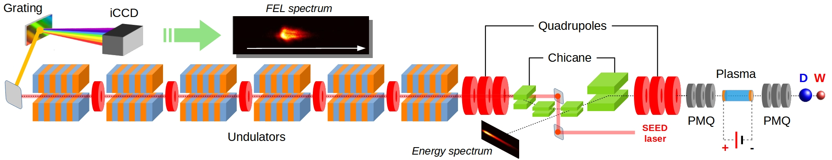
Proof of Seeded FEL from PWFA
The FEL setup is extended, and part of the EOS (IR) laser is used as seed
              Naturally synchronized with the beam, tunable energy (~10 nJ used in the experiment).
              Duration increased from ~200 to 600 fs (FWHM). Focused at the entrance of 1st undulator
Beam is partially displaced by using a magnetic chicane (4 dipoles in 5.75 m) to allow laser injection into the beamline
Same detection setup composed of photo-diodes is used (ND filter changed for larger intensity signals)
Seed Laser is transported up to the imaging spectrometer
Angelo.Biagioni@lnf.infn.it ▪ INFN-LNF
20/28
Notes:
2 mm offset?

Slide 21
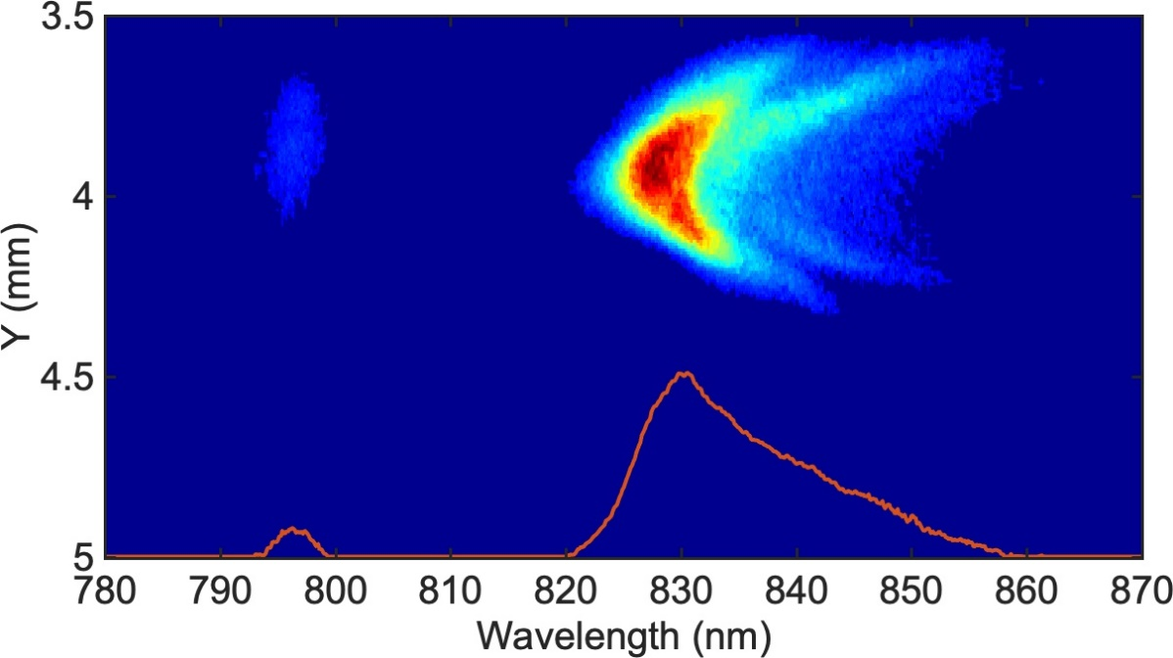
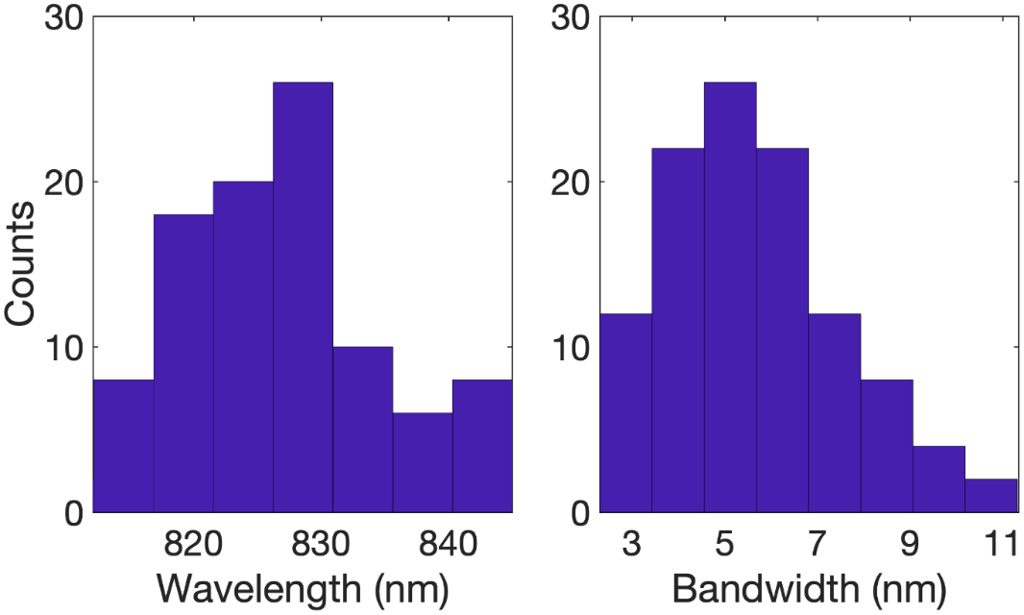
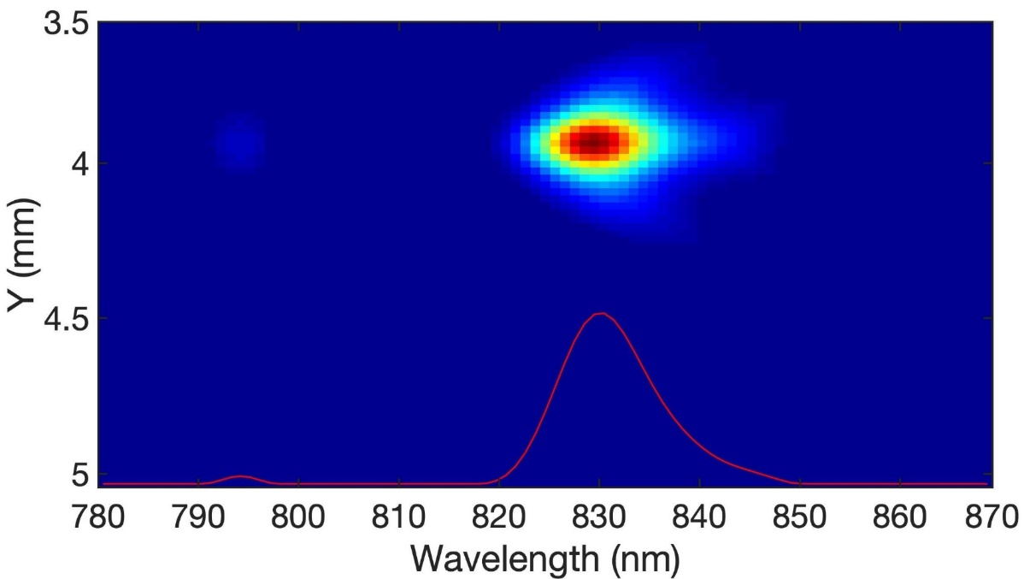
Seeded FEL from PWFA - Radiation spectrum
Theoretical spectrum
laser
Experimental spectrum
Seeded FEL single-shot spectrum
  Clear signals, reproducible day by day
  90% shot-to-shot reproducibility
  Centered @827 nm with 5 nm BW
  Pulse energy up to 1 µJ
laser
Angelo.Biagioni@lnf.infn.it ▪ INFN-LNF
21/28

Slide 22
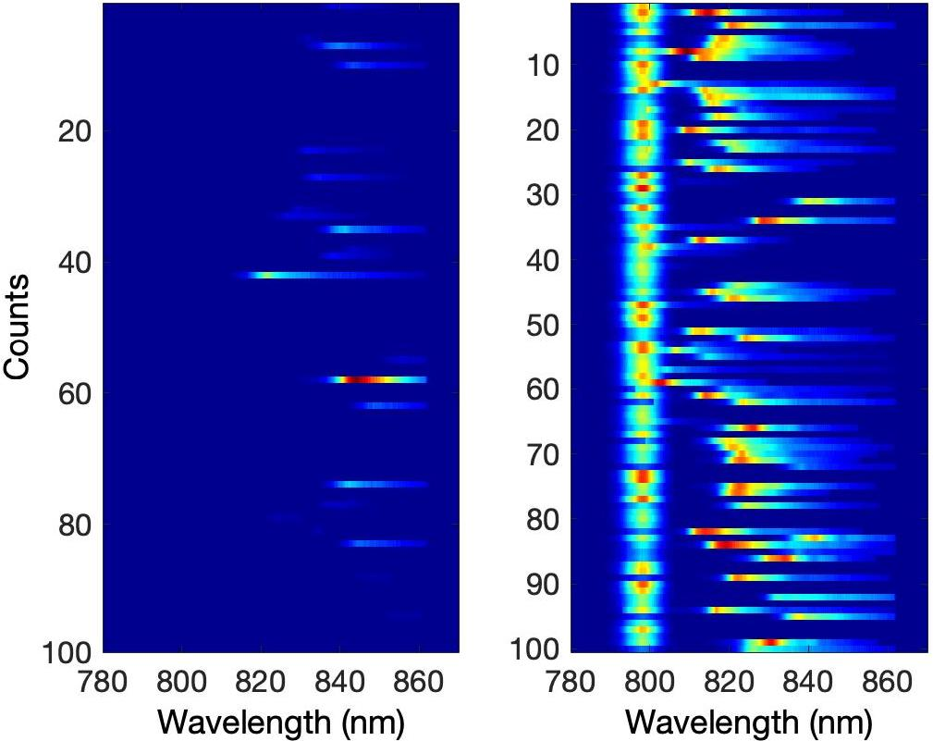
Seeded FEL from PWFA – improved performances
SASE
laser
SEEDED
FEL radiation output is largely stabilized by the seed laser, larger output energy
UNDs tuned for FEL radiation @827 nm → separated from the laser (@800 nm)
Lg SASE = 1.1 ± 0.1 m
Lg seeded = 1.03 ± 0.1 m
M. Galletti, et al. accepted by PRL
Angelo.Biagioni@lnf.infn.it ▪ INFN-LNF
22/28
Notes:
10³ ND filter used @ 6th photodiode

Slide 23
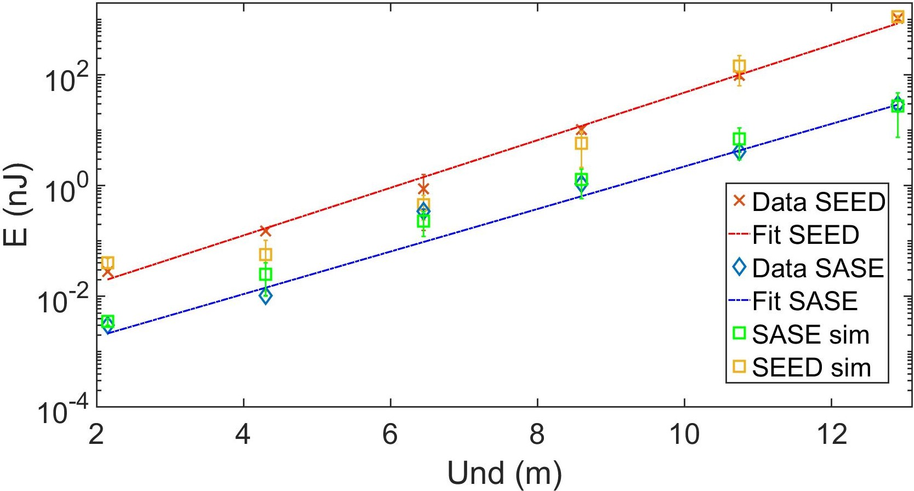
Seeded FEL from PWFA – exponential gain
~1 uJ (SEED)
~30 nJ (SASE)
Seeded FEL radiation
    Pulse energy increased 2 order of magnitude with respect to the SASE radiation
    6% pulse energy RMS fluctuations over 90% of successful shot respect to 17% over 30% of shot for SASE
23/28

Slide 24
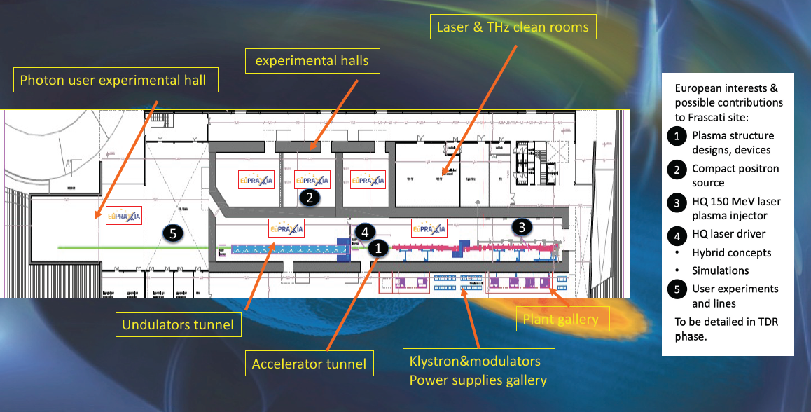
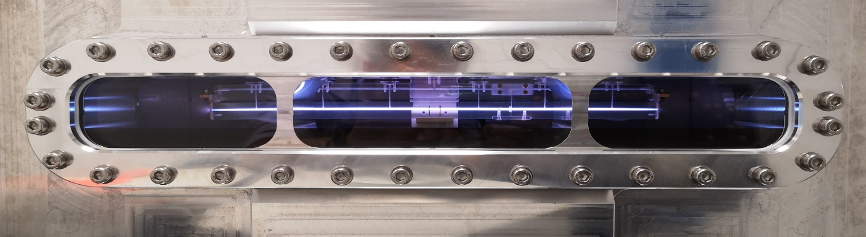
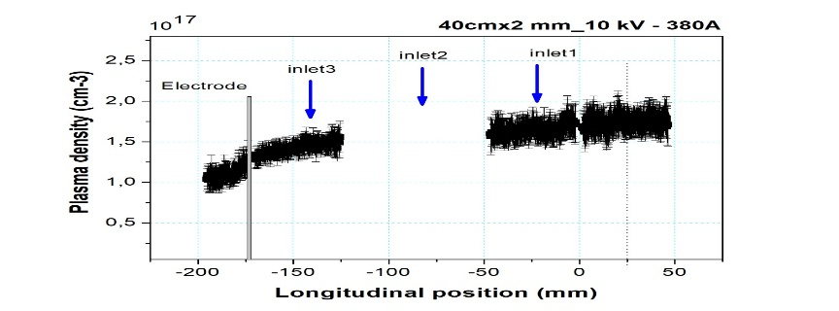

EuPRAXIA@SPARC_LAB design study
First EuPRAXIA goal: 1.1 GeV (1.5 GV/m – 40cm long capillary – 10¹⁶ cm-3 plasma density
X-band RF linac
  25 m (16 active length)
  60 MV/m
  ~ 1 GeV
100 Hz repetition rate
30 m FEL beamline
  $λ_{u}$= 1.5 cm
  K = 1.1
  $L_{g}$= 0.4 m
  $L_{s}$= 20 m
40cm x 2mm long capillary
Rep rate at 10 Hz
10 kV – 380 A (10¹⁷ cm⁻³)
6 inlets of 1 mm in diameter
24/28

Slide 25

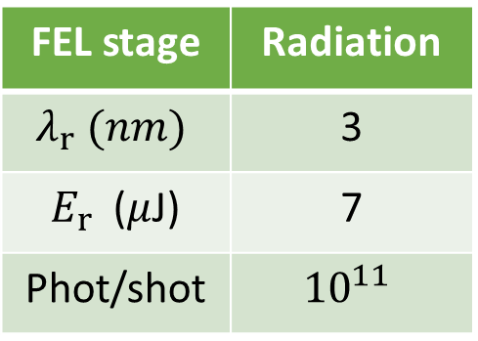
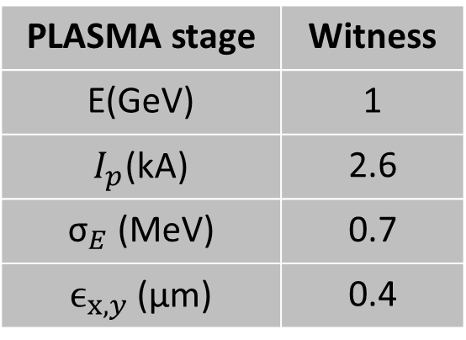
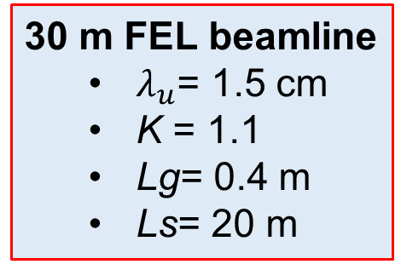
EuPRAXIA@SPARC_LAB design study
EuPRAXIA project foresees the realization of a plasma-based FEL facility in the X-rays range driven by GeV energy beams accelerated by a plasma wakefield acceleration stage.
Beam configuration for PWFA
PLASMA stage | Witness
E(GeV) | 1
$I_{p}$(kA) | 2.6
${\text{σ}}_{E}$ (MeV) | 0.7
$ϵ_{x,y}$ (μm) | 0.4
COMB | Driver | Witness
Q (pC) | 200 | 30
τ (fs) | 200 | 10
E (MeV) | 500 | 500
1.2 GV/m
40 cm long capillary
n_{e} = 10¹⁶ cm-3
30 m FEL beamline
  $λ_{u}$= 1.5 cm
  K = 1.1
  Lg= 0.4 m
  Ls= 20 m
FEL stage | Radiation
$$λ_{r} (nm)$$ | 3
$E_{r}$ ($μ$J) | 7
Phot/shot | $${10}^{11}$$
One user beam line
particular interest in performing measurement in the so-called water window
the energy range between carbon (282 eV) and oxygen (533 eV)
In this range the absorption contrast between the carbon of organelles and the water (cytoplasm and the liquid surrounding the cell) is quite high. For this reason, cells can be imaged in their living, native state, without the need of cooling or staining them
25/28

Slide 26
Conclusions
Optimization of plasma-based accelerators is still ongoing, many promising results obtained in the last few years
  Control of the accelerated beam parameters over many hours of operation
  Preservation of the beam quality in terms of energy spread
  Last experiments show accelerating gradients up to 830 MV/m
We have now evidence of first FEL lasing from particle-driven plasma wakefield acceleration
  Proof-of-principle experiments based on SASE and Seeded FEL radiation
Results obtained @SPARC_LAB test facility show that PWFA may be a possible solution for FELs
    Complete characterization of the plasma–accelerated witness bunch allowed proper matching into the undulators
    Measurements of the emitted radiation confirm the typical FEL amplification signatures
Fundamental steps toward the future EuPRAXIA plasma-based facility for user-oriented applications
26/28

Slide 27
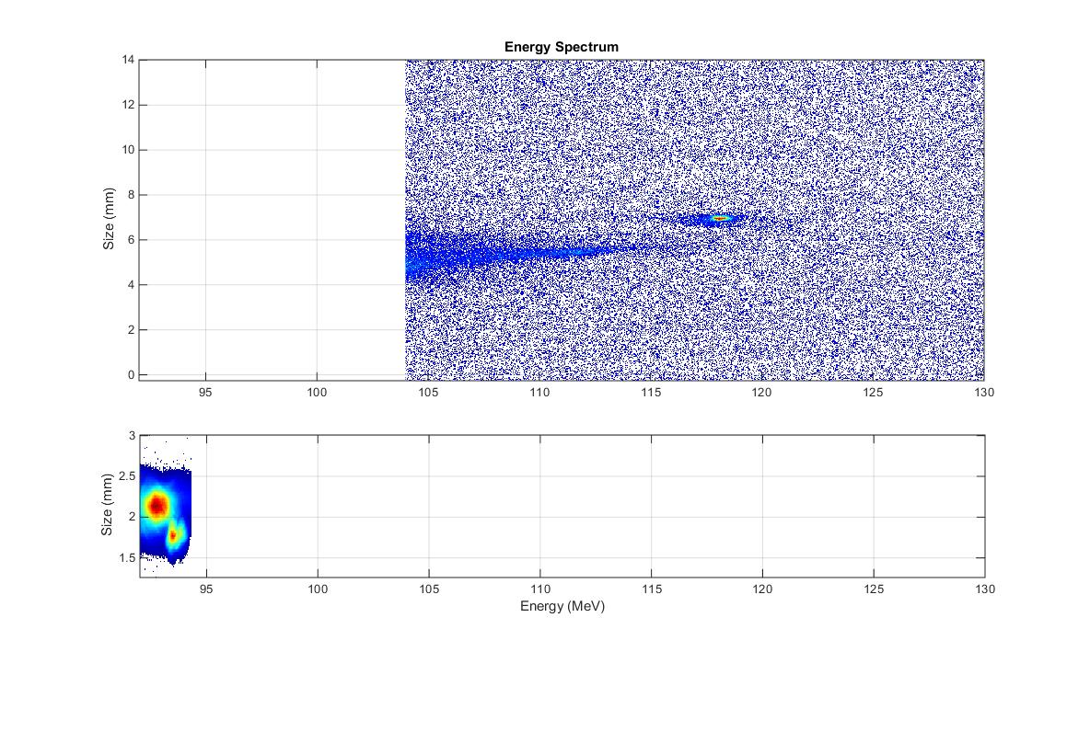
Last preliminary results
W
D+W
25 MeV acceleration in 3 cm plasma capillary with 1 nC driver/100 pC witness
  2x10¹⁵ cm-3 plasma density
  ~830 MV/m accelerating gradient
27/28

Slide 28


Thank you for your
attention
Angelo.Biagioni@lnf.infn.it ▪ INFN-LNF ▪ 6 – 11 November 2022

Slide 29
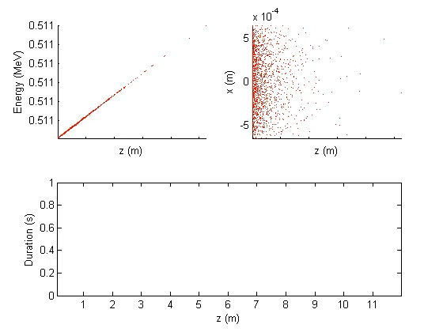
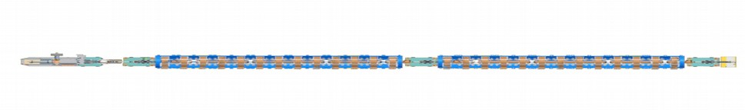
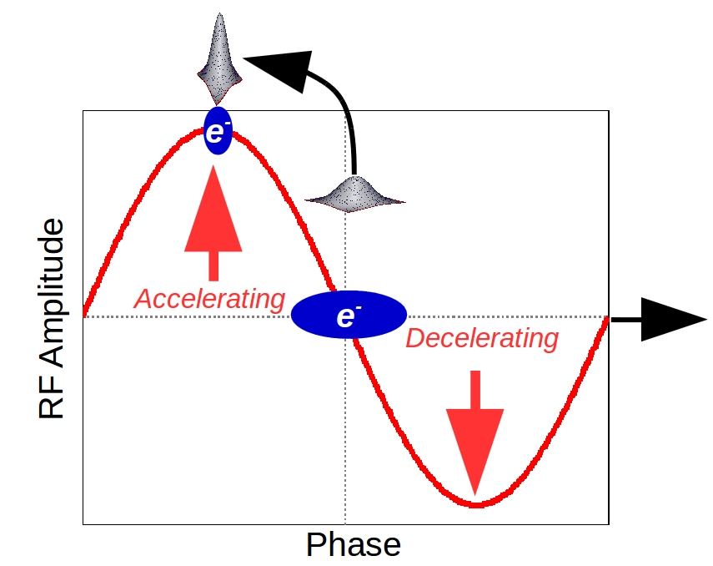
Velocity bunching
Alternative technique to compress bunches with respect to magnetic compression is the velocity bunching technique.
200+20 pC GPT simulation
Velocity bunching compression
It simultaneously accelerate and compress the electron bunches, making the photo-injector very compact.
Angelo.Biagioni@lnf.infn.it ▪ INFN-LNF

Slide 30

Velocity bunching
Seeded FEL radiation @827 nm energy gain obtained with a varying seeded laser wavelength (blue crosses)
Theoretically pulse energy increased 2 order of magnitude respect to SASE radiation
The red dashed line shows the Gaussian fit of the theoretical data centered @826.6 nm, meaning maximum extraction when FEL radiation and seed laser have the same wavelengths.
The green circle shows the prediction of the energy gain of the FEL seeded with our experimental parameters.
Experiment
Simulation
Angelo.Biagioni@lnf.infn.it ▪ INFN-LNF

Slide 31
Velocity bunching
Two pulse configuration produced directly in an interferometric-like setup equipped with pulse shaping stages.
Angelo.Biagioni@lnf.infn.it ▪ INFN-LNF

