Slide 1
Snowmass Process Advanced Accelerator Concepts
(AF6) Perspective
Cameron Geddes, Mark Hogan, Pietro Musumeci, Ralph Assmann (AF6)
Marlene Turner, Spencer Gessner (liasons to ITF & AF4)
9 November 2022
1

Slide 2
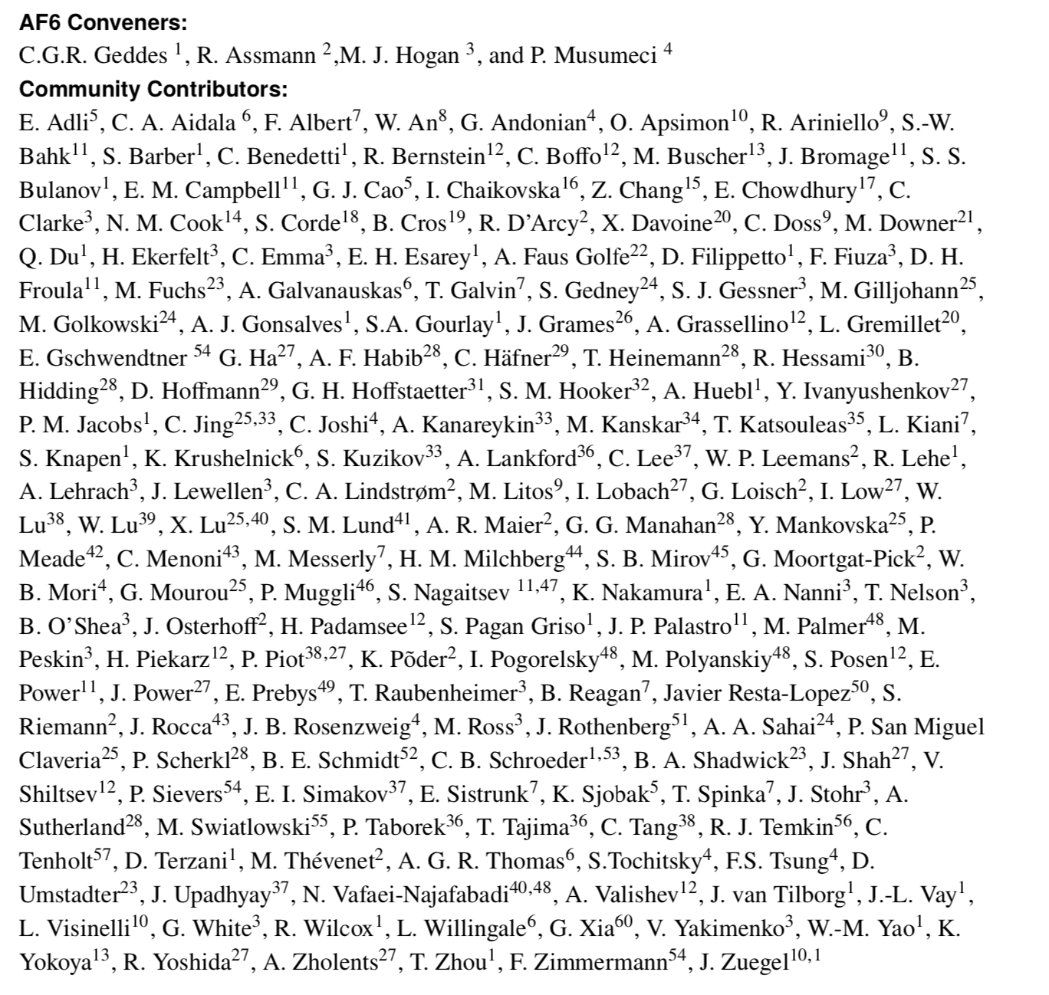
Thank You to the AF6 & Advanced Accelerator Community
Report of the Accelerator Frontier Topical Group 6 on Advanced Accelerator Concepts for Snowmass 2021
https://arxiv.org/abs/2208.13279
Thanks for coordination and work with the Implementation Task Force and AF4 collider Groups, the overall AF, EF, TF, CoF, CmF, and the overlapping European Strategy for Particle Physics Roadmap group.

Slide 3
AF6 Assessed and Planned Advanced Accelerator Options
For Future Colliders With Related Snowmass Groups
Decadal options for high energy physics informing P5 strategic planning & prioritization
Energy, Theory Frontier – motivation for high energy colliders, physics analysis of collider options
Community Engagement – near term applications, DEI…; Computational – simulation tools
Accelerator Frontier – needs to advance physics; state of art; facilities available in next decade; R&D to enable future opportunities; time and cost scales of R&D and test facilities
AF6– Advanced Accelerator Concepts for future colliders, relationship to other applications
AF4 – Multi-TeV colliders – Assessment of collider options and readiness – https://indico.fnal.gov/event/22303/contributions/246818/attachments/157318/205796/AF4_Summary_Rev3.pptx
Implementation Task Force – Compared collider properties – https://arxiv.org/abs/2208.06030
Joint AF/EF evaluation of lepton options: e+e- Collider Forum (https://arxiv.org/abs/2209.03472) & Muon Collider Forum (https://arxiv.org/abs/2209.01318)
Agora #5 on Future Colliders: Advanced Colliders – https://indico.fnal.gov/event/53848/
Physics limits of ultimate beams workshops – https://indico.fnal.gov/event/47217/
PASAIG, Plasma & Advanced Structure Accelerator Interest Group – https://aacseminarseries.lbl.gov/pasaig

Slide 4
Strong Energy & Theory Frontier Interest in 10+ TeV Leptons
Higher energy scale than emphasized in the last Snowmass driven by evolving data
Leptons offer clean collisions and strong physics potential
Motivates R&D to reduce cost and energy consumption and provide viable options at 10+ TeV
Similar physics is anticipated to be accessible with muons or e+e-
γγ colliders likely access significant portion of physics, analysis less complete
e+e- collider forum: identified potential for similar signatures, potential LC benefit via AF6 methods
Muon collider forum: included detailed EF analysis driven by renewed muon collider effort and presence, spanning accelerator, energy, instrumentation (detection) and theory frontiers
Challenging energy scale emphasizes
R&D on new technologies
Energy efficiency
Leverage of nearer term applications

Slide 5
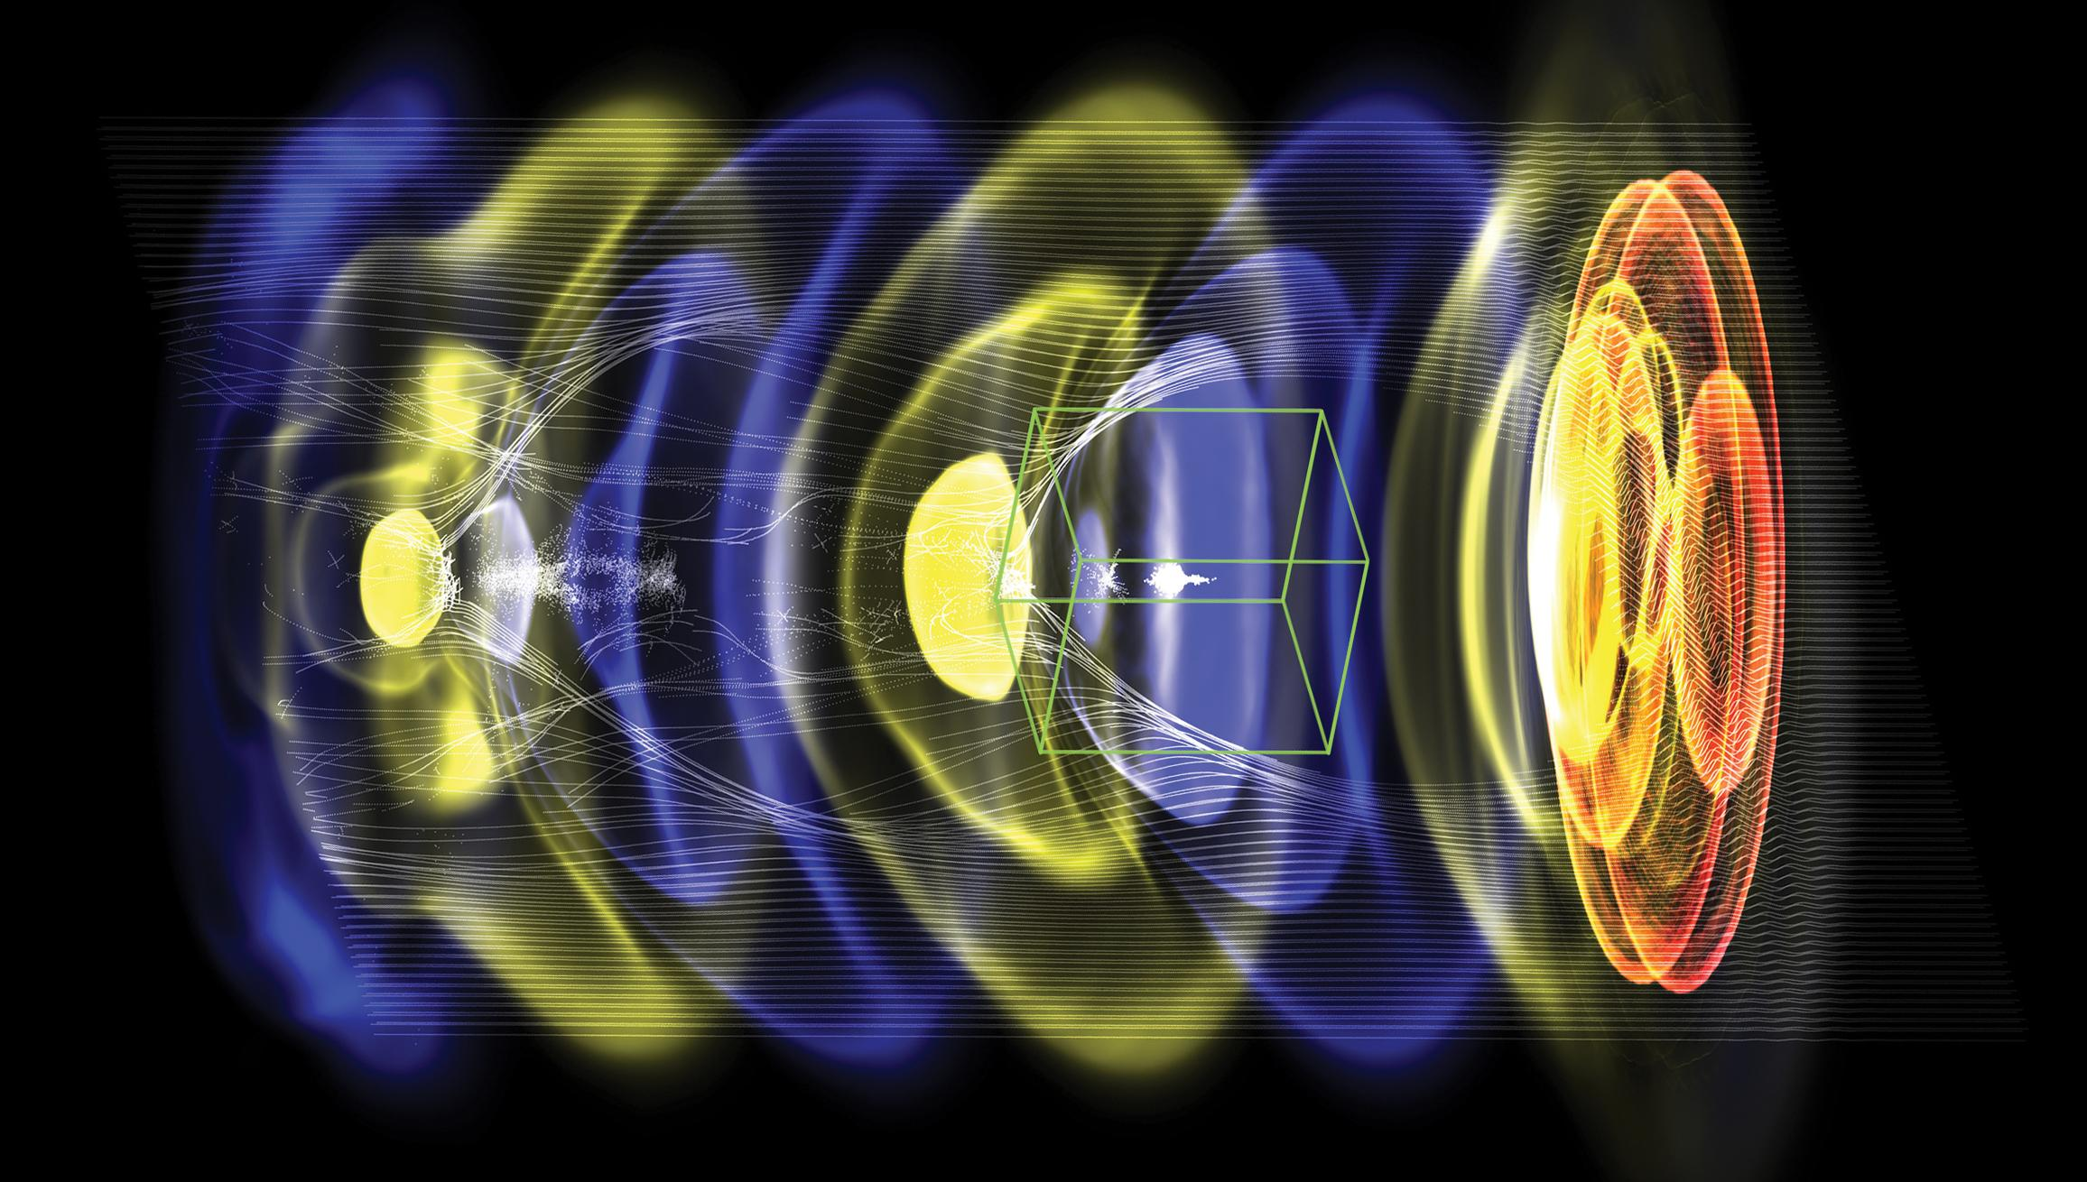
Advanced Plasma and Structure Based Accelerators:
High Gradients Offer Potential to 10+ TeV
Rapid accelerator R&D progress (this workshop)
Ultrahigh fields 1-100 GV/m
Ultra-bright beam generation, potential cooling
Strong focusing for compact beam delivery
Smaller linacs, smaller footprint, lower cost
Potential for energy recovery
Ultrashort bunches 10 fs – 1 ps
Reduced beamsstrahlung, high-luminosity/power
Compact colliders: polarized e+e-, gamma-gamma
Photon sources for applications in medicine, industry offering leverage to future colliders
Laser-driven plasma accelerator
(in quasi-linear regime)
Example: a laser or particle beam (red) drives a density wave (blue to yellow) in plasma, accelerating electrons (white) with fields of order 10 GeV/m
5

Slide 6
2016 Advanced Accelerator Development Strategy Guides Effort towards Colliders, Near Term Applications
Roadmaps developed following Snowmass 2013 and ensuing HEPAP sub-panel
Community representatives organized workshops and worked with DOE HEP to define roadmaps for three AAC technologies: LWFA, PWFA and SWFA; similar efforts in Europe
6

Slide 7
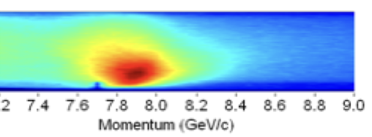
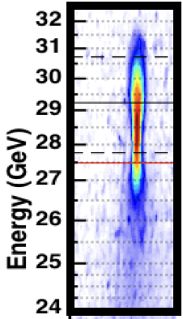
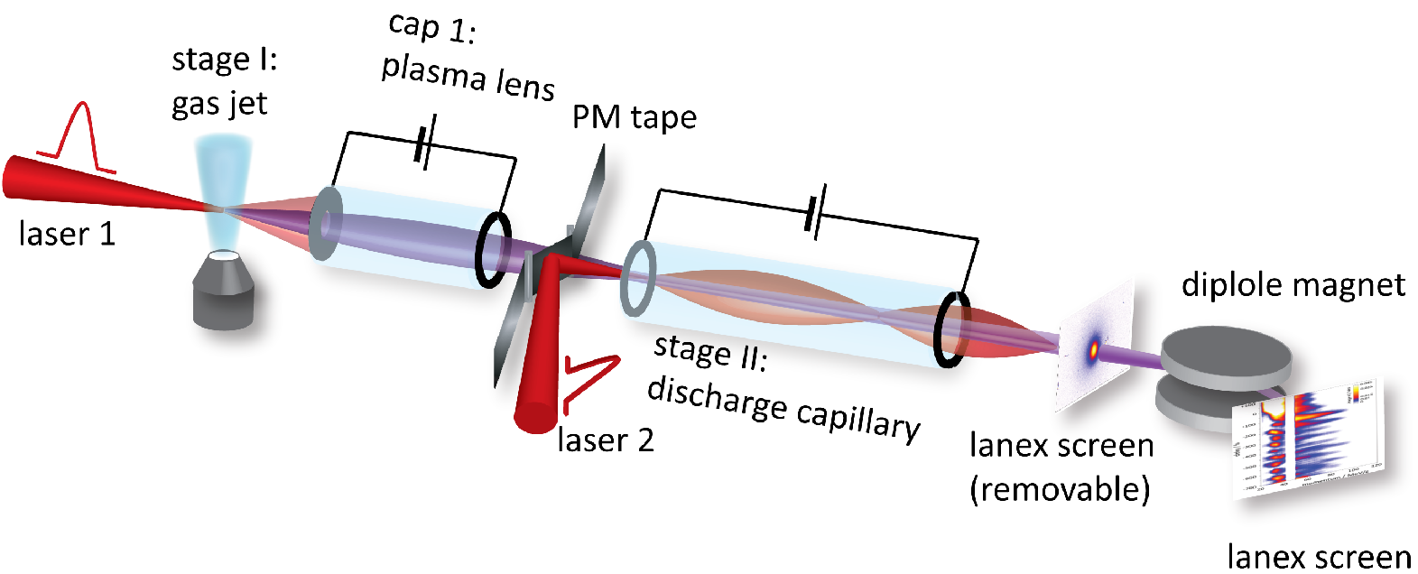
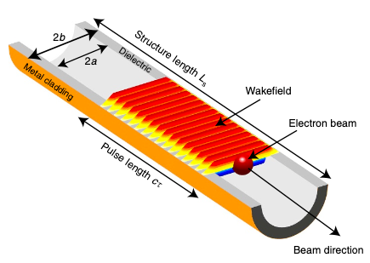
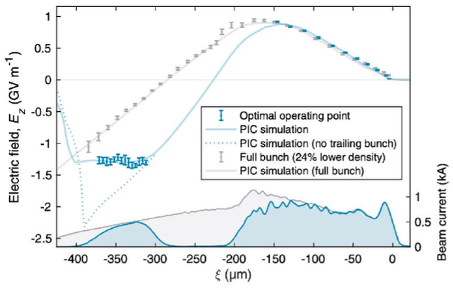
Rapid Progress is Retiring Risk, Advancing Collider Possibilities
LWFA: 8 GeV energy gain in 20 cm stage using BELLA PW laser
PWFA: 9 GeV in 1.3 m using SLAC at FACET
New: >10 GeV from LWFA at U Texas
Proof-of-principle staging of LWFAs (~100 MeV energy gain) using high gradient plasma-lenses
A. J. Gonsalves et al. PRL (2019)
M. Litos et al. PPCF (2015)
Optimized beam loading in PWFA
enables uniform, high-efficiency acceleration.
S. Steinke et al. Nature (2016)
42% transfer efficiency with 0.2% energy spread
Demonstration >1GeV/m gradients SWFA dielectric structures.
C. A. Lindstrom et al. PRL (2021)
B. O’Shea et al. Nature Comm. (2016)
Plasma recovery at high rep-rate
Demonstration 0.5 GW power SWFA structures.
R. D’Arcy et al., Nature (2022)
Driver Technology:
Superconducting XFELs, New laser technology (fibers, Thulium) promise high average power at high efficiency
Also: positron PWFA, hollow channels for low emittance growth, 0.1 micron emittance

Slide 8
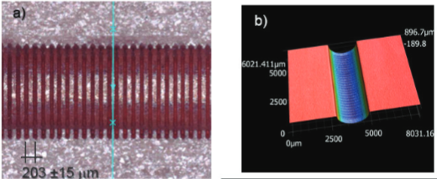
AAC Beam Test Facilities Positioned to Advance Roadmap
Circa 2025, anticipate high-level demonstrations at existing beam test facilities:
Laser driven staging of two multi GeV-class cells with high efficiency @ BELLA
Beam driven 10 GeV stage with mm-mrad emittance, percent energy spread, high-efficiency @ FACET-II
Plasma repetition rate limits characterized @ FLASHForward, FACET-II
500MeV SWFA demonstrator module @ AWA
Near term applications will establish technology, and benefit future colliders: ← AAC asset
Compton MeV photons, FELs, nQED, injector…
Societal benefit, increase HEP investment return
Argonne Wakefield Accelerator test facility
https://arxiv.org/abs/2203.11290

Slide 9
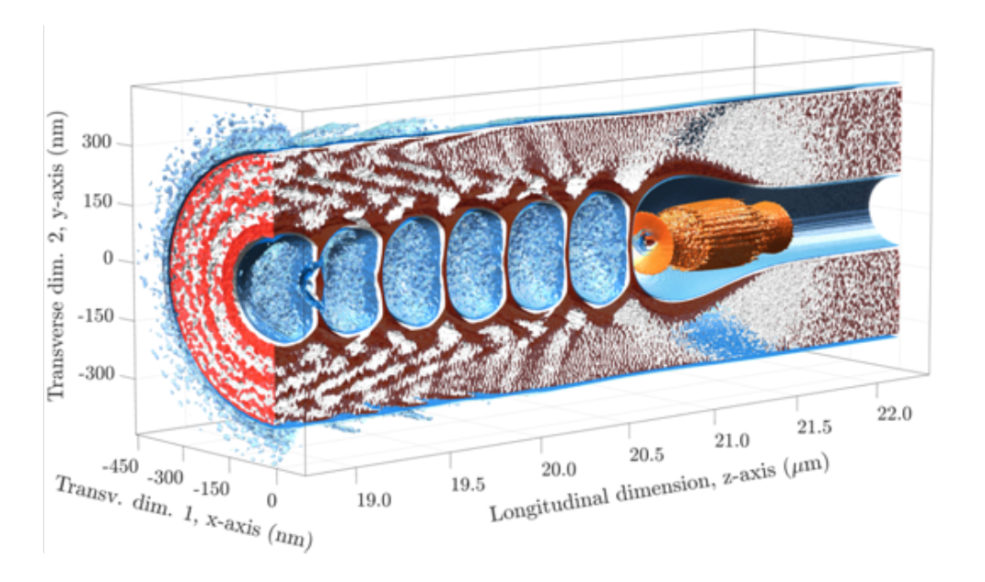
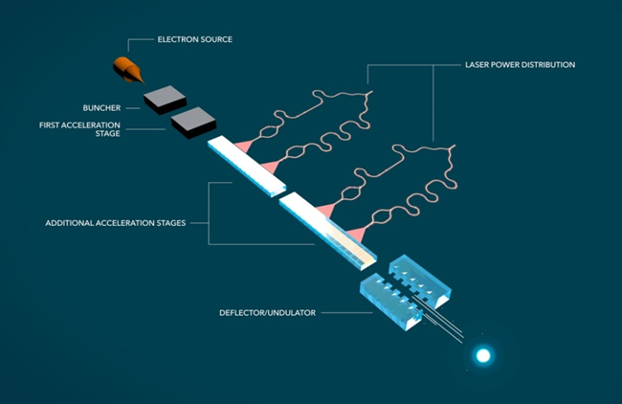
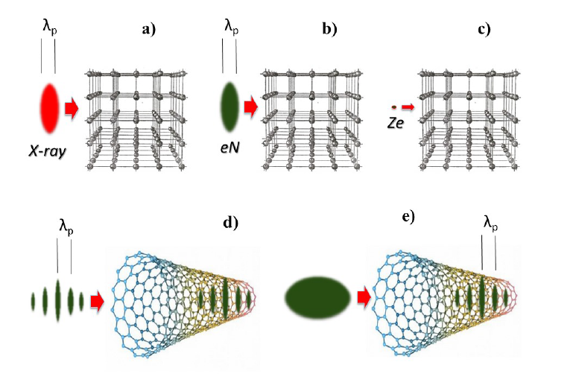
Roadmap Progress Parallelled by Innovation in New Concepts
Other new techniques continue to emerge and be developed ranging from laser driven structures to plasmonics and channeling demonstrating the rich potential of future accelerators to extend the reach of physics.
Laser driven structures: Accelerator-on-a-Chip
Plasmonic modes for ultrahigh gradient (approaching PV/m)
Structured plasma. Channeling-based accelerators
9

Slide 10
Assessment of Limits Indicates Potential for 15 TeV-class
AAC community has addressed key potential limits of high-gradient linac technology including
Shaped bunches can be used to efficiently accelerate beams without energy spread growth
Ion motion induced by dense beams can mitigate transverse hosing instability
Scattering in plasma mitigated by strong plasma focusing
Energy spread from synchrotron radiation in plasma limited by small beam emittances
Laser and beam energy recovery may be used for improved efficiency
Additional technical challenges require R&D
100’s of stages: Beam matching / coupling between including efficiency ≥ 99%
Small accelerating structures place challenging alignment and jitter tolerances
Plasma-based beam delivery system and final focus
Wall-plug power (operating costs) will limit energy reach of e+/e- linear colliders based on AAC
Beamstrahlung limits bunch charge and luminosity requirements increase required power:
Short beams and low emittance could reduce power requirements
High gradients could enable practical energy recovery
AAC technology are capable of 15-TeV-class e+e- linear collider parameters
10

Slide 11
Collider Potential to 15+ TeV & Re-using Near-Term Facilities
Example: similar sets for beam driven and structure
Similar parameter ranges accessible to each technology: coordinated example
TeV-class established as part of 2016 AARD report, extended to 15 TeV
Conceptual parameter sets, based on simulations of components
Sequence of collider options available to the 15 TeV class: polarized e+e- or gamma-gamma (with ITF)
New concepts continue to emerge that extend performances
Potential to re-use infrastructure of nearer-term LC (e.g. ILC, CCC) to enable many TeV
Planning coordinated with European Strategy Group, overlapping Snowmass
Laser-plasma linear e-/e+ collider |  | 3 TeV
Beam energy | TeV | 1.5
Particle number (1E9) |  | 1.2
Beam power | MW | 13
Luminosity (1E34) | cm-2 s-1 | 10
Transverse. beam sizes at IP, x/y | nm | 10 / 0.5
IP beta function, β* | mm | 0.1
RMS bunch length | micron | 8.5
Repetition frequency | kHz | 47
Time between collisions | microsec | 21
Beamstrahlung photons/e- |  | 1.7
Length (2x main linac tunnel) | km | 1.3
Facility site power (2 linacs) | MW | 315
LWFA parameters: 1 um laser wavelength, 10¹⁷ cm⁻³ plasma density
11

Slide 12
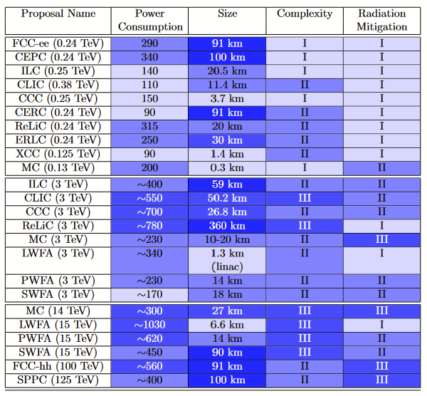
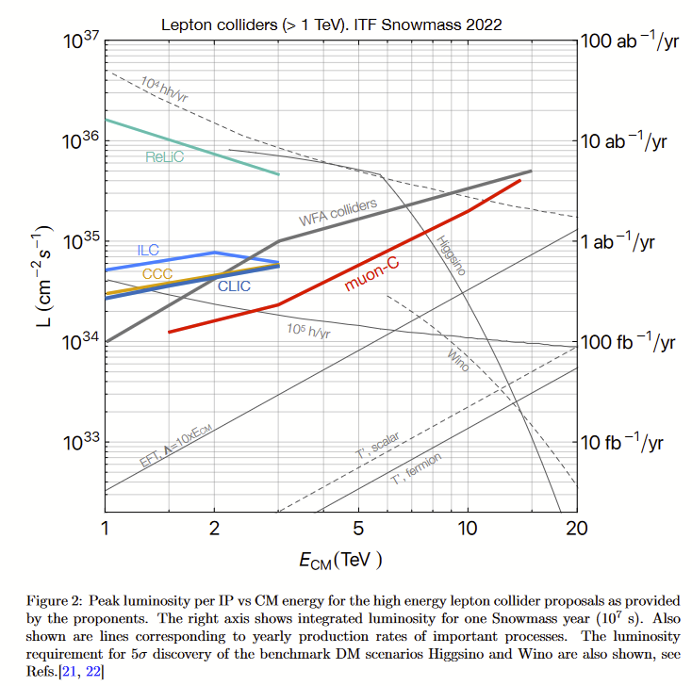
ITF Compared Potential Collider Properties
Potential for interesting parameters and cost, not all at same level of maturity
Next step for AF6 community: integrated self consistent parameter sets including tradeoffs to advance evaluation of collider options, and progress to integrated design study
It is noted that additional R&D may further reduce costs
12

Slide 13
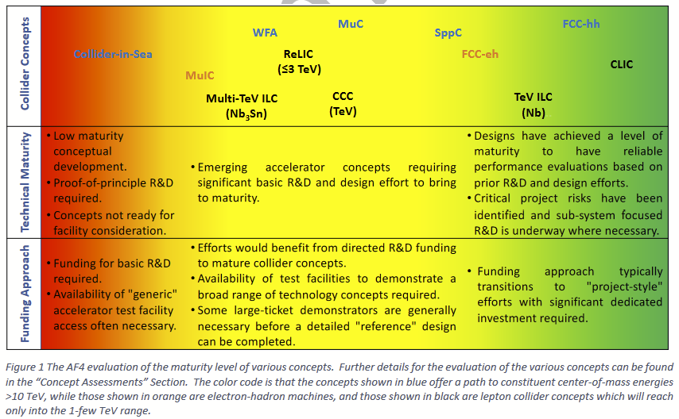
AF4 Evaluated Collider Options for Maturity
10+ TeV options highlighted in blue
Significant R&D required to mature concepts in the yellow shaded area.
Green maturity level required for decision making and informed comparison.
No lepton option in this range yet, including advanced accelerators
Interest remains in alternative paths including lepton-ion and γ−γ colliders.
R&D needs to advance technical maturity towards comparison in the coming decade
13

Slide 14
Selected Highlights
AF report: … discovery machines such as O(10 TeV c.m.e.) muon colliders have rapidly gained significant momentum… R&D is in progress on other concepts such as wakefield based e +e − or γγ systems which may present additional future options... will reduce the dimensions and thus potentially reduce the costs and power consumption of future high energy physics machines
Advanced wakefield accelerator concepts should strive toward demonstration of collider quality beams, efficient drivers and staging, and development of self-consistent parameter sets for potential colliders based on wakefield acceleration in plasma and structures (in close coordination with international programs such as the European Roadmap, EuPRAXIA, etc.)
AF6 key recommendations …vigorous research on advanced accelerators as part of General Accel. R&D
A targeted R&D program addressing high energy advanced accelerator-based colliders
Recognize near-term applications as essential & providing leverage to colliders-strengthen connections
Enhanced driver R&D to develop efficient, high repetition rate high average power… technology
Upgrade beam test facilities, continue strong role in workforce, recruiting
Pursue study for a collider demonstration facility and physics experiments at an intermediate energy
A DOE-HEP sponsored workshop should update and formalize the U.S. Advanced accelerator strategy

Slide 15
Next: Continue Engaging Collider and High Energy Physics Communities by Advancing Collider Parameter Sets & Design
Develop basis for consideration and evaluation as a collider option
Connect components, moving beyond component design to collider system
Fully integrated, consistent parameter set from source (e- and e+) to IP indicating how far current state of art is from collider needs, and corresponding development needs, in particular for e+
Define tolerances, transverse stability requirements, in particular for e+
Estimate costs to understand if the potential benefit of new technologies can be realized.
Develop reference documents, collaboration structures
Support IP and detector studies for particle physicists to understand HEP event rates.
Develop and validate simulations of beamsstrahlung & luminosity spectrum/fraction useful at 10’s TeV
Develop BDS designs including plasma lenses and round beam focus
Develop detector interface especially for plasma lenses, and how we integrate vertex detectors
Coordinate efforts, engage over the coming decade to develop & assess designs

Slide 16
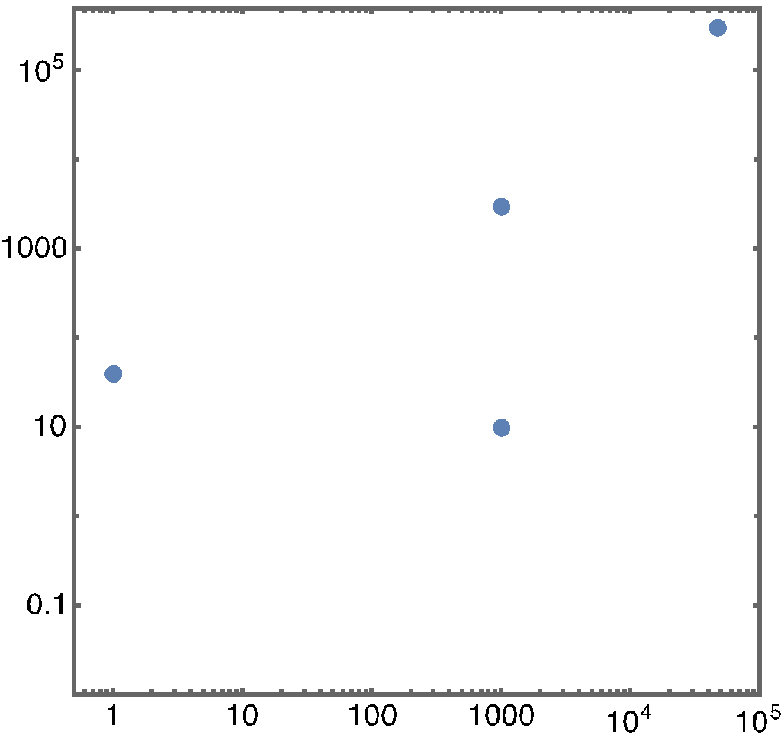
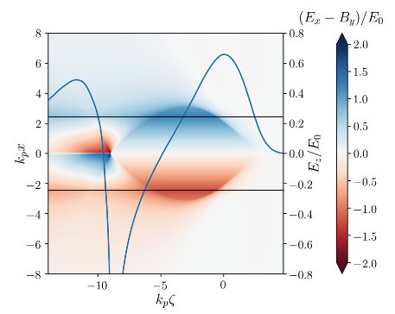
AAC facility next steps will advance technology
and test key remaining parameters
Rapid investment in Europe, Asia, incl. EuPRAXIA
US R&D, facility base creates leadership opportunities
Positron acceleration R&D
Technical challenges: plasma acceleration of stable, high-quality e+ beams, with high efficiency (comparable to e-)
FACET-II upgrade: plasma-based positron acceleration experiments/tests (e.g., plasma columns or hollow channels)
Staging of two modules and multiple-driver/injector beams
BELLA 2nd beamline: staging; future positrons & injectors
High-average power and high repetition rate plasma accelerators:
Technical challenges: targetry at repetition rate, heat deposition and management (~kW/cm), structure durability
kBELLA project: kHz, J-class laser. Technology available; precision via active feedback, applications on collider roadmap
Integrated submodule of TeV SWFA design:
GW rf power generation and sustainable 0.5GV/m acceleration
Over 50% of RF-to-beam efficiency with shaped main beam.
3GeV demonstrator in AWA-II High-Energy Upgrade.
collider parameters
kBELLA
Average power (W)
BELLA
kHz LWFA
Bunches / sec
Wake excited in plasma column
e+ focusing and accelerating region
S. Dieterichs et al. PRAB (2019)
16

Slide 17
AF6 Takeaway Messages
Interest has shifted from the TeV range to emphasize 10+ TeV/parton energies
Advanced accelerators offer potential for compact, energy efficient future e-e+/γγ colliders
Strong progress assessing limits and demonstrating technologies continues motivation
Experimental results: 10 GeV class beams, beam loading & efficiency, plasma recovery, staging, high transformer ratio, positrons, and FEL-lasing demonstrating high beam quality
Concepts addressing: ion motion, synchrotron radiation, scattering, hosing and positron acceleration
Collider conceptual parameter sets developed based on component simulations and models
The community continues strong discovery R&D with new concepts expanding possibilities. Strengthening R&D and test facilities while leveraging near term applications remains important.
Next steps towards consideration as future collider options include moving towards integrated design, starting with self consistent parameter sets (muon collider success in the last decade)
Integrating: injection, cooling alignment and jitter effects and tolerances, matching/coupling between many stages, BDS and Final focus
Engaging: the high energy physics and conventional collider communities, coordinating internationally

Slide 18
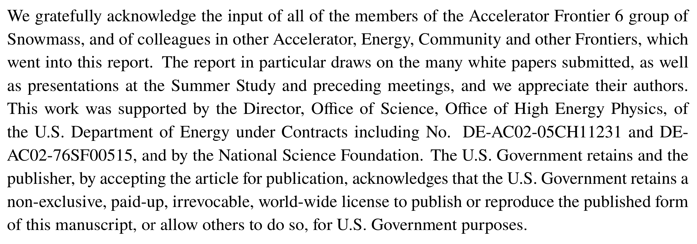
Acknowledgement and Backup material

Slide 19
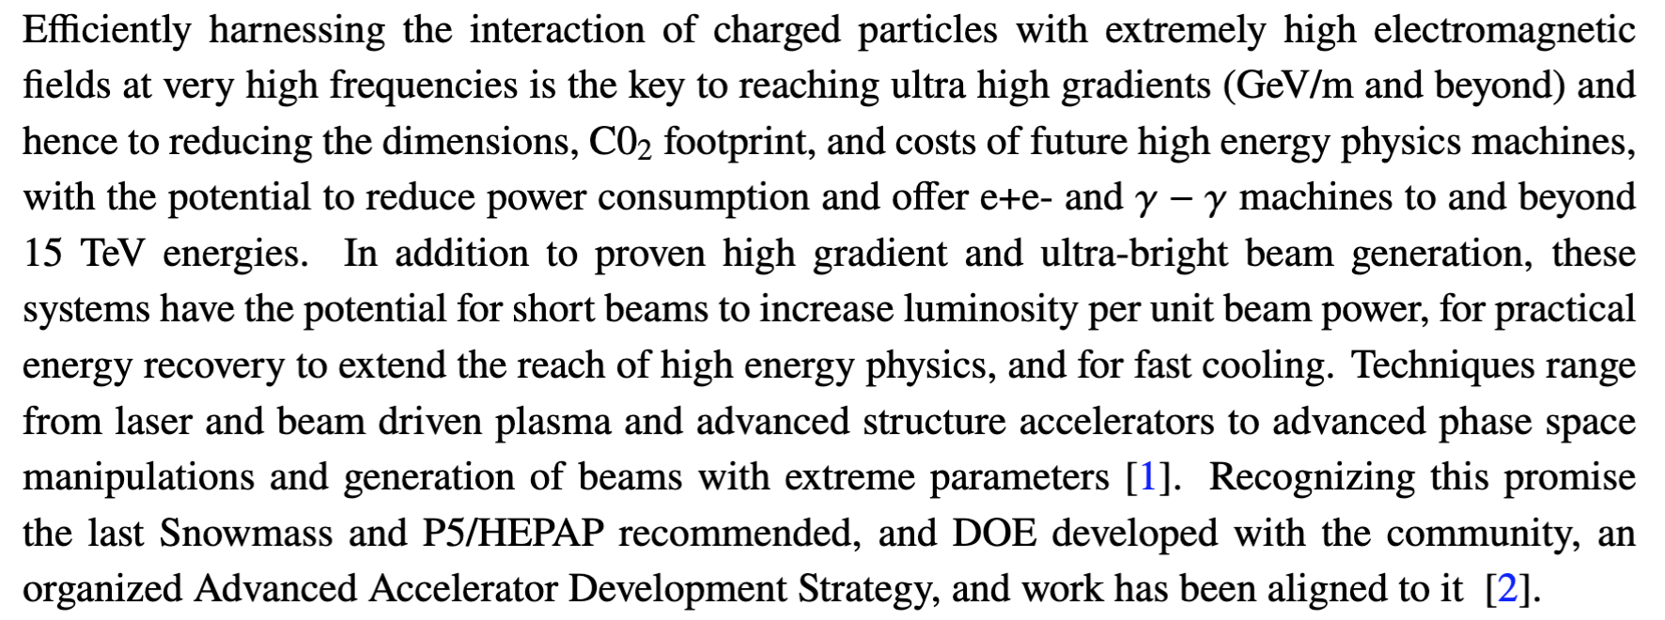
Advanced plasma and structure based accelerators:
High gradients offer potential from TeV to many TeV
19

Slide 20
Rapid experimental progress since last Snowmass
LWFA: 8 GeV energy gain in 20 cm stage using BELLA PW laser
PWFA: 9 GeV in 1.3 m using SLAC at FACET
New: 12 GeV from LWFA at U Texas (submitted)
Proof-of-principle staging of LWFAs (~100 MeV energy gain) using high gradient plasma-lenses
A. J. Gonsalves et al. PRL (2019)
M. Litos et al. PPCF (2015)
Optimized beam loading in PWFA
enables uniform, high-efficiency acceleration.
S. Steinke et al. Nature (2016)
42% transfer efficiency with 0.2% energy spread
Demonstration >1GeV/m gradients SWFA dielectric structures.
C. A. Lindstrom et al. PRL (2021)
B. O’Shea et al. Nature Comm. (2016)
Plasma recovery at high rep-rate
Demonstration 0.5 GW power SWFA structures.
R. D’Arcy et al., Nature (2022)
Driver Technology:
Superconducting XFELs, New laser technology (fibers, Thulium) promise high average power at high efficiency
Also: positron PWFA, hollow channels for low emittance growth, 0.1 micron emittance

Slide 21
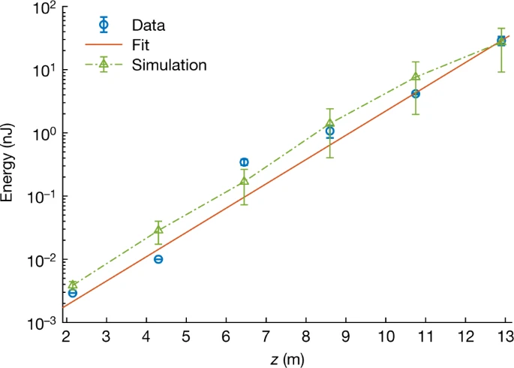
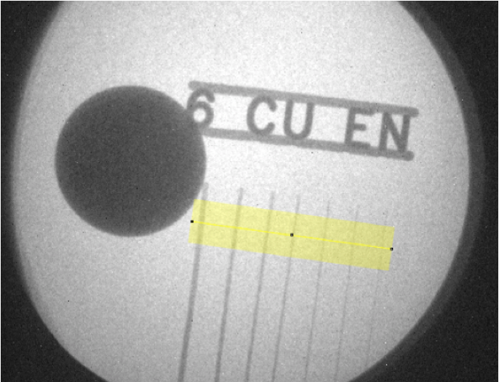
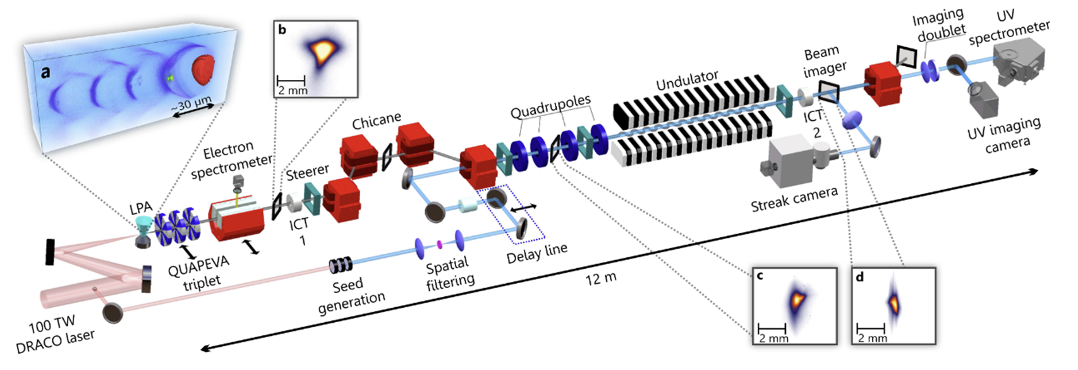
Plasma acceleration based light sources
PWFA FEL: R. Pompili et. al, Nature Vol 605 (2022)
LWFA FEL: W. Wang et. al, Nature Vol 595 (2021)
LWFA Thomson precision imaging
Seeded FEL: M. Labat et al.: DOI:10.21203/rs.3.rs-1692828/v1

Slide 22
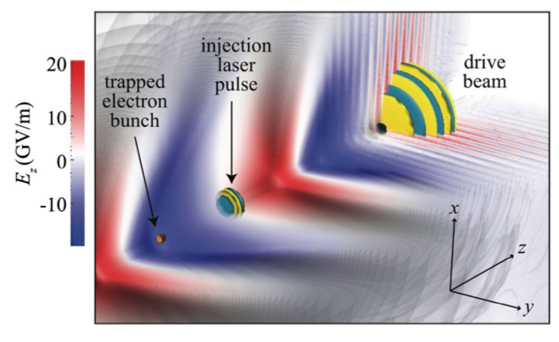
High fields enable ultra-bright sources
Conventional injector brightness constrained by transverse energy of emitted electrons and space charge forces
GeV/m plasma gradients transform electron brightness
Rapid acceleration + shielding reduce space charge effect
Primary limit due to transverse momentum
0.5 GeV/m gradients in SWFA Two Beam Accelerator gun
Rapid acceleration, ~10nm emittance
Ultralow dark-current
Control transverse momentum via ionization/structure
multi kA, 100 pC and 50 nm emittance beams, path to 10nm class directly from plasma injector
Reduces/eliminates cooling and conditioning needs
Positron sources; polarization using undulators or lasers
Polarized positrons, rapid acceleration, capture and cooling
Multi-beam control of emittance
Wakefield positron sources
Compact high-E and capture
e-
accel
High Z
e+
accel
Driver1
e-& e+
PWFA
Plasma lens
e-
e+
Driver2
Target or undulator
Potential to extend performance of nearer-term LC (e.g. ILC, CCC) & future AF6 concepts

Slide 23
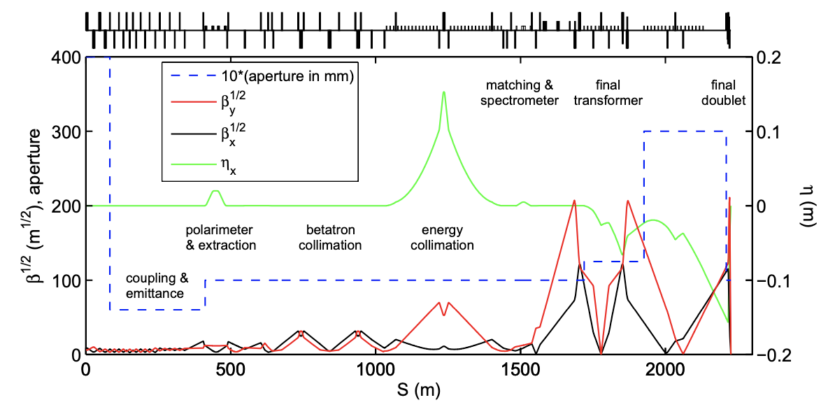
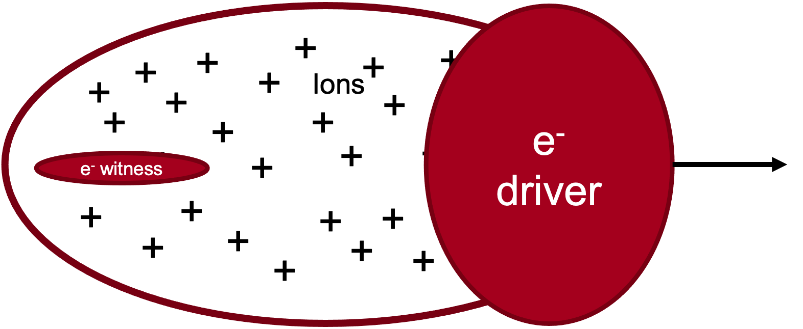
Interaction point beam delivery: strong focusing potential
BDS system includes diagnostic sections and collimation sections in addition to the Final Focus and Machine-Detector Interface.
The Final Focus uses the local chromatic correction in the final doublet.
Novel chromatic correction techniques and strong focusing from plasma lenses could be used to reduce beam spot and BSD length
Details: S. Gessner et al., Snowmass Contributed Paper
ILC BDS
Active Plasma Lens
Passive Plasma Lens
AF6 highlighted renewed interest in applying AAC technologies to many collider sub-systems
23

Slide 24
Advanced concepts offer path to increased luminosity / power
Short beams decrease beamsstrahlung. Figure of merit: (luminosity)/(wall-plug power)
classical beamstrahlung regime (Y<<1):
quantum beamstrahlung regime:
AAC linacs accelerate short beams (tens of um)
Note: beam disruption less severe for ultra-short beams
Plasma-based injectors produce ~nm normalized emittance
Energy recovery using recycling pulse
Particle beam energy (applicable to all colliders)
Wake energy, drivers (applicable to wakefields driven by beams and lasers in plasmas, structures)
Re-use pulses or recover energy in RF or PV systems
Potential 2x or more reduction in energy use
Detail: M. Turner, Snowmass CF workshop
Drive pulse
Witness bunch
Recycling pulse
Opportunities to reduce power consumption in-line with heightened environmental awareness

Slide 25
Rapid experimental progress since last Snowmass

Slide 26
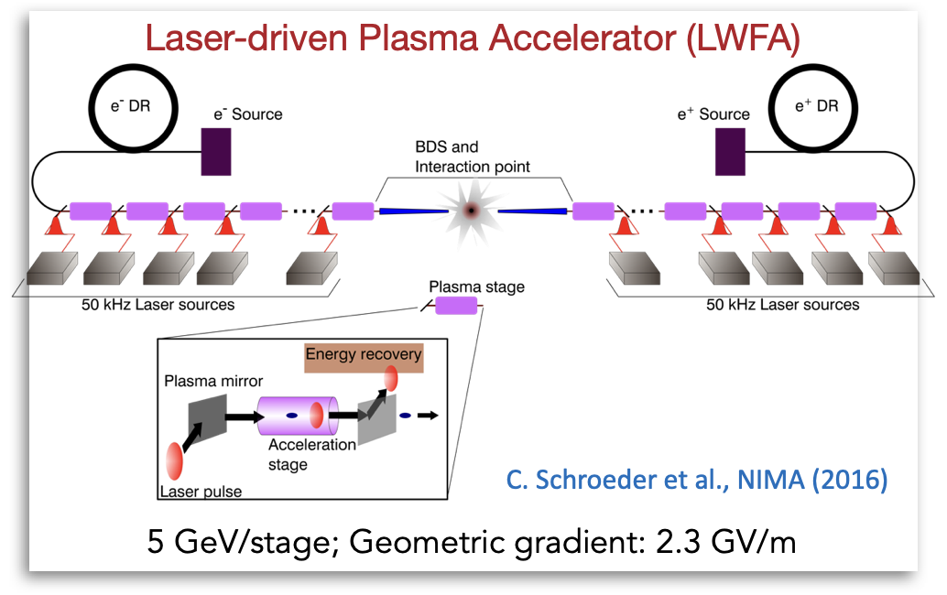
Wakefield-based Colliders: Staged High-gradient Accelerators with Geometric Gradients 0.2 - 2 GeV/m
Collider designs have been developed to guide research priorities (efficiency, staging…)
Next step – integrated design studies
26

Slide 27
Assessment of limits indicates potential for 15 TeV-class
27

Slide 28
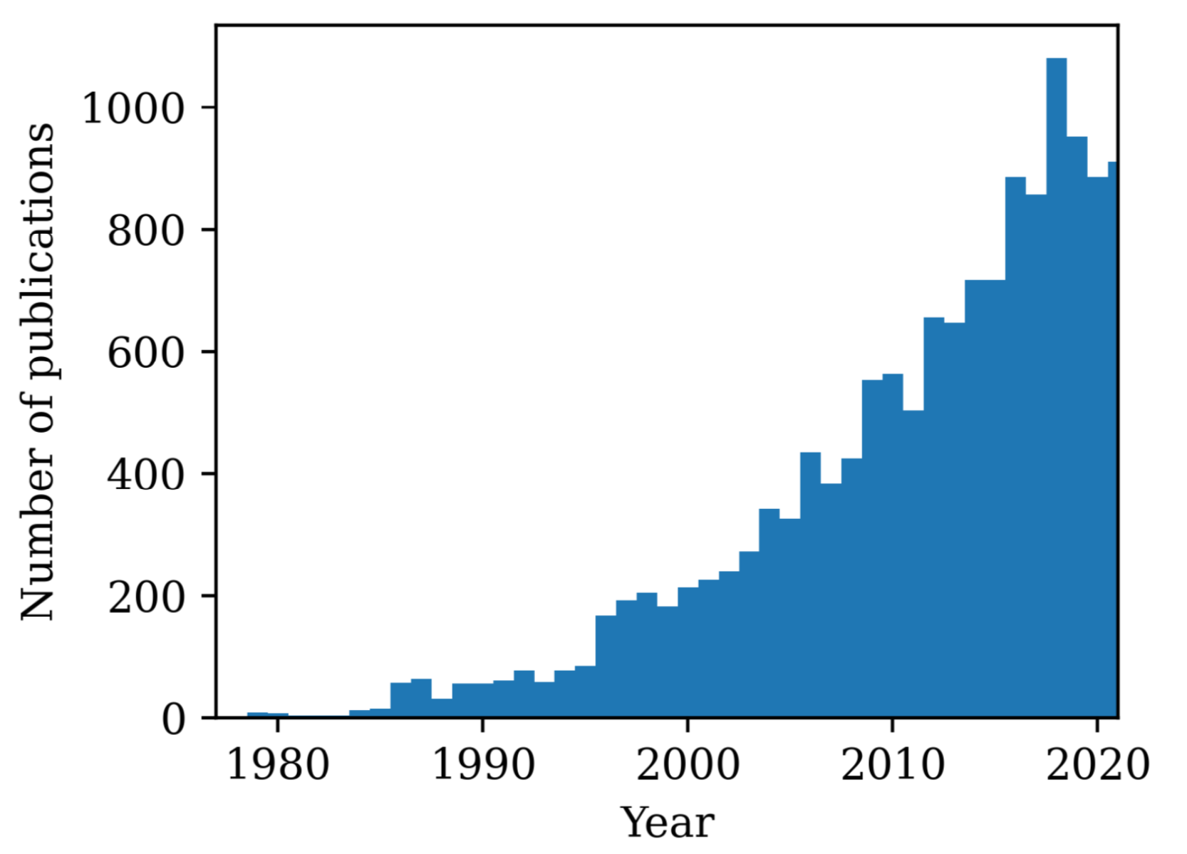
Strong role in workforce development
Over 1000 research papers published annually in advanced and novel accelerators.
Spawning numerous new ideas, concepts, techniques that will help bring a future advanced accelerator based collider to fruition.
Attracts students and new researchers to the field,
Provides opportunities that are important for involving more diverse communities,
Support the goals expressed in the CEF papers for diversity, equity and inclusion.

Slide 29
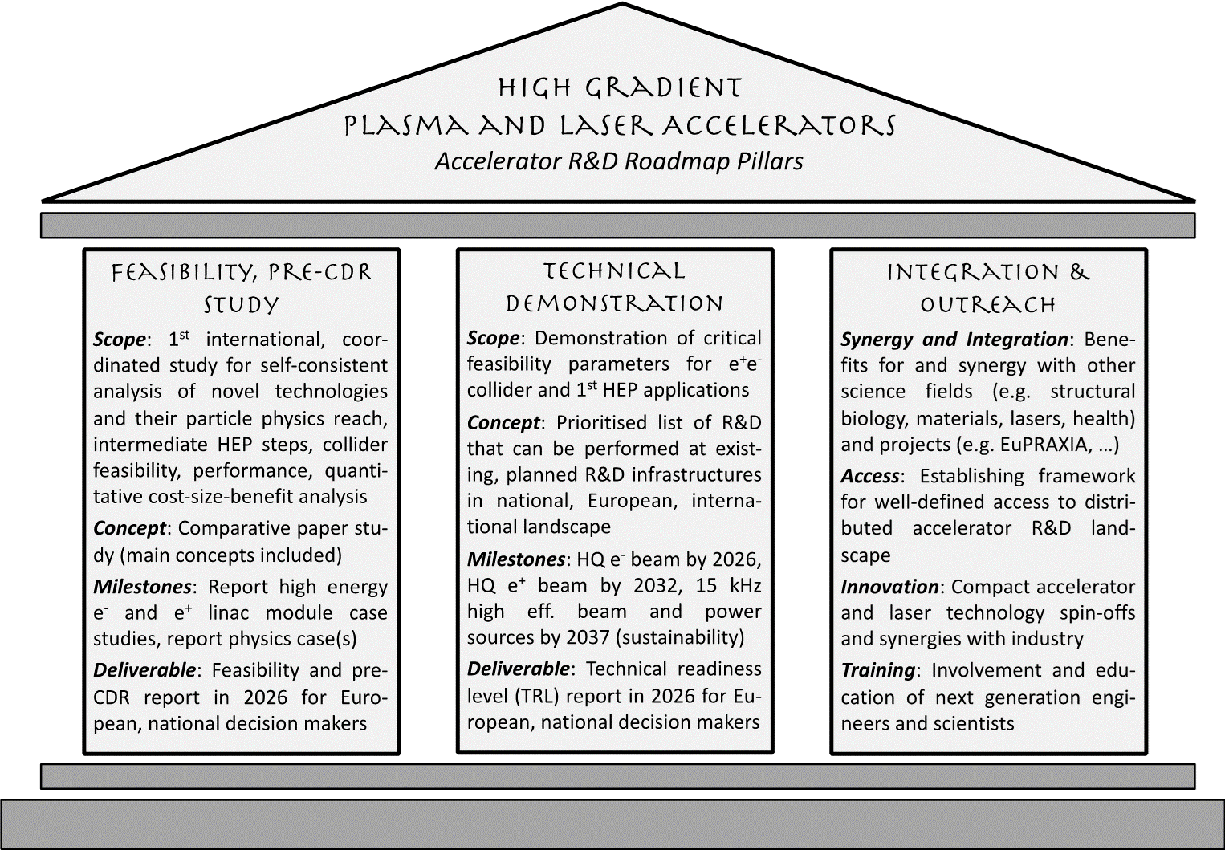
Integrated design study and near term applications
Strong overlap of AAC with compact light sources
European Strategy for Particle Physics Roadmap for Accelerator R&D highlights the need for pre-CDR study

Slide 30
Innovation in new concepts, strong role in workforce
30

Slide 31
Collider potential to 15+ TeV
31

Slide 32
Priority research directions

Slide 33
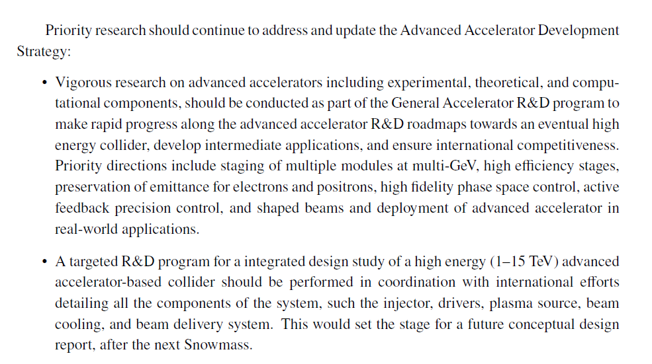
Recommendations
33

Slide 34
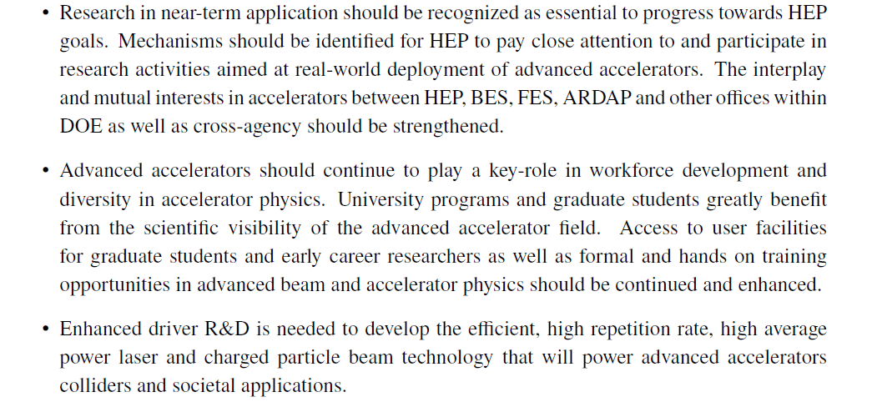
Recommendations
34

Slide 35
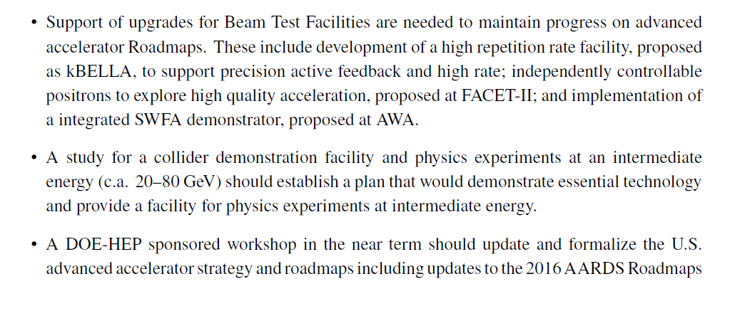
Recommendations
35

Slide 36
AF6: Coordination meetings
July 2020 Weekly AF6 meetings initiated
August 2020 LOIs submitted
September 2020 AF6 Snowmass prep LOI Workshop
Discuss 71 submitted LOIs
Encourage collaboration to group into focussed set of contributed papers with coherent message
October 2020 Community planning meeting
Topical interest groups formed focussed around contributed papers
The long pause…(but connected to ES/LDG process)
December 2021 AF6 Contributed Paper Planning Meeting
Scheduled review for each paper in coming weeks
February 2022 AF6 Review of all Contributed Paper Dafts
July 2022 Pre-Snowmass review of AF6 Summary
Snowmass in Seattle
In addition:
Positron polarization
AAC Agora
e-e+ Collider Forum
Cross Frontier Workshops with EF-TF-AF#
ITF
…
It’s been a long and busy couple years!
https://snowmass21.org/accelerator/advanced/start#white_paper_coordination
Notes:
Plasma and Advanced Structure Accelerator Interest Group

Slide 37
AF6: Contributed Papers & Interest Groups
Theme | POC(s)
PASAIG (multiple papers: PWFA, LWFA, SWFA) | E. Esarey, W. Mori, C. Schroeder, J. Power, C.Jing, N. Vafaei-Najafabadi
(GARD) Beam Test Facilities - AF1 | J. Power
Laser Drivers | L. Kiani, T. Zhou
BDS/IP Issues for Advanced Concepts | S. Gessner
Near term applications of Advanced Accelerators | J. Van Tilborg and C. Emma
Novel Electron Sources - AF7 | M. Fuchs
Polarized positron generation - AF7 | P. Musumeci
Laser Driven Structures | J. England
Nanoplasmonic accelerator | A. Sahai
Channeling based acceleration | S. Corde
To other Topical Groups:
AF4 white paper integrating all elements of collider for plasmas/structures, possibly others (separate format)
AF1 facilities paper (John P, from GARD facilities paper)
AF7/AF3 polarized positrons (P. Musumeci)
ITF input (input done, processing)
FNAL site filler, ILC extension using AF6 tech. CCC
Applications/industry, computing, environment…
https://snowmass21.org/accelerator/advanced/start
Notes:
Plasma and Advanced Structure Accelerator Interest Group

Slide 38
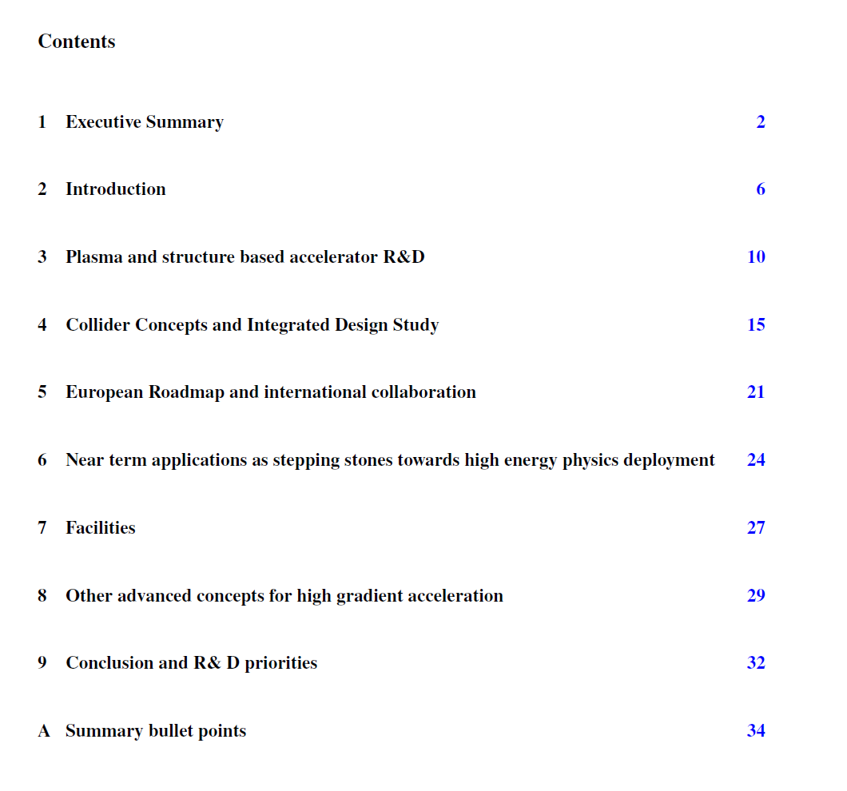
This presentation: highlights with representative report text

