Slide 1
First results of the two-color LWFA experiments at ATF
Navid Vafaei-Najafabadi, Rotem Kupfer, Irina Petrushina, Roman Samulyak, Aiqi Cheng, Igor Pogorelsky, Mikhail Polyanskiy, Marcus Babzien, William Li, Karl Kusche, Mikhail Fedurin, Mark Palmer
The Accelerator Test Facility

Slide 2
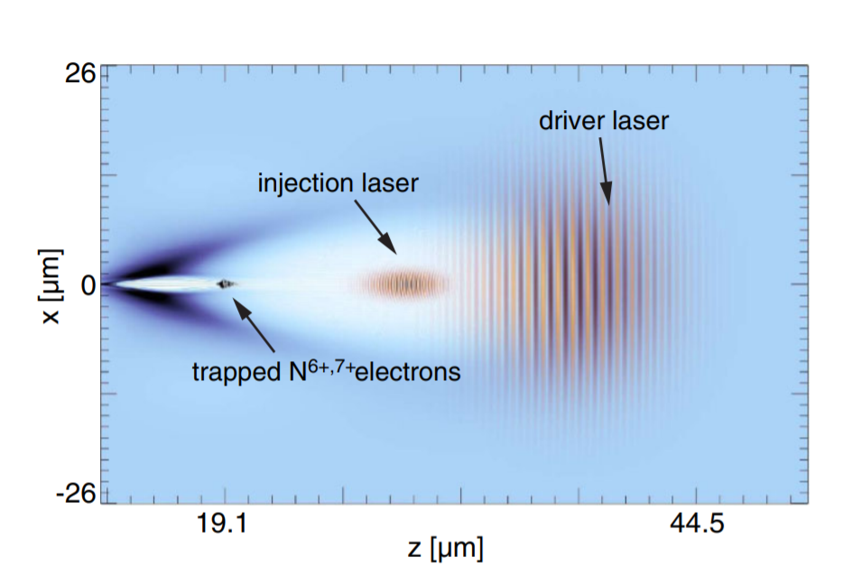
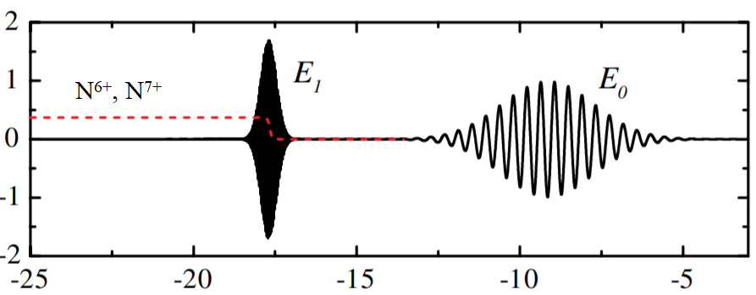
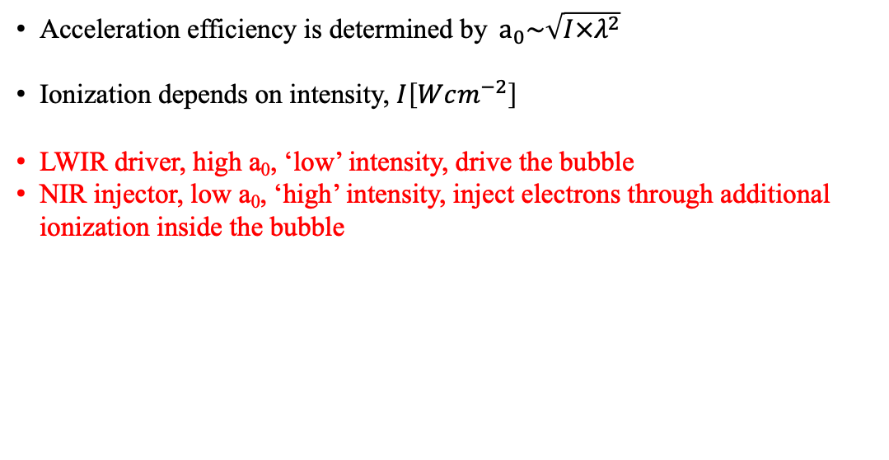
Two-Color Ionization-Injection LWFA
Controlled injection $→$ Ultralow emittance
Acceleration efficiency is determined by $a_{0}\sim \sqrt{I×λ^{2}}$
Ionization depends on intensity, $I\left[Wcm^{−2}\right]$
LWIR driver, high a₀, ‘low’ intensity, drive the bubble
NIR injector, low a₀, ‘high’ intensity, inject electrons through additional ionization inside the bubble
(1) C. B. Schroeder, arXiv:1505.05846 [physics.plasm-ph] (2015)
(2) X.L. Xu, et al., Physical Review Special Topics AB, 17, 061301 (2014)

Slide 3
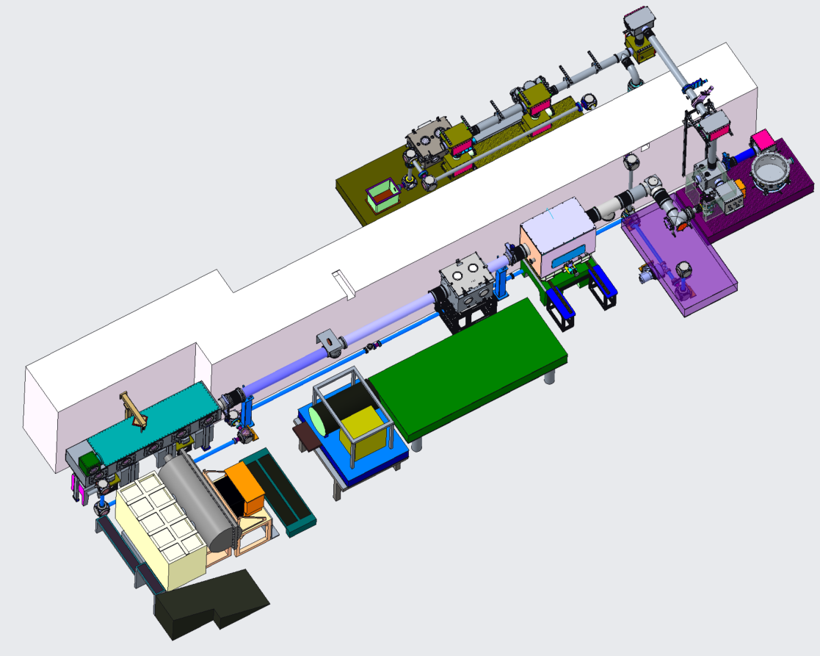
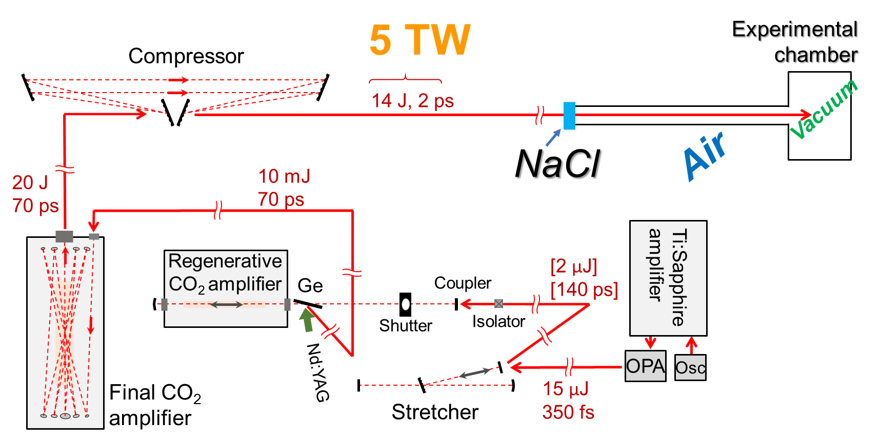
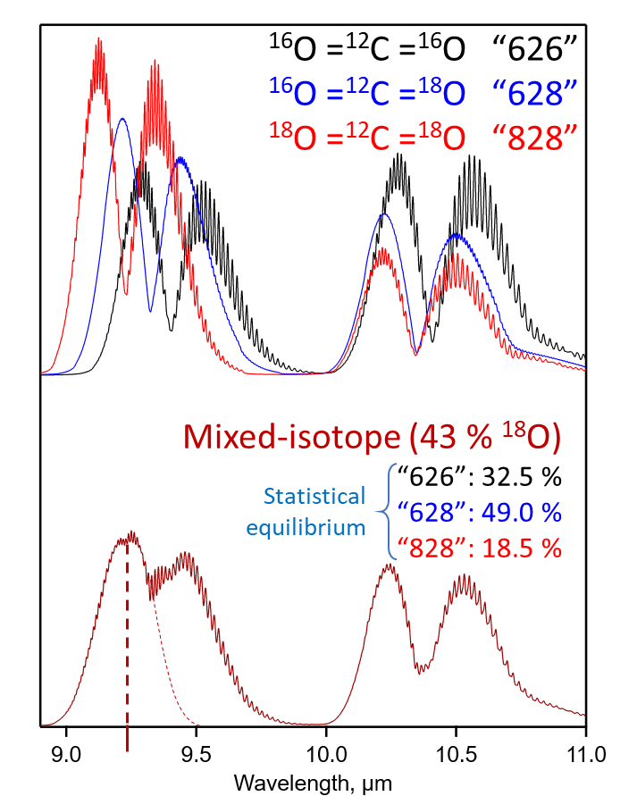
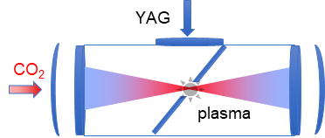
LWIR Drive Laser
LWFA chamber
Compressor
Plasma shutter
Regen
Front-end
9.2µm, ~2ps, 5J, 0.05Hz
Synchronized to master clock
Final amp
See also 9.3 microns: Toward next-generation CO₂ laser for particle accelerators (Th, WG 7+8)
Notes:
High gain of the regen results in gain narrowing – High P CO2 isotopes
Vacuum compressor +/- 400 micron – self focusing through salt window
Plasma Shutter as a protective device
Oscillatir frequency doubled Er
Beam is not imaged,
Experimental hall

Slide 4
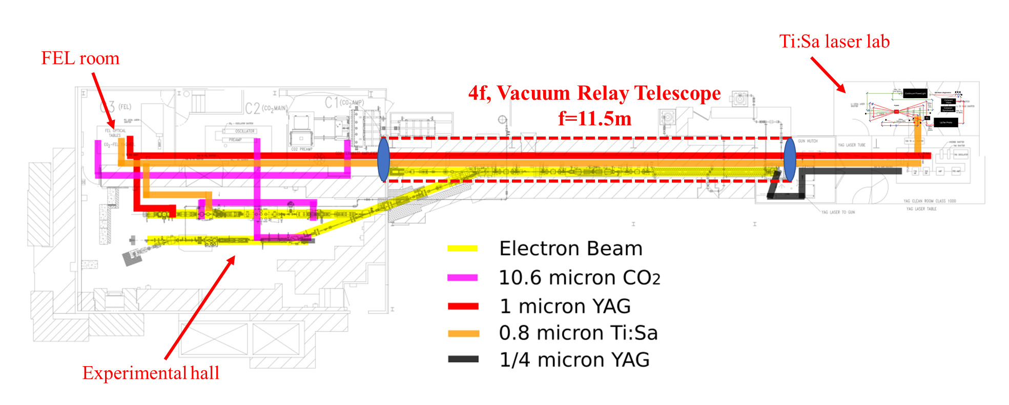
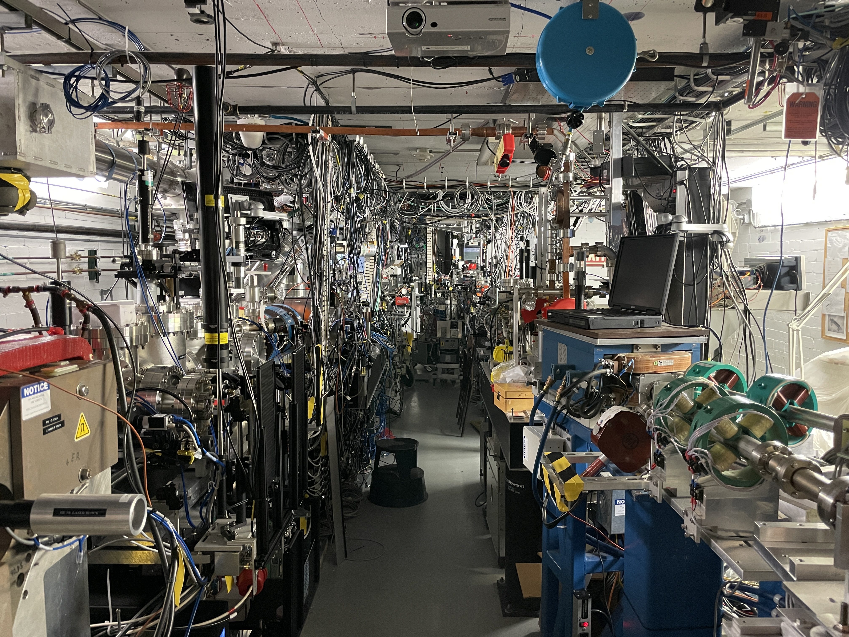
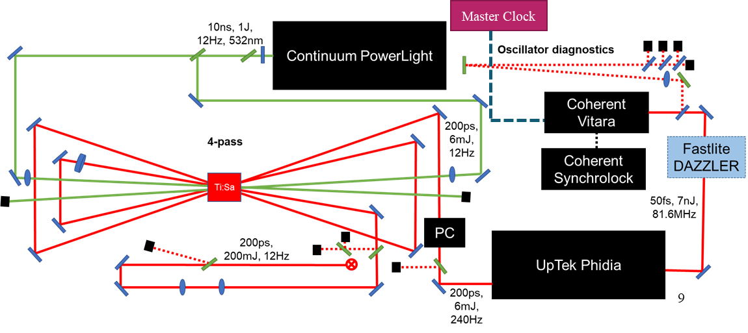
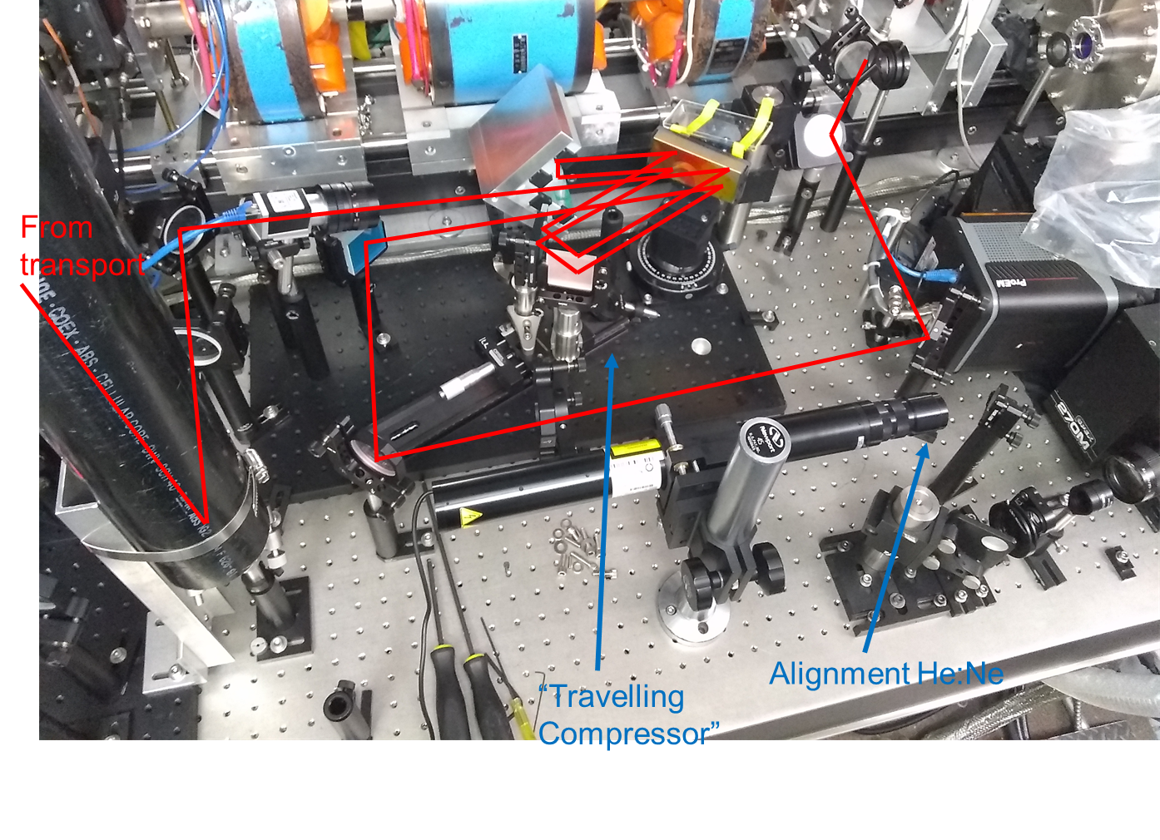
NIR Injector
Notes:
Laser is transported for 60 m, and hit a 5 micron spot
Not a straight shot!

Slide 5
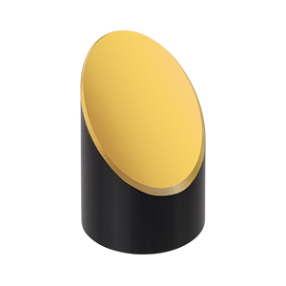
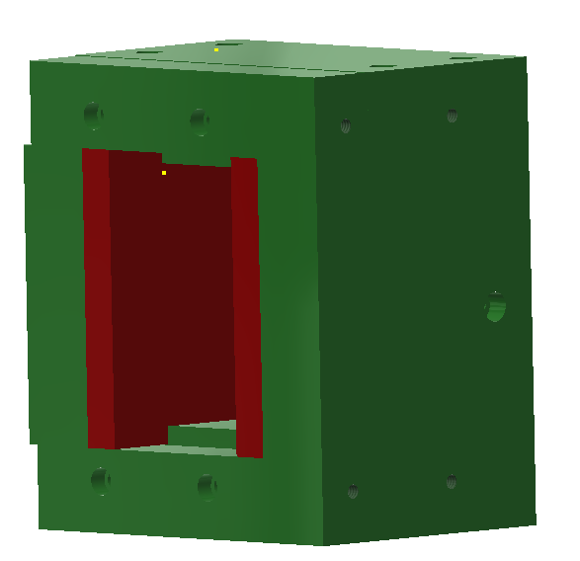
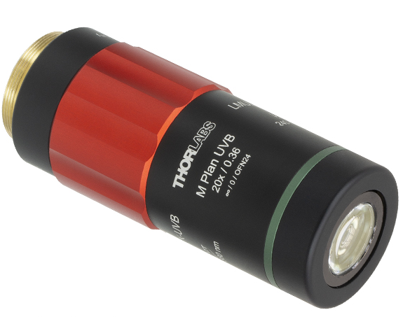
Two-Color Ionization-Injection LWFA
NIR pulse
LWIR pulse
Dipole
magnet
LANEX
Slit
f/#1.5 focusing
Nozzle
LWIR focus diagnostic
NIR focus diagnostic
f/#2 focusing

Slide 6
Overlap, Timing and Ionization Measurements

Slide 7
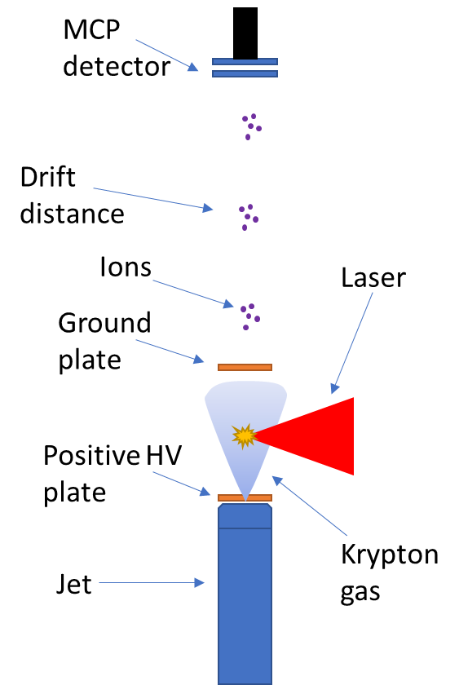
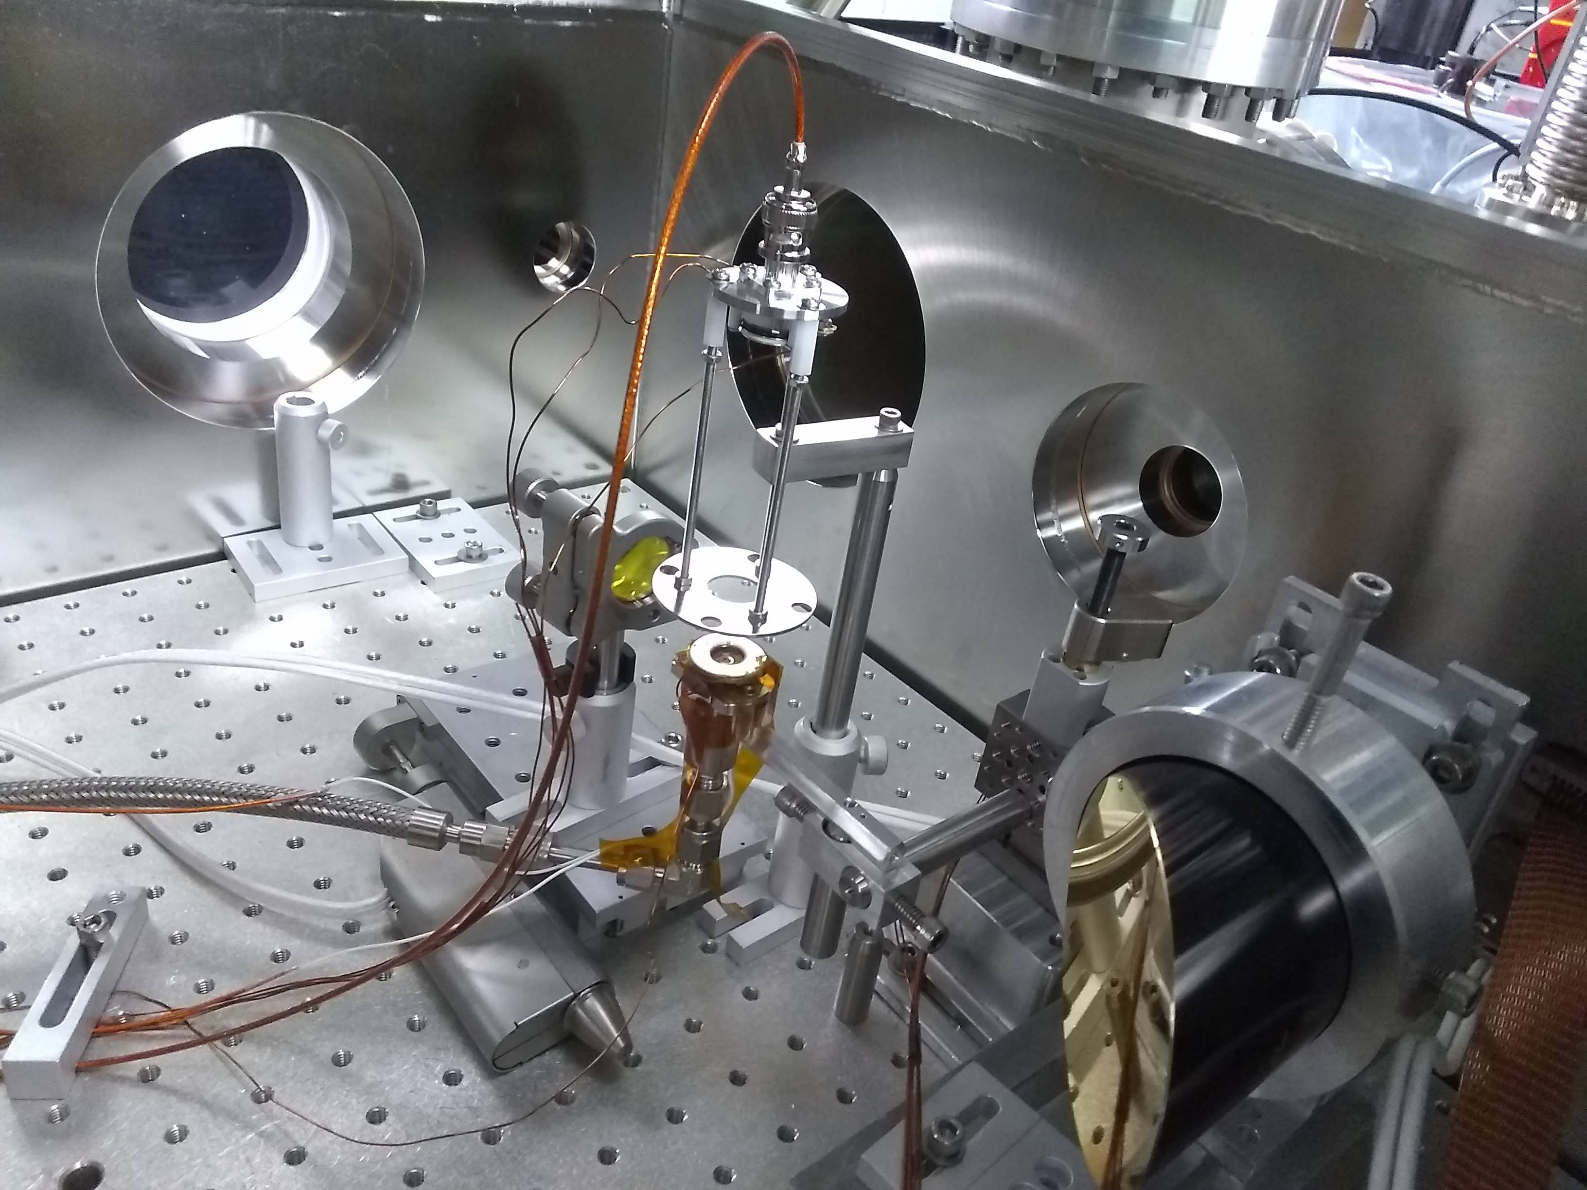
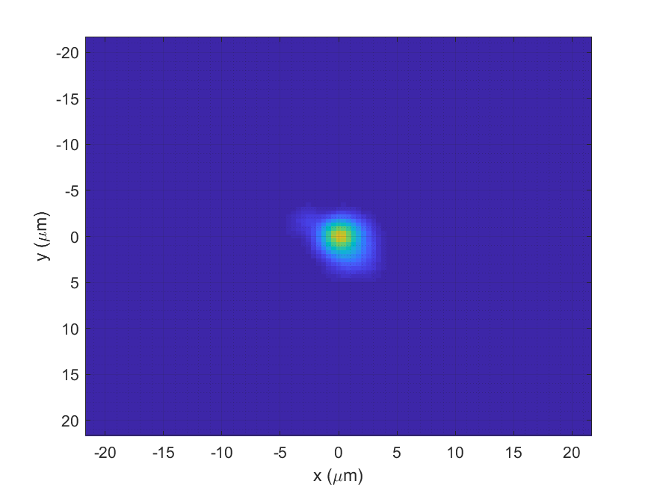
Time of Flight Measurement of Krypton Ions
Jet backing pressure ~14PSI, jet window 70µs, chamber’s steady state pressure 4.5x10⁻⁵ Torr
Accelerator plate voltage 2kV, MCP voltage 1.9kV, accl distance 40mm, drift distance 90mm, measurement averaged over 10 shots
Laser duration ~60fs, energies 1mJ ~ 12mJ, 12Hz rep rate
Focal spot:
Notes:
Top one is a ground plate 1 KV DC
2 PSU, one for voltage for the cathode and one for MCP
It was a fast MCP

Slide 8
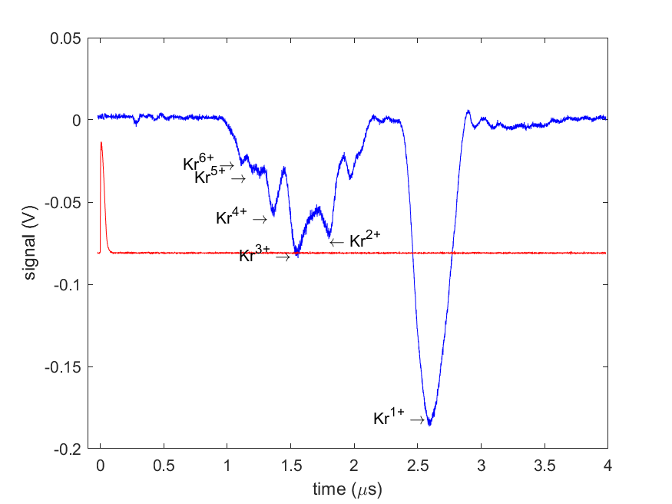

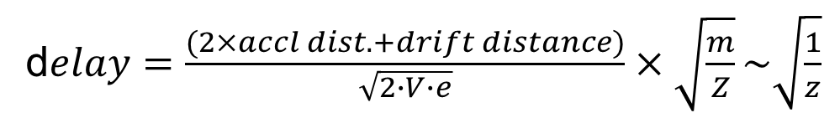
Time of Flight Measurement of Krypton Ions
$$1.7±0.2mJ$$
Low intensity – good agreement with ‘Textbook theory’
d$elay=\frac{(2×accl dist. +drift distance)}{\sqrt{2∙V∙e}}×\sqrt{\frac{m}{Z}}\sim \sqrt{\frac{1}{z}}$

Slide 9
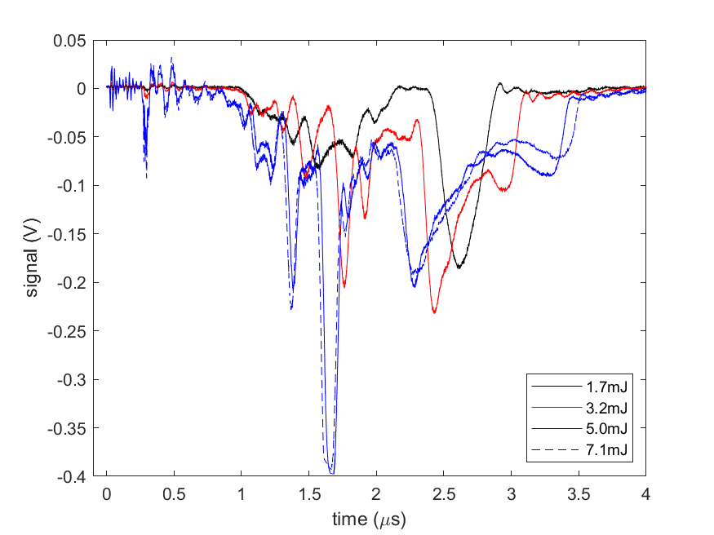
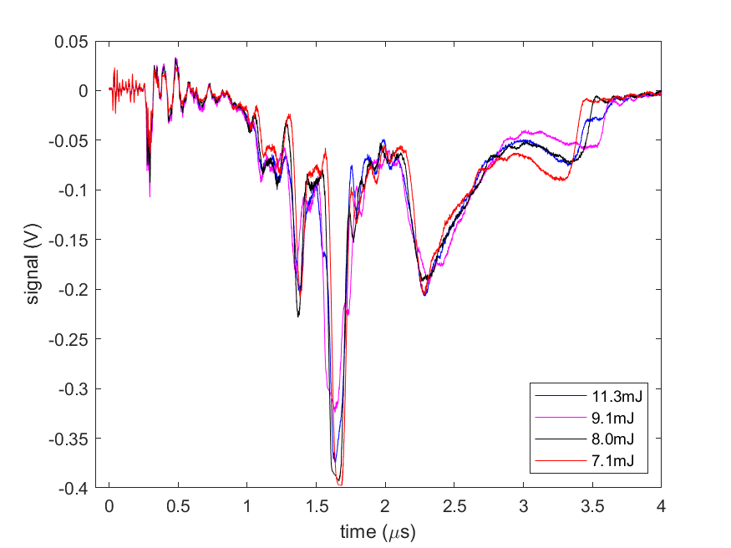


Time of Flight Measurement of Krypton Ions
$$1.7 to 5mJ$$
$$7.1mJ and above$$
Peak splitting
Mid intensity – peak splitting
Higher intensities – no additional splitting
Notes:
Space charge effect – some ions from coulomb explosion arrive earlier

Slide 10
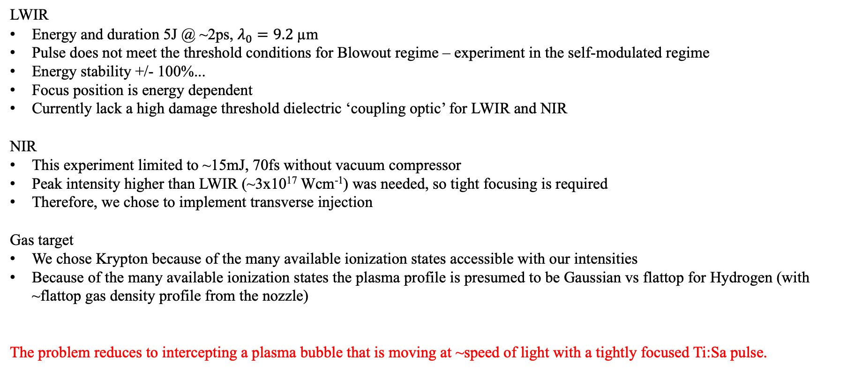
Two-Color Experiment Implementation at ATF
LWIR
Energy and duration 5J @ ~2ps, $λ_{0}=9.2$µm
Pulse does not meet the threshold conditions for Blowout regime – experiment in the self-modulated regime
Energy stability +/- 100%...
Focus position is energy dependent
Currently lack a high damage threshold dielectric ‘coupling optic’ for LWIR and NIR
NIR
This experiment limited to ~15mJ, 70fs without vacuum compressor
Peak intensity higher than LWIR (~3x10¹⁷ Wcm⁻¹) was needed, so tight focusing is required
Therefore, we chose to implement transverse injection
Gas target
We chose Krypton because of the many available ionization states accessible with our intensities
Because of the many available ionization states the plasma profile is presumed to be Gaussian vs flattop for Hydrogen (with ~flattop gas density profile from the nozzle)
The problem reduces to intercepting a plasma bubble that is moving at ~speed of light with a tightly focused Ti:Sa pulse.

Slide 11
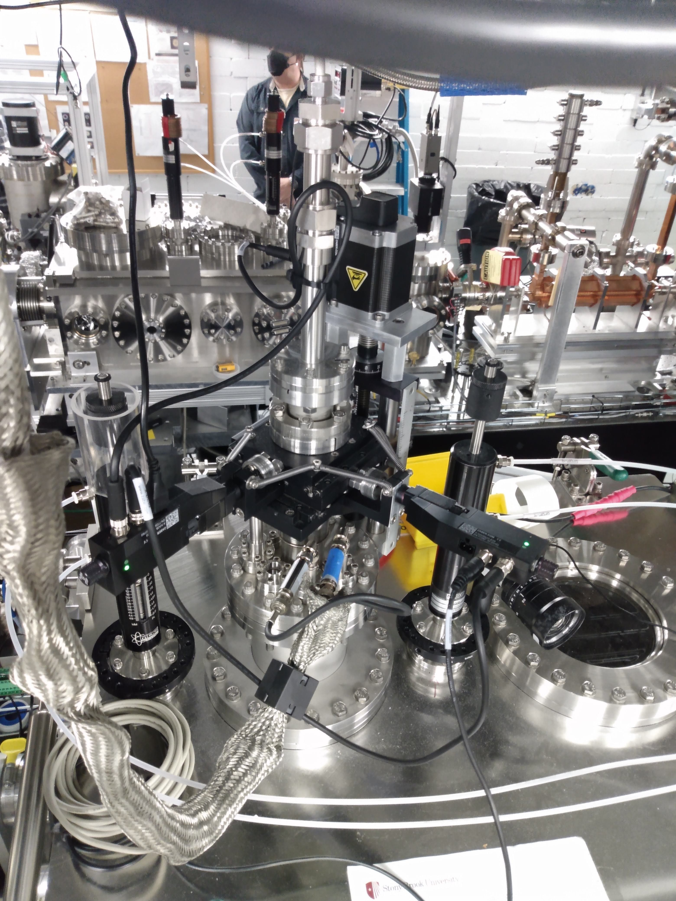
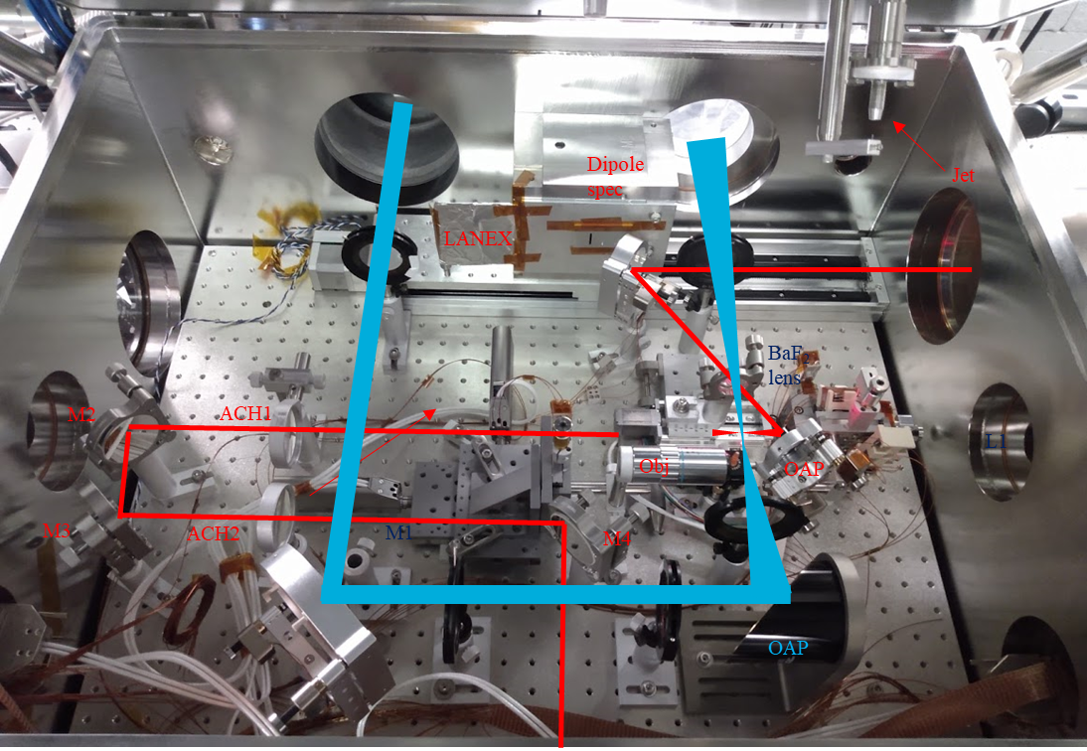
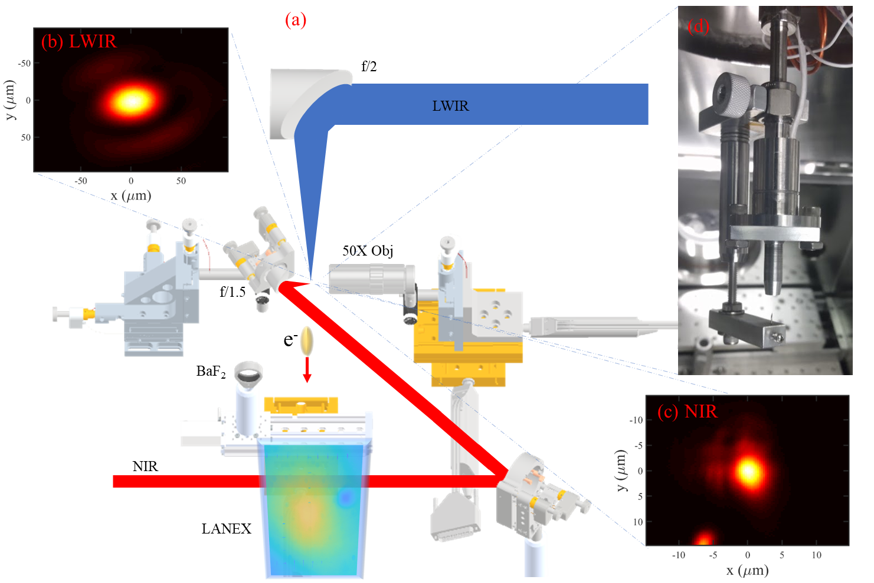
Beam Delivery

Slide 12
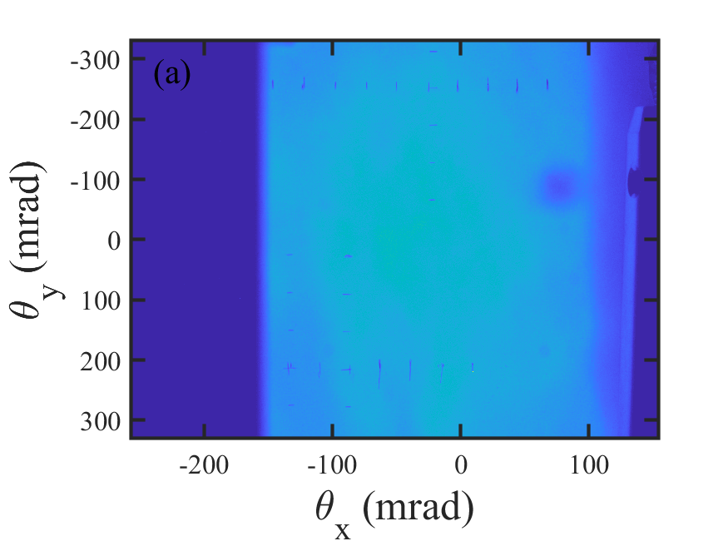
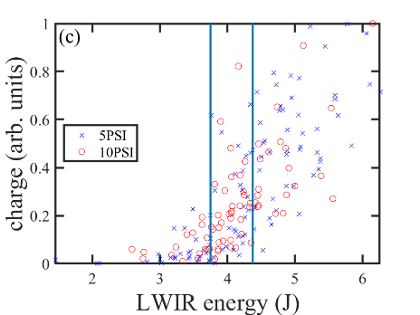
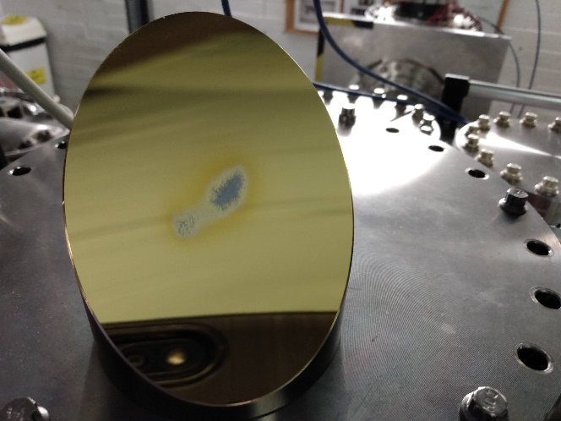
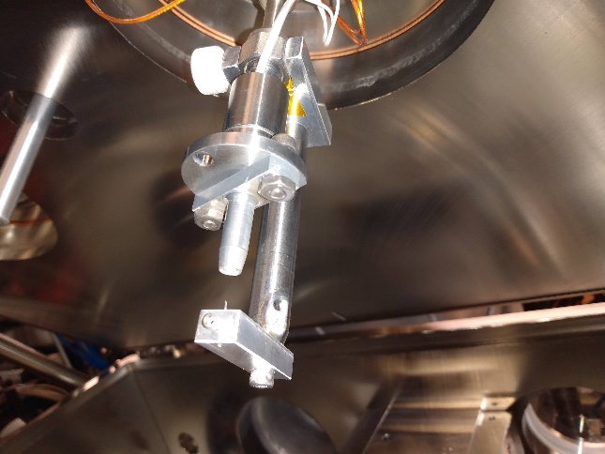
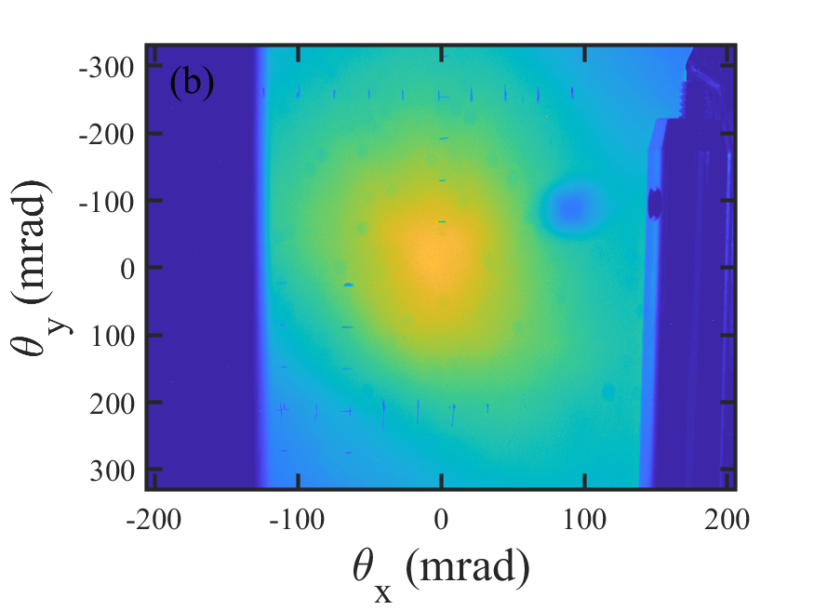
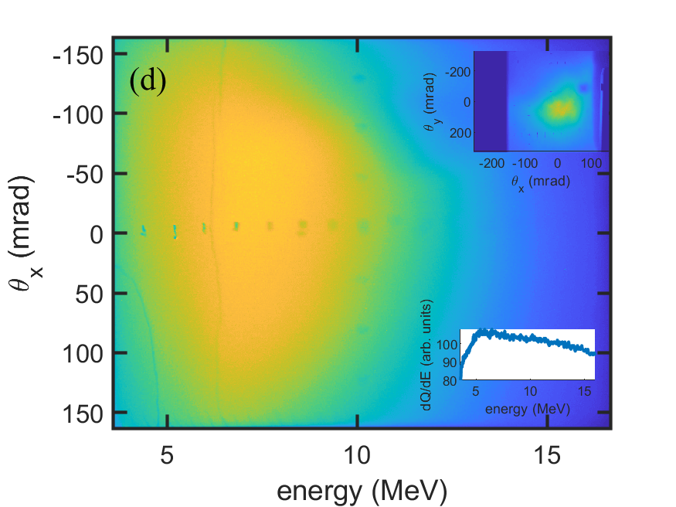
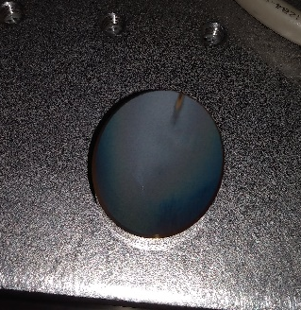
Preliminary Results
*We chose to work slightly above the threshold for self-injection where electron signal is always observed.
P=25PSI
Self injection at E_{LWIR}=5.3J, P=10PSI
Energy spectrum with H target
Completely fried the setup on day 12…
See also CO2-laser-driven wakefield acceleration
Notes:
At high energy you always get electrons at low energy inconsistent
Uniform illumination at 25 psi

Slide 13
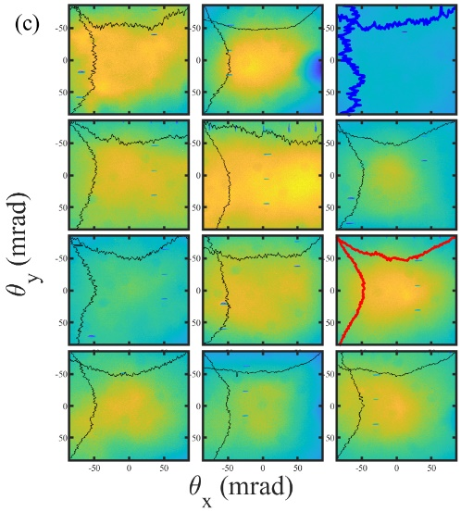
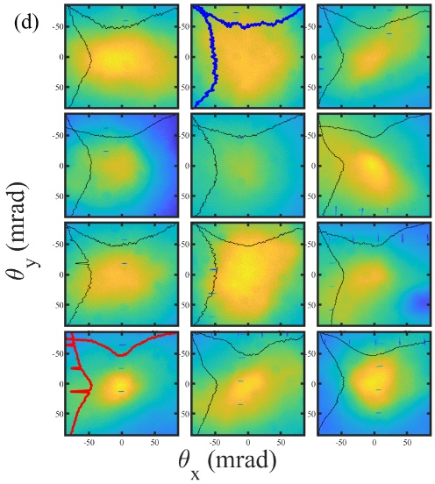
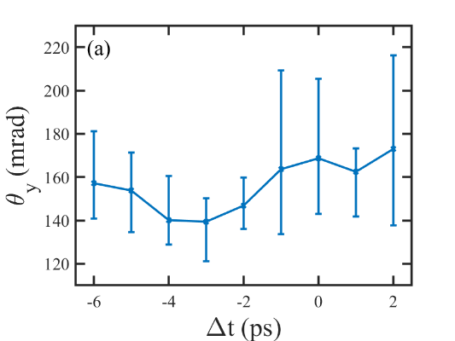
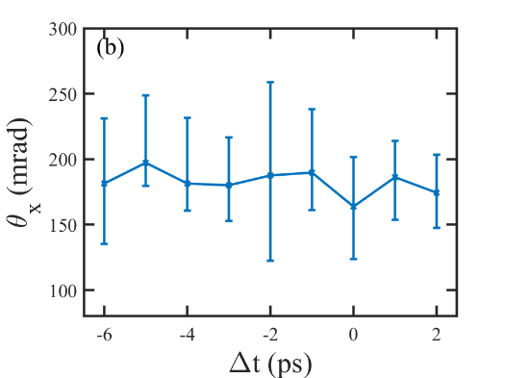
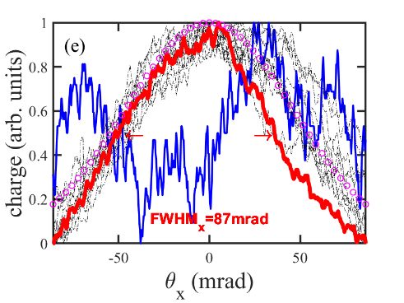
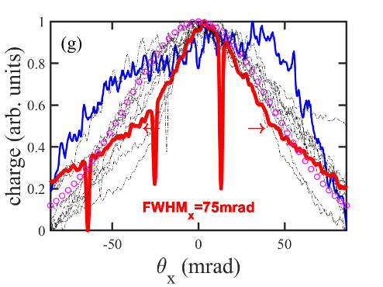
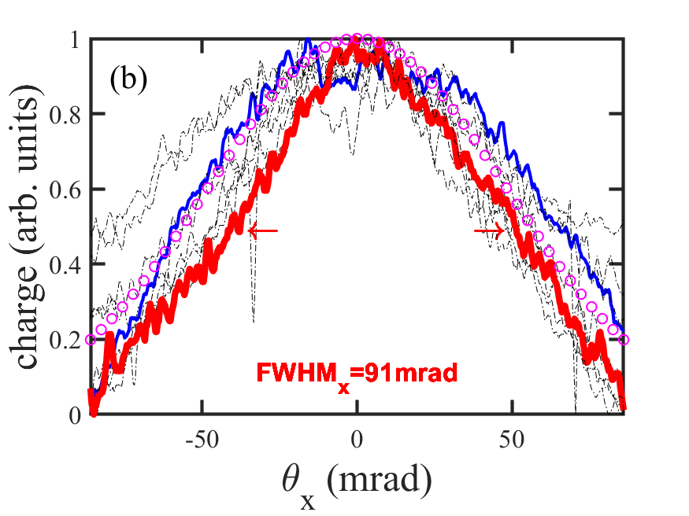
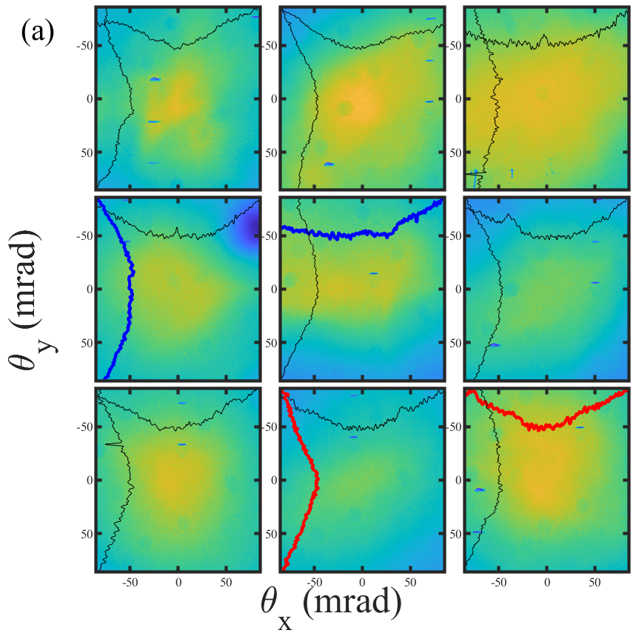
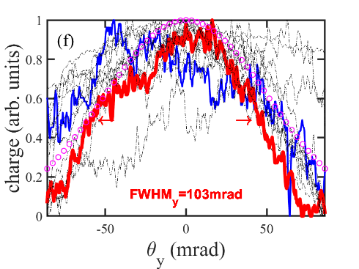
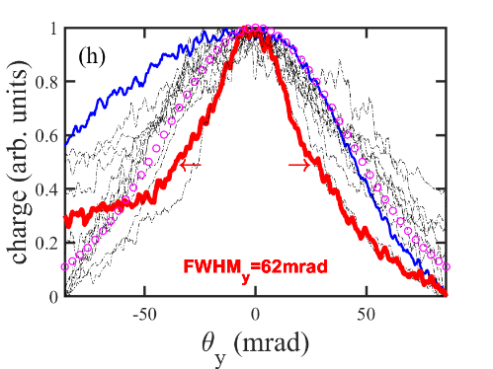
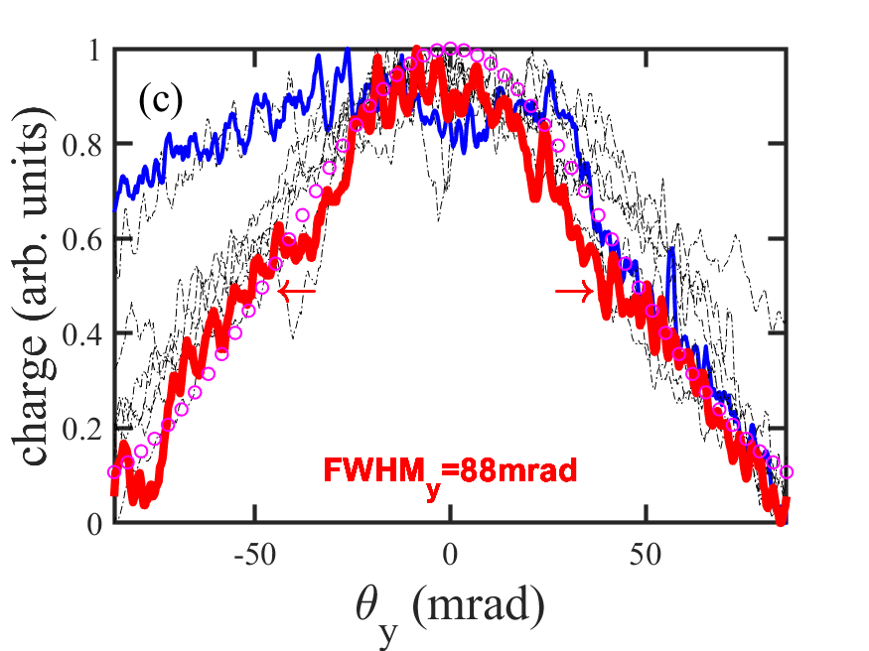
Preliminary Results
Injection OFF*
Injection ON*
Delay scan – effect only on y-divergence
High energy unseeded – self injection with high divergence
* Lowest divergence shots in each. Taken at no particular order.
Notes:
The best injection on is better than the self injected ones with the high energy
Negative delay is Ti:saph before CO2

Slide 14
Study of ionization injection (3D implementation)
A novel method has been implemented in SPACE for calculating multi-level ionization
Preionized profile implemented based on ionization calculation
Charge distribution by Ti:Sapph laser
(2ps after laser pass focus location)
Ion yield by Ti:Sapph laser
Notes:
Add experimental schematic

Slide 15
Divergence comparison with experiment
Preliminary

Slide 16
Summary
A first attempt at a two-color experiment using an LWIR in transverse geometry was made at ATF
Confirmed Ti:Sapphire’s ability to create highly ionized Kr state
Alignment and synchronization methods were successfully demonstrated with the LWIR and NIR lasers
Impact of NIR ionization on LWIR-driven wakefield in self-modulated regime was investigated
Multi-level ionization was implemented in simulations with preliminary results showing agreement with experiments

Slide 17
Next Steps
Implementation of NIR vacuum compressor will enable collinear injection
Reduction of the LWIR duration is needed for blowout regime
Improvement of LWIR vacuum transport will enable stability of focus position
Improvement of timing stability will allow for repeatable measurement

Slide 18
Related Talks
Tu, WG1, CO₂-laser-driven wakefield acceleration
Tu, WG 1, Self-injection process in laser‑wakefield accelerator driven by CO₂ laser pulses
Th, WG 2: Efficient algorithms for multi-level ionization of high-atomic-number gases and applications
Th, WG 6: Opportunities for advanced accelerator research with femtosecond long-wavelength laser
Th, WG 7+8: 9.3 microns: Toward next-generation CO₂ laser for particle accelerators
Th, WG 7+8: Fulfilling the mission of Brookhaven ATF as a DOE’s flagship user facility in accelerator Stewardship

Slide 19
The End

Slide 20
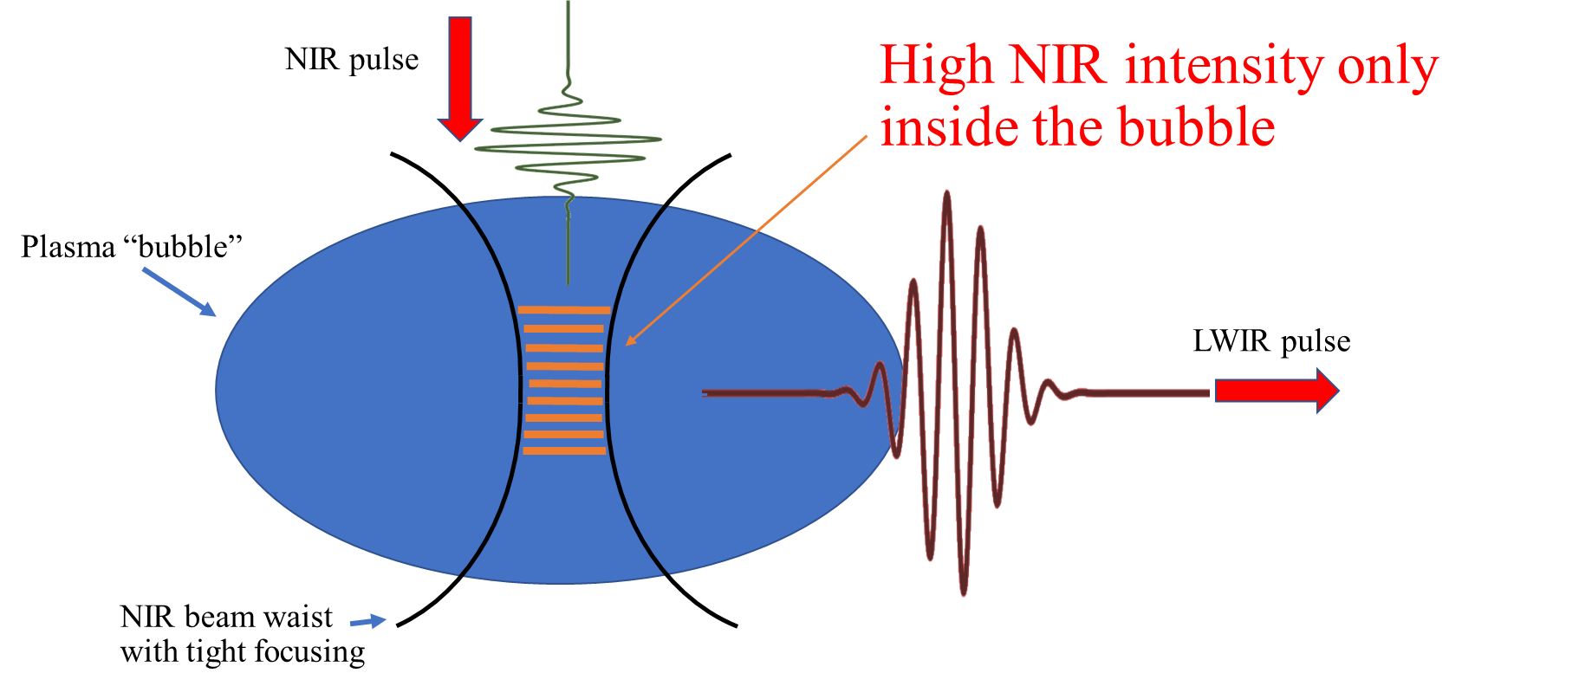
Transverse Injection Geometry Selected for a First Try

