Slide 1




UNIVERSITY OF MARYLAND AT COLLEGE PARK
Dept. of Physics
Dept. of Electrical and Computer Engineering
Institute for Research in Electronics and Applied Physics
Spatiotemporal Optical Vortices and Relativistic Optical Guiding
M. Le¹, G. A. Hine¹, J. P. Palastro² and H. M. Milchberg¹
¹Institute for Research in Electronics and Applied Physics, University of Maryland, College Park, Maryland 20742, USA
²University of Rochester, Laboratory for Laser Energetics, Rochester, New York 14623, USA
Support: AFOSR, ONR, NSF

Slide 2
Outline
Brief introduction to spatiotemporal optical vortices (STOVs)
Simulation: intense laser pulse propagation in plasma
Spatiotemporal optical vortices in plasma
  Formation of STOVs from laser-plasma interaction
  Role of STOVs in mediating laser energy density flow

Slide 3
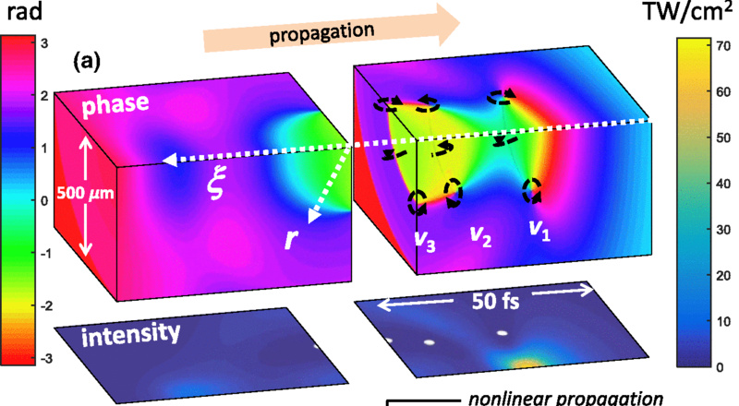
Spatiotemporal Optical Vortices
First discovered as emerging from self-focusing collapse arrest during filamentation in air.
N. Jhajj et al.
Spatiotemporal optical vortices
Phys. Rev. X 6, 031037 (2016)

Slide 4
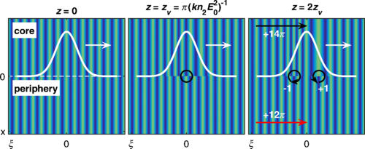
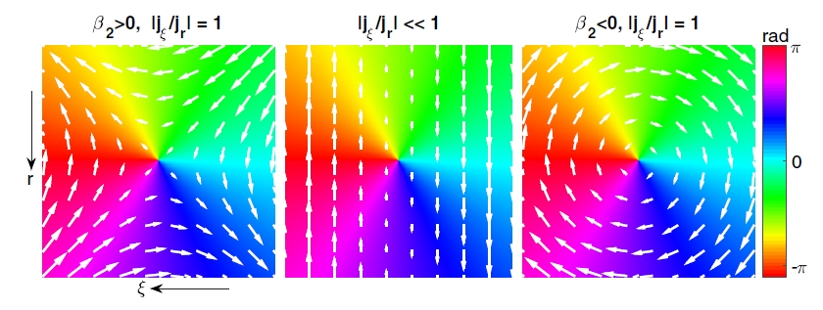
Spatiotemporal Optical Vortices
Circulate phase and energy spatiotemporally and carry transverse orbital angular momentum.
N. Jhajj et al.
Spatiotemporal optical vortices
Phys. Rev. X 6, 031037 (2016)

Slide 5
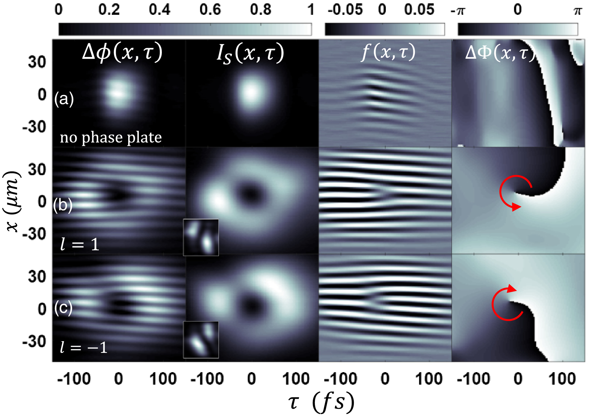
Spatiotemporal Optical Vortices
They have also been generated linearly with the use of a pulse shaper and can propagate in free space.
S. W. Hancock et al. Free-space propagation of spatiotemporal optical vortices, Optica 6, 1547 (2019)

Slide 6


Plasma filamentation
In atmospheric filamentation, STOVs form from phase shear between the high-intensity, self-focusing core and lower-intensity periphery, arising from the n₂ in air (Optical Kerr Effect).
Analogous, though distinct, nonlinearities such as relativistic and ponderomotive effects can impose a similar change in refractive index that leads to self-focusing for intense pulses in plasma.
$$F_{p}∝∇(E^{2})$$
$$n={\left(1−\frac{ω_{p}^{2}}{{γω}^{2}}\right)}^{1/2}$$

Slide 7
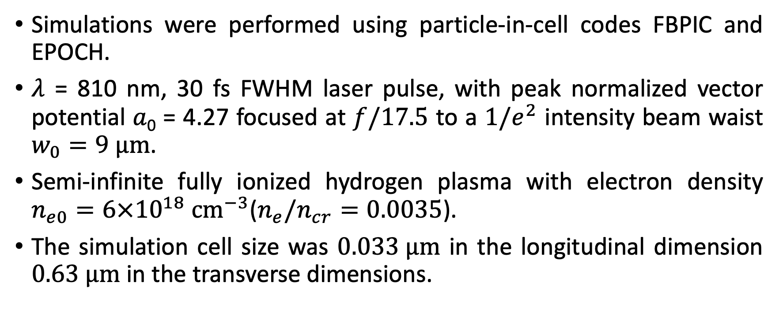
Simulation parameters
Simulations were performed using particle-in-cell codes FBPIC and EPOCH.
$λ$ = 810 nm, 30 fs FWHM laser pulse, with peak normalized vector potential 𝑎₀ = 4.27 focused at $f/17.5$ to a $1/e^{2}$ intensity beam waist $w_{0}=9 μm$.
Semi-infinite fully ionized hydrogen plasma with electron density $n_{e0}=6×{10}^{18} cm^{−3}$($n_{e}/n_{cr}=0.0035$).
The simulation cell size was $0.033 μm$ in the longitudinal dimension $0.63 μm$ in the transverse dimensions.

Slide 8


Propagation in plasma
Throughout the simulation, as the laser pulse propagates in plasma, it undergoes a couple cycles of self-focusing and diffraction analogous to filamentation in air.
$$F_{p}∝∇(E^{2})$$
$$n={\left(1−\frac{ω_{p}^{2}}{γω^{2}}\right)}^{1/2}$$

Slide 9
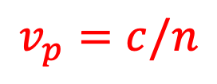


Propagation in plasma
Difference in phase velocity across the boundary between core and periphery leads to phase shear.
$$F_{p}∝∇(E^{2})$$
$$n={\left(1−\frac{ω_{p}^{2}}{γω^{2}}\right)}^{1/2}$$
$$v_{p}=c/n$$

Slide 10
Formation of STOVs
Phase shear accumulates as wavefronts in the core lag those in the periphery.
Two STOVs of opposite winding are generated and diverge relative to the pulse.
Phase defect/field null emerges as phase shear reaches critical point.

Slide 11
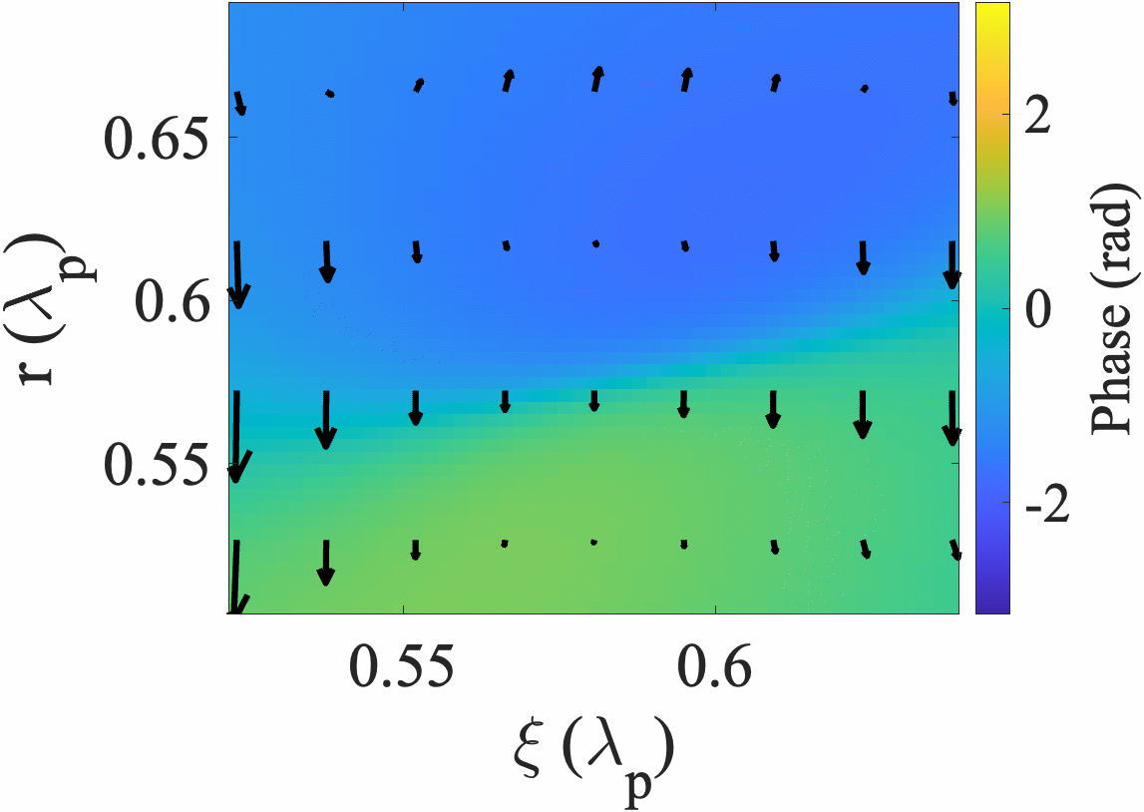
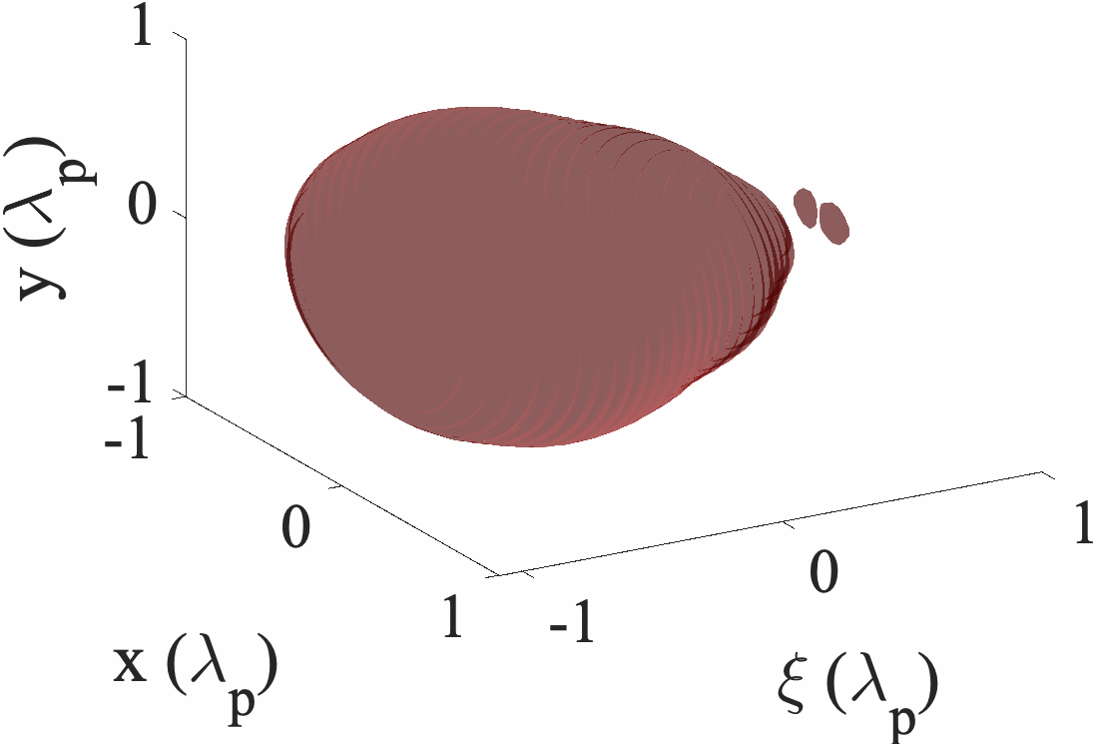
Formation of STOVs

Slide 12
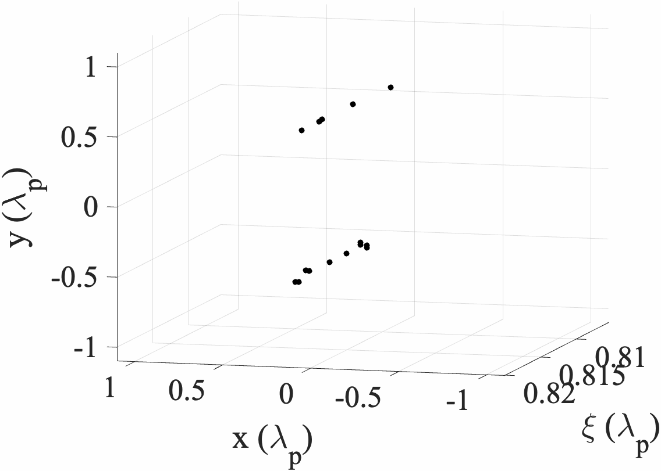
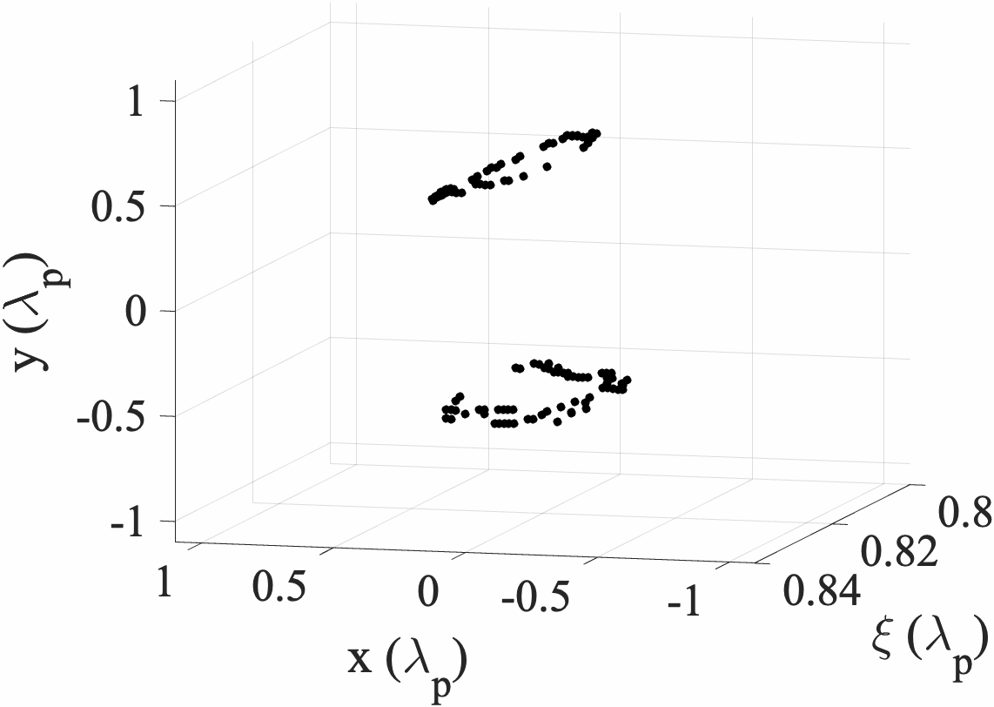
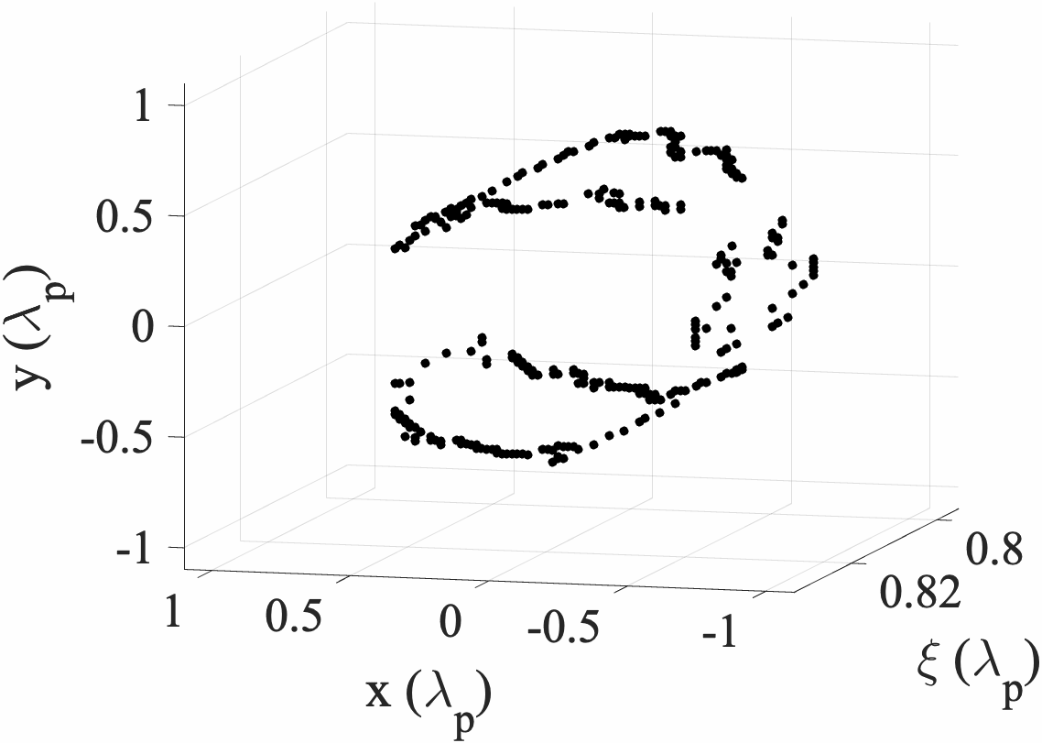
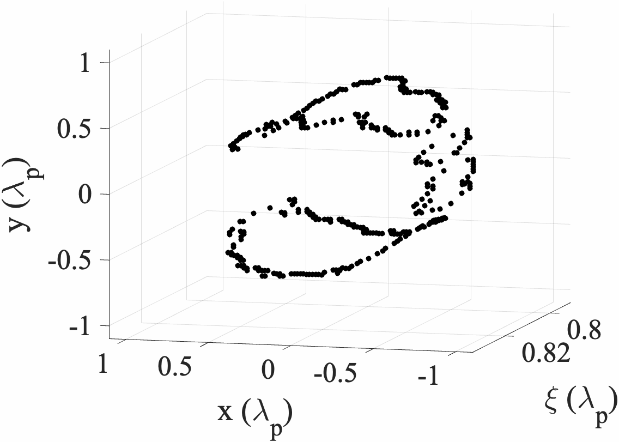
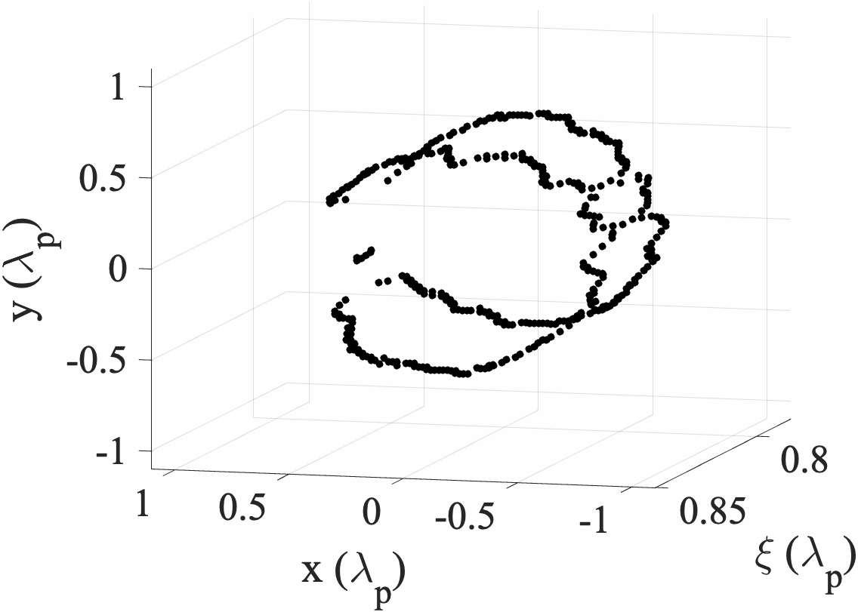
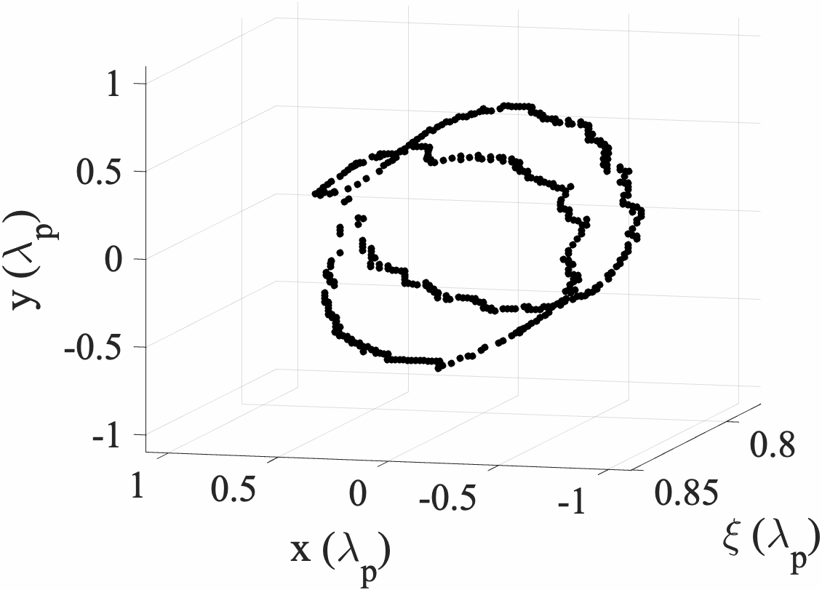
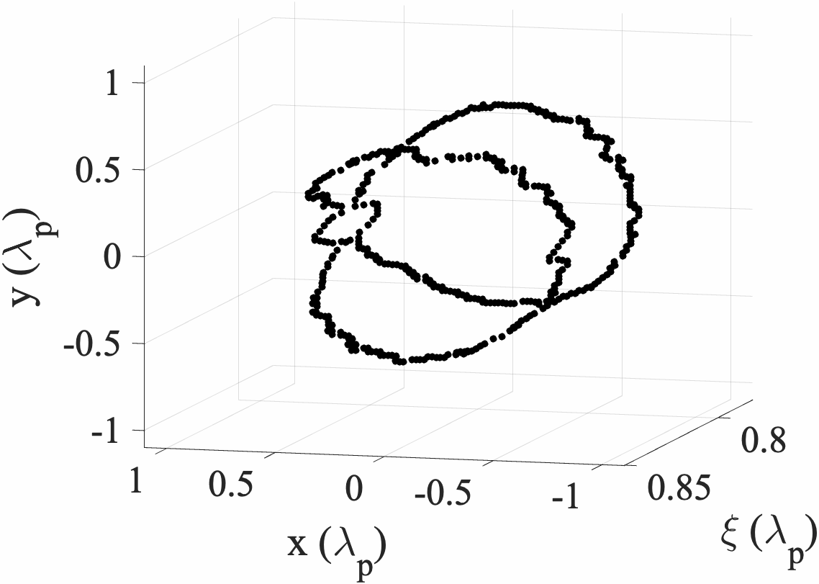
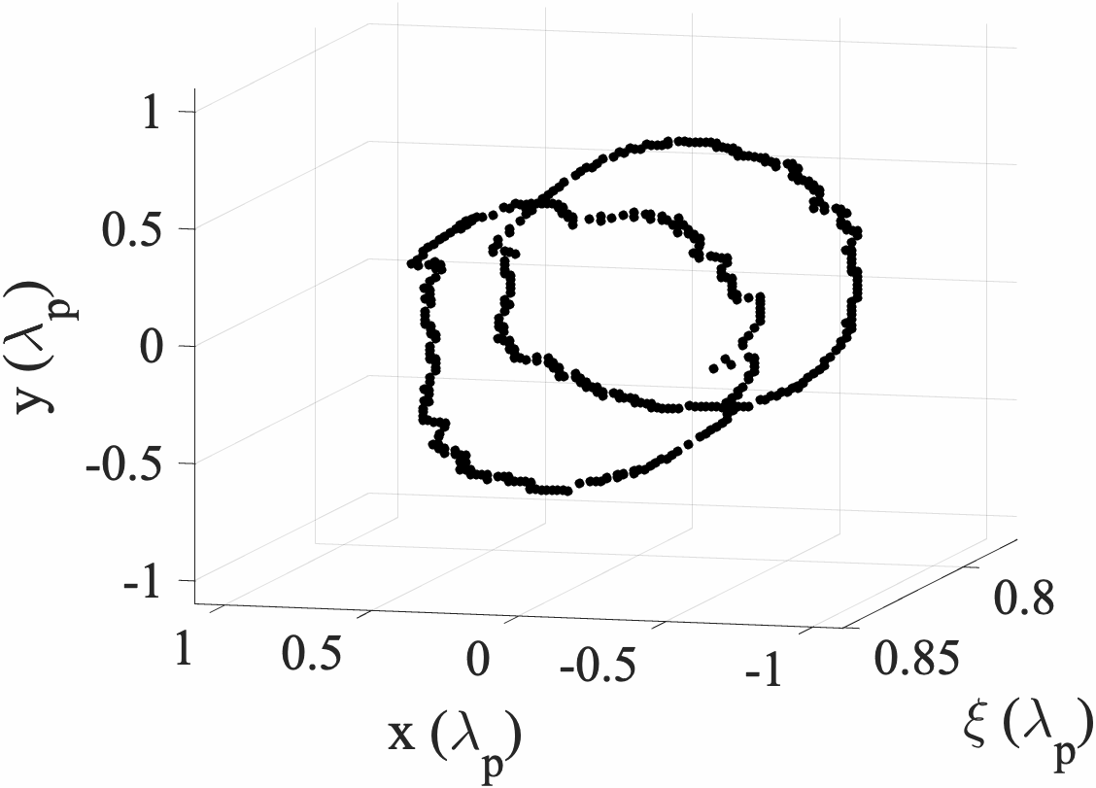
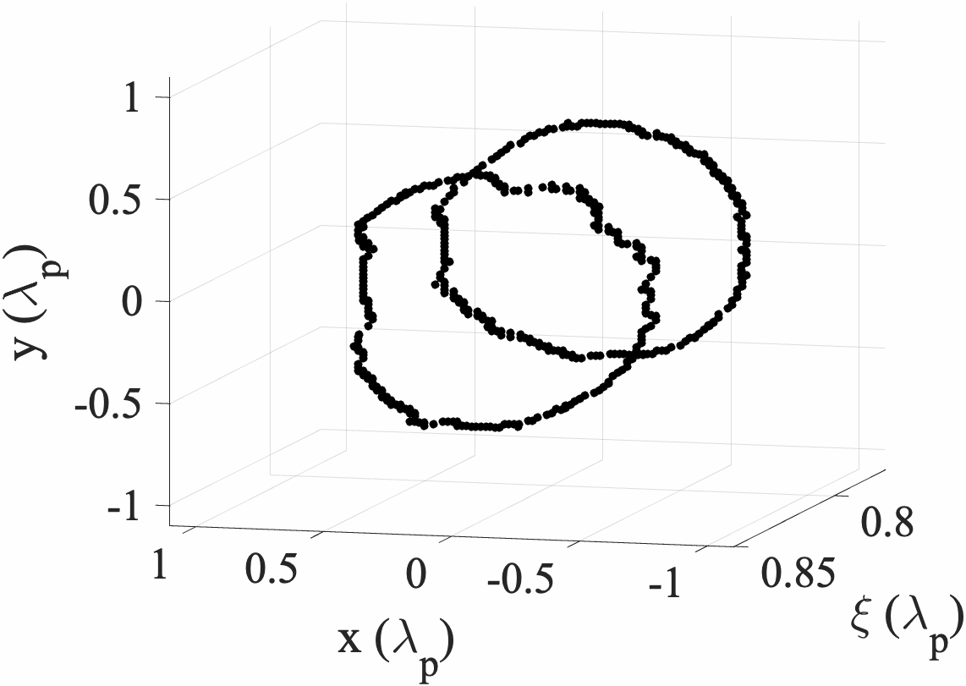







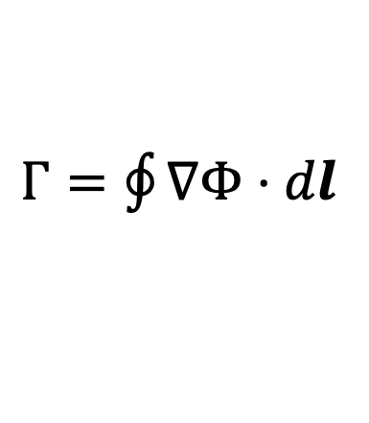


Formation of STOVs: Nucleation
$$z=188. 2μm$$
$$z=190.1 μm$$
$$z=191.9 μm$$
STOVs are found to nucleate at points about the pulse before forming rings.
The electric field polarization of the laser breaks symmetry; nucleation is the result.
$$z=192.5 μm$$
$$z=193.7 μm$$
$$z=194.3 μm$$
$$z=195.5 μm$$
$$z=196.1 μm$$
$$z=197.3 μm$$
$Γ=\oint{∇Φ}⋅dl$

Slide 13
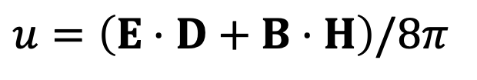
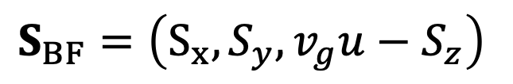
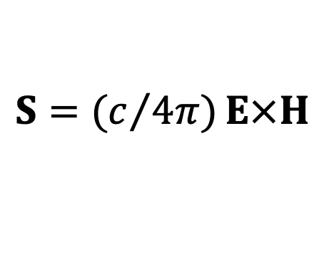
Mediation of energy flow by STOVs
We calculate the time-averaged Poynting vector <S> and energy density <u> to illustrate the local energy density flux about each STOV.
a)
$S_{BF}=\left(S_{x},S_{y},v_{g}u−S_{z}\right)$
$S={(c}/{4π)}E×H$
$u=\left(E⋅D+B⋅H\right)/8π$

Slide 14



Mediation of energy flow by STOVs
$$z=116 μm$$
On the broader scale, STOVs enable a transition from primarily inward energy flux to outward, and their formation here punctuates each cycle of self-focusing and diffraction.
$$z=197 μm$$
$S_{BF}=\left(S_{x},S_{y},v_{g}u−S_{z}\right)$
$$z=278 μm$$
$S={(c}/{4π)}E×H$
$u=\left(E⋅D+B⋅H\right)/8π$

Slide 15
Mediation of energy flow by STOVs
The previous plot of the laser pulse propagation throughout the simulation corroborates the change in direction observed in the Poynting vector. When each STOV pair appears (dotted line), there is a transition from focusing to defocusing.

Slide 16
Discussion
Just as in atmospheric filamentation, we see that STOVs are associated with arrested relativistic self-focusing in plasma, their formation bridging the self-focusing and defocusing phases of propagation.
Given sufficient power, STOV pairs will emerge multiple times as continued phase shear causes wavefronts to curve inward again and to self-focus again in a cycle.
The transition from focusing to defocusing lags the appearance of STOVs as they signal the start of a shift in the energy flow.

Slide 17
Summary
Spatiotemporal optical vortices, which were first discovered and measured in previous work arising from filamentation in air, are found in simulation to emerge from relativistic self-focusing in plasma.
They are generated by phase shear induced by intensity-dependent relativistic and ponderomotive optical nonlinearities.
3D particle-in-cell simulations show that STOVs nucleate at points before reconnecting to form toroids that wrap around the pulse
STOVs mediate the flow of electromagnetic energy within the laser pulse and enable a transition from inward energy flux (focusing) to outward (defocusing).

Slide 18
End
Questions?

