Slide 1
Exploring potential of 3D printed structures in PW laser driven ion acceleration
Sergei Tochitsky, Nuno Lemos, R.A. Simpson, D.A. Mariscal, A. Pak, J. Chou, F. Fiuza, D. Haberberger, A. Haid, and C. Joshi
Neptune Laboratory, Department of Electrical Engineering, UCLA
Lawrence Livermore National Laboratory
Stanford Linear Accelerator National Laboratory
Laboratory for Laser Energetics
General Atomics

Slide 2
PW Laser Driven Ion Accelerators 2022
Good Old TNSA mechanism with proton energy scaling E_{p}∞a₀
Petawatt class laser
E_{L} ~ 300-500 J
τ_{L} = 500-800 fs
r_{L} ≤ 10μm
I_{L} = 3-5x10²⁰W/cm²
RAL, 2018
GSI, 2016
UCLA
H⁺
Enhanced TNSA/RT regime in
≥100 nm nanofoils
E_{max} H⁺ = 94MeV
-K. Zeil et. al., New J. Phys. 12, 045015 (2010)
GSI-F. Wagner et al, PRL, 116, 205002 (2016);
RAL-A. Higginson et al, Nat. Commun. (2018)
AAC-2022

Slide 3
New ion acceleration platform: pinted targets
TIM10
Θ = 27, ɸ = 0
EPPS1
Along same line of sight but slightly below target
( EPPS Diagnostic)
General Atomics 3D Printed target
TIM12
Θ = 0, ɸ = 0
Thomson Spec.
Proton Beam Imager & Energy Spectrometer (“PROBIES”)
+ RCF layers
Target
1-μm beam
Focused OMEGA EP Laser
~700 TW, 700-800 fs
a₀~10-20
OMEGA EP UCLA’s NLUF experiment 2022-2023.
AAC-2022
Notes:
We expect with CSA to see a more monoenergetic proton spectrum, perhaps a different spatial distribution, and PROBIES can directly give you that information. EPPS measures energies of up to 10MeV, and PROBIES goes up to 60 MeV+ spatial distribution.

Slide 4
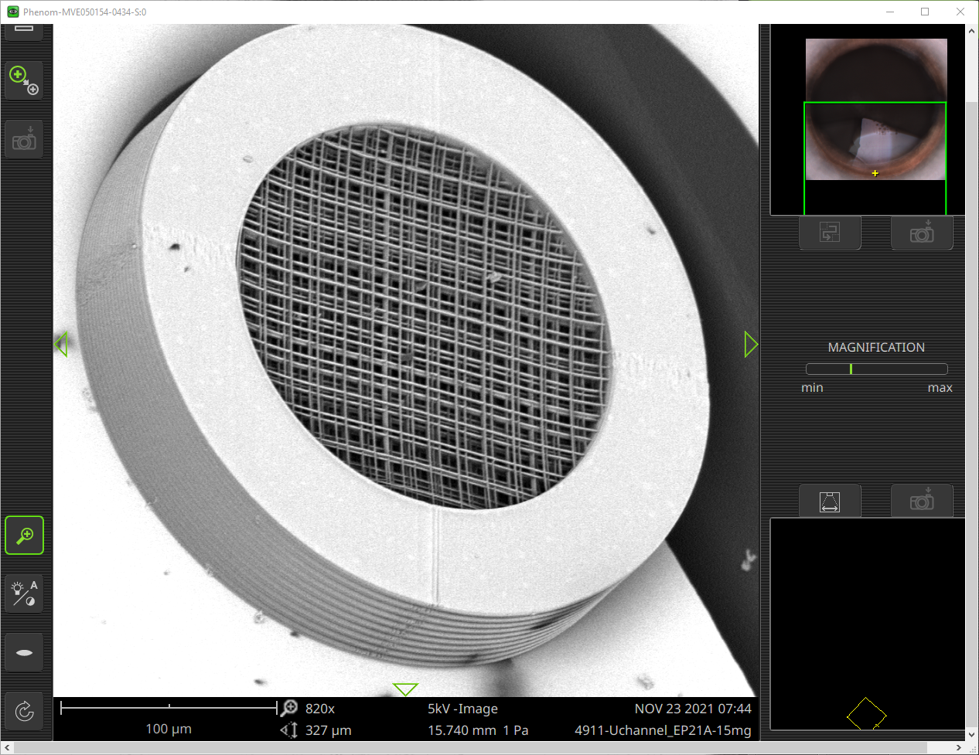
A 3D designer microstructure target GA
X-ray
Δt = 325 ps
AAC-2022

Slide 5
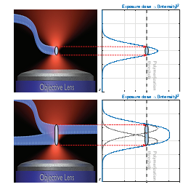
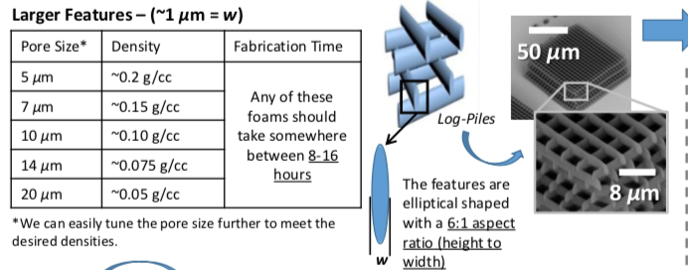
Two-Photon Absorption Laser Nanoprinting
Voxel size for λ=800 nm, transverse λ/4=200 nm, axial ~500 nm
AAC-2022

Slide 6
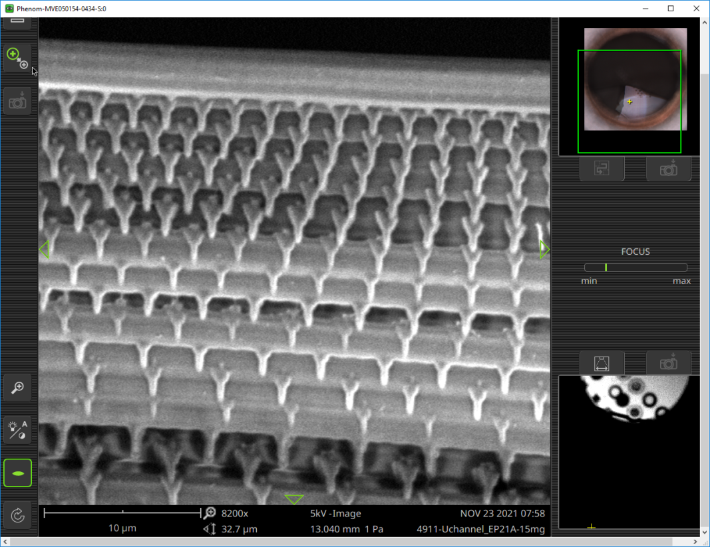
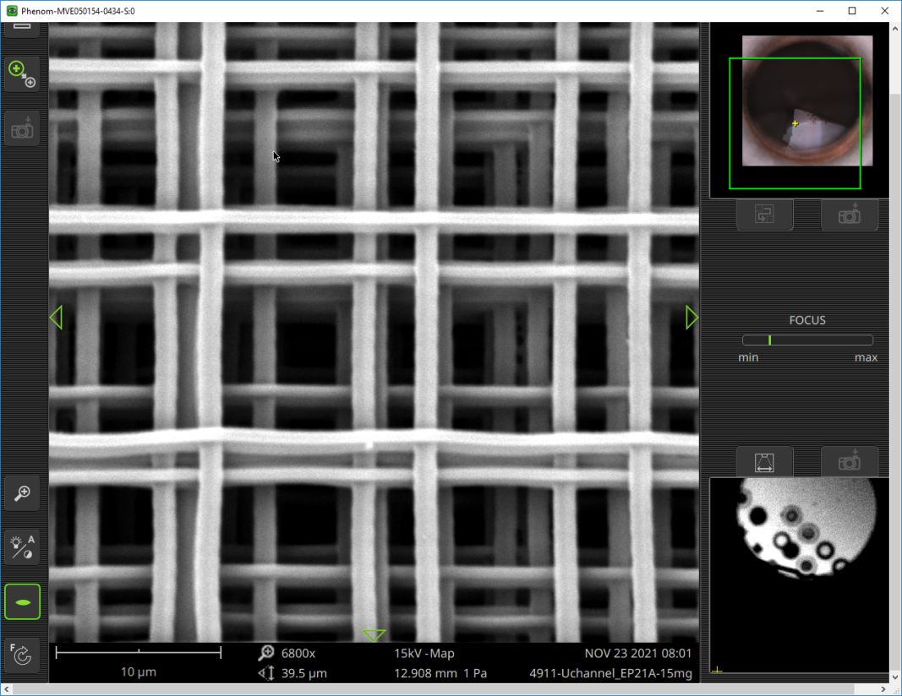
3D log-pile structure works as a system of organized wires in which laser light eventually hits the wire. Targets with stochastic or randomly distributed wires have been also tested.
A 3D designer microstructure target by GA
X-ray
Δt = 325 ps
AAC-2022

Slide 7
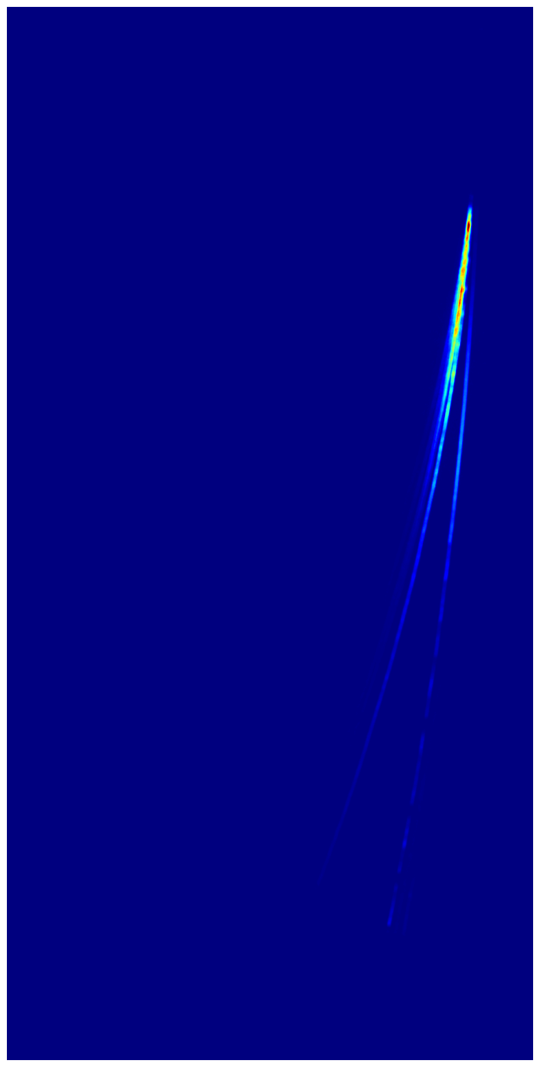
Proton Data for Log-Pile Printed Targets
Thompson Parabola Data after 5 scans of imaging plates strong C⁶⁺ and p⁺
10 um thick Log-pile structure
Proton Num, (MeV⁻¹xSr⁻¹)
C⁶⁺
p+
Proton Energy
50 um thick Log-pile structure
C⁶⁺
Proton Num, (MeV⁻¹xSr⁻¹)
p+
Proton Energy
High proton yield >10⁹ is achieved for near-80 MeV favoring shorter interaction length.
AAC-2022

Slide 8
Comparison between foil and log-pile structure
Thompson Parabola data after 5 scans of imaging plates p+ using a 2 μm foil (TNSA shot).
Electron Number
Proton Num, (MeV⁻¹xSr⁻¹)
Proton Energy
Electron Energy, MeV
Proton yield in the case of a log-pile microstructure is comparable with a classical TNSA spectrum. Maximum Ep~60 MeV for a foil is lower indicating the enhanced TNSA regime likely due to additional electron heating in a bulk.
AAC-2022

Slide 9
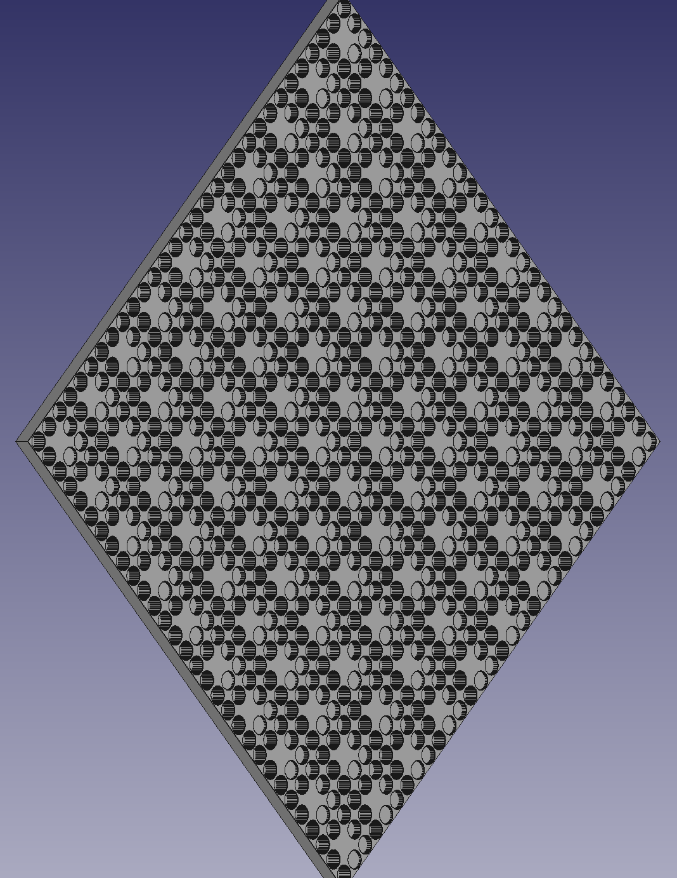
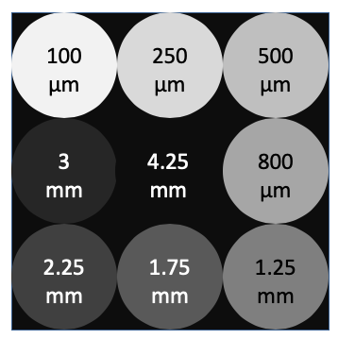
NTA @ TIM 14 will be a ~70 layer RCF pack -- Thank you Danielle!
Proton Data from a PROBIES diagnostic
LLNL 80 MeV Proton Beam Imaging Energy Spectrometer (Probies) (D. Mariscal, PPCF, 63, 2021)
Repeated Drilled out pattern with different thickness
5.5
mm
AAC-2022

Slide 10
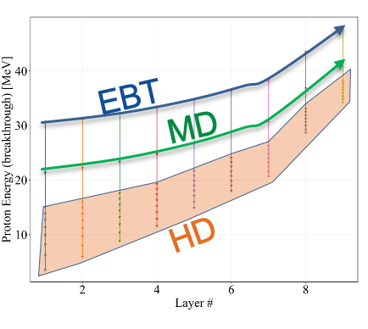
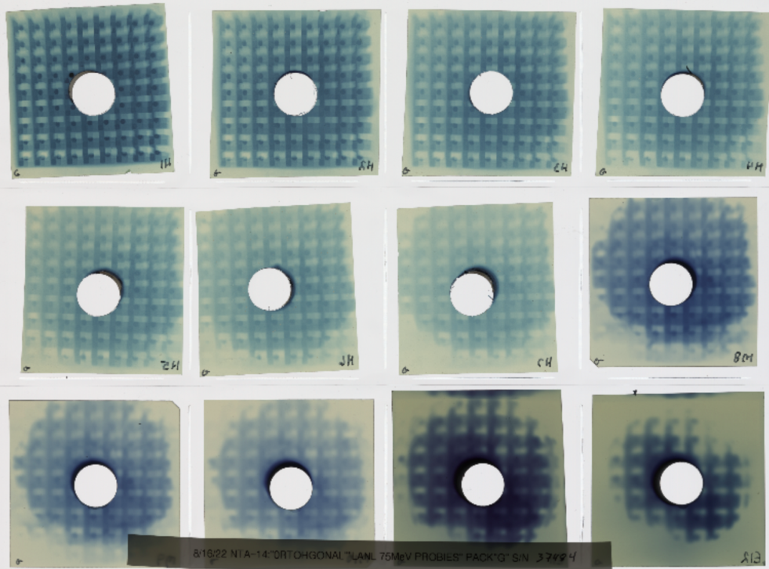
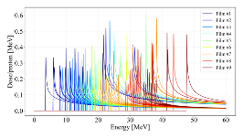
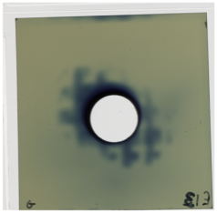
RCF data for a 10 μm Log-pile Target
RCF stack exposure for a 10 μm microstructured target
5
14
20
25
29
33
40
46
61
68
51
56
Nice looking round beam with E_{max} for protons reaching ~80 MeV .
80 MeV
AAC-2022

Slide 11
MicrostructuredTarget Modeling (OSIRIS)
X-ray
Δt = 325 ps
AAC-2022

Slide 12
Sheath Dynamics in Microstructured Target
X-ray
Δt = 325 ps
AAC-2022

Slide 13
Accelerating Field 2D Structure
X-ray
Δt = 325 ps
AAC-2022

Slide 14
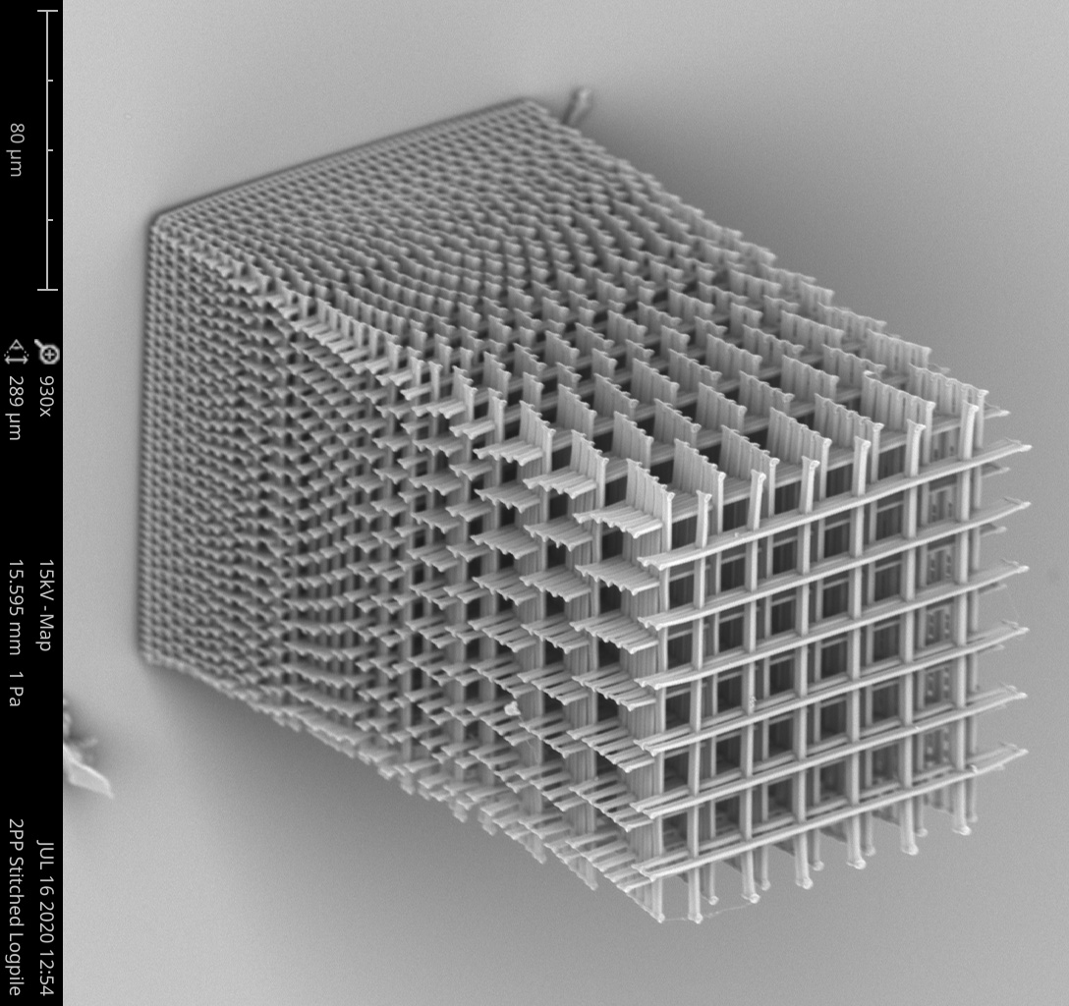
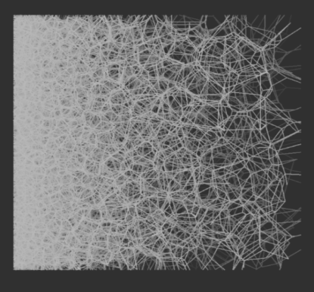
We demonstrate that log-pile 3D printed microstructures irradiated by an intense 1 μm, picosecond laser pulse (a₀=10-25) can generate high energy ion beams with a large yield.
Conclusions
N_{p}~10⁹ protons are accelerated to an energy of ~80 MeV in a 10 μm thick log-pile 3D laser printed structure.
Hotter and larger quantity electrons measured for microstructured target in comparison with a foil target indicates that the enhanced sheath field is responsible for observed ion spectra. Physics of electron heating is complex.
PIC simulations of a microstructured log-pile targets show that laser-plasma interaction on a picosecond time scale is related to yet to be expanded wires.
Log-pile
3D printed
2PP target
Stochastic
Laser printed
2PP target
Thank NNSA (DE-NA0003842) for supporting this study.
AAC-2022

