Slide 1
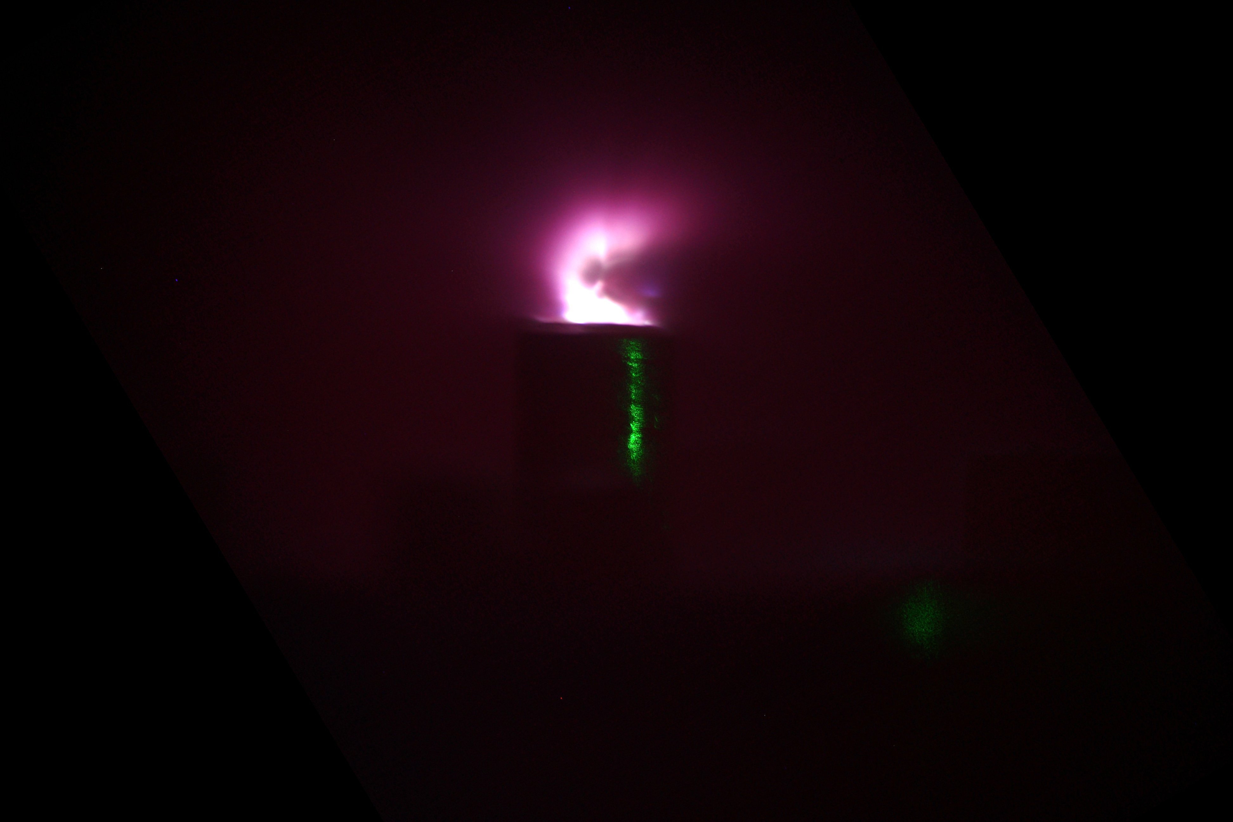
Proton acceleration with a CO₂ laser at the ATF
Igor Pogorelsky, O.C.Ettlinger, N.P.Dover, E.-J. Ditter, M.N.Polyanskiy, M.Babzien, M.Palmer, Z.Najmudin
Advanced Accelerator Concepts
9th November 2022

Slide 2

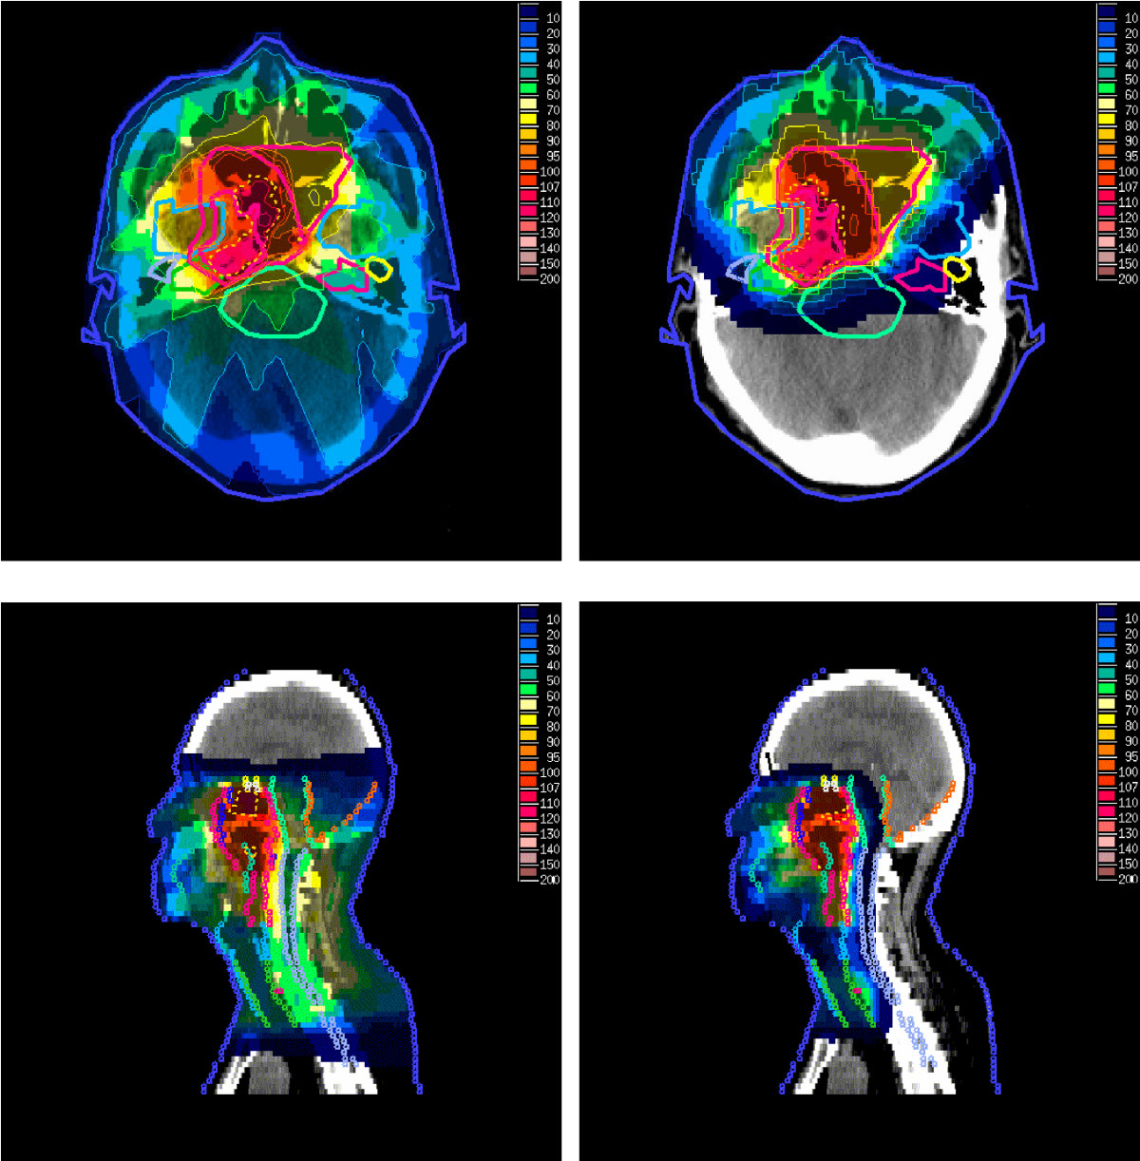
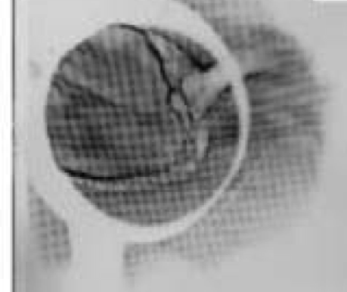
Why are laser accelerated ions interesting…
Protons/Carbon ions for particle therapy
Proton radiography
Z. Taheri-Kadkhoda et al. Radiation Oncology 3 (2008)
G. Sarri et al., European Phys. Jour. D, (2009)
Require high energy, narrow energy spread, low divergence, etc.
Energy depends on what you’re probing, thermal energies, divergence less critical

Slide 3


Why are laser accelerated ions interesting…
Protons/Carbon ions for particle therapy
Proton radiography
Z. Taheri-Kadkhoda et al. Radiation Oncology 3 (2008)
G. Sarri et al., European Phys. Jour. D, (2009)
Also isochoric heating, neutron production for industrial imaging, medical isotope production, fast ignition, transmutation of nuclear waste, etc…

Slide 4

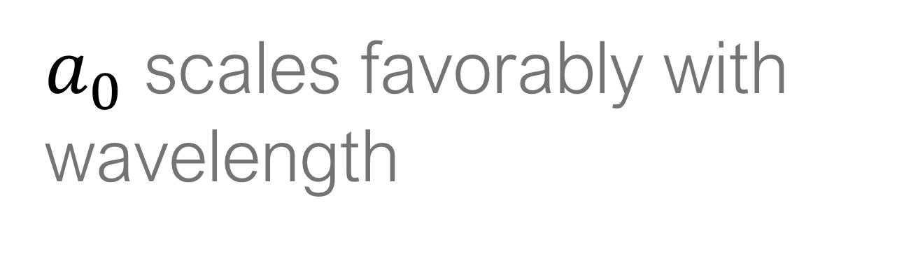

CO2 lasers - the benefits of longer wavelengths?
CO2 lasers offer a number of benefits over the more typical ~1µm lasers we normally use…
$a_{0}$ scales favorably with wavelength
$$a_{0}=\frac{eE_{0}}{m_{e}c}⋅\frac{λ}{2πc}$$
As the result, demonstrated with !0¹⁶ W/cm² same TNSA as with 10¹⁸ W/cm² solid state laser.
This means also that a 10-μm CO2 laser of the same power as a 1-μm laser can produce at least 100x more TNSA ions.
I.V. Pogorelsky et al. / Nuclear Instruments and Methods in Physics Research A 620 (2010) 67

Slide 5

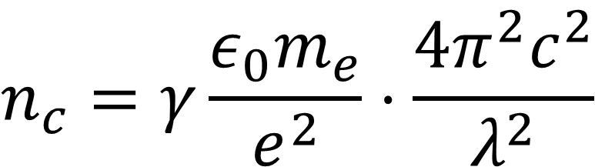
CO2 lasers - the benefits of longer wavelengths?
CO2 lasers offer a number of benefits over the more typical ~1µm lasers we normally use…
Critical density of a plasma scales favorably with wavelength
$$n_{c}=γ\frac{ε_{0}m_{e}}{e^{2}}⋅\frac{4π^{2}c^{2}}{λ^{2}}$$
This is even more interesting as now one can reach critical density even with a gas target opening access to new acceleration mechanisms such as collisionless electrostatic shock wave acceleration.
Plasma density dynamics in expanded laser cavities can be explored with optical diagnostic using visible lasers.
We are able now to explore in details radiation pressure driven ion acceleration.

Slide 6


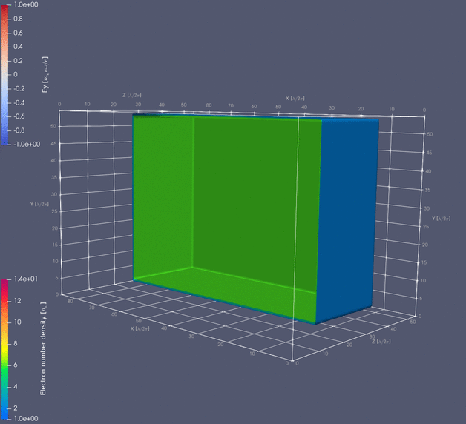
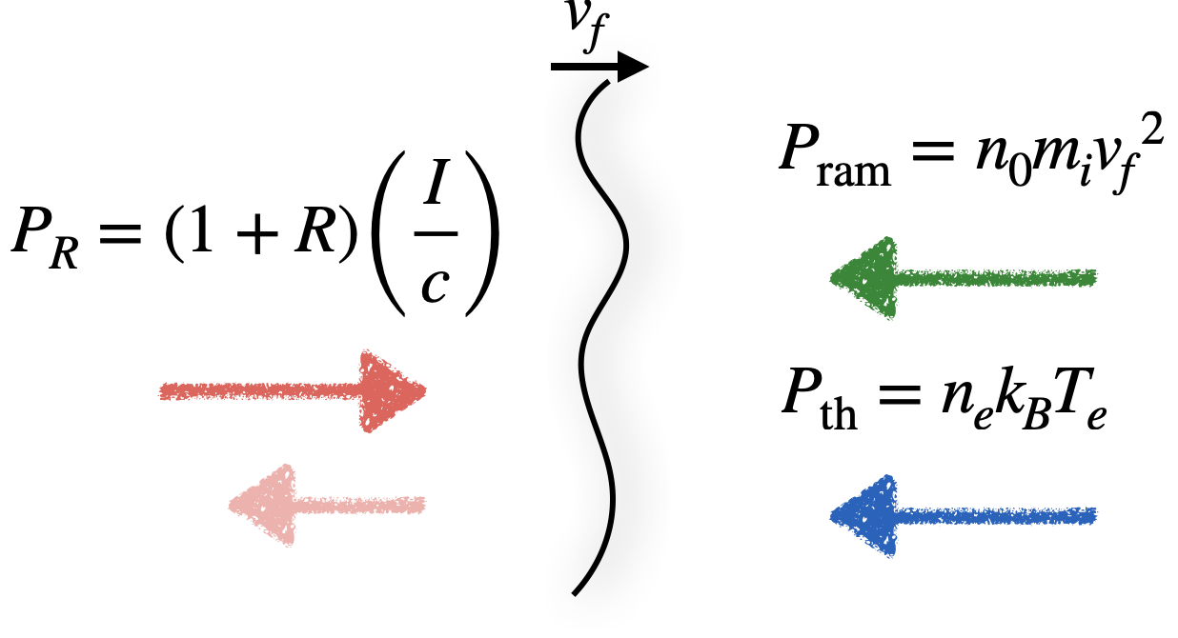


Radiation Pressure Driven Acceleration
6

Slide 7

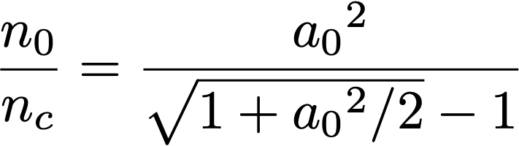

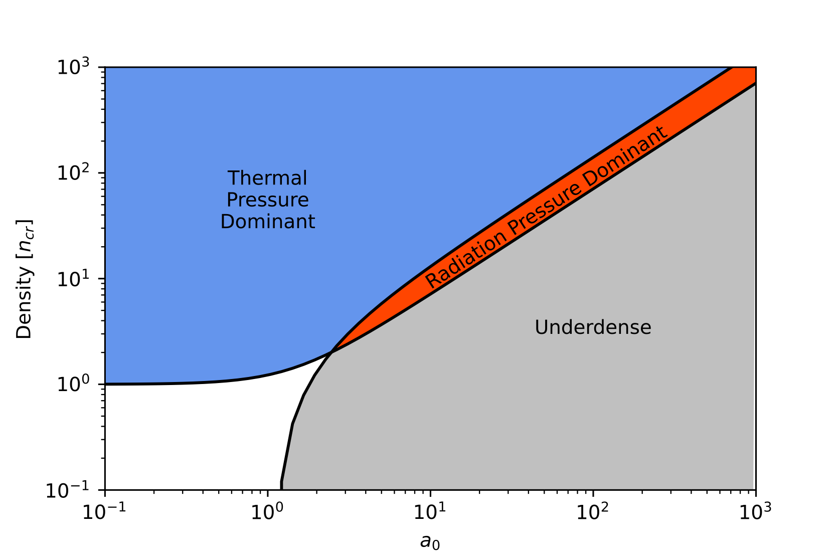



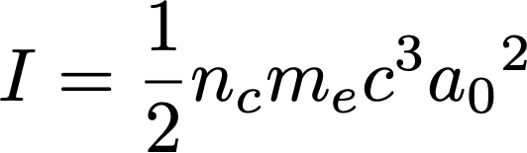
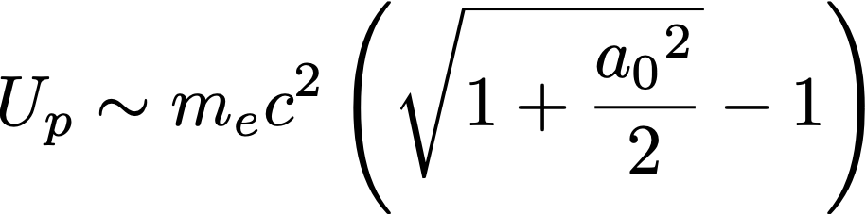
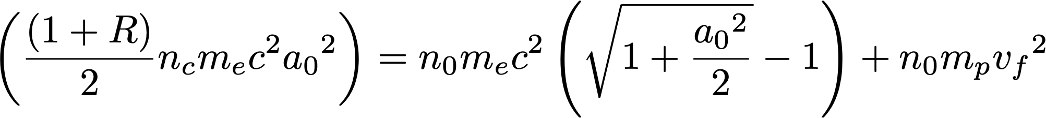
Radiation Pressure Driven Acceleration
Comparing the radiation and thermal pressure

Slide 8
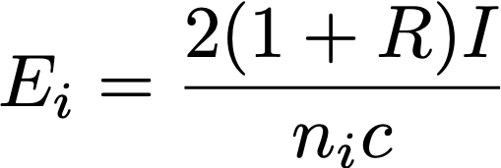
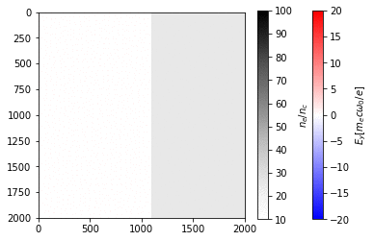
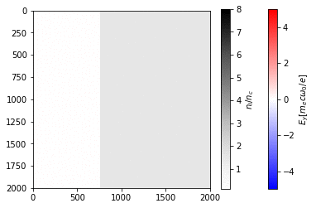
Radiation Pressure Driven Acceleration
Radiation pressure dominant - hole boring radiation pressure acceleration
Thermal pressure dominant - possible to form a collisionless shock structure, accelerating ions

Slide 9
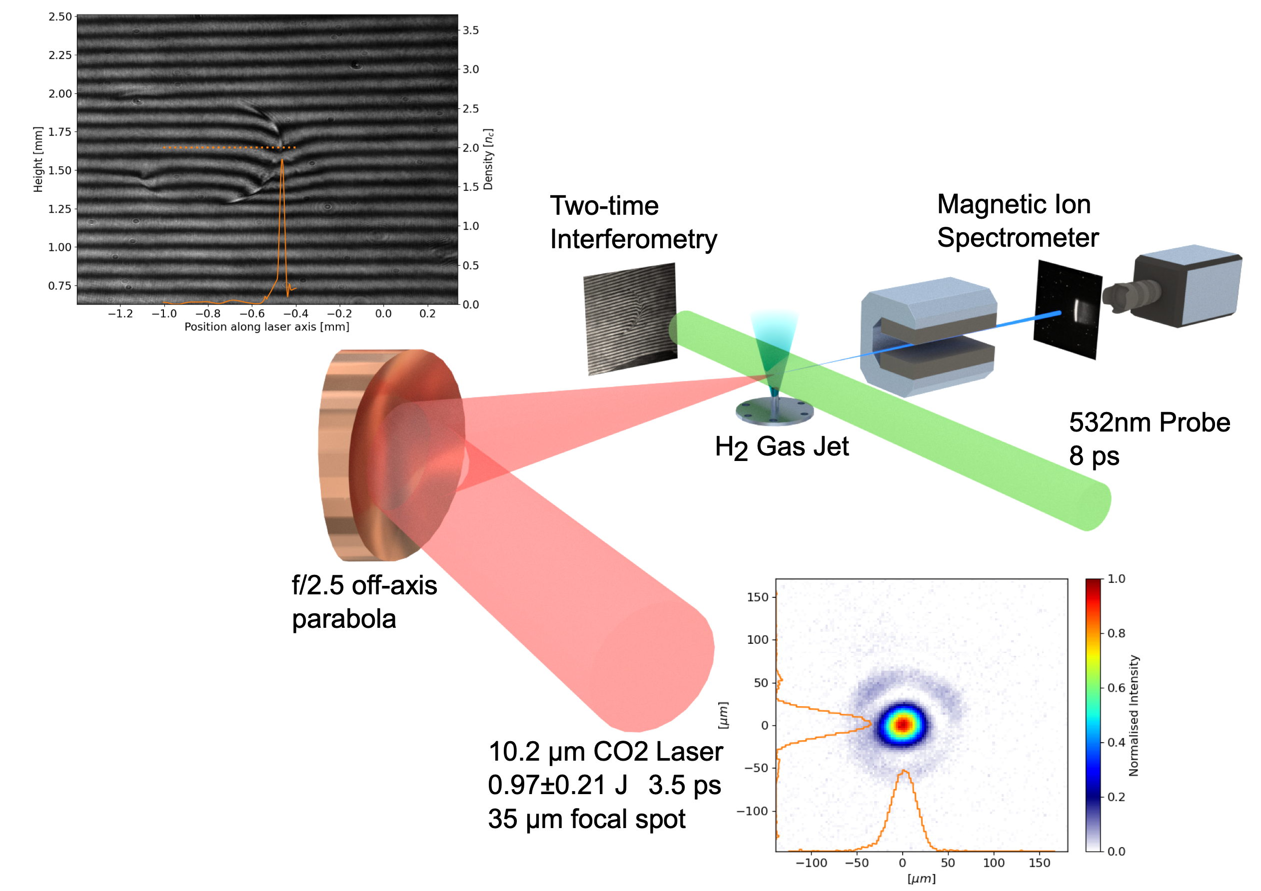
Experiment set-up
mJ level laser pre-pulse produces a “blast wave” to shape gas, optimizing density profile -

Slide 10
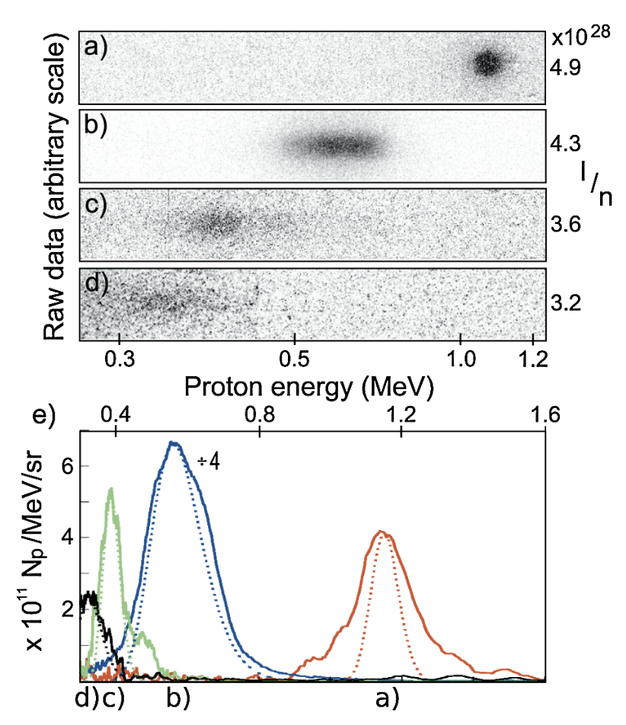
Radiation Pressure Driven Acceleration
If you can drive this accelerating structure at a constant velocity, it is possible to accelerate mono-energetic ion beams
C Palmer et al., PRL, (2011)

Slide 11
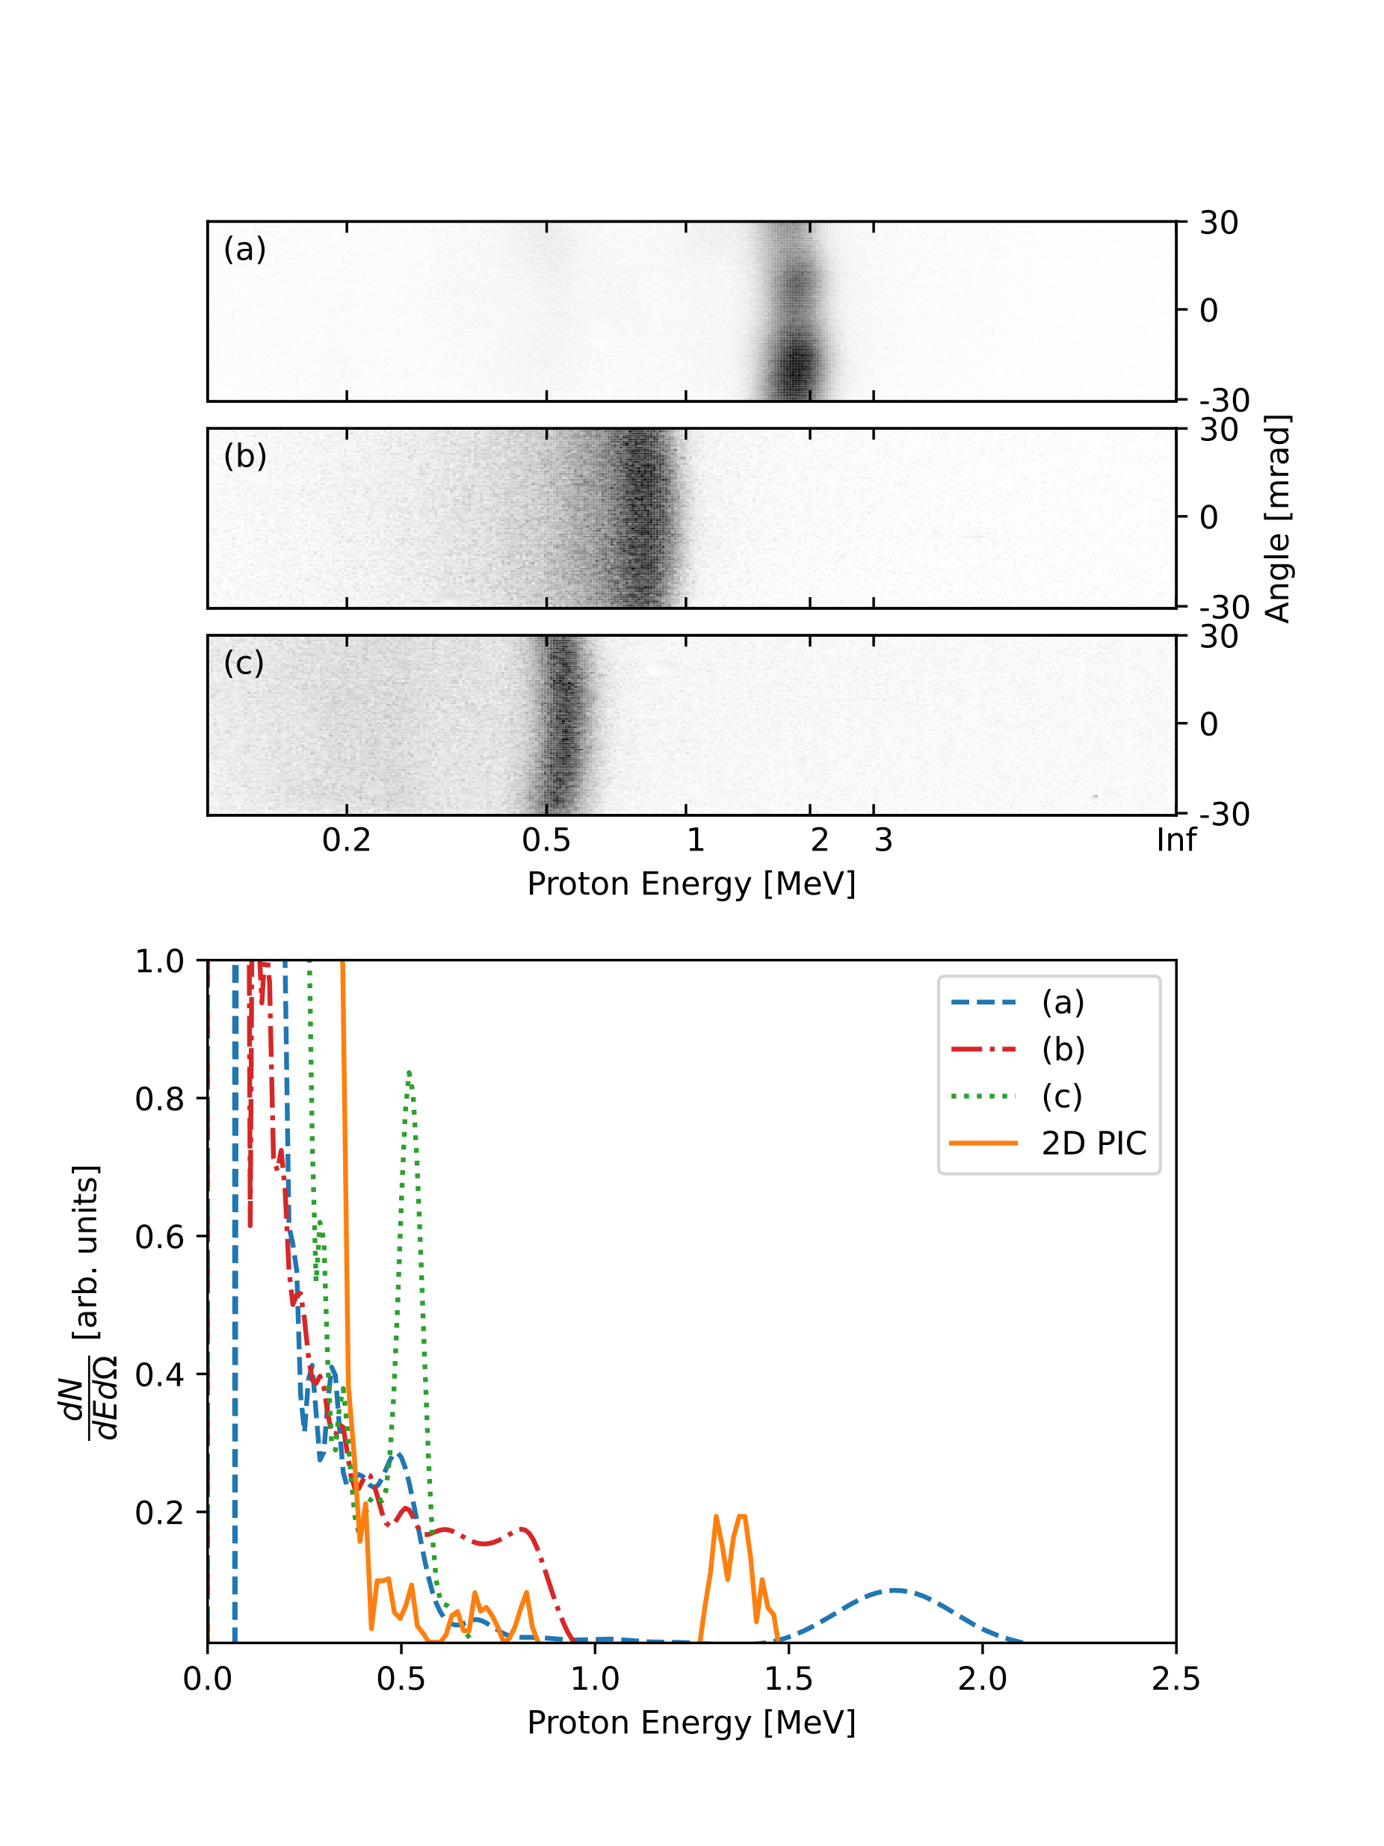
Mono-energetic protons produced
Raw data from magnetic spectrometer
Processed proton spectra
A good signature of shock acceleration is the generation of mono-energetic proton beams

Slide 12
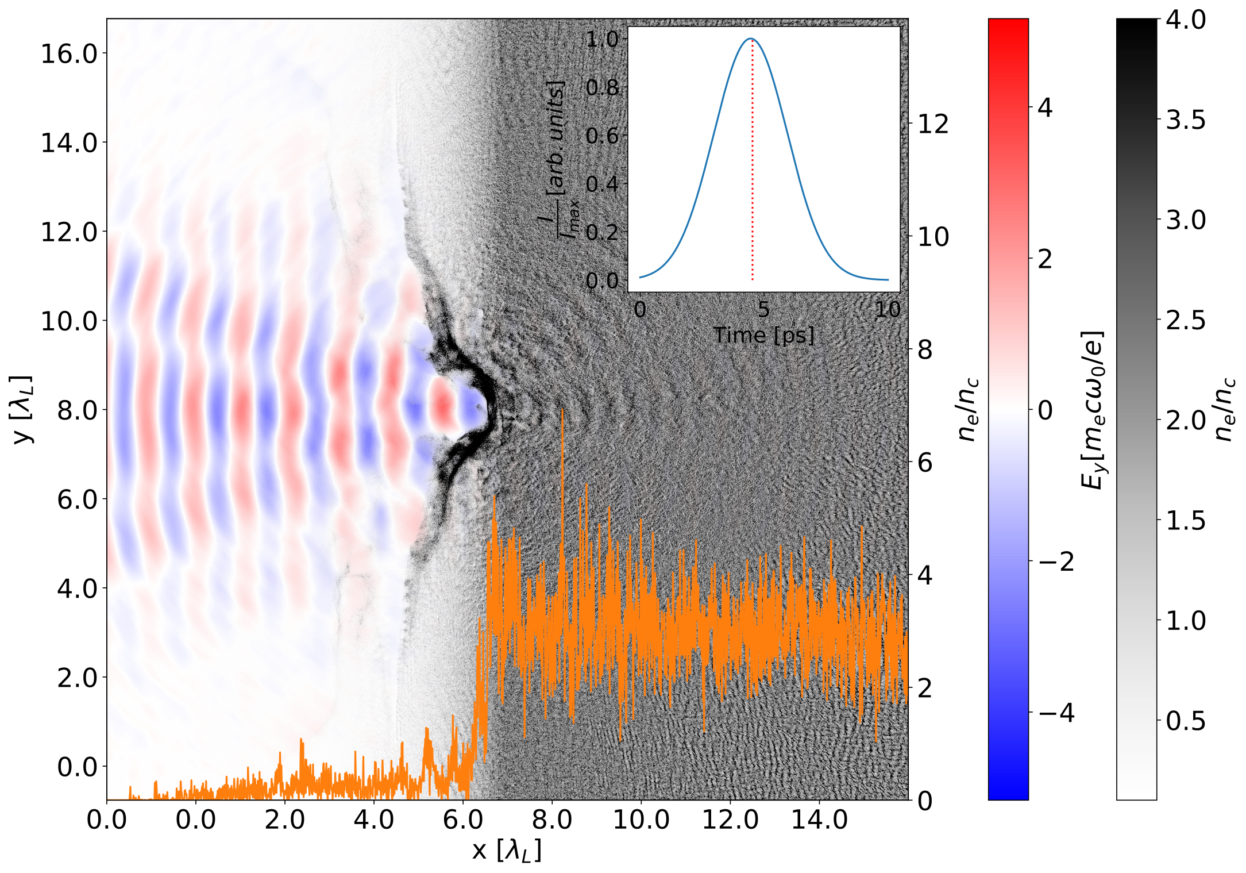
Comparison to theoretical scaling
Intensity dependent R obtained from simulations

Slide 13


Comparison to theoretical scaling
How do we explain these points??
Intensity higher than predicted via means of self focusing in the density ramp preceding the critical surface?
  But… why does this not happen on all shots?
Does collisionless shock acceleration play a role? The balance of PR / Pth ~ 5, so the radiation pressure is not totally dominant

Slide 14
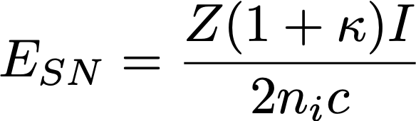
Comparison to theoretical scaling
Stockem Novo, Sci. Rep. (2016)
Collisionless shocks observed to form at later times in simulations although do not appear to be the dominant mechanism – still under investigation.

Slide 15
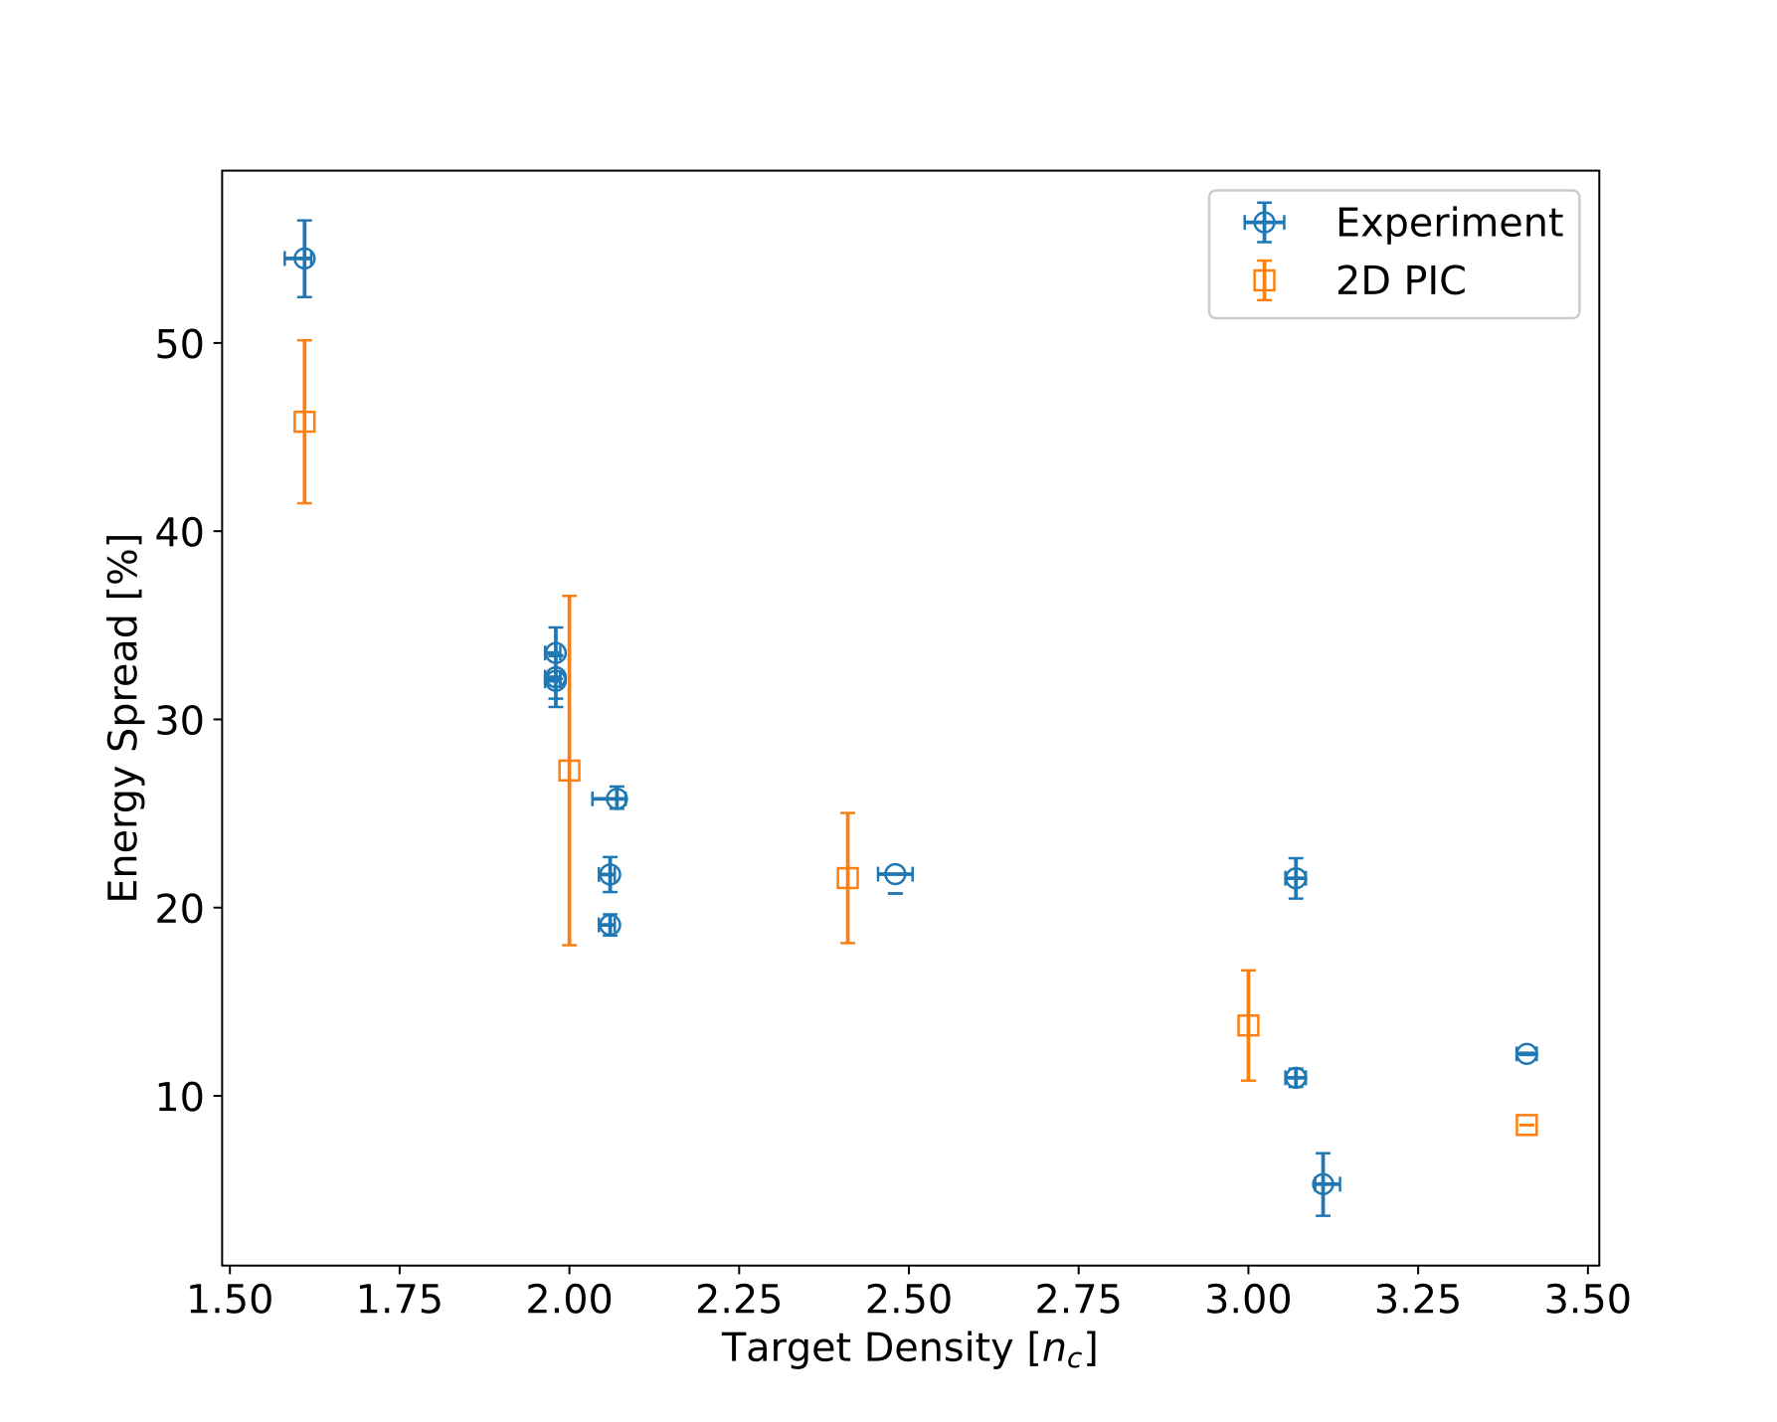
Density dependence on energy spread
Still trying to fully understand why this density dependence occurs

Slide 16
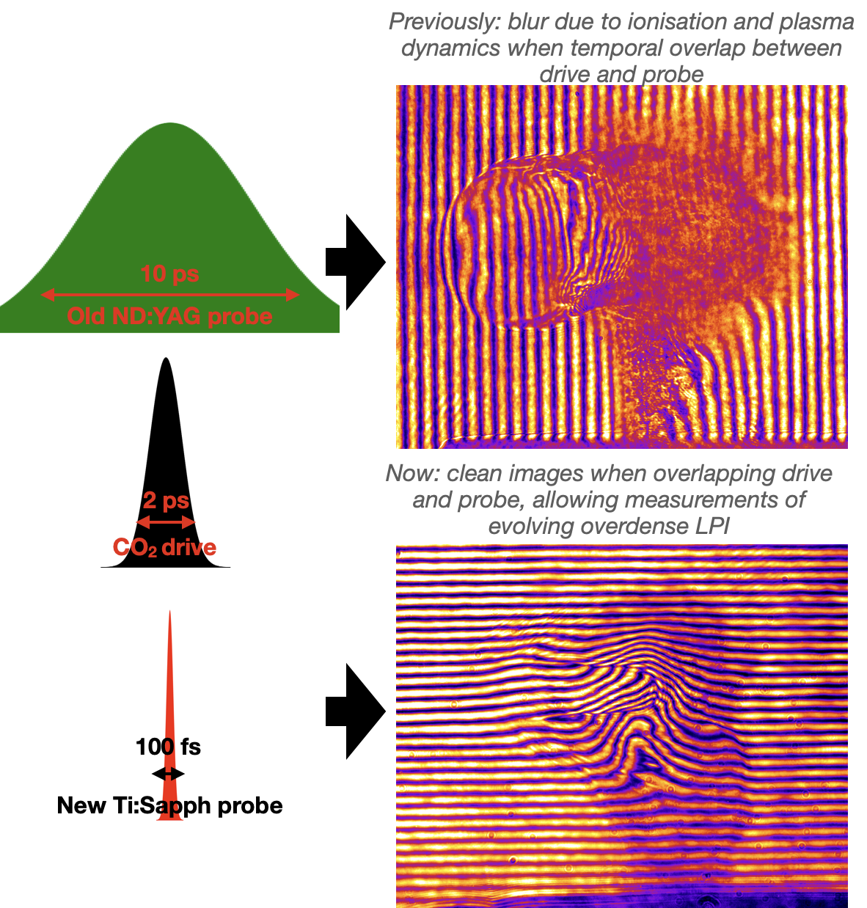
New Probing Capabilities at the ATF
Previous Nd:YAG, ~10ps probe resulted in significant image blur
New Ti:sapphire beam installed which offers exciting new opportunities for probing these interactions:
<100fs, mJ level energy beam
large relative wavelength difference to CO2 laser makes probing near-critical interactions considerably simpler.
Possibility to now observe the shock structures and intra-pulse dynamics.

Slide 17
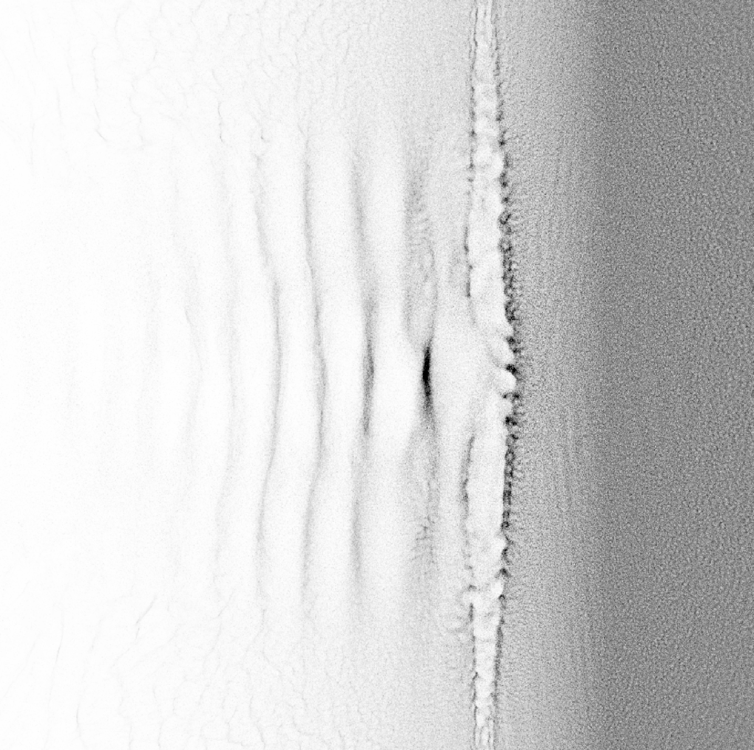
Summary
CO2 lasers offer a unique platform to study shock based ion acceleration mechanisms
Can produce narrow energy spread shock accelerated protons in regime where both HB-RPA and CSA is possible.
Target density dependence on the proton bunch energy spread - still trying to understand this.
New Ti:sapphire laser offers interesting probing opportunities to study intra-pulse dynamics.

Slide 18
Questions?
Questions?

