Slide 1

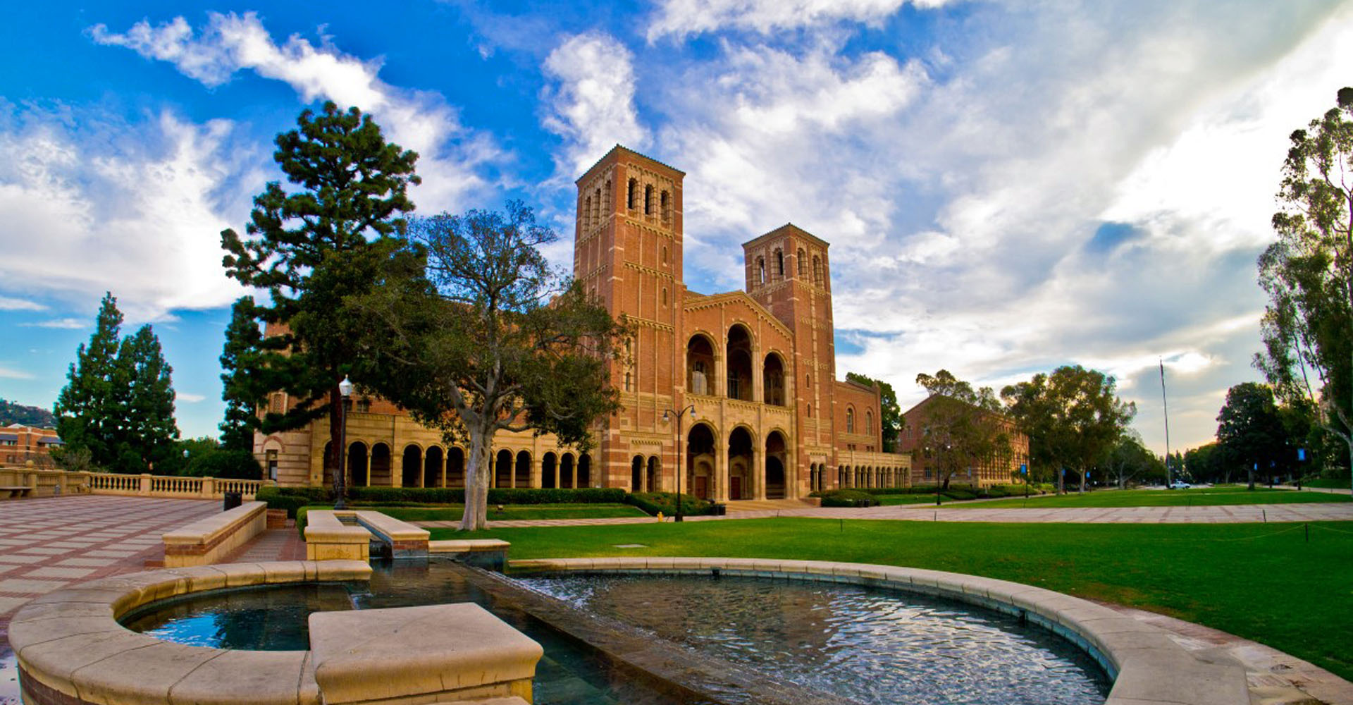

Sub-fs electron beam generation at UCLA Pegasus Laboratory
P. Denham, P. Musumeci
UCLA Department of Physics and Astronomy
AAC workshop, Hauppage, Long Island, November 8th 2022

Slide 2






Acknowledgements
UCLA Pegasus Laboratory group
E. Cropp, P. Denham, M. Lenz, S. Crisp, A. Fisher, D. Garcia. Graduate students.
A. Ody. Development engineer
Collaborators: A. Kogar, R. K. Li, J. Maxson, G. Andonian, F. Carbone, D. Filippetto, A. Minor, J. Luiten, S. Karkare, A. Murokh
Funding sources
  DOE Accelerator Stewardship DE-SC0009914.
  NSF Accel Science PHY-1734215
  GBMF4744 Accelerator-on-a-Chip

Slide 3
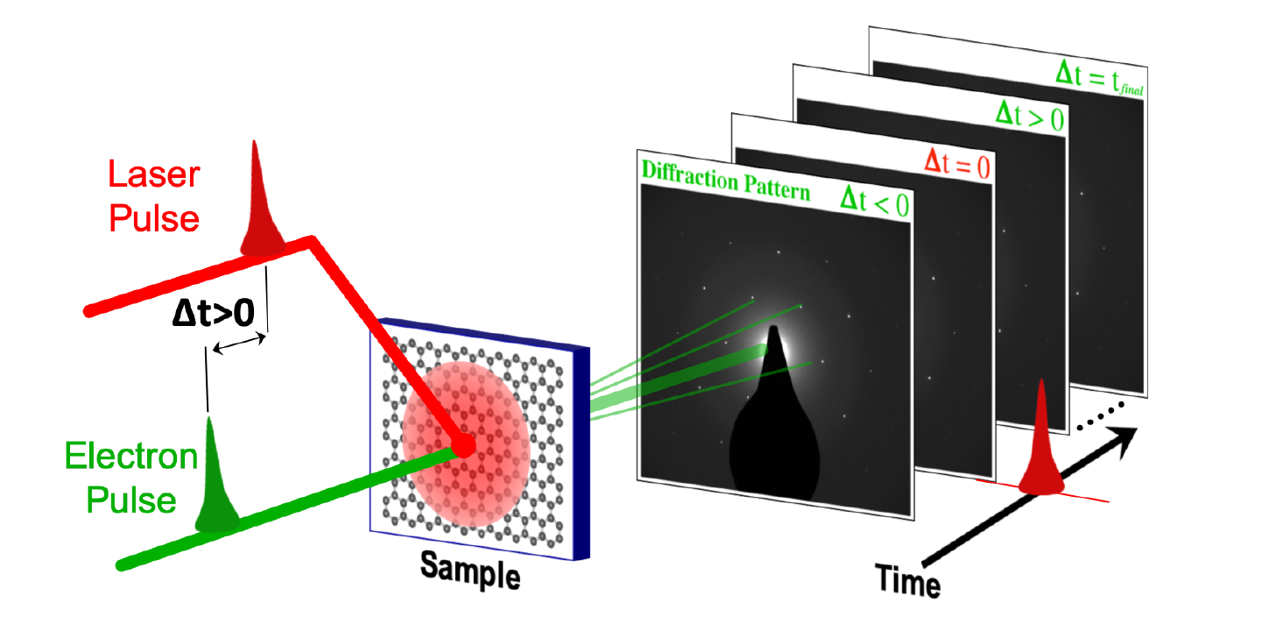
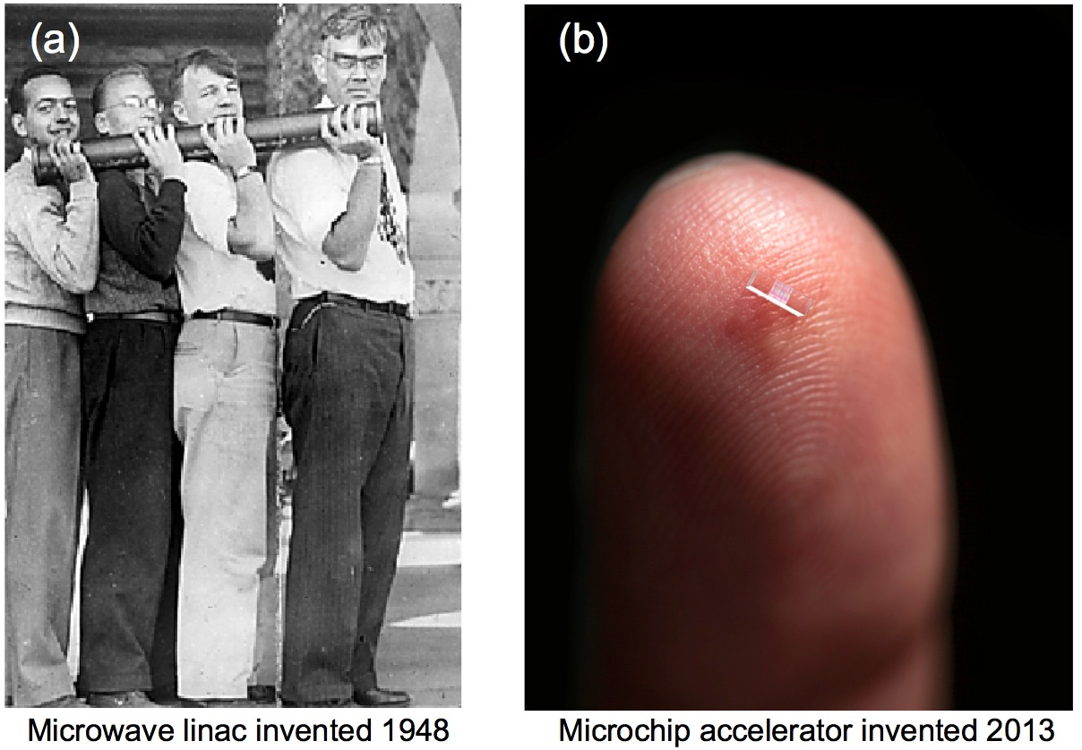
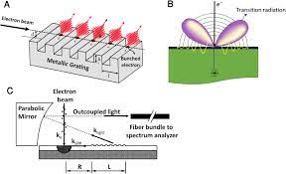
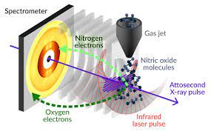
Application of sub-fs electron bunches
Ultrafast Electron Diffraction
Injection into optical-scale accelerators
Broadband radiation sources
Electron-based attoscience

Slide 4
Outline
Velocity bunching compression for low energy beamlines
Non linear effects in ultrashort bunch generation
  RF and space charge. (P. Denham et al. https://arxiv.org/abs/2106.02102 )
Compensation of non-linearities
  Laser shaping.
  Higher harmonic RF compensation.
Start-to-end simulations of PEGASUS beamline.
Sub-fs bunch length measurement techniques.

Slide 5

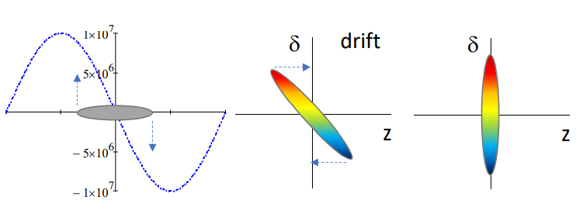
How to obtain ultrashort electron bunches
Need a strongly chirped longitudinal phase space.
Magnetic compression: higher energy electrons take a longer path through the bends, while lower energy take a shorter path. Longitudinal focus is achieved in a shorter distance. Needed for ultra-relativistic beams.
Ballistic compression: RF cavity imparts negative chirp on beam then beam drifts to longitudinal focus. Favored at lower energy.
Magnetic compression
Ballistic compression

Slide 6
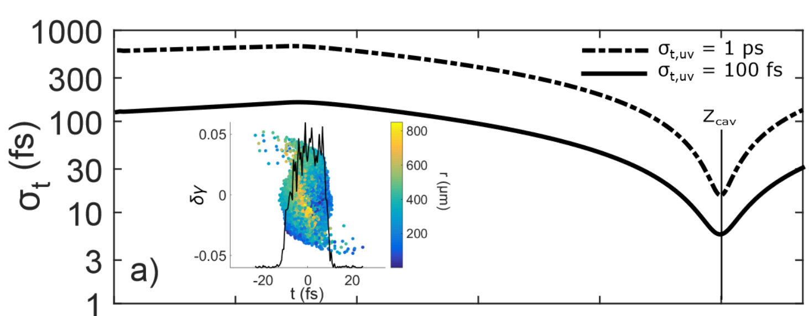
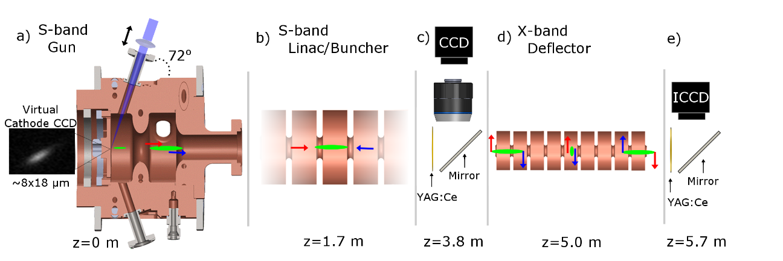
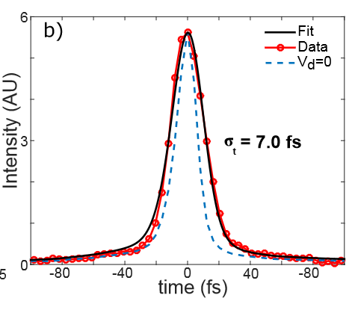
Sub 10fs RF compression at few MeV energies
Demonstrated sub 10fs RF compression at Pegasus.
Shorter initial pulse achieved shortest focus.
What are the limitations?
  How do optimal bunch lengths scale with beam and RF parameters?

Slide 7


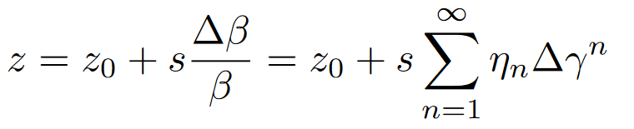



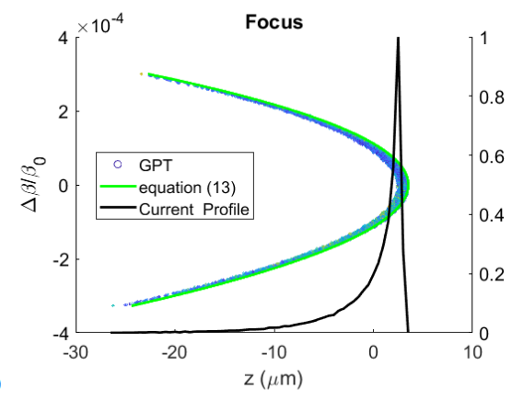
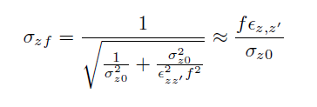
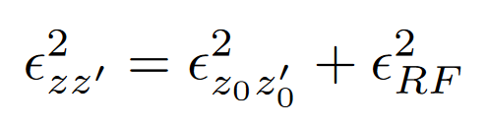
Non linear effects in RF compression
Ballistic bunching is inherently non-linear.
RF curvature
Vacuum dispersion
These cause emittance growth
  Distortions manifest as a ramped current profile.
To compute final bunch length we can include emittance growth in envelope analysis

Slide 8
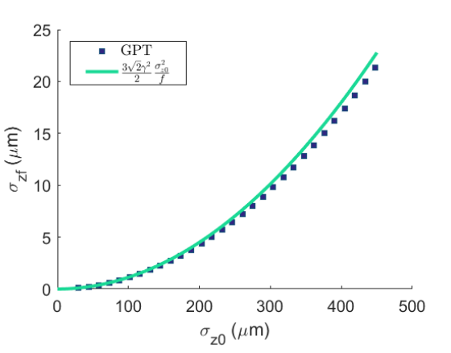
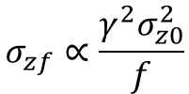
Analytical estimate of bunch length from RF non-linearities (Ignoring space charge).
At few MeV energies, bunch length dominanted by quadratic distortions at the ballistic focus
$$σ_{zf}∝\frac{{γ^{2}σ}_{z0}^{2}}{f}$$
Smaller longitudinal emittance enables better compression.
Few electron pulses (stroboscopic) can achieve attosecond durations.
What about single shot? Space charge limits?

Slide 9
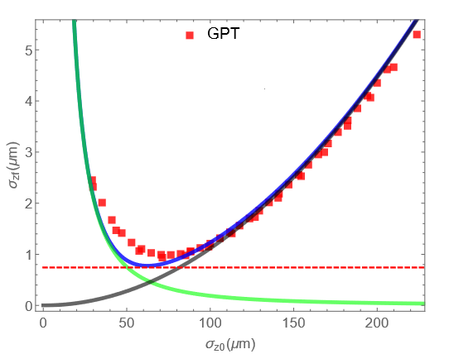
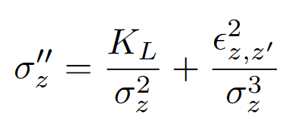
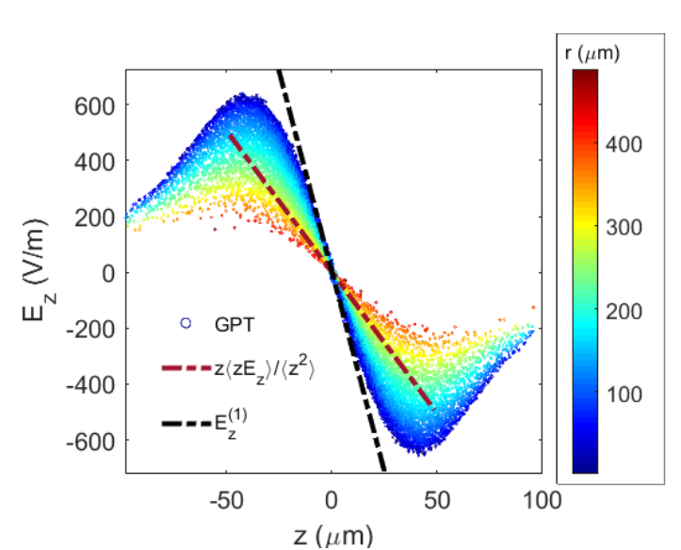
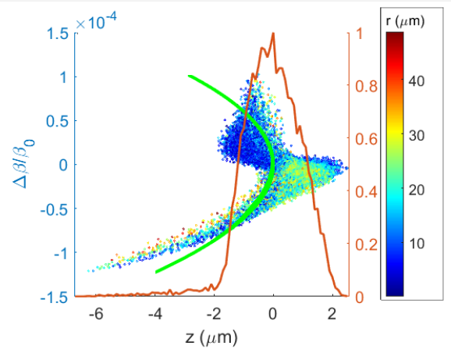
Limitations set by space charge (linear and nonlinear)
Space charge at first order is included using longitudinal perveance
Non-linear space charge forces: e.g., Gaussian induces emittance grows up to ballistic focus. Effect amplified for shorter initial bunches.
  Fine tune initial bunch length for optimum compression—Optimal trade off between space charge and RF effects-- Ideal working point.
$$fixed focal length optimum σ_{zf}∝Q^{1/2}γ^{−3/2}$$
Emittance growth sensitive to electron 3D distribution and its evolution.

Slide 10
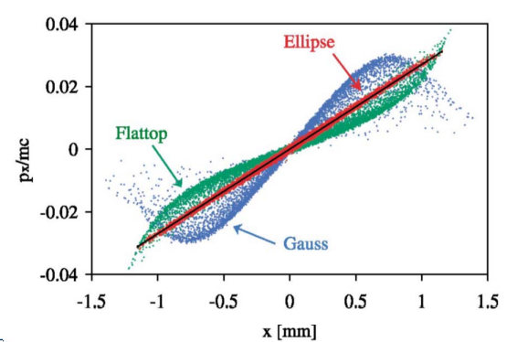
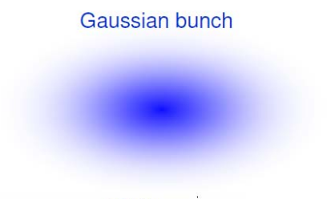
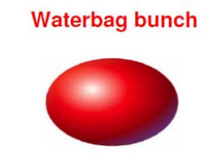
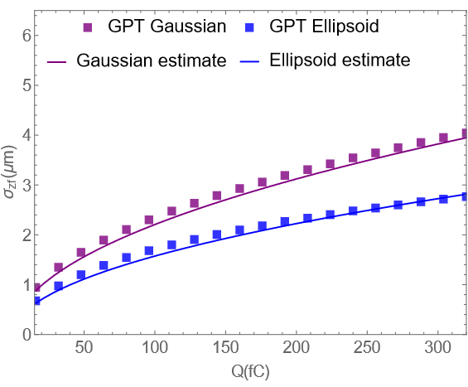
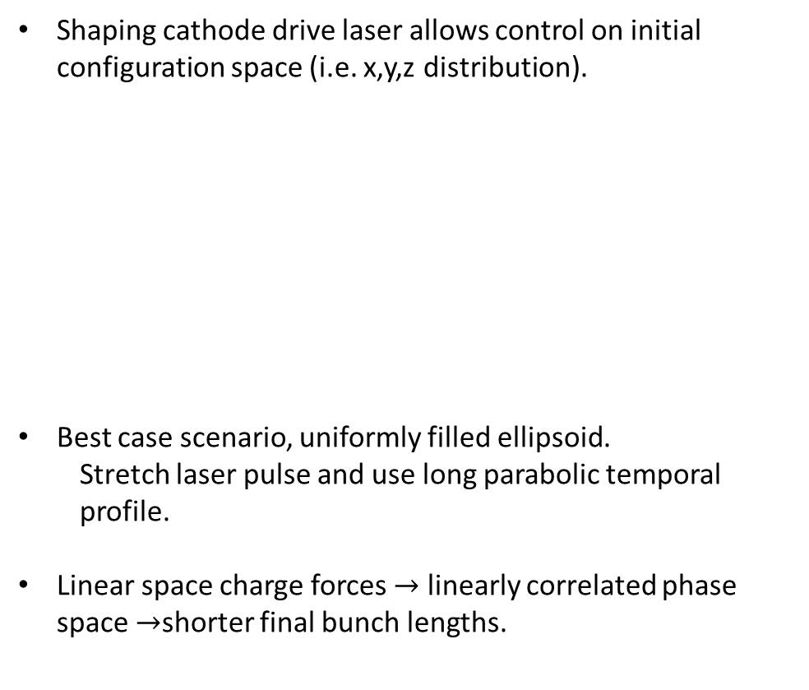
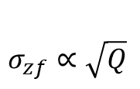
Electron beam shaping
Shaping cathode drive laser allows control on initial configuration space (i.e. x,y,z distribution).
Best case scenario, uniformly filled ellipsoid.
  Stretch laser pulse and use long parabolic temporal profile.
Linear space charge forces $→$ linearly correlated phase space $→$shorter final bunch lengths.
$$σ_{zf}∝\sqrt{Q}$$
Focal length 1.88 m

Slide 11
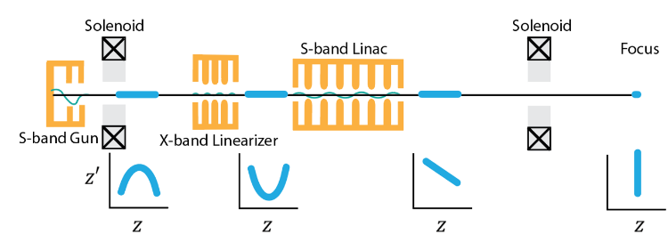
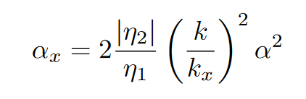
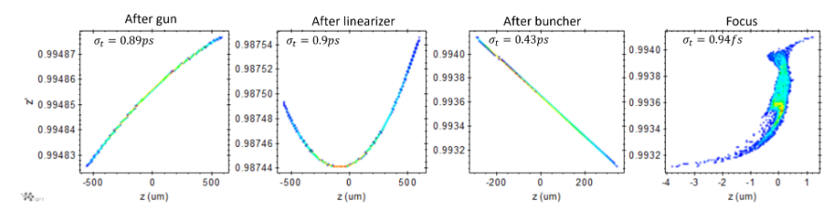
Higher harmonic compensation of emittance growth
Deceleration in 3rd harmonic cavity removes second order curvature.
Third order removal possible as well properly tuning Linac gradient and phase
Compensation allows longer bunch lengths to be used to relax space charge effects.

Slide 12
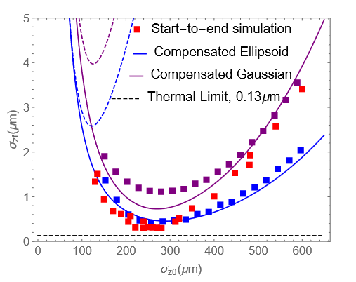
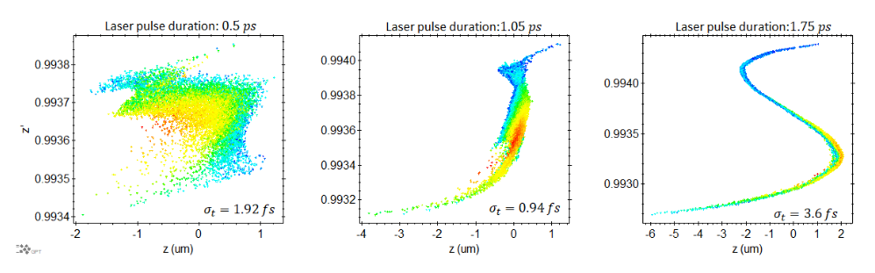
Start-to-end simulations for UCLA PEGASUS
10^6 electrons – 160 fC bunches
Shortest bunches achieved when 2nd and 3rd order RF non-linearities are compensated, and electronic distribution is optimally shaped into uniform ellipsoid.
Approaching final limit -- set by initial beam thermal emittance.

Slide 13

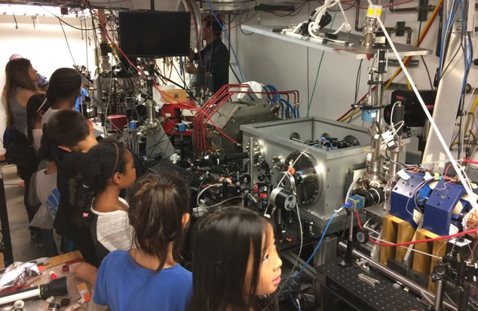

High peak brightness beam research at UCLA Pegasus Laboratory
3-14 MeV student-run university-size accelerator beamline optimized for sub-pC beams
High brightness electron beams:
  High resolution ultrafast electron diffraction
  Single shot imaging / UEM
  THz acceleration
  High efficiency THz FEL
J Maxson, et al., Direct measurement of sub-10 fs relativistic electron beams with ultralow emittance. Phys. Rev. Lett., 118 154802 (2017)
D. Cesar, et al., Demonstration of single-shot picosecond time-resolved MeV electron imaging. Phys. Rev. Lett., 117, 024801 (2016)
E. Curry et al. Meter-scale THz-driven acceleration of a relativistic electron beam. Phys. Rev. Lett. 120, 094801 (2018)
A. Fisher, Y. Park et al. High efficiency single pass THz FEL. Nature Photonics, 16, 441 (2022)
Notes:
One of the few/only MeV high brightness beamlines in a university. Much different environment than National Laboratory
Education and outreach (here is me trying to explain to 4th graders what is it that we do).
Focus on low charge high brightness beam research.
Don’t have time to show highlights here, just point you to the list of recent publications from the laboratory

Slide 14
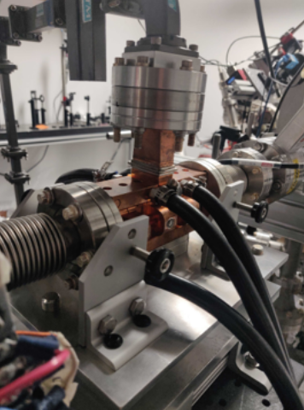
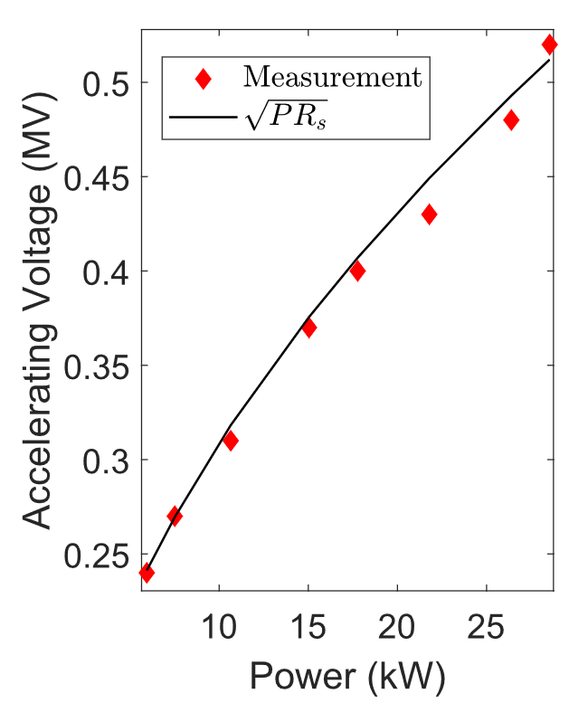
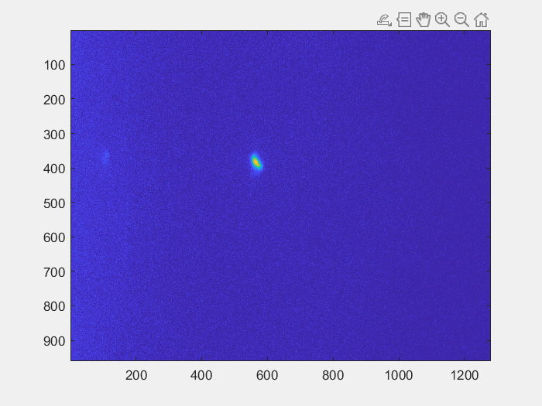
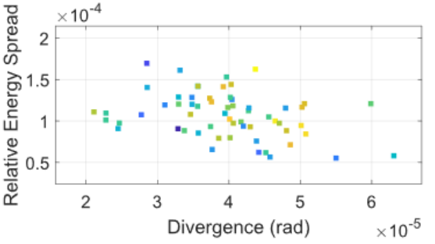
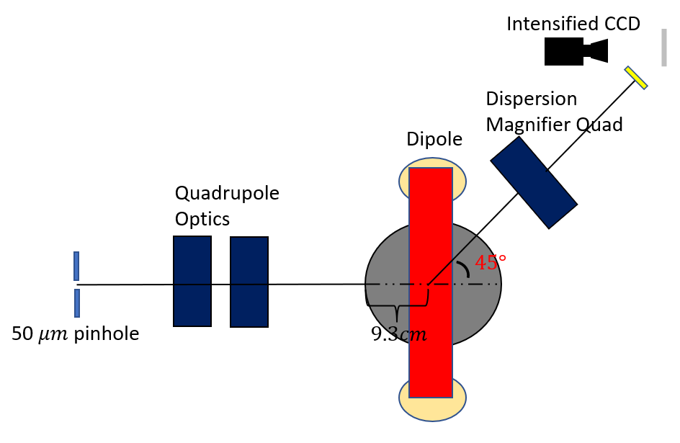


Demonstration of X-band LPS linearization
Install and commission X-band cavity
Removal of non-linearities in LPS for energy spread minimization as well.
Application to minimize chromatic aberrations in ps-time resolved MeV TEM
P. Denham, et al., “X-Band Harmonic Longitudinal Phase Space ... presented at the NAPAC'22
$β−tron contribution$subtraction
high resolution spectrometer
$$\frac{σ_{γ}}{γ}<{10}^{−4}$$

Slide 15

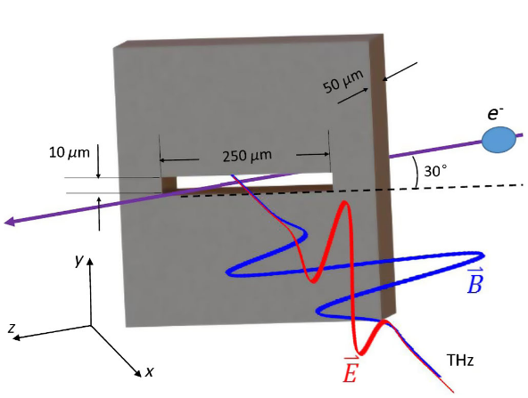
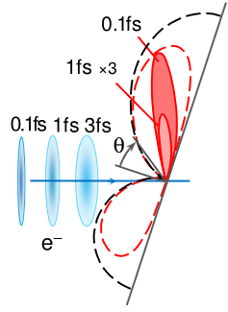

Options for sub-fs electron bunch measurements
RF techniques.
  RF deflecting cavity--Resolution limited by cavity frequency and screen resolution.
THz streaking
  Sensitive to timing jitter
  Limited availability of THz power
Laser techniques.
  Laser Induced energy modulations in DLA or bend magnets?
Radiative techniques.
  Optical transition radiation—coherence factor suppressed by transverse extent of the bunch.
  Different geometries enhance optical coherence.
$$σ_{y}$$
$$θ$$
L. Zhao, et al. Phys. Rev. X 8, 021061
M.V. Tsarev and P. Baum 2018 New J. Phys. 20 033002

Slide 16
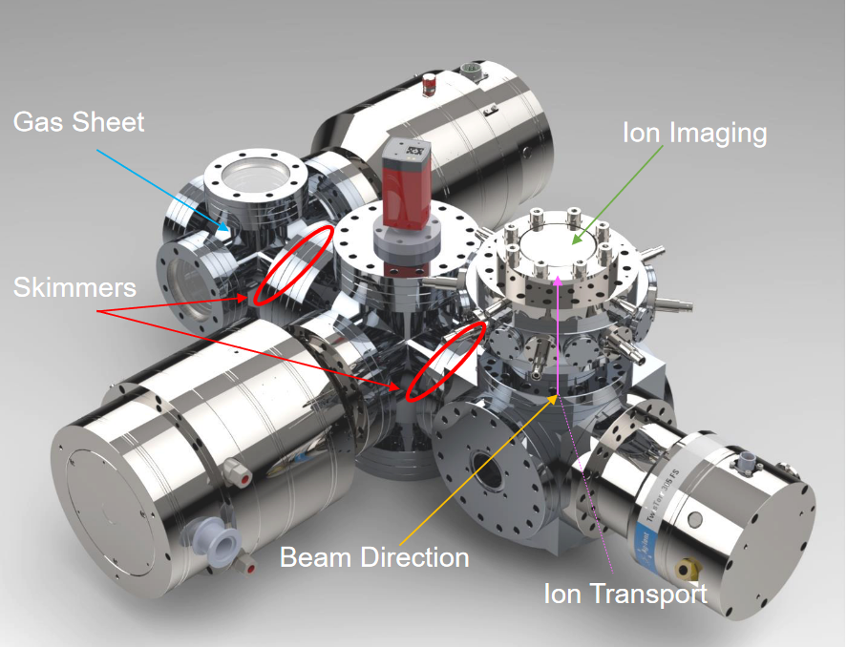
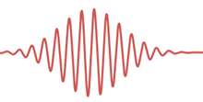
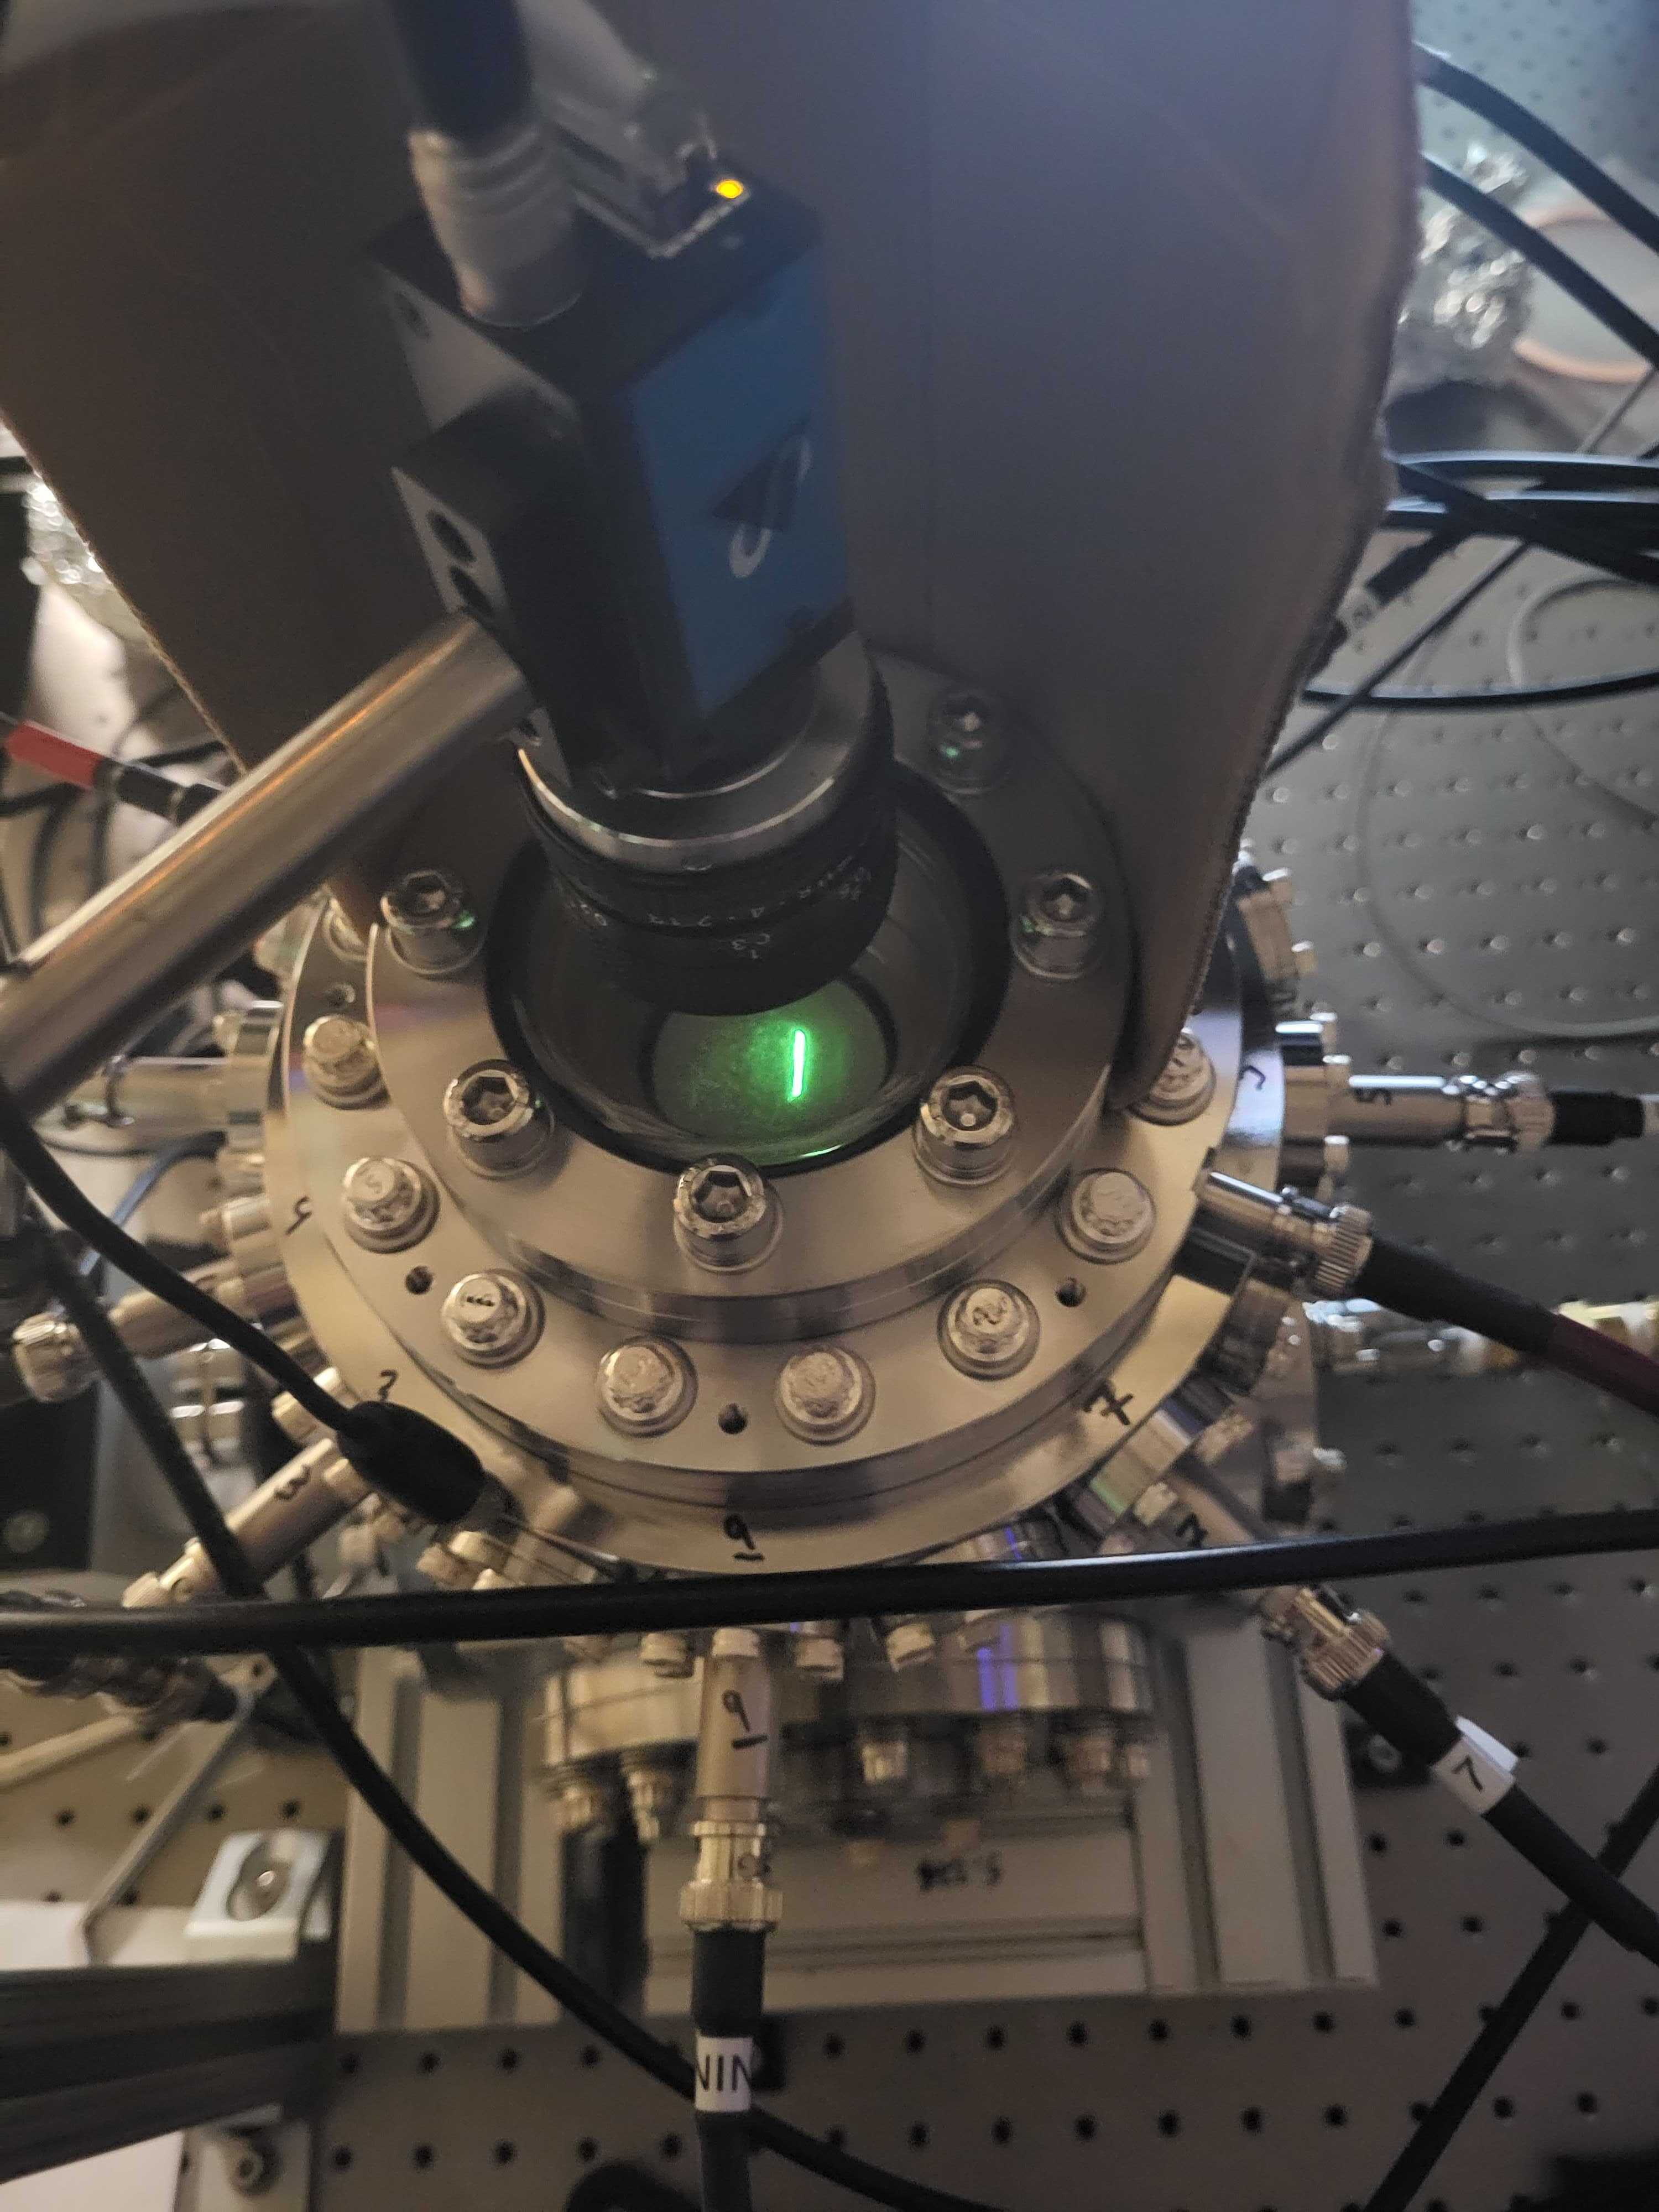
Ionized electron Velocity Map Imaging
doi:10.18429/JACoW-NAPAC2022-THZE4
Learn a lesson from attosecond X-ray sources
Set e-beam ballistic focus at gas sheet plane.
Impact ionization of gas sheet.
Laser streaking of “knocked” electrons.
Ion microscope tuned to image velocity space at interaction point.
Image time dependent streak profile—signature of e- beam duration.
What is the signature exactly? What dilutes the signal dependence on bunch duration?
Photoelectron transport

Slide 17
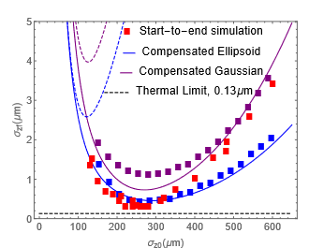
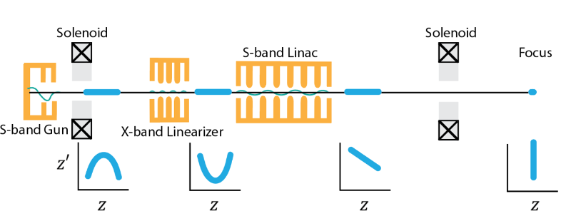
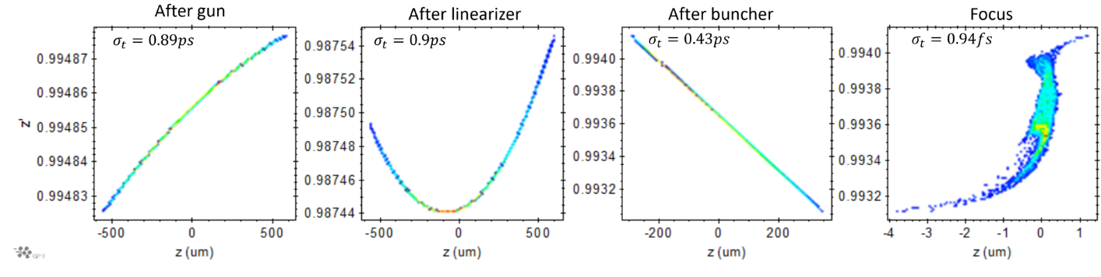
Summary: Ultrashort Beam generation at PEGASUS.
Single shot UED temporal resolution determined by the bunch length at ballistic focus.
Competing non-linear effects limiting the shortest achievable bunch length.
Overcome non-linearities with laser shaping of electron beam and higher harmonic compensation.
Bunch lengths in attosecond to sub-fs regime (for 10-100 fC charge) achievable.
Implemented X-band and took measurements of LPS linearization—reduced energy spread.
Seeking novel bunch length diagnostic to measure sub-fs bunches. Developments underway.

Slide 18
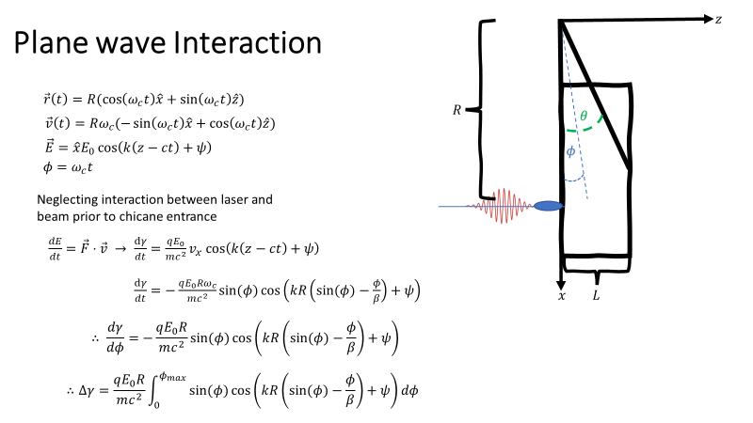
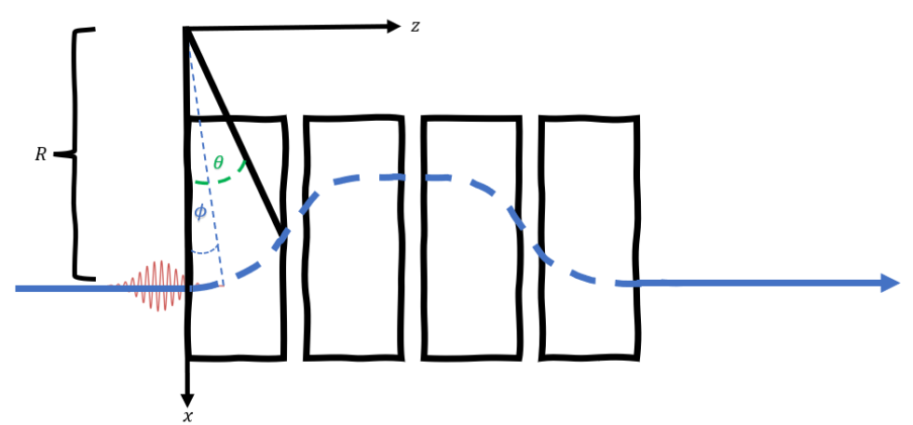
Laser Induced Energy Modulations in a Dipole
How do we preserve temporal structure in transport?

