Slide 1
Plasma Wakefield Accelerator-Based
Low Emittance Muon Source
Vladimir SHILTSEV (Fermilab)
AAC’22
November 6-11, 2022

Slide 2
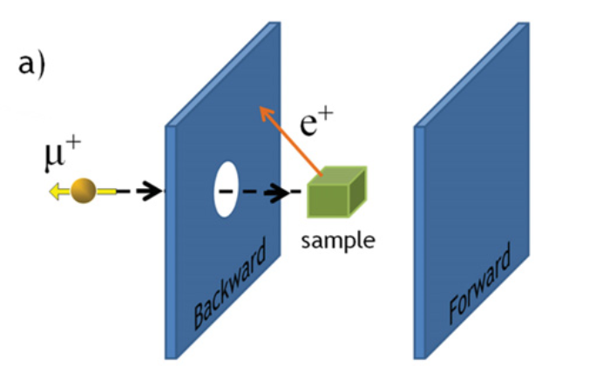
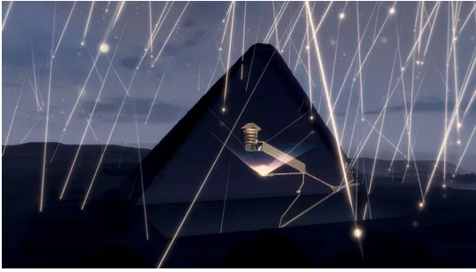
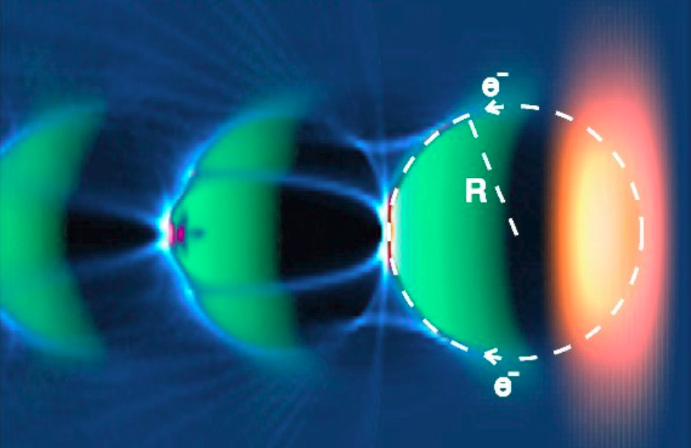
Promise of Muons
μSR for solid state research
Screening NNSA/DARPA applications
g-2 and mu2e experiments
Circular muon colliders
Linear & crystal muon colliders
Intensity is the key
Need low emittance
and high N

Slide 3
Challenges
Muon are unstable
2.2 us → almost no time for collection, cooling and acceleration... all should be superfast
Muons are secondary/tertiatry
Need high intensity primary (depnds on efficiency)
Come in large angular spread ~m_{muon}/E_{primary}

Slide 4
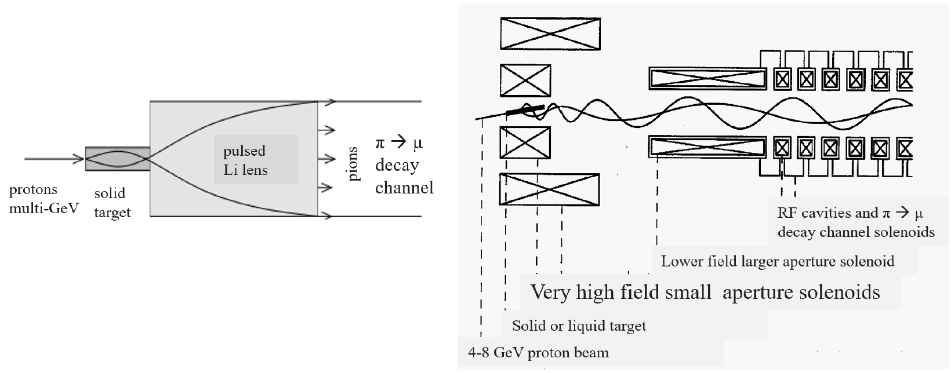
Traditional Muon Sources
pulsed short-focus Lithium lens
FNAL g-2 experiment:
116 kA → 232 T/m
2 GeV p+ → 3.1 GeV muons
Eff 2e-7 (dE/E ~1%)
O(30 T) target solenoid
Future 10-14 TeV muon collider/MAP:
About 0.1 muon/proton
Large emit ~10(-3) rad
Ionization cooling channel ε~25μm

Slide 5
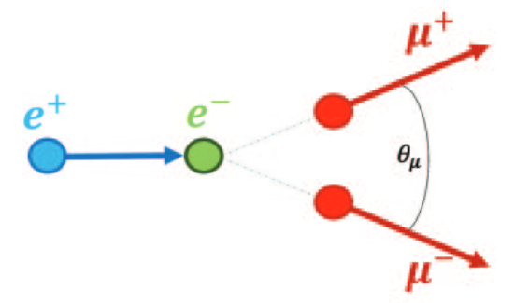
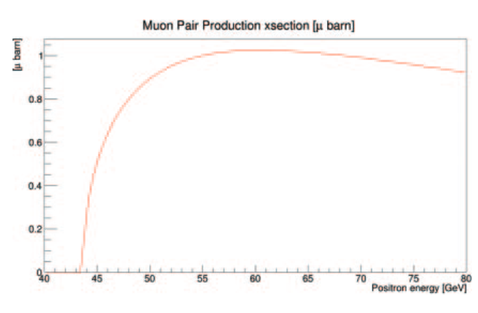
LEMMA
M.Boscolo, M. Antonelli, et al
NIM A 807 (2016) 101–107
Low emittance muon pair
at threshold
need 45 GeV positrons
Findings wrt MAP scheme:
Emittance ~1/500
Intensity ~1/10,000
Luminosity ~1/1000
Cost +30%, Site power ~x2
D. Neuffer and V. Shiltsev 2018 JINST 13 T10003

Slide 6
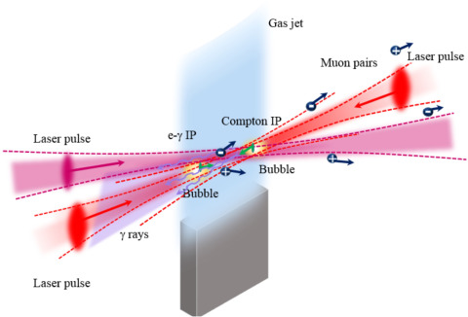
Recent Idea
e-gamma collider source
NIM A 909 (2018) 309–313
10-100kHz 1 J laser
LWFA 2 GeV e-
1-100 μ’s/s at ~GeV

Slide 7
New (Another) Approach
Employ Plasma-Wakefields (PWA cells)
They are very strong transversely – can capture lots of muons
They are very strong longitudinally – very fast acceleration to high γ=E/mc and long muon lifetime
Presumably compact

Slide 8
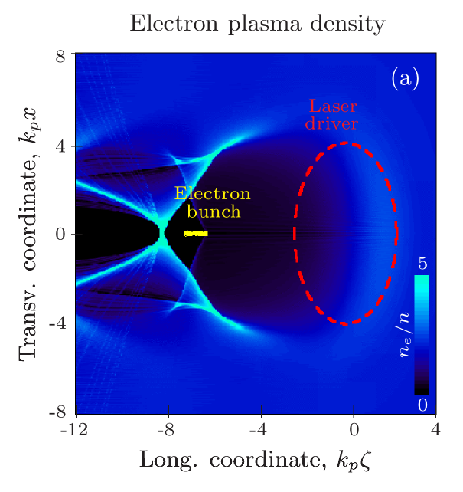
EM Fields in Plasma Waves
Eg in the bubble regime, forces:
where
That’s exactly what’s needed for a muon source

Slide 9
Conceptual Scheme
Muons are born in the plasma WFA channel
Either via photoproduction (need O(1+ GeV) e- beam)
Or via pion decay
Muons originally have large angular spread and small transverse dimension:
θ≈m_{μ}/E _{μ}
r smaller than the radius of the bubble ~3/k_{p}=λ_{p}/2
Muons get quickly accelerated in the plasma while being super-strongly focused by the focusing fields of the plasma:
Come out with small emittance
Come out with very high energy O(10 GeV)

Slide 10
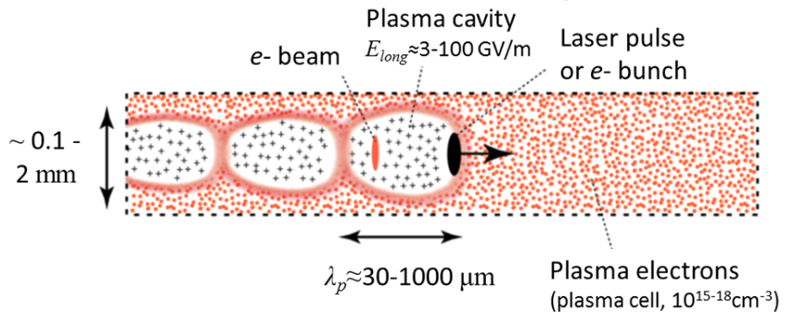
Plasma WFA Muon Source Concept
_{μ}
~λ_{p}

Slide 11
Generation of Muons: Two Schemes

Slide 12
Equations of Motion
The betatron motion is fast
So the amplitude drops adiabatically

Slide 13
Equations on Emittance
Max amplitude and angular spread define max acceptable emittance
Assuming at birth γ~1, if max accepted emittance is ε~25 μm for n=10^16 cm-3 , in that case the length of a 10 GeV source is about 1 m
For denser plasma n=10^18 cm-3 the max accepted emittance is ε~2.5 μm and 10 GeV source is about 10 cm.
Plasma density rampup can make the source shorter without loss of the acceptance (see next slide)

Slide 14
Tapered Plasma Density Rampup
γ_{p} ≈ (1+az)^{4/3}
n_{p}=n₀ (1+az)^{2/3}
Plasma density and muon energy in tapered PWA-based 10 GeV muon source with normalized acceptance of 25 μm - corresponding to

Slide 15
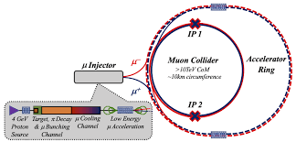
PWA μ Source MC
May eliminate the most complex muon production and early acceleration part of multi-TeV muon colliders
Very compact O(1 m) total
O(10 GeV) beams with norm. emittance from few to tens μm
Very large energy and angle acceptance
(solves so many problems of traditional muon ionization cooling scheme – from scattering and struggling to massive hardware needs, magnets and RF)

Slide 16
BUT : Challenges and Open Questions (1)
Acceleration and focusing of μ+ as challenging as for positrons in “traditional” LPWA and PWFA
Collider application requires both small emittances and high intensity (ie brightness) μ beams – very hard, see next slide
Plasma wakes are essentially low-Q, so only few plasma periods/bubbles can be employed → few short μ bunches
Bubble wake will be loaded by secondaries (e+e-, pions, etc)

Slide 17
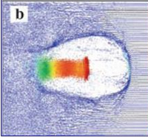
Muon Generation Challenges – Possible Schemes
Photoproduction: need multi-GeV e- beam, BH cross-section is 1/m_{μ}^2 small, O(1μ /pulse), wake loading by e+e- pairs… solid target in the bubble?
e+e- annihilation: even small cross-section
Proton-nucleon: need 1-10 GeV protons, cross section is very high, but plasma density is low and pions need ~8 m to decay (in the wake)
Can solid density object
be inserted in the bubble?
Prompt muons: either D or require O(100-100) GeV p+, cross-section is high O(μbarn) but plasma density is low
External injection: sub-mm short intense muon bunches!!!

Slide 18
Conclusions:
Fast acceleration and strong focusing in plasma wakefields allow compact O(10 cm) 10 GeV muon source
If muons produced inside the bubble, then captured emittance is about
Difficulties (so far) : a) probably does not work for μ+ b) muon generation schemes do not promise decent intensities (other schemes?); c) bubble wake will be loaded by secondaries
(The only practical application might be) external injection of mmxmmxmm muon bunches in the plasma WFA channel

Slide 19
Muons are the Particles of the Future!
Thanks for your attention!
Special thanks to
Philippe Piot for inviting me to submit this work to ICFA BD Newsletter 83 (JINST)
WG5 conveners for inviting me
… see JINST Technical Report publication :
https://iopscience.iop.org/article/10.1088/1748-0221/17/05/T05010/meta

Slide 20
Back up slides

Slide 21
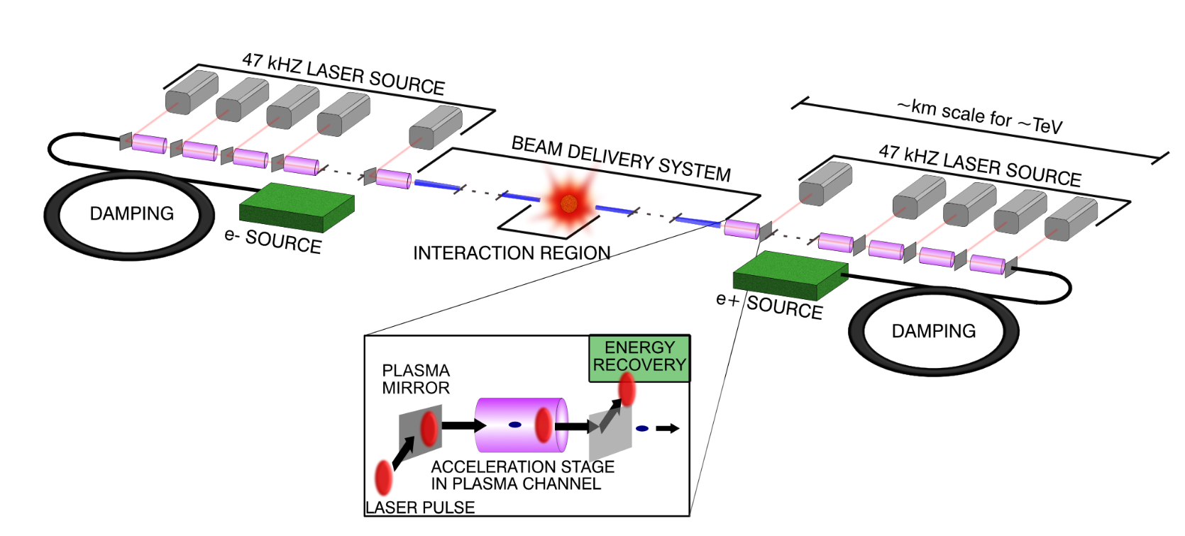
Linear e+e- Colliders
15 TeV e+e-
100+ km
10-15 km
Either RF acceleration (50-200 MeV/m) or
wake-field acceleration in plasma (2-5 GeV/m)
Major limitations:
100% energy spread at IP (beamstrahlung)
One-time collisions ineffective → Lumi ~P/(Eσ)
Very long/complex Final Focus to get nm IP size
Extreme sensitivity to nm jitters of linac elements
In plasma – ultra-strong focusing hurts staging,
impossible(?) to accelerate positrons
Plasma sustains high fields
Takes about 1 GW electic power even for 15 TeV

Slide 22
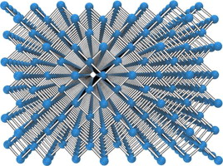
Exotic Colliders
Plasma-wakefield acceleration and channeling in structured media, eg CNTs or crystals ( only muons!!! )
Major advantages:
solid density → 1-10 TV/m gradients
continuous focusing and acceleration (no cells, one long channel, particles get strongly cooled betatron radiation)
small size promises low cost
Lumi ~1/E² …totally unproven yet concept:
proof-of-principle experiment E336 @ SLAC

Slide 23
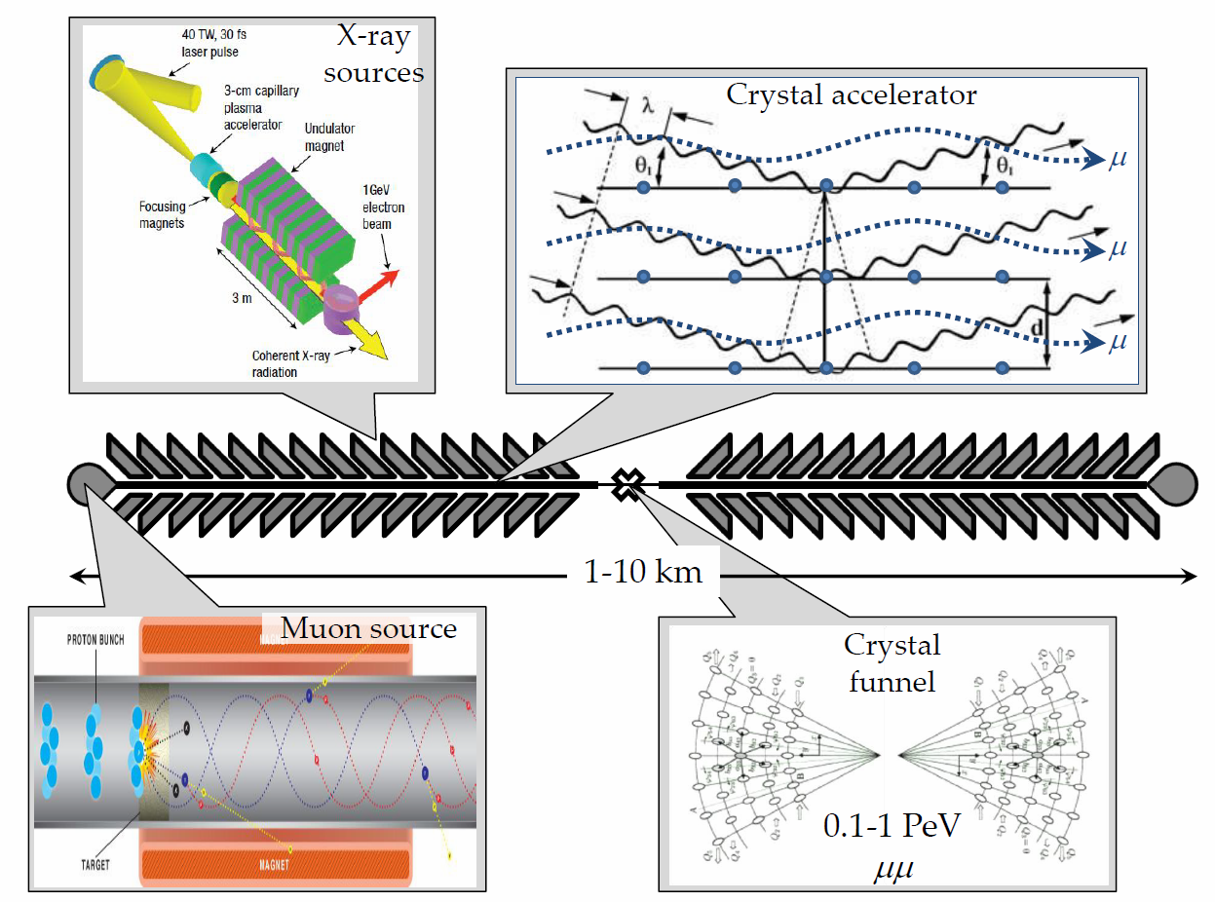
Xtal Collider
n~10²² cm⁻³, 10 TeV/m →
1 PeV = 1000 TeV
n_{μ} ~1000, n_{B} ~100, f_{rep} ~10⁶ L ~10³⁰⁻³²
V.Shiltsev, Phys. Uspekhy 55 965 (2012)

