Slide 1
A Compact Source of Positron Beams with Small Thermal Emittance
Rafi Hessami, Stanford University
Spencer Gessner, SLAC
Advanced Accelerator Concepts Workshop 2022
November 7, 2022

Slide 2
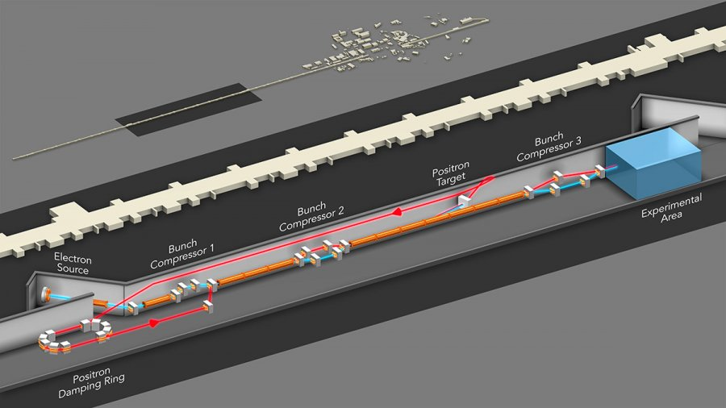
Motivation
  Positron plasma wakefield acceleration has only been studied at SLAC (FFTB, FACET, FACET-II).
  Significant infrastructure is required to produce intense, highly-compressed positron beams.
Are there alternative sources of positron beams that may be suitable for PWFA experiments?
Notes:
“Positrons are 50% of a collider but 5% of research” – SAY IF YOU CAN FIND WHO SAID IT

Slide 3
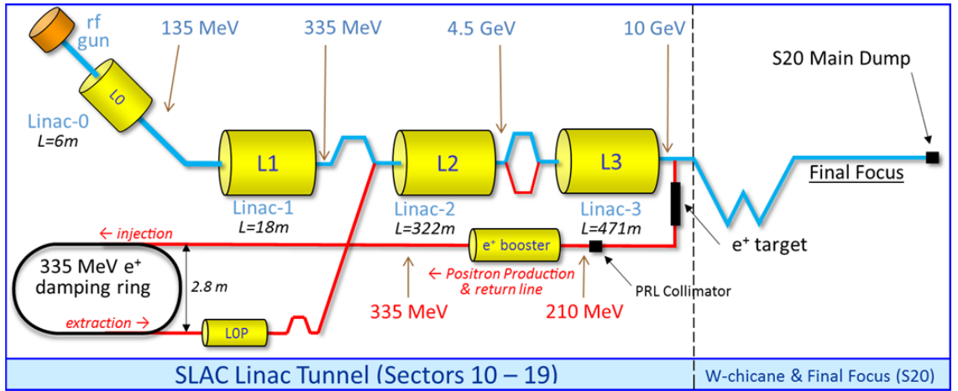
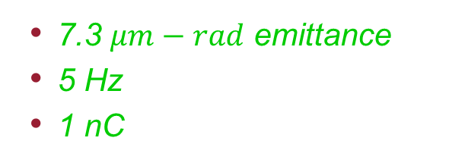
Current Positron Sources
  FACET-I used an rf gun-electron beam on a target and a damping ring.
  7.3 $μm−rad$ emittance
  5 Hz
  1 nC
  Expensive
  Large
Positron Beamlines and Dynamics,
G. White, FACET-II Science Workshop (2019)
Notes:
All emittances mentioned are normalized

Slide 4
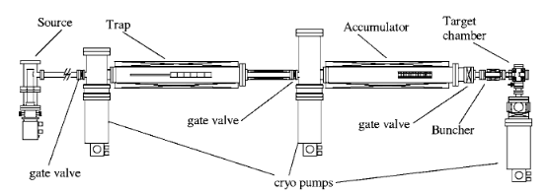

GBAR’s Method of Making Positrons
  The GBAR experiment uses an MeV linac operating at pair production threshold.
    About 10⁸ e⁺/s
  The ILC uses electron or photon beam on target.
    About 10¹⁴ e⁺/s
Neon moderator
This is not a replacement for traditional positron beam production from targets.
The GBAR antimatter gravity experiment,
P. Perez et al., Hyperfine Interactions 233, 21-27 (2015)
Notes:
Highlight it’s good for R&D

Slide 5
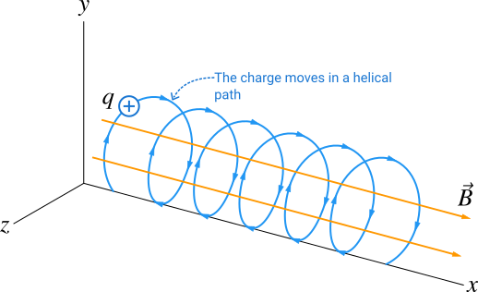
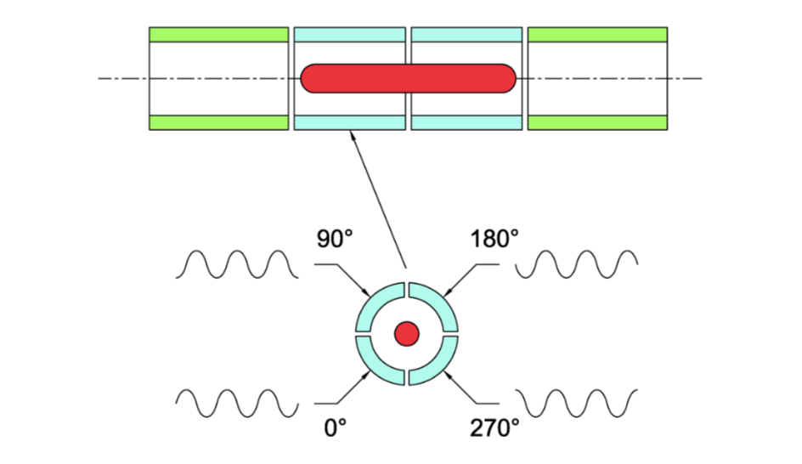
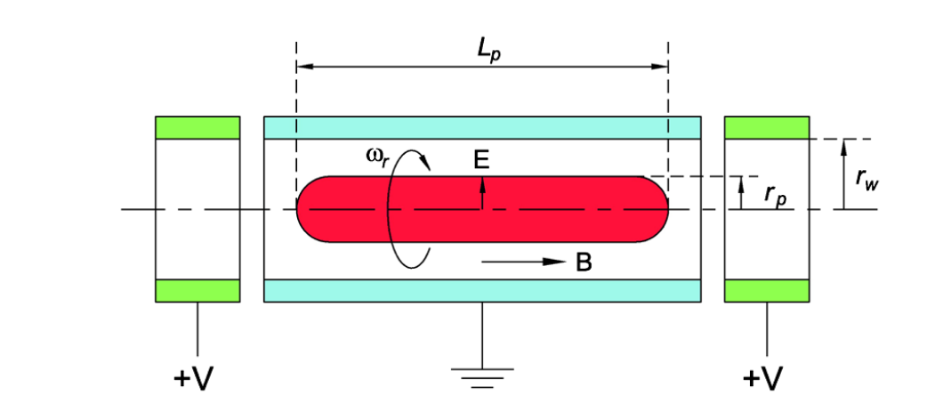
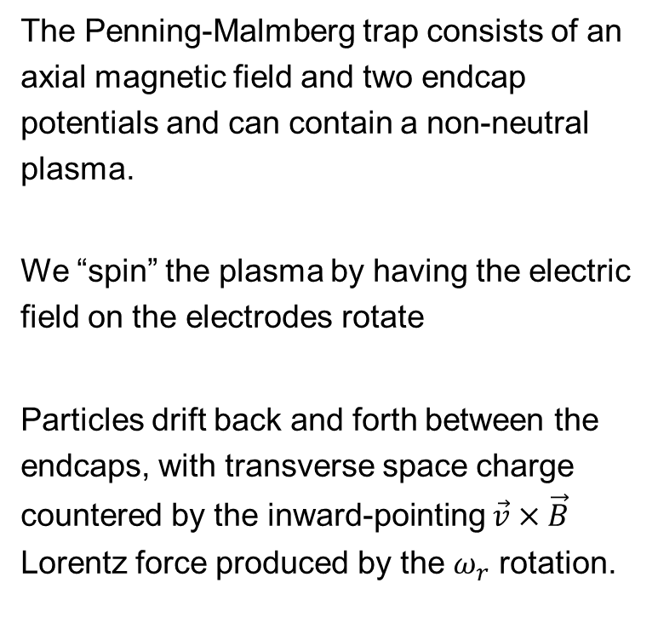
Penning-Malmberg Trap
The Penning-Malmberg trap consists of an axial magnetic field and two endcap potentials and can contain a non-neutral plasma.
We “spin” the plasma by having the electric field on the electrodes rotate
Particles drift back and forth between the endcaps, with transverse space charge countered by the inward-pointing $\vec{v}×\vec{B}$ Lorentz force produced by the $ω_{r}$ rotation.
Single-Particle Trajectory
“Rotating Wall”
https://journals.aps.org/rmp/abstract/10.1103/RevModPhys.87.247
Notes:
TRY TO UNDERSTAND ROTATING WALL ON THE PLANE

Slide 6
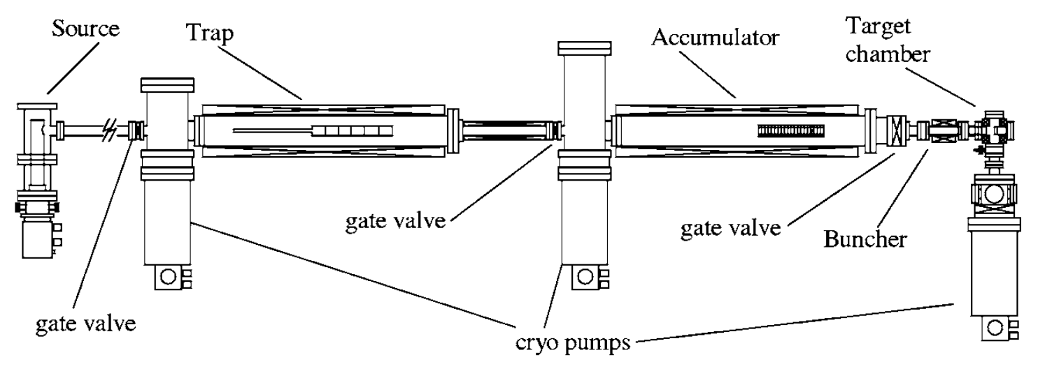
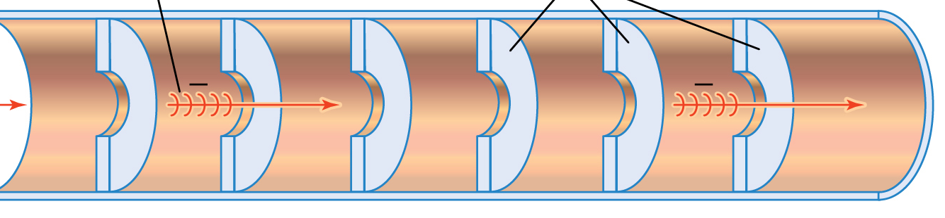
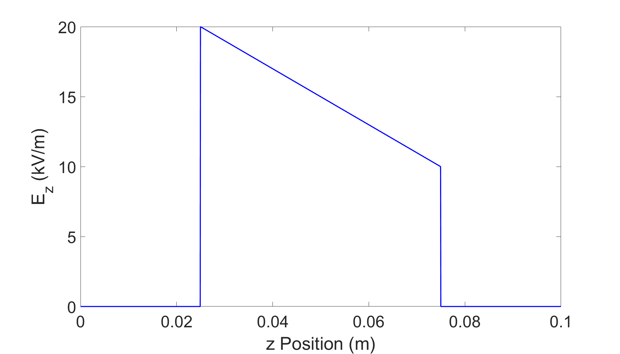
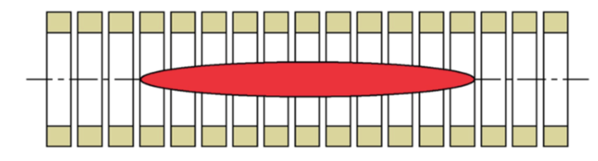
Our Proposal
Electrostatic acceleration
s-band cavity
Buncher/
accelerator
Electrostatic extraction/compression

Slide 7

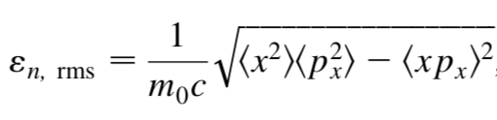
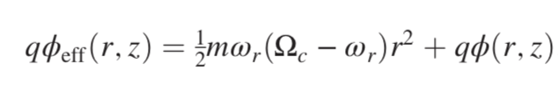
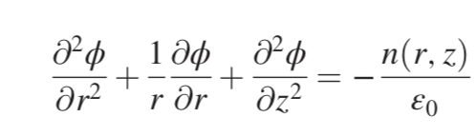
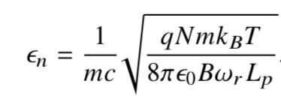
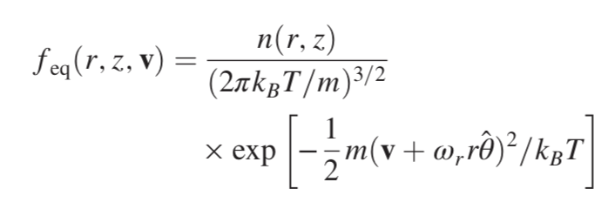
Thermal Emittance
Using equations of state and the following definition of emittance:
We find:
for N positrons, B solenoid field, and L_{p} trap length.
Equations of State

Slide 8
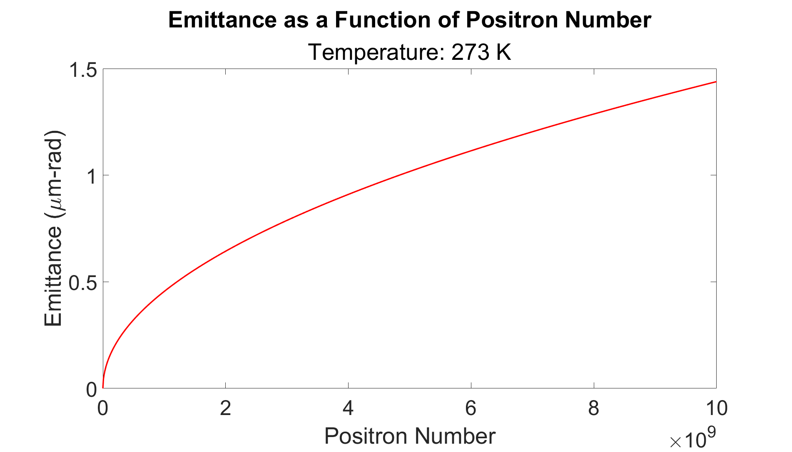
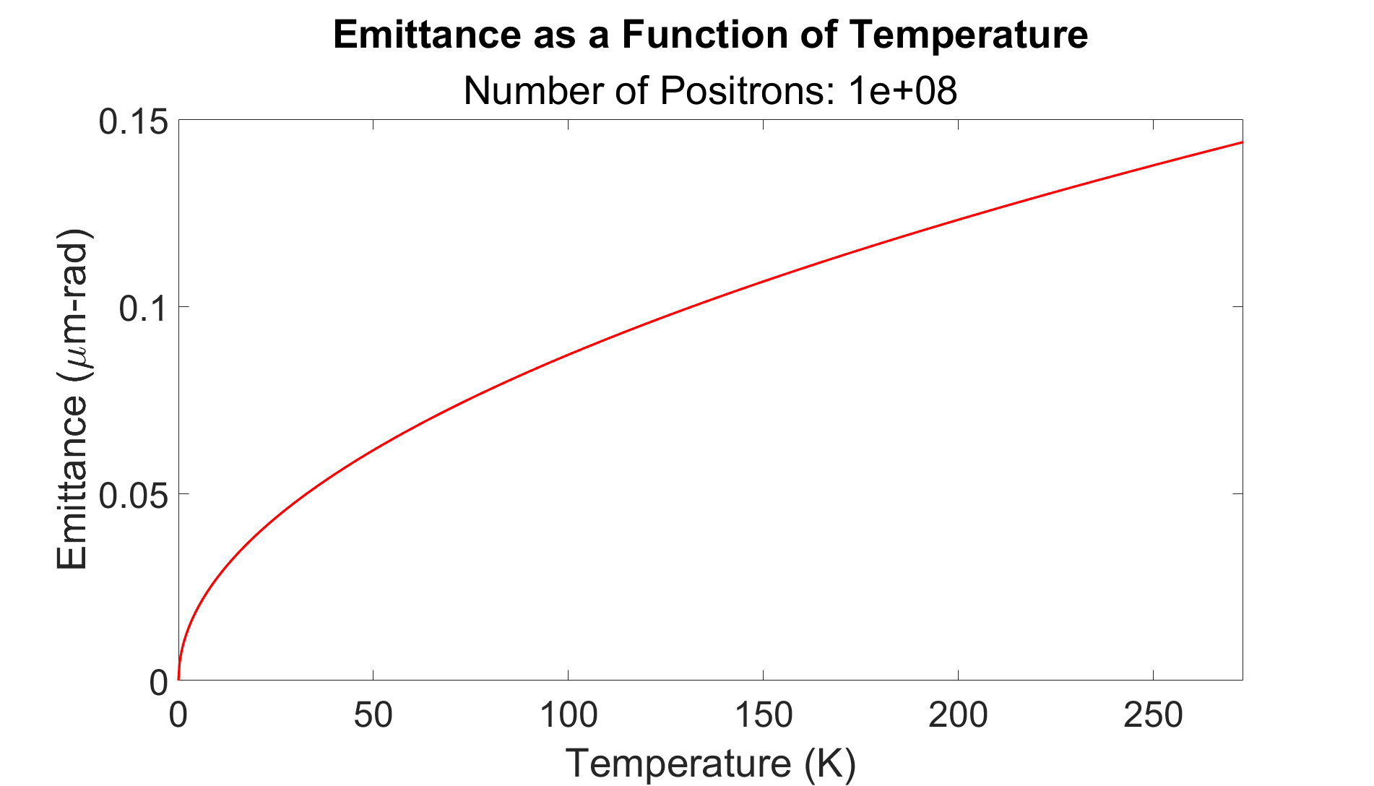
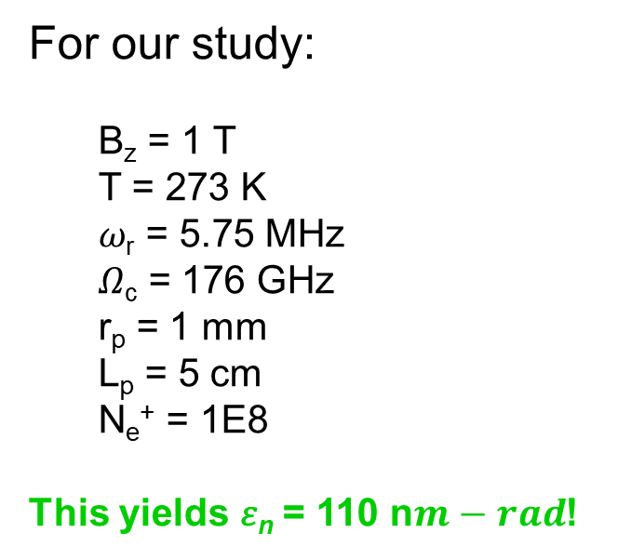
Thermal Emittance
For our study:
  B_{z} = 1 T
  T = 273 K
  𝜔_{r} = 5.75 MHz
  𝛺_{c} = 176 GHz
  r_{p} = 1 mm
  L_{p} = 5 cm
  N_{e}⁺ = 1E8
This yields 𝜀_{n} = 110 n$m−rad$!
Notes:
Mention that far right side of upper plot is same charge as FACET-I
Can’t go higher than ~10^10 because the space charge is just too much, pushes particles out of the trap (CHECK THAT THAT’S THE MAX)

Slide 9
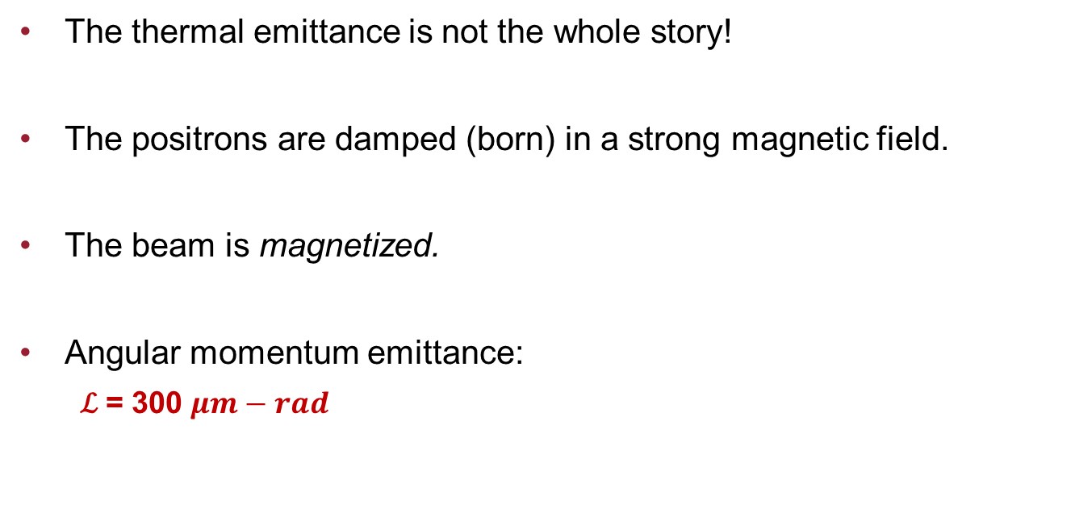
Angular Emittance
The thermal emittance is not the whole story!
The positrons are damped (born) in a strong magnetic field.
The beam is magnetized.
Angular momentum emittance:
  ℒ = 300 $μm−rad$
Notes:
High angular emittance makes this good for studying round to flat transforms, actually an opportunity since colliders like that to suppress beamstrahlung (READ PAPER FROM RIVER FIRST)

Slide 10
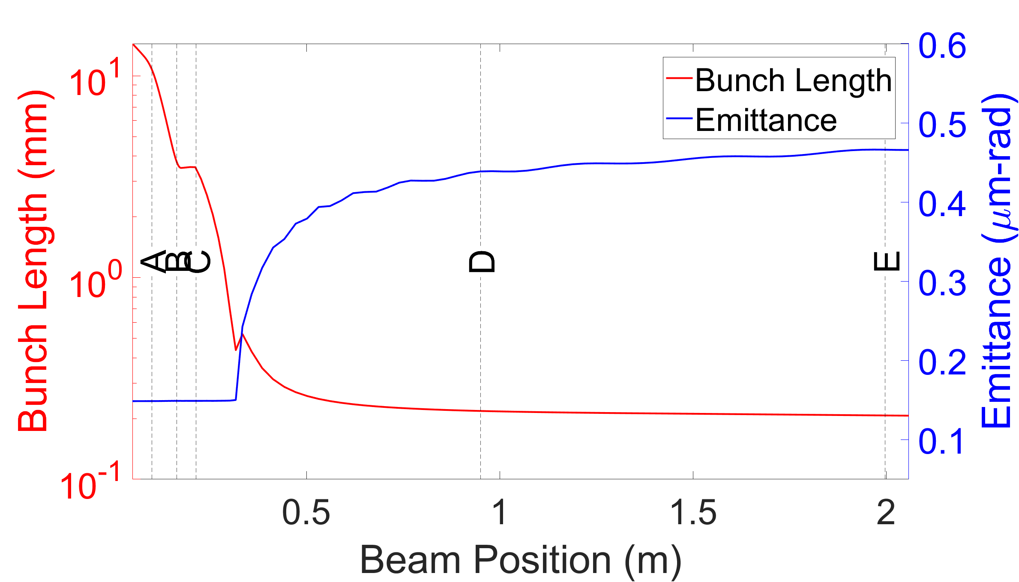
GPT Simulation
To see if the trap is useful in a beamline, we simulated it in GPT
We see bunch length decrease to ~10s of mm before the S-band cavity at D
Positron trap from 0 to A
Electrostatic accelerator from B to C
S-band cavity from D to E

Slide 11
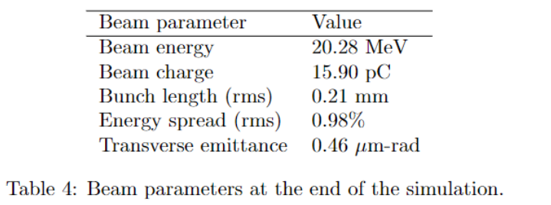
Final Bunch Parameters
In our simulation, we were able to compress and accelerate the positron beam with low emittance!

Slide 12
Future Work
Lots of work on optimization needs to be done
  Emittance growth at cavity start
  Charge loss at cavity start
Better ways to compress/accelerate a large/slow beam?

Slide 13
Thanks!
GBAR: Dirk Peter Van Der Werf, Samuel Niang, Laszlo Liszkay
The AWAKE electron source team: Seongyeol Kim, Mohsen Dayyani Kelisani, Steffen Doebert.
Helpful discussions with Allen Mills, UC Riverside, and David Cassidy, University College London.
Thank you all for listening!

Slide 14
Backup Slides

Slide 15
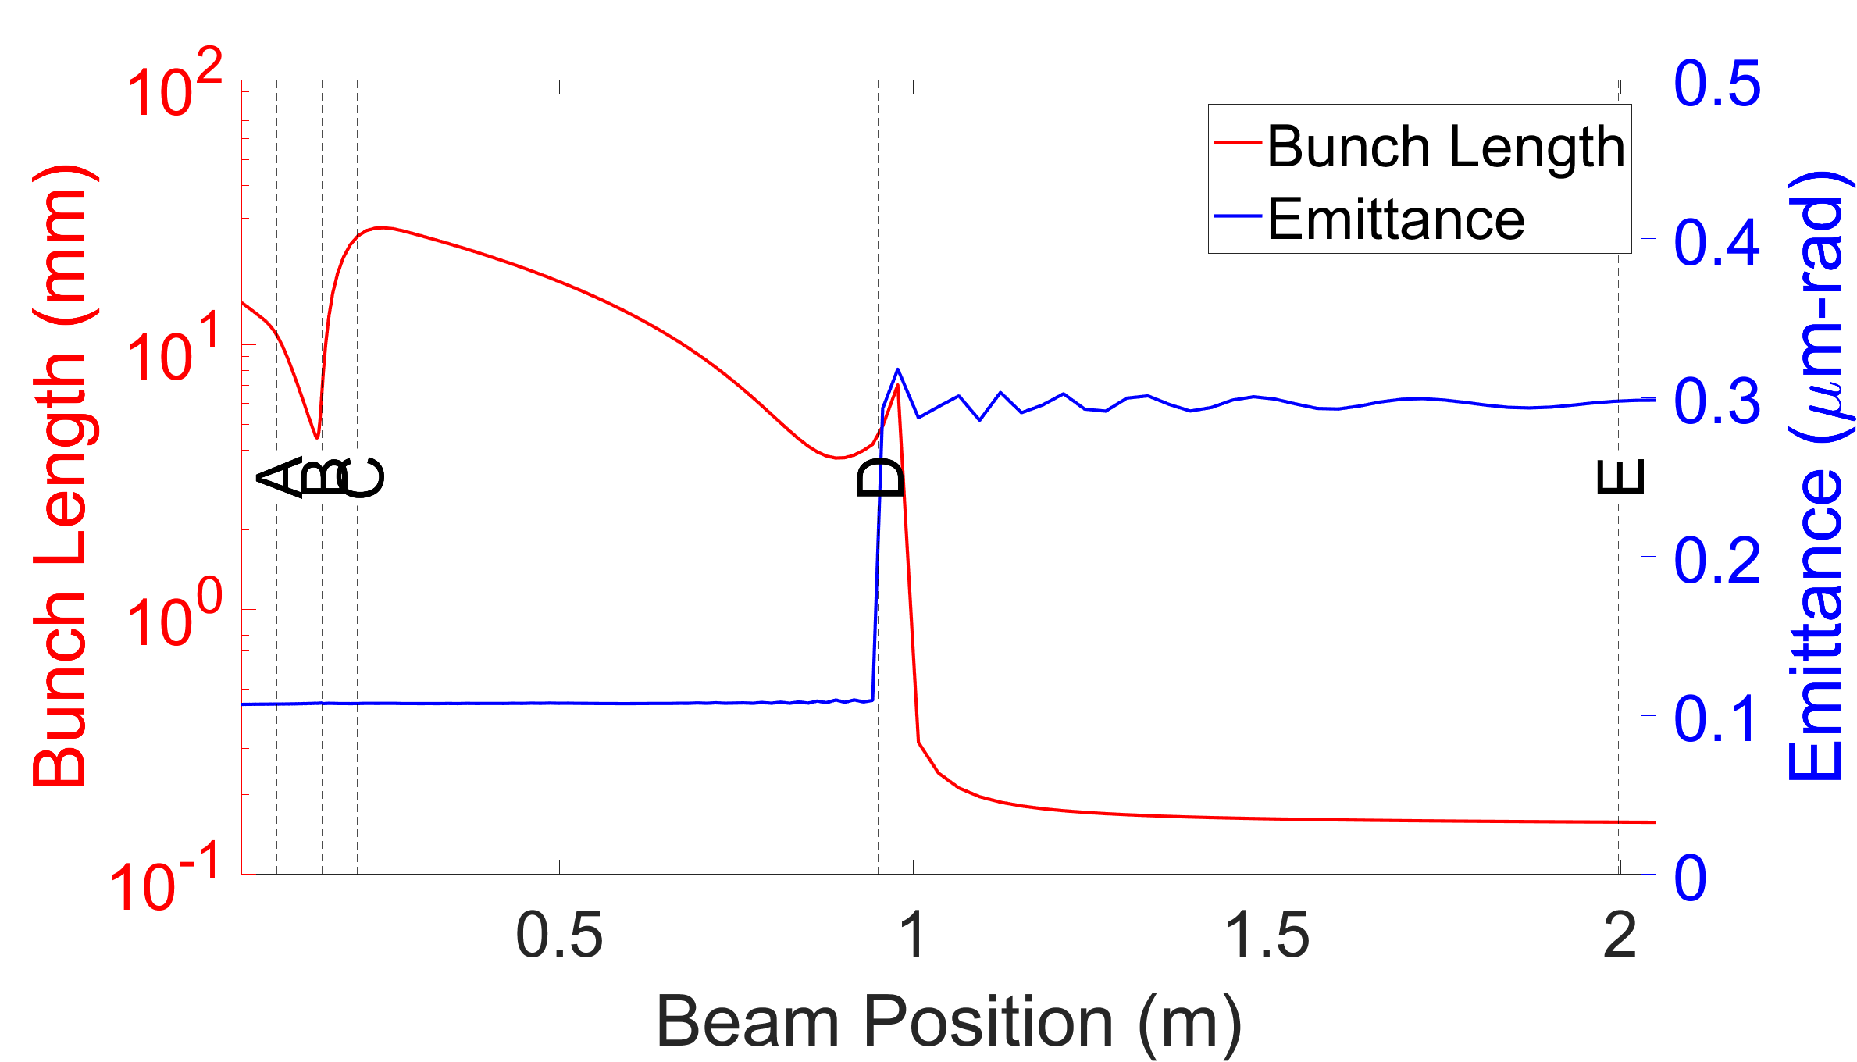
GPT Simulation
To see if the trap is useful in a beamline, we simulated it in GPT
We see bunch length decrease to ~10s of mm before the S-band cavity at D
Positron trap from 0 to A
Electrostatic accelerator from B to C
S-band cavity from D to E

Slide 16
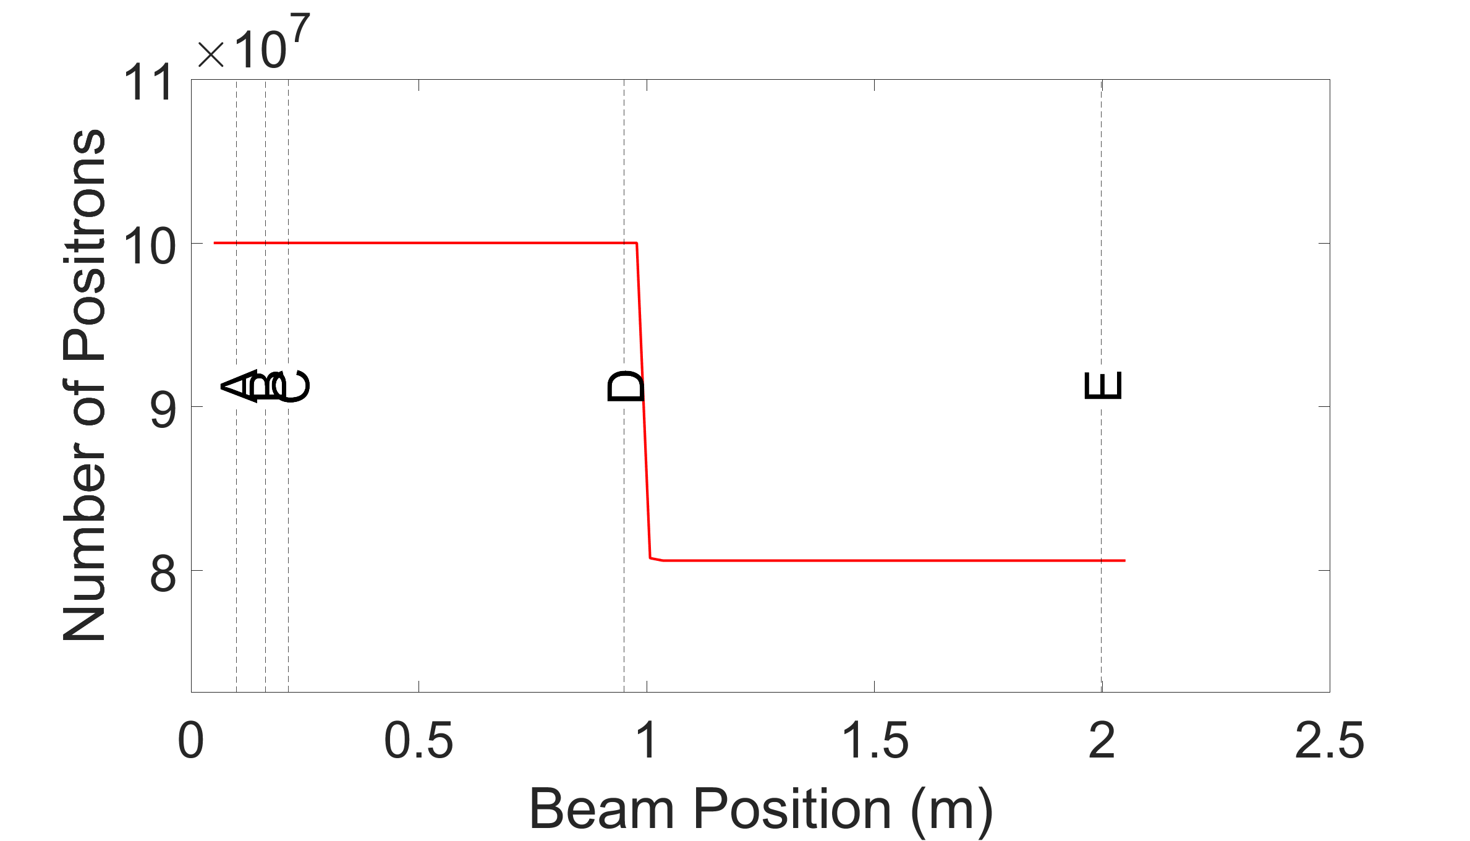
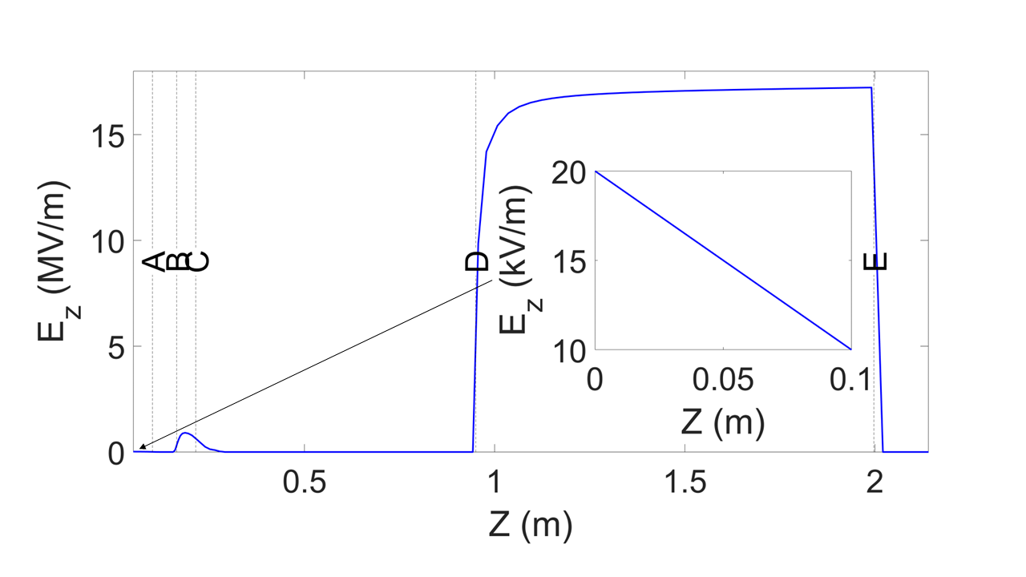
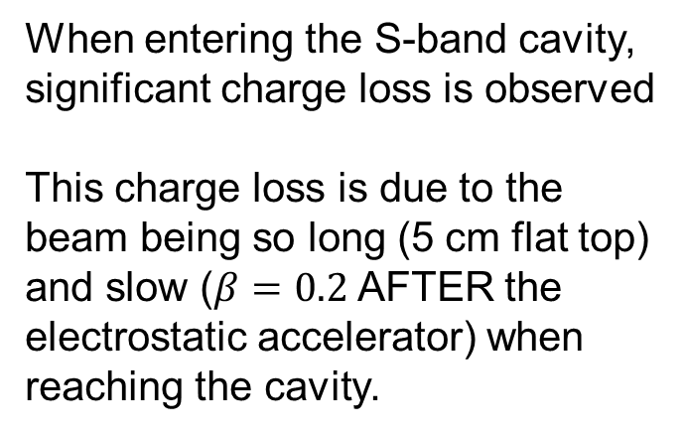
Charge Loss
When entering the S-band cavity, significant charge loss is observed
This charge loss is due to the beam being so long (5 cm flat top) and slow ($β=0.2$AFTER the electrostatic accelerator) when reaching the cavity.

Slide 17
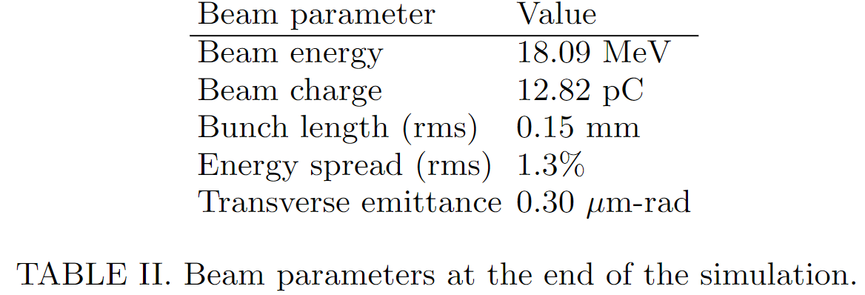
Final Bunch Parameters
In our simulation, we are able to compress and accelerate the positron bunch with low emittance!
But we also observe significant charge loss

Slide 18
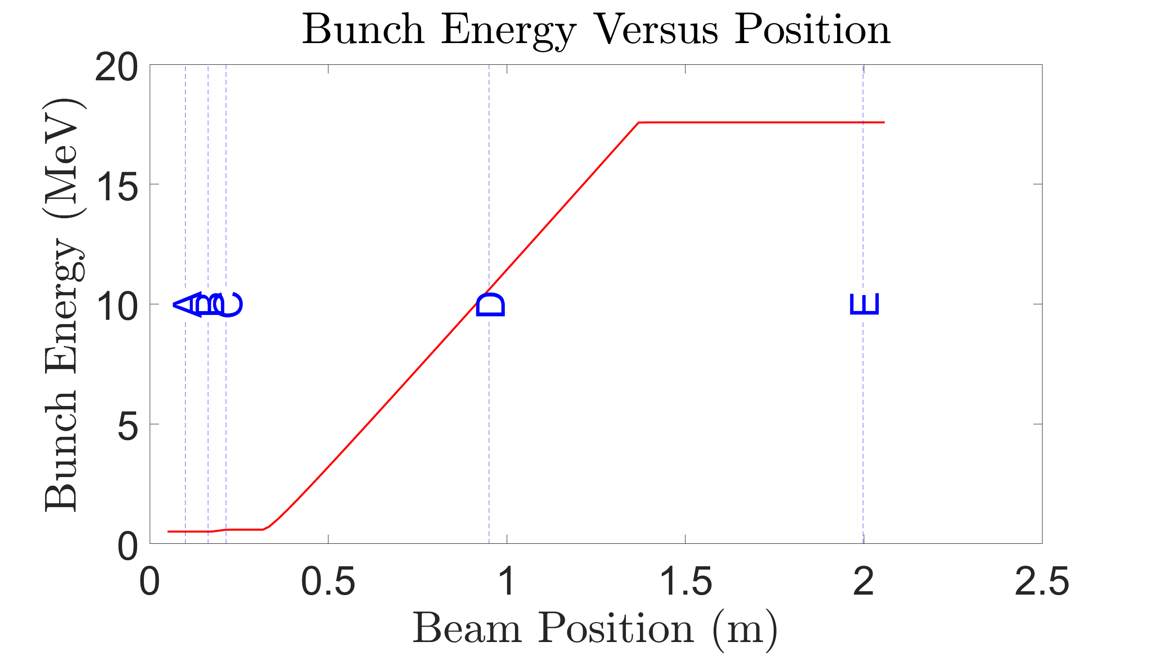
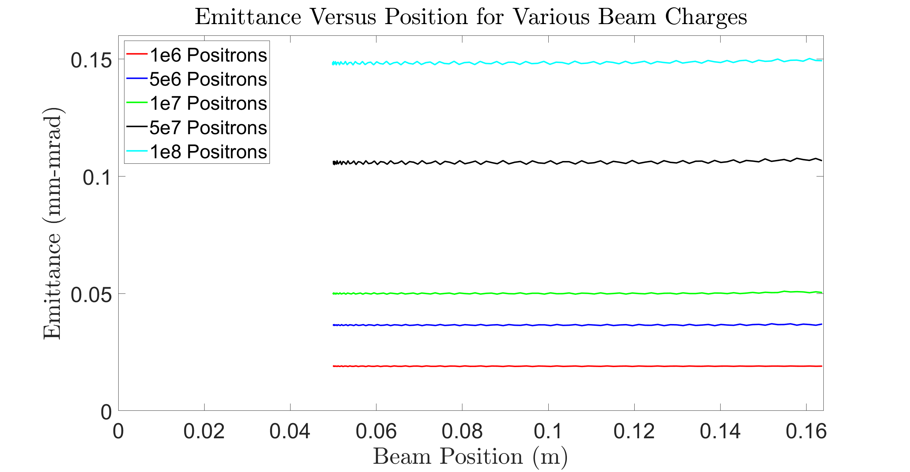
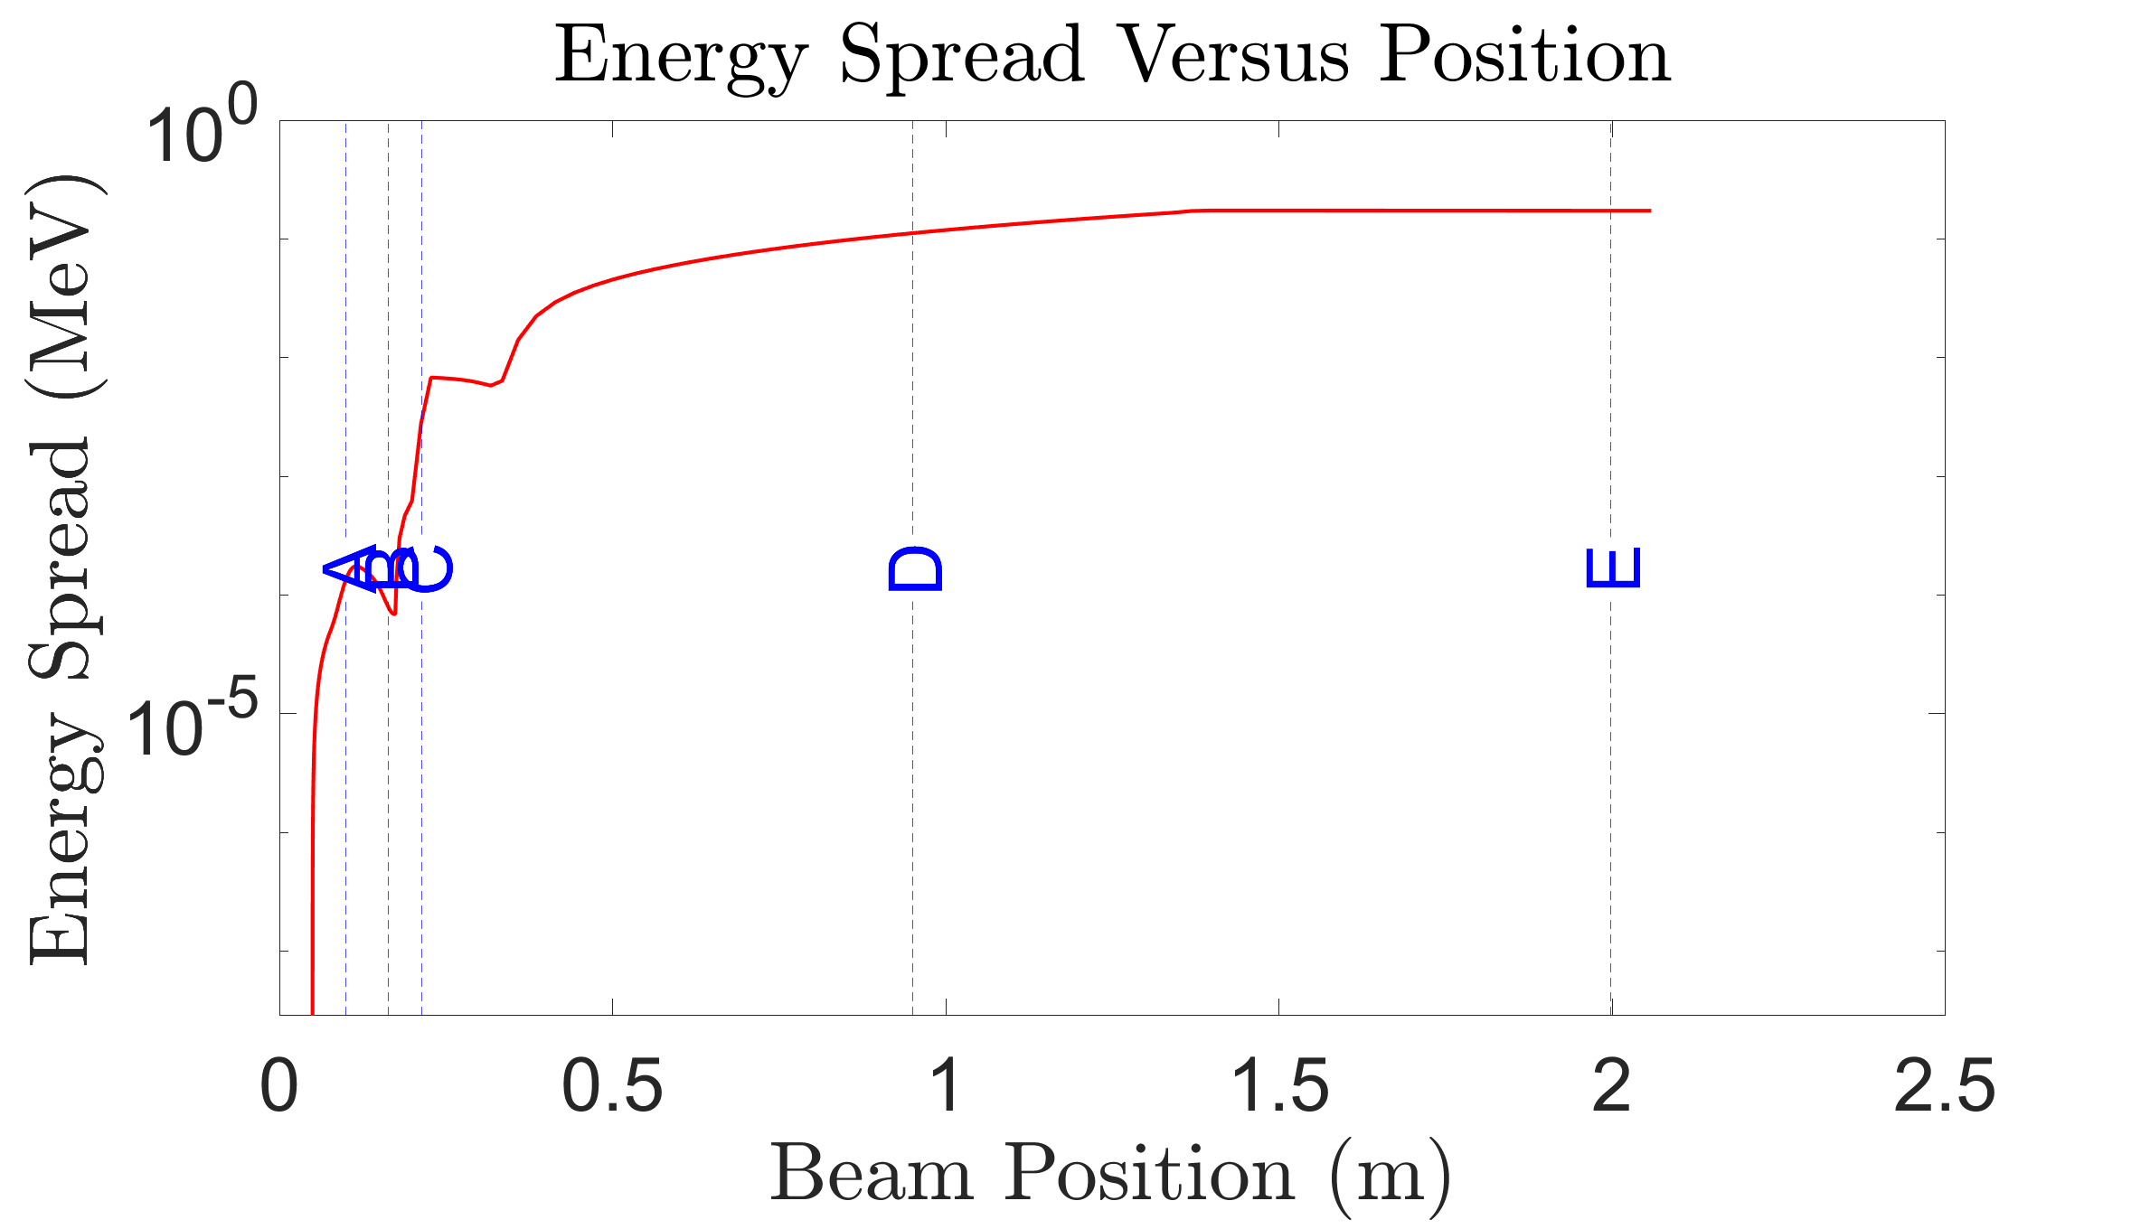
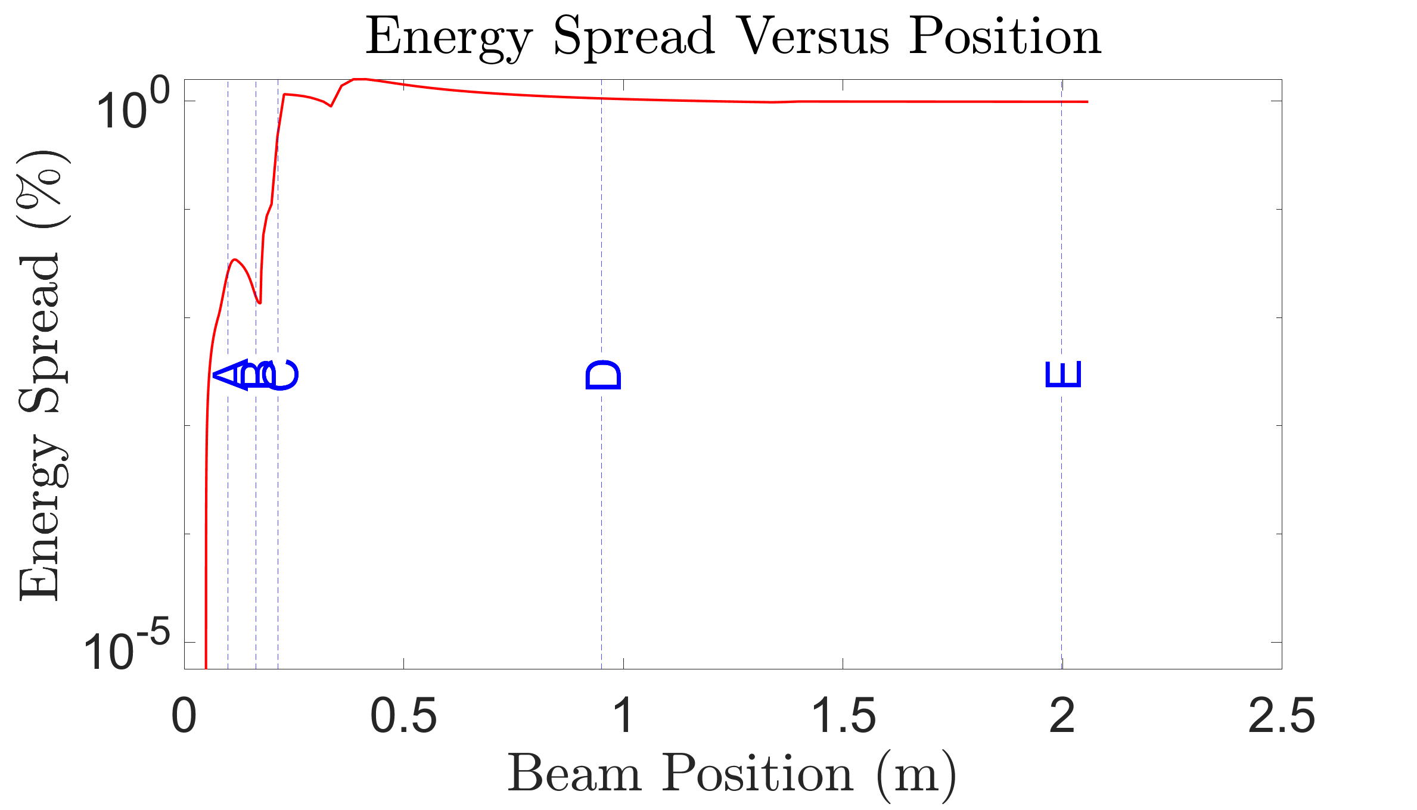
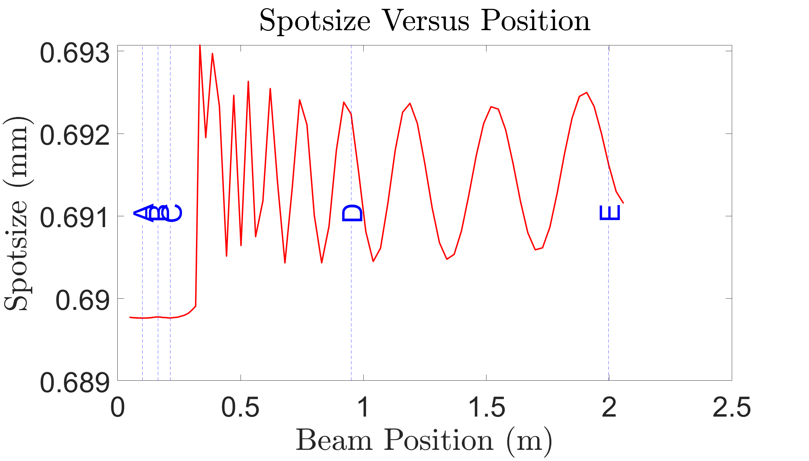
Assorted Properties of the GPT Simulation

Slide 19
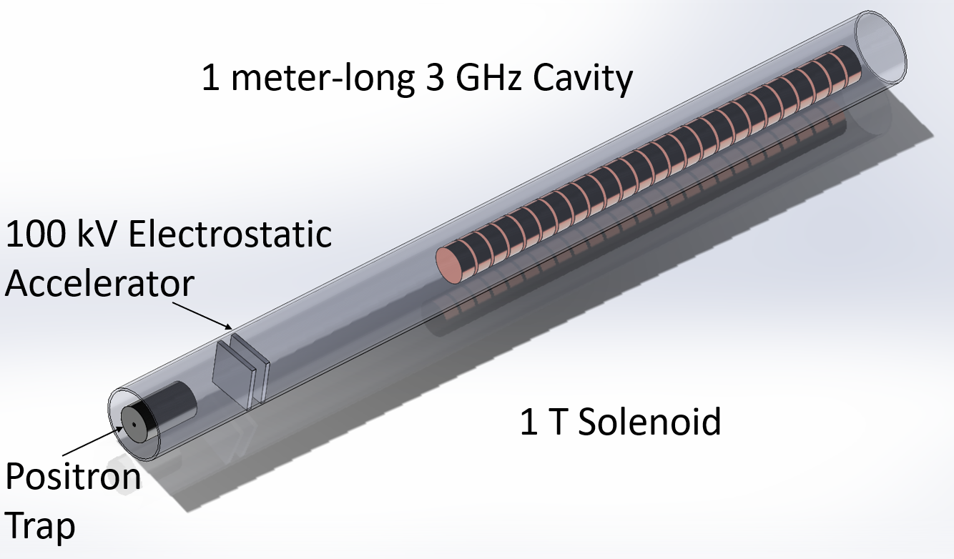
Beamline CAD Idea

