Slide 1
Stabilization & manipulation of laser-driven plasma acceleration with a weak auxiliary laser pulse
*LWFA driver: ≤ 4 J, ~30 fs, 0.8 µm, lin-pol;
self-truncated ionization injection (STII) regime¹
*auxiliary pulse: < 0.5 J, co-propagates with variable ∆t,
strong shot-to-shot phase fluctuations.
*
B. Bowers, R. Rudzinsky, M. LaBerge, M.C. Downer
The University of Texas at Austin
T. Püschel, J.P. Couperus-Cabadağ, Y.Y. Chang, A. Irman,
P. Ufer, M. Smĭd, R. Gebhardt, S. Bock, U. Schramm
Helmholtz-Zentrum Dresden-Rossendorf
T. Wang, G. Shvets
Cornell University
* PhD 2022
¹ Mirzaie et al., Sci. Rpts. 5, 1-9 (2015)
1
Notes:
Shot-to-shot fluctuation in performance remain a major inhibitor of many potential applications of laser wakefield accelerators. In this work, we show, first of all, that a small fraction of the energy of an LWFA drive pulse can be responsible for such fluctuations, and, secondly, that an equally small fraction in the form of an auxiliary laser pulse much weaker than the drive pulse can manipulate LWFA performance in signficant ways. These experiments were carried out at HZDR by my former PhD student Brant Bowers
Change as you see fit. This is the author list on the paper. The order is arbitrary except for the first and last ones on each attribution. Once we include Thomas’s work, it would make more sense for him to be first on the HZDR line as the paper will then be a split between his work, Tianhong’s, and mine with only a slight weight towards mine.

Slide 2
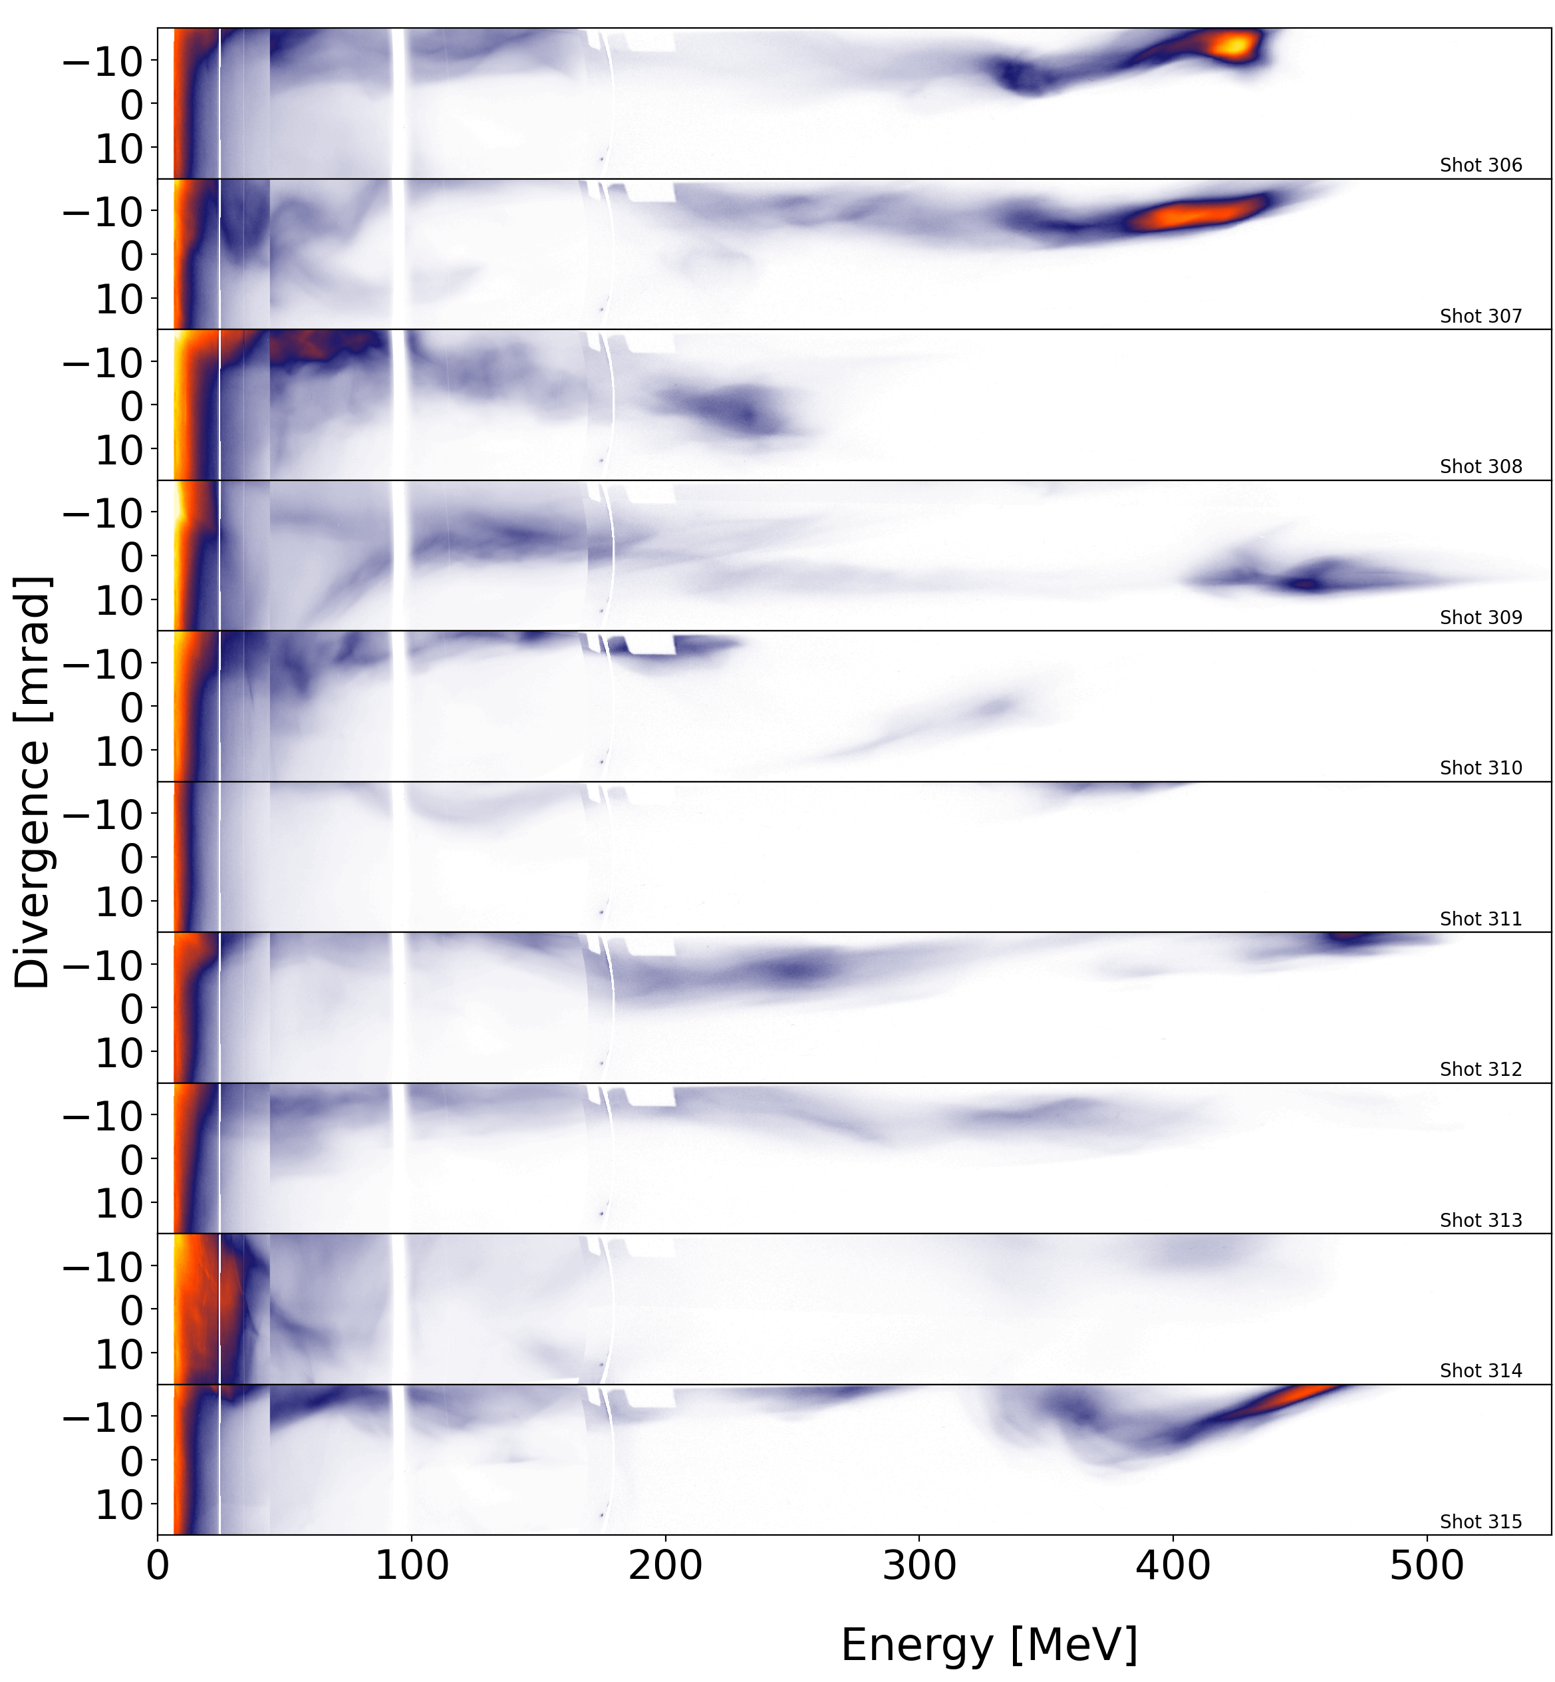
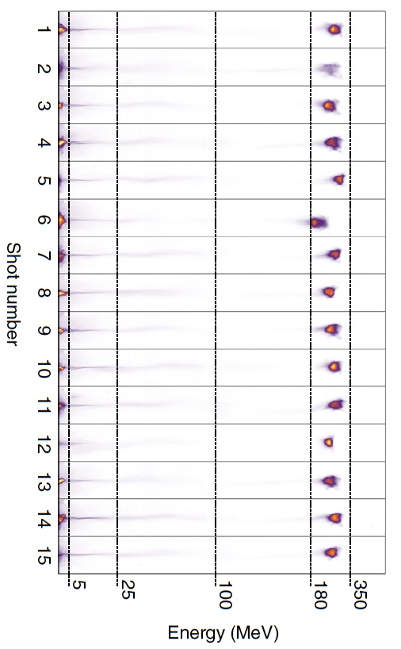
Phase jitter at drive pulse edges
compromises LWFA stability
Full LWFA Drive Beam (unoptimized)
Full LWFA Drive Beam (optimized)
Couperus et al., Nat. Commun. 20, 487 (2017)
2
Notes:
This illustrates that the phase jitter causes the same issue even with no global delay, reinforcing that the effect may be due to envelope variation more than DLA variations

Slide 3
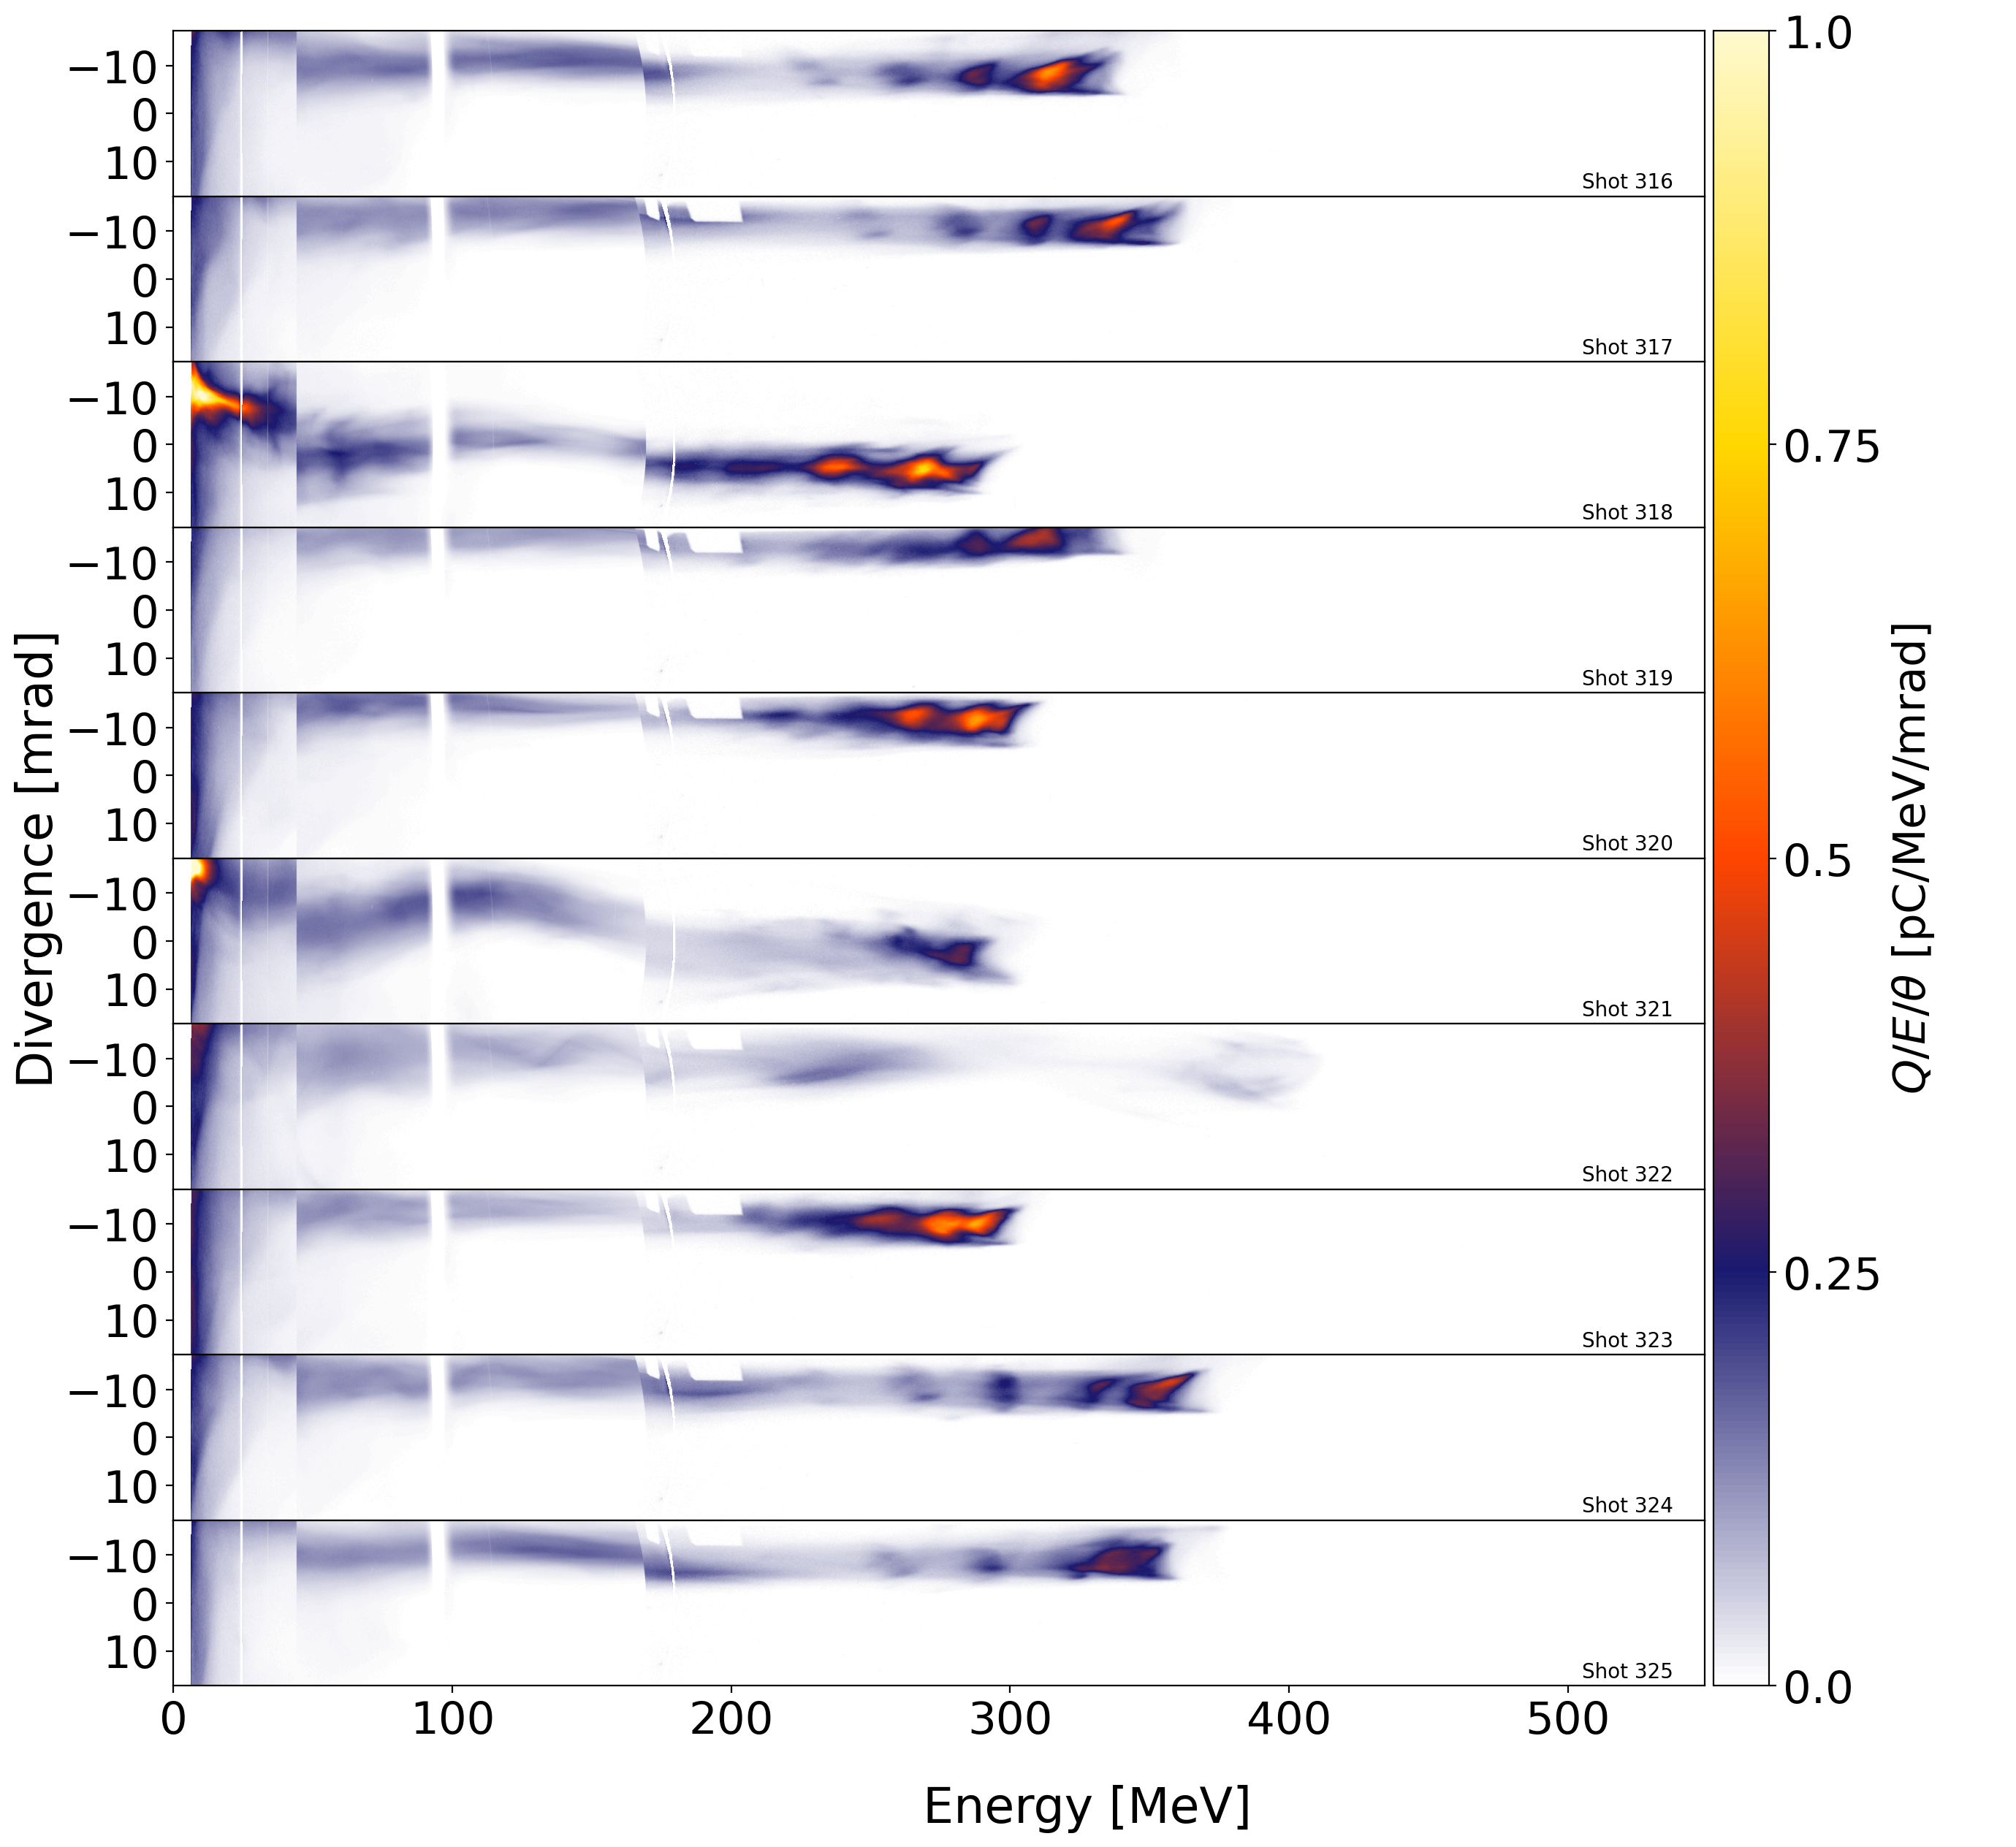
Phase jitter at drive pulse edges
compromises LWFA stability
near field transverse
drive beam profile
mask blocks
outer edge
(10 -15%
of energy)
immediate, robust
improvement in
stability of:
Full Drive Beam
Masked Drive Beam
• e-beam energy
& pointing
• X-ray yield
& spectrum
• charge
Mask evidently
removes shot-
to-shot phase
fluctuations
from portions
of beam that
experienced
unsaturated gain.
3
Notes:
This illustrates that the phase jitter causes the same issue even with no global delay, reinforcing that the effect may be due to envelope variation more than DLA variations

Slide 4
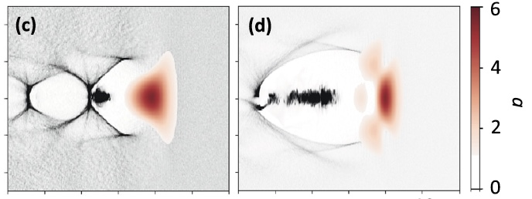
To explore phase-controlled LWFA manipulation, we
re-shaped removed light into a delayed auxiliary pulse...
NEAR FIELD
FAR FIELD
auxiliary wake
manipulation pulse
segmented
turning
mirror
LWFA drive pulse
• Auxiliary pulse delay ∆t₀ controlled
independently of LWFA drive pulse,
a distinction from prior work.*
Focusing LWFA drive
pulse from OAP
*J. L. Shaw et al., Phys. Rev. Lett. 118, 064801 (2017)
J. L. Shaw et al., Plasma Phys. Control.Fusion 60, 044012 (2018)
4
Notes:
Because of its strong phase fluctuations, this is of course exactly the wrong auxiliary pulse that one would want to use for real LWFA control. One would want to use a CEP-stabilized pulse. But here we use the built-in phase fluctuations as a means to scan phase parameter space, in order to discover the ∆t ranges in which such control can be most effective.

Slide 5
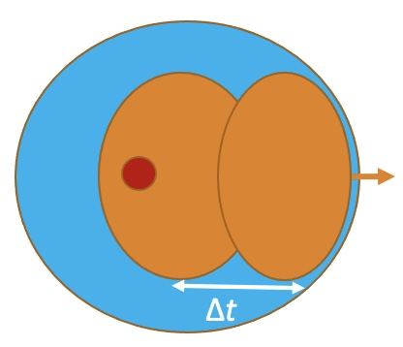
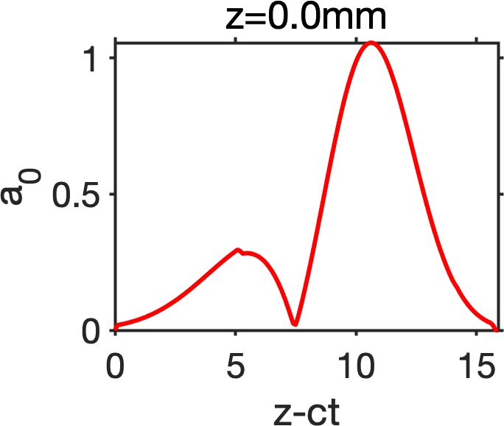
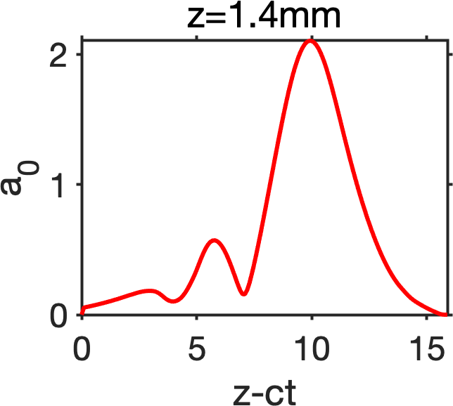
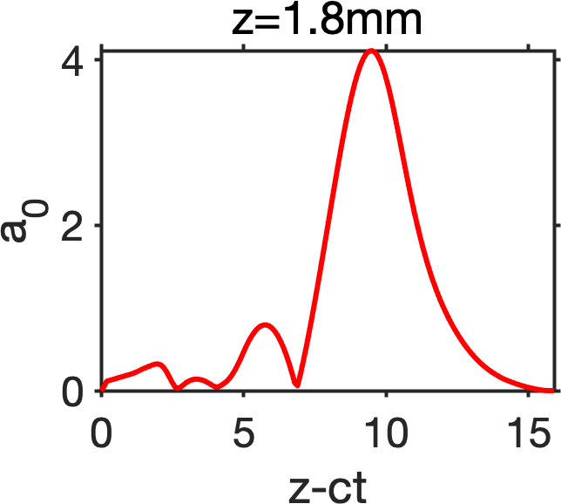
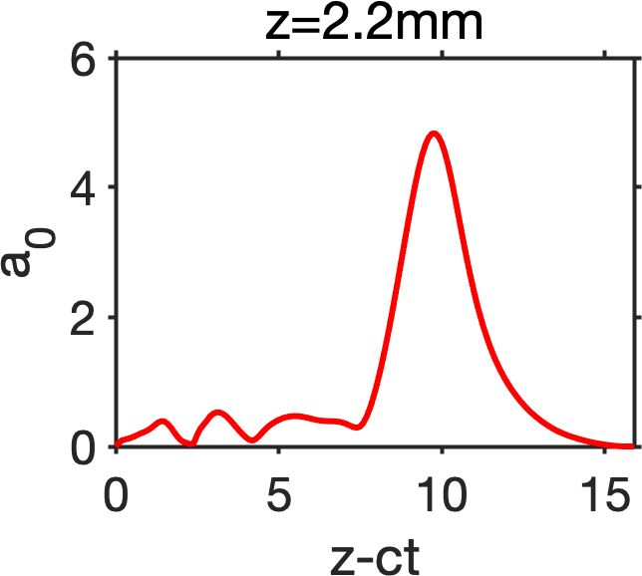
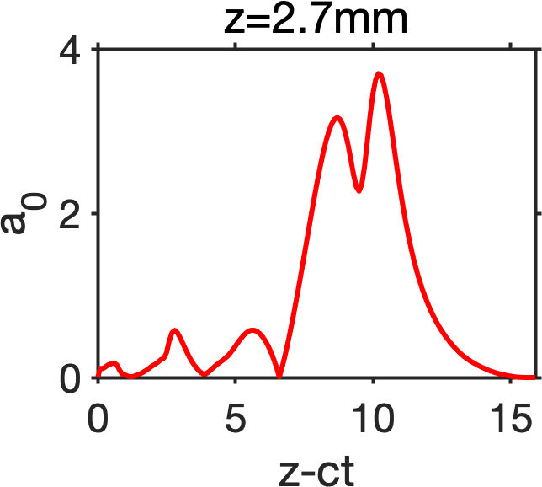
Simulations predict several 2-pulse effects
• Pulse envelope evolves strongly as trailing pulse
overtakes and interferes with drive pulse.
• Overlap of laser with e⁻ causes Direct Laser Acceleration (DLA), which
can increase e⁻ energy, transverse momentum & betatron X-ray yield...
Transverse Momentum
Electron Energy
Betatron X-ray Spectrum
LWDA*
LWFA
Shaw et. al.
Zhang, Shvets et al., Plasm. Phys. and Contr. Fusion 10, 60 (2018)
*LWDA = Laser Wakefield &
Direct-Laser Acceleration
5
Notes:
Key here is that the second pulse can be made to overlap more or less with the accelerating electrons in order to change the direct laser interaction. Incidentally the following pulse will experience a different index of refraction from the leading pulse, causing a change in the evolution of the collective intensity.

Slide 6
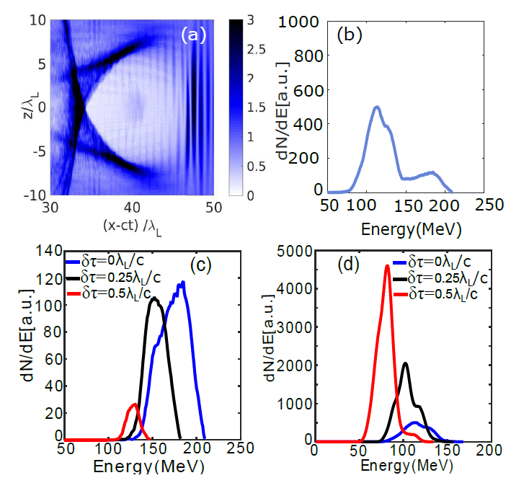
Simulations predict several 2-pulse effects
...but is sensitive to small phase differences
between drive and auxiliary pulses
Standard Peak
DLA Peak
Direct Laser
Acceleration
Direct Laser
Deceleration
6

Slide 7
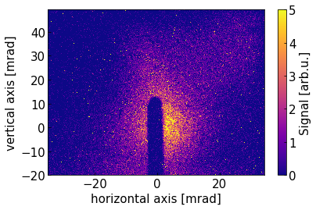
Experimental Setup
Pulse diagnostics
insertion mask
2, wedge
spectral interferometry
(h)
DRACO
drive
laser
e-spectro-
(i)
segmented
turning
mirror
gas
jet*
meter
betatron
X-ray
diagnostics:
(i) photon-counting
X-ray CCD
(ii) HOPG spectro-
meter
(ii)
4 J, 27 fs
f/25 OAP
e-energy spectrum
delay
control
*He + 1% N₂, 3 mm,
n_{e} ≈ 3 × 10¹⁸ cm⁻³
250 MeV
insertion mask 1
7
Notes:
This is just a diagram of the experimental setup:
a is a pulse mask for determining the delay between any two points on the wavefront (not during experiment)
b is a pickoff mirror for the spectral interferometer line (one line bounces off inner mirror, other off outer mirror, and a flat ~3ps delay is added by a delay stage at f, flat mirror available to compare interference
c is the mirror itself, the outside is fixed and the inside slides on rails. The mirrors are balanced to create nearly zero torque on the system
d is the pulse masks and wedge, the masks allow us to isolate either the inner or outer pulse for focal diagnostics or to drive the LWFA (outer pulse fails at this as it has too low power)
e is the electron spectrometer dipole
f is the spectral interferometer line with the delay and a camera behind a beamsplitter to detect overlap between the two pulses
g is the INSIGHT/thru focus spectral interferometer for characterization of the full, unsplit pulse
h is the betatron profiler, showing the flux and opening angle of the x-rays
i is the single-pixel counting x-ray camera (at the end of a long line) for the x-ray spectrum
j is an alternate x-ray spectrometer using a HOP-G crystal

Slide 8
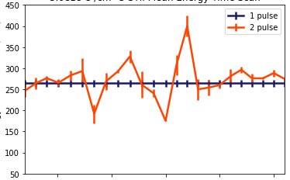
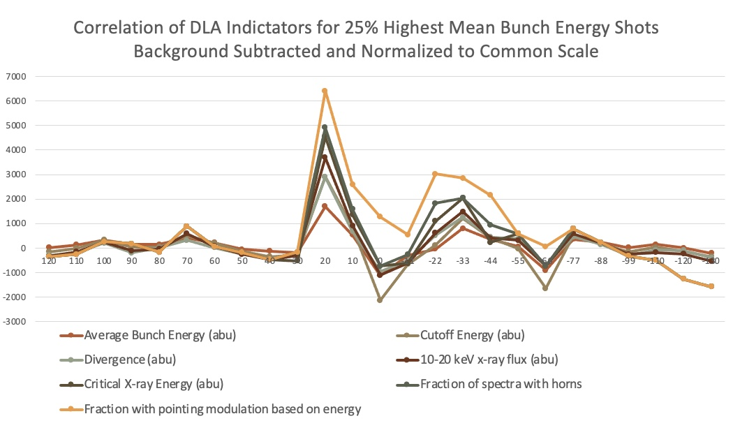
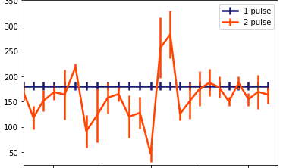
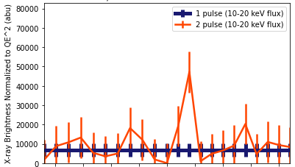
Experimental results: correlated peak at ∆t ≈ 25 fs in several DLA indicators
n_{e} = 3 × 10¹⁸ cm⁻³
Mean electron
energy
<Energy> (MeV)
Electron
charge
Q_{e} >100 MeV (pC)
Normalized
Betatron
X-ray flux
F_{x} (10-20 keV) (arb. u.)
-100
-50
0
50
100
time delay ∆t₀ (fs)
8
Notes:
This illustrates that the ideal time delay (~20-30fs) creates fluctuation in energy, charge, and x-ray flux and that these fluctuations are coherent with each other. In other words, if a more stable phase difference could be achieved, the results on the right could be achieved consistently

Slide 9
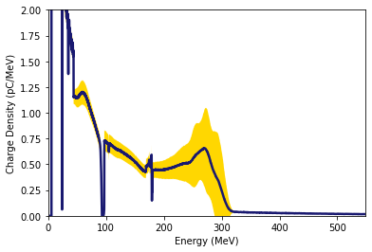
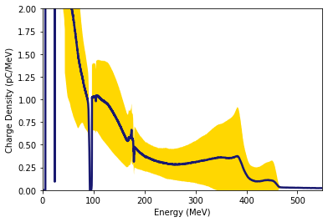
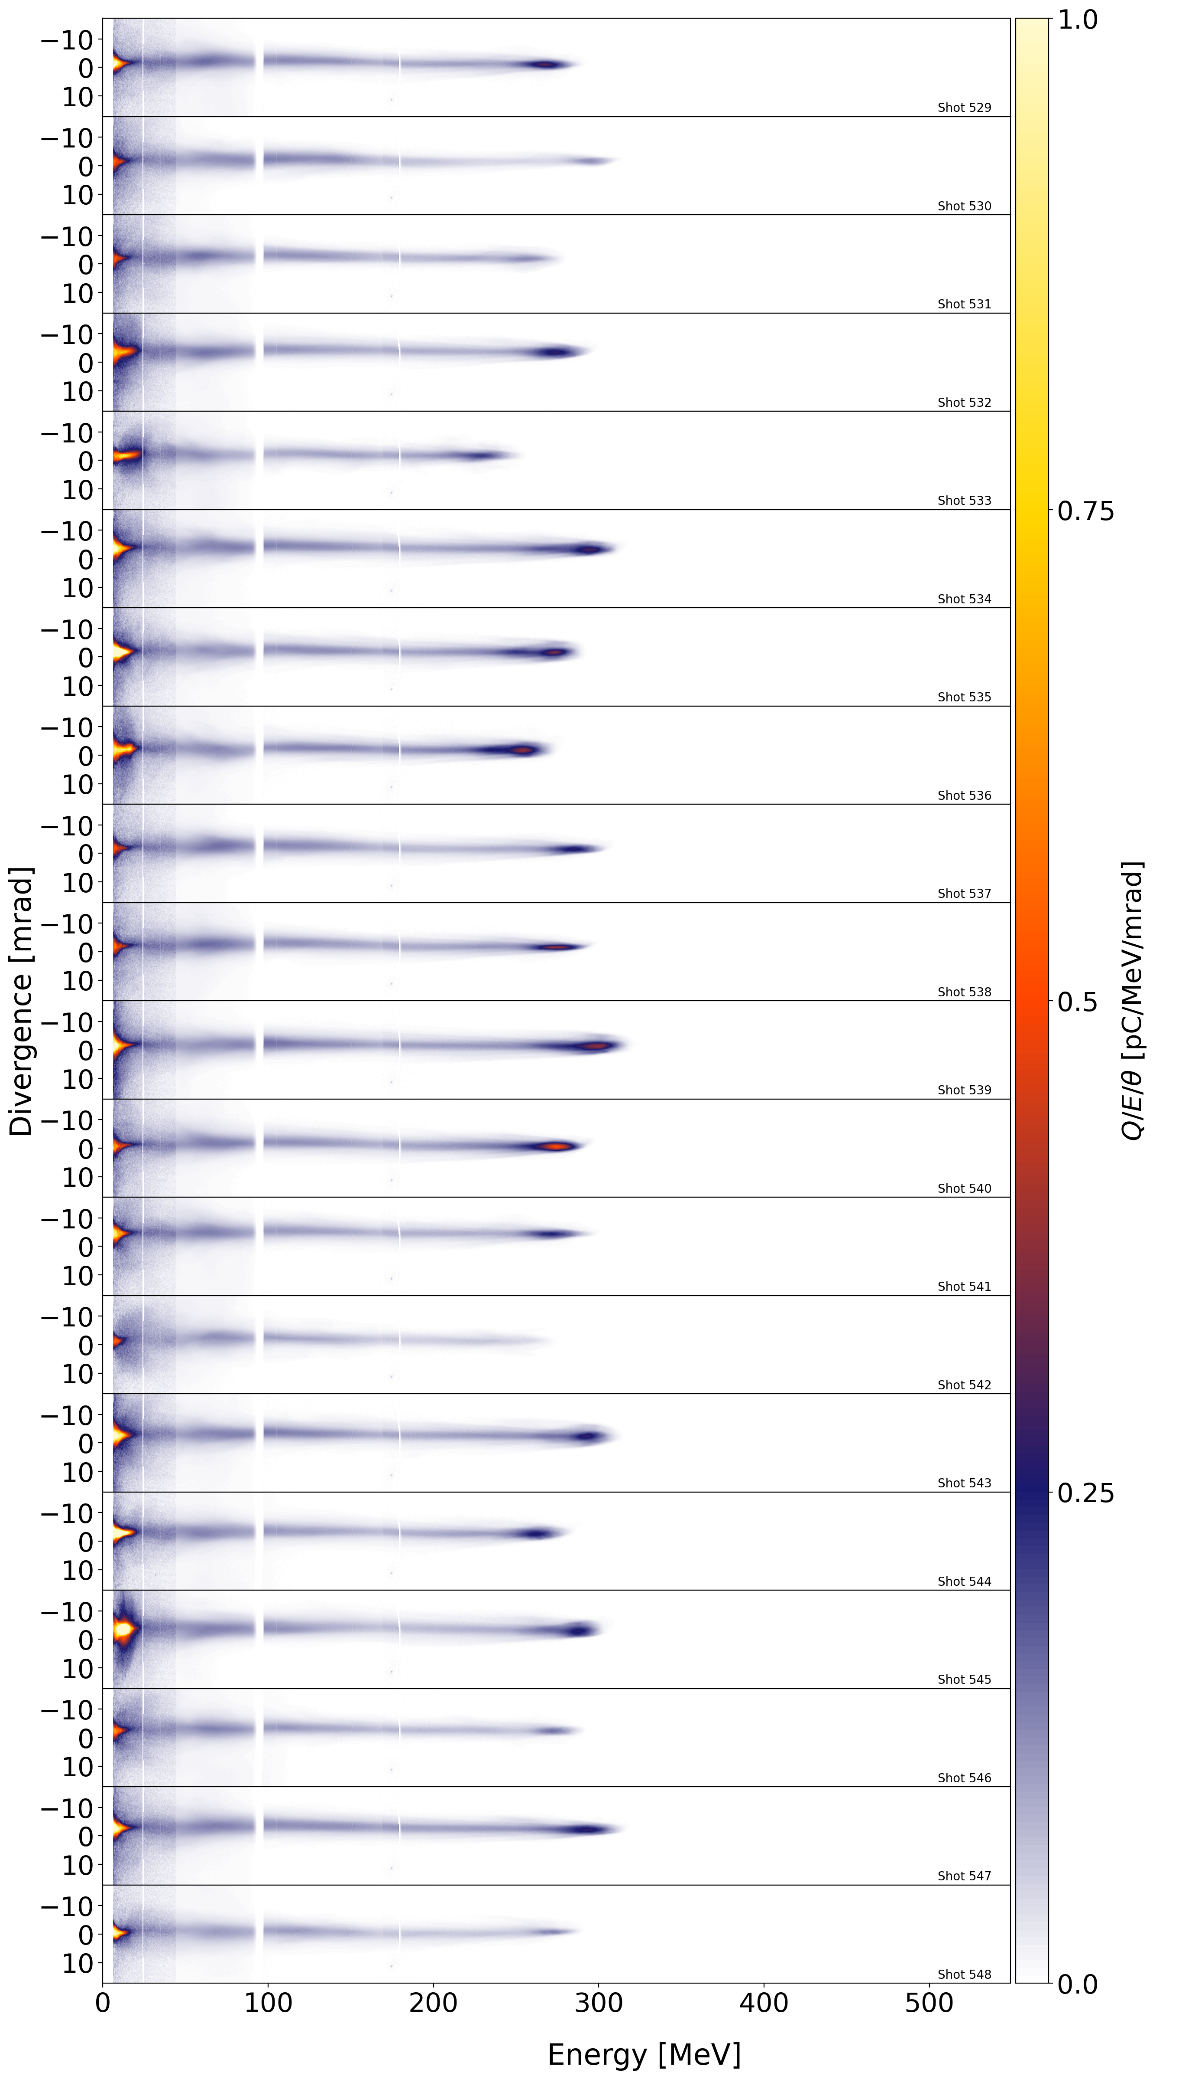
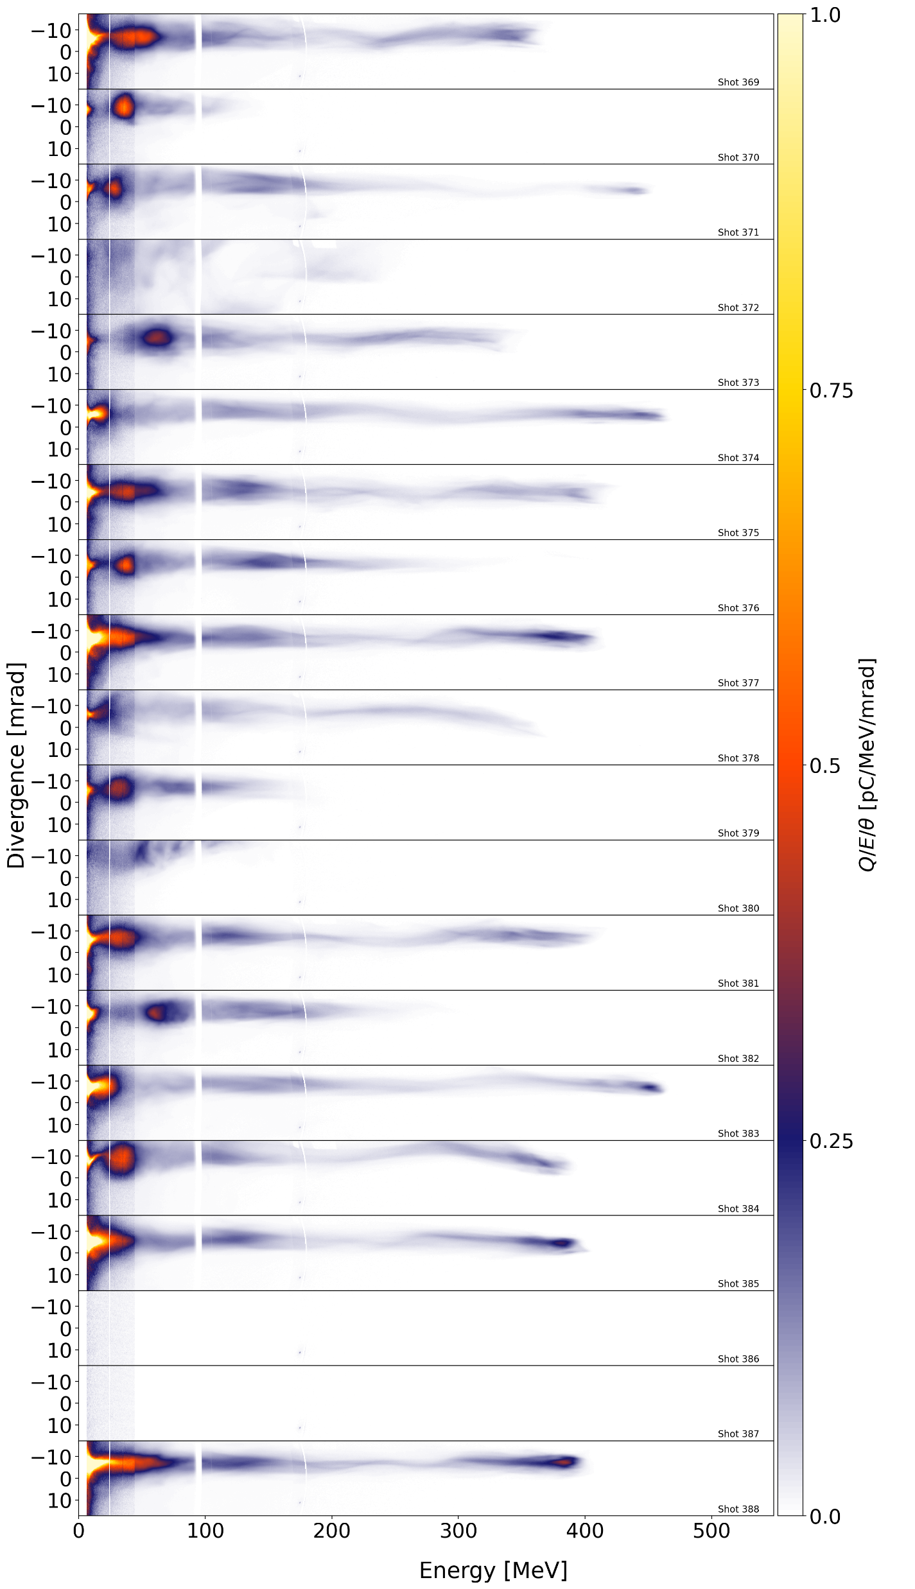
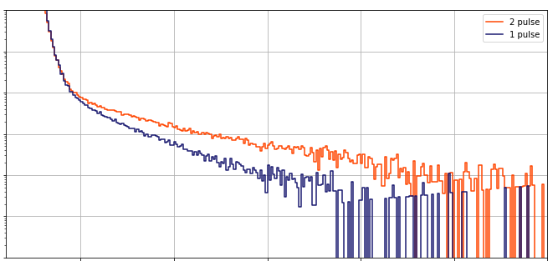
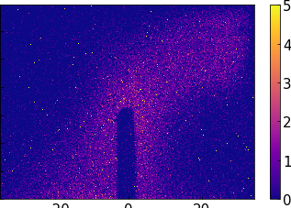
Electron spectra
2-pulse
(∆t = 25 fs)
1-pulse
“Hook ‘em Horns”
DLA structures*
2
Charge density
(pC/MeV)
1
0
1
Divergence (mrad)
Q/E/𝜃 (pC/MeV/mrad)
* Shaw et al. (2017, 2018)
10⁶
X-ray spectra
2-pulse
1-pulse
0
200
400
0
200
400
0
10⁴
Electron energy (MeV)
Photon counts
40
X-ray brightness
40
X-ray brightness
10²
20
20
Vertical (mrad)
Vertical (mrad)
Brightness (arb. u.)
Brightness (arb. u.)
0
0
10⁰
5
10
15
20
25
-20
0
20
-20
0
20
X-ray photon energy (keV)
Horizontal (mrad)
Horizontal (mrad)
9
Notes:
This is meant to illustrate the change in peak electron energy, fluctuation, x-ray flux, x-ray energy

Slide 10
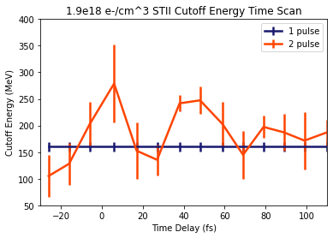
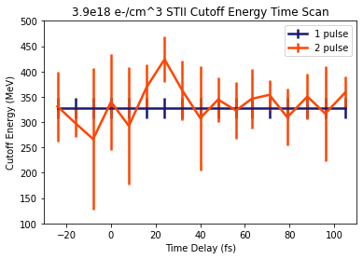
Optimum ∆t changes with
plasma density n_{e}
Peak at ∆t ≈ 45 fs for n_{e} = 1.9 × 10¹⁸ cm⁻³ (top)
Peak at ∆t ≈ 25 fs for n_{e} = 3.9 × 10¹⁸ cm⁻³ (bottom)
∆t = 0 accurate to ~10fs
∆t scales approximately as bubble size
10
Notes:
This illustrates that the ideal time delay varies with the bubble size (the square root of gas density) and therefore the distance from lead pulse to injected electrons. The correlation is not 1:1 as indicated by the ratio of the peaks being less than root(2). This implies that the peak is linked to DLA effects from second pulse overlap but is also affected by a separate effect that is less dependent on gas density (for example the envelope intensity modulation).

Slide 11
Summary
• Uncontrolled phase fluctuations in the periphery of LWFA drive
pulses contribute significantly to shot-to-shot LWFA instability.
• A weak, strategically-timed, independently-controlled auxiliary pulse
derived from this periphery substantially increases...
...electron energy
...betatron X-ray brightness & photon energy
...e-beam divergence
...charge
on average, but with large fluctuations.
• CEP-stabilized auxiliary pulses should avoid these fluctuations,
providing a low-cost, fine-tune control knob for LWFAs.
Work supported by DoE grant DE-SC0011617, Helmholtz Association (Matter & Technology
program, Accelerator R&D topic), Alexander von Humboldt Foundation.
11

