Slide 1
PARTICLE ACCELERATOR RESEARCH FOUNDATION – PARF
Presentation for Advanced Accelerator Concepts Workshop AAC2022
ELECTRON CYCLOTRON RESONANCE ACCELERATOR eCRA
ELECTRON CYCLOTRON RESONANCE ACCELERATOR eCRA*
Xiangyun Chang, Yong Jiang and Jay L. Hirshfield; PARF, New Haven, CT
Mikhail Fedurin, Mark Palmer, and Warren Stern; BNL, Upton, NY
Summary: Solutions [1] of the single-particle equations of motion for electrons in the fields of an idealized TE₁₁₁ microwave cavity in an external magnetic field near cyclotron resonance show acceleration rates that substantially exceed the limits for the CARA interaction [2]. We have dubbed this new accelerator “eCRA.” In this presentation, new simulation results are presented for a realistic TE₁₁₁ eCRA cavity geometry and finite space-charge beams that confirm the idealized solutions. The new features include cavity openings for RF inputs, beam injection, and pumping; RF input coupling factors that maximize efficiency; a thin window for exit of the accelerated beam; realistic magnetic field profiles; finite diameter multi-Ampere beams; and transient beam dynamics to model pulsed operation. We present several eCRA examples for a copper cavity with RF input power at each of the two ports of 12.5 MW, wherein 100 keV beams of 4.4 – 9.0 A are shown to be accelerated to 1.9 – 3.5 MeV, giving pulsed beam powers of 11 - 18 MW and efficiencies of 44 – 72%. As an example, these parameters augur well for successful design of an eCRA-based x-ray source to replace widely-used Co-60 gamma sources now in use for sterilization, using available technology. Many other applications have been identified for MW-class eCRA beams with energies in the range 1-10 MeV [3].
_________________________
[1] S.V. Shchelkunov, X. Chang, J.L. Hirshfield, Phys. Rev. Accel. Beams 25, 021301 (2022).
[2] J.L. Hirshfield, C.B. Wang, Phys. Rev. E 51, 2446 (1995).
[3] Basic research needs workshop on compact accelerators for security and medicine: Tools for the 21st century, 2019, Michael Fazio, chair; Office of Science, US Department of Energy.
*This work was sponsored in part by Brookhaven National Laboratory LDRD grants 22-075 and 23-060.

Slide 2
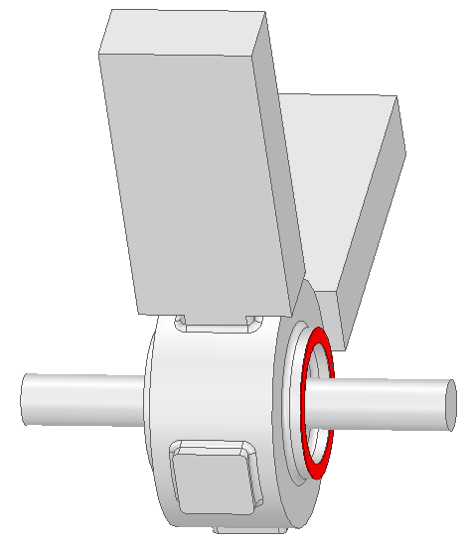
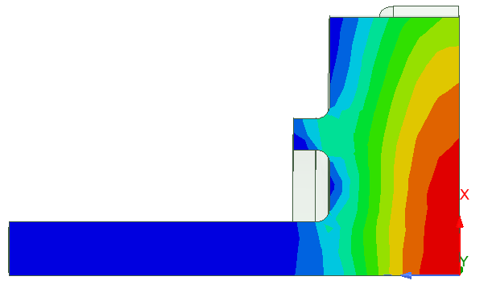
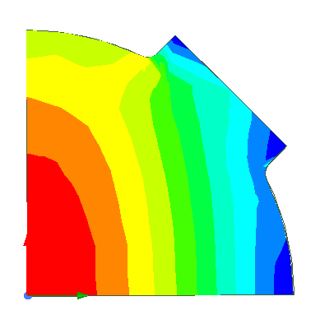
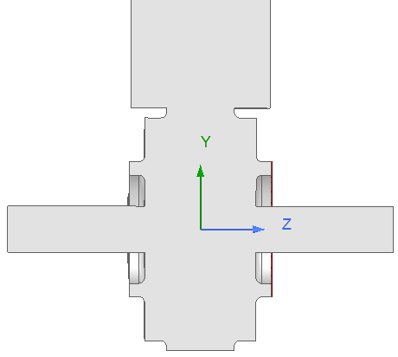
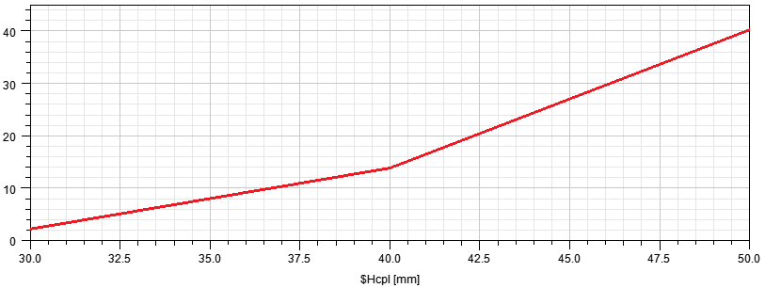
PARTICLE ACCELERATOR RESEARCH FOUNDATION – PARF
Presentation for Advanced Accelerator Concepts Workshop AAC2022
ELECTRON CYCLOTRON RESONANCE ACCELERATOR eCRA
Layout of a TE-111 eCRA cavity
WR284 waveguides excited in quadrature
beam entrance
Beryllium
window
compensating protrusion
Coupling Coefficient β
Coupler Opening Height

Slide 3
PARTICLE ACCELERATOR RESEARCH FOUNDATION – PARF
Presentation for Advanced Accelerator Concepts Workshop AAC2022
ELECTRON CYCLOTRON RESONANCE ACCELERATOR eCRA
Examples of particle orbits in an idealized S-band TE-111 eCRA cavity.
Note the acceleration in a single turn, the absence of bunching, and the scanning nature of the accelerated beam.

Slide 4
PARTICLE ACCELERATOR RESEARCH FOUNDATION – PARF
Presentation for Advanced Accelerator Concepts Workshop AAC2022
ELECTRON CYCLOTRON RESONANCE ACCELERATOR eCRA
Acceleration predictions in an eCRA cavity, with effective gradients for L = 6.1 cm of
44, 87, 166, 239, and 315 MVm.
Note: E(0) = 1.58 Ew.

Slide 5
PARTICLE ACCELERATOR RESEARCH FOUNDATION – PARF
Presentation for Advanced Accelerator Concepts Workshop AAC2022
ELECTRON CYCLOTRON RESONANCE ACCELERATOR eCRA
Energy gains in eCRA as functions of magnetic field, for several Ew’s.

Slide 6
PARTICLE ACCELERATOR RESEARCH FOUNDATION – PARF
Presentation for Advanced Accelerator Concepts Workshop AAC2022
ELECTRON CYCLOTRON RESONANCE ACCELERATOR eCRA
Peak power needed to sustain a given Ew, limits to heat load on cavity walls @100 W/cm2, and duty factors consistent with these, for several cavity radii.

Slide 7
PARTICLE ACCELERATOR RESEARCH FOUNDATION – PARF
Presentation for Advanced Accelerator Concepts Workshop AAC2022
ELECTRON CYCLOTRON RESONANCE ACCELERATOR eCRA
Average beam power, average beam current, and efficiency; vs peak RF power for Ew = 40 MV/m.
Note: For these cavity radii, accelerations up to 4.03, 4.36, and 4.58 MeV are predicted.

Slide 8
PARTICLE ACCELERATOR RESEARCH FOUNDATION – PARF
Presentation for Advanced Accelerator Concepts Workshop AAC2022
ELECTRON CYCLOTRON RESONANCE ACCELERATOR eCRA
Average beam power, average beam current, and efficiency; vs peak RF power with Ew =100 MV/m.
Note: For these cavity radii, accelerations up to 9.7, 10.2, and 10.7 MeV are predicted.

Slide 9
PARTICLE ACCELERATOR RESEARCH FOUNDATION – PARF
Presentation for Advanced Accelerator Concepts Workshop AAC2022
ELECTRON CYCLOTRON RESONANCE ACCELERATOR eCRA
Changes for simulations of realistic eCRA cavities, using CST-PIC solver
Idealized eCRA cavity*
No irises or apertures in cavity
No entry or exit beam channels
Uniform external B-field
Single-particle beam dynamics
Steady-state solutions
Fixed limit on wall heating
_____________
*S.V. Shchelkunov, X. Chang, J.L. Hirshfield,
PRAB 25, 021301 (2022).
Realistic eCRA cavity
Beam entry and exit apertures in cavity
Waveguide irises, with selected β = Pin/Pwall
Transient beam dynamics
Realistic external B-field
Includes space-charge effects
May use artificial low-Q (SS) cavity that shortens fill-time to shorten run times.
Uses beryllium foil beam window to contain cavity RF fields and to limit RF losses.

Slide 10
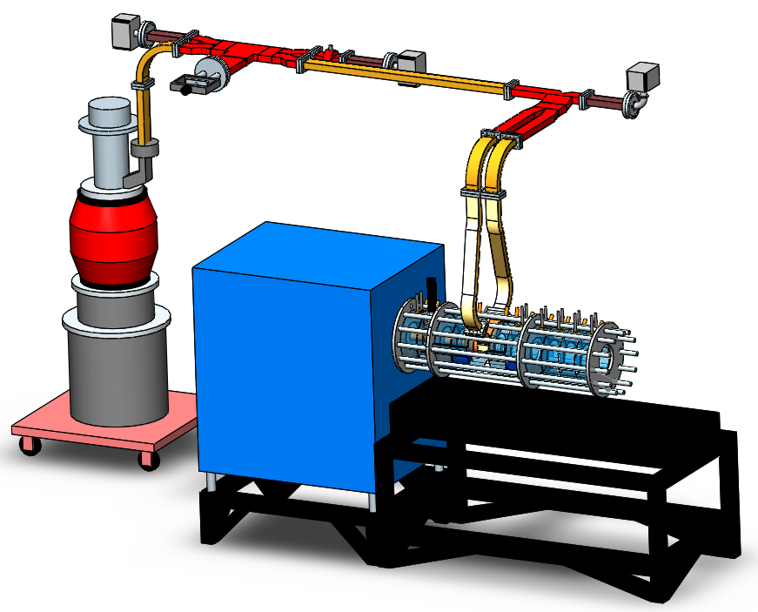
PARTICLE ACCELERATOR RESEARCH FOUNDATION – PARF
Presentation for Advanced Accelerator Concepts Workshop AAC2022
ELECTRON CYCLOTRON RESONANCE ACCELERATOR eCRA
Planned eCRA test stand to be built at BNL

Slide 11
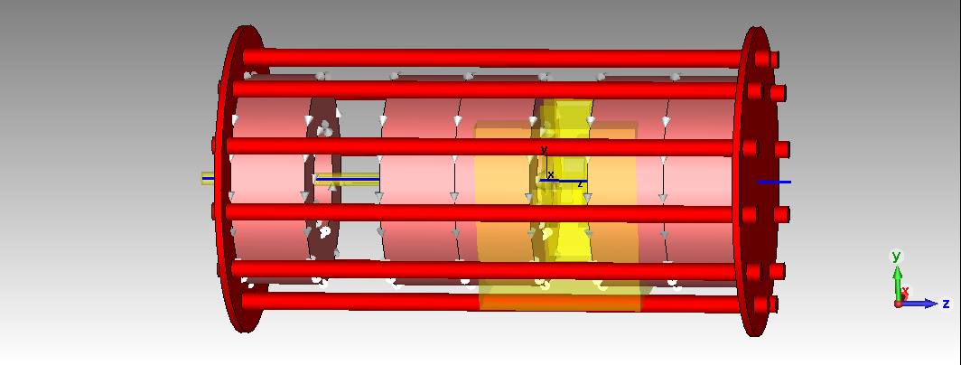
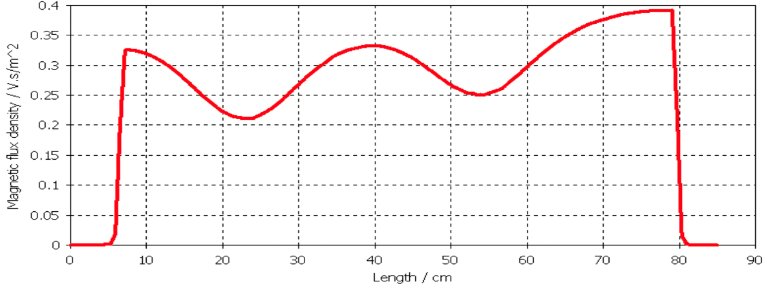
PARTICLE ACCELERATOR RESEARCH FOUNDATION – PARF
Presentation for Advanced Accelerator Concepts Workshop AAC2022
ELECTRON CYCLOTRON RESONANCE ACCELERATOR eCRA
Realistic Magnetic Field
Magnet structure and field are plotted along the axis, based on use of available coils.
The eCRA cavity is in the right-hand gap, and a pump-out port and gate valve are in the left-hand gap .

Slide 12
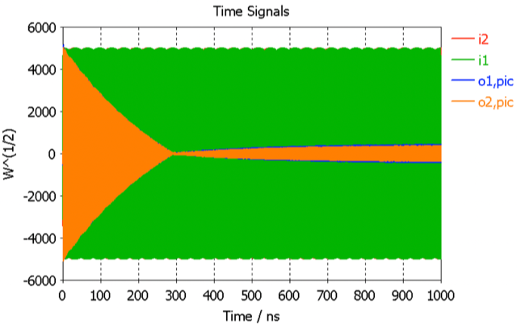
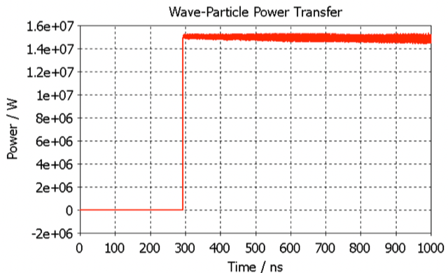
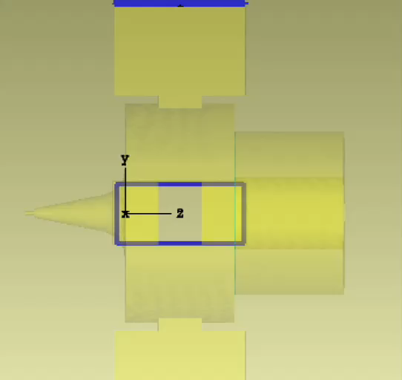
PARTICLE ACCELERATOR RESEARCH FOUNDATION – PARF
Presentation for Advanced Accelerator Concepts Workshop AAC2022
ELECTRON CYCLOTRON RESONANCE ACCELERATOR eCRA
Examples of results obtained from a CST PIC solver run
Parameters: initial beam energy 100 keV; beam final energy 3.5 MeV; beam current 4.4 A; beam power gain 15 MW, input power 25 MW; RF efficiency 60%; peak RF field in cavity 49 MV/m; beam turn-on time 293 ns; beam radius 1 mm; cavity frequency 2.84088 GHz; cavity length and radius both 6.0 cm; magnetic field 0.36 T. reflections vs time power transfer from RF to beam vs time beam orbit visualized
(units are square root of power) (700 ns corresponds to about 2000 turns) (right wall of cavity is transparent to beam) . .

Slide 13

PARTICLE ACCELERATOR RESEARCH FOUNDATION – PARF
Presentation for Advanced Accelerator Concepts Workshop AAC2022
ELECTRON CYCLOTRON RESONANCE ACCELERATOR eCRA
Two more examples from CST PIC solver that show the limits in eCRA imposed by the coupling factor 𝛽 in giving an upper limit to efficiency, namely (𝛽 – 1)/ 𝛽.
Coupling 𝛽 = 2; total input power = 25 MW; Coupling 𝛽 = 3.5; total input power = 25 MW; beam power = 11 MW; current = 6A; beam power = 18 MW; current = 9A; energy = 1.9 MeV; efficiency = 44% energy = 2.0 MeV; efficiency = 72%

Slide 14
PARTICLE ACCELERATOR RESEARCH FOUNDATION – PARF
Presentation for Advanced Accelerator Concepts Workshop AAC2022
ELECTRON CYCLOTRON RESONANCE ACCELERATOR eCRA
What is the optimal operating frequency for eCRA?
2856 MHz 915 MHz 650 MHz

Slide 15
PARTICLE ACCELERATOR RESEARCH FOUNDATION – PARF
Presentation for Advanced Accelerator Concepts Workshop AAC2022
ELECTRON CYCLOTRON RESONANCE ACCELERATOR eCRA
Conceptual layout of an eCRA-based horizontal scanning x-ray source to replace radioactive Co-60 gamma sources.
Note: A 1 MCi Co-60 source produces about 7 kW of 1.2 MeV gammas; while a 3.5 MeV, 20 kW e-beam can produce a spectrum of x-rays of roughly equivalent power centered at about 1.2 MeV.
1: beam source; 2: eCRA cavity; 3: diverging B-field; 4: beam target and x-ray source; 5: main field coils; 6: reversed field coil

Slide 16
PARTICLE ACCELERATOR RESEARCH FOUNDATION – PARF
Presentation for Advanced Accelerator Concepts Workshop AAC2022
ELECTRON CYCLOTRON RESONANCE ACCELERATOR eCRA
CONCLUSIONS
Simulations for the eCRA acceleration mechanism using CST-PIC Solver confirm our published results that are based on single-particle theory.
Use of a realistic B-field profile and a realistic cavity geometry do not vitiate the eCRA mechanism.
Transient analysis reveals the need for a long-pulse (> 4 µs) RF source for achieving high efficiency, on account of significant cavity fill time before the beam is accelerated.
The limit on efficiency imposed by use of a given coupling factor β have been demonstrated.
Use of thin Beryllium foil at the beam exit channel is a viable solution to contain RF in the cavity, and to pass the beam.
Future eCRA designs should be at 915 or 650 MHz, to capitalize on higher shunt impedance.
Achievement of desired average beam powers into the MW-range will, as with any RF-driven accelerator, require new developments of high peak- and average-power RF sources. But existing RF sources appear adequate for an eCRA-based X-ray source for replacement of radioactive Co-60 gamma sources.

