Slide 1
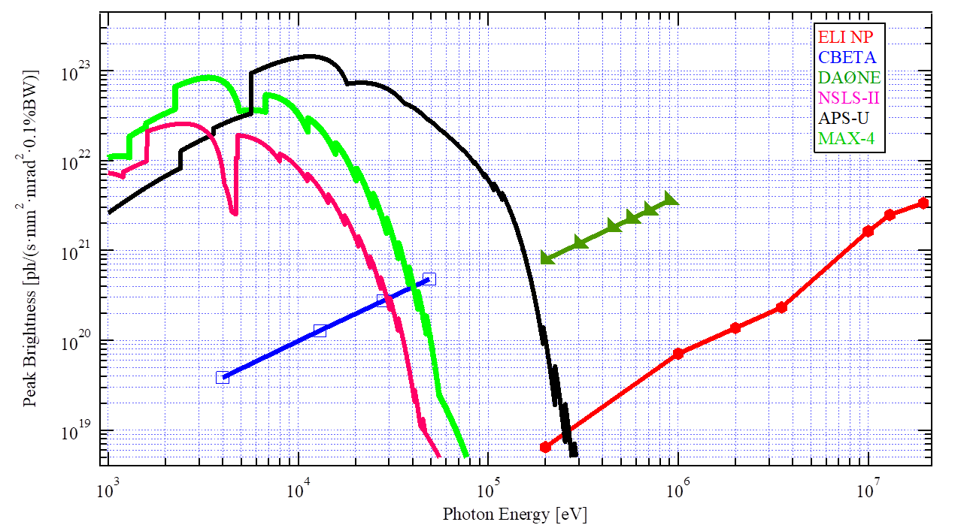
high-brilliance COMPTON LIGHT SOURCES based on CO₂ LASERs
I. Pogorelsky (ATF), M. N. Polyanskiy (ATF), T. Shaftan (NSLS II)
A new approach to synchrotron light sources with “laser undulator” where a multi-MHz solid state lasers are replaced with a multi-stage CO2 laser system operating in a pulse-burst regime at 10kHz cumulative repetition rate.
Based on concrete examples of DAΦNE and CBETA RF accelerators, they show 4-5 orders of magnitude increase in x-ray ICS peak brightness while preserving average brightness.
Such ICS sources can be used for pump-probe experiments.
5-50 ps
Multi-pass
(pulse multiplier)
The Accelerator Test Facility

