Slide 1
high-brilliance
COMPTON LIGHT SOURCES based on CO₂ LASERs
Igor Pogorelsky (ATF)
co-authors: M. N. Polyanskiy (ATF) and T. Shaftan (NSLS II)
AAC 2022
The Accelerator Test Facility

Slide 2
State of the art

Slide 3
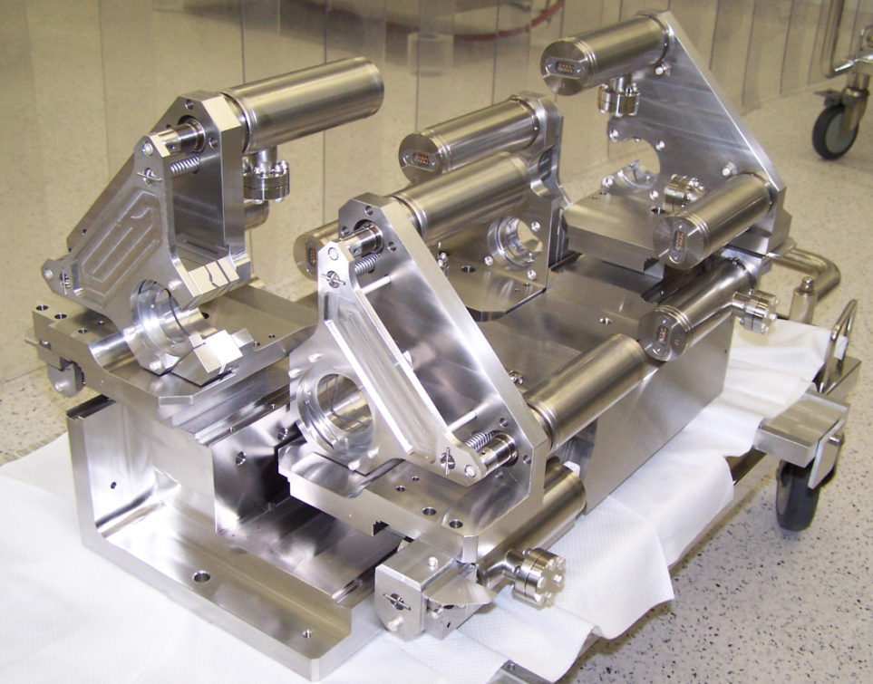
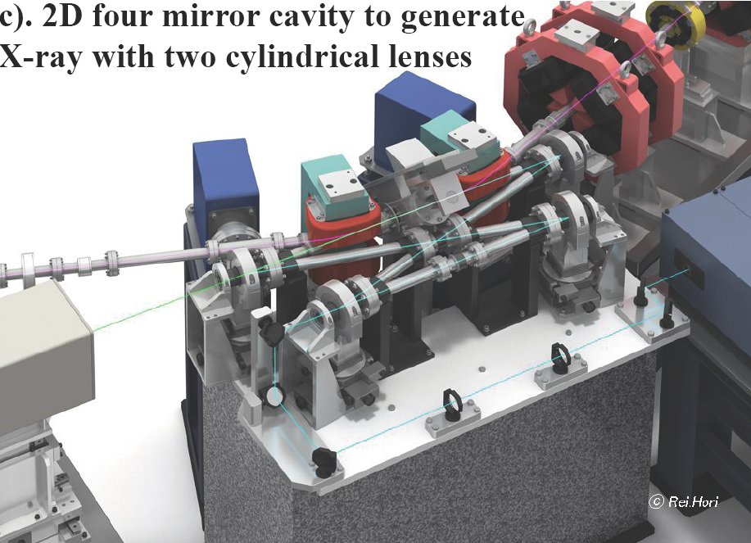
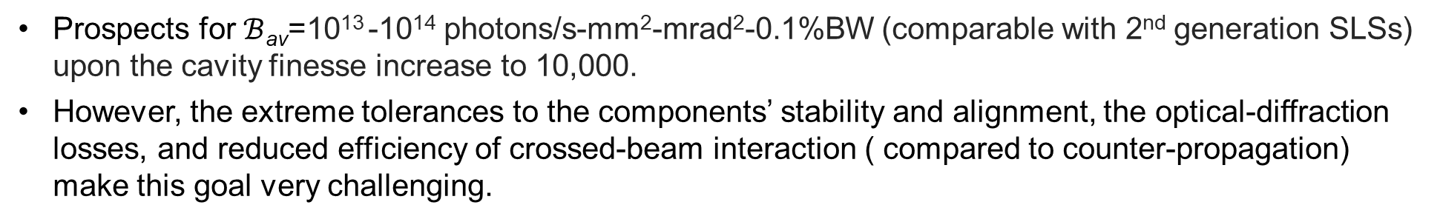
Super-cavity Compton source
Prospects for $ℬ$_{av}=10¹³ -10¹⁴ photons/s-mm²-mrad²-0.1%BW (comparable with 2nd generation SLSs) upon the cavity finesse increase to 10,000.
However, the extreme tolerances to the components’ stability and alignment, the optical-diffraction losses, and reduced efficiency of crossed-beam interaction ( compared to counter-propagation) make this goal very challenging.
Laboratoire de l’Accélérateur Linéaire
e-beam
KEK
X-rays
laser

Slide 4
Alternative approach with CO2 lasers
Currently limited to the 0.1-1 mJ energy per near-IR laser pulse circulating inside a F-P cavity single-shot x-ray yields from such ICS sources don’t exceed thousands of photons per pulse, which is usually below the requirements for pump-probe studies.
Our approach is based on Joule-class CO₂ lasers. Conventional atmospheric-pressure CO₂ lasers are not well-suited for a quasi-CW, mode-locked regime due to the narrow spectral bandwidth of the active medium. Instead, our proposed concept is based on high-pressure CO₂ laser amplifiers known to produce picosecond pulses.
CO₂ lasers can deliver high concentrations of laser photons in the laser/e-beam interaction region to produce instantaneous picosecond x-ray fluxes that exceed those attained with NIR- based ICS sources by several orders of magnitude. This makes CO₂ laser-based ICS sources better positioned for pump-probe experiments.
Admittedly, near-IR lasers provide easier access to the gamma region compared to CO₂ lasers, which operate at 9-11 μm wavelengths belonging to the LWIR spectral domain. However, the resulting shift of the ICS output towards a softer x-ray area where the major community of synchrotron radiation users is currently active has its own compelling merits.

Slide 5
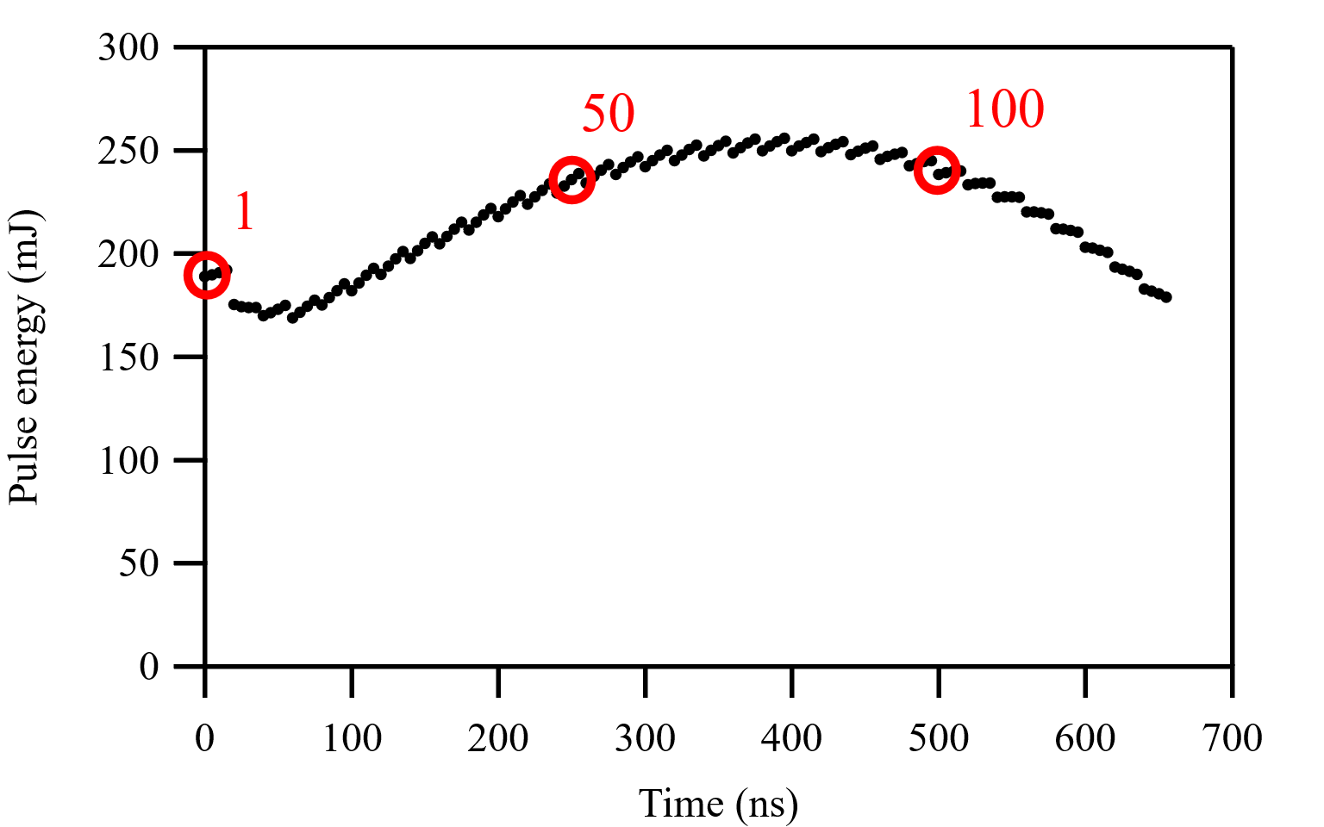
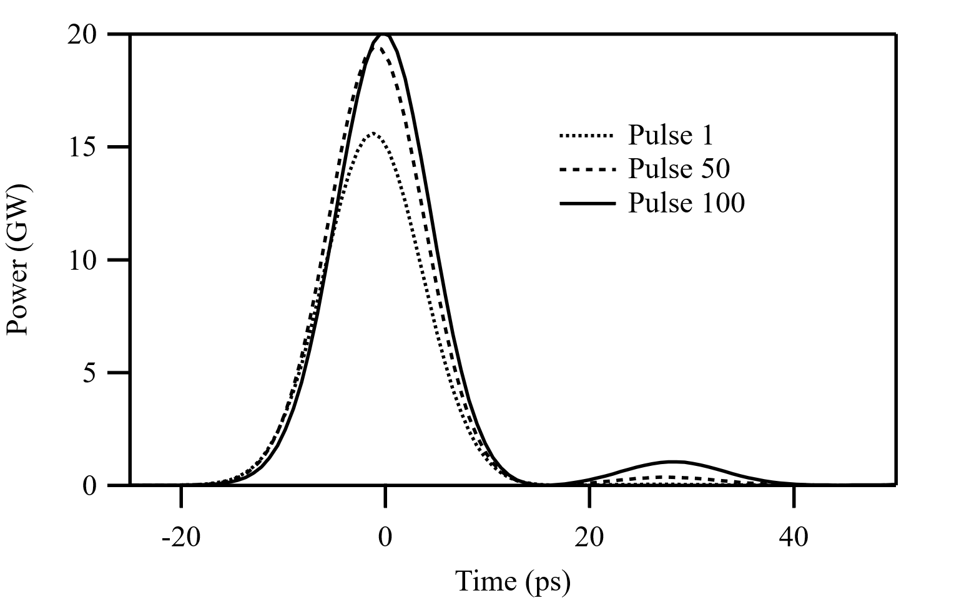
Proposed pulse-burst CO₂ laser architecture
Picosecond seed via semiconductor optical slicing.
Followed by series of high-pressure CO2 laser amplifiers.
Pulse splitting to a train of 100 pulses in a ring amplifier.
Trains of 200 mJ picosecond pulses interact in a single pass with counterpropagating synchronized e-beam.
5-50 ps
Multi-pass
(pulse multiplier)
For 150 Hz lasers, cumulative pulse repetition rate is 15 kHz.

Slide 6
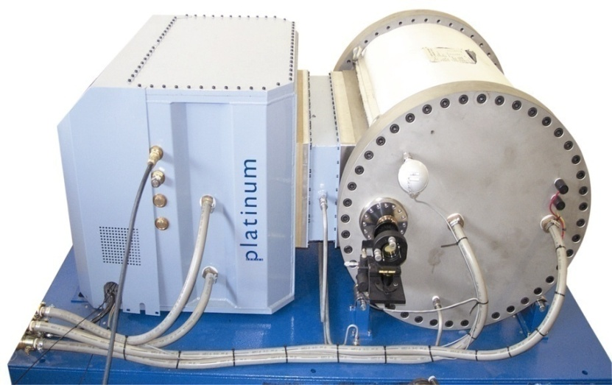
Our scheme is based on commercial lasers
Commercially available from PaR Systems (USA) high-pressure CO₂ lasers can operate at a repetition rate of up to 300 Hz. Combined with the novel approach of multiplying the repetition rate in the pulse-burst mode, which we propose here, this can bring us up to an effective repetition rate of >10 kHz.
This is still by orders of magnitude below the multi-MHz repetition rate of RF accelerators and mode-locked solid-state lasers paired to them. However, a much higher pulsed energy attainable with high-pressure CO₂ lasers, coupled with a higher photon number per unit of the laser energy, allows us to reach the same average x-ray photon intensity as an NIR FEC approach despite the difference in the repetition rate.

Slide 7
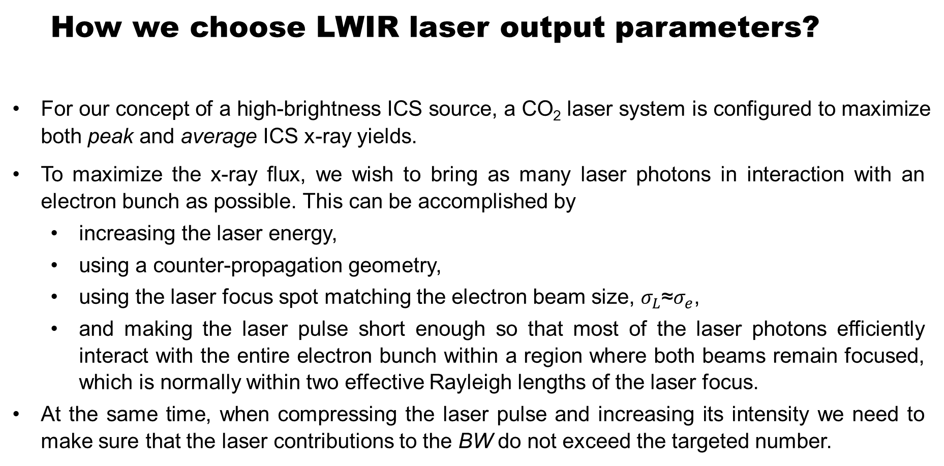
How we choose LWIR laser output parameters?
For our concept of a high-brightness ICS source, a CO₂ laser system is configured to maximize both peak and average ICS x-ray yields.
To maximize the x-ray flux, we wish to bring as many laser photons in interaction with an electron bunch as possible. This can be accomplished by
  increasing the laser energy,
  using a counter-propagation geometry,
  using the laser focus spot matching the electron beam size, $σ_{L}$≈$σ_{e}$,
  and making the laser pulse short enough so that most of the laser photons efficiently interact with the entire electron bunch within a region where both beams remain focused, which is normally within two effective Rayleigh lengths of the laser focus.
At the same time, when compressing the laser pulse and increasing its intensity we need to make sure that the laser contributions to the BW do not exceed the targeted number.

Slide 8
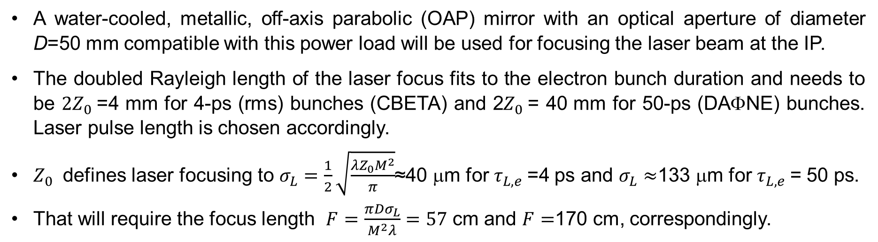
Counter-propagation geometry for maximum efficiency
A water-cooled, metallic, off-axis parabolic (OAP) mirror with an optical aperture of diameter D=50 mm compatible with this power load will be used for focusing the laser beam at the IP.
The doubled Rayleigh length of the laser focus fits to the electron bunch duration and needs to be ${2Z}_{0}$=4 mm for 4-ps (rms) bunches (CBETA) and 2$Z_{0}$= 40 mm for 50-ps (DAΦNE) bunches. Laser pulse length is chosen accordingly.
$Z_{0}$ defines laser focusing to $σ_{L}=\frac{1}{2}\sqrt{\frac{{λZ_{0}M}^{2}}{π}}$≈40 μm for $τ_{L,e}$=4 ps and $σ_{L}≈$133 μm for $τ_{L,e}$= 50 ps.
That will require the focus length $F=\frac{π{Dσ}_{L}}{M^{2}λ}=57$ cm and $F=$170 cm, correspondingly.

Slide 9


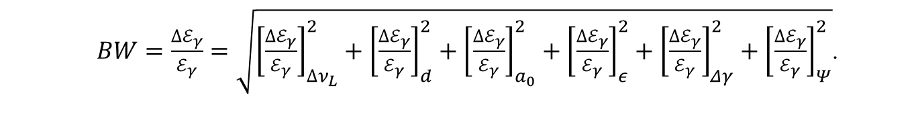

Spectral Bandwidth (BW$=\frac{{∆ℰ}_{γ}}{ℰ_{γ}}$)
Monochromaticity is an important capability of ICS sources. Several factors can contribute to the spectrum smearing on top of the ideal $θ$ angle dependence factored into .
Main contributions to the total x-ray relative energy spread or bandwidth, $BW ,$imposed by the laser:
Laser natural bandwidth for a transform limited Gaussian pulse ${\left[\frac{{∆ℰ}_{γ}}{ℰ_{γ}}\right]}_{∆ν_{L}}≈\frac{λ}{2τ_{L}c}$
Laser’s natural divergence or diffraction ${\left[\frac{{∆ℰ}_{γ}}{ℰ_{γ}}\right]}_{d}={\left[\frac{M^{2}λ}{4πσ_{L}}\right]}^{2}$
“Red shift” , ${\left[\frac{{∆ℰ}_{γ}}{ℰ_{γ}}\right]}_{a_{0}}=\frac{{a_{0}^{2}}/3}{1+{a_{0}^{2}}/2}≈{a_{0}^{2}}/3$
……and by electron beam’s:
4. Normalized emittance $ε_{n}, {\left[\frac{{∆ℰ}_{γ}}{ℰ_{γ}}\right]}_{ε}={\left[\frac{ε_{n}}{σ_{e}}\right]}^{2}.$
5. Energy spread ${\left[\frac{{∆ℰ}_{γ}}{ℰ_{γ}}\right]}_{Δγ}=\frac{2Δγ}{γ}.$
$ℰ_{γ}≈4γ^{2}ℰ_{L}/\left[1+γ^{2}θ^{2}\right]$
Accelerator Contribution Laser λ | CBETA |  | DAFNE
 | 1.06 mm | 9.2 mm | 1.06 mm | 9.2 mm
Electron emittance | 1% |  | 0.5%
Electron energy spread | 0.1% |  | 0.12%
Laser band | <0.1% | 0.3% | <0.1%
Laser diffraction | <0.1% | <0.1% | <0.1%
Laser strength | <0.1% | 0.2% | <0.1%
Above combined | 1% | 1.07% | 0.6%
Acceptance | 1% | 0.9% | 0.6%
Total BW | 1.4% | 1.4% | 0.85%
$BW=\frac{{∆ℰ}_{γ}}{ℰ_{γ}}=\sqrt{{\left[\frac{{∆ℰ}_{γ}}{ℰ_{γ}}\right]}_{∆ν_{L}}^{2}+{\left[\frac{{∆ℰ}_{γ}}{ℰ_{γ}}\right]}_{d}^{2}+{\left[\frac{{∆ℰ}_{γ}}{ℰ_{γ}}\right]}_{a_{0}}^{2}+{\left[\frac{{∆ℰ}_{γ}}{ℰ_{γ}}\right]}_{ε}^{2}+{\left[\frac{{∆ℰ}_{γ}}{ℰ_{γ}}\right]}_{Δγ}^{2}+{\left[\frac{{∆ℰ}_{γ}}{ℰ_{γ}}\right]}_{Ψ}^{2}}$.

Slide 10
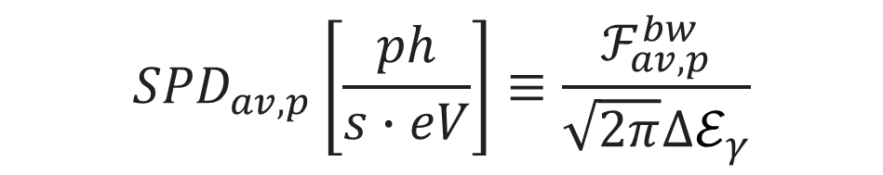
essential expressions
γ photons per shot
Intensity (peak and average)
Photons in 0.1% BW
Intensity in 0.1% BW
Brightness or brilliance
$${SPD}_{av,p}\left[\frac{ph}{s∙eV}\right]≡\frac{ℱ_{av,p}^{bw}}{\sqrt{2π}∆ℰ_{γ}}$$
Spectral density

Slide 11
Parameters of ICS sources based on CBETA and DAΦNE electron accelerators driven by Nd:YAG or CO₂ lasers
Facing a diversity of potential requirements for future ICS applications, we offer here a comprehensive performance characterization for ICS sources based on concrete examples of circular accelerators, including DAΦNE (synchrotron) and CBETA (S-ERL) paired to either an NIR solid-state laser or an LWIR CO₂ gas laser.
Due to high laser energy per pulse, combined with order-of-magnitude higher number of laser photons per Joule of laser energy, LWIR approach allows us to increase the x-ray peak flux and brilliance by four orders of magnitude while maintaining essentially the same average brilliance.

Slide 12
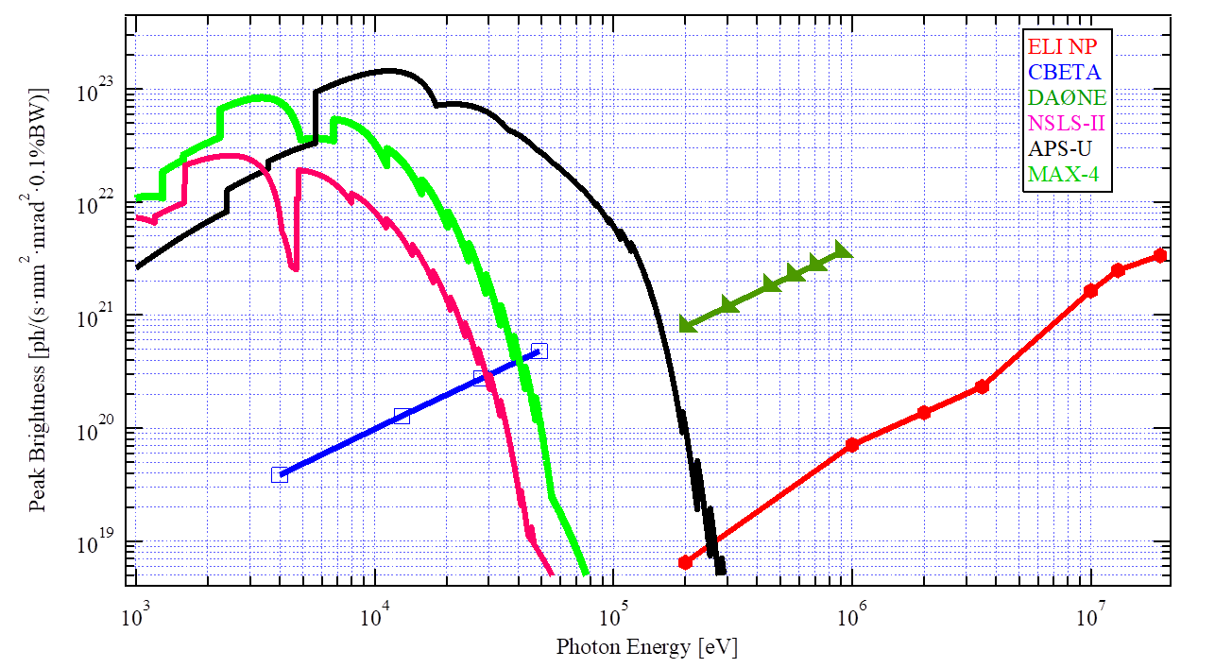
Positioning ICS sources CBETA-9μm and DAΦNE-9μm in terms of their peak brightness compared to 3rd generation SLSs and ELI-NP.
The x-ray brightness is usually the main parameter used to characterize and compare different light sources. Therefore, it is instructive to compare existing and emerging light sources by this parameter.
We see that with peak brightness 10²⁰-10²¹ in hard x-rays range the proposed sources are comparable or exceed the capabilities of contemporary synchrotron light sources (SLSs) and complement the ELI facility.
They will be about 100 times smaller in footprint compared to those synchrotron sources.

Slide 13
Utility
In addition to the typical applications attained with 3rd generation SLSs, the CBETA 50-keV x-ray source can be used for time-resolved studies where high-repetition machines are difficult to fit. These applications, more typical for 4th generation coherent SLSs, include:
  Dynamic molecular reaction microscopes
  Time-resolved photoemission and absorption spectroscopy
  Time-resolved resonant inelastic x-ray scattering
  X-ray photon correlation spectroscopy
  Time-resolved x-ray scattering
  Pump/probe experiments
  Additive manufacturing
DAΦNE ICS source will offer extended spectral coverage into the gamma range, up to 900 keV, where it can be compared in the peak brightness and repetition rate only to the Extreme Light Infrastructure Nuclear Physics (ELI-NP) facility.
Similar to ELI-NP, with the proposed DAΦNE ICS, researchers will be able to investigate fundamental problems and applications in the field of nuclear physics, such as the study of photonuclear processes using tunable energy, high resolution γ-ray beams.

Slide 14
Conclusions
We introduced a concept of using bursts of LWIR laser pulses for building high peak brightness ICS sources based on existing RF electron accelerators.
To realize this concept, we proposed a new architecture of LWIR laser based on available and emerging CO₂ gas laser technology.
As examples, we elaborated here on ICS source design parameters of the DAΦNE and CBETA electron accelerators, which have been considered for conversion into x-ray and gamma-ray user facilities.
Overall, the desired x-ray and γ-ray energy is case-specific with the spectral coverage spanning several decades, which cannot be satisfied with a single source. Therefore, a variety of different kinds of ICS sources based on the combined capabilities of ring-based and linac-based machines, as well as different laser drivers, will be needed to provide a sufficiently broad range of characteristics required to meet current user requirements and future challenges.

Slide 15
Thank you!
Further reading:
“Converting conventional electron accelerators to high peak brilliance Compton light sources”, PRAB v.23, p.120702 (2020)

Slide 16
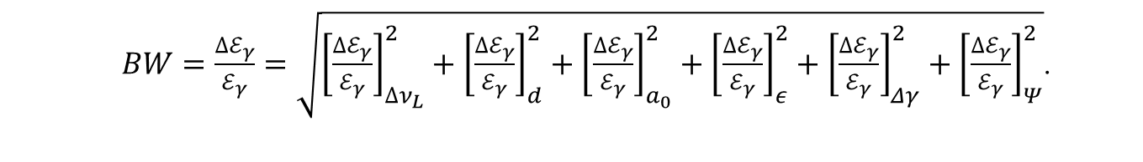
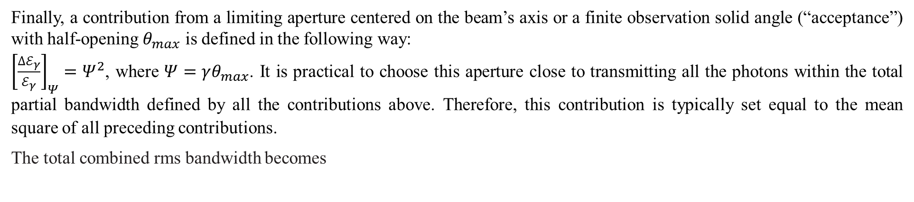
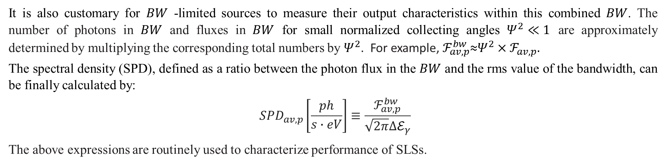
Finally, a contribution from a limiting aperture centered on the beam’s axis or a finite observation solid angle (“acceptance”) with half-opening $θ_{max}$ is defined in the following way:
${\left[\frac{{∆ℰ}_{γ}}{ℰ_{γ}}\right]}_{Ψ}=Ψ^{2}$, where $Ψ=γθ_{max}$. It is practical to choose this aperture close to transmitting all the photons within the total partial bandwidth defined by all the contributions above. Therefore, this contribution is typically set equal to the mean square of all preceding contributions.
The total combined rms bandwidth becomes
$BW=\frac{{∆ℰ}_{γ}}{ℰ_{γ}}=\sqrt{{\left[\frac{{∆ℰ}_{γ}}{ℰ_{γ}}\right]}_{∆ν_{L}}^{2}+{\left[\frac{{∆ℰ}_{γ}}{ℰ_{γ}}\right]}_{d}^{2}+{\left[\frac{{∆ℰ}_{γ}}{ℰ_{γ}}\right]}_{a_{0}}^{2}+{\left[\frac{{∆ℰ}_{γ}}{ℰ_{γ}}\right]}_{ε}^{2}+{\left[\frac{{∆ℰ}_{γ}}{ℰ_{γ}}\right]}_{Δγ}^{2}+{\left[\frac{{∆ℰ}_{γ}}{ℰ_{γ}}\right]}_{Ψ}^{2}}$.
It is also customary for $BW$ -limited sources to measure their output characteristics within this combined $BW$. The number of photons in $BW$ and fluxes in $BW$ for small normalized collecting angles $Ψ^{2}≪1$ are approximately determined by multiplying the corresponding total numbers by $Ψ^{2}$. For example, $ℱ_{av,p}^{bw}$≈$Ψ^{2}×ℱ_{av,p}$.
The spectral density (SPD), defined as a ratio between the photon flux in the $BW$ and the rms value of the bandwidth, can be finally calculated by:
$${SPD}_{av,p}\left[\frac{ph}{s∙eV}\right]≡\frac{ℱ_{av,p}^{bw}}{\sqrt{2π}∆ℰ_{γ}}$$
The above expressions are routinely used to characterize performance of SLSs.

