Slide 1
The Ion Channel Laser: Physics Advances and Experimental Plans
Claire Hansel^{1,*}, Jacob Pierce², Christopher Doss¹, Valentina Lee¹, Zhirong Huang^{3,4}, Mark Hogan³, Warren Mori², Michael Litos¹
¹University of Colorado Boulder
2University of California Los Angeles
3SLAC National Accelerator Laboratory
4Stanford University
*claire.hansel@colorado.edu

Slide 2
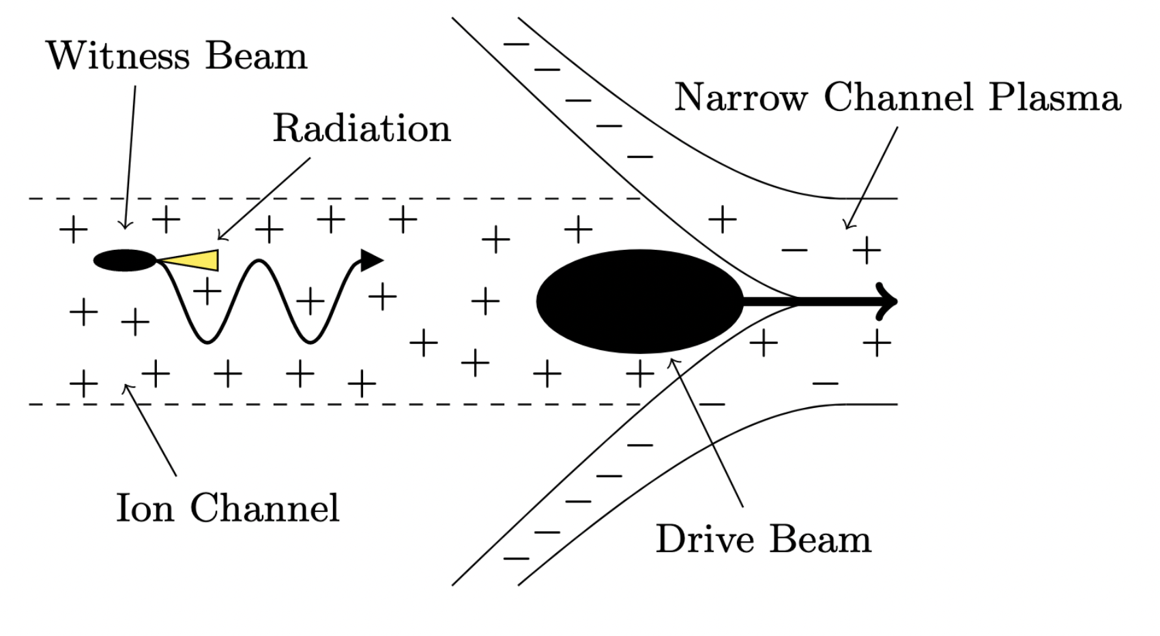
What is an Ion Channel Laser?
Similar to the FEL, but the magnetic undulator is replaced with the uniform ion channel inside a blowout regime plasma bubble.
ICL Betatron wavelength $λ_{β}$ analogous to FEL undulator period $λ_{u}$.
ICL physics is broadly similar to FEL physics, but many subtle and important differences exist.
Can lase in extremely short distances (meter or less) and with large energy spread (a few percent).
1

Slide 3
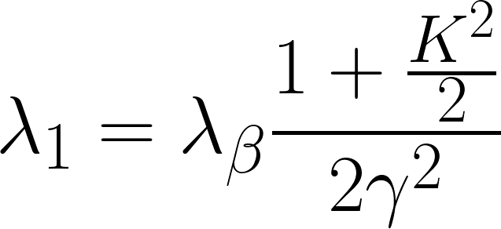
What is an Ion Channel Laser?
Similar to the FEL, but the magnetic undulator is replaced with the uniform ion channel inside a blowout regime plasma bubble.
ICL Betatron wavelength $λ_{β}$ analogous to FEL undulator period $λ_{u}$.
ICL physics is broadly similar to FEL physics, but many subtle and important differences exist.
Can lase in extremely short distances (meter or less) and with large energy spread (a few percent).
Resonance Condition
1

Slide 4
What is an Ion Channel Laser?
Similar to the FEL, but the magnetic undulator is replaced with the uniform ion channel inside a blowout regime plasma bubble.
ICL Betatron wavelength $λ_{β}$ analogous to FEL undulator period $λ_{u}$.
ICL physics is broadly similar to FEL physics, but many subtle and important differences exist.
Can lase in extremely short distances (meter or less) and with large energy spread (a few percent).
Resonance Condition
1

Slide 5
What is an Ion Channel Laser?
Similar to the FEL, but the magnetic undulator is replaced with the uniform ion channel inside a blowout regime plasma bubble.
ICL Betatron wavelength $λ_{β}$ analogous to FEL undulator period $λ_{u}$.
ICL physics is broadly similar to FEL physics, but many subtle and important differences exist.
Can lase in extremely short distances (meter or less) and with large energy spread (a few percent).
Resonance Condition
1

Slide 6
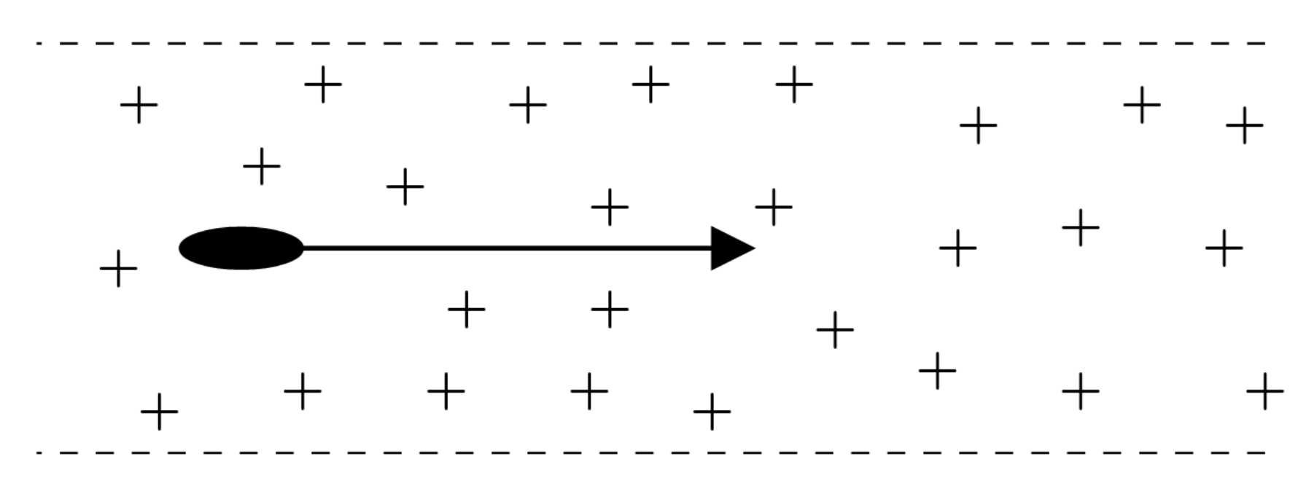
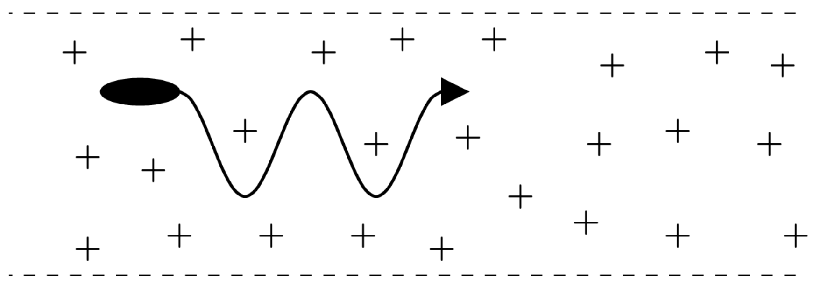
On-Axis vs Off-Axis
Original proposal (Whittum et al. 1990) and most literature considers on axis beam with small divergence.
This case requires an impractically small emittance (Ersfeld et al. 2014).
Off axis case is still feasible!
Large gaps in the literature. Only two peer reviewed papers published entirely on the off-axis ICL (Ersfeld et al. 2014, Davoine et al. 2018).
On-Axis ICL
Off-Axis ICL
2

Slide 7
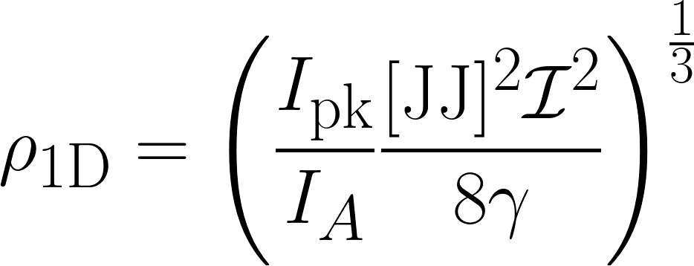
Effects of Strong Focusing
Strong ion channel focusing → Small beam/radiation interaction area → Pierce parameter $ρ$ at least an order of magnitude larger than in an FEL.
Consequence 1: Can lase with few energy spread beams (such as from LWFA).
Consequence 2: Extremely short gain length.
Consequence 3: Diffraction effects significant.
Other Consequences: Short cooperation length, special physics for $ρ≳0.2$, larger radiation bandwidth, spacecharge effects more significant.
3

Slide 8
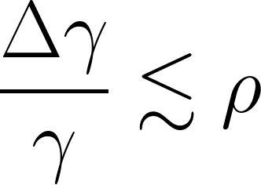
Effects of Strong Focusing
Strong ion channel focusing → Small beam/radiation interaction area → Pierce parameter $ρ$ at least an order of magnitude larger than in an FEL.
Consequence 1: Can lase with few energy spread beams (such as from LWFA).
Consequence 2: Extremely short gain length.
Consequence 3: Diffraction effects significant.
Other Consequences: Short cooperation length, special physics for $ρ≳0.2$, larger radiation bandwidth, spacecharge effects more significant.
3

Slide 9
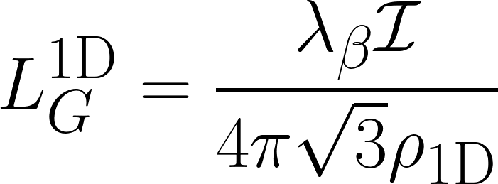
Effects of Strong Focusing
Strong ion channel focusing → Small beam/radiation interaction area → Pierce parameter $ρ$ at least an order of magnitude larger than in an FEL.
Consequence 1: Can lase with few energy spread beams (such as from LWFA).
Consequence 2: Extremely short gain length.
Consequence 3: Diffraction effects significant.
Other Consequences: Short cooperation length, special physics for $ρ≳0.2$, larger radiation bandwidth, spacecharge effects more significant.
3

Slide 10
Effects of Strong Focusing
Strong ion channel focusing → Small beam/radiation interaction area → Pierce parameter $ρ$ at least an order of magnitude larger than in an FEL.
Consequence 1: Can lase with few energy spread beams (such as from LWFA).
Consequence 2: Extremely short gain length.
Consequence 3: Diffraction effects significant.
Other Consequences: Short cooperation length, special physics for $ρ≳0.2$, larger radiation bandwidth, spacecharge effects more significant.
3

Slide 11
Effects of Strong Focusing
Strong ion channel focusing → Small beam/radiation interaction area → Pierce parameter $ρ$ at least an order of magnitude larger than in an FEL.
Consequence 1: Can lase with few energy spread beams (such as from LWFA).
Consequence 2: Extremely short gain length.
Consequence 3: Diffraction effects significant.
Other Consequences: Short cooperation length, special physics for $ρ≳0.2$, larger radiation bandwidth, spacecharge effects more significant.
3

Slide 12
Diffraction
ICL gain length always longer than the Rayleigh length.
Small ${L_{G}^{1D}}/{z_{R}}$ ideal but not required for lasing.
Power increase via gain is exponential $P∼e^{z/{L_{G}}}$
Power loss via diffraction is inverse quadratic $P∼{\left(1+(z/z_{R})^{2}\right)}^{-1}$.
Theory and simulations show ICL feasibility despite diffraction (Davoine et al. 2018).
4

Slide 13
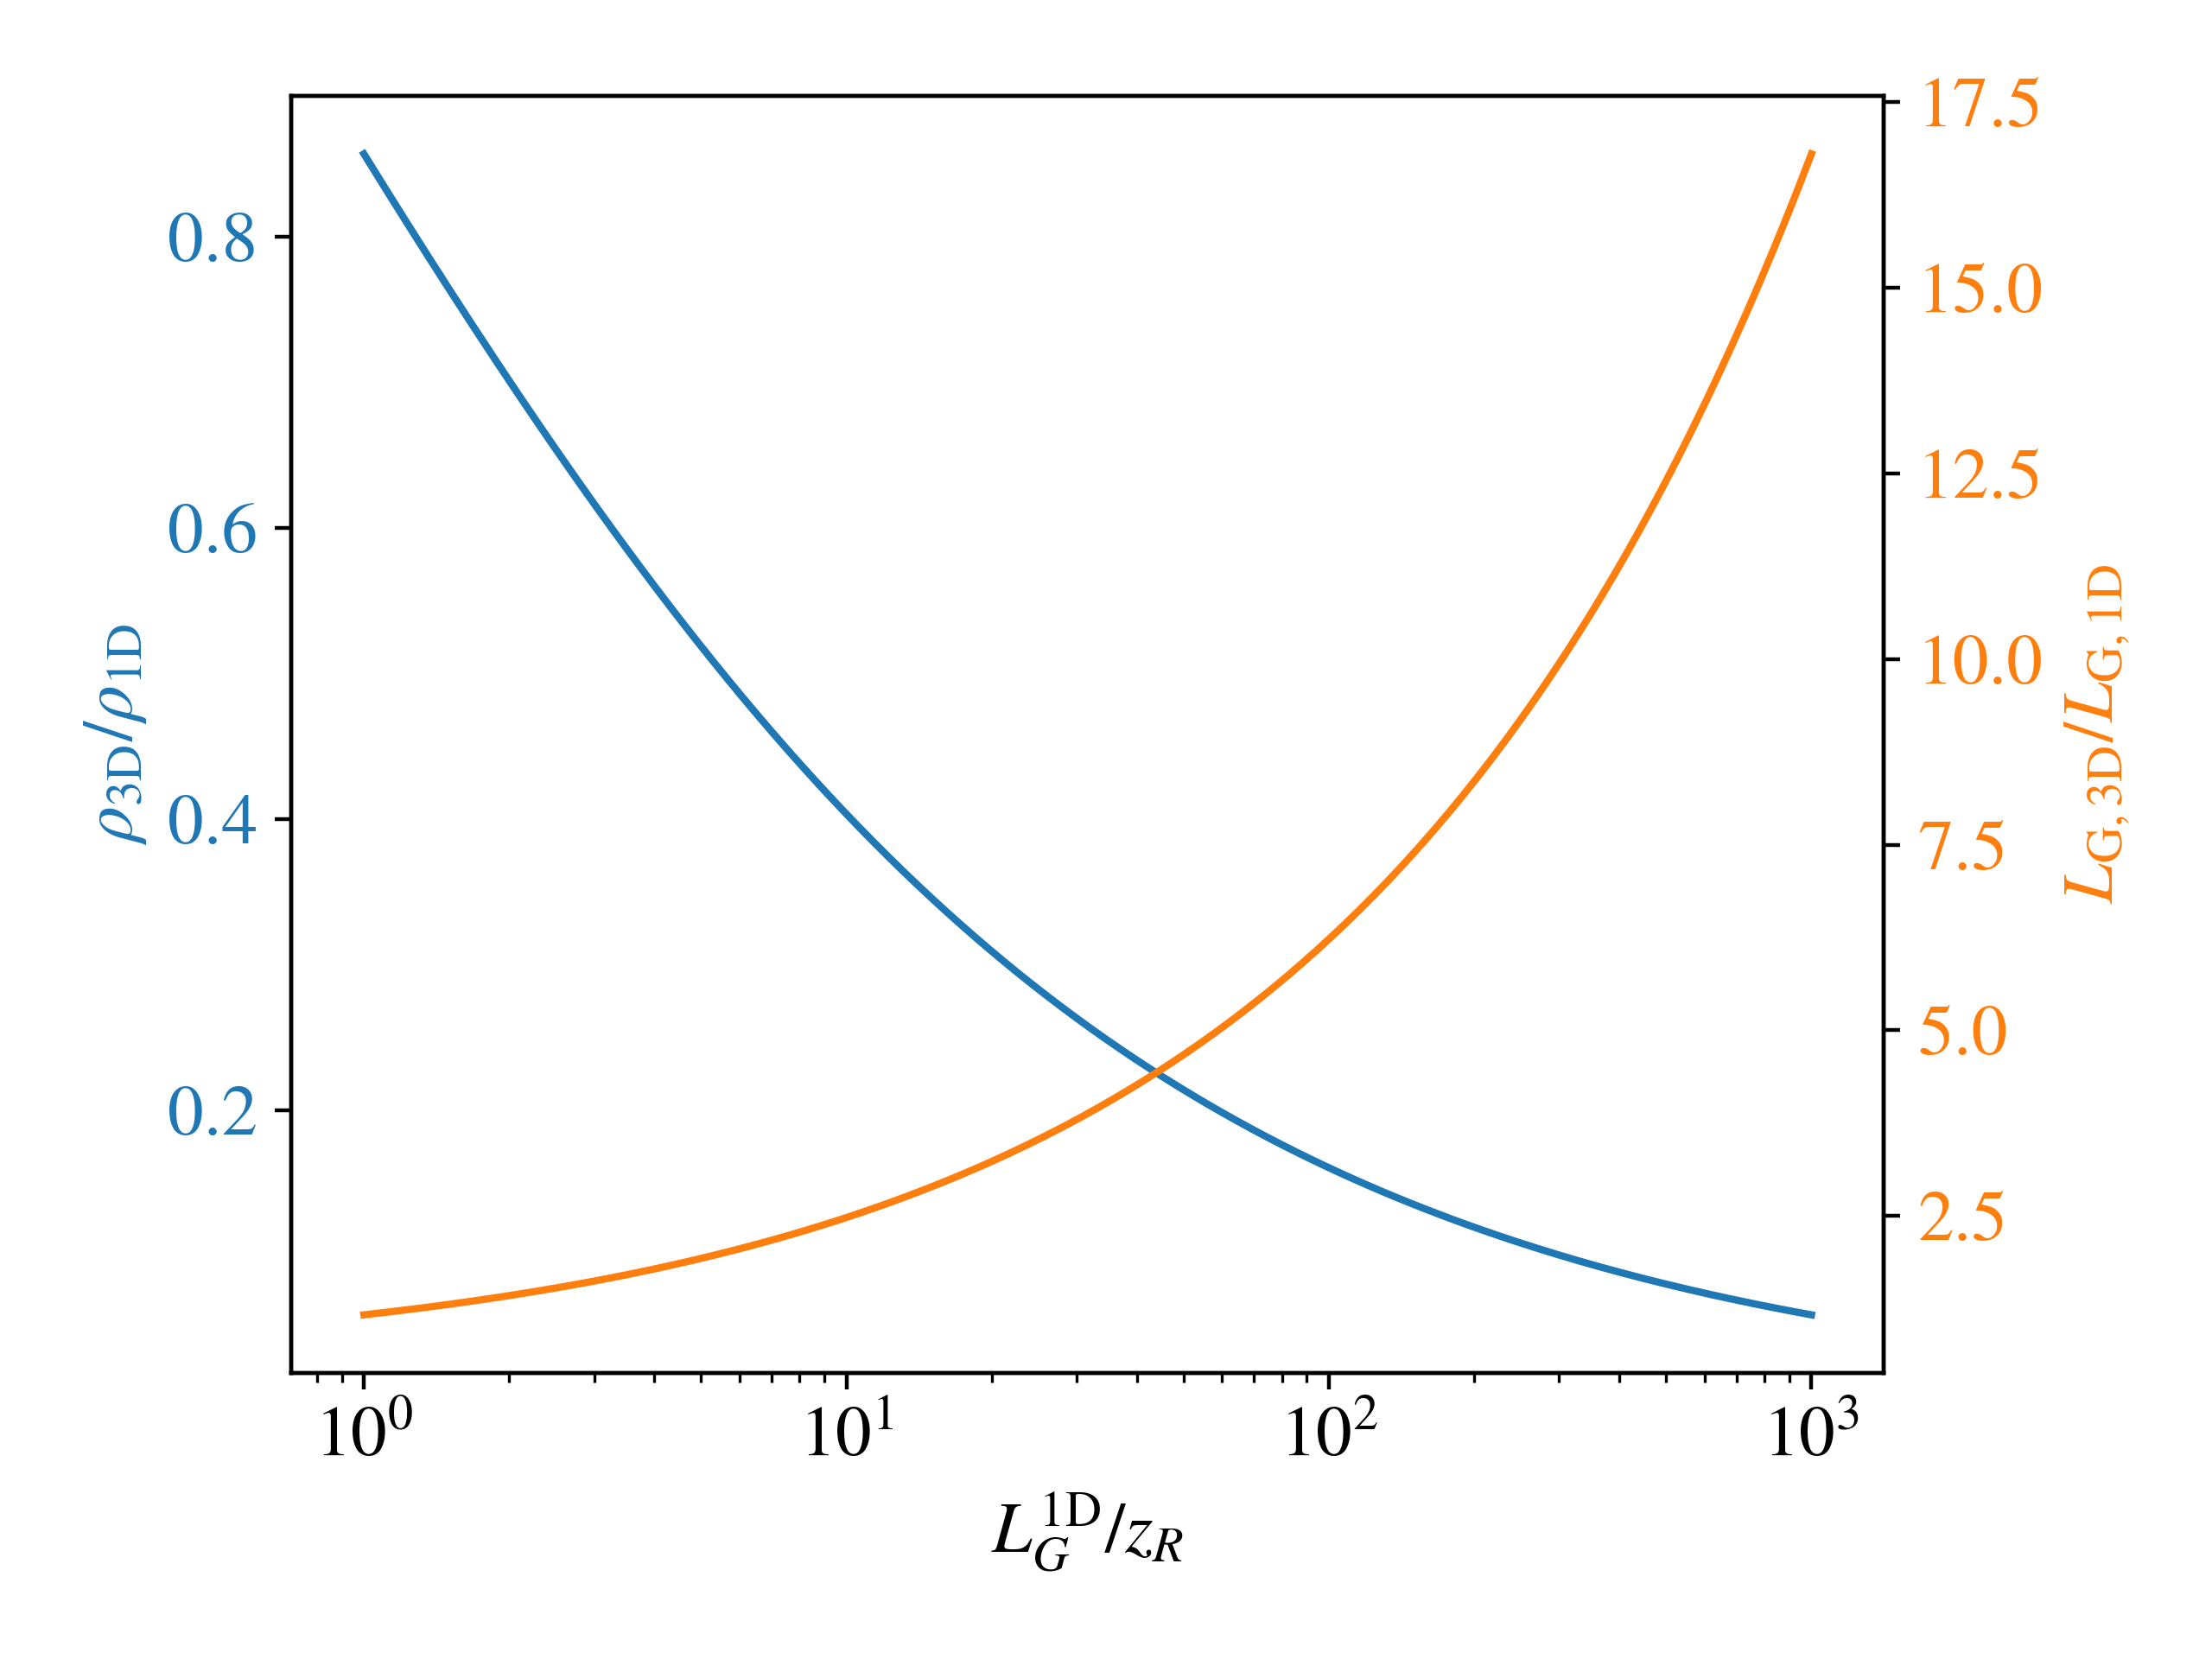
Diffraction
ICL gain length always longer than the Rayleigh length.
Small ${L_{G}^{1D}}/{z_{R}}$ ideal but not required for lasing.
Power increase via gain is exponential $P∼e^{z/{L_{G}}}$
Power loss via diffraction is inverse quadratic $P∼{\left(1+(z/z_{R})^{2}\right)}^{-1}$.
Theory and simulations show ICL feasibility despite diffraction (Davoine et al. 2018).
4

Slide 14
Diffraction
ICL gain length always longer than the Rayleigh length.
Small ${L_{G}^{1D}}/{z_{R}}$ ideal but not required for lasing.
Power increase via gain is exponential $P∼e^{z/{L_{G}}}$
Power loss via diffraction is inverse quadratic $P∼{\left(1+(z/z_{R})^{2}\right)}^{-1}$.
Theory and simulations show ICL feasibility despite diffraction (Davoine et al. 2018).
4

Slide 15
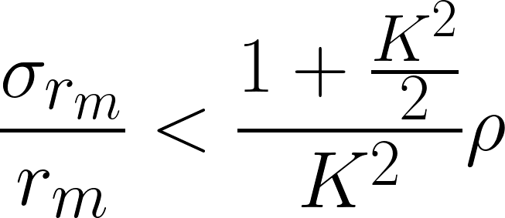
Electric vs Magnetic Fields
ICL uses linear electric field, FEL uses period magnetic field.
Two particles enter at different transverse positions
FEL: same oscillation amplitude → same $K$ → same resonant wavelength $λ$.
ICL: different oscillation amplitudes → different $K$s → different resonant wavelengths $λ$.
Resonant wavelength spread constraint $σ_{λ}/λ<ρ$ implies constraint on maximum transverse oscillation amplitude $r_{m}$
This is the most stringent condition for lasing in an ICL!
5

Slide 16
Electric vs Magnetic Fields
ICL uses linear electric field, FEL uses period magnetic field.
Two particles enter at different transverse positions
FEL: same oscillation amplitude → same $K$ → same resonant wavelength $λ$.
ICL: different oscillation amplitudes → different $K$s → different resonant wavelengths $λ$.
Resonant wavelength spread constraint $σ_{λ}/λ<ρ$ implies constraint on maximum transverse oscillation amplitude $r_{m}$
This is the most stringent condition for lasing in an ICL!
FEL
ICL
5

Slide 17
Electric vs Magnetic Fields
ICL uses linear electric field, FEL uses period magnetic field.
Two particles enter at different transverse positions
FEL: same oscillation amplitude → same $K$ → same resonant wavelength $λ$.
ICL: different oscillation amplitudes → different $K$s → different resonant wavelengths $λ$.
Resonant wavelength spread constraint $σ_{λ}/λ<ρ$ implies constraint on maximum transverse oscillation amplitude $r_{m}$
This is the most stringent condition for lasing in an ICL!
FEL
ICL
5

Slide 18
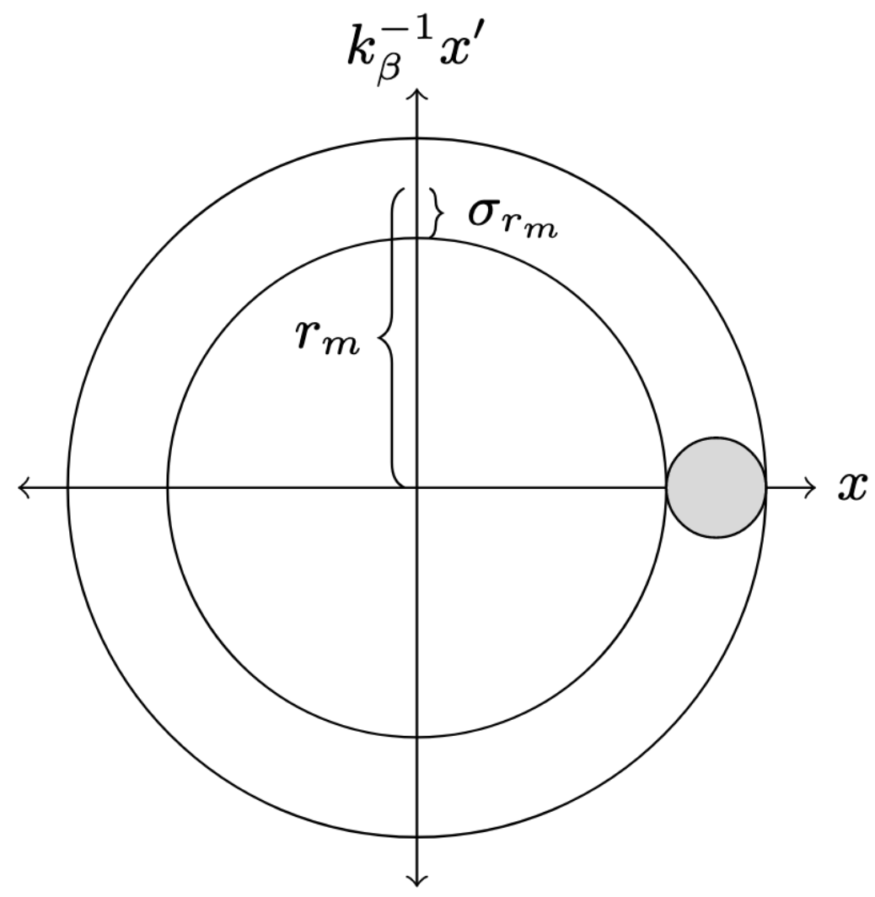
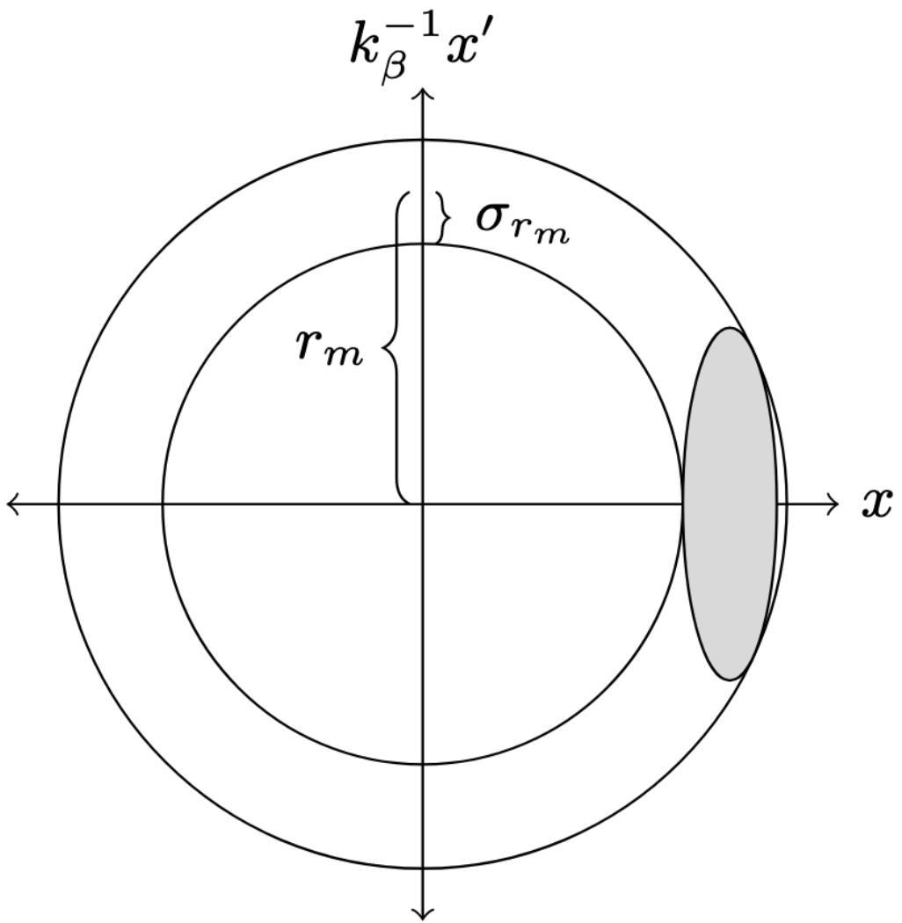
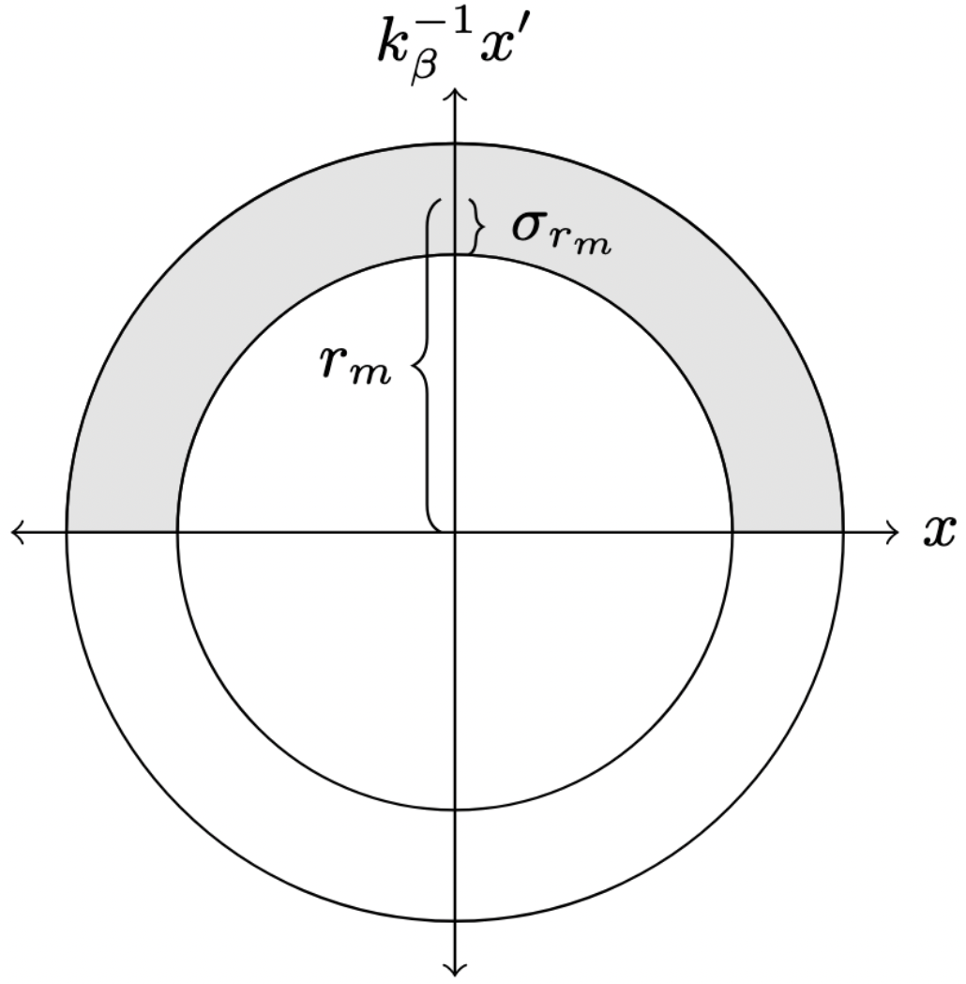
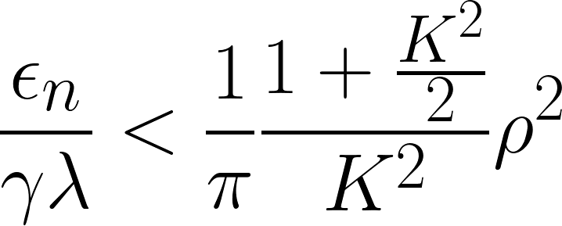
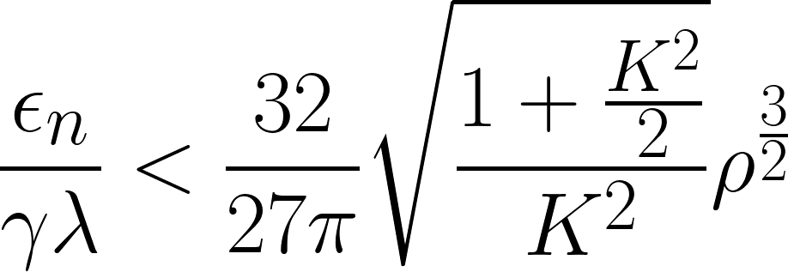
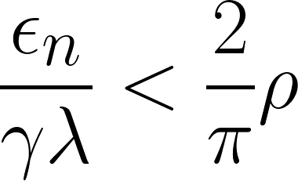
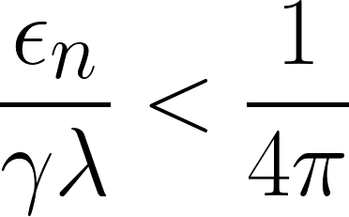
Phase Space Shaping
Type | FEL | Matched ICL | Optimally Overfocused ICL | “Half-Annulus” ICL
Phase Space
Emittance Constraint
λ = 1 nm, E = 10 GeV ρ = 0.05, K = 2
6

Slide 19
Phase Space Shaping
Type | FEL | Matched ICL | Optimally Overfocused ICL | “Half-Annulus” ICL
Phase Space
Emittance Constraint
λ = 1 nm, E = 10 GeV ρ = 0.05, K = 2
6

Slide 20
Phase Space Shaping
Type | FEL | Matched ICL | Optimally Overfocused ICL | “Half-Annulus” ICL
Phase Space
Emittance Constraint
λ = 1 nm, E = 10 GeV ρ = 0.05, K = 2
6

Slide 21
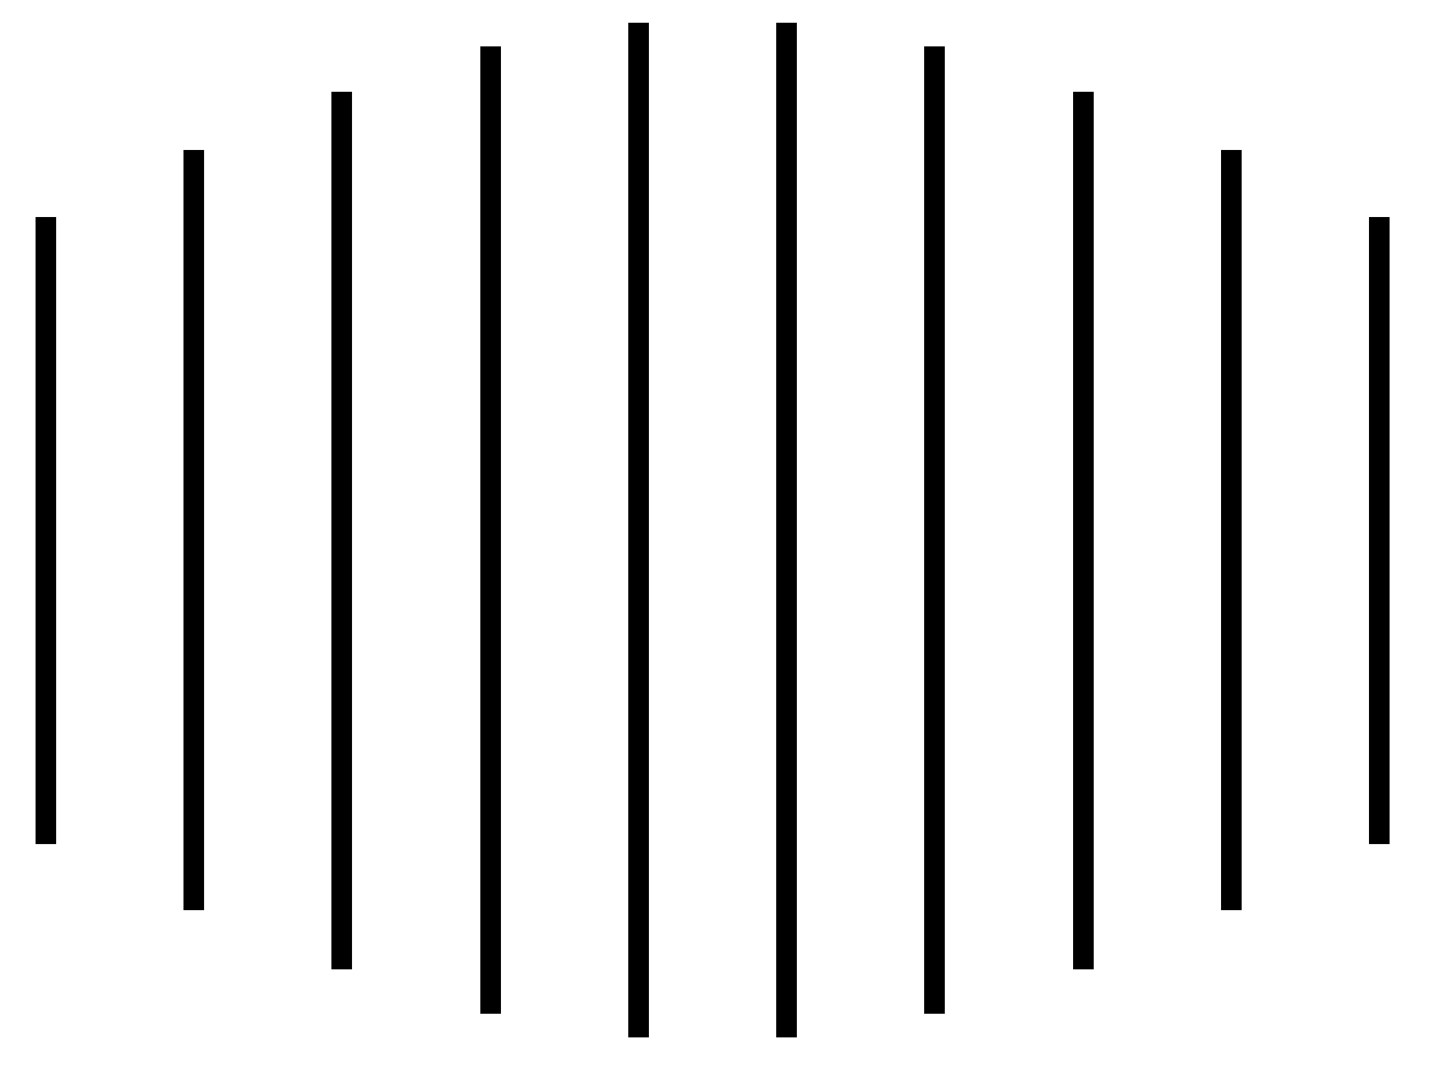
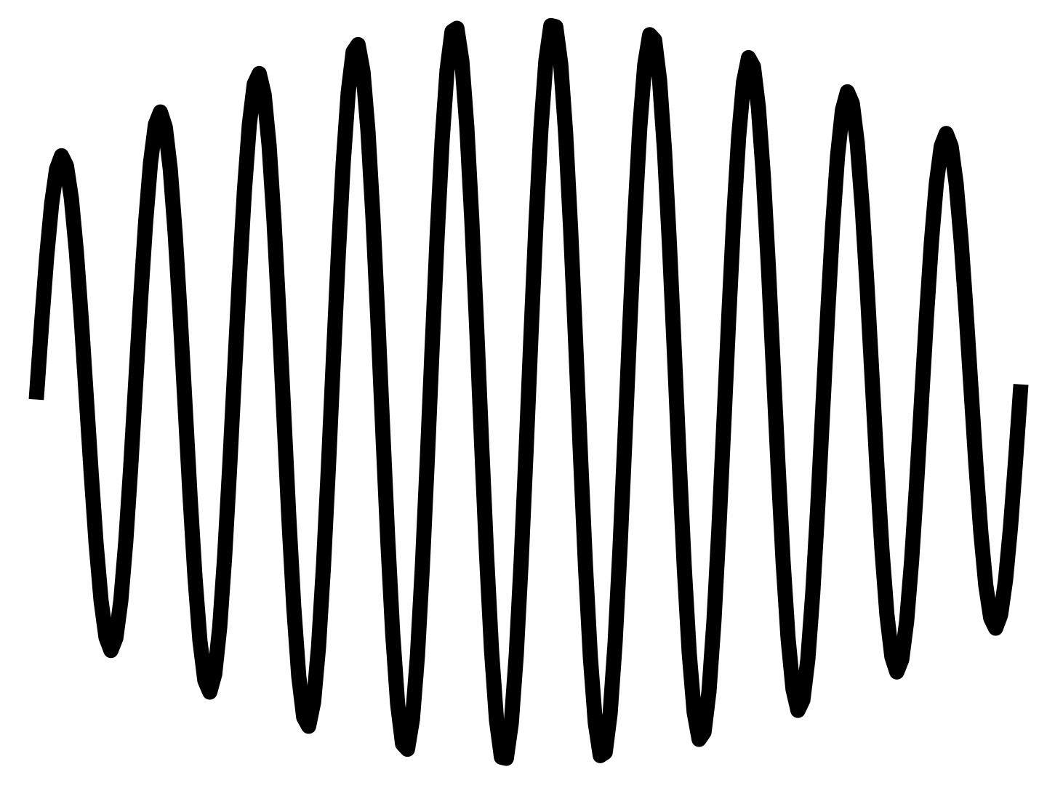
Miscellanea
ICL does not microbunch, it “microsnakes”.
Spacecharge effects are more significant in the ICL.
It may be possible to have the witness beam gently accelerate to replenish the energy lost to radiation.
ICLs are capable of producing linear, circular, or elliptically polarized light.
Microbunching
Microsnaking
7

Slide 22
Miscellanea
ICL does not microbunch, it “microsnakes”.
Spacecharge effects are more significant in the ICL.
It may be possible to have the witness beam gently accelerate to replenish the energy lost to radiation.
ICLs are capable of producing linear, circular, or elliptically polarized light.
Microbunching
Microsnaking
7

Slide 23
Miscellanea
ICL does not microbunch, it “microsnakes”.
Spacecharge effects are more significant in the ICL.
It may be possible to have the witness beam gently accelerate to replenish the energy lost to radiation.
ICLs are capable of producing linear, circular, or elliptically polarized light.
Microbunching
Microsnaking
7

Slide 24
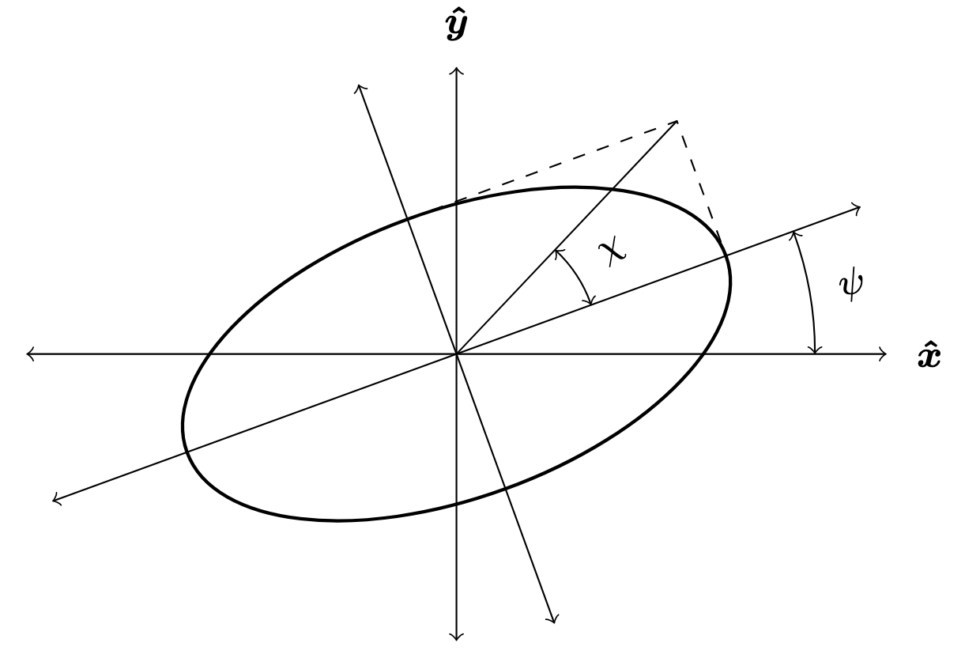
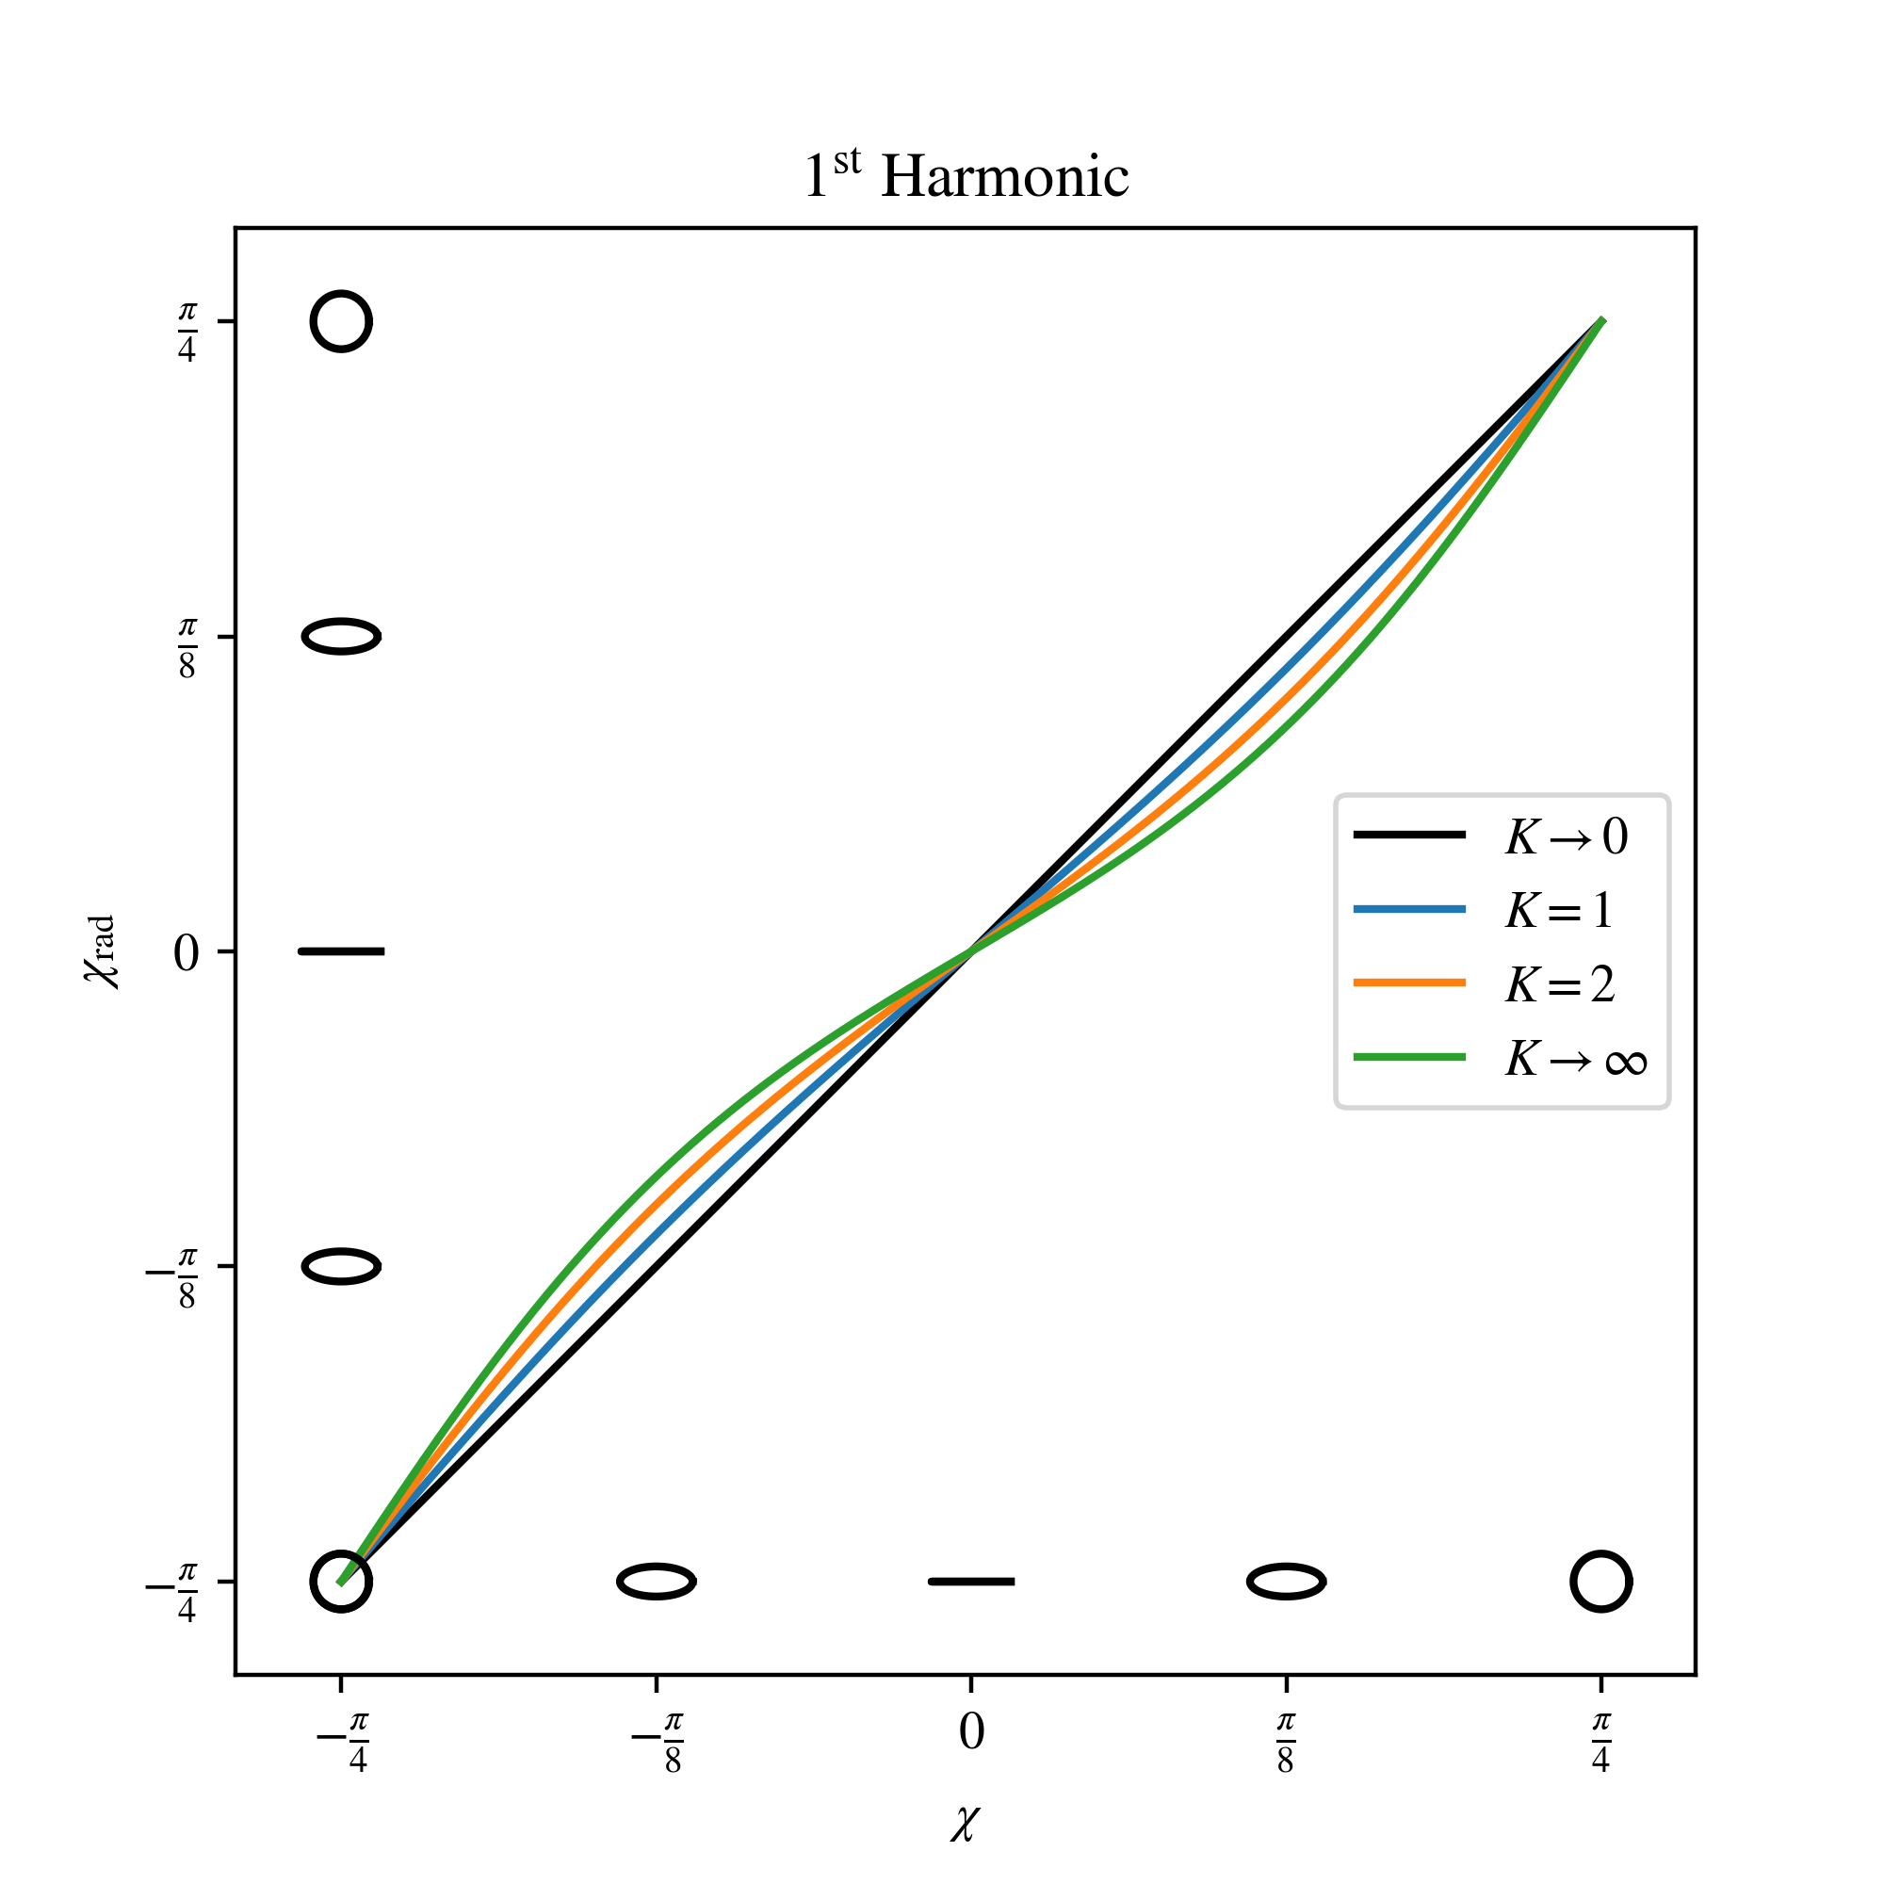
Miscellanea
ICL does not microbunch, it “microsnakes”.
Spacecharge effects are more significant in the ICL.
It may be possible to have the witness beam gently accelerate to replenish the energy lost to radiation.
ICLs are capable of producing linear, circular, or elliptically polarized light.
Microbunching
Microsnaking
7

Slide 25
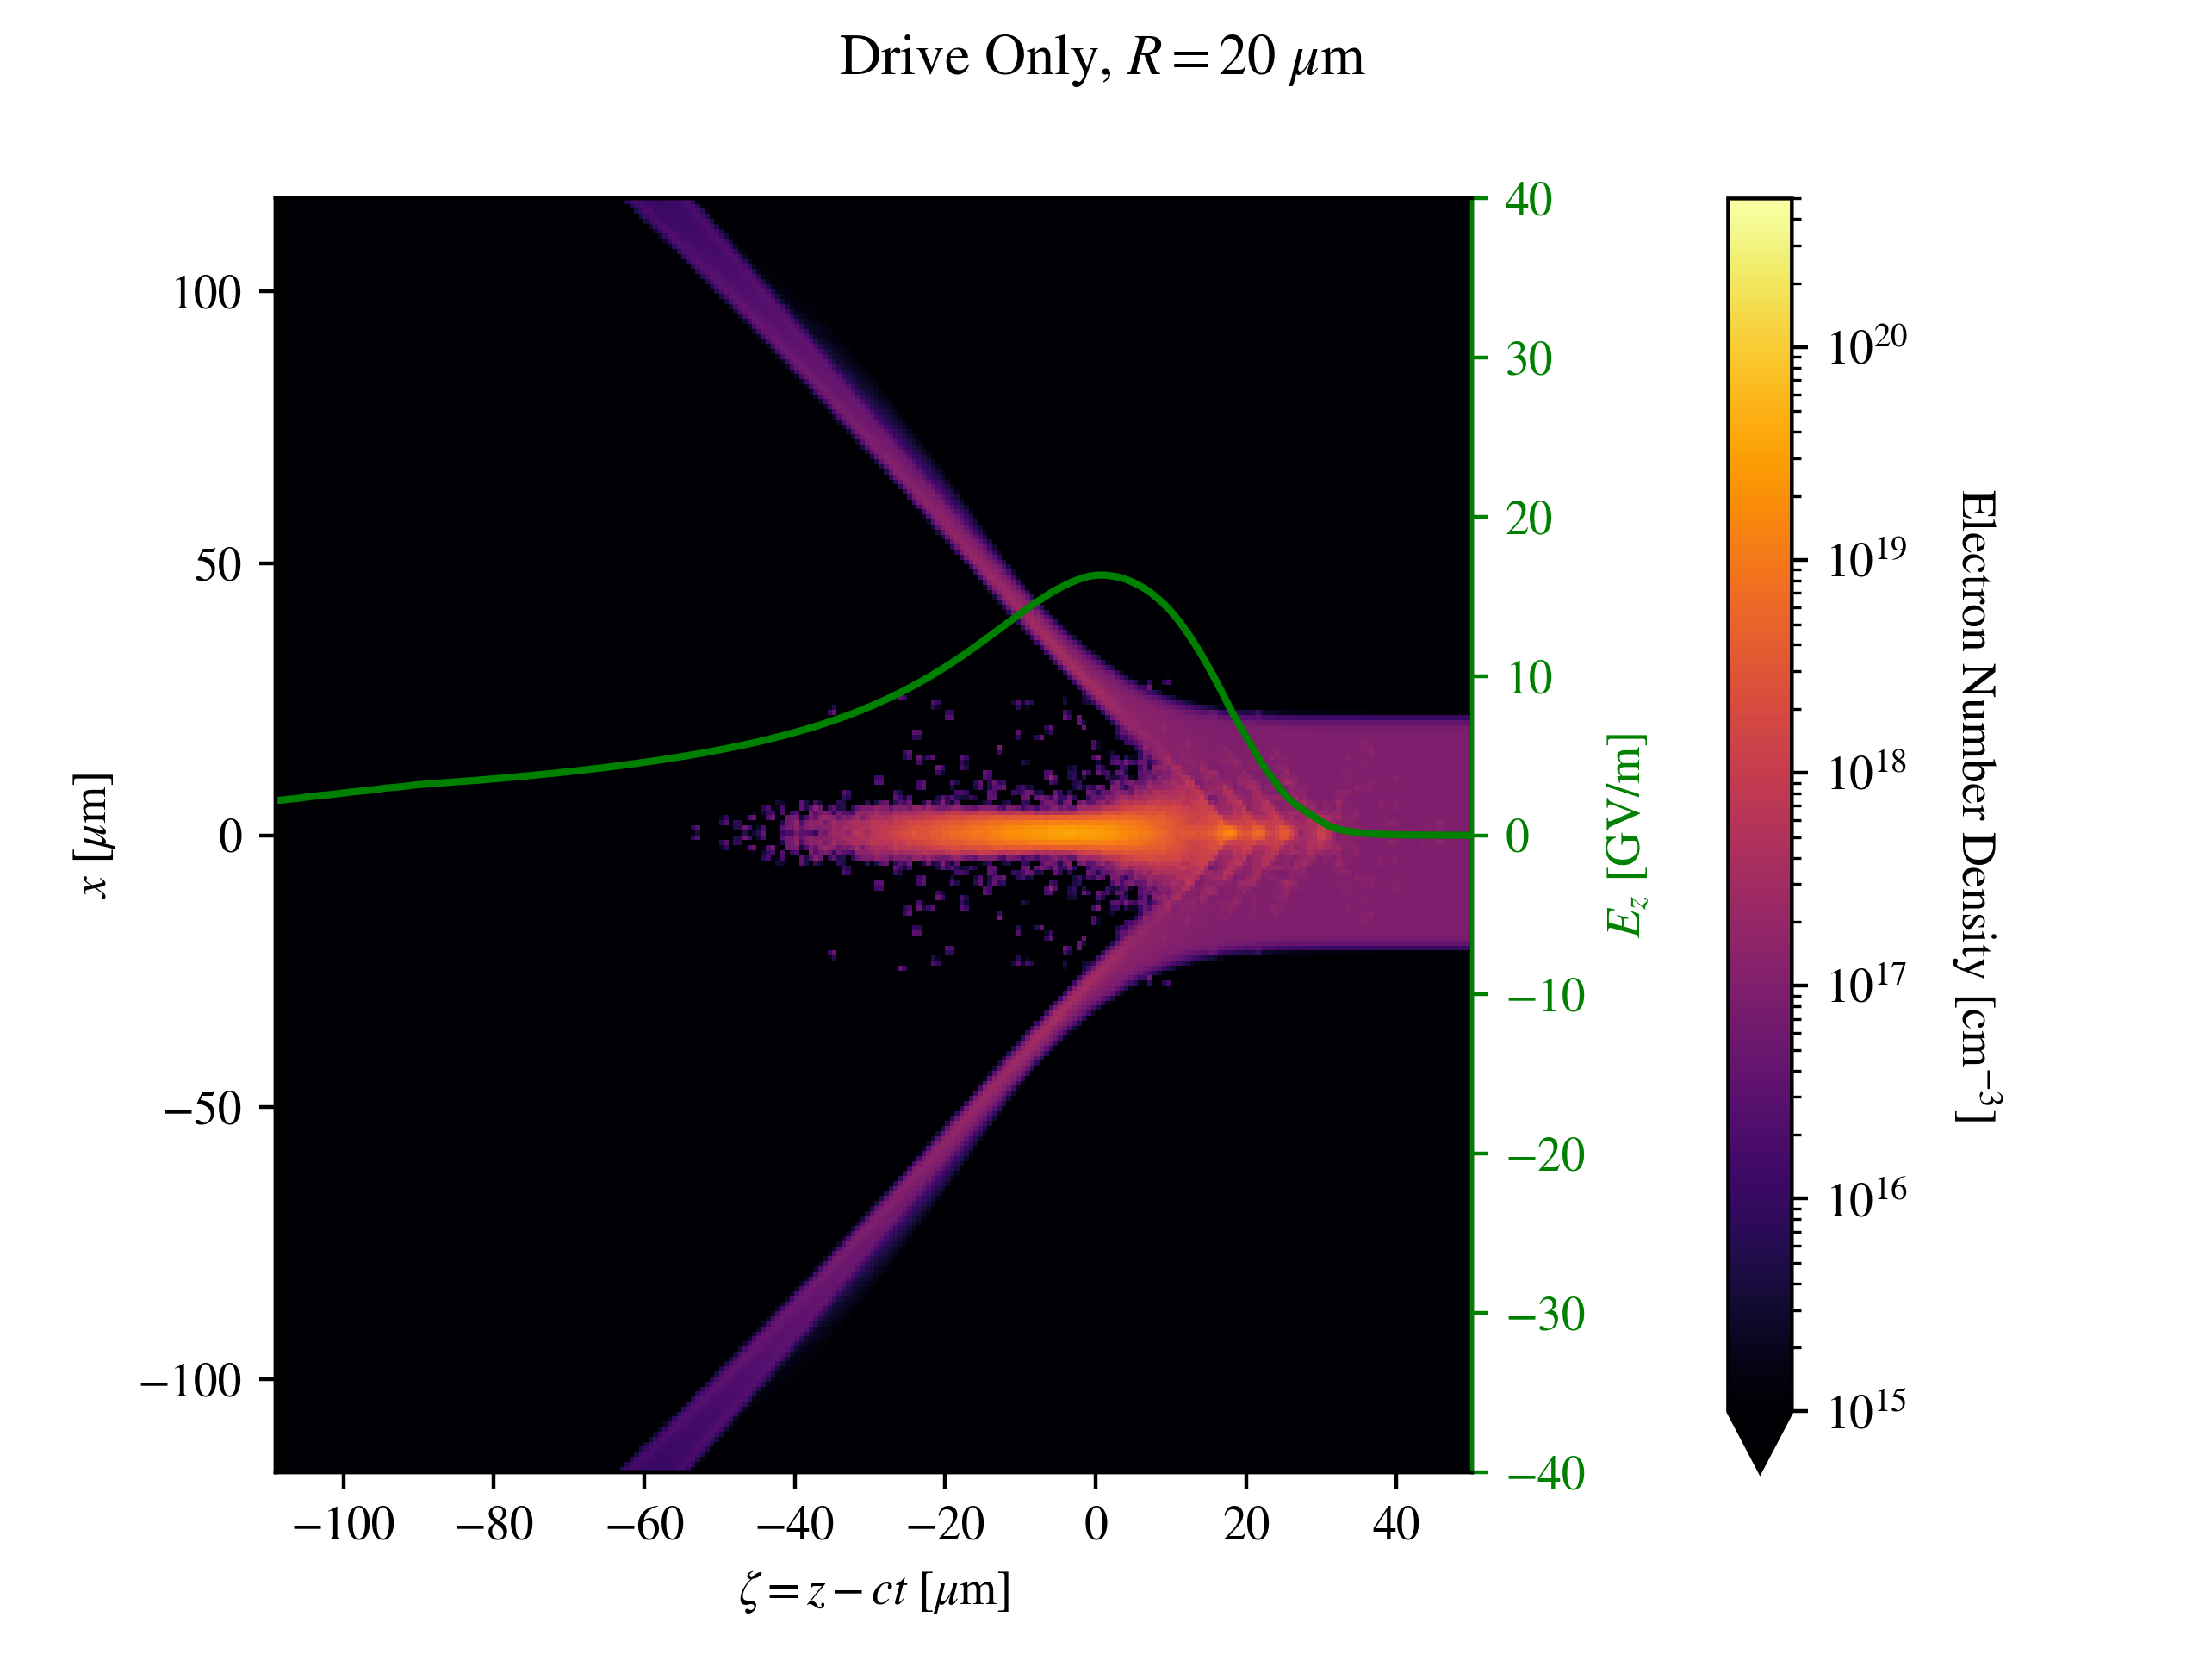
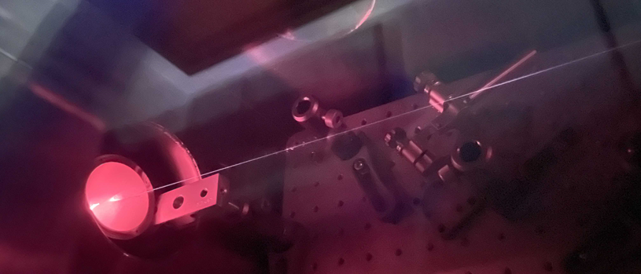
Ion Channel Creation
Narrow channel (wakeless) plasma required to prevent unwanted acceleration, hosing instability, and sampling of field nonlinearities. Can be ionized by a laser or the drive beam’s space charge.
Laser drivers cannot create an ion channel of sufficient length due to diffraction and dephasing, a drive beam is required.
8

Slide 26
Simulation Program
The only PIC simulations (Davoine et al. 2018) so far were done either in 2D or in 3D but with a contrived beam distribution. Spacecharge effects not accurately accounted for.
Collaboration with UCLA to simulate the ICL in OSIRIS.
Challenges:
Lorentz boosted frame required.
High charge density can lead to unphysical numerical effects.
Heavily diffraction dominated regime requires large window to resolve radiation.
9

Slide 27
Experimental Program
Microwave amplification via the same mechanism has been shown (Whittum et al. 1993), but an ICL has never been built.
Experiment E306 at FACET-II at SLAC aims to demonstrate an Ion Channel Laser.
Two Phases
E306a will attempt to lase in visible light (most likely 400nm) using the FACET-II witness beam.
E306b will attempt to lase in ultraviolet using a plasma injected beam.
10

Slide 28
Summary
The ICL is a plasma-based alternative to the FEL that can lase in compact distances and with high energy spread beams. Could be a path forward to a compact x-ray light source.
However, the ICL needs a drive beam and places stringent requirements on the witness beam’s transverse phase space shape and emittance.
Major gaps exist in the literature and the ICL has not yet been demonstrated.
Our group has already made progress in theory and simulation and is planning the first demonstration of an ICL at FACET-II E306
11

Slide 29
Acknowledgements & Questions
References:
Acknowledgements:
D. Whittum, A. Sessler, and J. Dawson, Ion-Channel Laser, Phys. Rev. Lett. 64, 2511 (1990).
D. Whittum, K. Ebihara, S. Hiramatsu, J. Kishiro, T. Monaka, T. Ozaki, and K. Takayama, Experimental Studies of Microwave Amplification in the Ion Focused Regime, IEEE Trans. Plasma Sci. 21, 136 (1993).
B. Ersfeld, R. Bonifacio, S. Chen, M. Islam, P. Smorenburg, and D. Jaroszynski, The Ion Channel Free-Electron Laser with Varying Betatron Amplitude, New J. Phys. 16, 093025 (2014).
X. Davoine, F. Fiúza, R. Fonseca, W. Mori, and L. Silva, Ion-Channel Laser Growth Rate and Beam Quality Requirements, J. Plasma Phys. 84, 905840304 (2018).
Special thanks to Xinlu Xu (SLAC) and Victor Yu (Radiabeam Technologies LLC) for helpful conversions.
This work is supported by the NOGLSTP / Out to Innovate 2020 Ben Barres Fellowship, the National Science Foundation through grant NSF-2047083, and the US Department of Energy through grant DE-SC0017906.
This research used resources of the National Energy Research Scientific Computing Center (NERSC), a U.S. Department of Energy Office of Science User Facility located at Lawrence Berkeley National Laboratory, operated under Contract No. DE-AC02-05CH11231 using NERSC award HEP-ERCAP0021840.
The authors would like to acknowledge the OSIRIS Consortium, consisting of UCLA and IST (Lisbon, Portugal) for providing access to the OSIRIS 4.0 framework. Work supported by NSF ACI-1339893.

