Slide 1
A compact laser-plasma based setup for positron production and collection
D. Terzani, C. Benedetti, S. S. Bulanov, C. Schroeder, E. Esarey
BELLA Center, LBNL
AAC 2022
11/10/2022
HAUPPAUGE, NY
Supported by the Director, Office of Science, Office of High Energy Physics, of the U.S. Department of Energy under Contract No. DE-AC02-05CH11231

Slide 2
Motivation
A compact positron generation and collection scheme is missing
LPA acceleration enables production of $10 GeV e^{−}$ beams in compact setups
Positron generation scheme has potential application in $e^{−}e^{+}$ LPA-based linear colliders
Conventional optics are not suitable to collect positrons generated by LPA beams
Positron generation using high intensity laser pulse:
Stepan Bulanov, next talk!
Notes:
Is missing with compatible characteristics with current LPA and laser capabilities
And those beams can be used as a source for positron generation.
Not only possible scheme: check out Stepan’s talk on positron generation in high field

Slide 3
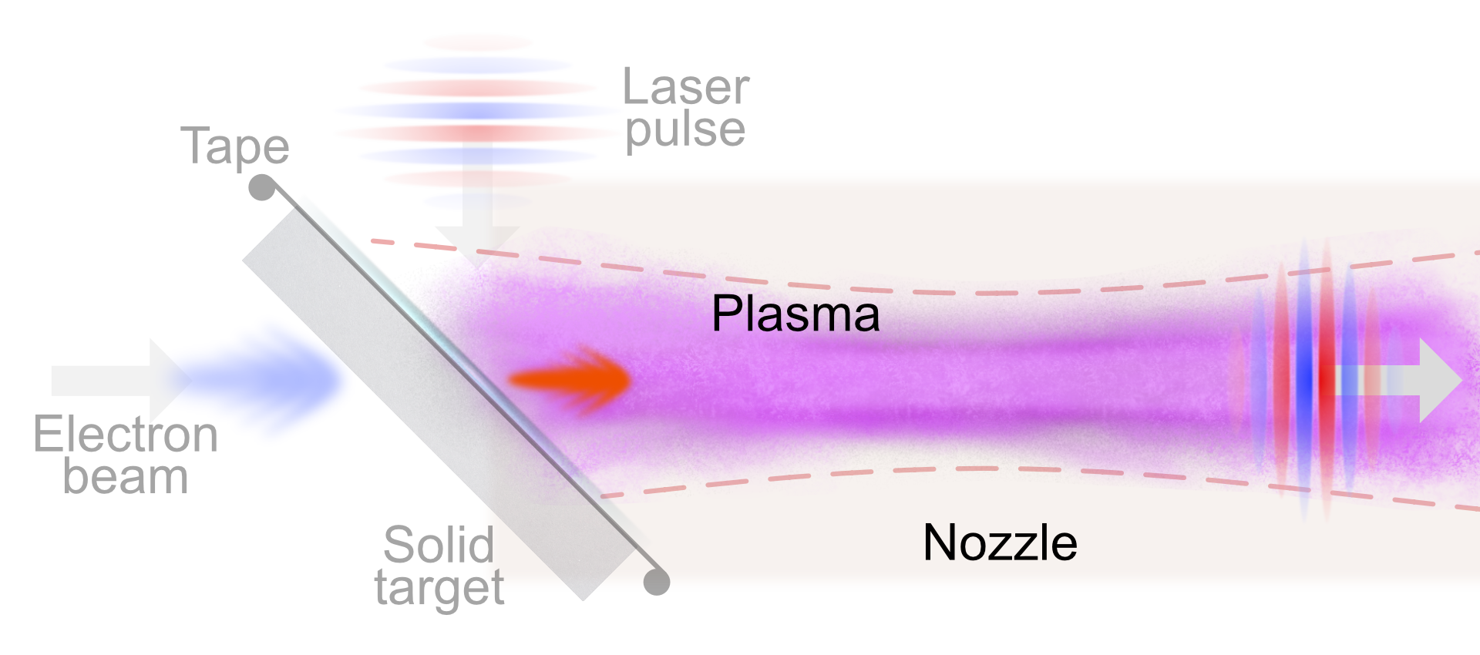
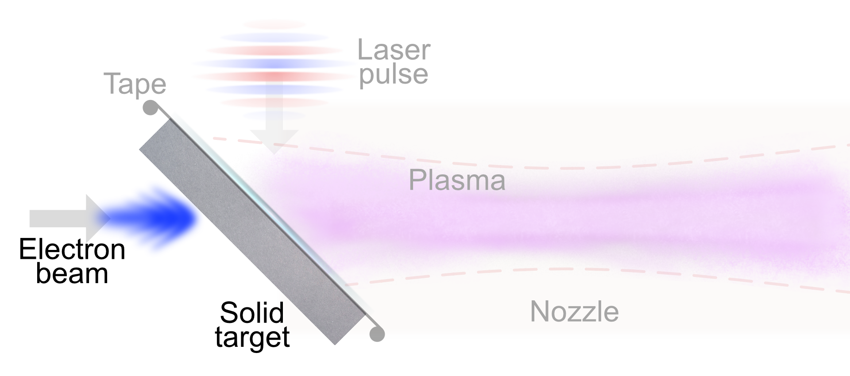
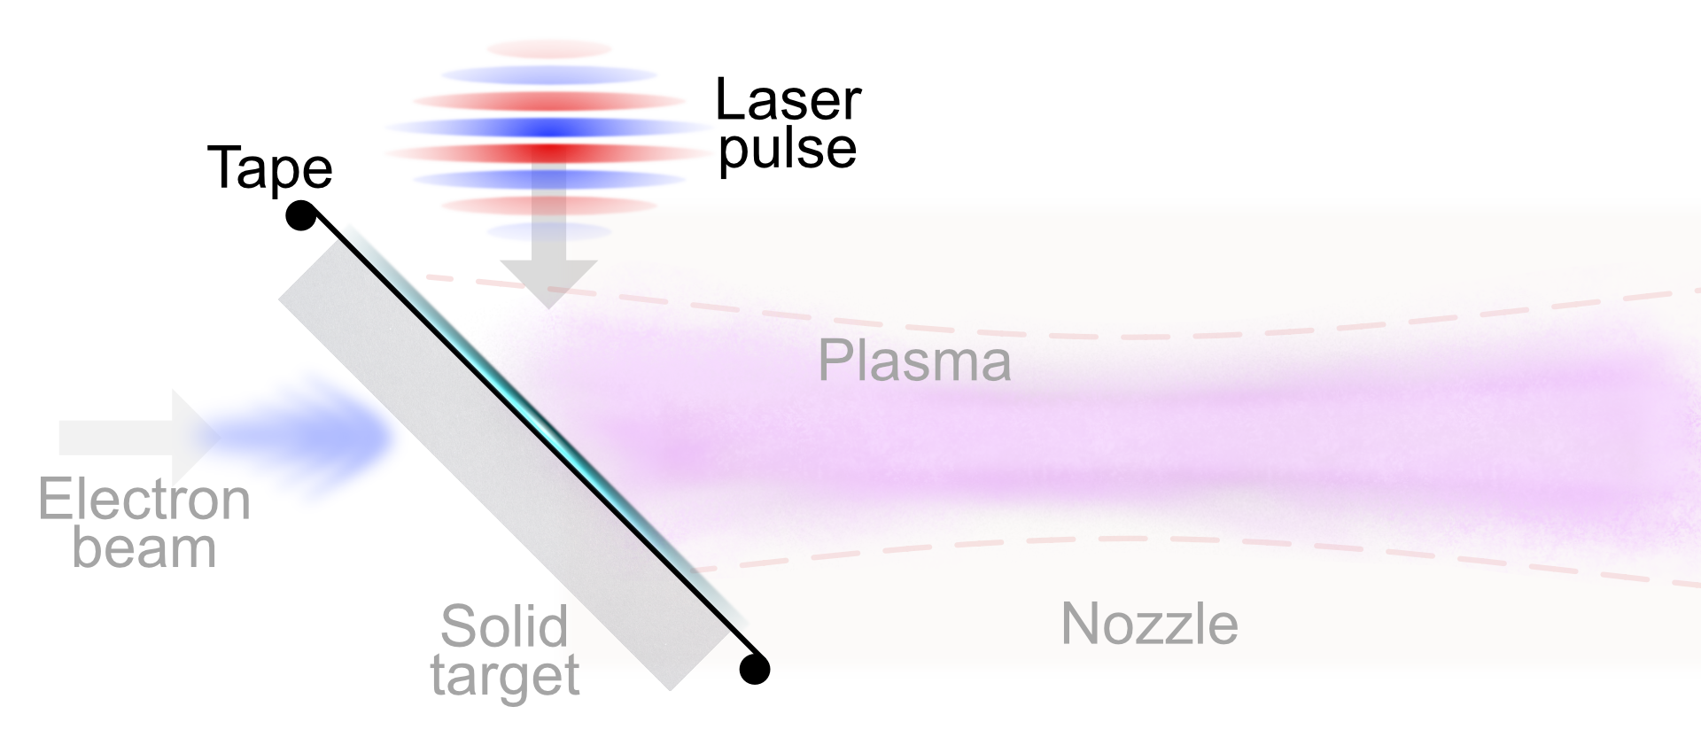
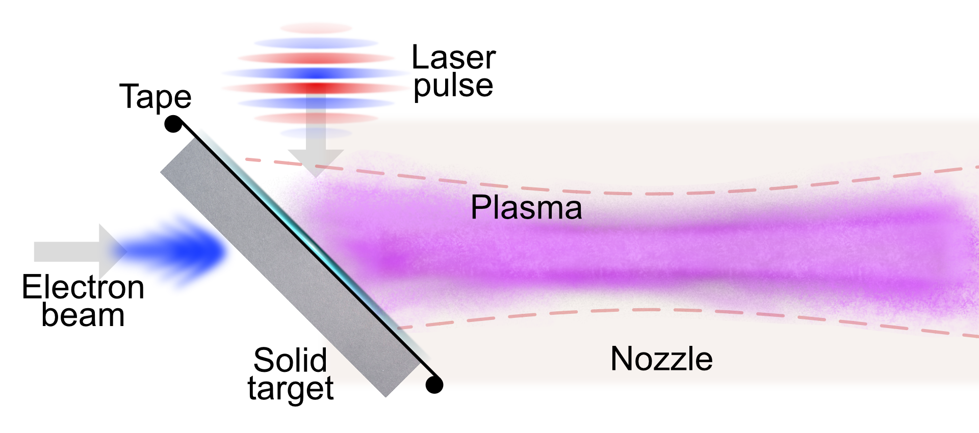
Schematic diagram of the compact positron generation scheme
Incoming laser pulse impinges on Plasma Mirror at 45°
Positron propagation in linear wakefield is modeled using a particle tracker
Dedicated Geant4 analysis of $e^{−}$ beam interaction with Tungsten
Tape is placed on the back of the solid target
$\sim 8$Rayleigh ranges
Notes:
A main limitation of the existing schemes is the lack of compactness: positrons escape from the side.
Key feature: plasma stage close to production point
We can dissect the scheme in three parts:
e- solid
laser on PM
e+ collection and acceleration

Slide 4
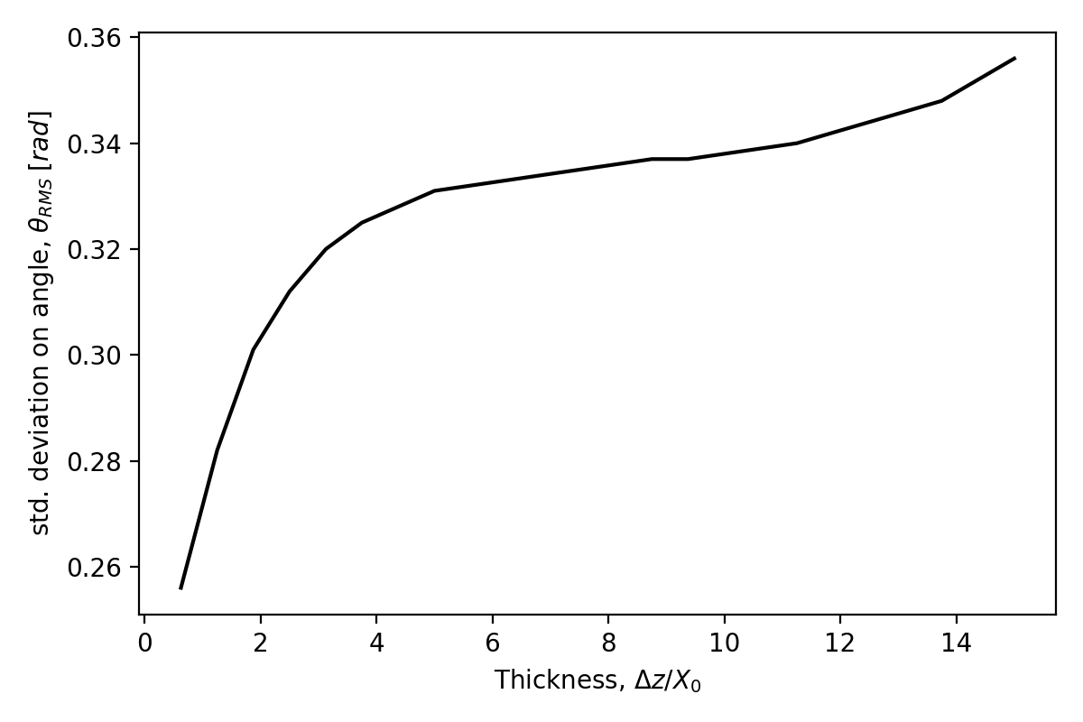
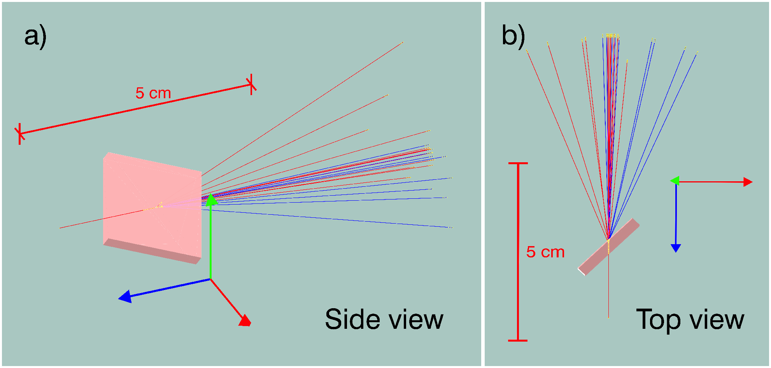
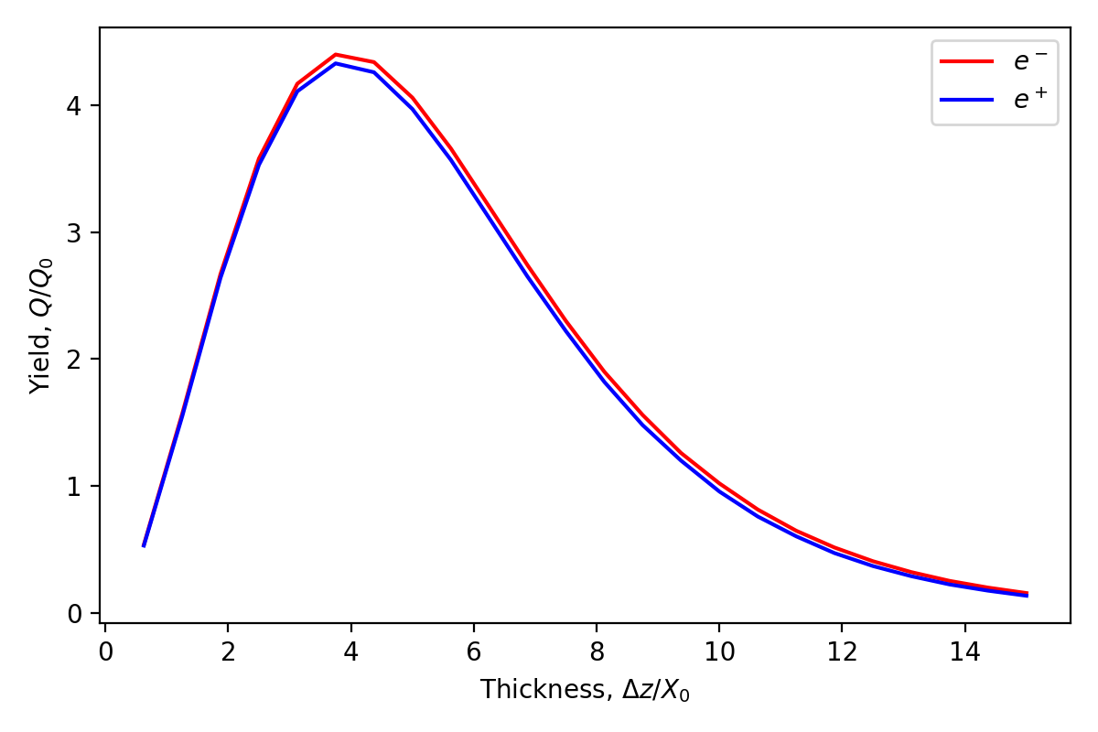
Properties of positron beams produced from a thick target
Tungsten $X_{0}=3.5mm$
rms divergence of the final positron beam
$10 GeV$ BELLA LPA $e^{−}$
Positron yield for maximum divergence
$$θ=0.1 rad$$
Production of bremsstrahlung photons
Photon conversion in $e^{−}e^{+}$ pairs
We take into account realistic beam parameters using a Geant4 application that simulates the interaction of the $e^{−}$ beam and the tungsten target and computes the final spatio-temporal distribution of the positrons
Notes:
Main process in bremsstrahlung
Geant4 application
Thickness dependence

Slide 5
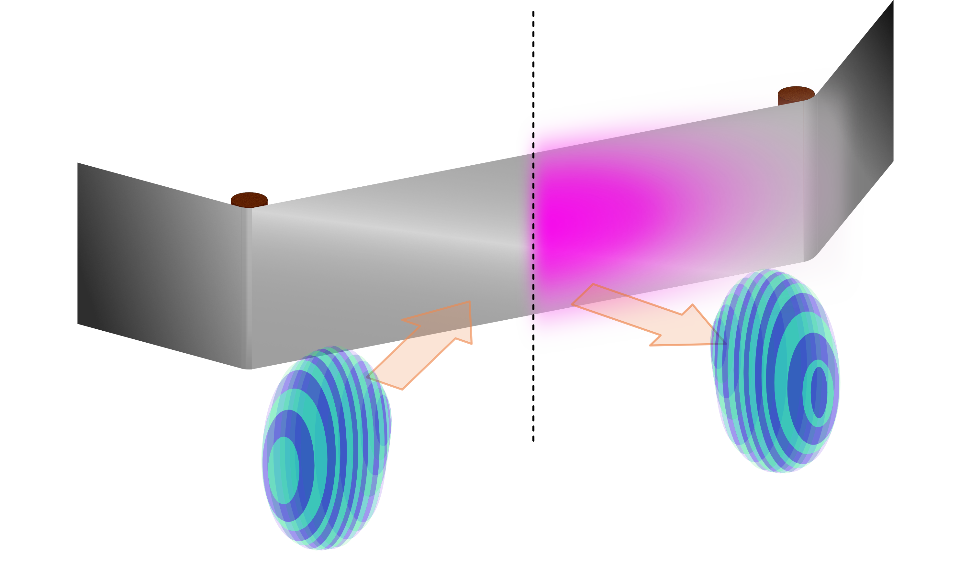
Plasma mirror enables reflection of high intensity laser pulse
Laser prepulse hits the surface generating a $μm$-size overdense plasma
Plasma is a dielectric that reflects the incoming laser pulse
For intensities up to $I\sim {10}^{16}W/cm^{2}$, PM reflectivity and final pulse quality is good
$$I_{0}\left[\frac{W}{cm^{2}}\right]=1.37×\frac{{10}^{18}a_{0}^{2}}{λ{\left[μm\right]}^{2}}$$
At focus
$$a_{0}=0.6$$
$$w_{0}=100μm$$
$$I_{PM}=\frac{I_{0}}{1+\frac{{\left(z−z_{F}\right)}^{2}}{z_{R}^{2}}}$$
PM at $\sim 4Z_{R} (16cm)$ from focus
[Shaw et al., POP, 2016]
Notes:
Specify that plasma mirror allows reflection of high intensity laser pulses so it can be put close to the plasma source

Slide 6
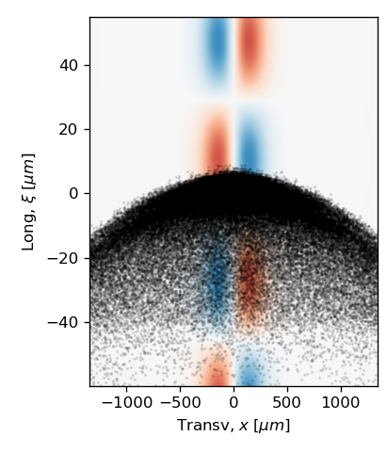
Accelerating and focusing wakefield is maximized in linear regime
$$\frac{E}{E_{0}}=−\frac{c}{2}\int_{0}^{t}{dt^{′}}\sin\left[ω_{p}\left(t−t^{′}\right)\right]∇a^{2}$$
Modelling of the scheme is done in linear regime
Snapshot of generated positron in the transverse wakefield
Fields can be computed analytically, therefore particle are evolved using a particle tracker code (very fast simulations)
Laser evolution
Particles evolution
We assume a double gaussian laser pulse
Equation of motion of the particles is solved using an RK4 scheme where the fields are evaluated analytically on particle position
Laser pulse undergoes Rayleigh diffraction
To ensure validity of the model over long distance we assume $P/P_{C}<1$

Slide 7
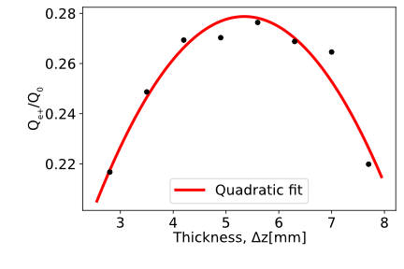
Optimization of the target thickness to maximize trapping
Number of positrons was measured at the end of the acceleration stage: Positrons gaining $ΔE>50 MeV$ are $Q_{e+}/Q_{0} ≃28\%$ with a thickness $Δz=5.6mm$.
Tungsten target thickness scan
Thin
Thick
Divergence
Lower
Higher
Plasma:
Idealized gas jet
$n_{0}=2×{10}^{17}cm^{−3}$
Conversion efficiency
Lower
Higher
Laser:
Double gaussian
Matched duration $T=80 fs$
$a_{0}=0.6$
$w_{0}=100 μm$
$E=12 J$
$Z_{R}≃4 cm$
Notes:
Code is a particle tracker
Fields are ideally linear
Electrons diffract
Beam charge effect are negligible
Particles are selected with DE>50 Mev, but no radius selection.
Specity feasibility, linear regime (a0=0.6) and that P/P_c < 1 (avoid selffocussing)

Slide 8
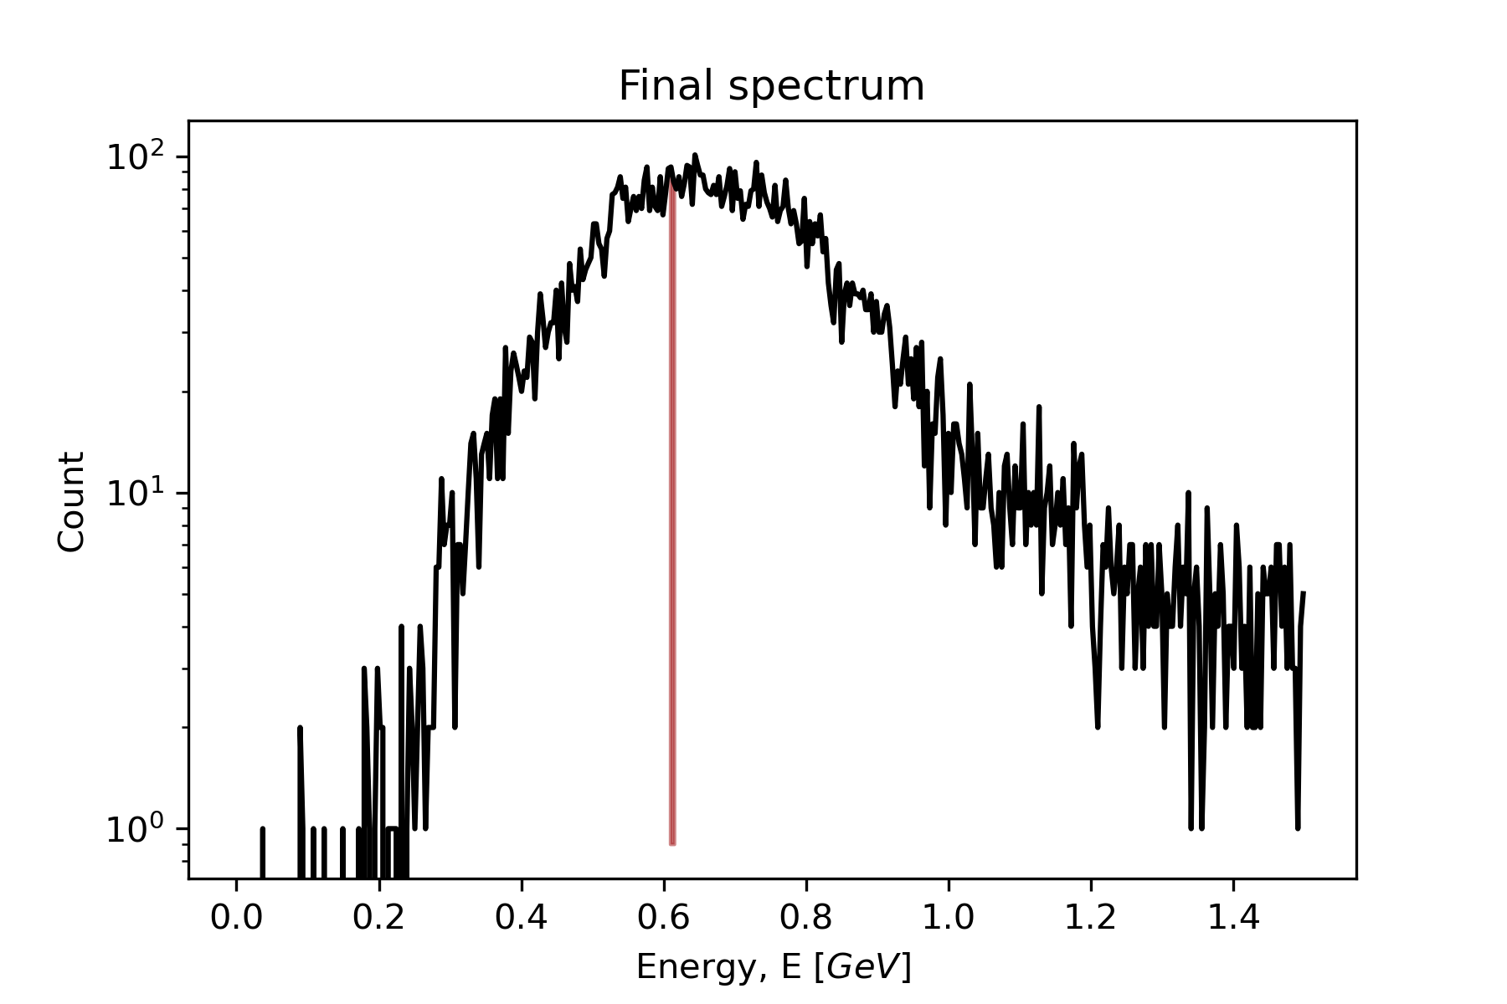
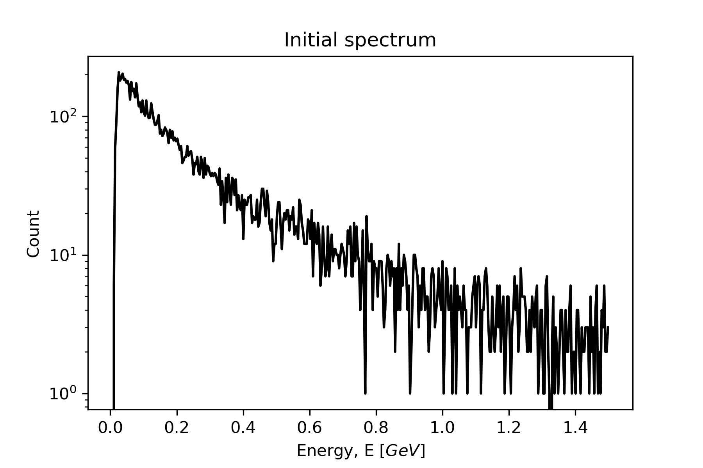
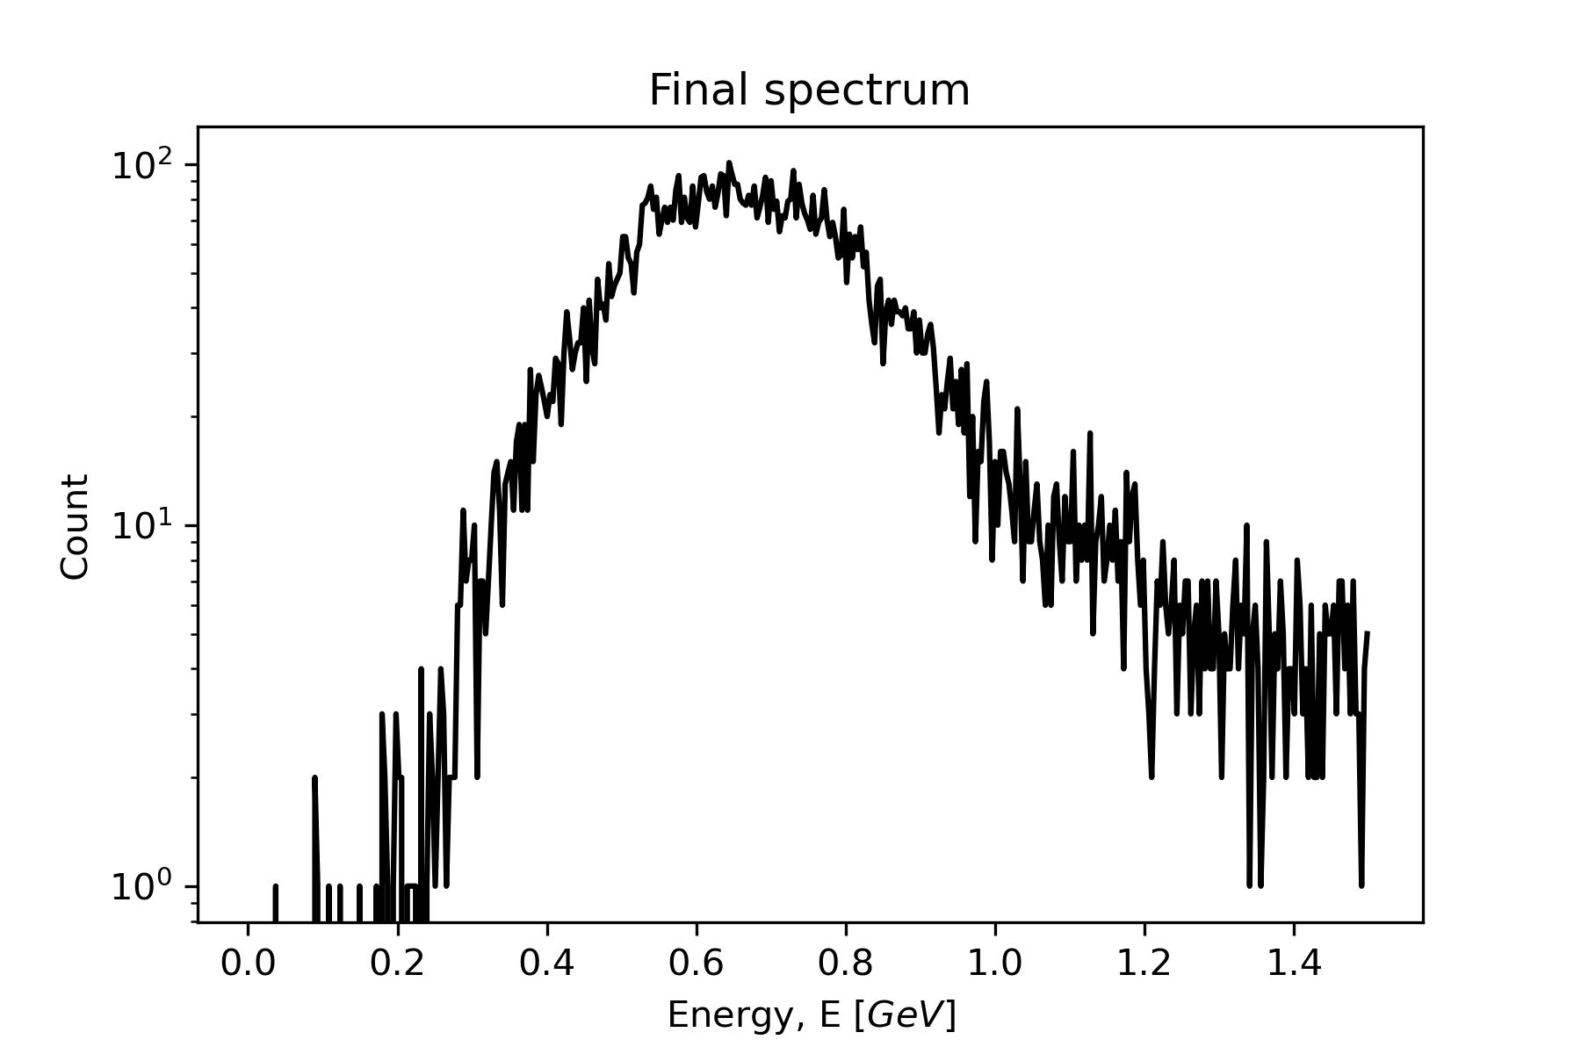
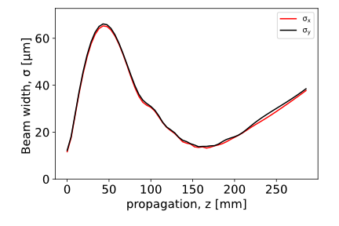
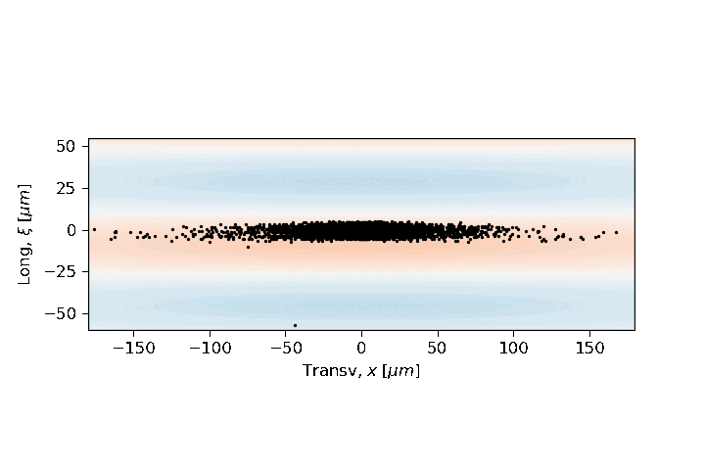
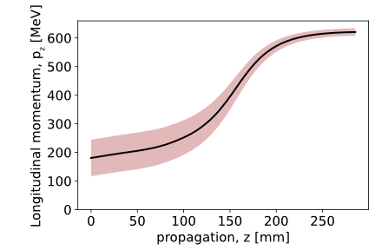
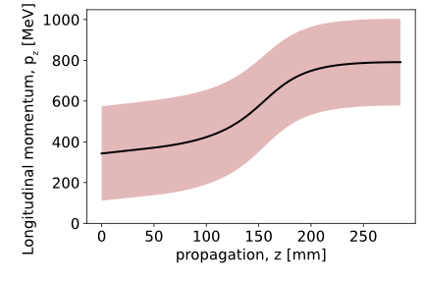
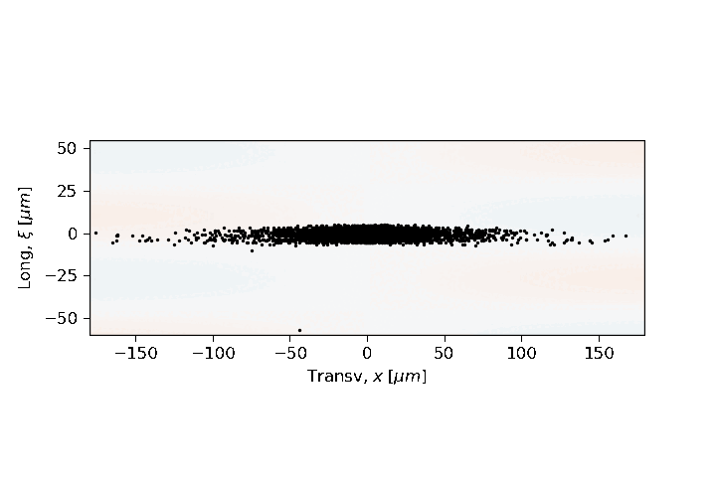
Positron beams experience strong accelerating gradients
Initial selection:
$$ΔE>50MeV$$
$$\frac{Q_{e+}}{Q_{0}}≃4\%$$
$$620 MeV±5\%$$
Accelerating field
$$\sim 1.3GV/m$$
Focusing field

Slide 9
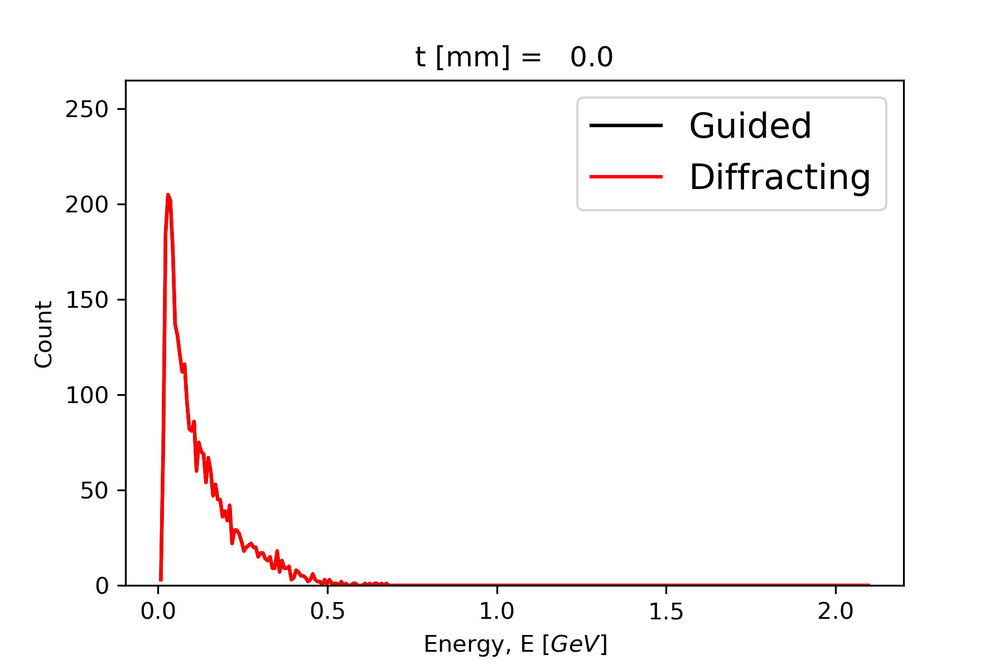
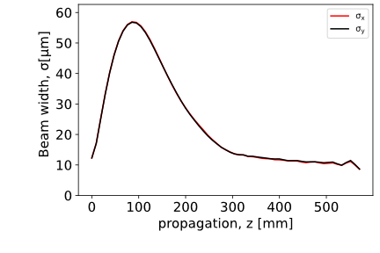
Guided laser pulse can further improve energy gain
Guiding is modeled as a diffracting pulse entering a perfectly matched channel when it reaches its focal point
Focal point
Identifies “trapped” particles:
Selecting particles that gain energy $ΔE>50MeV$ and that remain confined $r_{MAX}<w_{0}/2$
$$\frac{Q_{e+}}{Q_{0}}≃16\%$$
Notes:
Simulated 14 Zr total

Slide 10
Conclusion and next steps
We presented a compact scheme for positron beam generation and collection that does not require any conventional optics and relies on currently available laser pulses
We tuned the scheme to maximize the conversion efficiency of a $e^{−}$ beam generated using the BELLA laser
Average acceleration gradient $E≃1.3 GV/m$
Conversion efficiency $Y≃4×{10}^{−2}$ for $ΔE/E=5\%$
Guiding the laser pulse can further increase the final positron beam energy
Future work: optimization of the accelerating gradient and final beam quality using weakly/mildly nonlinear wakefields
Multiple jobs at the career-track research scientist and post-doctoral level are available at the BELLA Center. Please contact jvantilborg@lbl.gov and visit jobs.lbl.gov and search for “BELLA”
Supported by the Director, Office of Science, Office of High Energy Physics, of the U.S. Department of Energy under Contract No. DE-AC02-05CH11231

