Slide 1
Multi-Color Operation via Coherent Harmonic Generation in a Plasma Driven Attosecond X-Ray Source
Rafi Hessami on behalf of the PAX Collaboration
Advanced Accelerator Concepts Workshop 2022
November 7, 2022

Slide 2
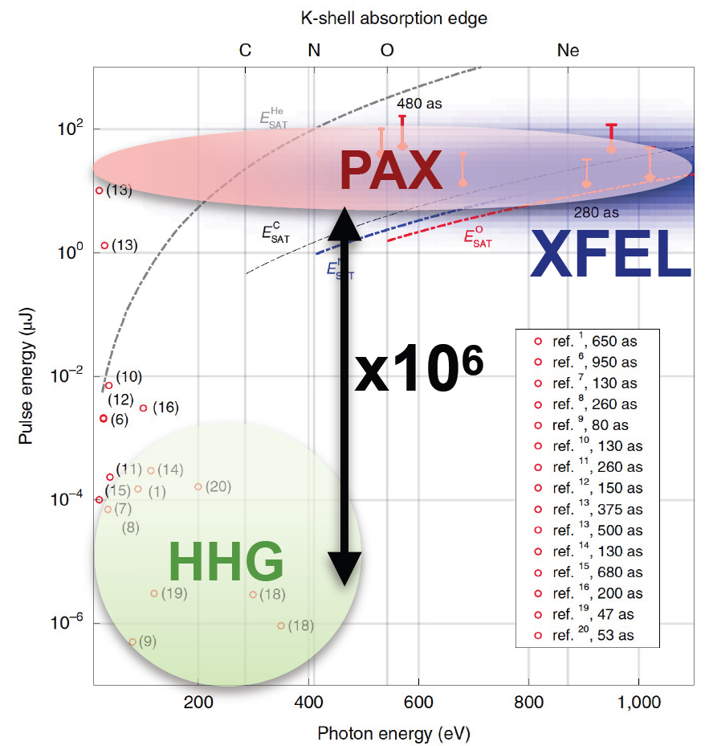
Motivation
Attosecond science can probe electron dynamics.
Facilities producing high-power (specifically TW-scale) attosecond X-ray pulses are currently nonexistent.
High-power attosecond X-ray pulses would be interesting to many fields!
Tunable isolated attosecond X-ray pulses with gigawatt peak power from a free electron laser,
J.Duris, et al., Nature Photonics 14, 30-36 (2020)
Notes:
Talk about attosecond sources as a concept, intro that world, describe the plot, were like XFELs but short and attosecond

Slide 3
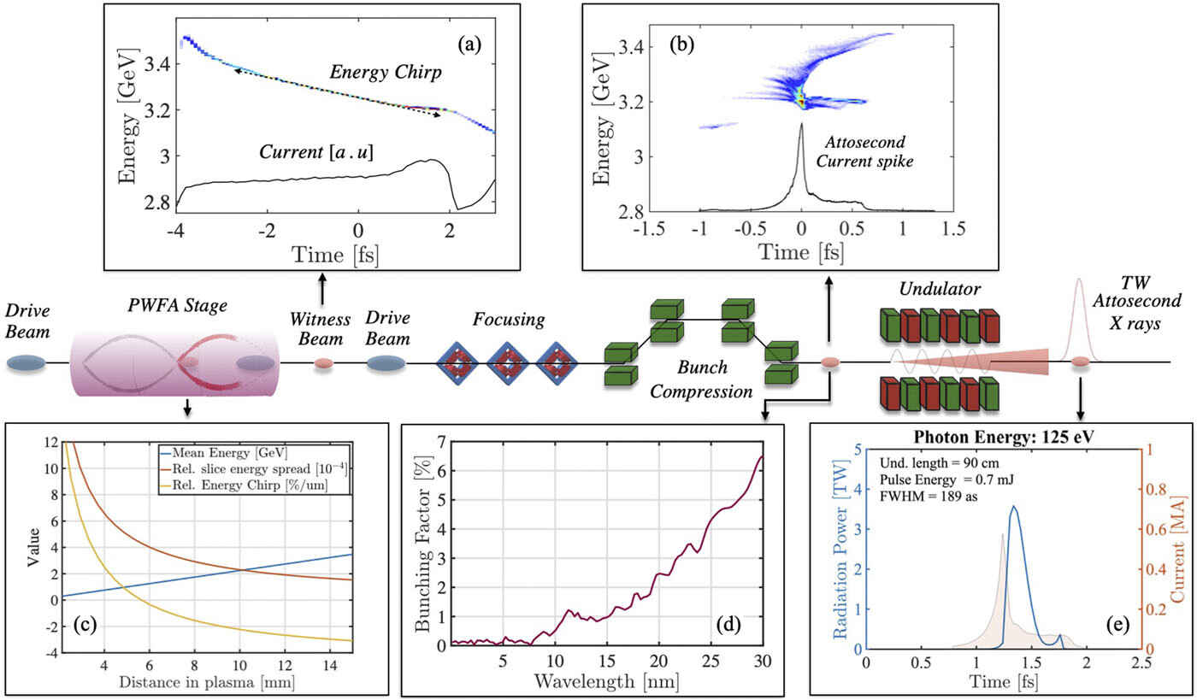
PAX as a TW X-Ray Source
PAX plans to compress a PWFA beam with a large chirp to 10s of nm, producing radiation at that scale.
Terawatt attosecond x-ray source driven by a plasma accelerator,
C.Emma, et al., APL Photonics 6, 076107 (2021)

Slide 4
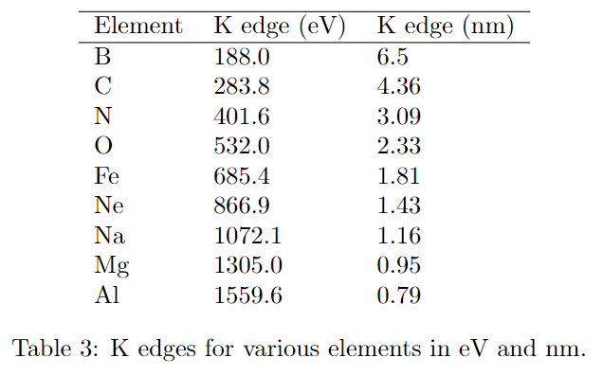
Limitations
This is fantastic for light greater than 10 nm, but many attosecond science experiments want to see above the Carbon K edge at 283 eV.
Biomolecular Crystallography: Principles, Practice, and Application to Structural Biology,
B. Rupp, Garland Science, 1st edition (2009)

Slide 5
Our Proposal
We propose to extend the beamline with undulators tuned to 1 nm.
Use the 10th harmonic bunching to jumpstart the FEL process at 1 nm in the beam.
Step 1: Pre-bunched at ~100 nm
Compress in chicane
Step 2: Pre-bunched at 10 nm
10 nm undulator
Step 2: Pre-bunched at 2 nm
2 nm undulator
TW as pulse at 2nm!
Notes:
Paul Corkum said 30 attoseconds is the fastest process time
Advantages over FEL: shorter pulse time, shorter beamline because no SASE (CHECK WHAT TYPICAL FEL PULSE TIME IS)

Slide 6
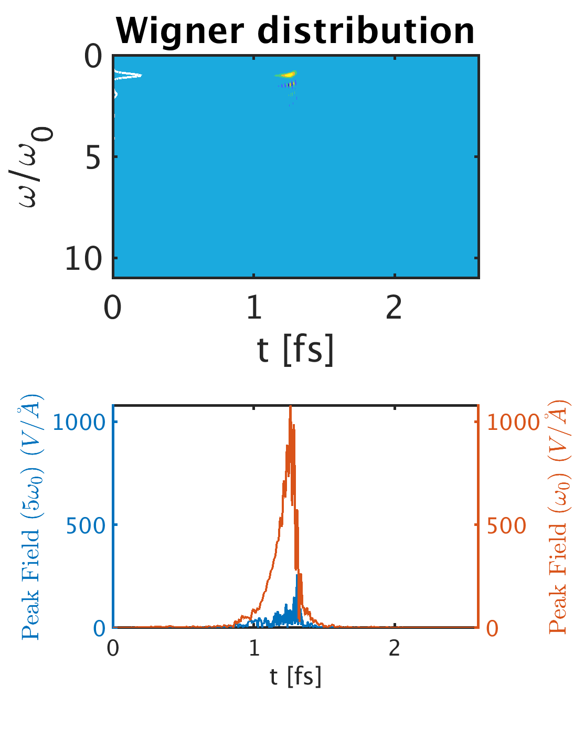
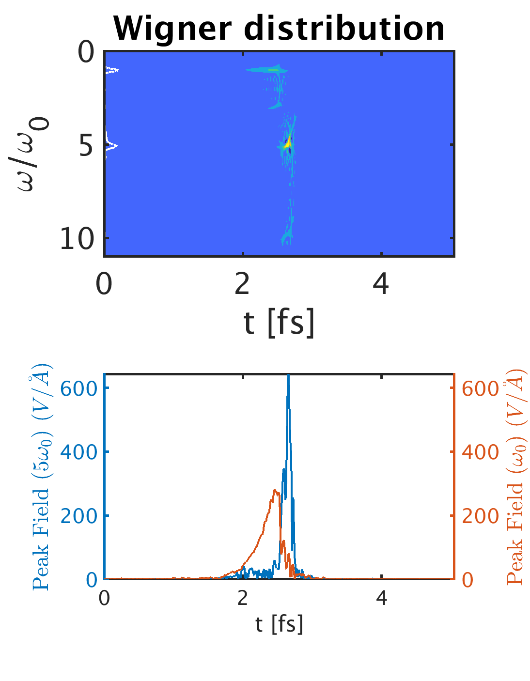
Wigner Plots Along the Beamline
1.12 m
1.12 m
1st Harmonic
5th Harmonic

Slide 7
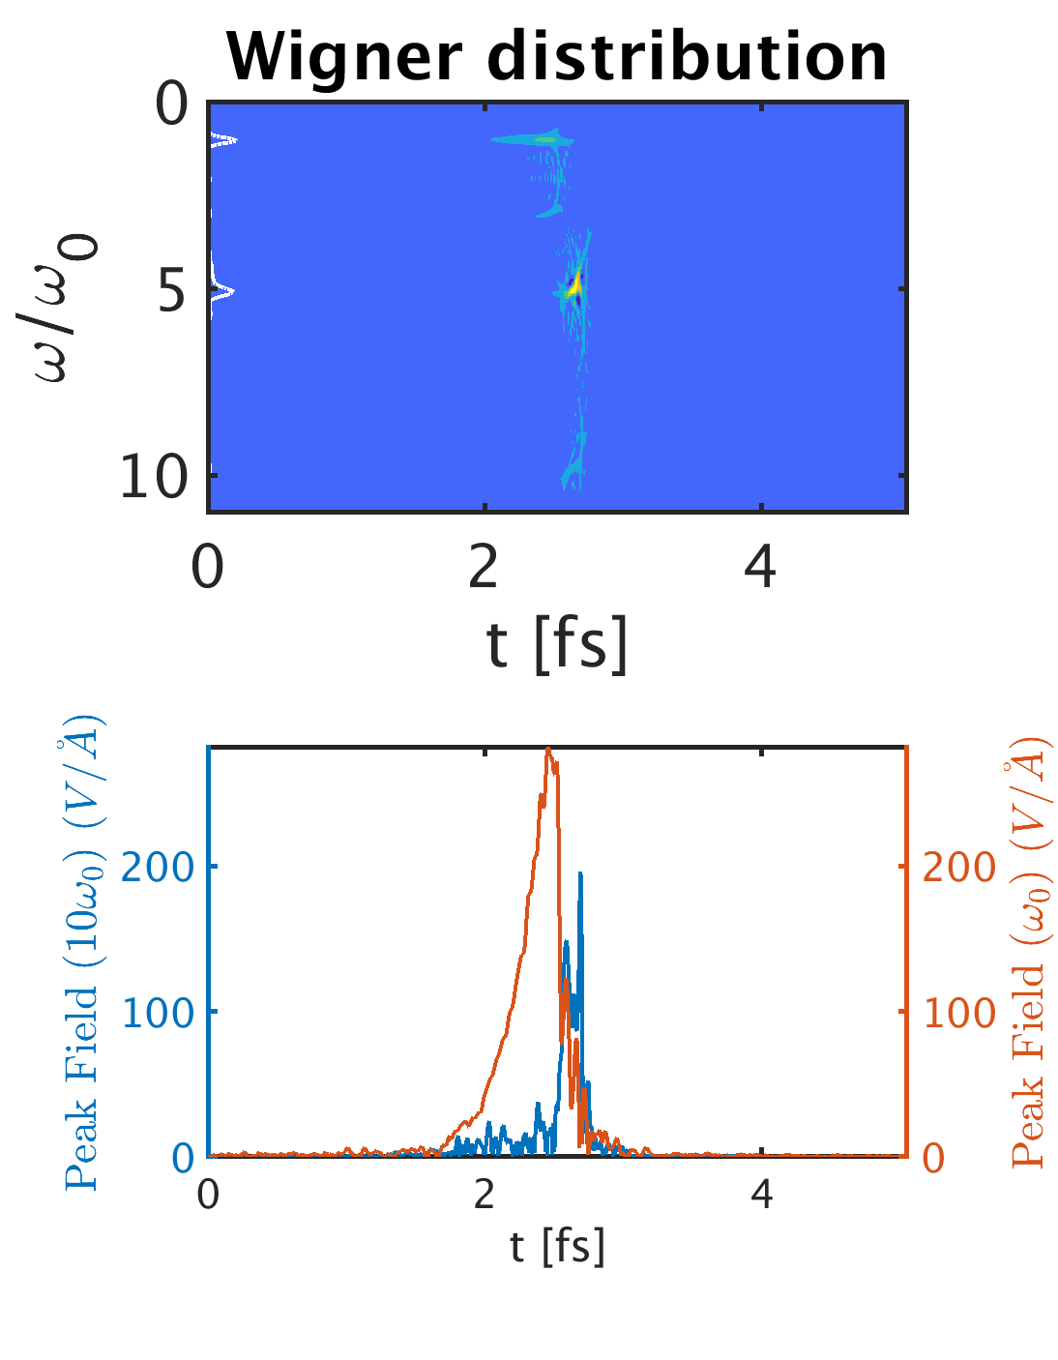
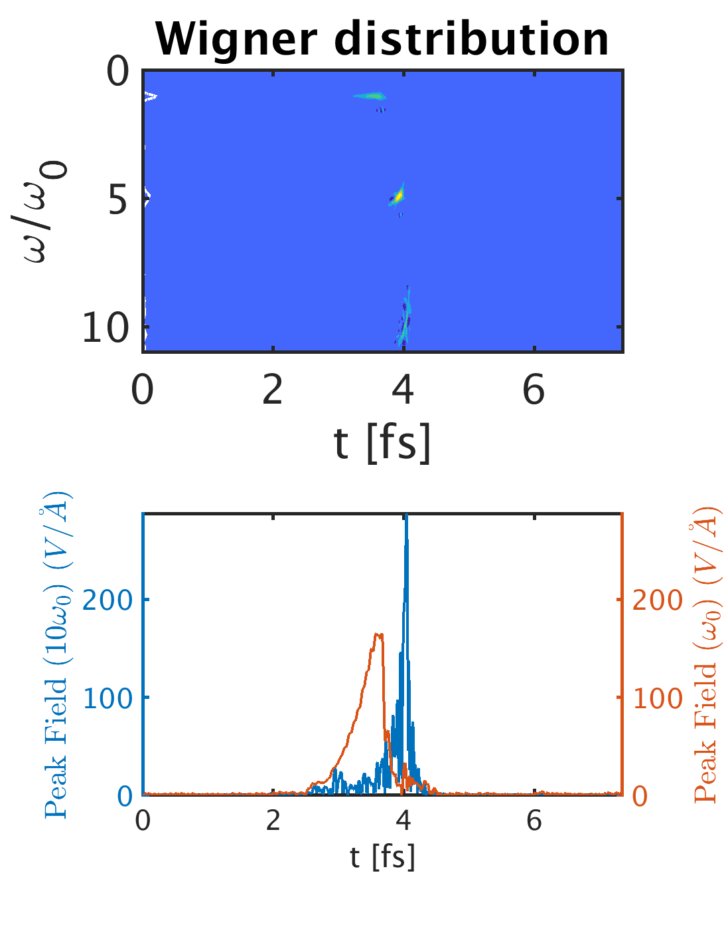
Wigner Plots Along the Beamline
1.12 m
1.12 m
1.12 m
1st Harmonic
5th Harmonic
10th Harmonic

Slide 8
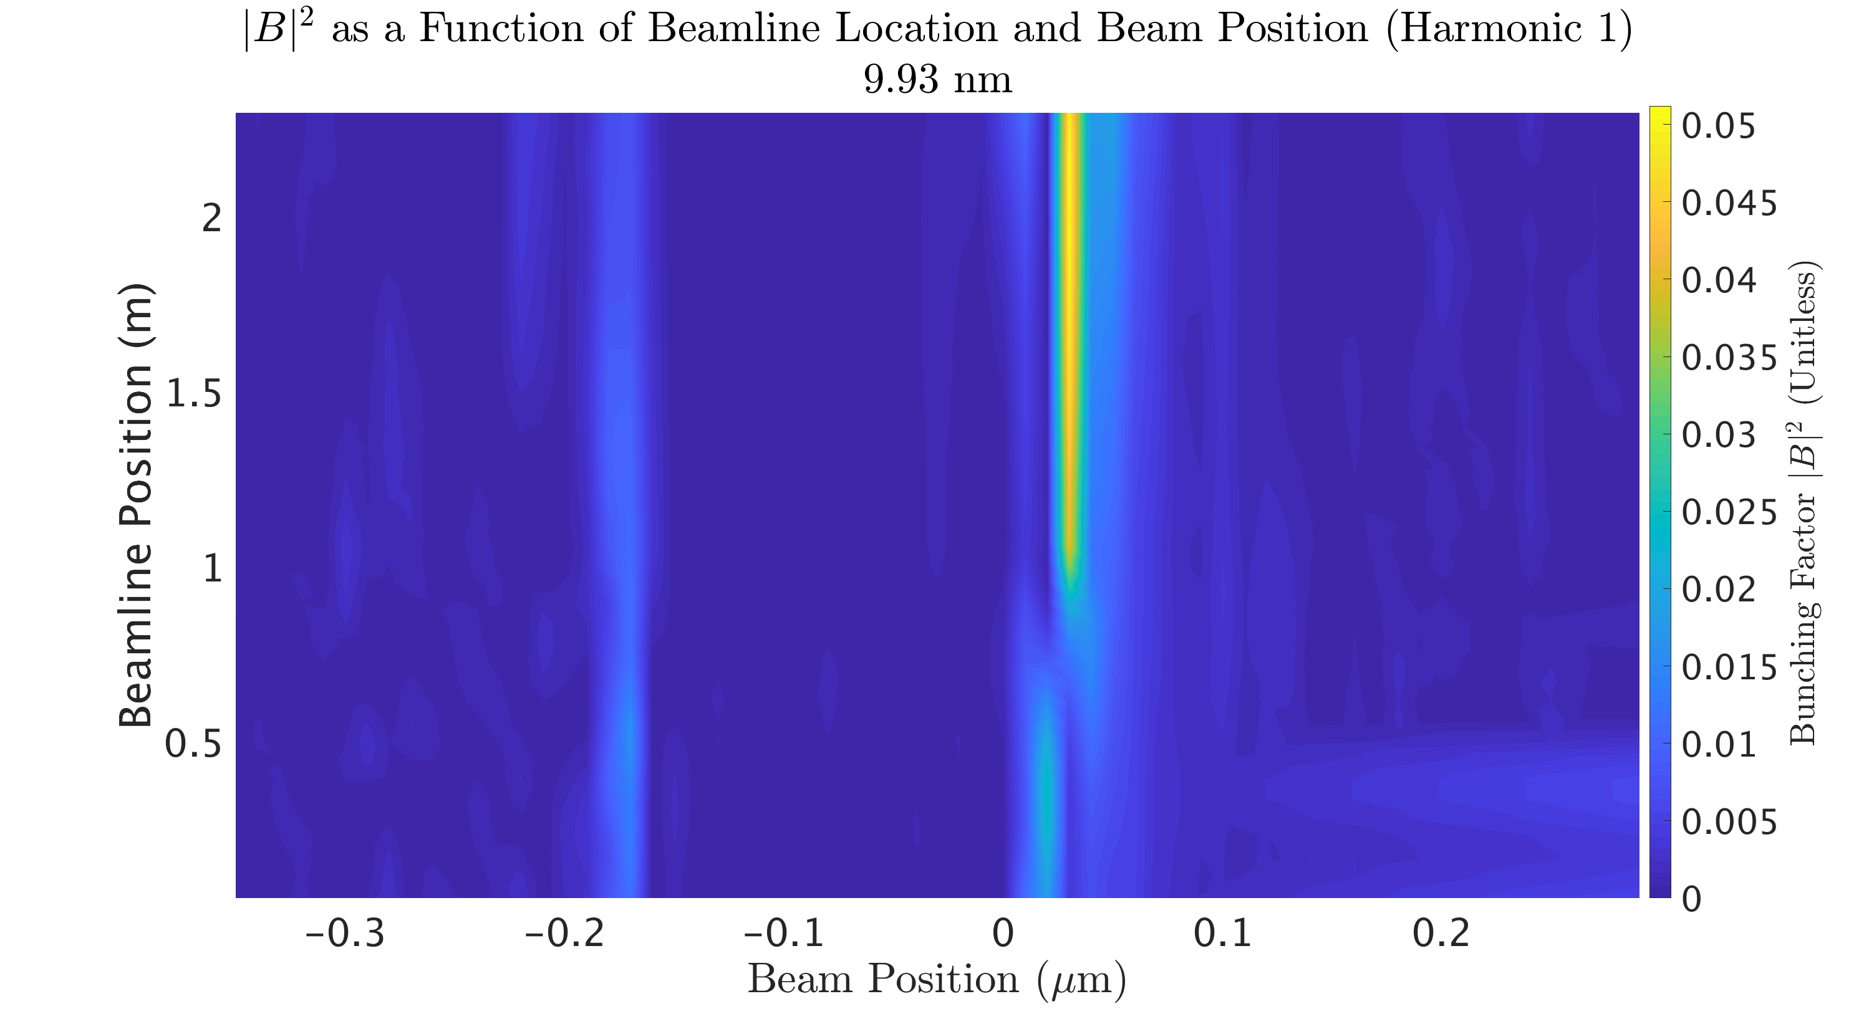
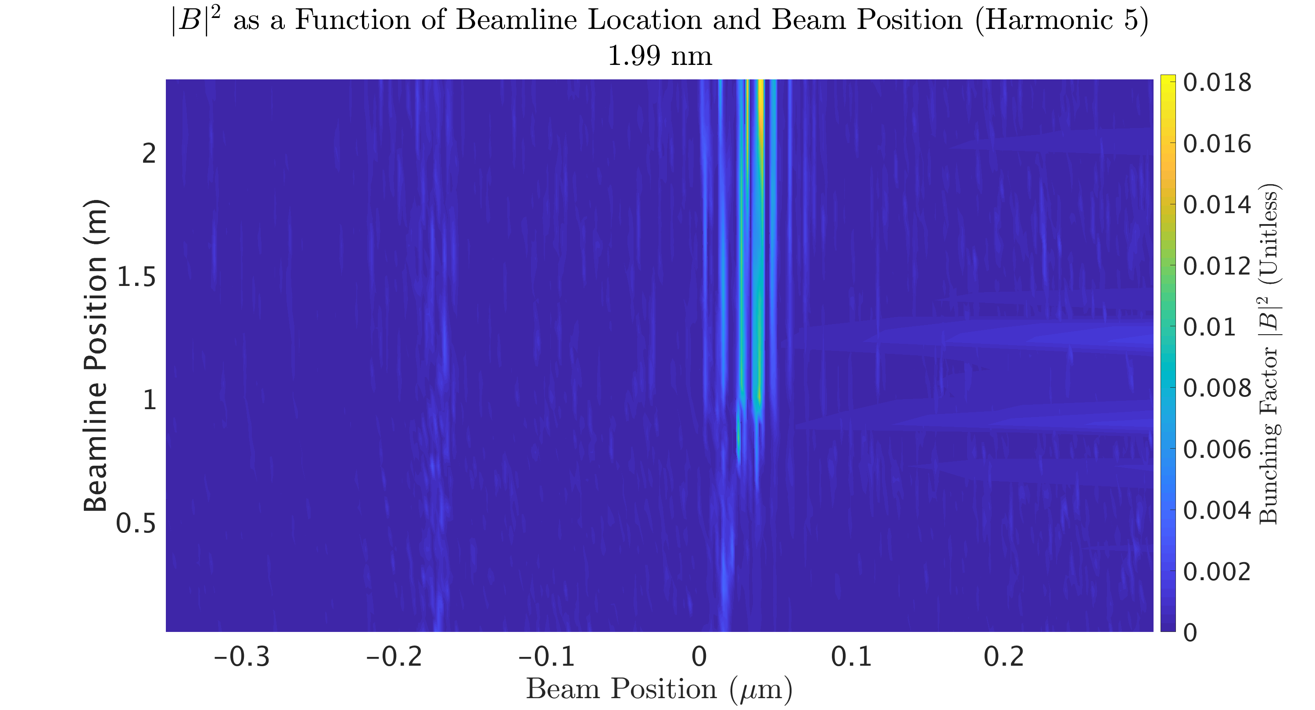
Bunching (Two Stage)
1st Harmonic:
5th Harmonic:
Red arrow indicates where 1st harmonic undulator ends, 5th harmonic undulator starts

Slide 9
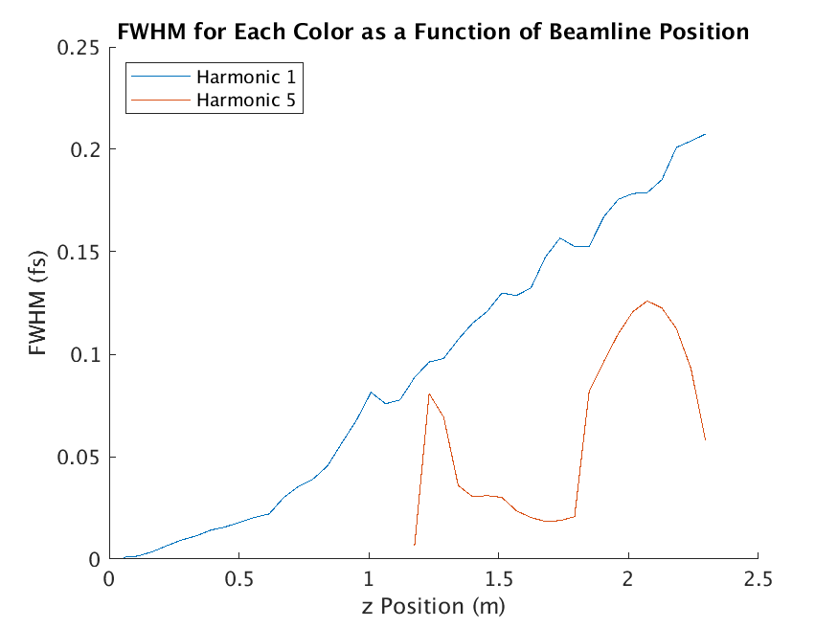
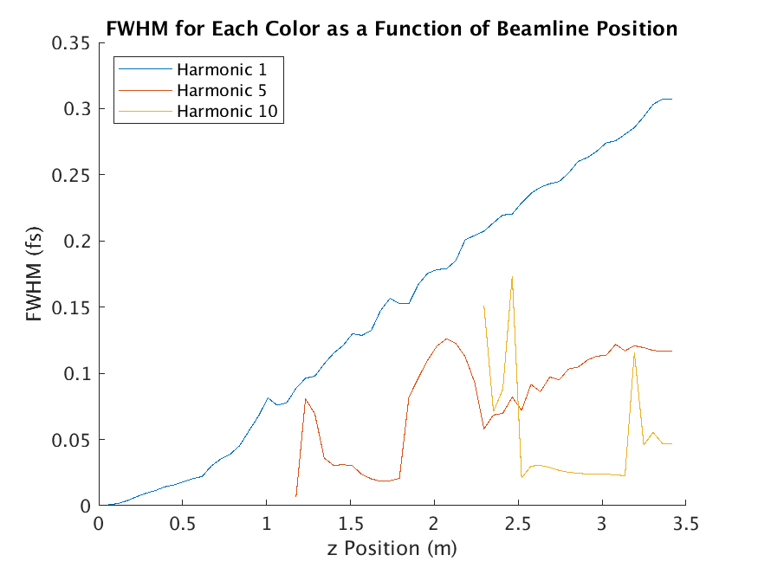
Pulse Length
Very short pulses!
Two Color:
Three Color:

Slide 10
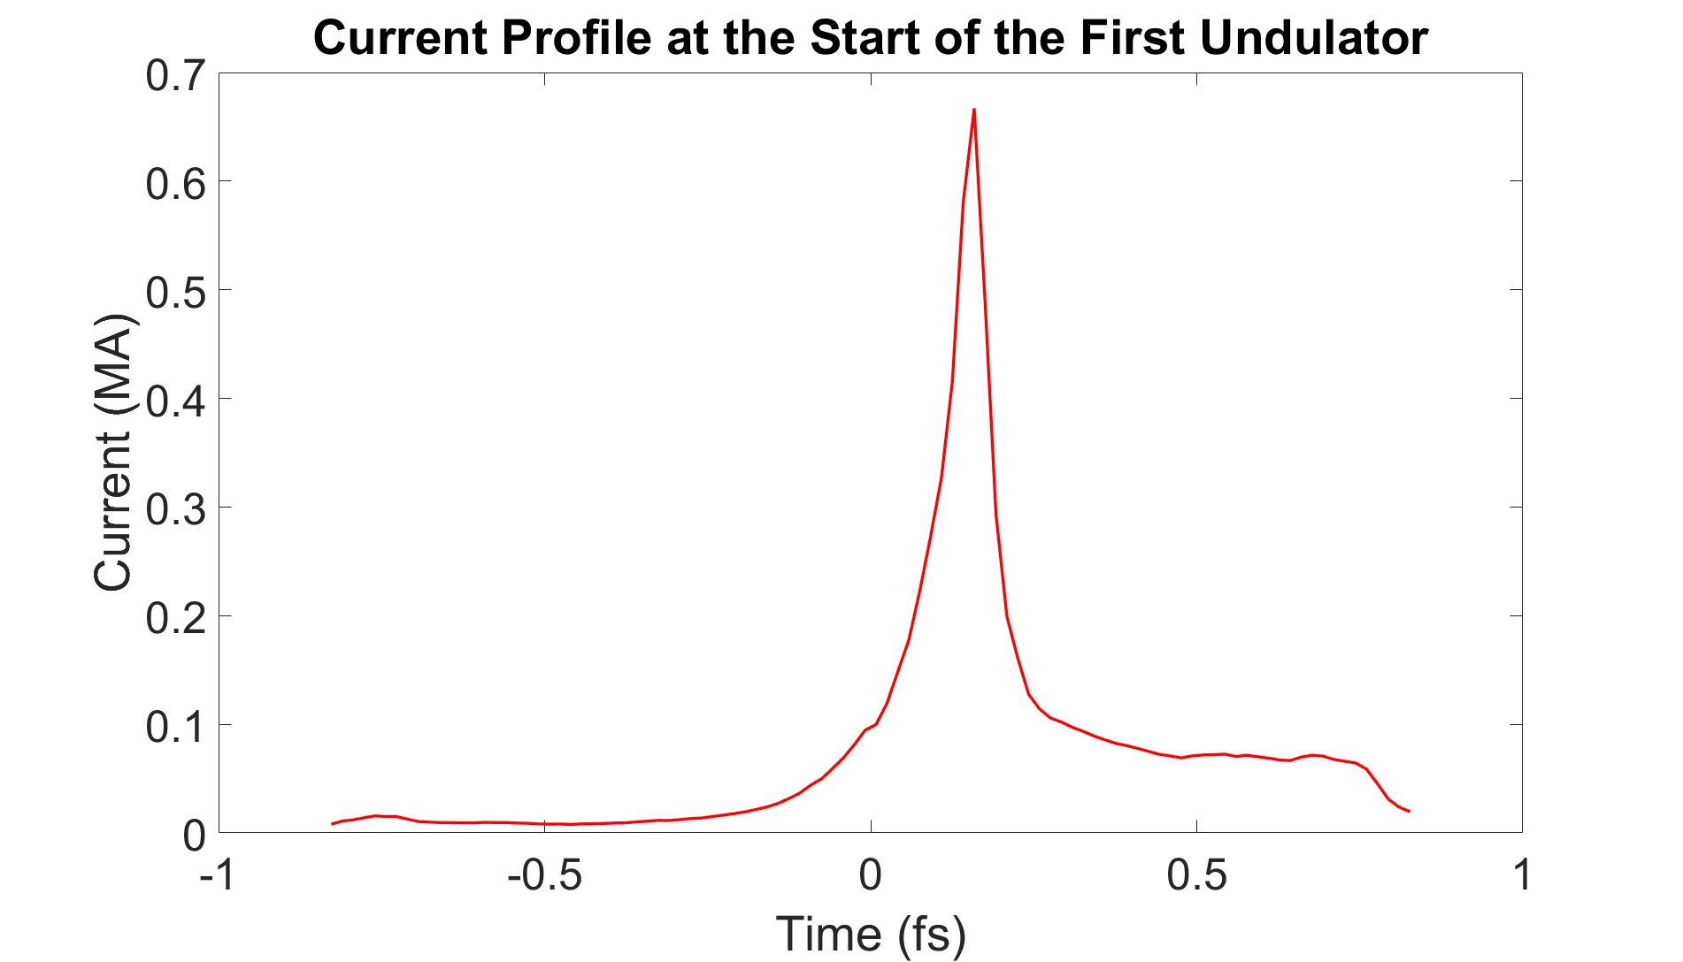
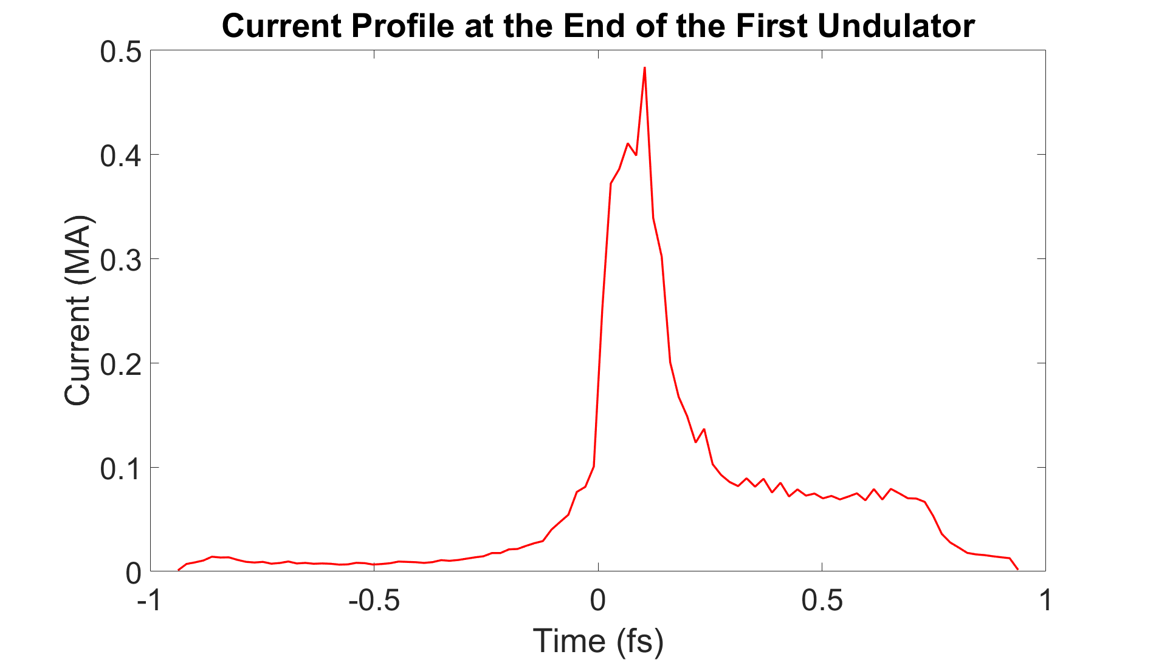
Space Charge
Simulations for this talk were done in PUFFIN, which does NOT include space charge.
This is a major limitation of this simulation.
$\frac{L_{g}}{λ_{P}}=0.17$, pondermotive force dominates

Slide 11
Conclusions and Future Work
Future Work:
Add space charge to PUFFIN
Conclusions:
PAX can be upgraded to a TW-scale source of 2 nm radiation with very short pulse length

Slide 12
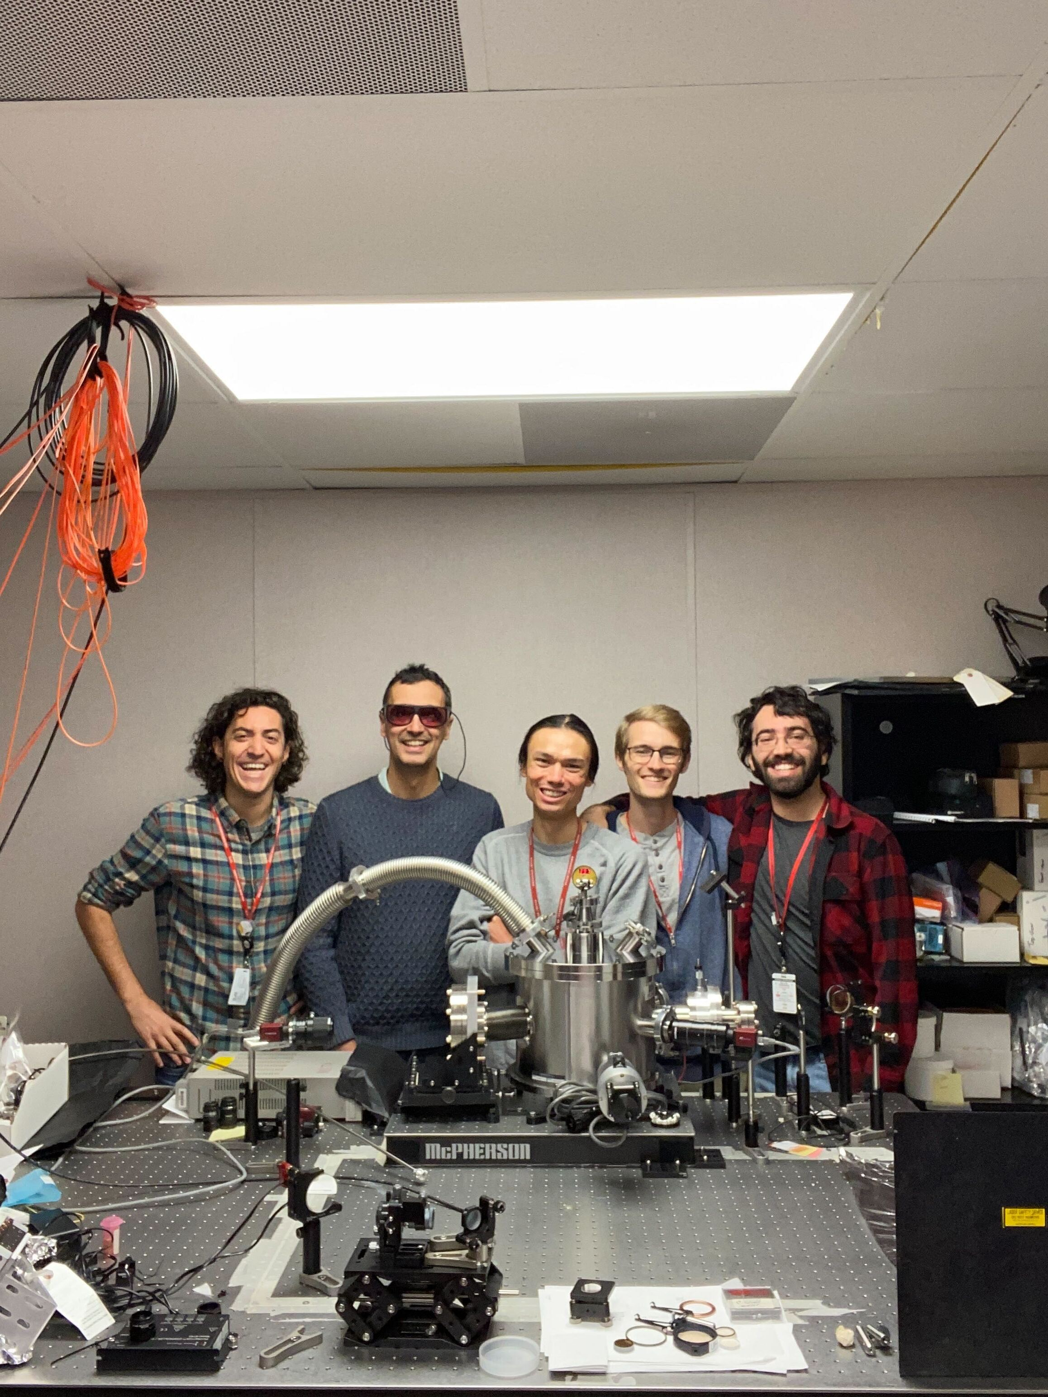
Thanks!
Other talks related to this topic:
Status and Prospects for the Plasma-drived Attosecond X-ray (PAX) source experiment at FACET-II – Claudio Emma
3:30 pm, 8/11
Plasma-based Attosecond X-ray Pulses – Agostino Marinelli
9:30 am, 11/11, Ballroom Salon D-E
Radiation detection for the PAX Experiment at FACET-II (Poster) – Rafi Hessami
5 pm, poster session
Thank you all for listening!

Slide 13
Backup Slides

Slide 14
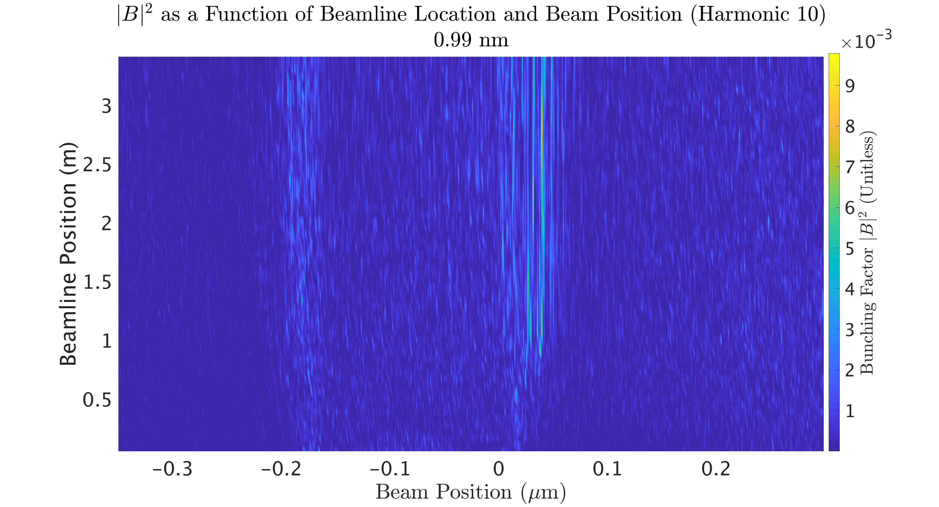
Bunching (3 Stage)
10th Harmonic:

Slide 15
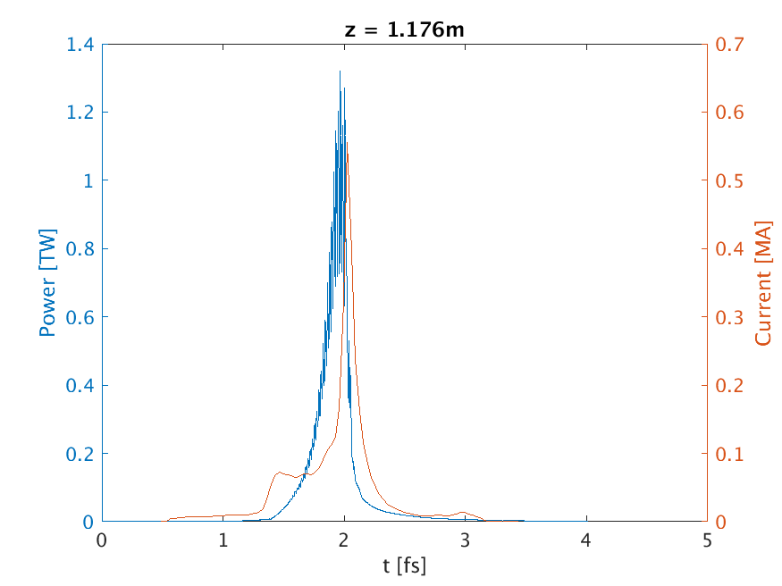
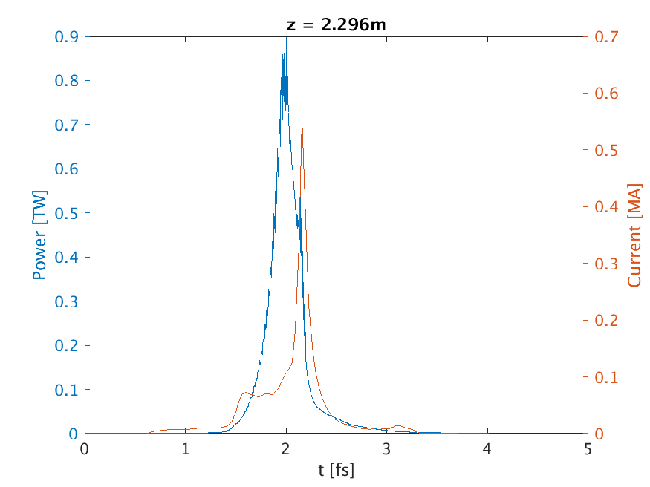
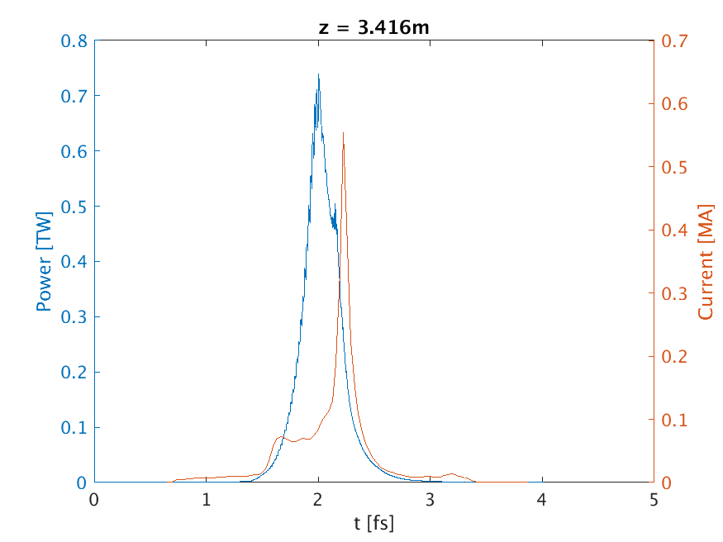
Total Power After Each Undulator

