Slide 1
AAC 2022
Nov 7th, 2022
Highly spin-polarized multi-GeV sub-femtosecond electron beams generated from single-species plasma photocathodes
Zan Nie,¹ Fei Li,¹ Felipe Morales,² Serguei Patchkovskii,² Olga Smirnova,²
Weiming An,³ Chaojie Zhang,¹ Yipeng Wu,¹ Noa Nambu,¹ Daniel Matteo,¹
Kenneth A. Marsh,¹ Frank Tsung,¹ Warren B. Mori,¹ and Chan Joshi¹
1. University of California Los Angeles
2. Max Born Institute, Berlin, Germany
3. Beijing Normal University, Beijing, China

Slide 2
Collaborators
UCLA
Fei Li, Chaojie Zhang, Yipeng Wu, Noa Nambu, Daniel Matteo, Kenneth A. Marsh, Frank Tsung, Warren B. Mori, Chan Joshi
MBI
Felipe Morales, Serguei Patchkovskii, Olga Smirnova
BNU
Weiming An

Slide 3
Outline
Background
Conventional spin-polarized electron sources
Proposals based on plasma-based accelerators
Our schemes based on ionization injection in a PWFA
Xenon + Lithium (SP ~ 31%)
Ytterbium (SP ~ 56%)
Summary

Slide 4
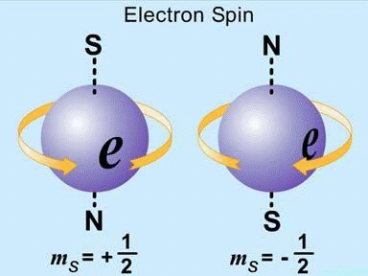
Background
Spin-polarized electrons are important in high-energy physics
colliders
parity violation measurement
new physics beyond the standard model
Plasma-based accelerators can shrink the size and cost of future colliders
However, there is still no feasible way to generate spin-polarized electrons in situ from plasma-based accelerators
D. Abbott et al. (PEPPo Collaboration), Phys. Rev. Lett. 116, 214801 (2016).
P. L. Anthony et al. (SLAC E158 Collaboration), Phys. Rev. Lett. 92, 181602 (2004).
G. Moortgat-Pick, et.al, Physics Reports 460, 131–243 (2008)

Slide 5
Conventional spin-polarized electron sources
Self-polarization via Sokolov-Ternov effect
Photoionization of state selected alkali atoms
Photoionization: Fano effect
Electron scattering (Mott)
Optically pumped He discharge
Field emission from EuS
Photoemission from GaAs
None of them can be directly incorporated into plasma-based accelerators

Slide 6
Photoemission from GaAs
$$P=\frac{N_{↑}−N_{↓}}{N_{↑}+N_{↓}}$$
$$P_{max}∼50\%$$
$$P_{max}∼100\%$$
G. Moortgat-Pick, et.al, Physics Reports 460, 131–243 (2008)

Slide 7
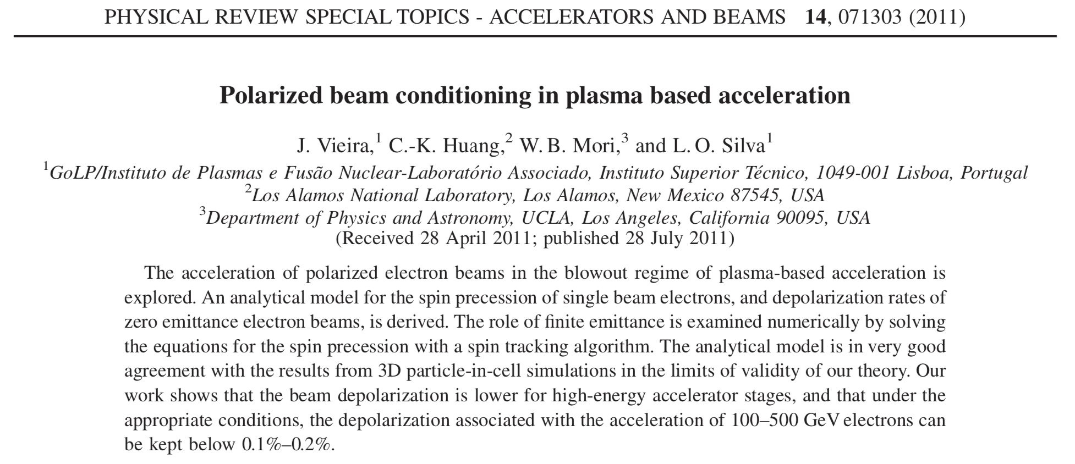
First proposal based on PBAs
J. Vieira, C.-K. Huang, W. B. Mori, and L. O. Silva, Phys. Rev. STAB 14, 071303 (2011)

Slide 8
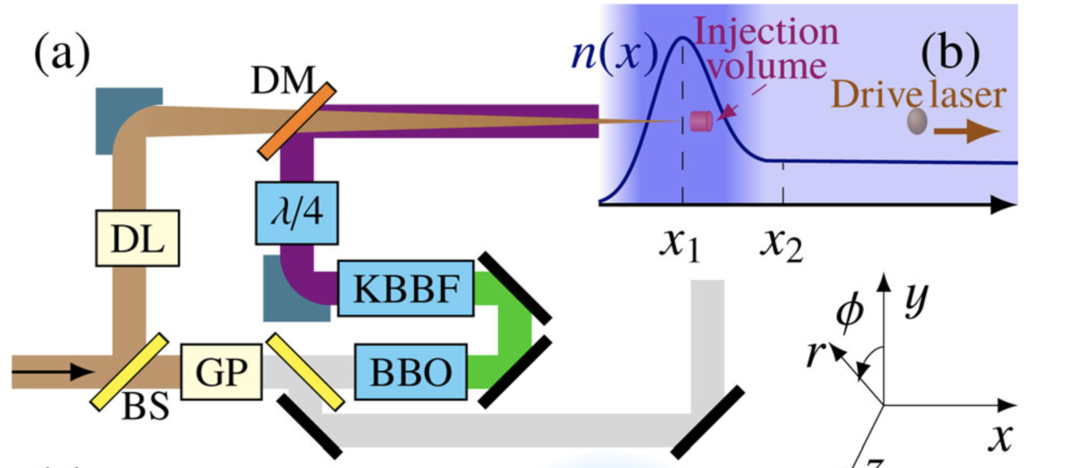
Proposals based on down-ramp injection
Down-ramp injection
2
3
M. Wen, et al., PRL 122, 214801 (2019)
Y. Wu, et al., NJP 21, 073052 (2019)
Y. Wu, et al., PRE 100, 043202 (2019)
1
1
HF molecule
alignment
(LP⟂)
2
HF molecule
photodissociation
(CP∥)
3
Photonionization
& acceleration
(LP∥)

Slide 9
Spin precession
$$\frac{ds}{dt}=Ω×s$$
T-BMT equation:
$$a=(g−2)/2=1.16×{10}^{−3}$$
$$Ω=−\left[\left(a+\frac{1}{γ}\right)B−\left(a+\frac{1}{γ+1}\right)v×E−\frac{aγ}{γ+1}v(v⋅B)\right]$$
Normalized units
$$(e=1,m=1,c=1)$$
$$(γ∼1)$$
$$(γ≫1,v_{r}≪v_{z}≃1)$$
$$Ω≃−\frac{B_{φ}}{γ}$$
$$Ω≃−\left[\left(a+\frac{1}{γ}\right)F_{r}e_{φ}\right]$$
V. Bargmann, L. Michel, and V. L. Telegdi, Phys. Rev. Lett. 2, 435–436 (1959)

Slide 10
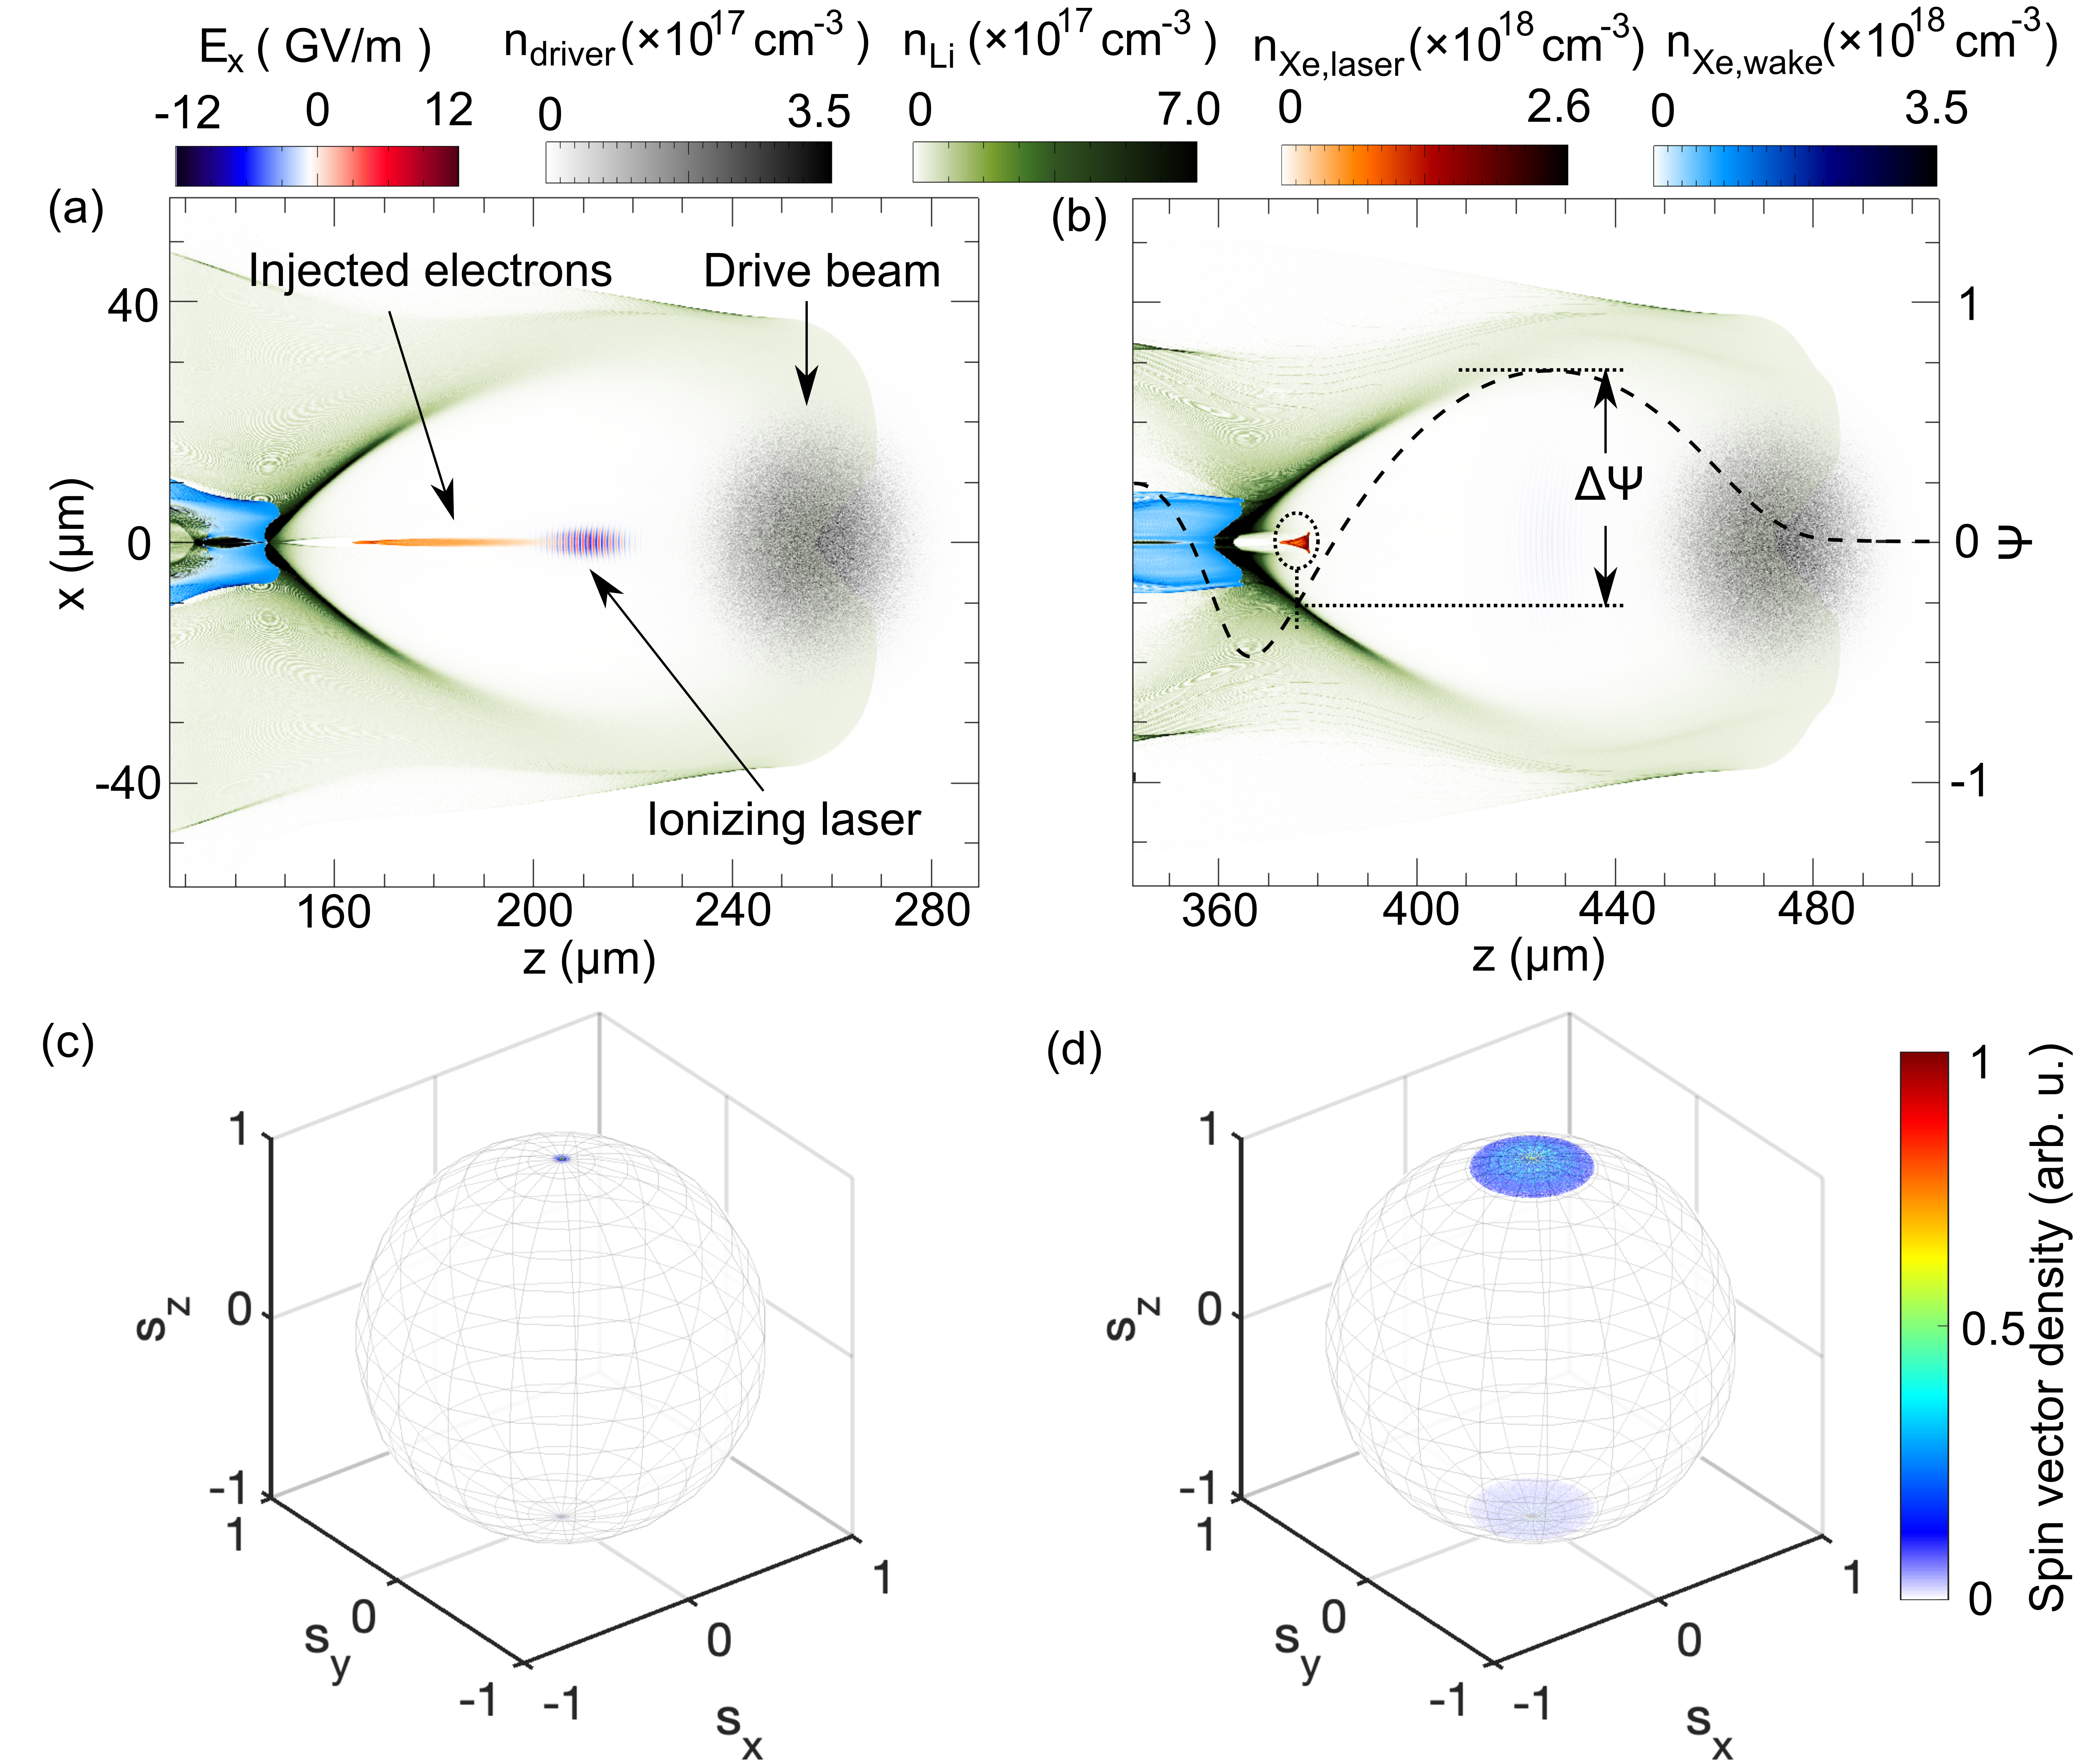
Our first scheme:
Lithium (5.4 eV) + Xenon (12.1 eV)
Spin-dependent strong-field ionization by CP lasers (not frequency-sensitive)
Trapping and acceleration in PWFA
P=32.0%
P=30.7%

Slide 11
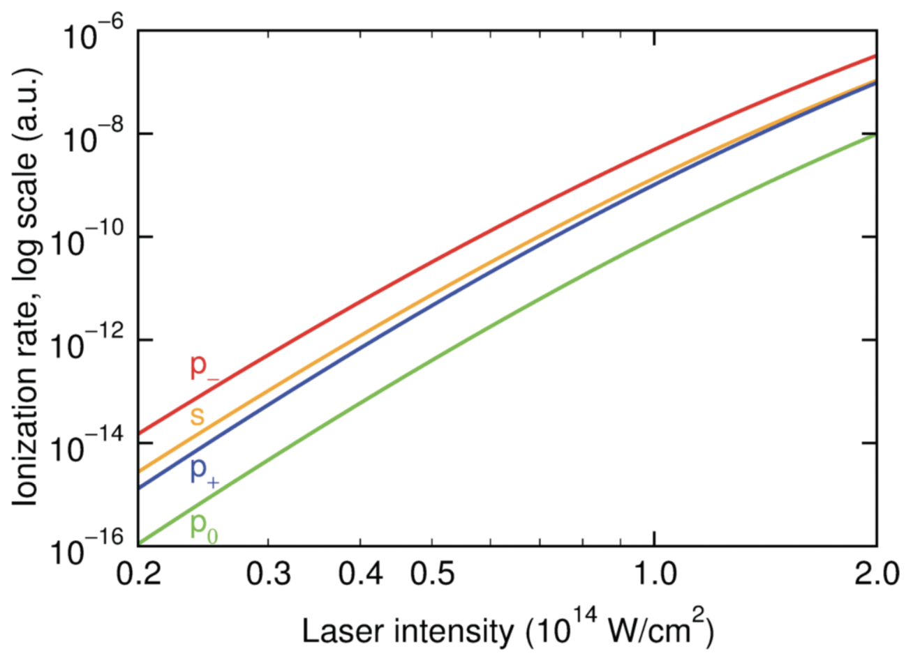
Spin-dependent strong-field ionization by CP lasers
$$W_{±}^{p±}(E)=|C_{κl}|^{2}I_{p}\left(\frac{E}{2E_{0}}\right)h_{±}^{p±}(γ)exp\left(−\frac{2E_{0}}{3E}g(γ)\right)$$
$$h_{±}^{p_{0}}(γ)=h^{s}(γ)\frac{3E}{2E_{0}}(1−ζ)\sqrt{\frac{1+γ^{2}}{ζ^{2}/γ^{2}+1}}$$
$$h_{±}^{p±}(γ)=h^{s}(γ)\frac{3(1+γ^{2})}{2(1−ζ_{0}^{2})}{\left(\sqrt{\frac{ζ^{2}/γ^{2}+1}{1+γ^{2}}}∓\frac{ζ_{0}}{γ}sgn(m)\right)}^{2}$$
Revolving door
I. Barth, et al., Phys. Rev. A. 87, 013433 (2013)

Slide 12
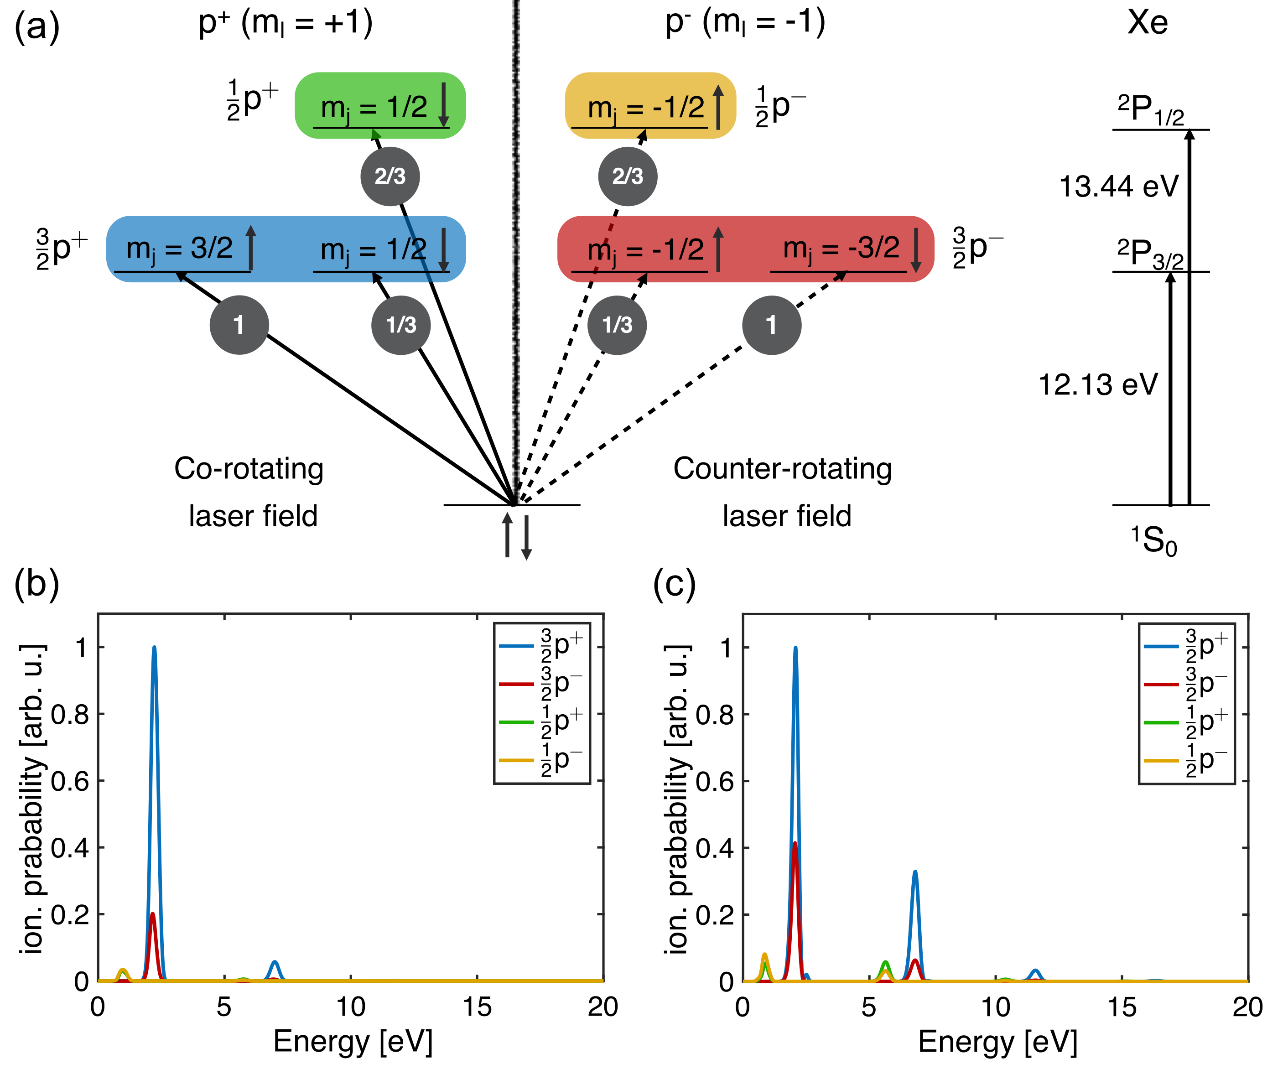
Spin selectivity of p-orbitals
$$Xe=[Kr]4d^{10}5s^{2}5p^{6}$$
$$P=\frac{N_{↑}−N_{↓}}{N_{↑}+N_{↓}}$$
$$W_{↑}=W_{\frac{3}{2}p^{+}}+\frac{2}{3}W_{\frac{1}{2}p^{−}}+\frac{1}{3}W_{\frac{3}{2}p^{−}}$$
$$W_{↓}=W_{\frac{3}{2}p^{−}}+\frac{2}{3}W_{\frac{1}{2}p^{+}}+\frac{1}{3}W_{\frac{3}{2}p^{+}}$$
$$P_{max}≃\frac{3−1}{3+1}=50\%$$

Slide 13
TDSE results in multi-photon regime (260 nm)
Z. Nie, et al., PRL 126, 054801 (2021)
𝜸 = 20.7
𝜸 = 8.8
$$I=4.5×{10}^{12}W/cm^{2}$$
$$I=2.5×{10}^{13}W/cm^{2}$$
$$P=37\%$$
$$P=32\%$$

Slide 14
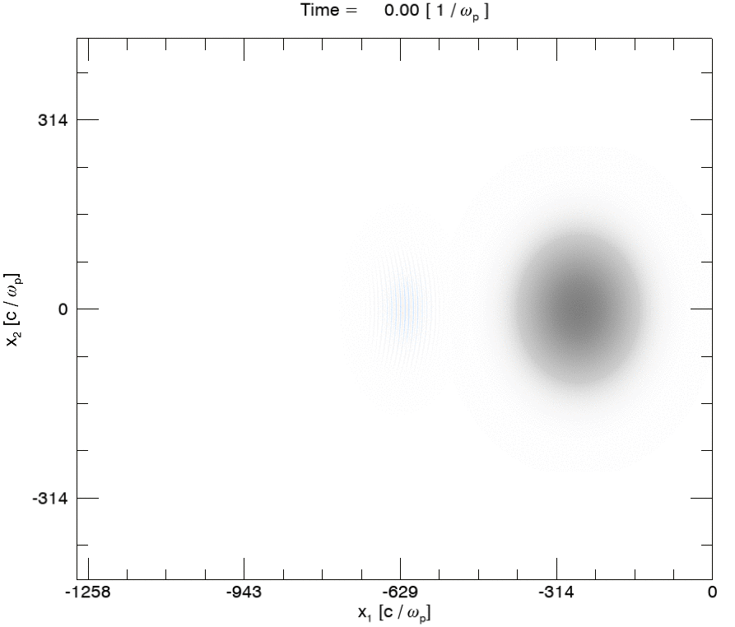
Evolution of injected electrons
Li density | 8.7⨉10¹⁶ cm⁻³
Xe density | 8.7⨉10¹⁷ cm⁻³
Drive beam energy | 10 GeV
Drive beam charge | 658 pC
Drive beam 𝝈r | 11.4 𝜇m
Drive beam 𝝈z | 11.4 𝜇m
Laser polarization | Circular
Wavelength | 260 nm
Peak a0 | 7.8⨉10⁻⁴
Peak intensity | 2.5⨉10¹³ W/cm²
Spot size w0 | 1.5 𝜇m
Pulse duration | 30 fs

Slide 15
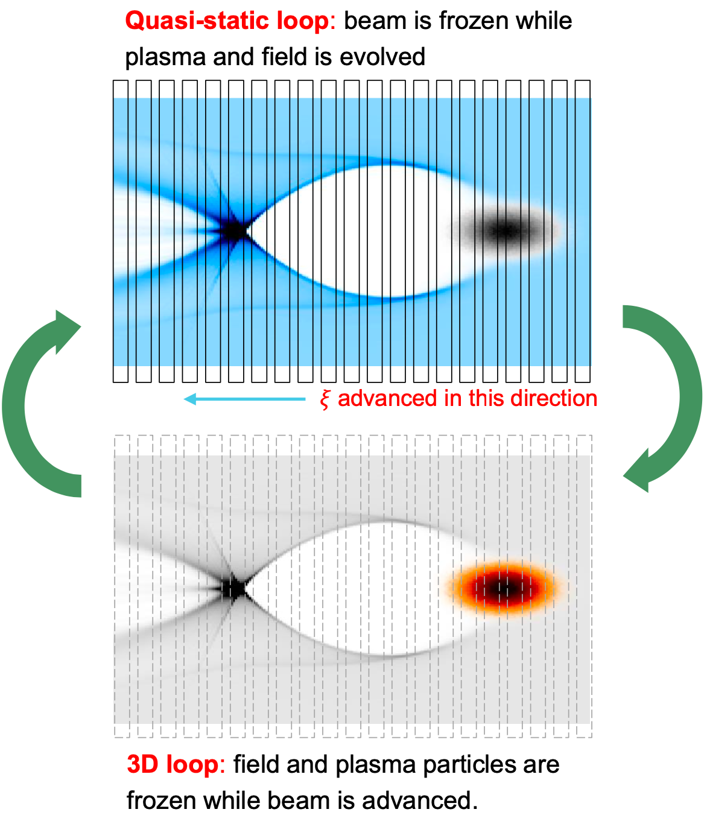
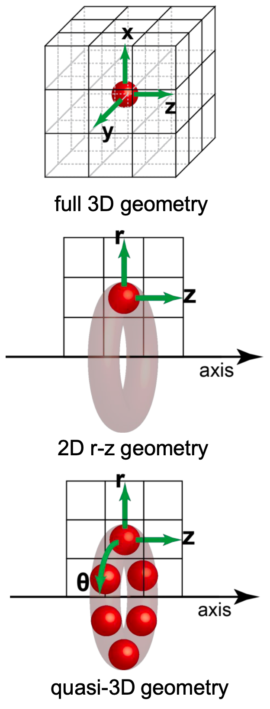
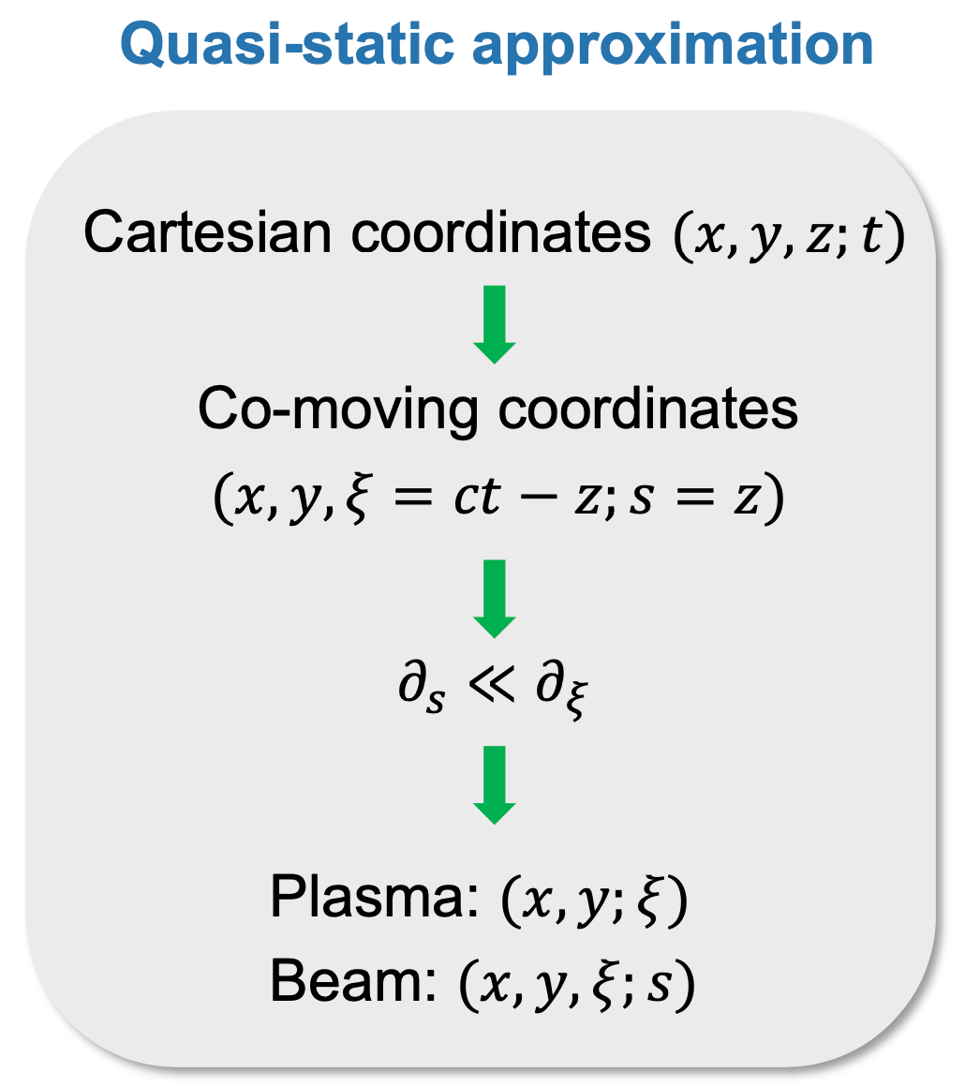
QuickPIC with Azimuthal Decomposition
Quasi-static + Quasi-3D
F. Li, et al., CPC 261, 107784 (2021)

Slide 16
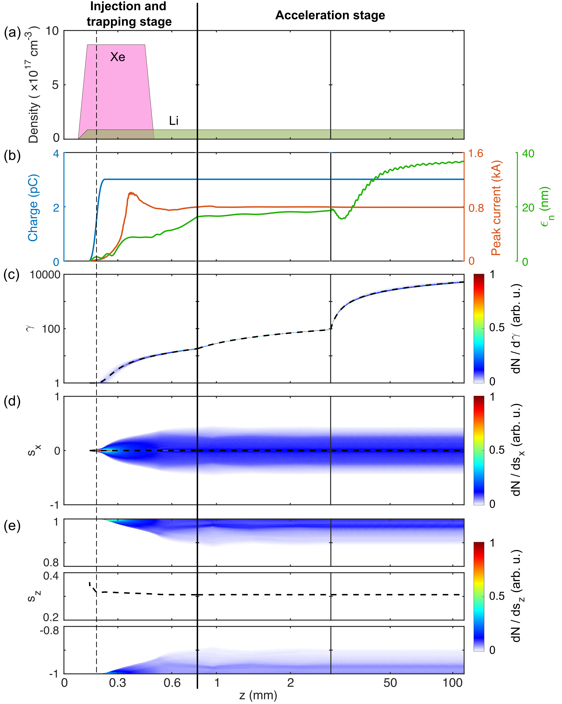
Evolution of injected electrons
Z. Nie, et al., PRL 126, 054801 (2021)
OSIRIS
QPAD
$$Q=3pC$$
$$I_{peak}=0.8kA$$
$$ε_{n}=36.6nm$$
$$⟨γ_{b}⟩=2.7GeV$$

Slide 17
OSIRIS
QPAD
Z. Nie, et al., PRL 126, 054801 (2021)
$$P=⟨s_{z}⟩=30.7\%$$

Slide 18
Our second scheme:
using Yb instead of Xe + Li
$$Xe=[Kr]4d^{10}5s^{2}5p^{6}$$
SP electrons
$$Yb=[Xe]4f^{14}6s^{2}$$
$$Li$$
Plasma background electrons

Slide 19
Spin selectivity of f-orbitals
$$Yb=[Xe]4f^{14}6s^{2}$$
$$m_{l}=+3$$
$$m_{l}=−3$$
$$Yb^{3+}$$
$$m_{j}=5/2$$
$$m_{j}=−5/2$$
$$J=5/2$$
6/7
6/7
$$I_{p}^{5/2}=26.32eV$$
$$m_{j}=7/2$$
$$m_{j}=5/2$$
$$m_{j}=−5/2$$
$$m_{j}=−7/2$$
$$J=7/2$$
1
1/7
1/7
1
$$P_{max}≃\frac{7−1}{7+1}=75\%$$
$$I_{p}^{7/2}=25.05eV$$
Co-rotating
laser field
Counter-rotating
laser field
$$Yb^{2+}$$
J. Kaushal and O. Smirnova, J. Phys. B 51, 174001 (2018)
J. Kaushal and O. Smirnova, J. Phys. B 51, 174003 (2018)
W. C. Martin, R. Zalubas, and L. Hagan, Atomic Energy Levels
- the Rare-Earth Elements : (Gaithersburg, MD, 1978).

Slide 20
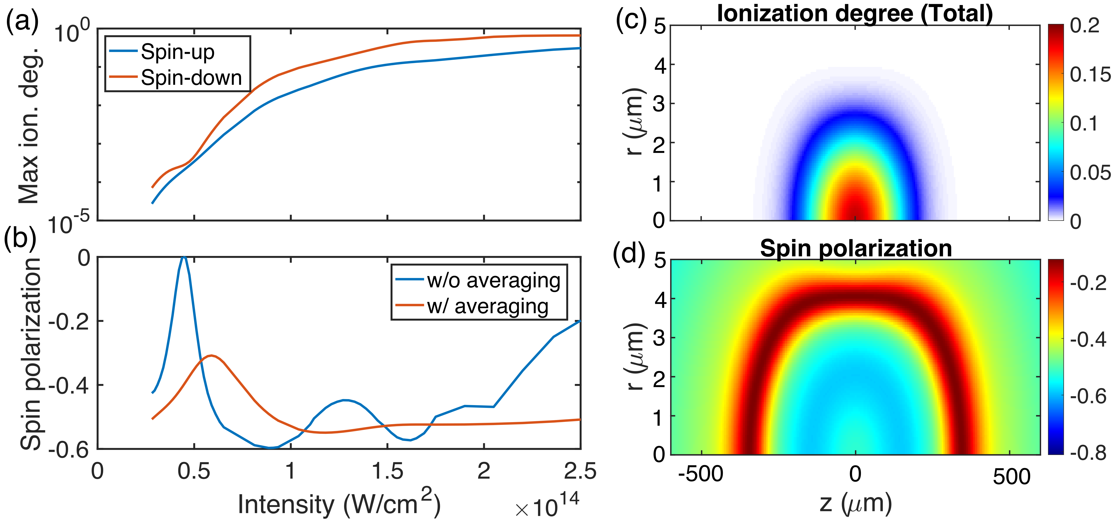
Spin polarization of Yb III
Freeman
resonance
Z. Nie, et al., PRR 4, 033015 (2022)

Slide 21
Simulation parameters
Yb density | 5.2⨉10¹⁶ cm⁻³
Drive beam energy | 10 GeV
Drive beam charge | 1.2 nC
Drive beam 𝝈r | 6.4 μm
Drive beam 𝝈z | 12.7 μm
Normalized emittance εN | 16 μm
Laser polarization | Circular
Wavelength | 400 nm
Peak a0 | 2.62⨉10⁻³
Peak intensity | 1.18⨉10¹⁴ W/cm²
Spot size w0 | 6 μm
Pulse duration | 60 fs

Slide 22
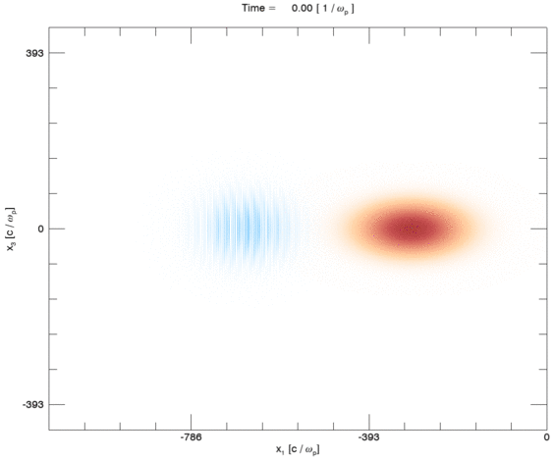
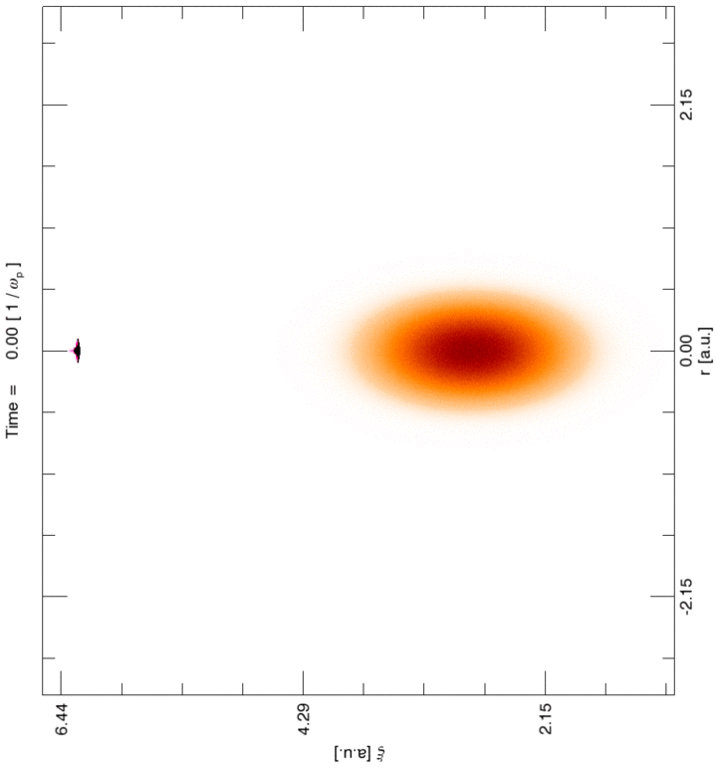
OSIRIS and QPAD simulations of Yb
QPAD
OSIRIS
Z. Nie, et al., PRR 4, 033015 (2022)

Slide 23
Two snapshots of PIC simulations
Z. Nie, et al., PRR 4, 033015 (2022)

Slide 24
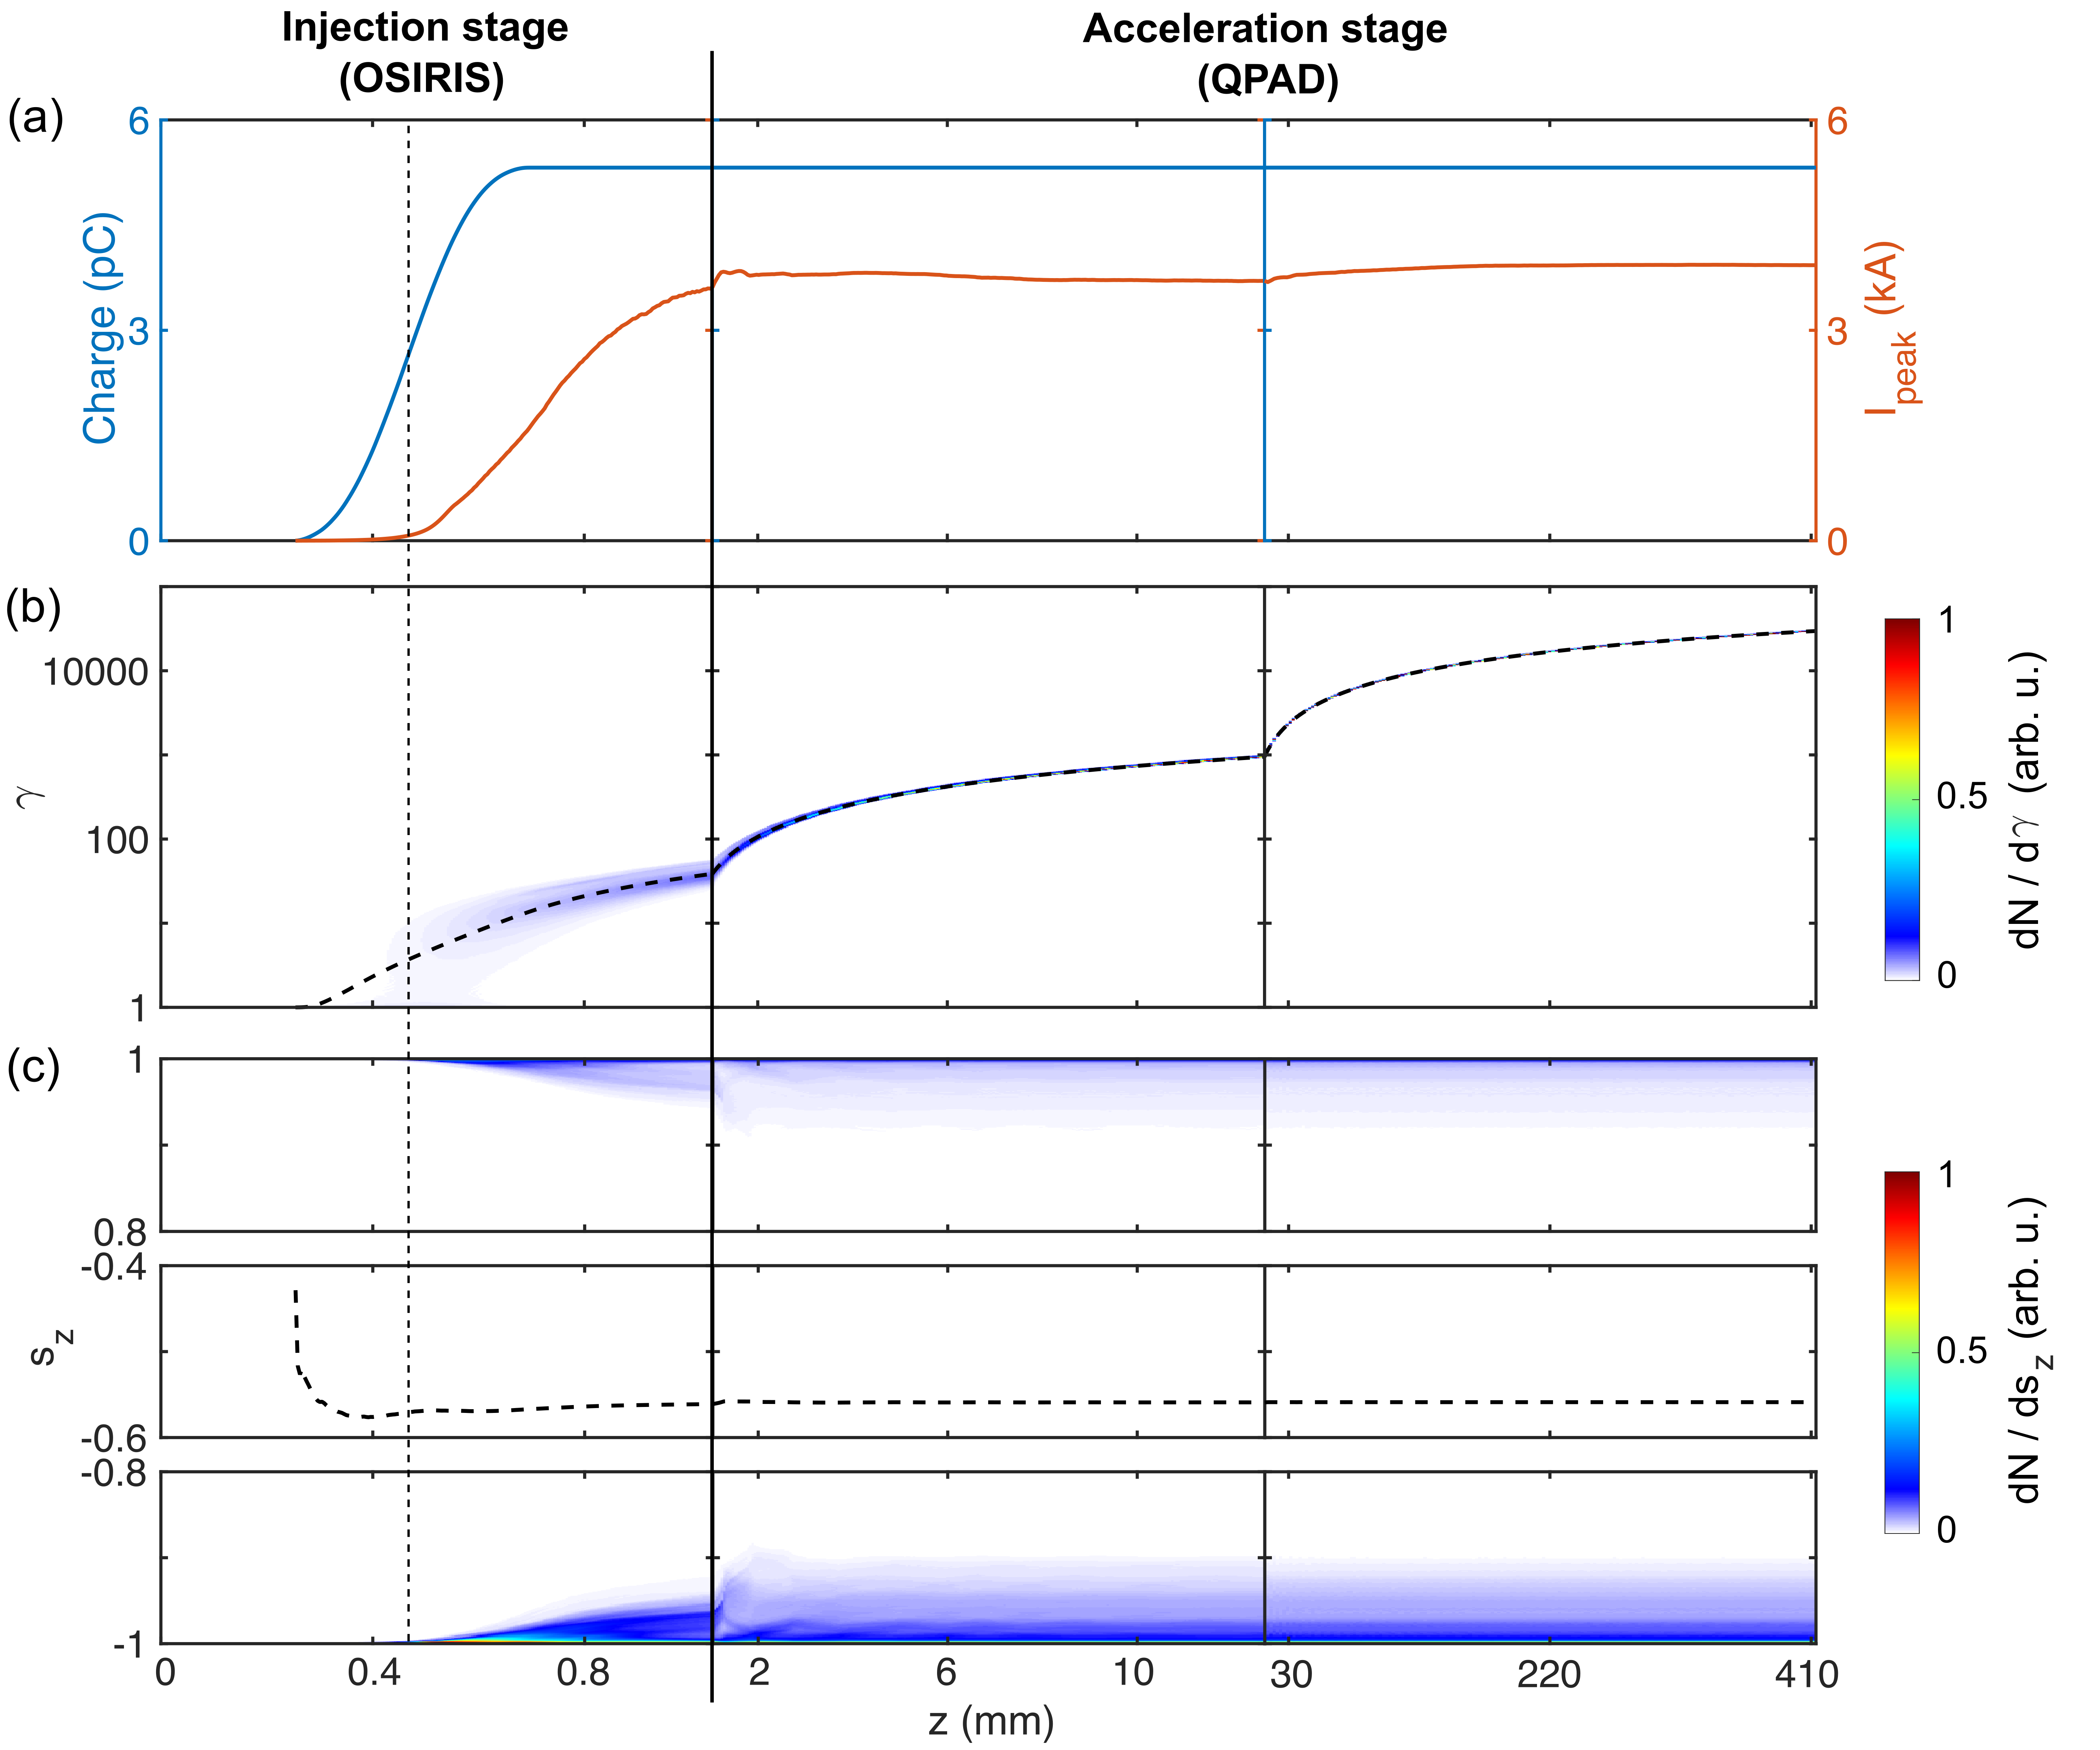
$$P=⟨s_{z}⟩=56\%$$
$$E=15GeV$$
$$Q=5.3pC$$
$$I_{peak}=4kA$$
$$ε_{n}=180nm$$
Z. Nie, et al., PRR 4, 033015 (2022)

Slide 25
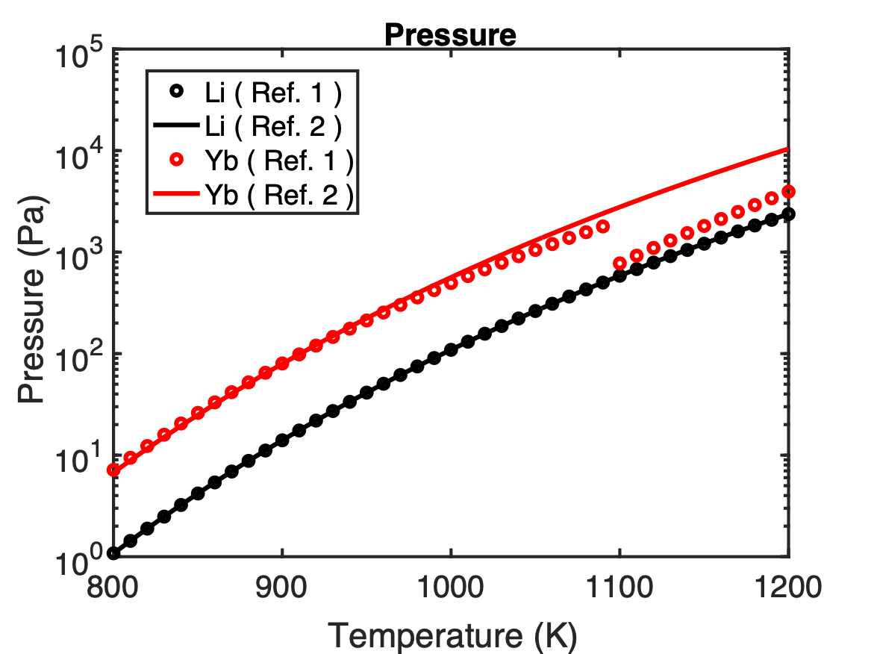
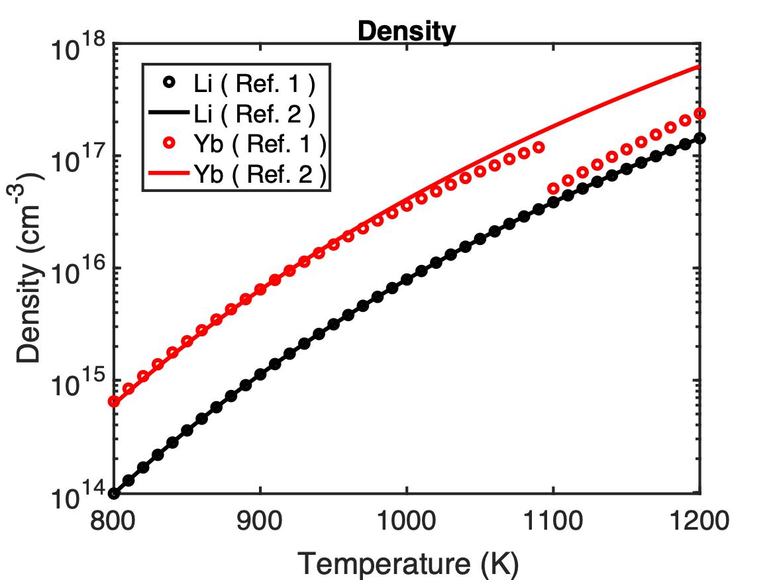
Yb oven v.s. Li oven
Melting point of Yb
[1] https://www.iap.tuwien.ac.at/www/surface/vapor_pressure
[2] Alcock, C. B., Itkin, V. P., and Horrigan, M. K., Canadian Metallurgical Quarterly, 23, 309, 1984;
https://en.wikipedia.org/wiki/Vapor_pressures_of_the_elements_(data_page)

Slide 26
Summary
We proposed a new scheme to generate high-energy, low-emittance, high-peak-current, spin-polarized electrons in situ by spin-dependent photoionization injection in a PWFA.
We verified such a scheme by TDSE/PIC simulations.
High degree of spin-polarization (56%) is obtained by ionizing f-orbital electrons of Yb.
Next talk by Nainoa Nambu will discuss how to measure spin-polarized GeV electrons from a PWFA.

