Slide 1

Plasma Heating and Expansion in PWFA Experiments at FACET
Formation of Collisionless Shocks and Filamentation Instability
Ken Marsh
Advance Accelerator Concepts 2022
Long Island New York

Slide 2
The problem of heat removal in PWFA’s
In the best case all the beam energy is deposited into the wake creating a very high temperature plasma
This energy will have to be removed before the next beam cycle
FACET I beam parameters
  20 GeV
  20 kA
  2 nC (approximately 40 joules deposited into wake)
Interesting physics of the filamentation instability of the remaining hot plasma

Slide 3
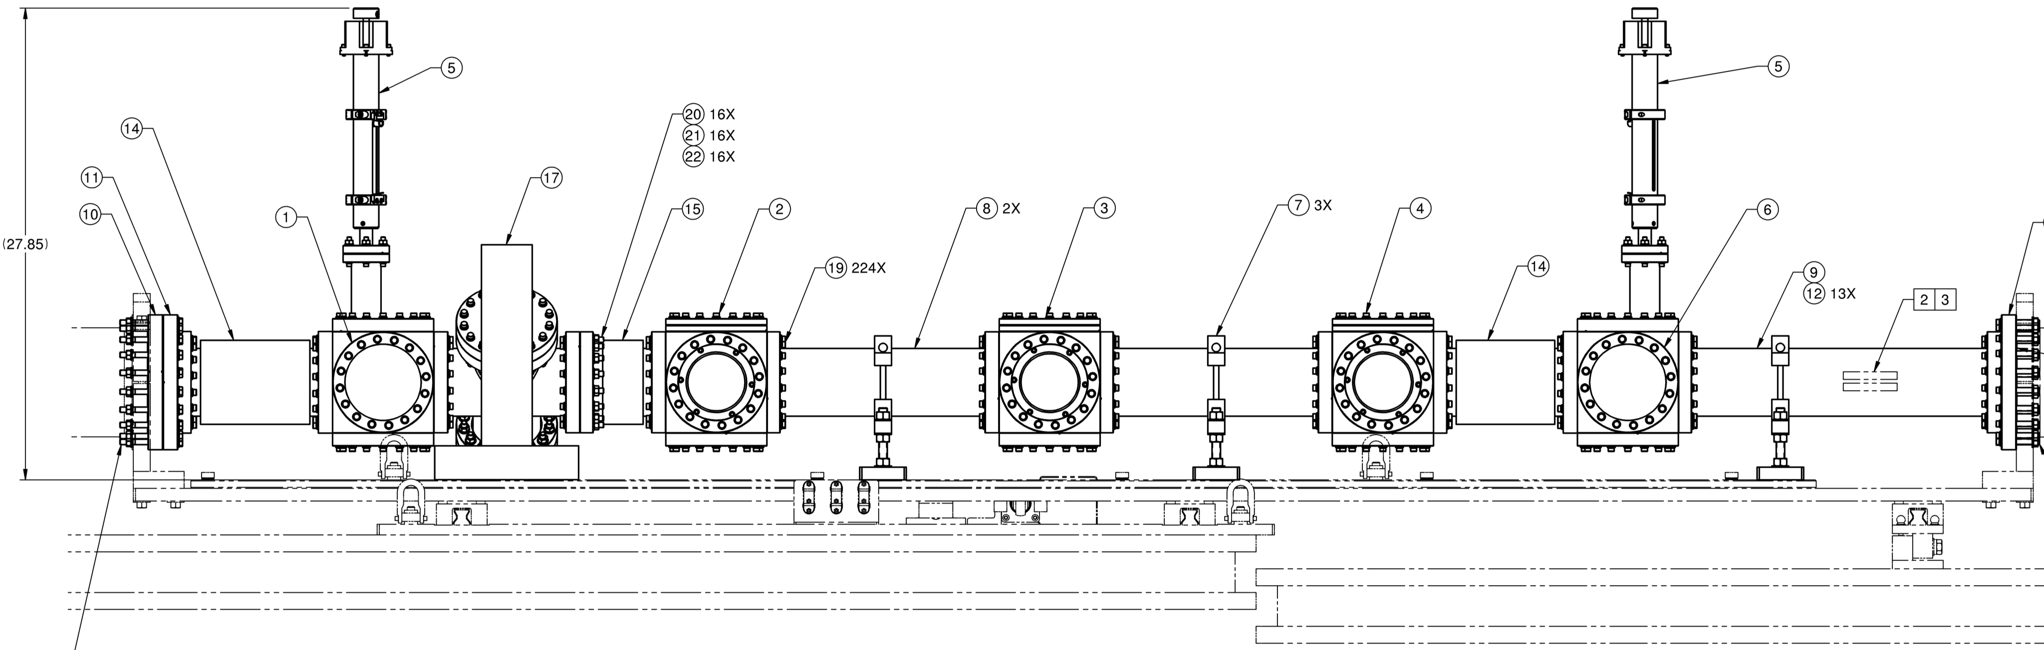
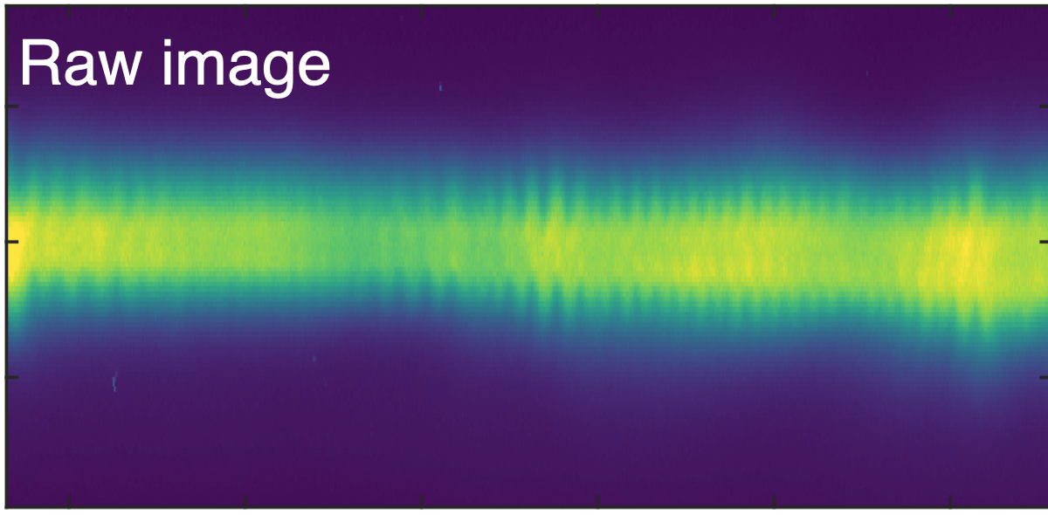
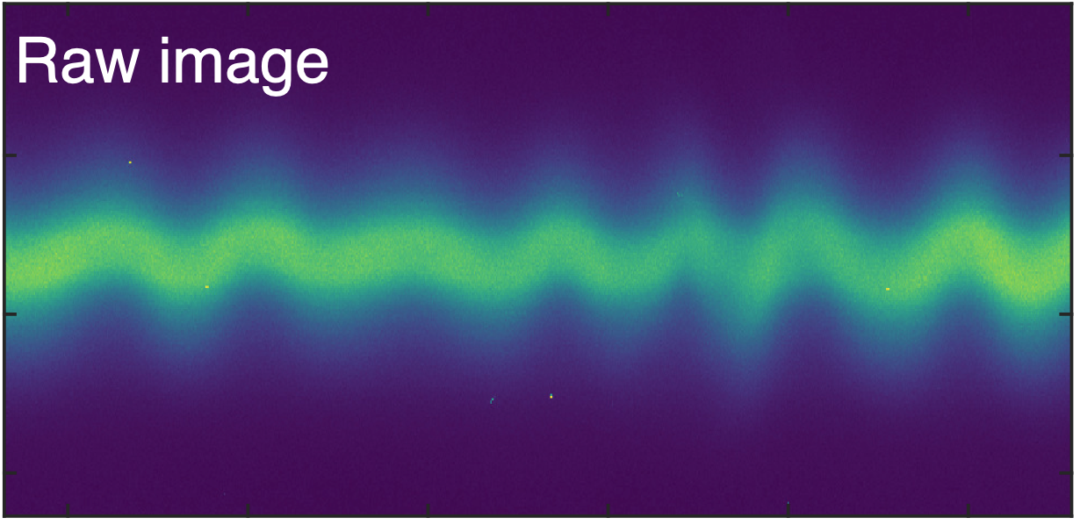
Experimental set up
View ports along hydrogen filled beamline show oscillations in plasma recombination light
at long and short wavelengths
Notes:
Oscillating structure can be seen in viewports

Slide 4
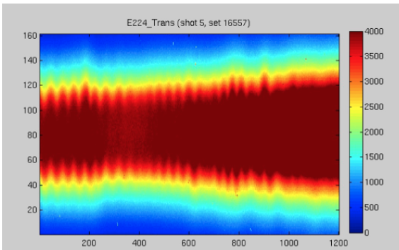
Periodic structures seen in time integrated recombining plasma.
Recombination light from H2 plasma using line filter; 656 nm (H alpha)
Long wavelength structures appear at low density
and not yet understood
Short wavelength, large radius structures can be explained by
Weibel/filamentation instability

Slide 5
Some image processing
Raw – DC image
Raw image
DC component
These structures are from embedded ion density modulations.
Weibel/filamentation instabilities can create
periodic magnetic fields and density structures in plasmas.
Notes:
Processed image removes DC light levels

Slide 6
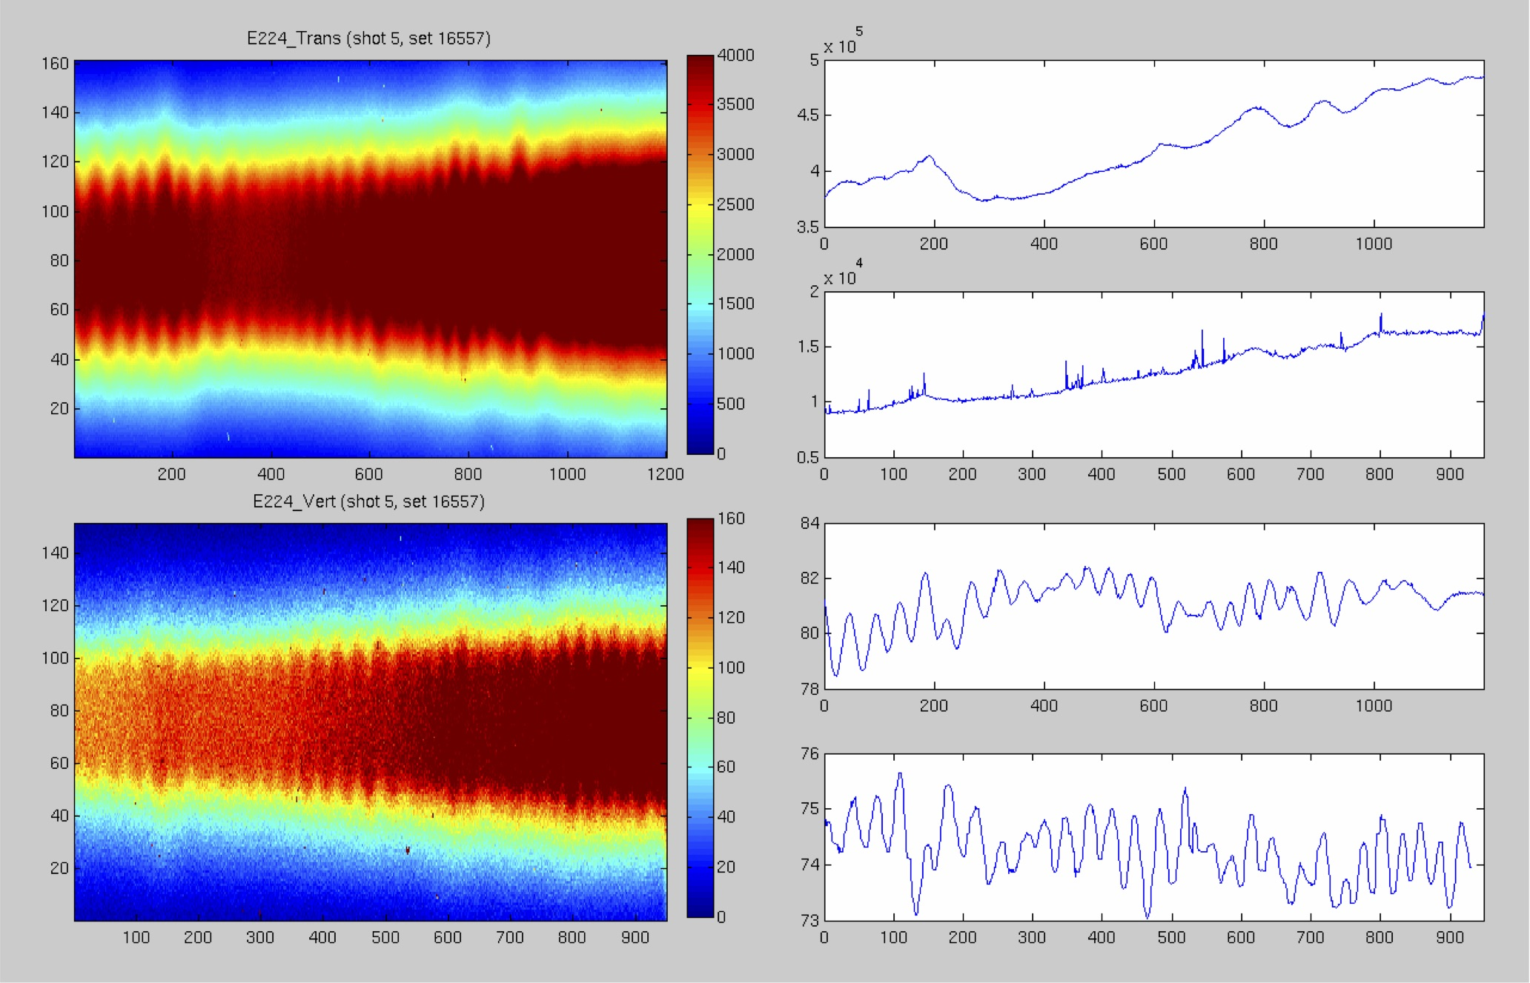
Top view and side view cameras show helical structure.
Side view
Top view
Notes:
These helical structures are known in simulation but not seen in lab

Slide 7
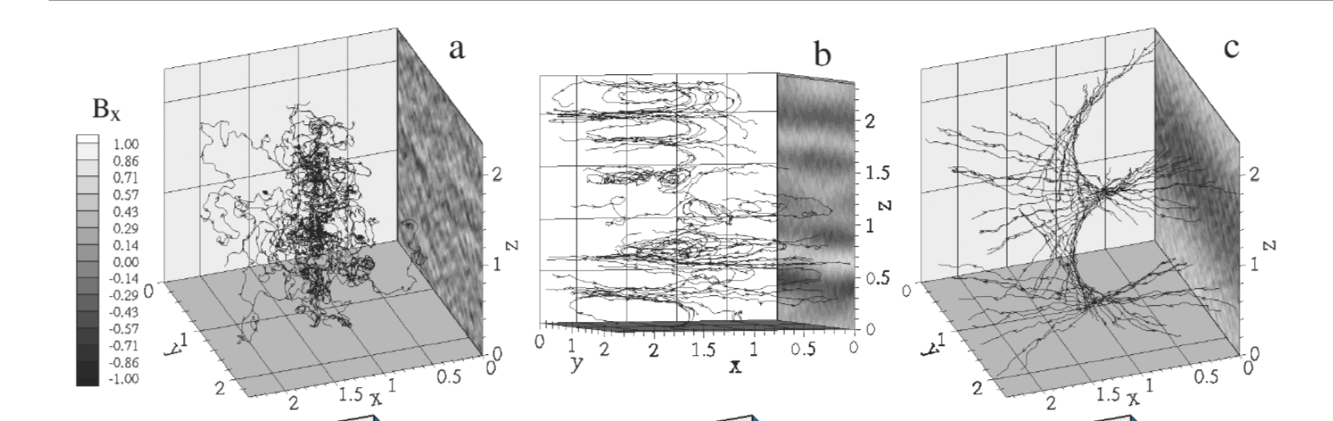
Helical B fields seen in simulations
Helical magnetic structures from anisotropic electrons, seen in plasma simulation and theory
  D. V. Romanov PRL, 93, 215004 (2004)
  Zhang (2020)
Notes:
Created hot plasma asymmetry and let it expand. Magnetic field evolves in time

Slide 8
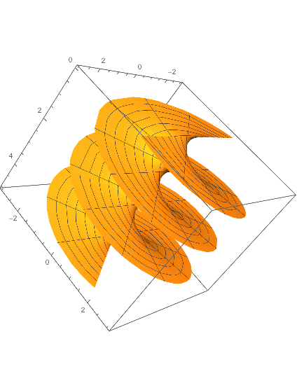
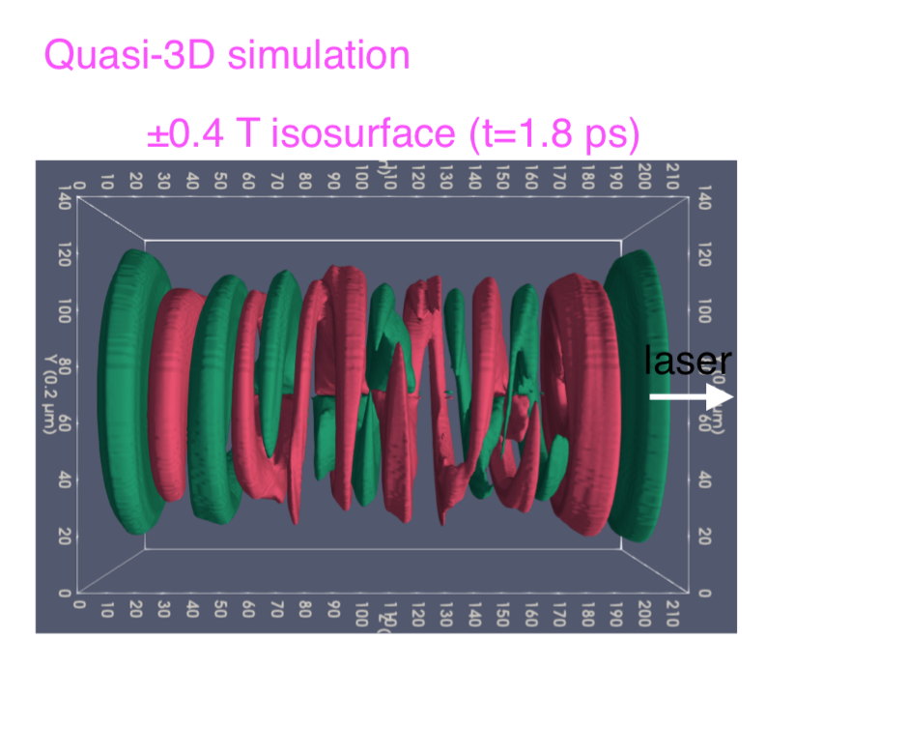
Helicoid magnetic field,
Also seen in cylindrical PIC
Laser plasma electron instability
by Chaojie Zhang UCLA
B
Notes:
Actually helicoid shape as opposed to helix.
At about the same time we saw the structures at FACET Chaojie started investigating Weibel filamentation instabilties in laser produced plasmas

Slide 9
Simplified Physical Mechanism
Large amount of energy into wake -> phase mixing heating-> hot plasma electrons
Plasma expands -> shock formation -> ambient gas ionization
Ion Weibel/ filamentation instability
B field is frozen into plasma along with ion density modulation

Slide 10
Initial plasma temperature
Energy balance shows average electron temperature scales as (density)^{1/2}
Initial plasma temperature in PIC, 100-200 keV
Cooling to 40 keV in first 60 psec

Slide 11
Plasma expansion
Not typical hydrodynamic expansion
Collisionless shock expansion requirements.
Can shock ionize ambient hydrogen to a mm scale radius?
Ionizing collisions from expanding plasma ions?
Notes:
Not hydro like in laser experiments. But no electron collisions

Slide 12
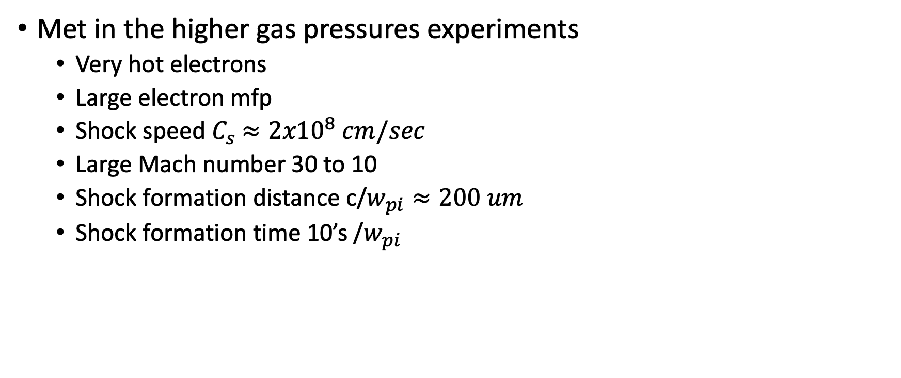
Collsionless shock formation requirements
Met in the higher gas pressures experiments
  Very hot electrons
  Large electron mfp
  Shock speed $C_{s}$ $≈{2x10}^{8} cm/sec$
  Large Mach number 30 to 10
  Shock formation distance c/$w_{pi}≈200 um$
  Shock formation time 10’s /$w_{pi}$

Slide 13
Ionization of ambient surrounding gas, H2
Difficult to fully beam ionize H2
  First ionization 15.4 eV, second ionization 30 eV
  Direct e-beam ionization estimate ∼50%, H₂⁺
Ionization of surrounding gas
  Shock field partially ionize surrounding gas.
  Collisional ionization from expanding ions (H⁺, H₂⁺)

Slide 14
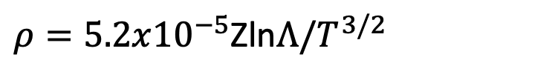

Magnetic diffusion time is very long
$$T_{D}=L^{2}μ_{0}/ρ$$
resistivity
$ρ=5.2x{10}^{−5}$Zln$Λ/T^{3/2}$
For T=1 keV, L=1 mm
T_{D}=76 us
For T=10 keV, L=1 mm
T_{D}=204 ms
Does not depend on density!

Slide 15
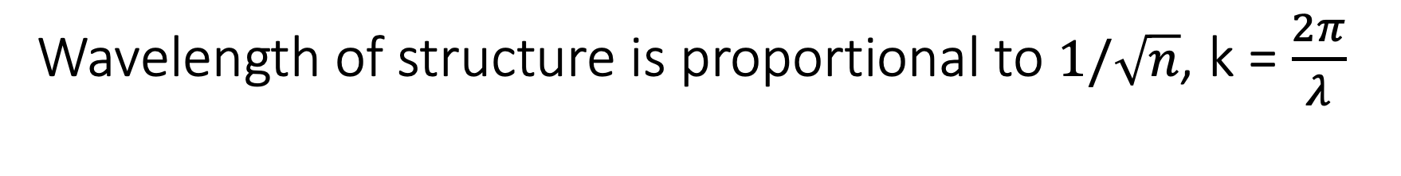
Wavelength of structure is proportional to $1/\sqrt{n}$, k = $\frac{2π}{λ}$
Measured filament wavelength verses full ionization density
k_{max} = (a_{i}/3)^{1/2} w_{pi}/c
= (f)^{1/2} (a_{i}/3)^{1/2} w_{pi}/c
f is the ionization fraction correction
Agrees with simulation

Slide 16
Temperature anisotropy verses time in PIC
Simulation work in progress
Notes:
Due to phase mixing

Slide 17
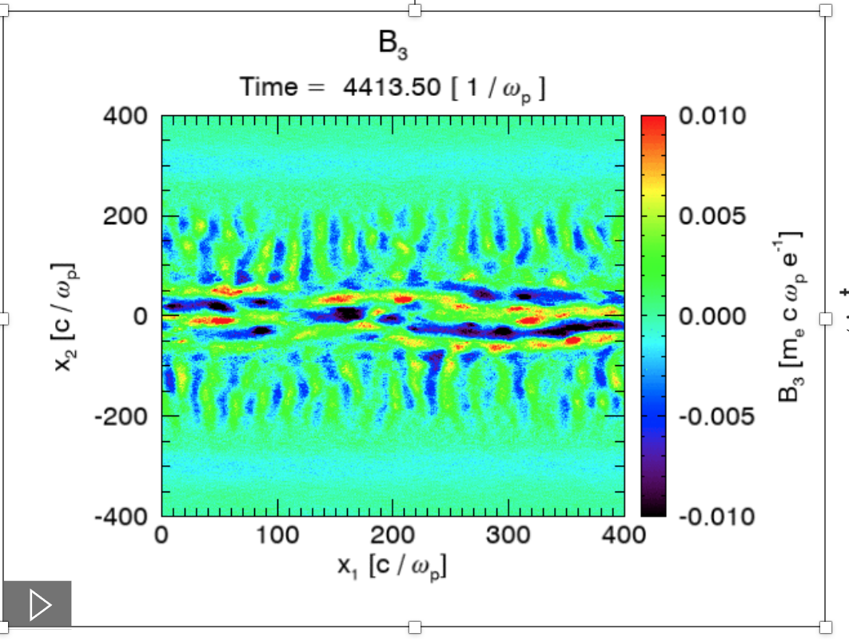
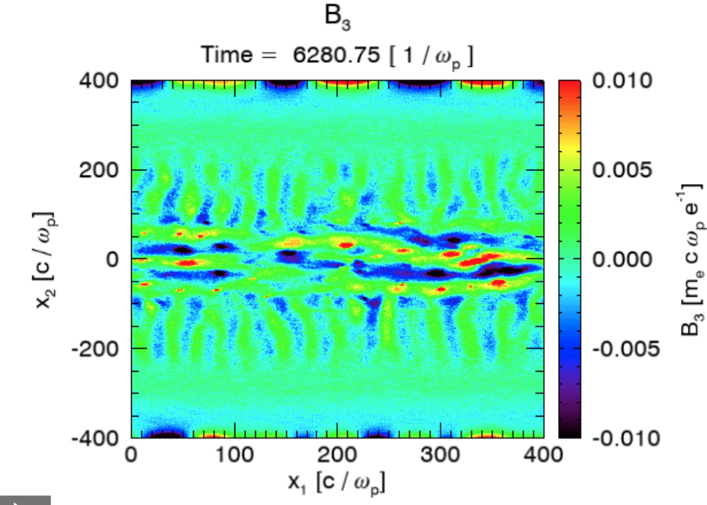
PIC simulation of B field
As plasma cools the wavelength of B field grows

Slide 18
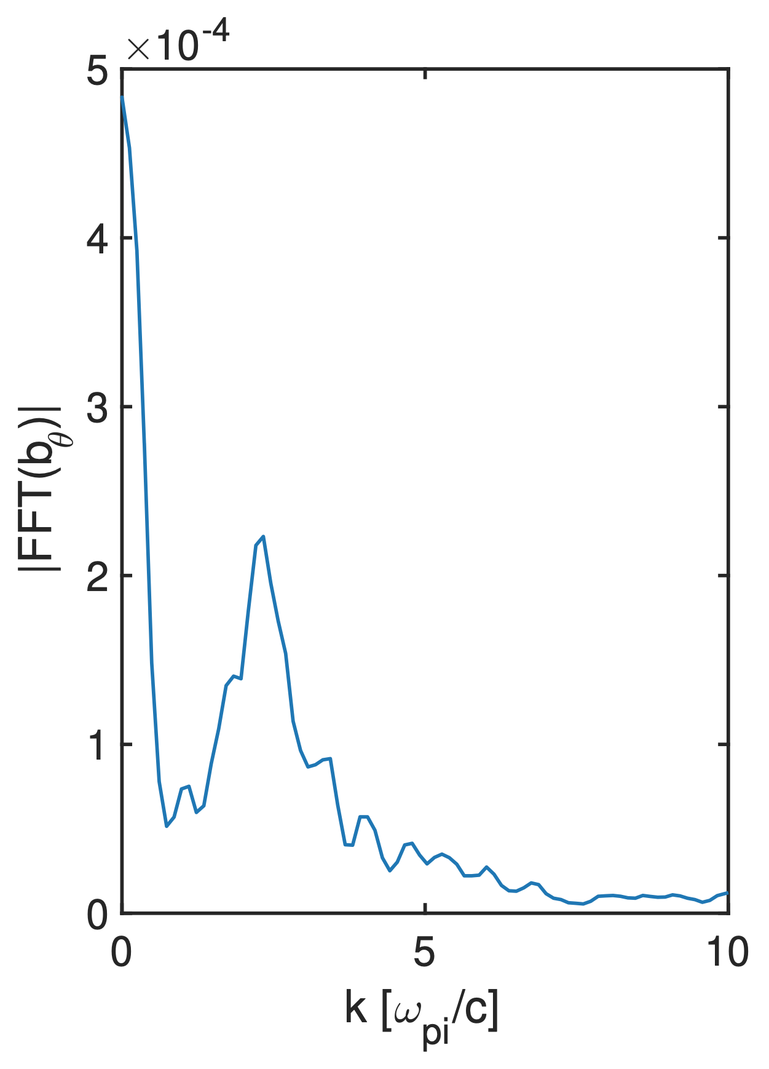
Wavenumber approximately the same in simulation, experiment and theory
k∼2.3 ωpi/c

Slide 19
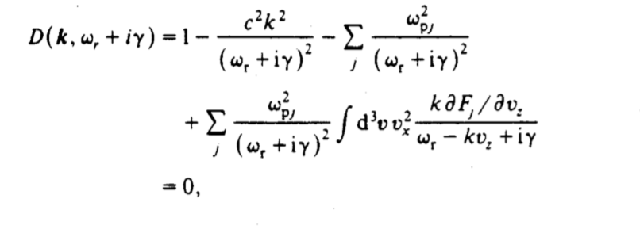
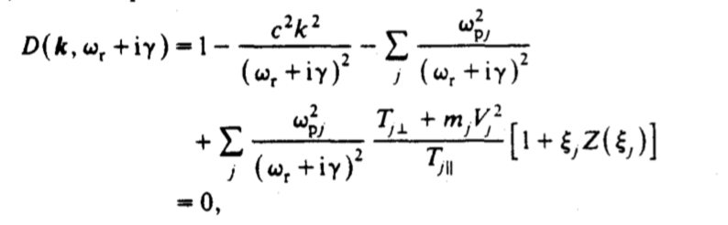
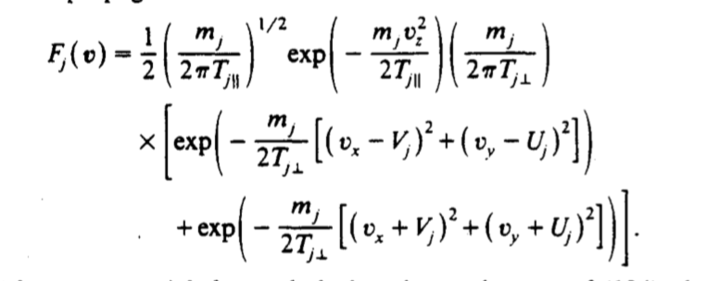
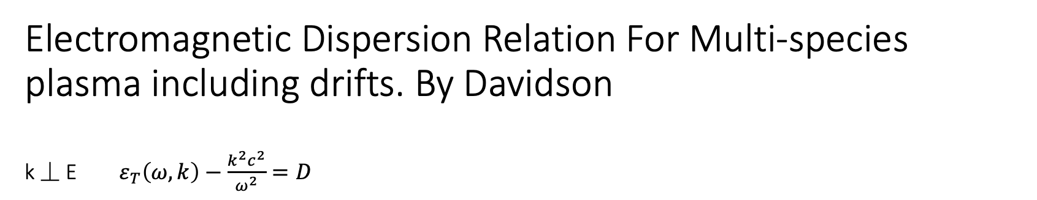
Electromagnetic Dispersion Relation For Multi-species plasma including drifts. By Davidson k ⏊ E $ε_{T}\left(ω,k\right)−\frac{k^{2}c^{2}}{ω^{2}}=D$
Notes:
No time for theory but added to slides

Slide 20

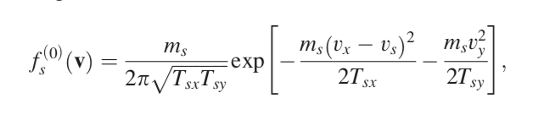
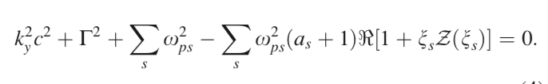

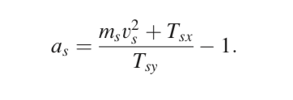



C. Ruyer’s model of ion Weibel/filamentation
Dispersion relation
PoP 22 (2015)
Drifting Maxwellian
Multi species dispersion relation
Species anisotropy and with drift
First order approximation to Z
Electrons
Ions

Slide 21

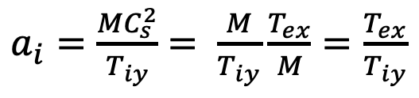
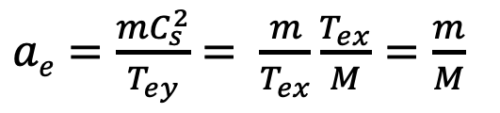

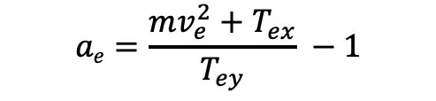
For growing instability, anisotropy $a_{s}$>0
Electron anisotropy
$$ae=\frac{mv_{e}^{2}+T_{ex}}{T_{ey}} −1$$
From PIC phase mixing
$$T_{ex}=T_{ey}$$
Electrons expand at sound speed ∼ C_{s}
Very weak initial electron anisotropy.
∼ 0 growth.
$ae=\frac{mC_{s}^{2}}{T_{ey}}$ $= \frac{m}{T_{ex}}\frac{T_{ex}}{M}=\frac{m}{M}$
$a_{i}=\frac{MC_{s}^{2}}{T_{iy}}$ $= \frac{M}{T_{iy}}\frac{T_{ex}}{M}=\frac{T_{ex}}{T_{iy}}$
Large initial ion anisotropy.
Large growth
Notes:
For these experimental parametrs, can show no electron instability only ion filamentation

Slide 22

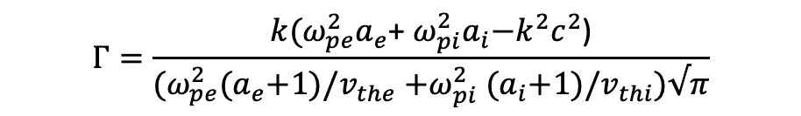


More simplification. Growth rate for Ⲅ/w_{pi} <<1
$$Γ=\frac{k(ω_{pe}^{2}a_{e}\text{+} ω_{pi}^{2}a_{i}\text{−}k^{2}c^{2}\text{)}}{{(ω}_{pe}^{2}{(a}_{e}+1)/v_{the}{+ω}_{pi}^{2}{(a}_{i}+1)/v_{thi})√π}$$
Another simplification; For isotropic electrons and cold drifting ions
$$a_{e}≈0$$
${(ω}_{pe}^{2}{(a}_{e}+1)/v_{the}$ << $ω_{pi}^{2}{(a}_{i}+1)/v_{thi}$
$$Γ=\frac{k(ω_{pi}^{2}a_{i}\text{−}k^{2}c^{2}\text{)}}{(ω_{pi}^{2}{(a}_{i}+1)/v_{thi})√π}$$
Initial growth rate of a very dynamic process

Slide 23
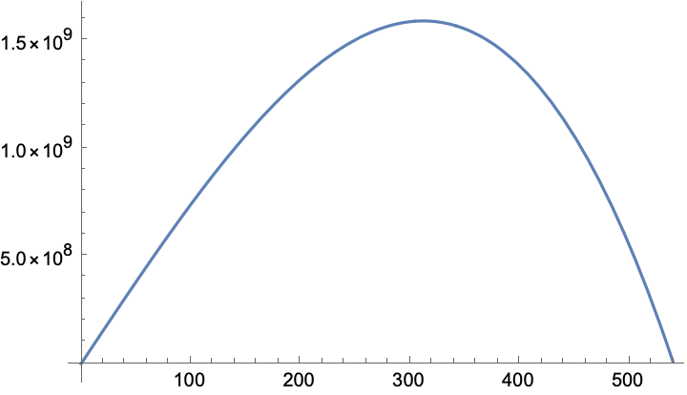
Ion Filamentation initial growth rate, a_{i}=150, n_{e0}=2x10¹⁸ f =0.5
k_{max} = (a_{i}/3)^{1/2} w_{pi}/c
= (f)^{1/2} (a_{i}/3)^{1/2} w_{pi}/c = 300
f is the ionization fraction
growth rate
sec⁻¹
Growth time 0.66 ns
k cm⁻¹
Notes:
Close agreement but does not include dynamics of plasma temperature change

Slide 24
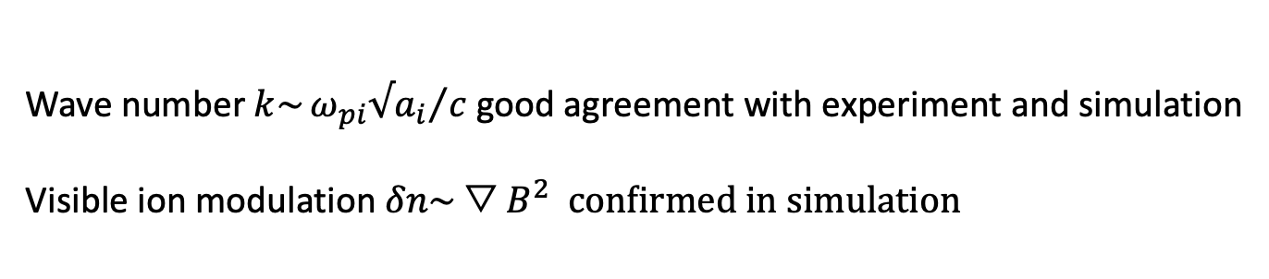
Experimental observations consistent with simple theory
1/w_{pi} (ps)< expansion time (t=L/ c_{s}$)\sim$ growth time (ns) < recombination time (10-100 ns) < B decay time
Wave number $k\sim {ω_{pi}{√a}_{i}}/c$ good agreement with experiment and simulation
Visible ion modulation $δn\sim {▽B}^{2} confirmed in simulation$

Slide 25
Final thoughts
Try to observe filamentation at E300, E301 experiments,
Do comprehensive simulations.
  Complicated time dependence; expansion, cooling filamentation, recombination
Calculate the saturated magnetic field and k_{sat}
What are the correct plasma densities
  Beam ionized H2 (H⁺, H₂⁺)
  Expanding plasma consists of single ionized H2 molecules?
  No electron collisions but might have ion collisions with ambient H2

Slide 26
Acknowledgements:
UCLA, SLAC FACET, Ecole Poly, U Colorado, U Texas, CERN
E200 Collaboration FACET-I
Data; Erik Adli, Carl Lindstrom, PIC; Chaojie Zhang

Slide 27
Extra slides

Slide 28
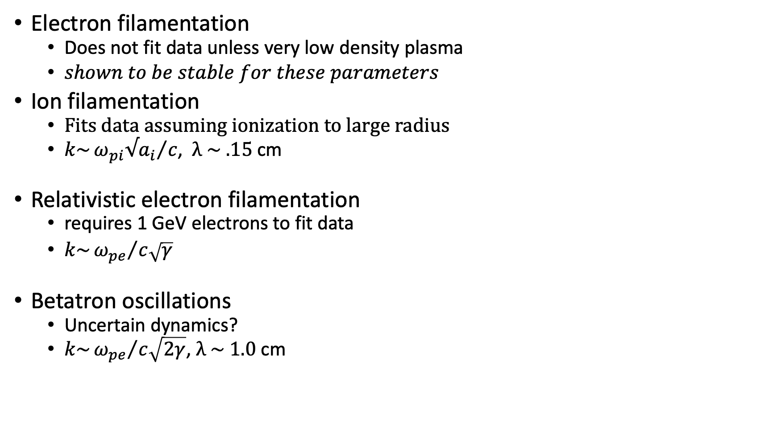
Wavelength for Weibel/Filamention type instabilities
Electron filamentation
  Does not fit data unless very low density plasma
  $shown to be stable for these parameters$
Ion filamentation
  Fits data assuming ionization to large radius
  $k\sim {ω_{pi}{√a}_{i}}/c$, $λ$ $\sim .15$ cm
Relativistic electron filamentation
  requires 1 GeV electrons to fit data
  $k\sim {ω_{pe}}/{c\sqrt{γ}}$
Betatron oscillations
  Uncertain dynamics?
  $k\sim {ω_{pe}}/{c\sqrt{2γ}}$, $λ$ $\sim 1.0$ cm

Slide 29
Electron vs Ion Filamentation/Weibel
Electron Weibel large A
  grows very fast < 5 psec
  Large k, small wavelength, 10 um
  Initially broad chaotic unstable k spectrum
  As anisotropy reduces unstable k spectra narrows
Electron Weibel small A
  PIC shows smaller anisotropy than expected
  Slower growth
  Narrow k spectra could match SLAC data
Ion Weibel
  Seems to match SLAC results wip

Slide 30
Literature search (so far)
Weibel/filamentation type instabilities is a very active area of research.
  ICF and fast ignition
  Astrophysics
  Cosmic magnetic field generation
  Even quantum chromodynamics!
Helical magnetic structures seen simulation and theory
No reference to experimental observation
This could be first observation for laboratory plasma

Slide 31
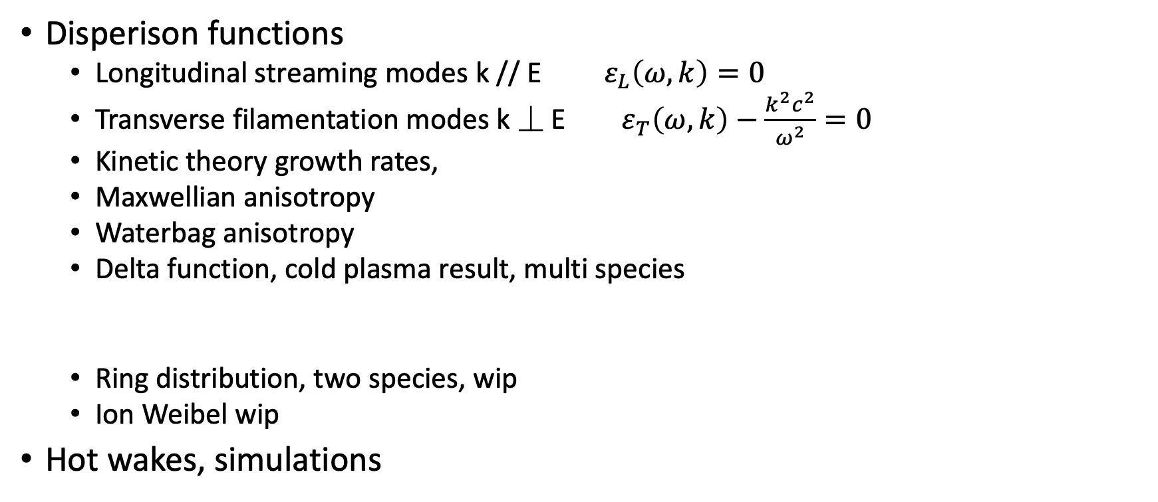
Theory work
Disperison functions
  Longitudinal streaming modes k // E $ε_{L}\left(ω,k\right)=0$
  Transverse filamentation modes k ⏊ E $ε_{T}\left(ω,k\right)−\frac{k^{2}c^{2}}{ω^{2}}=0$
  Kinetic theory growth rates,
  Maxwellian anisotropy
  Waterbag anisotropy
  Delta function, cold plasma result, multi species
  Ring distribution, two species, wip
  Ion Weibel wip
Hot wakes, simulations

Slide 32
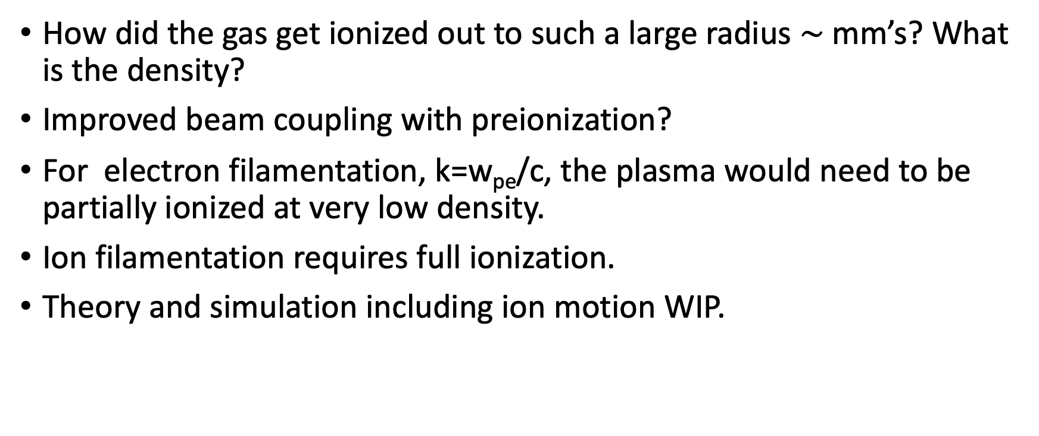
Problems
How did the gas get ionized out to such a large radius $\sim$mm’s? What is the density?
Improved beam coupling with preionization?
For electron filamentation, k=w_{pe}/c, the plasma would need to be partially ionized at very low density.
Ion filamentation requires full ionization.
Theory and simulation including ion motion WIP.

Slide 33
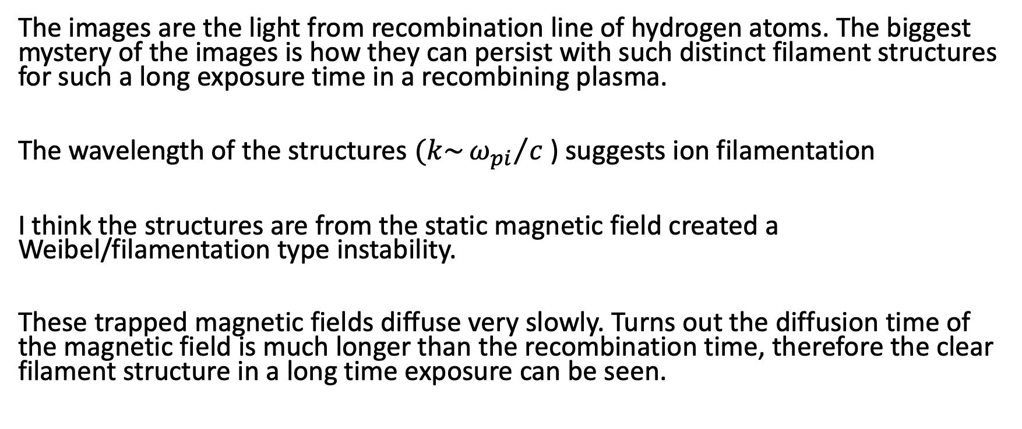
Summary
The images are the light from recombination line of hydrogen atoms. The biggest mystery of the images is how they can persist with such distinct filament structures for such a long exposure time in a recombining plasma.
The wavelength of the structures $(k\sim {ω_{pi}}/c$ ) suggests ion filamentation
I think the structures are from the static magnetic field created a Weibel/filamentation type instability.
These trapped magnetic fields diffuse very slowly. Turns out the diffusion time of the magnetic field is much longer than the recombination time, therefore the clear filament structure in a long time exposure can be seen.

Slide 34
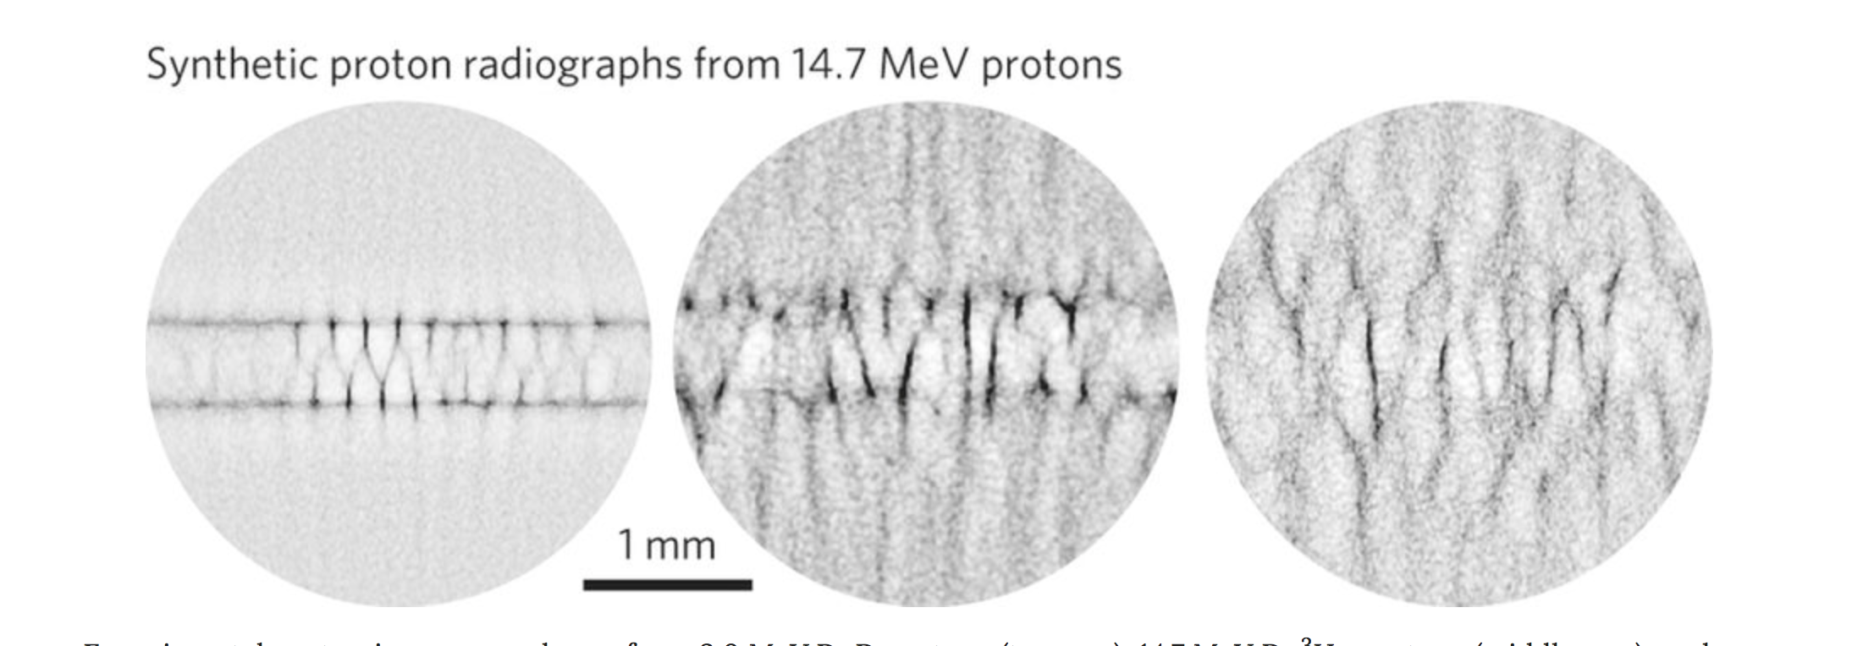
Coalescence from colliding streams at OMEGA, Nature Physics 11, 2015

Slide 35
OMEGA experiment

Slide 36
Wavelength of structure is proportional to $1/\sqrt{n}$, k = $\frac{2π}{λ}$
Single ionized H2
Betatron
k_{b}=w_{pe}/c/(2𝜸)^{1/2}
Ion
k_{i}=w_{pi}/c
Plot created by Lindstrum, Adli

Slide 37
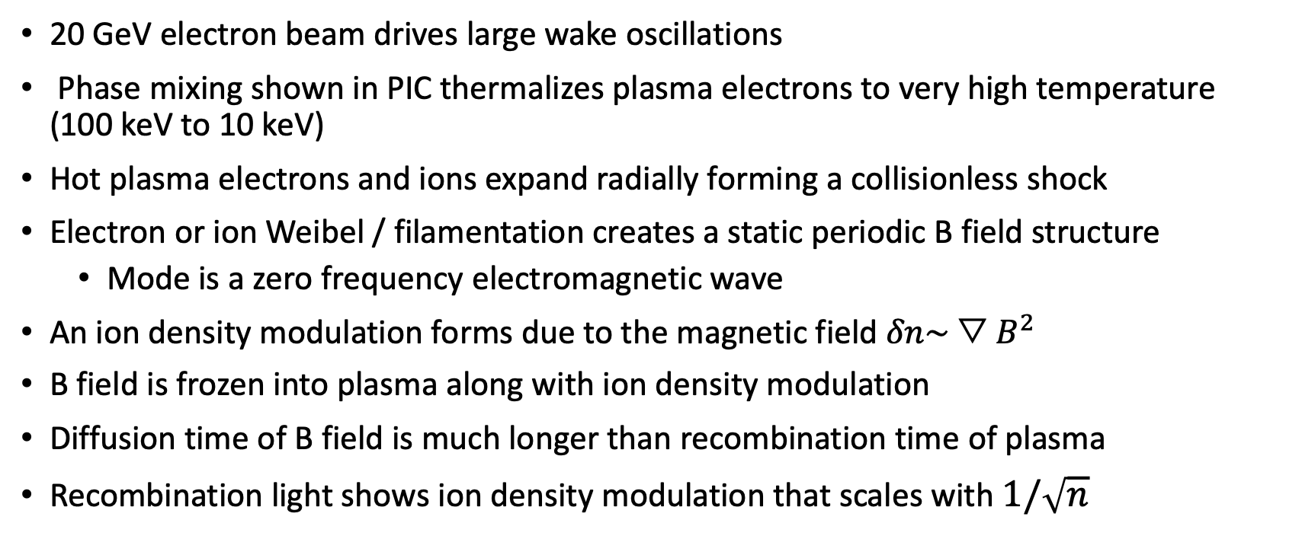
A Possible Physical Mechanism
20 GeV electron beam drives large wake oscillations
Phase mixing shown in PIC thermalizes plasma electrons to very high temperature (100 keV to 10 keV)
Hot plasma electrons and ions expand radially forming a collisionless shock
Electron or ion Weibel / filamentation creates a static periodic B field structure
  Mode is a zero frequency electromagnetic wave
An ion density modulation forms due to the magnetic field $δn\sim {▽B}^{2}$
B field is frozen into plasma along with ion density modulation
Diffusion time of B field is much longer than recombination time of plasma
Recombination light shows ion density modulation that scales with $1/\sqrt{n}$

