Slide 1
External Injection at CLARA
Laura Corner
Cockcroft Institute, University of Liverpool

Slide 2
Motivation
Laser wakefield acceleration (LWFA) has produced extremely high accelerating gradients and energies (10GeV), but issues with stability, energy spread, repeatability, emittance.
CERN Expert Panel Roadmap (https://e-publishing.cern.ch/index.php/CYRM/issue/view/146) identifies both quality and staging as milestones for credible LWFA.
External injection of high quality, low energy electrons into plasma wakefield: high gradient acceleration w/o loss of quality in simulation.
Experiments @ CLARA (Daresbury Laboratory) – test injection & acceleration experimentally (few expts.so far Amiranoff et al. PRL 81, 995, 1998, Wu et al., Nature Physics 17, 801, 2021).
Investigation of staging without problems of capturing low quality beams from LWFA first stage.
CLARA near-unique facility in the world – accelerator, laser, experimental area.

Slide 3
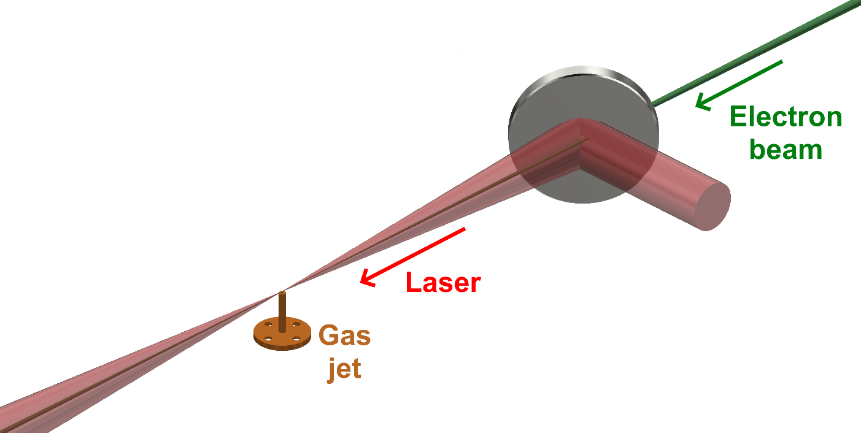
Experimental schematic
Inject electron bunch into laser driven accelerating wakefield in nitrogen plasma.
Electron bunch length (~ 6ps) >> plasma period.
Expect acceleration and deceleration of electrons.
Electron energy spectrum broadening.
Proof of principle experiment at CLARA – aim to build on this.
Programme planned to show guiding, emittance measurement, pure acceleration.

Slide 4
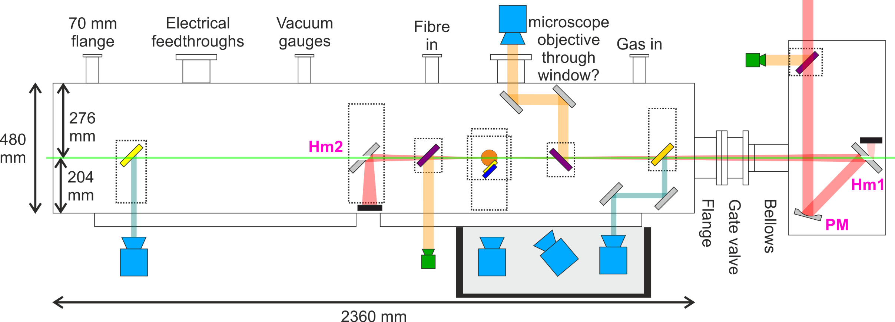
Experimental layout in chamber
To electron
spectrometer
Electron bunch: 6ps full duration, 20pc, transverse size σ = 20 – 40μm.
Laser pulse: 90fs, 8 – 40mJ on target, w₀ ∼ 40μm.

Slide 5
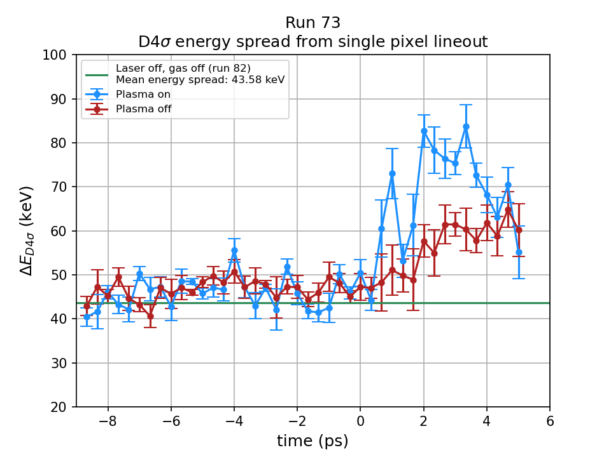
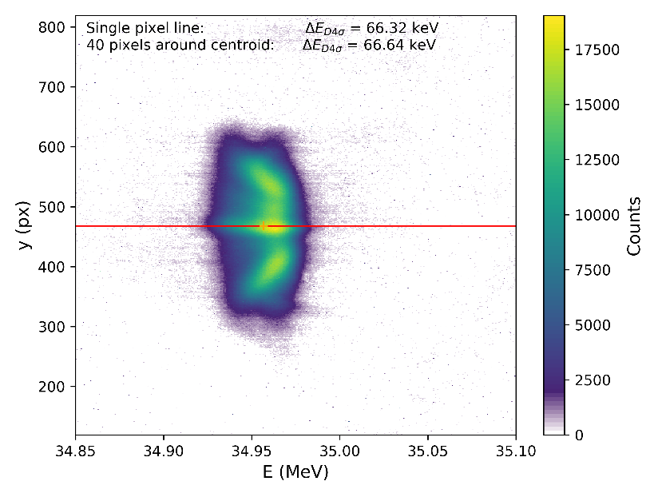
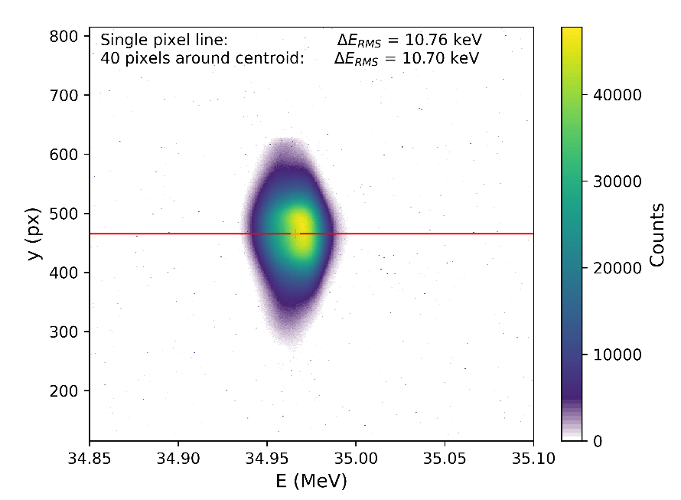
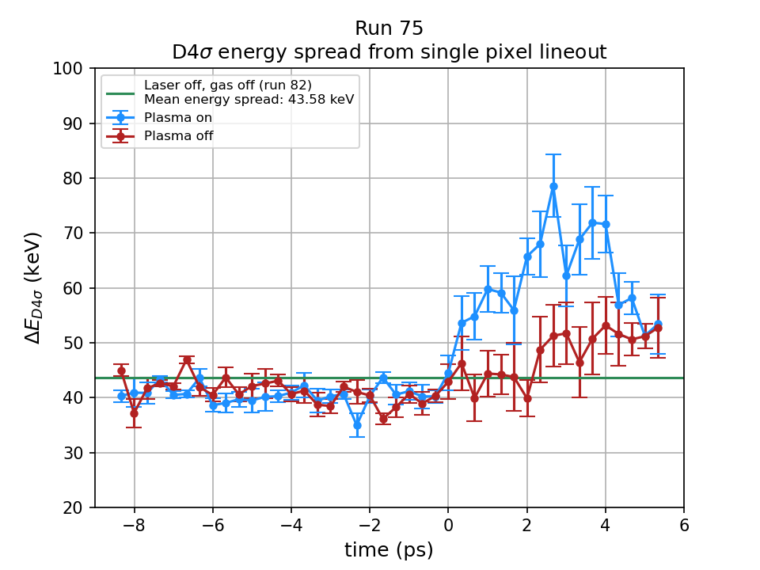
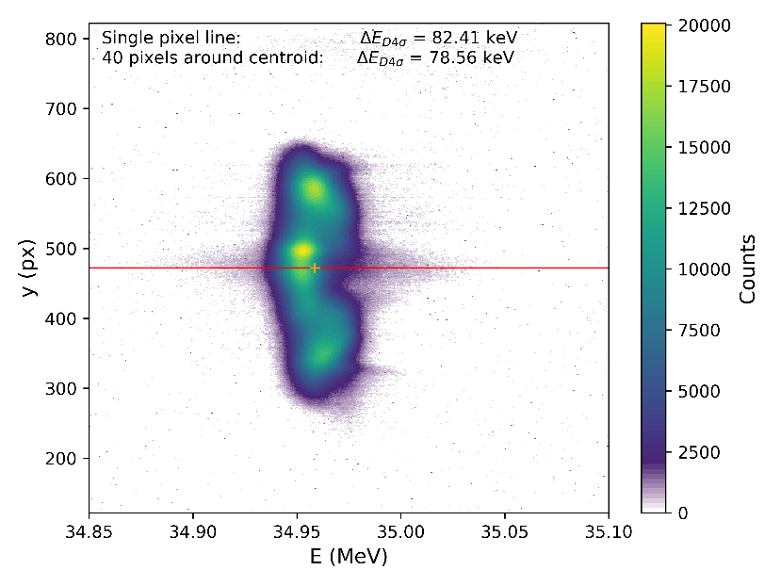
Results – Preliminary
250 mJ in laser lab
40 mJ on target
Laser & electron beam – 10 Hz
gas jet opening – 5Hz.
Complicated by low density plasma in chamber when gas jet off.
Looking at width (energy spread) of electron beam on e – spec with arrival time of laser & e- bunch.
40 mJ
32 mJ
Analysis: Dr. L. Reid

Slide 6
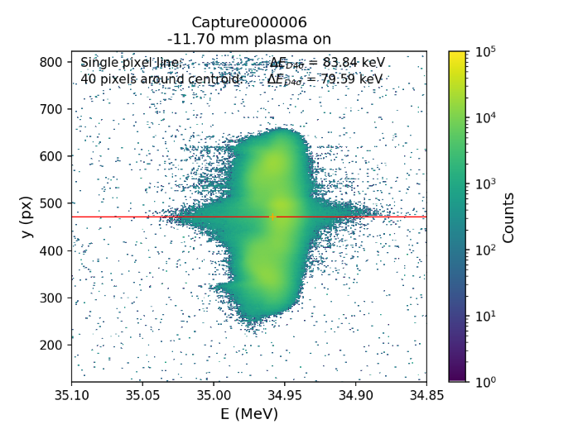
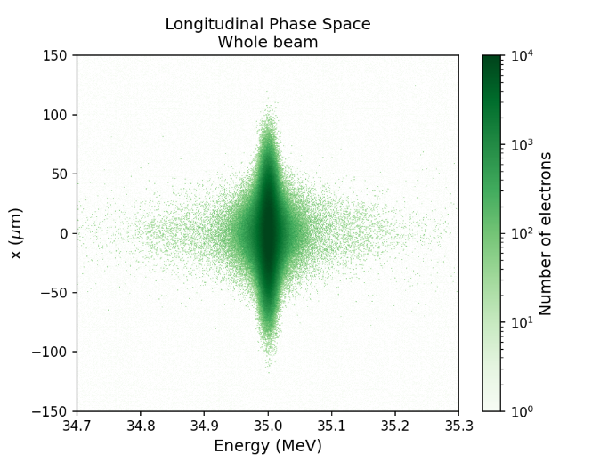
Simulations
Simulated (left) and experimental (right) electron spectrometer images showing electron spectral broadening.
Simulations: Dr. L. Reid

Slide 7
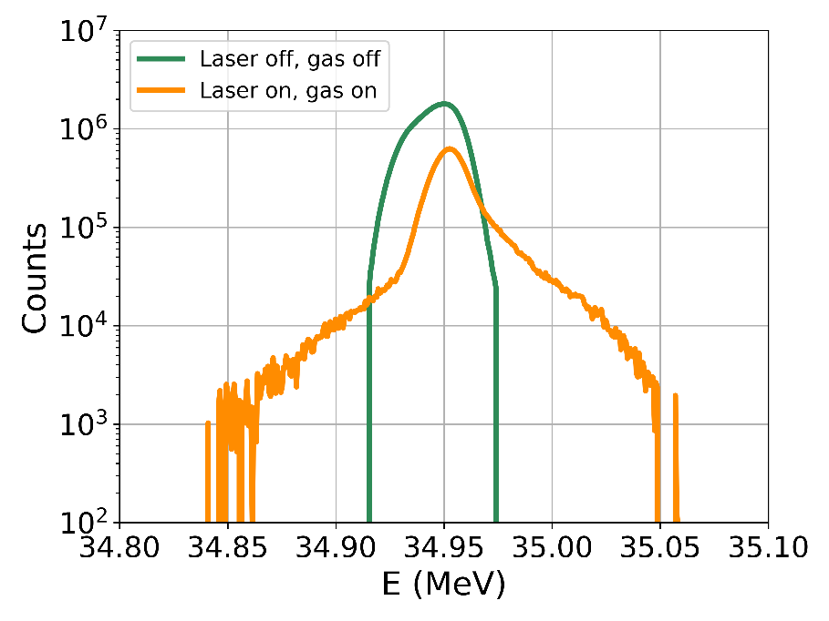
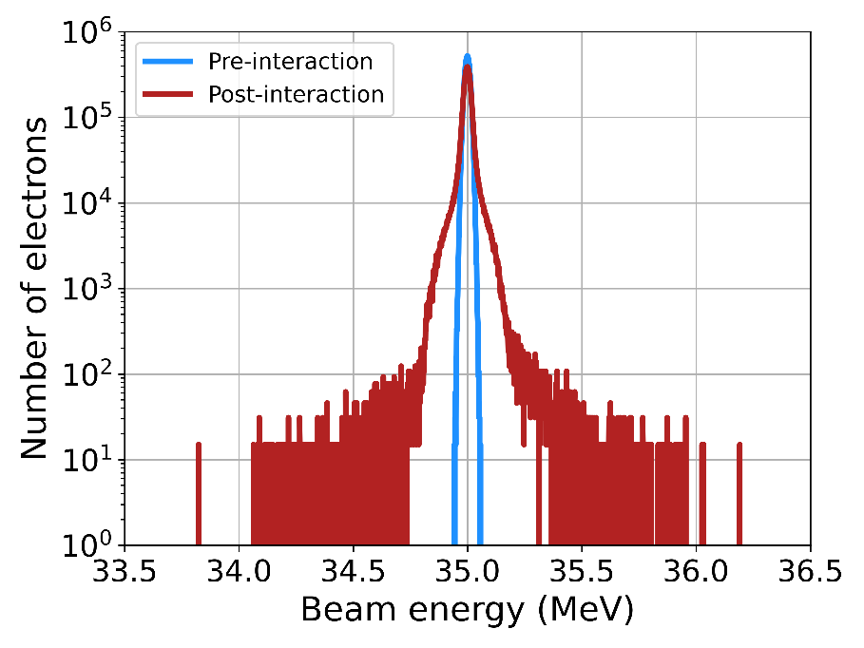
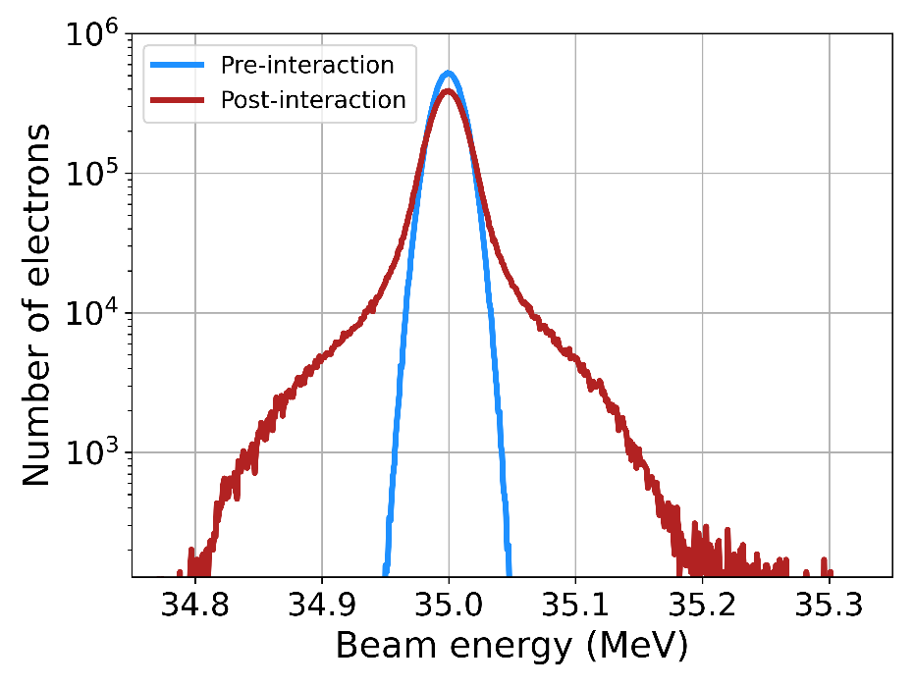
Accelerating gradient - preliminary
Experiment:
Max. energy gain ~ 100 keV.
8mm plasma (overestimate): gradient ~ 12.5 MV/m.
Simulations:
Ionisation effects - laser defocusing.
Model detector response.
Energy gain of 900 keV if all the simulation electrons are taken into account: 112 MV/m (8mm plasma).
Assuming 12 bit camera, expect to see up to 200 keV: 25 MV/m.
2 x experiment – e-spec YAG screen response, imperfect spatial overlap effects.

Slide 8
New FEBE upgrade and laser
CLARA
Phase 1
CLARA
Phase 2
CLARA
FEBE
100 TW Class Laser
PI Laser:
Variable longitudinal pulse shape
Variable Bunch Compressor
Variable R56
Low T566
FEBE Mask
Flexible design
Linac 1
Linac 2
Linac 3
Linac 4
FEC1
FEC2
FEBE Arc
Variable R56
FEBE Hutch
RF Gun:
100 Hz
250 pC
4th Harmonic
Cavity
Dechirper
Electron energy up to 250MeV.
Funding received for 100TW laser – space to upgrade to 250TW.
New shielded area with 2 vacuum chambers for experiments.

Slide 9
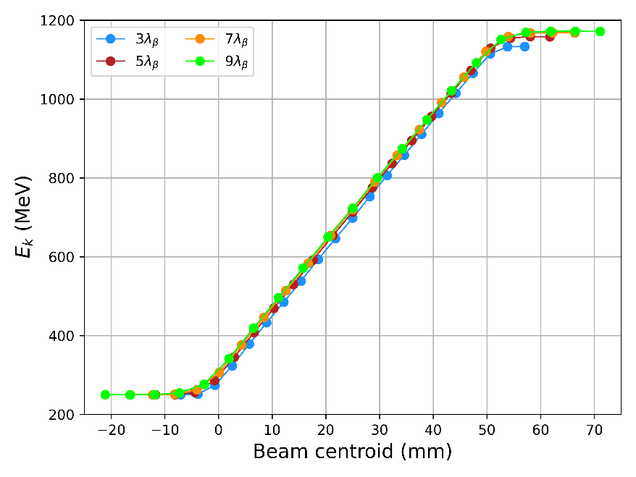
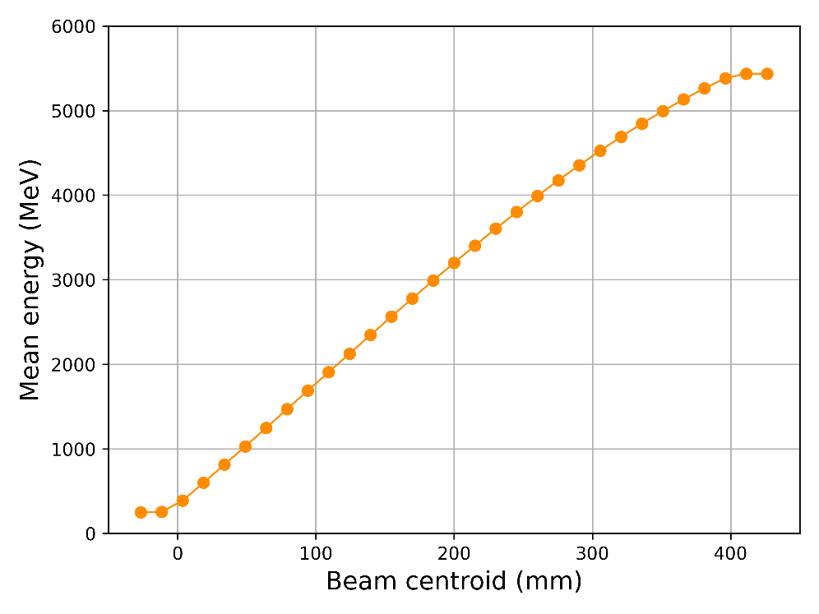
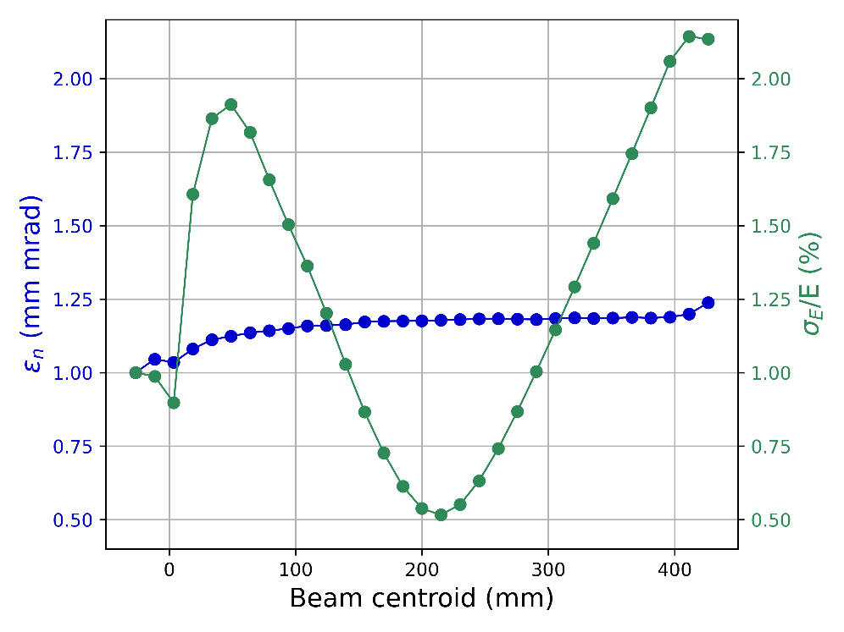
External injection experiments at FEBE
100TW
250TW
250TW
250TW | Pre-interaction | Post-interaction
Charge (pC) | 5 | 5
Central energy (MeV) | 250 | 5436
Energy spread (RMS) | 1% | 2.13%
σ_{x} (µm) | 5 | 2.27
σ_{z}/c (fs) | 5 | 5
ε_{n} (mm mrad) | 1.0 | 1.24
100TW: 1GeV in 80mm – 2GeV in 140mm.
250TW: 5GeV in 400mm.

Slide 10
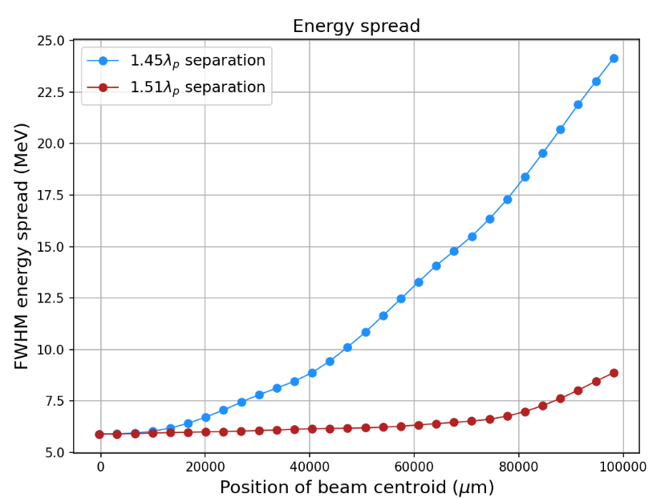
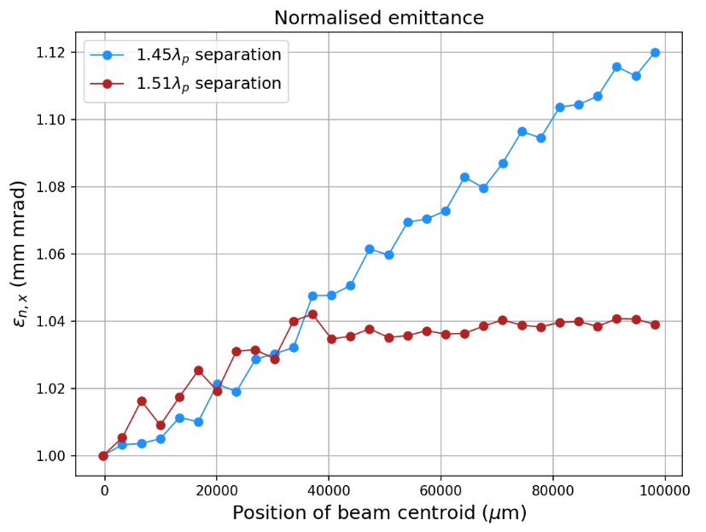
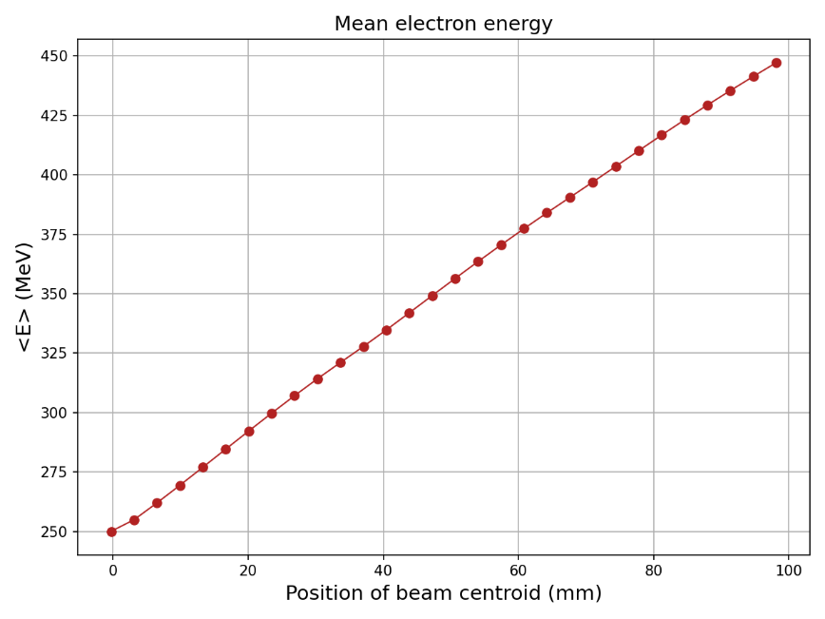
Fibre laser driver simulations
What can we do with a different (efficient!) laser?
Fibre laser: 2J, 150fs,
250MeV to 450MeV in 100mm.
Gradient 2 GV/m.
Energy spread: FWHM 2.4% - 3.5%.
Emittance: 1 mm mrad – 1.04 mm mrad.
Simulations not optimised!
FEBE high rep rate photocathode @ 400Hz – can we make this laser?
Combined fibres have shown 120fs, 10mJ pulse energy and
20% measured WPE.
Simulations: Jonathan Christie

Slide 11
Vision
Can we take the best of both worlds?
High quality beams from rf accelerator and high gradients from laser driven plasma.
“Too big! Plasma accelerators are compact”
………… but are they?
Need the laser space anyway – why not have a linac underneath?
Relativistic electron beams, say, 100MeV, from conventional rf accelerator < 10m? Certainly 20m.
Put the laser room over the rf accelerator, same footprint as fully LWFA self injection facility.
Bunch compression: conventional or THz manipulation.
Drive wake in plasma waveguide: 100s mm demonstrated, stand alone above long gas jet – no cell or discharge capillary in the laser beam (no damage!).
Realistic technology for FEL or FEL booster.
Use high efficiency, high rep rate combined fibres to drive single stage 5GeV, sub 1% energy spread, low emittance electron bunches for applications or staging to higher energies.

Slide 12
Acknowledgements
Liverpool: Lewis Reid, Harry Jones, Miles Radford, Jonathan Christie, Alex Morris
DESY: Lewis Boulton
LOA: Alex Knetsch
Lancaster: Elisabetta Boella
Strathclyde: Bernhard Hidding
ASTeC: Tom Pacey, Will Okell, Dave Walsh, Ed Snedden, Keith Middleman, Andrew Vick, Matthew King, Duncan Scott
(and more!)
Data analysis & simulations
Liverpool: Lewis Reid, Harry Jones, Jonathan Christie Lancaster: Dave Scott, Elisabetta Boella
Work supported by UKRI Grant no: ST/V001612/1

Slide 13
Back Up

Slide 14
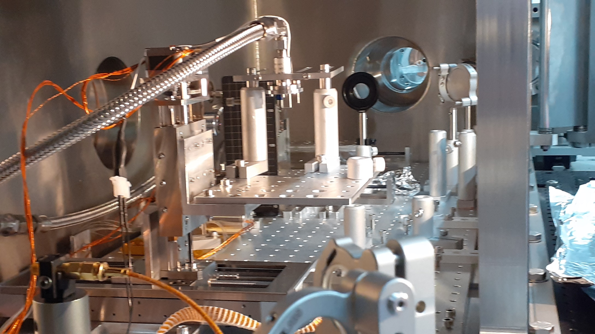
Experiment

Slide 15
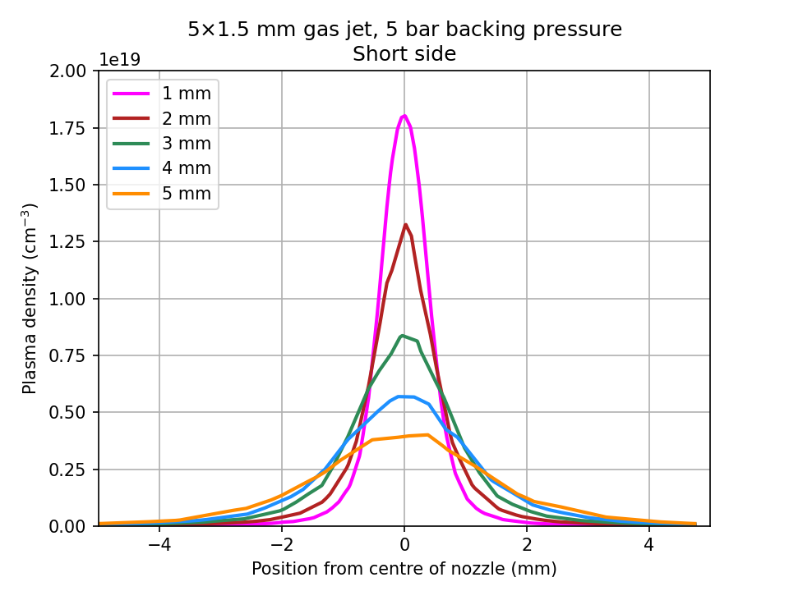
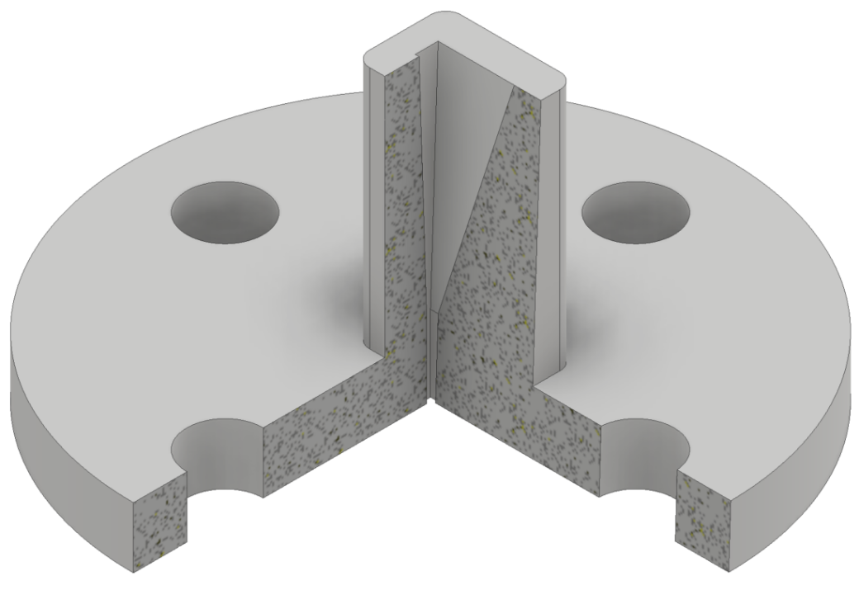
Gas profile
Shot across short side of nozzle and higher above the jet than optimised (5mm rather 1 – 2mm).
The longitudinal gas profile did not contain a region of constant density.
Zero-to-zero length ~ 8mm – overestimate of accelerating length, underestimate of accelerating gradient.
n_{e} = 2.1×10¹⁸ cm⁻³
λ_{p} = 23 μm
T_{p} = 76 fs
5mm height
Simulations: Harry Jones

Slide 16
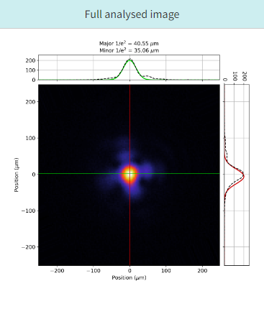
Laser Focus
Laser spot analysed.
50% of energy within 1/e² diameter.
Experiments range from 8 – 40mJ in spot.

Slide 17
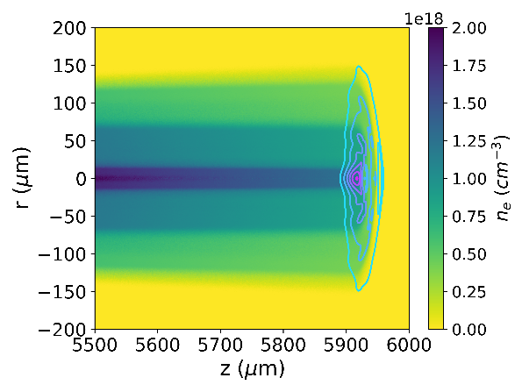
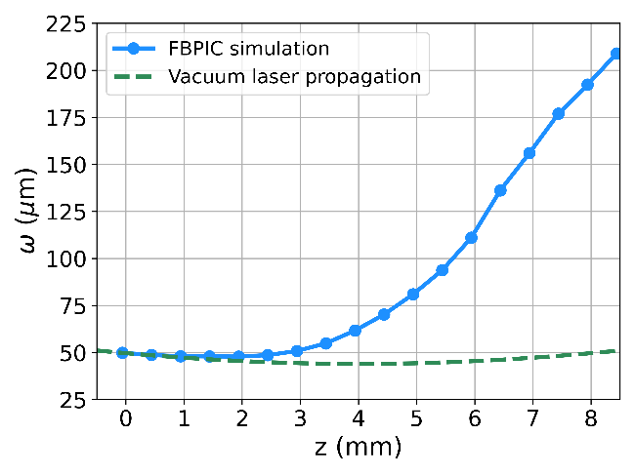
Laser Propagation
FBPIC modelling including ionisation of neutral gas density from FLUENT 5mm above jet.
Radial plasma density acts as defocusing lens.
Significant growth of laser spot – reduction in a₀.

Slide 18
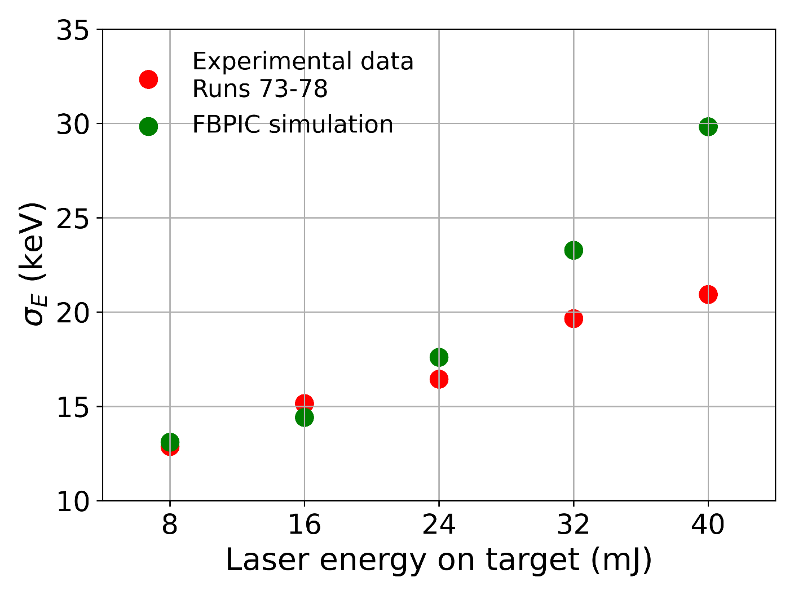
Electron energy spread scaling with laser energy

