Slide 1
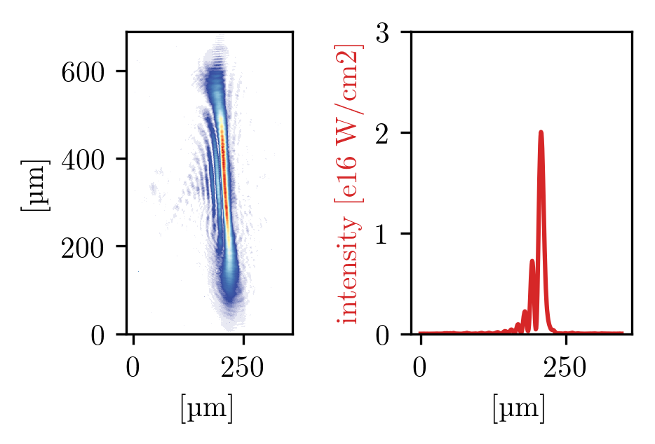
Laser Wakefield Acceleration to GeV Electron Energies for the Breit-Wheeler Experiment
Goal: 2.5 GeV high quality electron bunches from LWFA for Breit-Wheeler Experiment
Slit Nozzle with HOFI Shock Injection:
high quality beams
Gas Cell with Self Injection:
over 2 GeV
HOFI Gradients for Shock Injection
density
0 ns
2 ns

