Slide 1
Laser Wakefield Acceleration to GeV Electron Energies for the Breit-Wheeler Experiment
AAC’22
Hyatt Regency Long Island, NY
2022/11/10
K.v.Grafenstein F.M.Foerster
F.Haberstroh
A.Döpp
F.Irshad
E.Travac
N.Weiße
S.Karsch
F.Salgado
M.Zepf
A.Schletter
D.Campbell

Slide 2
Outline
Our Lab at CALA
Breit-Wheeler Experiment
Development of Gas Targets for LWFA
Measurement Results with different targets and injection methods
Summary/Outlook

Slide 3
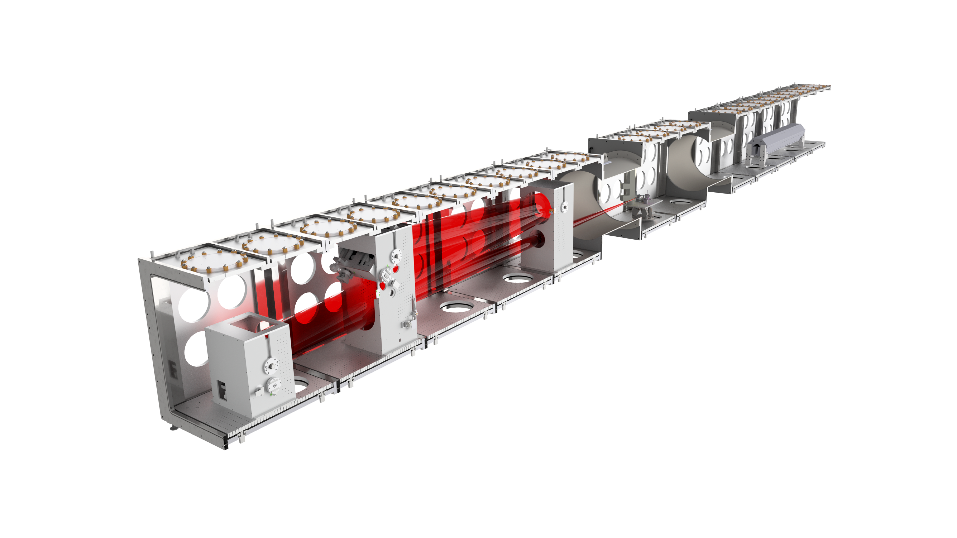
Electron and Thomson Test Facility (ETTF) at CALA
30fs, up to 3PW laser pulses from ATLAS3000, used for now with 300TW
f = 10m spherical mirror, F/56
gas jets / cells as targets
I = 8.9 x 10¹⁸ W/cm⁻³
a₀ = 2.0

Slide 4
Breit-Wheeler Experiment
T G Blackburn, M Marklund 2018 Plasma Phys. Control. Fusion 60 054009

Slide 5
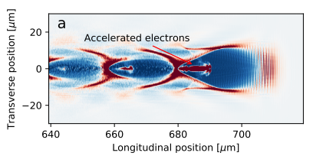
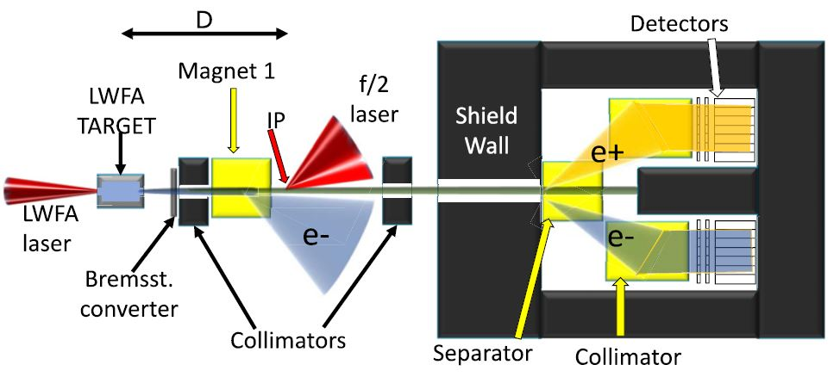
Breit-Wheeler Experiment
Electron Beam goal:
2.5 GeV
monoenergetic
high charge
low divergence
low pointing jitter
stable, reproducible
F C Salgado et al 2021 New J. Phys. 23 105002
S Schindler et al 2019 Proc. of SPIE 11037N-1

Slide 6
Development of Gas Targets for LWFA

Slide 7
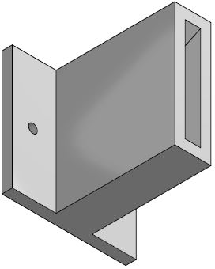
Gas Nozzle Design – CFD Simulations of Convergent-Divergent Slit Nozzles
Width: 3 mm
Length: 20 mm
Width: 3 mm
Length: 20 mm
x
z
Simulation Software: Ansys Fluent

Slide 8
Gas Nozzle Design – CFD Simulations of Convergent-Divergent Slit Nozzles
Old Design: Width: 0.75 mm
New Design: Width: 3 mm
Density gradient in y-direction is less steep for new nozzle
→ wakefield and injected electrons are less strongly bend upwards

Slide 9
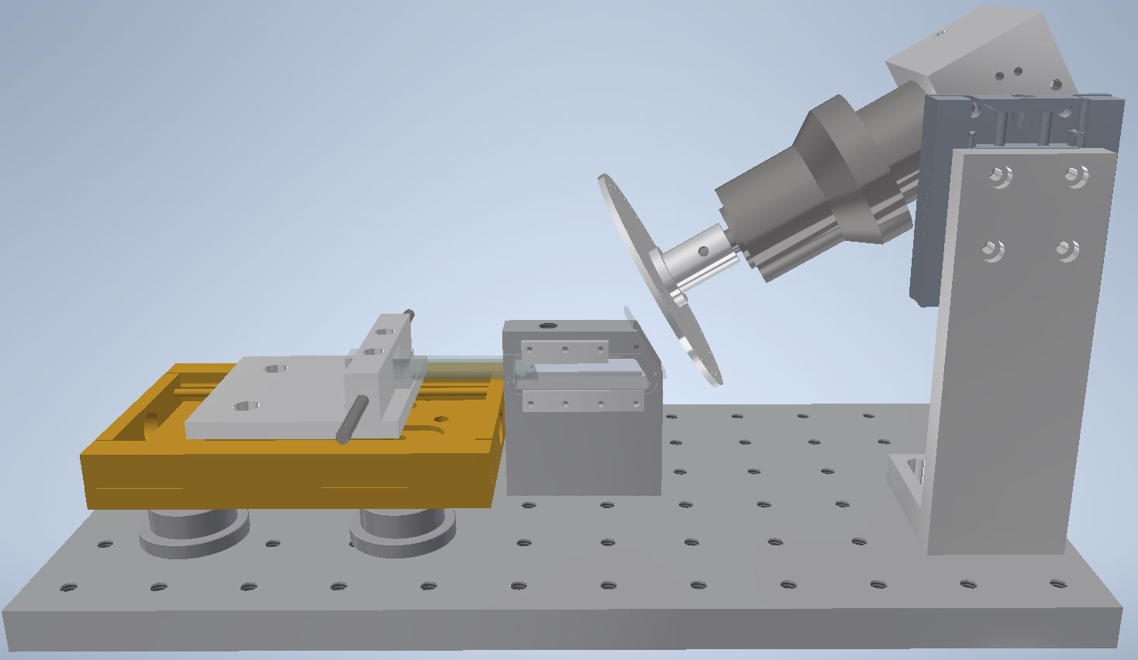
Variable Length Gas Cell
Gas inlet
LWFA driving laser beam
Optical shock inducing laser beam

Slide 10
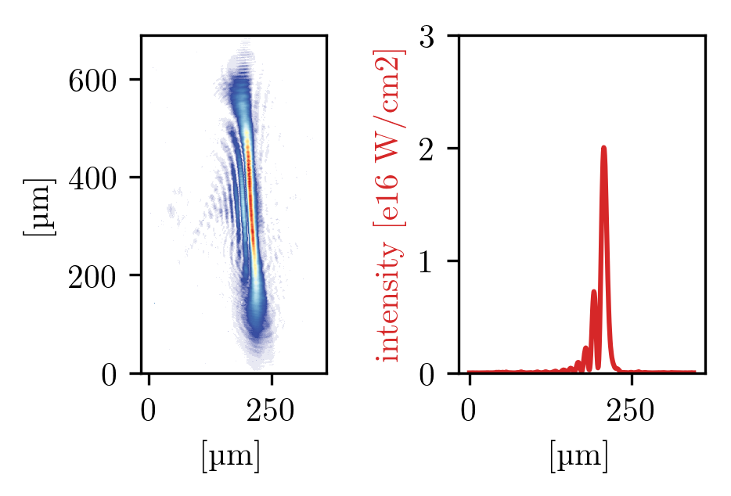
Hydrodynamic Optical Field Ionized (HOFI) Shocks
2 ns
density
0 ns
Background
density
-50 µm +50 µm
Image courtesy to F.M.Foerster; Plasma simulation support from Oxford (A.Ross et al.)

Slide 11
LWFA Measurements

Slide 12
Gas Cell – Optically induced Shock Injection
6m focal length optic
~1 GeV; mean charge in peak ~ 24 pC

Slide 13
Gas Cell – Self Injection
Gas density: 9.1 x 10¹⁷ cm⁻³
Energy reaching over 2 GeV
Mean Charge: ~10 pC over 2 GeV ( ~38 pC over 1.5 GeV)
RMS divergence: 0.3 mrad
Notes:
Between 200-400pC charge in total (~650pC for one shot)

Slide 14
Gas Cell – Length scan (Self Injection)
Gas density: 9.3 x 10¹⁷ cm⁻³

Slide 16
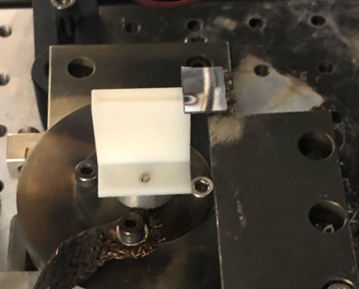
Slit Nozzle in Laser Wakefield Acceleration Setup
Blade to produce shock
Gas flow
LWFA driving laser beam
Optical shock inducing laser beam

Slide 17
Slit Nozzle – Shock Injection
Gas density: 9.4 x 10¹⁷ cm⁻³
Optically induced
~1 GeV; FWHM ~80 MeV; RMS divergence 0.5 mrad, ~100 pC in peak
Gas density: 1.0 x 10¹⁸ cm⁻³
Obstacle induced
~0.6 GeV; FWHM ~40 MeV; RMS divergence 0.7 mrad, ~93 pC in peak

Slide 18
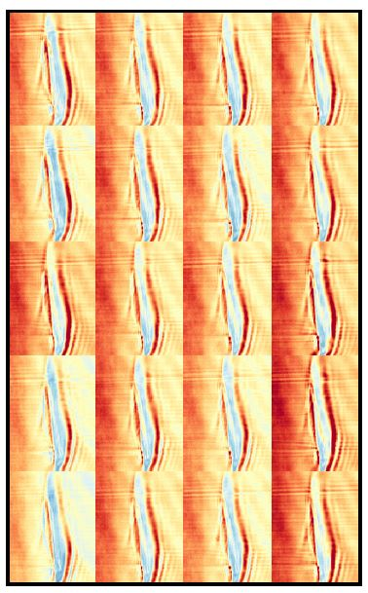
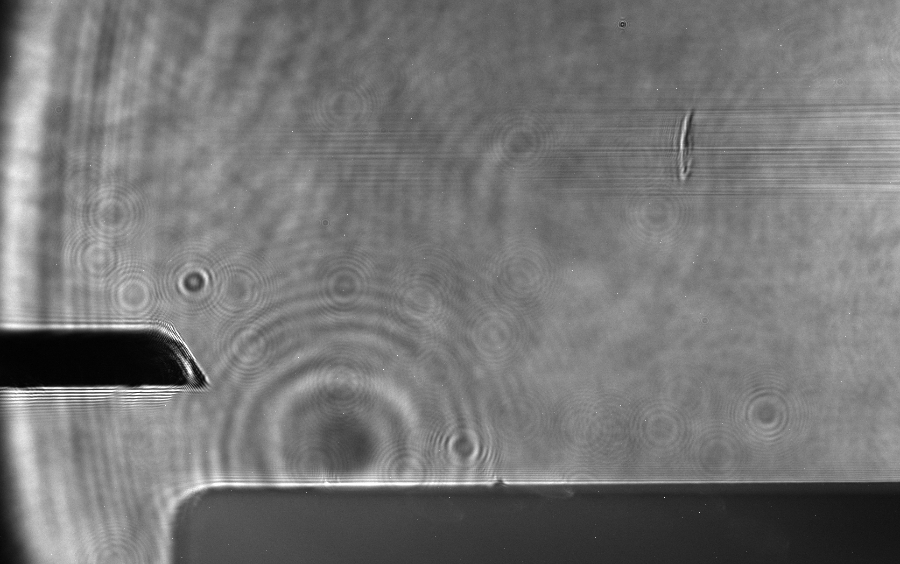
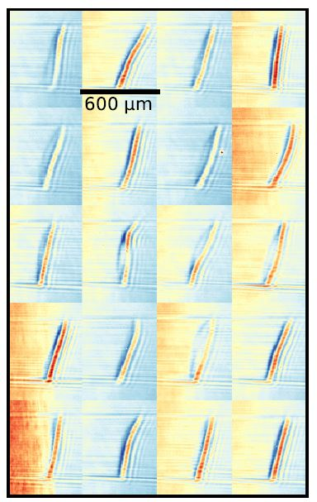
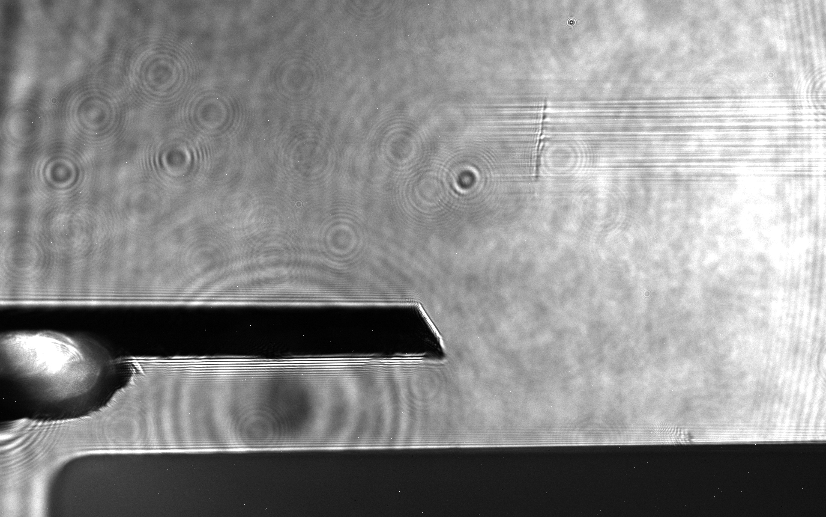
Slit Nozzle – Shock Injection
6 mm
Optically induced
onset of ionization trace
F.M.Foerster et al. (arXiv:2206.00507)
1 mm
1.8 mm
onset of ionization trace
Obstacle induced

Slide 19
Variable Length Gas Cell
Gas inlet
LWFA driving laser beam
Optical shock inducing laser beam

Slide 20
Slit Nozzle – Self Injection
Energy reaching over 1.5 GeV
Mean Charge: ~8 pC over 1.5 GeV ( ~32 pC over 1 GeV)

Slide 21
Summary and Outlook
Energies of over 2 GeV reached (close to goal of 2.5 GeV)
High quality beams produced with optical shock injection in slit nozzles
Need to combine high quality with higher energy
Planned for next year: Gas Cell with injection hole further downstream, ramp-up laser energy, finish Breit-Wheeler Setup

Slide 22
Thank you!

