Slide 1
Raman-based wavelength conversion for seeding and optical pumping of CO₂ laser amplifiers
William Li, Brookhaven National Laboratory
AAC, November 6-11, 2022

Slide 2
Acknowledgments
BNL ATF
  Marcus Babzien, Karl Kusche, Rotem Kupfer (now at LLNL), Igor Pogorelsky, Mikhail Polyanskiy, Mark Palmer
BNL Chemistry
  Furong Wang, James Wishart
BNL Instrumentation
  Luca Cultrera, Triveni Rao
Stony Brook University
  Navid Vafaei-Najafabadi
This work was funded by BNL Laboratory Directed Research and Development grants LDRD-001-21 and LDRD-18-026, and U.S. Department of Energy Office of Science contract DE-SC0012704.

Slide 3
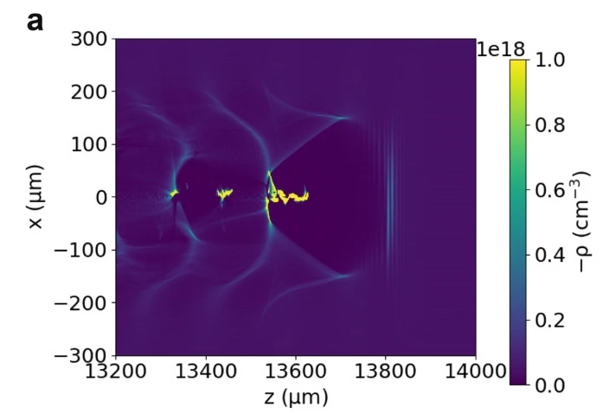
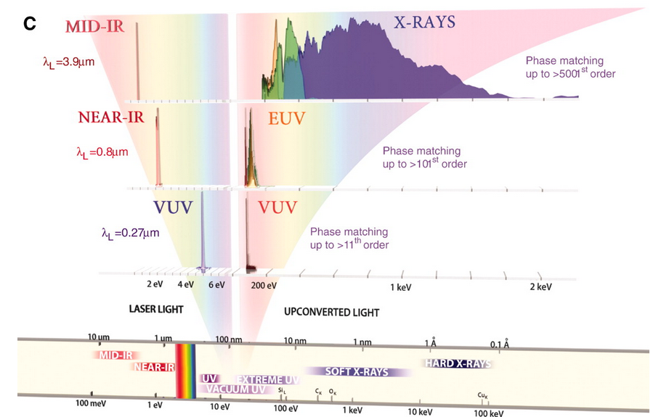
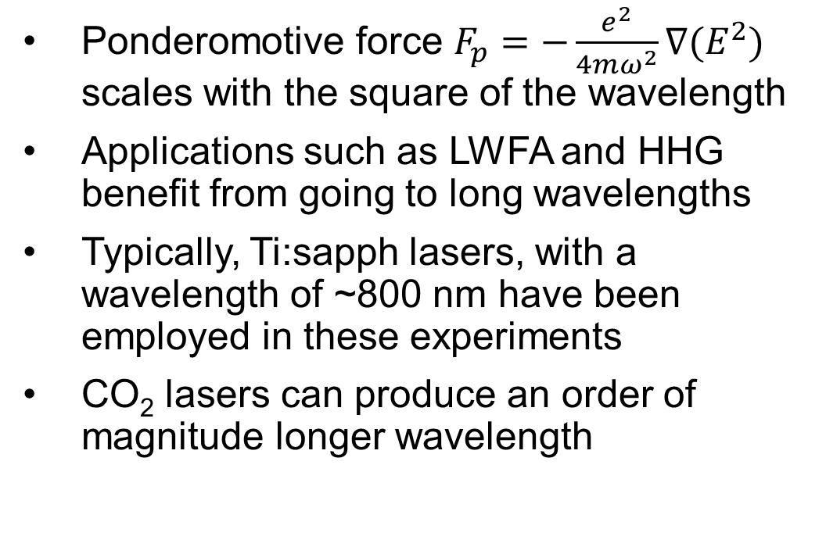
Why CO₂?
Ponderomotive force $F_{p}=−\frac{e^{2}}{4mω^{2}}∇(E^{2})$ scales with the square of the wavelength
Applications such as LWFA and HHG benefit from going to long wavelengths
Typically, Ti:sapph lasers, with a wavelength of ~800 nm have been employed in these experiments
CO₂ lasers can produce an order of magnitude longer wavelength
Brunetti, Scientific Reports 12, 6703 (2022)
Popmintchev, Science 336, 1287 (2012)

Slide 4
LWIR laser at the Accelerator Test Facility
Polyanskiy, OSA Continuum 3, 459 (2020)

Slide 5
Improving performance
Optical pumping
Increase seed energy
4.5 μm
9.2 μm
Improved energy stability and repetition rate
Reduced gain narrowing and pulse length
Polyanskiy, OSA Continuum 3, 459 (2020)

Slide 6
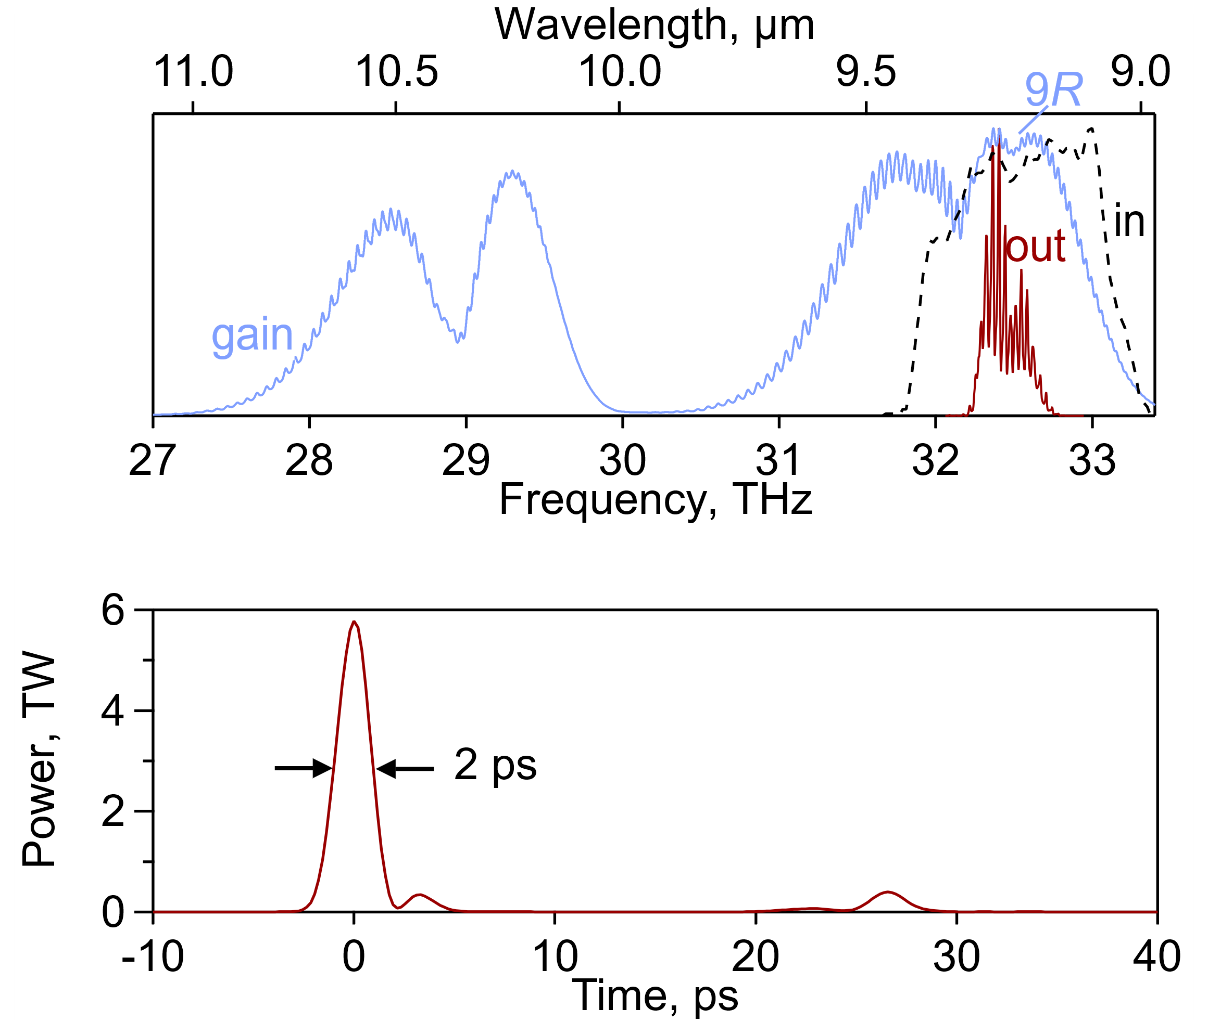
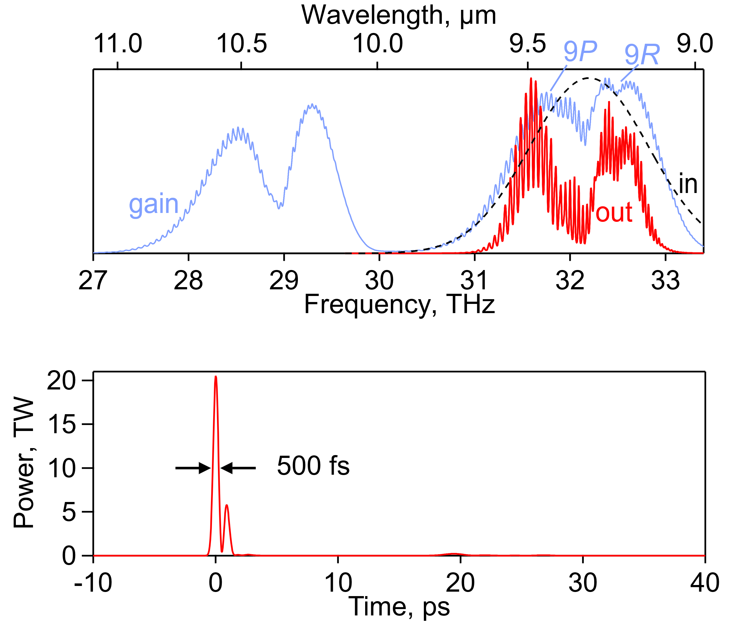
Higher pump energy
Seed: 2 µJ
Two CO₂ amplifiers
Amplification ~10¹¹
Seed: 10 mJ
Single CO₂ amplifier
Amplification ~10³
M. Polyanskiy: WG7+8, Thursday, 2:10 PM
Polyanskiy, Photonics 8, 101 (2021)

Slide 7
Raman scattering
How do we generate the necessary wavelengths?
Inelastic scattering with vibrational modes, known as Raman scattering
Commonly used for spectroscopy
Virtual energy states
Stokes
(give energy to vibrations)
Anti-Stokes
(take energy from vibrations)
Vibrational energy states

Slide 8


Raman conversion
Residual pump ω_{p}
Residual pump ω_{p}
Raman Converter
$$ω_{vibration}=ω_{target}$$
Nonlinear crystal $χ^{(2)}≠0$
$$ω_{p}−\left(ω_{p}−ω_{target}\right)=ω_{target}$$
ω_{target}
‘Cheap’ high energy laser source ω_{p}
Converted pump ω_{p}- ω_{target}
Converted pump ω_{p}- ω_{target}
Typical Raman shifts are on the order of 1000 cm⁻¹
Perfect for generating LWIR!

Slide 9
Improving performance
Increase seed energy
9.2 μm
Reduced gain narrowing and pulse length

Slide 10
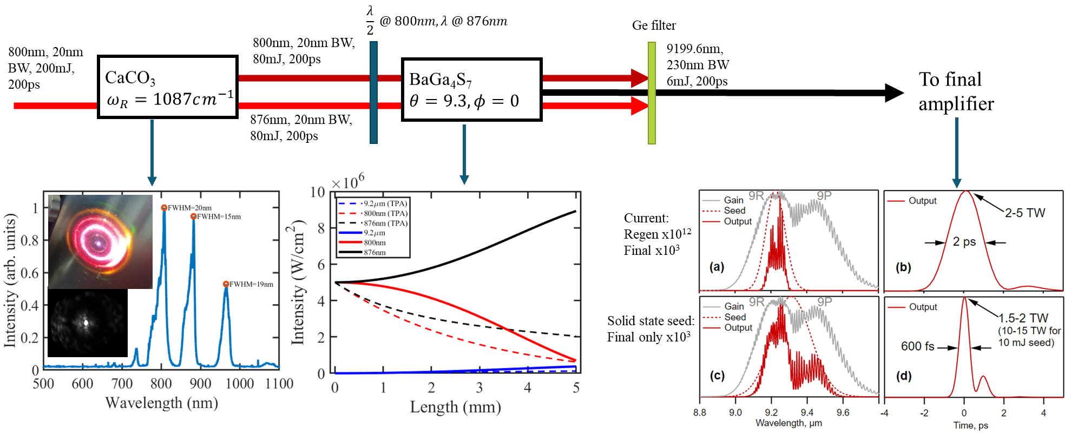
Seed generation in calcite
Calcite chosen for availability and correct vibrational modes
BGSe crystal suppresses two-photon absorption
Ti:sapph input
BaGa₄Se₇
simulated
simulated

Slide 11
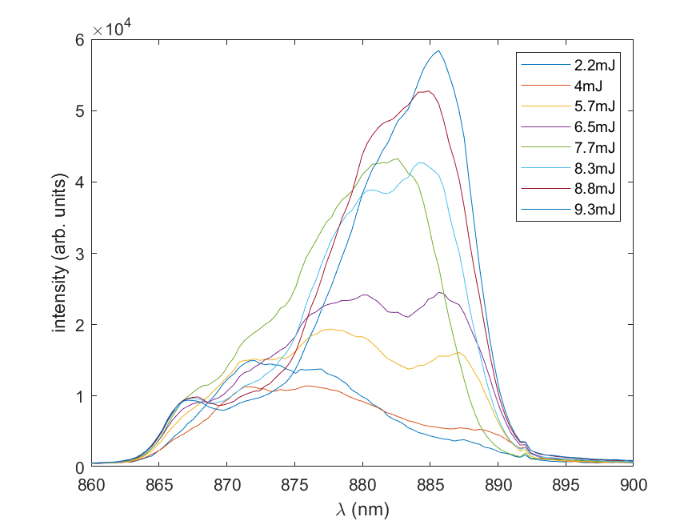
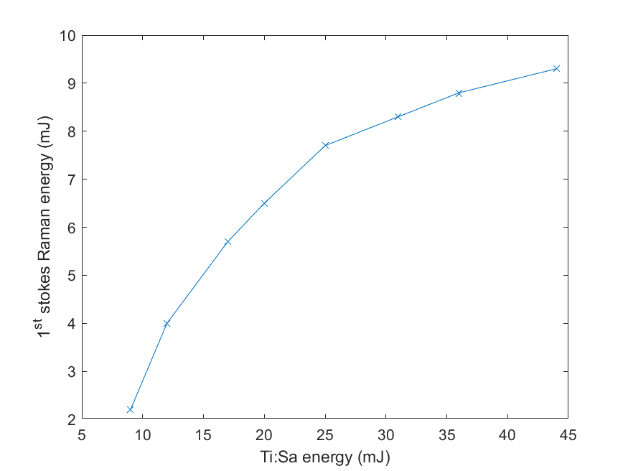
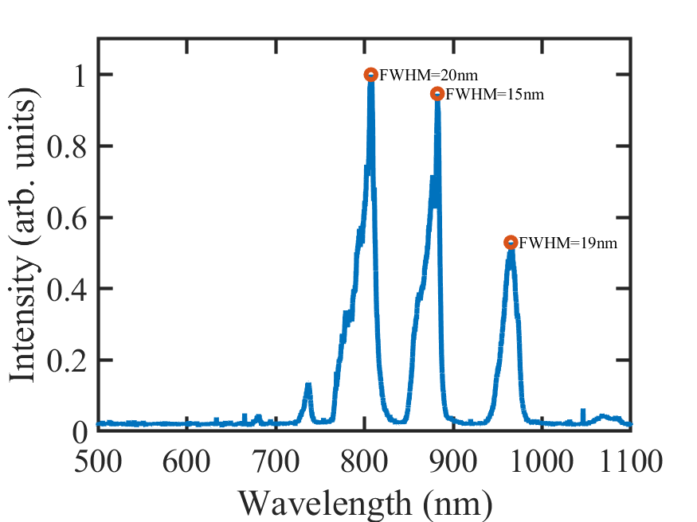
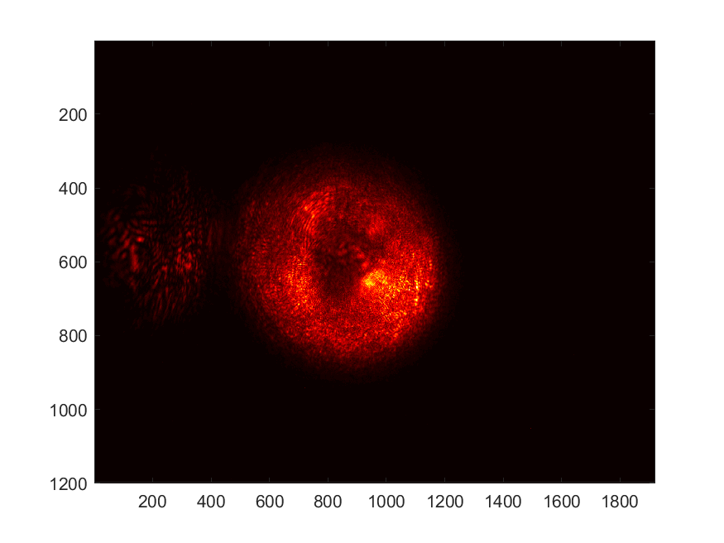
Calcite conversion
Spectrum redshifts as the conversion saturates
“tunable”
Large amount of residual 800 nm and converted 876 nm.
Suitable for DFG in the BGSe crystal.
Recently received BGSe crystals. DFG in near future.

Slide 12
Improving performance
Optical pumping
4.5 μm
Improved energy stability and repetition rate

Slide 13
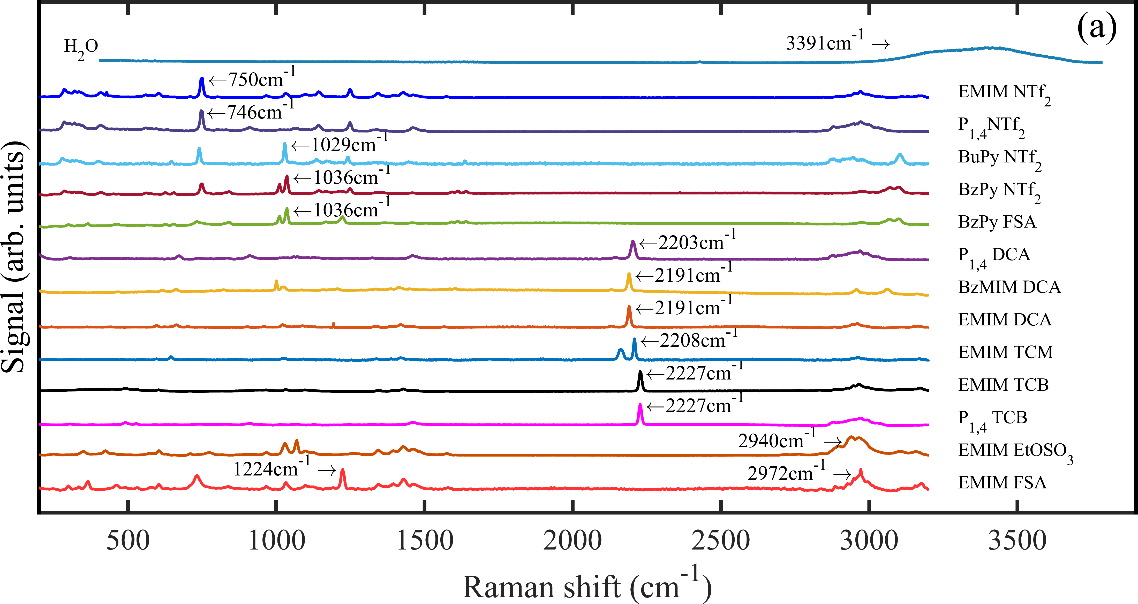
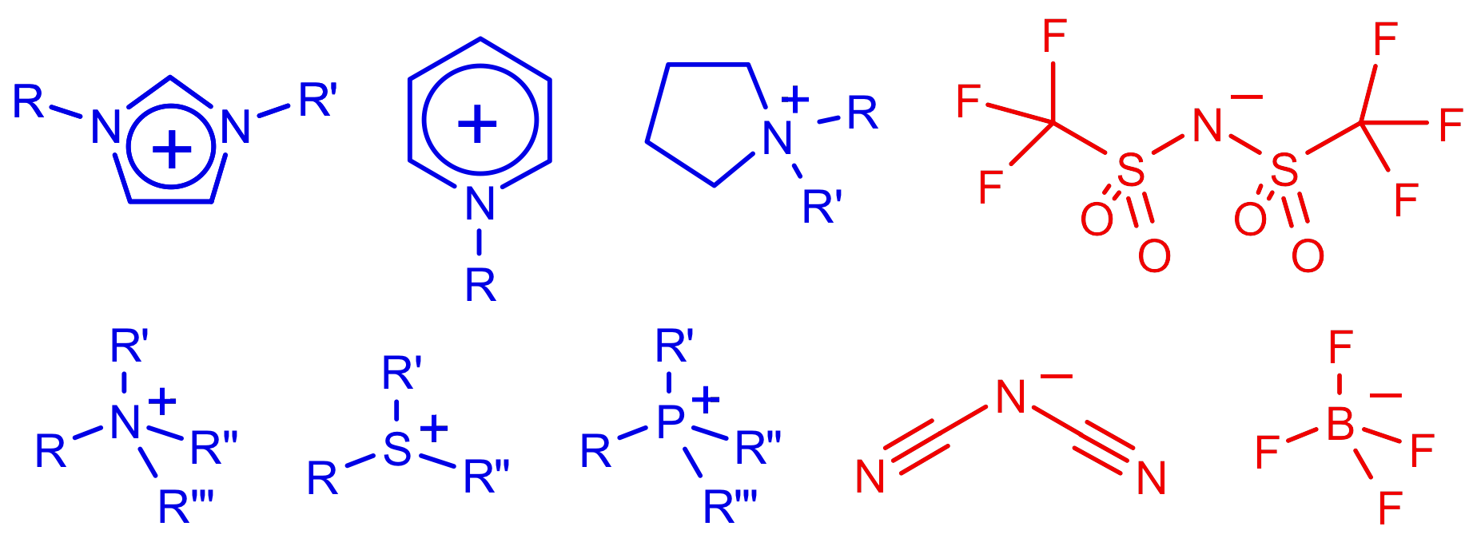
Ionic liquids
Artificial salts that are liquid at room temperature
Can be designed to have specific properties
Selection criteria:
  Transparent at pump and Stokes wavelengths
  Peak Raman cross section at desired shift
  High viscosity (suppressing Brillouin scattering)
  Good stability
Desired shift (~4300nm for optical pumping of CO₂) using anions containing nitrile groups (C-N triple bonds)

Slide 14
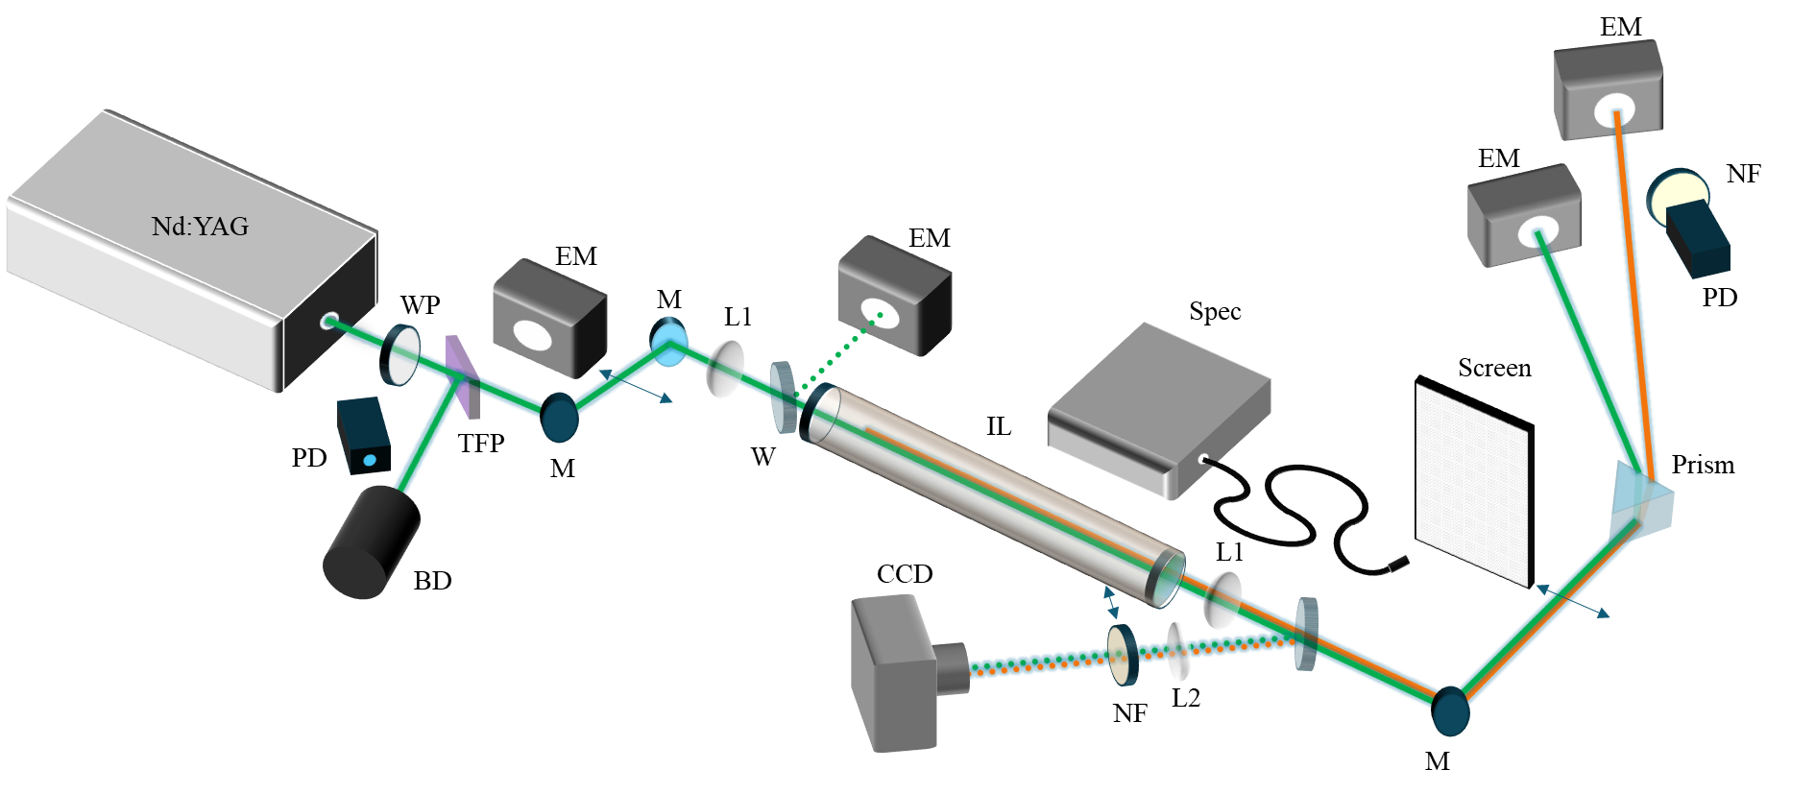
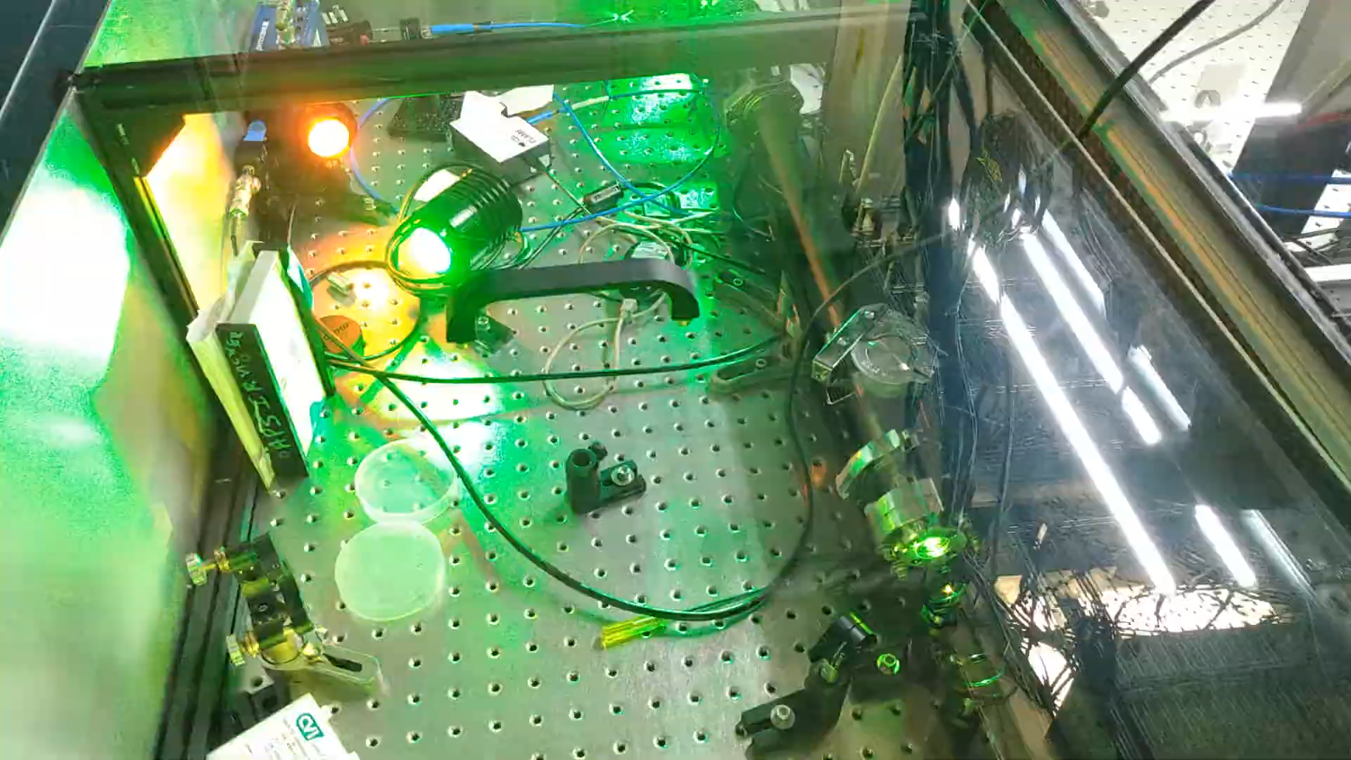
Ionic liquids experimental setup

Slide 15
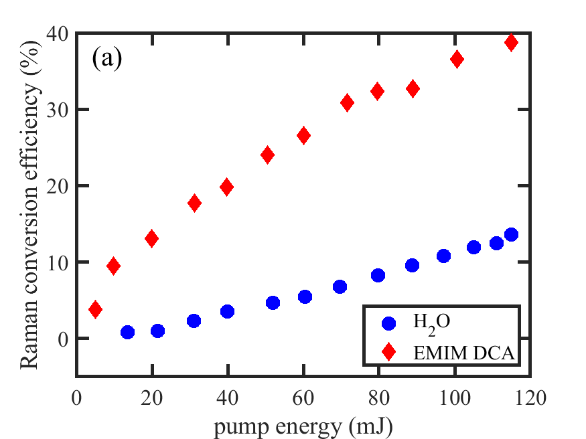
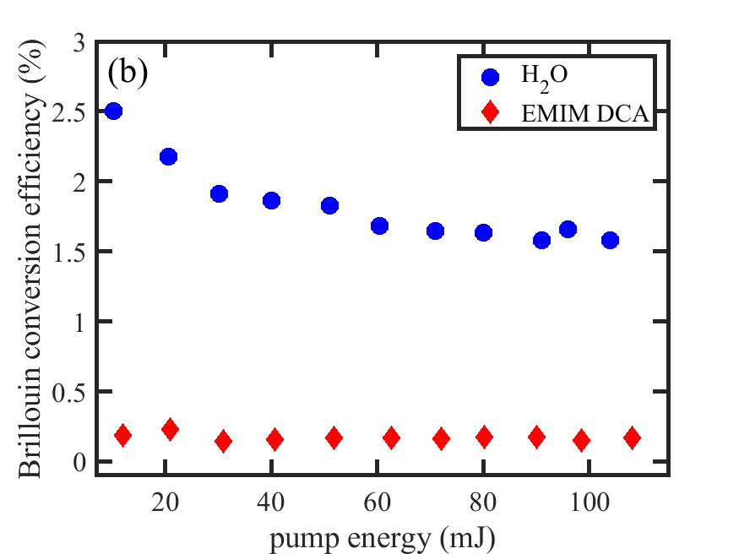
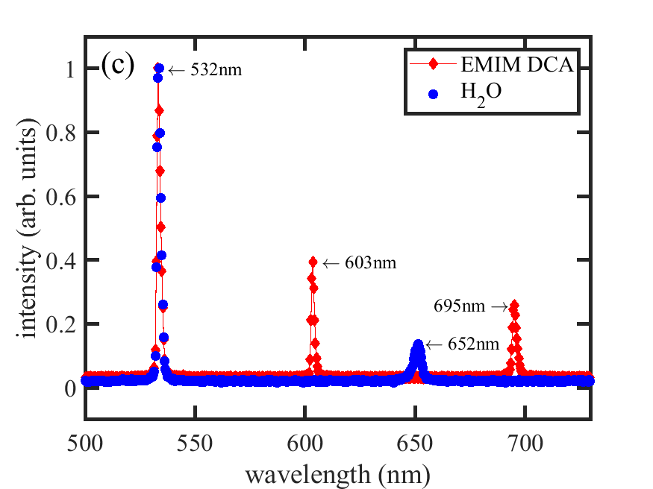
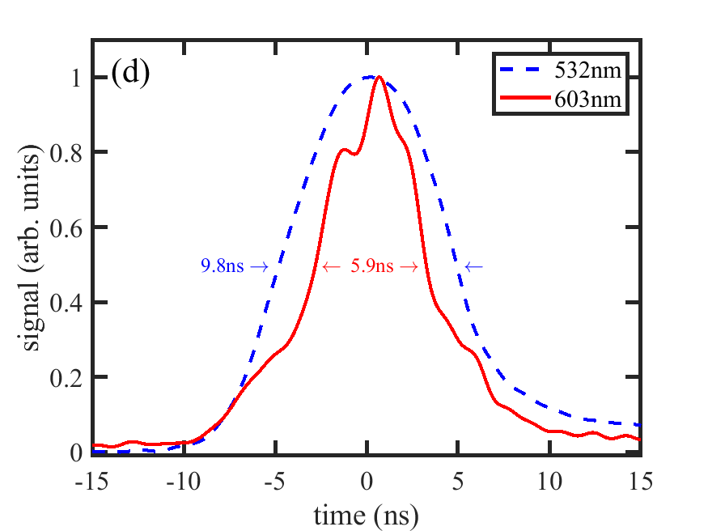
EMIM DCA Raman conversion
Low Brillouin scattering losses
3x higher efficiency than water
Good spectrum
Good temporal profile

Slide 16
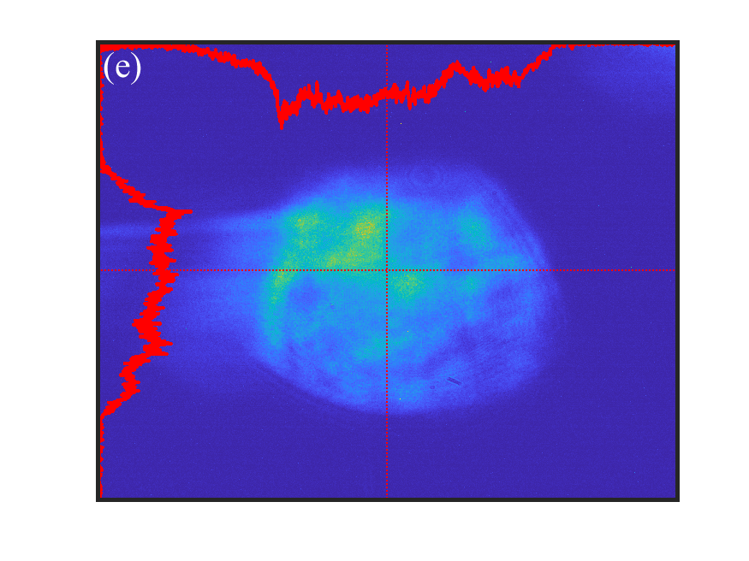
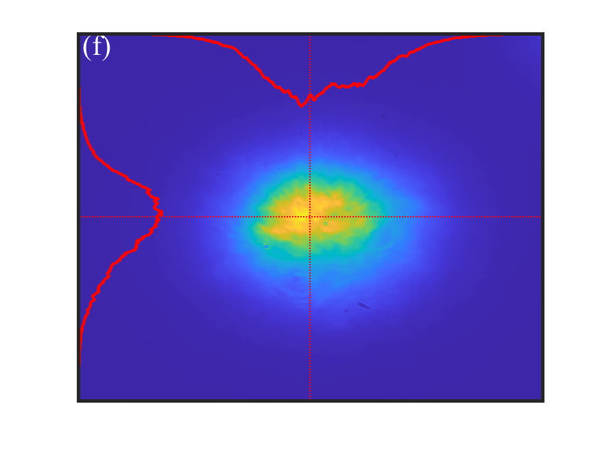
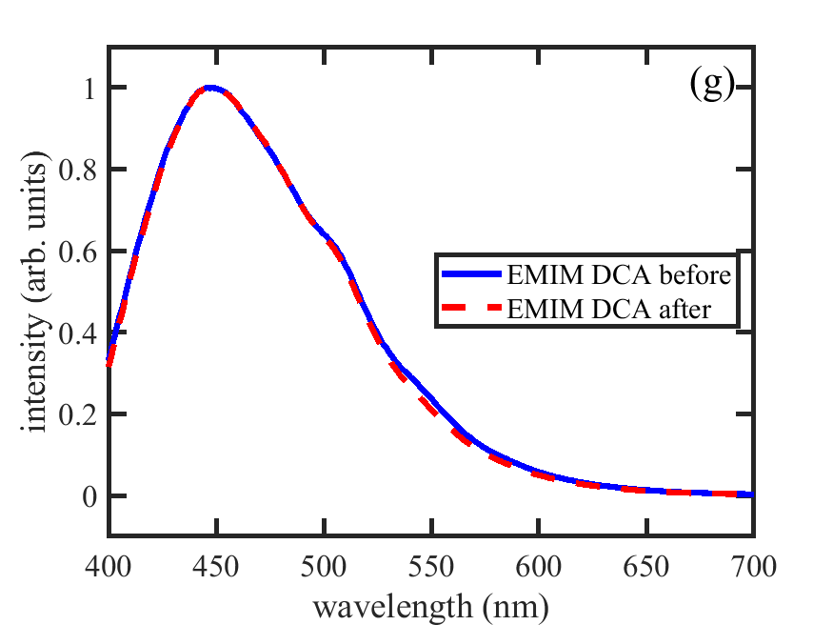
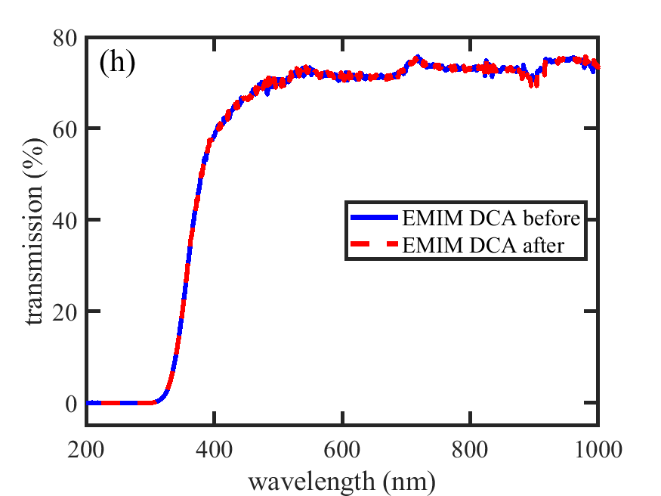
EMIM DCA Raman conversion
Good spatial profile
IL not damaged by this process

Slide 17
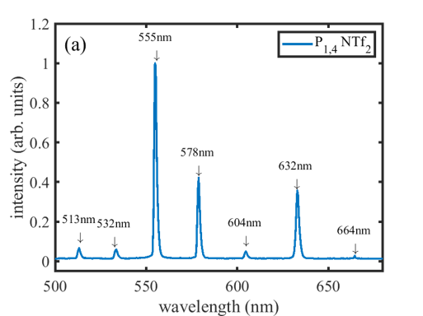
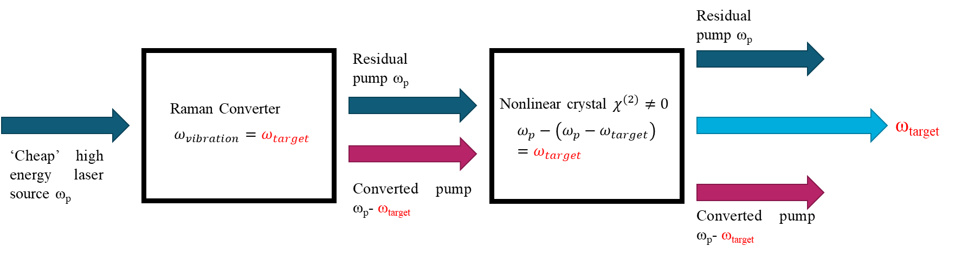
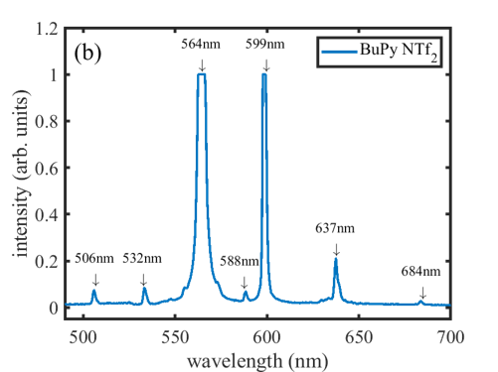
Future work
Examine other ionic liquids
Employ DFG to produce the actual seed and pump wavelengths

Slide 18
Conclusion
Typical Raman shift energies suit them for generating LWIR wavelengths through DFG
We have demonstrated appropriate Raman shifts from commonly available solid-state laser wavelengths (Ti:sapph and Nd:YAG)
Raman shifting provides a simple, flexible method for wavelength conversion

