Slide 1
Experimental Opportunities for Plasma Wakefield Acceleration in a Narrow Plasma Channel
AAC
November 10, 2022
Valentina Lee, Carlo Benedetti, Severin Diederichs, Eric Esarey, Spencer Gessner, Claire Hansel, Mark Hogan, Michael Litos, Jens Osterhoff, Carl Schroeder, Maxence Thevenet

Slide 2
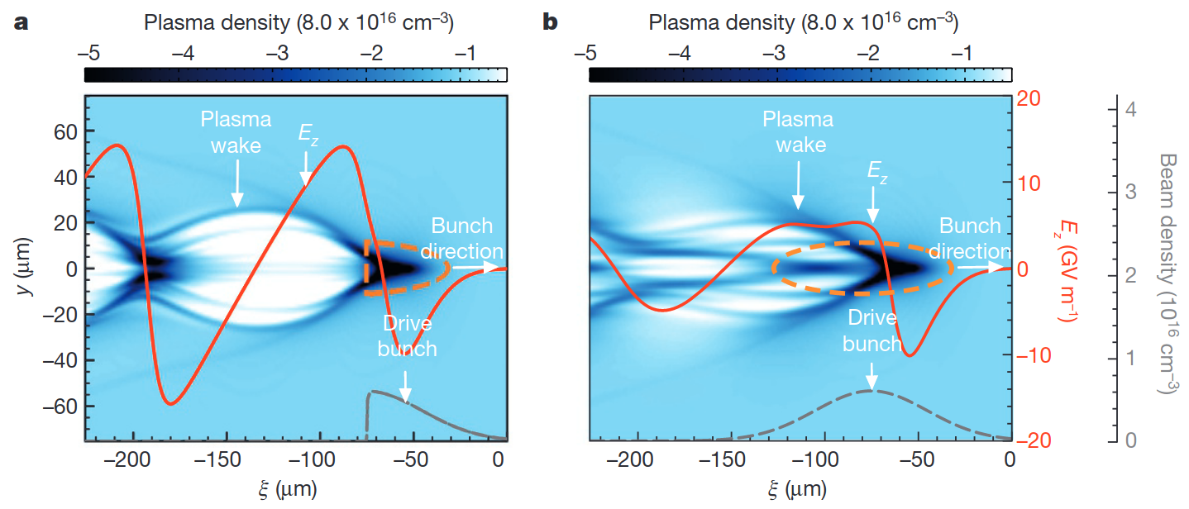
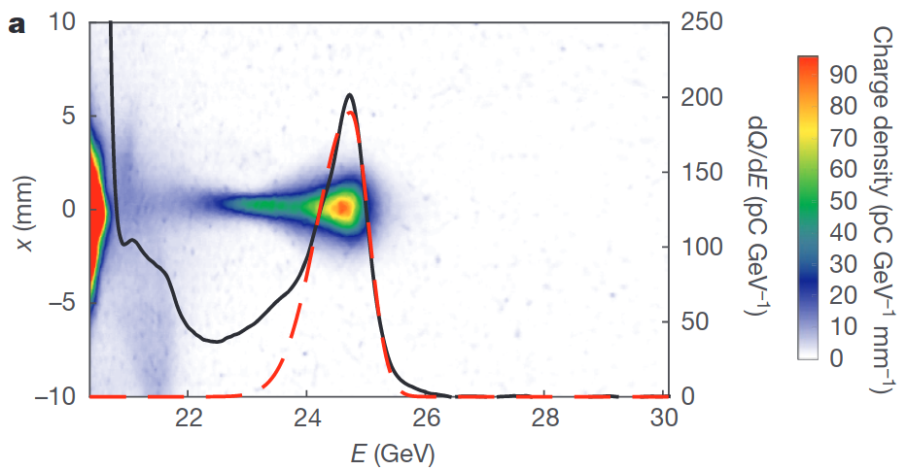
Background – Positron Acceleration
Positron Driven Nonlinear Plasma Wake
Multi-GeV acceleration of positrons in a self-loaded plasma wakefield was demonstrated at FACET-I.
It is not ideal for applications.
S. Corde, et. al., Nature, vol. 524, no. 7566, pp. 442–445, 2015.

Slide 3
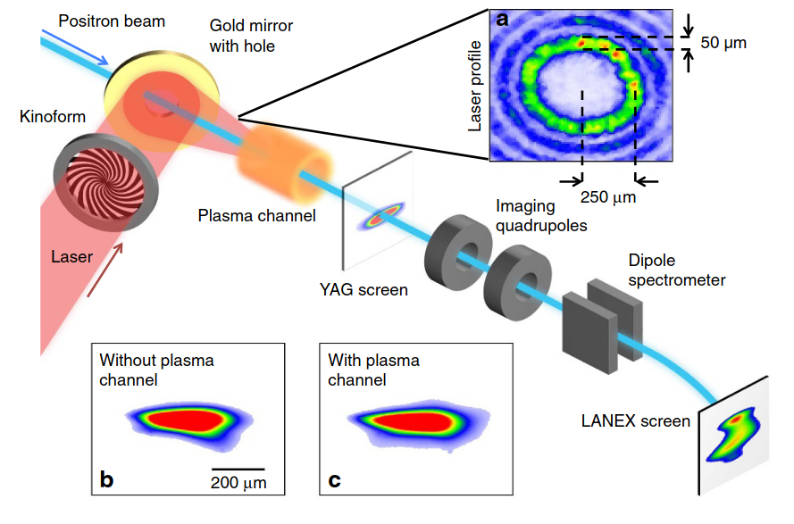
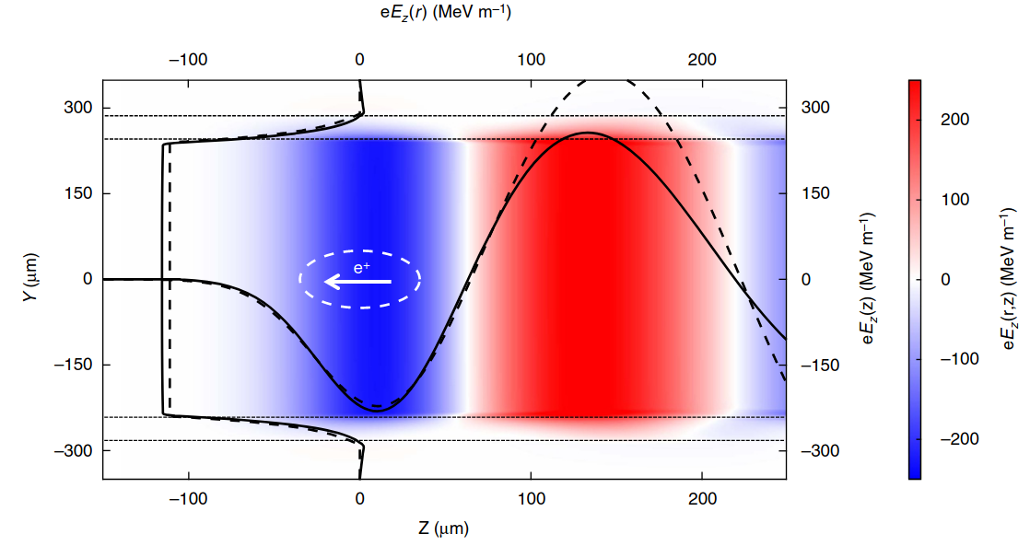
Background – Positron Acceleration
Positron Driven Nonlinear Plasma Wake
Multi-GeV acceleration of positrons in a self-loaded plasma wakefield was demonstrated at FACET-I.
It is not ideal for applications.
Hollow Channel
There is no transverse field in a symmetric hollow channel.
Drive beam misalignment results in dipole wake field.
Transverse focusing field is a major challenge that must be solved in order to realize positron acceleration.
S. Corde, et. al., Nature, vol. 524, no. 7566, pp. 442–445, 2015.
S. Gessner, et. al., Nature Communications, vol. 7, no. 1, 2016.

Slide 4
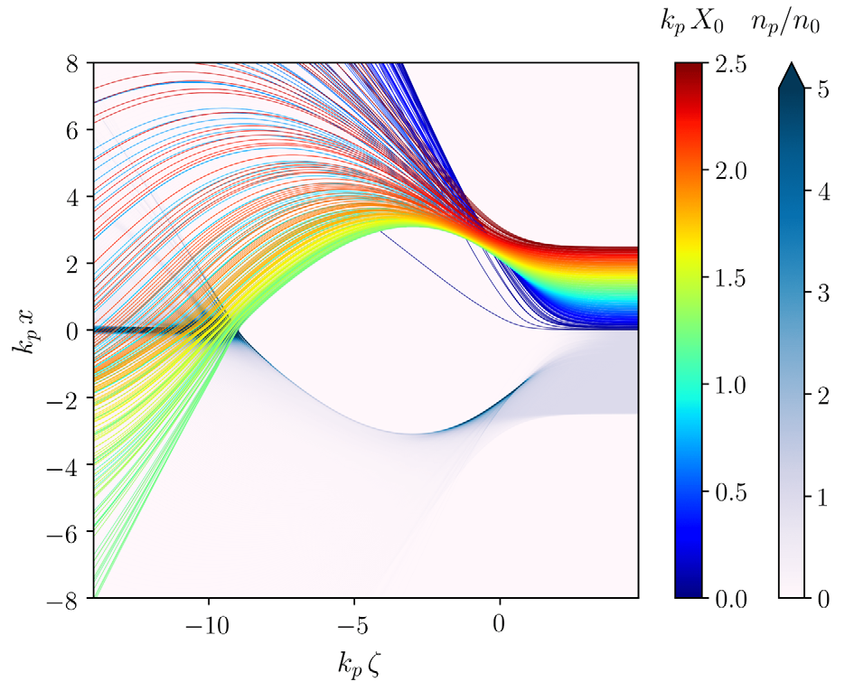
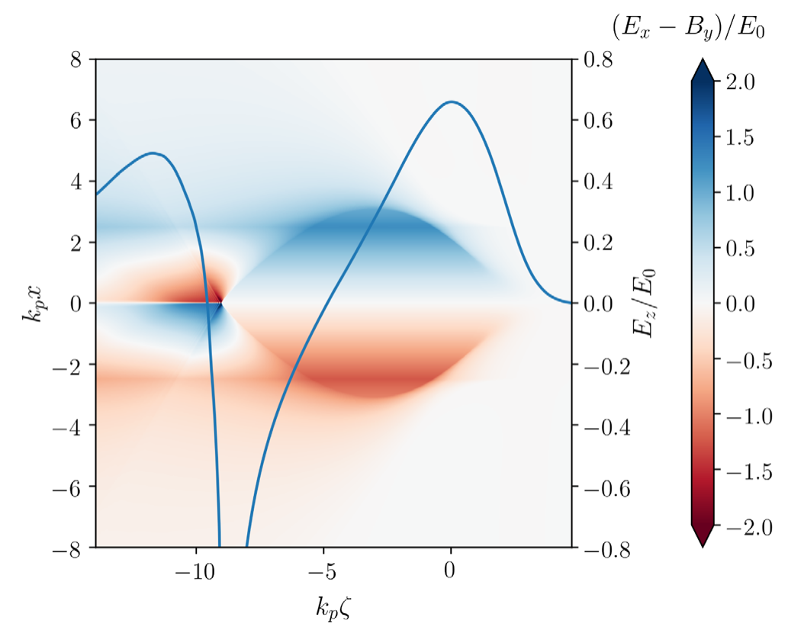
Positron Acceleration in a Narrow Channel
Homogeneous plasma
Sheath electrons return at roughly the same longitudinal position on axis.
Narrow Plasma Channel
Sheath electrons return to different longitudinal positions depending on their initial transverse position.
Transverse focusing field in accelerating phase
The elongated on-axis electrons create a region of transverse focusing field within accelerating phase for positrons.
S. Diederichs, C. Benedetti, E. Esarey, J. Osterhoff, and C. B. Schroeder, “High-quality positron acceleration in beam-driven plasma accelerators,” Physical Review Accelerators and Beams, vol. 23, no. 12, 2020.
Notes:
Homogeneous plasma
Transvers wakefield has a linear radial dependence within the ion cavity.
Narrow Plasma Channel
For a plasma with a finite radius smaller than the blowout radius, the transvers wakefield only increases within the plasma column.
Transverse field fall off for r > R_{p}

Slide 5
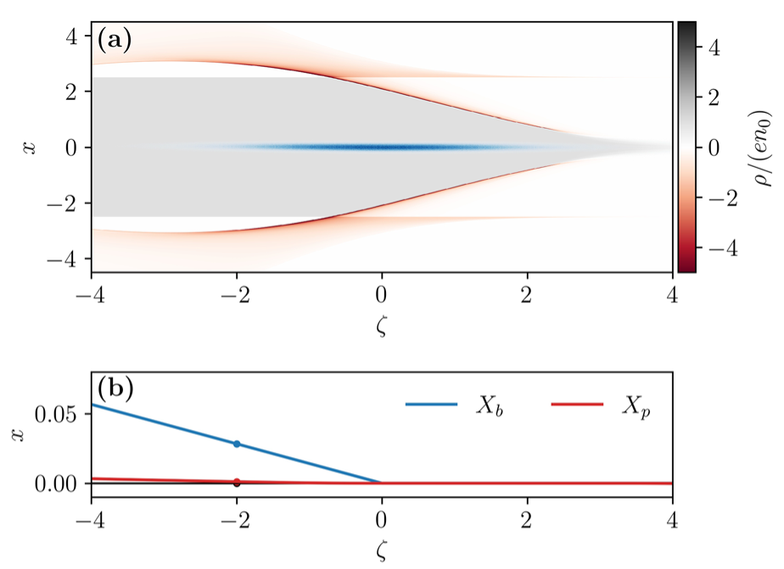
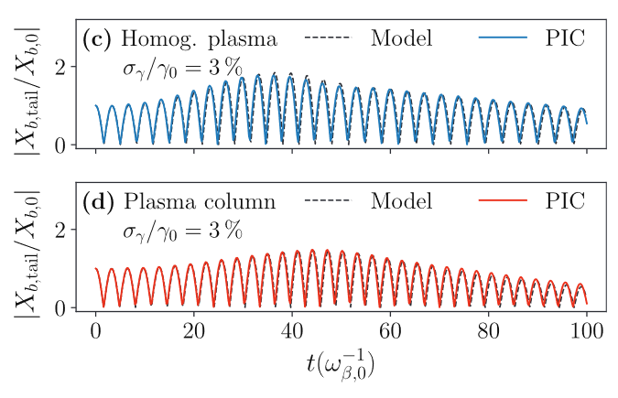
Narrow Plasma Suppress Hosing Instability
S. Diederichs, C. Benedetti, E. Esarey, M. Thévenet, J. Osterhoff, and C. B. Schroeder, “Stable electron beam propagation in a plasma column,” Physics of Plasmas, vol. 29, no. 4, p. 043101, 2022.
In a narrow plasma channel, the electron sheath is spread over a larger radial extent, and thus suppresses the hosing instability of initial titled drive beam.
The propagation of the drive beam needs to be on axis of the plasma column.
This paper showed the analytical model of narrow plasma suppressing hosing instability and experimentally achievable misalignment tolerance for this scheme.

Slide 6
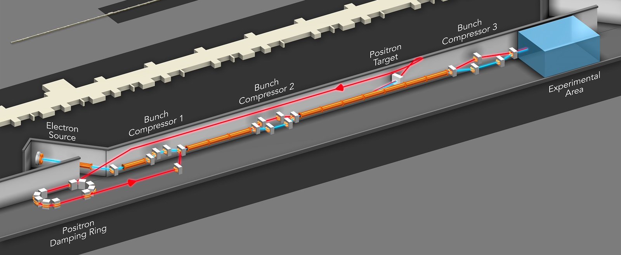
E333 Experiment at FACET-II
FACET-II is a research facility at SLAC National Lab which allows beam driven plasma wakefield accelerating positron to be possible in the future.
10GeV, 1nC bunches of positrons may be available in coming years at FACET-II.
Electron PWFA experiment in a narrow plasma channel can be realized in the next two years.
E333 is an experiment deliciated to positron acceleration at FACET-II.

Slide 7
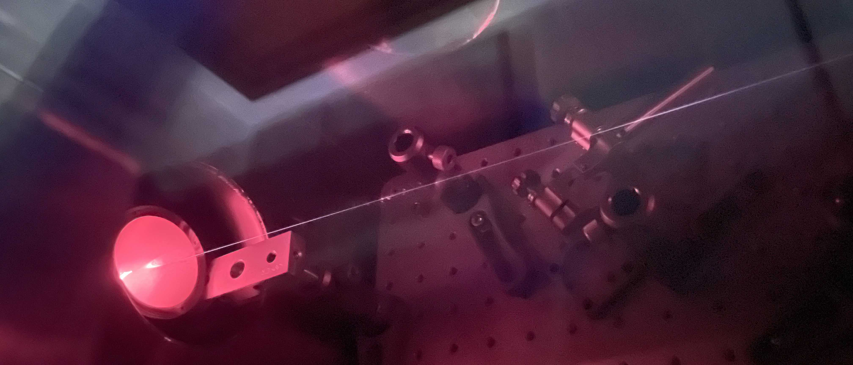
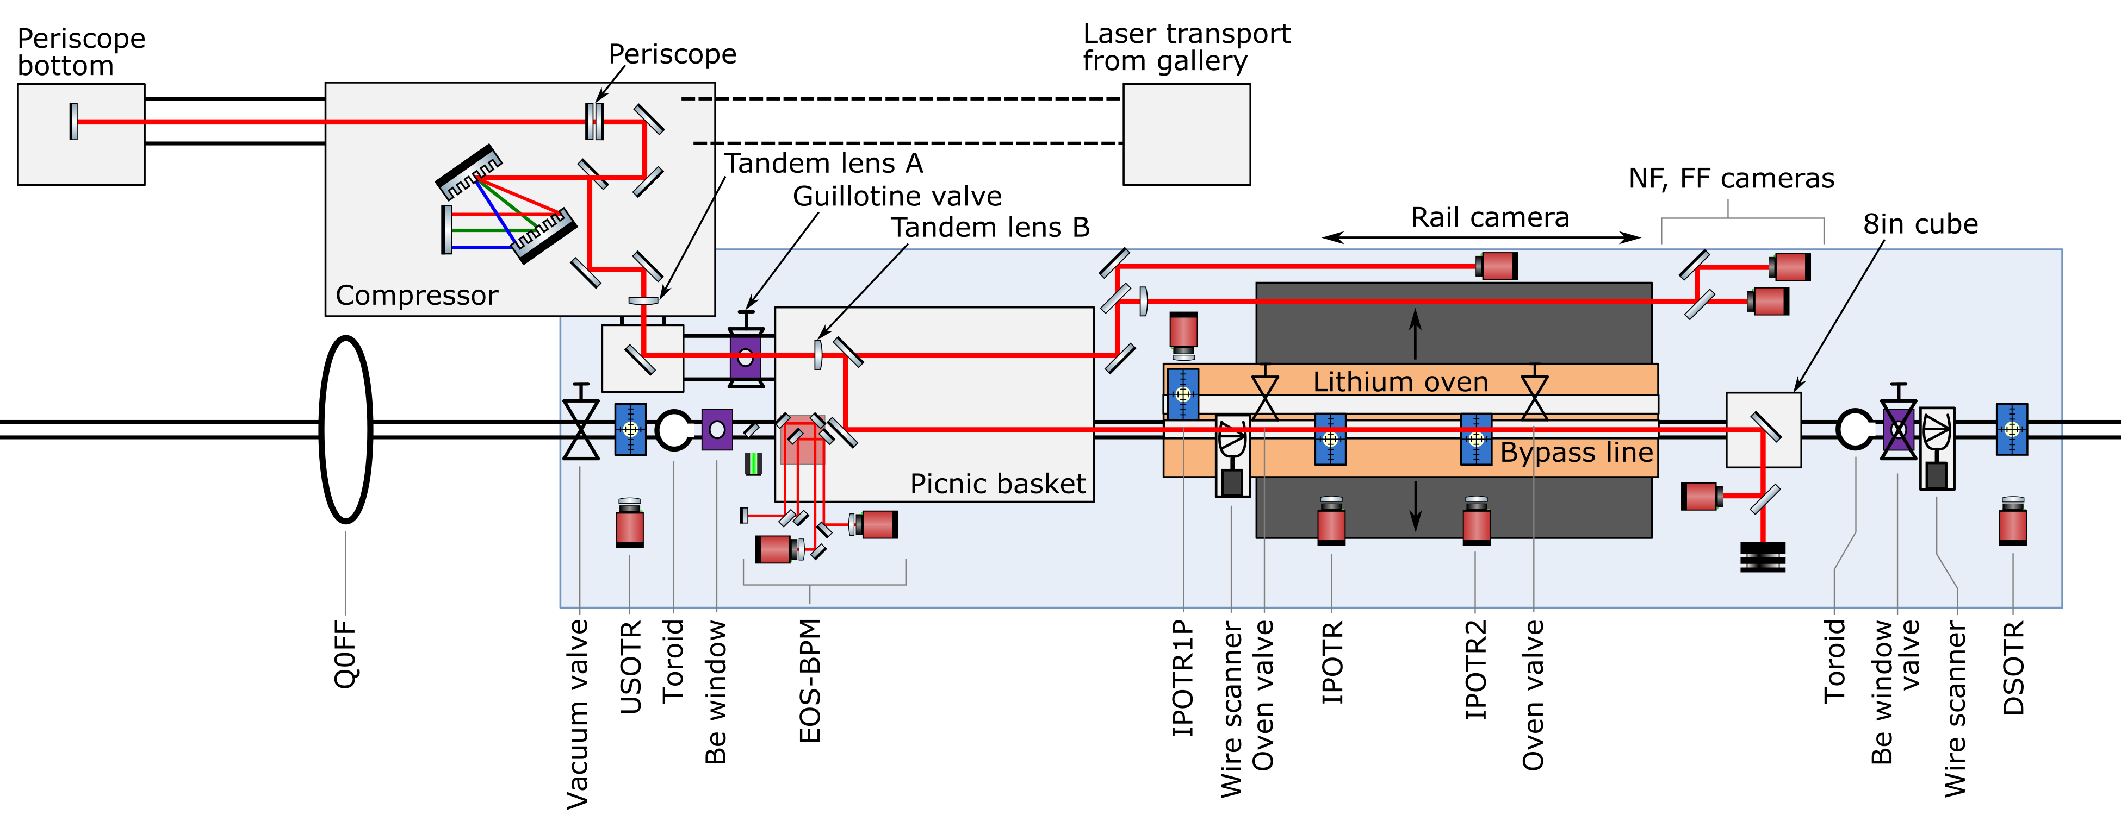
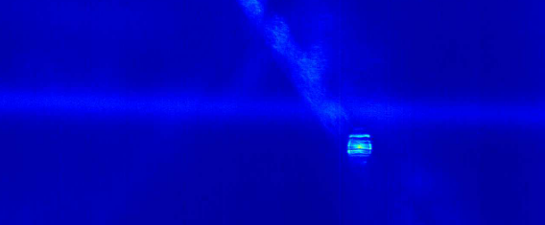
FACET-II Plasma Sources
Unconfined gas ionized by laser
Optics: Axicon lens or diffractive optic
Laser parameters:
It is easier to make narrow plasma than wide plasma experimentally.
40um
Energy | 700mJ
Pulse Duration | 50fs
Peak Power | 14TW
80cm
First laser ionized plasma at FACET-II
Laser ionized plasma sources can be shaped by a careful control of the optic used, laser intensity, and gas density.

Slide 8
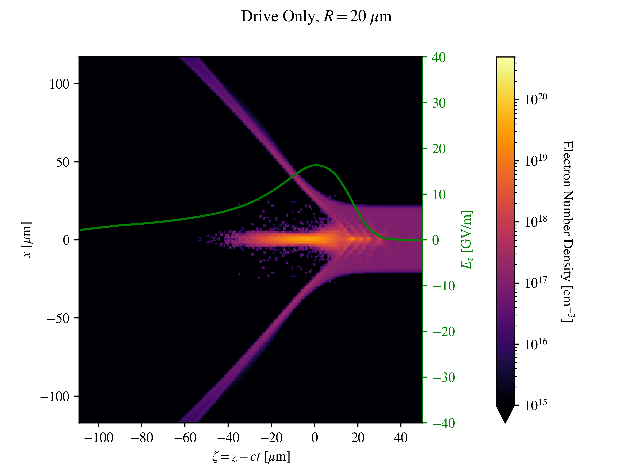
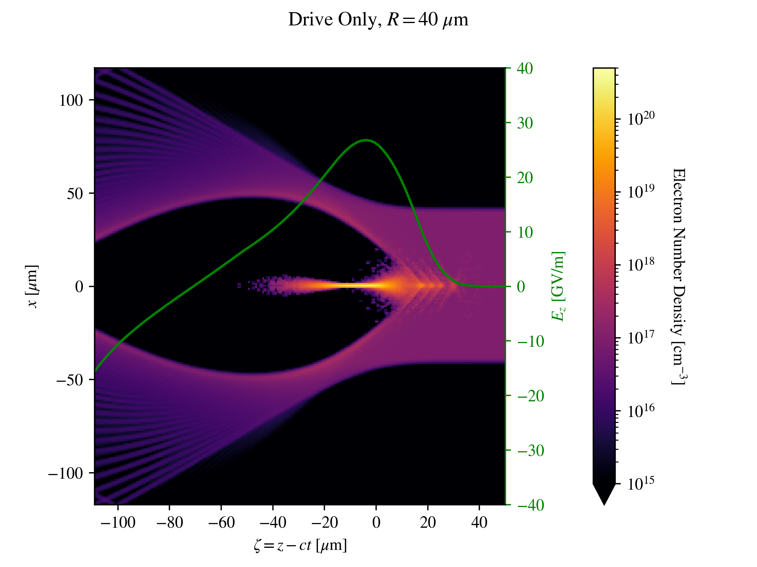
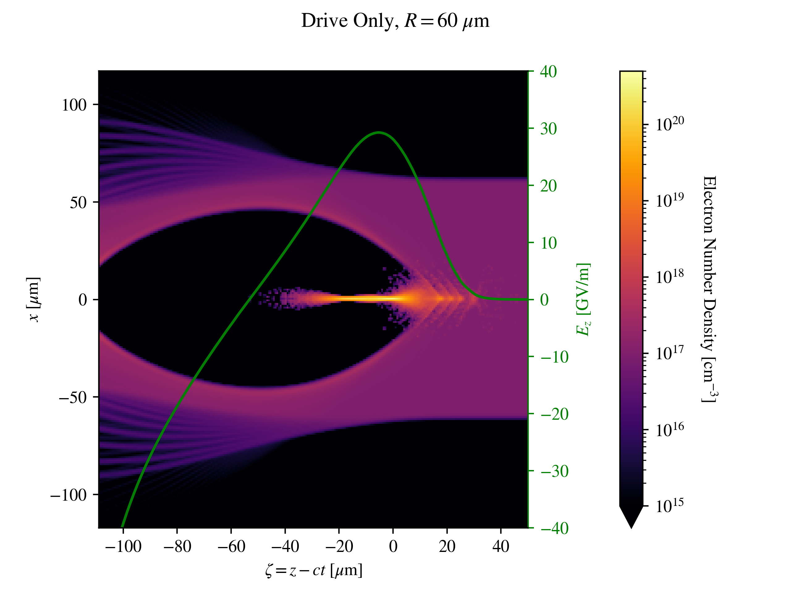
Phase One – Longitudinal Dynamics
In the phase one experiment, a long single bunch electron beam or two bunches will be used to probe the longitudinal wakefield.
We aim to demonstrate the capability of a narrow channel PWFA and the possibility of positron acceleration.

Slide 9
Experimental Plan for Narrow Plasma Channel
At FACET-II E333 experiment, we will study the longitudinal field created by an electron drive beam in a narrow plasma channel.
The two main experimental parameters are the width of the plasma and the density of the plasma.
The two main longitudinal dynamics to be studied are the energy transformer ratio and the acceleration gradient.
This experiment is to study how to create a stable wake with narrow channel while maintain a usable acceleration efficiency.

Slide 10
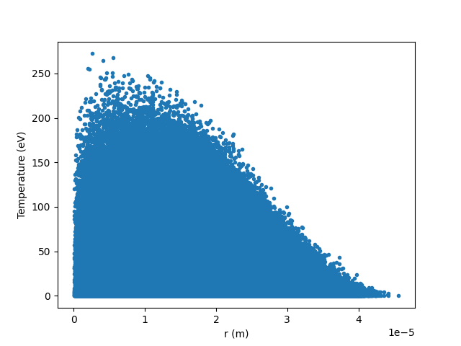
Plasma Source Diagnostics
Diagnosing PWFA plasma source is challenging because of its density range.
Experimental efforts have been deliciated into diagnosing cold plasma source by its afterglow imagery via modeling the expansion as a fluid.
Te_{avg}= 13.53 eV

Slide 11
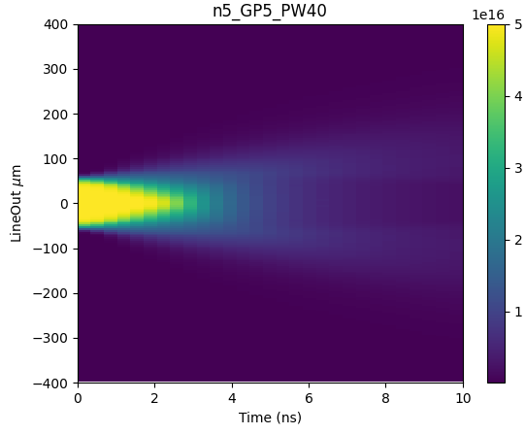
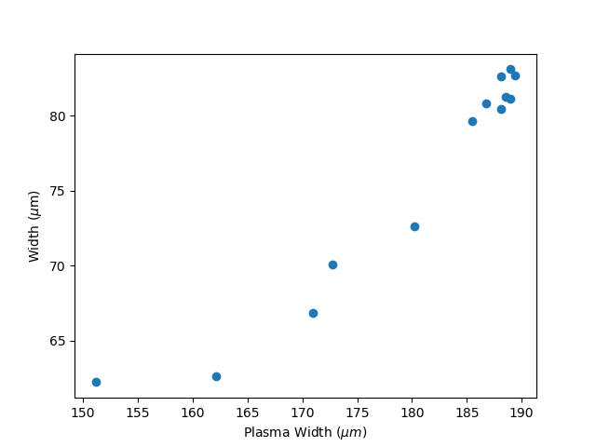
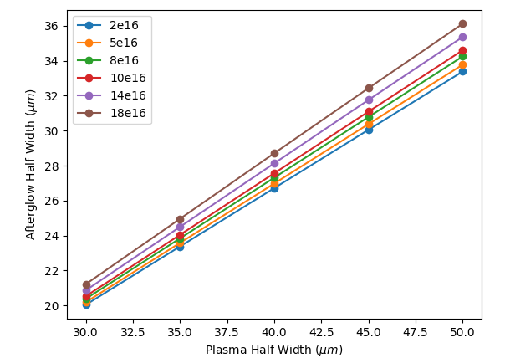
Plasma Source Diagnostics
Diagnosing PWFA plasma source is challenging because of its density range.
Experimental efforts have been deliciated into diagnosing cold plasma source by its afterglow imagery via modeling the expansion as a fluid.
Te_{avg}= 13.53 eV
Simulation
Experiment
Preliminary
Plasma Afterglow Signal Width
Plasma Afterglow Signal Width
Initial Plasma Width
Initial Plasma Width

Slide 12
Summary
We presented the phase one experimental plan for the E333 experiment at FACET-II.
The narrow plasma channel is worth study in experiments because:
It may be a viable method for acceleration of positrons in a PWFA
It provides transverse stability to the drive beam, suppressing hosing instability
At FACET-II, we plan to eventually study positron acceleration in a narrow channel PWFA in E333.
In phase one, longitudinal dynamics study, we plan on studying the impact on the energy transformer ratio, energy gain, and efficiency from various widths and densities of a narrow plasma channel.
This study aims to create a stable wake with a narrow channel while maintain a usable acceleration efficiency.

Slide 13
Thank You for Your Attention
This work was funded by the U.S. DOE Office of Science award number DE-SC0017906 and NSF Award Number PHY-1806053.

