Slide 1
Transverse Stability in an Alternating Gradient Planar Dielectric Wakefield Structure
W. Lynn, G. Andonian, N. Majernik, S. O’Tool, J. Rosenzweig | UCLA
S. Doran, SY. Kim, J. Power, C. Whiteford, E. Wisniewski | Argonne National Laboratory
P. Piot | Northern Illinois University

Slide 2
Overview
Background
Alternating gradient structure
Mechanical design
AWA machine study
Simulation results
Some troubles/concerns

Slide 3
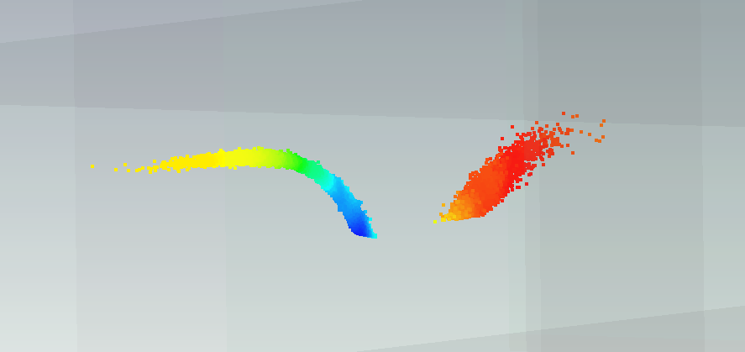
Background
Beam break up is serious issue
Flat beams suppress dipole interaction
Quad wakes deadly even without dipole
Notes:
30 cm interaction for flat beam

Slide 4
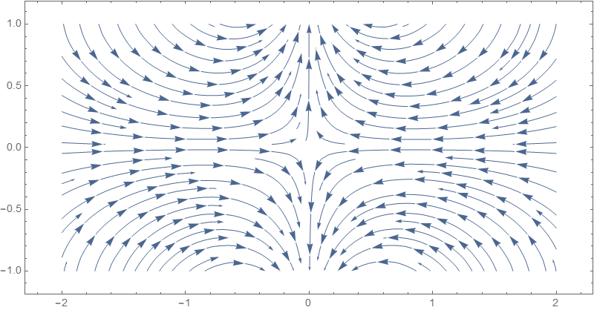
Alternating Gradient Structure
If you can’t beam ‘em, join ‘em
Orientation of quad wake determined by structure
Allows wake to be modified as beam progresses
S. S. Baturin, G. Andonian, and J. B. Rosenzweig, Analytical treatment of the wakefields driven by transversely shaped beams in a planar slow-wave structure, Phys. Rev. Accel. Beams 21, 121302 (2018).

Slide 5
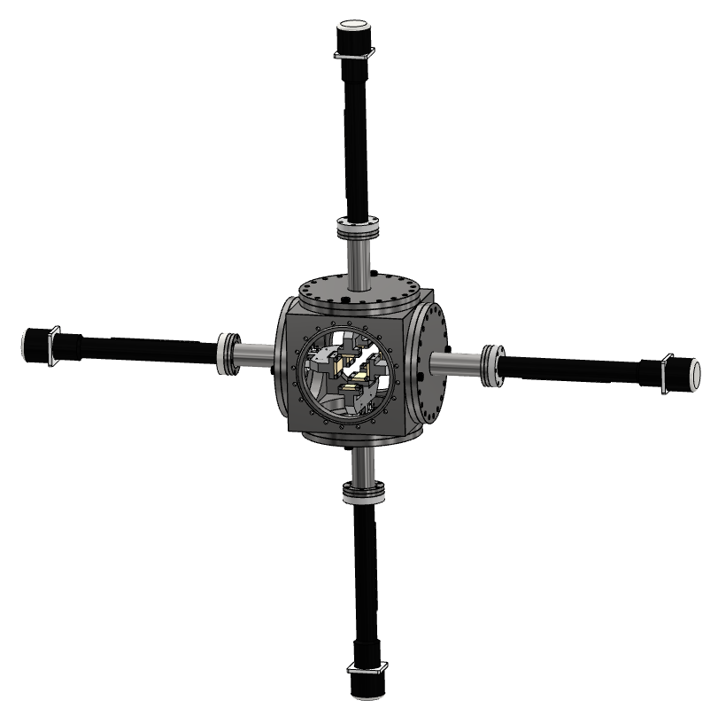
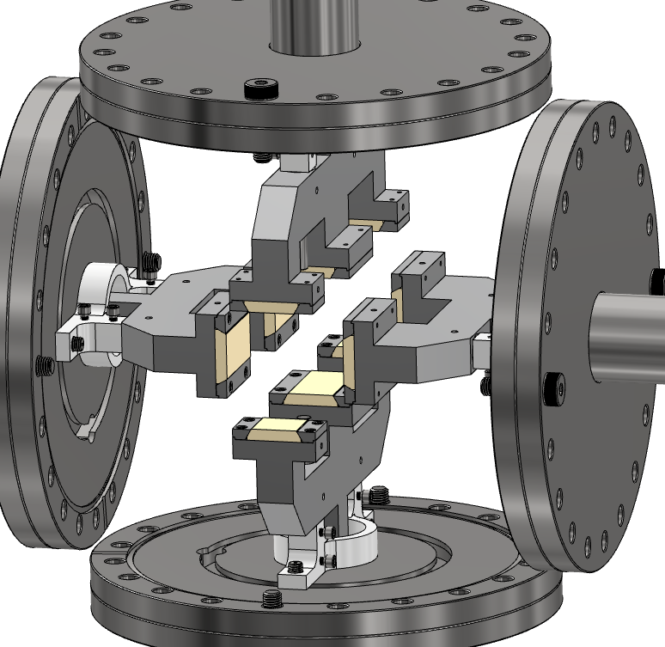
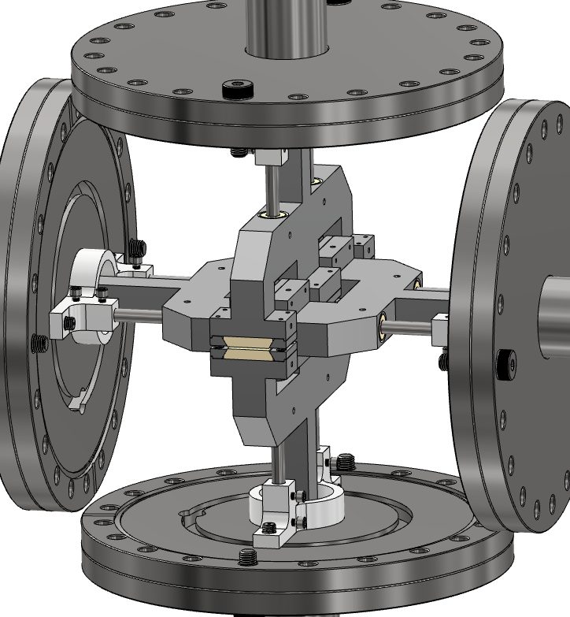
Mechanical Design

Slide 6
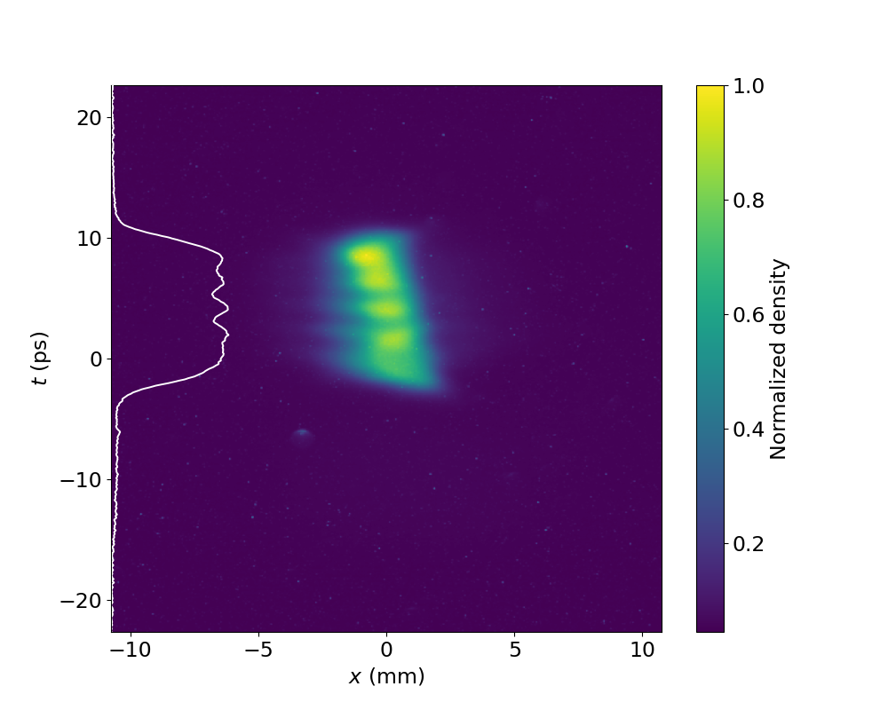
Machine Study
Avg over 100 shots
Based on OPAL simulations
Optimized for low emittance
U = 61 MeV
Q = 1 nC
FWHM = 12.71 ± 0.39ps
Notes:
Record low emit, John Power WG8:S1 for more AWA stuff.

Slide 7
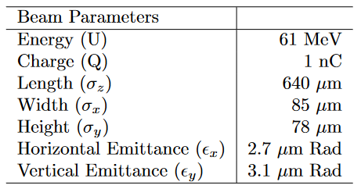
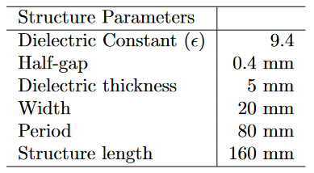
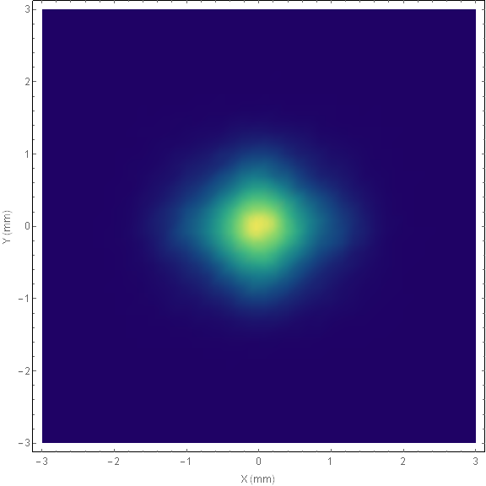
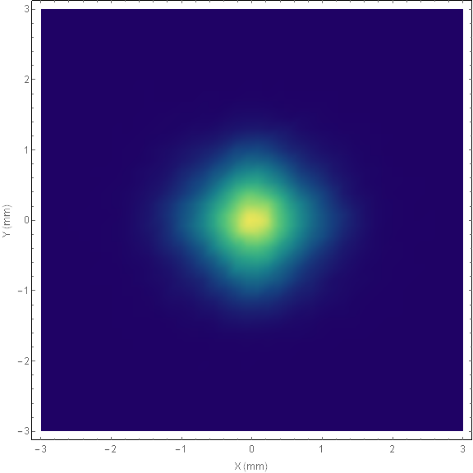
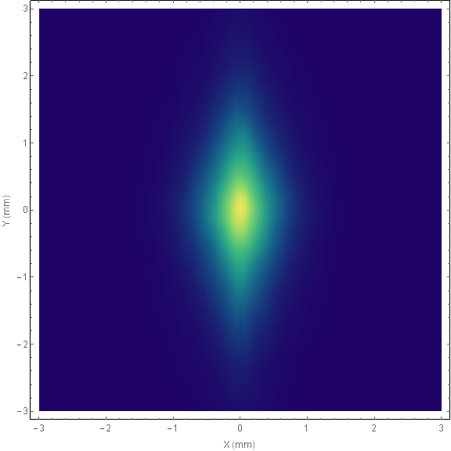
Simulation
Virtual YAG images of the on-axis beam for three different configurations
No interaction
Alternating gradient
Non-alternating
Y
X
X
X

Slide 8
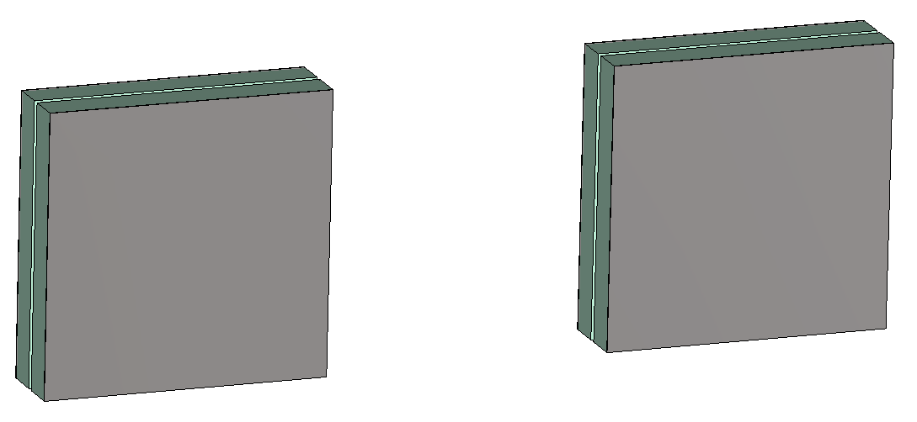
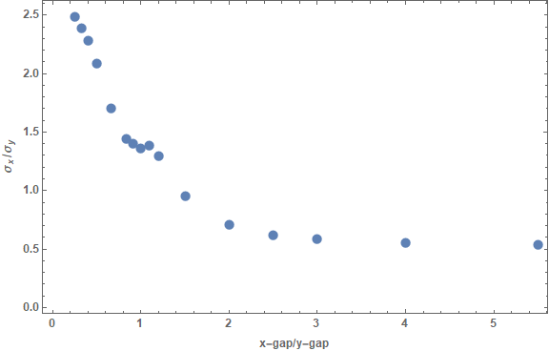
More simulation
$$\frac{σ_{x}}{σ_{y}}$$

Slide 9
Movies
Non-Alternating
Alternating

Slide 10
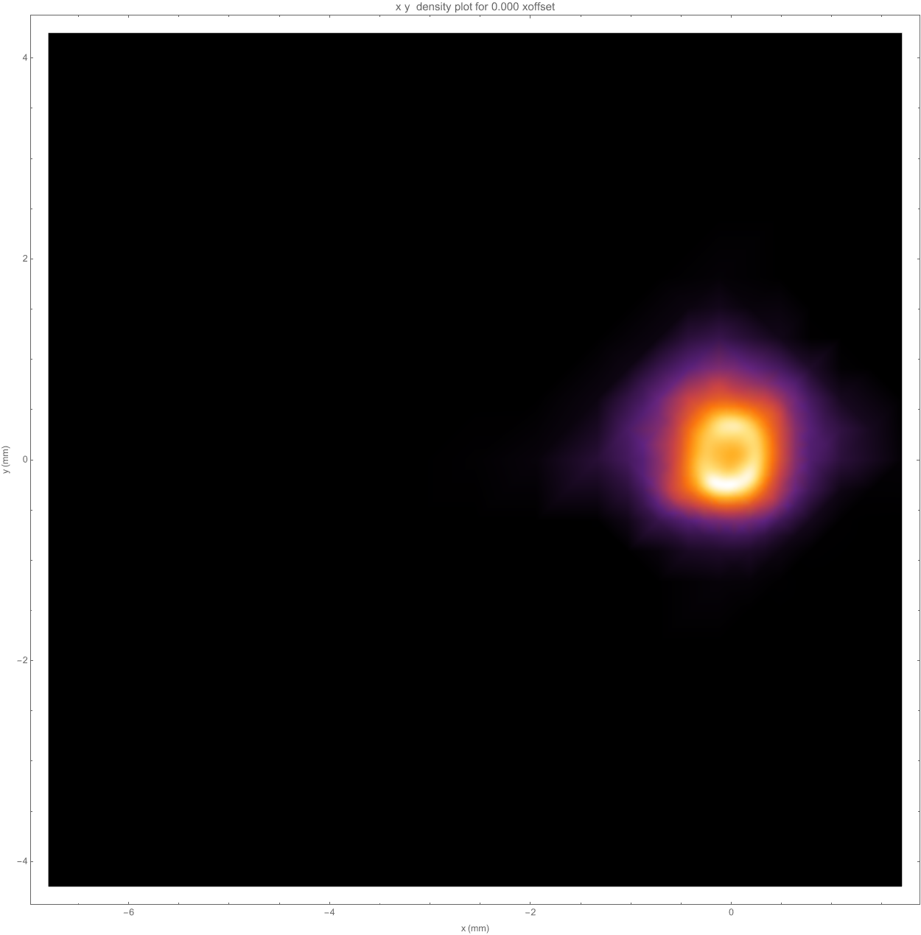
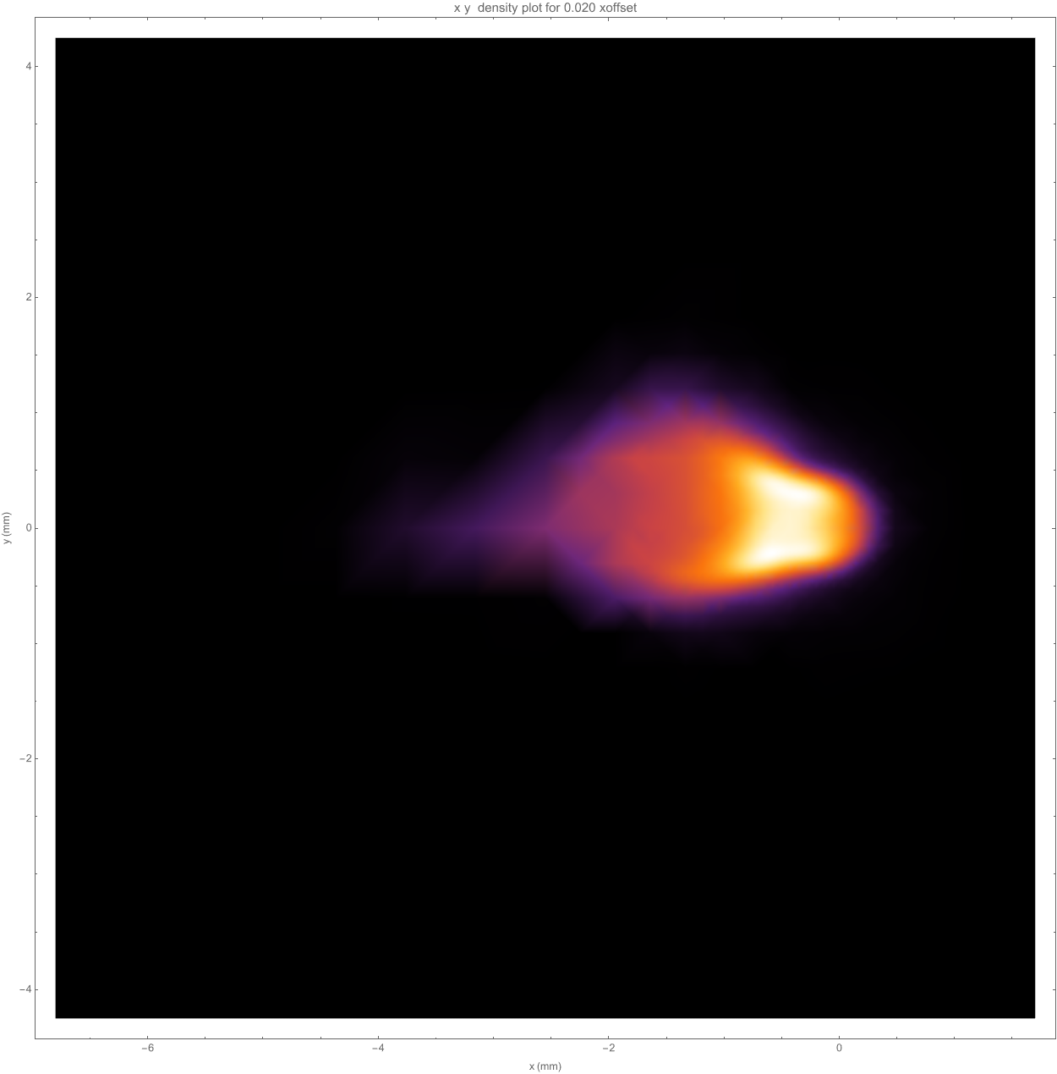
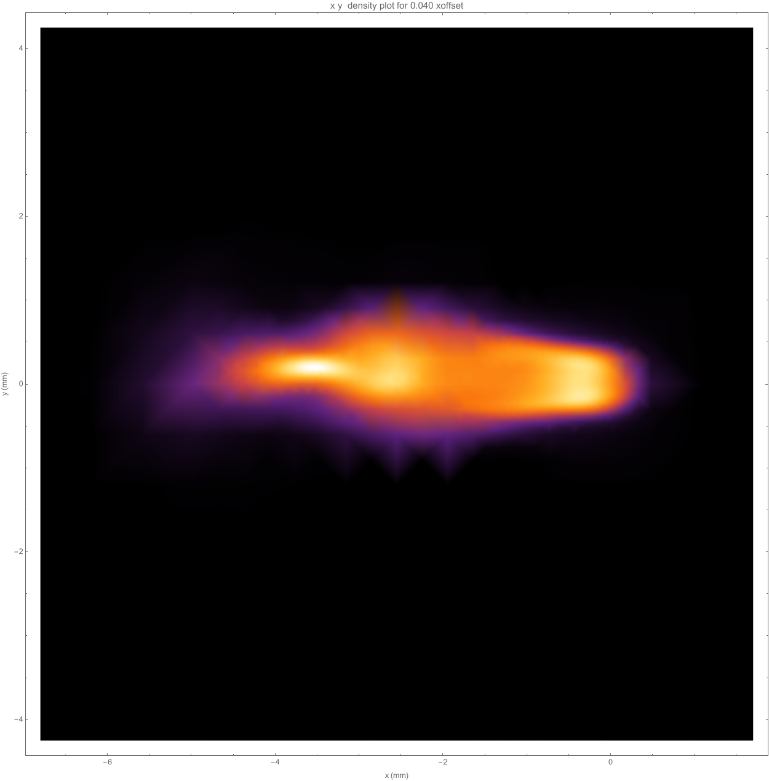
Off-axis sensitivity
Strictly looking at quadrupole fields
Off-axis beam experiences heavy deflection
Y
X
X
X

Slide 11
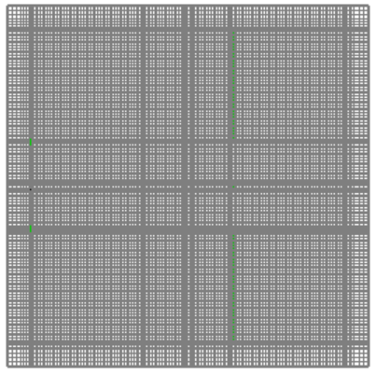
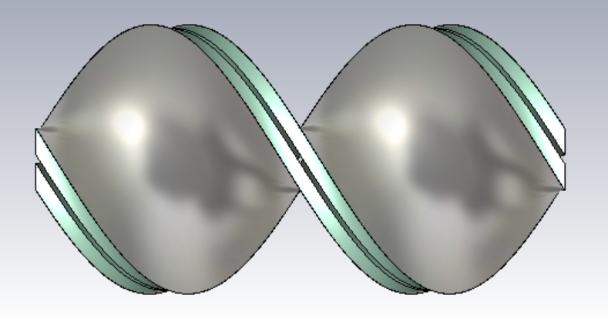
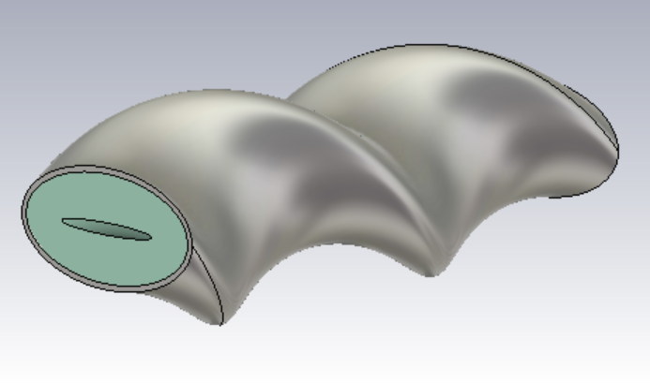
Simulation issues
Longitudinal variation leads to much larger mesh than necessary
CST has no moving window option, also very wasteful
Other codes struggle with longitudinal variation
Interested in exploring more exotic geometries
Interesting bit

Slide 12
Conclusion
Beam breakup a serious issue for DWA schemes
Alternating gradient a possible way to mitigate quadrupole wakes
Simulations can be challenging
Data soon
Thank you to everyone who has helped

