Slide 1
An Analytic Theory of Chromatic Emittance Growth in a Plasma Wakefield Accelerator
AAC
November 7-11, 2022
R. Ariniello, C. E. Doss, V. Lee, C. Hansel, J. R. Cary, M. D. Litos

Slide 2
Chromatic Emittance Growth in a Plasma
Chromatic phase spread causes projected emittance growth for an electron bunch in an ion column.
Motion in an ion column:
Oscillation frequency depends on particle energy:
Emittance growth is minimized when different energy particles overlap in phase space, matched beam.
Emittance growth is a major problem that must be solved in order for plasma-based accelerators to be useful.

Slide 3
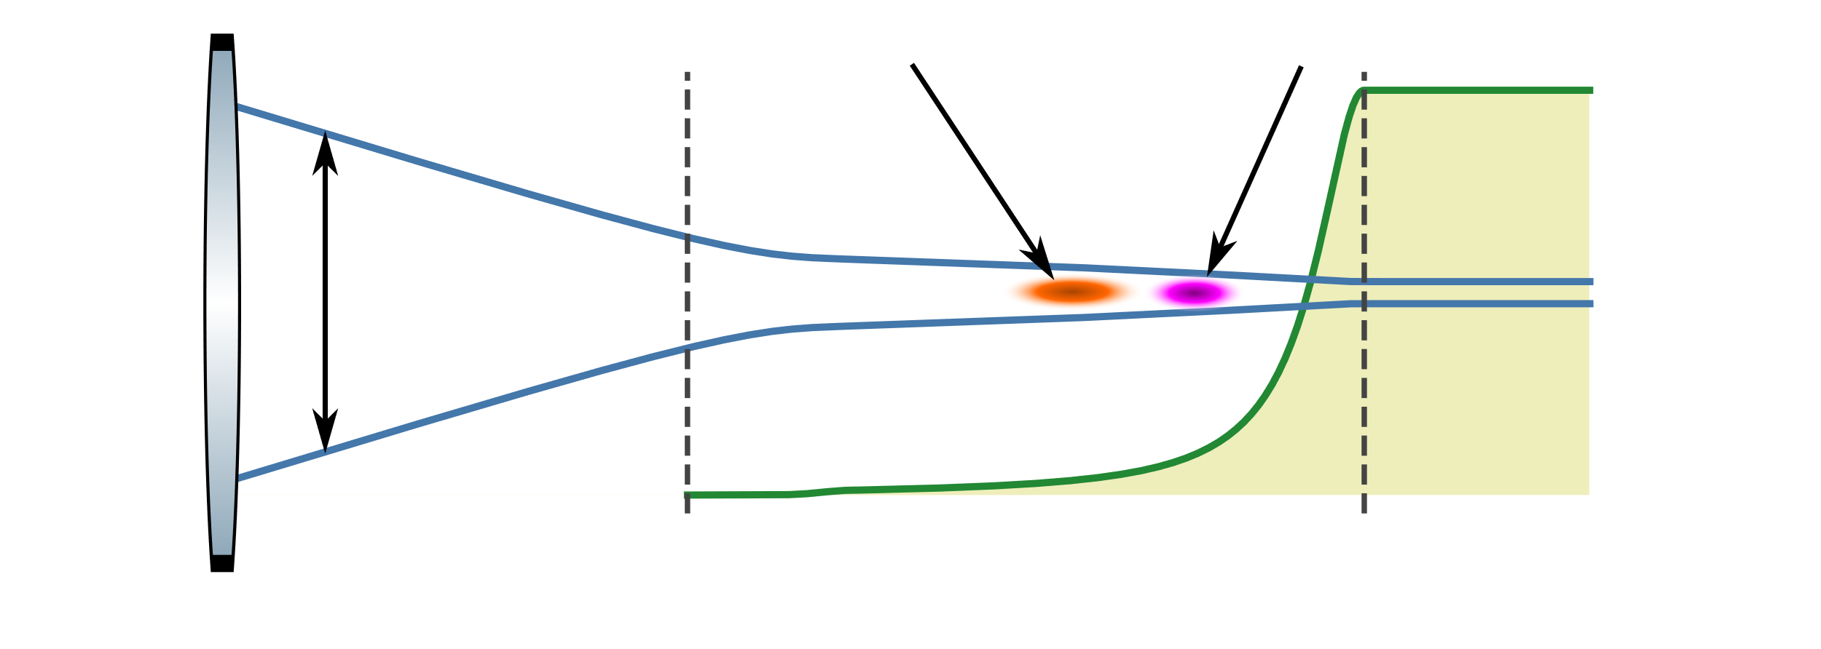
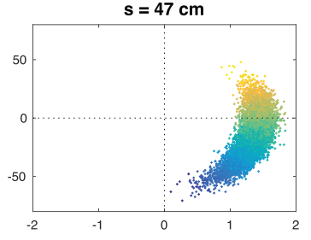
Causes of Chromatic Emittance Growth
Witness beam
Drive beam
Mismatch
Beam divergence is not matched to focusing in plasma.
Typically results from limitations in magnetic focusing system.
Plasma ramp focuses beam to matched size.
Transverse offset
If the witness beam is transversely offset with respect to the drive beam it will oscillate.
Energy spread
Changes in the longitudinal phase space can change the rate of emittance growth.
Beam envelope
Plasma ramp
Lindstrom et al. IPAC Prec. 2016
How does energy gain and the plasma density profile effect emittance growth?
How does the emittance grow for a beam that is offset?
How does the slice emittance evolve?

Slide 4
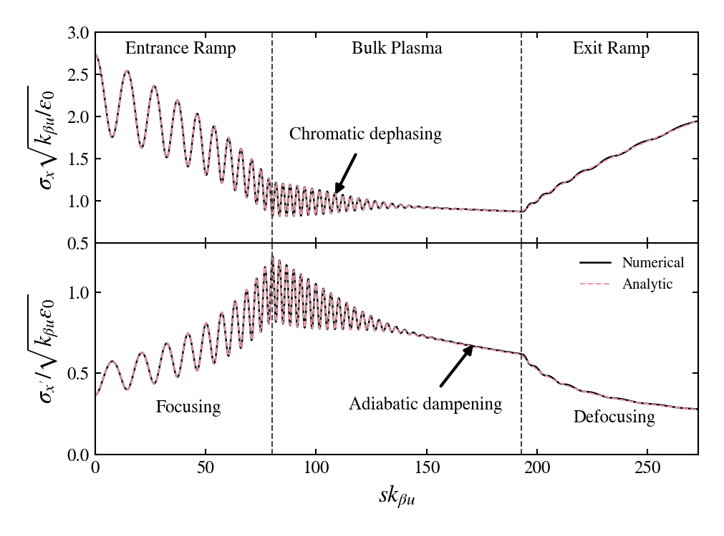
Beam Evolution in a Typical Plasma Stage
Beam is initially mismatched to the ramp.
Assumed a simple energy gain model that varies with density and longitudinal slice.
Ramps
Entrance ramp focuses beam.
Exit ramp reduces beam divergence.
Bulk Plasma
The beam is accelerated and undergoes adiabatic dampening.
Spot Size
Divergence
We can calculate the full beam evolution, including in adiabatic ramps, analytically.
(emittance and moments)

Slide 5
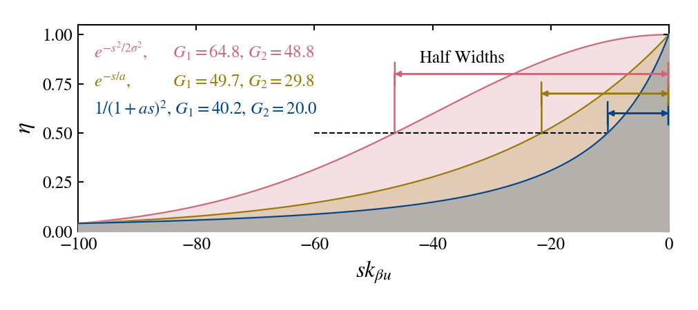
Beam Evolution in a Typical Plasma Stage
The integral of the plasma density (shaded area) determines how much emittance growth and energy spread there is in the ramp.
All these ramps focus the same amount!
Ramps are best described by the amount of focusing and the integral.

Slide 6
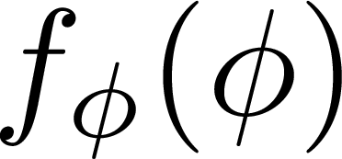
Emittance Evolution Through a Plasma Stage
Saturated emittance is the sum of the mismatch and offset:
Mismatch
Transverse offset
The evolution of the emittance is described by:
Mismatch
Transverse offset
dependence comes from:
Magnitude of the Fourier transform of

Slide 7
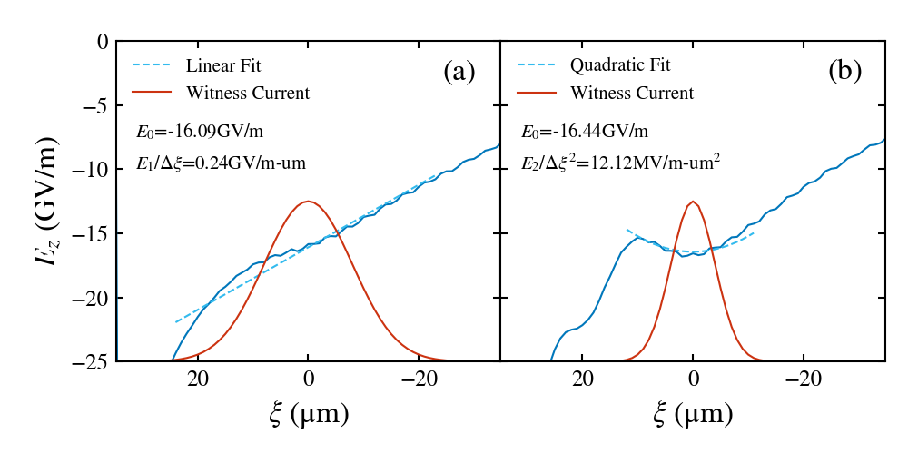
Spot Size Variation Across the Energy Slices
Two cases:
Beam has too little current – longitudinal field is linear.
Beam has too much current – longitudinal field is quadratic.

Slide 8
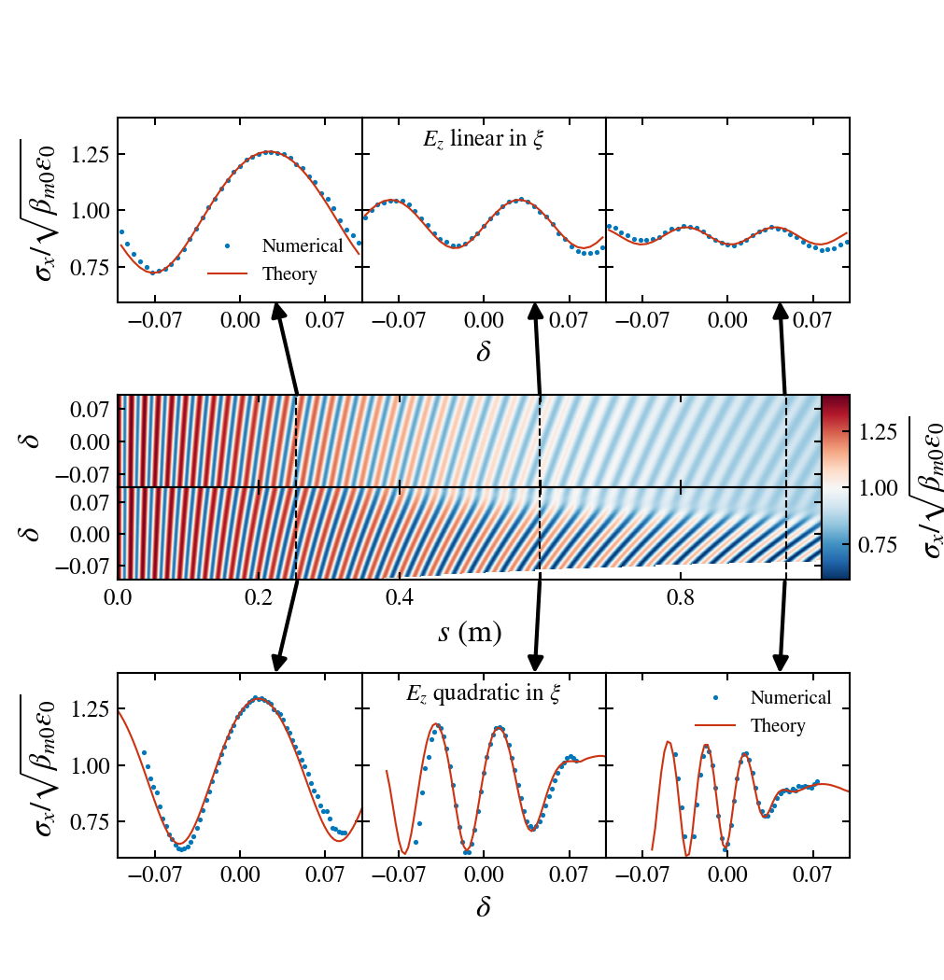
Spot Size Variation Across the Energy Slices
Two cases:
Beam has too little current – longitudinal field is linear.
Beam has too much current – longitudinal field is quadratic.
Different energy slices will come out with different spot sizes, divergences, and emittance depending on the wake loading.

Slide 9
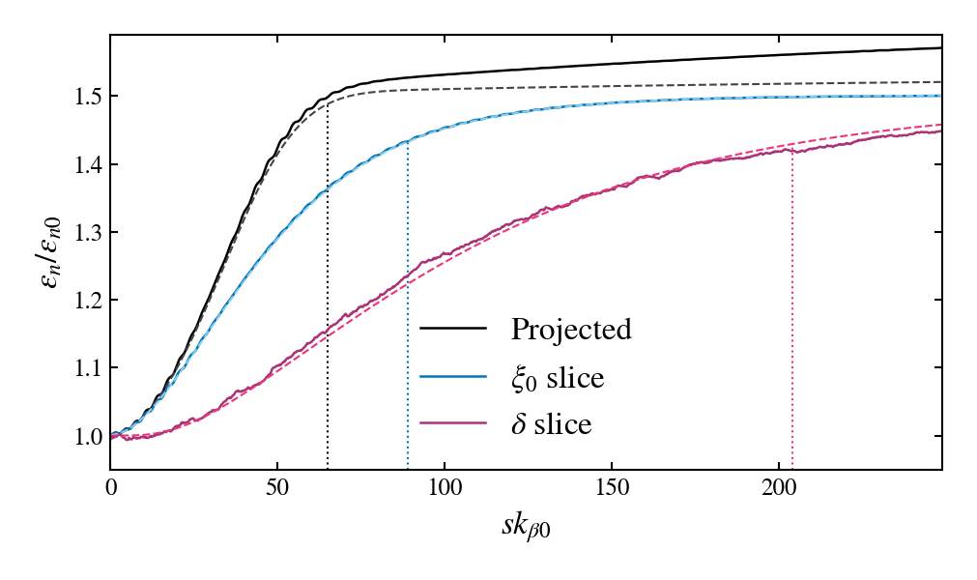
Comparison of the Different Emittances
Energy slice emittance grows because particles mix between energy slices.
Occurs if the wake is not perfectly loaded.
Saturation Lengths
Dotted lines are analytic saturation lengths.
Projected emittance > longitudinal slice emittance > energy slice.

Slide 10
Summary
We developed a general approach to calculating emittance growth from chromatic phase spread.
It includes the effects of:
Initial energy spread in the beam
Change in energy spread due to wake loading
Longitudinal density profile of the plasma source
Energy gain
Transverse offsets between the witness and wake
The beam’s initial longitudinal phase space
Using this approach, we analytically calculated
The effect of the ramps on the beam
The growth of the projected and slice emittance of the beam
The variation in beam parameters within the slices
Analytic formulas help choose parameters before doing simulations.
For details: arXiv:2111.02332, soon in PRR

Slide 11
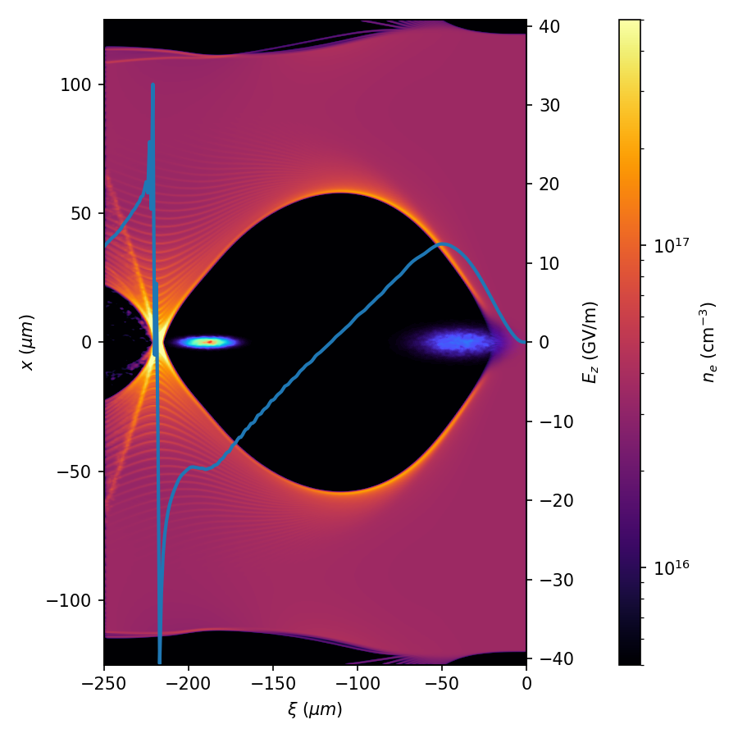
Thanks for Your Attention
This work was funded by the U.S. DOE Office of Science award number DE-SC0017906.

