Slide 1
Trojan Horse-II at FACET-II: prospects and experimental plans
Andrew Sutherland
University of Strathclyde, Glasgow
Cockcroft Institute, Daresbury
On behalf of the E31x collaboration:
A. Sutherland, L. Berman, G. Andonian, R. Ariniello, D. L. Bruhwiler, L. Boulton, D. Campbell, C. Clarke, A. Dickson, C. Doss, H. Ekerfeld, S. Gessner, A. F. Habib, C. Hansel, T. Heinemann, A. Hewitt, B. Hidding, M. Hogan, A. Knetsch, A. Lenart, M. Litos, G.G. Manahan, P. Manwani, A. Nutter, B. O‘Shea, J. Rosenzweig, L. Rutherford, P. Scherkl, D. Storey, M. Stumpf, D. Ullmann, M. Yadav, V. Yakimenko.

Slide 2
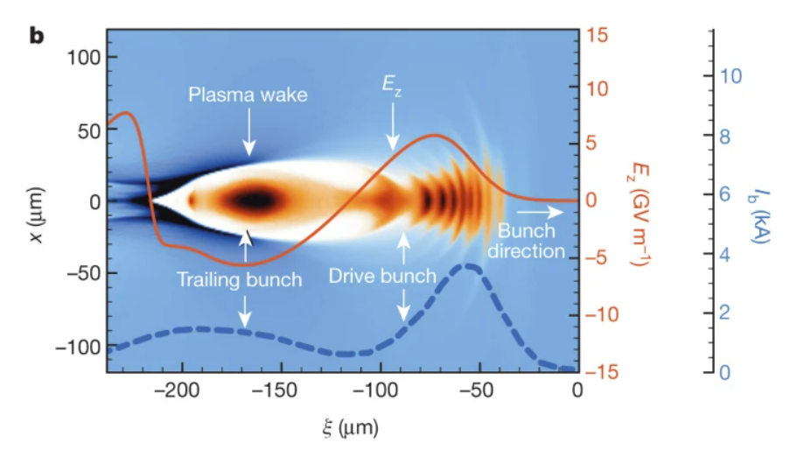
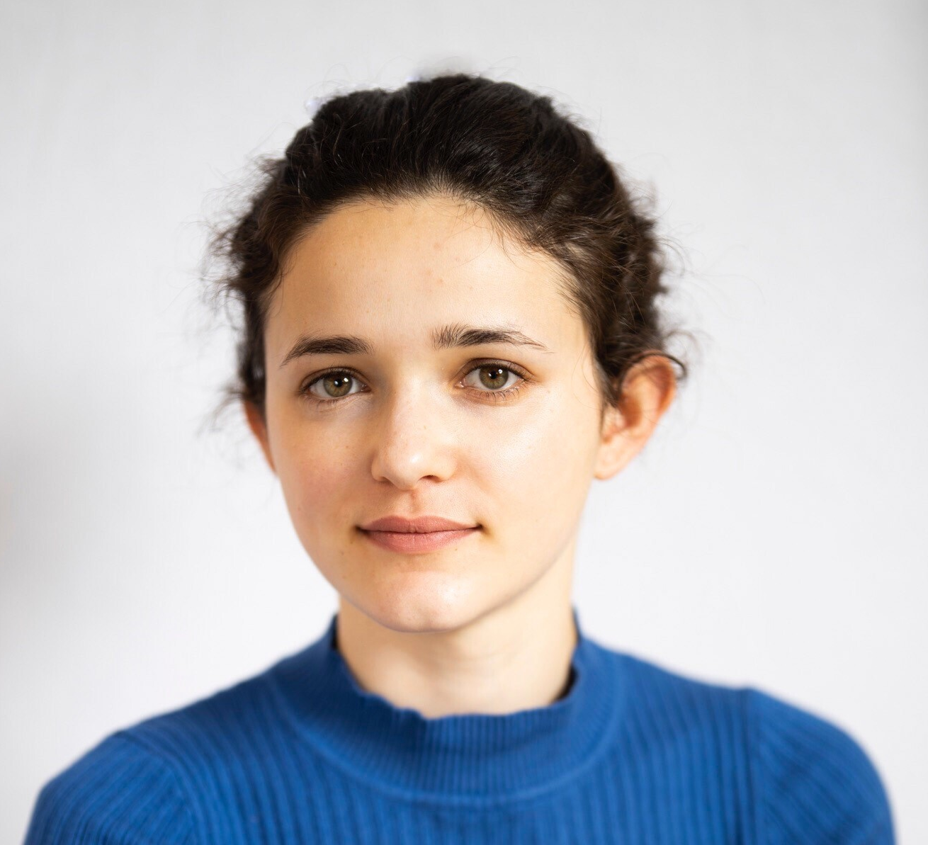
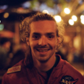
Trojan Horse-II at FACET-II: prospects and experimental plans

Slide 3
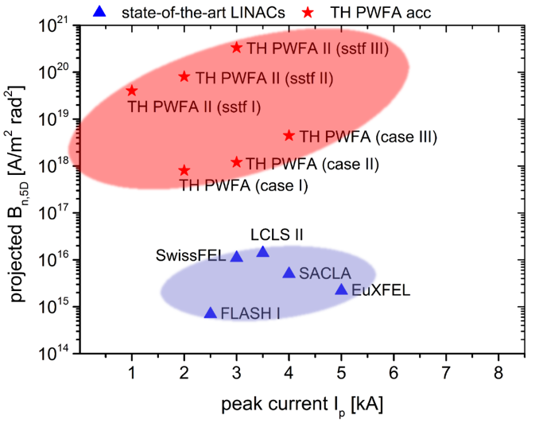
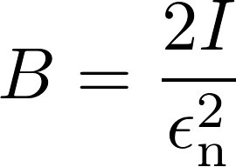
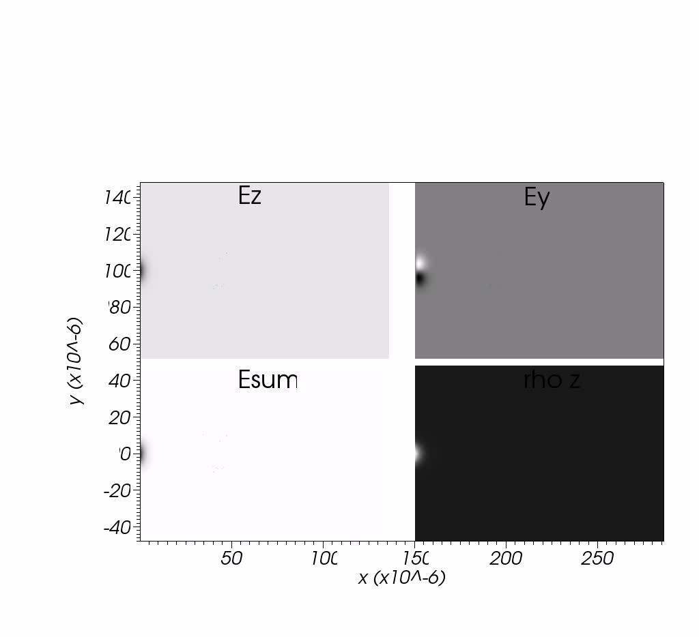

Trojan Horse
Synchronized laser pulse ionises in focus and releases ultracold electron population from High Ionisation Threshold component
Enable generation of next-generation
high-brightness beams
Beam-driven blowout
in Preionized Low Ionisation Threshold component
Released electrons are rapidly accelerated and form bunch with ultralow emittance
GW
e⁻
e⁻
e⁻
e⁻
e⁻
e⁻
e⁻
~c
e⁻
e⁻
Improve brightness whilst shrinking facility costs and footprints
Electric field magnitude, a.u.
Two plasma components, one with low and one with high ionization threshold (e.g. H2 and He)
Hidding et al., Phys. Rev. Letters 108, 035001 (2012)

Slide 4
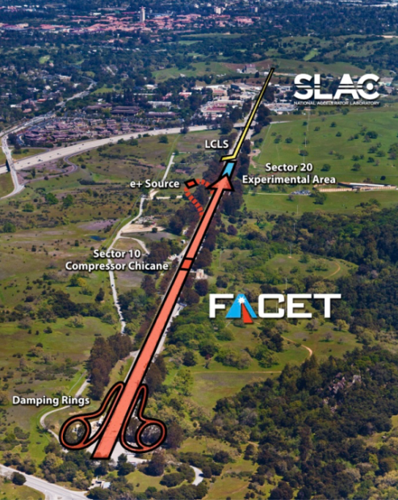
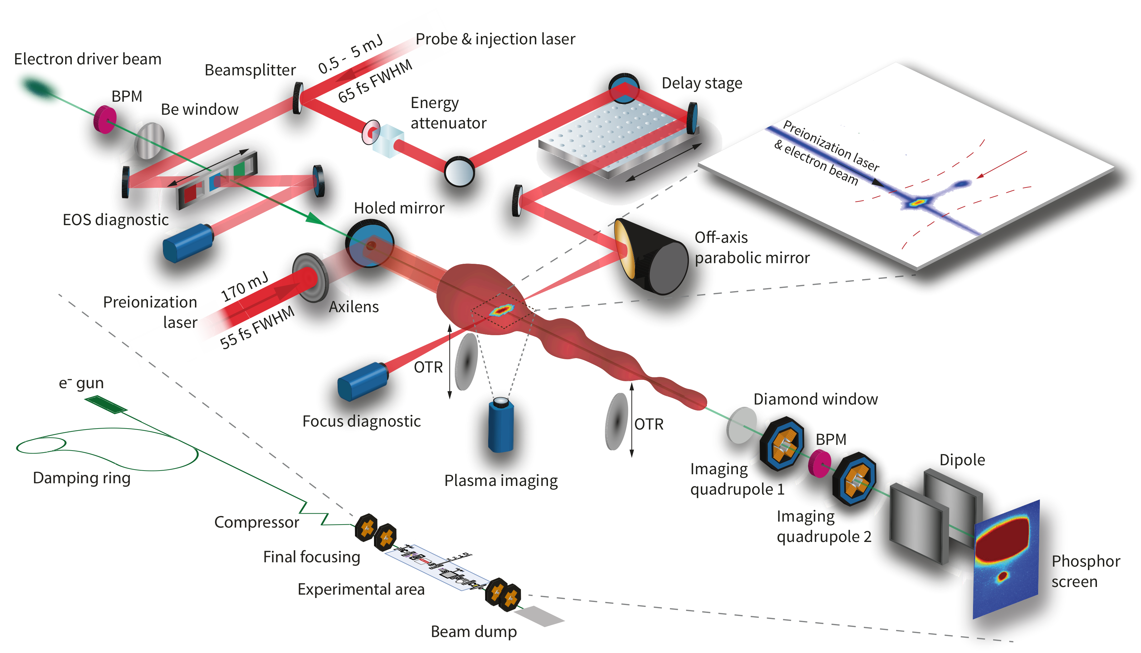
E210 Experiment at FACET
First Experimental Tests
FACET driver beam parameters:
20 GeV, 3 nC, σ_{z} ≈ σ_{x,y} ≈ 30 µm
Full E210 experiment

Slide 5
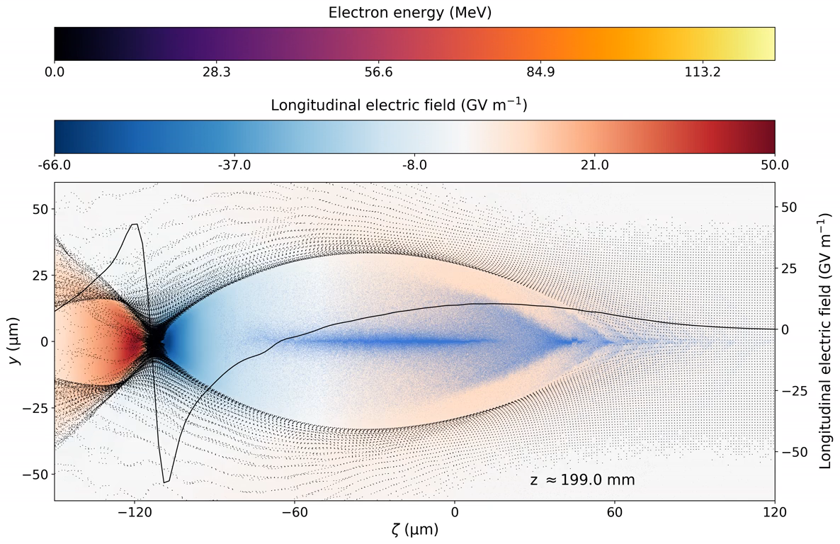
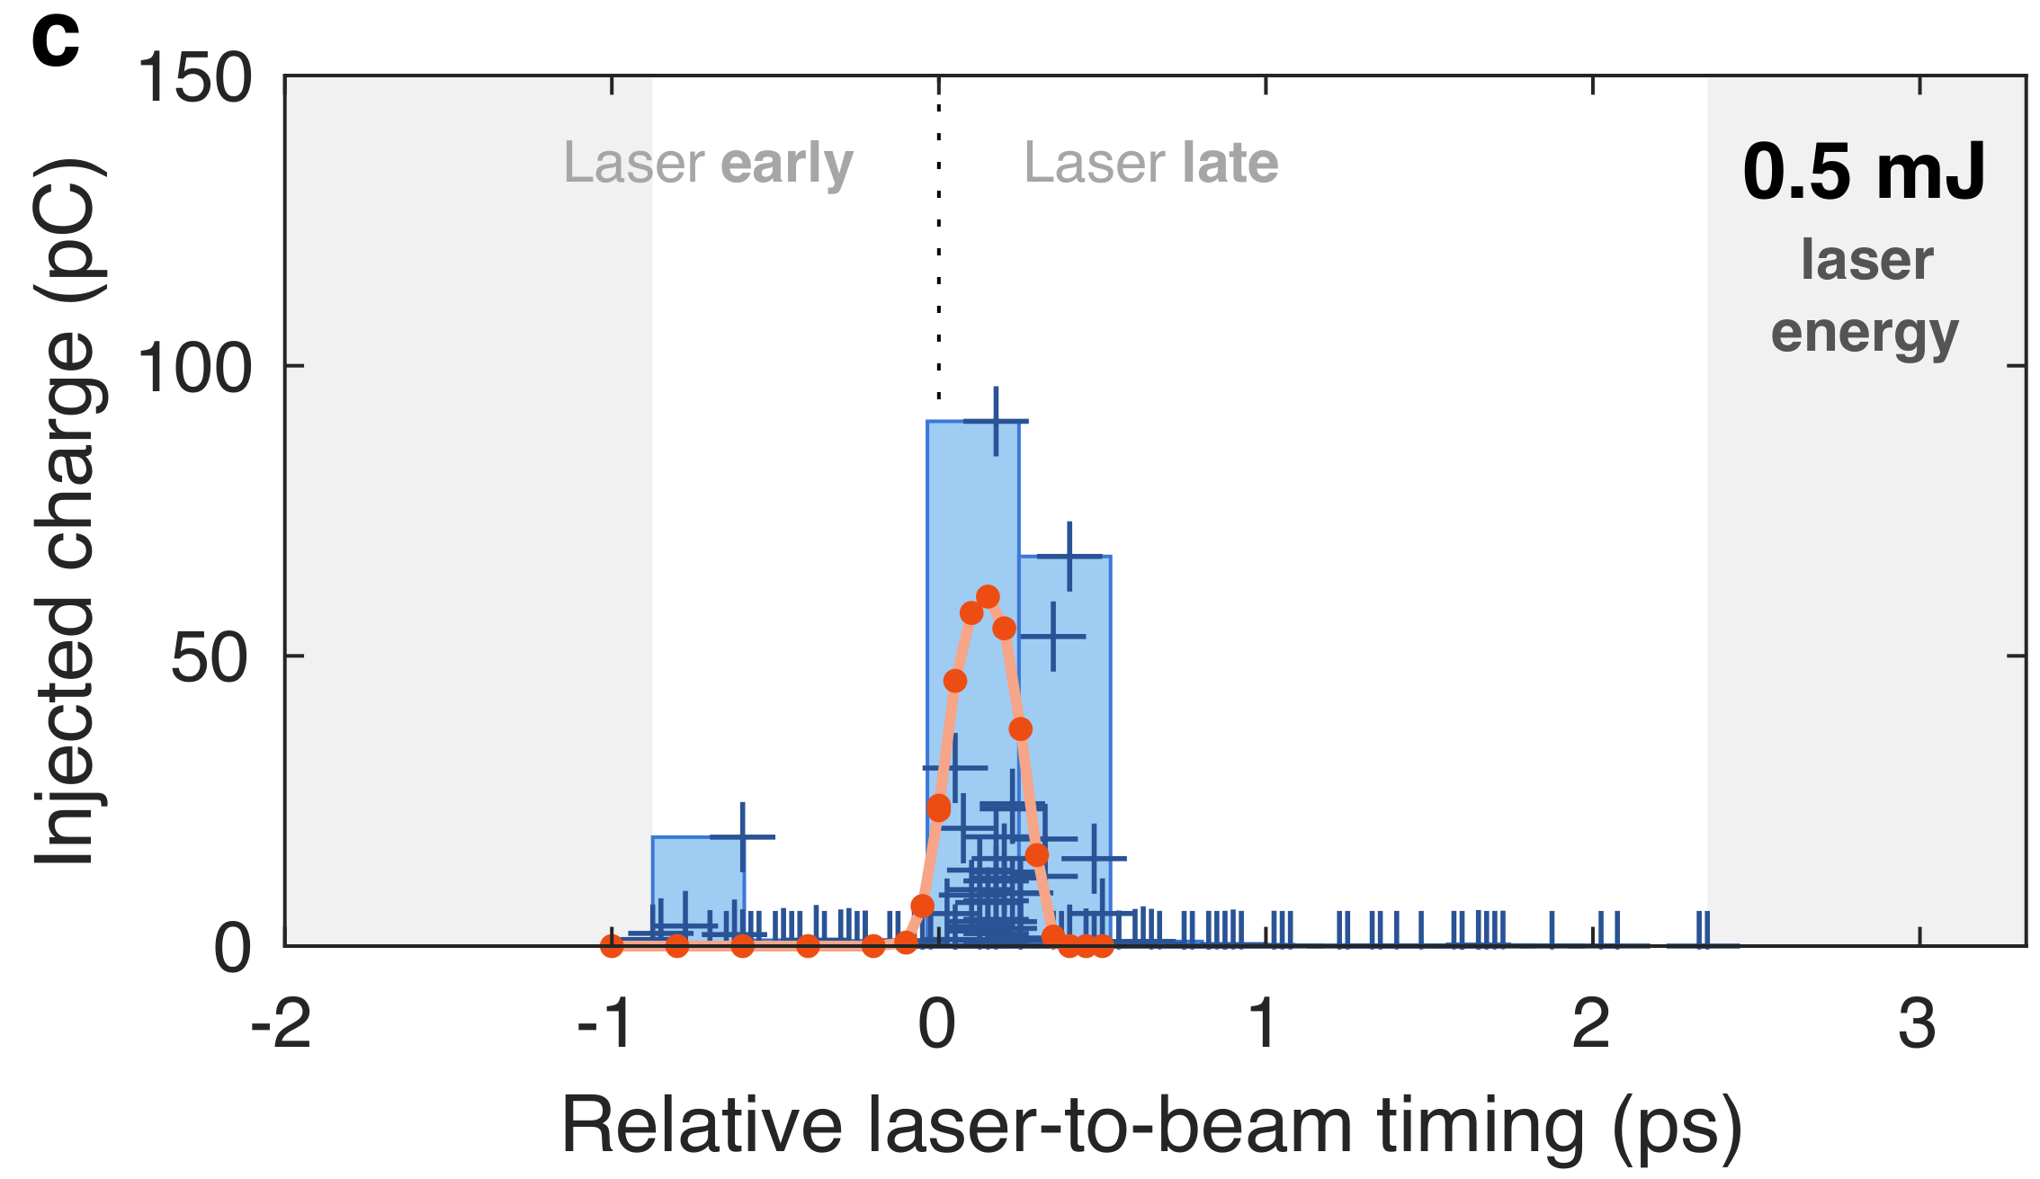
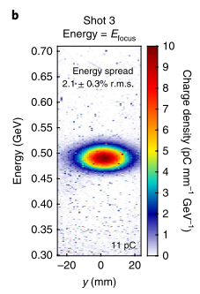
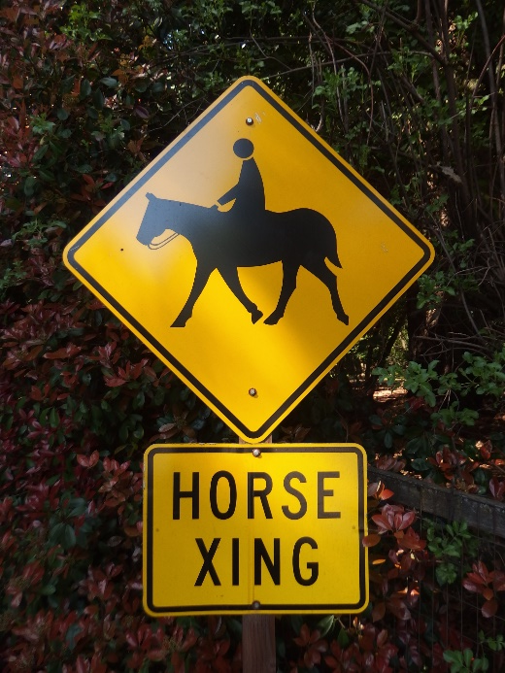
E210 Trojan Horse Results
Electrons originate from inside the blowout
Deng et al. Nat. Phys. 15 1156-1160 (2019)

Slide 6
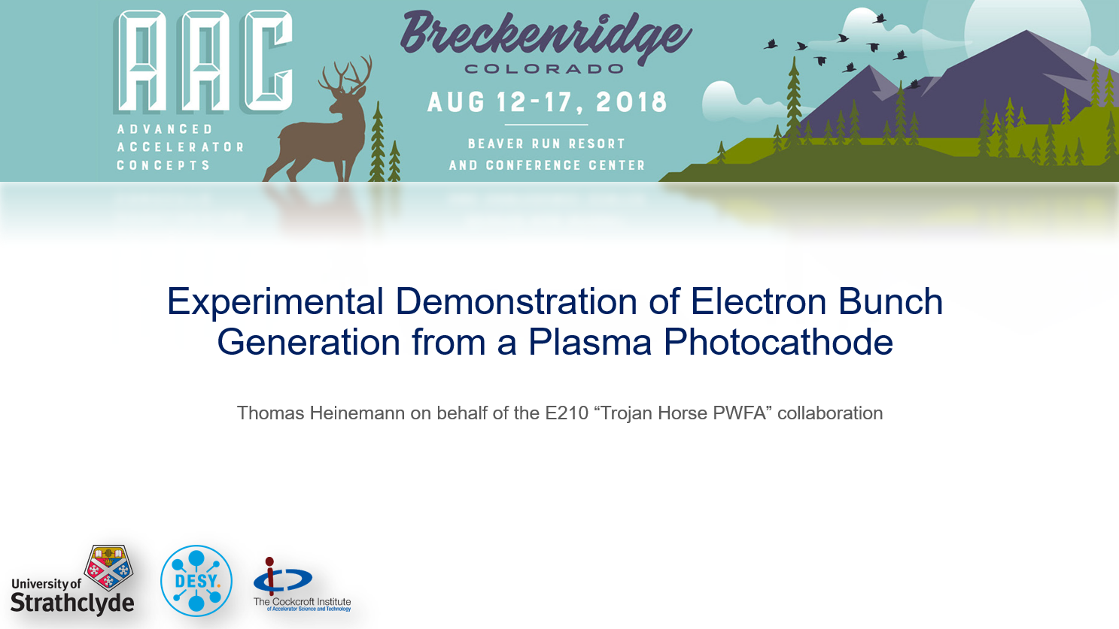
E210 “Next Steps”
Timing Jitter
  Incoming driver and laser order of plasma wavelength
  Reflected fluctuations in output witness beam
Narrow plasma channel width
  Limits obtainable energy
  Forces a smaller blowout/higher density
  Injection overlaps with beam field
90° geometry
  Limits emittance values
As set out in presentation by T. Heinemmann at AAC 2018

Slide 7
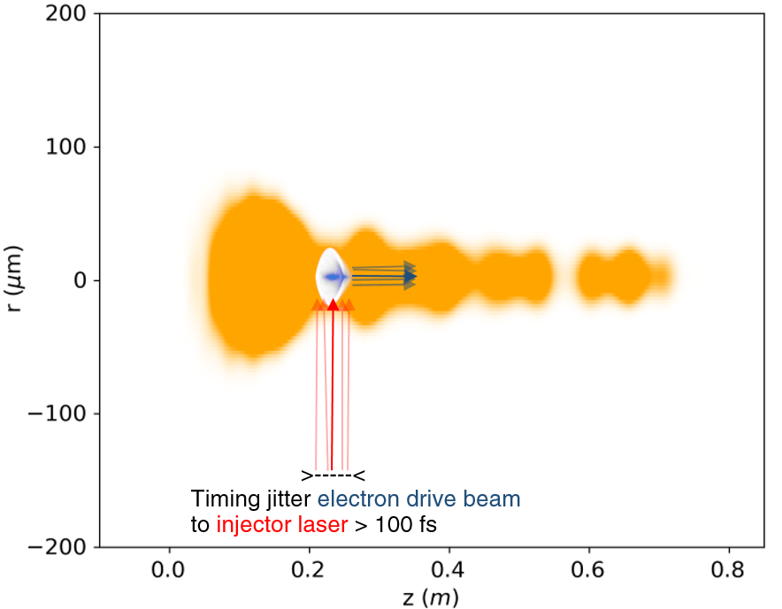
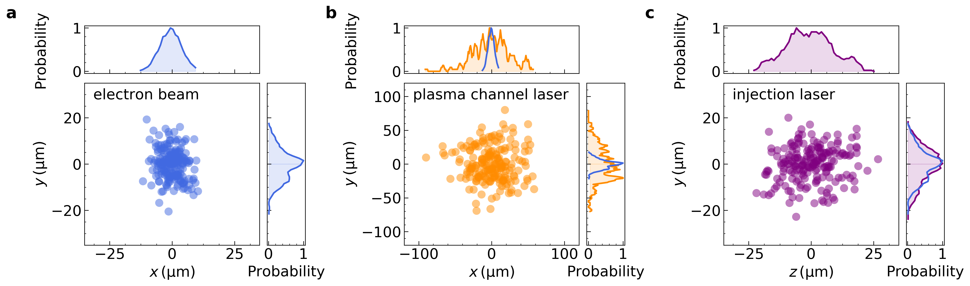
E210 “Next Steps”
Timing Jitter
  Incoming driver and laser order of plasma wavelength
  Reflected fluctuations in output witness beam
Narrow plasma channel width
  Limits obtainable energy
  Forces a smaller blowout/higher density
  Injection overlaps with beam field
90° geometry
  Limits emittance values

Slide 8
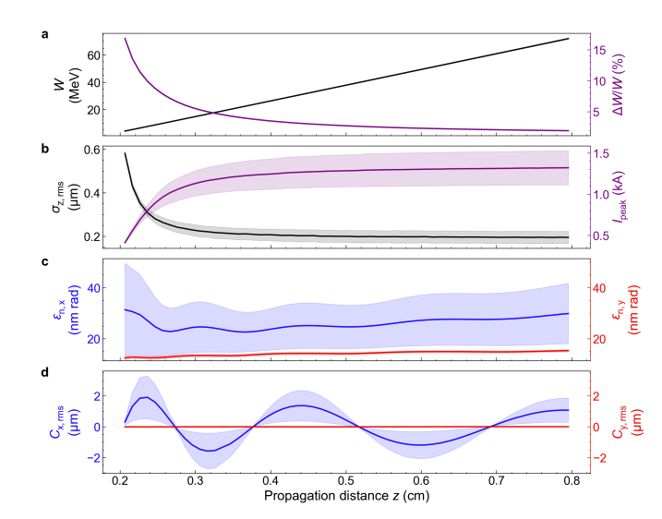
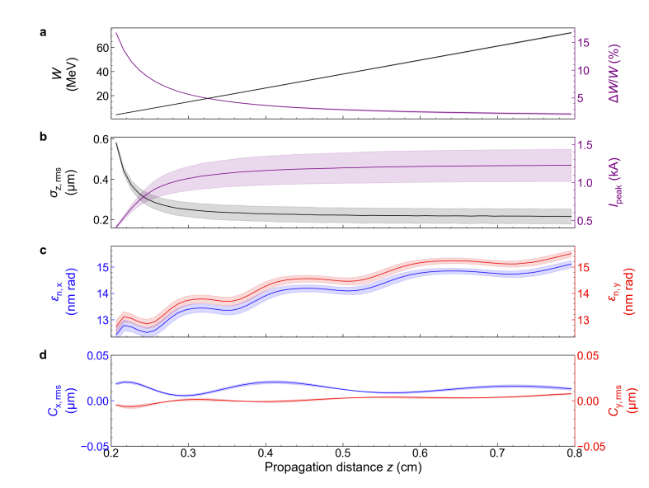
Injection Laser Jitter (collinear)
Effect of +/-10 um transverse misalignment
Effect of +/-30 fs temporal misalignment
“Ultrahigh brightness beams from plasma photoguns”, Habib, Heinemann et al. Arxiv/2111.01502 (2021)

Slide 9
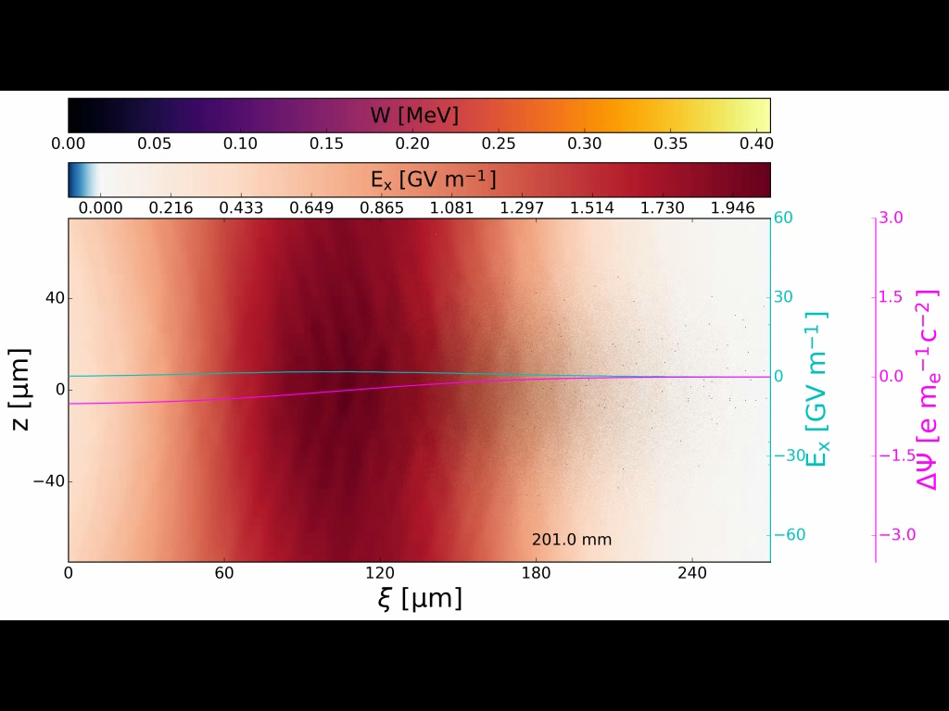
E210 “Next Steps”
Timing Jitter
  Incoming driver and laser order of plasma wavelength
  Reflected fluctuations in output witness beam
Narrow plasma channel width
  Limits obtainable energy
  Forces a smaller blowout/higher density
  Injection overlaps with beam field
90° geometry
  Limits emittance values

Slide 10
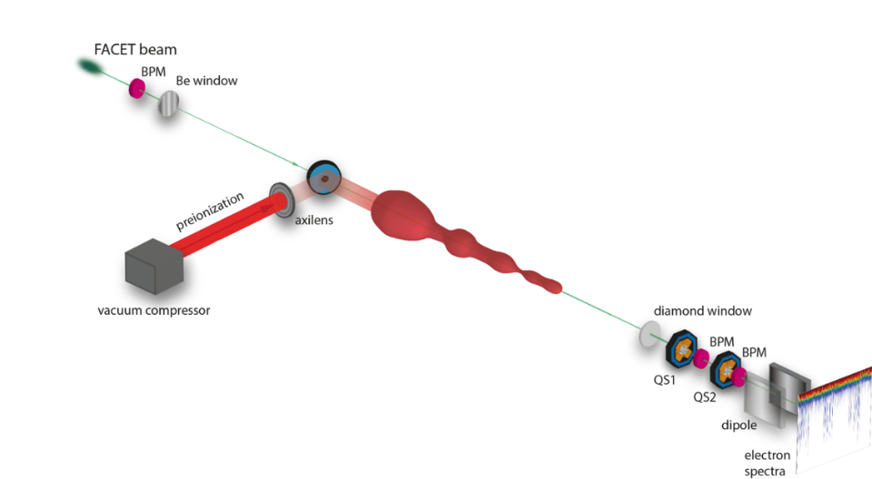
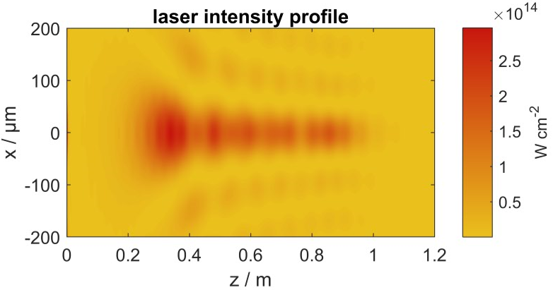
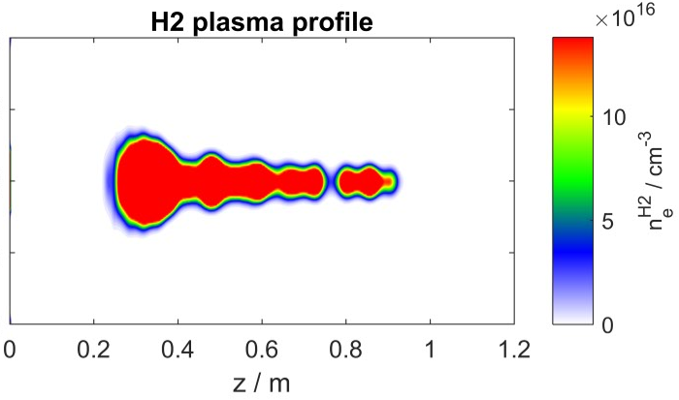
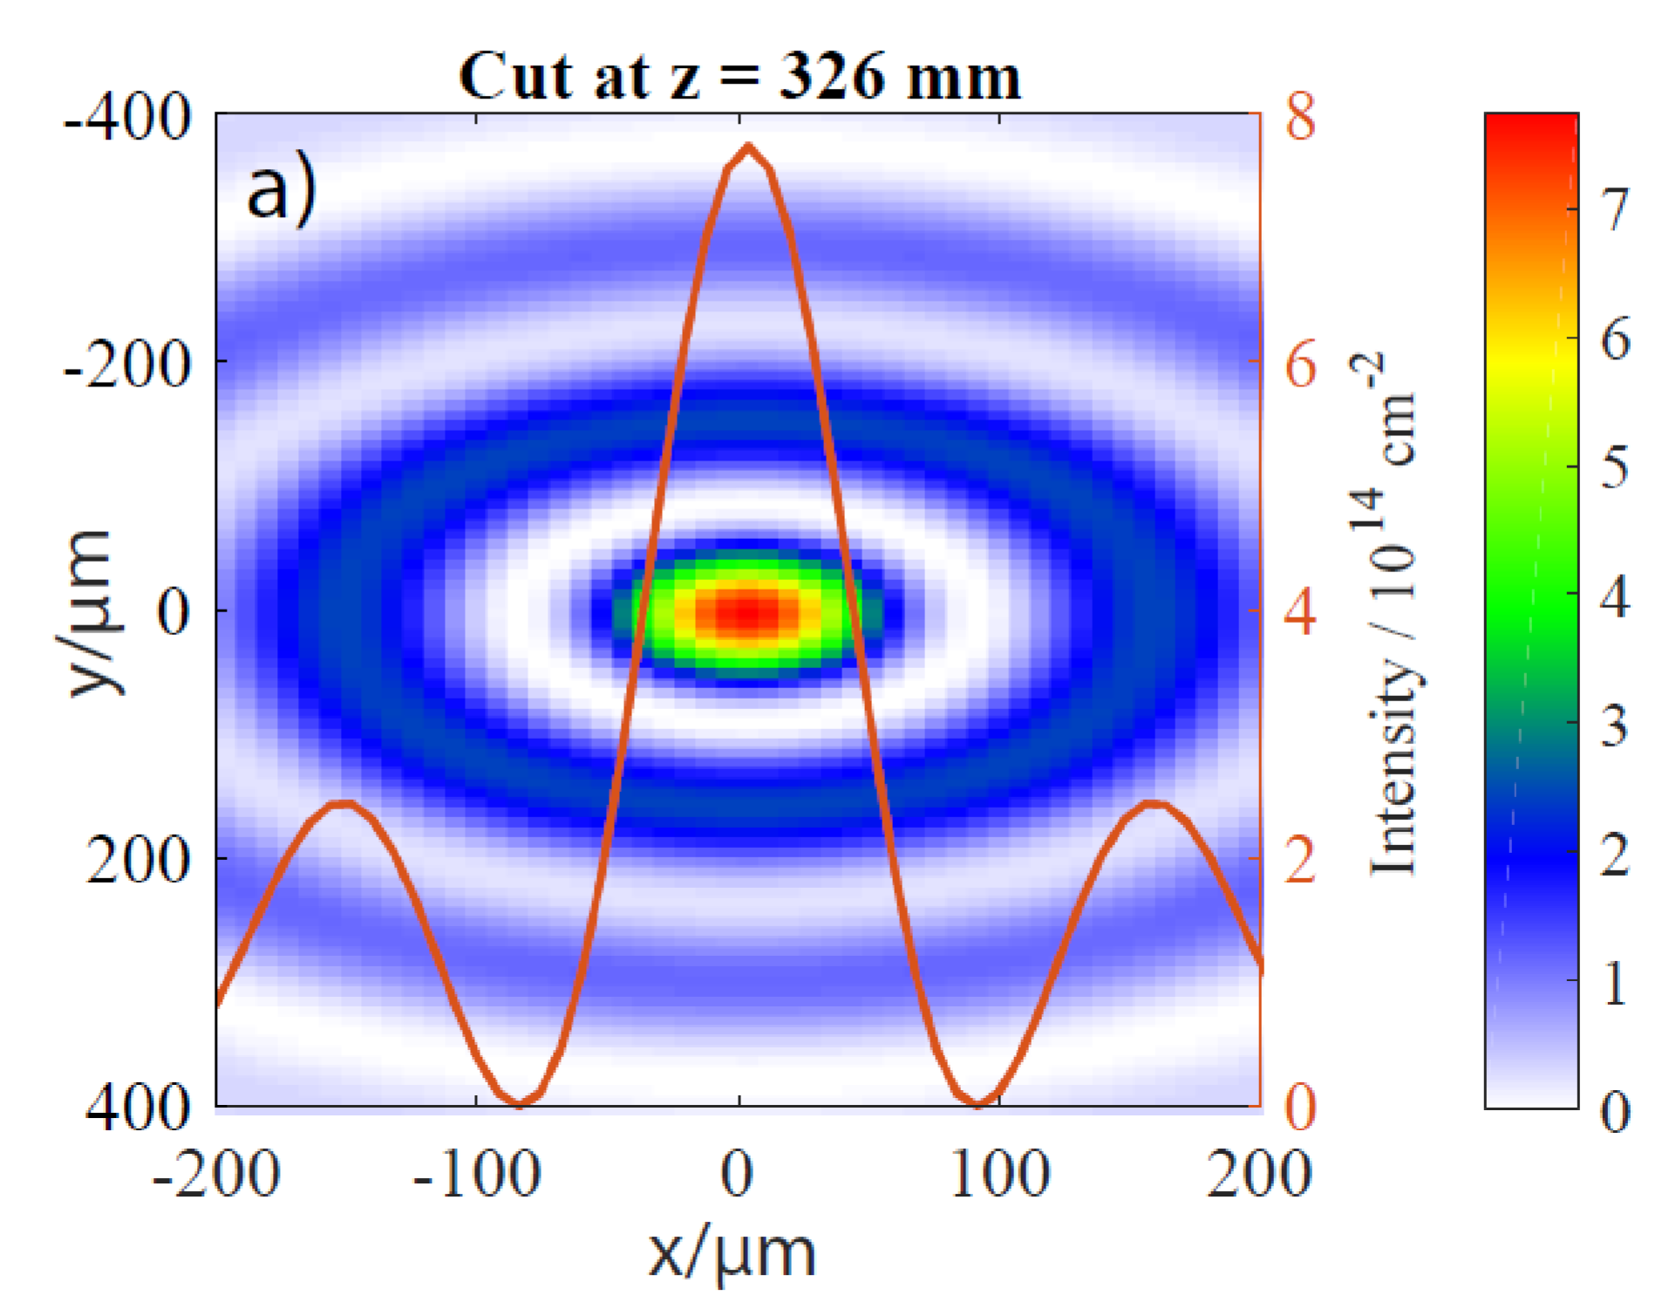
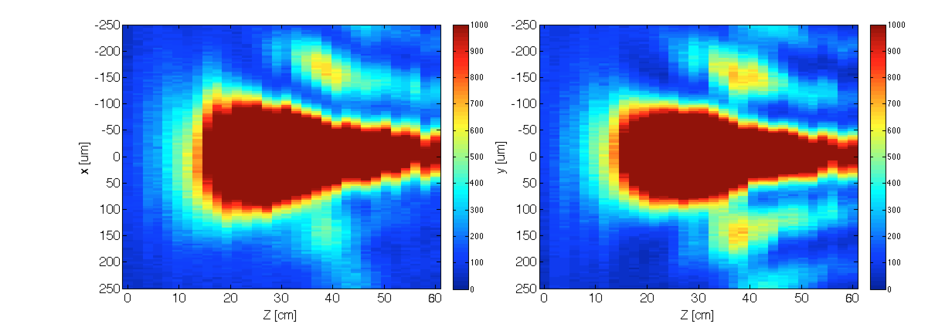
E210 Plasma Channel
Goal:
  Create a metre-scale plasma column
  But also sufficiently wide to host blowout
Approach: axilens (3x1 m)
creates transverse Bessel profile
  n₀ ≈ 1.3 x 10¹⁷ cm⁻³
calculated
laser
measured
plasma afterglow
WG5 Thursday 13:30 for details on plasma-photonic diagnsotic

Slide 11
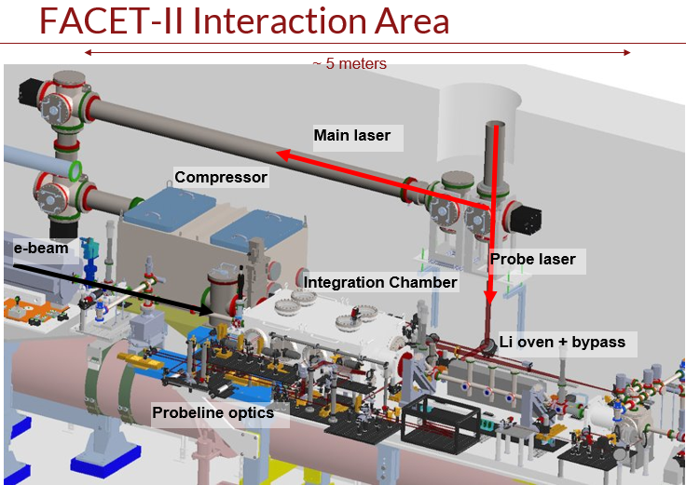
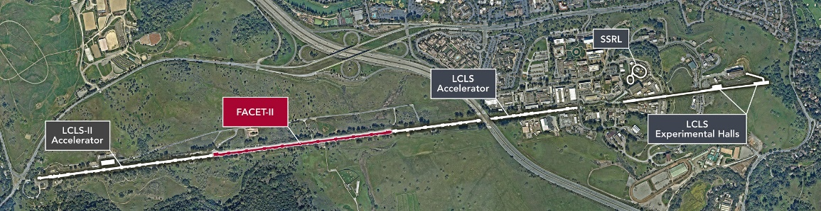
FACET-II Interaction Area
E310 Plasma Channel design brief:
>100 um radius over ~1m
Low Intensity Threshold Ionization only

Slide 12
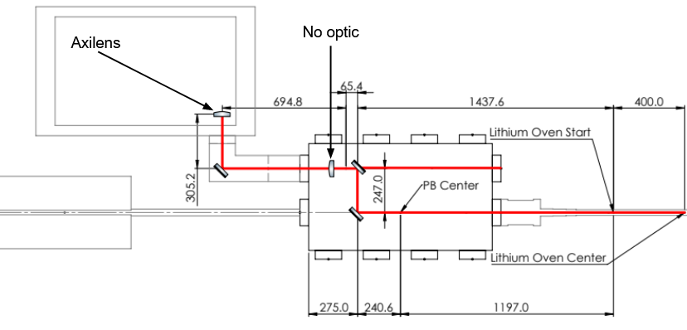
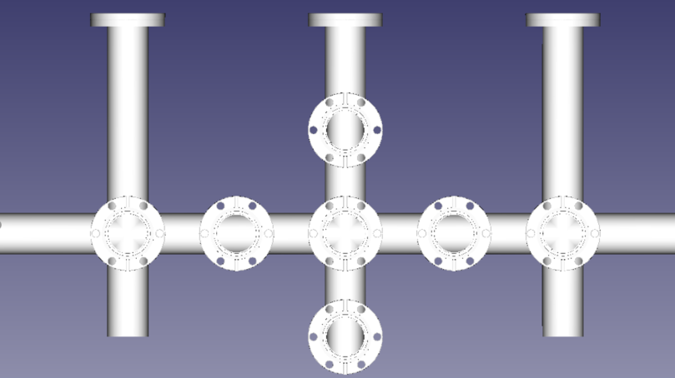
FACET-II Interaction Area
Main (Preionization) Laser Compressor
Integration Chamber (“Picnic Basket”)
Bypass
90 degree
Electron Beam →
Collinear
Use Argon as LIT and Argon+ as HIT

Slide 13
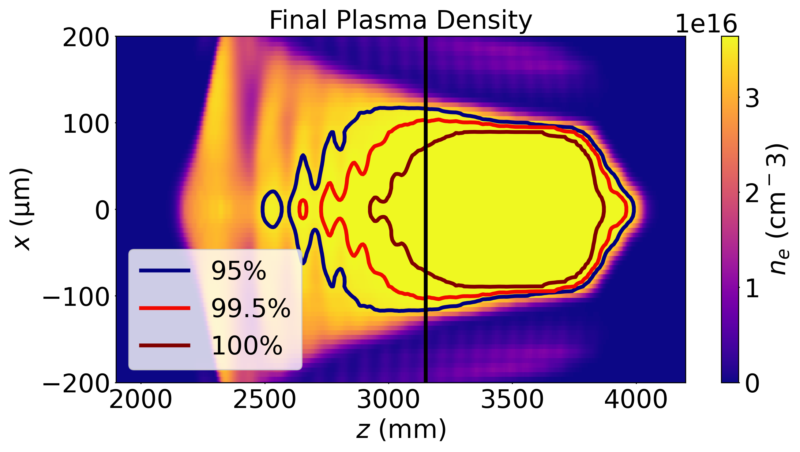
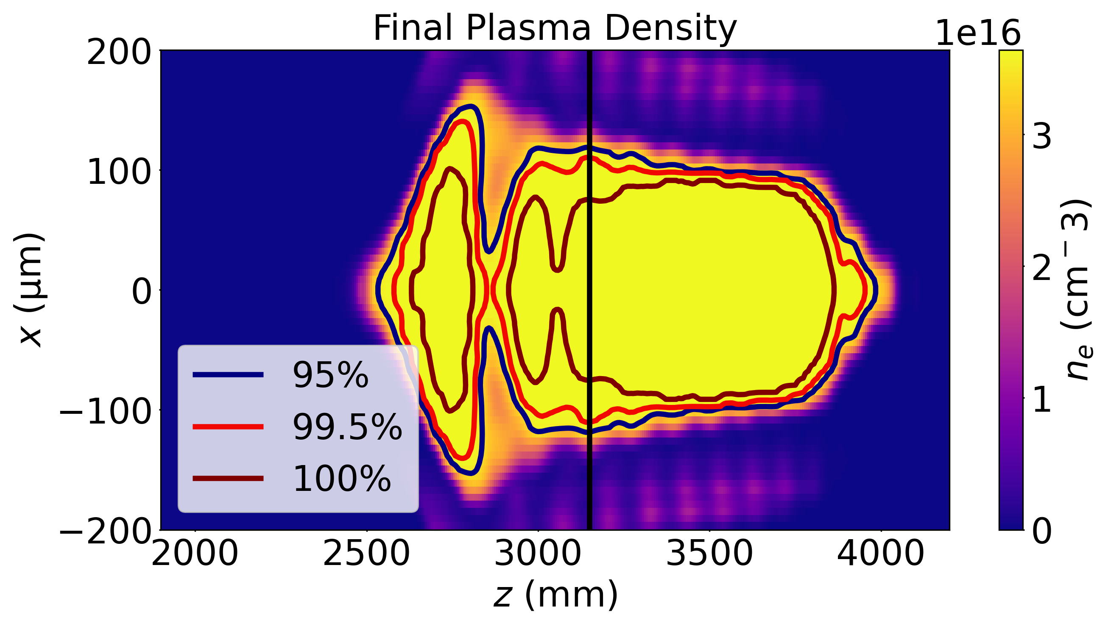
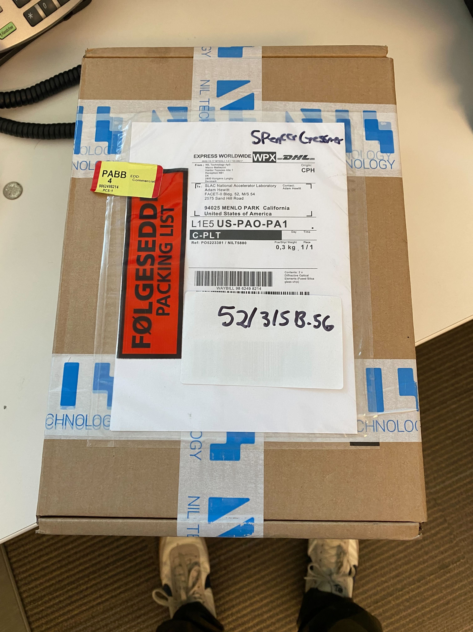
E310 Channel
Laser + Density Parameters
 | E210 | E310
Input Radius (mm) | 20-30 | 20
Supergaussian Order |  | 30
Laser Energy (mJ) | 170 | 210
Laser Duration (fs) | 55 | 40
Plasma Density (cm⁻³) | 1.3e17 | 3.5e16
Axicon Parameters
 | E210 | E310
Focal Length (m) | 3 | 2.1
Depth of Focus (m) | 1 | 1.9
Radius (mm) | ~25 | 20
No mask
With 10mm centre mask
Profiles generated using Split-Step Fourier Method developed by R. Ariniello and CU Boulder

Slide 14
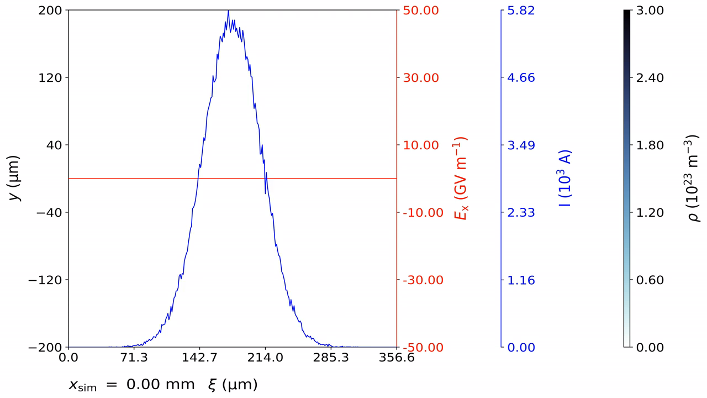
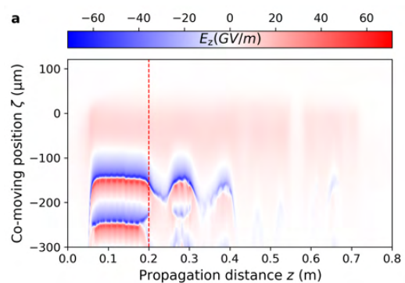
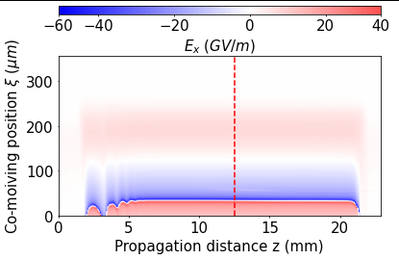
E310 Wakefield
Electron Beam Parameters
 | E210 | E310
Energy (GeV) | 20 GeV | 10 GeV
Charge (nC) | 3.2 | 1.5
Bunch Length (um) | 20-40 | 32
Bunch Width (um) | 30 | 5
Emittance (um.rad) | 10 | 50
E-210
E-310

Slide 15
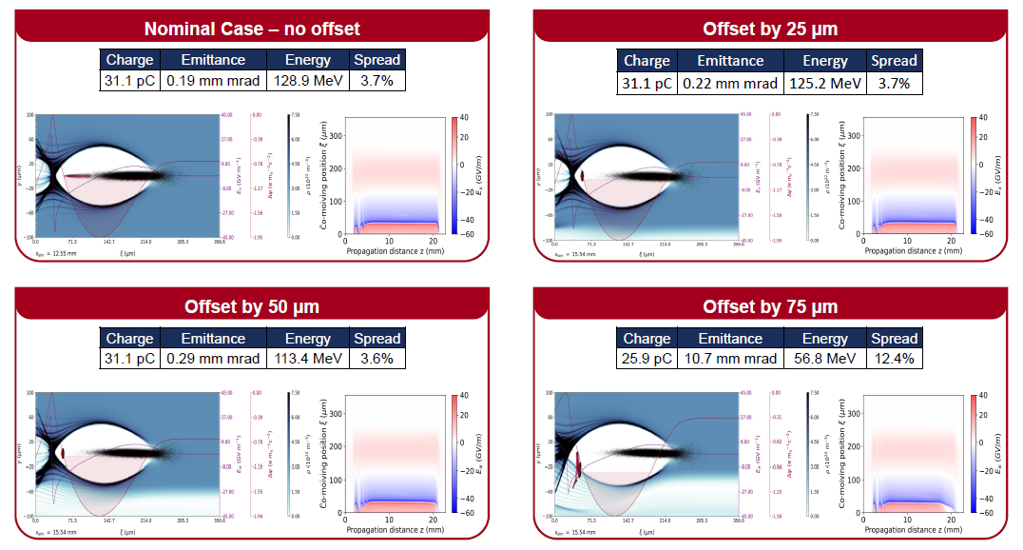
E310 Wakefield
Hewitt et al. (In preperation)
Initial PIC Simulations conducted show promising resilience to misalignments.
Further in depth analysis of witness electron bunch post-acceleration under way.

Slide 16
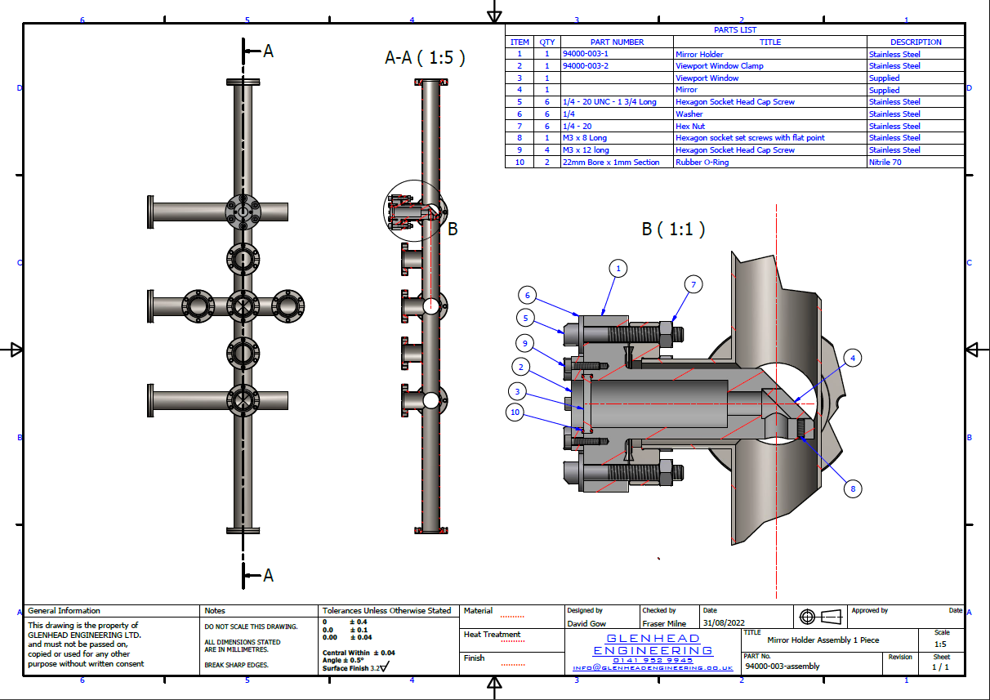
E210 Challenges
Narrow plasma channel width
  Limits obtainable energy
  Forces a smaller blowout/higher density
  Injection overlaps with beam field
Timing Jitter
  Incoming driver and laser order of plasma wavelength
  Reflected fluctuations in output witness beam
90° geometry
  Limits emittance values
Experimental Area has been designed with access for both 90 degree and collinear style injection

Slide 17
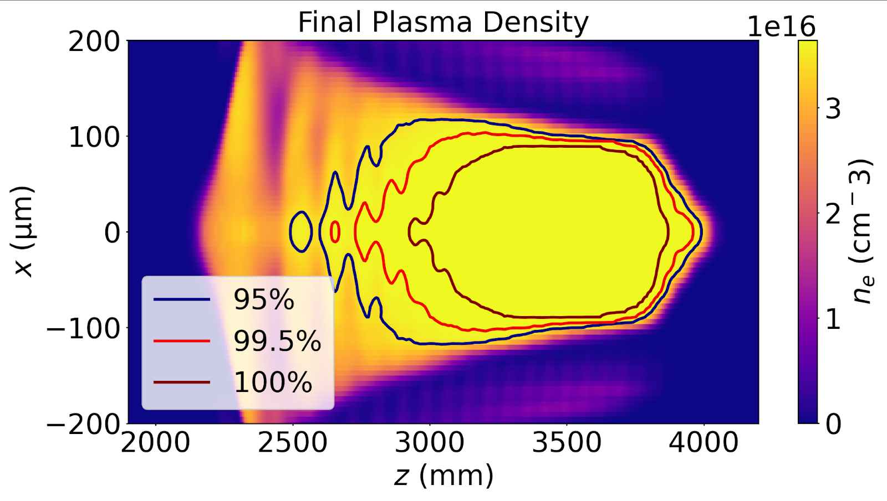
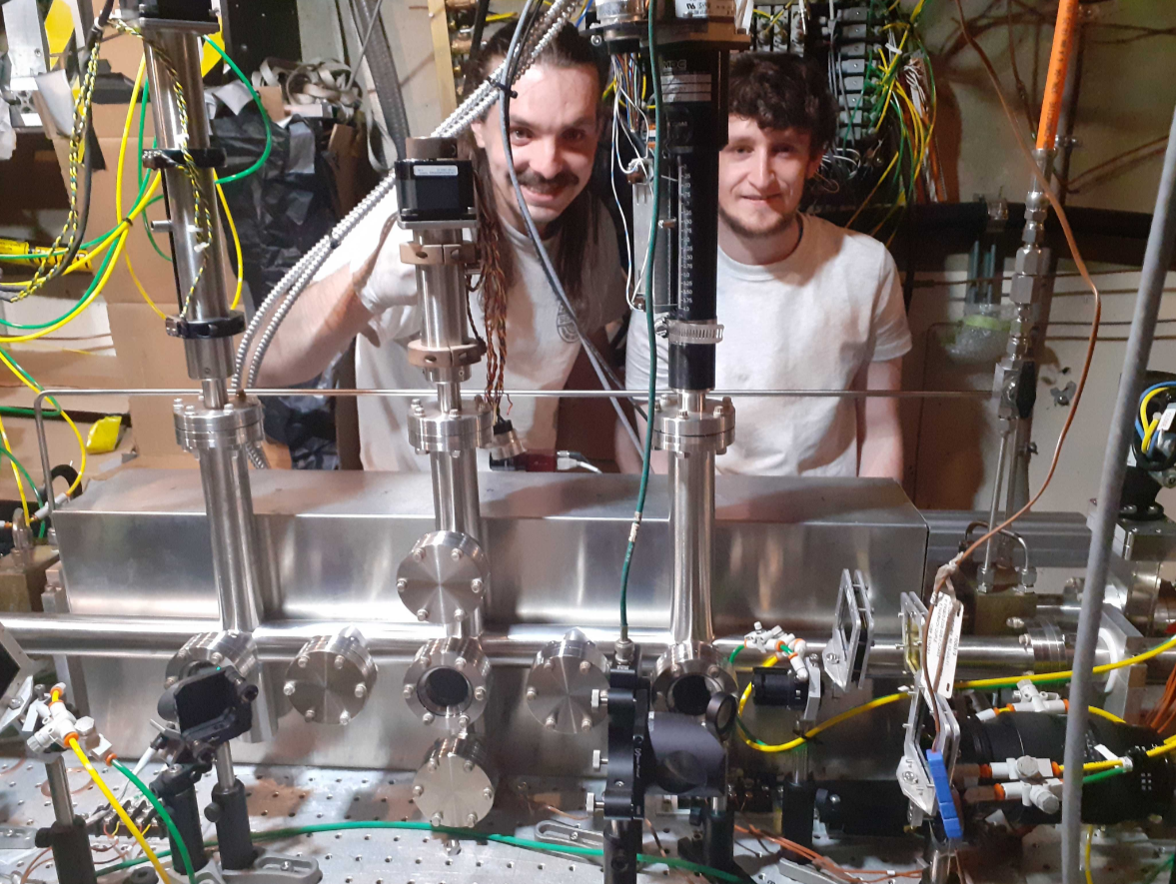
Summary
Building on the science generated at FACET, we have developed an optimised plasma channel.
  Studies performed on acceptable injection tolerances
  Plasma profile generation and optic fabrication
  Experimental implementation ongoing
Next steps
Witness injection optimization study via PIC based on FACET-II deliverables
More pictures that include Spencer’s shoes

Slide 18











E-310 Collaboration
NeXource
Notes:
And that’s what the two main work packages 3 and 4 are centered on. Work package 3 on experiments with laser-plasma-accelerators at SCAPA at Strathclyde, and work package 4 on experiments with world-leading linacs in the US, Germany and the UK. These work packages 3 and 4 are highly complementary as regards available electron driver energy, stability, repetition rate and synchronization with the plasma photocathode laser. That’s great because it minimizes risks, and at the same time maximizes scientific output and impact of the project.
Work package 2, Simulations, will guide experimental work from start to end. Preliminary simulations show that ultrahigh brightness can be produced, and also survives the extraction from the plasma stage and transport to applications. Work package 5 will explore these applications, and will also be an interface to the wider community.
For example, into an FEL undulator setup, where it produces ultrabright, ultrashort coherent photon bursts.

Slide 19
Backup

Slide 20
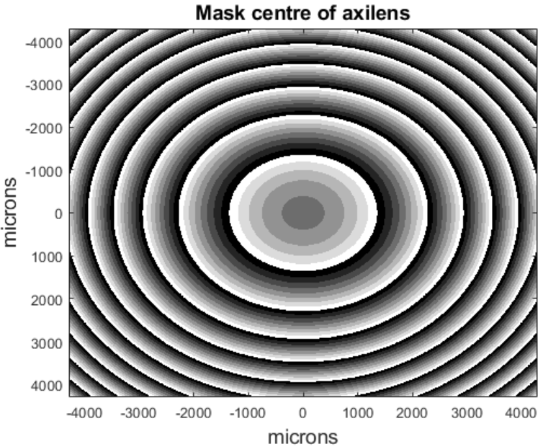
Axilens Specifications
> Chip size: 44 mm
> Active area: 40 mm diameter
> Substrate thickness: 1 mm>
> Material: Fused silica
> Total depth: 1160 nm
> Levels: 8

Slide 21
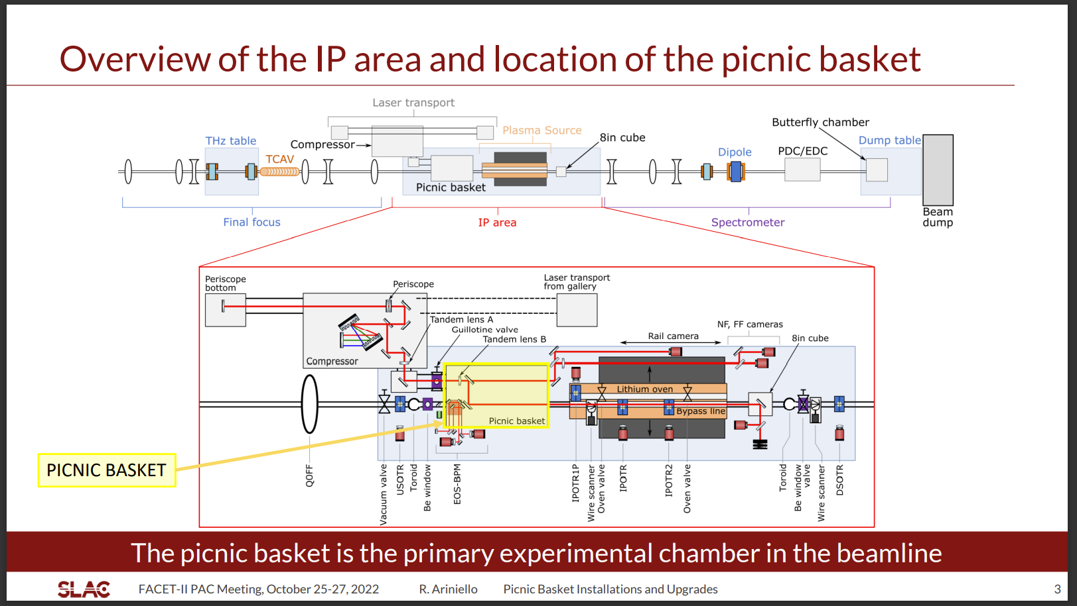

Slide 22
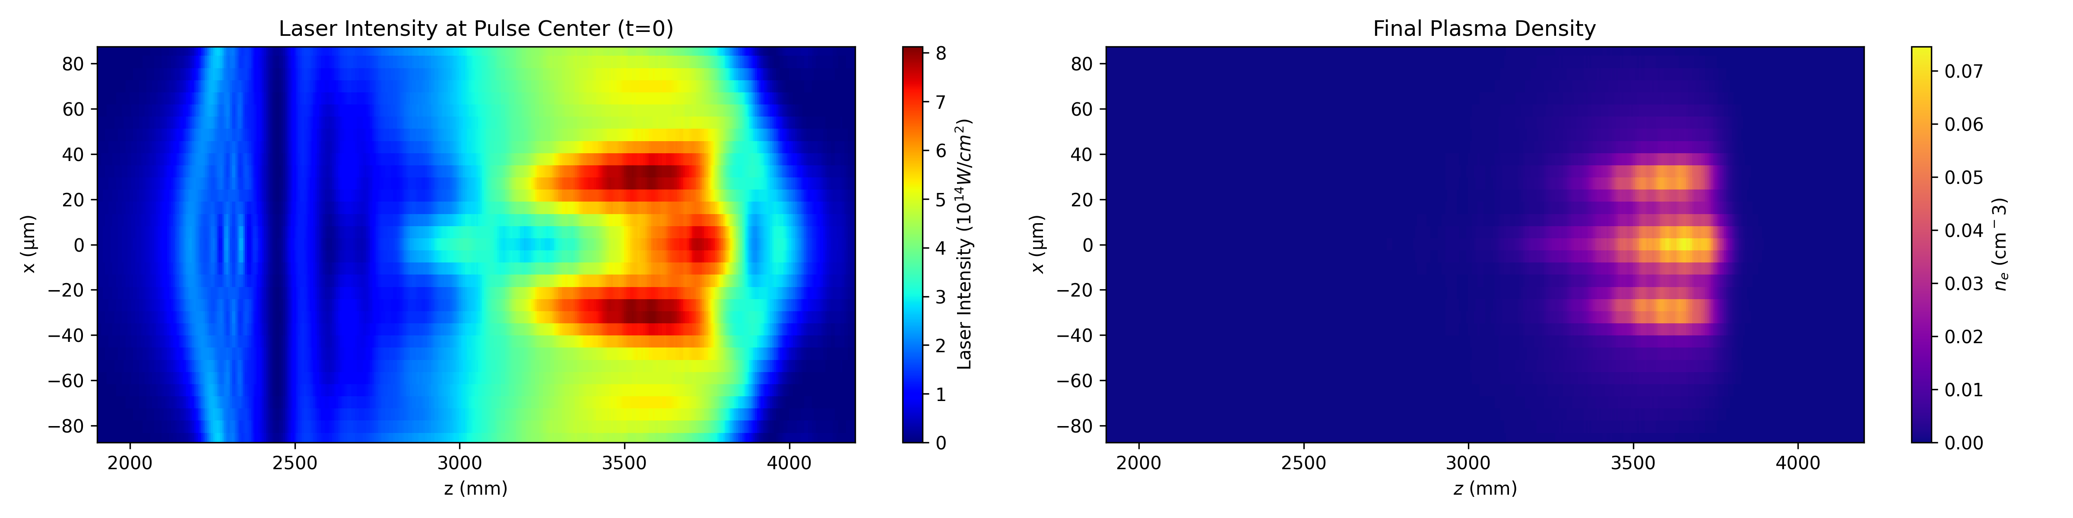
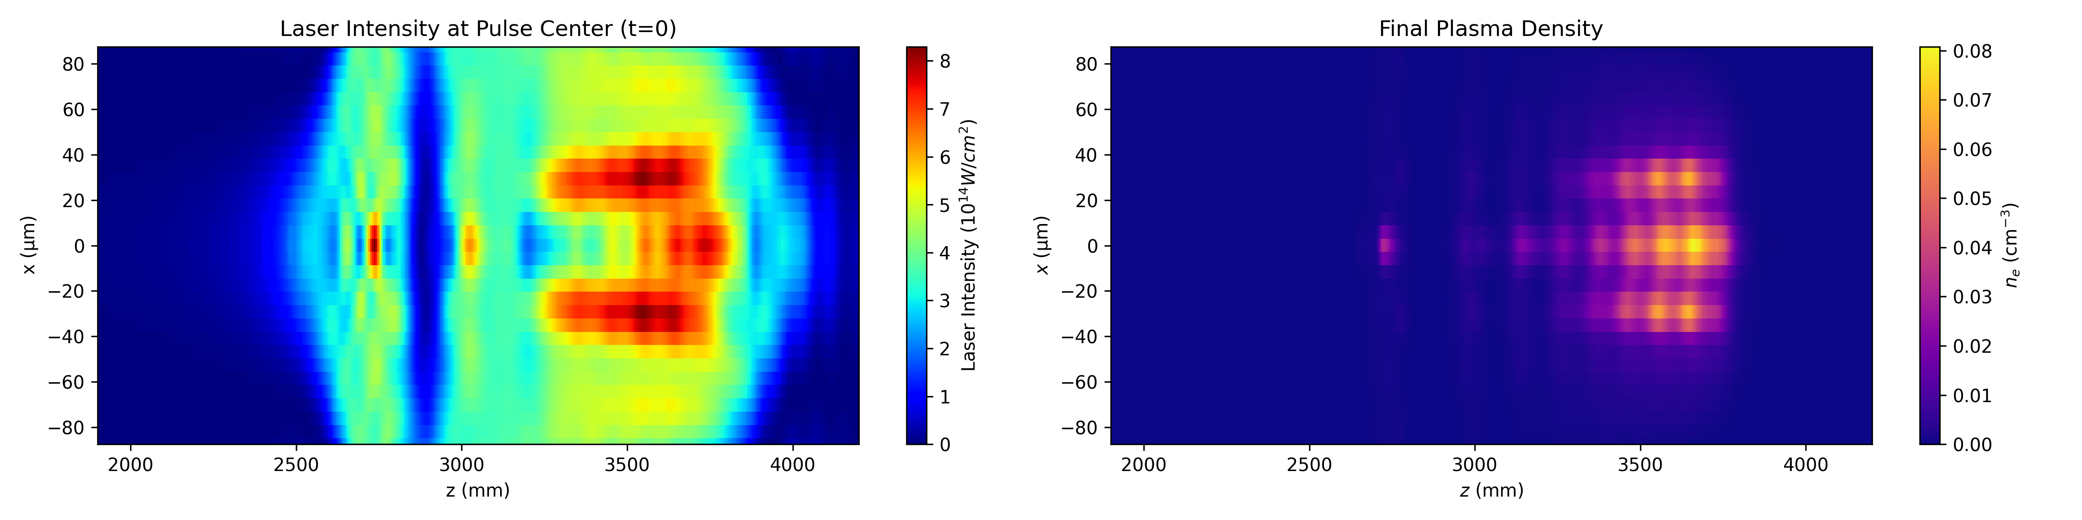
Argon HIT ionization

Slide 23
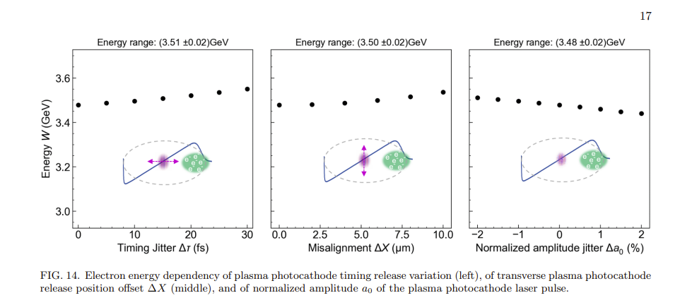
Injection tolerance

