Slide 1
Witness beam realignment in plasma wakefield accelerators in the linear collider regime
Lance Hildebrand¹, Yujian Zhao¹, Fei Li¹, Weiming An², Xinlu Xu³, Warren Mori¹, Chan Joshi¹
¹University of California, Los Angeles
²Beijing Normal University
³SLAC National Accelerator Laboratory

Slide 2
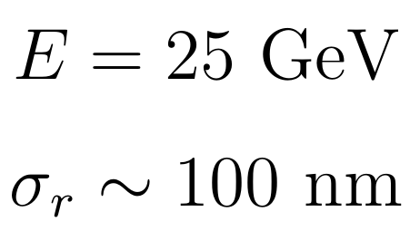
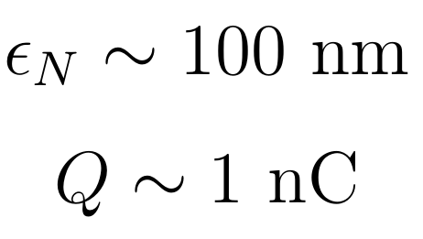
Linear collider (LC) regime
PWFA has shown potential for future LCs due to high acceleration gradients, low energy spread, low emittance growth and high efficiency.
Requires small spot size, high current beams to achieve high luminosities.
Current designs include acceleration of a witness bunch over multiple meter long plasma stages to reach several hundred GeV
Very difficult to simulate due to vast scale difference – need to resolve the beam spot size and large blowout radius $\sim 500$x larger.
Beam stability is crucial. Hosing must be suppressed in each stage and transverse motions eliminated before the interaction point.
W. An et al., PRL 118, 244801 (2017)

Slide 3
Ion motion in PWFA-LC
Narrow, high current beams will draw plasma ions into the beam within its transit time, causing non-linear focusing forces and potentially large emittance growth.
An et al. (2017) showed tolerable emittance growth due to the ion column being very narrow even compared to the beam spot size.
This paper also derived an analytical model for emittance growth using a Gaussian transverse ion profile, $ρ_{i}=Ae^{−r^{2}/2σ^{2}}$
Emittance growth can be reduced by matching the beam to the non-linear focusing force (overfocusing). Theory paper still in progress (including emittance growth for offset beams)
S. Lee and T. Katsouleas, AIP Conf. Proc. (1999)
J. Rosenzweig et al., PRL 95, 195002 (2005)
W. An et al., PRL 118, 244801 (2017)

Slide 4
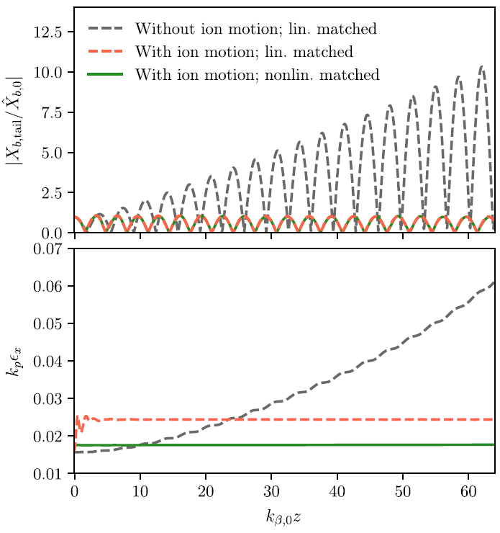
Misaligned witness beams
Mehrling et al. (2018) showed hosing is suppressed by the ions. In the case of a uniform beam offset, the ions collapse w.r.t. the axis of symmetry of the beam and oscillate with it, therefore the emittance growth is the same as the aligned case.
Hosing is also suppressed with moderate ion motion via the BNS mechanism due to the longitudinally varying ion density.
T. J. Mehrling et al., PRL 121, 264802 (2018)

Slide 5
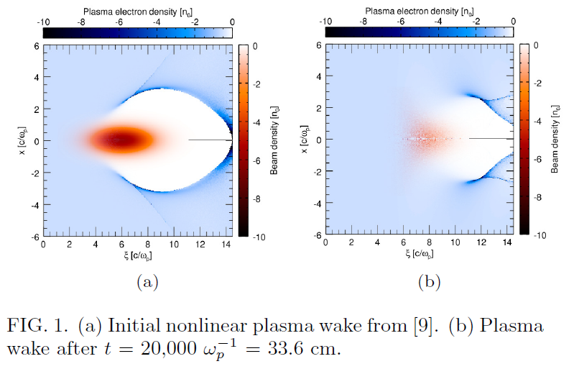
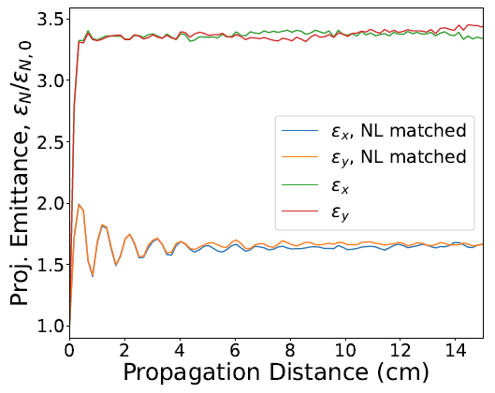
Drive beam induced ion motion
Both previously mentioned simulation studies assumed non-evolving, wide drivers so that they don’t cause ion motion.
In reality, these drivers cause severe head erosion so that the wake quickly deteriorates.
Using a pre-cursor beam is one solution to this problem
Another solution is using a narrow drive beam, however this causes much more ion motion

Slide 6
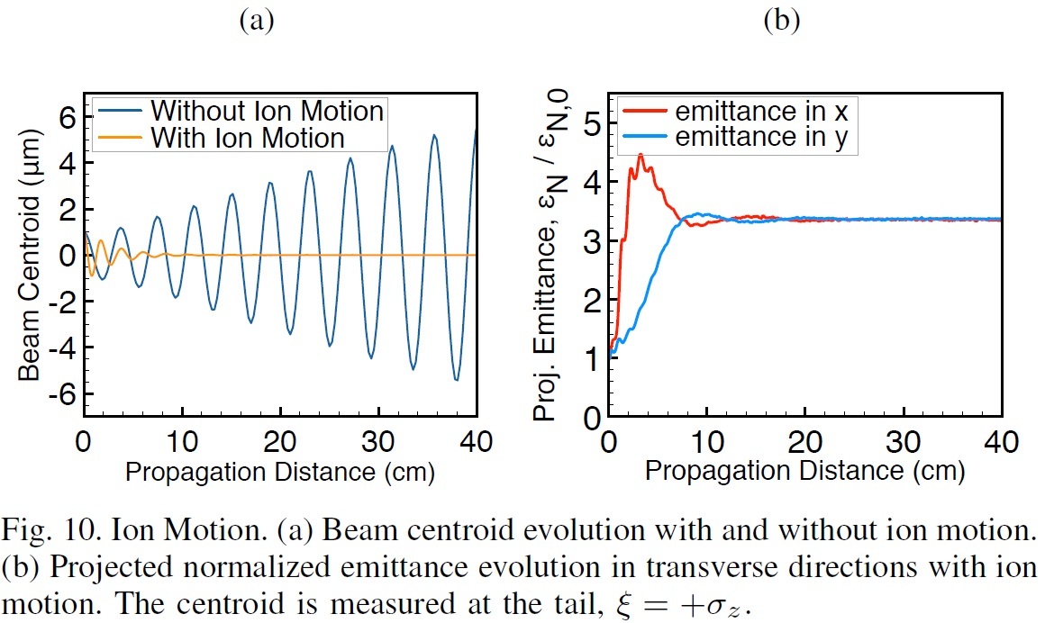
Realignment of the witness beam
Ion motion from driver will eliminate any witness beam centroid at the cost of emittance growth
Hildebrand et al. (2018) shows beam realignment with FACET-II like parameters (1 $μm$ emittances for drive and witness)
LC parameters show realignment but with severe emittance growth ($\sim$5x)
L. Hildebrand et al., AAC Proceedings (2018)

Slide 7
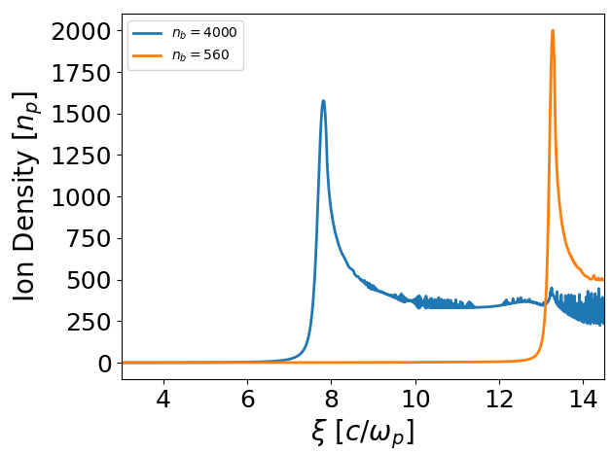
Drive beam spot size
The driver spot size will determine the ion density the witness beam sees (driver kept linearly matched)
Two regimes: Overfocused regime where the ions that begin within the beam reach the axis before the witness beam arrives and underfocused regime where they arrive after
Generally overfocused regime works better
We’ve found lithium plasma works better than hydrogen for the LC regime

Slide 8
Adiabatic density ramp design
Yujian Zhao has recently shown adiabatic plasma ramps in the LC regime (with ion motion) can limit emittance growth to only a couple percent for the entire stage (WG4 - 1:48pm)
Trade-off between ramp length, adiabaticity $(\left|α_{m}\right|≪1)$, and initial plasma density (to control initial ion motion)
Ramp design for 25 GeV beam found to preserve emittance well by Yujian:

Slide 9
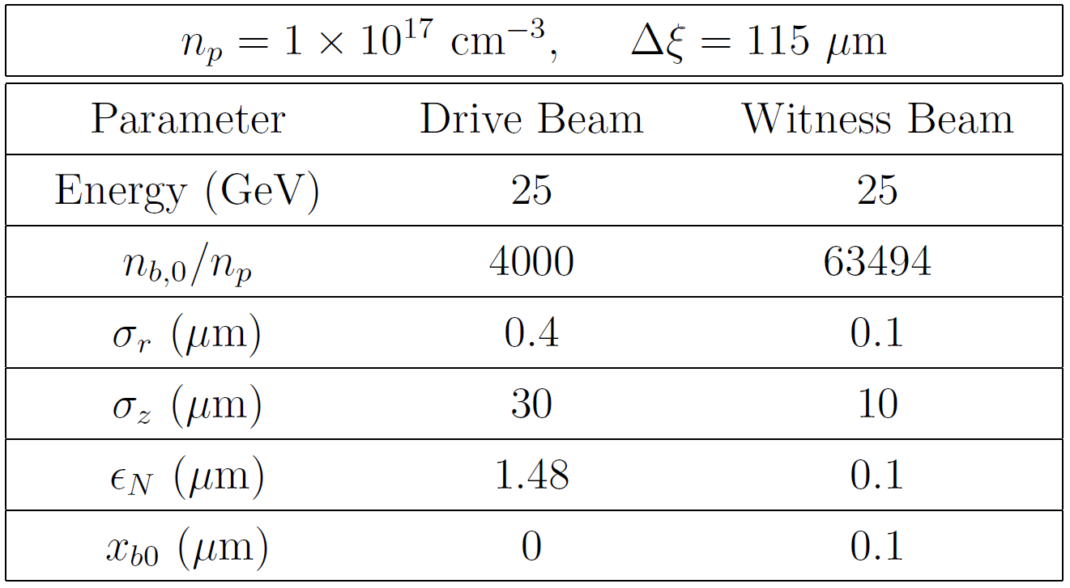
Fully self-consistent QPAD simulation of LC
QuickPIC with Azimuthal Decomposition (QPAD) written by Fei Li allows us to simulate LC parameters.
We use the adiabatic ramps discussed with lithium plasma using beam parameters similar to An et al. (2017) but with a narrow driver (overfocused regime - 26x smaller spot size) and an offset witness beam
We use up to m=5 azimuthal modes and a transverse resolution of 10.3 nm.
F. Li et al., Comp. Phys. Commun., 107784 (2022)

Slide 10
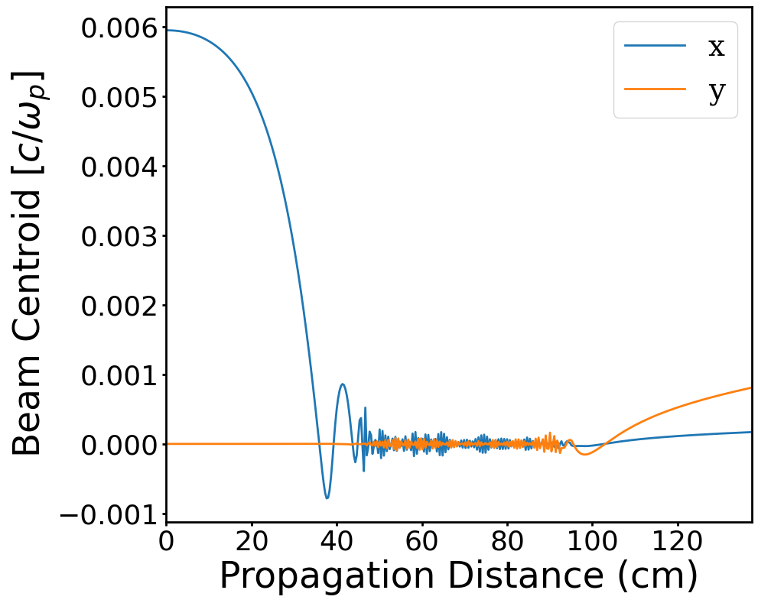
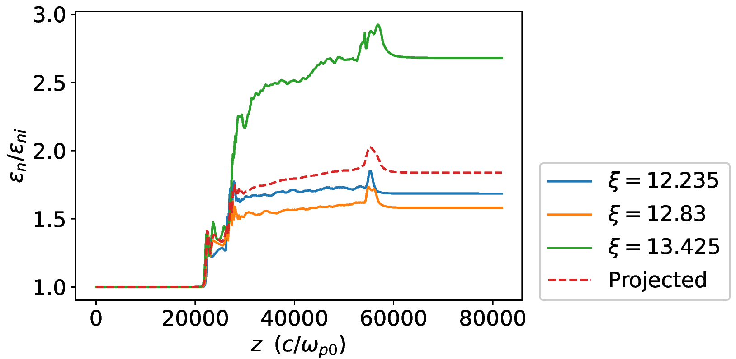
Simulation results (preliminary)
We see the witness beam centroid decays to zero in the upramp (and a small growth from noise in the downramp)
About 85% emittance growth, only a small amount because of the offset - 70% growth with no offset
2% energy spread growth (will run with shaped beams next)
>50% drive-to-witness energy transfer efficiency

Slide 11
Conclusions
Narrow drive beams pull ions to the axis and the ions subsequently pull the witness beam to the axis eliminating any misalignment.
The adiabatic plasma upramp can simultaneously match the witness beam while eliminating the centroid.
Because we have much more ion motion with narrow drivers we see much larger emittance growths.
In a future collider, we may use this stage as a final stage to eliminate any misalignment built up from previous staging. In the early stages, using a wide driver with a precursor beam will be preferable because there will be smaller emittance growth and hosing will not grow.
Final stage will have higher energy which requires a longer ramp and we expect more emittance growth.

