Slide 1
Observation of Skewed Electromagnetic Wakefields in an Asymmetric Structure Driven by Flat Electron Bunches
W. Lynn, G. Andonian, N. Majernik, S. O’Tool, J. Rosenzweig | UCLA
S. Doran, H. Gwanghui, J. Power, C. Whiteford, E. Wisniewski | Argonne National Laboratory
P. Piot, T. Xu | Northern Illinois University

Slide 2
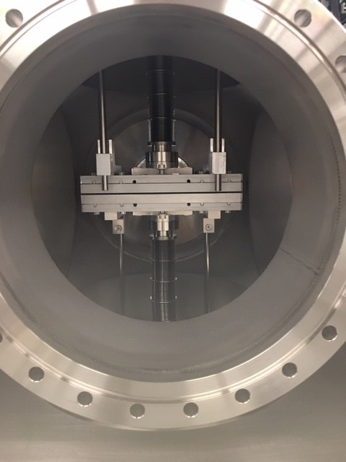
Overview
Background
Experimental overview/setup
Beam parameters and generation
Dielectric structure in question
Theoretical analysis
Simulations
Results
Wakefield reconstruction
e-

Slide 3
Background
What did we do?
Why Dielectric Wakefield Acceleration?
Why flat beams?
Why tilt flat beams?
Y
X
Y
X

Slide 4
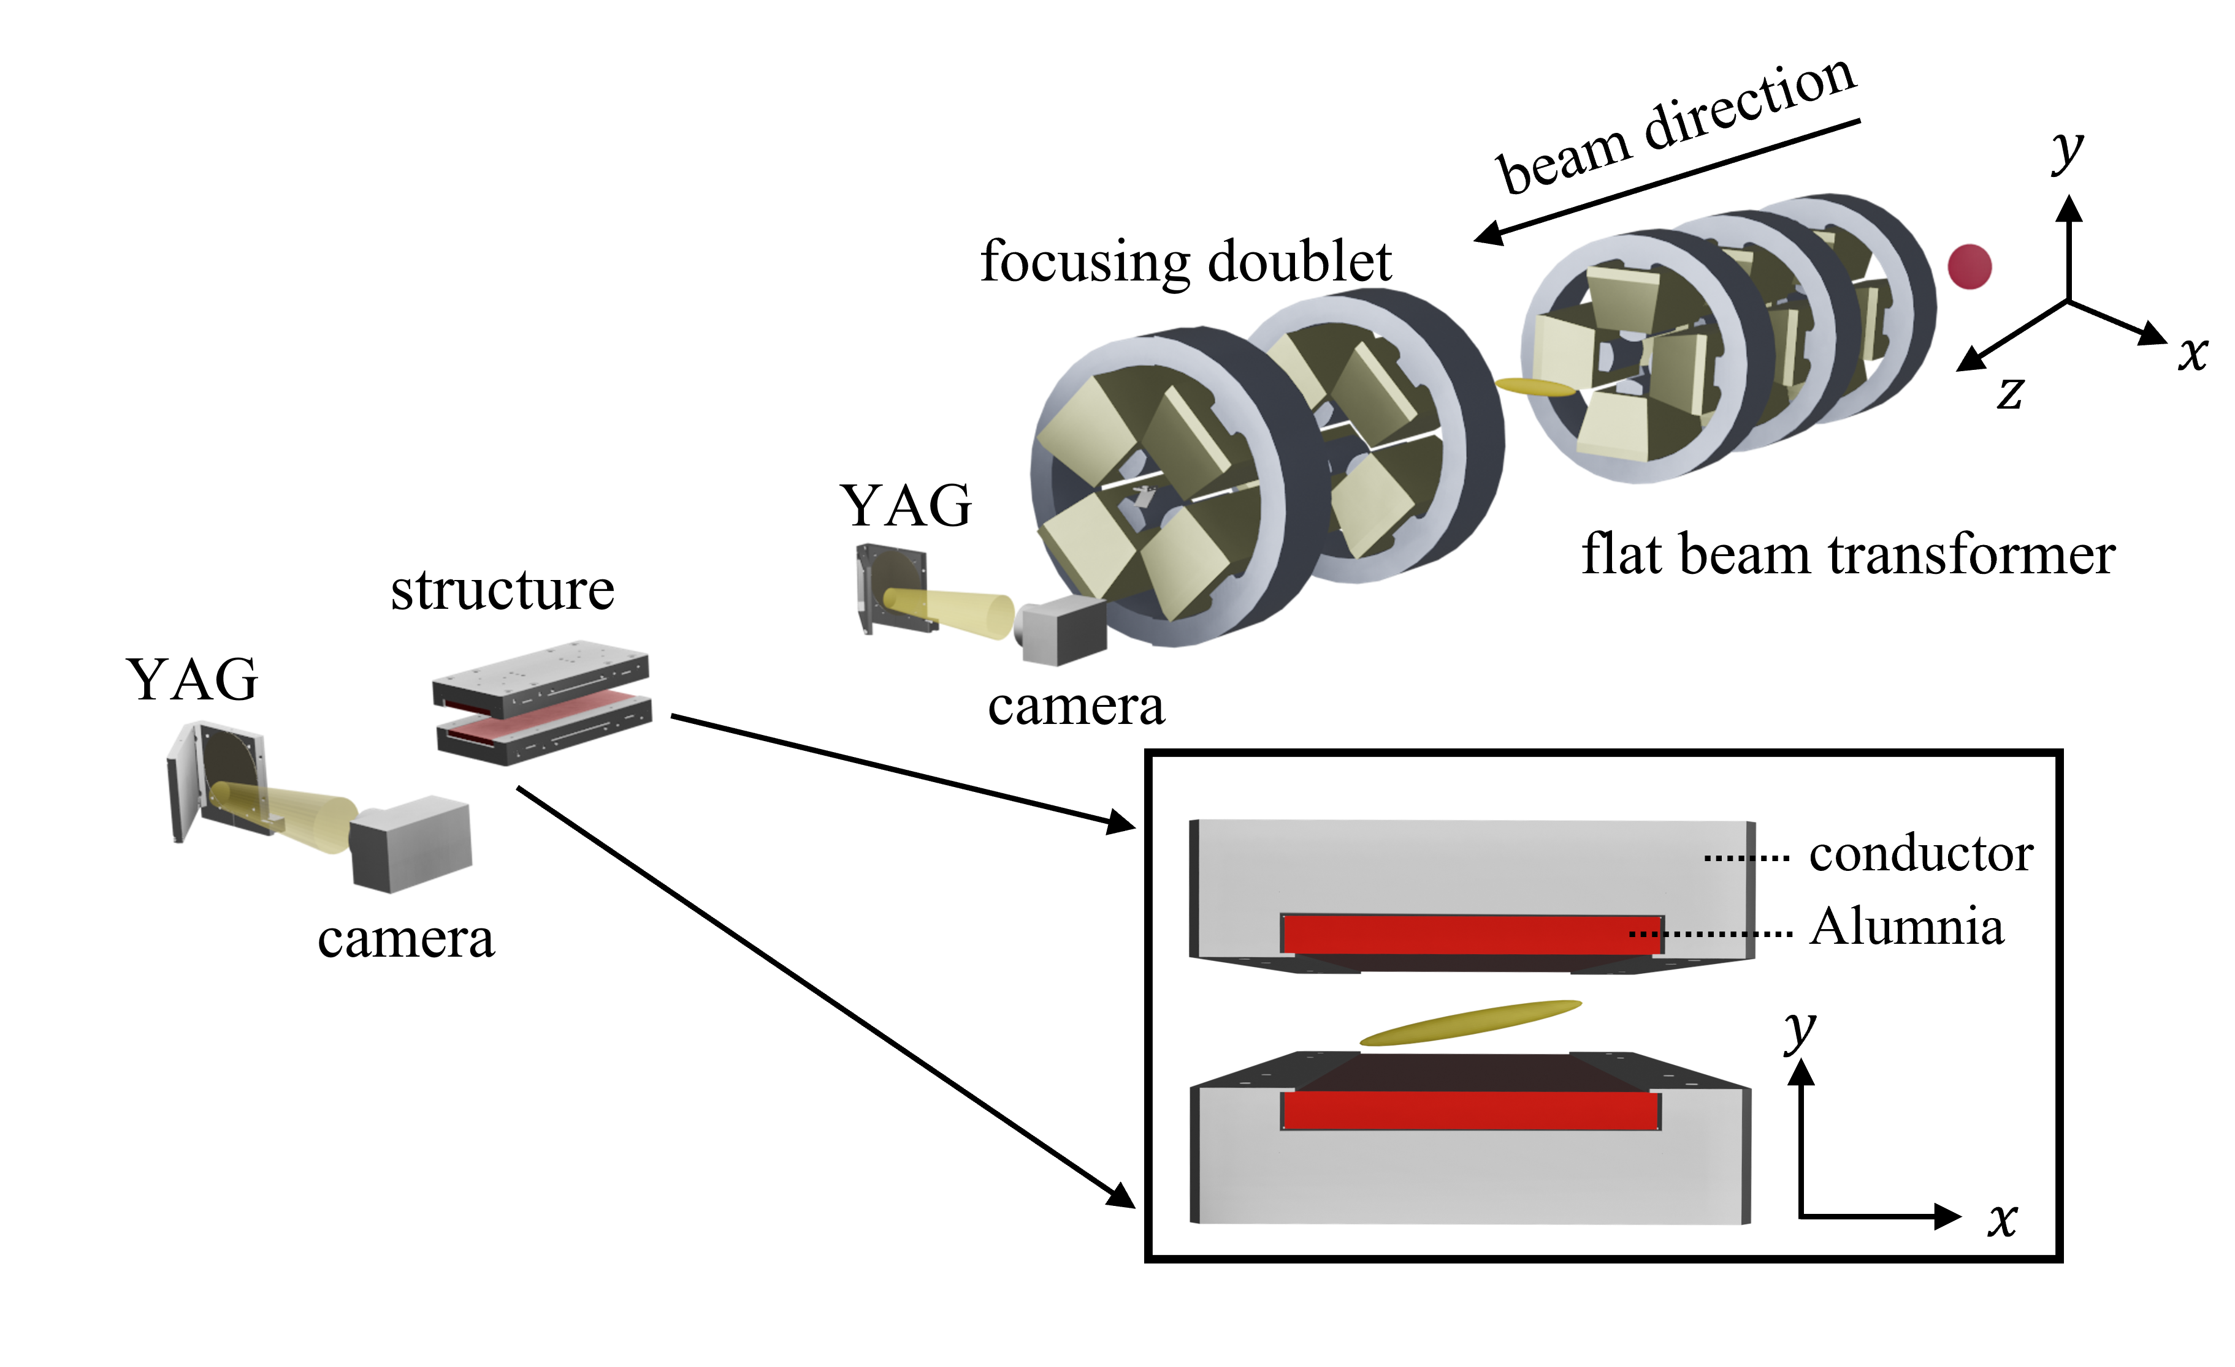
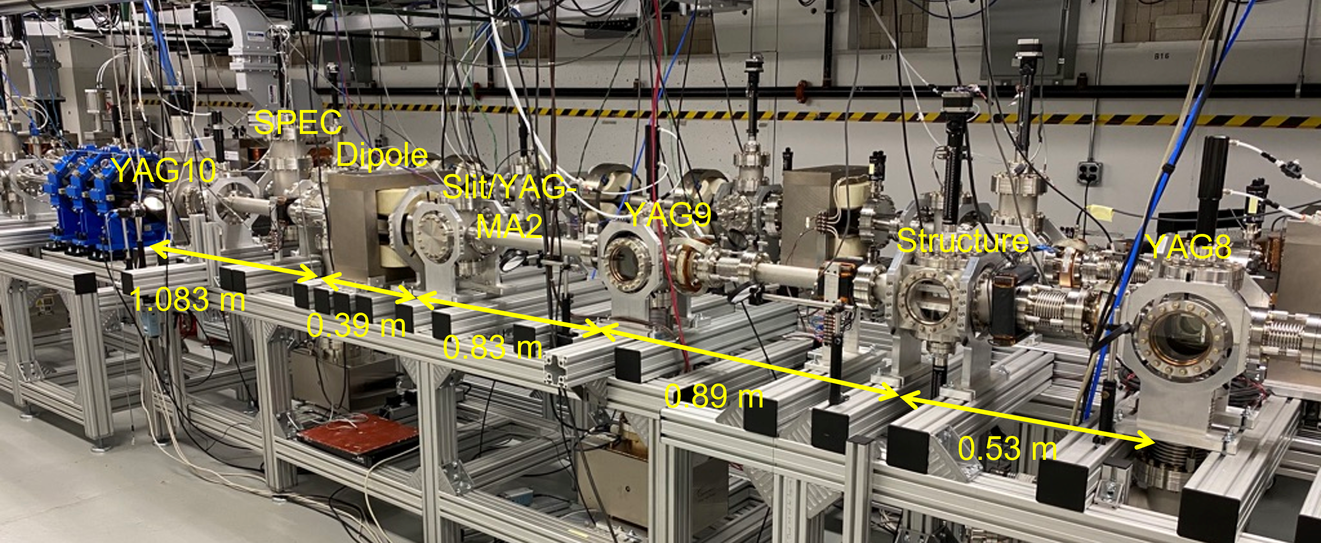
Experimental Setup
Main AWA beamline
YAG screens for transverse profile
Deflecting cavity and spectrometer

Slide 5
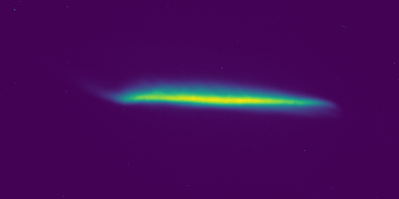
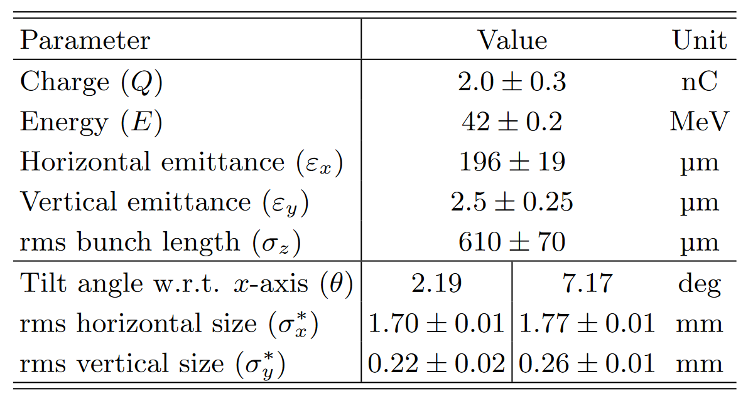
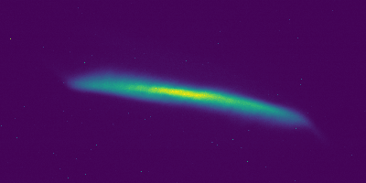
Beam
YAG image of beam with tilt 1
Y
X
YAG image of beam with tilt 2
Y
X

Slide 6
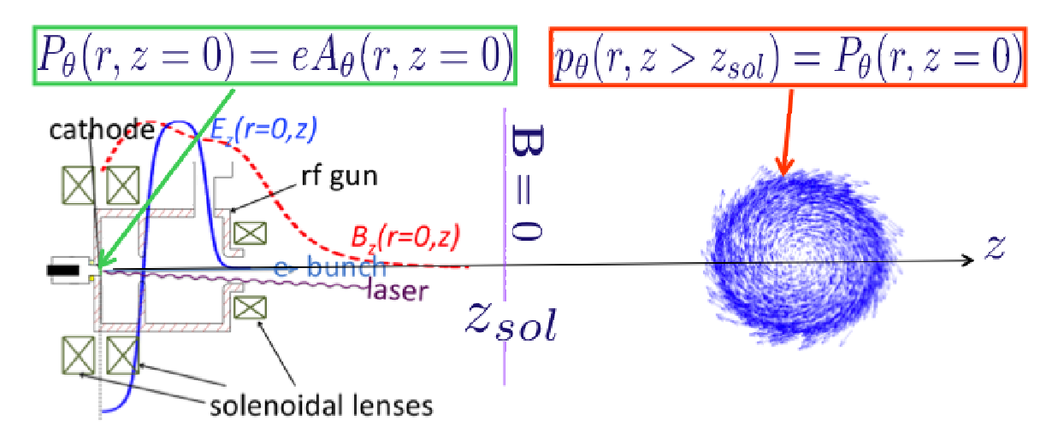
Round to Flat
Flat beam generated with round-to-flat transformer
Tilt angles generated by tweaking transformer process

Slide 7
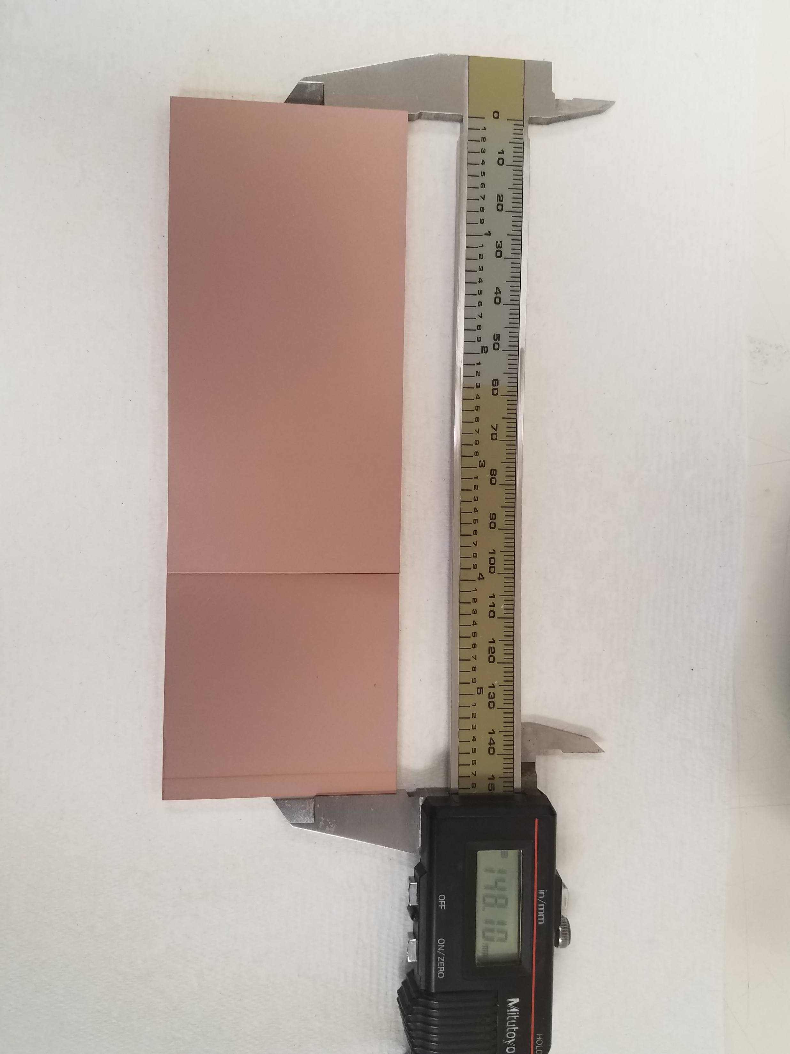
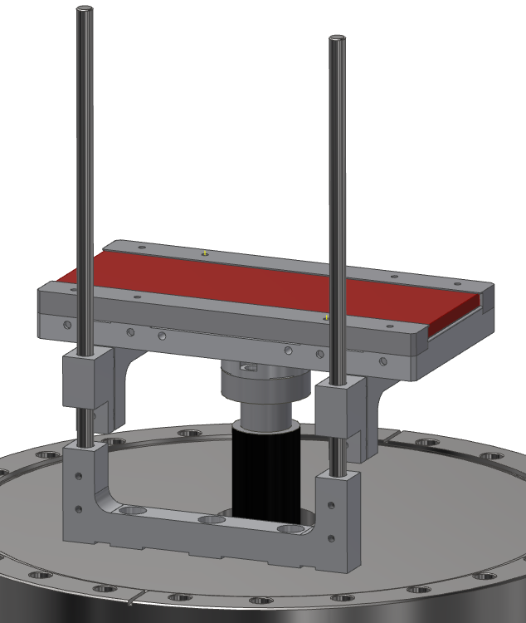
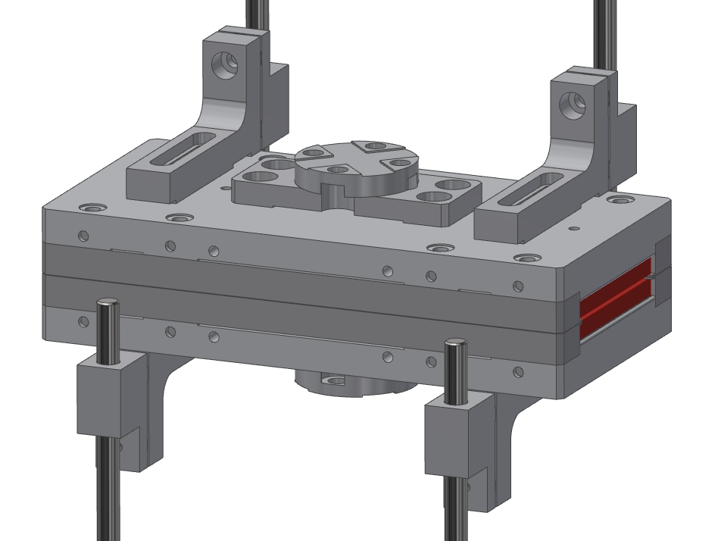
Dielectric Structure
Two 5x15x0.5cm slabs of alumina
Sputtered copper on exterior face

Slide 8
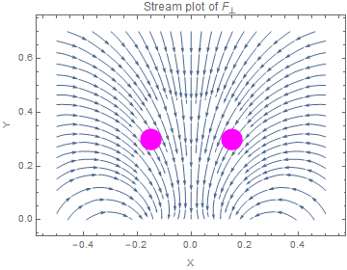
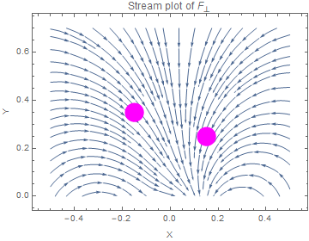
Analytical model for upper bound of transverse forces
Y
X
X
Derivation omitted
S. S. Baturin and A. D. Kanareykin, New method of calculating the wakefields of a point charge in a waveguide of arbitrary cross section, Phys. Rev. Accel. Beams 19, 051001 (2016).

Slide 9
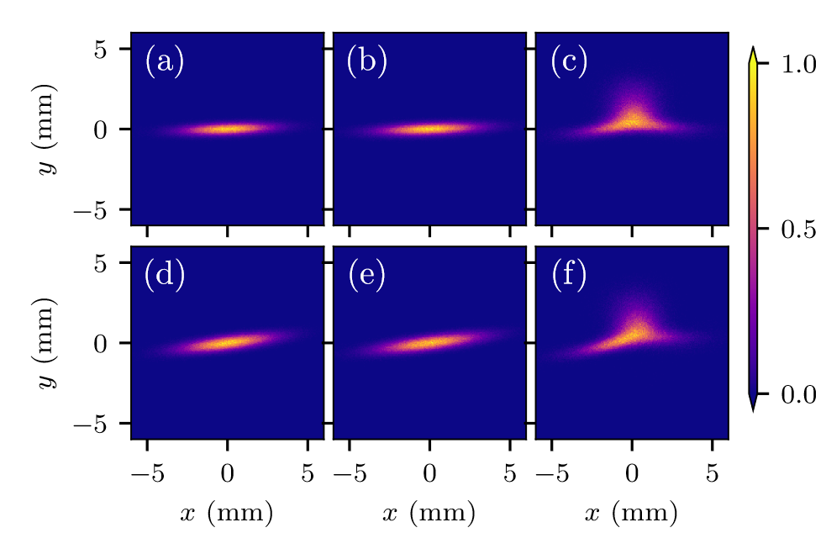
Simulations
Particle in cell simulations with CST Studio Suite and WARP
After drift without Structure
After drift with Structure
At structure location
Tilt 1
Tilt 2

Slide 10
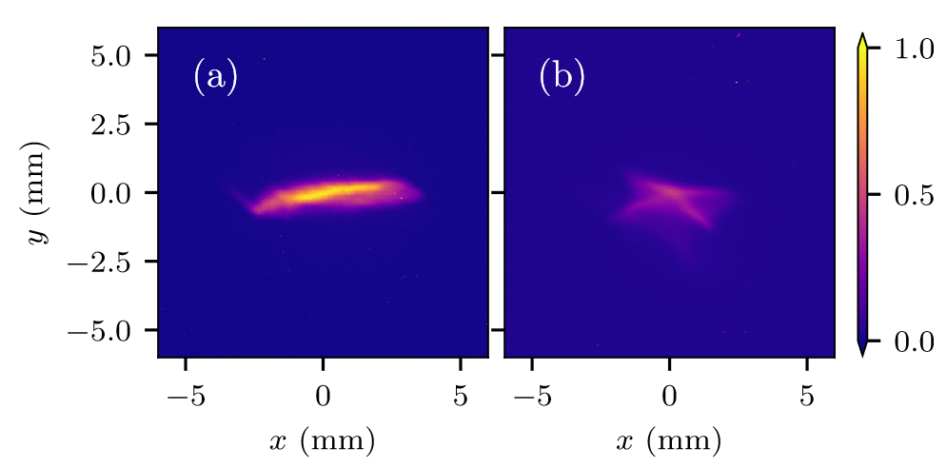
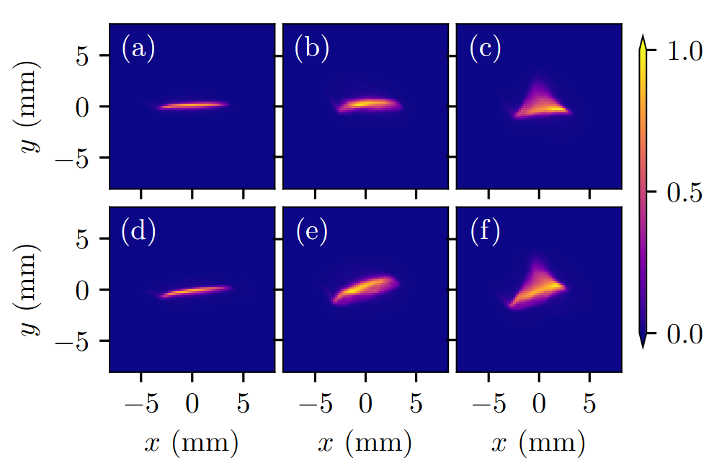
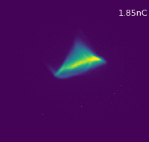
Experimental Results
After drift without Structure
After drift with Structure
At structure location
Double Slab
Tilt 1
Single Slab
Tilt 2

Slide 11
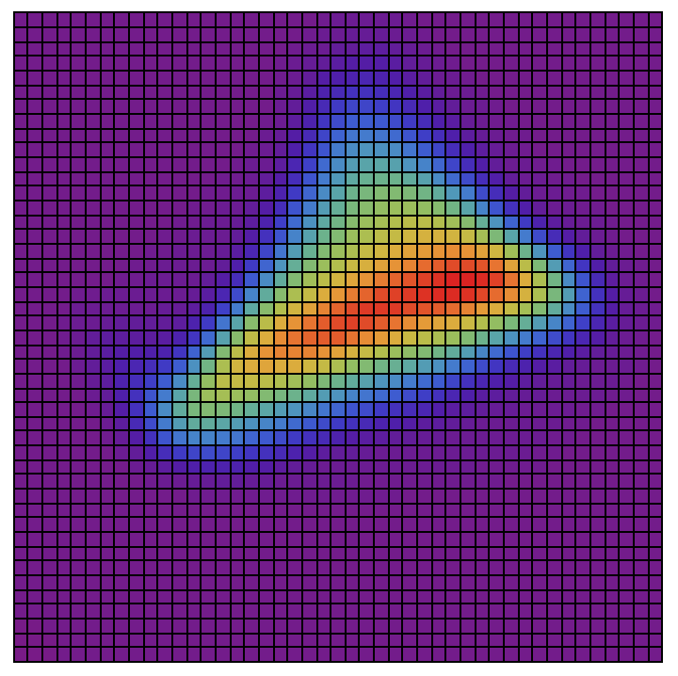
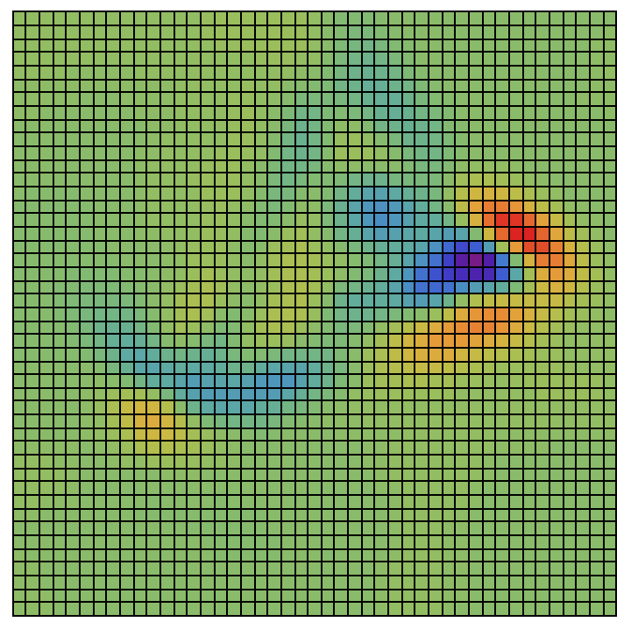
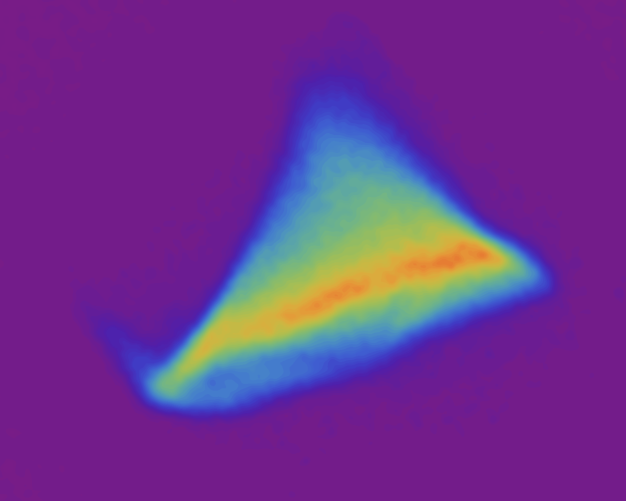
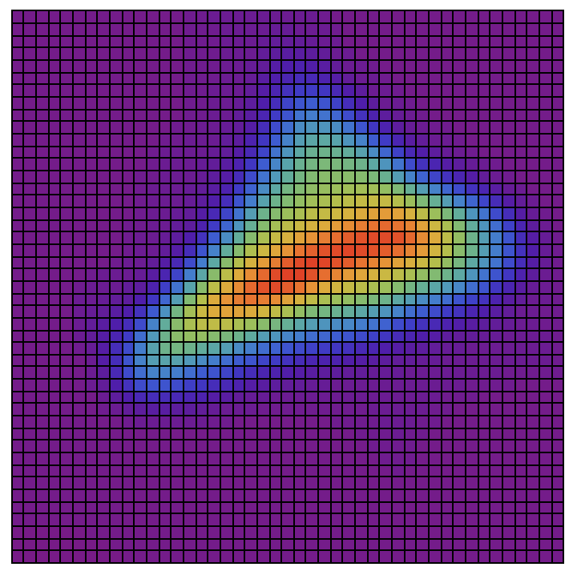
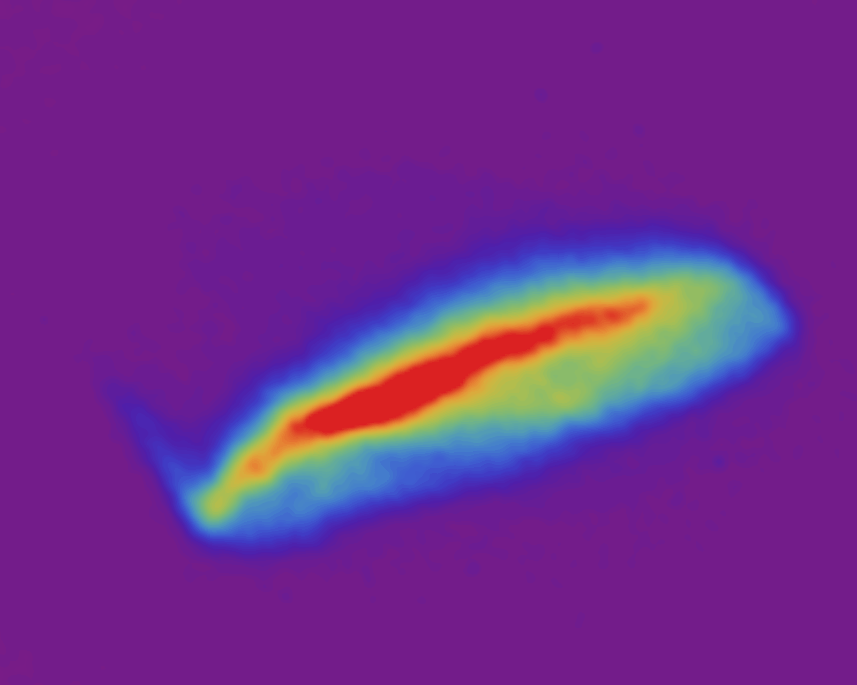
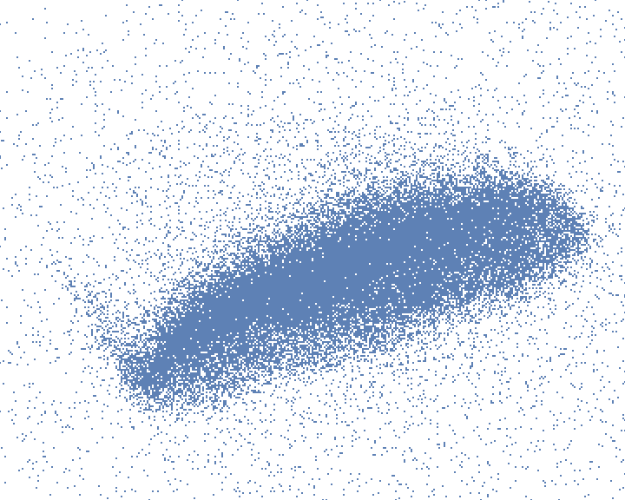
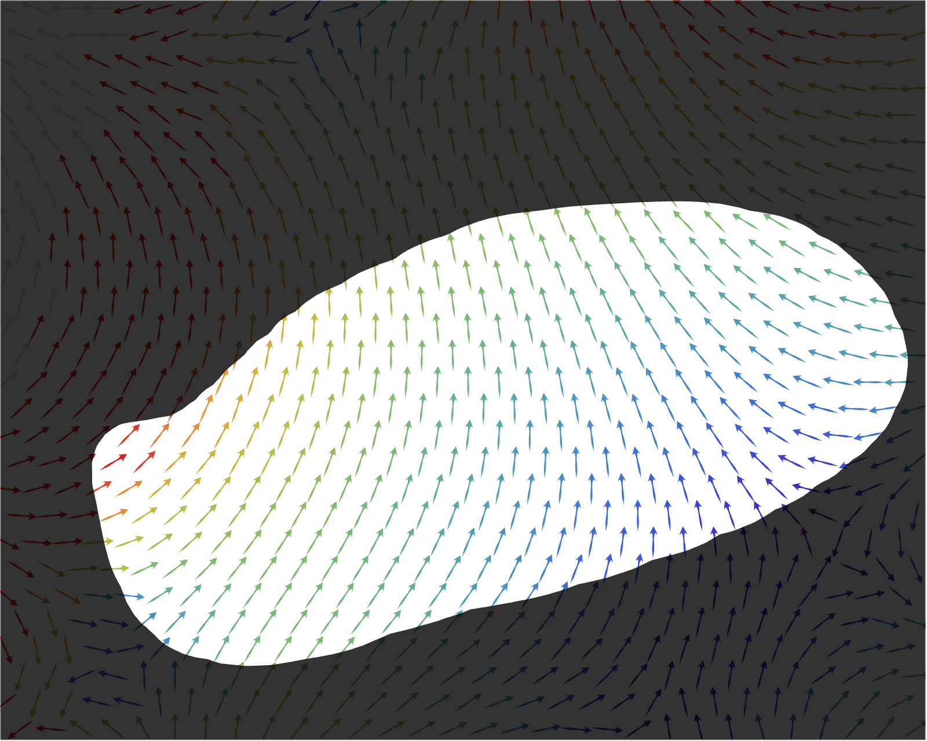
Wakefield Analysis
Binwise errors
With-structure
screen image
Binned with-structure population
Without-structure screen image
Particles
𝜖_{fit}
Particle transform
Parameter vector
Binned test population
Reconstructed wakefield
Skew and normal quadrupole coefficients
$$a_{2}=\text{0.31}$$
$$b_{2}=\text{0.24}$$
Notes:
Nathan’s talk WG5: S8

Slide 12
Conclusion
Goal to better understand DWA interaction leading to beam breakup
Skew wakes unexpected but interesting result
Novel analysis tools required
Submitting to journal soon
Thank you to everyone who worked on this

