Slide 1
AAC 2022
Nov 8th, 2022
QPAD modeling of wake excitation and acceleration in meter-long beam-ionized plasma at FACET-II
Zan Nie
UCLA
E300 Collaboration

Slide 2
Acknowledgement
E300 Collaboration
UCLA
SLAC FACET-II
Ecole Polytechnique
University of Colorado Boulder
University of Texas at Austin
CERN

Slide 3
Outline
First run of the E300 experiment
Single-bunch, beam-ionized (H2 or He) PWFA
Ionization of hydrogen molecules
Photoionization
Beam ionization
QPAD simulations
Comparison with experimental H2 and He results
Summary

Slide 4
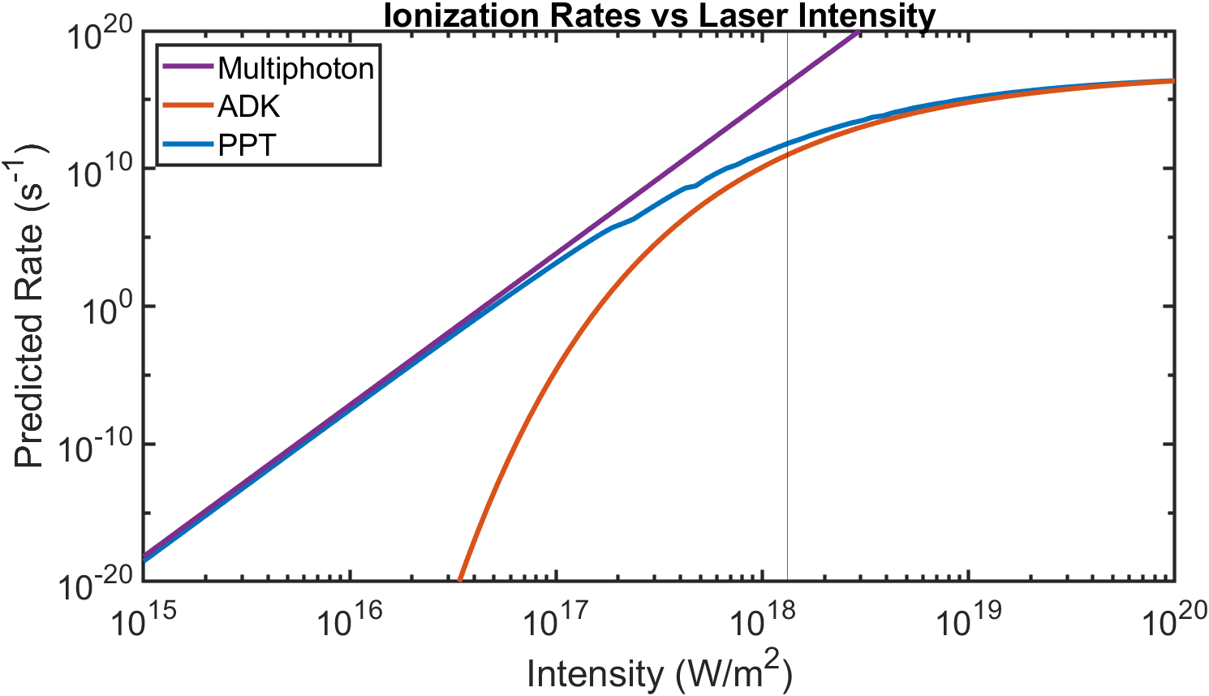
Photoionization regimes
Barrier suppression
Multi-photon
( 𝜸 ≫ 1 )
Tunneling
( 𝜸 ≪ 1 )
Keldysh parameter:
L. V. Keldysh, Sov. Phys. JETP 20, 1307–1314 (1965).
A. M. Perelomov, V. S. Popov, and M. V. Terentev, Sov. Phys. JETP 50, 1393–1409 (1966).
M. V. Ammosov, N. B. Delone, and V. P. Krainov, Sov. Phys. JETP 64, 1191 (1986).
I. Barth, et al., Phys. Rev. A. 87, 013433 (2013)
$$γ=\frac{ω\sqrt{2mU_{i}}}{eE}$$

Slide 5
Ionization pathways of H2
Molecular ionization
(MO-PPT, MO-ADK)
15.4 eV
30.0 eV
+
H2
++
H2
H2
Dissociation
4.5 eV
2.8 eV
Coulomb explosion*
Atomic ionization
(PPT, ADK)
H + H
+
H + H
13.6 eV
13.6 eV
+
+
H + H
D. Pavicˇic ́, et. al., Phys. Rev. Lett. 94, 163002 (2005)
J-N. Vigneau, et al, arXiv:2209.10205

Slide 6
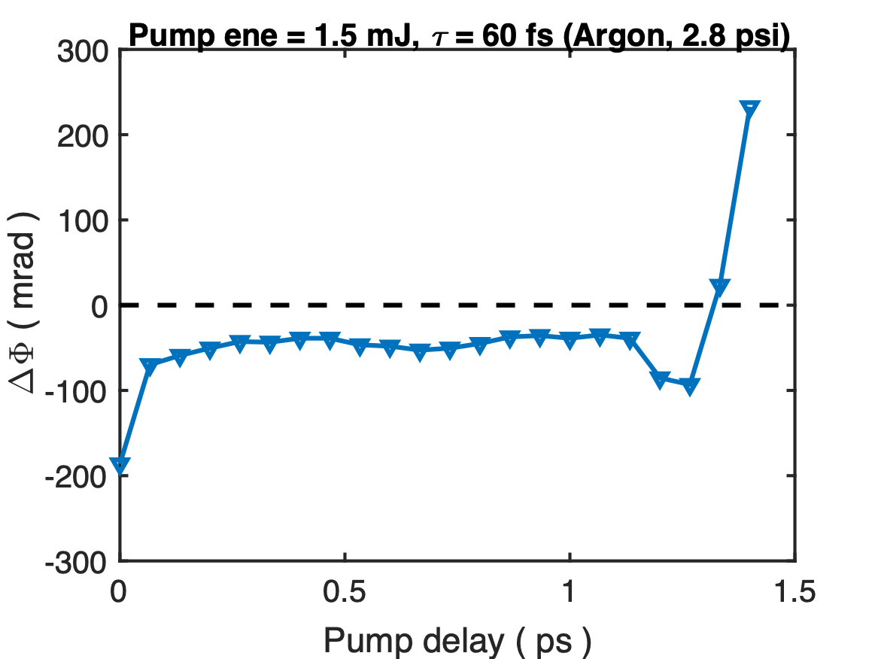
Cross-Polarized Temporal Interferometry
1.6 ps
Ref
$$Δϕ=∫\frac{2π}{λ}⋅Δndz=∫\frac{2π}{λ}⋅\frac{n_{p}}{2n_{c}}dz$$
Plasma phase shift:
Plasma signal
$$Δϕ_{min}∼0.6mrad$$
$$(n_{p}⋅L)_{min}∼2.6×{10}^{13}cm^{-2}$$
Probe
Z. Nie, et. al., Optics Express 30, 25696 (2022)

Slide 7
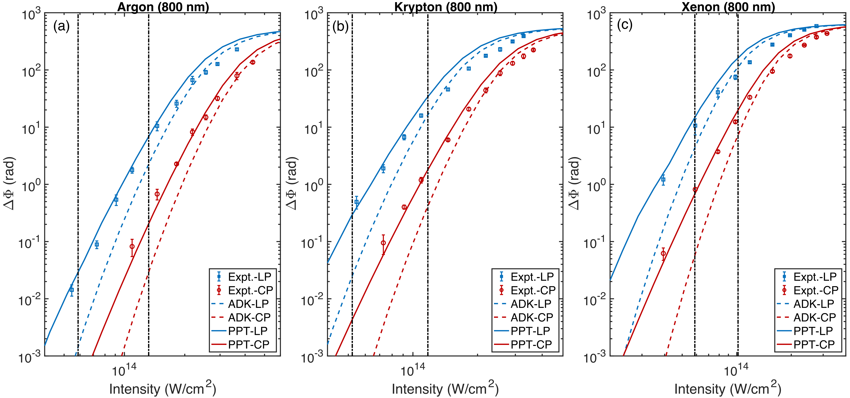
ADK v.s. PPT
𝜸 = 1
𝜸 = 1
𝜸 = 1
Z. Nie, et. al., Optics Express 30, 25696 (2022)

Slide 8
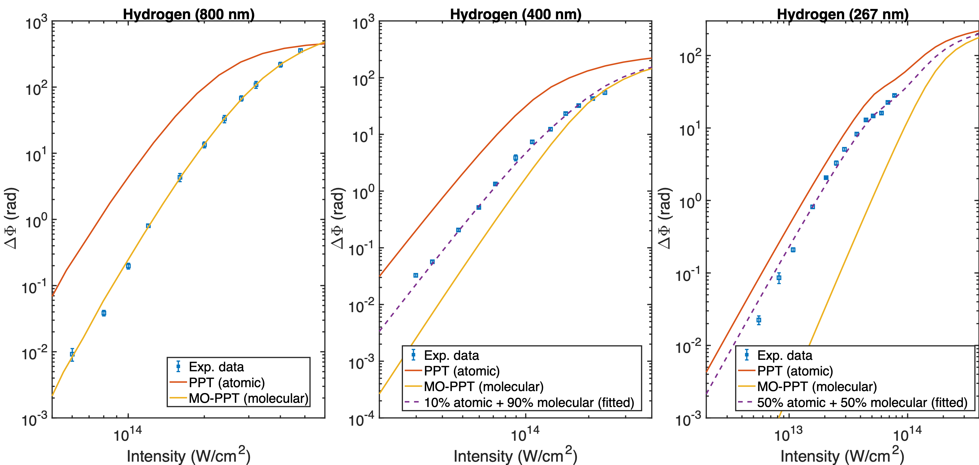
Photoionization of H2 (MO-PPT v.s. PPT)
I = 5⨉10¹⁴ W/cm²
Emax = 61.4 GV/m
Z. Nie, et. al., Optics Express 30, 25696 (2022)

Slide 9
MO-ADK v.s. ADK
$$W_{ADK}(E)=ω_{a.u.}|C_{n^{*},l^{*}}|^{2}f(l,m)\frac{U_{i}}{2U_{H}}{\left(\frac{2E_{0}}{E}\right)}^{2n^{*}-|m|-1}exp\left(-\frac{2E_{0}}{3E}\right)$$
$$W_{MO-ADK}(E,θ)=ω_{a.u.}\underset{m^{′}}{∑}\frac{B^{2}(m^{′},θ)}{2^{|m^{′}|}|m^{′}|!}\frac{1}{κ^{2n^{*}-1}}{\left(\frac{2E_{0}}{E}\right)}^{2n^{*}-|m|-1}exp\left(-\frac{2E_{0}}{3E}\right)$$
 | C0 | C2 | C4
H2 | 2.435 | 0.107 | 0.001
H2⁺ | 4.37 | 0.05 | 0.00
$$B(m^{′},θ)=\underset{l>=m}{∑}C_{l}Q(l,m^{′})D_{m^{′},m}^{l}(0,θ,0)$$
$$B(m^{′}=0,θ)=\underset{l>=0}{∑}\sqrt{\frac{2l+1}{2}}C_{l}P_{l}(cosθ)$$
M. V. Ammosov, N. B. Delone, and V. P. Krainov, Sov. Phys. JETP 64, 1191 (1986)
X. M. Tong, Z. X. Zhao, and C. D. Lin, Phys. Rev. A 66, 033402 (2002)
M. Awasthi, et al, Phys. Rev. A 77, 063403 (2008)

Slide 10
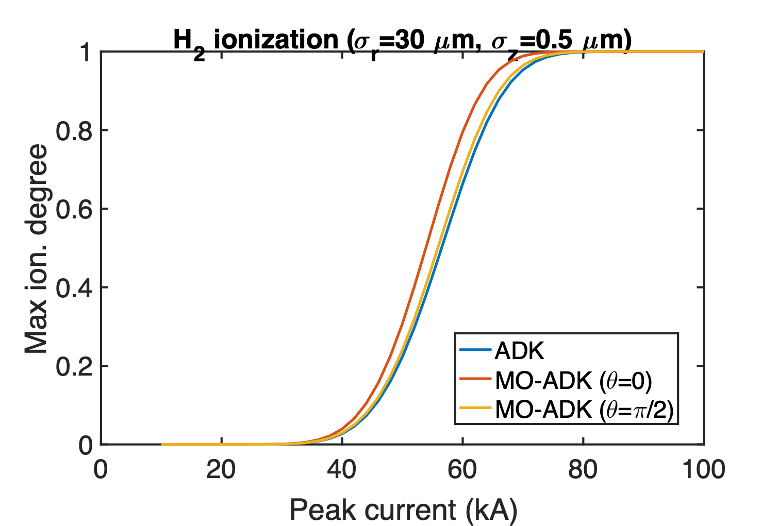
Beam ionization of H2 (MO-ADK v.s. ADK)

Slide 11
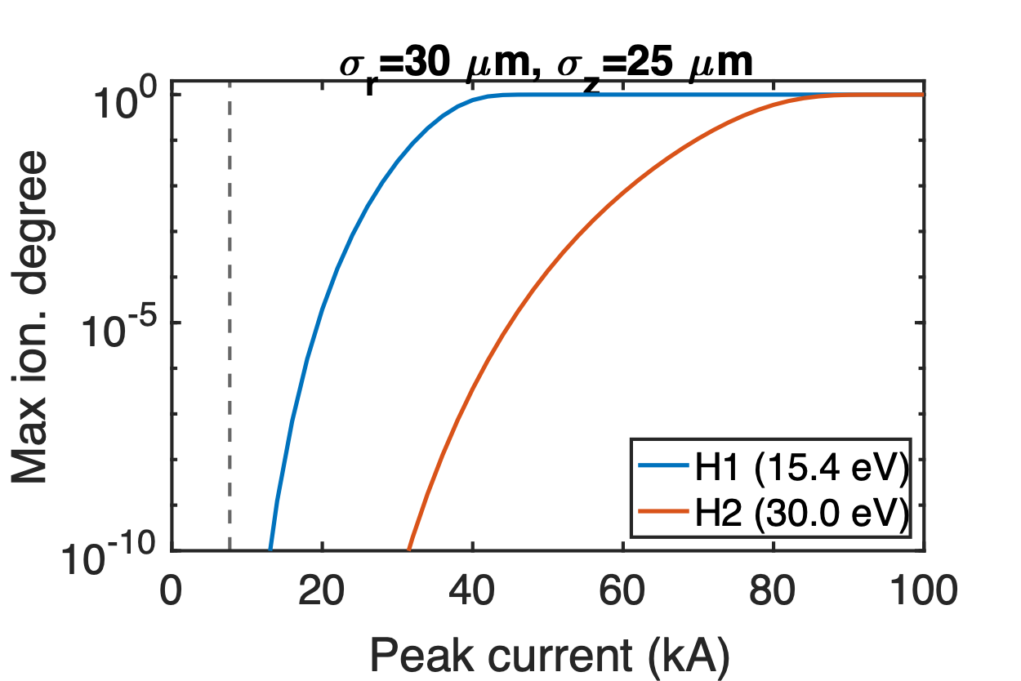
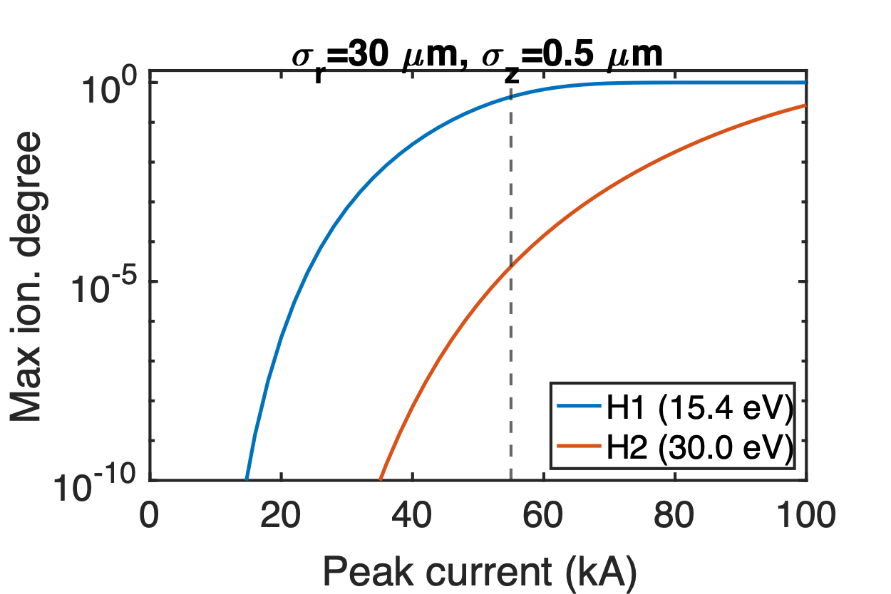
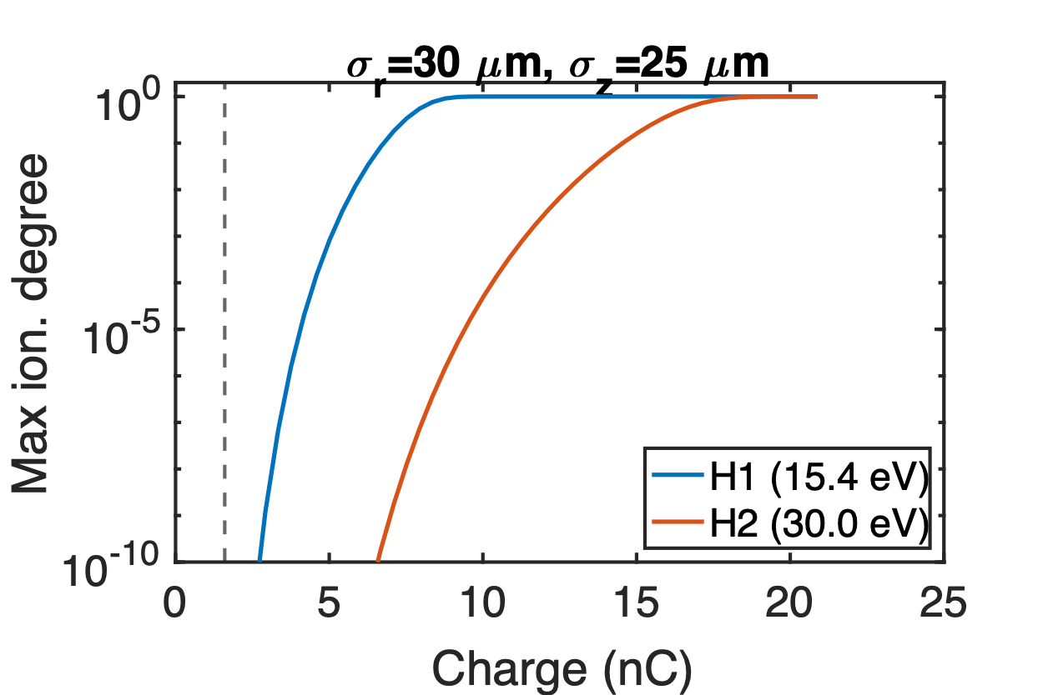
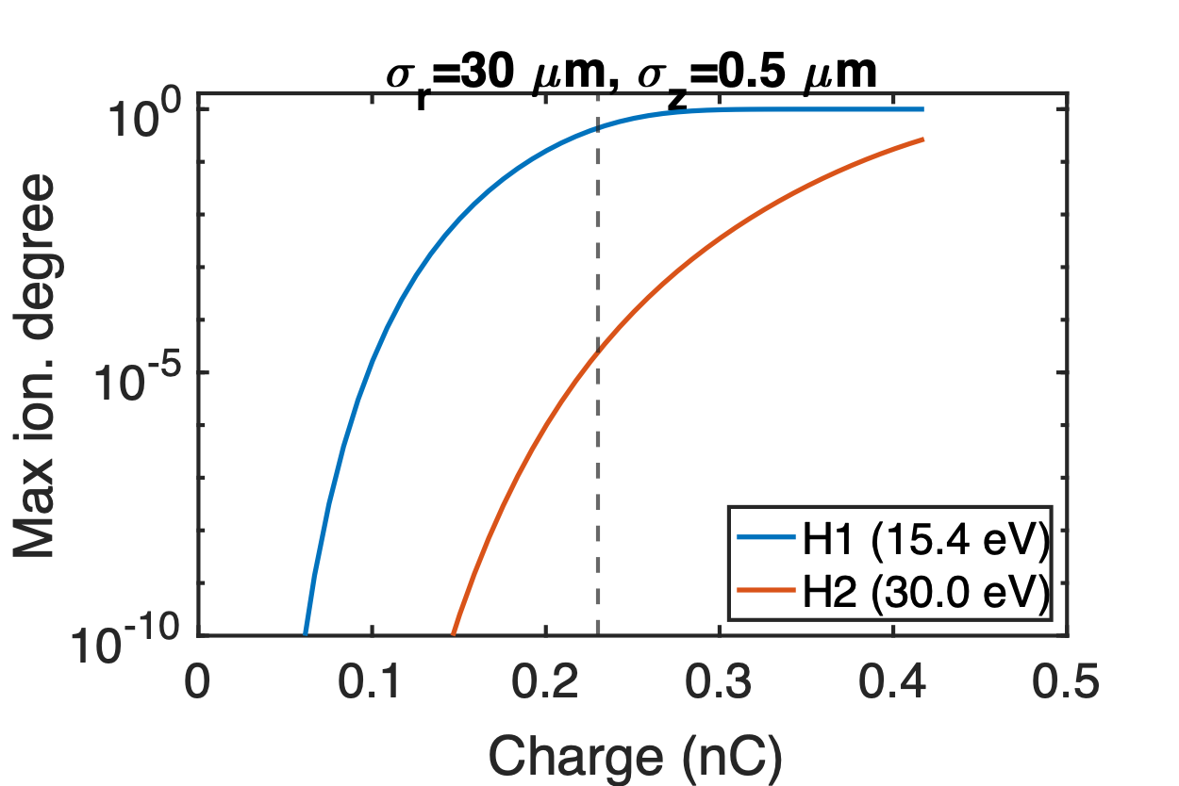
Beam ionization of H2
$$E_{r,max}=10.4\frac{N}{{10}^{10}}\frac{10}{σ_{r}[μm]}\frac{50}{σ_{z}[μm]}[GV/m]$$
Without spike
Spike only
7.7 kA
Emax=6.9 GV/m
Emax=49.6 GV/m
55 kA
1.6 nC
0.23 nC

Slide 12
Comparison of observables
Beam parameters:
Observables:
Lowest energy due to deceleration
Total energy loss
Scallop due to betatron oscillations
Charge | 𝝈r | 𝝈z | εN | 𝛽*
1.5 nC | ~25 𝜇m | ~25 𝜇m | ~25 𝜇m | 0.5 m

Slide 13
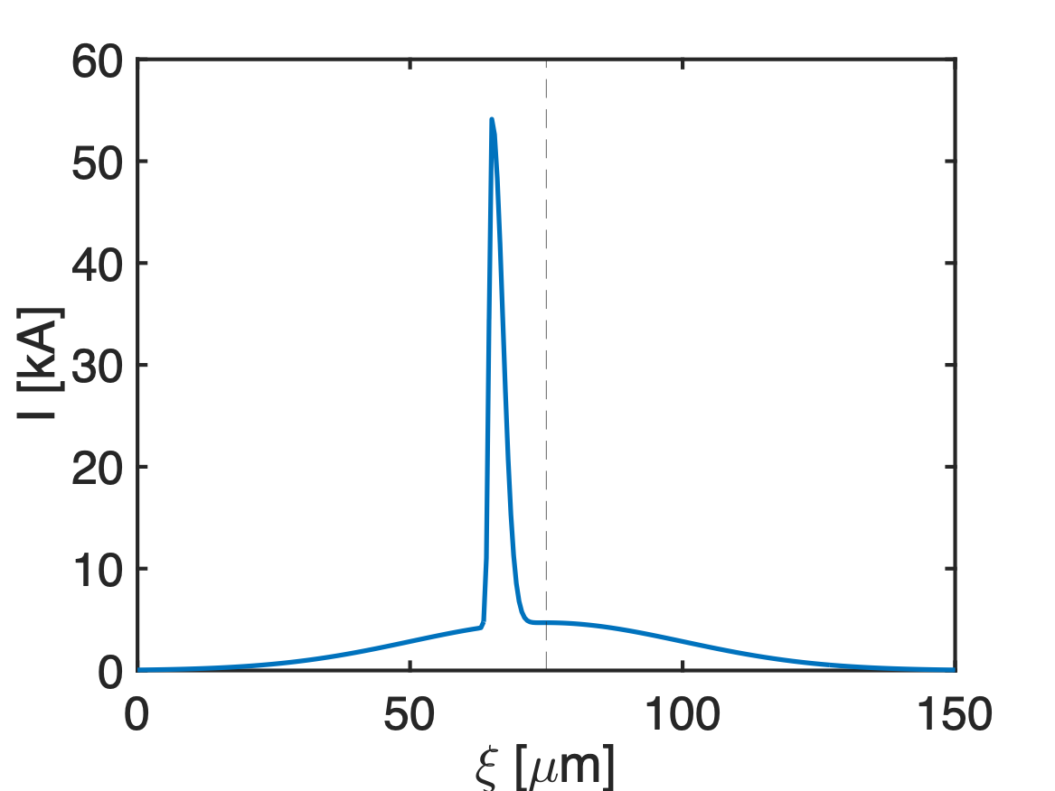
Modeled beam current profile
Main bunch
Spike
Charge | 0.98 nC
Peak current | 4.7 kA
𝝈r | 25 𝜇m
𝝈z1 | 25 𝜇m
εN | 25 𝜇m
𝛽* | 0.5 m
Charge | 0.52 nC
Peak current | 49.8 kA
𝝈r | 25 𝜇m
𝝈z2 | rise: 0.5 𝜇m fall: 2.0 𝜇m
εN | 25 𝜇m
𝛽* | 0.5 m
0.4𝝈z1
Could be a collection
of micro-bunches
~32% unaffected

Slide 14
Latest simulation results from Glen
The spike almost doesn’t loose any energy because it’s too short.
If the spike is at the head and contains ~30% of the charge, then the unaffected electrons all come from the spike.

Slide 15
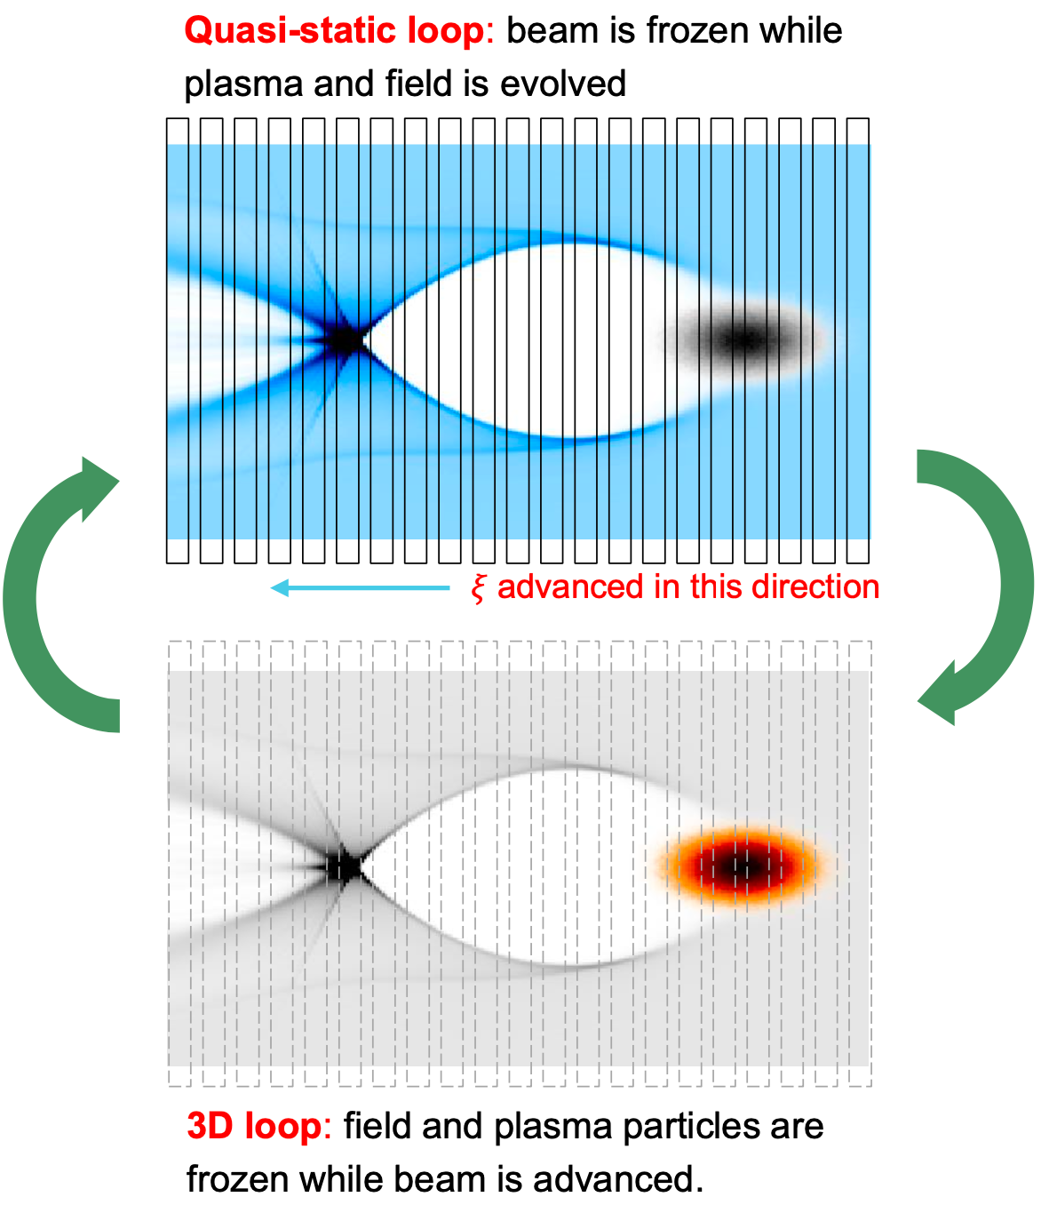
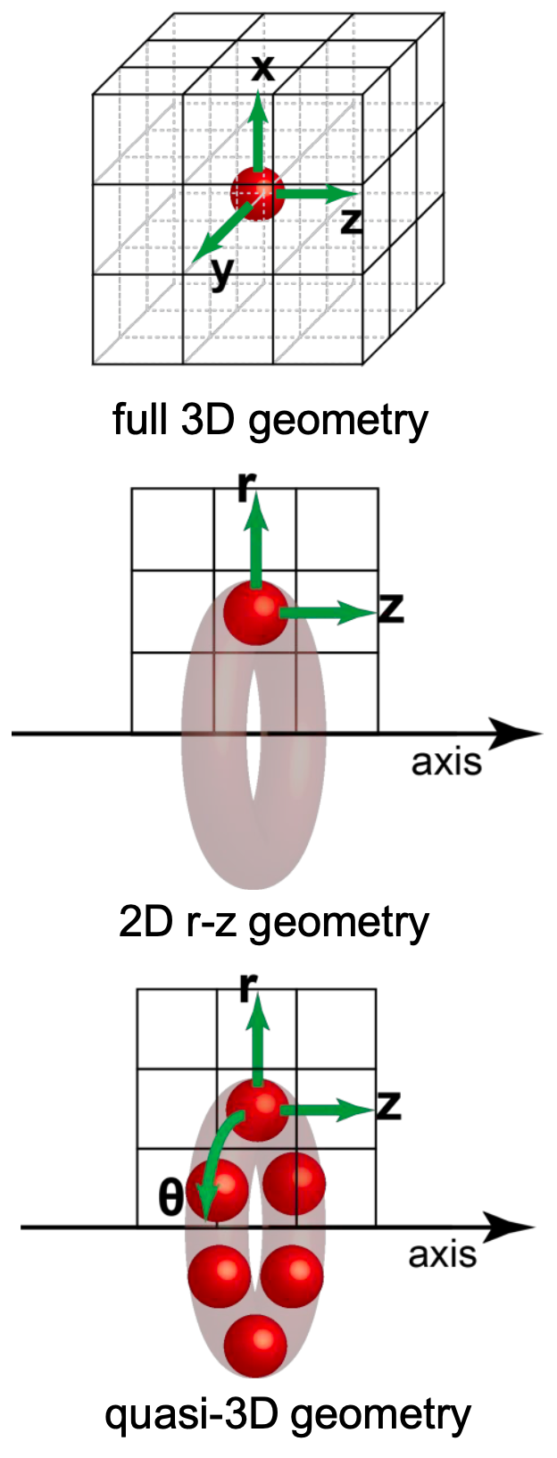
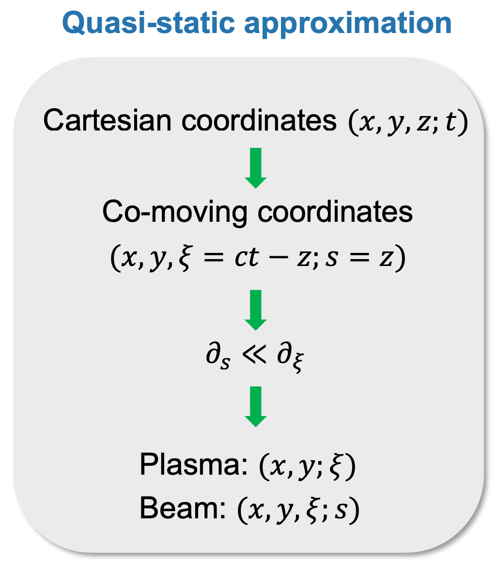
QuickPIC with Azimuthal Decomposition
Quasi-static + Quasi-3D
F. Li, et al., CPC 261, 107784 (2021)

Slide 16
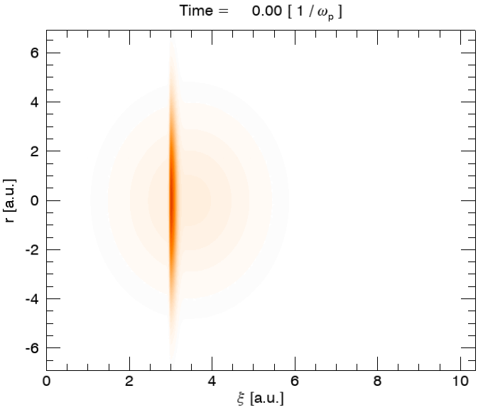
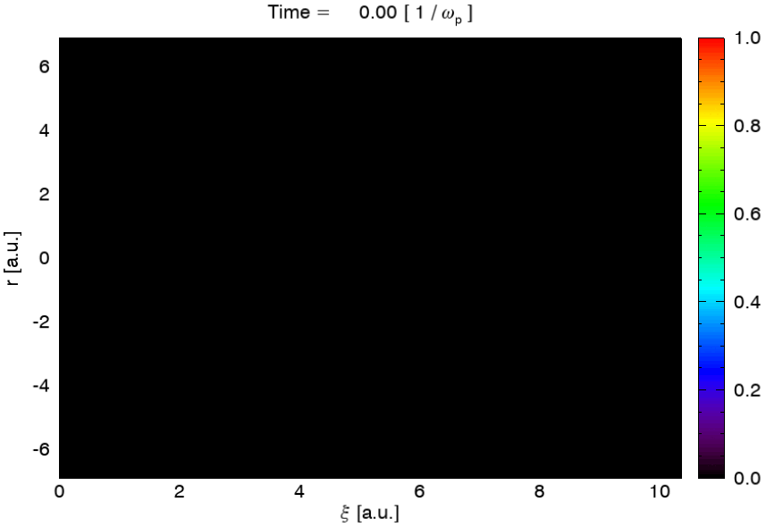
QPAD simulation (1.7 Torr H2)

Slide 17
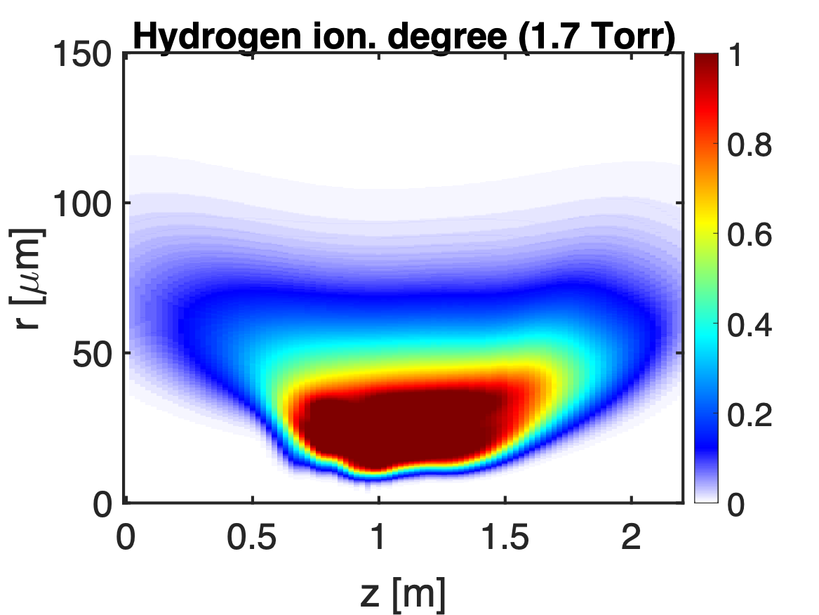
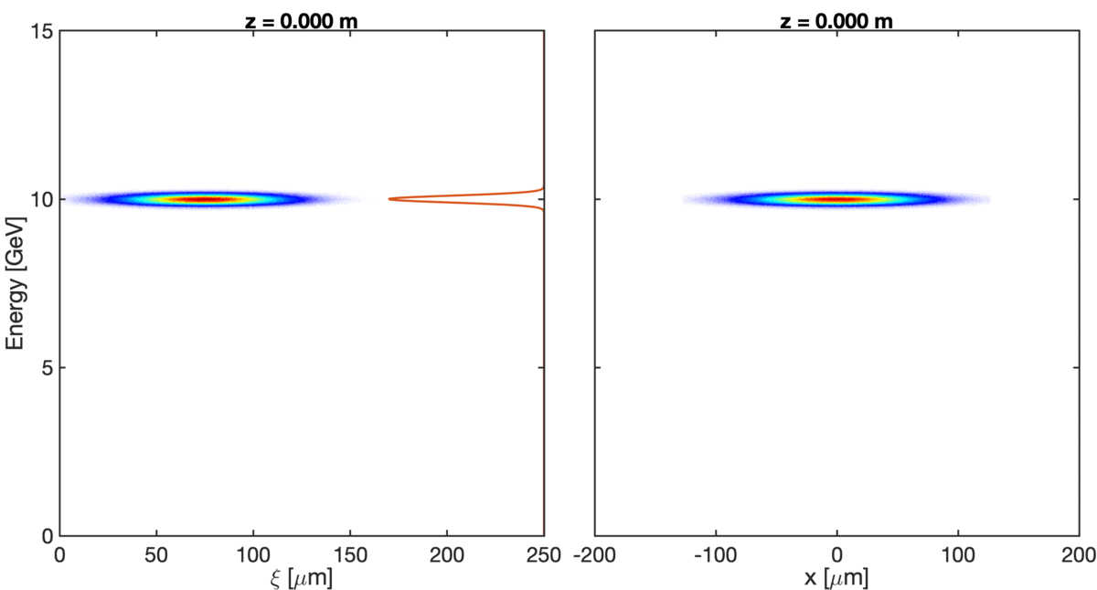
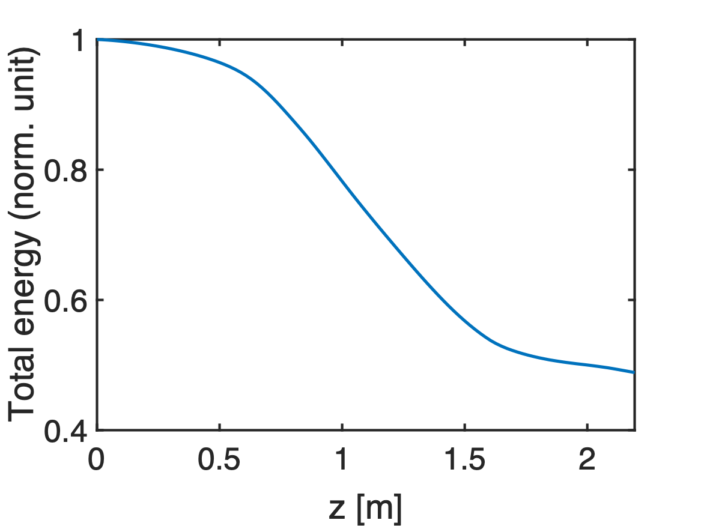
QPAD simulation: beam-ionized H2 case
~50% total energy loss
~70% beam-to-wake

Slide 18
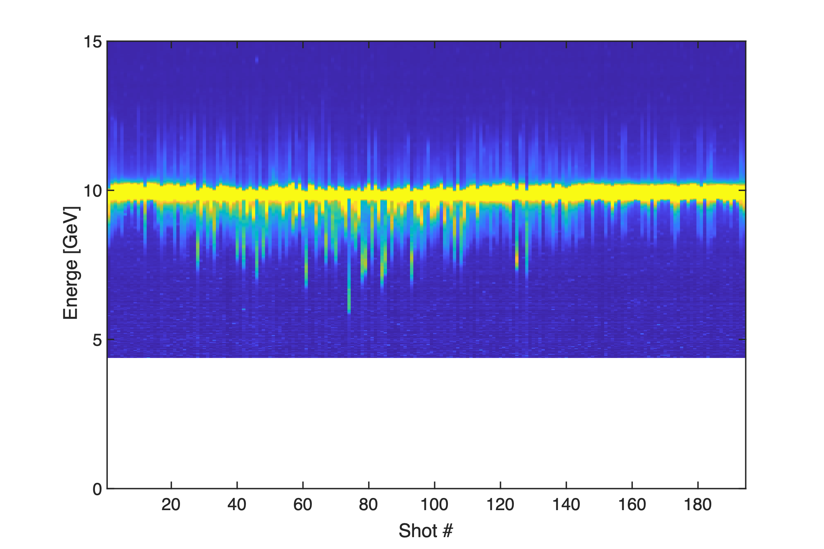
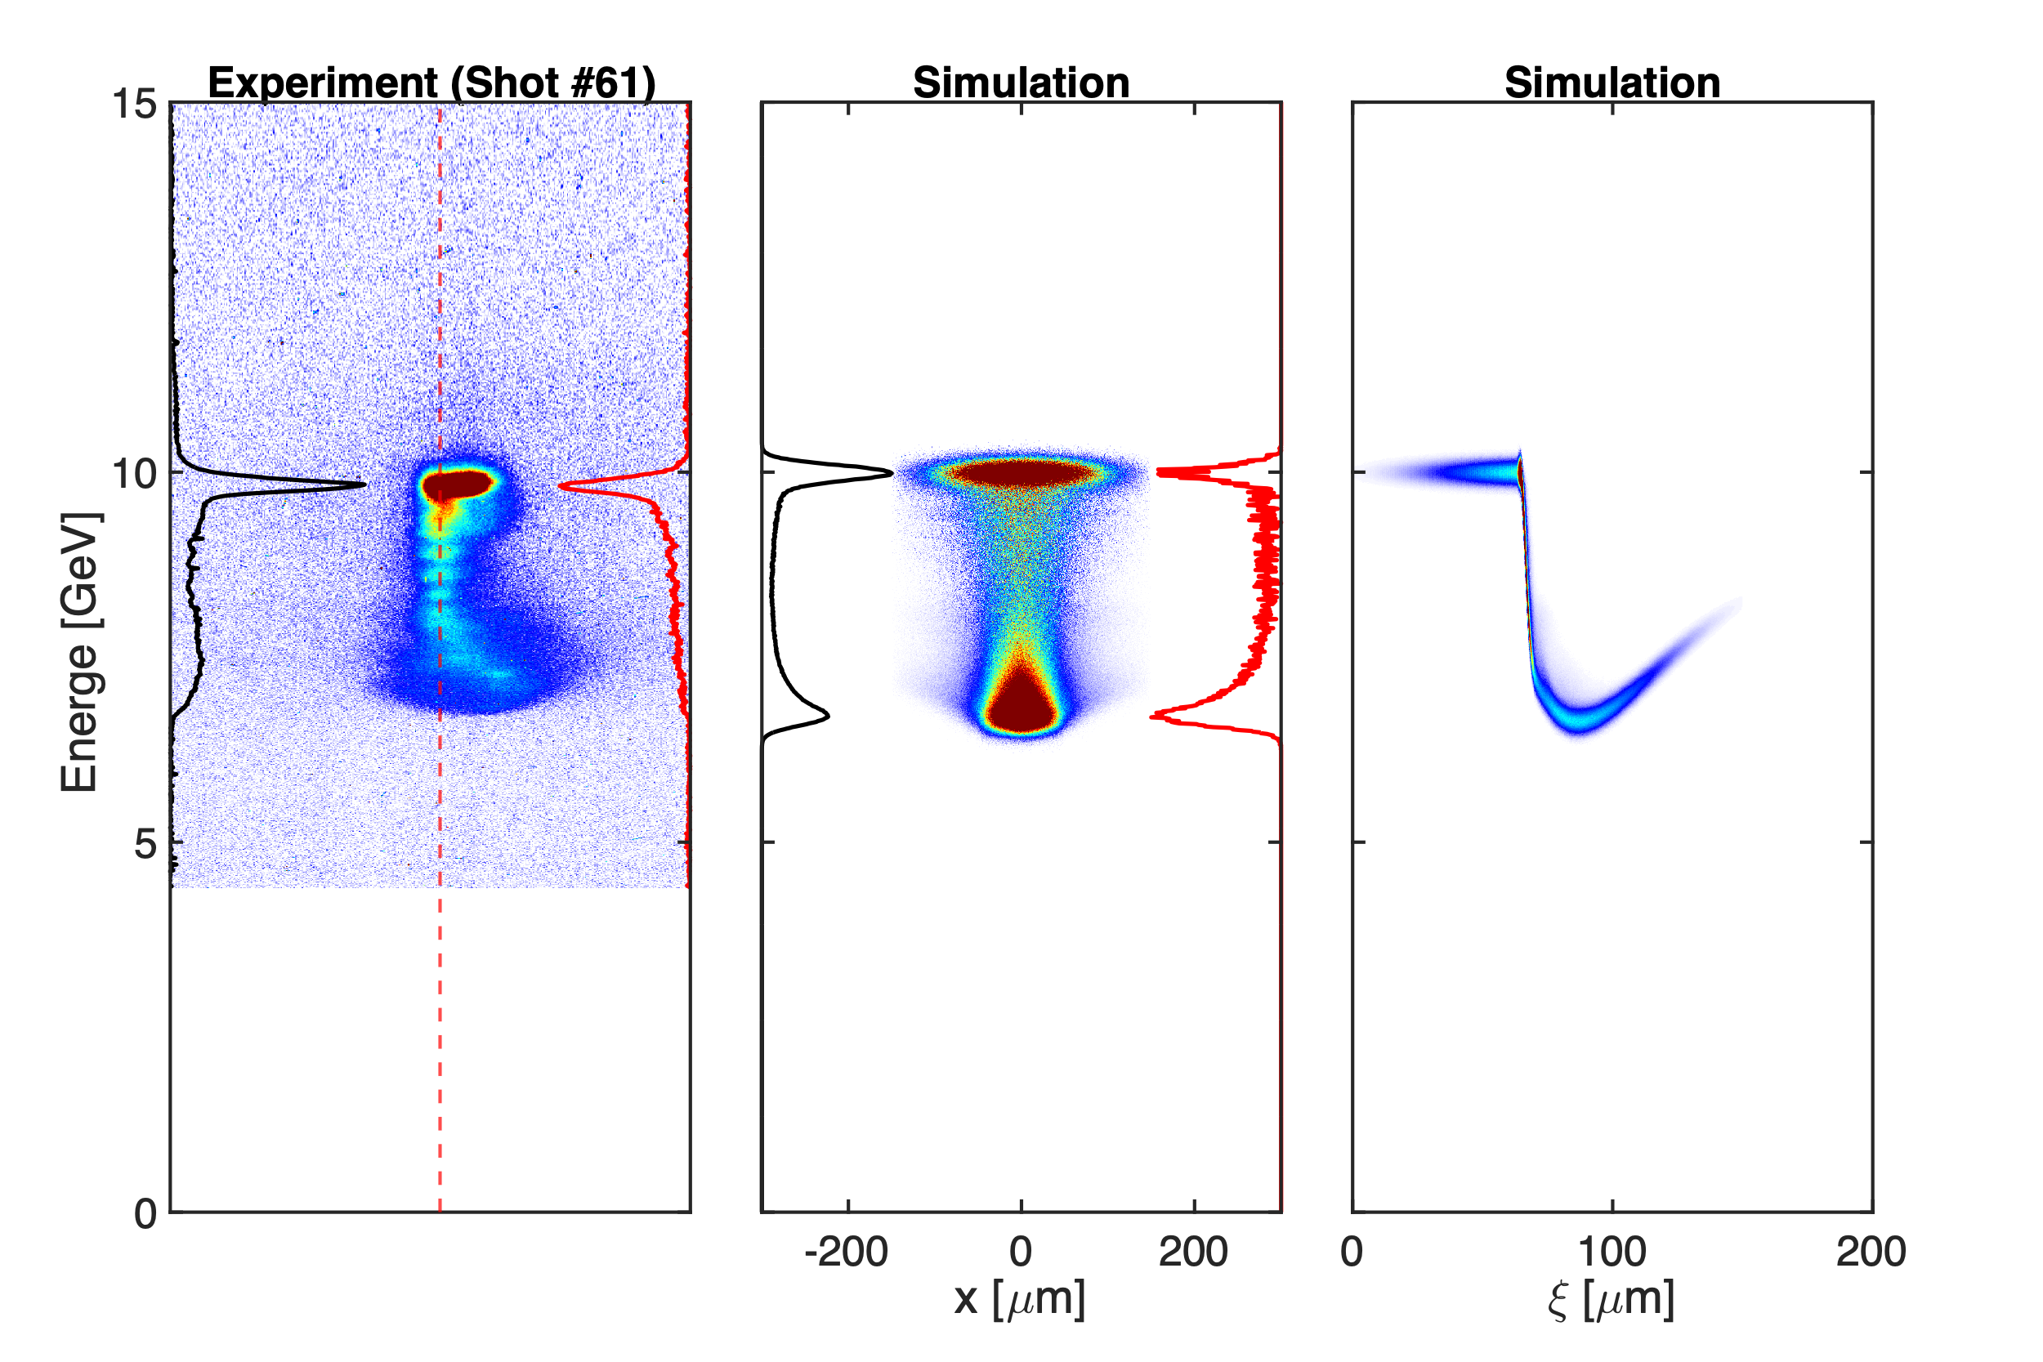
Compared with experiment (0.3 Torr H2)
E300_02789

Slide 19
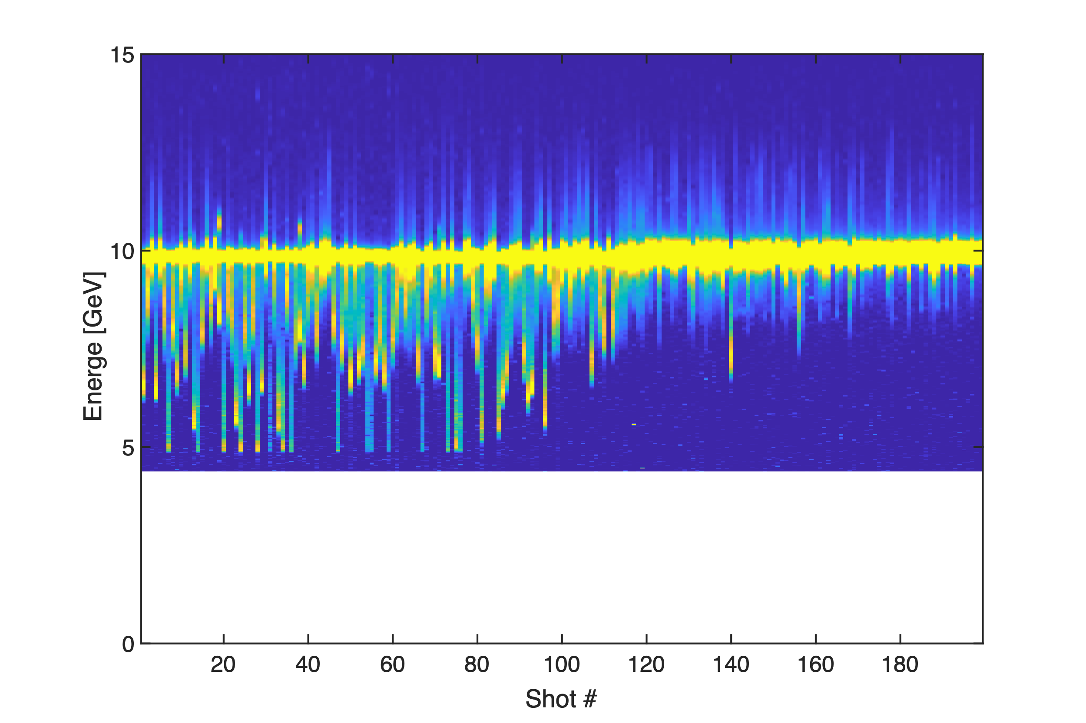
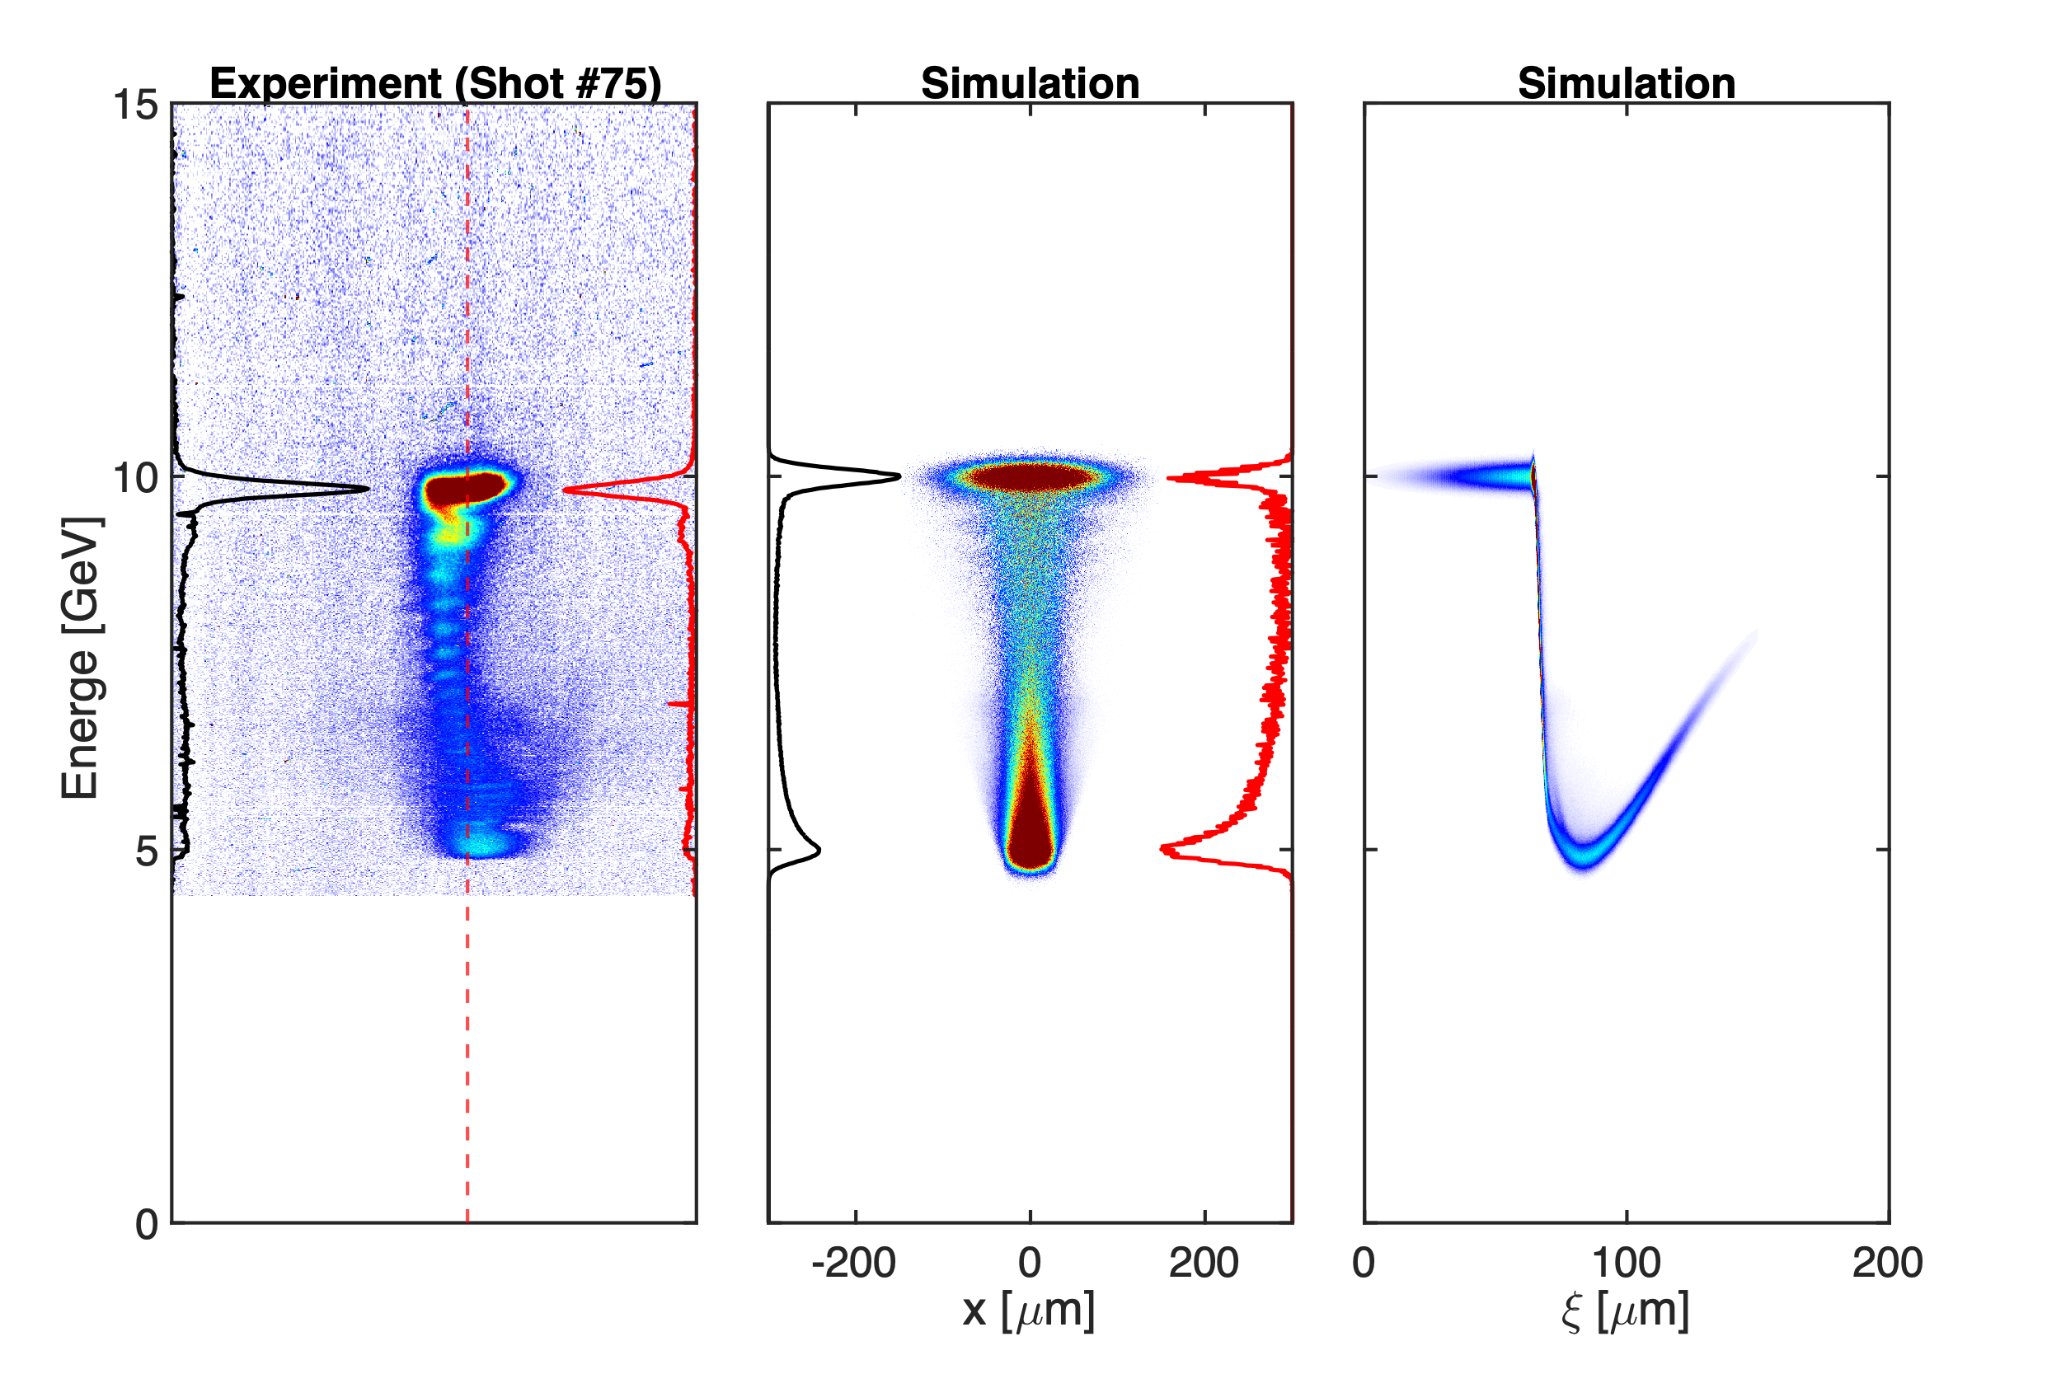
Compared with experiment (0.5 Torr H2)
E300_02799

Slide 20
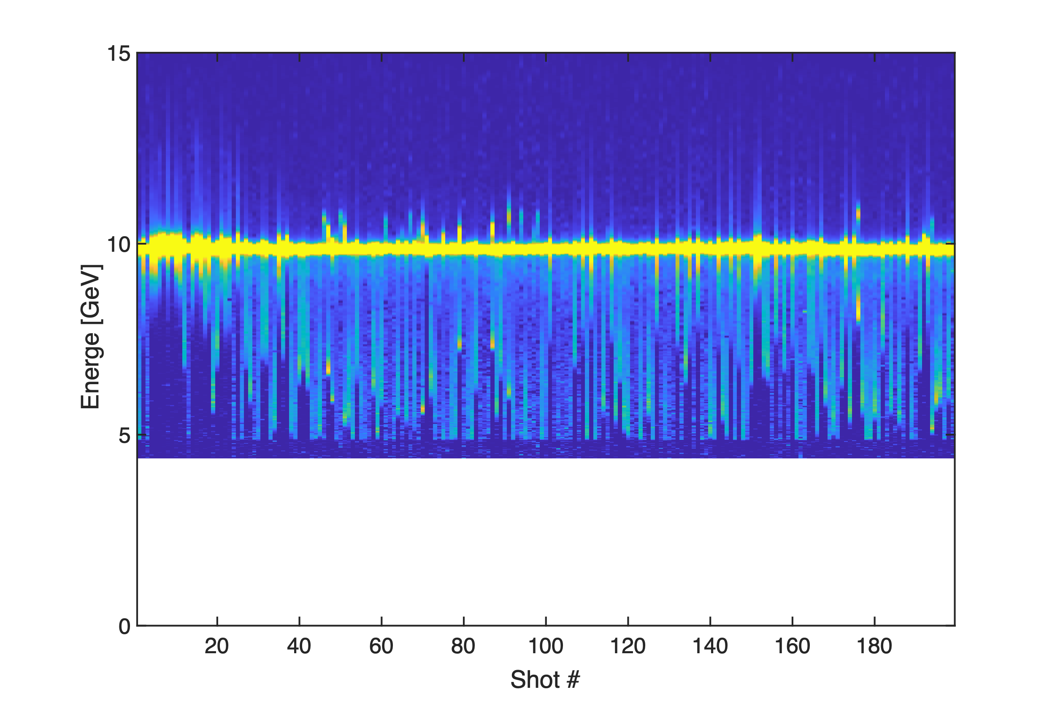
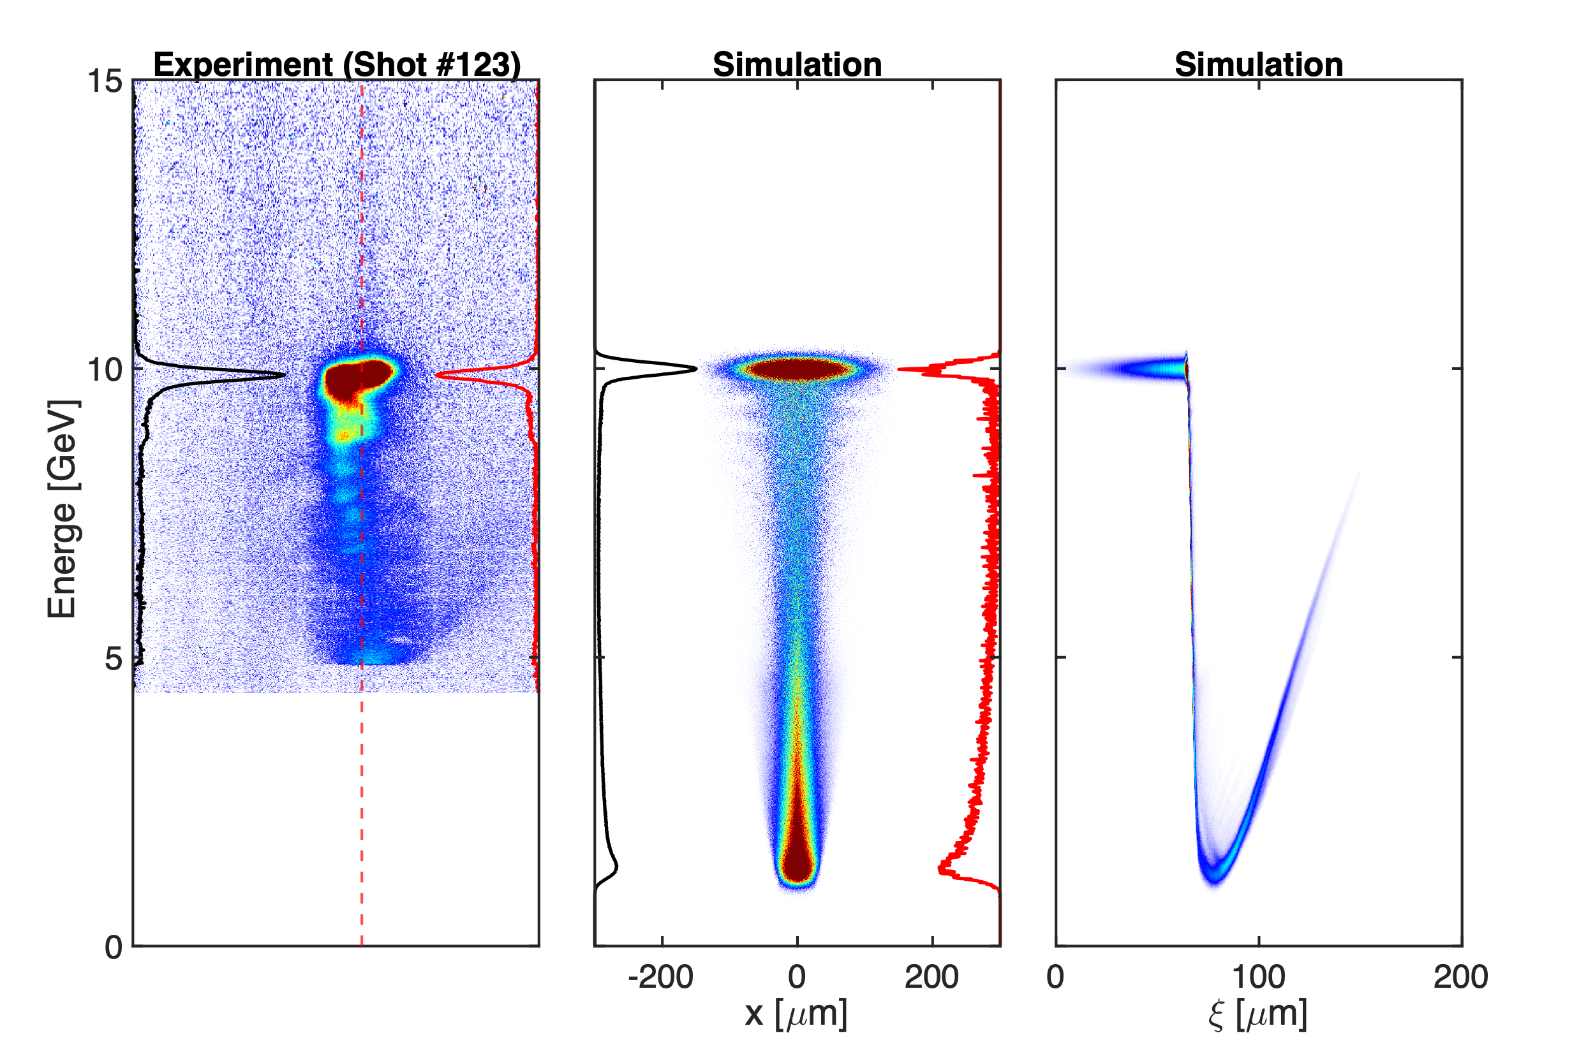
Compared with experiment (1.0 Torr H2)
E300_02801

Slide 21
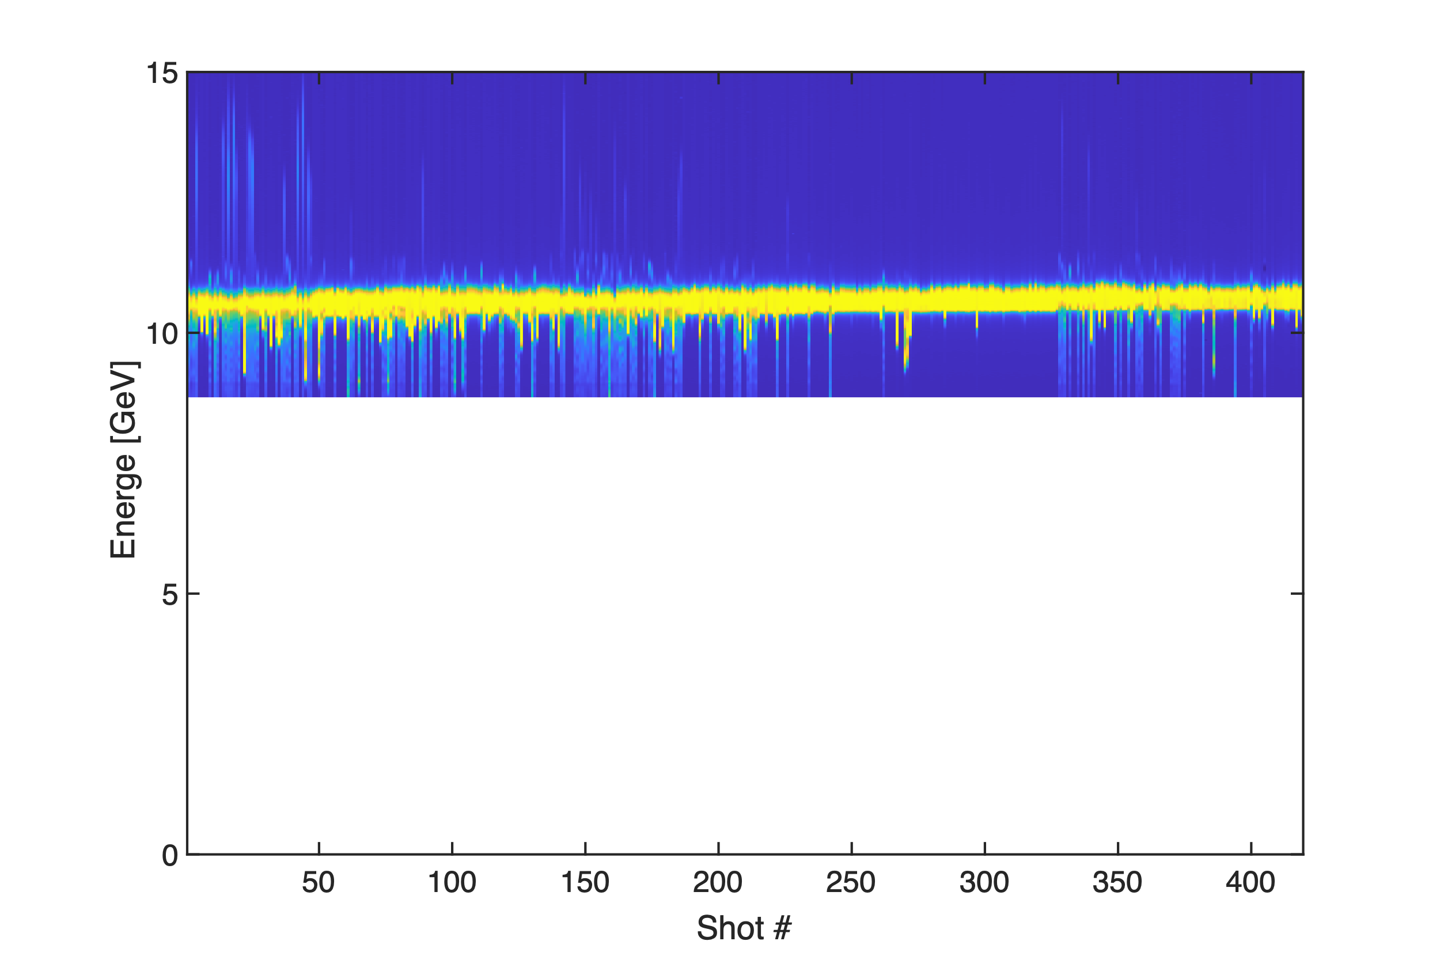
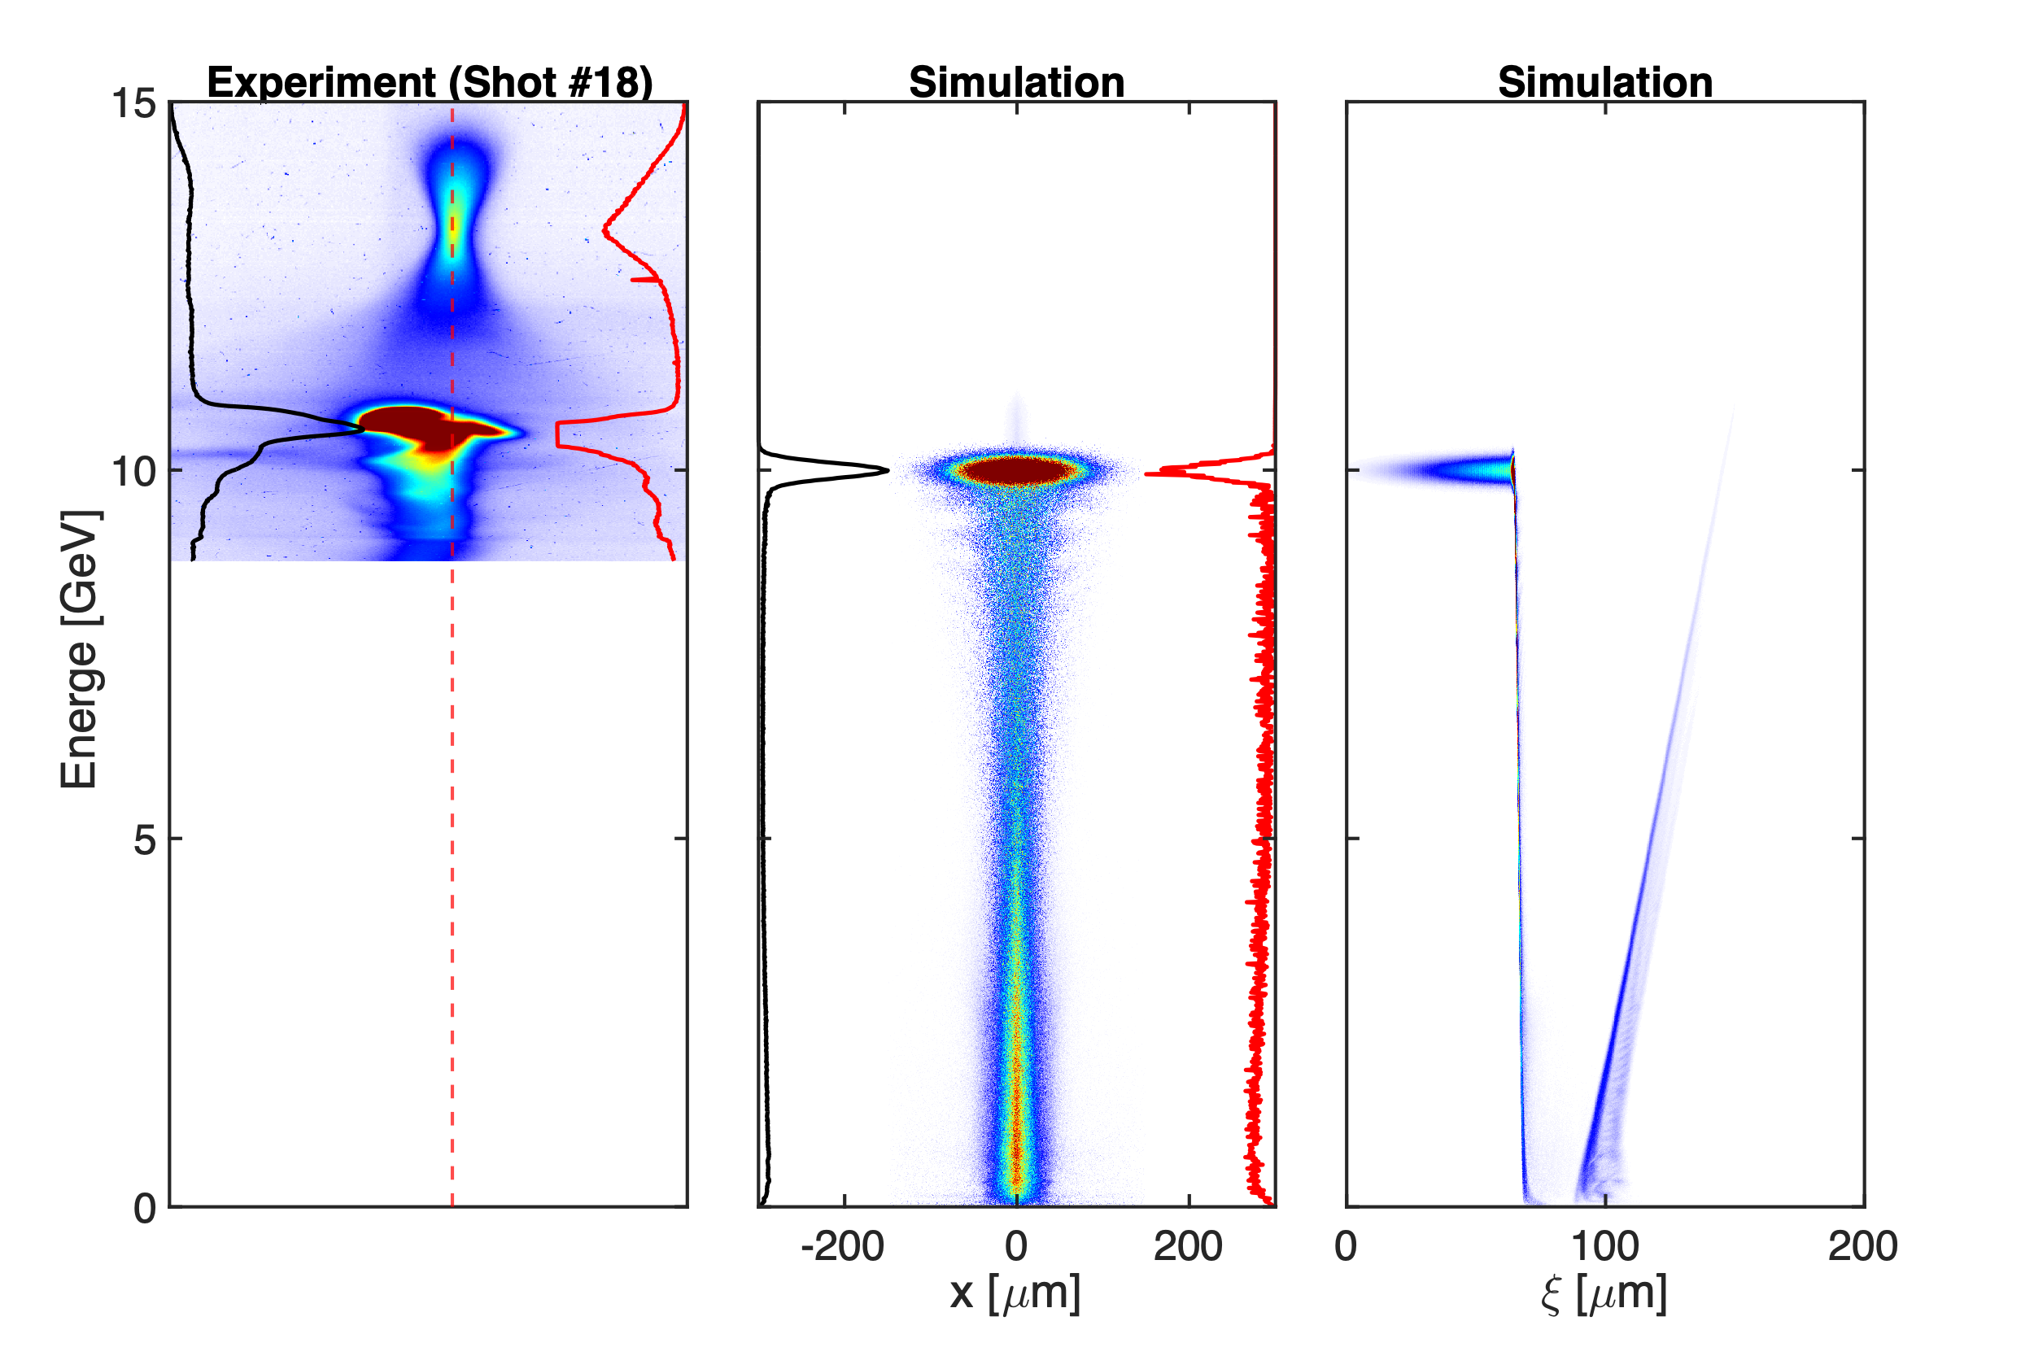
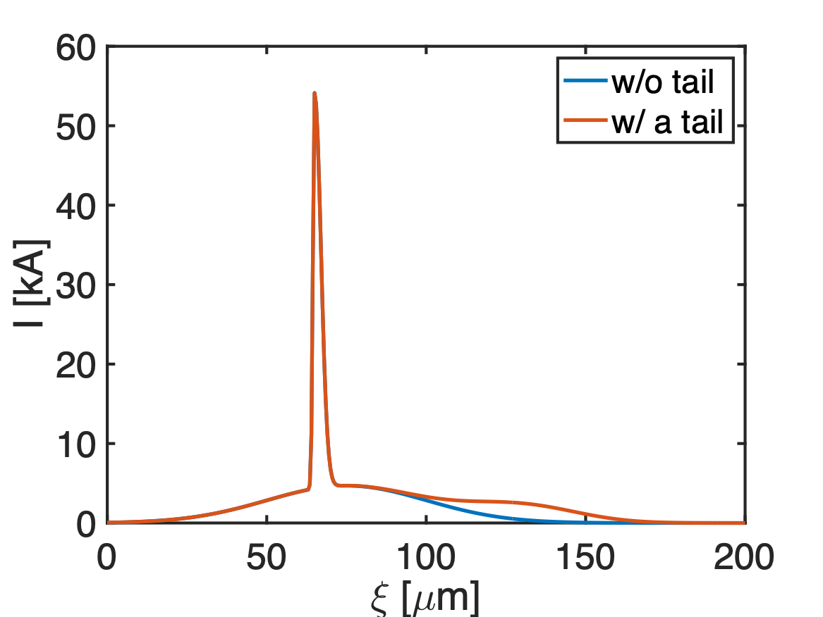
Compared with experiment (1.5 Torr H2)
w/o a tail
E300_02837

Slide 22
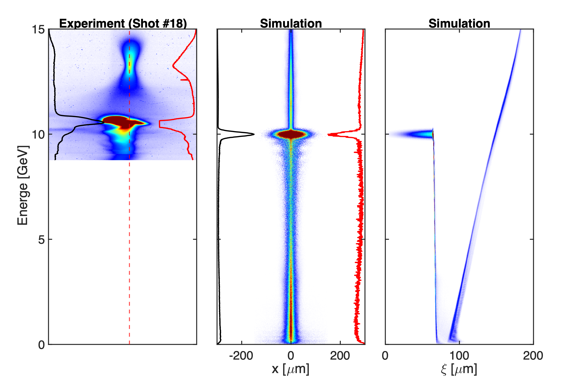
Compared with experiment (1.5 Torr H2)
w/ a tail
E300_02837

Slide 23
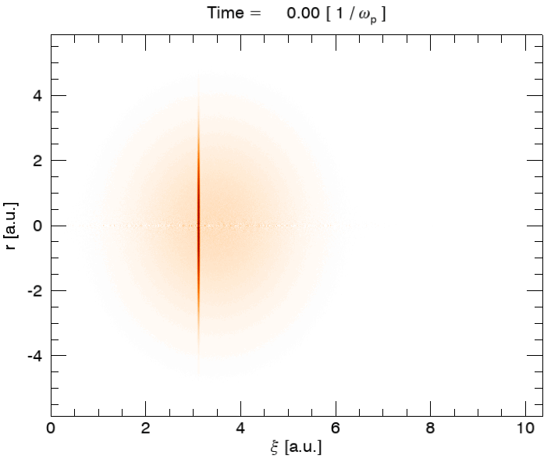
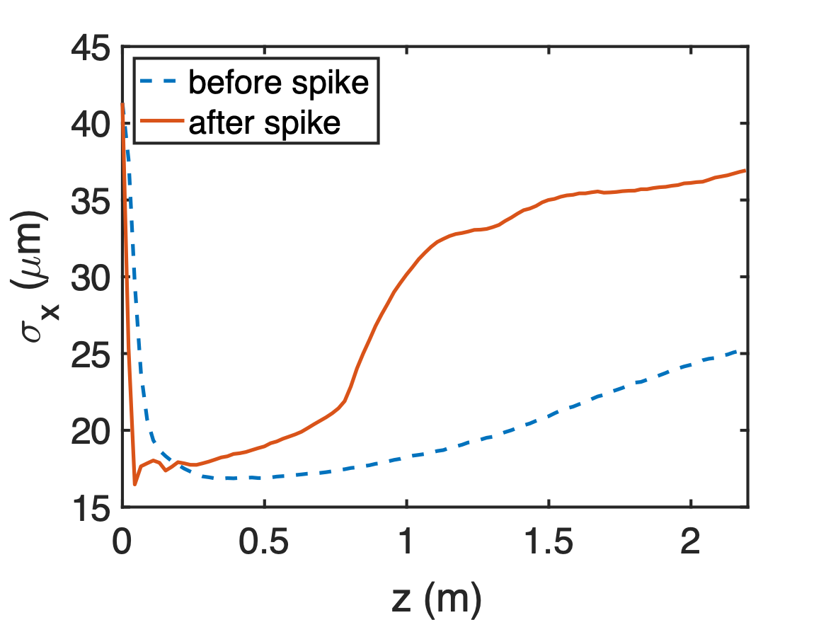
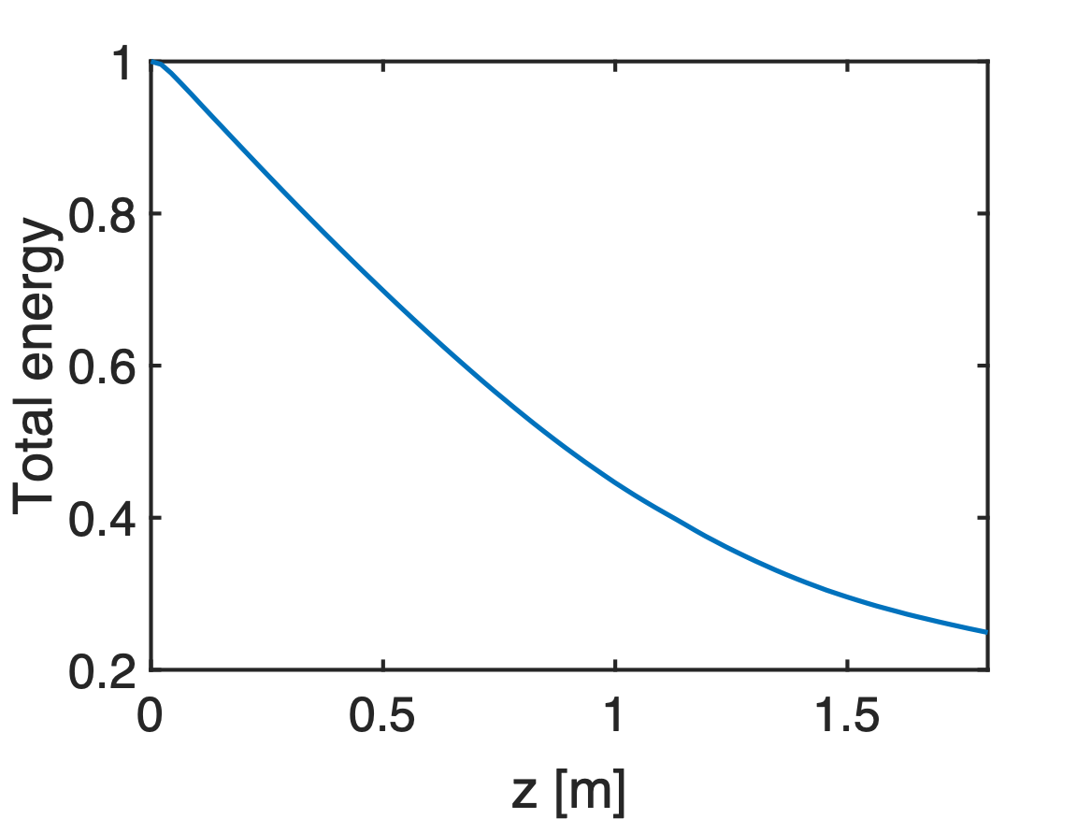
Pre-ionized case (1.7 Torr H2, 6⨉10¹⁶ cm⁻³)
~75% total energy loss

Slide 24
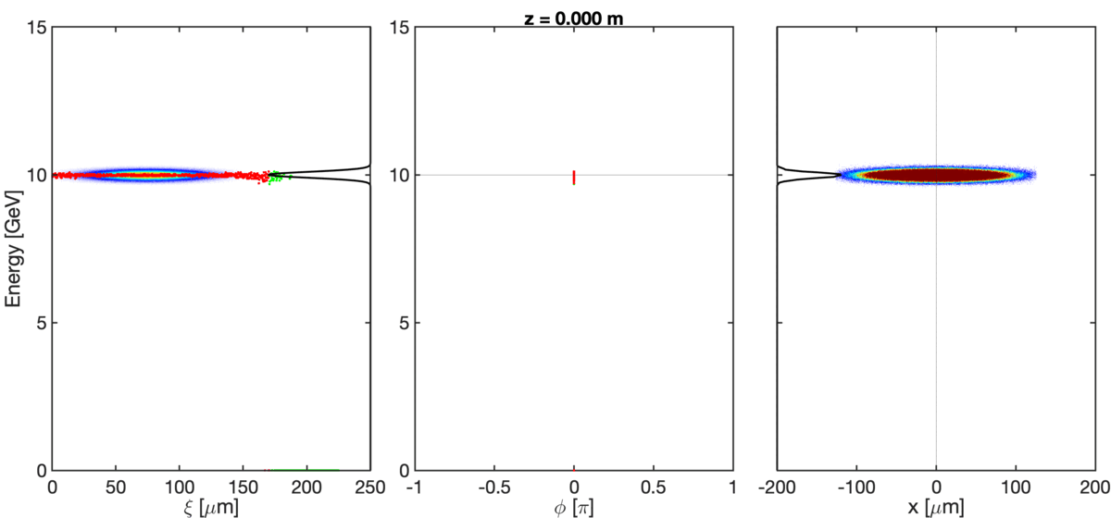
Pre-ionized case (1.7 Torr H2, 6⨉10¹⁶ cm⁻³)

Slide 25
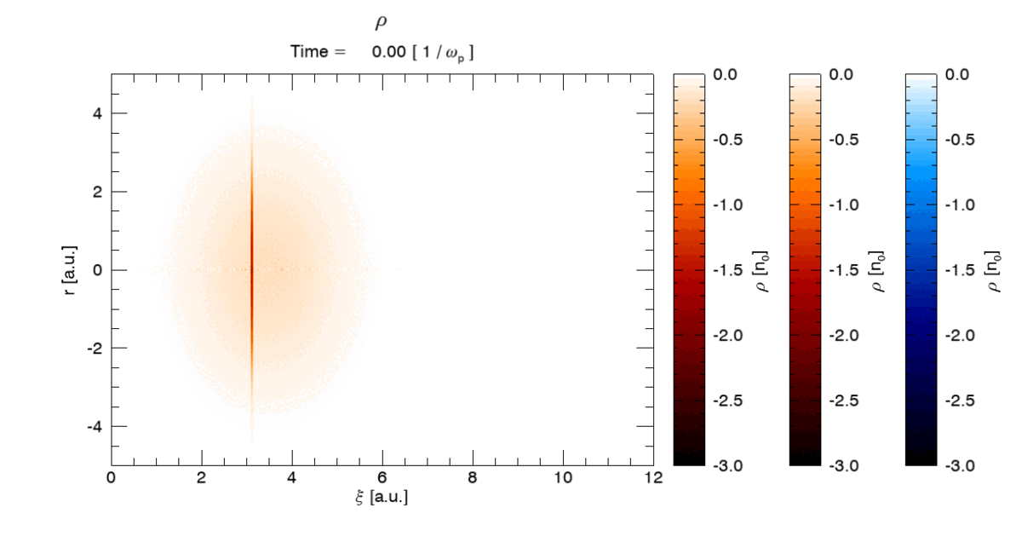
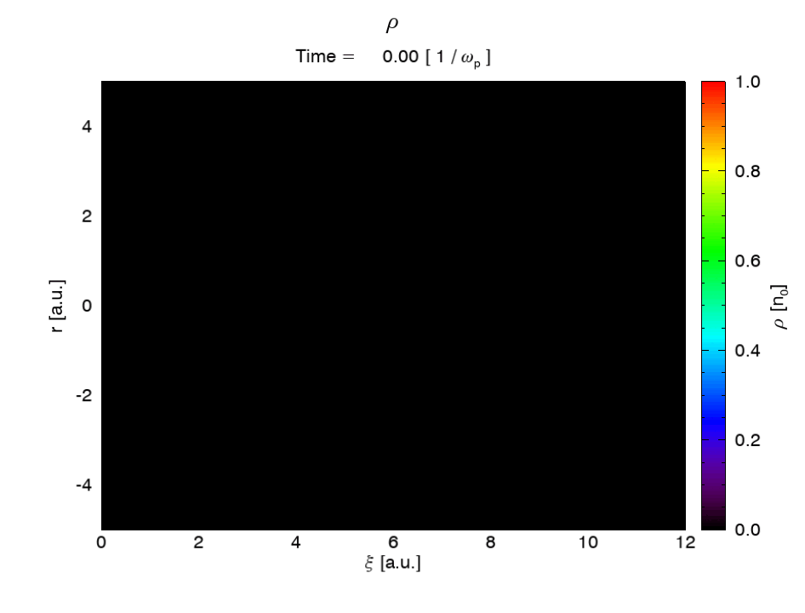
Beam-ionized case (1.7 Torr H2)

Slide 26
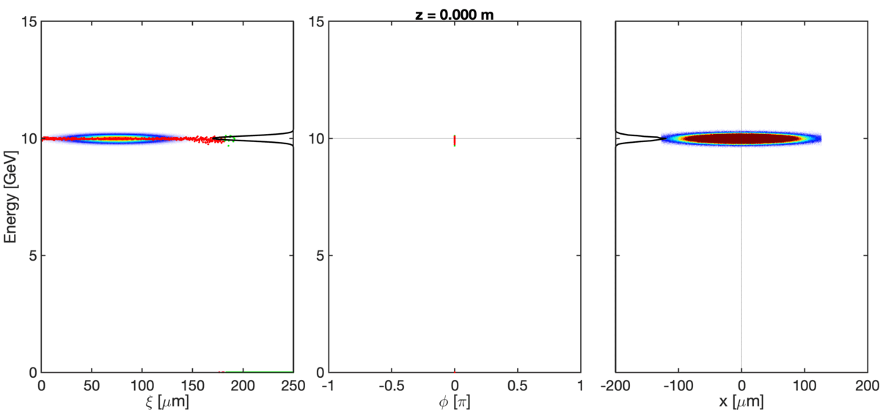
Beam-ionized case (1.7 Torr H2)

Slide 27
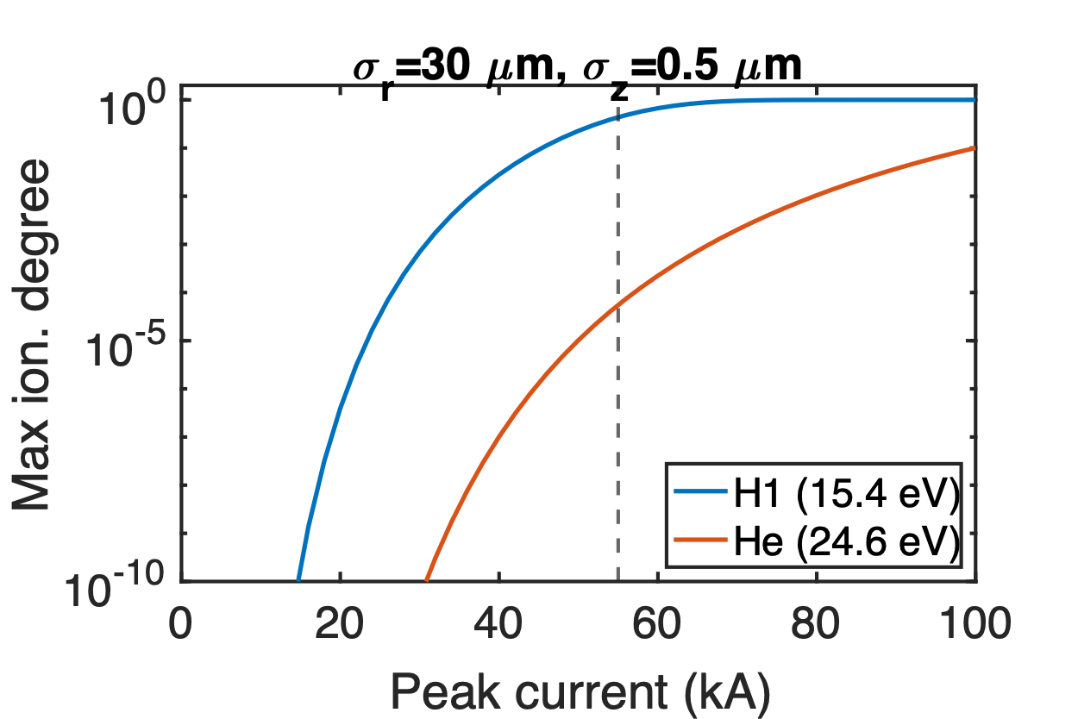
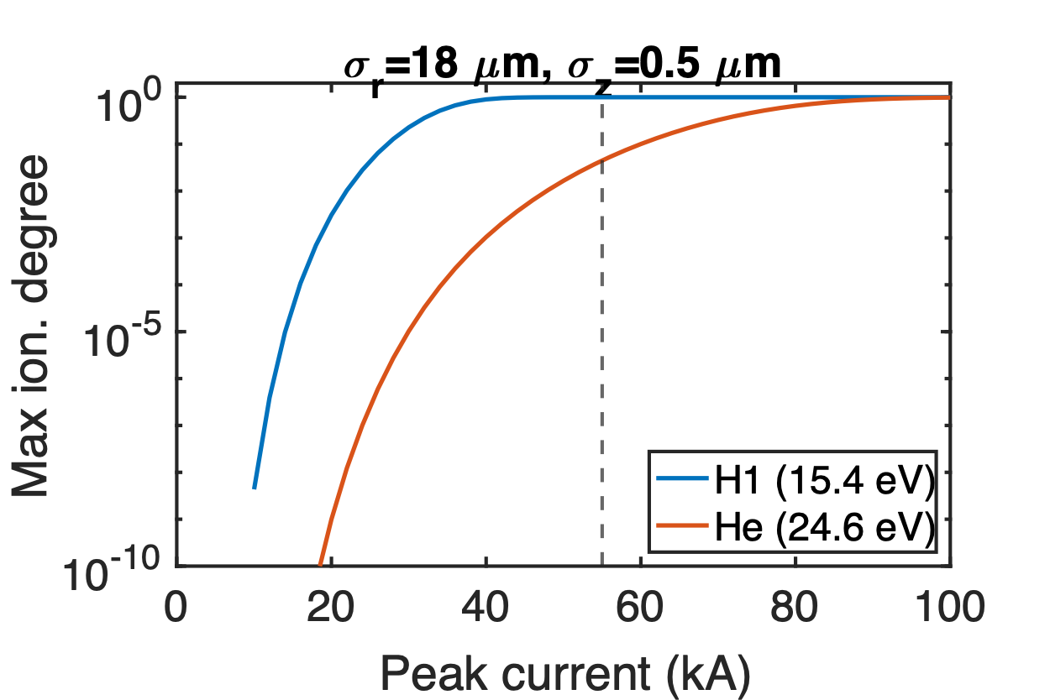
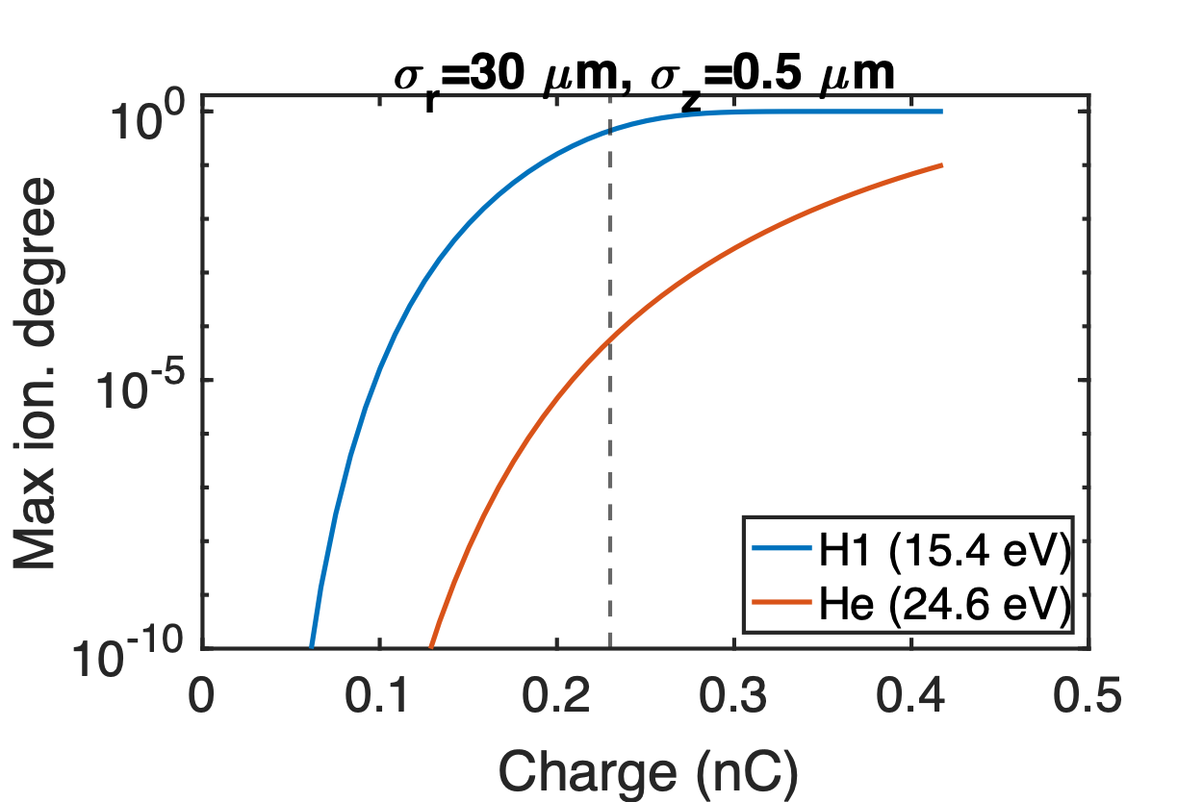
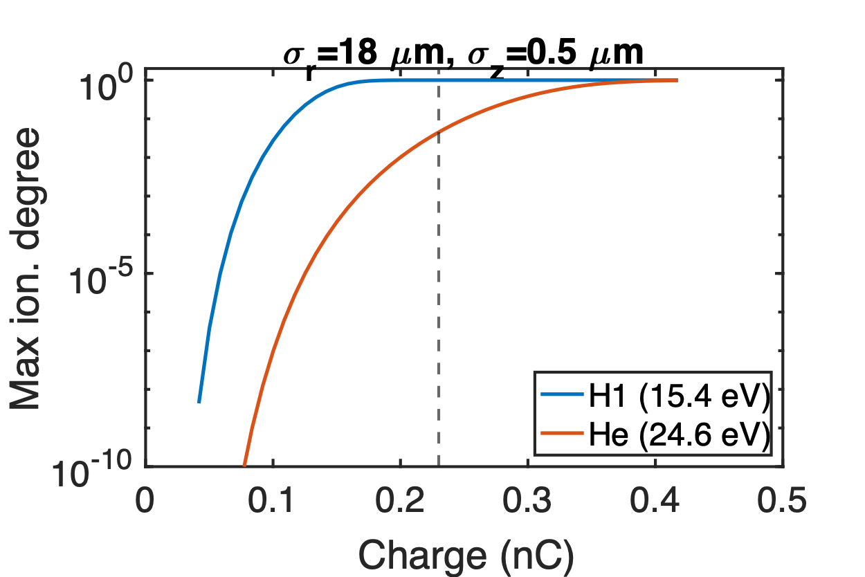
Beam ionization comparison of H2 and He
Suppose the spike has smaller beam size
5%
Emax=49.6 GV/m
55 kA
55 kA
Emax=82.7 GV/m
0.23 nC
0.23 nC

Slide 28
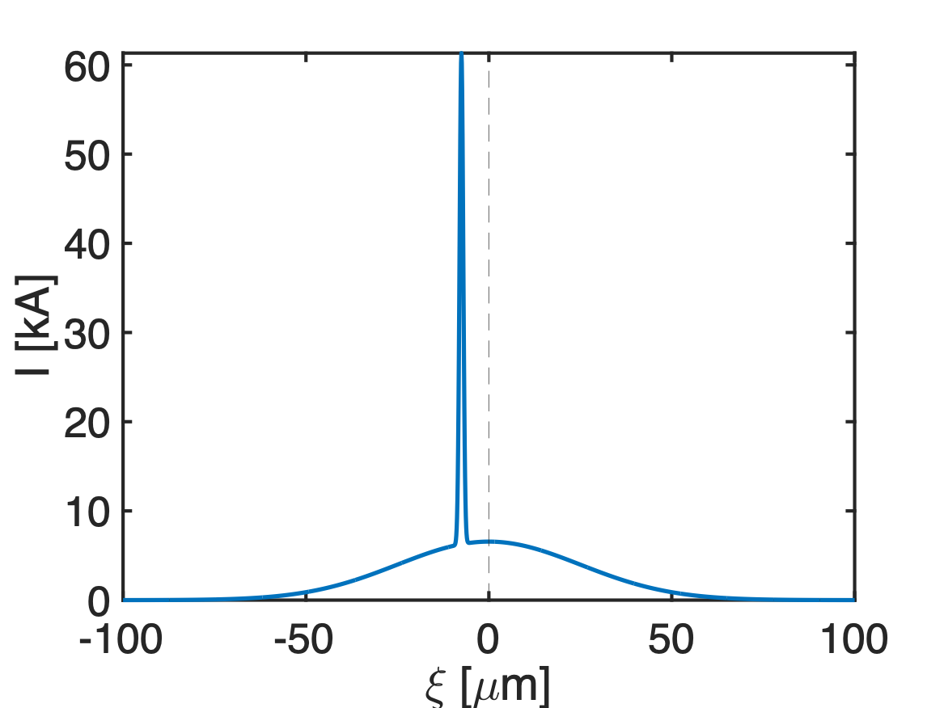
Modeled beam current profile for He case
Main bunch
Spike
Charge | 1.37 nC
Peak current | 6.6 kA
𝝈r | 30 𝜇m
𝝈z1 | 25 𝜇m
εN | 20 𝜇m
𝛽* | 0.88 m
Charge | 0.23 nC
Peak current | 55 kA
𝝈r | 18 𝜇m
𝝈z2 | 0.5 𝜇m
εN | 7.2 𝜇m
𝛽* | 0.88 m
0.3𝝈z1
~40% unaffected

Slide 29
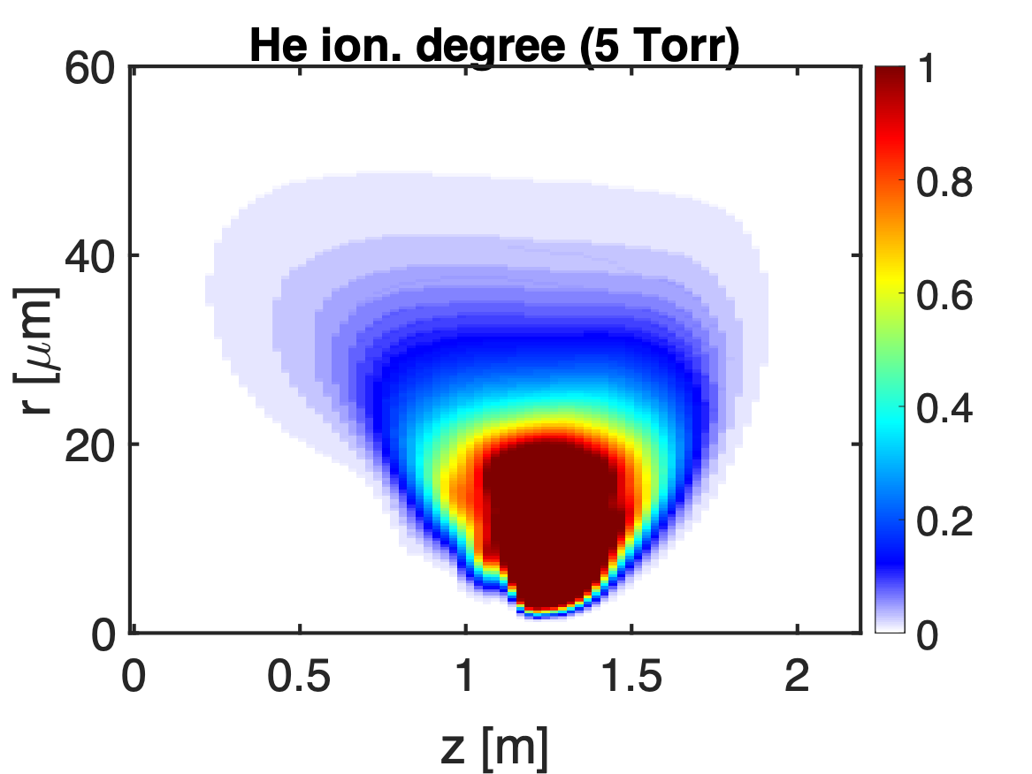
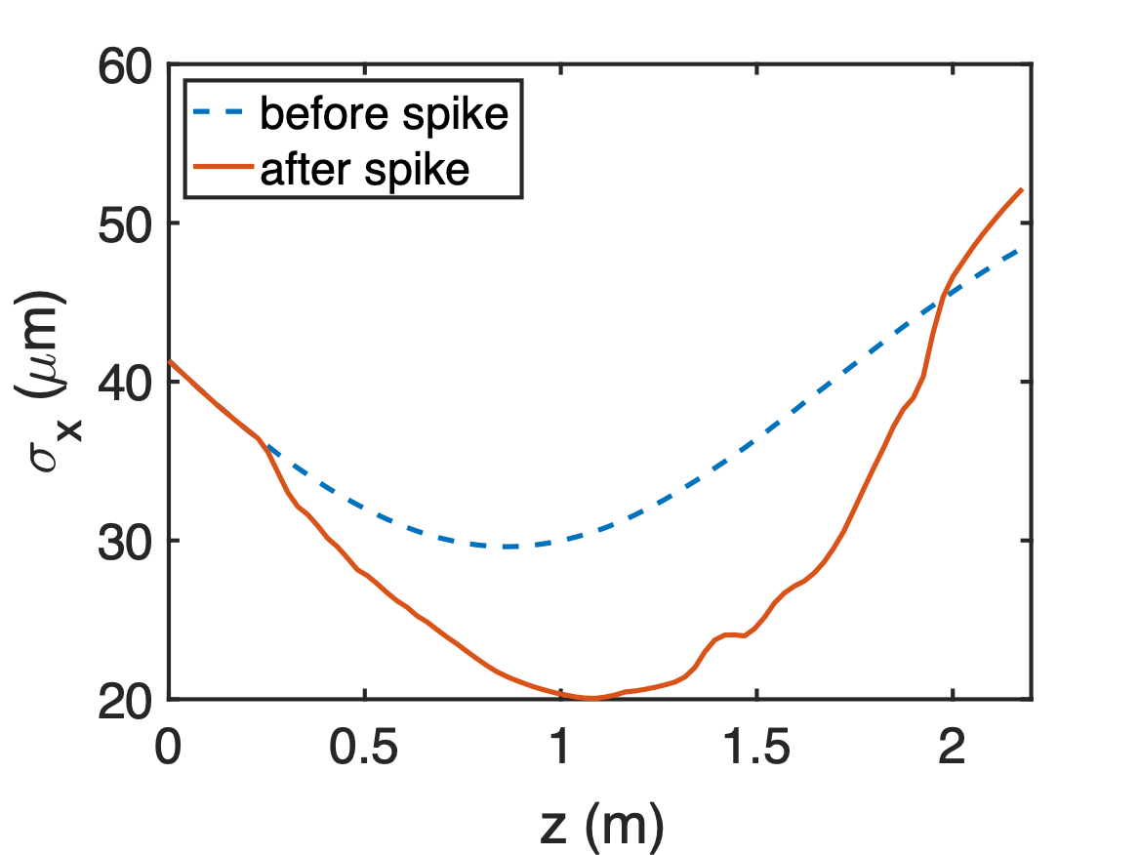
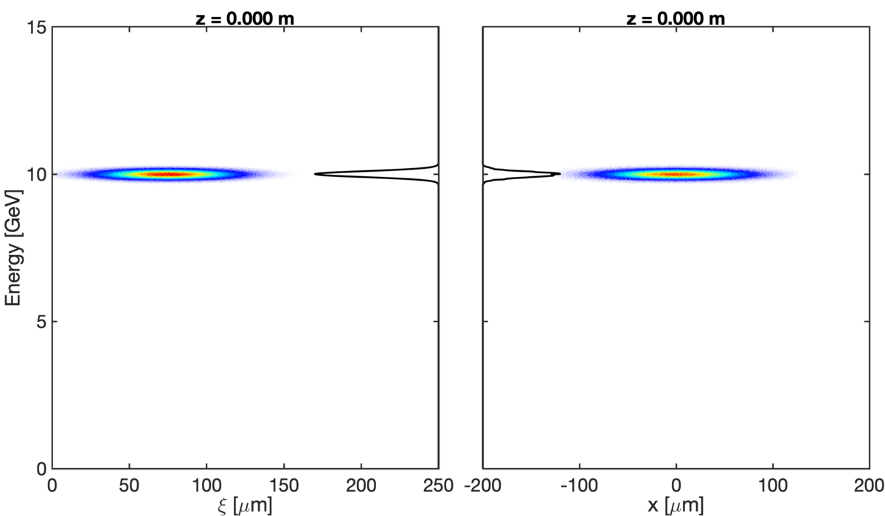
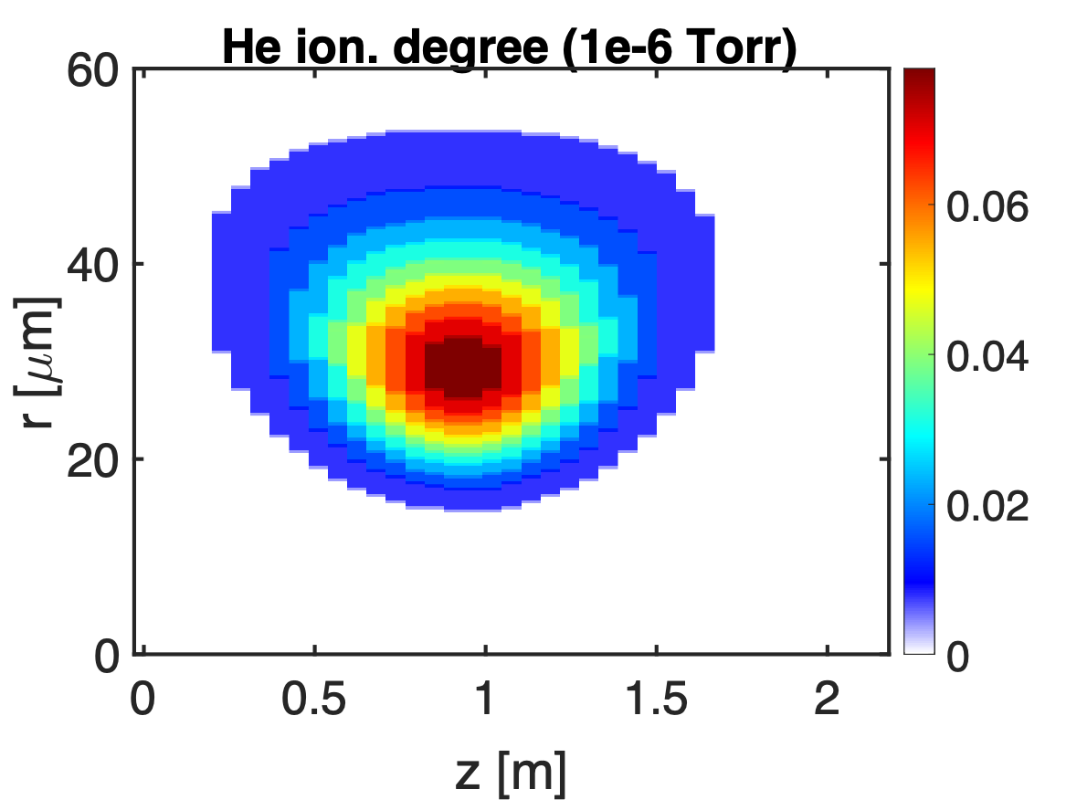
QPAD simulation: beam-ionized He case (5 Torr)

Slide 30
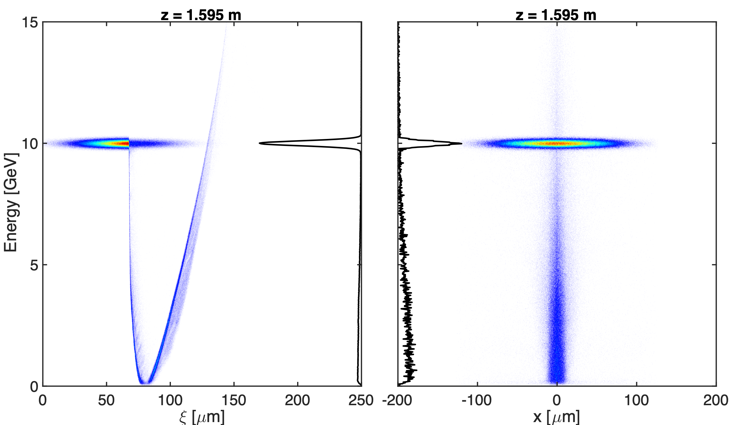
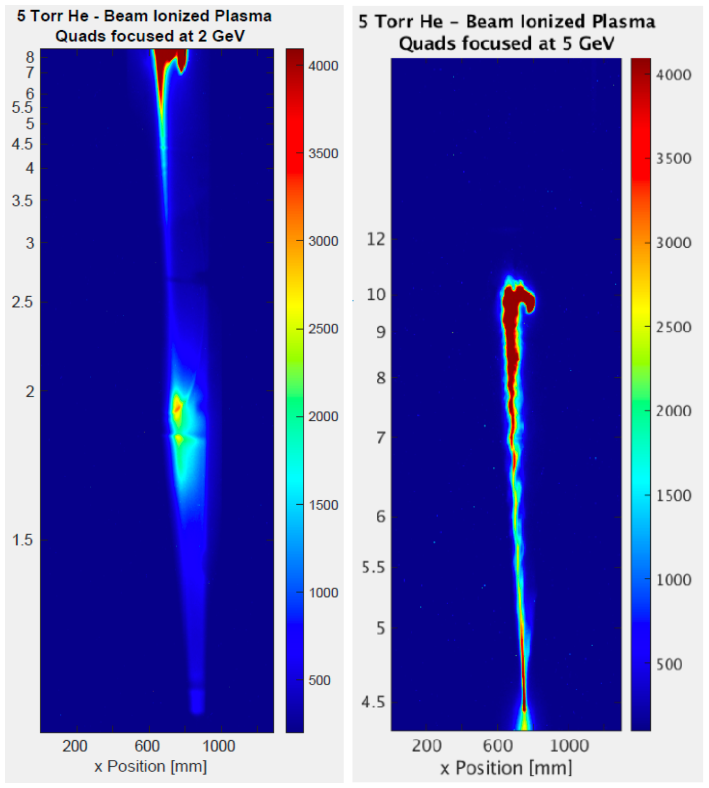
Comparison with experiment (5.0 Torr He)

Slide 31
Summary
>50 kA current spike is needed to fully ionize H2.
~30-40% of the beam was not losing any energy, however beam-to-wake energy transfer efficiency can approach ~70%.
The main bunch with a ultrashort spike reproduced the H2 results. To reproduce the He results, a spike with a smaller beam size was used.
Scallop due to betatron oscillations observed in experiments are also reproduced in simulations using a slightly longer spike (~2 𝜇m) or multiple spikes.
Beam ionization induced by spikes fluctuates shot-to-shot since the spike peak current and position might change. Pre-ionization capability will be helpful in the future run.

Slide 32
Back up

Slide 33
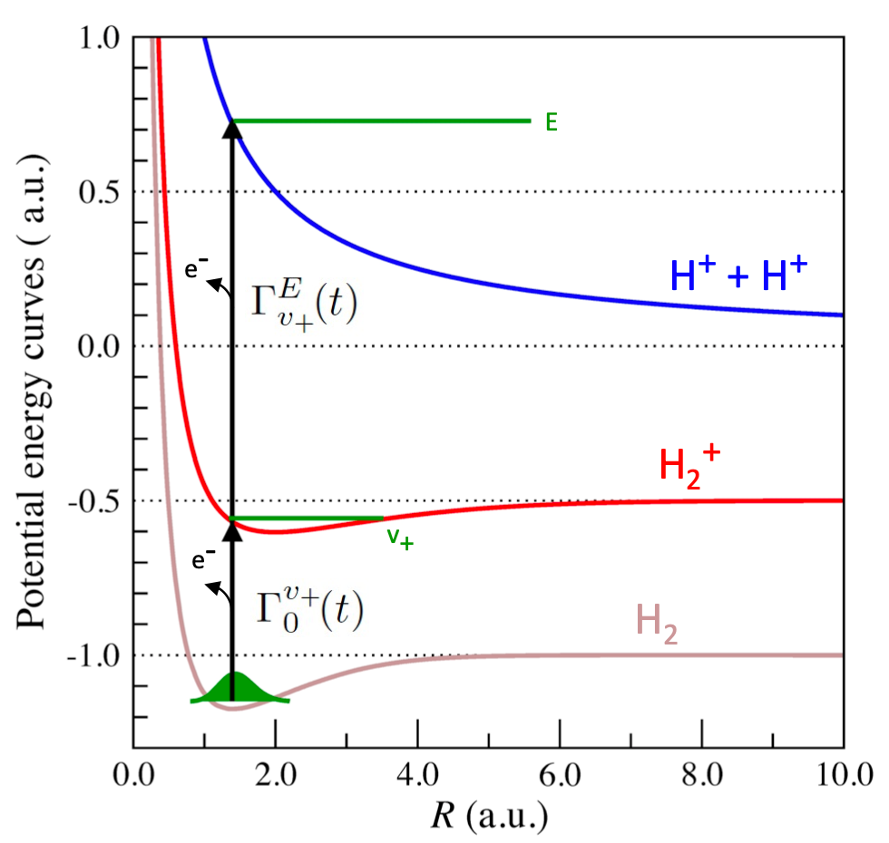
A recent paper on hydrogen ionization
Negligible ionization by Coulomb explosion when I < 3⨉10¹⁴ W/cm²
J-N. Vigneau, et al, arXiv:2209.10205

Slide 34
Modeled beam current profile 1
Main bunch
Spike
Charge | 1.37 nC
Peak current | 6.6 kA
𝝈r | 30 𝜇m
𝝈z1 | 25 𝜇m
εN | 20 𝜇m
𝛽* | 0.88 m
Charge | 0.23 nC
Peak current | 55 kA
𝝈r | 30 𝜇m
𝝈z2 | 0.5 𝜇m
εN | 20 𝜇m
𝛽* | 0.88 m
0.3𝝈z1
~40% unaffected

Slide 35
QPAD simulation: case 1 (1.7 Torr H2)

Slide 36
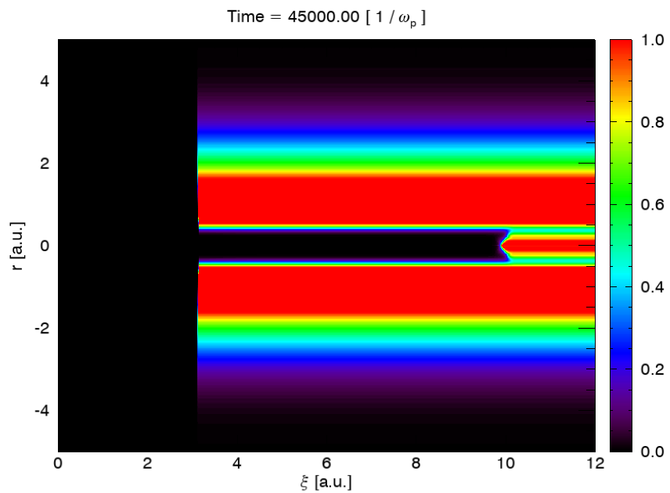
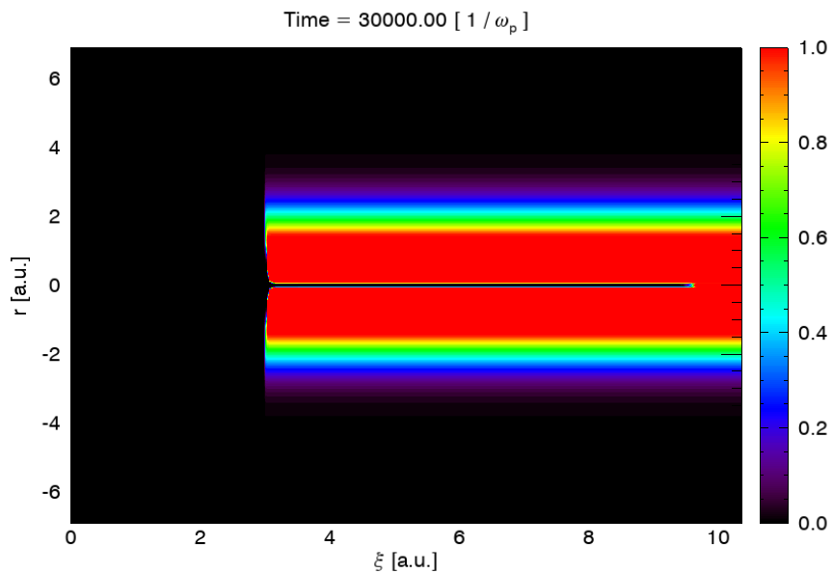
Comparison of two cases (1.7 Torr H2)
Case 1
Case 2

Slide 37
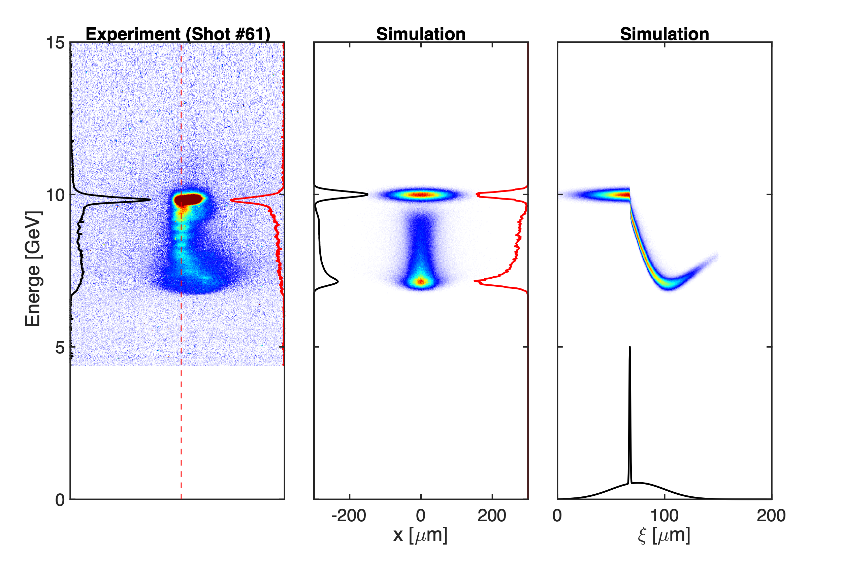
Comparison with experiment (0.3 Torr H2)
E300_02789

Slide 38
Comparison with experiment (0.5 Torr H2)
E300_02799

Slide 39
Comparison with experiment (1.0 Torr H2)
E300_02801

Slide 40
Comparison with experiment (1.8 Torr H2)
E300_02808

Slide 41
Comparison with experiment (1.5 Torr H2)
E300_02837

Slide 42
1e-6 Torr H2

Slide 43
0.08 Torr H2

Slide 44
0.3 Torr H2

Slide 45
0.5 Torr H2

Slide 46
1.0 Torr H2

Slide 47
1.7 Torr H2

Slide 48
QPAD simulation: beam-ionized He case (5 Torr)

