Slide 1
Emittance preservation in a single PWFA-LC stage using adiabatic plasma density ramp matching sections in the presence of ion motion
Yujian Zhao¹, F. Li¹, X. Xu², W. An³, L. Hildebrand¹, W. B. Mori¹
¹University of California, Los Angeles, CA, USA
²SLAC National Accelerator Laboratory, CA, USA
³Beijing Normal University, China
Work supported by :
DOE HEP DE-SC0010064
DOE SciDAC under a FNAL subcontract 644405
NSF 2108970
Notes:
Hello everyone, my name is Yujian, I am a graduate student at UCLA. Today I am gonna talk about xxxxx

Slide 2
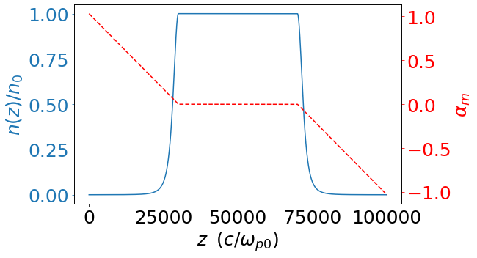
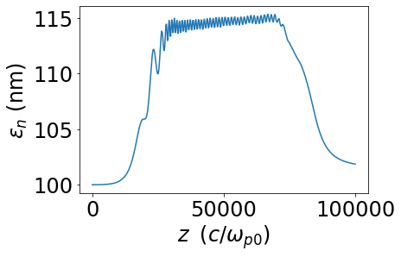
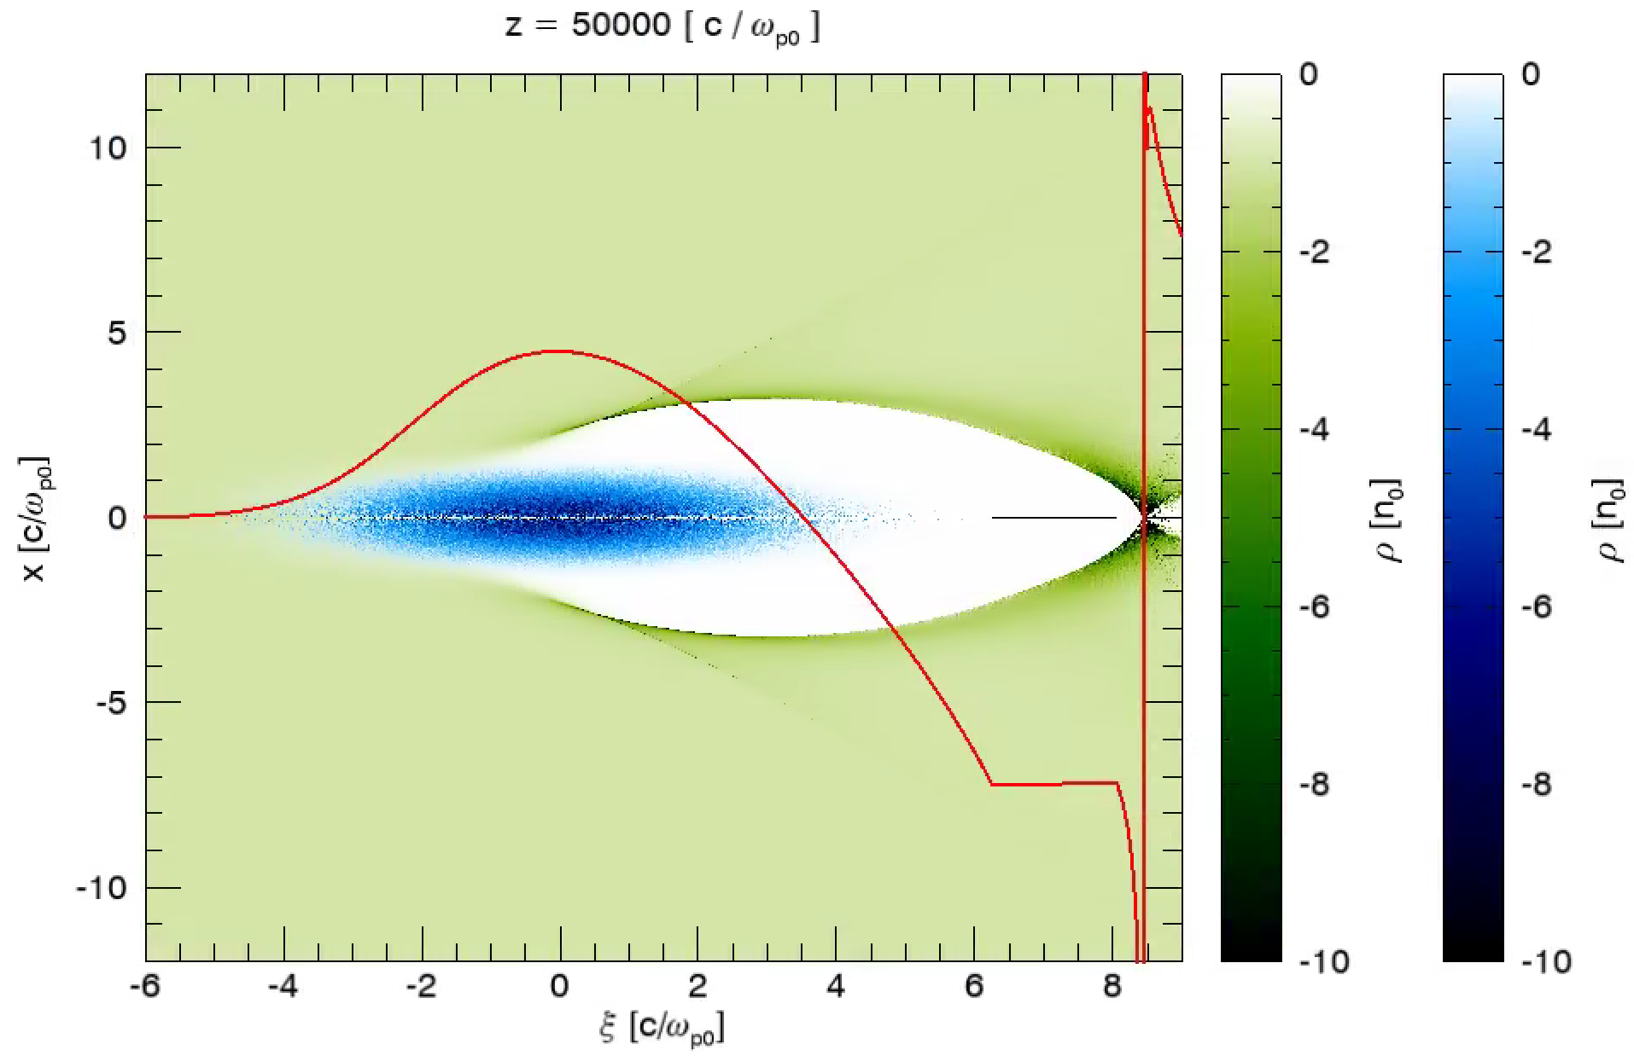
Only 2% emittance growth in a PWFA-LC stage!
$$n_{0}={10}^{17}cm^{−3}$$
Drive beam:
25GeV, Q = 4.8nC, $σ_{r}=10μm, σ_{z}=30μm.\frac{n_{b0}}{n_{0}}=6$, non-evolving.
Witness beam:
25GeV, Q = 1.6nC ($I_{head}=25.26 kA, I_{tail}=6.42 kA, L=30μm)$
$ε_{n}=100$ nm.
QPAD simulation: $Δr=5×{10}^{−4} c/ω_{p0} (8.4 nm)$. 24000 cells.
$Δξ=0.01c/ω_{p0} (170 nm)\text{.}$ 1500 cells. m=0 mode. $3×{10}^{4}$ core hours.
$$1.7 m$$
$$\frac{{eE}_{z,dec}}{mcω_{p0}}=0.75$$
25GeV → 50GeV
$σ_{γ}/\overline{γ}$ : 0 → 0.1%
2% growth
$$\frac{{eE}_{z,acc}}{mcω_{p0}}=−1.2$$
M. Tzoufras et al., PRL 101, 145002 (2008)
T. N. Dalichaouch et al., POP, 28, 063103 (2021)
F. Li et al., Comput. Phys. Comm. 261, 107784 (2021)

Slide 3
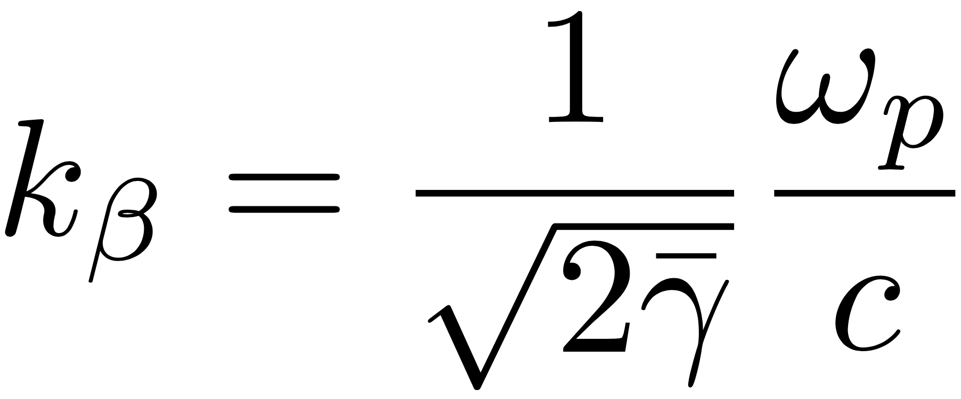
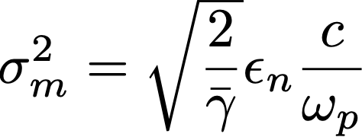
Emittance preservation: Matching
Preserving witness beam’s emittance is critical
Matching is critical to preserve the emittance.
Matching condition in a uniform plasma:
matched
unmatched

Slide 4
Matching condition in non-uniform plasma
For non-uniform plasma:
Adiabaticity parameter
Adiabatic condition
K. Floettmann et al., PRSTAB, 17, 054402 (2014)
R. Ariniello et al., PRAB, 22, 041304 (2019)
Y. Zhao et al., PRAB, 23, 011302 (2020)
Notes:
The matching condition for a non-uniform plasma can be generalized in a straight forward way. For the plasma frequency in these expressions, we just need to use the plasma frequency corresponding to the local plasma density. A small difference from the matching condition in a uniform plasma is that the matched Twiss parameter alpha is no longer zero. Instead, it is defined self consistently to be minus one half d beta_m dz.
It turns out that absolute value of this alpha_m is the adiabatic parameter, which describes how fast the plasma density changes for this particular beam. If the adiabatic factor is much smaller than 1, which is called the adiabatic condition, then the beam will feel the plasma density is changing very slowly.
Now that we know what an adiabatic plasma ramp is, let me introduce the problem of ion motion.

Slide 5
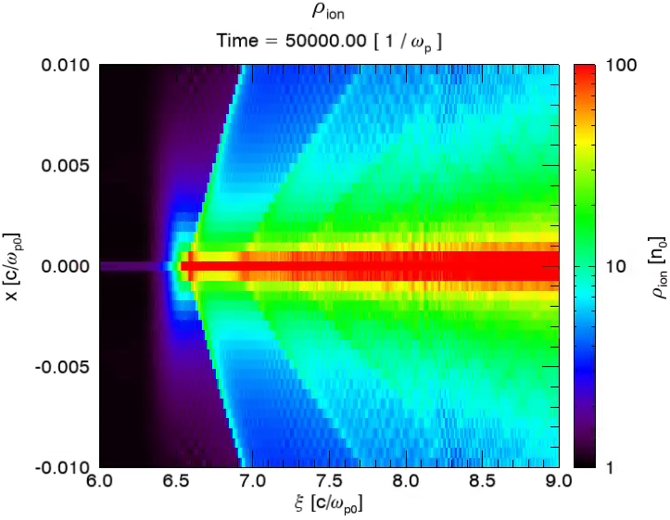
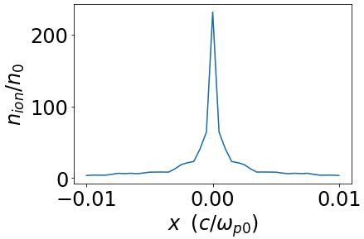
Ion motion
In the beam’s co-moving frame
Ion motion parameter:
$Φ_{b}∼1$: Ion motion regime
Slice dependent non-linear $F_{r}$ → $ε_{n}$ growth
$$ξ=ct−z$$
$$Γ=\frac{π}{2}$$
J. B. Rosenzweig et al., PRL 95, 195002 (2005)
S. Lee, T. Katsouleas, AIP Conference Proceedings 472, 524 (1999)
Notes:
A lot of times when we analyze problems about plasma, we often assume the ions are immobile because the ions are much heavier than the electrons. However, in PWFA, when the witness beam’a parameters approaches linear collider parameters, this assumption is not valid anymore. In other words, during the time when the witness beam passes by. the phase advance of ions are no longer negligible. To see this, let’s take a look at a cartoon. For simplicity, let’s say our witness beam is just a uniform cylinder, propagating to the left. And we are going to observe how ions respond to the witness beam in the beam’s co-moving frame.
Let’s consider two ions that are initially located inside the witness beam. Due to the electric field produced by the witness beam, the ions will be sucked in, following a simple harmonic oscillation. Finally they collapse on the axis. In this process, the phase advance of the ions are pi / 2.
To characterize how severe the ion motion is, we introduce an ion motion parameter Gamma, which is nothing but the phase advance of an ion assuming a simple harmonic oscillator model when the beam passes by. The Lb in the expression is just the length of the beam.
We know that then Gamma is around 1, the phase advance of an ion is no longer negligible, so ion motion is an issue.
Let’s take a look at an ion that is initially outside of the beam. It will be sucked in due to the electric field produced by the witness beam, but it will not follow a simple harmonic oscillation.
Due to the ion motion, the focusing force will be non-linear and slice dependent, which causes the emittance to grow.
So a natural question to ask is: How can we mitigate this emittance growth due to the ion motion?
Xi = 7.5

Slide 6
QuickPIC with Azimuthal Decomposition: QPAD
High $γ$ and low $ε_{n}$ makes the $σ_{m}$ tiny: ${10}^{−2}\sim {10}^{−3}c/ω_{p0}$
Simulation box: $10 c/ω_{p0}$
Requires high resolution to resolve $σ_{m}$,
not to mention the narrower ion collapse
QPAD makes it possible. Only m=0 mode. $3×{10}^{4}$ core hours.
F. Li et al., Comput. Phys. Comm. 261, 107784 (2021)

Slide 7
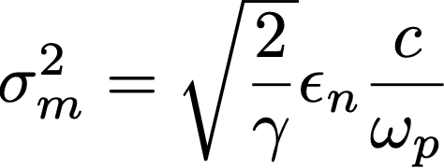
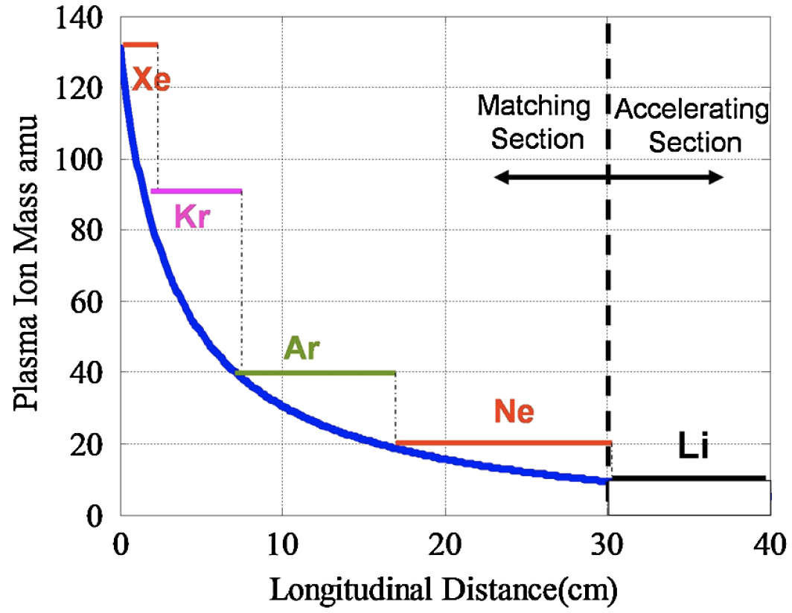
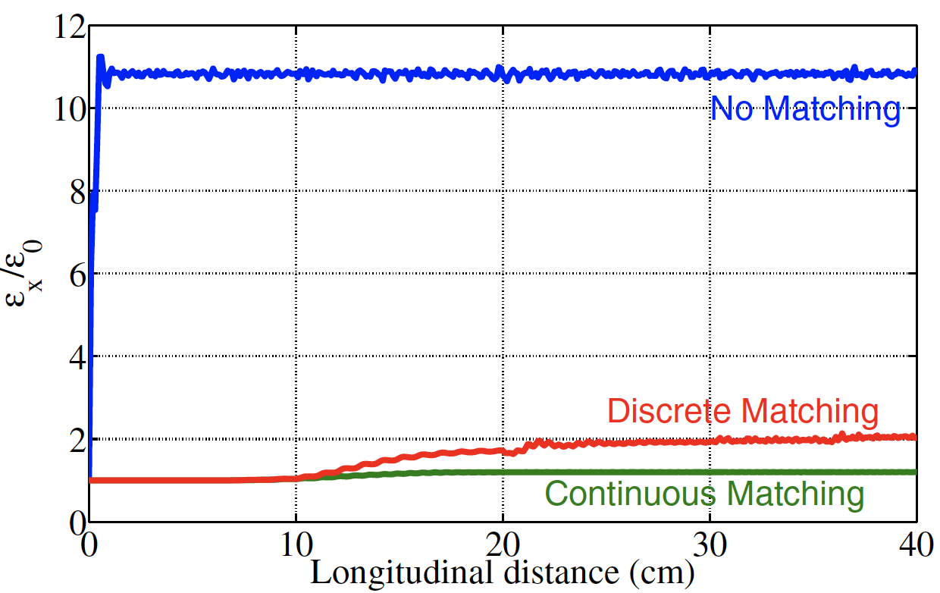
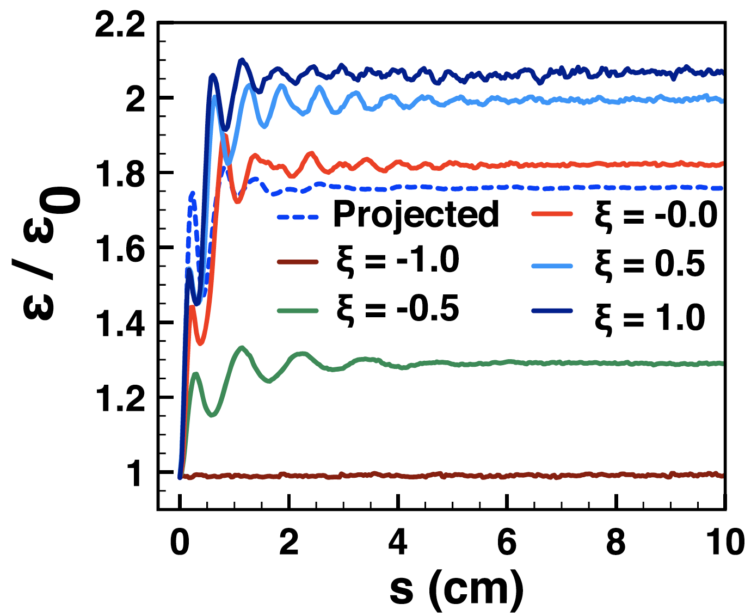
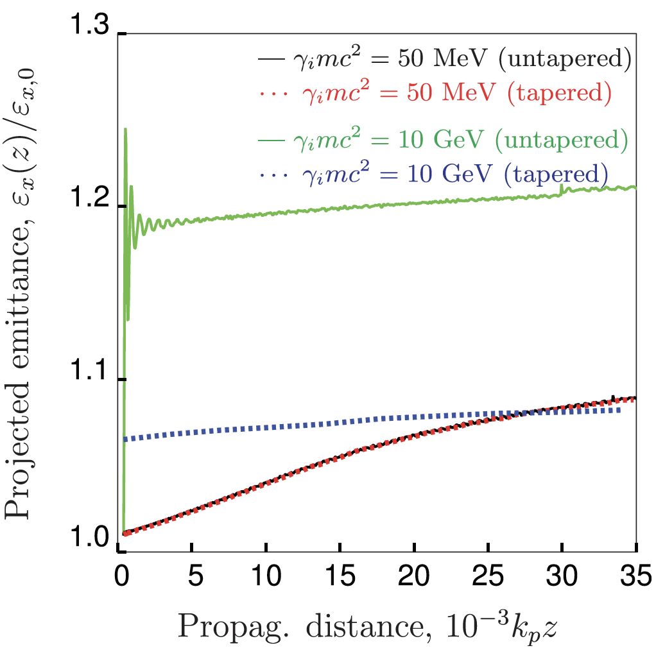
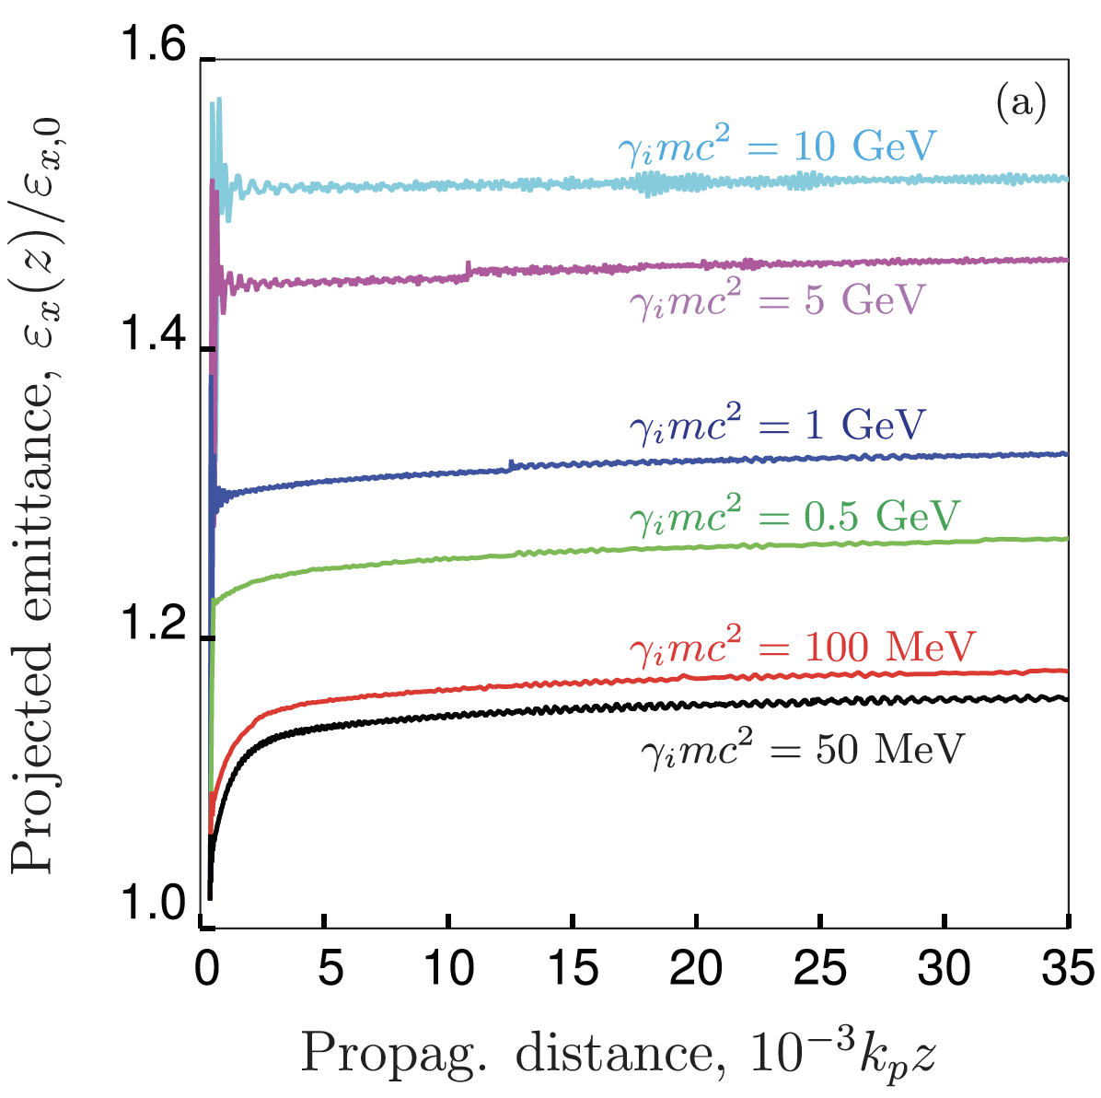
Methods to mitigate emittance growth due to ion motion
Adiabatic matching section: Decreasing ion mass
Matched spot size in the absence of ion motion:
Uniform ion column, linear focusing force
Direction matching to the uniform plasma
R. Gholizadeh et al., PRL 104, 155001 (2010)
Adiabatic matching section: Acceleration from low energy
W. An et al., PRL 118, 244801 (2017)
C. Benedetti et al., Phys. Plasmas 28, 053102 (2021)
Notes:
Once again, this expression gives us the beam’s matched spot in the absence of ion motion, which is the matched spot size in a uniform ion column, when the beam feels a linear focusing force.
It turns out that if we match the low emittance beam directly to the plasma using the spot size given above, the beam’s emittance will roughly double, then saturate very quickly. The emittance growth is actually much less than people previously thought. The emittance doubles because the beam’s initial profile is not the same as the equilibrium profile after the ion motion is triggered. While the beam readjusts its profile to the equilibrium profile, it experiences some emittance growth.
Then the question is: How can we possibly mitigate this?
Previous work show we could use a matching section with a plasma that has an adiabatically decreasing ion mass. Or we could use the idea of adiabatic acceleration.
In this talk, I am going to propose a new idea

Slide 8
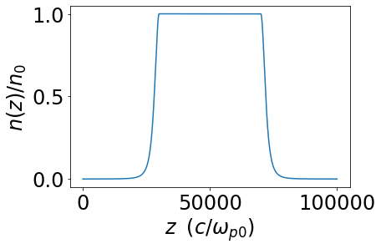
New idea: Use an adiabatic plasma density ramp
Small $σ_{m}$ → large $n_{b0}$→ Lots of ion motion
At entrance, low density ($ω_{p}$) → large $σ_{m}$→ low $n_{b0}$→little ion motion
In upramp, $ω_{p}↑,$ $σ_{m}↓, n_{b0}↑$, ion motion is slowly triggered.
Similar but opposite process in downramp
We hope the beam’s emittance can be preserved in this adiabatic process.
Large $σ_{m}$ → low $n_{b0}$ → little ion motion
Notes:
which is using an adiabatic plasma density ramp. The idea is as follows:

Slide 9
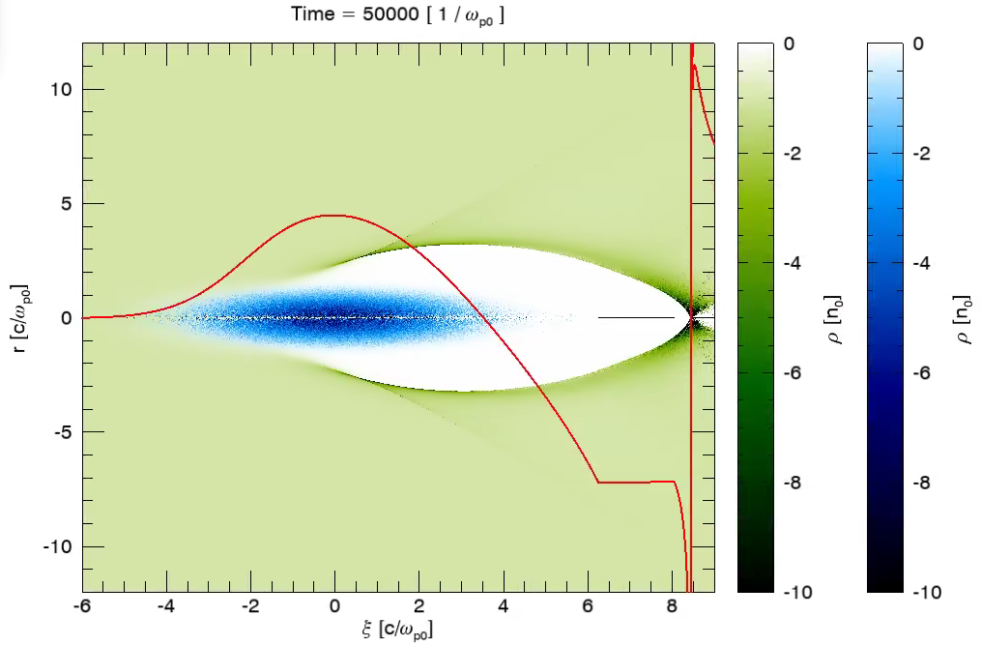
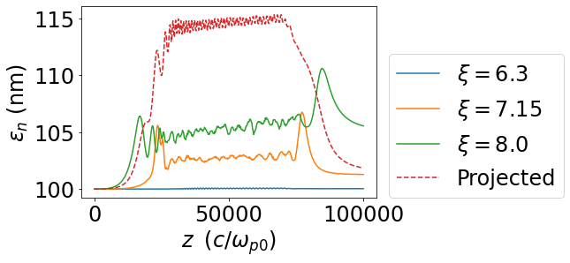
LC parameters: ~2% emittance growth!
Drive beam: 25GeV $\frac{n_{b0}}{n_{0}}=6$, non-evolving.
Witness beam: 25GeV, $ε_{n}=100$ nm
$$\text{(}I_{head}=25.26 kA, I_{tail}=6.42 kA, L=30μm)$$
$$n_{0}={10}^{17}cm^{−3}$$
$$L_{ramp}=3×{10}^{4} c/ω_{p0}$$
$$n_{entrance}/n_{0}={10}^{−4}$$
$n_{b0,head}/n_{0}∼777$
Notes:
There are 2 questions to be answered:
Why does the projected emittance evolve this way?
Why does the slice emittance evolve this way?

Slide 10
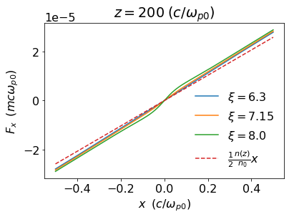
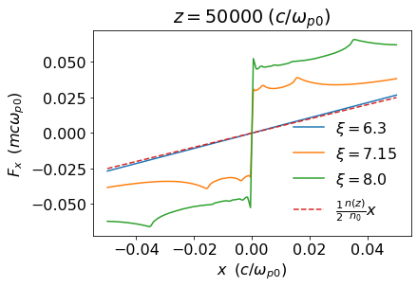
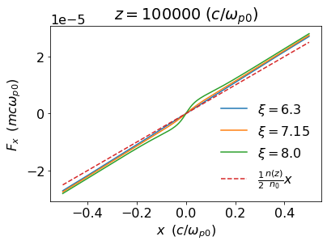
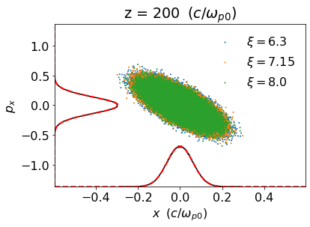
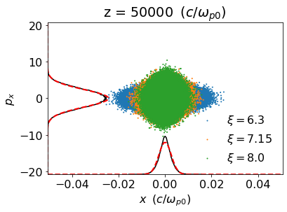
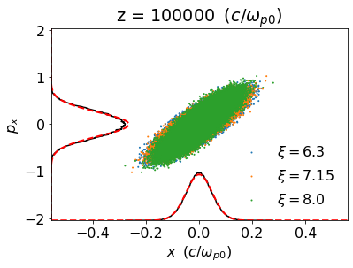
Evolution of phase space ellipses

Slide 11
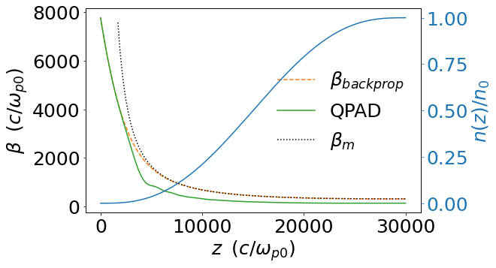
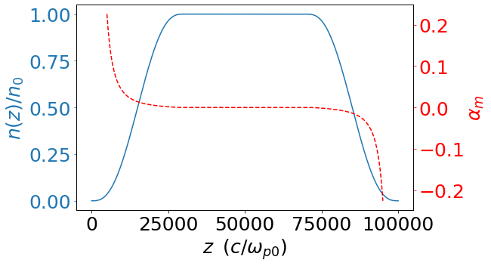
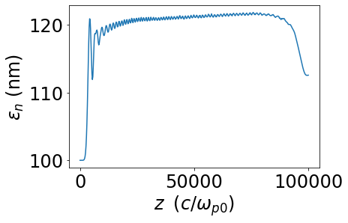
General ramp: 5th order polynomial
$$L=30000 c/ω_{p0}$$
$β=\sqrt{2\overline{γ}}\frac{c}{ω_{p0}}$ , $α=0$
$β_{i}$, $α_{i}$
13% growth
Notes:
Because the density starts at exactly 0, the matched CS parameters diverge at the entrance
Dashed orange curves initially follows the dashed back curve well, since the region is adiabatic. When they diverge, that’s the point where the plasma becomes non-adiabatic
We initialize the beam at plasma entrance according to the beta we got from back propagation
Initially ion motion is negligible in the low density region (because the beam’s spot size is large), so the actual evolution of the beta follows the back propagation result well.
When the green curve and the dashed orange curve starts to diverge, this is the point where ion motion starts to play a role. We hope when ion motion starts, the beam has already entered the adiabatic region. This can be achieved using a longer ramp. However, this is not quite the case here.
As a result, we get 13% emittance growth.

Slide 12
Adiabaticity & Initial ion motion trade off
Plasma density upramp:
$$β_{m0}=\sqrt{2\overline{γ}}c/ω_{p0}$$
At $z=0$ (entrance)
Smaller $n\left(0\right) \& α_{m}(0)$, the better. Can be achieved by a longer $L$.
For a given $L:$
$n\left(0\right)$ and $α_{m}\left(0\right)$ changes in different direction
For a higher energy beam, $n\left(0\right)↑$ (more initial ion motion) or $α_{m}\left(0\right)↑$ (ramp is less adiabatic). More challenging.
$$\frac{n\left(0\right)}{n_{0}}=\frac{1}{{\left(1+\frac{α_{m}\left(0\right)}{β_{m0}}L\right)}^{2} }$$

Slide 13
Higher energy simulation

Slide 14
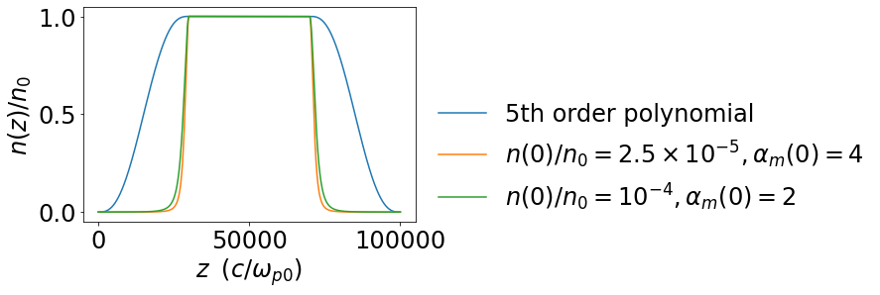
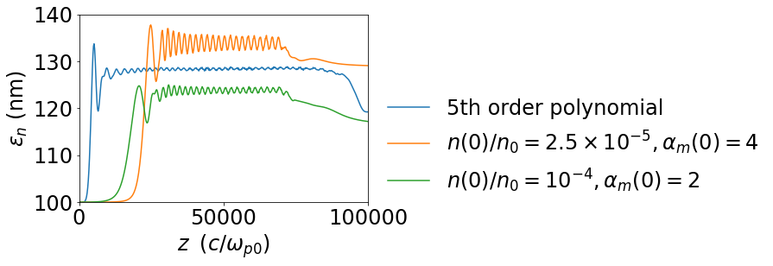
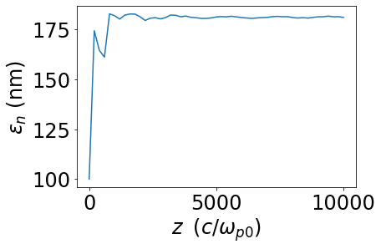
100GeV witness beam simulation
80% emittance growth if match to uniform plasma directly

Slide 15
Summary
In PWFA-LC, ion motion leads to slice-dependent non-linear focusing force, which is the dominant factor for emittance growth.
The witness beam’s tiny spot size makes the simulation challenging. QPAD makes it possible.
Using adiabatic plasma density ramps with appropriate matching, emittance growth can be mitigated.
The trade off between the initial ion motion & adiabaticity of the ramp need to be considered for ramp design.

