Slide 1


Latest advances in the Particle-In-Cell code WarpX for efficient modeling of plasma accelerators at Exascale
Jean-Luc Vay
Lawrence Berkeley National Laboratory
On behalf of the WarpX team
LBNL, LLNL, SLAC, CEA, DESY, Modern Electron, CERN
Joint Session Working Groups 1+2
Advanced Accelerator Concepts Workshop (AAC22)
Long Island, NY, USA
November 6-11, 2022

Slide 2
Outline
WarpX overview
Latest advances in WarpX
  Coulomb collision module
  QED module
  a time-averaged pseudo-spectral PIC solver that enables larger timesteps,
  a hybrid nodal-staggered PIC loop that provides improved stability,
  an algorithm to handle particles crossing Perfectly Matched Layers,
  application of mesh refinement to the modeling of ion motion in a plasma accelerator.
Thoughts toward the establishment of a 10-year roadmap for advanced accelerator concepts computation
2

Slide 3


Novel BLAST integrated ecosystem of accelerator (& more) codes
BLAST Particle-in-cell Codes
WarpX: t-based EM & ES PIC + lattice
ImpactX: s-based ES + lattice
HiPACE++: Quasistatic PIC (similar to QuickPIC, pyHeadtail, …)

Slide 4

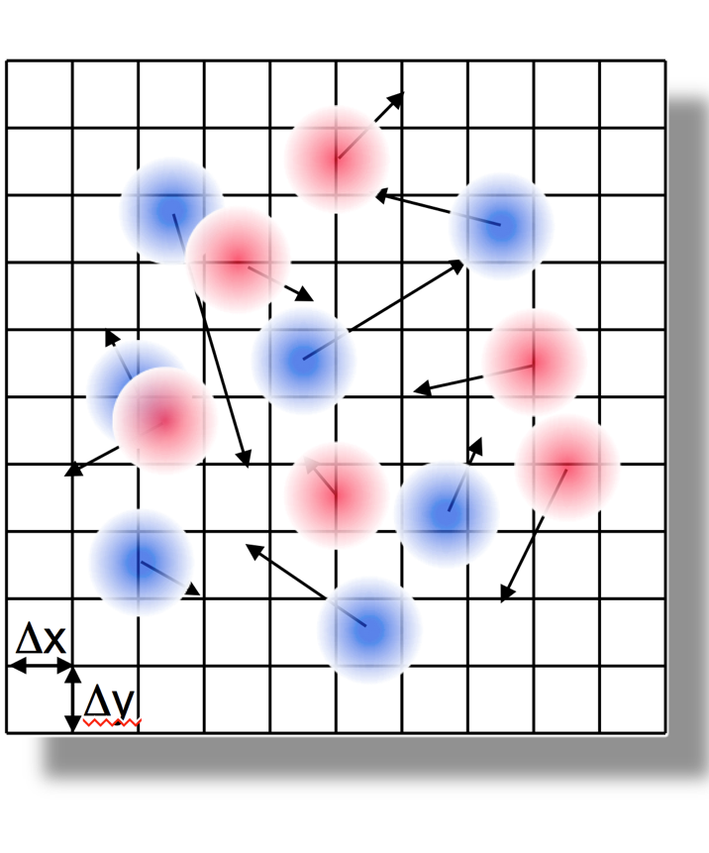
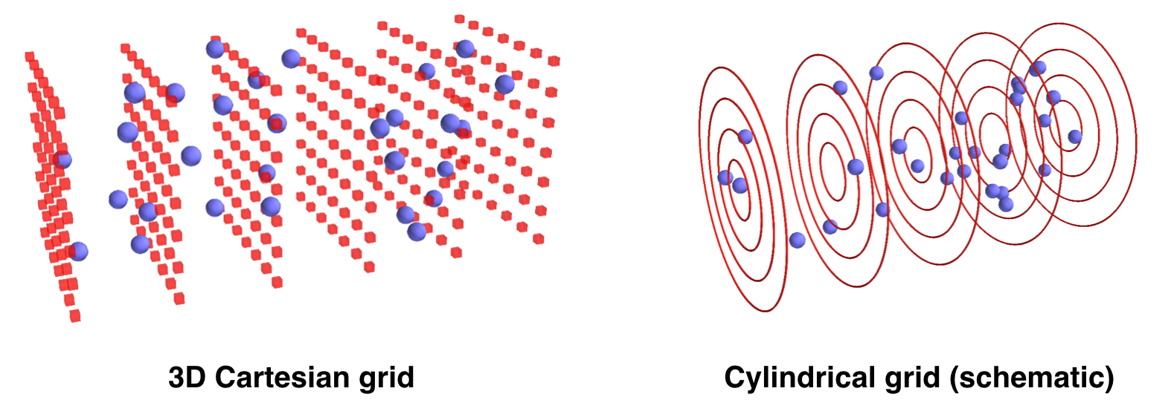






WarpX: Multi-Physics Particle-in-Cell Code for Exascale
Particle-in-Cell
Geometries
1D3V, 2D3V,
3D3V and
RZ (quasi-
cylindrical)
Multi-Node parallelization
MPI: 3D domain decomposition
dynamic load balancing
On-Node Parallelization
GPU: CUDA, HIP and SYCL
CPU: OpenMP
Scalable, Parallel I/O
AMReX plotfile and
openPMD (HDF5 or ADIOS)
in situ diagnostics
macro-
particles
electro-
magnetic (EM) fields on a grid
Advanced Algorithms Pioneered by our Team
boosted frame, spectral solvers, Galilean frame, MR, ...
Multi-Physics Modules
field ionization of atomic levels, Coulomb
collisions, QED processes (e.g. pair creation), macroscopic materials, embedded boundaries + CAD, …
Open source
ecp-warpx.github.io

Slide 5
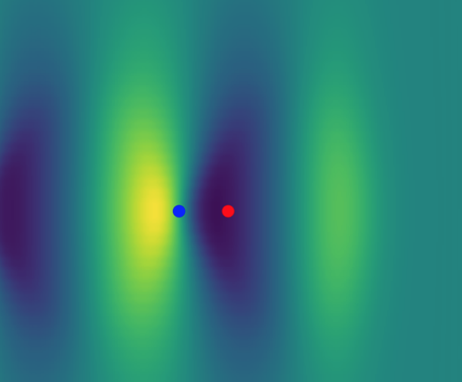
New module of Monte Carlo binary interactions
Interaction between macro-particles within the same cell
Physical interactions currently implemented in WarpX:
  Coulomb collisions
  Nuclear fusion (D+T, D+D, P+B11, …)
  Extensible to other interactions (impact ionization, …)
Works on CPU and GPU
  (Uses 1 thread per cell on GPU)
Works in different WarpX geometries:
  2D/3D Cartesian
  RZ (assuming pure cylindrical symmetry)
Used in production:
simulations of
emittance growth due
to Coulomb collisions
Y. Zhao, et al., Phys. Plasmas 29, 103109 (2022) https://doi.org/10.1063/5.0102919
Y. Zhao, et al., Phys. Plasmas 27, 113105 (2020) https://doi.org/10.1063/5.0023776

Slide 6
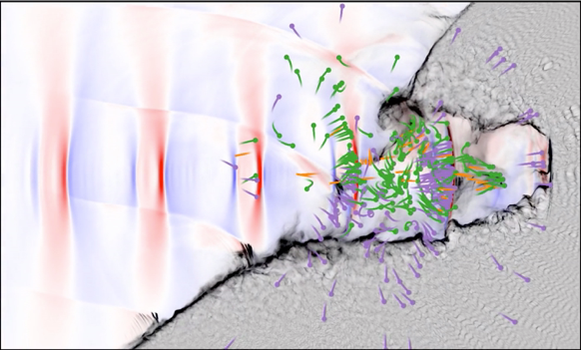
New module for Quantum ElectroDynamic (QED) Processes
QED processes implemented:
  Nonlinear Breit-Wheeler pair production
  (a photon decays into an electron-positron pair)
  Quantum synchrotron
  (an accelerated charged particle emits a hard photon)
  Schwinger process
  (high electric field generates electron-positron pairs)
Works on CPU and GPU
Implemented in the library PICSAR
  github.com/ECP-WarpX/picsar
  Can be used in other codes
Has been used to simulate the interaction of Doppler-boosted lasers with matter and the quantum vacuum
(collaboration with CEA Saclay)
L. Fedeli, et al., New J. Phys. 24 025009 (2022) https://doi.org/10.1088/1367-2630/ac4ef1
L. Fedeli, et al., Phys. Rev. Lett. 127, 114801 (2001) https://doi.org/10.1103/PhysRevLett.127.114801
E. Zoni et al, Comp. Phys. Comm., 279, 108467 (2022) https://doi.org/10.1016/j.cpc.2022.108457

Slide 7
Time-averaged pseudo-spectral PIC solver enables larger timesteps*
Takes advantage of Pseudo-Spectral Analytical Time-Domain (PSATD) solver to average fields analytically
in k-space over one time step before field gather
The fields that evolve with Maxwell’s
equations are untouched (there is no
field damping over time, i.e., no
spurious laser depletion)
Push particles
Gather forces
Deposit currents
iFFT: k➔x
FFT: x➔k
Average fields to gather over 1 time step
Field solve in k-space
*O. Shapoval, et al., Phys. Rev. E 104, 055311 (2021) doi.org/10.1103/PhysRevE.104.055311

Slide 8
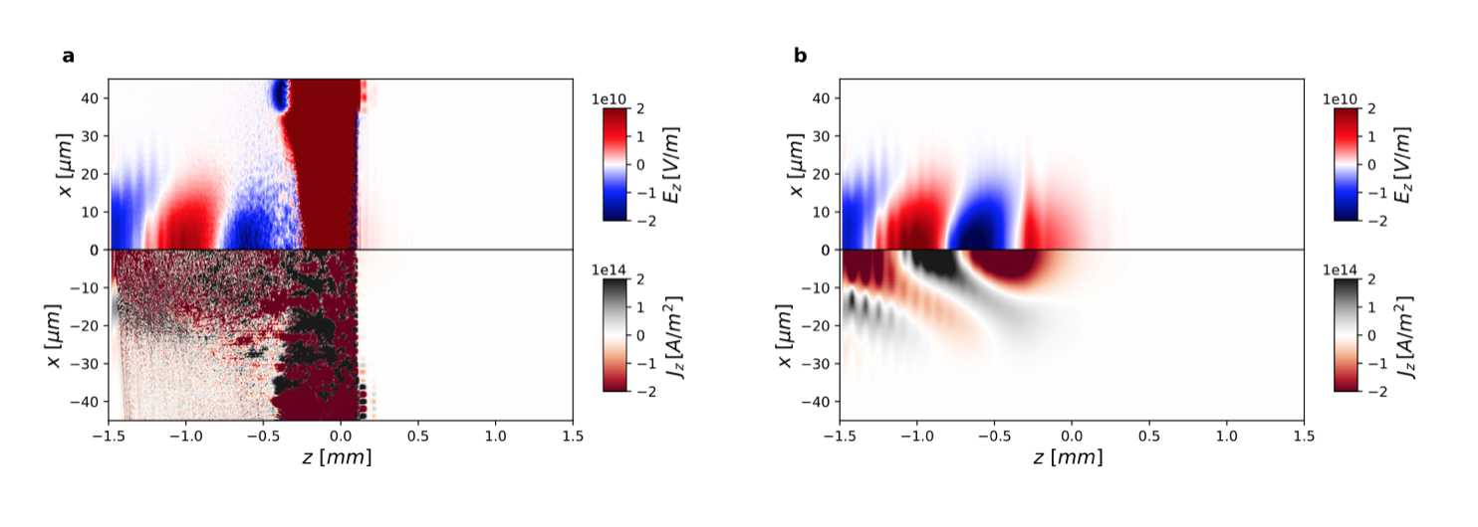
Averaged PSATD PIC speeds up laser plasma accelerator simulations
Δz=10Δx
Example: cΔt=Δz=10Δx
Δx
Standard Galilean PSATD-PIC
Averaged Galilean PSATD-PIC
Velocity push:
Sampled fields within time step
Averaged field within time step
Unstable
Stable
~x10
speedup
laser
laser
➔ Enables full PIC simulations with computational costs similar to quasistatic PIC.
*O. Shapoval, et al., Phys. Rev. E 104, 055311 (2021) doi.org/10.1103/PhysRevE.104.055311

Slide 9
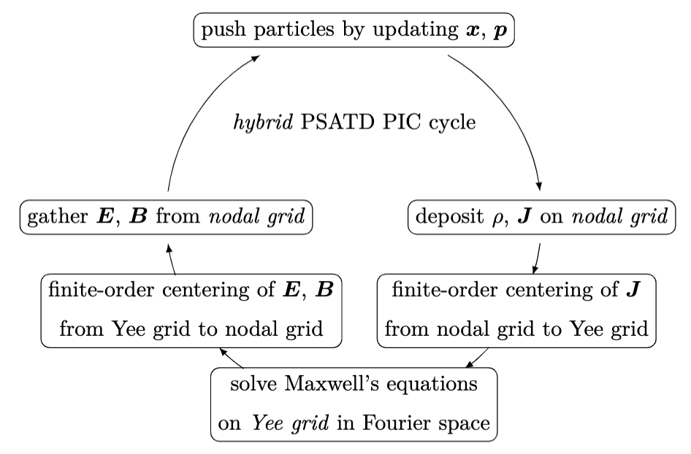
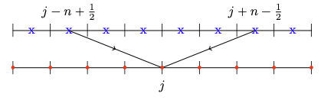
Hybrid nodal-staggered PIC loop provides improved stability*
Combines advantages of staggered Maxwell solver with nodal field gather (& current deposition).
Lower numerical dispersion
More compact support of high-order stencil
Higher parallel stability
No interpolation errors (E+VxB)
Higher PIC stability (e.g., numerical Cherenkov instability)
Staggered
Nodal
Finite centering = finite order approximation of shift in k-space: e^{-ikΔx/2}
*E. Zoni, et al., Comput. Phys. Comm. 279, 108457 (2022) doi.org/10.1016/j.cpc.2022.108457

Slide 10
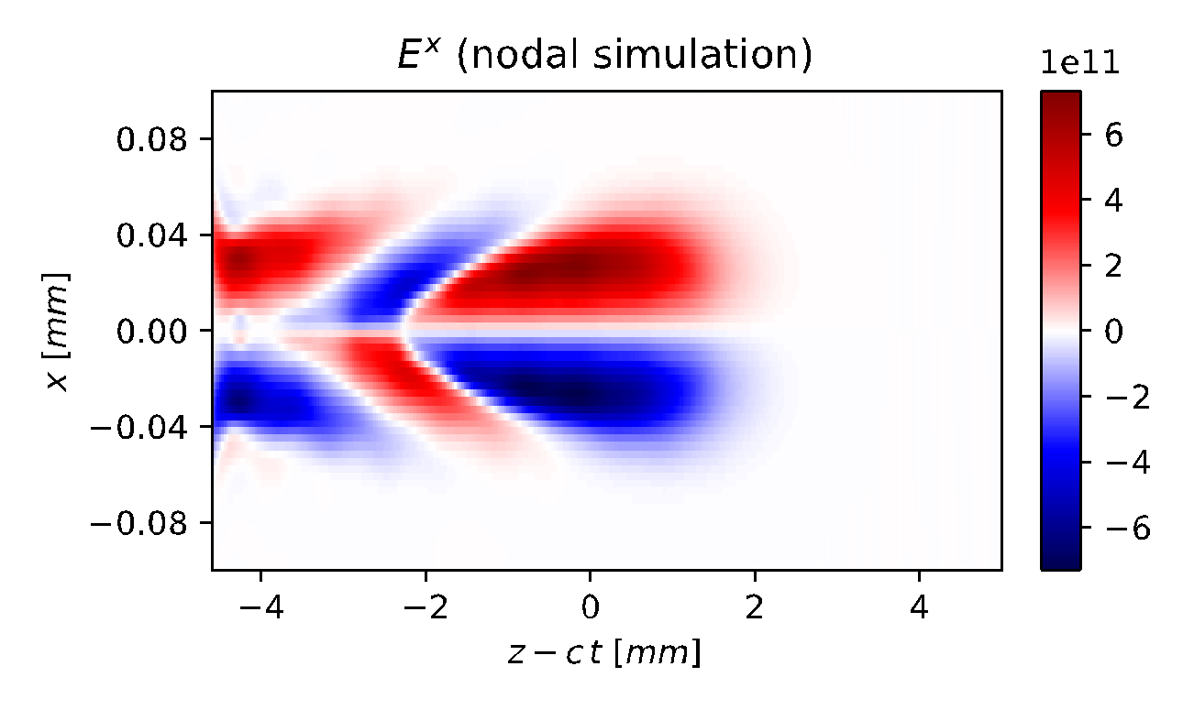
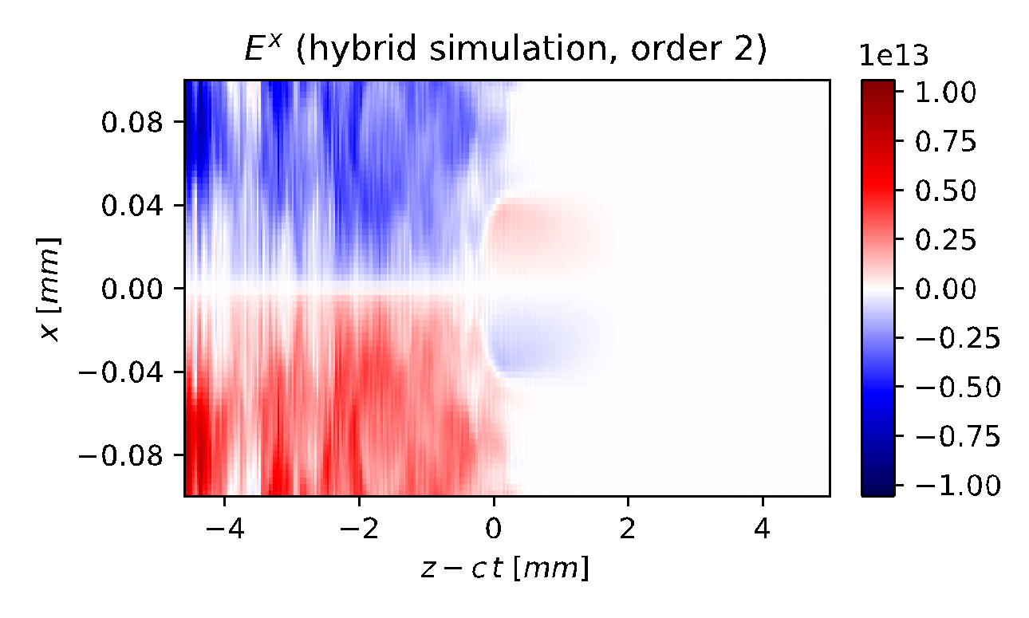
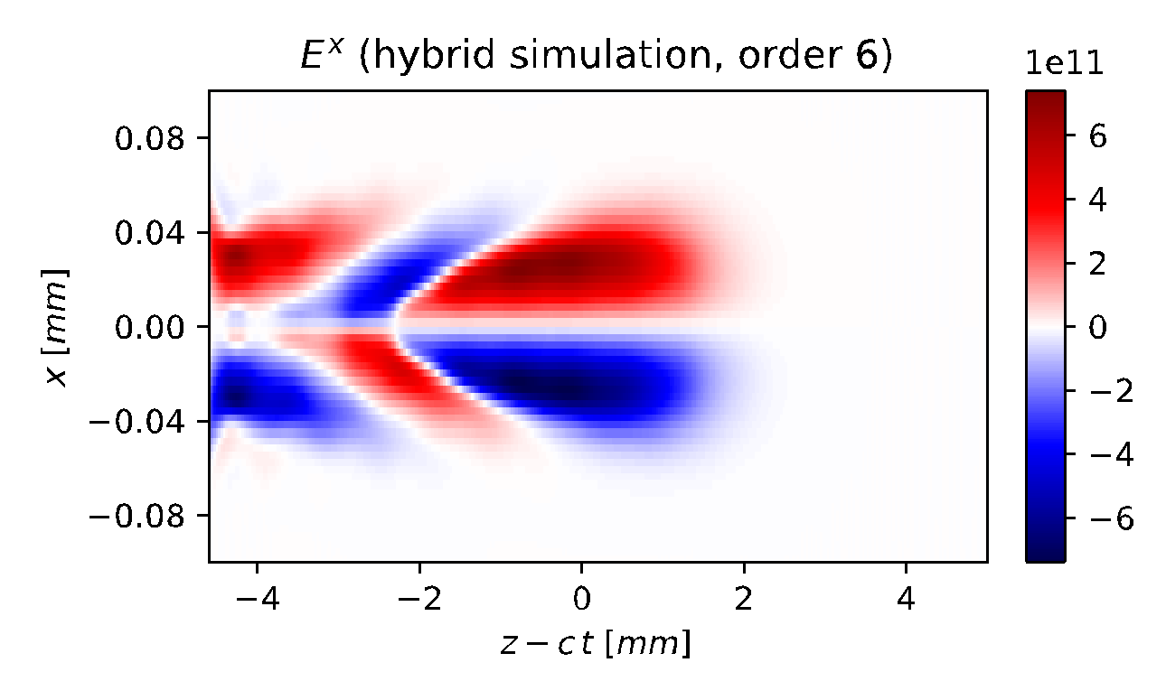
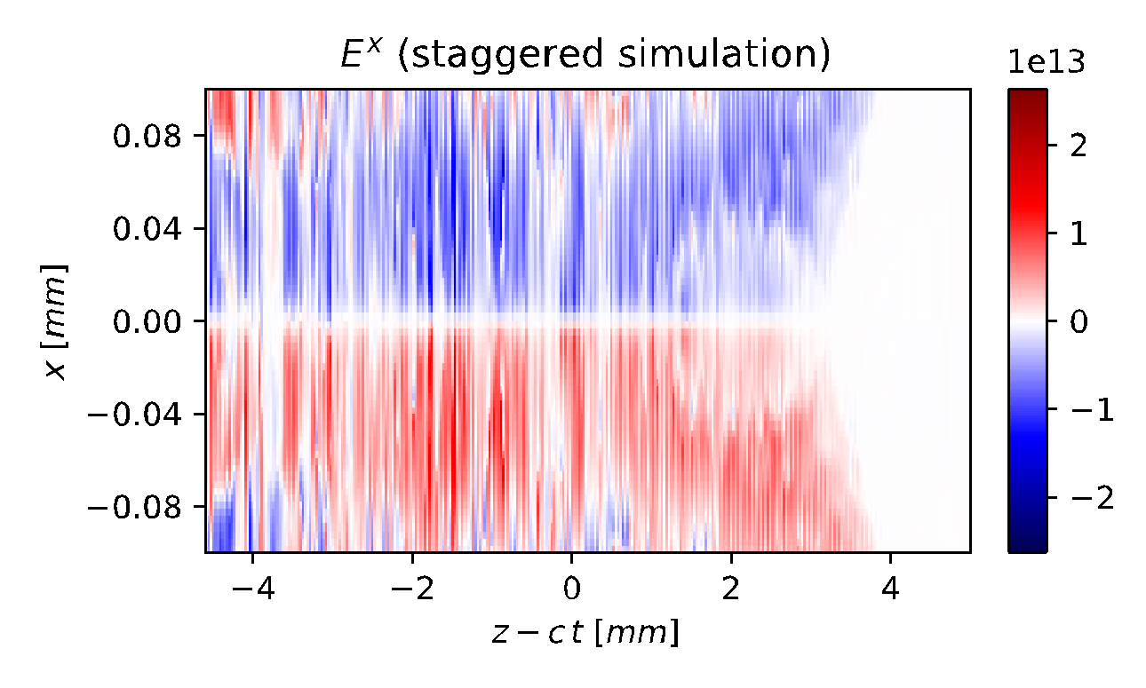
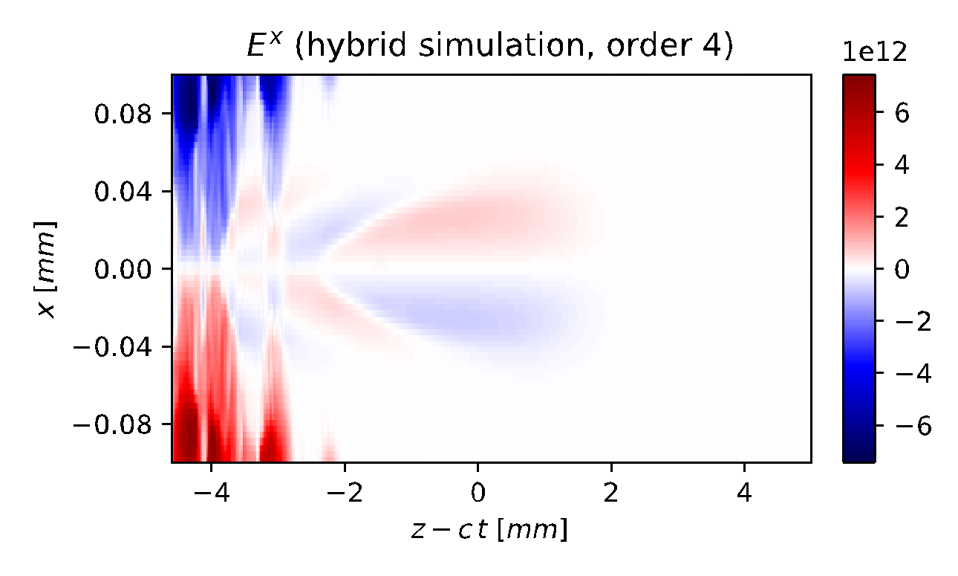
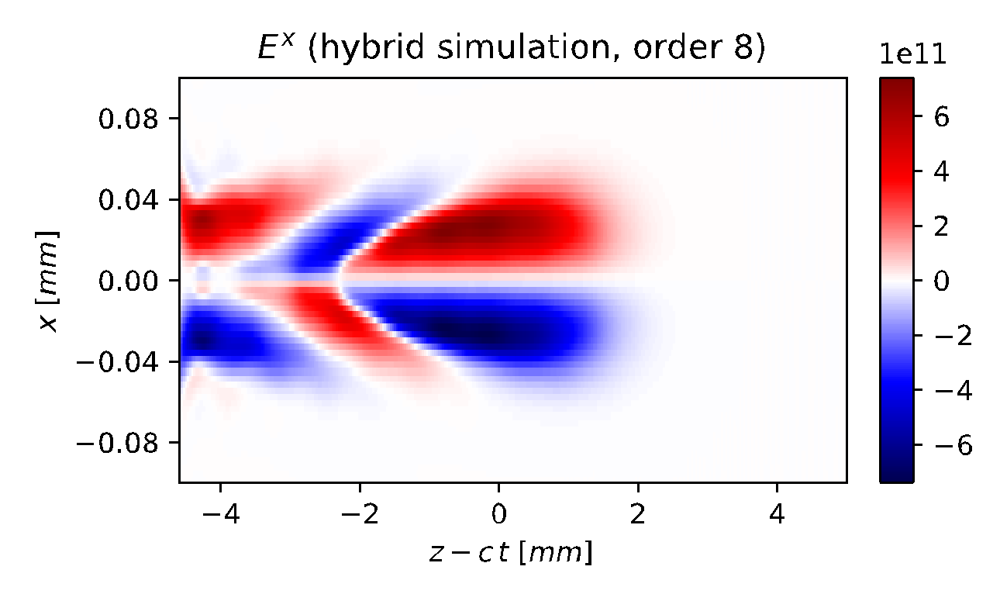
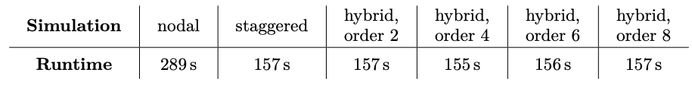
Hybrid nodal-staggered PIC loop provides significant speedup
~✕2 speedup simulations of laser-plasma accelerator
~✕10 speedup simulations of high-field physics with QED effects*
Nodal: stable
Hybrid: order 2
Hybrid: order 6
laser
More guard cells
Staggered: unstable
Hybrid: order 4
Hybrid: order 8
Less guard cells
*E. Zoni, et al., Comput. Phys. Comm. 279, 108457 (2022) doi.org/10.1016/j.cpc.2022.108457

Slide 11
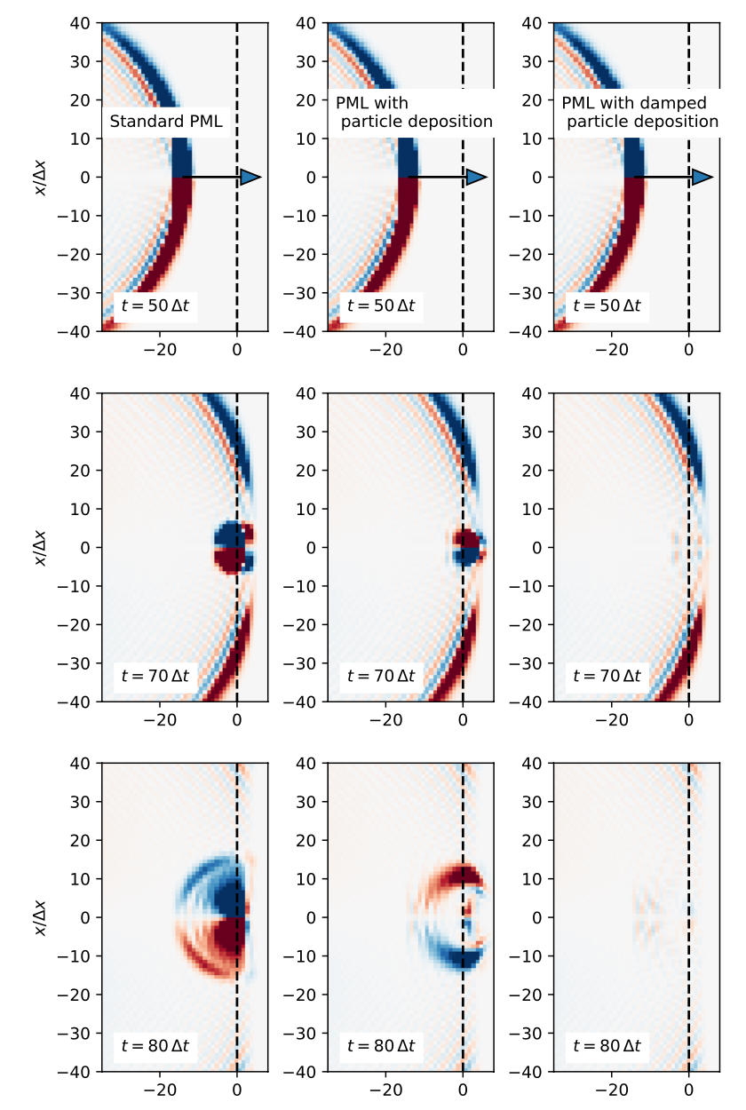
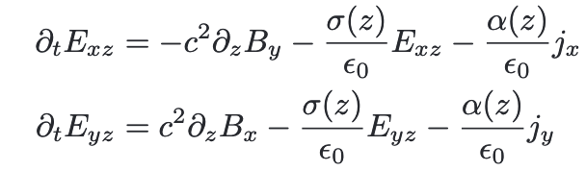
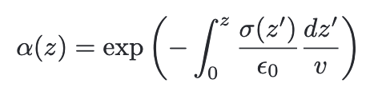
New algorithm to handle particles crossing Perfectly Matched Layers*
Standard PML
PML w/ deposition
PML w/ damped deposition
Standard Perfectly Matched Layer (PML)
New terms for particles crossing PML
Additional terms are exact solution for absorbing layer for particles crossing PMLs at normal incidence.
*R. Lehe, et al., Phys. Rev. E 106, 045306 (2022) doi.org/10.1103/PhysRevE.106.045306

Slide 12
New algorithm provides efficient absorption of electrons ejected transversally in LPA simulations
*R. Lehe, et al., Phys. Rev. E 106, 045306 (2022) doi.org/10.1103/PhysRevE.106.045306

Slide 13
Absorption is less perfect when particles are ejected at a lower angle.
Work is underway to extend algorithms to wider range of angles.
*R. Lehe, et al., Phys. Rev. E 106, 045306 (2022) doi.org/10.1103/PhysRevE.106.045306

Slide 14
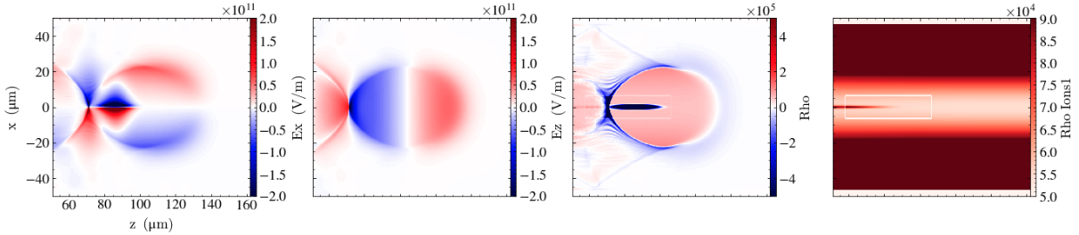
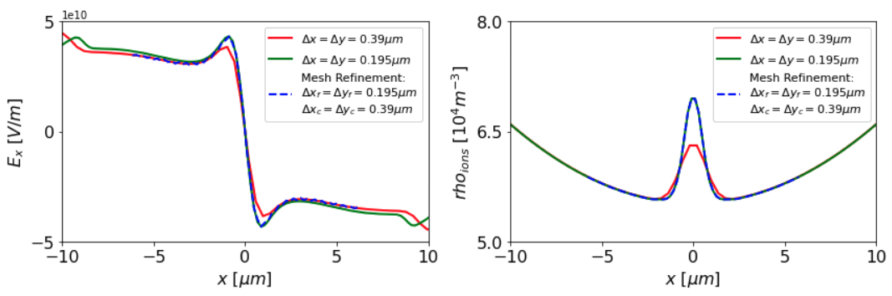


MR bring 2x computational cost reduction in modeling ion motion in LPA
Transverse Field ($E_{x})$
$$z=75 μm$$
Ion Density ($ρ_{ions})$
$$z=75 μm$$
Without Mesh Refinement
(#Nodes)*(Time)
= 32*0.195 = 6.24
With Mesh Refinement
(#Nodes)*(Time)
= 8*0.365 = 2.38
Computational Cost
Estimates

Slide 15
Outline
WarpX overview
Latest advances in WarpX
  Coulomb collision module
  QED module
  a time-averaged pseudo-spectral PIC solver that enables larger timesteps,
  a hybrid nodal-staggered PIC loop that provides improved stability,
  an algorithm to handle particles crossing Perfectly Matched Layers,
  application of mesh refinement to the modeling of ion motion in a plasma accelerator.
Thoughts toward the establishment of a 10-year roadmap for advanced accelerator concepts computation
15

Slide 16
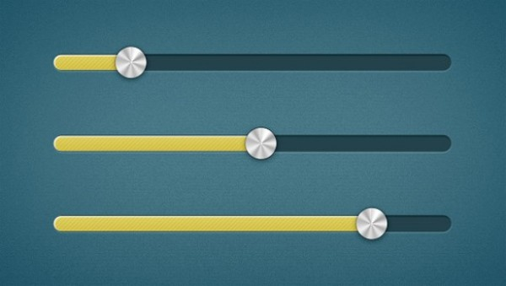
Ultimate goal: End-to-end Virtual Accelerator (EVA) with on-the-fly tunability from users of physics & numerics complexity
Speed
Great for ensemble runs for design studies
Fidelity
Great for detailed runs for physics studies
Reduced physics
Full physics
1D-1V
3D-3V
Low resolution
High resolution
Surrogate models
First principles
Present state of the art: complicated command-line workflows; each lab or group has its own code(s)

Slide 17

Accelerator modeling: the norm used to be life without standards
No standards
Simulation codes
Input code A
Code A
Output Code A
Different input formats
Different output formats
Input code B
Code B
Output Code B
Input …
...
Output …
Difficult for benchmarks, workflows, optimization or AI/ML engines, …
Fun comparison! Imagine:
the car makers not following standards
➔ drivers having to learn “from scratch” to drive each car

Slide 18


















Complexity in accelerator modeling requires us to work together
With standards
Simulation code
Particle-In-Cell
Modeling Interface
Code A
open Particle Mesh Data standard
Code B
...

Slide 19
Thoughts toward the establishment of a 10-year roadmap
for advanced accelerator concepts computation
Proposal
Ultimate goal: End-to-end Virtual Accelerators (EVA) with on-the-fly tunability from users of physics & numerics complexity
Development and adoption of input/output standards as early activities of roadmap
Development of workflows with plug & play swap of models/codes enabled by standards
Development of EVAs and Virtual Test Stands (VTS) for various AAC thrusts (LWFA, PWFA, SWFA, DLA, …)
Application of EVAs and Virtual Test Stands (VTS) for various AAC thrusts with milestones
  E.g., for LWFA: model chain of 10 multi-GeV stages for HEP collider, maximizing beam charge and energy gain, and minimizing energy spread and emittance growth
19

Slide 20
Backups
20

Slide 21
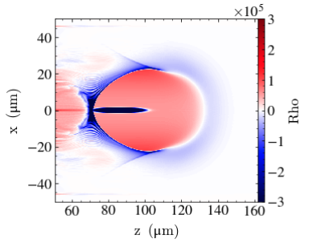
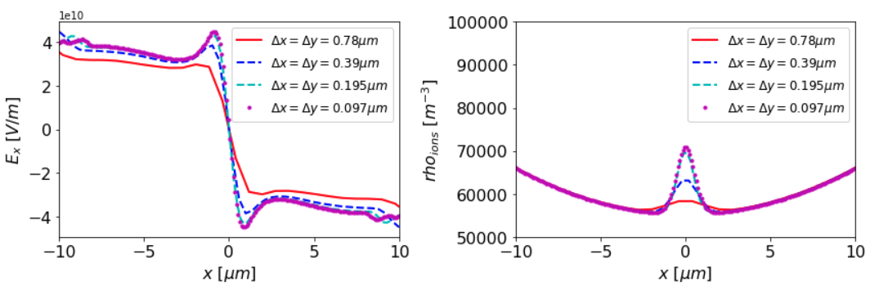
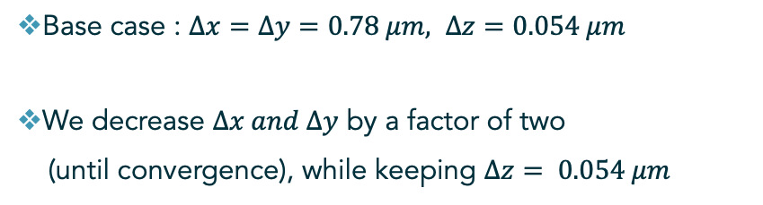


Transverse resolution scan (without mesh refinement)
Base case : $Δx=Δy=0.78 μm, Δz=0.054 μm$
We decrease $Δx and Δy$ by a factor of two
(until convergence), while keeping $Δz= 0.054 μm$
Transverse Field ($E_{x})$
$$z=75 μm$$
Ion Density ($ρ_{ions})$
$$z=75 μm$$

