Slide 1

First-Principle Simulations of Electron-Bunch Compression Using a Large-Scale Lienard-Wiechert Solver
Afnan Al Marzouk, Dept. of Physics, Northern Illinois University
ICFA Beam Dynamics Newsletter, No. 38
Notes:
High brightness electron beams is essential for many current applications such as FELs. We need very short bunches (<100 fs) of high currents (a few kilo amps). One way to get such bunches is through bunch compression. The most common way to compress longitudinally is the magnetic chicane which usually consists of four dipoles. The principle of a magnetic chicane is to have an energy chirp introduced by RF acceleration which ideally will be a linear correlation; lowering the energy in the head and increasing it in the tail. That creates different path lengths through the chicane where the lower energy head takes a long path, and the higher energy tail takes a shorter path; then the bunch length will be compressed. The main problem here is the coherent synchrotron radiation (CSR) emitted by the bunch as it travels through the chicane, which can impact the bunch.
Computing CSR in detail within a bunch, especially in three dimensions, is one of the most challenging problems in accelerator physics. It has only been pursued recently because of the seemingly high computational cost. The earliest efforts focused on making approximations and reducing the dimensionality of the problem. So the 1D model is widely used, then the 2D model, and not long ago the 3D model. First-principle simulations in 3D will give better understanding of CSR in the bunch compression chicane and it’s impact on beam brightness. These simulations will also allow to explore the limitations of the 1D and 2D models and benchmark the faster 3D models.

Slide 2
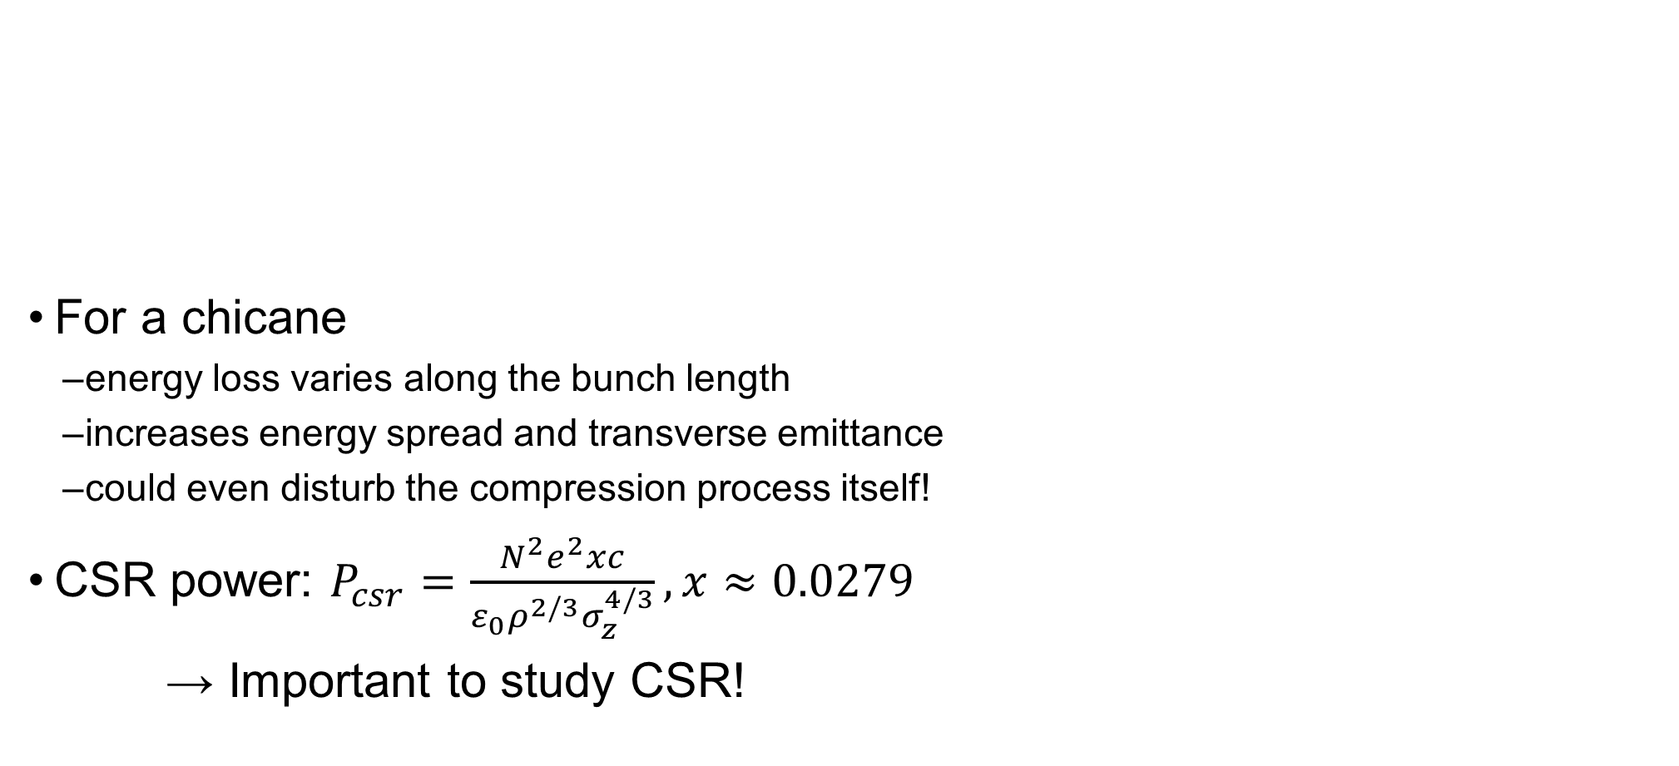
Impact of CSR
For a chicane
  energy loss varies along the bunch length
  increases energy spread and transverse emittance
  could even disturb the compression process itself!
CSR power: $P_{csr}=\frac{N^{2}e^{2}xc}{ε_{0}ρ^{2/3}σ_{z}^{4/3}}, x≈0.0279$
  → Important to study CSR!
Picture from: Peter Williams talk in ERL2019 "Beyond the Limits of 1D Coherent Synchrotron Radiation.“
Notes:
Before I talk about the simulations, let’s talk about how the CSR can impact on the beam through a single bend. From energy conservation, the CSR energy is equal to the energy lost by the particles producing it. Geometrically as the bunch moves on an arc, radiation emitted by particles in the back of the bunch can interact with particles in the front of the bunch. For relativistic bunches in free space, the center and back of the bunch lose energy, while the head of the bunch gains some energy. The total force on a particle due to the whole bunch is called the CSR wakefield.

Slide 3
Computational CSR
Basic approach to compute the CSR wakefield is from Liénard-Wiechert eq.
The 1D model → gives overall insight. Validity?
Similarly for the 2D model.
There are some 3D models, but not first-principle.
Picture from: Peter Williams talk in ERL2019 "Beyond the Limits of 1D Coherent Synchrotron Radiation.“
Notes:
The 1D model is good to give an overall sight of CSR. But, as it assumes a line charge and ignores the transverse coordinates, their domain of validity is questioned. Until which transverse size these models are valid? There are some 3D models currently, but first-principle simulations are important for the validation of different models.

Slide 4
The LW3D Code
Developed by R. Ryne in 2012.
First-principle large-scale code → computes the 3D fields directly from 𝑁 particles in a bunch using Liénard-Wiechert eq.
Fields are computed on a 3D grid points from the retarded positions at chosen timesteps.
The initial code is not self-consistent → fields do not interact with the particles.
Massively parallel → runs on 10s of thousands of cores.
Notes:
The only CSR code from first-principle.

Slide 5
The LW3D Code
Advantages:
  explore limitations of the 1D and 2D CSR models
  benchmark and validate faster 3D CSR codes
The 𝑁-body self-consistent LW3D code is currently under development.
C.E. Mayes, “Computational approaches to Coherent Synchrotron Radiation in two and three dimensions,” ICFA BEAM DYNAMICS NEWSLETTER#82 - ADVANCED ACCELERATOR MODELLING (2021)

Slide 6
Motivation: Bunch Compression at AWA
AWA: Argonne Wakefield Accelerator
No experiment were performed, yet!

Slide 7
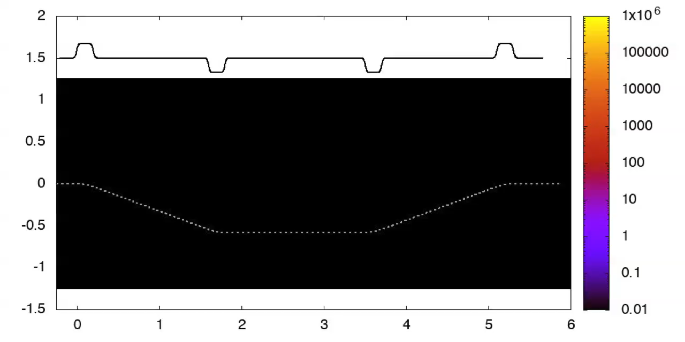
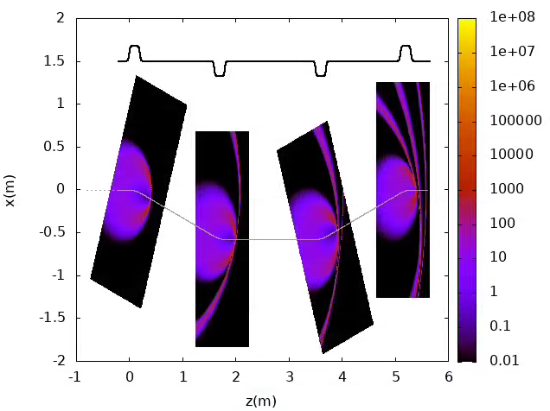
LW3D Simulations of AWA Chicane
Radiation wavefronts (no kick applied to the bunch).
x (m)
z (m)
Courtesy of R. Ryne

Slide 8
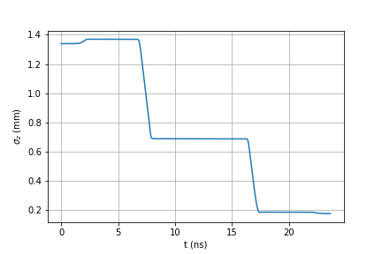
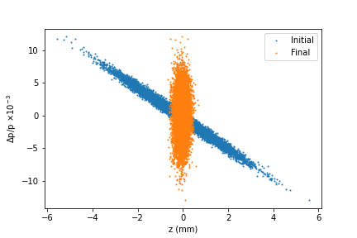
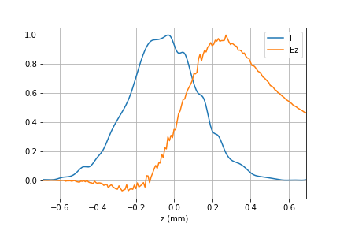
LW3D Simulations of AWA Chicane
Showed
compression
by a factor
of 7.5
Notes:
At fixed energy, shot noise goes down with increasing # of particles. At fixed # of particles, shot noise increases with energy.

Slide 9

The Self-Consistent LW3D Code
Ideally: compute the fields at each particle’s position due to all other particles in the bunch → scales as $N^{2}$; add to that storing the time history of each particles → really complicated.
A more straight forward approach is to interpolate the computed fields on grid points at the position of each particle at each time step.

Slide 10
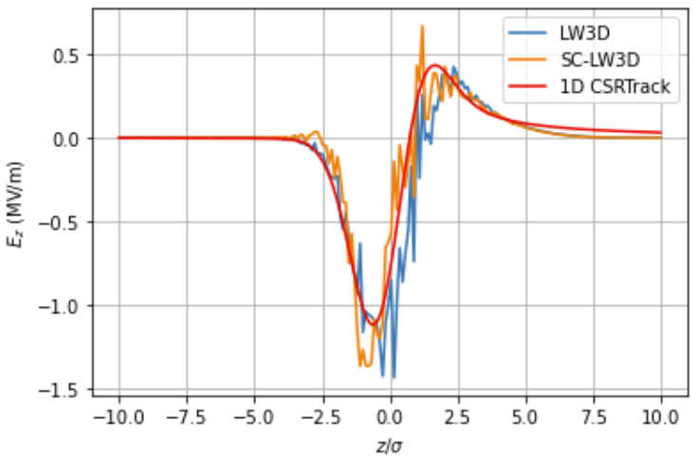
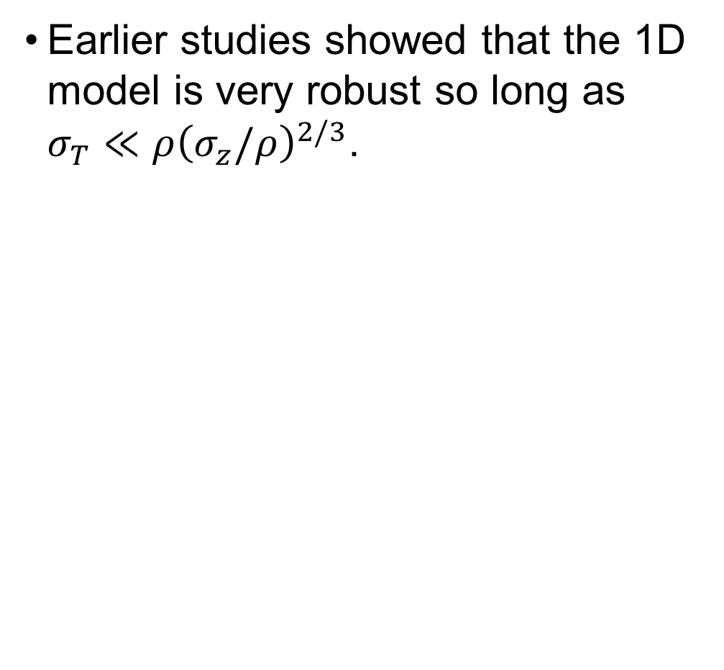

SC-LW3D Simulations
$σ_{z}=σ_{x}=100μm,∆γ=0$
Noise is due to discreetness, can be smoothed.
Earlier studies showed that the 1D model is very robust so long as $σ_{T}≪ρ{\left(σ_{z}/ρ\right)}^{2/3}$.
Ryne, R. D., C. Mitchell, J. Qiang, B. Carlsten, and N.
Yampolsky. "Large scale simulation of synchrotron radiation
using a Lienard-Wiechert approach." Proc. IPAC 46 (2012).

Slide 11
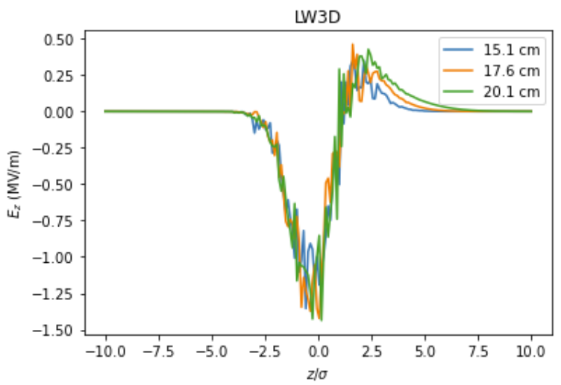
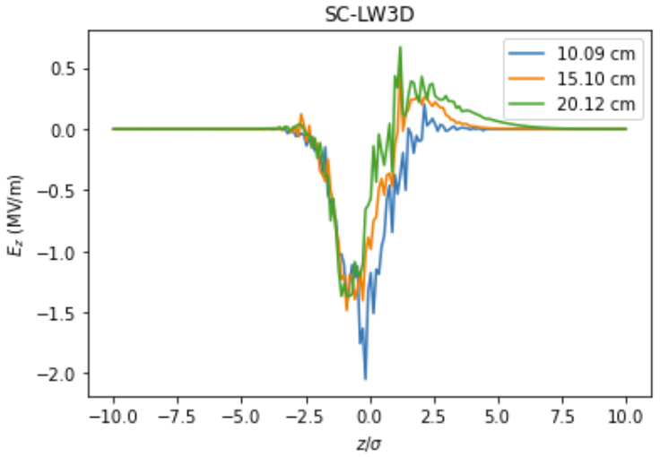
SC-LW3D Simulations
Longitudinal field

Slide 12
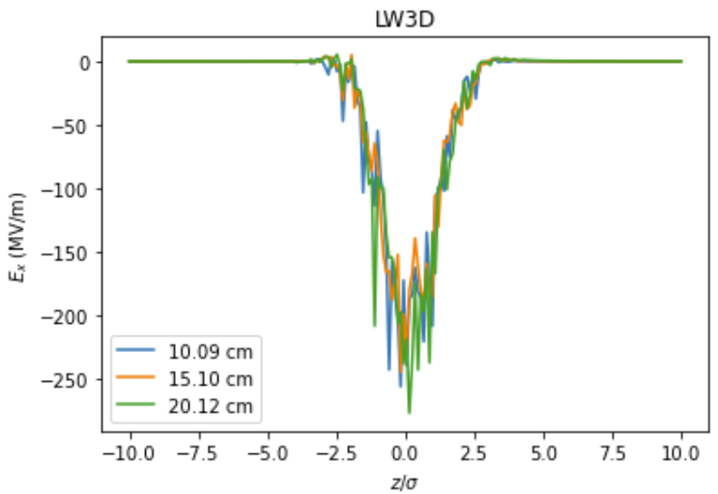
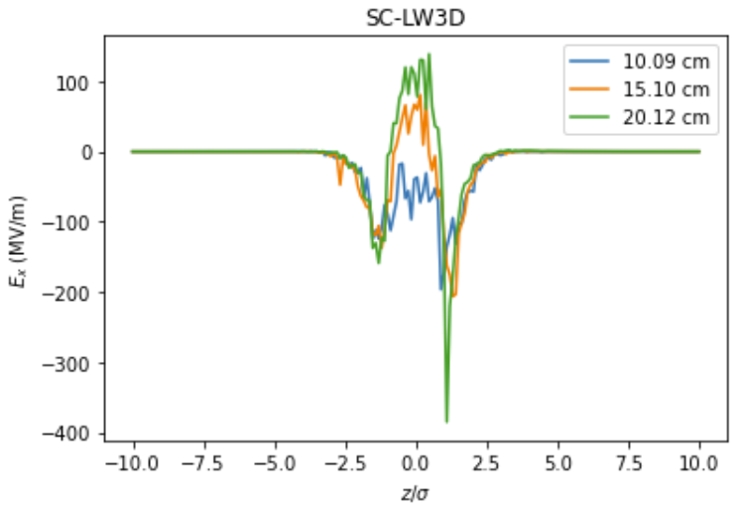
SC-LW3D Simulations
Transverse field

Slide 13
Conclusions and Outlooks
We have performed first-principle simulations of CSR for the bunch compressor at AWA.
The N-body self-consistent LW3D is in progress, and it shows that CSR can differ from the non-self-consistent.
We will study the CSR impact on beam brightness with the self-consistent code along with possible CSR mitigations.
Acknowledgments
Collaborators: R. D. Ryne, C. E. Mitchell, J. Qiang.
This work was support by the U.S. National Science Foundation under award PHY-1549132 to Cornell University and NIU.
This research used resources of the National Energy Research Scientific Computing Center; a DOE Office of Science User Facility supported by the Office of Science of the U.S. Department of Energy under Contract No. DE-AC02-05CH11231 using NERSC award BES-ERCAP0020725.

