Slide 1
ERLs, RLAs, FFAs, and EIC: Designing Advanced Beamline Layouts with Bmad
J. Scott Berg Brookhaven National Laboratory Bmad Development Workshop
October 6, 2022

Slide 2
Decoupling Layout from Orbits
In most accelerator designs, layout is tightly coupled to a particle orbit
In the design, there is a particle that follows the magnet axes
That “reference particle” defines
A local coordinate system
A reference clock for RF
There are circumstances where it is impractical for an actual particle to follow a magnet axis
Fixed field alternating gradient accelerators (FFAs)
Energy recovery linacs (ERLs) and recirculating linear accelerators (RLAs)
In the EIC, there are cases where this is required

Slide 3
FFAs
Single beamline transmitting a wide range of energies (factor of 2 or more)
Typical design
Repeating, simple cells
Combined function magnets
Characteristics
Energy-dependent periodic orbit
No orbit follows the magnet axis
Orbit period different for each energy

Slide 4
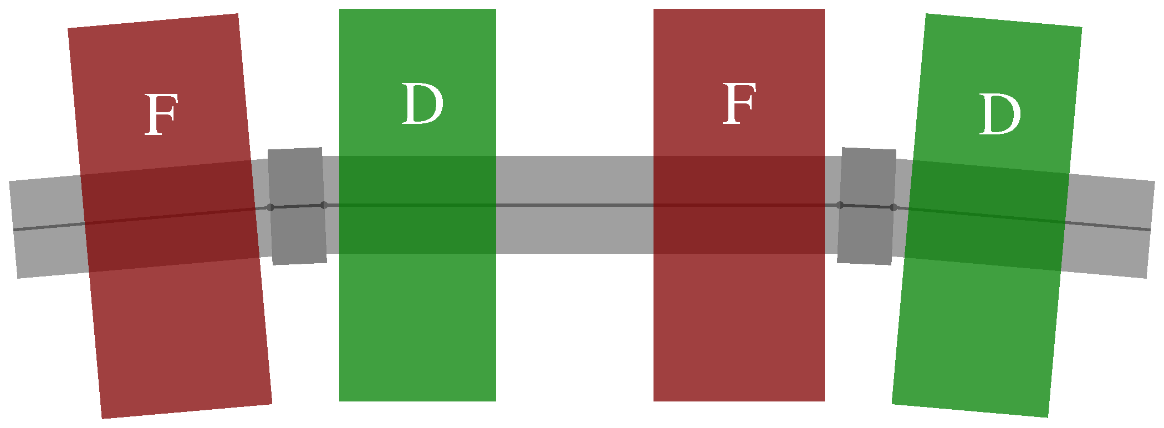
FFAs
Design steps
Specify where you want the beam to be
Set magnet fields to put the beam there
Key Bmad tools
dg or db_field attributes
patch elements

Slide 5
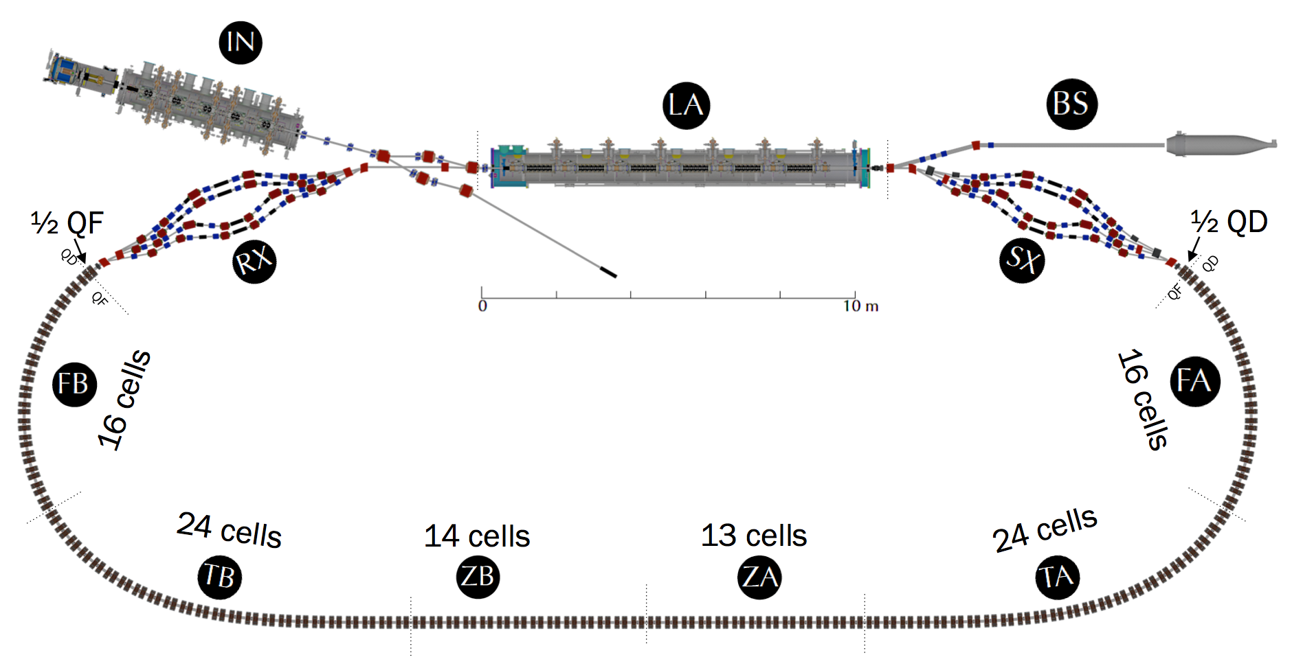
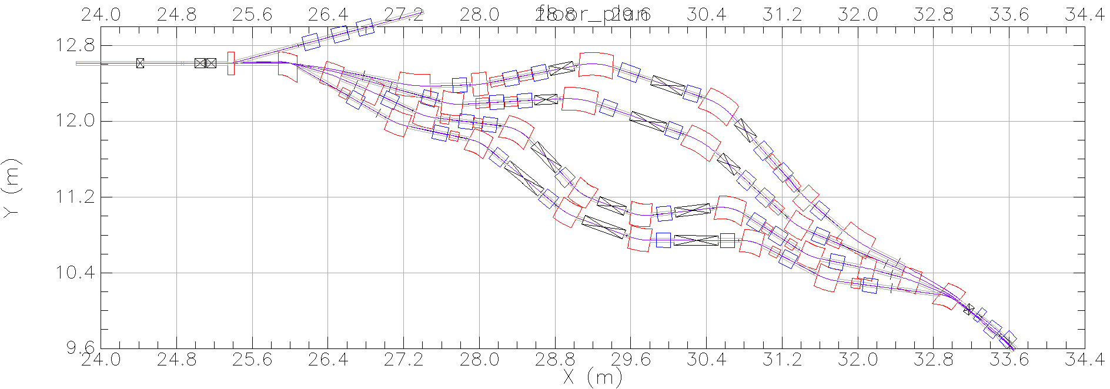
ERLs and RLAs
A beam makes a small number of passes through a linac to be accelerated and (for an ERL) decelerated
Near the entrance and exit of the linac, the beam circulates in different beamlines depending on its energy (i.e., how many times it has passed through the linac)

Slide 6
ERLs and RLAs
Beam passes through the same magnet with different energies and thus different design trajectories: multipass lines
Magnet exit coordinates nonzero, restore to zero once in unshared beamline: patch element

Slide 7
ERLs and RLAs: RF Timing
Time along reference orbit in element may not be design particle time through element
May want to re-synchronize reference time: t_offset or user_sets_length attribute to patch
Avoid having RF voltage/phase changes affect reference time
Use gradient_err attribute of lcavity, autoscale_*=f
Use e_tot_set attribute of patch to set design energies

Slide 8
EIC
EIC also has several places where the design orbit intentionally departs from the magnet axis
HSR forward IR
HSR radial shift
HSR switching dipoles
ESR superbends

Slide 9
EIC: HSR Forward IR
Magnets in HSR forward IR are not aligned to the beam
Magnet apertures driven by requirements to
Transmit collision products to far-forward detectors
Maximize distance to ESR (cross-talk)
Field in first dipole stays fixed independent of collision energy; orbits follow different paths for different configurations
Disconnect between magnet positions and orbits
No obvious design orbit to follow

Slide 10
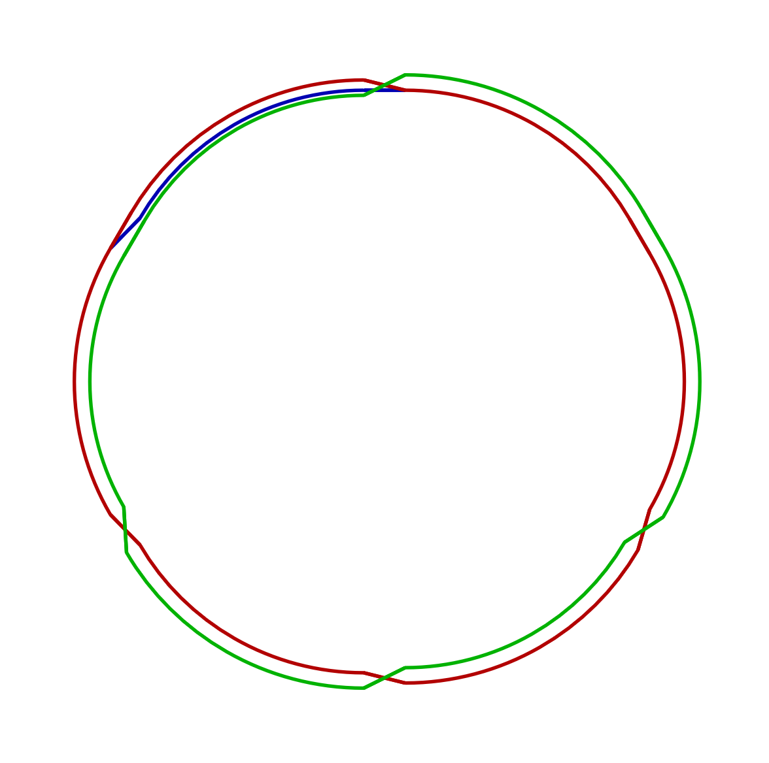
EIC: HSR Radial Shift and Beamline Switch
Three HSR design energies: 41, 100, and 275 GeV
Time of flight must be synchronized to the ESR
100 and 275 GeV use the same beamline, but beam is shifted transversely in the arcs (use dg)
For 41 GeV, use a different line, but common magnets (dg, patch)

Slide 11
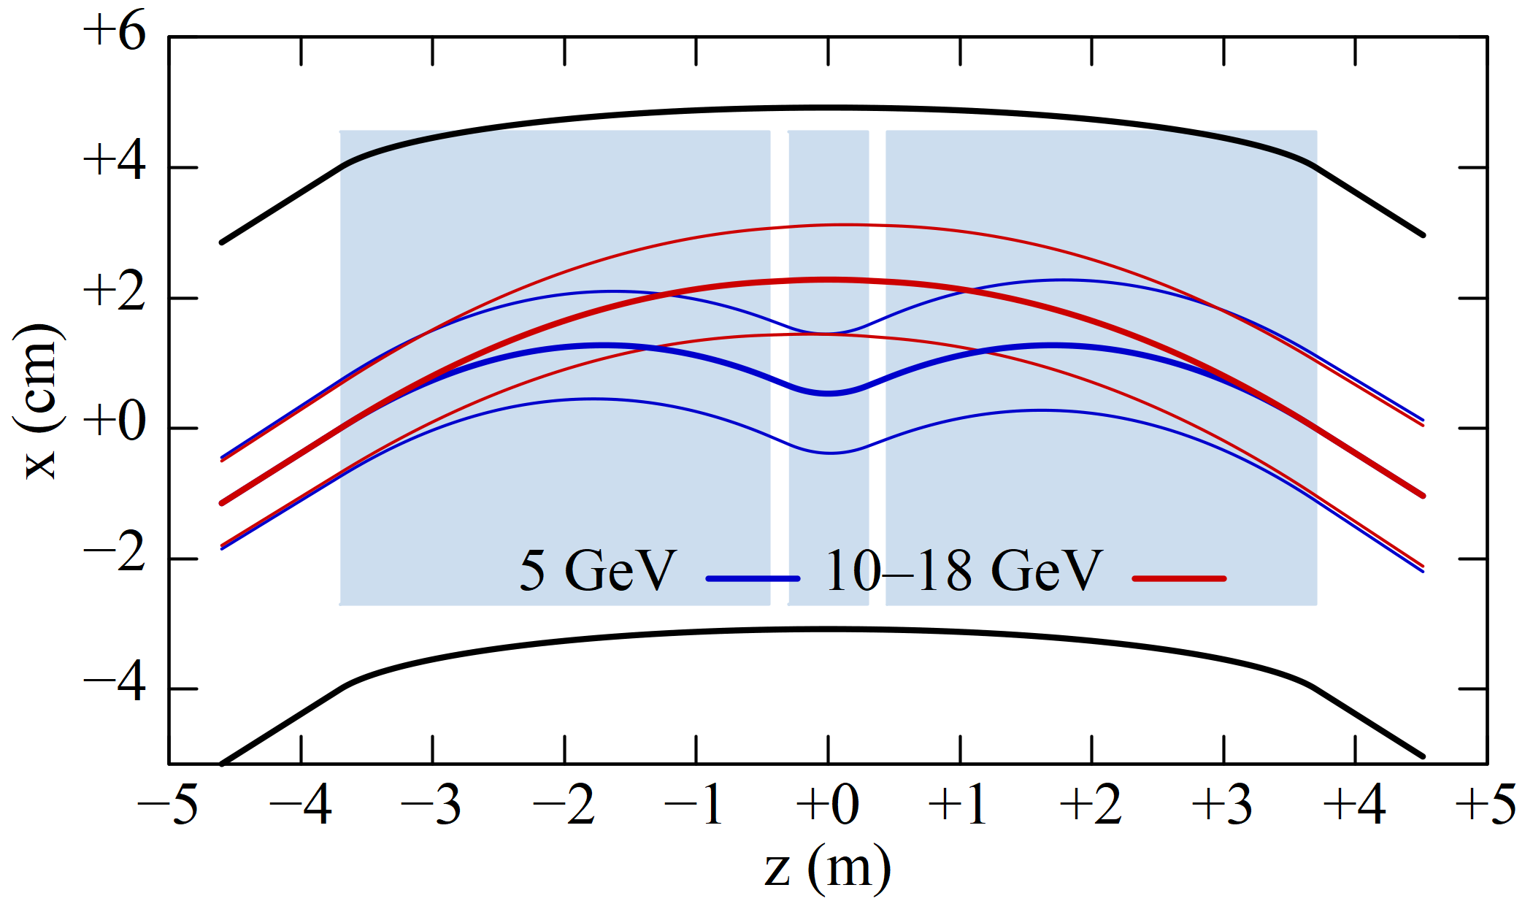
EIC: ESR Superbends
The ESR in the EIC operates at energies of 5, 10, and 18 GeV
We need to make radiation at 5 GeV
To create sufficient damping
To have a large enough emittance
chicane(larc,angle_arc,th2,id) : macro={
l01_arc = l01_str*(0.5*(angle_arc)-(th2))/(sin(0.5*(angle_arc))-sin(th2));
l23_arc = l23_str*(th2)/sin(th2);
l12 = ((larc)*sin(0.5*(angle_arc))/(angle_arc) - l01_str - 0.5*l23_str)/cos(th2);
dccn_id : sequence, l=2*(l01_arc+l12)+l23_arc;
d01a_id : sbend, at=0.5*l01_arc, l=l01_arc,
angle=0.5*(angle_arc)-(th2), e1=0.5*(angle_arc), e2=-(th2);
d23_id : sbend, at=l01_arc + l12 + 0.5*l23_arc, l=l23_arc,
angle=2*(th2), e1=(th2), e2=(th2);
d01b_id : sbend, at = 1.5*l01_arc + 2*l12 + l23_arc, l=l01_arc,
angle=0.5*(angle_arc)-(th2), e1=-(th2), e2=0.5*(angle_arc);
endsequence;
};

Slide 12
EIC: ESR Superbends
Can be done without patches, but ugly
Implementation with patches much cleaner
Geometry never changes!
And better for adding magnet errors
p: patch, x_pitch=0.5*angle_arc
d01: sbend, l=l01_str
o12: drift, l=l12_str
d23: sbend, l=l23_str
dccn: line=(p,d01,o12,d23,o12,d01,p)
ov_dccn: overlay={
d01[dg] : ...,
d23[dg] : ...}, var={th2}
chicane(larc,angle_arc,th2,id) : macro={
l01_arc = l01_str*(0.5*(angle_arc)-(th2))/(sin(0.5*(angle_arc))-sin(th2));
l23_arc = l23_str*(th2)/sin(th2);
l12 = ((larc)*sin(0.5*(angle_arc))/(angle_arc) - l01_str - 0.5*l23_str)/cos(th2);
dccn_id : sequence, l=2*(l01_arc+l12)+l23_arc;
d01a_id : sbend, at=0.5*l01_arc, l=l01_arc,
angle=0.5*(angle_arc)-(th2), e1=0.5*(angle_arc), e2=-(th2);
d23_id : sbend, at=l01_arc + l12 + 0.5*l23_arc, l=l23_arc,
angle=2*(th2), e1=(th2), e2=(th2);
d01b_id : sbend, at = 1.5*l01_arc + 2*l12 + l23_arc, l=l01_arc,
angle=0.5*(angle_arc)-(th2), e1=-(th2), e2=0.5*(angle_arc);
endsequence;
};

Slide 13
Final Thoughts
Ability manage design orbits that are not tightly coupled to the geometric layout is an important feature of Bmad that greatly simplifies design of complex accelerators.
Significant barriers to doing things this way
Habitual mode of thinking
Lack of support in other accelerator codes
I haven’t made much use of the ability to drop in field maps, add errors
Correct handling of large angles, offsets, and energy deviations important

