Slide 1


Project # 2 (Year 6):
Applications of Machine Learning in compact Photoinjectors
Presenter: Aasma Aslam (Machine Learning expert)
Supervisor: Dr. Sandra Gail Biedron
Research Team: University of New Mexico (Aasma Aslam, Sandra Biedron)
Brookhaven National Laboratory (Marcus Babzien)
Funding source:
Center for Bright Beams (CBB), support of the National Science Foundation and Technology Center (NSF).

Slide 2
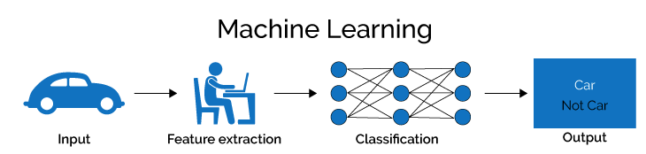
What is Machine Learning
Machine learning is the concept that a computer program can learn and adapt to new data without human intervention.

Slide 3
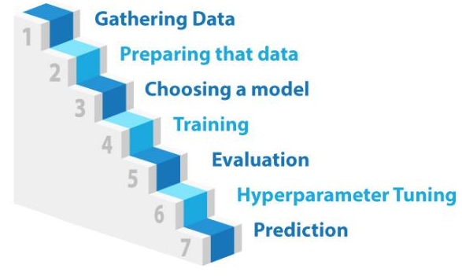
Steps of Machine Learning

Slide 4
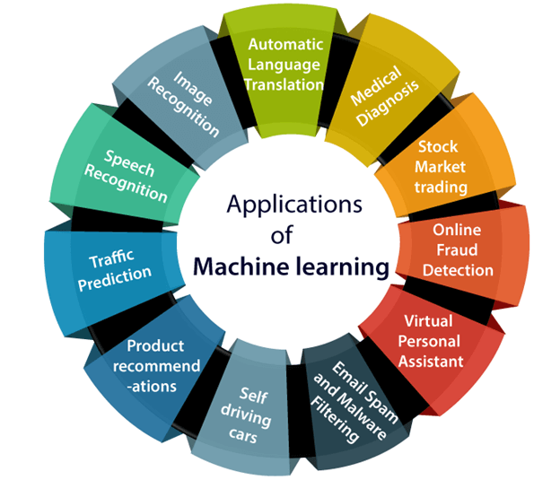
Applications of Machine Learning

Slide 5
The research methodology of the work can be summarized simply by breaking the work into the following steps.
Research Methodology
Developing the NN
Demonstrating the Control using NN
Modeling
Training of the NN and loading process
Testing the model.

Slide 6
Abstract
In this research, our goal is to reliably tune a laser and photoinjector system suite to deliver the desired electron bunch.
The drive laser, cathode uniformity, the cathode quantum efficiency, and the electron gun (RF and solenoid/steering magnets) must be able to be adjusted with high precision.
At the ATF, the fine-tunability of the laser parameters are of extreme importance as we try to model further applications of the photoinjector.
The laser pulse incident on the photocathode critically affects the bunch 3D phase space. In our program we are implementing a spatial light modulator to manipulate the phase space.

Slide 7
Activities of the Project
Configuration of the Photoinjector
To configure a photoinjector to reproduce a given electron bunch with the desired characteristics, it is necessary to adjust the operating parameters with high precision. The fine-tunability of the laser parameters are of extreme importance as we try to model further applications of the photoinjector.

Slide 8
Activities of the Project
Parameter
Control
Parameters such as the Laser pulse transverse shape, total energy, and temporal profile (fixed) must be controlled independently, and undesired laser pulse variation over both short and long-time scales also requires correction.
Control of Electron Bunch
.
The ability to produce arbitrary laser intensity distributions enables better control of electron bunch transverse and longitudinal emittance by affecting the space-charge forces throughout the bunch.

Slide 9
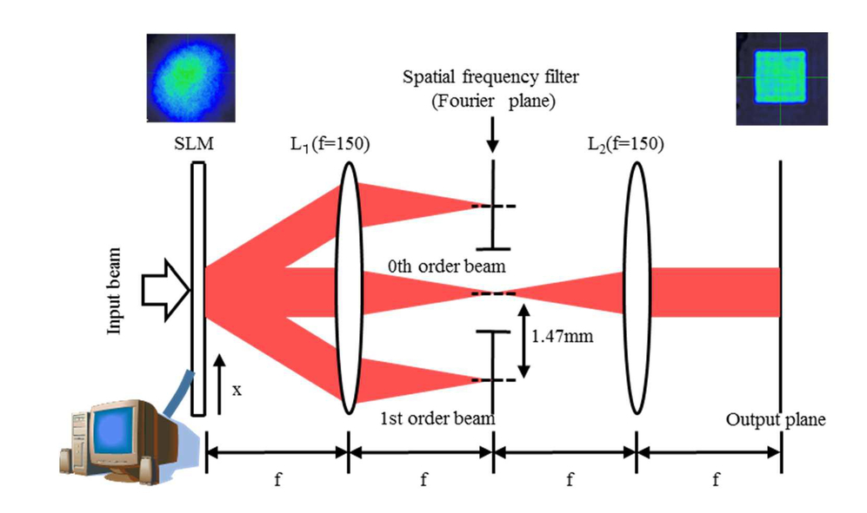
Drive laser optical layout
Spatial Light Modulator (SLM) will modulate phasefronts and cause beam reshaping through diffraction
Inserting SLM between second and fourth harmonic generation crystals allows device to operate at optimum efficiency and damage threshold
Modulated green beam profile is transferred to UV and imaged to photocathode
Higher-order energy diffracted out of central beam is filtered by aperture or limited acceptance angle of fourth harmonic crystal (~few mradian).

Slide 10
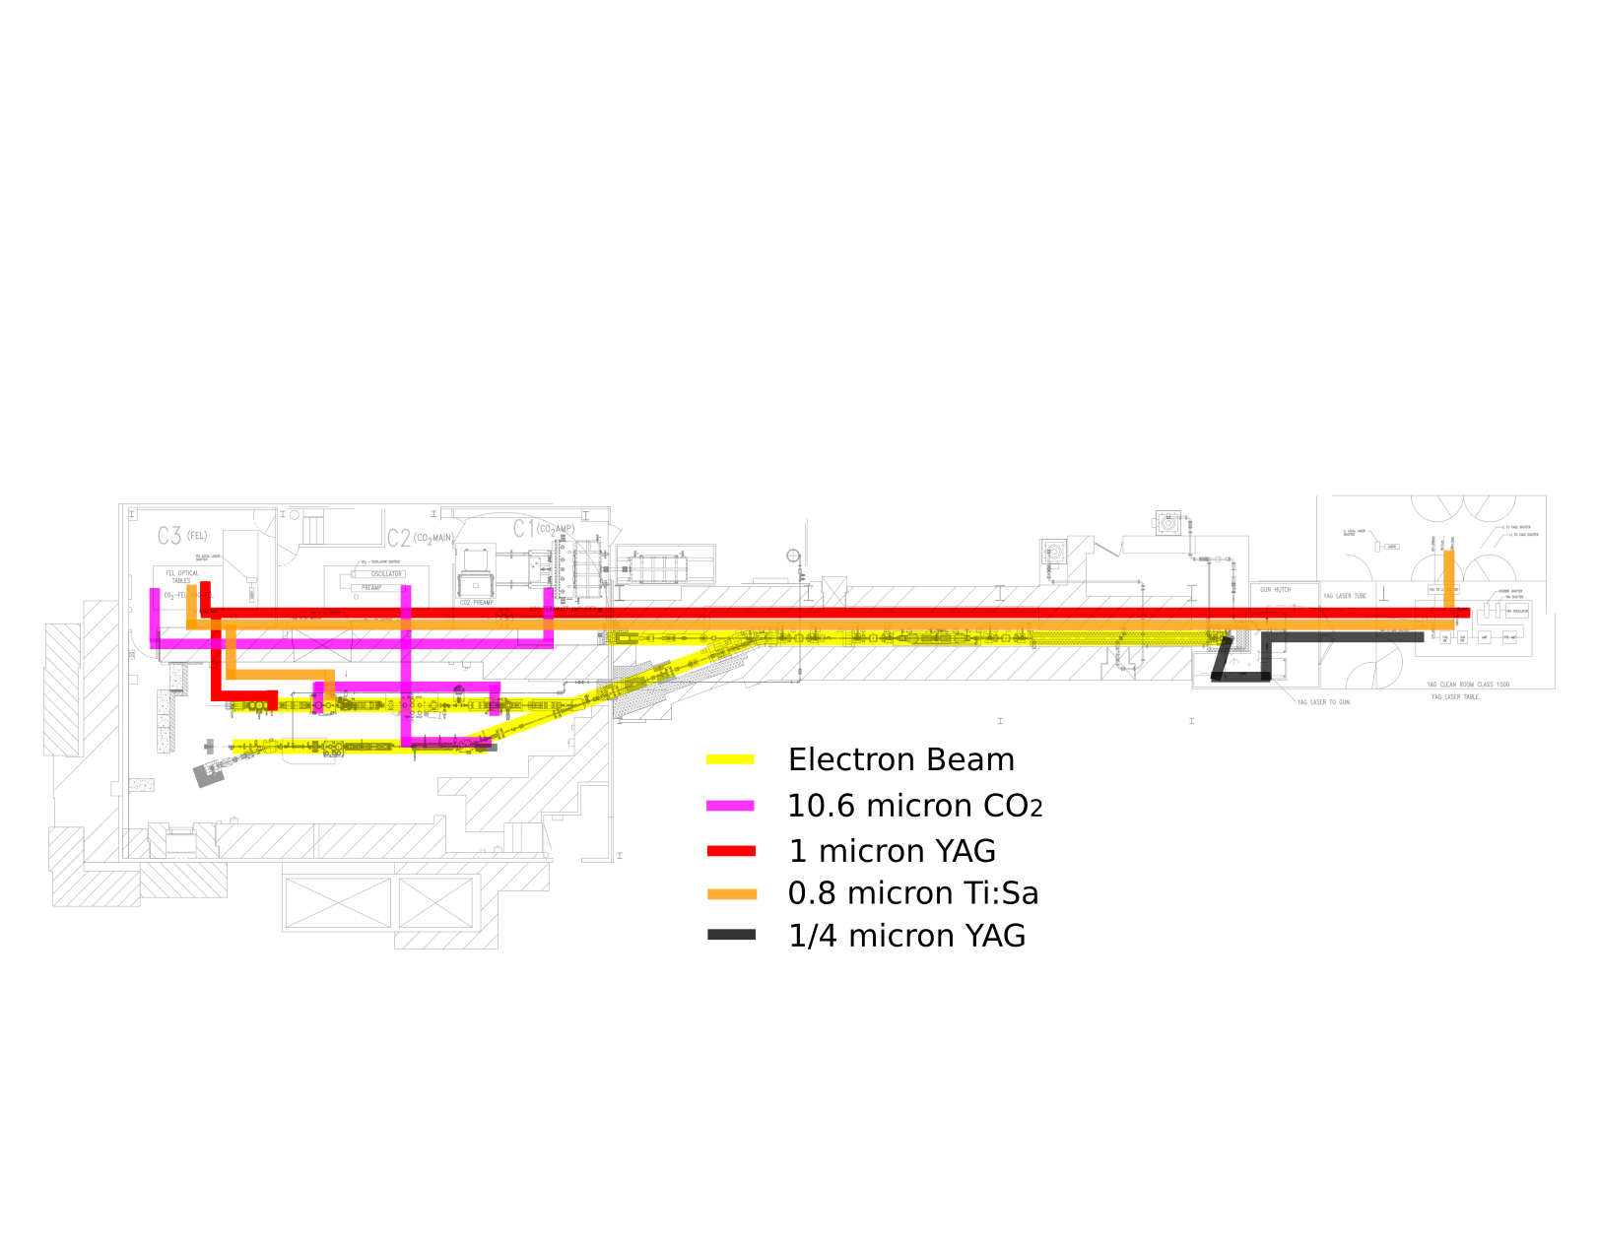
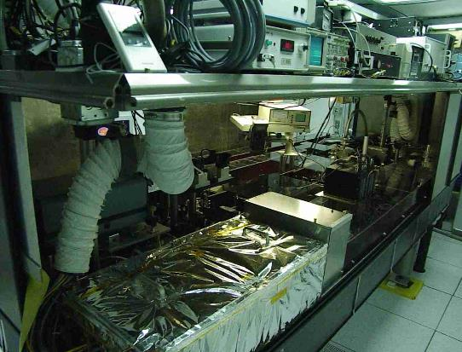
Laser delivery to photoinjector already incorporates Fourier relay imaging transport from laser room
YAG Laser Room
Harmonic generation and SLM location

Slide 11
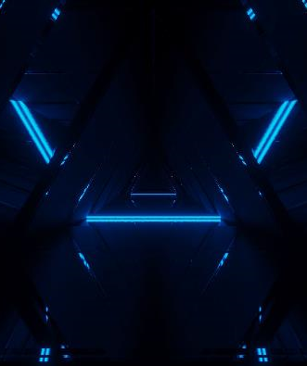
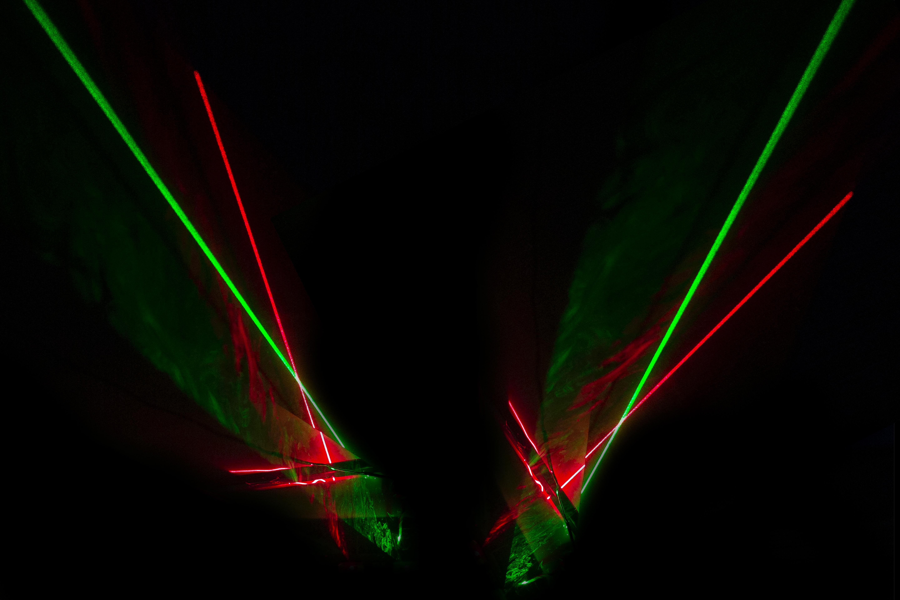
Experimental setup: Detail
Optical configuration consists of a series of image planes transferred through the system by lens pairs in a 4f arrangement.
An initial object plane is repeatedly imaged to critical elements such as amplifiers and harmonic generation crystals in the laser system, and finally to the photocathode.
This will also enable the use of a spatial light modulator (SLM) between the two harmonic generation crystals for intensity control of the second harmonic of the ATF Nd: YAG laser at 532 nm.
Subsequent fourth harmonic generation and image relaying will allow the profile at the photocathode to be controlled and optimized.

Slide 12
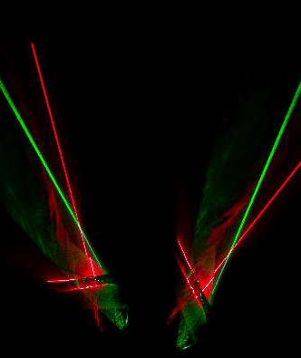
Experiemtal setup:detail
Shaping optics are usually placed close to the photocathode, and diagnostic elements are also as close to the photo-emission gun as possible to provide accurate measurements of laser parameters on the photocathode.
Commonly used metal photocathodes are very robust and long-lived in operation.
Their work functions are 3-4 eV, and so UV laser pulses are used to generate photoemission, with typical wavelengths between 250-300 nm.
This places stringent requirements on optical fabrication tolerances that are rarely achieved in practice.

Slide 13
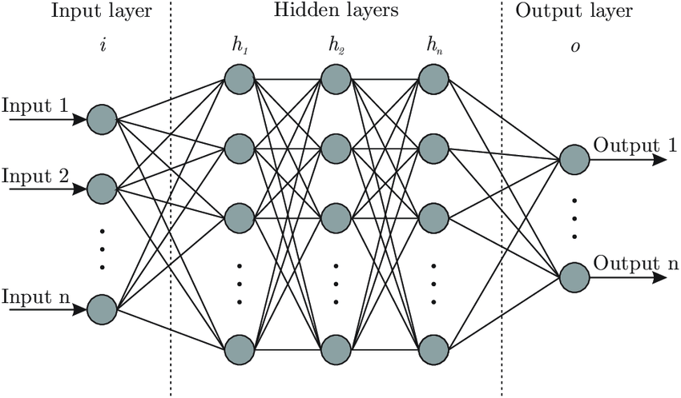
Developing the NN:
Surrogate Model
We will apply a Feedforward Neural Network (FFNN) with different numbers of layers and with different Inputs.
The feed-forward model is the simplest form of a neural network as information is only processed in one direction. While the data may pass through multiple hidden nodes.

Slide 14
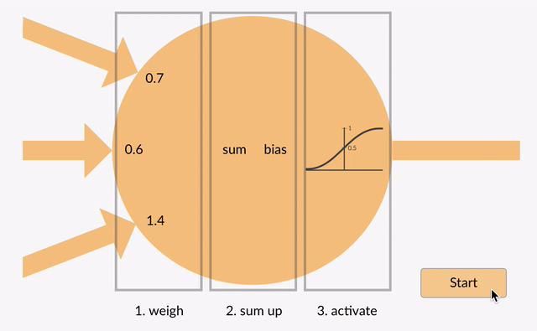
Developing the NN:
An Artificial Neural Network (ANN) is made up of
many interconnected neurons:
How each neuron works?
How Each Neutron Works
The neuron’s output value (e.g. -0.05) is often an input for another neuron.

Slide 15
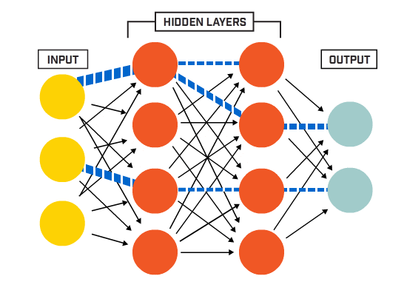
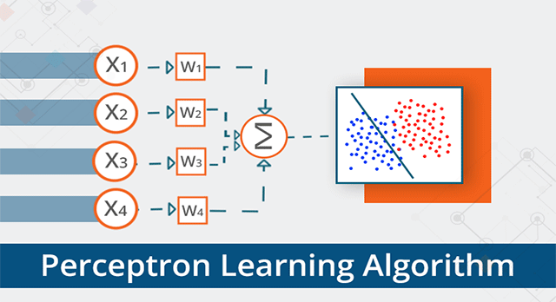
Developing The NN: Steps for Feed forward Neural Networks
The output of the perceptron’s acts as the final prediction.

Slide 16
The FFNN contains:
Developing the
Neural Network
01
      Training set
02
      Adaption set
www.companyname.com

Slide 17
The choice for training function is plenty especially for a FFNN such as:
Developing the
Neural Network
01
      Levenberg-Marquardt.
Gradient descent method and Gauss-Newton method.
02
      Bayesian Regularization.
03
      Scaled Conjugate Gradient.
www.companyname.com

Slide 18
      Levenberg-Marquardt is used for training.
01
02
Tansig symmetric sigmoid transfer function.
Review of Training and Testing Process
03
Nguyen-widrow layer for optimization.
      Sequential order incremental adoption.
04
05
Gradient descent with momentum.
06
Mean squared error for performance measurement.
07
70% of the data will be taken for training, 15% for validation and 15% for testing.
www.companyname.com

Slide 19
Modelling the Laser
To model this complex system using ML, we will initially use few data points to train the NN.
Later, we will increase the data points to train the NN and for comparison of the small and large dataset results, first we will use 5, 10, and then 15 neurons in three hidden layers. We will use the remaining points to validate the results to find the computed outputs are closer or far from the target values.

Slide 20

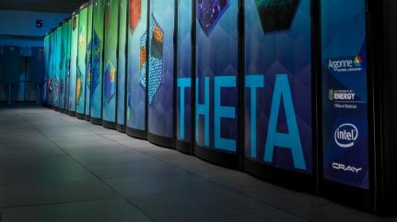
Argonne Leadership Computer Facility
Our AI for accelerators projects have allocations at the ALCF’s THETA supercomputer.
We currently use THETA for:
  simulations using VSim.
  Deep learning and optimization.
  Surrogate models
  Training of AI-based controllers.
THETA is a 11.69 petaflops system based on the second-generation Intel® Xeon Phi™ processor, 281,088 cores.
For more information: https://www.alcf.anl.gov/theta

Slide 21
Literature Reference
Ultraviolet laser transverse profile shaping for improving x-ray
free electron laser performance
Adaptive electron beam shaping using a photoemission gun
and spatial light modulator
Li et. al. demonstrated that ultraviolet laser transverse profile shaping could be utilized to improve X-ray free electron laser performance [7].
On the other hand, Maxson et. al. [8] used a SLM for shaping the drive laser of a dc photoemission gun.
The authors employed a digital micromirror device to control the shape of a 253 nm drive laser at the linear coherent light source.
The authors created a simple shaping algorithm which results in a detailed transverse laser shaping with very high fidelity.
An active feedback system was put in place which would take the unshaped electron beam image, and then create accurate detailed laser shaping further contributing to better efficiency.
However, due to the low damage threshold of the digital micromirror in the UV, the work is limited in its applications

Slide 22
Training Process Methods
First Method
In this project, we aim to use a liquid crystal based SLMs to control the transverse shape of the second harmonic of a Nd:YAG laser at 532 nm.
  An image of the photocurrent can be formed downstream with the magnetic optics that reproduces the emission profile at the photocathode.
  This profile can then be recorded by phosphor screen and camera. Image analysis will then permit the quality of fit between the ideal and measured emission profiles to be calculated and used as a fitness function to train the neural network.
Nd:YAG laser at
532nm
In order to enable optimization of laser profile for a specific photoinjector and electron beam parameters, a learning phase is required to train the neural network.
Second Method
  Second, at each iteration of the neural network-controlled laser profile, an emittance scan can be performed with the magnetic optics and beam profile monitors, and the beam emittance calculated for use as a fitness function
  .
  These two methods can be compared for efficiency and may prove to be complimentary.

Slide 23
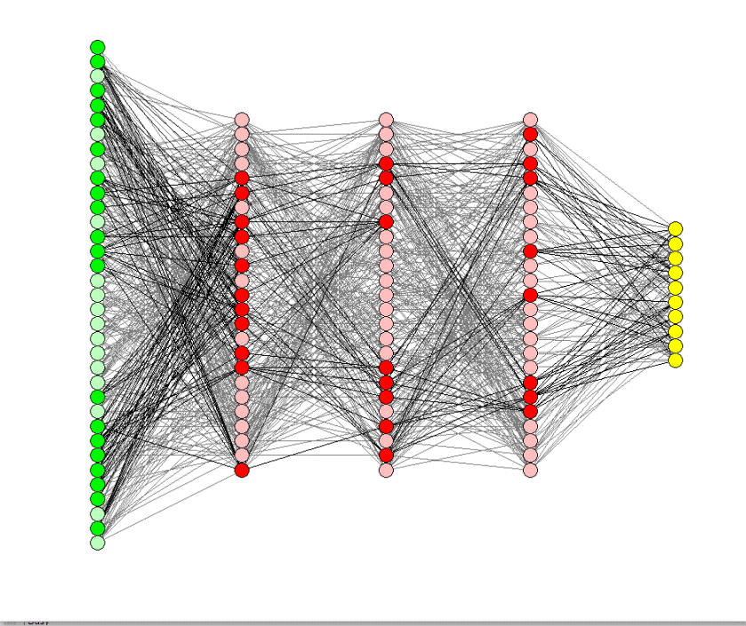
Experimental detail: Surrogate Model
We will apply Feedforward Neural Network (FFNN) or Fit Regression NN (FRNN)with the different number of layers and Neurons. The feed-forward model is the simplest form of a neural network as information is only processed in one direction. While the data may pass through multiple hidden nodes. Schematic for the internal structure of the feedforward Neural Network is given below:
Inputs
Outputs
Hidden layers

Slide 24
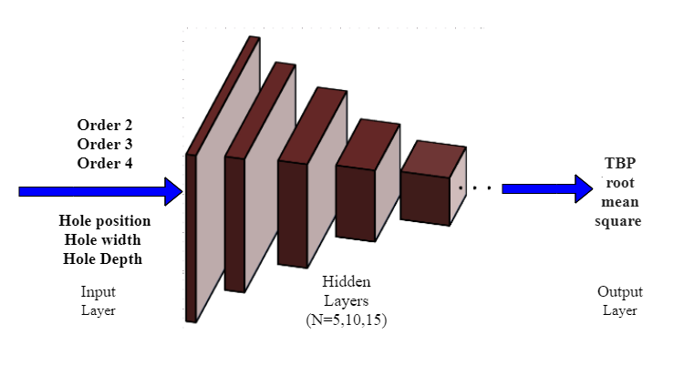
Experimental detail: Surrogate Model
Control of Electron Bunch
Parameter
Control
Inputs:
Outputs:

Slide 25
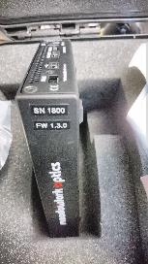
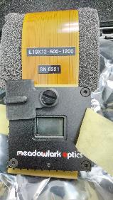
We received a device and cabling a couple of weeks ago, as seen in the attached photos.

Slide 26
Current Status
1) Surveyed available SLM hardware and designed best method to integrate functionality with ATF drive laser
2) Worked with vendors to identify best candidate devices from available models
3) Down-selected vendor and model
4) Worked with vendor to identify possible issues
5) Plan to test SLM for optical damage limits to reduce risk
6) Negotiated damage testing protocol and timeline
7) Identified ancillary optics and interface components
8) Beginning to refine code interface and defining proper pathway
9) Discussion for ATF running Schedule and location at ATF
10) Purchased SLM
11) Ready to run experiment
Notes:
l

Slide 27
Current Status (change all to past)
12) Registration of BNL user guest account
13) Surveyed Machine Learning Algorithms
14) Once we receive data set then we will be able to implement our machine learning approach
15) VSIM installation and data Generation
16) Learning ALCF (Theta) for further research
17) Research Articles
Notes:
l

Slide 28
Current Status
Submission of recent work at IPAC22 paper + Poster Presentation
Submission of recent work at NAPAC22 paper + Poster Presentation
Poster Presentation at 3rd ICFA Beam Dynamics Mini-Workshop on Machine Learning Applications for Particle Accelerators, Hosted by Brookhaven National Laboratory November 1–4, 2022
Research article for the Journal named “ Nuclear Instruments and Methods in Physics Research Section A: Accelerators, Spectrometers, Detectors and Associated Equipment”. Partially accepted: Under 3rd Revision (Previous Project)
Research article for the Journal named “ Nuclear Instruments and Methods in Physics Research Section A: Accelerators, Spectrometers, Detectors and Associated Equipment”. Write up process (Recent Project)
Outcomes

Slide 29
Future Scope
The future scope of this work includes investigating dependence on the number of layers, number of neurons, type of NN and many other parameters to evaluate the performance of our NN and its variants.
We will automate method for optimizing the number of layers, number of nodes, choice of NN.
We are also planning to test this approach experimentally at BNL and to obtain data sets to refine our model to reliably modeling the complex system.
As large amounts of labeled experimental data are generally needed, it is a challenge to collect data and label suitable data in the case of CNN. Additionally, in the future we can use a variation in the feedforward network.

Slide 30
S. Li, S. Alverson, D. Bohler, A. Egger, A. Fry, S. Gilevich, Z. Huang, A. Miahnahri, D. Ratner, J. Robinson, and F. Zhou, “Ultraviolet laser transverse profile shaping for improving x-ray free electron laser performance” Phys. Rev. Accel. Beams 20, 080704 – Published 17 August 2017.
J. Adnan, N. G. N. Daud, M. T. Ishak, Z. I. Rizman, and M. I. A. Rahman, “Tansig activation function (of MLP network) for cardiac abnormality detection,” in AIP Conference Proceedings, vol. 1930, no. 1.AIP Publishing LLC, 2018, p. 020006.
M. Wayahdi, M. Zarlis, and P. Putra, “Initialization of the Nguyen-Widrow and Kohonen algorithm on the backpropagation method in the classifying process of temperature data in Medan,” in Journal of Physics:Conference Series, vol. 1235, no. 1. IOP Publishing, 2019, p. 012031.80
Z. Zhang, S. Liu, Y. Zhang, C. Wang, S. Zhang, Z. Yang, and W. Xu, “Optimization of low-power femtosecond laser trepan drilling by machine learning and a high-throughput multi-objective genetic algorithm,” Optics & Laser Technology, vol. 148, p. 107688, 2022.
H. Yu and B. M. J. I. e. h. Wilamowski, "Levenberg-marquardt training," vol. 5, no. 12, p. 1, 2011.
. H. Moayedi, B. Aghel, B. Vaferi, L. K. Foong, D. T. J. J. o. P. S. Bui, and Engineering, "The feasibility of Levenberg–Marquardt algorithm combined with imperialist competitive computational method predicting drag reduction in crude oil pipelines," vol. 185, p. 106634, 2020.
References

Slide 31
7. J. Adnan, N. G. N. Daud, M. T. Ishak, Z. I. Rizman, and M. I. A. Rahman , "Tansig activation function (of MLP network) for cardiac abnormality detection", AIP Conference Proceedings 1930, 020006 (2018) Zhu, P., Zhu, Y., Hidaka, Y., Wu, L., Cao, J., Berger, H., ... & Tobey, R. I. (2015). Femtosecond time-resolved MeV electron diffraction. New Journal of Physics, 17(6), 063004.
8. Accelerator Test Facility.” BNL, www.bnl.gov/atf.
11. A. Aslam, S. Biedron, M. Martinez-Ramon, S. Sosa, Y. Ma, J. Murphy, K. Krushelnick, "Convolutional neural network-based control of plasma dynamics by spatial deformation of the ultrafast pulsed laser wavefront," manuscript in preparation for Nuclear Instruments and Methods A.
References

