Slide 1

Center for
BRIGHT BEAMS
A National Science Foundation Science & Technology Center
​Building the ASU Cryogun beamline as a photocathodes testing platform
Gevork S. Gevorkyan
October 2022
Ggevorky@asu.edu

Slide 2
​Building the ASU Cryogun beamline as a photocathodes testing platform
Contents:
Purpose of this project
Gun design and assembly
Gun cryogenic cooling
Gun voltage conditioning
Design of the beamline for cathode diagnostics
P. Musumeci, et al, Nucl. Instrum. Meth. A, 907, 209 (2018)
W. H. Li, et al, Structural Dynamics 9.2 024302 (2022)

Slide 3
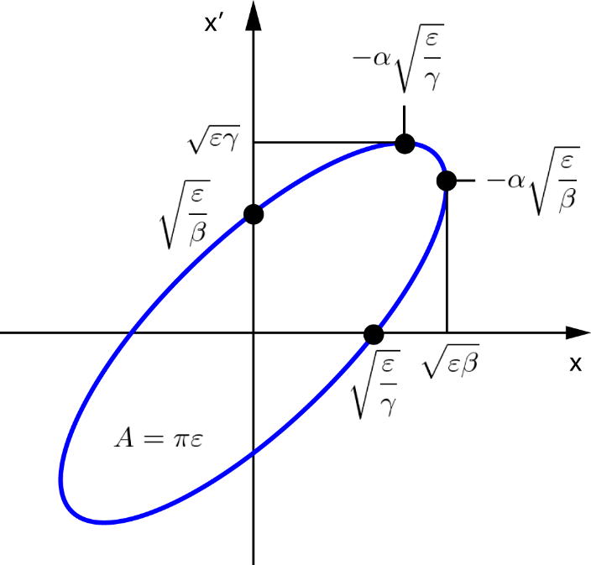
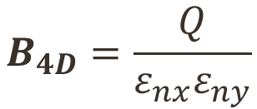


Purpose – Brightness and Emittance
$$B_{4D}=\frac{Q}{ε_{nx}ε_{ny}}$$
$$ε_{n, rms}=\frac{1}{m_{0}c}\sqrt{\left\langle x^{2}\right\rangle \left\langle p_{x}^{2}\right\rangle −{\left\langle xp_{x}\right\rangle }^{2}}$$
$$ε_{tr, rms}=\sqrt{\left\langle x^{2}\right\rangle \left\langle {x^{′}}^{2}\right\rangle −{\left\langle xx^{′}\right\rangle }^{2}}$$
Beam emittance is
the area occupied in
phase space by the
particle distribution

Slide 4
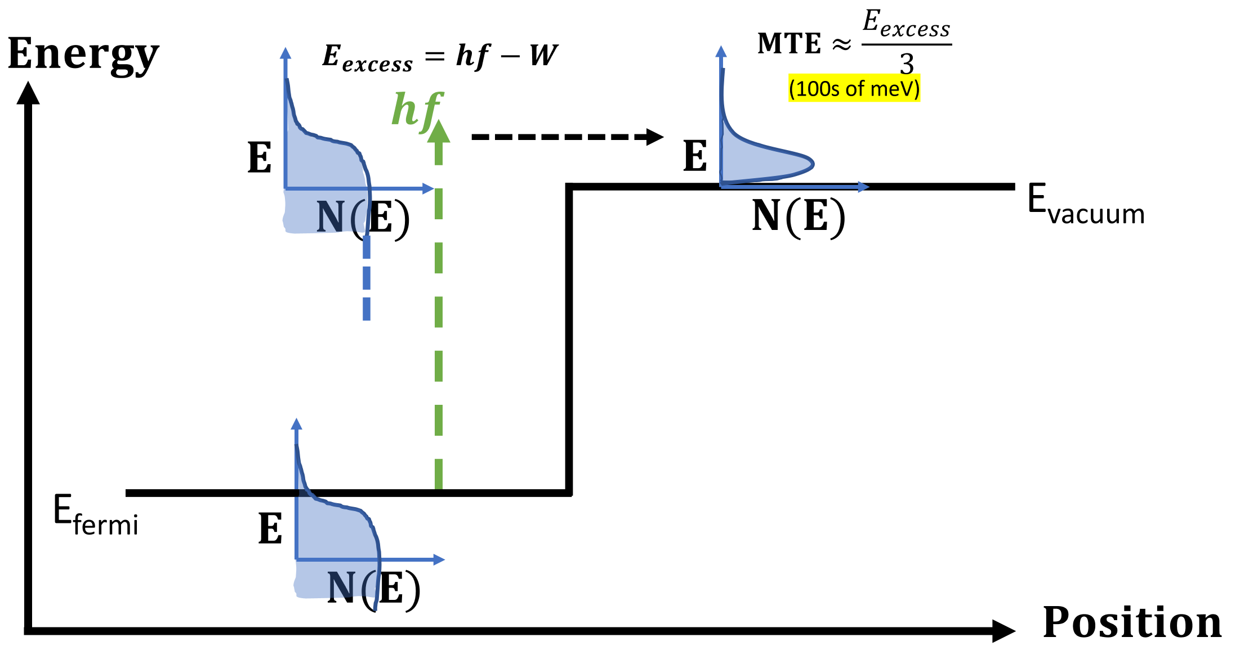


Photocathode and Emittance
$$B_{4D}∝\frac{E_{0}^{n}}{MTE}$$
$$ε_{n,rms}=σ_{i}\sqrt{\frac{MTE}{m_{e}c^{2}} }$$
D. H. Dowell, J. F. schmerge, Phys. Rev. STAB, 12, 074201 (2009)

Slide 5
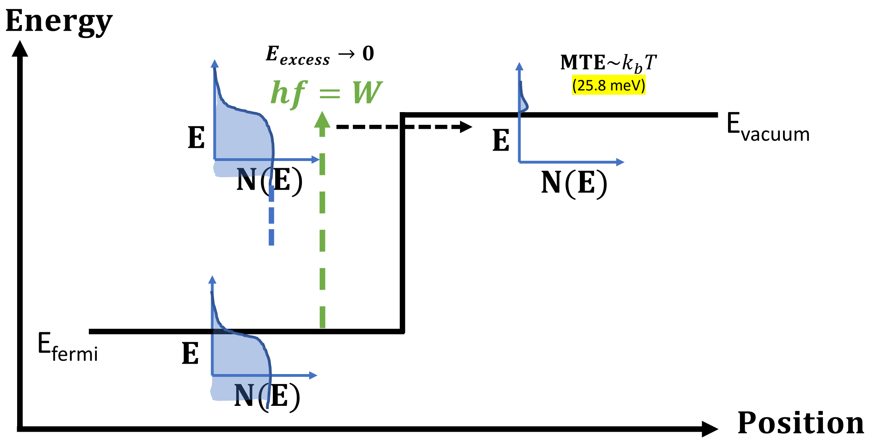


Photocathode and Emittance
$$B_{4D}∝\frac{E_{0}^{n}}{MTE}$$
$$ε_{ni}=σ_{i}\sqrt{\frac{MTE}{m_{e}c^{2}} }$$
D. H. Dowell, J. F. schmerge, Phys. Rev. STAB, 12, 074201 (2009)

Slide 6
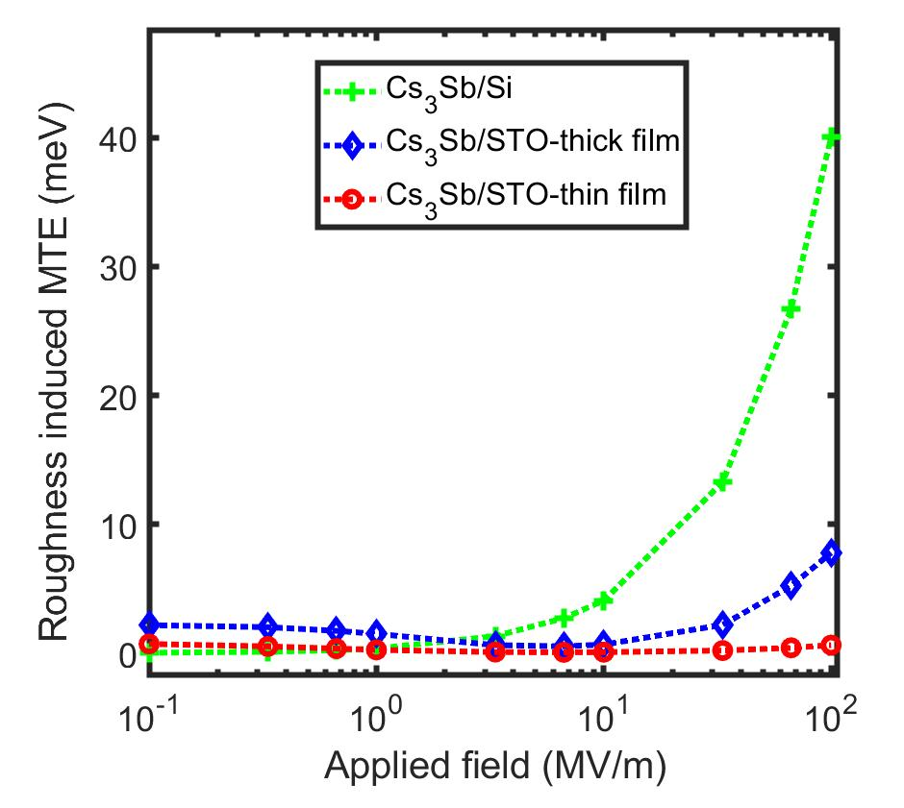
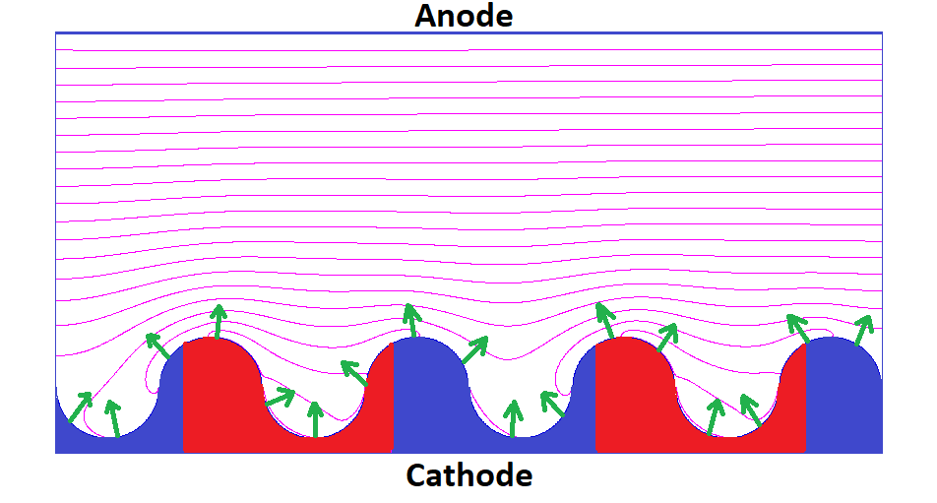




Photocathode and Emittance
$$B_{4D}∝\frac{E_{0}^{n}}{MTE}$$
Rough vs Smooth Cs₃Sb
Non-linear Photoemission
Thermal Effects
Physical Roughness
Chemical Roughness
…
$$MTE\sim k_{b}T$$
$$MTE ∝ E_{0}$$
$$MTE ∝E_{0}^{−1}$$
Photocathode Cartoon
Need atomically ordered surface, cold photocathodes!
G. Gevorkyan, et al. Phys. Rev. STAB, 21, 093401 (2018)
P. Saha, et al., Appl. Phys. Lett. 120, 194102 (2022)

Slide 7
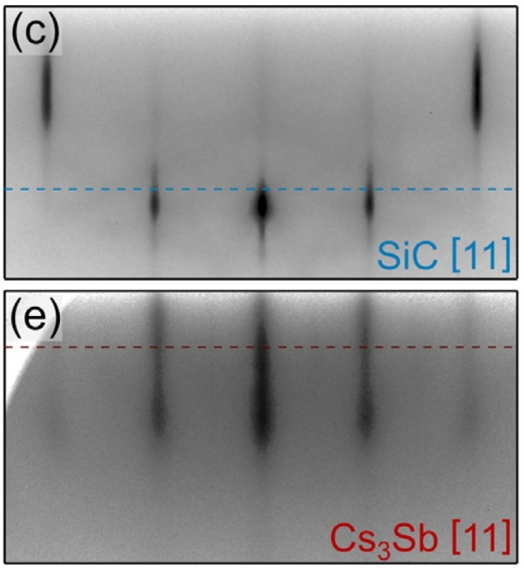
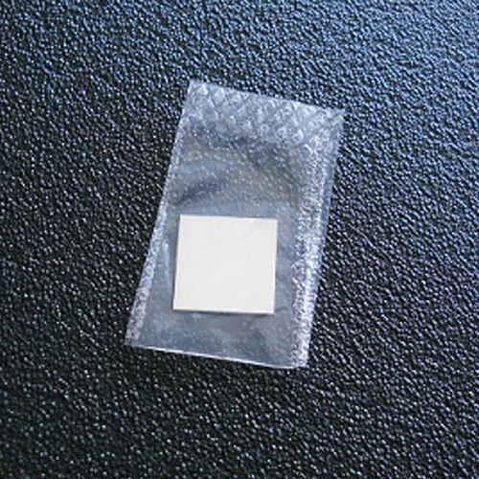
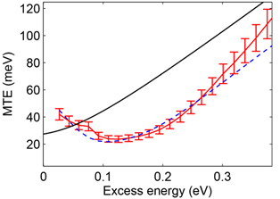
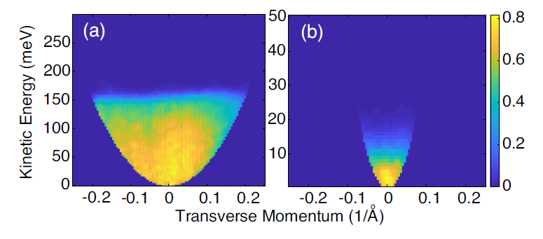

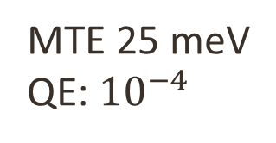
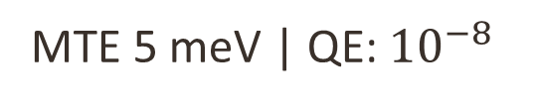

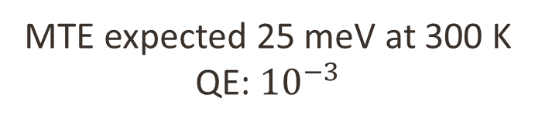
Photocathode and Emittance
Ag (111)
MTE 25 meV
QE: ${10}^{−4}$
RHEED Cs₃Sb (SiC)
Cu (100)
Total
Transverse
MTE expected 25 meV at 300 K
QE: ${10}^{−3}$
S. Karkare, et al, Phys. Rev. Lett., 118, 164802 (2017)
S. Karkare, et al, Phys. Rev. Lett., 125, 054801 (2020)
A. Galdi, et al, Phys. Rev. Lett. 128, 114801 (2022)
MTE 5 meV | QE: ${10}^{−8}$

Slide 8
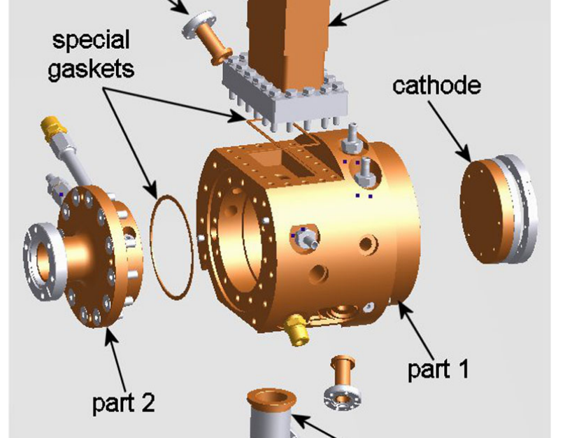
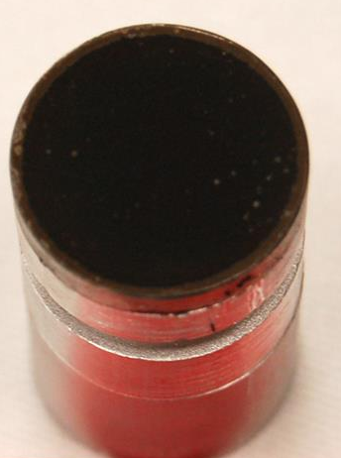
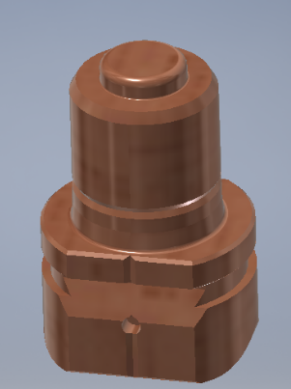
RF and DC Electron Guns
RF Guns
DC Guns
INFN Cathode
Emission from backplate (copper)
D. Alesini, et al, Phys. Rev. Lett. STAB, 18, 092001, (2015)

Slide 9
​Building the ASU Cryogun beamline as a photocathodes testing platform
Contents:
Purpose of this beamline
Gun design and assembly
Gun cryogenic cooling
Gun voltage conditioning
Design of the beamline for cathode diagnostics
P. Musumeci, et al, Nucl. Instrum. Meth. A, 907, 209 (2018)
W. H. Li, et al, Structural Dynamics 9.2 024302 (2022)

Slide 10
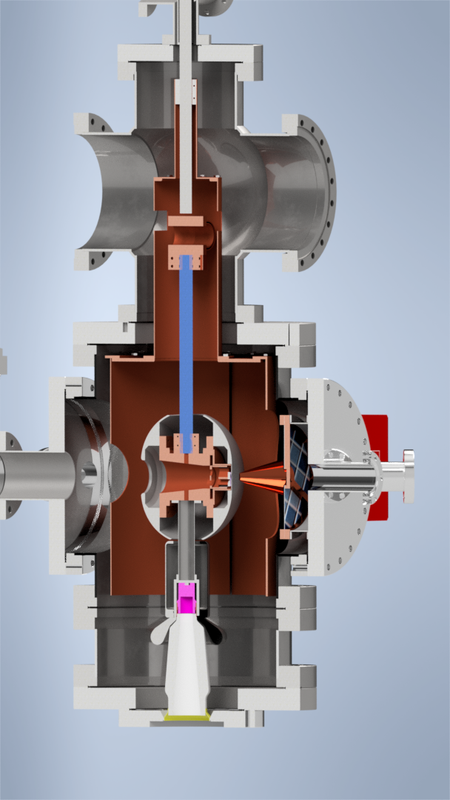
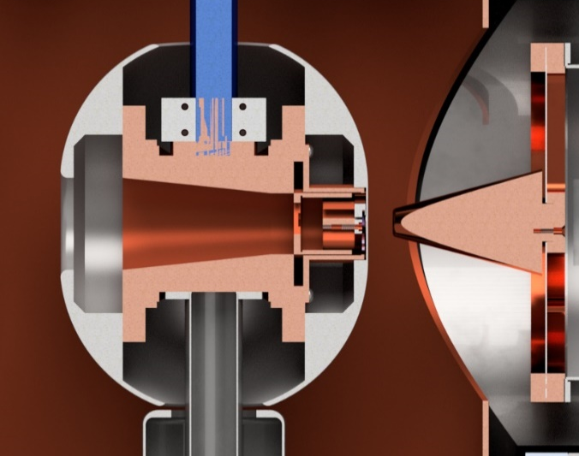
ASU Cryocooled DC Electron Gun
A – Cryostat
Based on Cornell’s
Cryogun Design
B – Sapphire rod
C – Cryoshielding
D – Thin Wall Tube
E – HV plug
F – Omicron Paddle
G – Pierce Electrode
H – Conical Anode
H. Lee, et al, Rev. Sci. Instrum., 89, 083303, (2018)
G. Gevorkyan, et al, Proc. NAPAC’19 OPLM16 (2019).

Slide 11
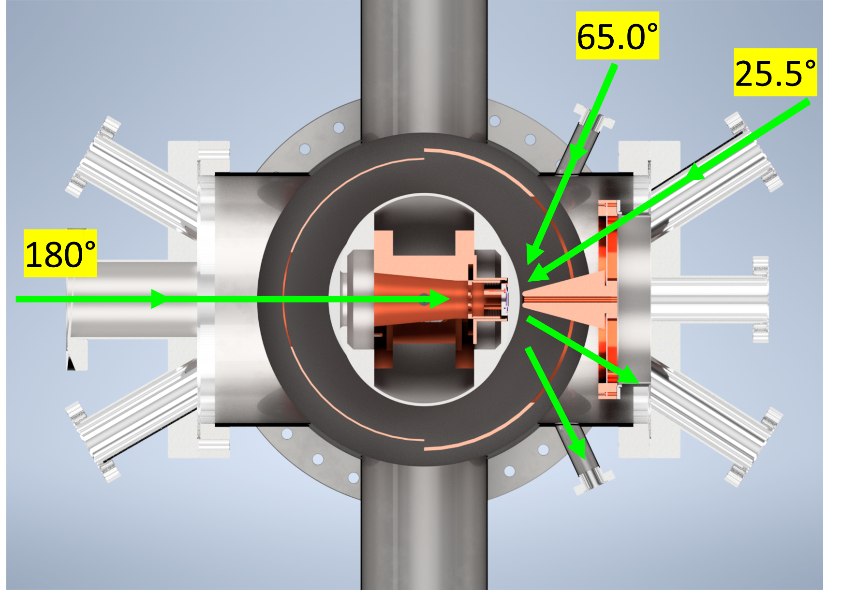
ASU Cryocooled DC Electron Gun
Pump
Pump

Slide 12
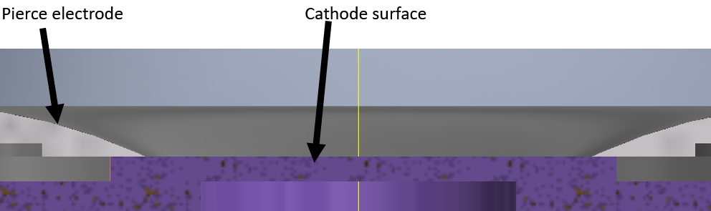
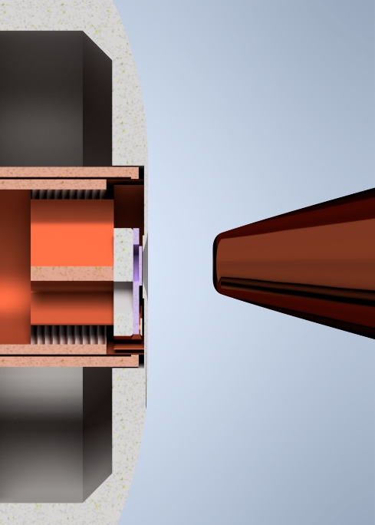
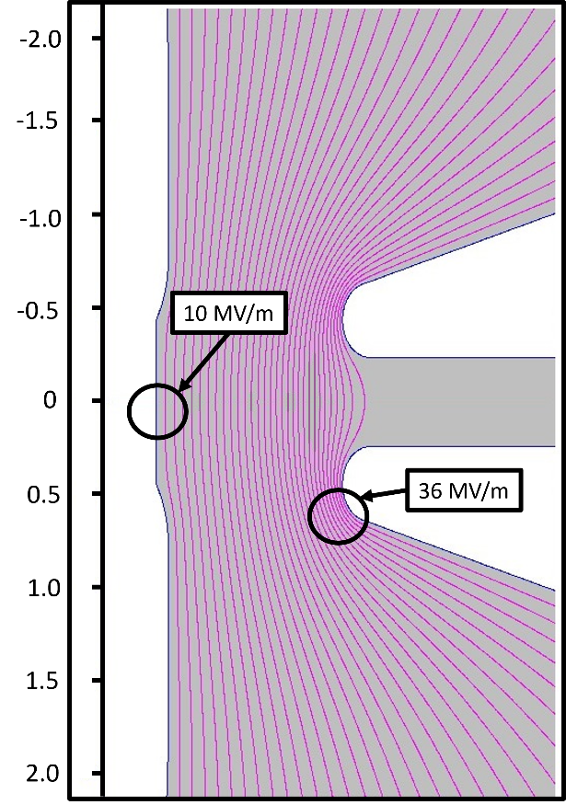
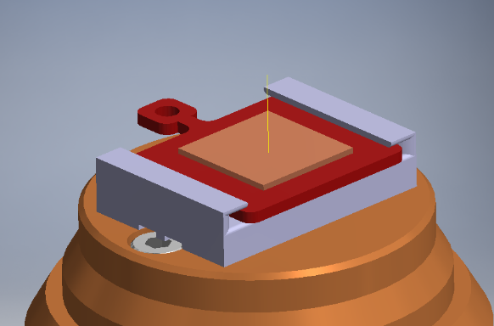
ASU Cryogun - Cathode
10 MV/m at 200 kV
Omicron Paddle

Slide 13
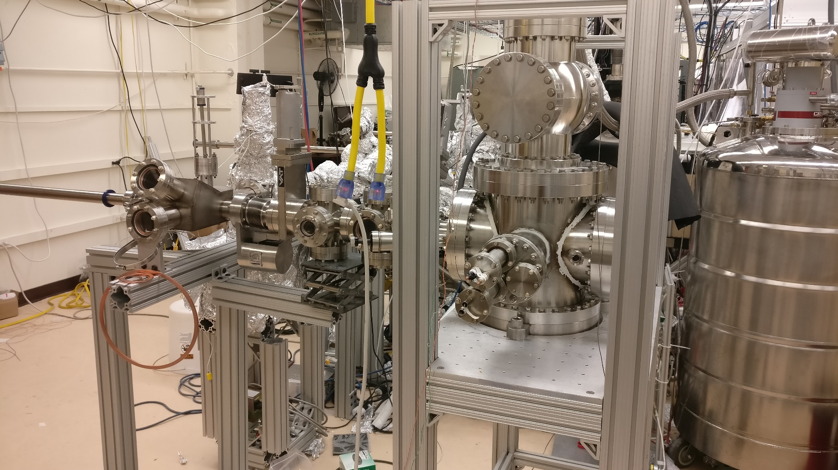
ASU Cryogun - Cathode

Slide 14
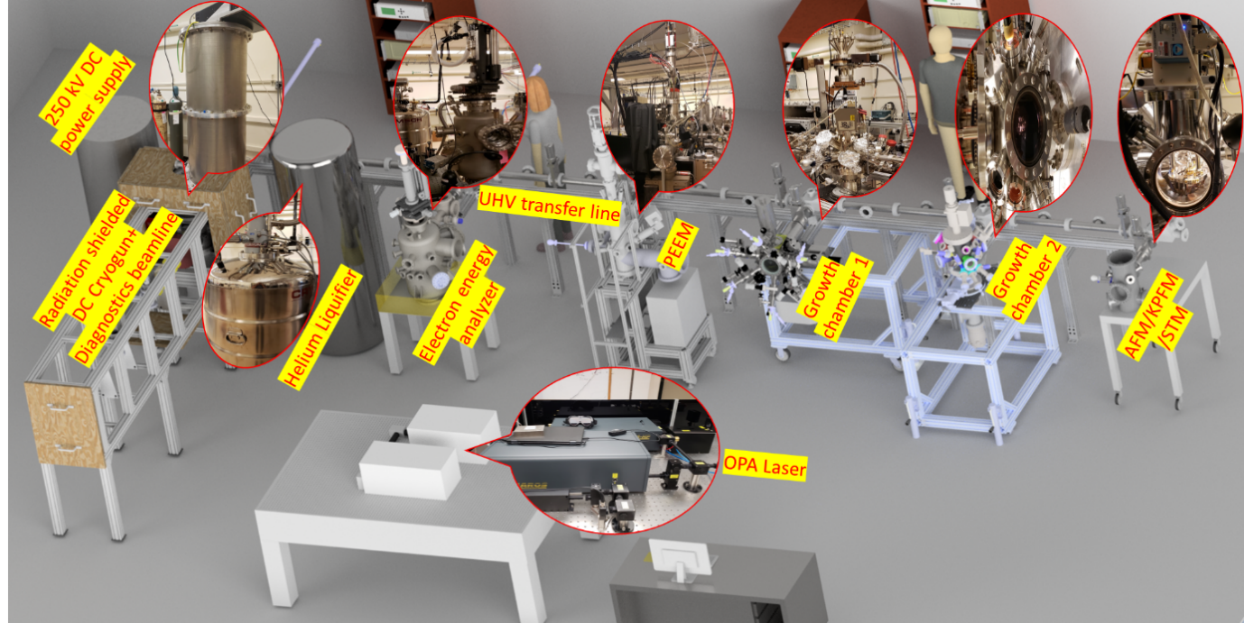
ASU Cryogun - Cathode

Slide 15
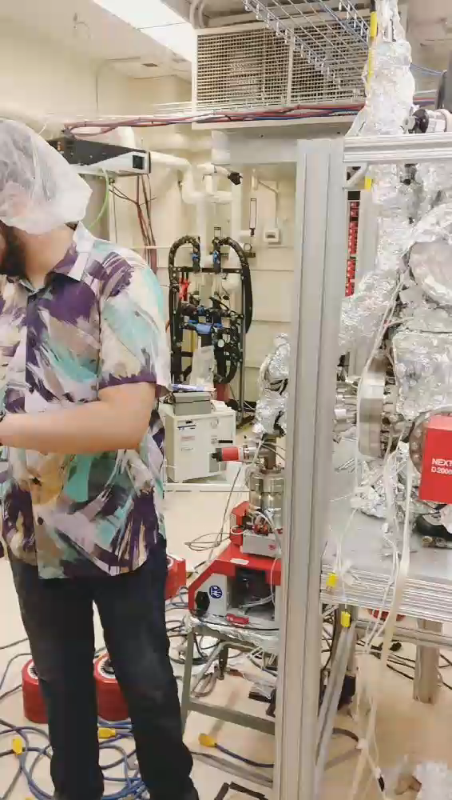
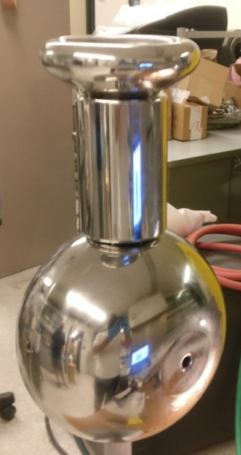
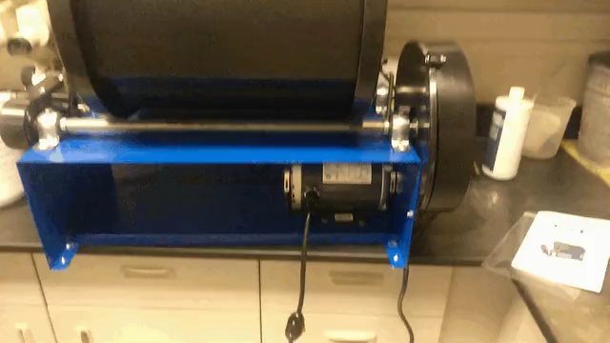
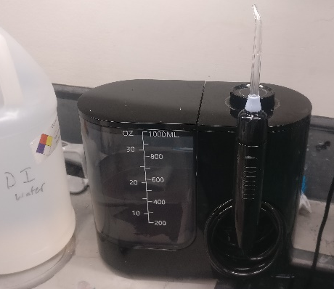
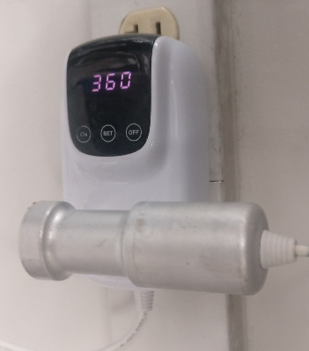
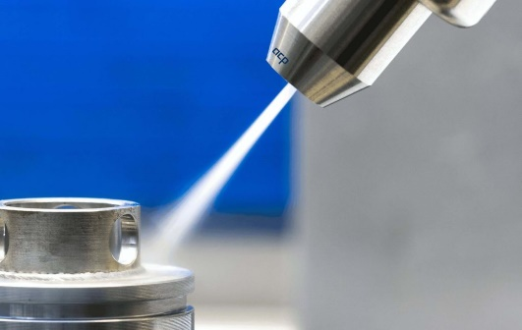
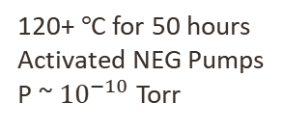
Surface Preparation and Assembly
Rotary tumbler polishing
120+$°$C for 50 hours
Activated NEG Pumps
P ~ ${10}^{−10}$Torr
Water flosser HPR
Ultrasonic
CO2 Snow-jet cleaning
C. Hernandez-Garcia, et al, Review of Scientific Instruments, 88.9, 093303 (2017)

Slide 16
​Building the ASU Cryogun beamline as a photocathodes testing platform
Contents:
Purpose of this beamline
Gun design and assembly
Gun cryogenic cooling
Gun voltage conditioning
Design of the beamline for cathode diagnostics
P. Musumeci, et al, Nucl. Instrum. Meth. A, 907, 209 (2018)
W. H. Li, et al, Structural Dynamics 9.2 024302 (2022)

Slide 17
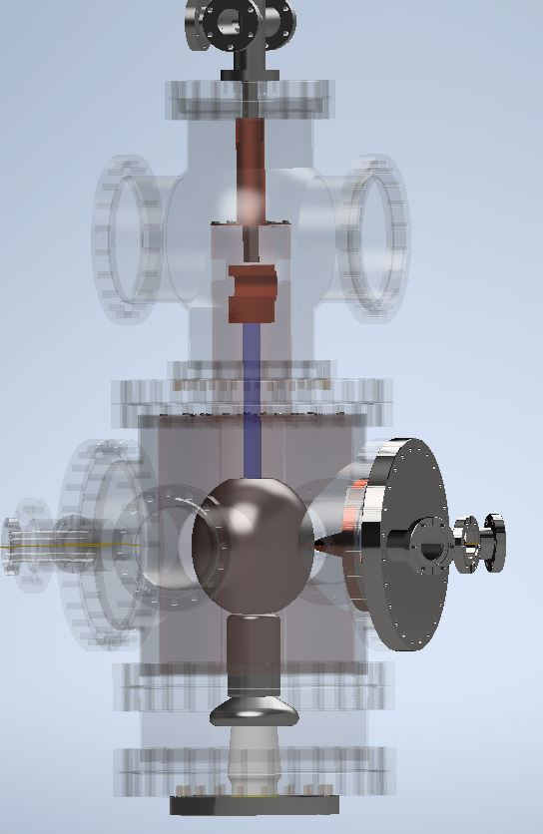
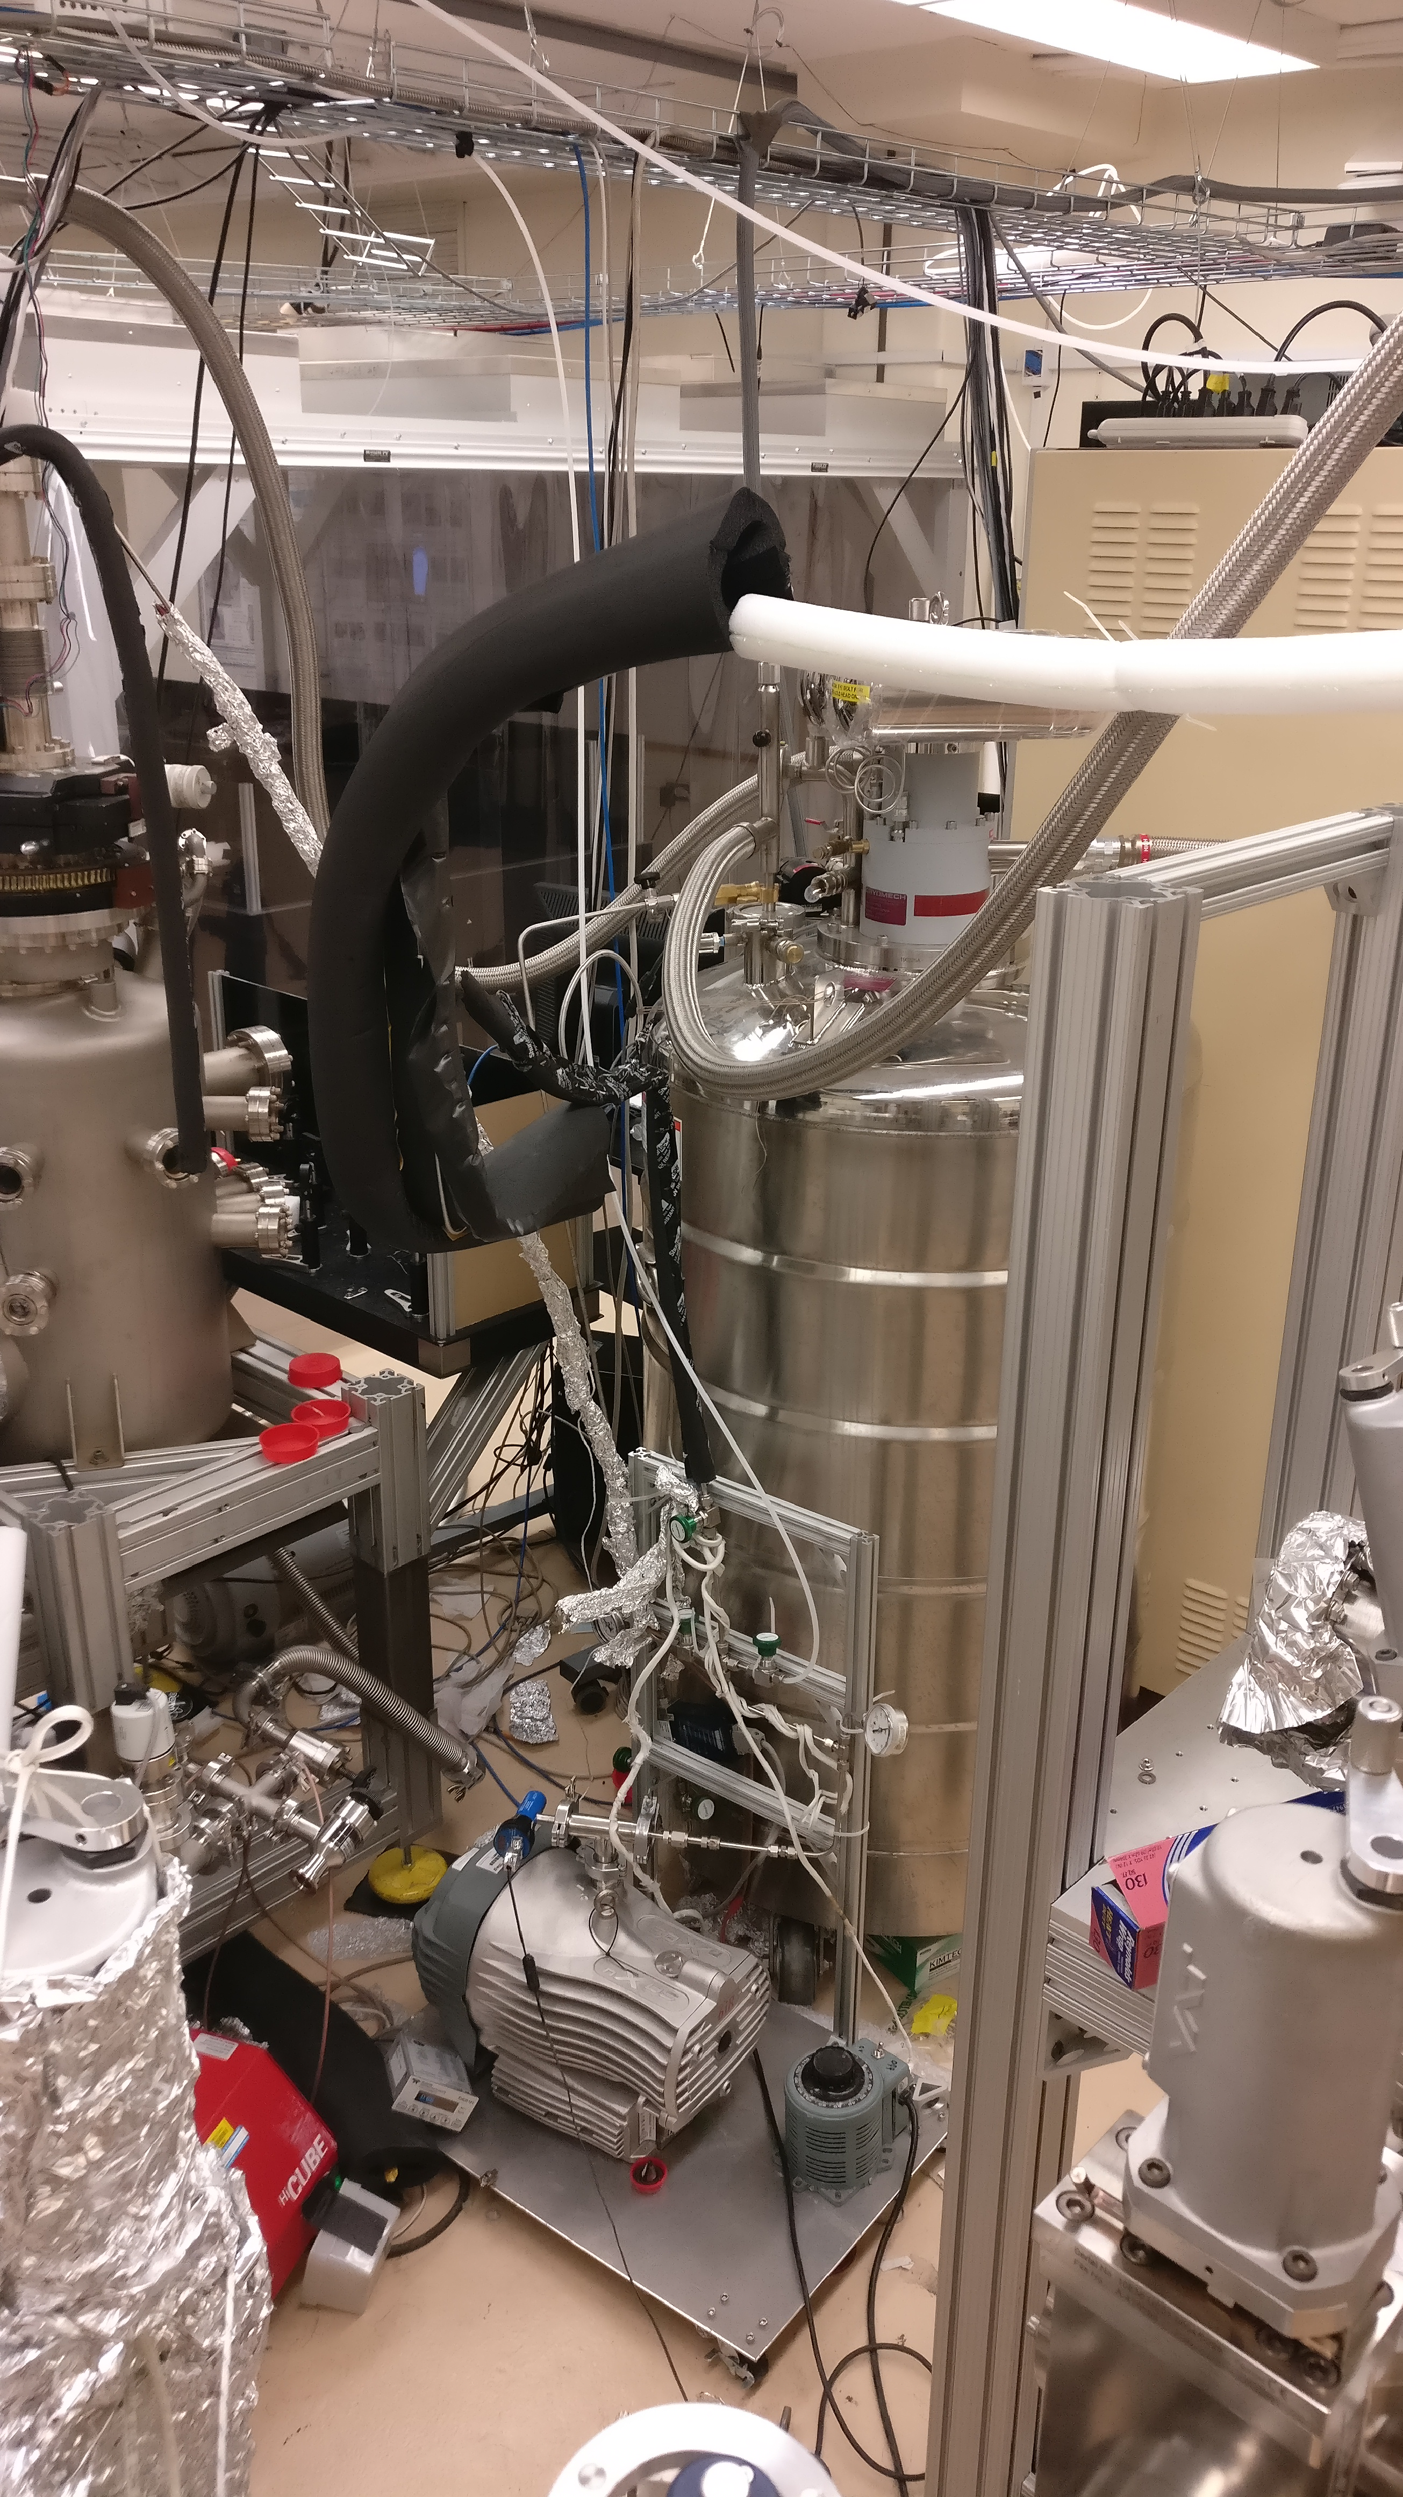
Cryocooling of the Gun
Helium Liquifier Plant

Slide 18
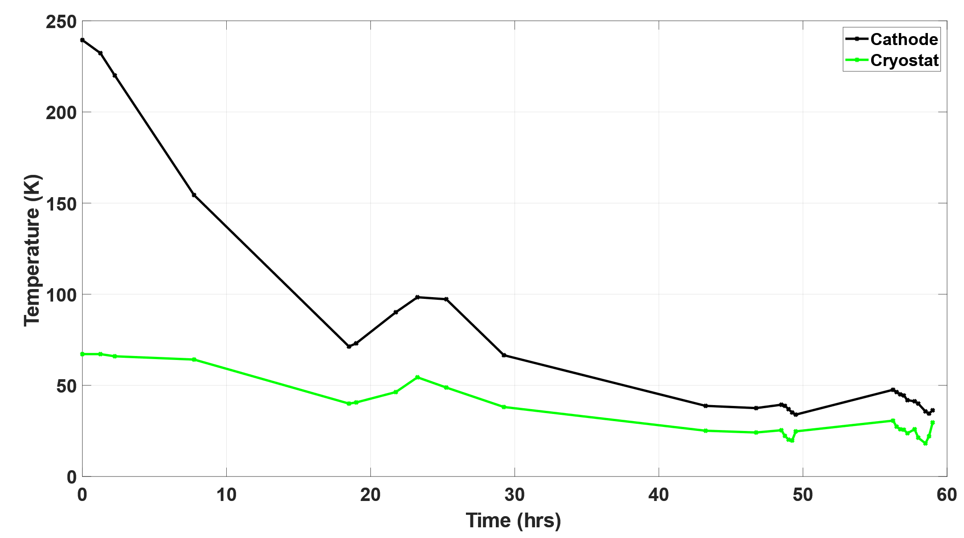

Cryocooling of the Gun
Calibration – Cathode Temperature vs Time
$$T_{min}\sim 34.5 K$$

Slide 19
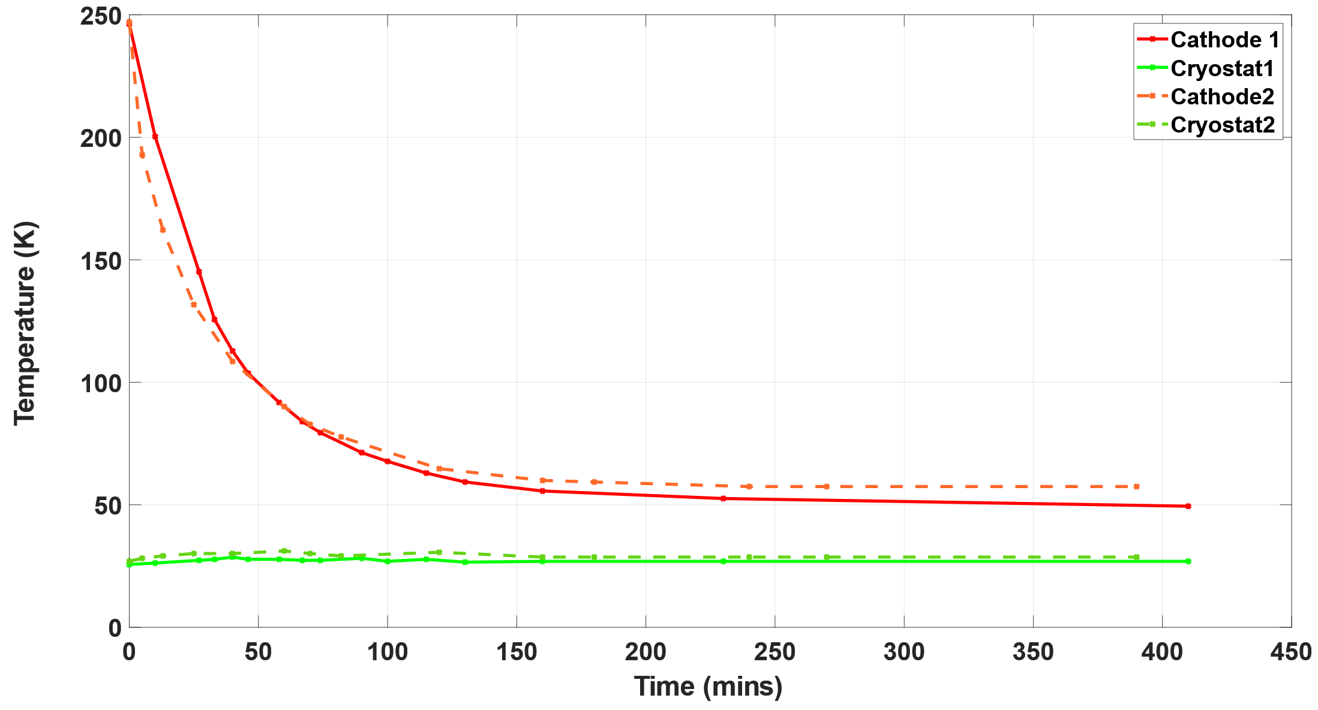

Cryocooling Calibration of the Gun
Cooling the Electron Gun
$$T\sim 60 K$$
$$t = 2 hrs$$

Slide 20
​Building the ASU Cryogun beamline as a photocathodes testing platform
Contents:
Purpose of this beamline
Gun design and assembly
Gun cryogenic cooling
Gun voltage conditioning
Design of the beamline for cathode diagnostics
P. Musumeci, et al, Nucl. Instrum. Meth. A, 907, 209 (2018)
W. H. Li, et al, Structural Dynamics 9.2 024302 (2022)

Slide 21
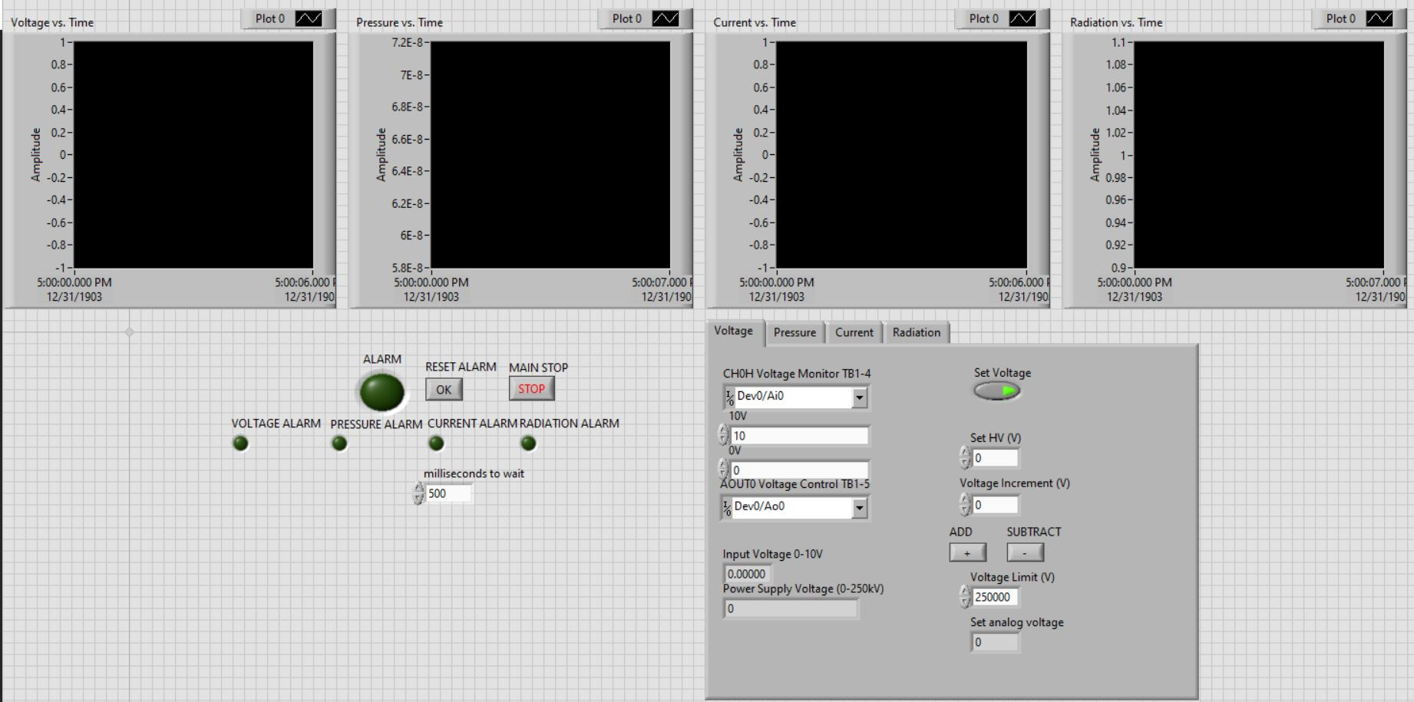
HV Conditioning Status

Slide 22
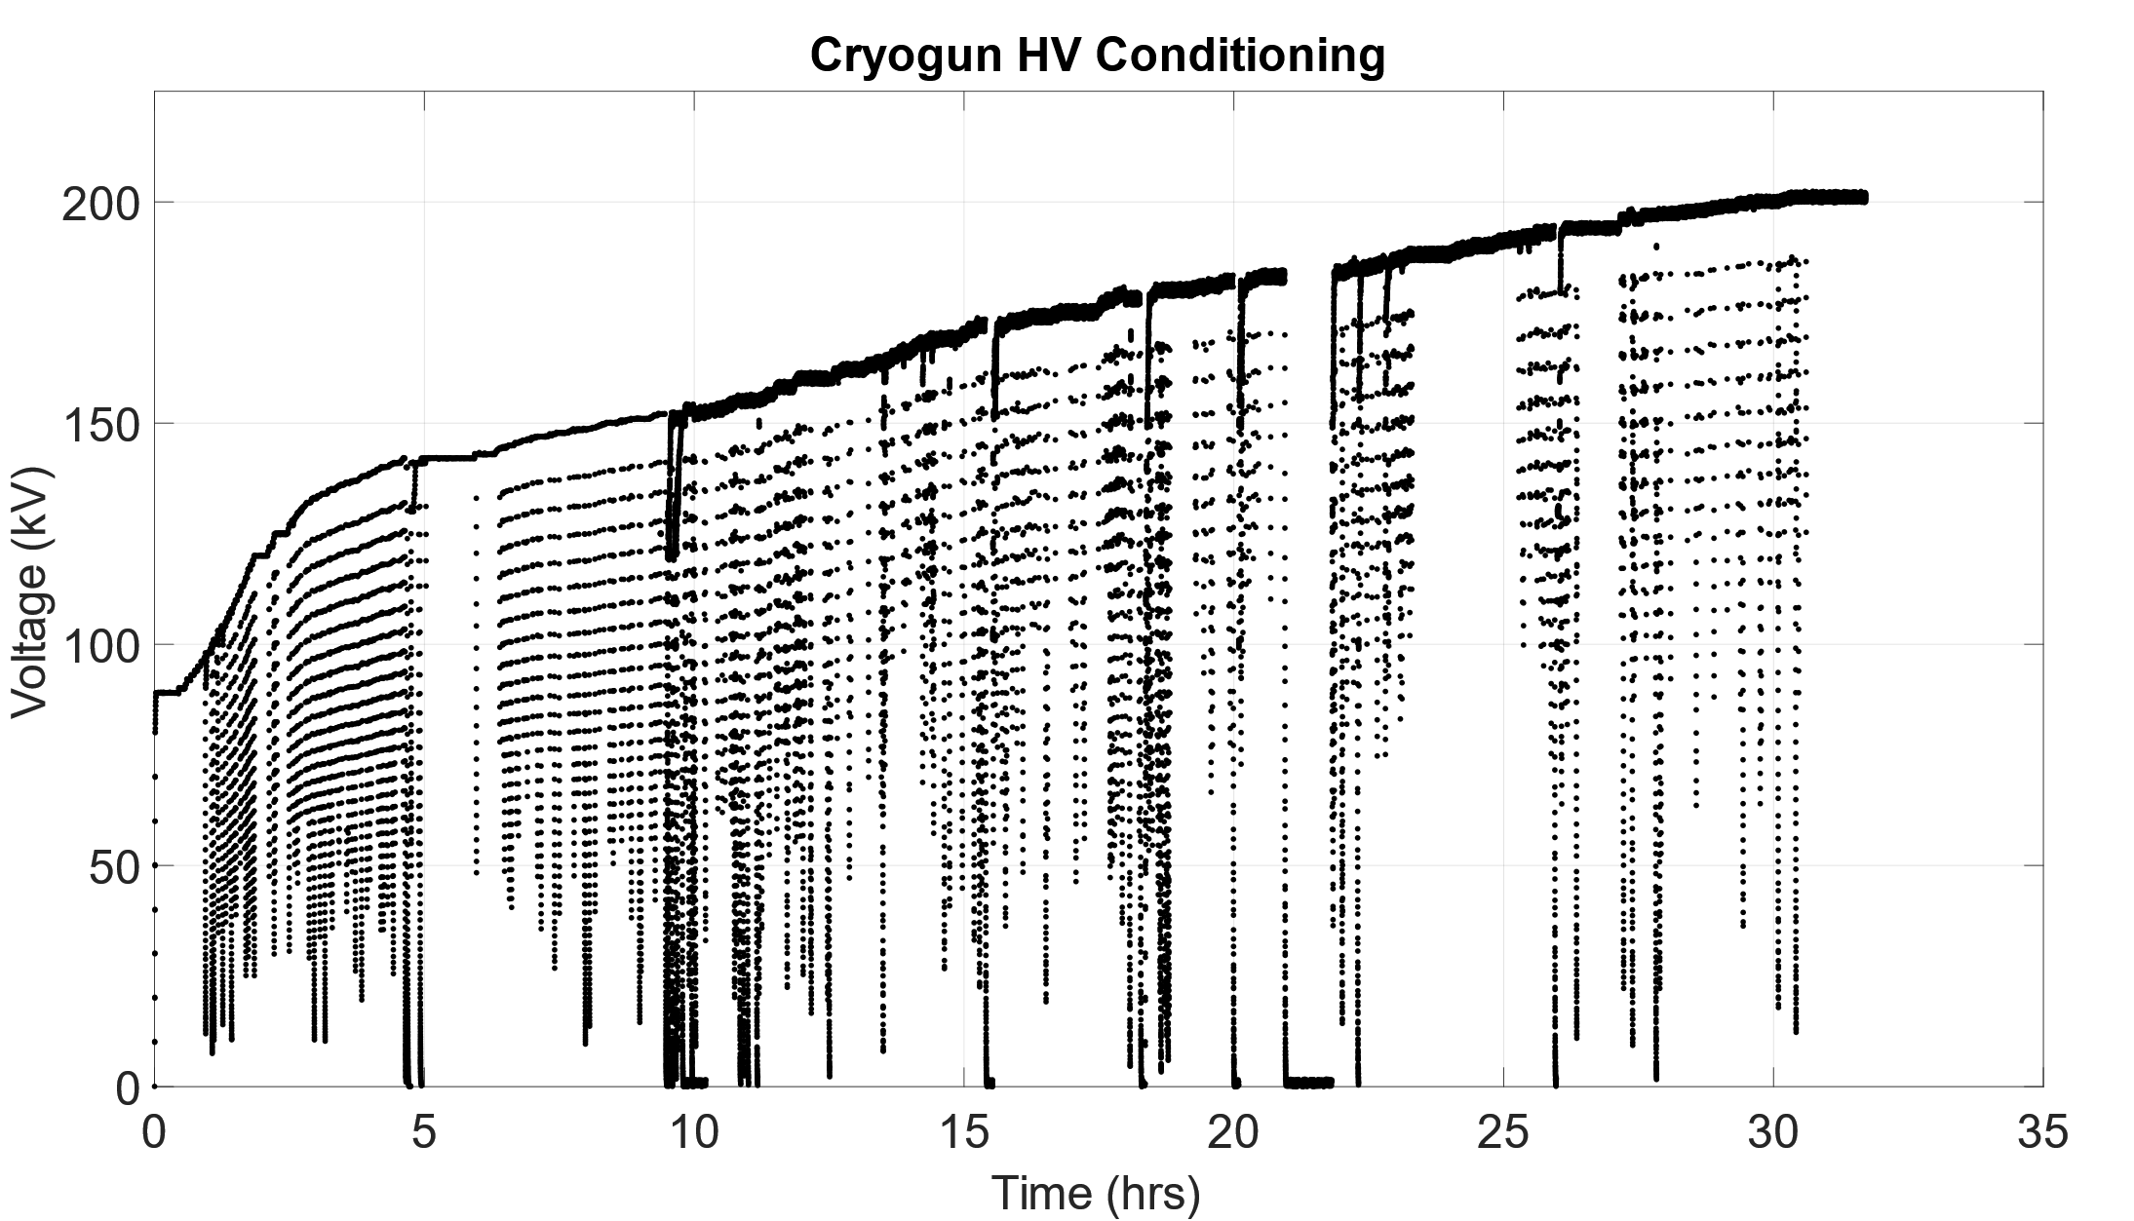
HV Conditioning Status

Slide 23
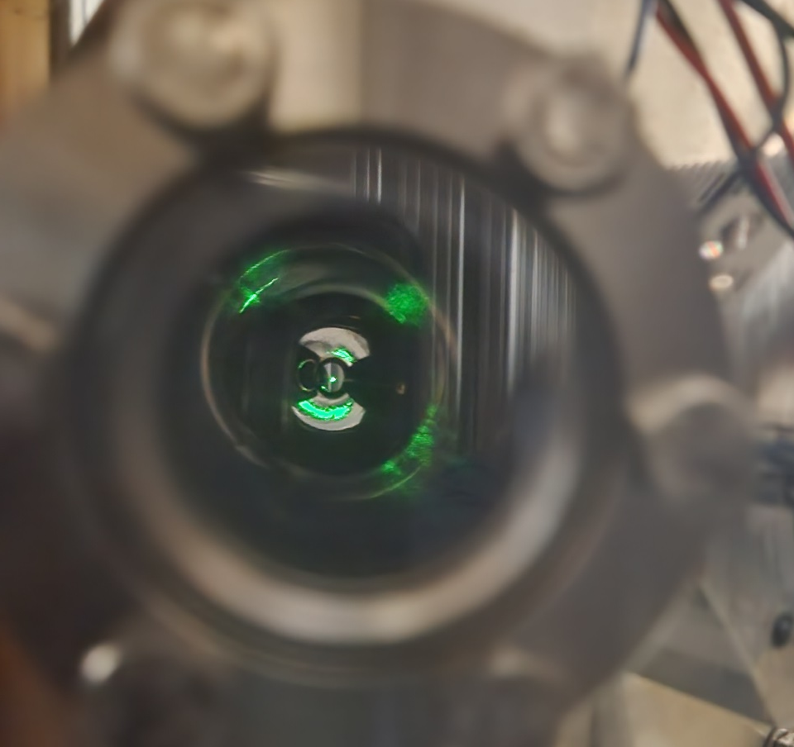
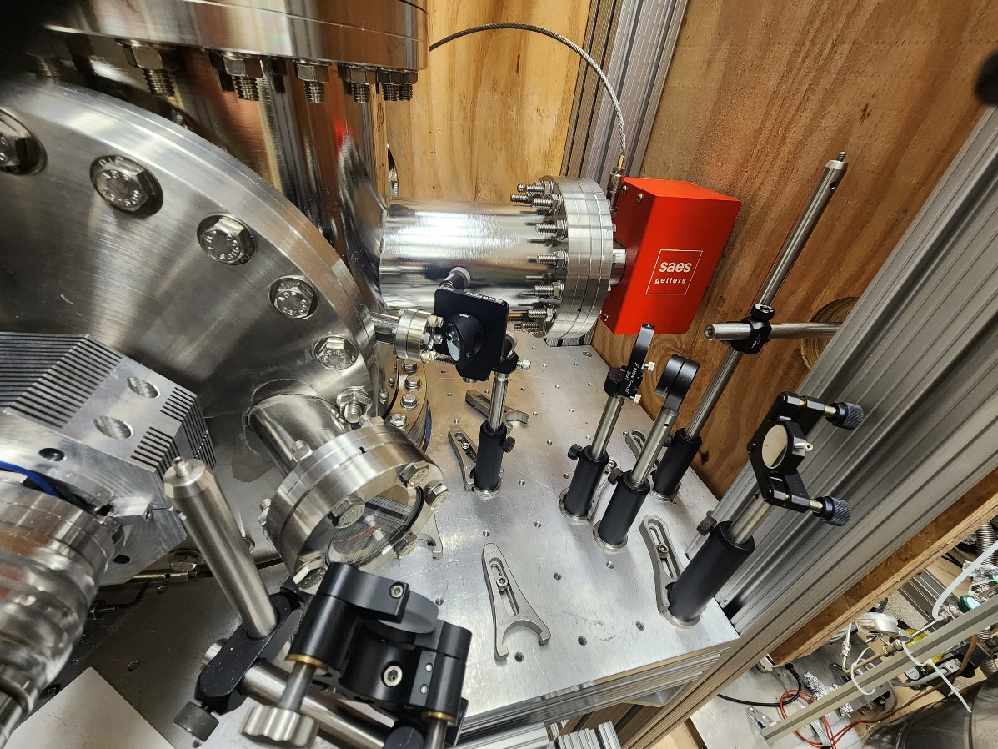
Electron Gun - first beam in progress!

Slide 24
​Building the ASU Cryogun beamline as a photocathodes testing platform
Contents:
Purpose of this beamline
Gun design and assembly
Gun cryogenic cooling
Gun voltage conditioning
Design of the beamline for cathode diagnostics
P. Musumeci, et al, Nucl. Instrum. Meth. A, 907, 209 (2018)
W. H. Li, et al, Structural Dynamics 9.2 024302 (2022)

Slide 25
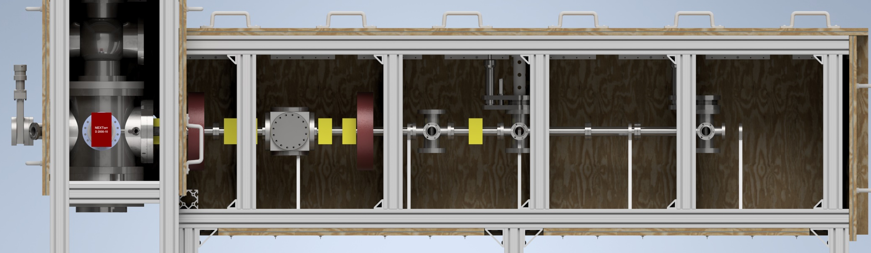
Design of the beamline
Solenoids
Deflection Cavity
Screen
Slit
Buncher Cavity
Corrector Coils
Pinhole scan technique for 4D phase space mapping
Solenoid scan emittance measurements
3.0 GHz deflection cavity for time response

Slide 26
Recap – Brightness and emittance
$$B_{4D}=\frac{Q}{ε_{nx}ε_{ny}}$$
$$ε_{n, rms}=\frac{1}{m_{0}c}\sqrt{\left\langle x^{2}\right\rangle \left\langle p_{x}^{2}\right\rangle −{\left\langle xp_{x}\right\rangle }^{2}}$$
$$ε_{tr, rms}=\sqrt{\left\langle x^{2}\right\rangle \left\langle {x^{′}}^{2}\right\rangle −{\left\langle xx^{′}\right\rangle }^{2}}$$
Beam emittance is
the area occupied in
phase space by the
particle distribution

Slide 27
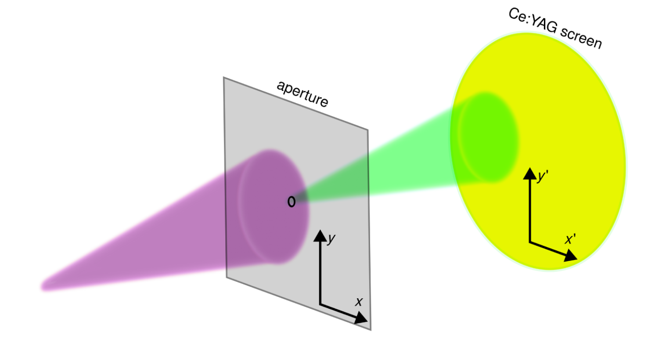
Emittance measurements
Move the pinhole to probe the beam, Alternatively, move the beam across the pinhole using corrector coils.
M. Gordon, et. al., “Four-dimensional emittance measurements of ultrafast electron diffraction optics corrected up to sextupole order,” Phys. Rev. Accel. Beams 25, 084001 (2022)

Slide 28
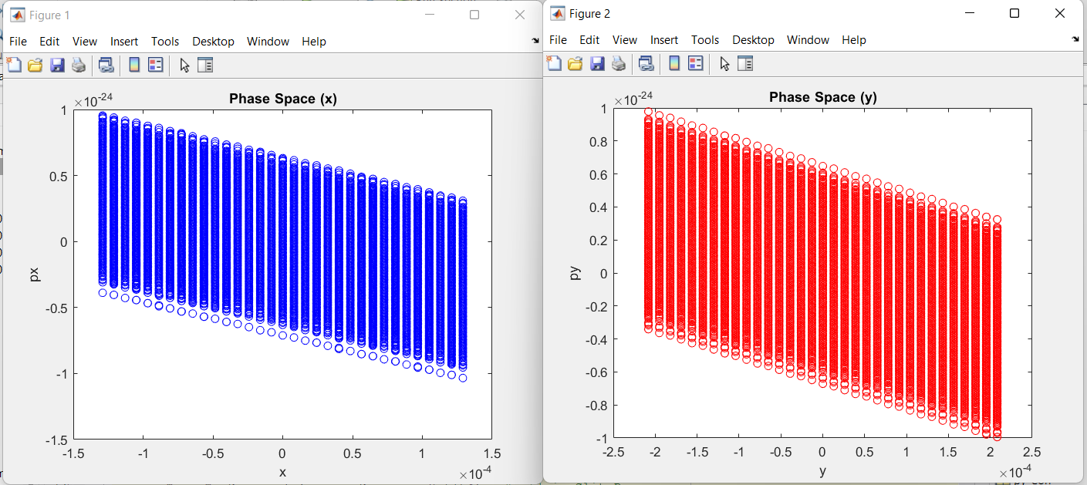
Emittance measurements
Beam Parameters
Beamline Elements
Simulate electrons via GPT
Phase Space
(X and Y)
Image electrons with detector
MATLAB Code
Can measure up to 1 nm.rad with 4% error

Slide 29
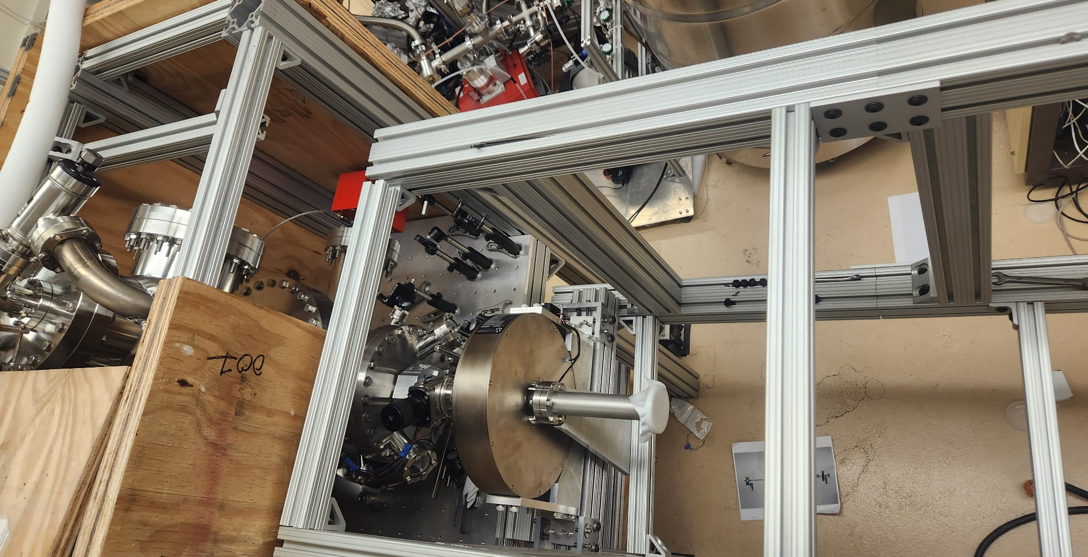
Beamline in progress
Questions? Thank you!

