Slide 1
Differentiable Preisach Modeling for Characterization and Optimization of Particle Accelerator Systems with Hysteresis
Kabir Dubey, University of Chicago
R. Roussel, A. Edelen, D. Ratner; J.P. Gonzalez-Aguilera, Y.K. Kim; N. Kuklev
Accepted by PRL
arXiv: 2202.07747

Slide 2
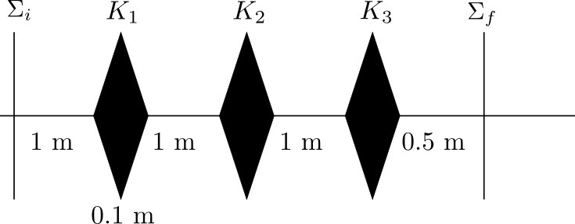
Introduction
Particle accelerators are designed with systems of magnets that bend and focus particles as desired. The arrangement of these magnets is a control problem addressed with optimization.
Goal: using machine learning techniques to automate routine tasks, improve performance, and enable new capabilities of particle accelerators.
Challenges: noisy beam diagnostics, incorporating prior knowledge, and scaling.
Notes:
Improve the surrogate model to choose better points for the acquisition function, gets optimized, and then tests

Slide 3
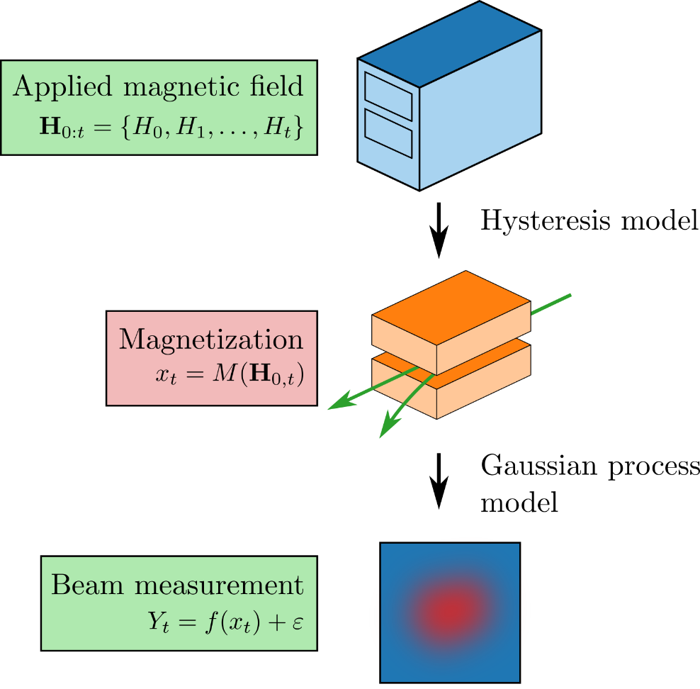

Slide 4
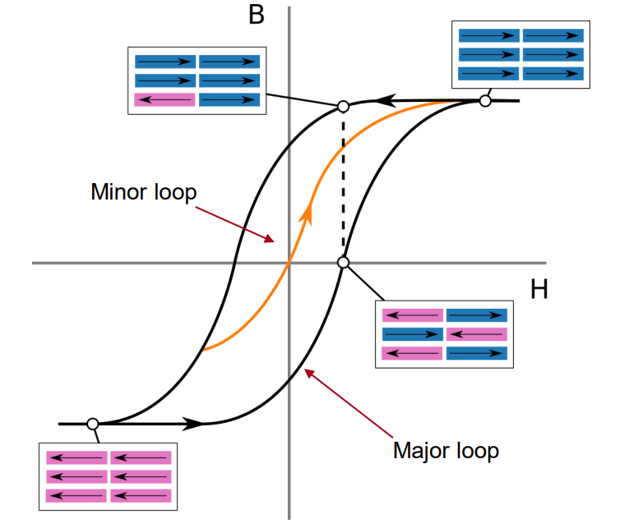
For every increase or decrease in applied current, there is a resulting error due to hysteresis.
Current optimization schemes ignore hysteresis
We only have control over applied current to magnetic elements
Research goal: to develop a fast-modeling strategy to improve online control without measuring the hysteresis curve directly.

Slide 5
The Preisach Model of Hysteresis
Magnetic domains are modeled with a discrete set of hysterons, which when added together model the output of a hysteretic system.
The hysteron state is determined by a hysteron operator, ${\hat{γ}}_{αβ}$, which maps the thresholds ($α,β$) to an output of $±1$.
The number of hysterons with values ($α,β$) is given by the hysteron density function $μ(α,β$), plotted on the Preisach ($α,β$)-plane.

Slide 6
Non-Parametric Differentiable Preisach Modeling
Parametric model comes with an identification problem,
$μ\left(α,β\right)=f\left(α,β;θ\right)$.
Non-parametric model discretizes the Preisach plane, $μ_{i}=μ\left(α_{i},β_{i}\right).$
This vastly increases the number of free parameters due to the curse of dimensionality.
https://aiaspirant.com/curse-of-dimensionality/#:~:text=It%20was%20R.,order%20to%20achieve%20high%20accuracy.
Notes:
~7000 free parameters

Slide 7
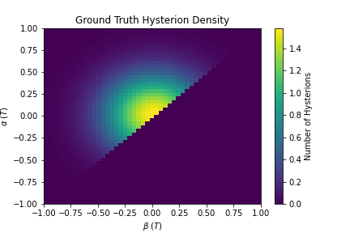
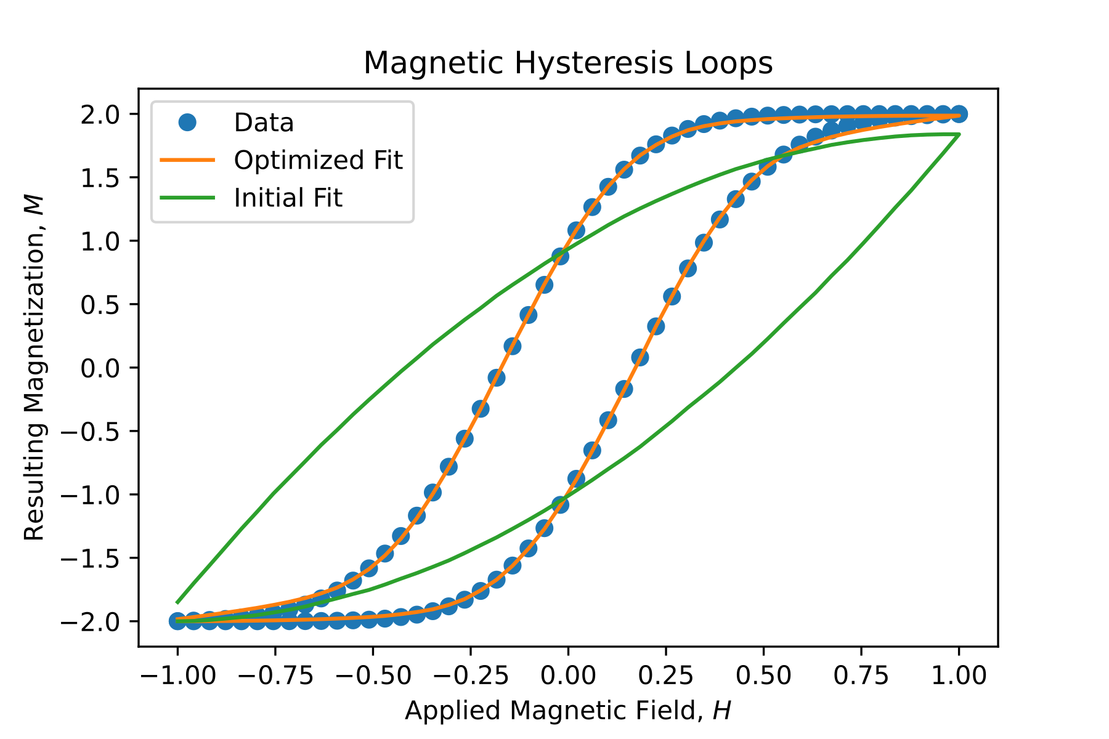
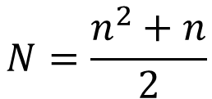
$$N=\frac{n^{2}+n}{2}$$
$$μ=\{μ_{1}, μ_{2},…,μ_{N}\}$$
$$M\left(H_{0:t};μ\right)=\sum_{i=1}^{N}{μ_{i}γ_{i}(H_{0:t})}$$
$$loss(μ)=MSE(Y,M(H;μ))$$
$$μ^{∗}={argmin}_{μ} loss(μ)$$

Slide 8
Gaussian Process Model
Directly measuring hysteresis output may be impractical or impossible.
We use a Gaussian Process (GP) model to represent beam propagation as a function of magnetic fields. We then infer hysteresis behavior from beam measurements with respect to the applied current on each magnet.
Fitting is done with a maximum log likelihood approach, which balances accuracy with complexity.

Slide 9
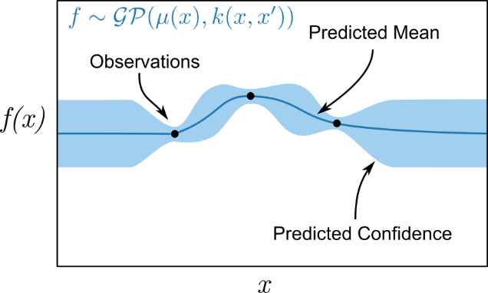

Slide 10
Discussion
Hysteresis has little effect when balancing exploration and exploitation. But when we prioritize exploitation, the joint-hysteresis-GP model significantly improves optimization performance in comparison to normal GP models.
This indicates that coarse searches for global optima may neglect hysteresis, even when hysteresis effects are significant.
However, hysteresis effects must be considered when attempting to exploit extrema during optimization.

Slide 11
Conclusion
We can create flexible, high-fidelity models of magnetic elements exhibiting hysteresis.
We cycle the magnet current while measuring the fields inside the magnet or indirectly measuring the effect of magnetic fields on beam properties. Then, the hysteresis model is combined with a GP model of the beam response to conduct Bayesian optimization to exploit predicted extrema.
Our solution is a problem-independent staged approach, where model and computational complexity is traded for optimization precision.

