Slide 1
Theoretical Studies of Electronic Energy-level Shifts in SRF Cavity Materials
Michelle Kwok
With Mentors Michelle Kelley and Nathan Sitaraman

Slide 2
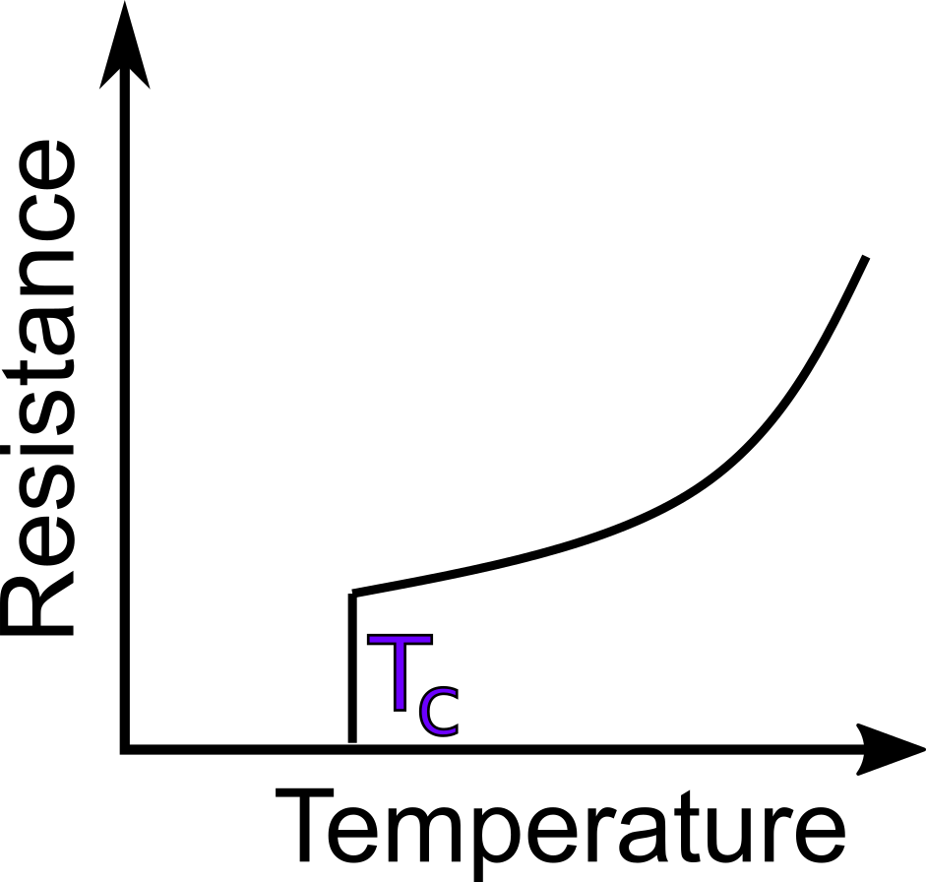
Superconducting Radiofrequency Cavity
Used to accelerate particles
Each cavity is made from a superconducting material
Nb, Nb-Zr, Nb3Sn, etc.
GIF from Matthias Liepe
Notes:
Less energy dissipated

Slide 3
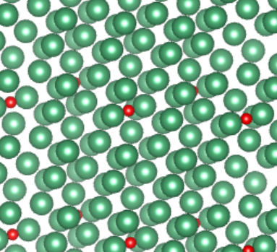
Material of SRF Cavities
Material may get oxidized and may have impurities
Impurities and layers of oxides changes properties of materials, some of which are good, some bad
$${Nb}_{2}O_{5}$$
$${NbO}_{2}$$
$$NbO$$
Defect Region
Nb
Notes:
Oxygen is bonded to Nb even in interstitial but not in well define phase in crystal structure, dispersed randomly

Slide 4
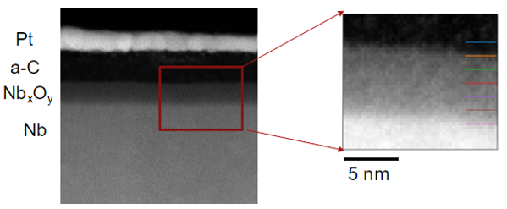
Image of Layers
Image from Zhaslan Baraissov and David A. Muller
Notes:
Mention there is clear distinction, just not as clear cut as simplification

Slide 5
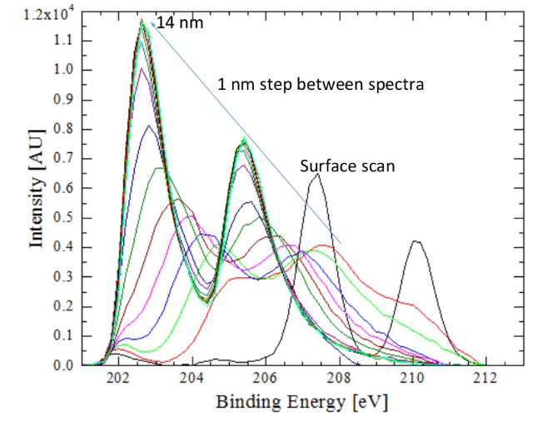
Experimental Data
Since new prototypes are expensive, we test small pieces of a mixture
Using x-ray photoelectron spectroscopy (XPS), unexplained spikes were found in the data
$$e^{−}$$
3d Orbital
X-ray
0 nm
$${Nb}_{2}O_{5}$$
$${NbO}_{2}$$
$$NbO$$
Defect Region
Nb
14 nm
Figure from Zeming Sun
Notes:
Talk about Zeming’s plots, talk about depth, green is Nb, black is a niobium oxide
Add nm to image on right
Talk about why there are two peaks for each line
Total angular momentum (l + s)

Slide 6
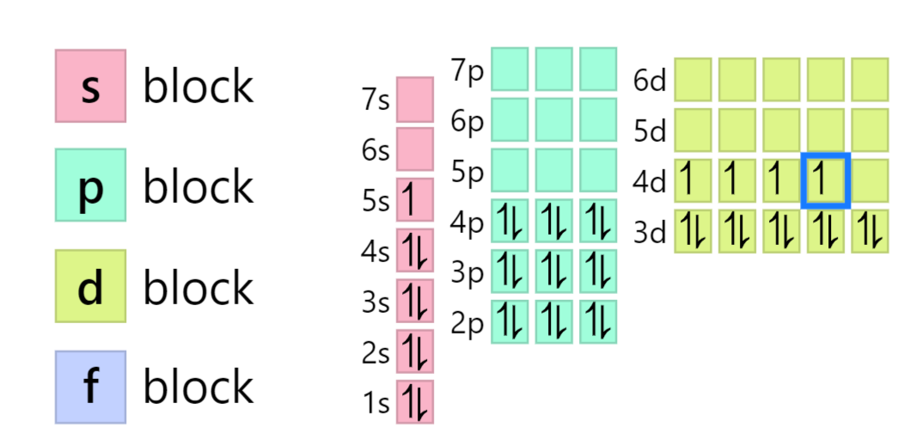
Energy Levels
Valence electrons
Involved in bonding, partially filled orbitals
Semi-core electrons
Affected by the bonding but not as much as the valence
First filled orbitals
Core electrons
Deep in the core and not directly involved in chemical bonding
Image from ptable.com
Notes:
When nb oxides form, the 5s, 4d are involved in the bonding but they never will be trading from sc and core levels

Slide 7
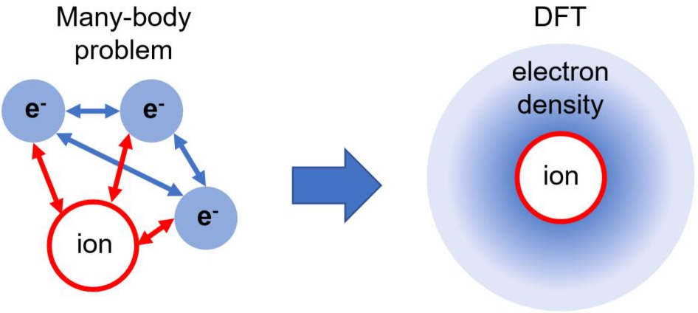
Method: Density Functional Theory (DFT)
Density functional theory (DFT) and JDFTx
$$U_{eff}$$
Hohenberg-Kohn Theorem: electron density determines properties of the system
Notes:
$U_{eff}$ takes into account the environmental and chemical conditions, reframes problem of many electrons interacting into individual electrons interacting in effective potential, same as the self consistent potential

Slide 8
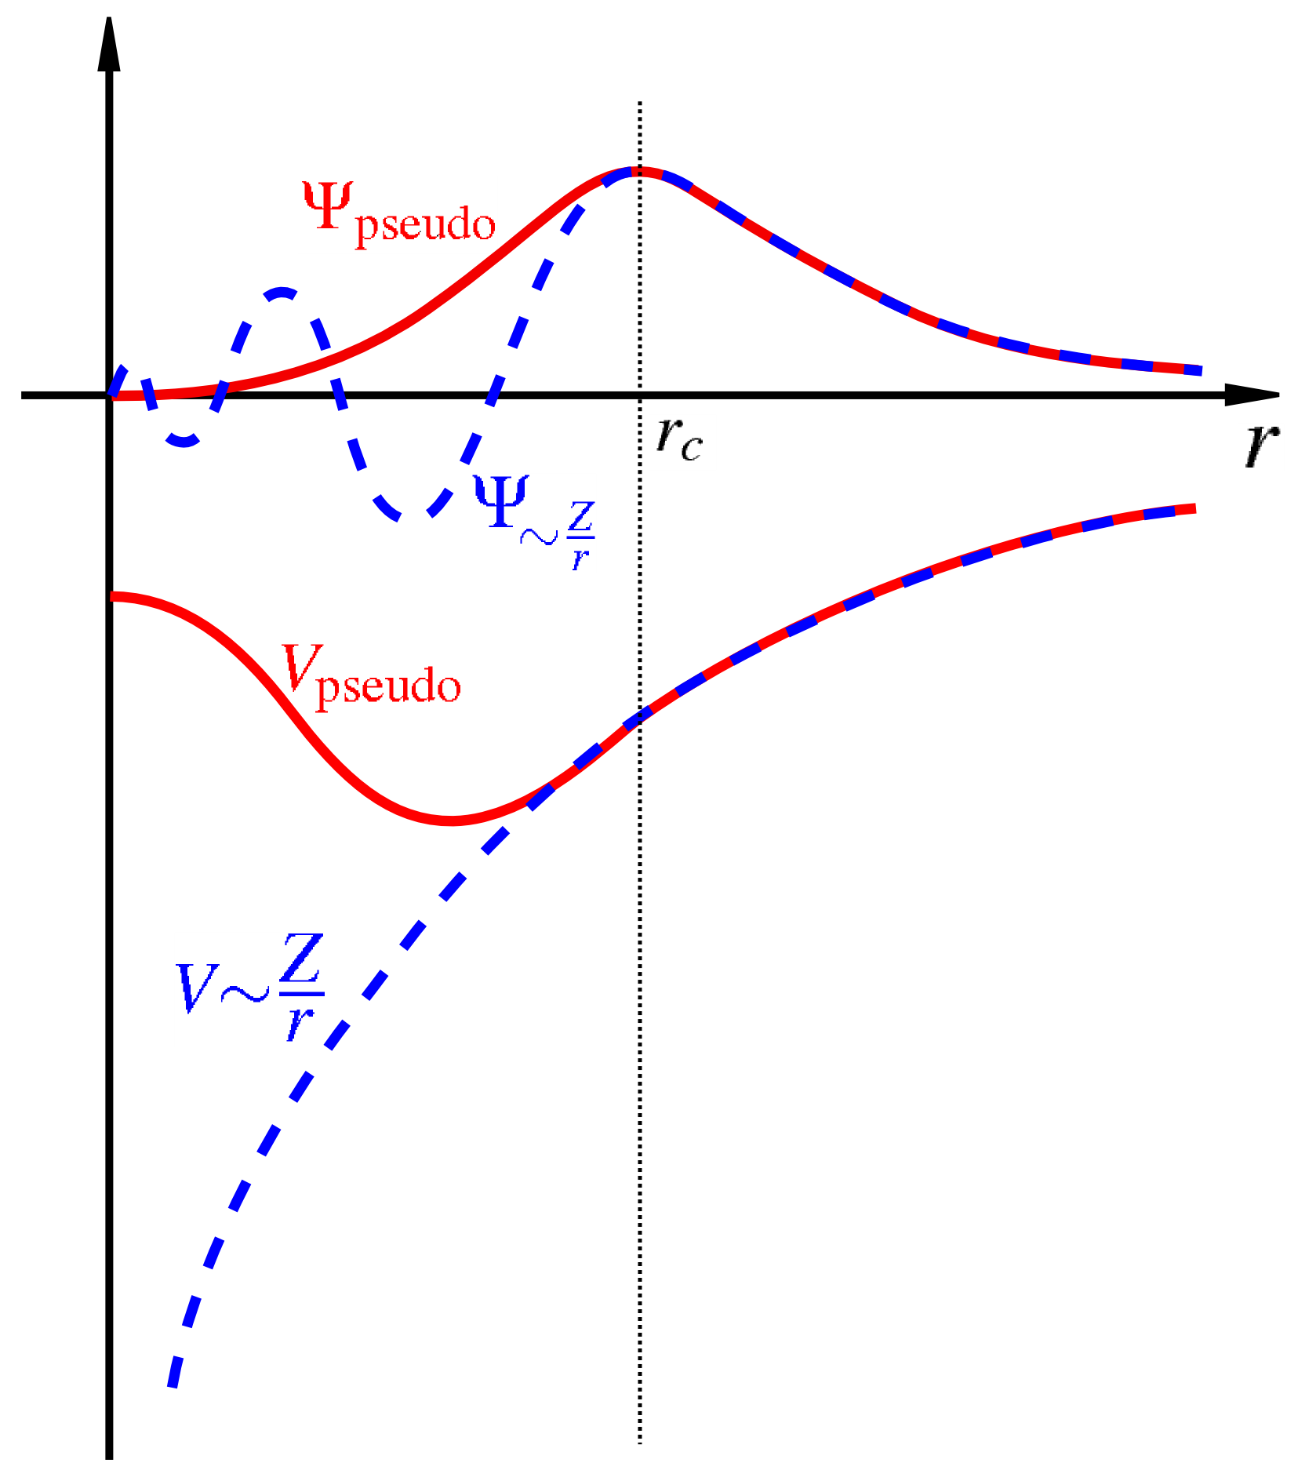
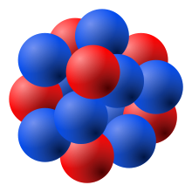
Pseudopotentials
Takes account of core electrons so less electrons to solve for
Nb has 28 electrons in pseudopotential including the 3d orbital
Screened Nucleus
Notes:
Really emphasize that core electrons screen nucleus
Don’t care about whats happening close to the nucleus since the e we are solving for is further

Slide 9
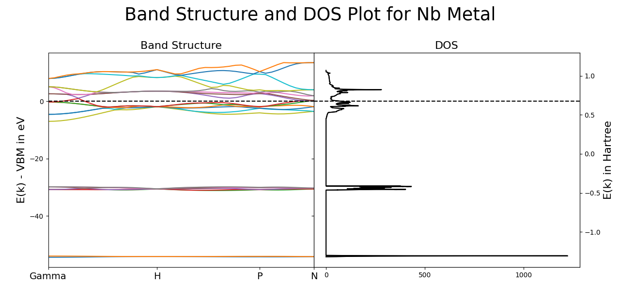
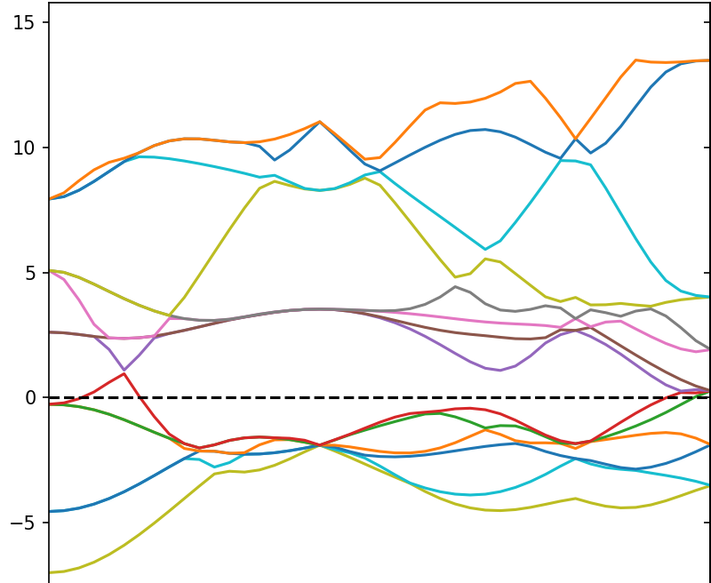
Band Structure Plot
Fermi level
Notes:
Talk about semicore vs valence, talk about how narrow the bands are meaning they’re pretty consistent while valence is interacting

Slide 10
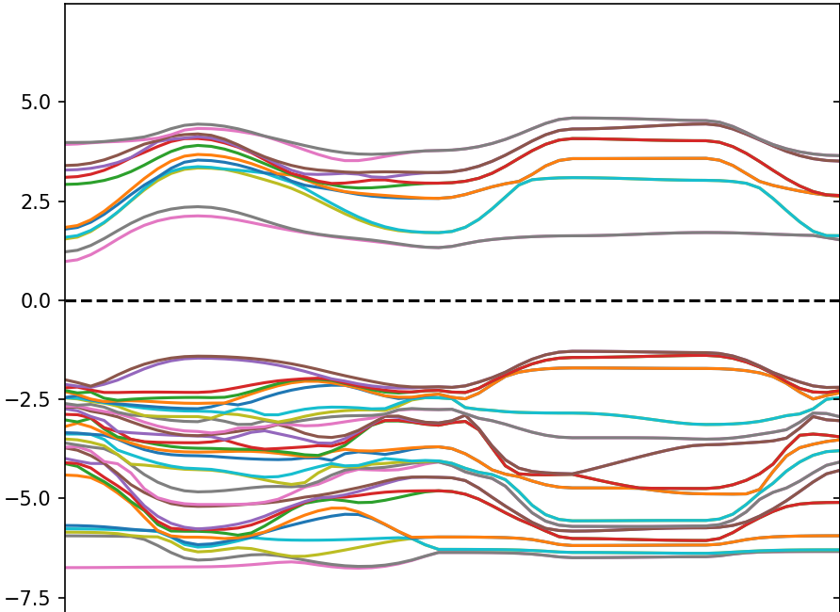
Band Structure Plot for Insulator

Slide 11
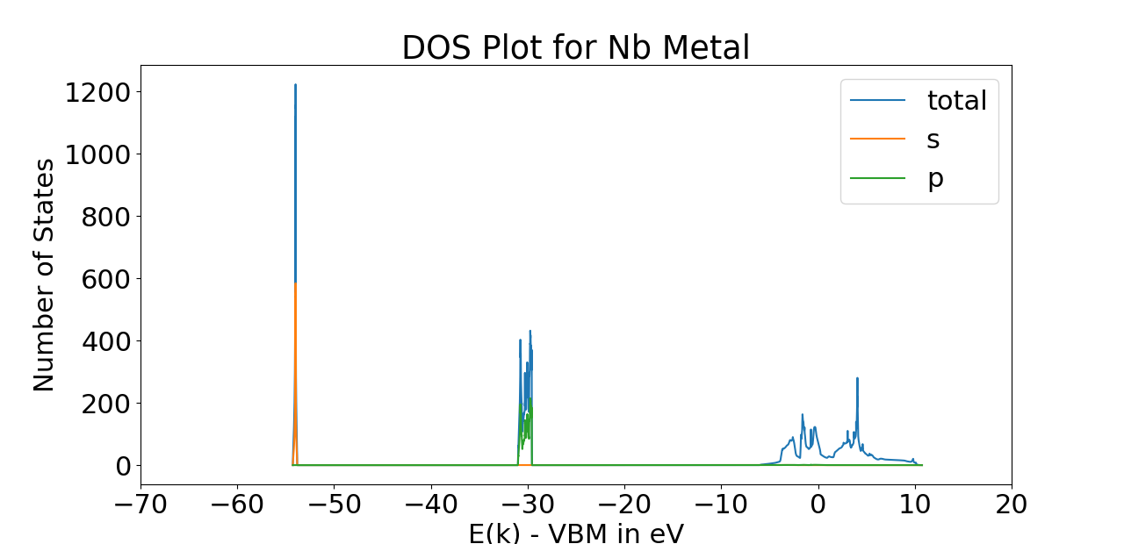
Density of State Plots
Density of States (DOS)
Proportion of states occupied by system
[number of states/(energy*volume)]
Can calculate energy level shifts from DOS plots
Semi-core levels
Valence levels

Slide 12
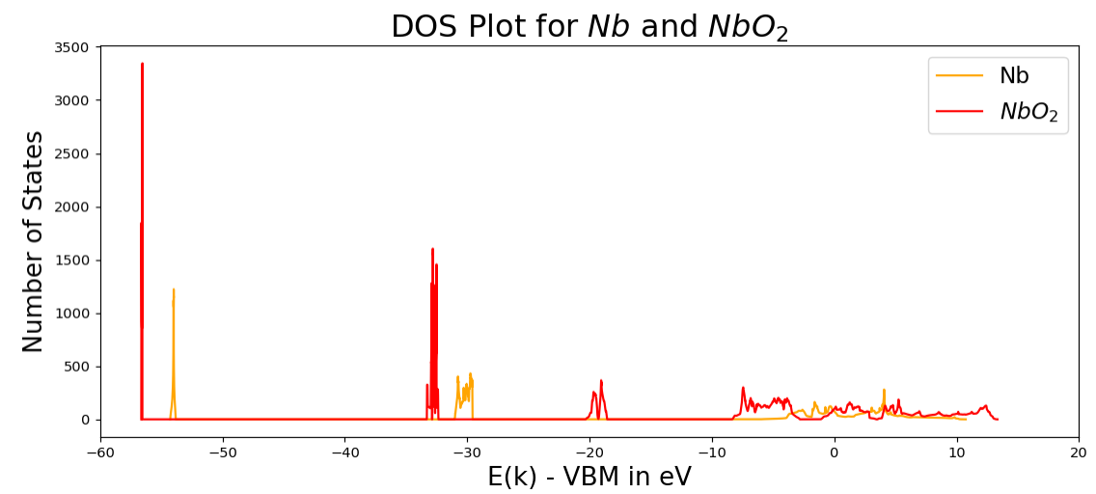
Nb and NbO2 Density of State Plots
4s
2.572 eV
4p
Notes:
Add shift

Slide 13
System Calculated
Metallic | Defected Materials | Oxides and Carbides
$Nb$ $Zr$ $NbZr$ ${Nb}_{3}Sn$ | $Nb$ with $O$ interstitial defect $NbC$ with $Zr$ substitutional defect $ZrC$ with $Nb$ substitutional defect $NbC$ with $C$ vacancy | $NbO$ ${NbO}_{2}$ ${Nb}_{2}O_{5}$ $NbC$ ${Nb}_{2}C$ $ZrC$ $NbO$ surface
Note: All systems with defects were calculated using both (2x2x2) and (3x3x3) supercells

Slide 14
System Calculated
Metallic | Defected Materials | Oxides and Carbides
$Nb$ $Zr$ $NbZr$ ${Nb}_{3}Sn$ | $Nb$ with $O$ interstitial defect $NbC$ with $Zr$ substitutional defect $ZrC$ with $Nb$ substitutional defect $NbC$ with $C$ vacancy | $NbO$ ${NbO}_{2}$ ${Nb}_{2}O_{5}$ $NbC$ ${Nb}_{2}C$ $ZrC$ $NbO$ surface
Note: All systems with defects were calculated using both (2x2x2) and (3x3x3) supercells

Slide 15
Calculated Energy Levels for Systems with Nb
Defected Materials
Carbides and Oxides
Metallic

Slide 16
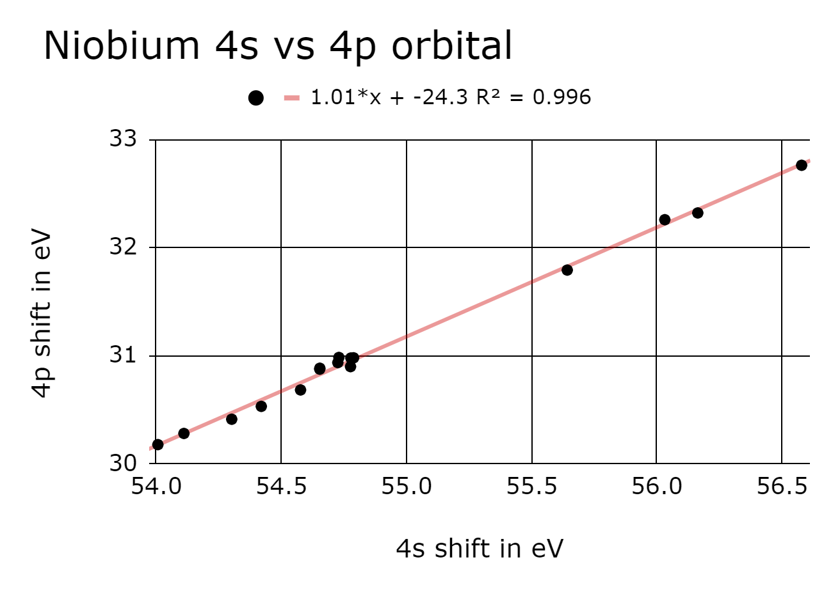
Correlation between Shifts
Shows that 4s shifts will probably correlate with 3d shift
4s orbital is more reliable since it is less affected by bonding at Fermi level

Slide 17
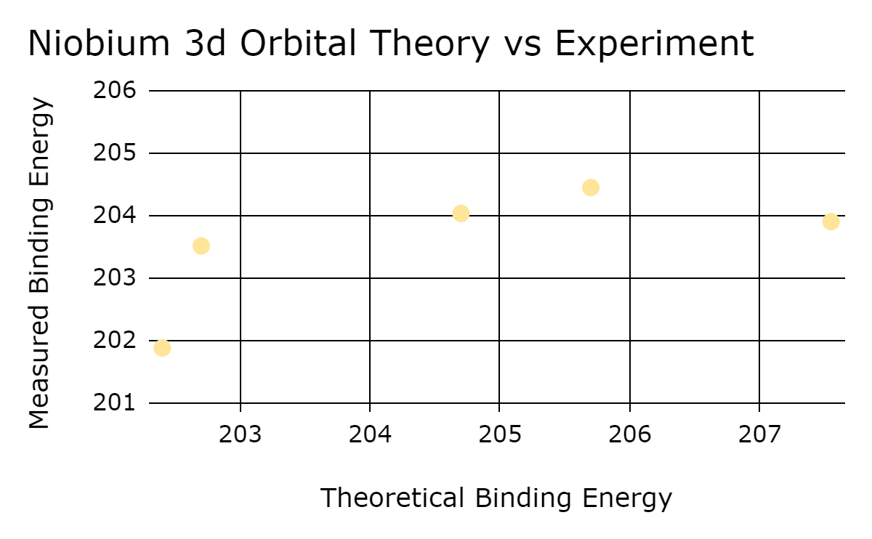
Experimental Data vs Theorical Data for 3d
One-to-one agreement line
NbO2
NbC
NbO
Nb2O5
Nb

Slide 18
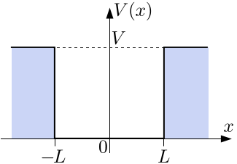
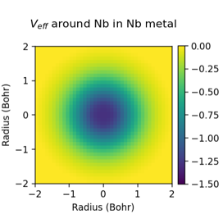
Effective Potentials
$U_{eff}$ takes into account the environmental and chemical condition
$$U_{eff}$$
-1eV

Slide 19
Effective Potential Plots
Notes:
higher shift at nucleus, fairly uniform spherically, drops to zero far from nucleus

Slide 20
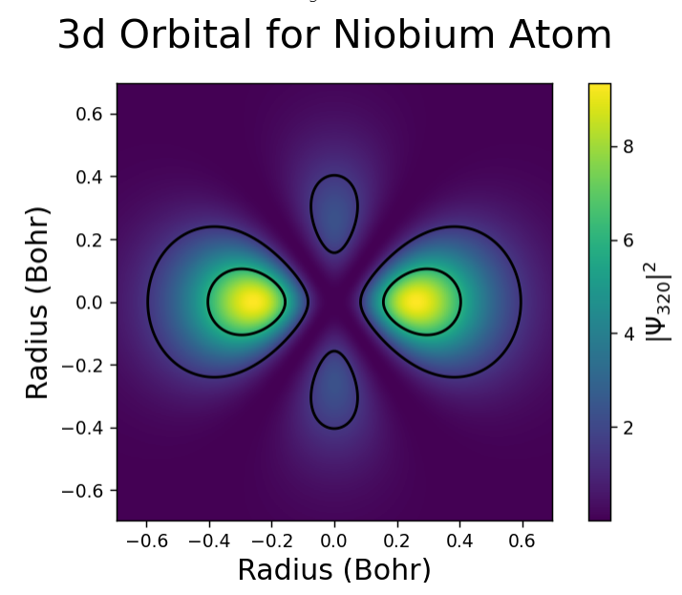
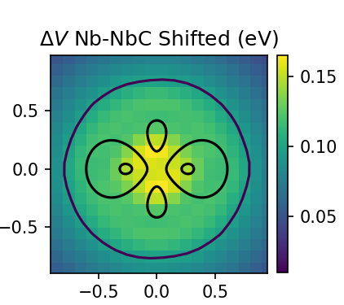
3d Orbital Plotted on Nb and NbC System
Notes:
Could be a factor that contributes to the shift
0.1-2.2

Slide 21
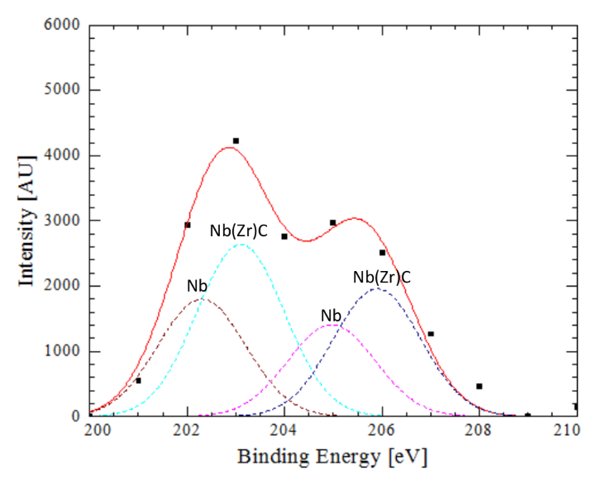
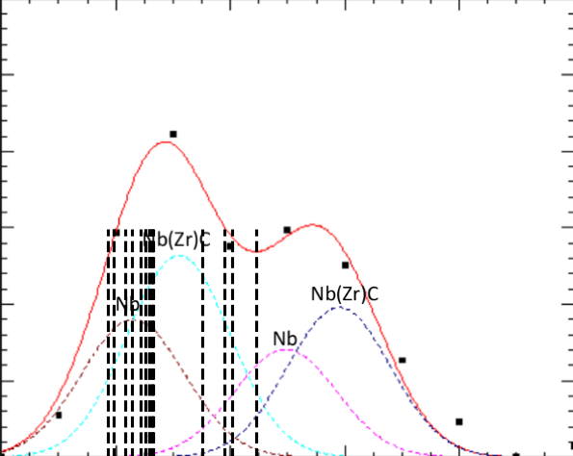
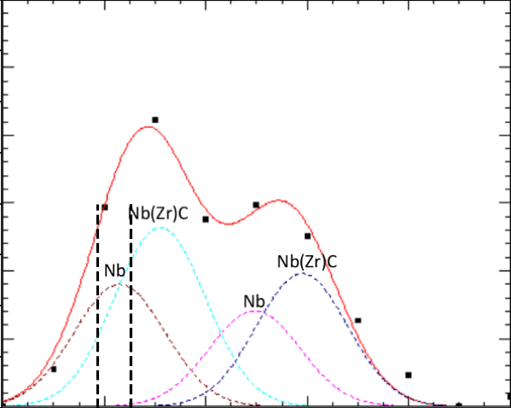
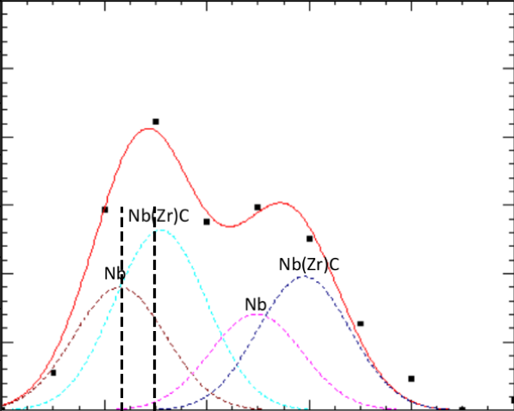
Comparison with Experimental
5/2 peak
3/2 peak
Figure from Zeming Sun

Slide 22
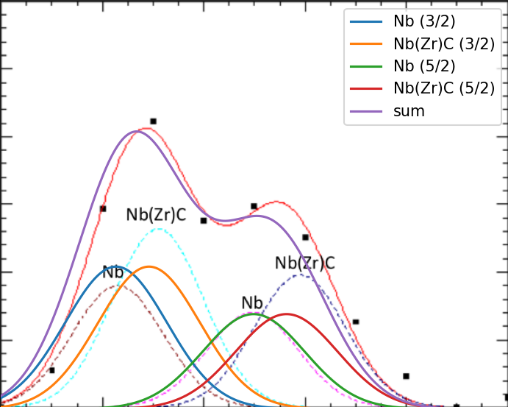
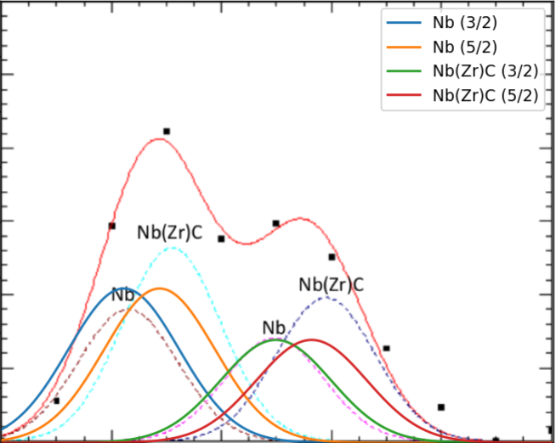
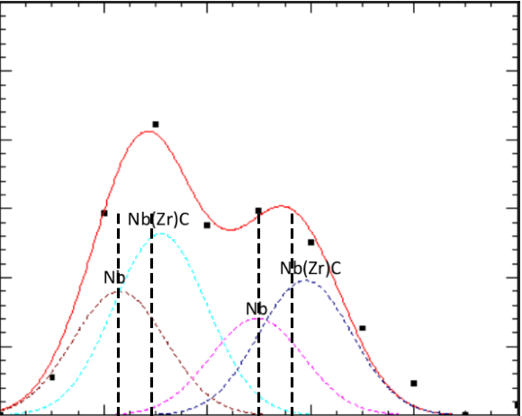
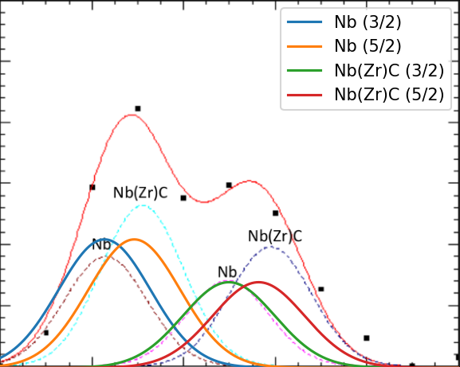
Summing Gaussians
Figure from Zeming Sun
Notes:
Briefly explain

Slide 23
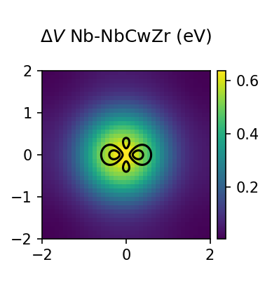
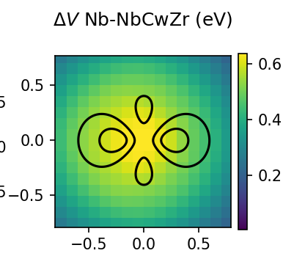
Effective Potential Shift
0.647 eV

Slide 24
Conclusions
Core electron energy shifts are highly correlated
Metallic oxides and carbides tend to have a higher energy level shift relative to pure metals
We are able to track changes in local potentials around atoms in different chemical environments
More investigation is needed to accurately identify materials in XPS data
Could try new method of making new pseudopotentials to calculate binding energy to high precision

Slide 25
Sources
L. Rademaker (2020). A Practical Introduction to Density Functional Theory. arXiv preprint arXiv:2011.09888.
M. Schlipf and F. Gygi, Computer Physics Communications 196, 36 (2015).
R. Sundararaman, K. Letchworth-Weaver, K. A. Schwarz, D. Gunceler, Y. Ozhabes, and T. Arias, SoftwareX 6, 278(2017).
W. A. Al-Saidi, E. J. Walter, and A. M. Rappe, Phys. Rev.B 77, 075112 (2008).
W. Kohn, A. D. Becke, and R. G. Parr, The Journal of Physical Chemistry 100, 12974 (1996),https://doi.org/10.1021/jp960669l.
Figures from Matthias Liepe, Michelle Kelley, Nathan Sitaraman, and Zeming Sun

Slide 26
Acknowledgements
Thank you to Michelle and Nathan all of the support they’ve given this summer and the time they’ve spent mentoring. Thank you to Matthias Liepe and Jim Alexander for directing the program and the weekly meetings. Thank you to everyone in the REU program for making it a great summer!
This work is supported by the U.S. National Science Foundation under award number NSF PHY-2150125
REU Site: Accelerator Physics and Synchrotron Radiation Science.

Slide 27
Thank you!
Questions?

