Slide 1
Simulating Multiple Scattering Effects in Ultrafast Electron Diffraction
Eliza Walters
Mentored by Cameron Duncan
CLASSE REU
August 18th, 2022

Slide 2
Project Motivation
UED - Ultrafast Electron Diffraction
Study structure of materials on an atomic scale
→ atomic spacing in Å or 10⁻¹⁰ m
Technique to reveal atomic structure of material by shooting laser and electron beam at sample
Analyze atomic motion through UED
Changing patterns allow us to see atomic motion over time

Slide 3
Visualization of UED and Diffraction Patterns
Detector
(Reciprocal Lattice)
Sample
(Real lattice)
Points in diffraction pattern are called reciprocal lattice points
The location of each point corresponds to a set of lattice planes within the crystal sample
Animation: Cameron Duncan

Slide 4
Visualization of Changing Diffraction Patterns
Real space
Reciprocal space
1000 000 000 000 × slow motion
hot - cold
Atomic response occurs on 10⁻¹³ – 10⁻¹² second timescale
(simulation)
Animation: Cameron Duncan

Slide 5
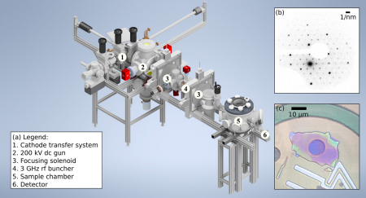
Project Background
[4]

Slide 6
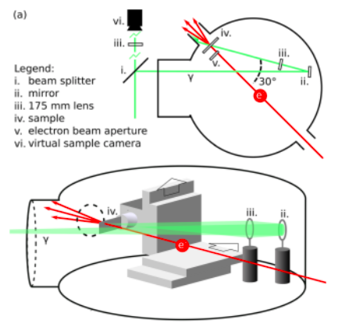
Project Background
Within Sample Chamber
Green laser beam (λ=515 nm)
Electron Beam with pm wavelength
[4]

Slide 7
Project Background
Accelerated Electron Beams with pm Wavelengths
Ultrafast Pulse Duration for Beams
Diffraction Patterns from Au Sample
Gold absorbs energy well at 515 nm
pm < Å
allows study of individual atoms
Atoms move in a picosecond scale (10⁻¹² s)
Gold is very well understood
allows for predictions & baseline for understanding multiple scattering effects
With an ultrafast, femtosecond (10⁻¹⁵ s) scale, we can view atomic motion with high resolution

Slide 8
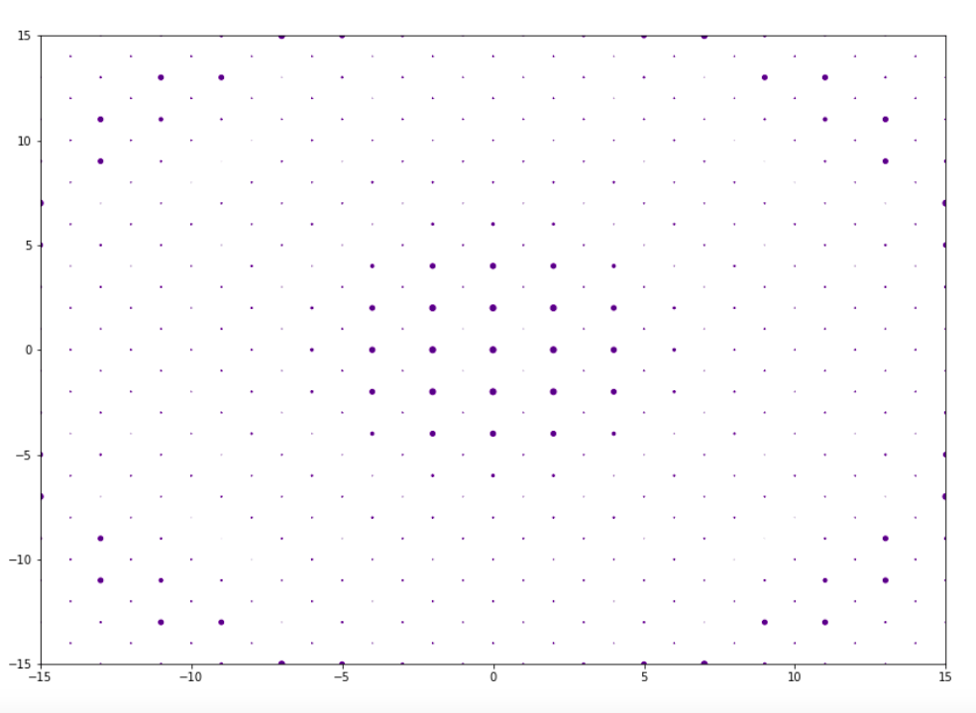
Thin Sample Theory
Simulated Diffraction Pattern with Thin Sample
In an atomically thin sample, there is an approximation that…
Intensity of Reciprocal Lattice Points ∝ |F(V)|²
where F(V) is the Fourier transform of the scattering potential (electrostatic potential)

Slide 9
Thin Sample Theory
What can affect the intensity of the reciprocal lattice points?
Temperature of Sample
∧
y
∧
∧
Specimen Tilt/ Beam Tilt
z
Φ
x
∧
y
∧
∧
Specimen Azimuth Tilt/ Beam Azimuth Tilt
z
Ө
x

Slide 10
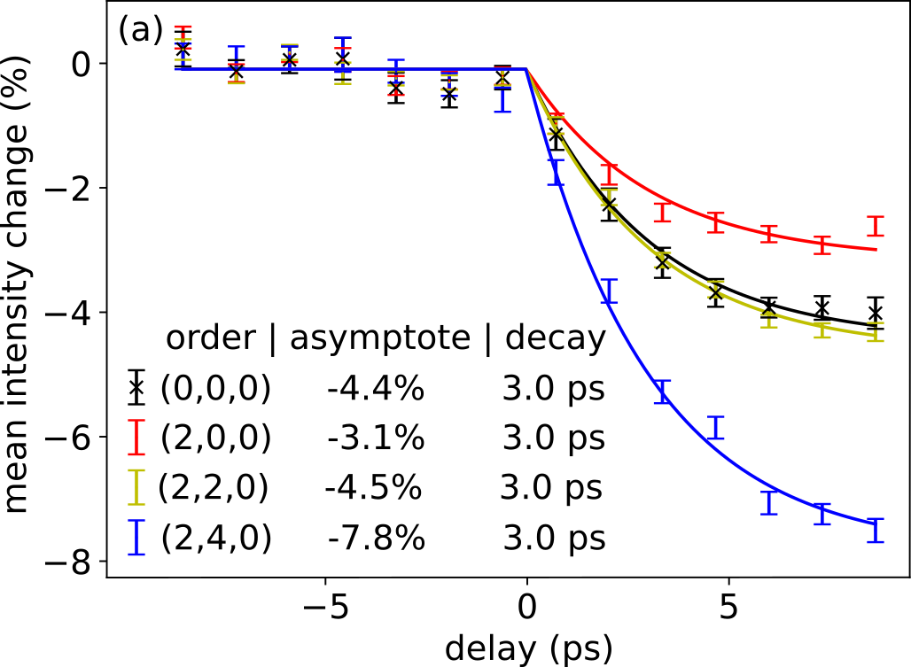
Breakdown of Thin Sample Approximation
Laser hits sample
With “thick” gold sample of about 20 nm (200 Å), we get the following experimental results
[4]

Slide 11
Breakdown of Thin Sample Approximation
Thin sample theory also predicts
Theoretical prediction for [000]
k
The [000] point is where the electron beam goes through the sample with theoretically no change in momentum
[000]
[240]
[220]
[200]
k is the reciprocal lattice vector, or the momentum “kick” the electron beam receives from sample
If this were true, k = 0 so ΔI / I should also equal 0, but experimental data shows otherwise
Multiple scattering effects arise from the non-thin sample → thin sample theory breaks down
Notes:
Specify that none of the points follow the trend but the most obvious is [000]

Slide 12
Research Goal:
Try to fit simulated model to experimental data with multiple scattering effects

Slide 13
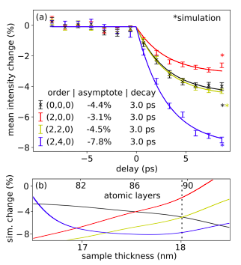
Previous Model
Simulated intensity change given by
Cold → before laser hits
Hot → after laser hits and heats sample
For this simulated model, hot temp. = 423 K, cold temp. = 273 K
[4]

Slide 14
Previous Model
[000] and [220] points follow similar trend for intensity change, so dashed line is placed at thickness where [000] and [220] simulated change curves intersect
At this thickness, the value of intensity change for each curve is plotted as an asterisk on the experimental graph

Slide 15
Methods
Asterisks are located at several times the experimental uncertainty from asymptotes…
Research Goal:
Try to fit simulated model to experimental data with multiple scattering effects
Adjust simulated model so that asterisks lie within experimental uncertainty

Slide 16
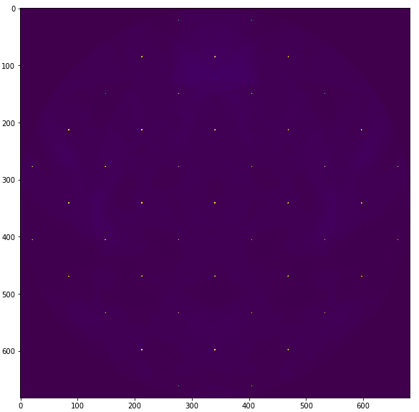
Finding Simulated Intensity with μSTEM
μSTEM Simulation Software
Creates simulated diffraction patterns for thick samples
[1]
Treats sample as a sum of multiple thin slices, adding contribution of each slice to final pattern
Can change temperature, tilts, thicknesses, and more
Example μSTEM diffraction pattern
Temperature = 273 K
Thickness = 199 Å
Specimen Tilt = 20 mrad
Specimen Azimuth Tilt = 1571 mrad (90º)

Slide 17
Batch of Simulation Runs in μSTEM
Temperature, specimen tilt, and specimen azimuth tilt change intensity of reciprocal lattice points
We can test combinations of these quantities in μSTEM
Batch of Runs
Temperatures (K): 273, 305, 336, 352, 384, 400, 423
Specimen Tilt (mrad): 20, 30, 40, 50, 60
Specimen Azimuth Tilt (mrad): 0, 785, 1571
For the simulated model, we need two temperatures and can add specimen tilt and/or specimen azimuth tilt

Slide 18
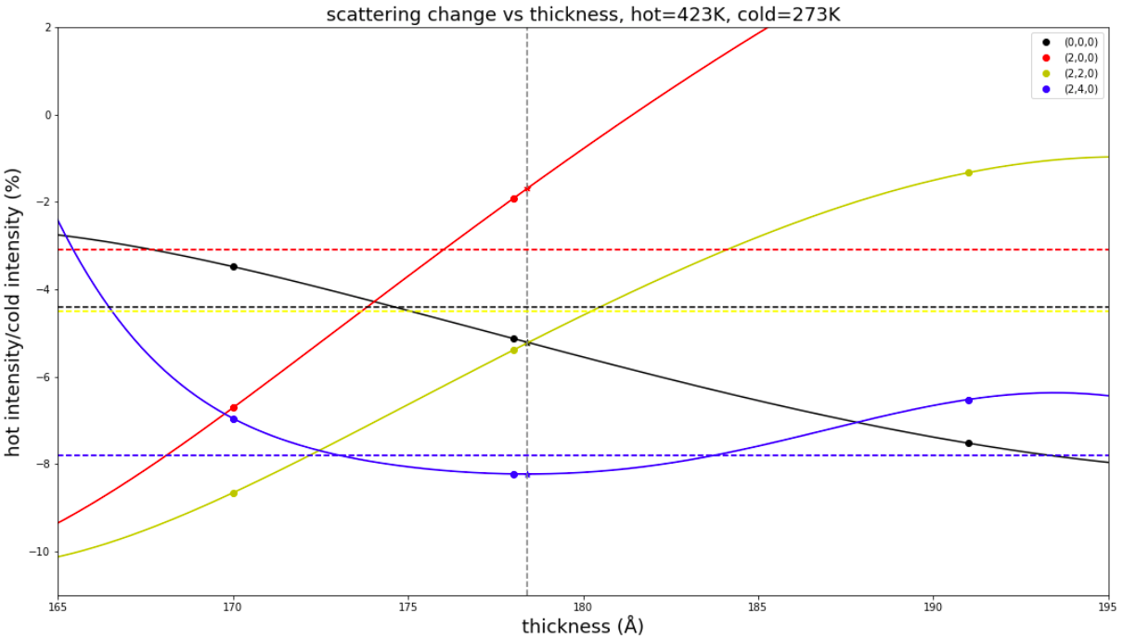
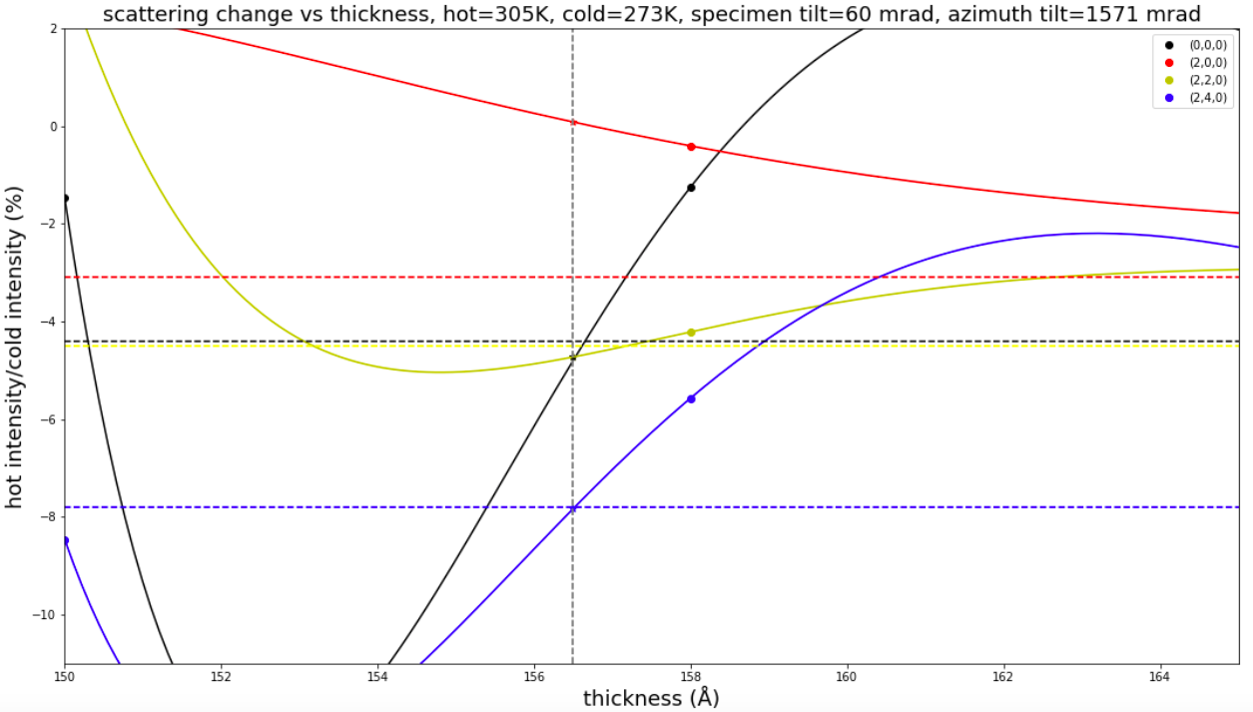
Results
Unable to complete entire batch due to duration of simulation runs
Of tested runs, there is one potential improvement towards matching experimental data
Previous Simulated Model
New Simulated Model
Thickness for [000] and [220] best fit curves’ intersection: 178.4 Å
Thickness for [000] and [220] best fit curves’ intersection: 156.5 Å
These results are unphysical since thickness can only be multiples of atomic spacing, which is 〜 4 Å

Slide 19
Because of time constraints, we could not restart analysis, but the following slides provide a guideline for how we would approach finding a good fit to experimental data, using unphysical result

Slide 20
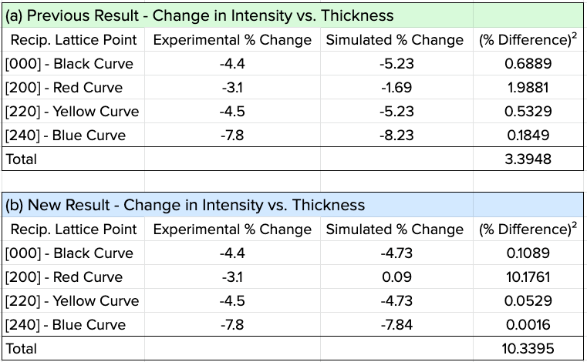
Results
Approximate simulated intensity change values based on thickness of [000] and [220] intersection
Better agreement for [000], [220], and [240]
Worse agreement for [200] … leads to overall sum of square difference much higher
We can experiment with these parameters more since there is improvement in 3/4 curves…

Slide 21
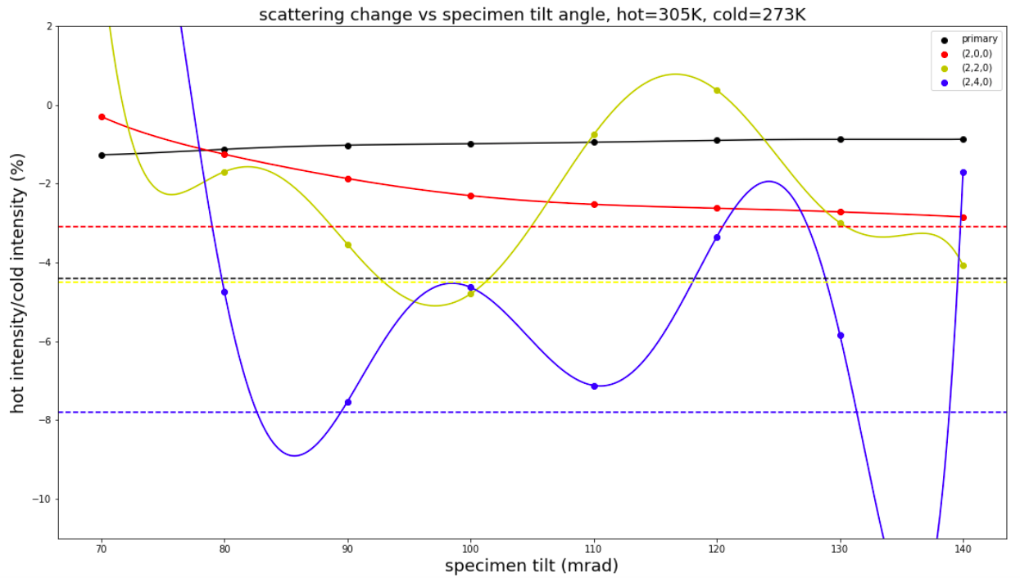
Results
Set thickness of 158 Å (physical thickness closest to interpolated intersection thickness of 156.5 Å)
Set specimen azimuth tilt of 1571 mrad
Testing range of specimen tilts (70-140 mrad) to see what angles yield simulated values close to experimental

Slide 22
Discussion
As specimen tilt increases…
Red [200] curve slowly approaches experimental value
Black [000] curve slowly gets farther from experimental value
Blue [240] and yellow [220] curves are much more sensitive to specimen tilt and oscillate in intensity change
Specimen tilt may not be parameter that needs to change for this thickness & temperature range…

Slide 23
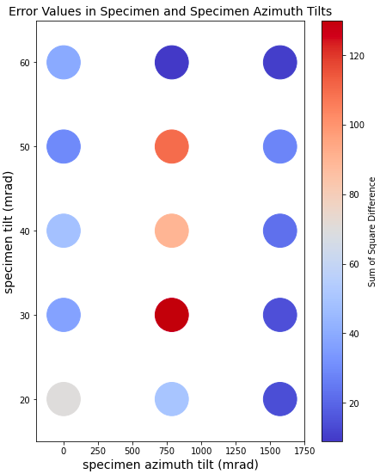
Discussion
Plot of tested tilts with color corresponding to size of error
Patterns that arise…
Specimen azimuth tilt of 1571 mrad seems to give overall lowest error vs. 0 mrad and 785 mrad (yet we found specimen tilt might not be the parameter needing to be changed for thickness & temps)
Specimen tilt of 60 mrad gives two lowest errors in entire plot
Next Step: Hold specimen tilt at 60 mrad and make scan of azimuth tilts to see if there is even lower error for 305 K & 273 K

Slide 24
Conclusions and Future Work
Temperature range of 273 K and 305 K still possible
Investigate if experimental and simulated intensity changes can match up at different azimuth tilts with specimen tilt 60 mrad
Continue running batch of simulations
Possibly expand/alter batch based on results found from tilt scans
In future reuse similar analysis methods, but only use intersection points that occur at multiples of atomic spacing

Slide 25
References
[1] Allen, L. J. A., Brown, H. G., J., D. A., Findlay, S., and Forbes, B. D., μSTEM v5.3, University of Melbourne, Melbourne, Australia (2018).
[2] Duncan, C., private communication (2022).
[3] Kohl, H.and Reimer, L., Transmission Electron Microscopy (Springer, New York, NY, 2008).
[4] Li, W., Duncan, C., Andorf, M., Bartnik, A., Bianco, E., Cultrera, L., Galdi, A., Gordon, M., Kaemingk, M., Pennington, C. et al., “A kiloelectron-volt ultrafast electron micro-diffraction apparatus using low emittance semiconductor photocathodes,” Structural Dynamics 9, 024302 (2022).

Slide 26
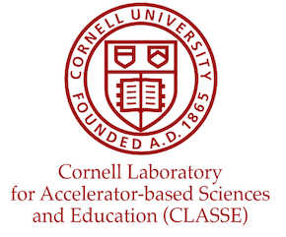
Acknowledgements
I would like to thank my mentor, Cameron Duncan, for supporting me throughout my research and providing this opportunity to extend my knowledge in physics, programming, and conducting research. I also wish to thank Matthias Liepe and Jim Alexander for hosting the REU program at CLASSE. This work was made possible by the U.S. National Science Foundation under award number NSF PHY-2150125, REU Site: Accelerator Physics and Synchrotron Radiation Science.

