Slide 1

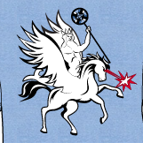


Application of Novel Computational Methods at HiRES
Particle Beam Physics Laboratory
Improving controls and diagnostics for high brightness beams in experiment
Frederick “Eric” Cropp
In Collaboration With D. Filippetto (LBNL)
and P. Musumeci (UCLA)

Slide 2
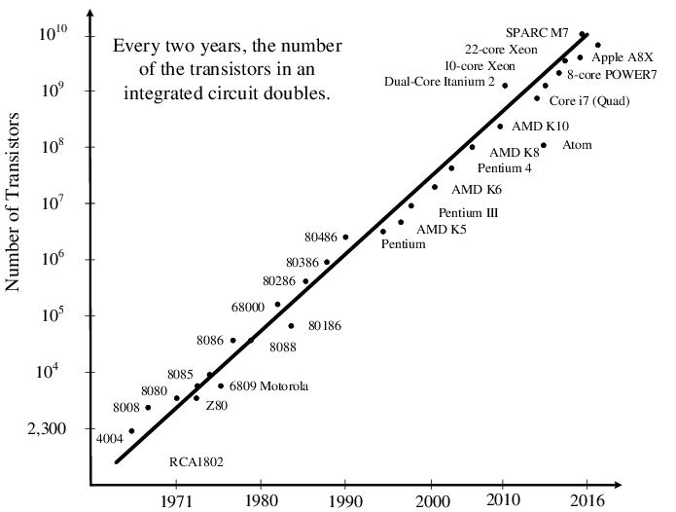
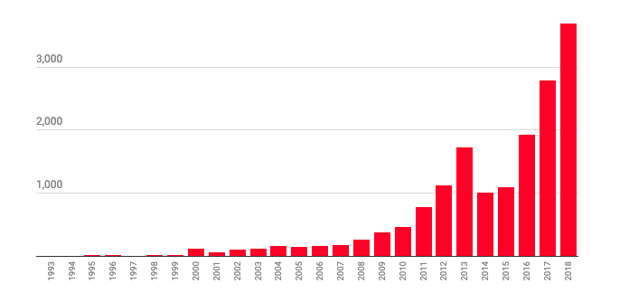
Motivation
Moore’s Law
Accelerators: complex systems with a plethora of problems that could be solved or mitigated with computational tools. E.g.
  Stability – long-term and short-term
    Adaptive control
    Global feedback
  Complexity
    Increasing speed and reliability of operations
Numerous results from our field e.g.
  J. Duris et al. Bayesian Optimization of a Free-Electron Laser Phys. Rev. Lett. 124, 124801, 2020
  C. Emma et al. Machine learning-based longitudinal phase space prediction of particle accelerators Phys. Rev. Accel. Beams 21, 112802, 2018
  A. Edelen et al. Machine learning for orders of magnitude speedup in multiobjective optimization of particle accelerator systems Phys. Rev. Accel. Beams 23, 044601, 2020
  Z. Zhang et al. Toward fully automated UED operation using two-stage machine learning model Scientific Reports 12, 4240, 2022
  R. J. Shalloo et al. Automation and control of laser wakefield accelerators using Bayesian optimisation Nature Communications 11, 6355, 2020
O. Aydin and O. Ucar, Adv. Sci. Technol.
Eng. Syst. J. 2(3), 1114-1128 (2017)
AI Papers by Year
https://www.technologyreview.com/2019/01/25/1436/we-analyzed-16625-papers-to-figure-out-where-ai-is-headed-next/

Slide 3
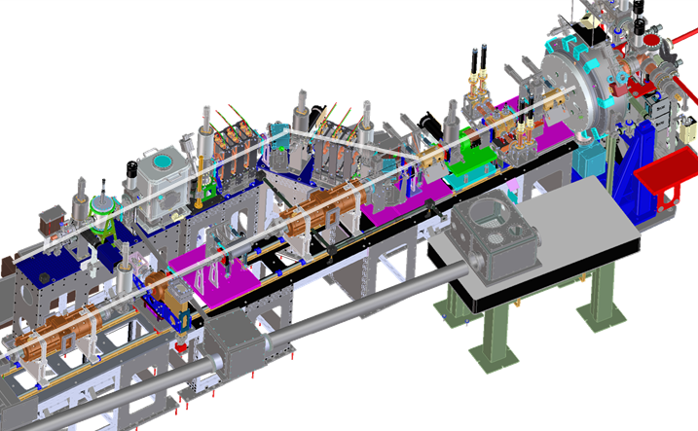
HiRES: Testbed for New Technology
Combines benefits of user facility with flexibility of compact accelerator
State of the art
  CW Gun (prototype for LCLS-II)
  LLRF/RF control and synchronization
  MHz UED
Flexible
  We retain control over all details of operations
  Can change operation modes with ease
Makes for an ideal environment to test new technologies, such as ML
Results easily adopted at larger user facilities
End goal: an adaptive, fully global feedback and control system

Slide 4
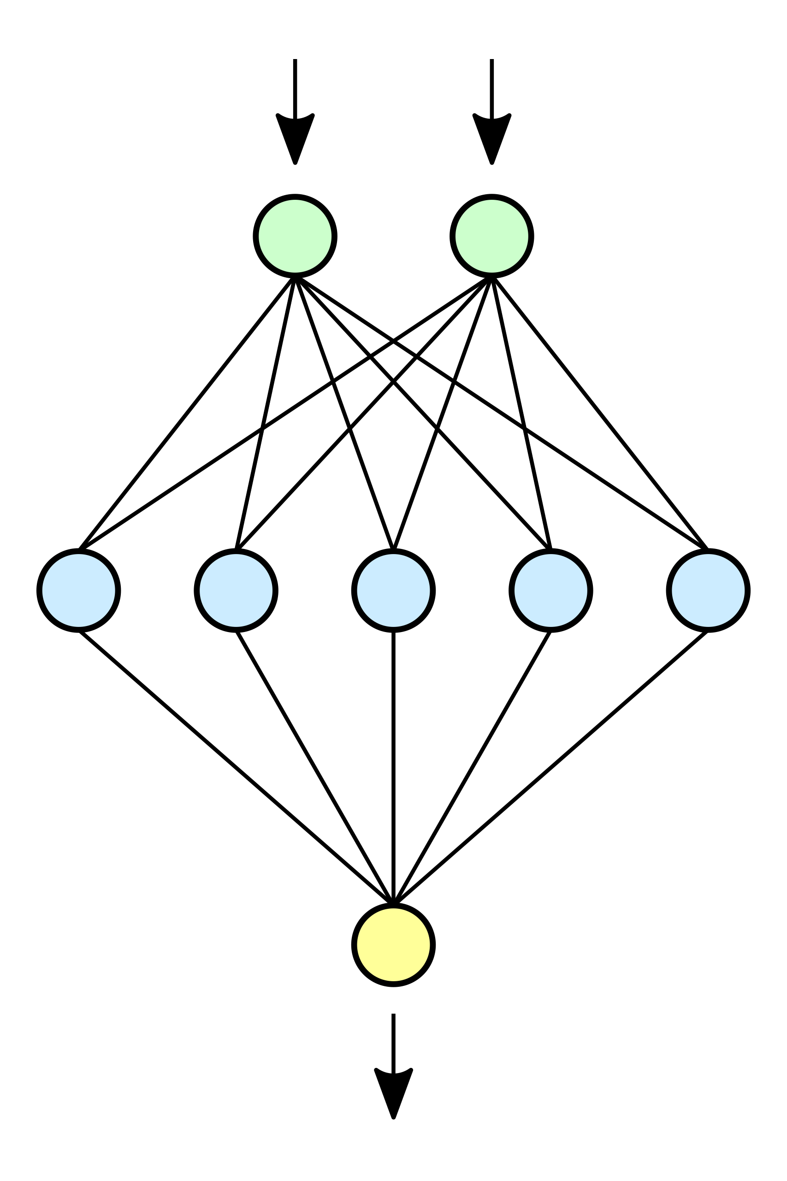
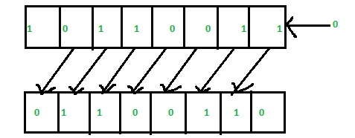
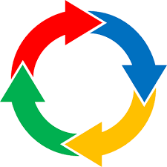

Adaptive, fully global feedback and control system
New data to match, train
Model-based predictions
Control inputs
New parameter setpoints
Data from experiment
Data-based predictions
Surrogate Modeling & Virtual Diagnostics
High-fidelity physics-based model
Fast executing NN-based surrogate model
Model-based virtual diagnostics
Adaptive, Optimal Control
Online tuning
Balancing multiple complementary inputs from measurements, virtual diagnostics and control parameters
Procedure for drifting outside training data
Synchronous Data Acquisition & Prediction
Synchronize and catalogue RF and image-based data
Build data-based model
Predict beam outcomes based on data-based model

Slide 5

Synchronous Data Acquisition & Prediction
High-level goals:
  Synchronize and catalogue data
  Understand correlations in data
  Use this understanding to predict outcomes (virtual diagnostic)
  Increase stability beyond state of the art for a UED measurement
Intermediate goals:
  Comparison of prediction techniques
  Show substantive improvement from prediction
Pending Tasks:
  Took possible final data set last week
  Perform model-based analysis of data
  Analyze data using LSTM, CNN, MLP, linear regression
Personnel:
  F. Cropp, A. Gilardi, D. Wang, A. Scheinker, S. Paiagua, P. Musumeci, D. Filippetto

Slide 6
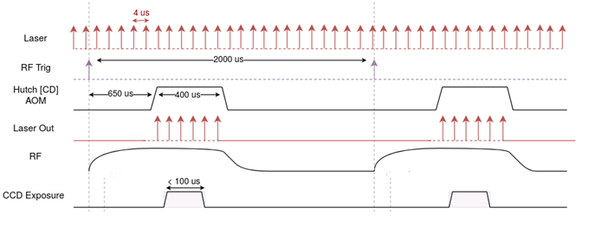
Synchronization
State-of-the-art RF chassis with FPGA-enabled RF feedback and data storage
  102 MSPS
Cameras acquired synchronously
Myriad other data taken asynchronously
  EPICS archiver appliance
    Temperatures
    In-loop buncher & TCAV RF
    Magnets
https://slacmshankar.github.io/epicsarchiver_docs/userguide.html

Slide 7
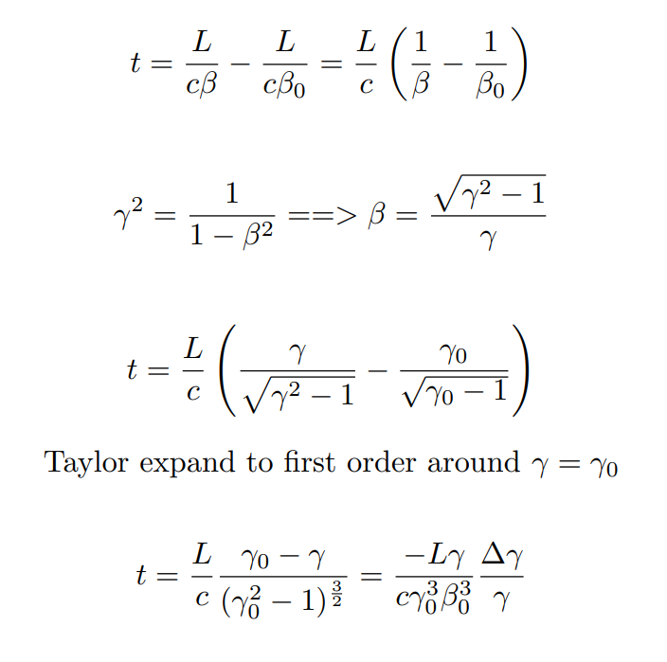
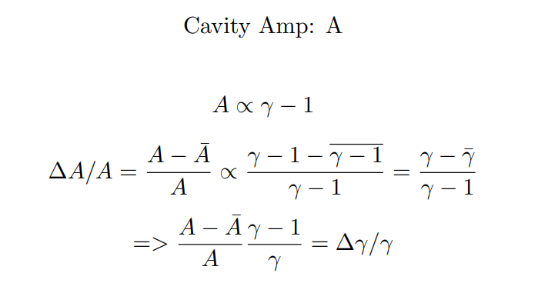
Context and Figures of Merit
Two operation modes:
  Open loop (no feedback): short-term energy stability ~10^-3
  Closed loop: short-term energy stability ~10^-4
Goal: do even better in closed loop
“Virtual feedback” → predictions of energy/TOA to reduce effect of variation in post-processing
  Ex: UED

Slide 8
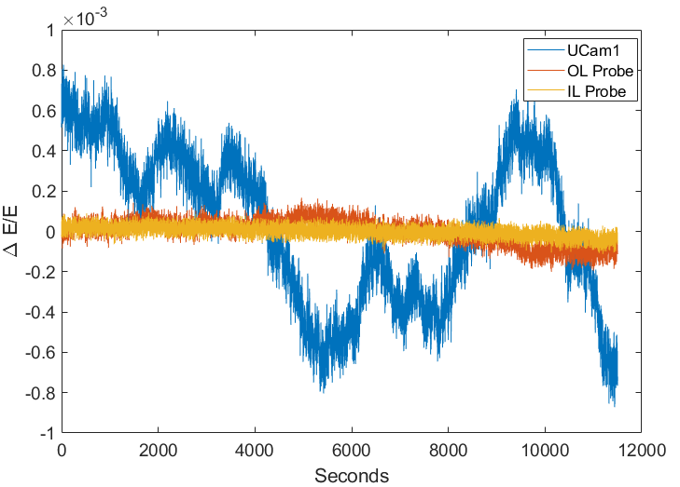
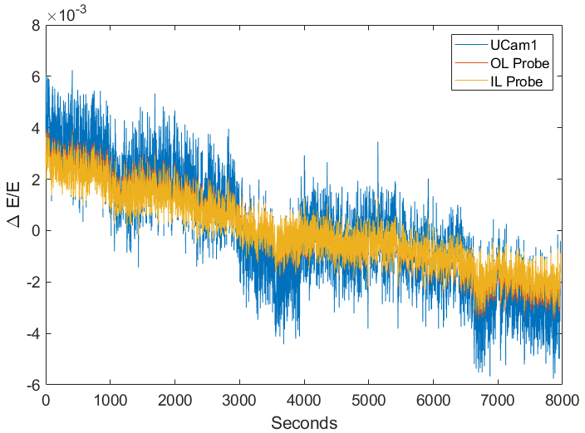
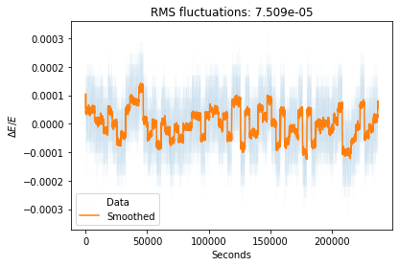
Unexplained Closed Loop Drift in Dogleg
Unexplained drifts (right) when gun in closed loop
Dipole fluctuations potential cause
Not as evident in open loop

Slide 9
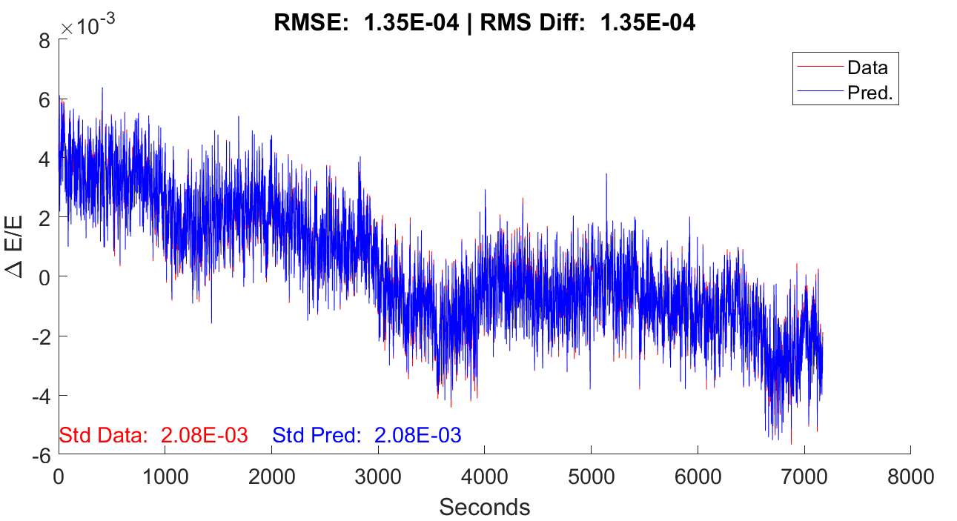
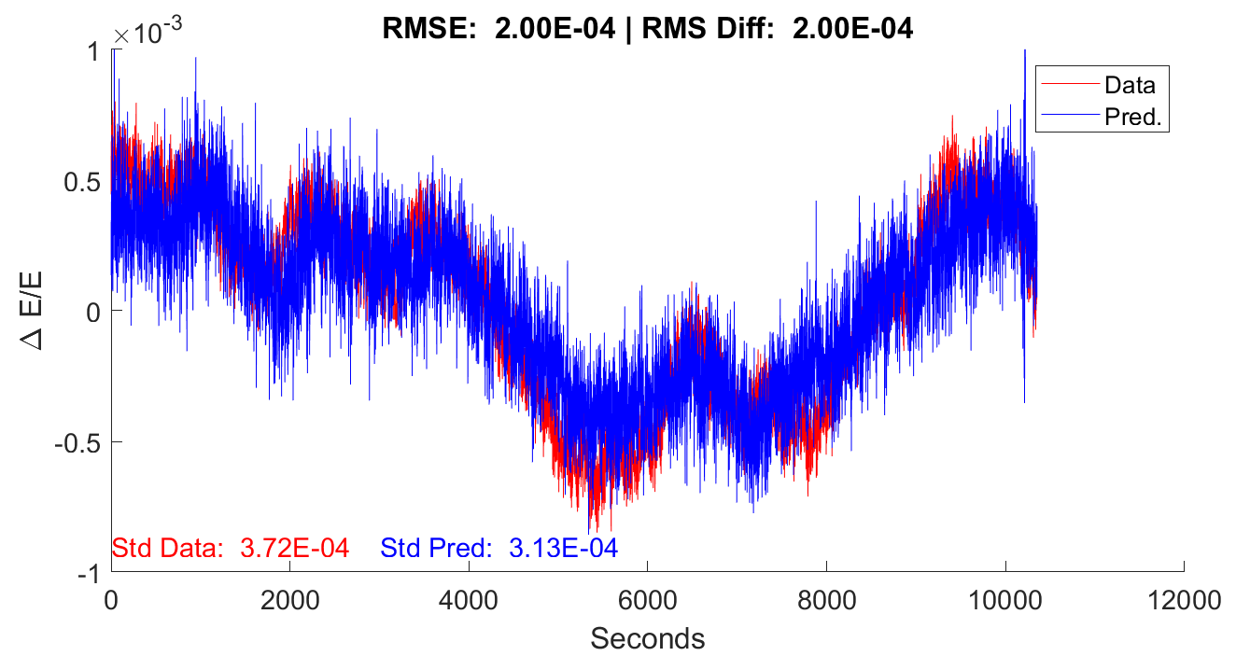
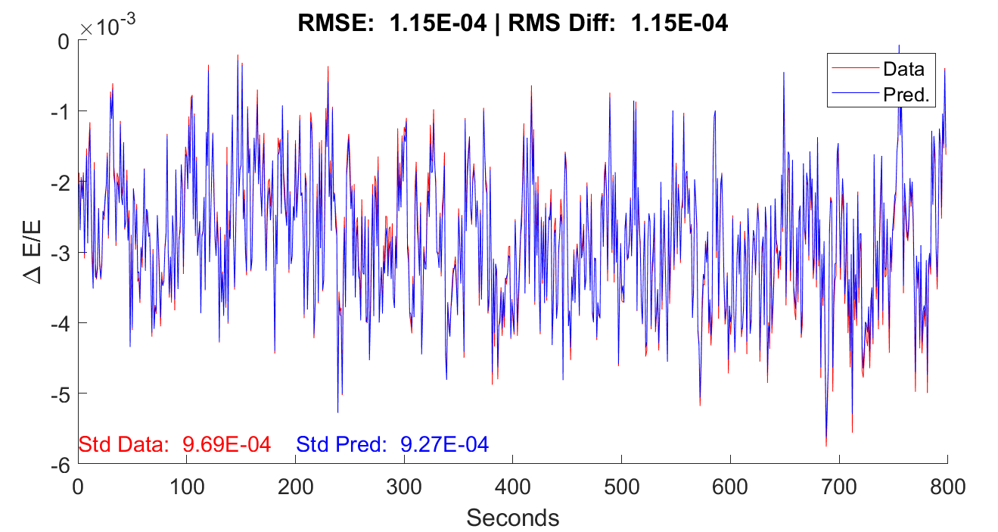
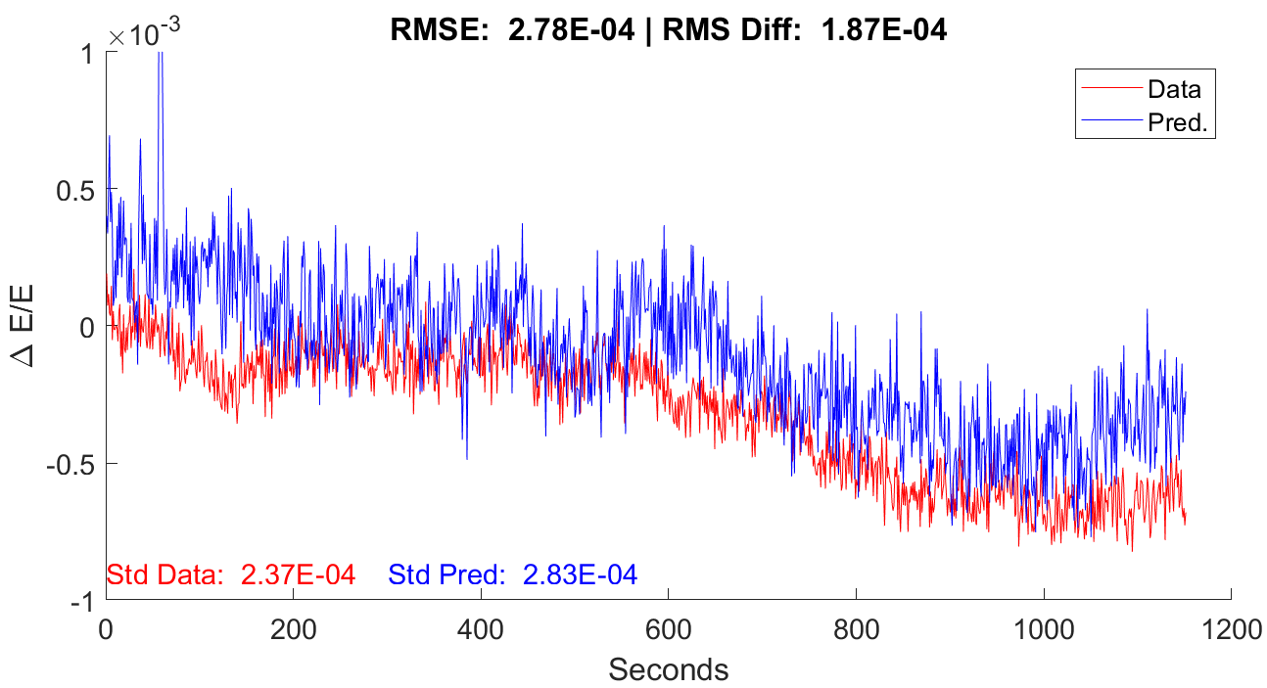
Baseline Predictions – Linear Regression
Train
Note that prediction accuracy is better in open loop.
Test
Gun Open Loop, Dipole
Gun Closed Loop, Dipole

Slide 10
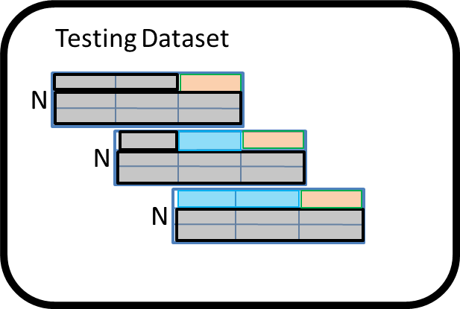
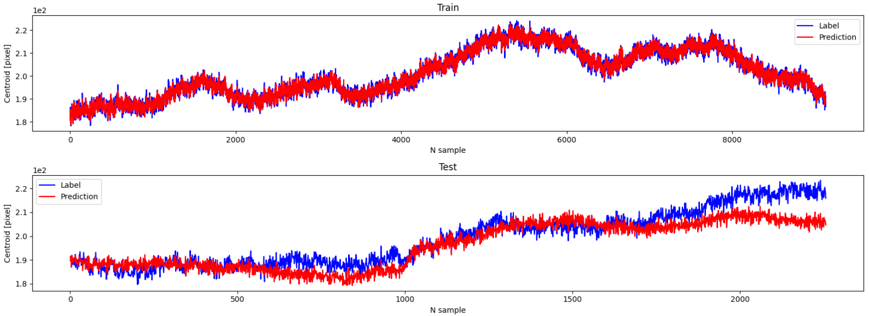
Advanced Predictions
In progress
Sparse vs. time series
Predict current vs next shot
Some improvement over baseline, but work in progress
Drifts vs. jitter
CNN taking into account 35 previous shots
STD (Data - Prediction): 1.6913e-4
RMSE: 1.7676e-4
A. Gilardi

Slide 11
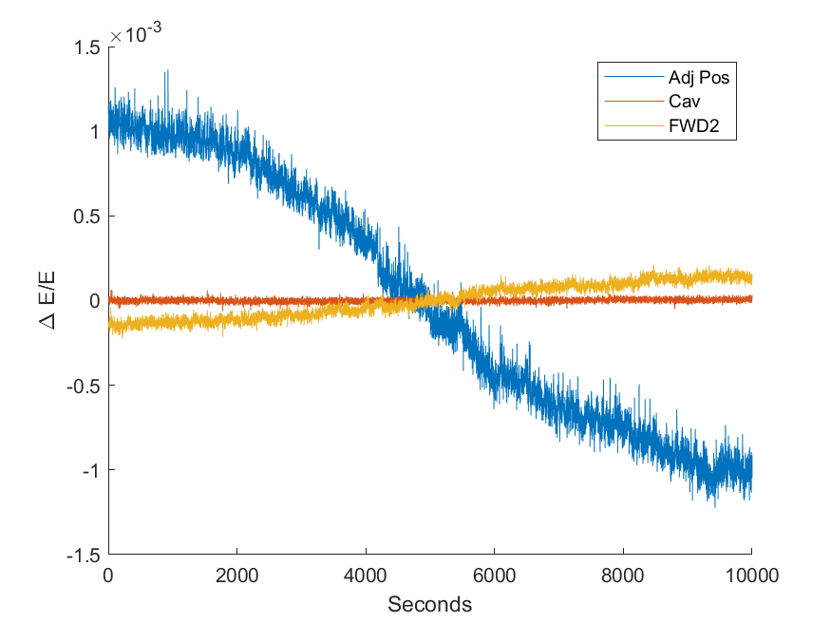
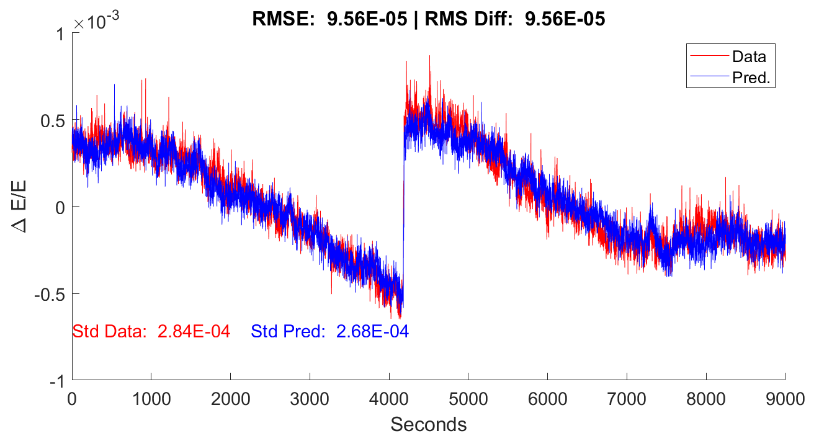
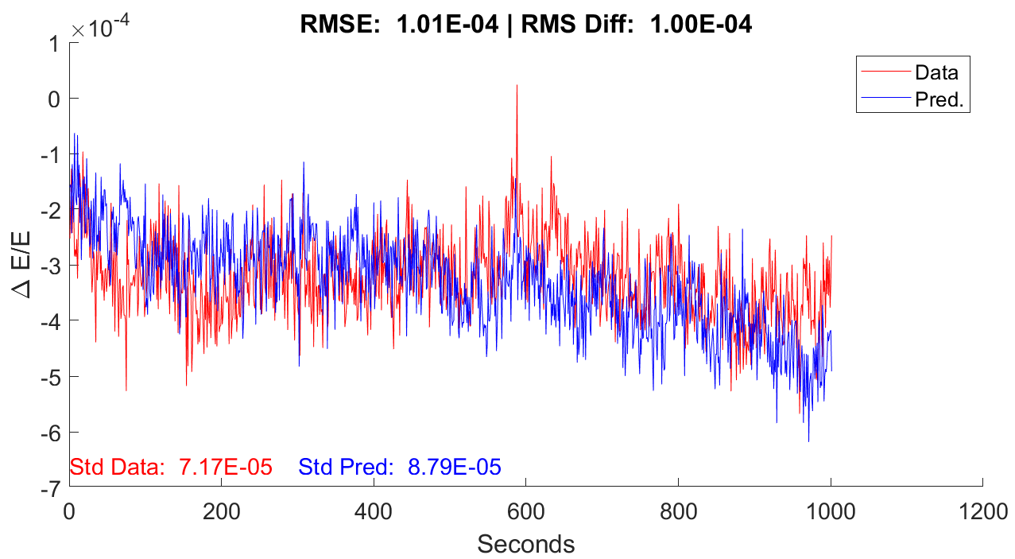
RF Cavities Added
Gun Closed Loop, TCAV
Train
Test
Unexplained TOA drifts, but clear correlations
Still a simple case
  What happens if we add another RF cavity?

Slide 12
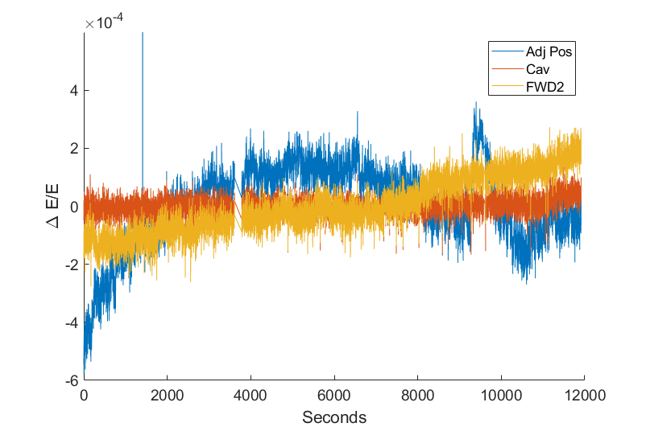
Outlook
Part of a broad effort to improve control and diagnostics at HiRES
Working to increase the stability of a state-of-the-art machine
  Drifts caused by dipole?
  Baseline TCAV predictions show promise
    Advanced prediction pending
  For UED and other applications, will need buncher cavity
    Data taken last week with three cavities (right)
    Full analysis pending

Slide 13
Questions?

