Slide 1

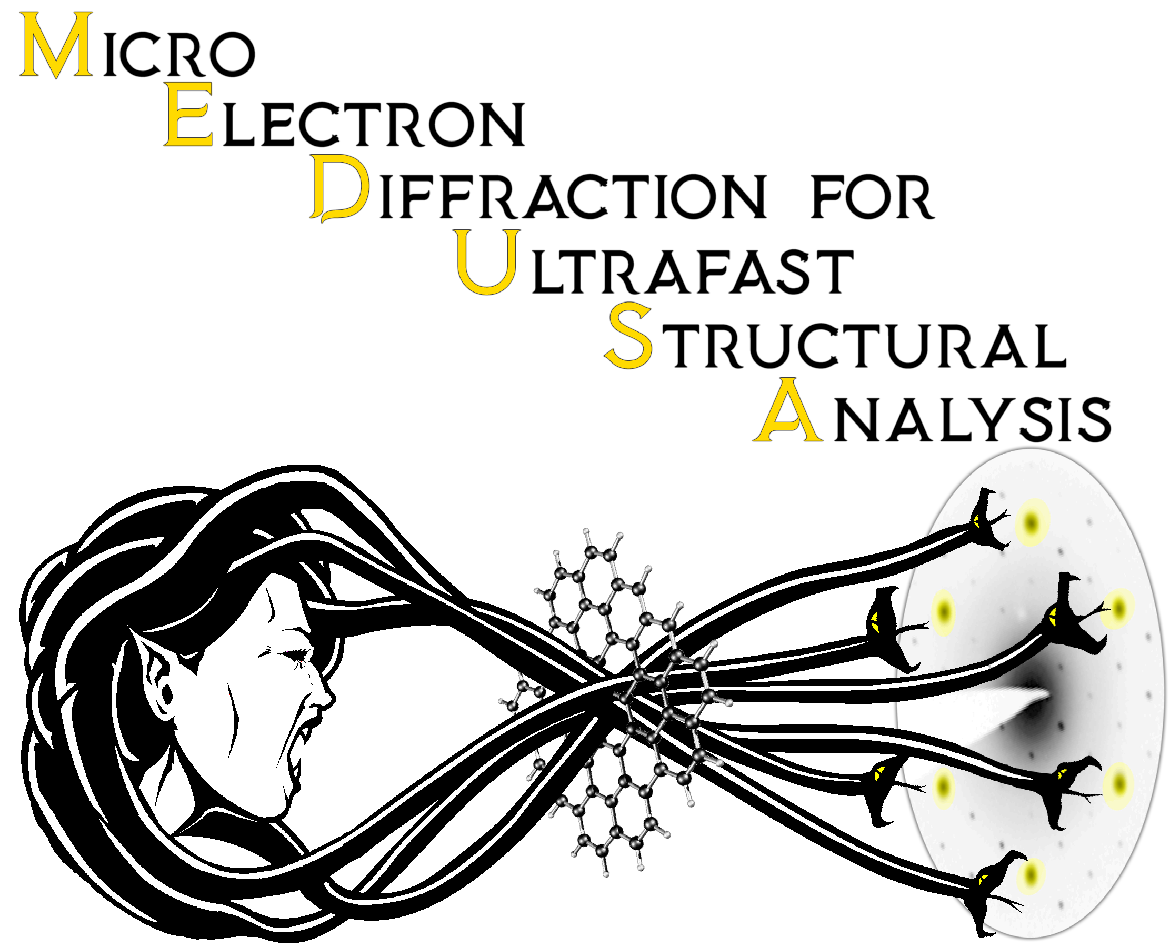

4D Emittance Measurements for keV Ultrafast Microdiffraction with Stray Sextupole Correction
Matthew Gordon¹ , W. H. Li², A. C. Bartnik², C. J. R. Duncan²,
M. Kaemingk² , C. A. Pennington², Y.-K. Kim¹, J. M. Maxson²
¹University of Chicago
²Cornell University
BDC Theme Meeting
4/14/22

Slide 2
Motivation
Make a molecular movie
MEDUSA beamline at Cornell
Photocathode with a sub 100 meV
Mean Transverse Energy (MTE)
Produces low “temperature” electron beams capable of time resolved diffraction
Preserve good beam quality to the sample

Slide 3
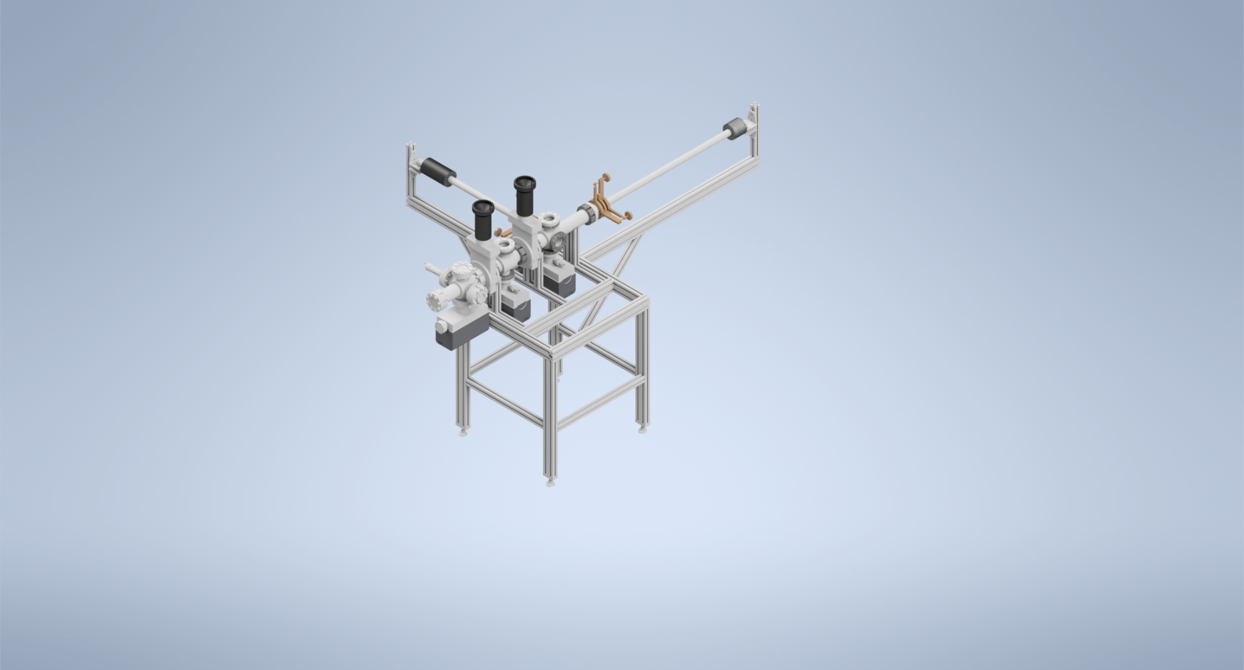
MEDUSA Beamline
Cathode transfer system
Na–K–Sb Photocathode
Cathode MTE < 100 meV

Slide 4
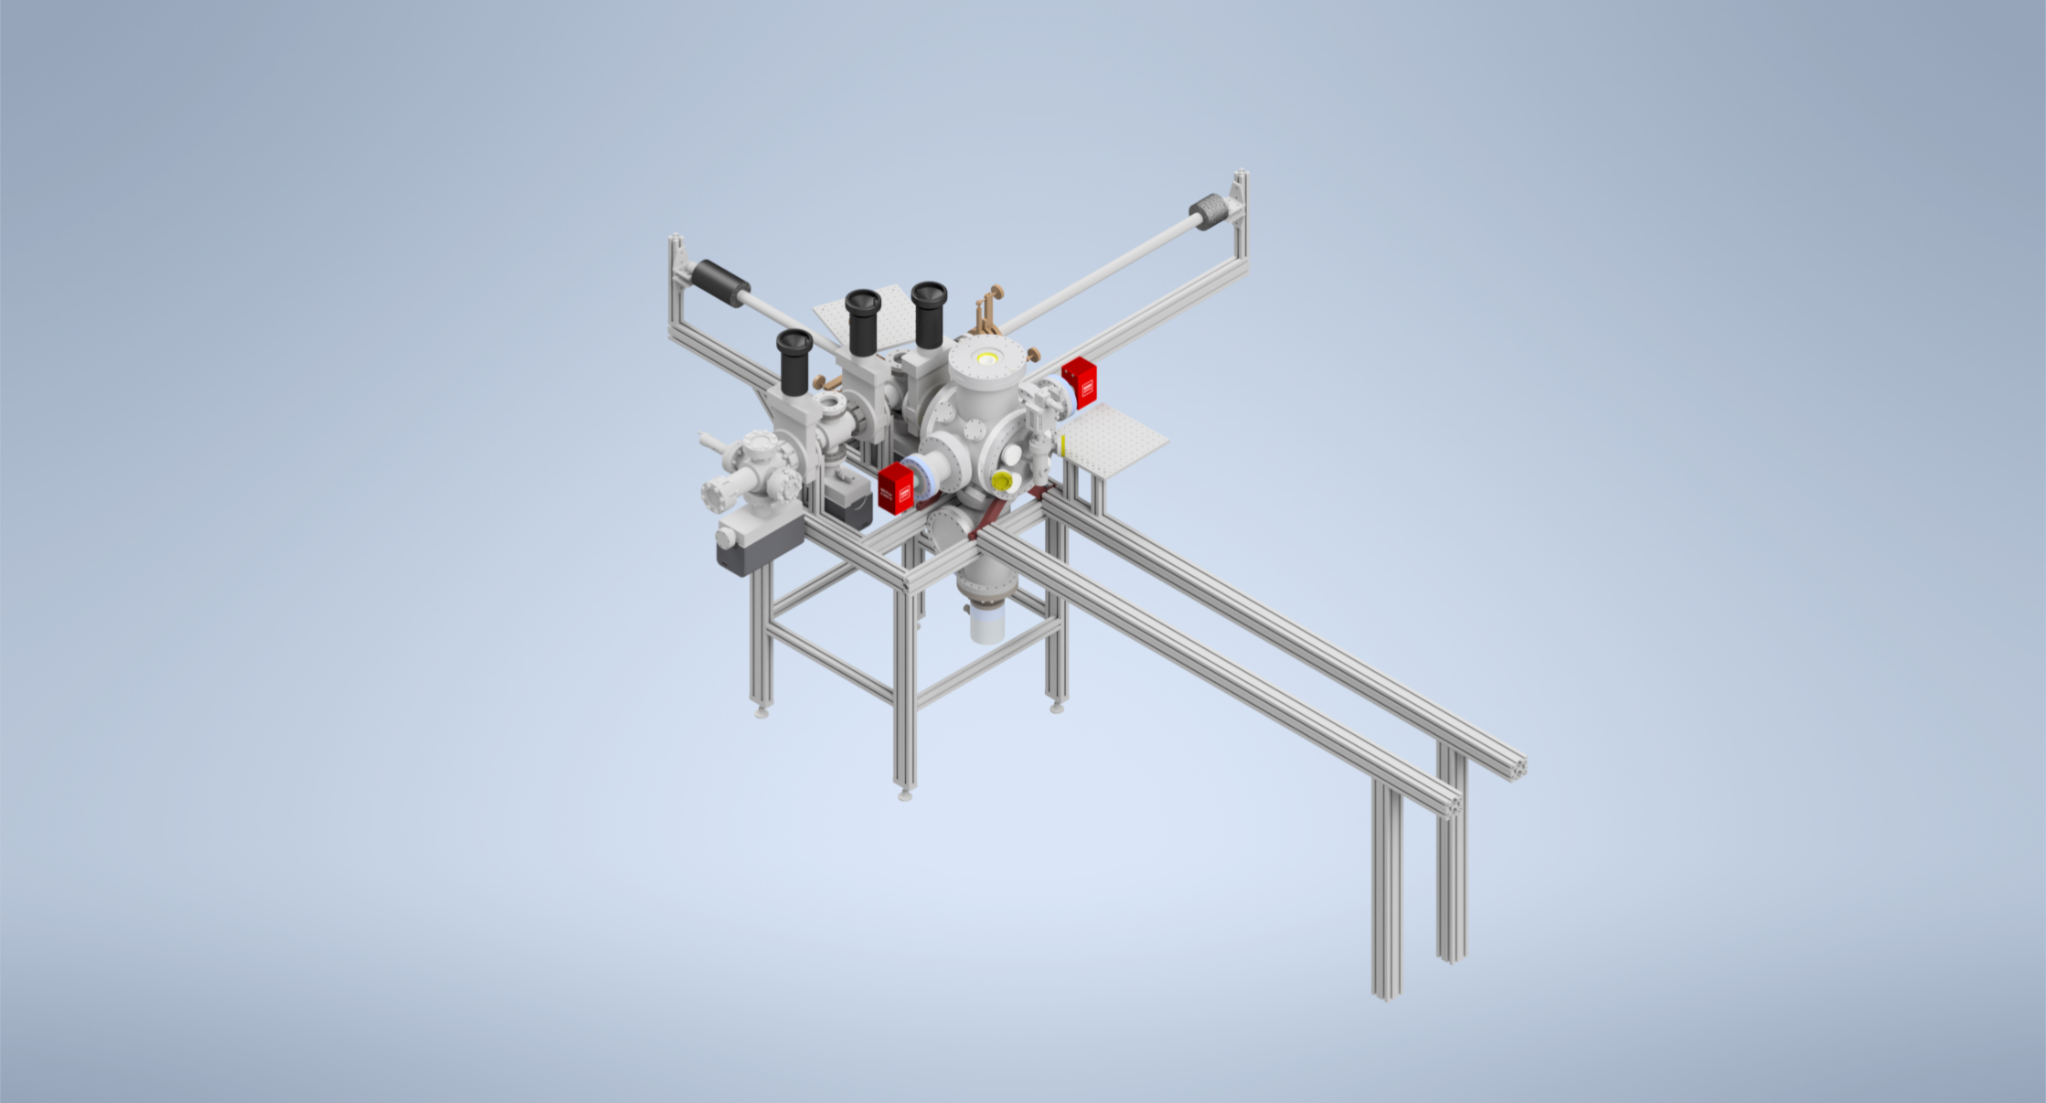
Beamline overview
Final Beam energy: 140 keV
Gun

Slide 5

Beamline overview
Focusing solenoid

Slide 6
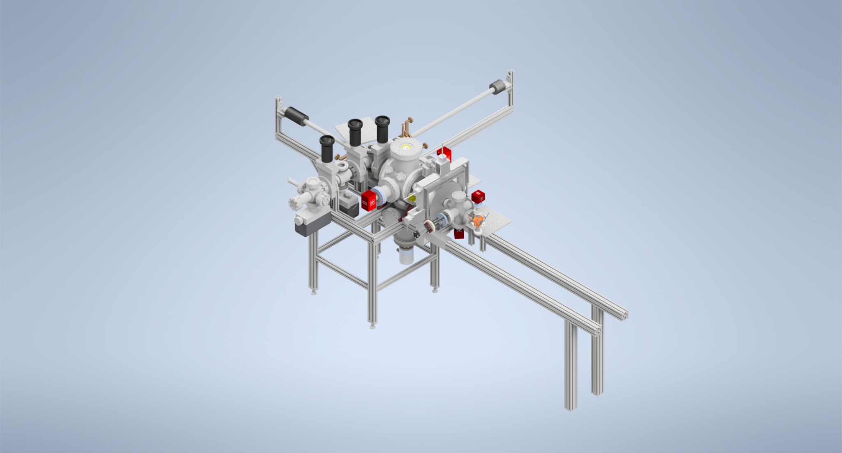
Beamline overview
Beam length: 10 ps→ <200 fs
Viewscreen
Buncher

Slide 7
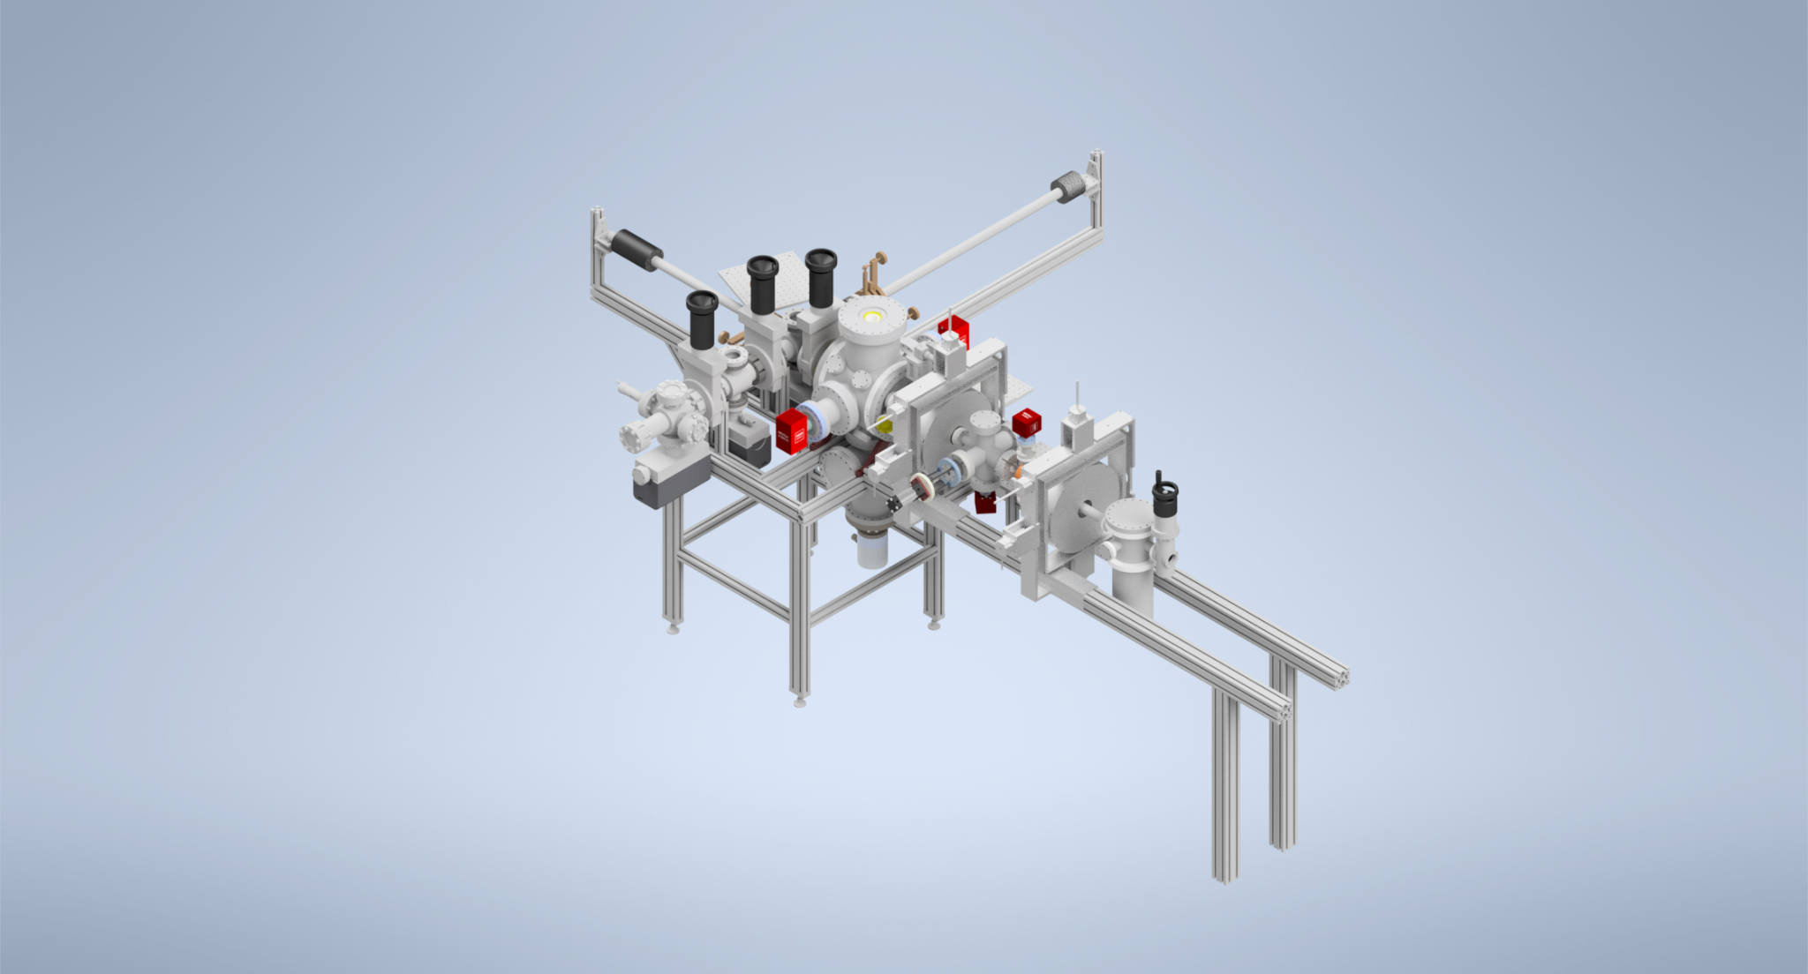
Beamline overview
Beam size:
100s of Microns→ 10s of Microns
Second focusing solenoid

Slide 8
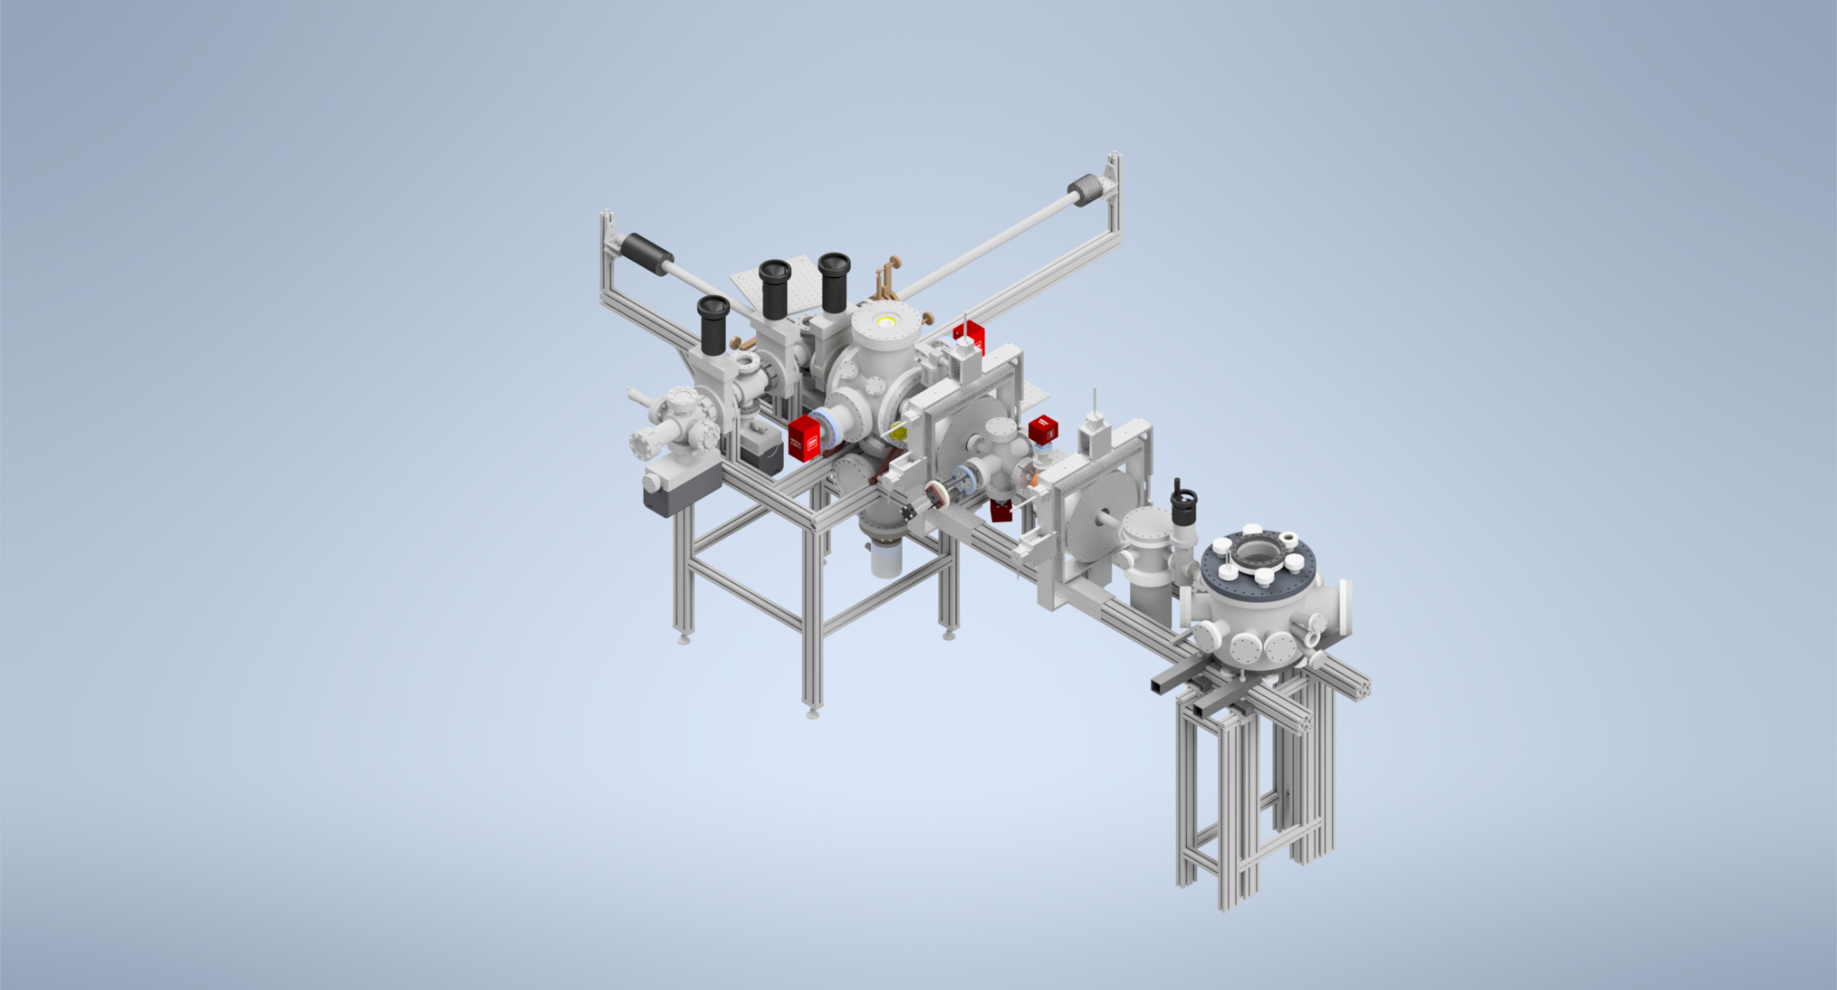
Beamline overview
Sample chamber
(Optional Pinhole)

Slide 9

Beamline overview
Detector

Slide 10
Correcting Stray Fields
Unintended (stray) fields mainly come from the solenoid and buncher
Non-linear fields and fields that couple x and y reduce beam quality
Quadrupole and sextupole correctors placed after second solenoid
HACLYI

Slide 11
Quadrupole Correction
Stary quadrupole moment coming from solenoids
Simulated effect of quadrupole on beam quality in General Particle Tracer (GPT)
x-p_{y} phase space projection shows uncorrected correlation

Slide 12
Sextupole Correction
Simulations of correcting a sextupole in GPT
Sextupole placed in buncher, correctors after second solenoid
Rotate angle of corrector and find correct strength

Slide 13
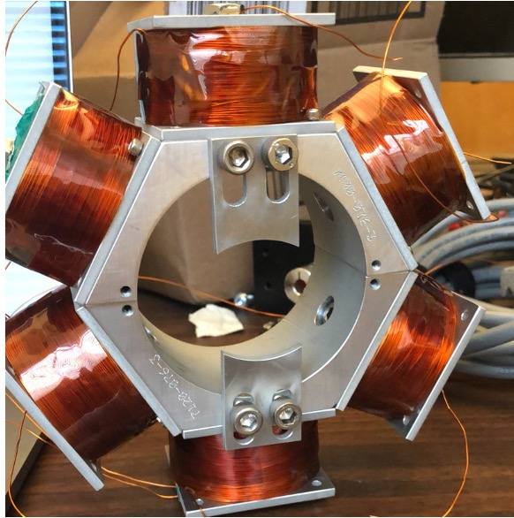



Sextupole Correction
Sextupole Corrector Off
Sextupole Corrector High Current
Sextupole Corrected

Slide 14
4d Phase Space Reconstruction
Bring beam to a focus at pinhole
Use pinhole to pick out a small fraction of the beam
Measure the beam fraction downstream (Intensity/momentum)
Move the beam over the pinhole
Reconstruct 4d phase space
Camera Image of Ce:YAG
~10 μm steps
500 μm
100 μm
screen pinhole separation

Slide 15
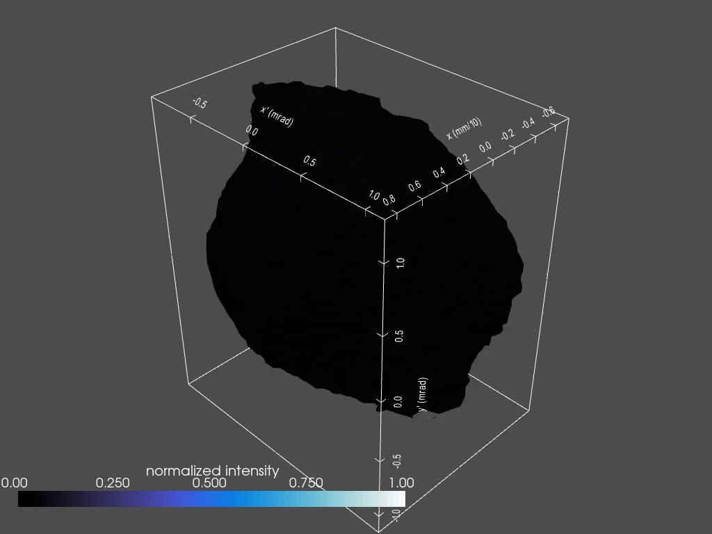
Phase Space 3D Projection

Slide 16
Phase Space Portraits
Now let’s look at 2D projections
x and y have small correlations (skew quadrupoles corrected)

Slide 17
Comparison to Simulation
Repeat this reconstruction procedure for different values of buncher voltages around peak bunching with (red) and without (blue) the sextupole corrector
Simulation in GPT with no sextupole in the buncher (red line) and with sextupole in the buncher (blue line)
Matches simulated electron beam with MTE of 80±20 meV

Slide 18
Conclusions
Corrected stray fields up to sextupole in a UED beamline (MEDUSA)
xy correlation near zero
Electron beam with size and emittance that agrees with a simulated cathode MTE of ~80±20 meV with no stray fields
Performance paper published in Structural Dynamics:
A kiloelectron-volt ultrafast electron micro-diffraction apparatus using low emittance semiconductor photocathodes
Paper detailing stray field correction upcoming

Slide 19
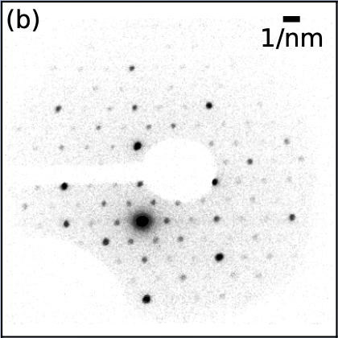
MEDUSA Beamline
Ultrafast Electron Diffraction Beamline at Cornell operating at
140 keV
Record diffraction patterns of materials before + just after being hit with a femtosecond scale laser
Record the difference in the diffraction patterns before and after
Diffraction of Nb₃Br₈ seen on the final screen, beam stop obscures part of pattern

Slide 20
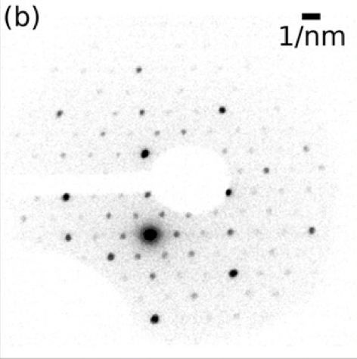
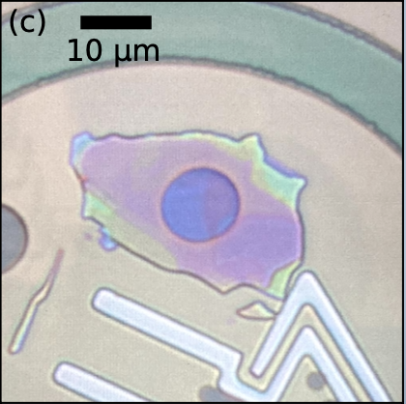
Samples
Micron sized samples capable of being studied at MEDUSA
Nb₃Br₈

Slide 21
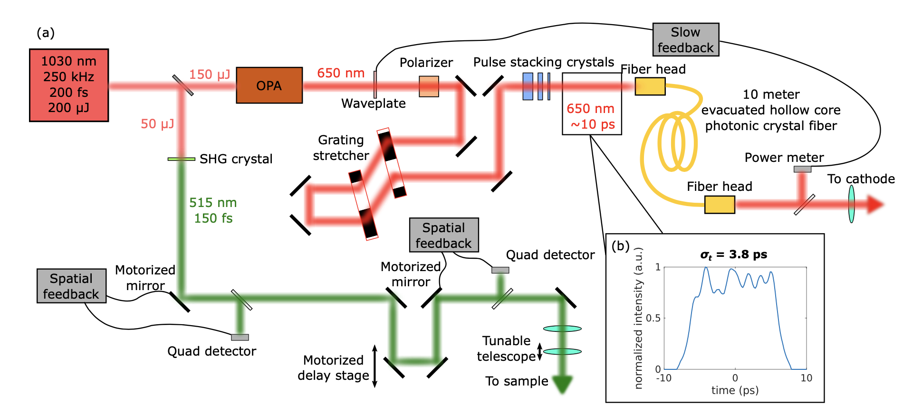
Medusa Laser System

Slide 22
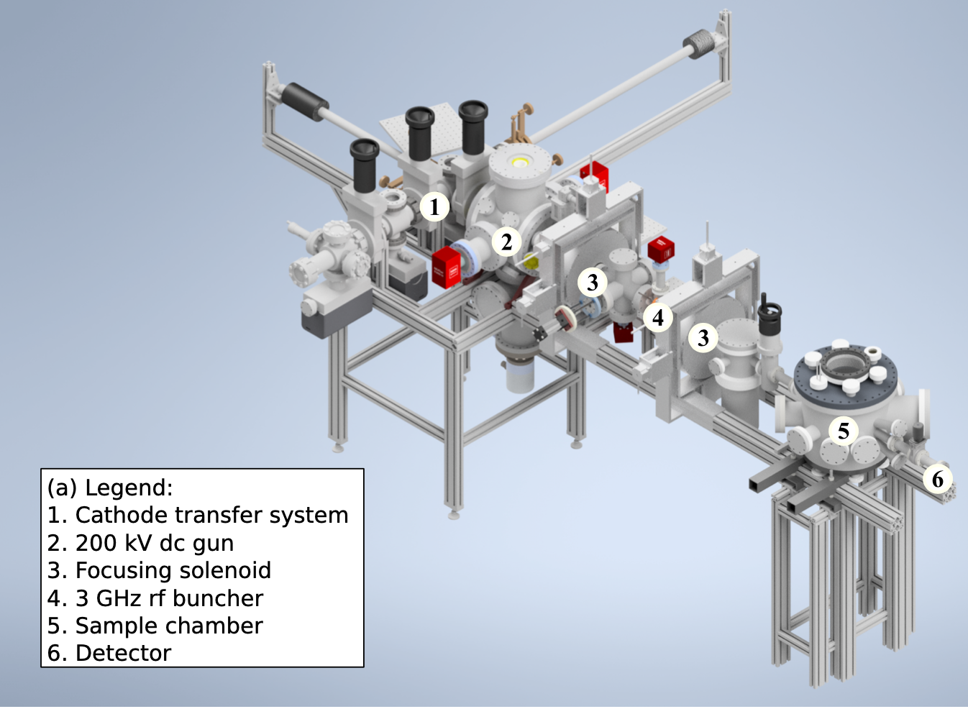
Full Beamline Schematic

Slide 23
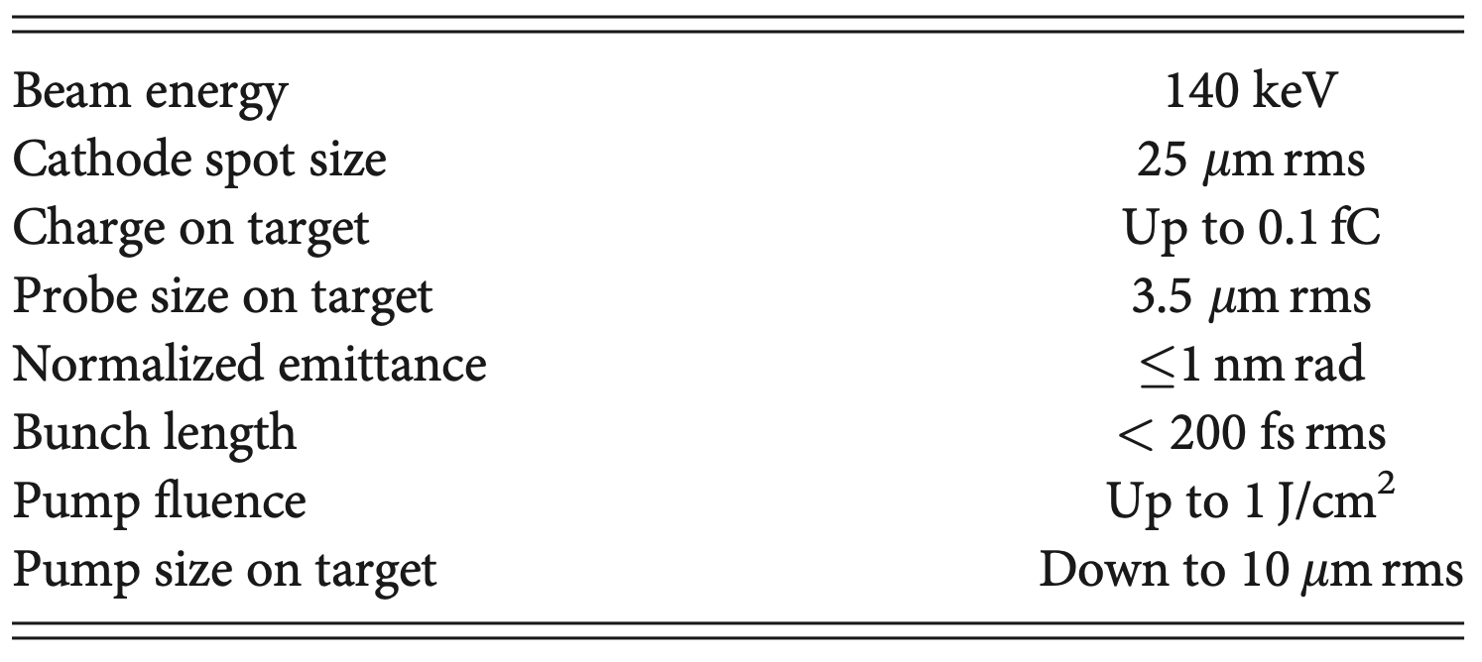
UED Micro-diffraction Parameters

Slide 24
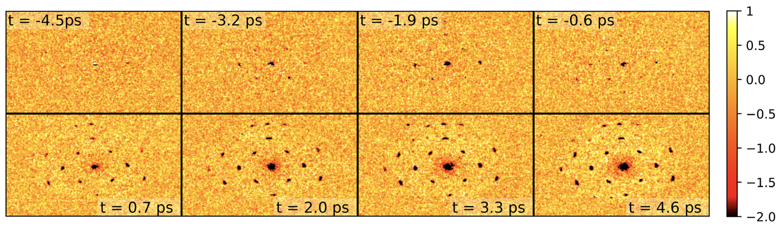
UED of Gold Difference Images

