Slide 1
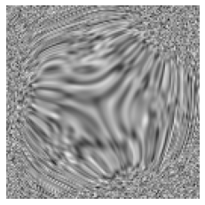
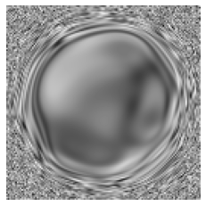
Aberration Corrector Tuning with Machine-Learning-Based Emittance Measurement and Bayesian Optimization
Chenyu Zhang1, Zhaslan Baraissov1, Cameron J. Duncan 2, Adi Hanuka3, Auralee L. Edelen3, Jared M. Maxson2, David A. Muller1
¹ School of Applied and Engineering Physics, Cornell University, Ithaca, 14853, NY, USA
² Cornell Laboratory for Accelerator-Based Science and Education, Cornell University, Ithaca, NY, 14853, USA
³ SLAC National Laboratory, Menlo Park, 94025, CA, USA
Bayesian optimization
Automatic tuning
Aberration corrector
20 mrad
Electron Ronchigram
Notes:
Going to be an overview

Slide 2
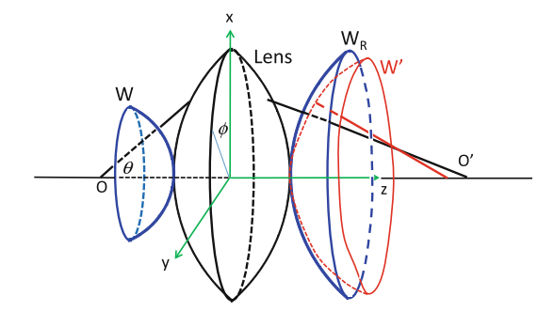
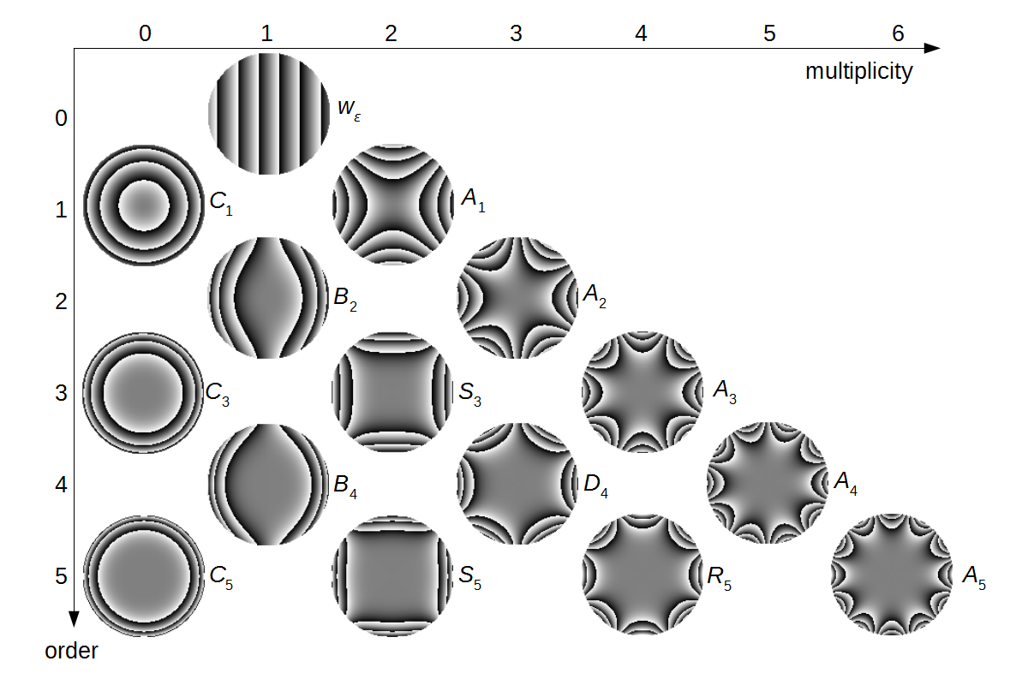
Probe Aberration and Aberration Corrector
Schematic of actual wavefront W’ and spherical wavefront W_{R}
Aberration corrector is an important component of scanning transmission electron microscope (STEM).
Aberration function describing the difference between actual wavefront and a spherical wavefront.
Aberration corrector cancels the aberration with a series of magnetic multipoles.
Atomic resolution image of Si <110> without (a),(b) and with (c), (d) aberration corrected.
Advanced Transmission Electron Microscopy, ISBN 978-1-4939-6605-9
Ultramicroscopy 189 (2018): 46-53.
Notes:
Convention of describing aberration in EM community, and we adopted emittance from accelerator community.

Slide 3
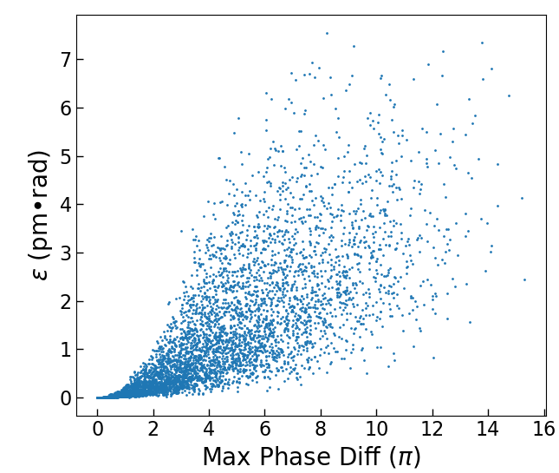
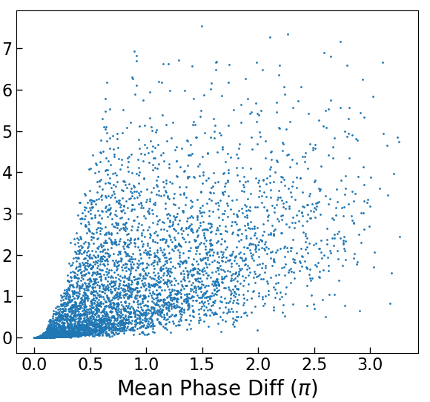
Beam Quality Metric: Emittance Growth
Minimum aberration
Defocus
Spherical Aberration
$$x$$
$$x$$
$$x$$
Emittance growth(ε): increase of volume of beam in the phase space.
Single measurement of beam quality.
Minimized emittance gives highest brightness.
$$α$$
$$α$$
$$α$$
$$B=\frac{ηI}{ε}$$
Consistent with other metrices such as phase difference.
Emittance vs other aberration metrics for random aberration combinations
3

Slide 4
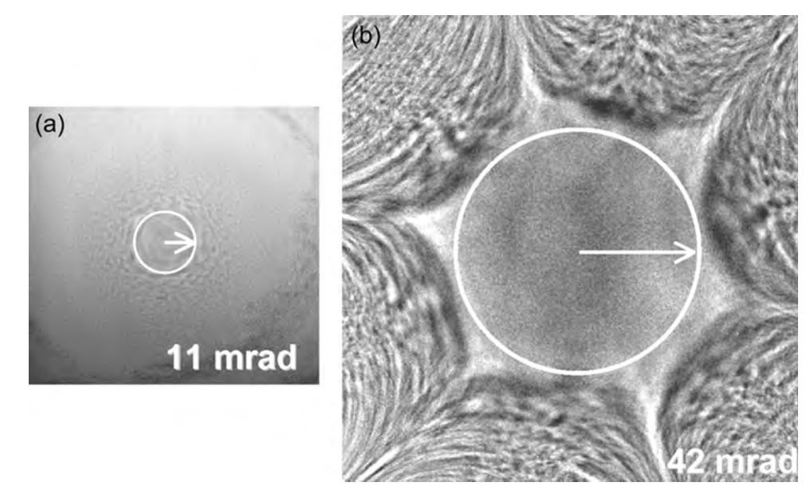
Beam Monitor: Electron Ronchigram
Electron Ronchigram: shadow image of a thin layer of amorphous material.
Center flat area: region with infinite magnification. All rays within this area go through the same point on the sample.
In a simple way: maximize the area of center flat region.
Next: estimate emittance from Ronchigram.
Ronchigram with (a) and without (b) spherical aberration corrected.
4

Slide 5
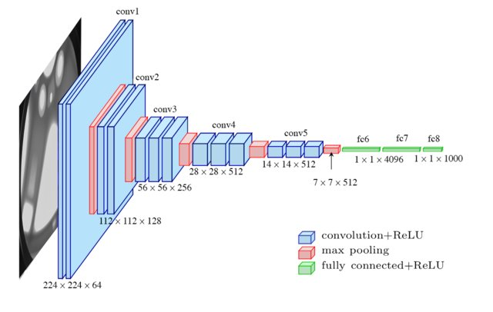
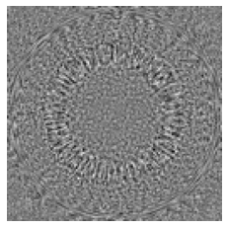
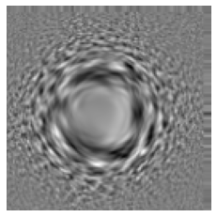
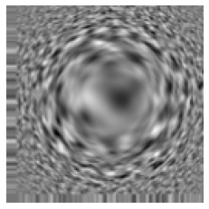
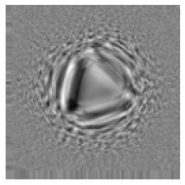
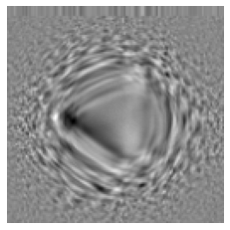
Predict Emittance with Convolutional Neural Network (CNN)
Architecture of a VGG16 network.
Training data: simulated Ronchigrams
Training label: normalized emittance + normalized defocus as training label, between 0 and 1. A score of the probe quality.
Electron Ronchigram
Emittance
Examples of training Ronchigrams
Extreme cases
Included different imaging conditions: noise level, center shift, collection angles.
20 mrad
~0 aberration and defocus
1 mm C3 and 1 μm defocus
https://ieeexplore.ieee.org/document/8258115
5

Slide 6
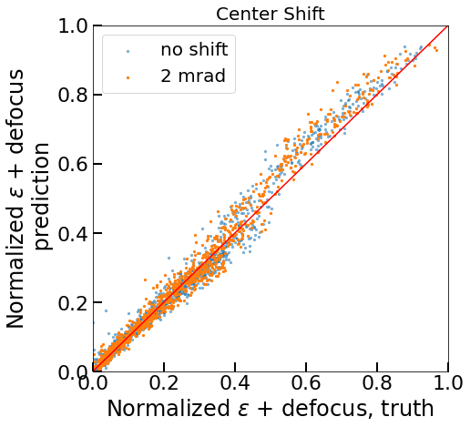
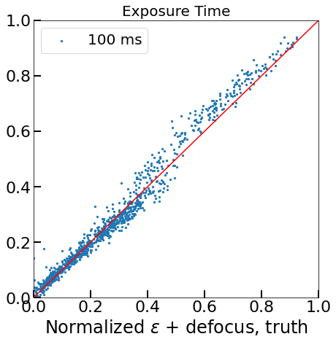
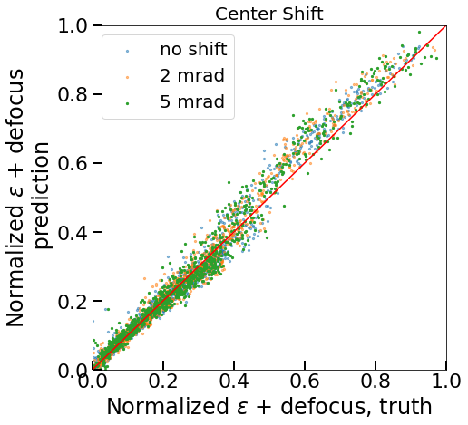
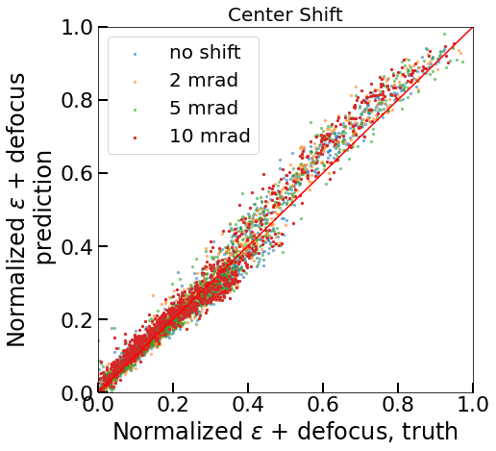
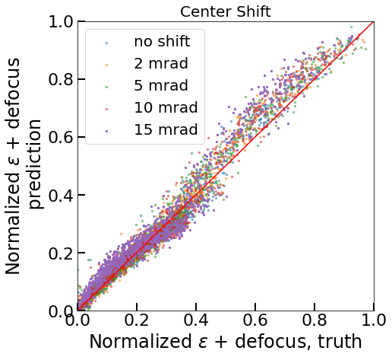
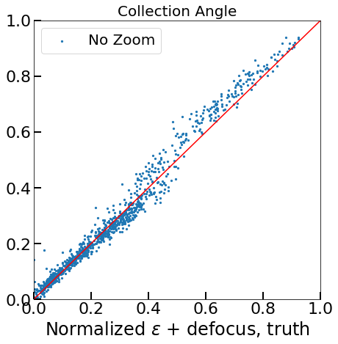
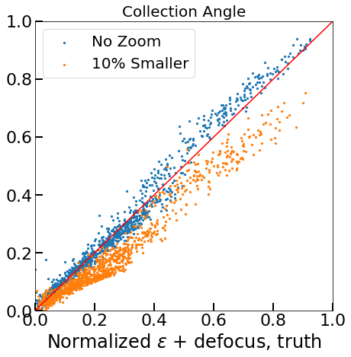
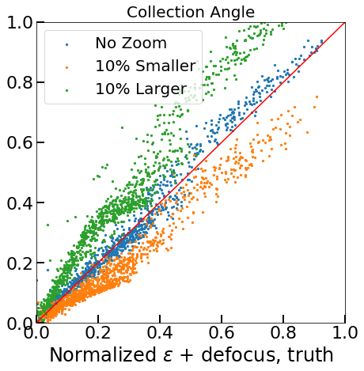
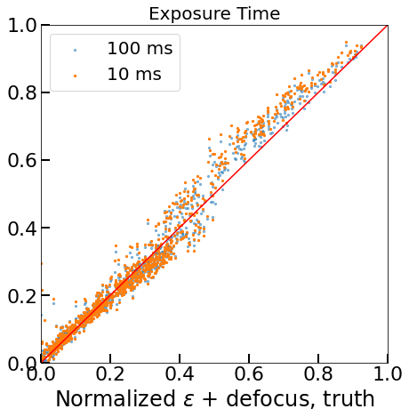
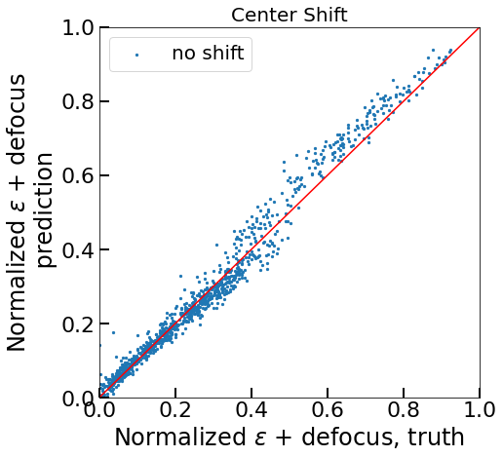
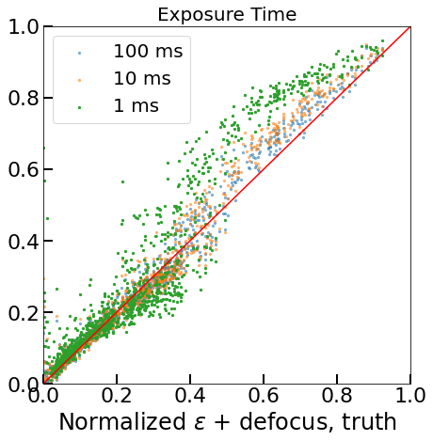
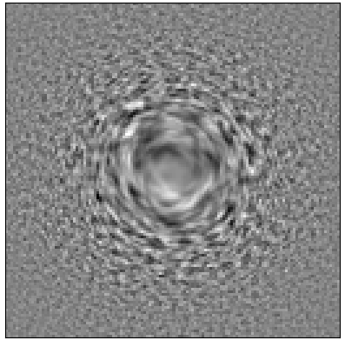
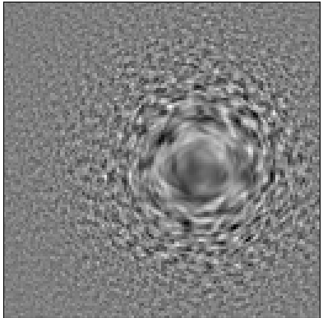
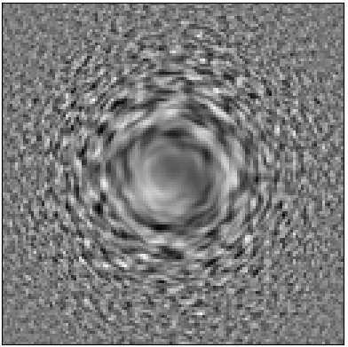
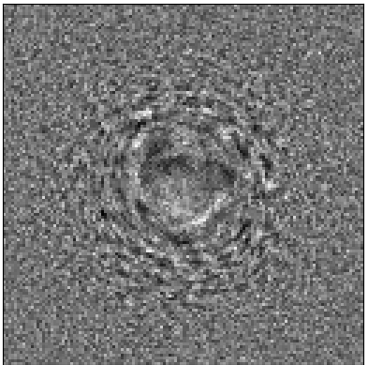
Validate CNN Performance
20 mrad
A new set of simulated data to validate CNN performance.
Robust against changes in acquisition conditions.
Next: Minimize the output from CNN.
6

Slide 7
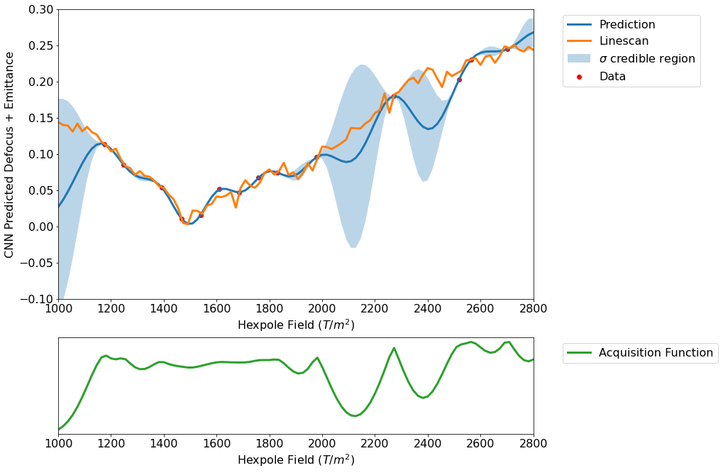
Bayesian Optimization (BO)
Global optimization of a black-box function.
Explore high-dimensional parameter space to optimize a single objective.
Predict underlying function and inform next acquisition.
Used Botorch as implementation.
Observations:
$$(\overset{⃑}{x},y)$$
Predict
$$y=f(\overset{⃑}{x})$$
Inform next point
$${\overset{⃑}{x}}_{new}$$
https://en.wikipedia.org/wiki/Bayesian_optimization
Duris, Joseph, et al. "Bayesian optimization of a free-electron laser." Physical review letters 124.12 (2020): 124801.
7

Slide 8
Bayesian Optimization
Normalized ε + defocus
20 mrad
Hexpole Strength (T/m²)
Instrument parameters
(parameter, emittance)
Electron Ronchigram
Convolutional Neural Network
8

Slide 9
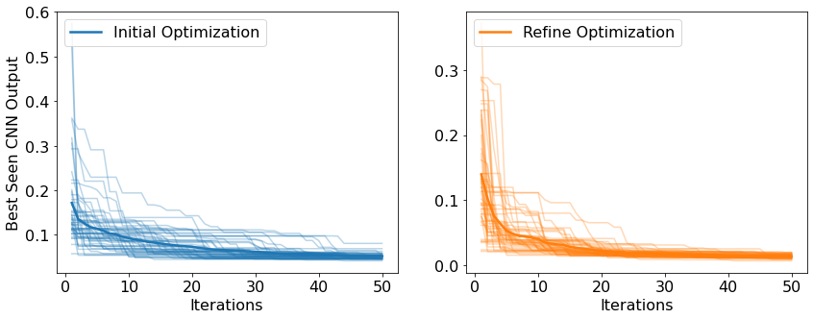
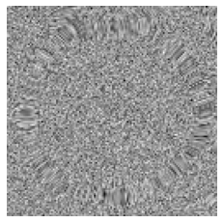
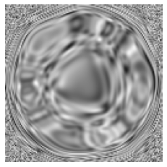
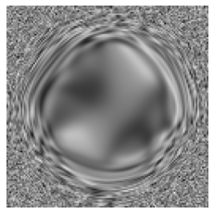
Optimization on GPT Simulation Model
Overview of the corrector simulation model
Hexapole corrector model simulated by general particle tracer (GPT).
Model provided by Cameron Duncan.
Control magnetic lens strength, to get the Ronchigram that minimize CNN output score.
HP: Hexapole SOL: Solenoid
Two step tuning with aperture applied on fine tuning step.
30 mrad
Optimization process from random starting points
20 mrad
Initial Ronchigram
Rough tuning
Fine tuning
9

Slide 10
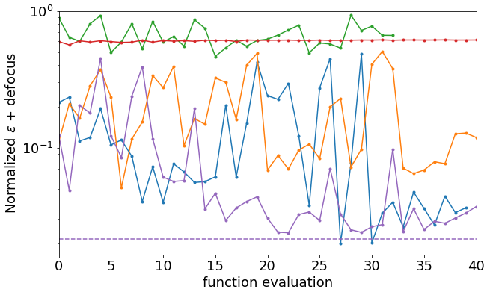
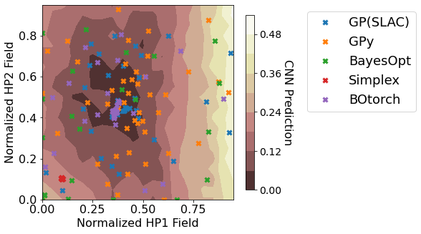
Benchmark Test, 2D Parameter Space
Benchmark test on 2 parameters and the parameter space
BayesOpt
Simplex
GPy
SLAC-GP
20x20 grid search
BOtorch
Test four different implementations of Bayesian optimization, and simplex method.
More measurement around minimum.
Bayesopt: https://github.com/fmfn/BayesianOptimization
Gpy: https://sheffieldml.github.io/GPy/
Simplex: scipy.optimize.minimize, method = ‘Nelder-Mead’
SLAC GP: https://github.com/adkoo/Bayesian-optimization-using-Gaussian-Process
Botorch: botorch.org
10

Slide 11
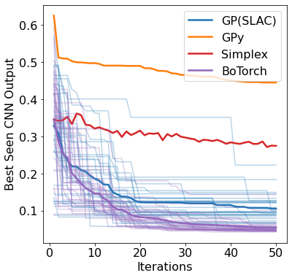
Benchmark Test, 6D Parameter Space
Averaged convergence for different method on 6D parameter space
BoTorch has more reliable performance with higher-dimensional parameter space.
Using GPT model:
Able to automatically tune corrector system with six parameters.
11

Slide 12
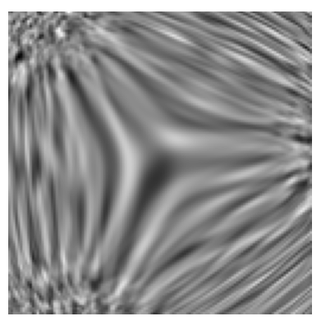
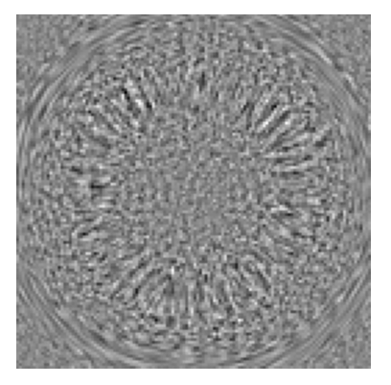
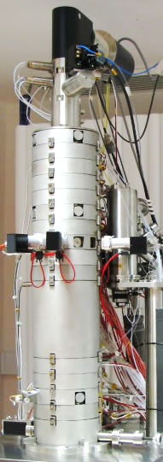
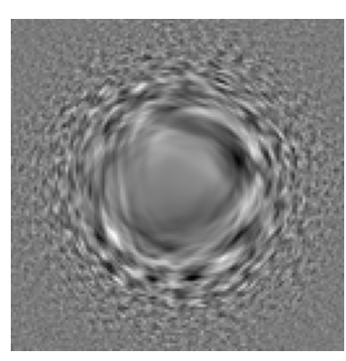
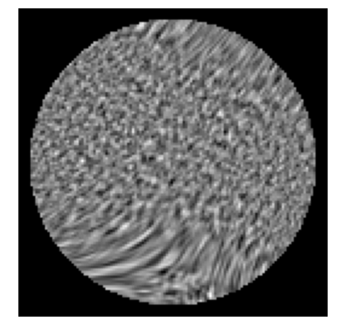
Alignment on a Real Aberration Corrector
Controls pre-calibrated aberration coefficients.
Simulated new CNN training data as a result of different imaging conditions.
http://www.nion.com/products.html
12

Slide 13
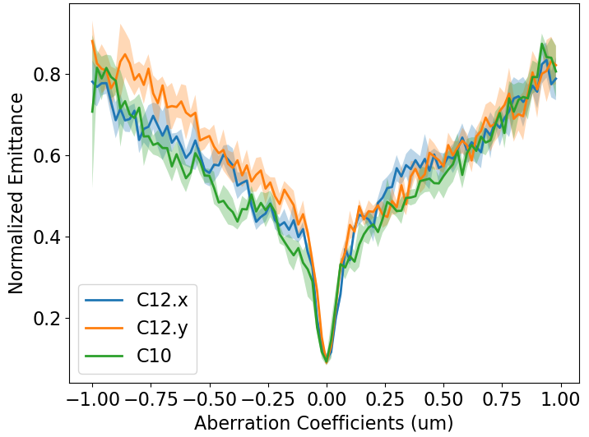
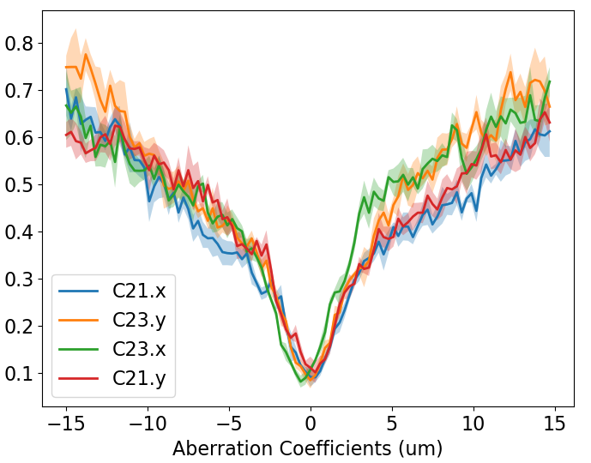
Validate CNN Performance
Validate with experimental data.
Start with manually tuned corrector, perform linescan of each aberration corrector.
Valley shaped curves suggests the trained CNN is able to tell the zero point of each aberration coefficient.
13

Slide 14
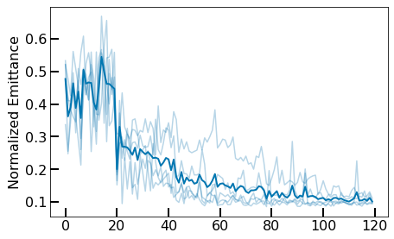
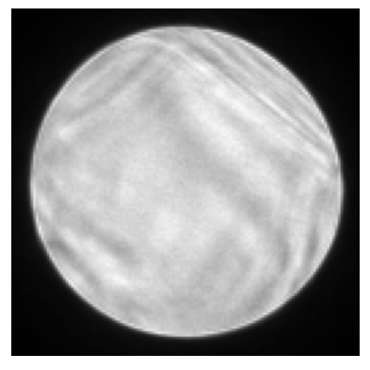
Correction up to 2nd Order Aberration
Ronchigrams after initialization
Optimize the CNN output over a total of 7 input parameters.
Use 20 measurements to initialize the model, then optimize for 100 iterations.
About 0.5 seconds per iteration.
Ronchigrams after optimization
Manually corrected example
~0.1
iterations
14

Slide 15
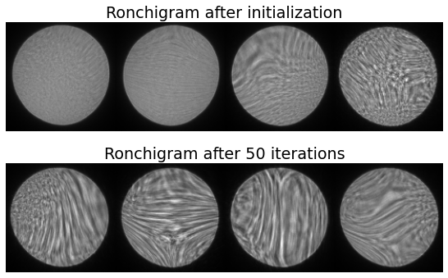
Correction up to 3rd Order Aberration
>0.2
Correct a total of 12 parameters.
Much worse performance when include 3rd order aberrations and increase the number of total parameters from 7 to 12.
15

Slide 16
Summary
Simulated Ronchigrams before and after tuning
Combination of CNN and BO to tune aberration corrector by minimizing emittance growth.
Faster and automated corrector tuning.
Tested on simulation model of a hexapole corrector and a real aberration corrector.
Test on a new GPT model with misalignment included and more parameters to be controlled.
Improve performance on experiments.
Implement on other STEMs.
20 mrad
Experimental Ronchigrams before and after tuning
20 mrad

