Slide 1
Electron sources summary
Luca Cultrera for the working group
ERL 2022 Workshop

Slide 2
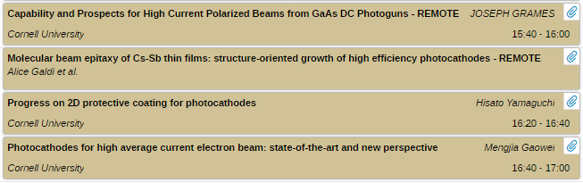
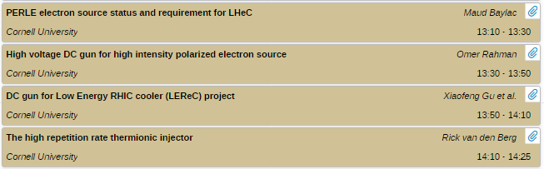
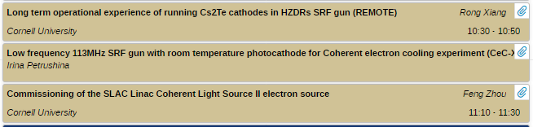
Electron sources workgroup
Photocathode technology and advances
DC and thermionic electron guns
SRF and NCRF electron guns

Slide 3
Progresses in last two years
Photocathodes
- Unpolarized electron beam: alkali antimonides and tellurides
- Spin polarized electron beams: SL-DBR GaAs/GaAsP
New electron guns
DC gun at @SBU/BNL
Thermionic
VHF @SLAC

Slide 4
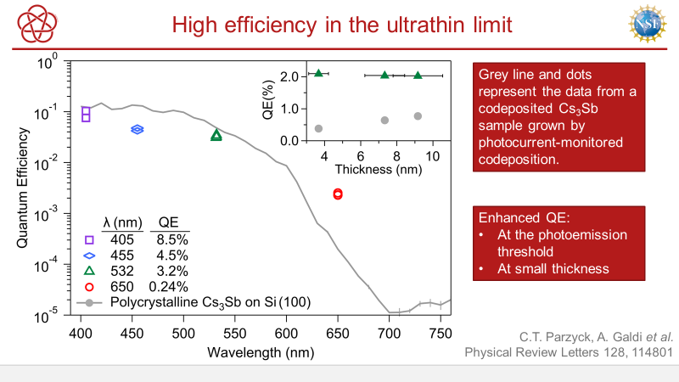
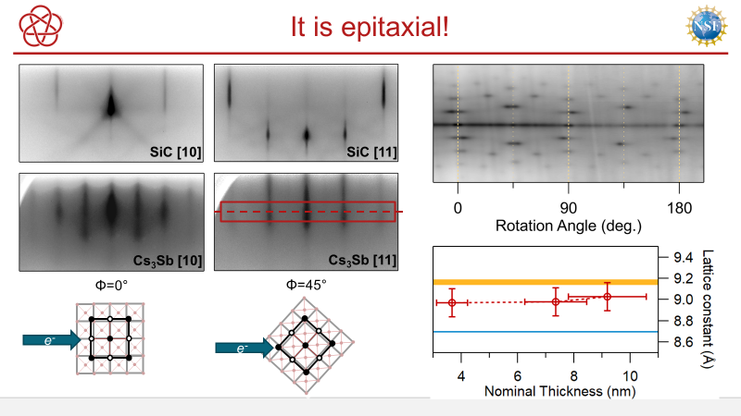
Alkali antimonides (1)
Key technology that enabled e-beam up to 75 mA at Cornell
Cs-K-Sb is the material of choice for a wide range of guns (DC and SRF) aiming at very high average beam currents.
Enabling the production of brighter beams by mitigating intrinsic emittance

Slide 5
Alkali antimonides (2)
At BNL also achieved epitaxial growth using a combination of X-ray techniques to monitor the growth process in-situ
But the surface of the alkali antimonide is quite reactive and prone to chemical contamination

Slide 6
Protective coating for Alkali Antimonides
Will prevent/mitigate the chemical poisoning

Slide 7
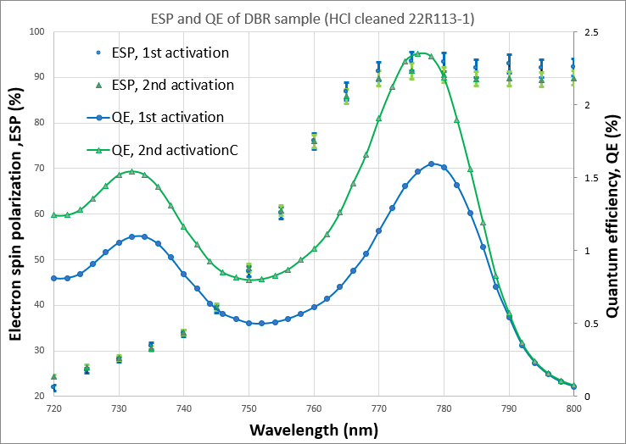
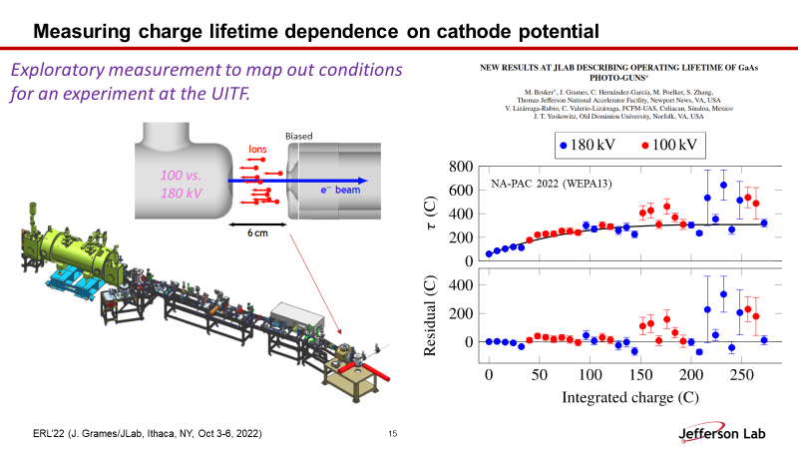
Spin polarized electron source
Several activities are established to restore the availability of photocathodes to produce highly spin polarized beams.
Crucial to develop spin polarized current at >1mA (but extended test are required)
July 2022 (unpublished) results of collaboration between Old Dominion University, Brookhaven National Lab and Jefferson Lab
It is not clear that larger gun voltages allowed longer lifetime
MOCVD growth of DBR-SLSP by industrial partner
  QE > 2%
  Polarization > 90%
> 10 mA/W

Slide 8
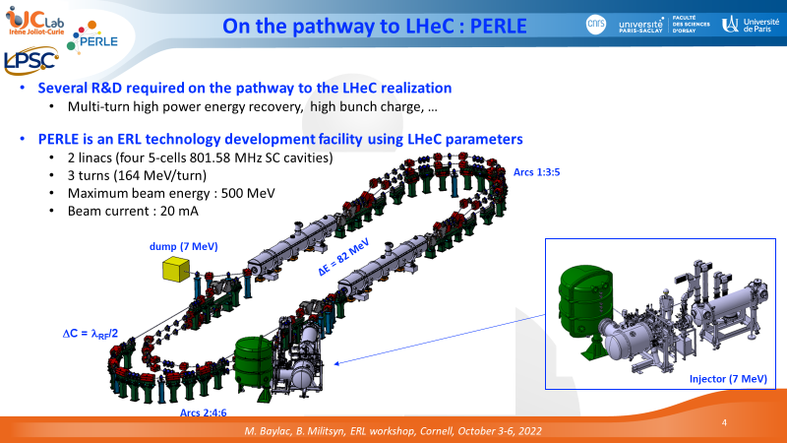
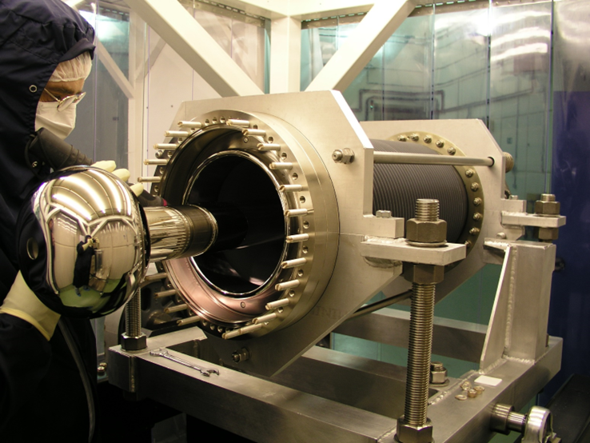
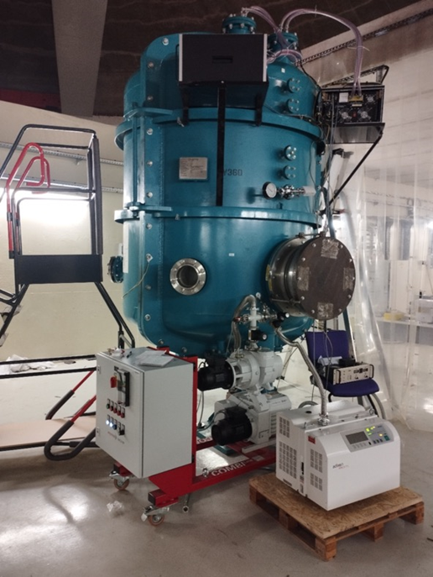
PERLE a test stand for LHeC
The initial stage sees operation with the old ALICE egun to acquire the required expertise
Second stage the gun will be upgraded with a load lock and operated aiming ad delivering the 20 mA for the ERL using alkali antimonides photocathodes
Aims a first functional tests in spring 2024

Slide 9
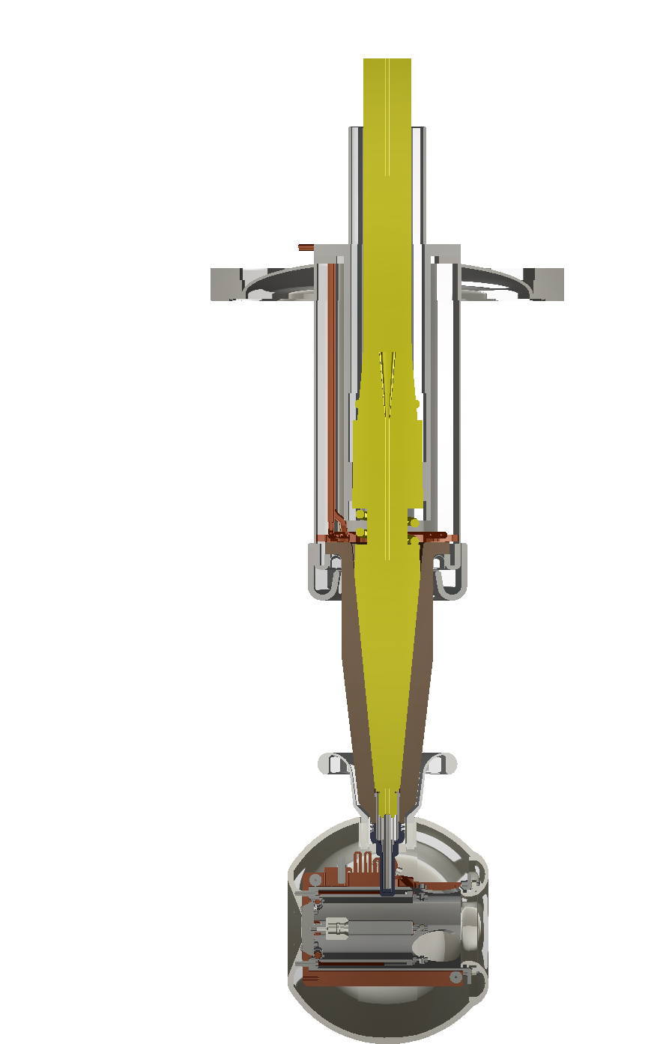
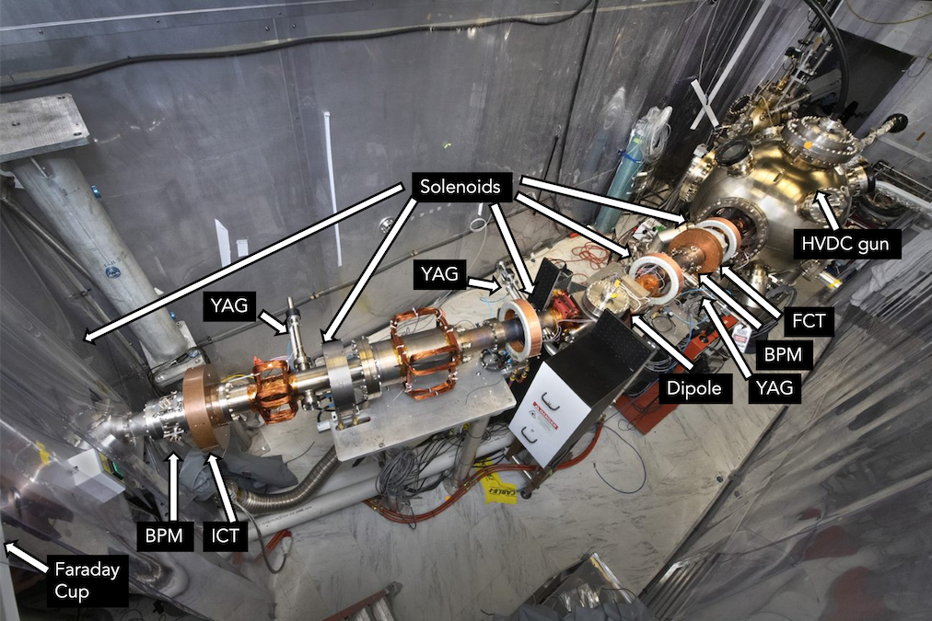
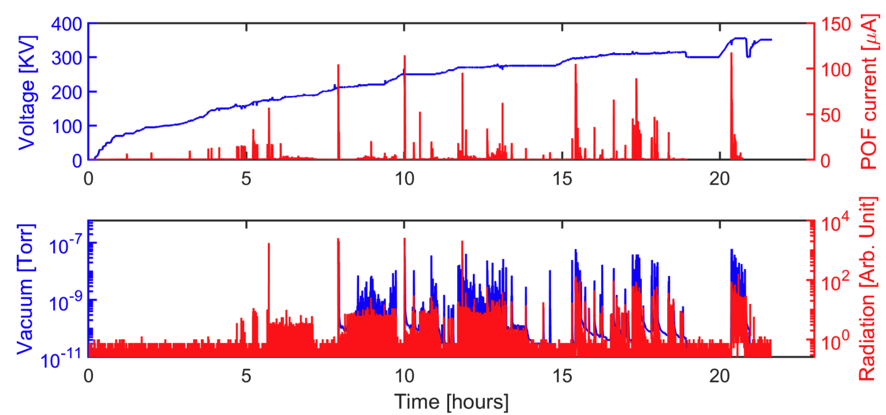
High Voltage DC Gun for High Intensity Polarized Electron Source
HV cable
FC72 inlet
Spiral grooves
Cathode puck
Heat exchanger
300 KV polarized gun for EIC, conditioned up to 350 KV with no field emission – highest operational voltage for polarized guns
High intensity – 7.5 nC/4.8 A peak current with very stable operation.
Exceeds EIC requirements by large margins
Copper
heat sink
- Active cooling scheme successfully implemented- will be used for both EIC polarized gun and SHC gun

Slide 10
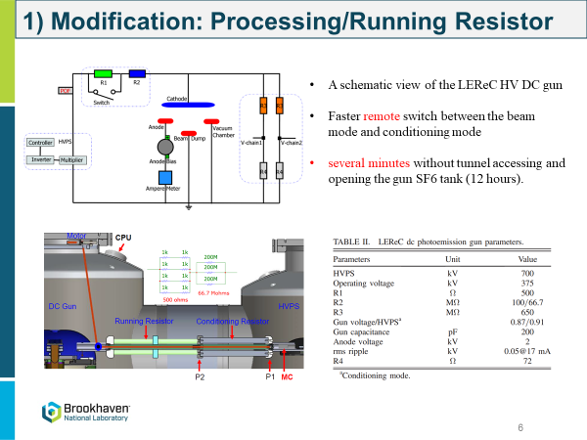
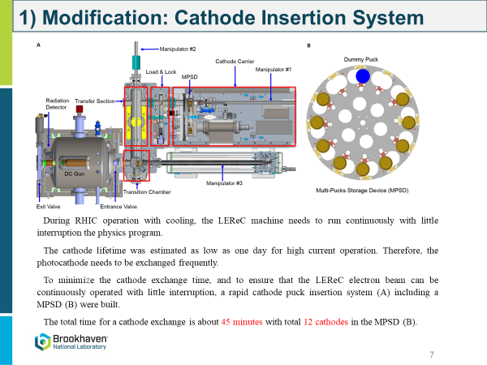
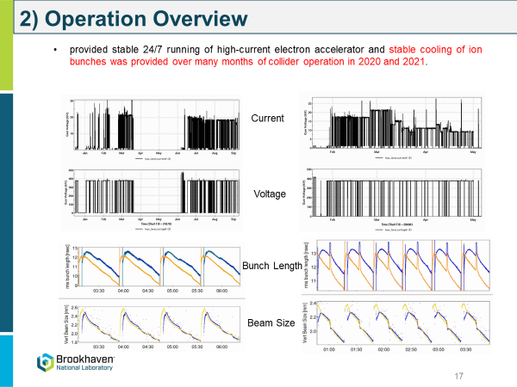
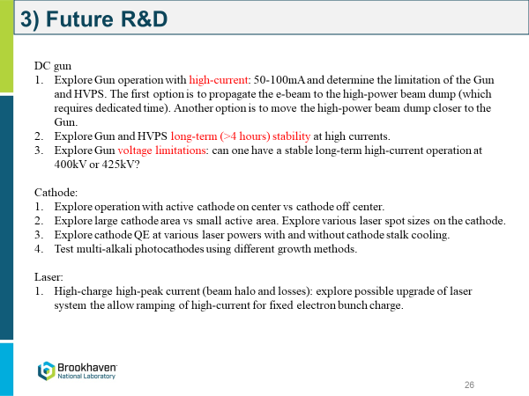
DC gun for LEReC @RHIC
Sustained operation up to 20-30 mA
during RHIC runs
Up to 50 mA of operation for ~1 hour

Slide 11
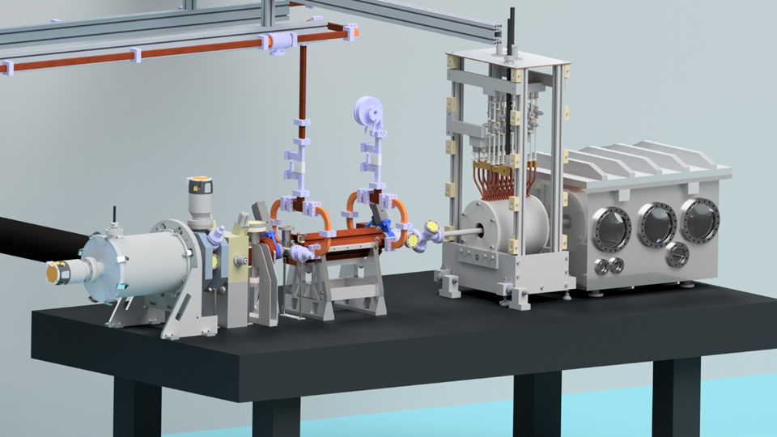
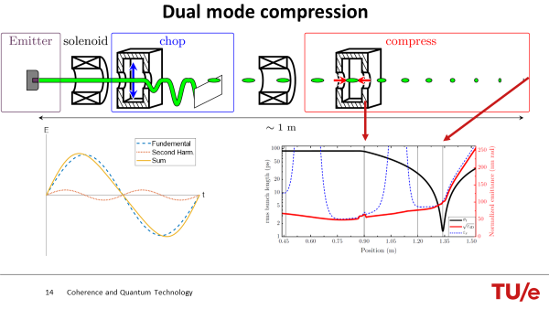
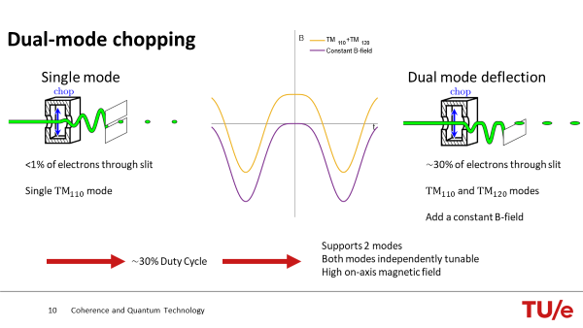
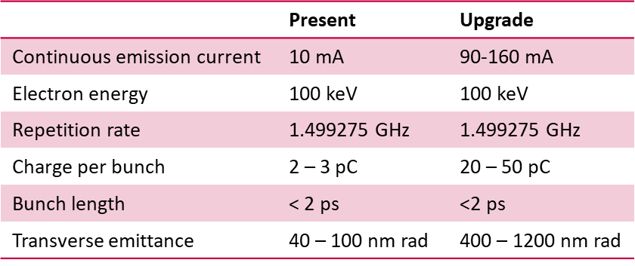
Thermionic injector
Compact high current high brightness source

Slide 12
SRF @ELBE

Slide 13
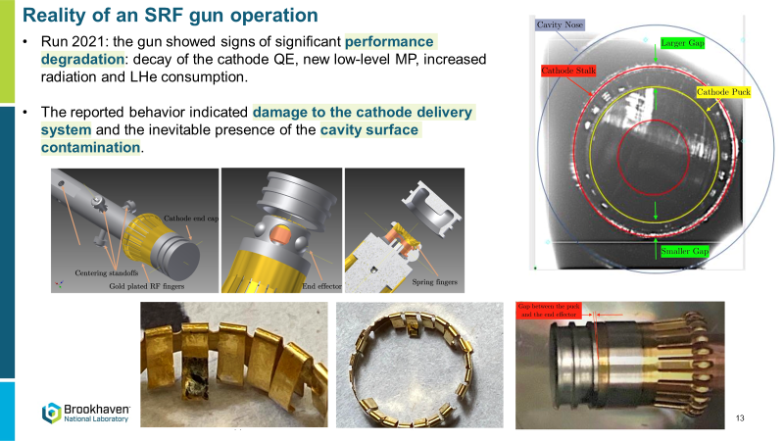
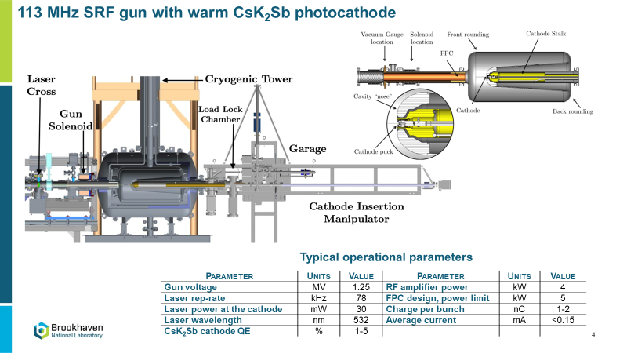
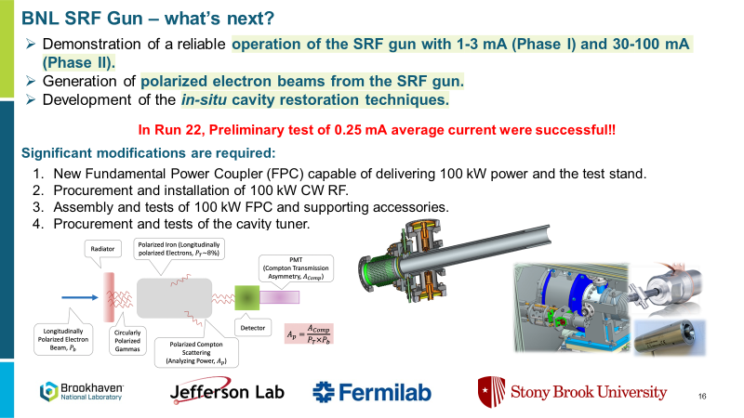
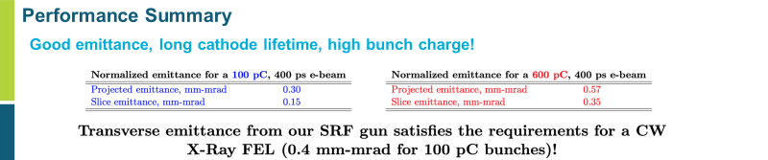
SRF gun @BNL

Slide 14
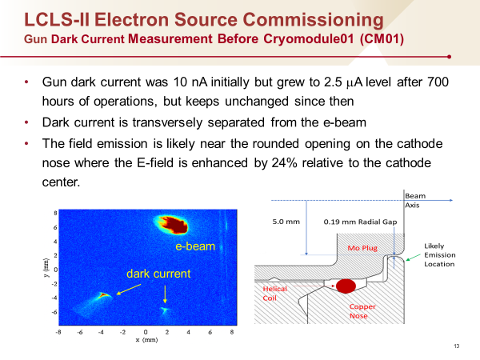
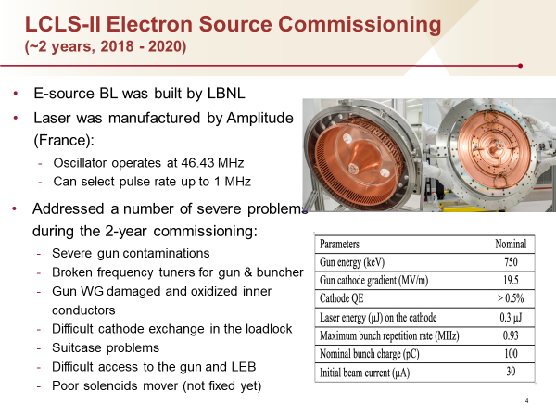
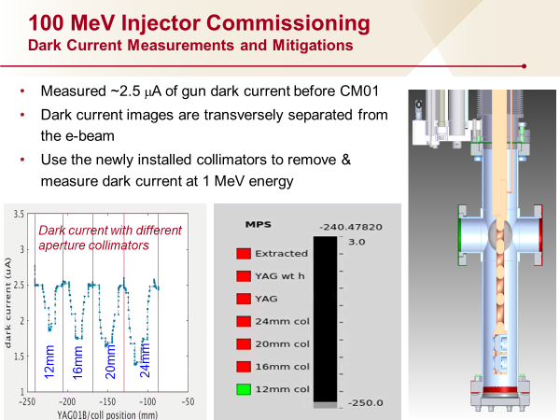
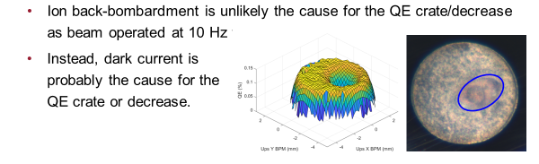
VHF @LCLS-II
Gun successfully commissioned !!

Slide 15
Summary
Photocathode technology:
Still limited to antimonides/tellurides and GaAs based
Consolidating the understanding on their synthesis
Making progress in protecting their surface with 2D materials
For high average currents >>1mA
Lifetime of photocathodes (pol @20mA, unpol @100mA)
  Replacing gun cathodes is routinely done but with inherent large risks
Long term operational stability @100mA (HVPS, laser and optics)
Power coupler required to push for high currents in SRF guns
Field Emission and cavity contamination
In SRF and VHF field emission and cavity (see also KEK and bERLinPro) might be compromised by failure of cathode insertion mechanism and particulate generation
Photocathode material compatibility with operation in SRF
Thermionic gun with RF chopper and buncher is an interesting option

