Slide 1
Uses & Applications WG Summary
Peter Williams & Erdong Wang

Slide 2
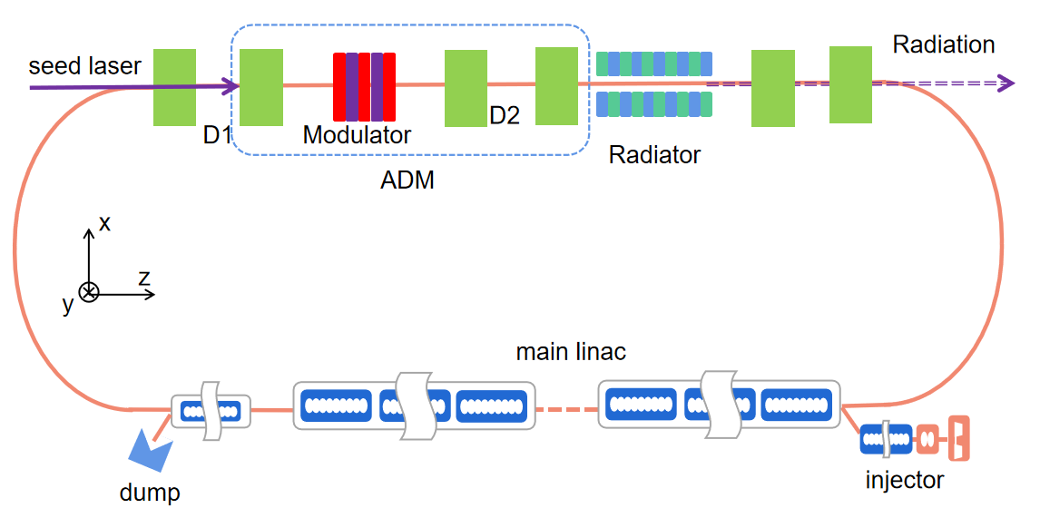
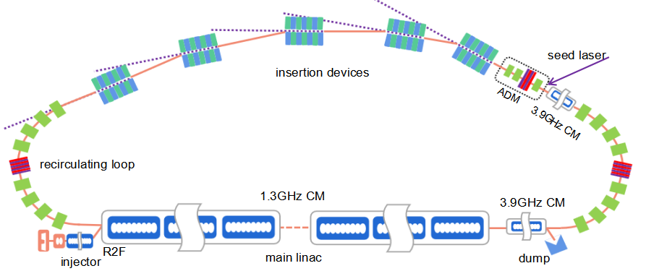
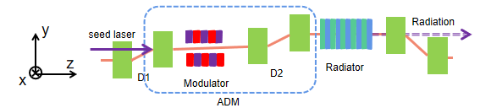

Zhao: ERL Based Fully Coherent Light Source
We report a new method for high repetition rate fully coherent pulse generation by taking advantages of the ERL and ADM.
The proposed light source holds the merits such as fully coherent radiation with a brightness 5–6 orders of magnitude higher than that of a DLSR with the same beam energy, and much higher repetition rate comparing with an FEL.
We also proposed two future ERL light sources to generate fully coherent EUV and X-ray radiations, and we considered a multi-radiation source system consists of DBAs and radiators to support multi-user operation.
However, limited by the photoinjector and the HOM BBU effect, the 100-mA-level average current is a big challenge. Meanwhile, dominated by the injector, the energy jitter, temporal jitter and the temporal stability might become larger than storage rings.
The ADM scheme has not been experimentally demonstrated yet, but a proof-of-principle experiment of ADM is under preparation at SARI.

Slide 3
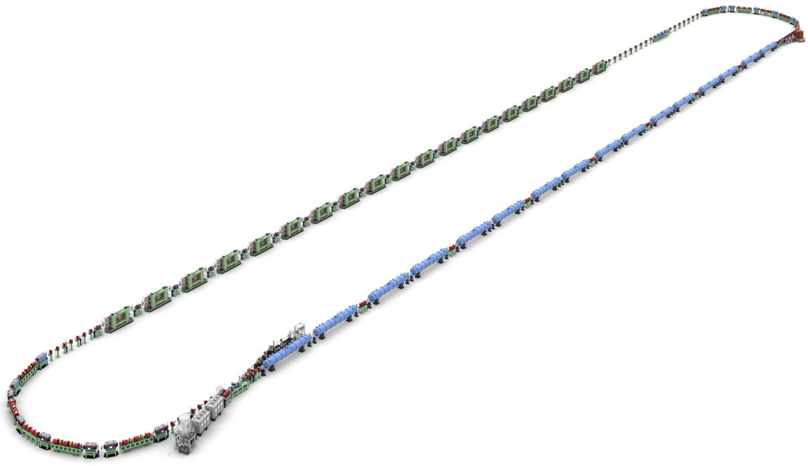
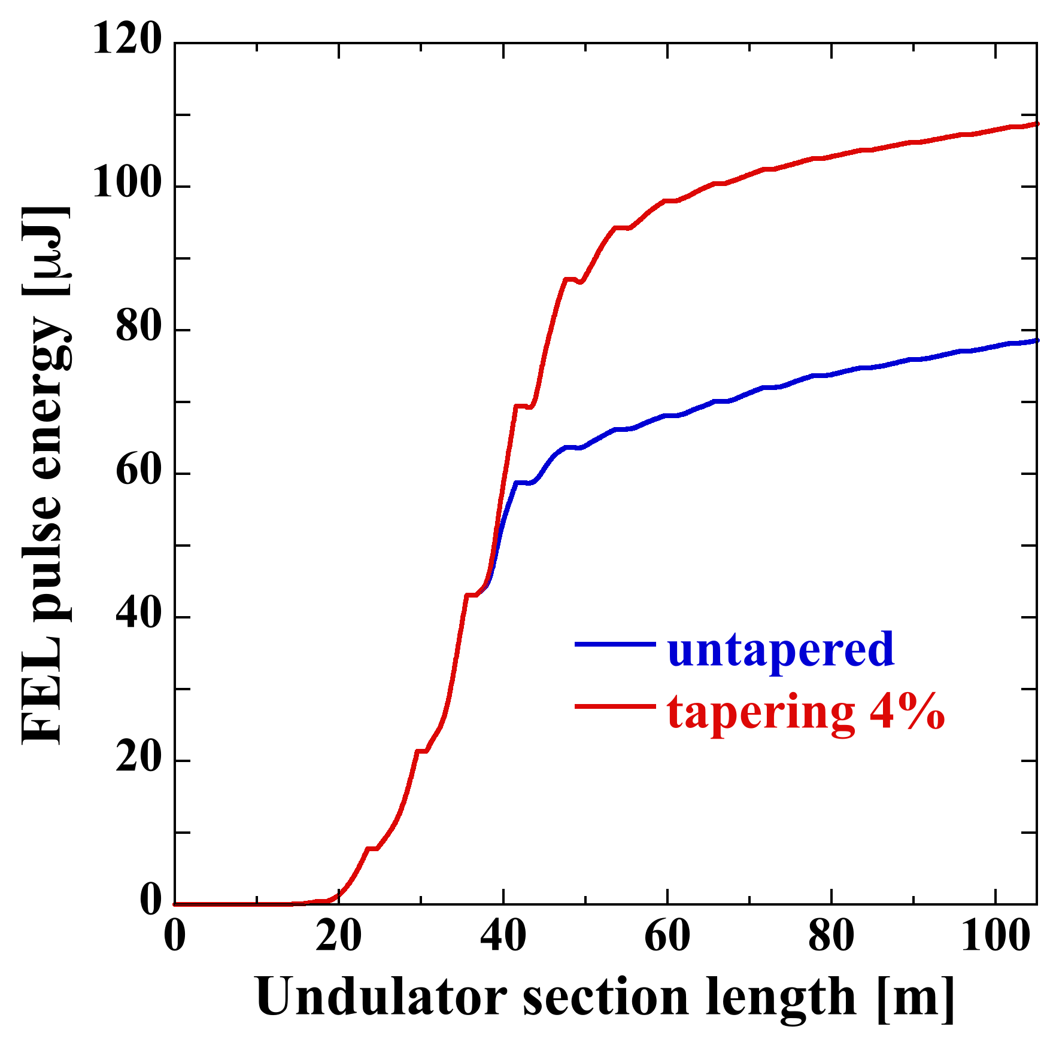
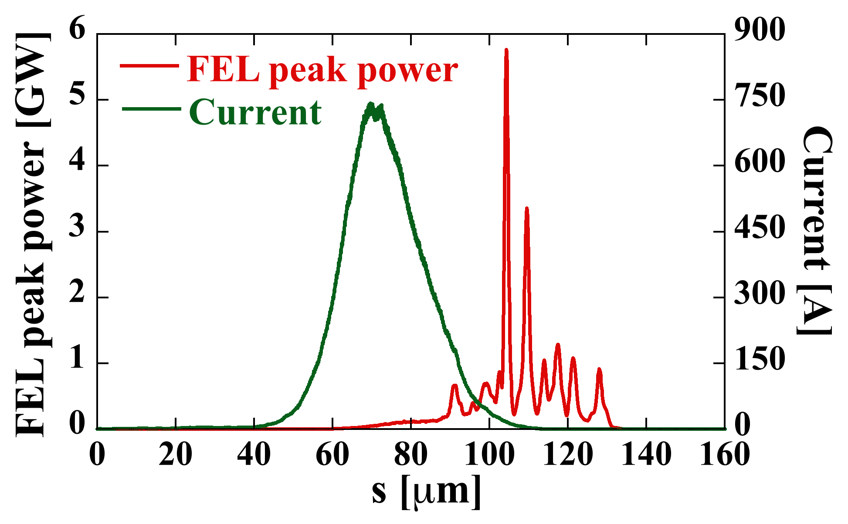
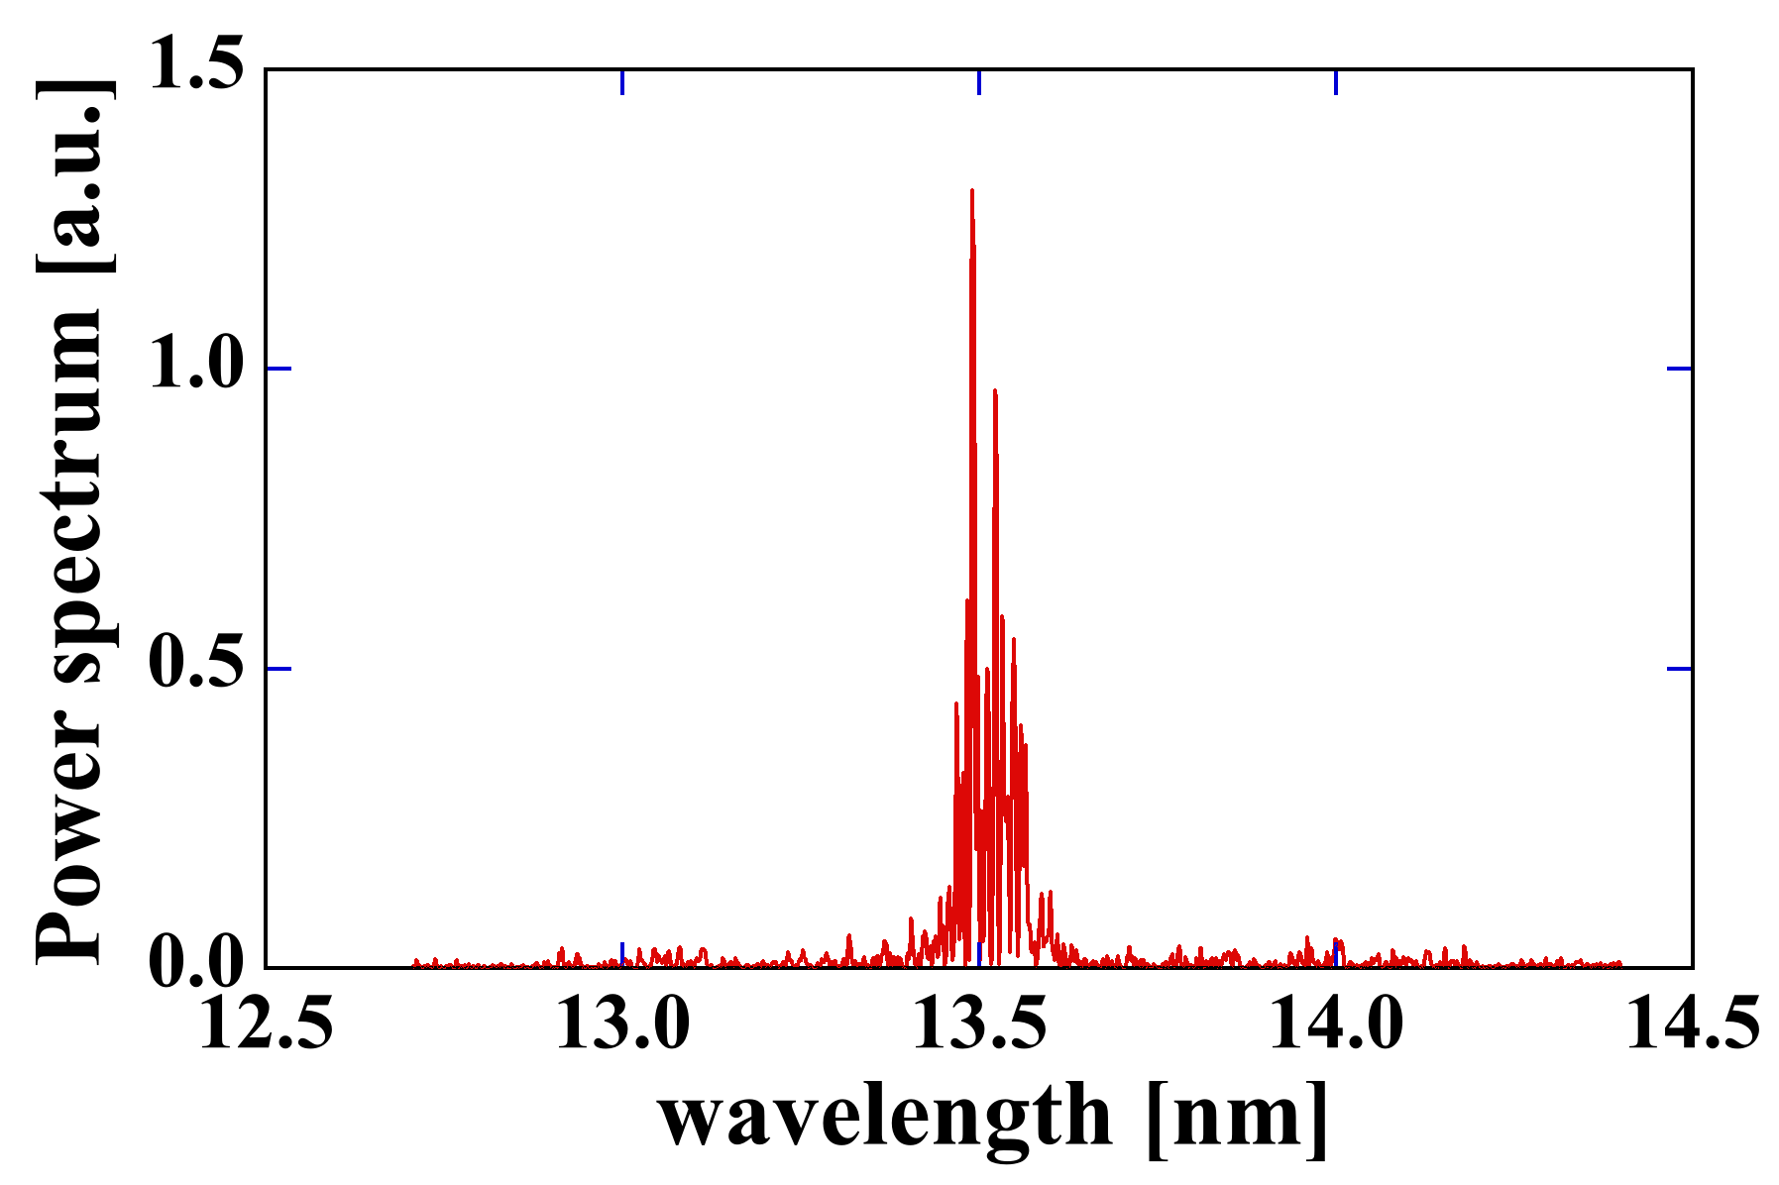
Nakamura: ERL based EUV-FEL light source for lithography
ERL based EUV-FEL light source
N. Nakamura (KEK)
Advantages (compared to LPP source) :
(1) High EUV power ( > 10 kW ) without Tin debris
→ 1-kW EUV power x 10 scanners
(2) Upgradable to a Beyond EUV(BEUV) FEL (6.6 - 6.7 nm)
(3) Variable control of polarization
→ polarization use for high-NA lithography
(4) Low electricity consumption
→ carbon neutral & sustainability
1st Arc
Beam Dump
150 ~ 200 m
Undulators(FEL)
Main Linac
©Rey.Hori/KEK
Injector Diagnostic Line
Parameter | Design value
Beam Energy | 800 MeV
Bunch Charge | 60 pC
Bunch Repetition | 162.5 MHz
Average Current | 10 mA
RF Frequency | 1.3 GHz
EUV Wavelength | 13.5 nm
EUV Power | > 10 kW
EUV Light
109.4 μJ
2nd Arc
Merger
~20 m
Gun
Injector Linac
79.2 μJ
Bandwidth of
Mo/Si reflectivity
EUV-FEL power with 4% tapering: 17.8/35.5 kW @ 9.75/19.5 mA (162.5/325 MHz)
N. Nakamura et al., Proc. ERL2015, pp.4-9(2015)
H. Kawata et al, J. Micro/Nanopattern Mater. Metrol. 212(2), 021210(2022)

Slide 4
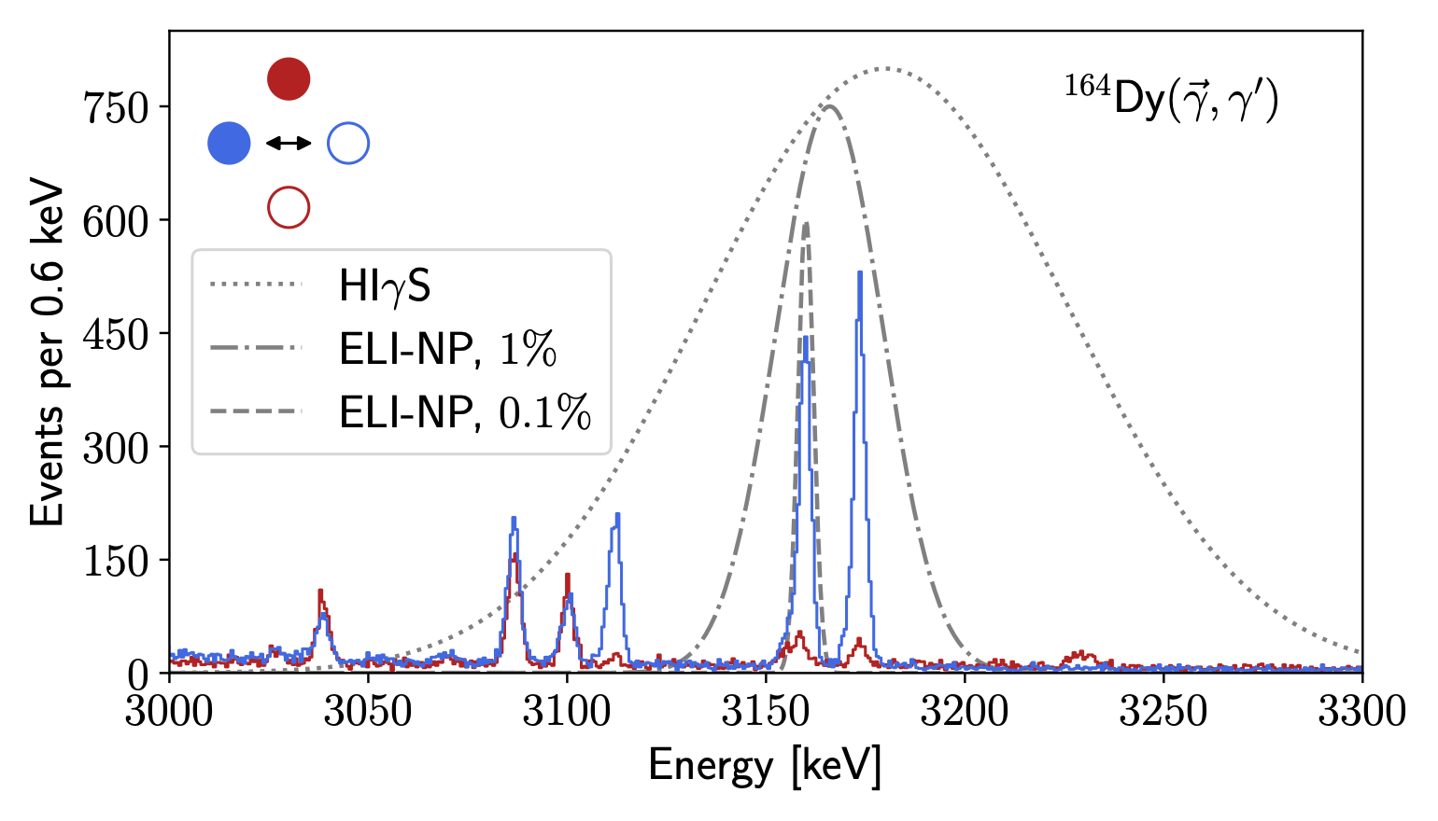
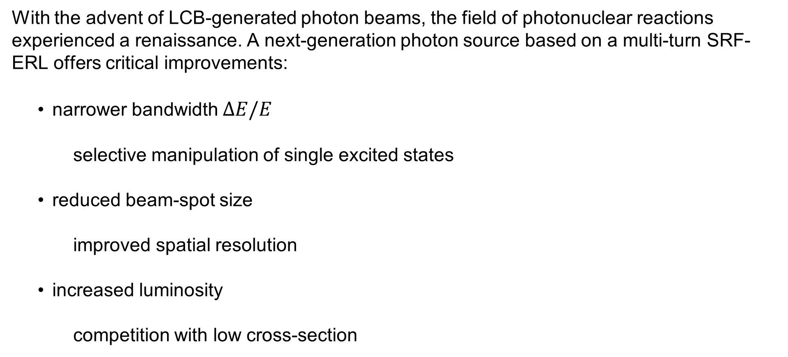
Beck: “Wishlist” for next-generation photon sources
With the advent of LCB-generated photon beams, the field of photonuclear reactions experienced a renaissance. A next-generation photon source based on a multi-turn SRF-ERL offers critical improvements:
    narrower bandwidth $ΔE/E$
                selective manipulation of single excited states
    reduced beam-spot size
                improved spatial resolution
    increased luminosity
                competition with low cross-section
Tobias Beck, ERL’22, 05.10.2022

Slide 5
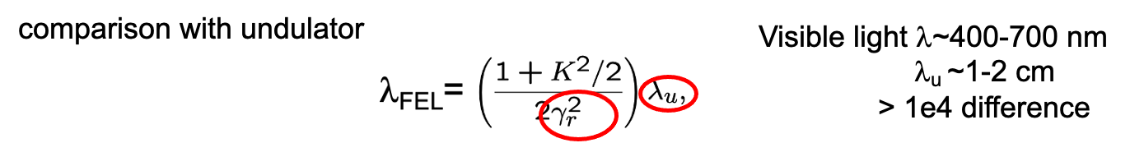
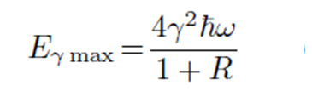
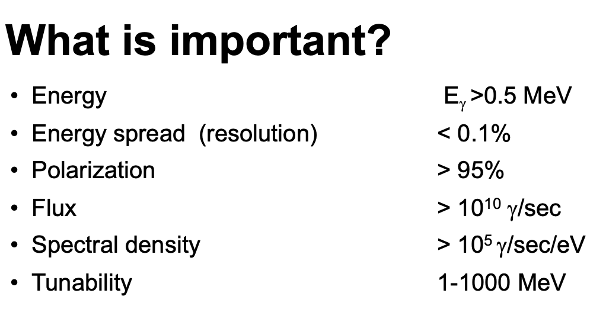
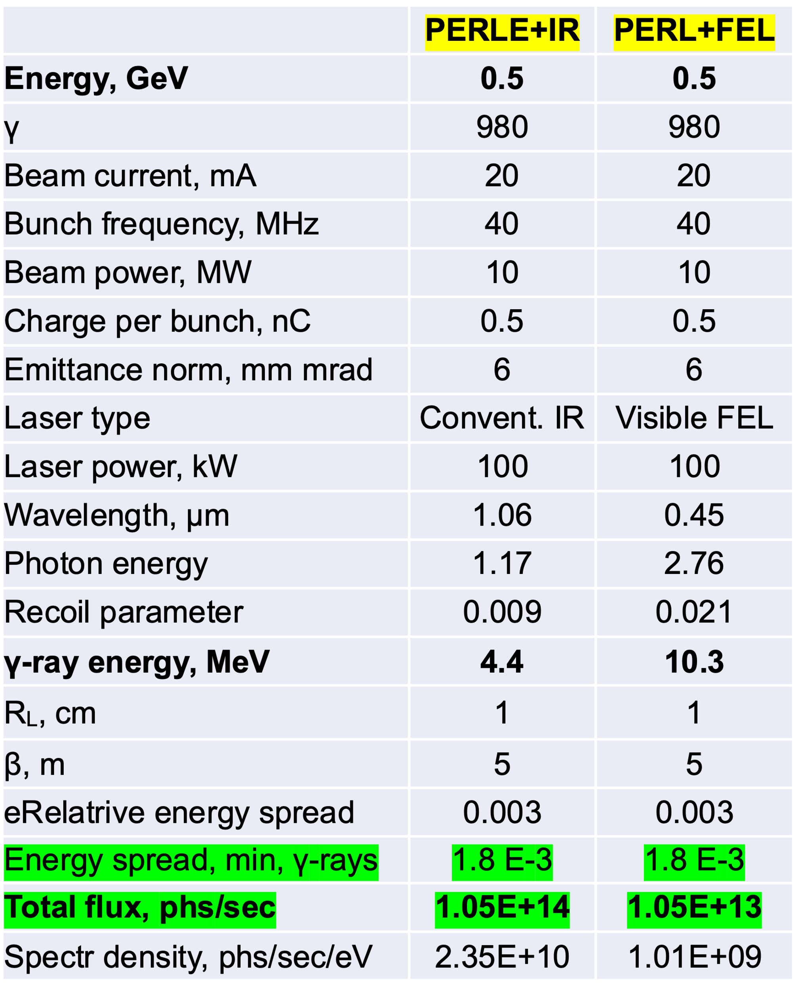
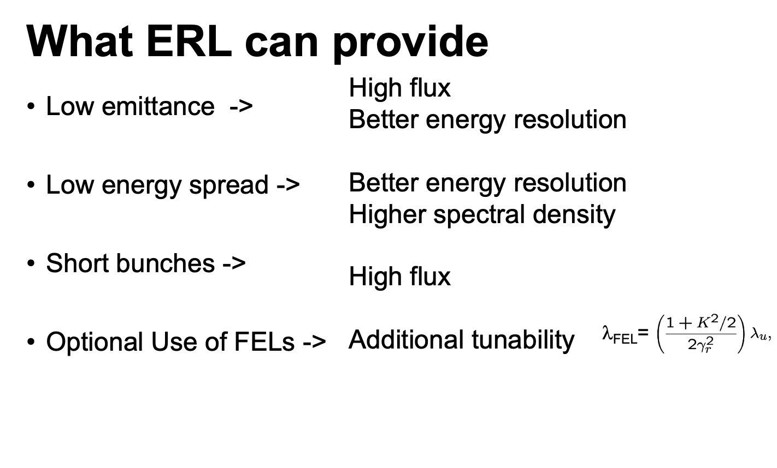
Kayran: ERL potential as a γ−ray source
Why Compton γ-ray sources?
Dmitry Kayran and Vladimir Litvinenko
Brookhaven National Laboratory Stony Brook University
Conclusions
The backscattering Compton sources are promising high intensity, monoenergetic and high brightness γ-ray beams
Combination of high current Energy Recovery Linacs with high power lasers (both the “conventional” and FEL with only 100 kW of intra-cavity power!) opens possibility of generating a few order of magnitude higher flux of γ-rays then currently available
Such sources can find applications expending from the high energy and nuclear physics to medical application and potentially disposal of radioactive waste

Slide 6
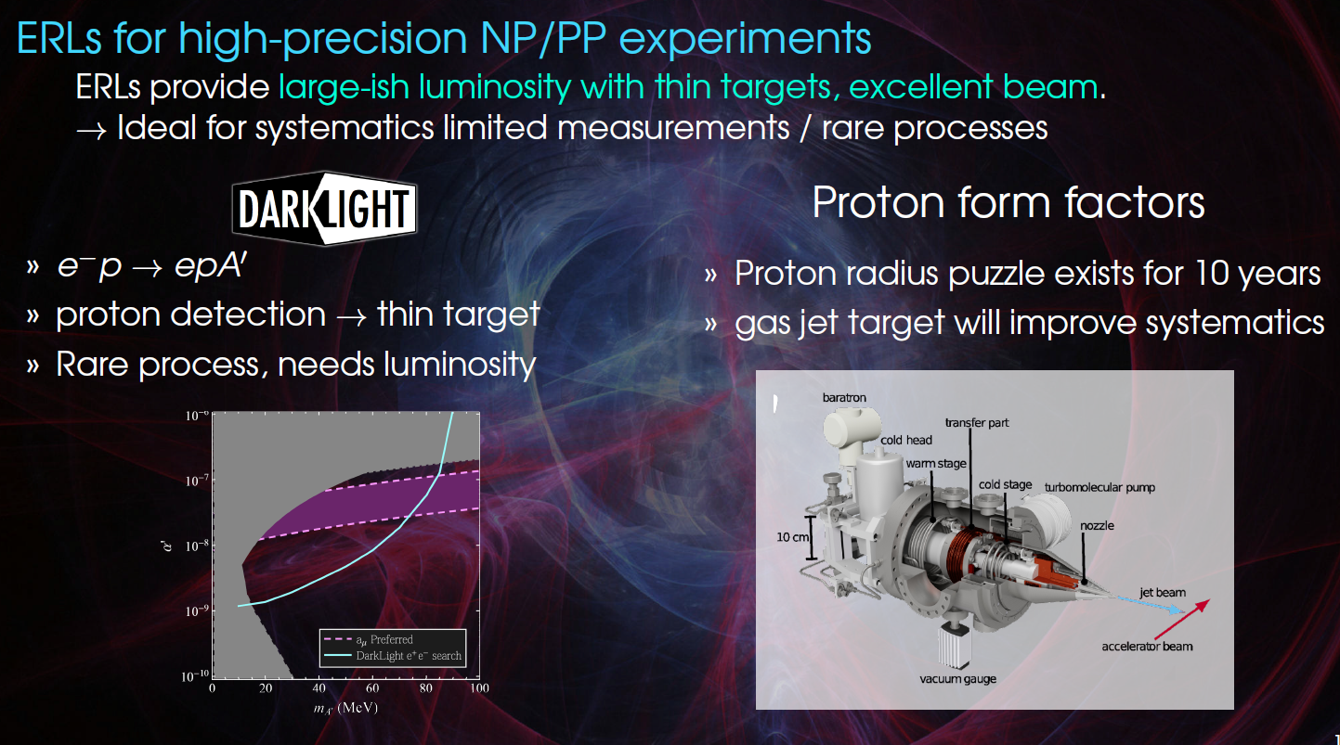
Bernauer

Slide 7
Hug: MESA Experiments
P2 experiment:
High target density, 0.15mA
External beam mode (EB)
Luminosity >10³⁹ cm⁻²s⁻¹
MAGIX experiment:
low target density, 1mA
Energy recovery mode (ERL)
Luminosity >10³⁵ cm⁻²s⁻¹
DarkMESA:
Beam dump experiment running parasitically to P2
Versatile facility for nuclear physics, particle physics and dark sector searches
High accuracy in beam stability, energy spread and polarization needed
Operation-modes | Target | Beam power@target
Ext. Beam (EB) | Solid/ Liquid | 0-25kW
Energy recovery(ERL) | Gas-jet | 0.1-1MW
H.Merkel Talk at DPG Springmeeting 2022

Slide 8
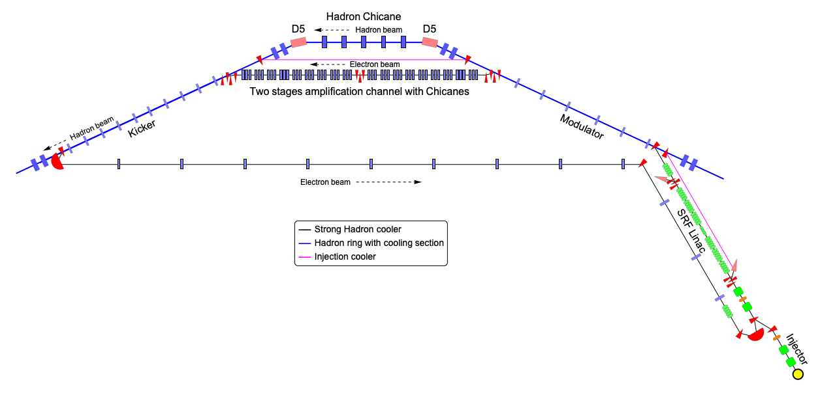
Wang: Strong Hadron Cooling in EIC with an ERL
E<E₀
H⁺
Modulator
E>E₀
Kicker
R₅₆
R₅₆
R₅₆
e⁻
EIC Strong hadron cooling is based on a coherent electron cooling concept using the micro-bunching amplifier.
It will boost EIC luminosity by a factor of 3-10.
The cooling needs a high-quality electron beam with 100 mA high current, 10⁻⁴ small energy spread, and small noise in the beam. It requires the development of an ERL with parameters beyond the state of the art.
Our simulations show that beam quality, energy spread, and beam noise can meet the cooling requirement.
Case 100 GeV 275 GeV
Electron Energy (MeV) 55 150
Electron Norm. Emit. (x/y) (mm-mrad) 2.8 / 2.8 2.8 / 2.8
Repetition rate (MHz) 98.5 98.5
Electron Bunch Charge (nC) 1 1
Electron Peak Current (A) 10 17
Electron Bunch Length (mm, rms)* 12 7
Electron Fractional Energy Spread 10⁻⁴ 10⁻⁴
Hor./Vert. Elec. Betas in Modulator (m) 86.6 / 14.1 64/ 11
Hor./Vert. Electron Betas in Kicker (m) 49.7 / 10 16 / 2
Modulator Length (m) 55 55
Kicker Length (m) 55 55
H/V/L Cooling time(hr) 1.3/2.5/1.7 0.8/2.1/1.2
H/V/L IBS time(hr) 2/4/2.5 2/5/2.9

Slide 9
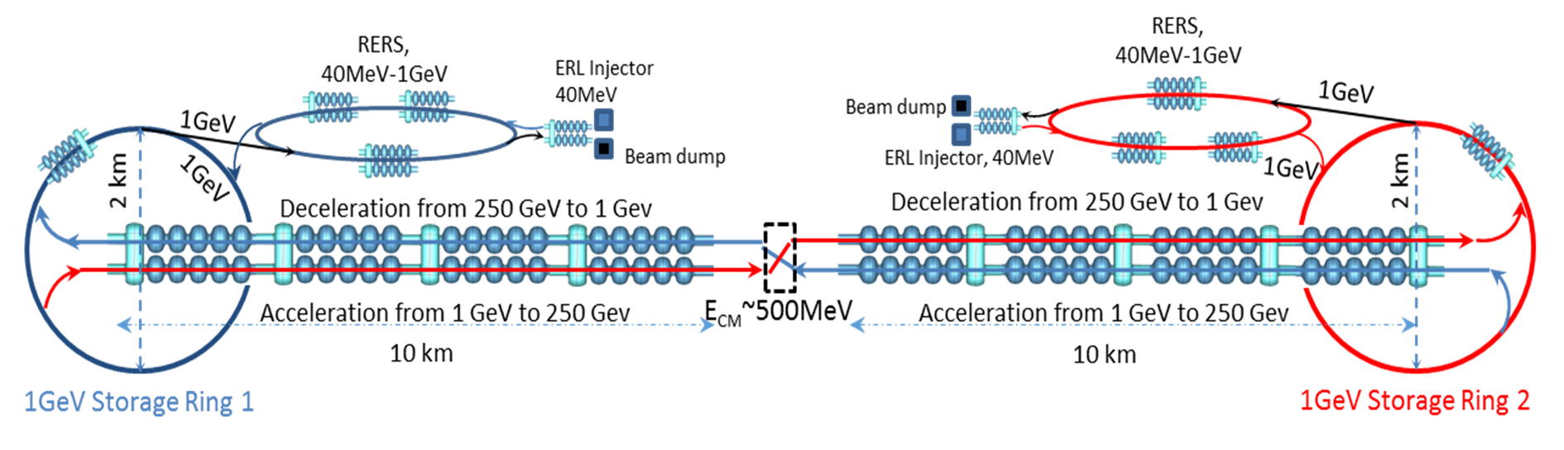
Konoplev: Circular-Linear energy recovery accelerator to probe the energy-frontier
I.V. Konoplev, S.A. Bogacz, Ya. Shashkov
Asymmetric dual-axis cavity
ILC
CLER-C
ERL injector 40MeV
Recirculating energy recovery system 1GeV
“non- emitting” Storage Ring (1GeV, 2km –diameter) to provide beams for photon factories and LERC
Photon factories – ERL FELs hubs driven by the Storage Ring
Linear Energy Recovery Collider driven by storage ring

Slide 10
Litvinenko: ReLiC and CERC: polarized e⁺e⁻ colliders
Vladimir N Litvinenko, Nikhil Bachhawat, Yichao Jing, Francois Meot, Maria Chamizo Llatas, Irina Petrushina and Thomas Roser
ReLiC: Recycling Linear Collider
Common features
  Recycling of used particles
  Energy recovery & High luminosity
  High polarization of both e+ and e- beams
Differences
  ReLiC has potential of operating at higher luminosity and higher energy that CERC
CERC: Circular Energy-Recovery Collider
SRF linac 1
SRF linac 2
Damp electron ring
Damping positron ring

Slide 11
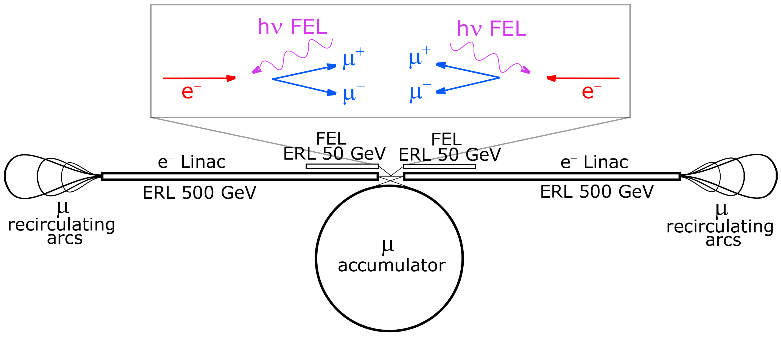
Serafini: Electrons and X-rays to muon pairs (EXMP)
Camilla Curatolo and Luca Serafini, Electrons and X-rays to Muon Pairs (EXMP) Appl. Sci. (2022), 12(6), 3149
GeV muon beams with picometer-class emittance from electron-photon collisions, ArXiv (2021)
E_{e}=500 GeV, hν=60 keV
Strongly asymmetric collision: relativistic Doppler → E_{CM} above MPP threshold
N_{μ}~10¹¹ /s
Recoil parameter X=4γ_{e}hν/M_{e}=4.6∙10⁵
muon production in-vacuum → no target handling, no cooling
no beam-beam, no ring → very tight focus allowed, L ~ 10⁴² cm⁻² s⁻¹
normalized rms transverse emittance @ source
av. curr. 200 mA
av. curr. 200 mA

