Slide 1
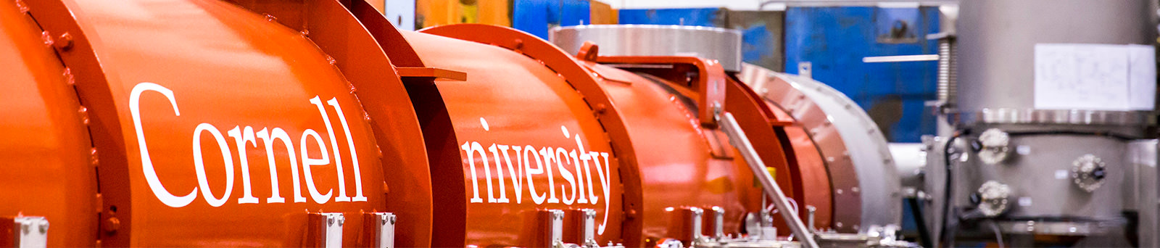
WG2: Beam Dynamics and Instrumentation
Meghan McAteer Helmholtz-Zentrum Berlin
Alex Bogacz Jefferson Lab
ERL 2022, 66th ICFA Advanced Beam Dynamics Workshop on Energy Recovery Linacs

Slide 2
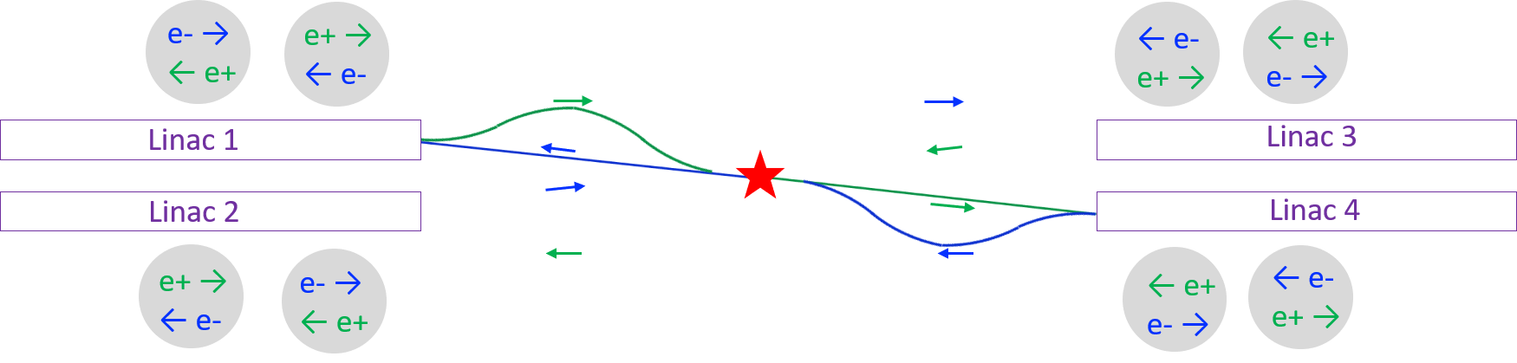
The Ghost Collider
The Ghost Collider is a new concept for a high-energy, high-luminosity e+e- collider.
Accelerating electrons and decelerating positrons in the same bucket eliminates higher order mode excitation.
Interestingly, this means that there is no need for large aperture SRF cavities and high-power HOM couplers.
The Ghost Collider adds the concept of four-beam collisions to remove beam-beam interactions and disruption.
This concept brings up a series of new beam dynamics problems which make optimization of the parameters difficult, but exciting!
Andrew Hutton

Slide 3
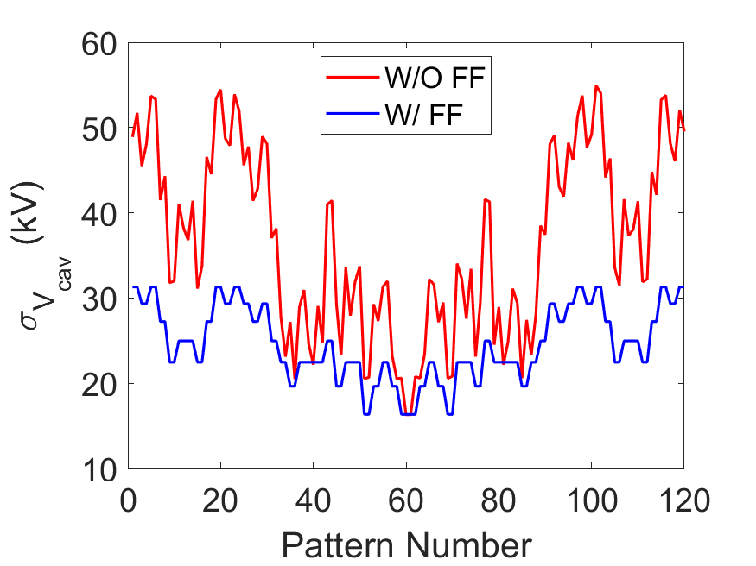
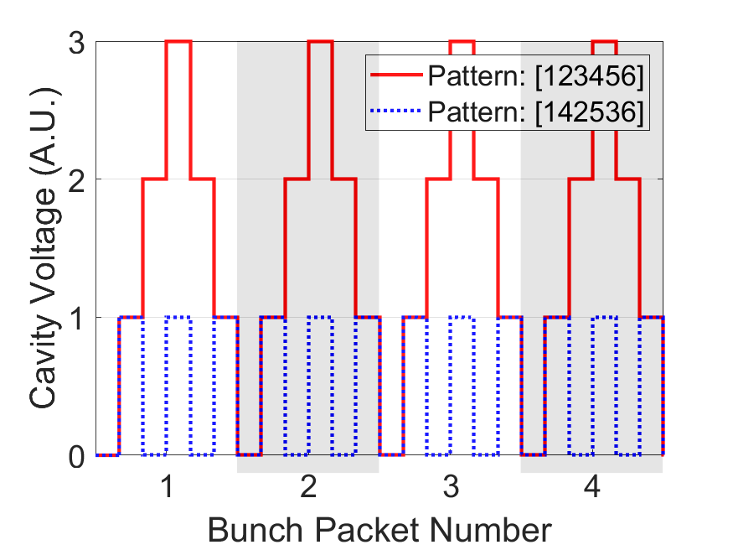
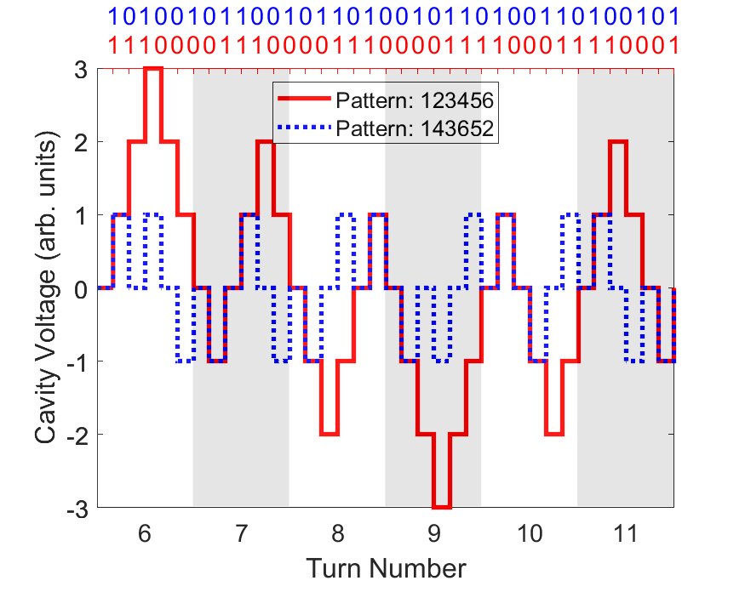
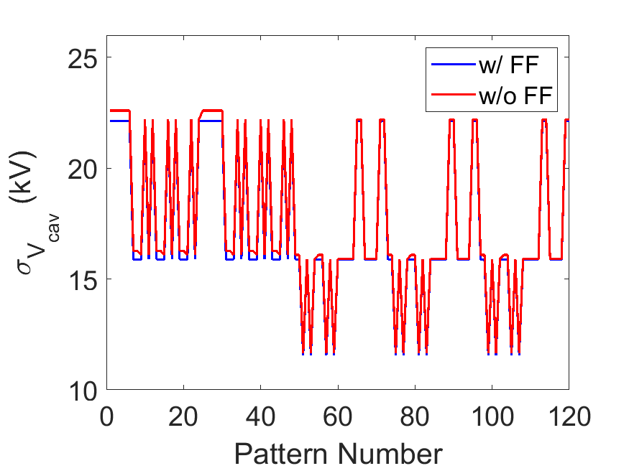
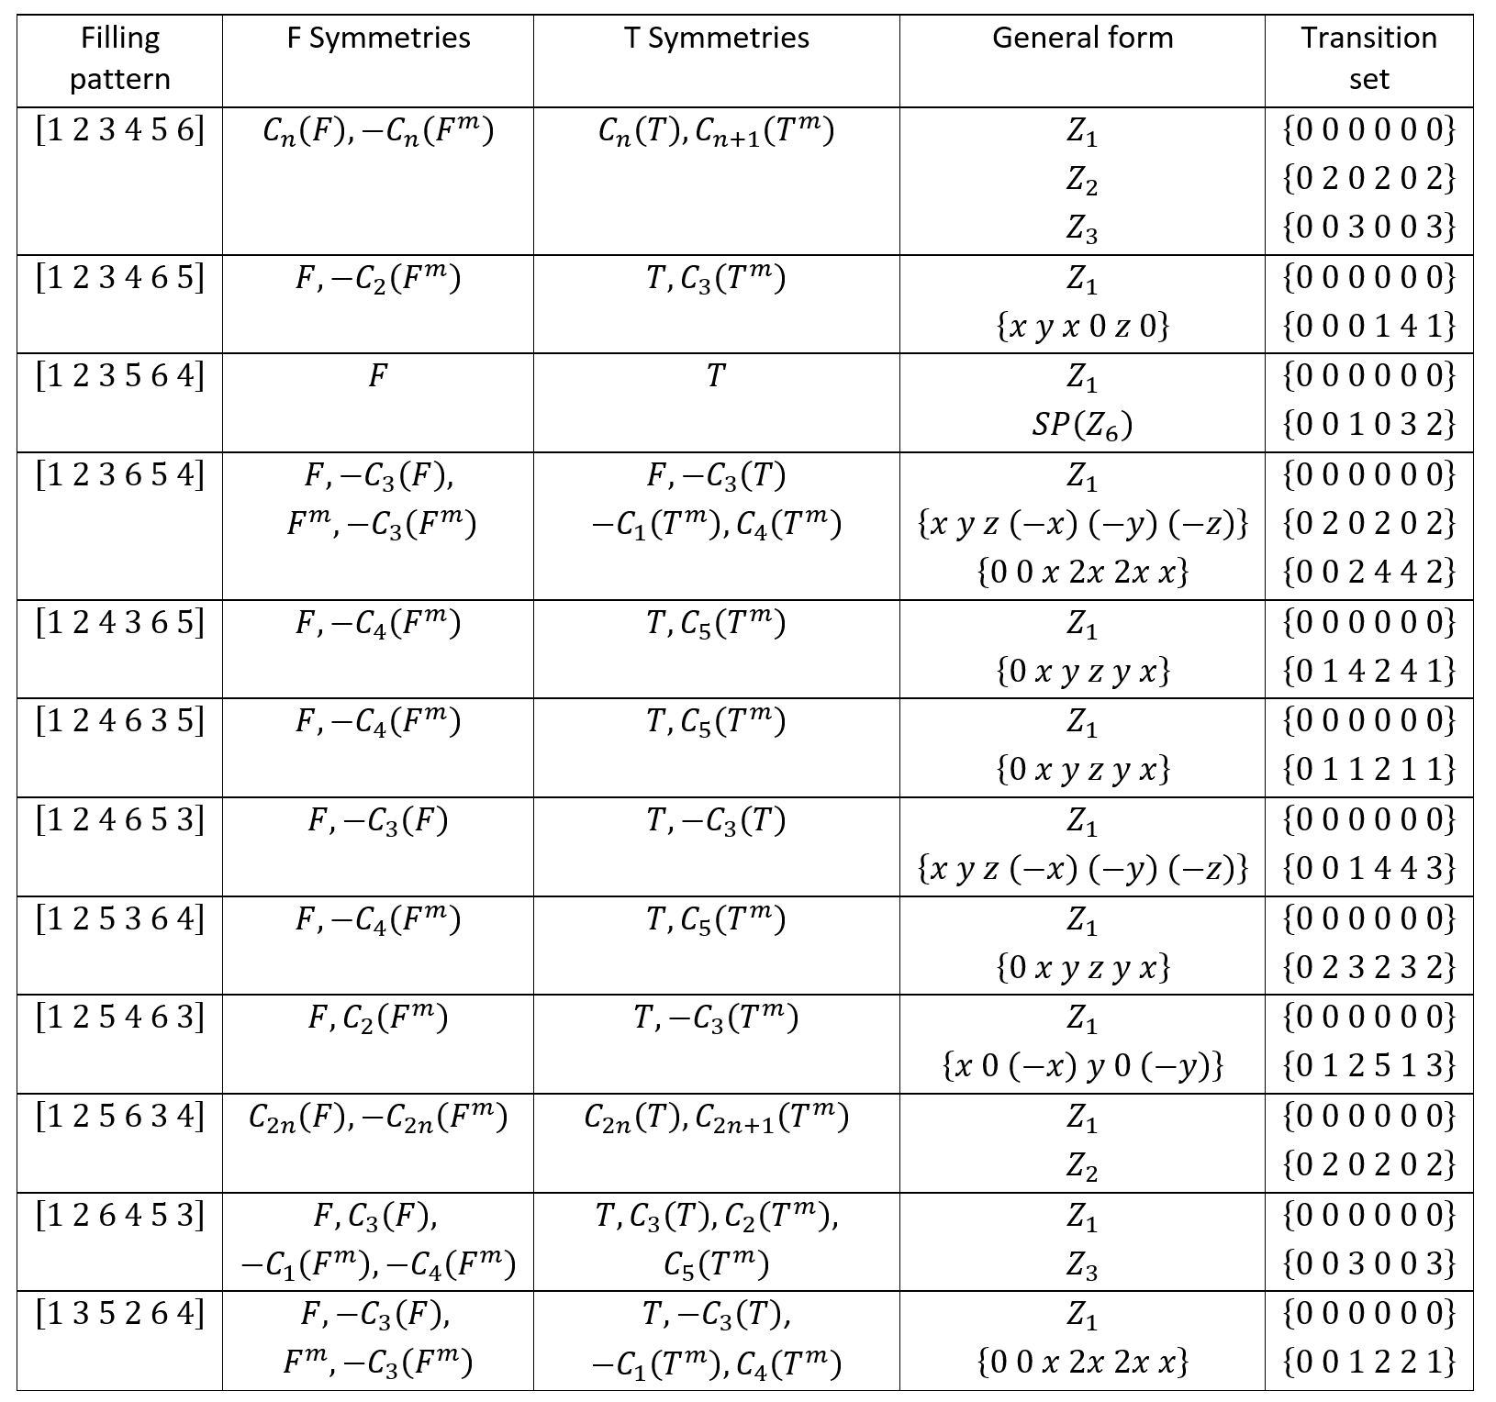
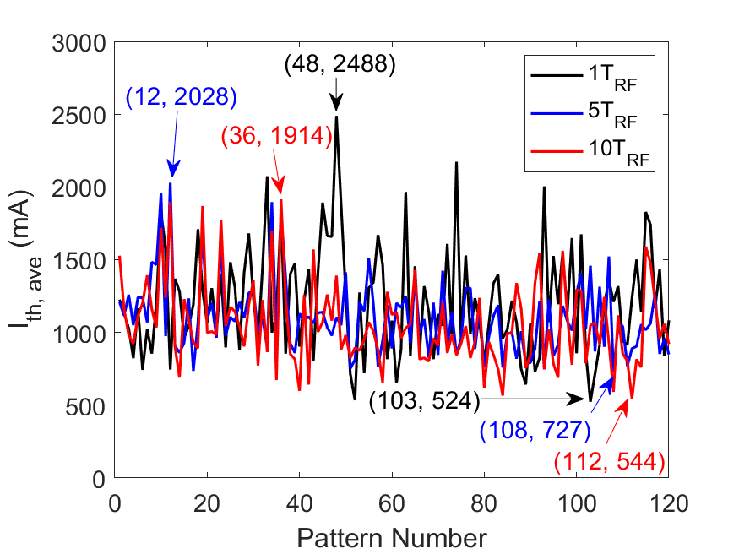
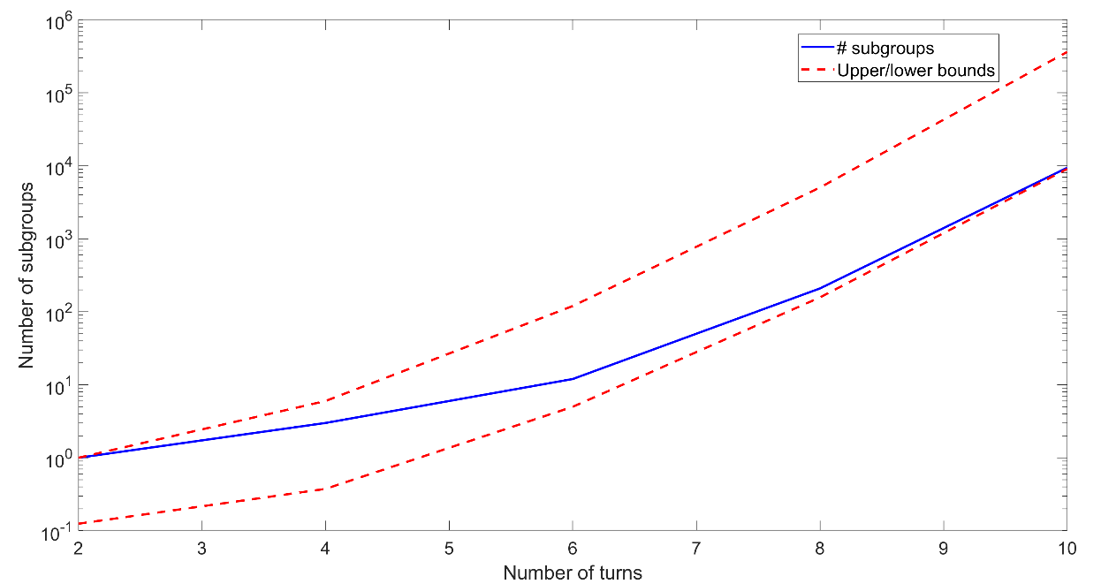
Optimizing beam filling patterns for multi-pass ERLs
Filling patterns and bucket transitions can drastically affect the performance and stability of ERLs
The developed mathematical formalism allows us to perform comprehensive studies to find a global optimum
This formalism allows for other applications such as optimisation of arc lengths
Rob Apsimon

Slide 4
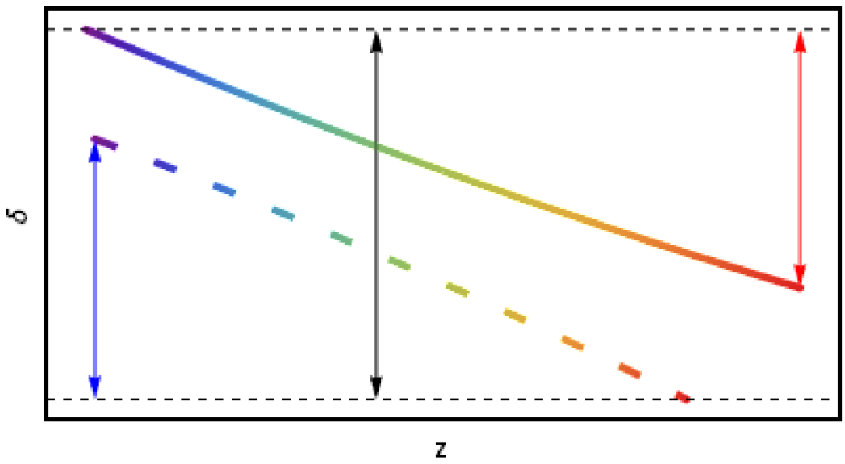
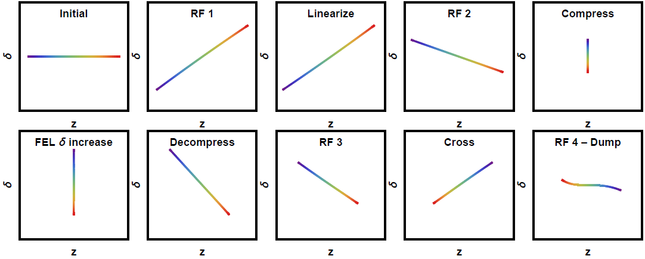
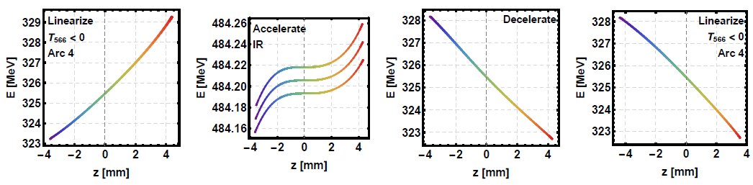
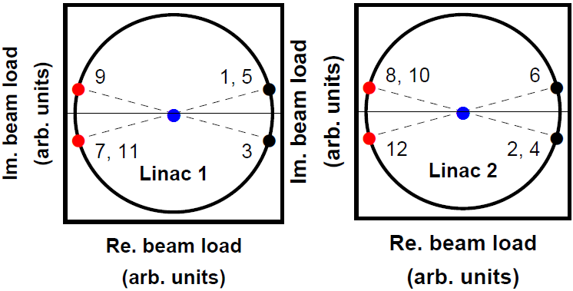
ERL Longitudinal Matches for Light Sources
Compressive match (FEL)
Common transport complications
Possible longitudinal matches
Energy spread minimization (FEL)
Gustavo Perez Segurana
Construction of self-consistent longitudinal matches in multipass energy recovery linacs

Slide 5
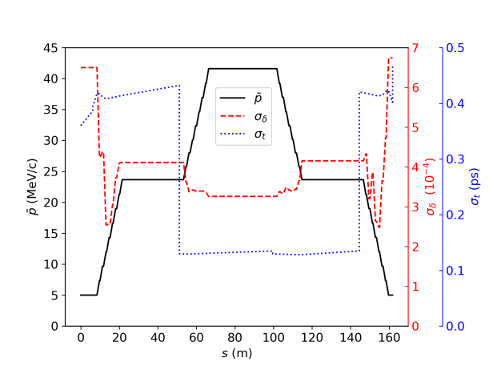
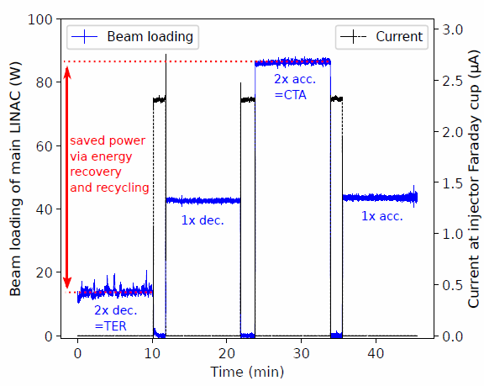
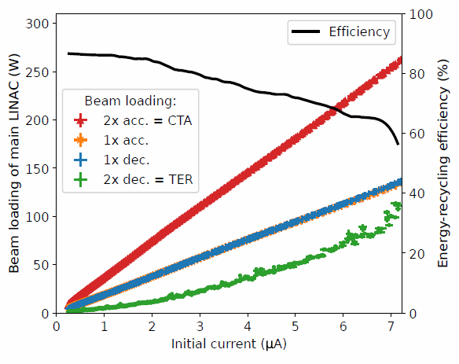
S-DALINAC Twice recirculation SRF multi-turn ERL
S-DALINAC uses common beam transport
Reduced number of degrees of freedom for
  Transverse confinement
  Target momenta and momentum spread control
Beam-dynamics simulations prior to beam tuning necessary
Operating with low momenta can increase efficiency, but phase space has to be taken into account
Simulation results have been used to tune machine and realize twofold ERL in August 2021
First proof of efficiency in a
SRF multi-turn ERL by measured
beam loading decrease
Efficiency of up to 87 %
Felix Schliessmann
F. Schliessmann et al., publication under review

Slide 6
Closed lattice design for EIC SHC-CeC ERL
Colwyn Gulliford

Slide 7
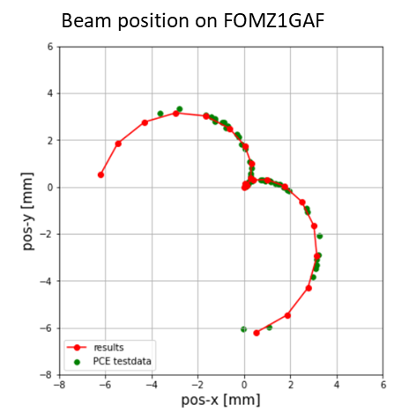
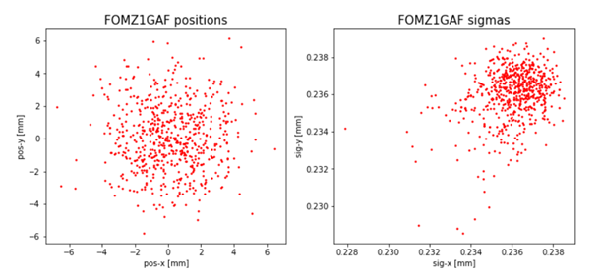
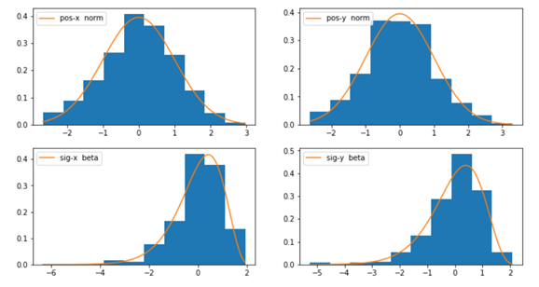
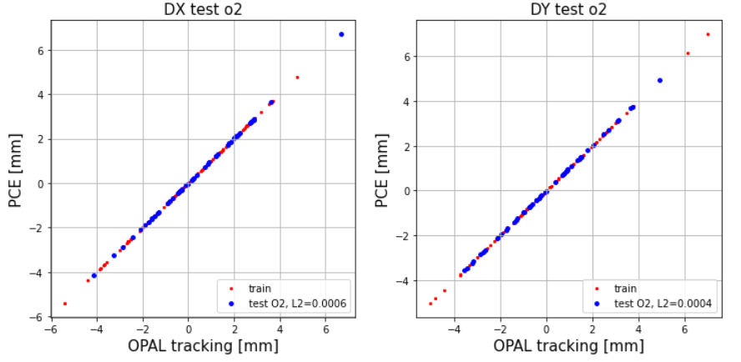
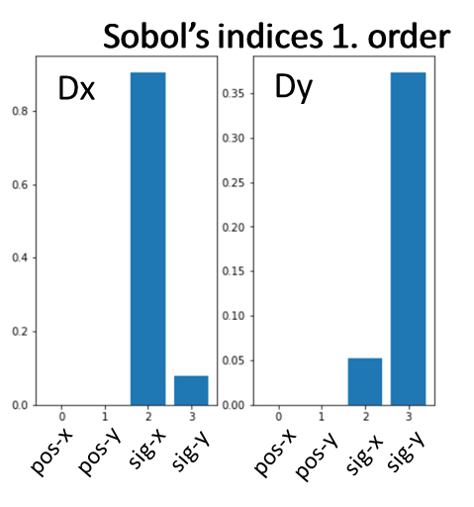
Polynomial Chaos expansion
Surrogate model determining
beam position on screen.
quantifies uncertainty in parametric systems
provides surrogate models
works on relatively few data point
easy to implement & fast
Create tracking / measured data
with distributed misalignments
Set up PCE
for joint distribution
for screen data
Fit polynomial coefficients to
determine
misalignments
Determine distributions
of 4 parameters on screen
Reverse PCE
Beam-based determination of solenoid transverse misalignment
using 100 sample points and a polynomial series of second order.
Sobol’s indices reveal the dominant impact of beam size determination
for uncertainty in the result.
Bettina Kuske

Slide 8
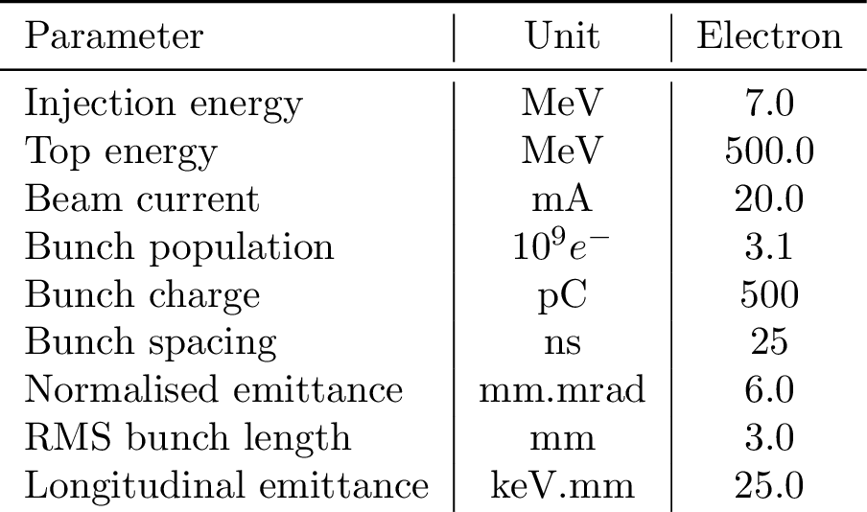
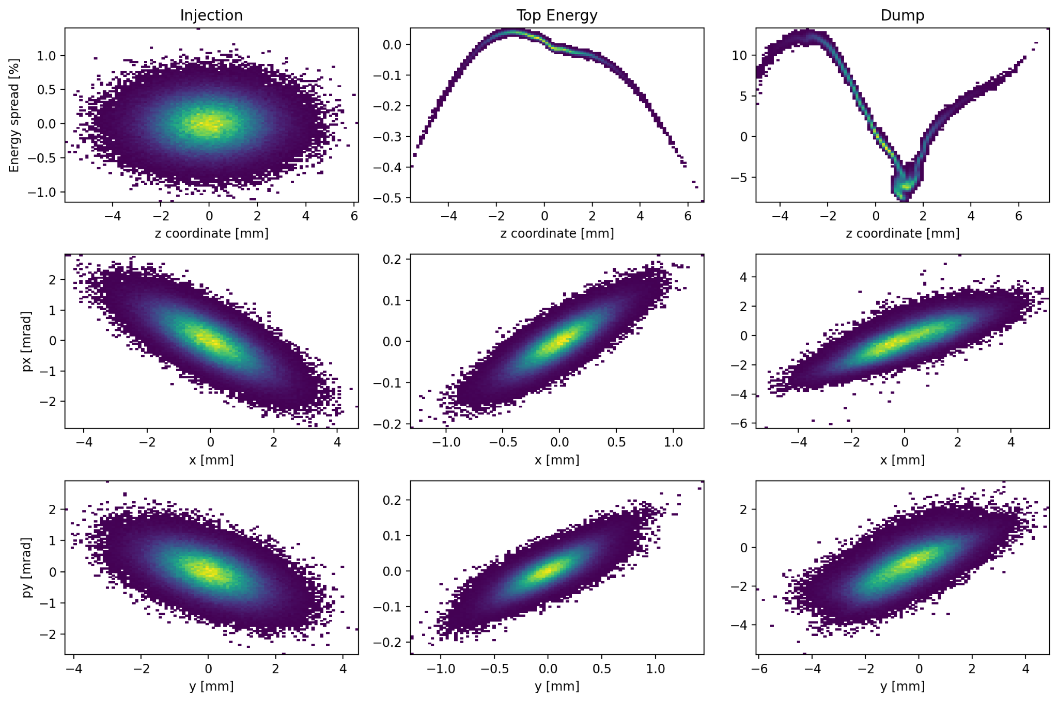
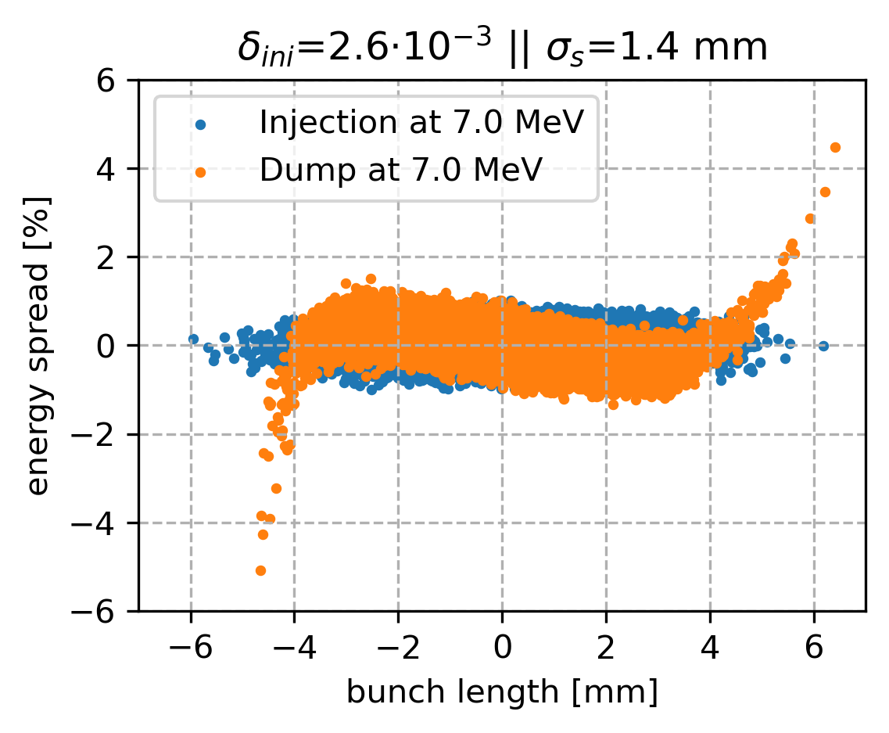
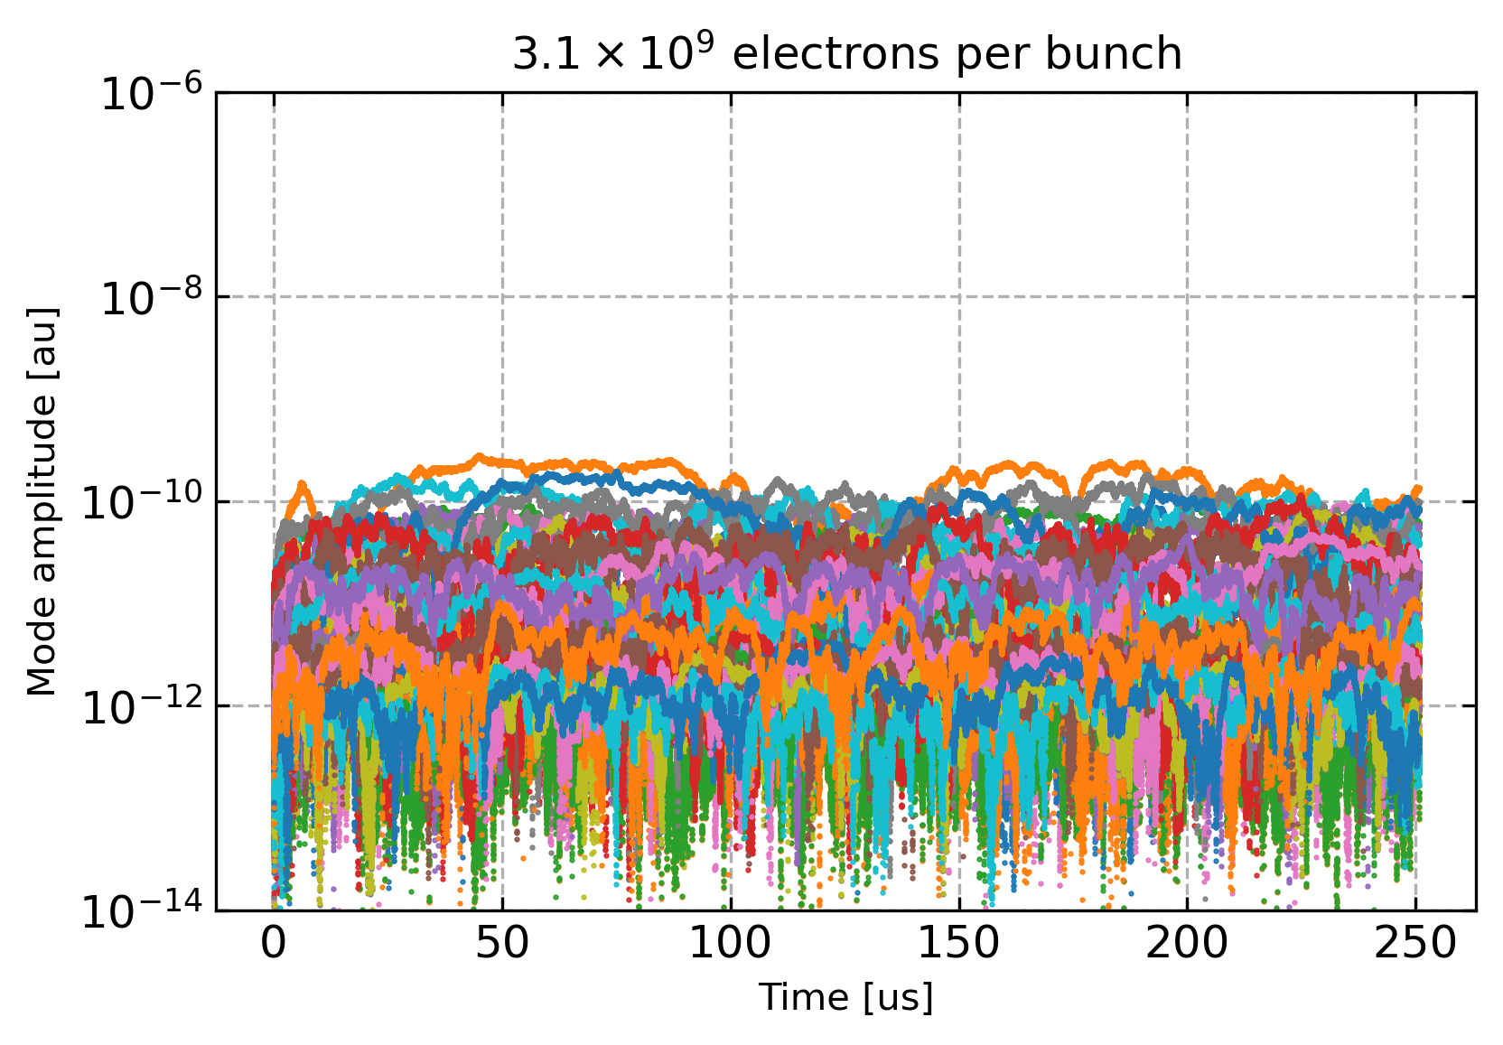
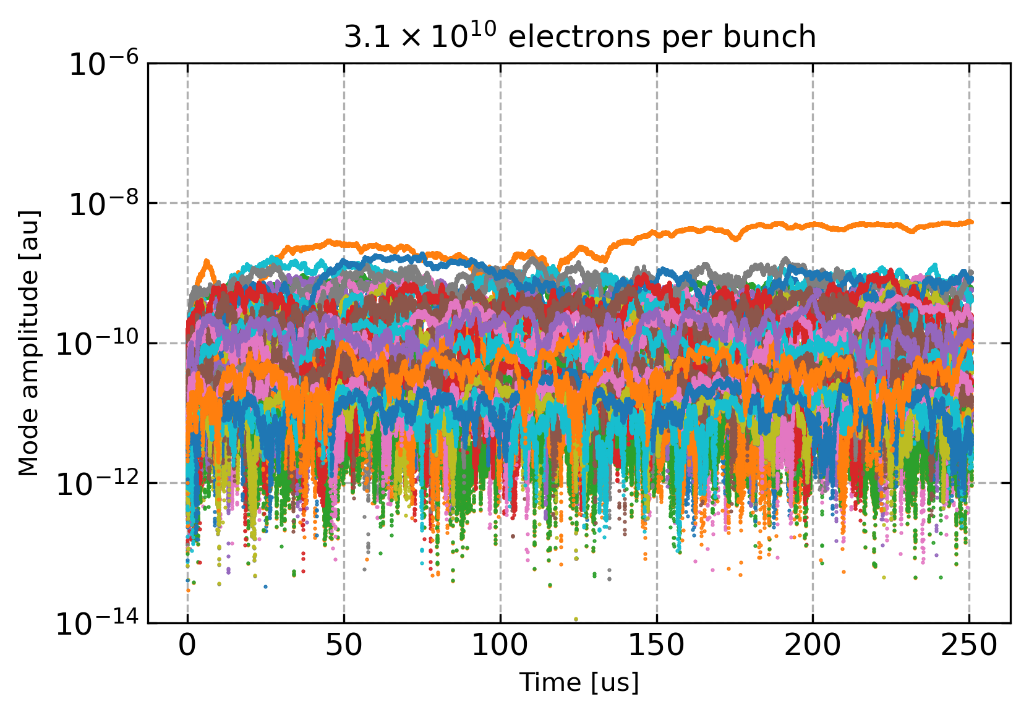
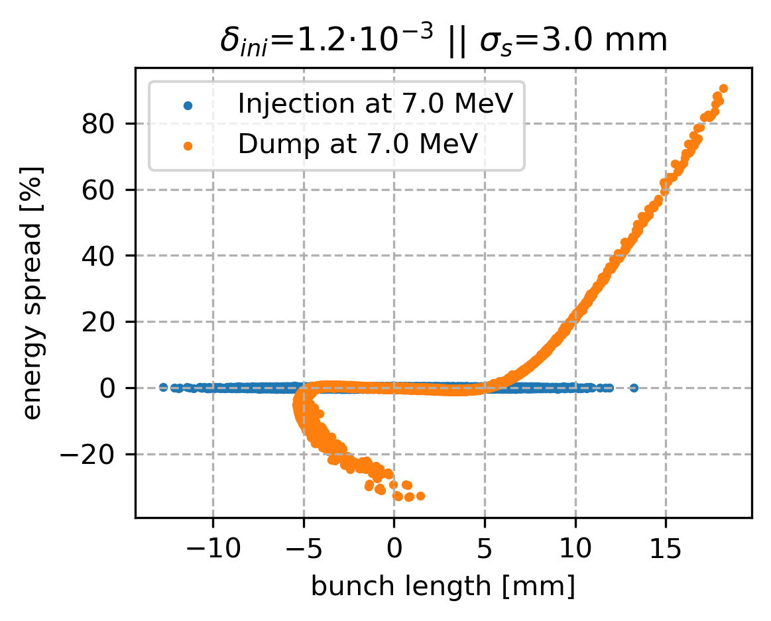
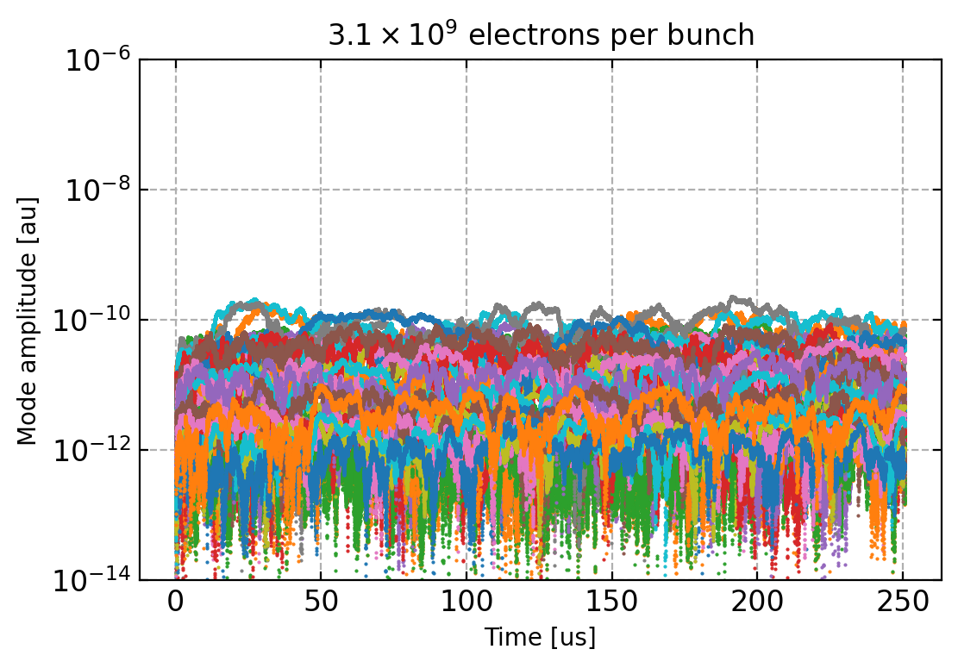
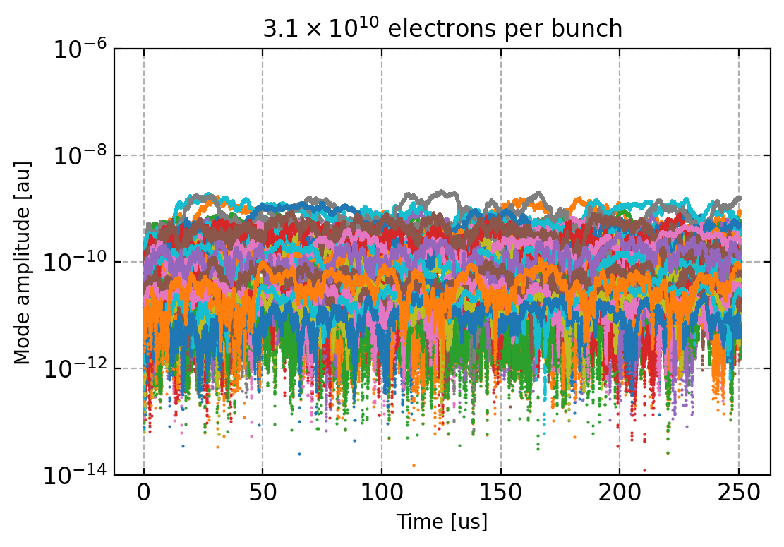
Beam Dynamics Studies of PERLE
Original filling pattern
Original filling pattern
‘Regular’ filling pattern
‘Regular’ filling pattern
Phase space at the dump from lossless tracking studies including CSR at nominal current with a reduced bunch length hence it seems comfortable with the nominal bunch length.
Reduction of the bunch length to 1.4mm avoiding longitudinal effects from the RF cavities until a lattice featuring longitudinal matching is available.
Multi-bunch tracking is stable at nominal current, the optimisation of the bunch filling pattern does not show unstable HOMs up to 10 times the nominal current as opposed to the original filling pattern.
Kevin Andre

Slide 9
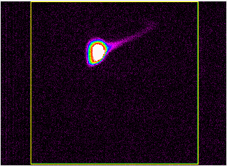
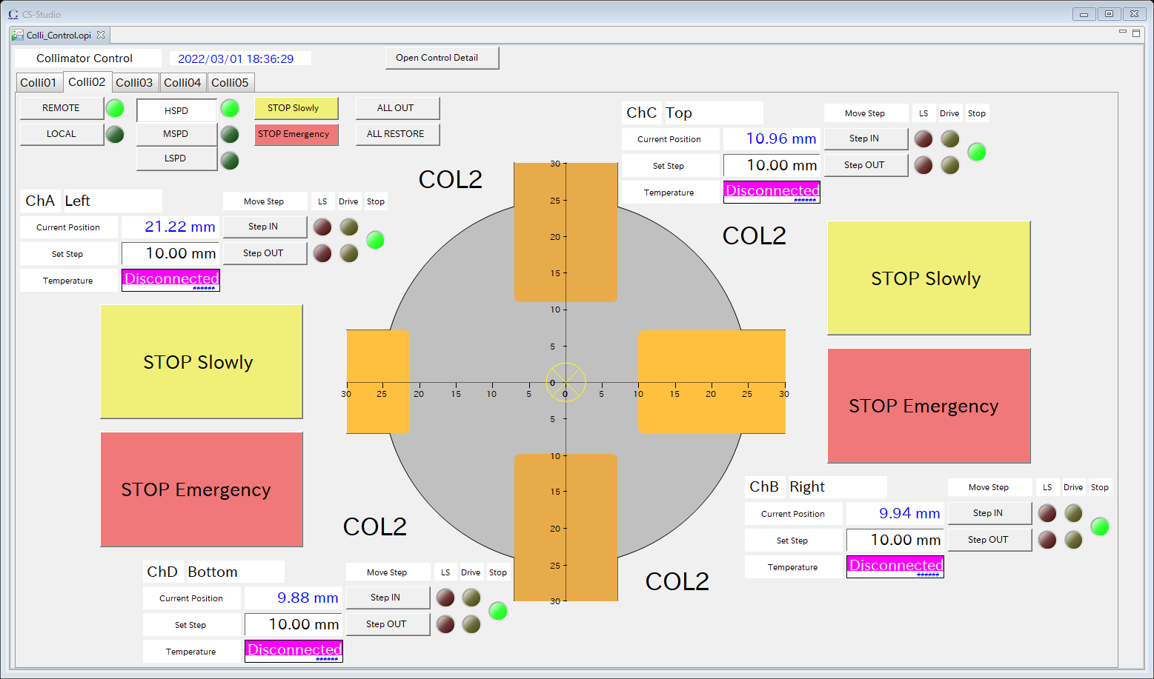
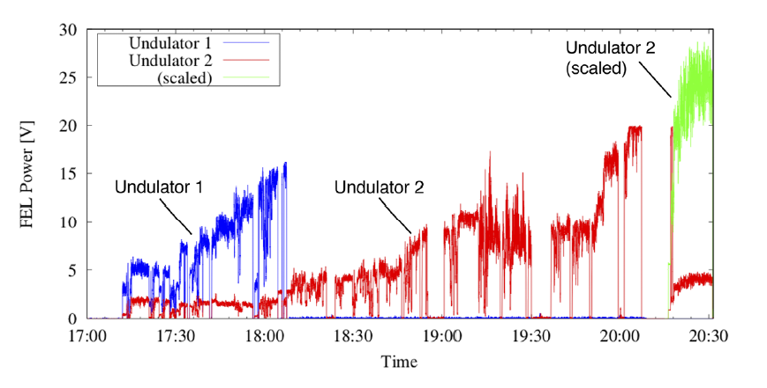
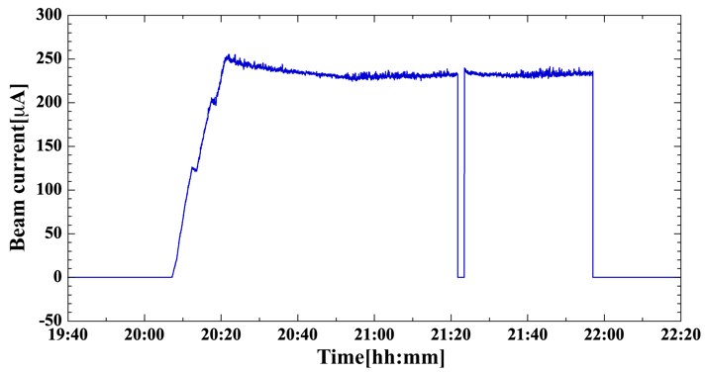
IR-FEL
Beam tuning at Compact ERL after installing undulators
High current operation at CW mode
We try AI beam tuning for maximizing IR-FEL intensity. It makes the beam tuning highly effective because 3~6 parameters are optimized at once
The 250uA current operation is successful with low radiation level by collimating the halo and tail at low energy
Beam halo
cam8
U2 orbit
U2 matching
U2 orbit
Buncher,inj
R56, SX
U1 matching
U2, R56
R56, SX
R56, SX
ML2
R56, SX
250 μA for 2 hours
Example of AI tuning (~ 3 hours)
Miho Shimada

Slide 10
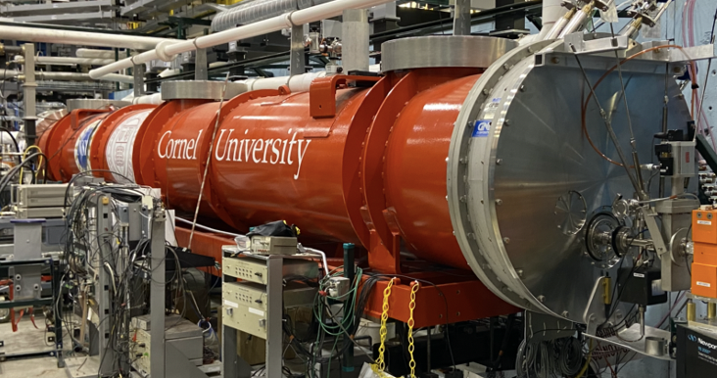
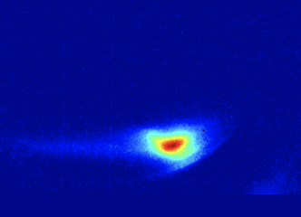
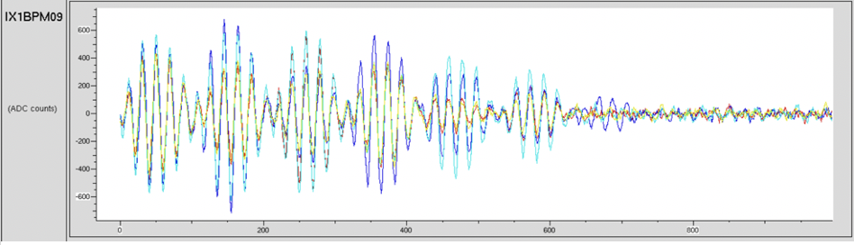
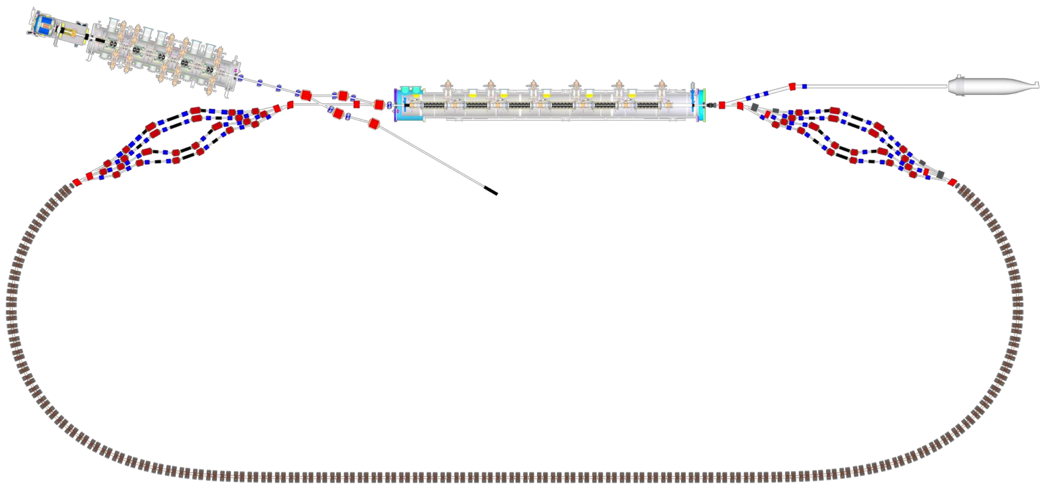
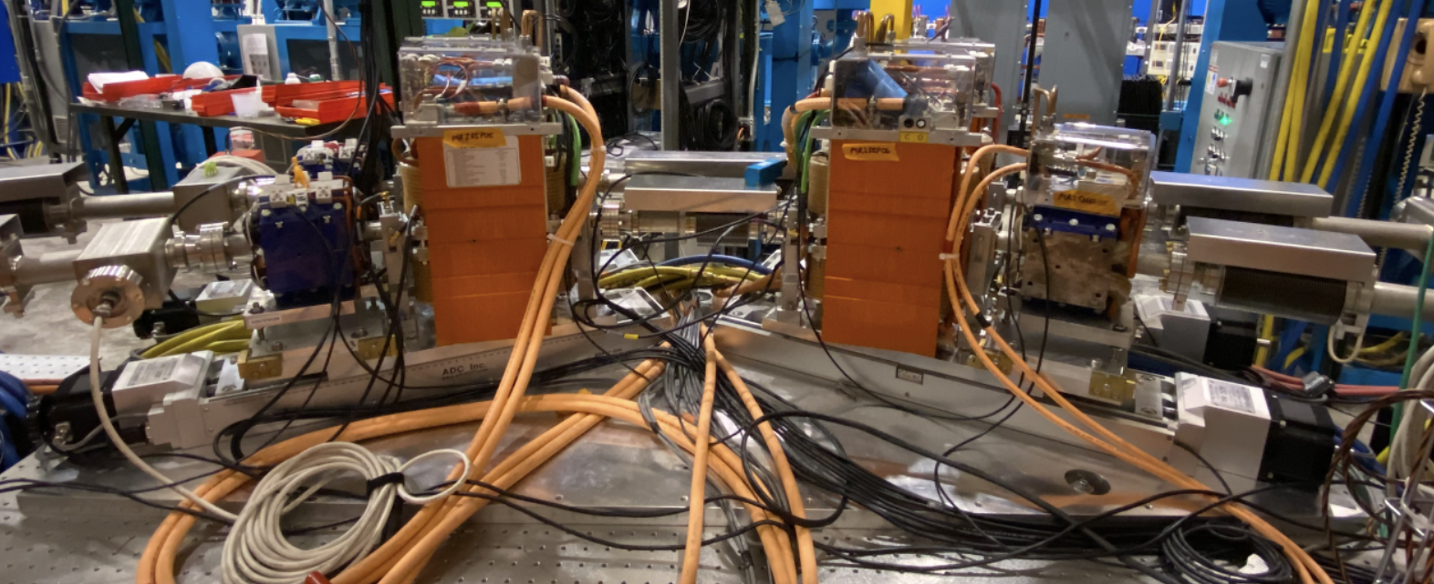
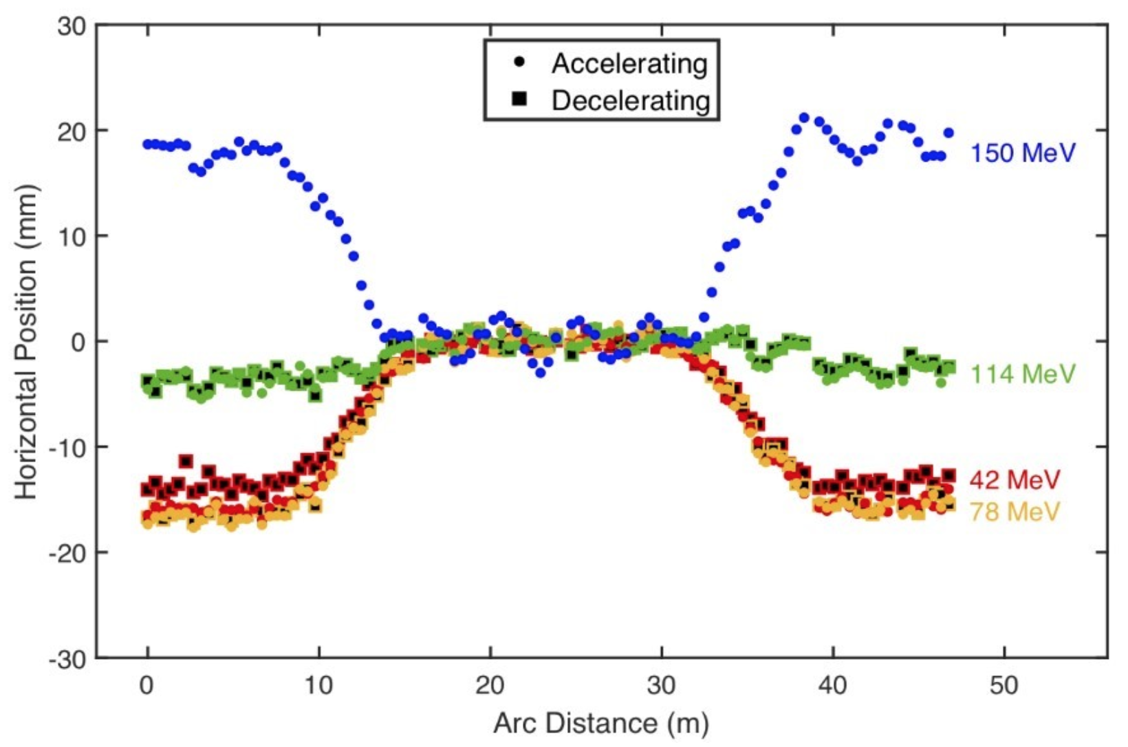
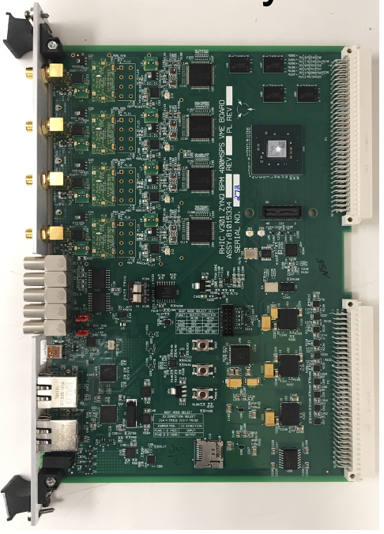
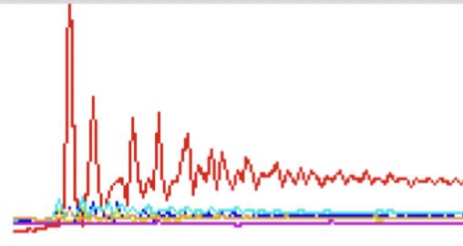
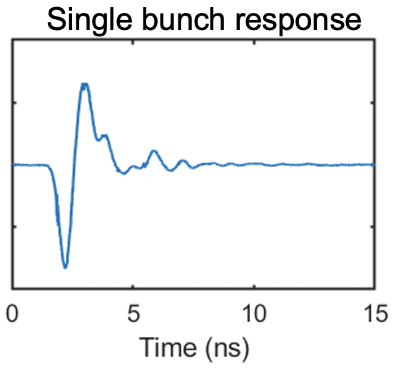
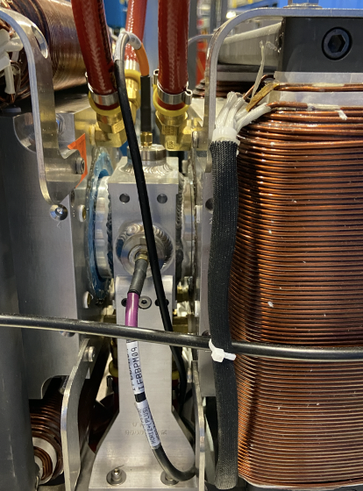
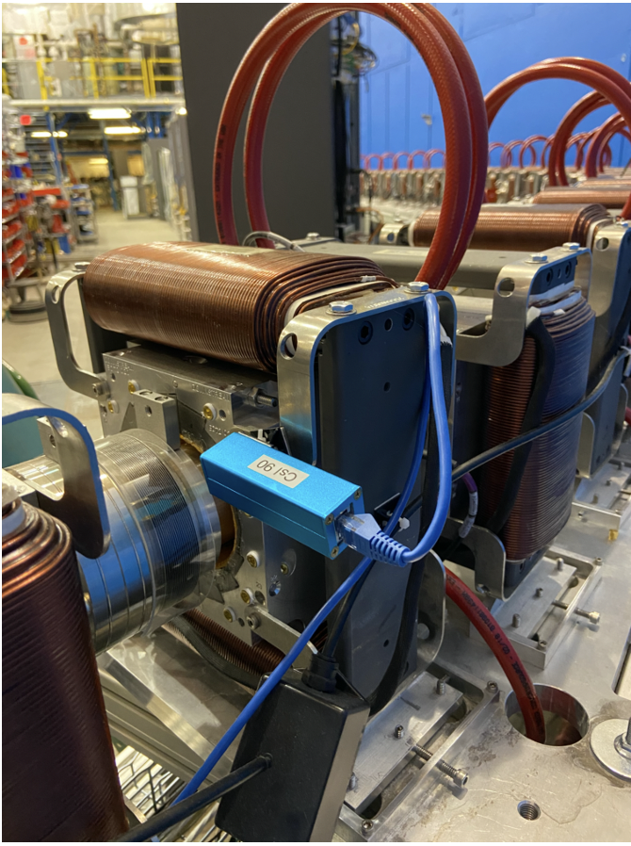
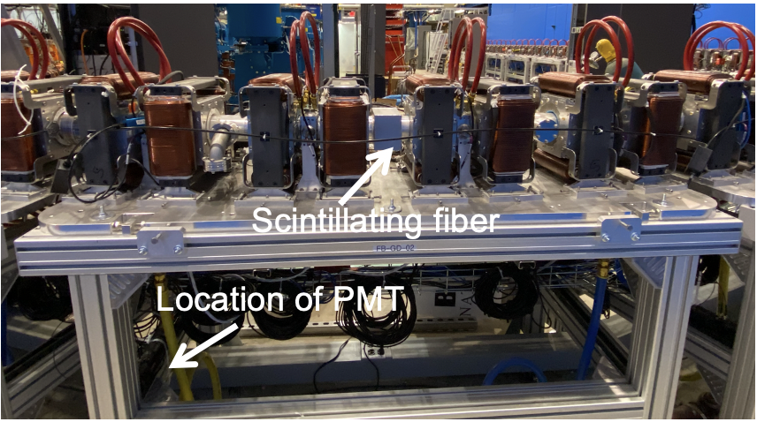
CBETA Instrumentation
Injector cryomodule
Electron source
LA
DU
Dump
Merger
IN
RX
Main linac cryomodule
Splitter B
Diagnostic line
Splitter A
DI
SX
FFA
arc B
FFA
Arc A
FB
FA
FFA Transition B
FFA
Transition A
FFA straight
TB
ZB
ZM
ZA
TA
Beam energy with each MLC pass:
6 to 42 MeV 150 to 114 MeV
42 to 78 MeV 114 to 78 MeV
78 to 114 MeV 78 to 42 MeV
114 to 150 MeV 42 MeV to 6
view screens, beam position monitors (BPM), phase measurement bunch arrival monitors (BAMs), slow loss monitors and fast loss monitors
Robert Michnoff

Slide 11
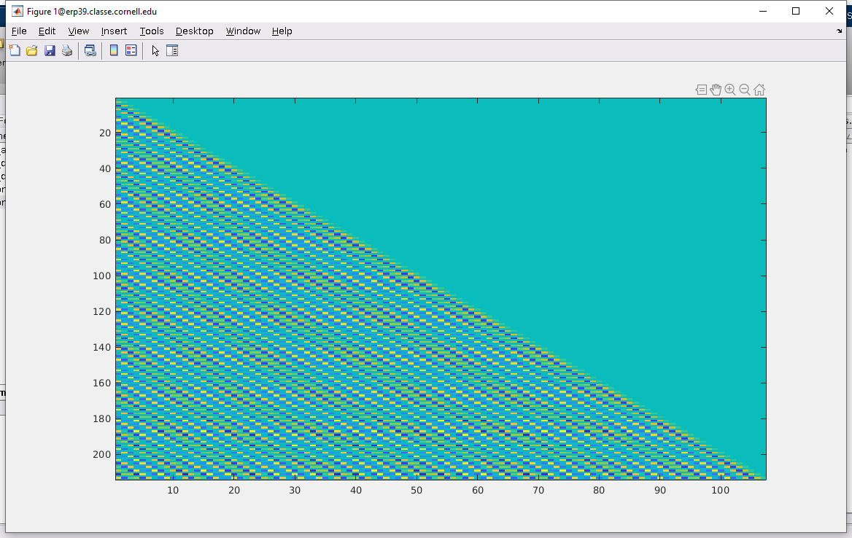
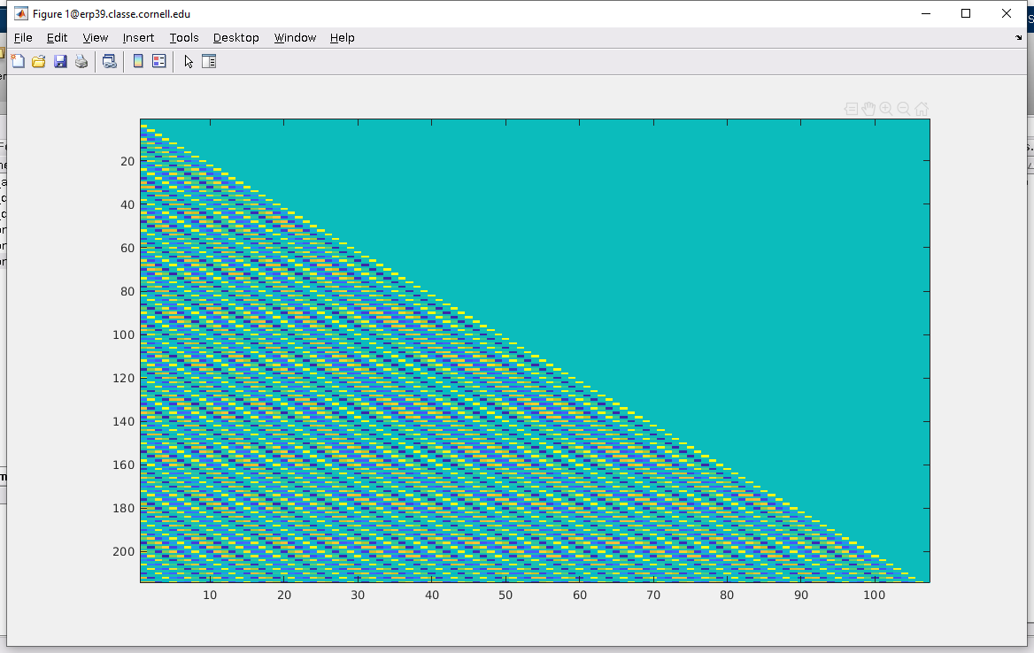
CBETA Multi-Turn Performance Studies and Beam Dynamics Issues
Full Response Matrices from CBETA-V
Halo after injector
Quad centering (through S1-R1 splitters)
Tool: Quads as BPMs
1-turn commissioning (piecewise SVD correction)
1-turn intensity
Semi-empirical response matrix
Real full response matrix for diagnostic use
Tool: get_all_tunes for day-to-day tune variation
Multi-turn response matrix and correction
4-turn intensity
4-turn tunes vs. model
Tool: accelerating vs. decelerating splitter orbits
TOF adjustment
Degaussing
Closed bumps
FFA correctors → FFA BPMs
Stephen Brooks

