Slide 1
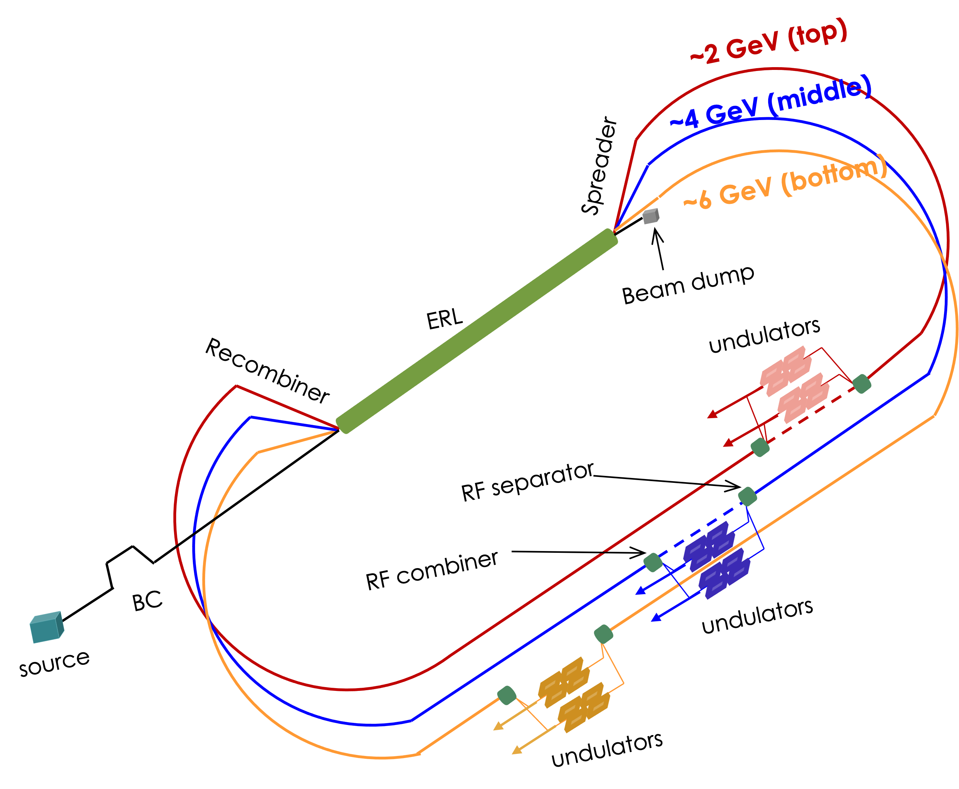
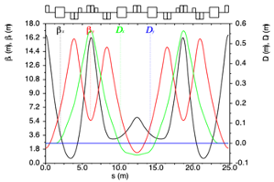
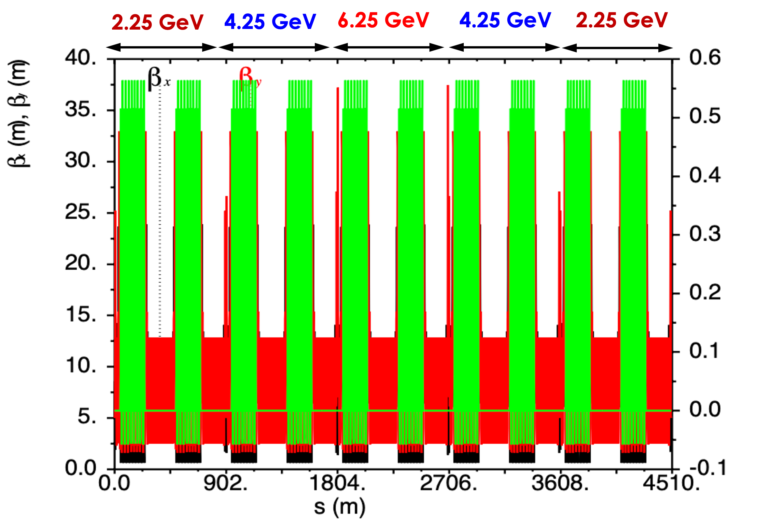
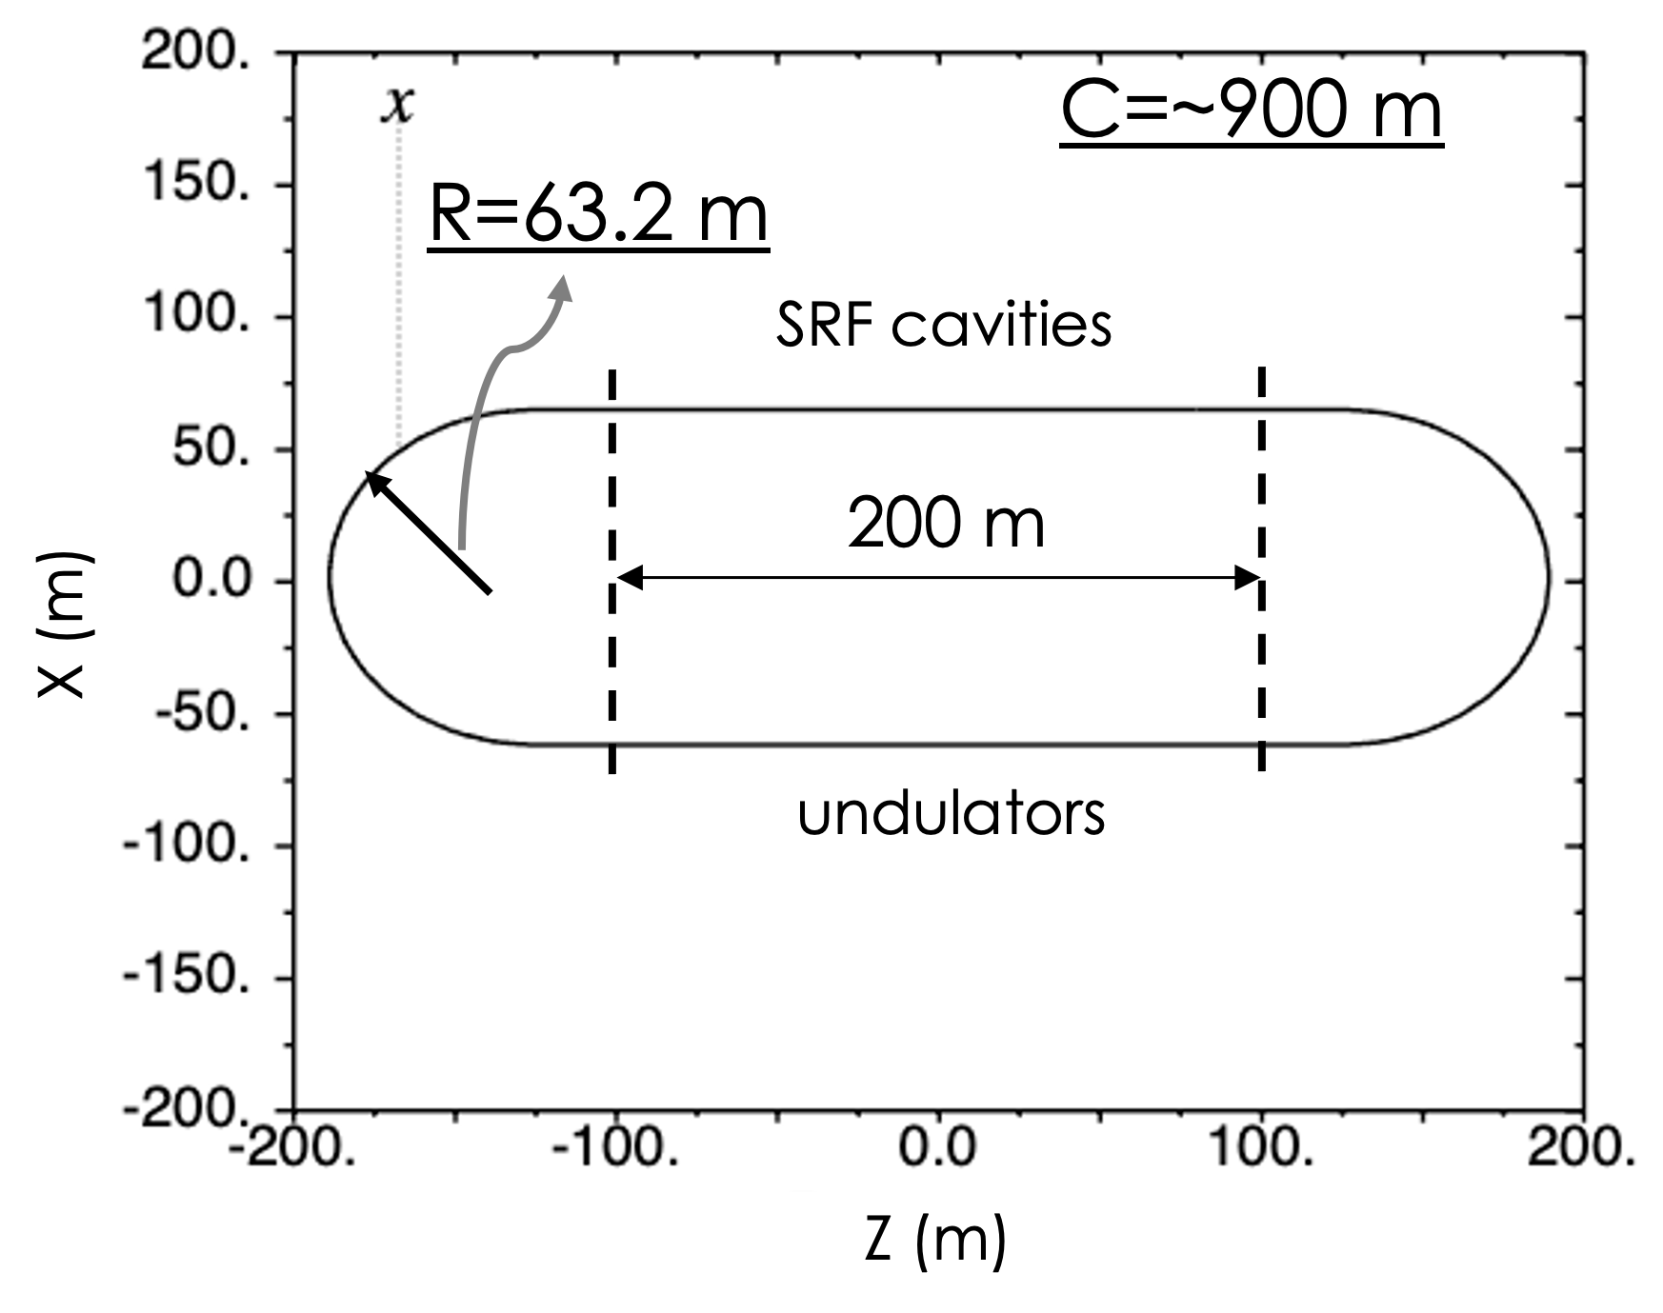
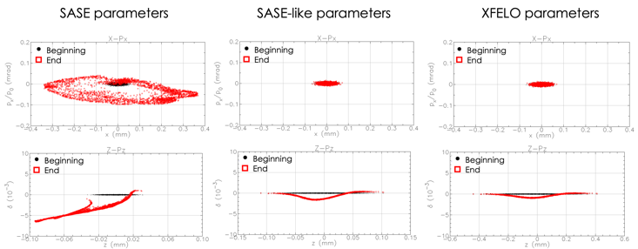
Study of an ERL-based Compact X-ray FEL*
F. Lin, V. Morozov, ORNL; J. Guo, Y. Zhang, Jefferson Lab
ABSTRACT : We propose to develop an energy-recovery-linac (ERL)-based X-ray free-electron laser (FEL). Taking advantage of the demonstrated high-efficiency energy recovery of the beam power in the ERL, the proposed concept offers the following benefits: i) recirculating the electron beam through high-gradient SRF cavities shortens the linac, ii) energy recovery in the SRF linac saves the klystron power and reduces the beam dump power, iii) the high average beam power produces a high average photon brightness. In addition, such a concept has the capability of optimized high-brightness CW X-ray FEL performance at different energies with simultaneous multipole sources. In this paper, we will present the preliminary results on the study of optics design and beam Dynamics.
CONCEPT
BEAM DYNAMICS
Advantages:
Cost effective with recirculating SRF cavities, operation of SRF, short SRF section
Energy saving with up to 99% energy recovery efficiency in ERL
Better performance with CW beams to enhance the average photon brightness
Incoherent Synchrotron Radiation (ISR)
Refer to SR power emitted in a fully incoherent region in dipole magnets
Excite a growth of energy spread and emittance
Simultaneous multiple XFEL sources at different photon energies
Particle distributions in phase spaces
Beam properties at undulators
($x, x^{′}$)
Energy (GeV) | Location | $δ$ (10⁻⁵) | $ε_{x}$ (10⁻¹² m)
2.25 | Initial | 3.91 | 43.7
2.25 | Undulators | 3.97 | 44.1
4.25 | Undulators | 3.92 | 31.4
6.25 | Undulators | 9.30 | 81.3
($z, δ$)
OPTICS
Coherent Synchrotron Radiation (CSR)
Refer to SR power emitted in a fully coherent region in dipole magnets
Impose a serious impact on beam energy spread and emittance
Arc cell:
Achromatic for better control of horizontal emittance
Isochronous for better control of CSR-induced emittance growth
Phase advances of $\left(φ_{x},φ_{y}\right)=(\frac{5π}{2},\frac{3π}{2})$ for better control of nonlinear resonances
Beam parameters used for studying CSR effect at 2.25 GeV
Cases | Unit | SASE | SASE-like | XFELO
Energy | GeV | 2.25
Initial rms $ε_{x}^{N}$ | um | 0.3
Initial rms $δ$ | 10⁻⁵ | 4.4
Charge per bunch | pC | 30 | 30 | 100
Bunch length rms | um/fs | 9/30 | 30/100 | 120/400
SRF Multi-Pass BBU
Comparison of SRF multi-pass BBUs from dipole HOM and monopole HOM
assuming similar M₁₂ , M₃₄ , and M₅₆
Comparing the relative impedance budgets
Dipole impedance budget: $R_{d}k≅\frac{2E(eV)}{I_{b_r}M_{12 or 34}}∝\frac{2E(eV)}{I_{b_r}\left(mA\right)}$
Monopole impedance budget: $R_{m}k≅\frac{2E(eV)}{I_{b_r}M_{56}}∝\frac{2E(eV)}{I_{b_r}\left(mA\right)}$
We explore the design feasibility of an ERL-based XFEL. A linear optics is completed, and beam dynamics study is performed. Growth of the beam horizontal emittance and energy spread, due to both incoherent and coherent synchrotron radiation is modest. Further optics and parameter optimization will be carried out.
CONCLUSION
Cases | Unit | 6 GeV CEBAF | Jlab FEL | EIC cooler | This design
Injected energy | MeV | 67.5 | 9 | 5 | 250
Total beam current $I_{b_t}$ | $$mA$$ | $$5 x 0.2$$ | 2 x 9.1 | 2 x 100 | 6 x 4
Recirculating beam current $I_{b_r}$ | mA | 4 x 0.2 | 1 x 9.1 | 1 x 100 | 5 x 4
Dipole imp. budget |  | 168.75 | 1.98 | 0.1 | 25
Monopole imp. budget |  | 168.75 | 1.98 | 0.1 | 25
Thanks to Sarah Cousineau, Fulvia Pilat, Andrei Shishlo (ORNL), Steven Benson, Andrew Hutton, Geoffery Krafft, Gunn Tae Park, Robert Rimmer, Chris Tennant, He Zhang (JLAB), David Sagan (Cornell) and Henry Lovelace III (BNL) for their support, suggestions and help.
ACKNOWLEDGEMENTS
* Work supported by UT-Battelle, LLC, under contract DE-AC05-00OR22725, and Jefferson Science Associates, LLC, under contract DE-AC05-06OR23177.

