Slide 1

Capability and Prospects for High Current
Polarized Beams from GaAs DC Photoguns
CEBAF Polarized Photogun
Joe Grames

Slide 2
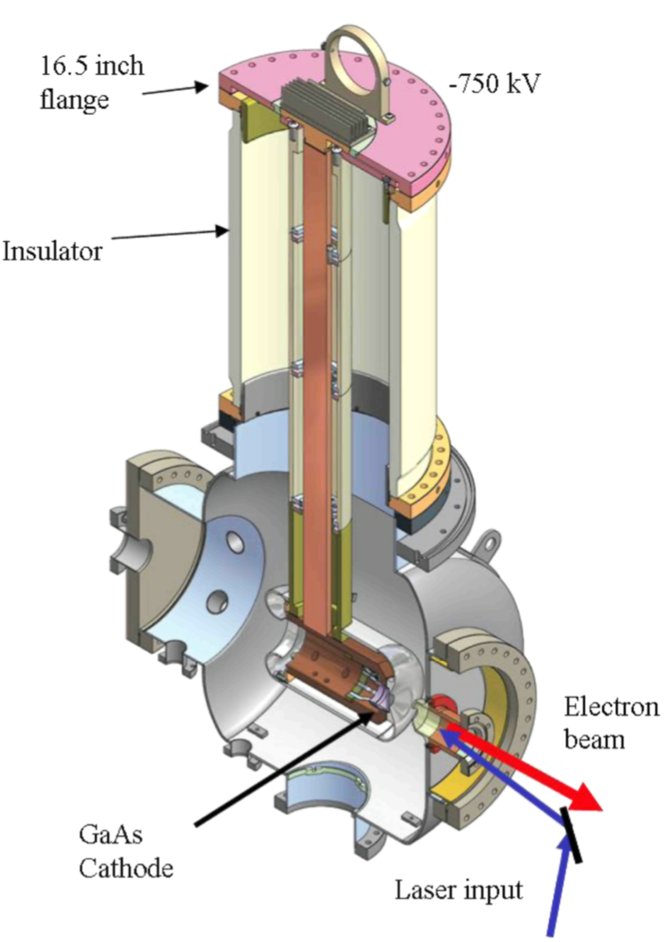
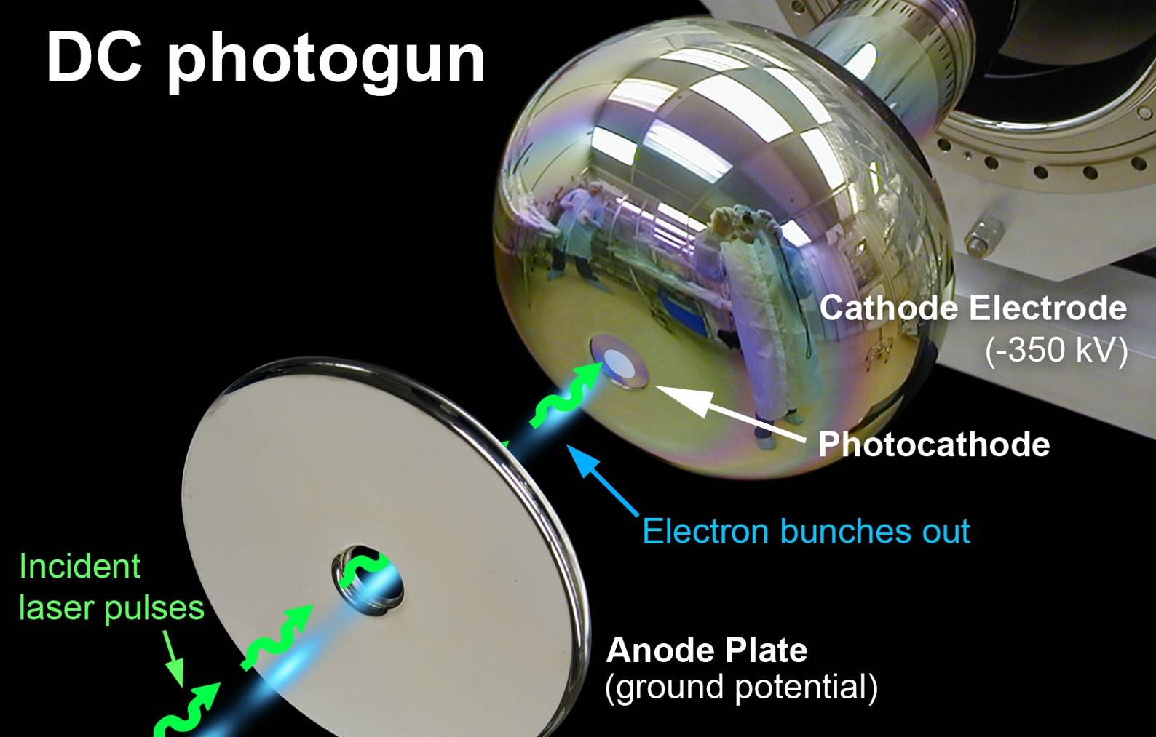
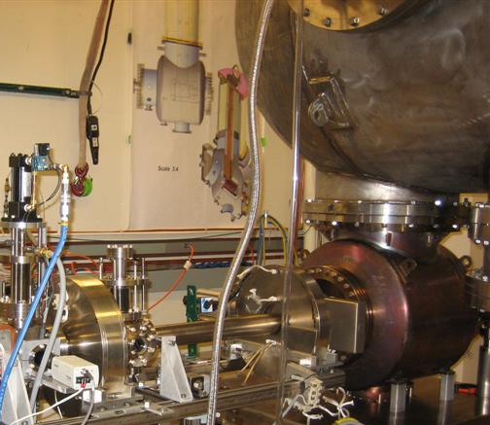
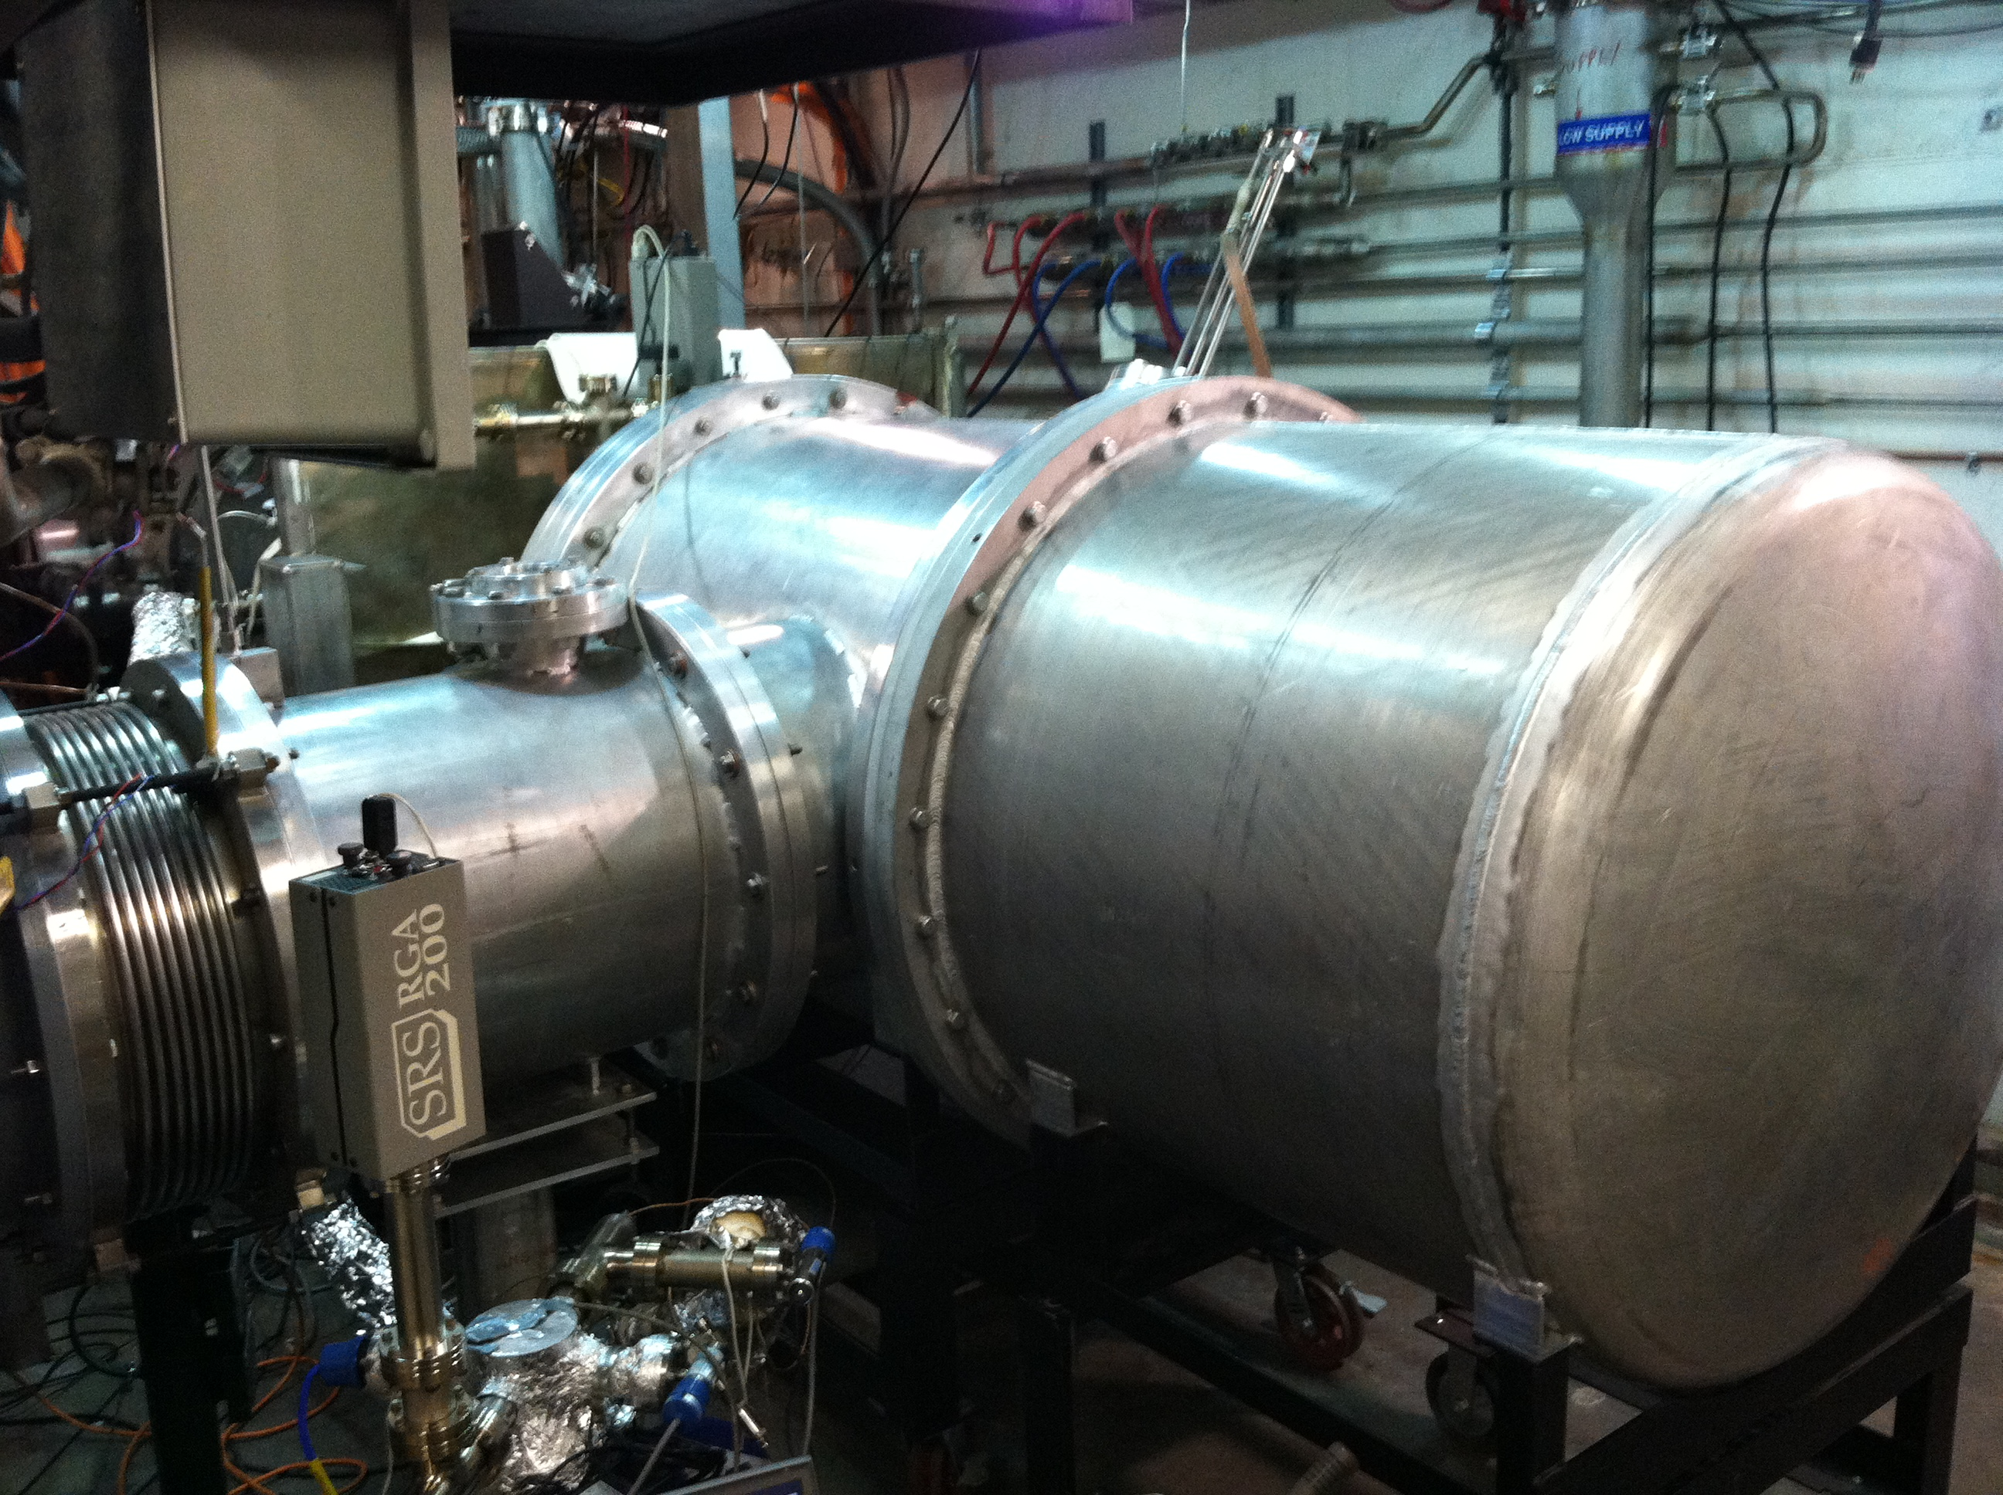
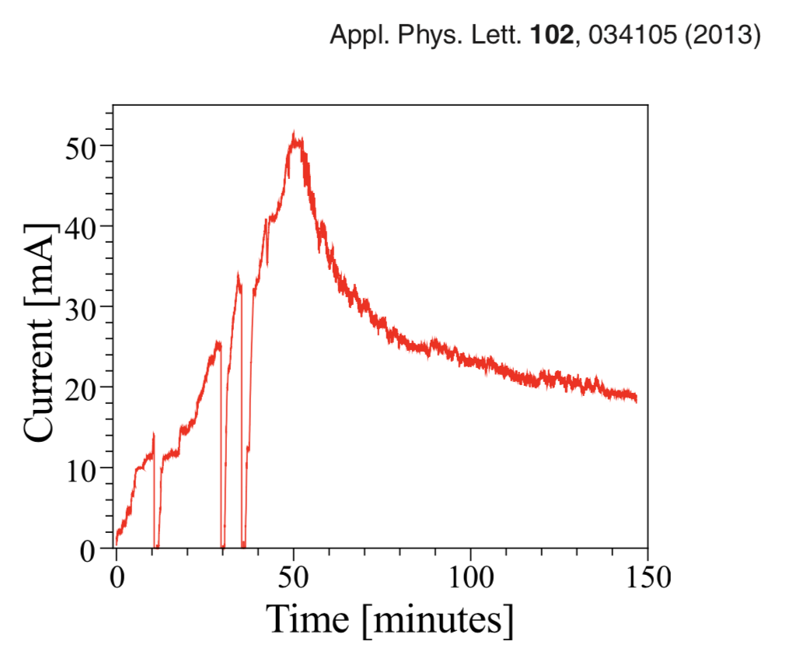
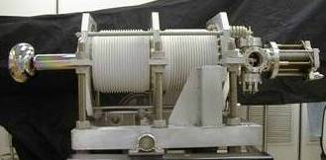
DC guns have demonstrated mA CW beam current from GaAs
JLab 10 kW Upgrade IR FEL DC gun
Gun operating voltage: 350 kV
Sustained beam current: 8 mA CW at 532 nm
Photocathode lifetime at 5 mA CW: 550 h
Total charge extracted from a single bulk GaAs photocathode: 7000 C
Cornell DC gun
Gun operating voltage: 250 kV
Max beam current: 52 mA CW at 532 nm
Total charge extracted from a single bulk GaAs spot: 200 C
Total CW beam time delivered by a single GaAs wafer: 900 h
Vertical SF₆ tank
Horizontal SF₆ tank
B. Dunham et al., “Record high-average current from a high-brightness photoinjector”, Appl. Phys. Lett. 102, 034105 (2013)
V. SHUTTHANANDAN et al., “Surface science analysis of GaAs photocathodes following sustained electron beam delivery”, Phys. Rev. ST Accel. Beams 15, 063501 (2012)

Slide 3

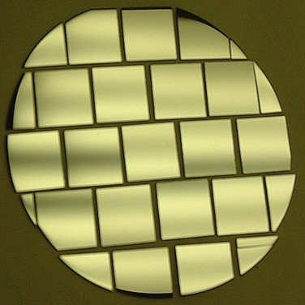
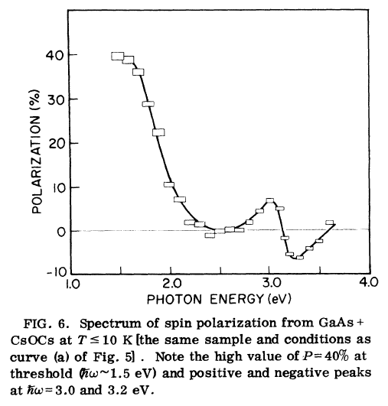
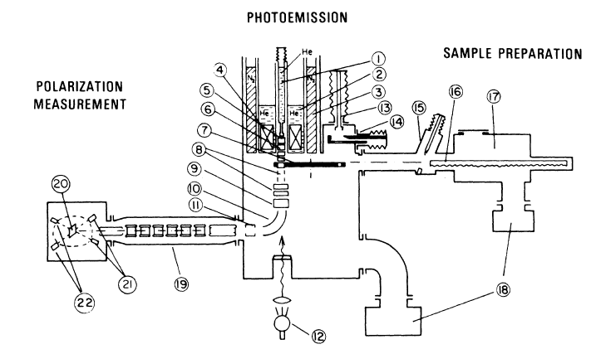
First Observation of Polarization from GaAs reported in 1976
Diced GaAs wafer
530 nm
QE
polarimeter
780nm
bias
vacuum
light

Slide 4
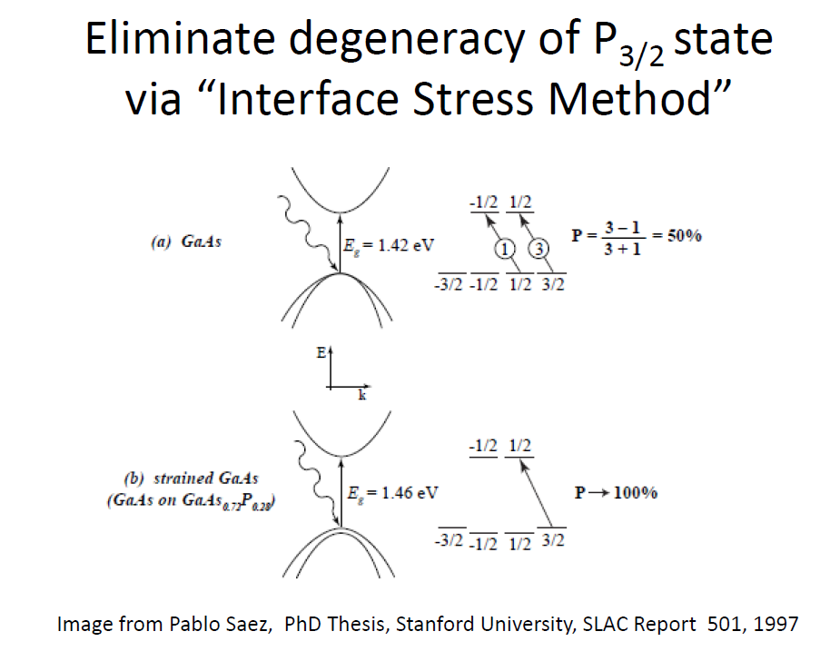
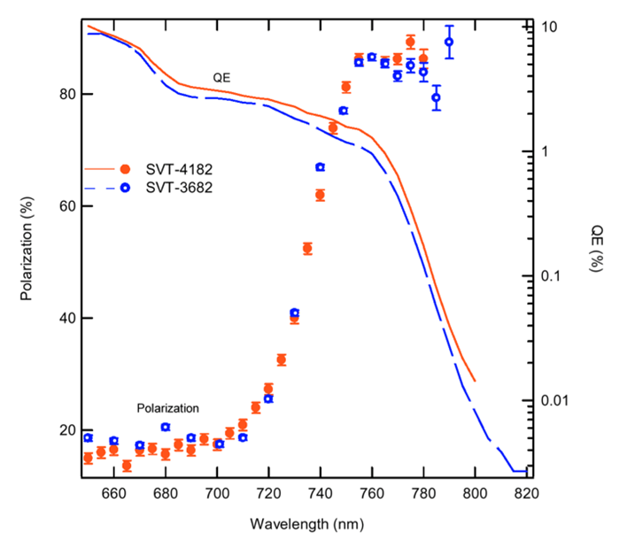
High Polarization GaAs Photocathodes
Strained Superlattice Photocathode
Bulk GaAs
Max P=50%
100 nm
Active Region
GaAs_{0.64}P_{0.36}
Buffer
2.5μm
GaAs_{(1-x)}P_{x} Graded Layer
2.5μm
GaAs Substrate
Strained GaAs
Split degeneracy
Max P=100%
QE 1% and Polarization 85%
From Aaron Moy, SVT Assoc and SLAC, PESP2002
Images: Pablo Saez PhD Dissertation, Stanford 1997

Slide 5
CEBAF : spin polarization from GaAs photocathodes
GaAs photocathodes with both high QE and POL is the enabling technology.
Polarization measured by Mott polarimetry at 5 MeV (sampled from beam)
Reliable
expectation
….…
Reliable
expectation

Slide 6
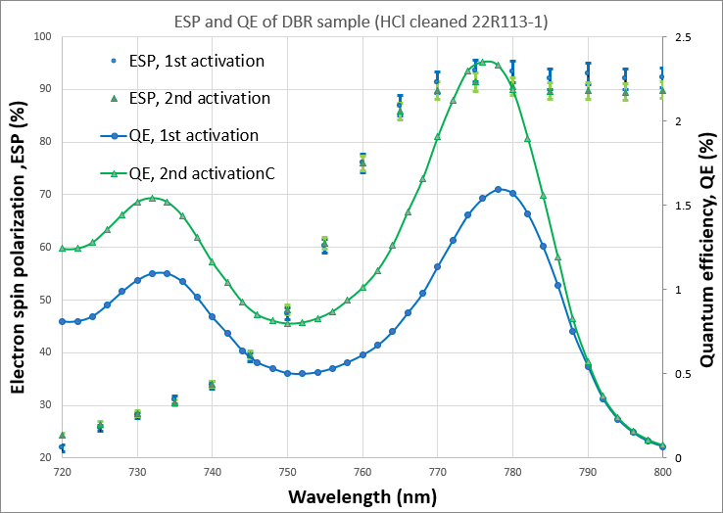
Diffracted Bragg Reflector (DBR) superlattice
W. Liu, S. Zhang, M. Stutzman, M. Poelker, Y. Chen, W. Lu, and A. Moy, Appl. Phys. Lett. 109, 252104 (2016)
July 2022 (unpublished) results of collaboration between Old Dominion University, Brookhaven National Lab and Jefferson Lab
MOCVD growth of DBR-SLSP by industrial partner
  QE > 2%
  Polarization > 90%
> 10 mA/W

Slide 7
Polarized electron source landscape…
Prepared table Spring 2022 for Snowmass workshop on Electron Sources …
CW < 1 pC
(< 200 μA)
Pulsed > 1 nC
(< 100 μA)
CW < 1 nC
(> 1000 μA)
Older sources
Newer sources

Slide 8

CEBAF 12 GeV : cw high-energy electron accelerator
Spin polarized electron beams for over 25 years...
Parameter | Value
Topology | Recirculating LINACS (1– 5.5 pass)
Multiplicity | 4 halls
Energy | 11 GeV (ABC) / 12 GeV (D)
Duty Factor | 100% (1.497 GHz)
Intensity | 170 μA (1 MW dumps)
Polarization | >85%
Helicity | 2 kHz
Photoinjector (123 MeV SRF)
1.1 GeV SRF LINAC
D
A
B
1.1 GeV SRF LINAC
C

Slide 9

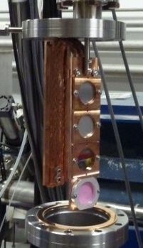
PEPPo : Polarized Electrons for Polarized Positrons
The spin transfer from e⁻ to e⁺ was tested in a feasibility experiment at CEBAF in 2012
J. Grames, E. Voutier et al.,JLab Experiment E12-11-105 (2011)
8 MeV, 1μA, 85% polarization
Record for linac positron polarization.
P(e+) = 82.2 %
Tungsten (1mm)
Efficiency >95%
PEPPo possible due to support from SLAC E166, DESY, Princeton, Cornell, International Linear Collider Project and the Jefferson Science Associates
D. Abbott et al., Phys. Rev. Lett. 116 (2016) 214801

Slide 10
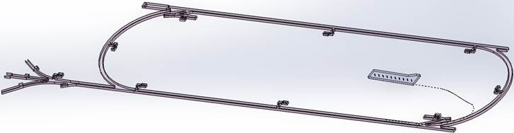

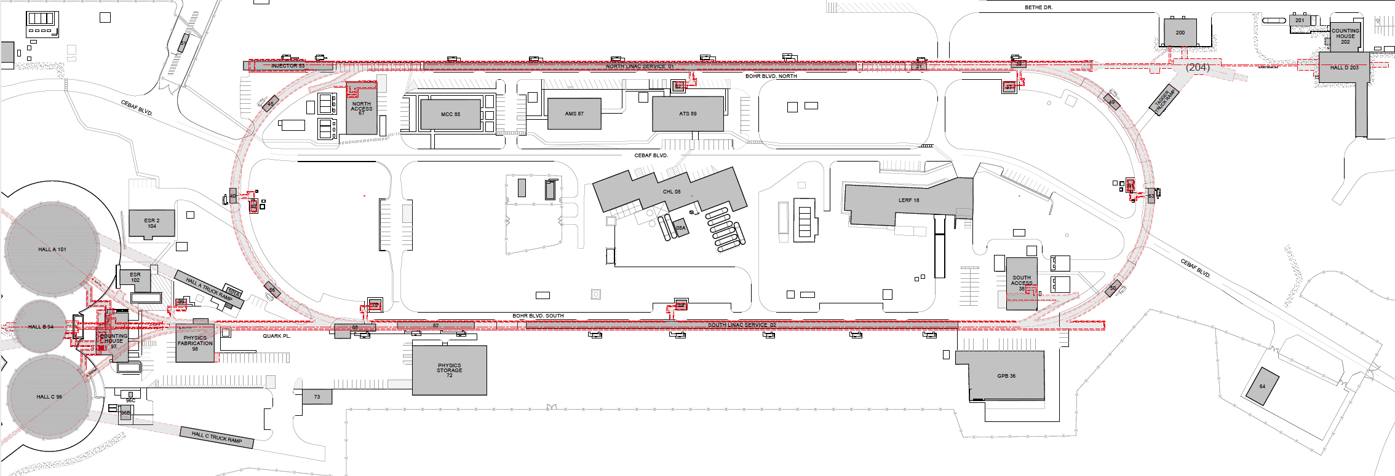
What next ?
We have been evaluating where to build & stage a new 123 MeV e⁺ injector…
…many of us imagined constructing a new vault here.
123 MeV
123 MeV

Slide 11
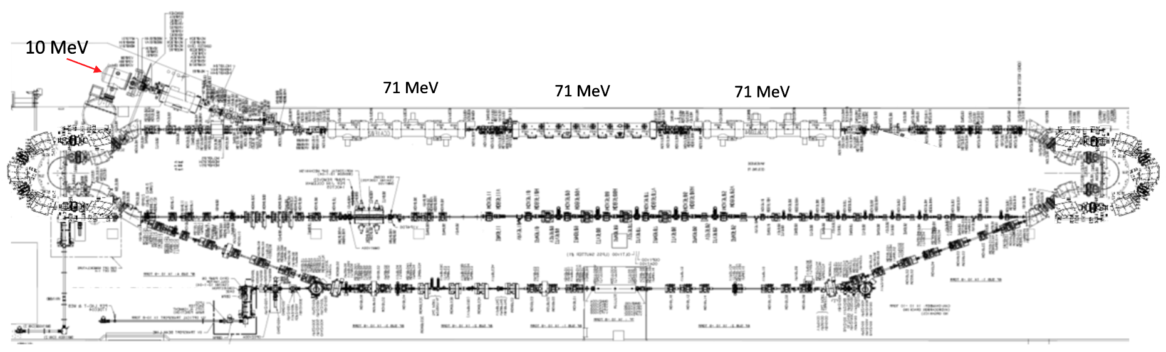
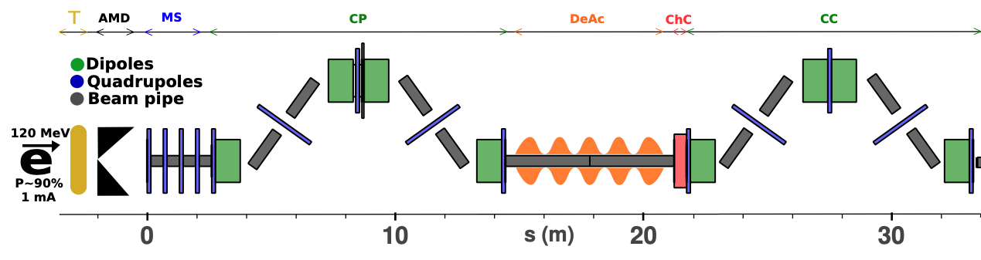
PEPPo II : Polarized e⁺ Prototype Experiment
Next, we want to build a scalable polarized positron injector at LERF to demonstrate beam
  300 kV polarized gun + Wien filter, demonstrate > 1kC lifetime at milliamp current
  Build up the SRF e- injector 50 – 100 MeV
  Ramp up efforts for high power target 50 – 100 kW, e+ collection and compression
  Complete start-to-end concept in FY23
#1 – Compact P-Gun, Wien filter, 10 MeV e- injector
#6 – SRF accelerate e+ to 123 MeV
#2 - SRF accelerate 60-120 MeV
#5 – Injector e+ to linac
#3 – Extract e- to target
#4 - Produce e+ accelerate to 50-70 MeV
#7 – Transport e+ at 123 MeV to exit LERF
A e⁺ collection efficiency of 10⁻⁴ requires polarized e⁻ intensities > 1 mA for a program
11

Slide 12
Can the CEBAF photo-gun support an e⁺ program?
Positively biasing the photo-gun anode has had a tremendous impact on JLab gun lifetime.
PhD work of J. Yoskowitz in preparation for PR-AB
With a >400 C lifetime we could operate at 1 mA for almost 1 week

Slide 13
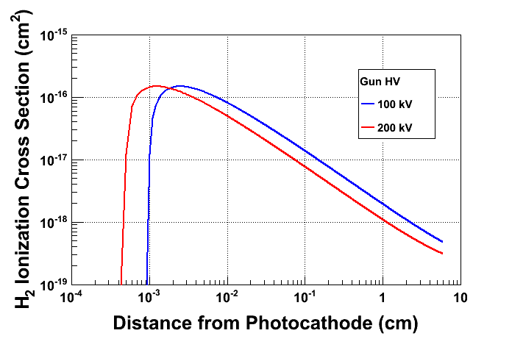
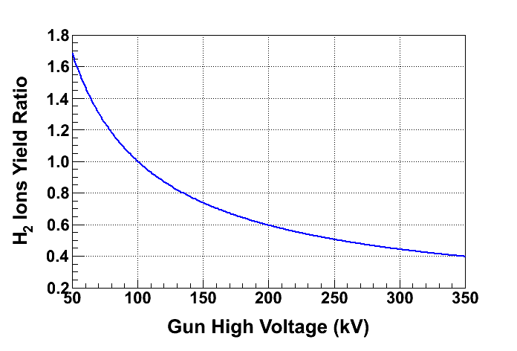
Optimizing the gun voltage for charge lifetime
What about the cathode potential, i.e. is there is “best” potential for increasing charge lifetime?
Ion generation largest here
Fewer ions created as gun voltage increases

Slide 14
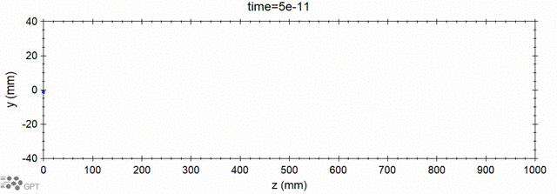
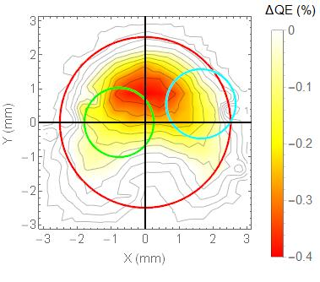
Modeling ion generation and bombardment
GPT custom element IONATOR simulates electron-impact ionization of residual beam line gasses and tracks outgoing particles.
Simulations of ion back-bombardment predict ions created within the cathode-anode gap, depositing their energy at the photocathode, closely resembles the measured damage pattern.
e- beam
ions
ejected e-
scattered e-
Simulated
Simulated
Simulation of biased anode
PhD work of Josh Yoskowitz
Measured
QE Loss

Slide 15
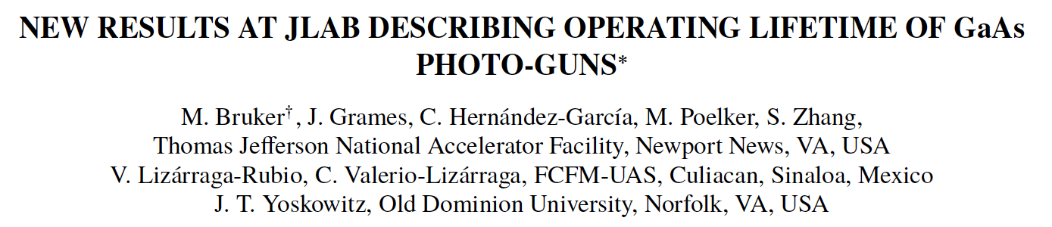
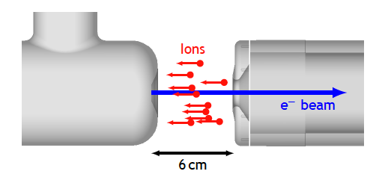
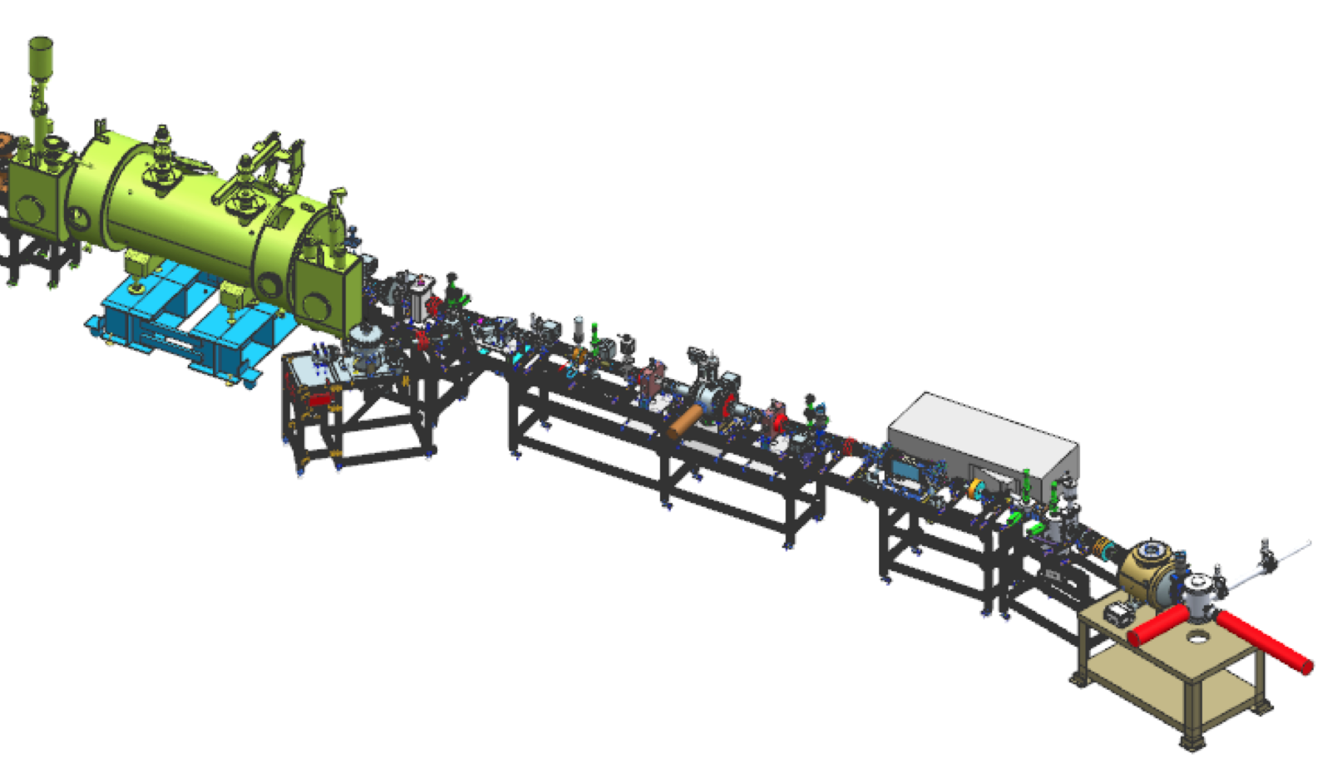
Measuring charge lifetime dependence on cathode potential
Exploratory measurement to map out conditions for an experiment at the UITF.
Biased
100 vs. 180 kV
NA-PAC 2022 (WEPA13)

Slide 16



PES: reducing ion surface density to increase lifetime
Increasing laser beam size at photocathode has increased charge lifetime…
J. Grames, et al., Phys. Rev. ST Accel. Beams 14 043501 (2011)
Bulk 532nm
GaAs/GaAsP 780nm

Slide 17
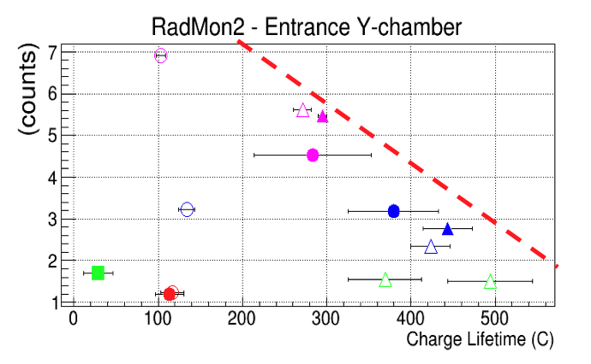
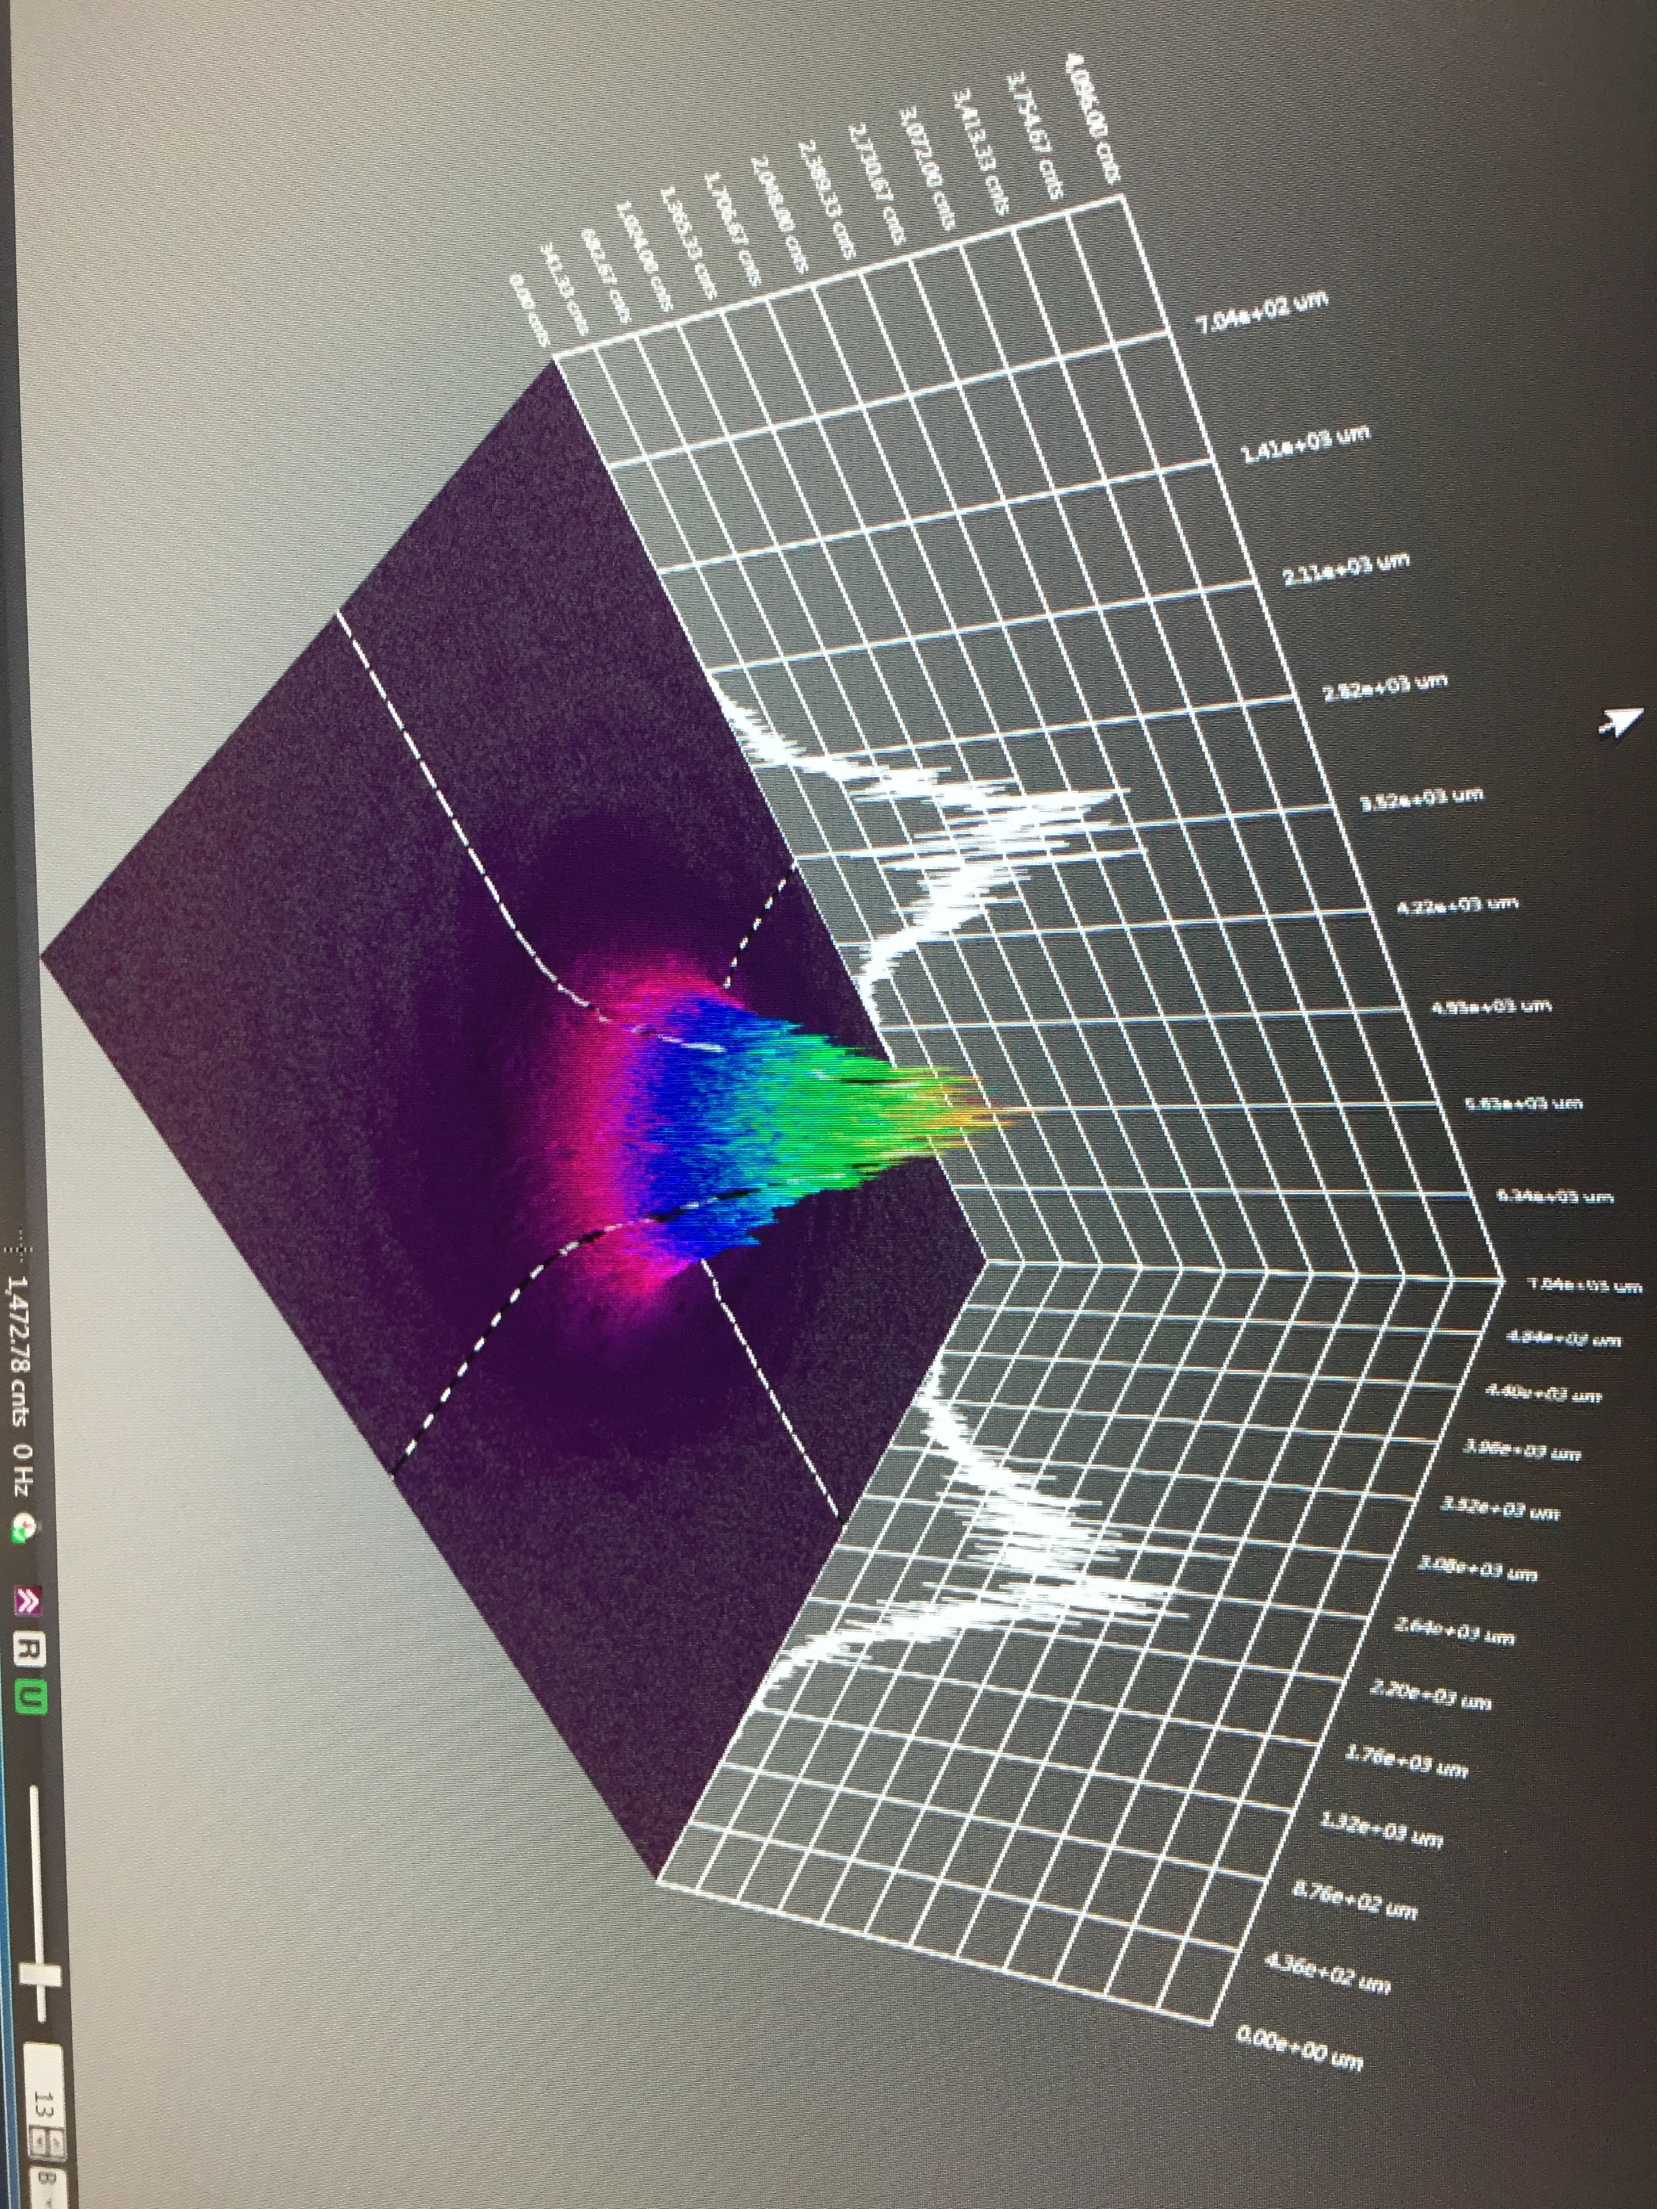

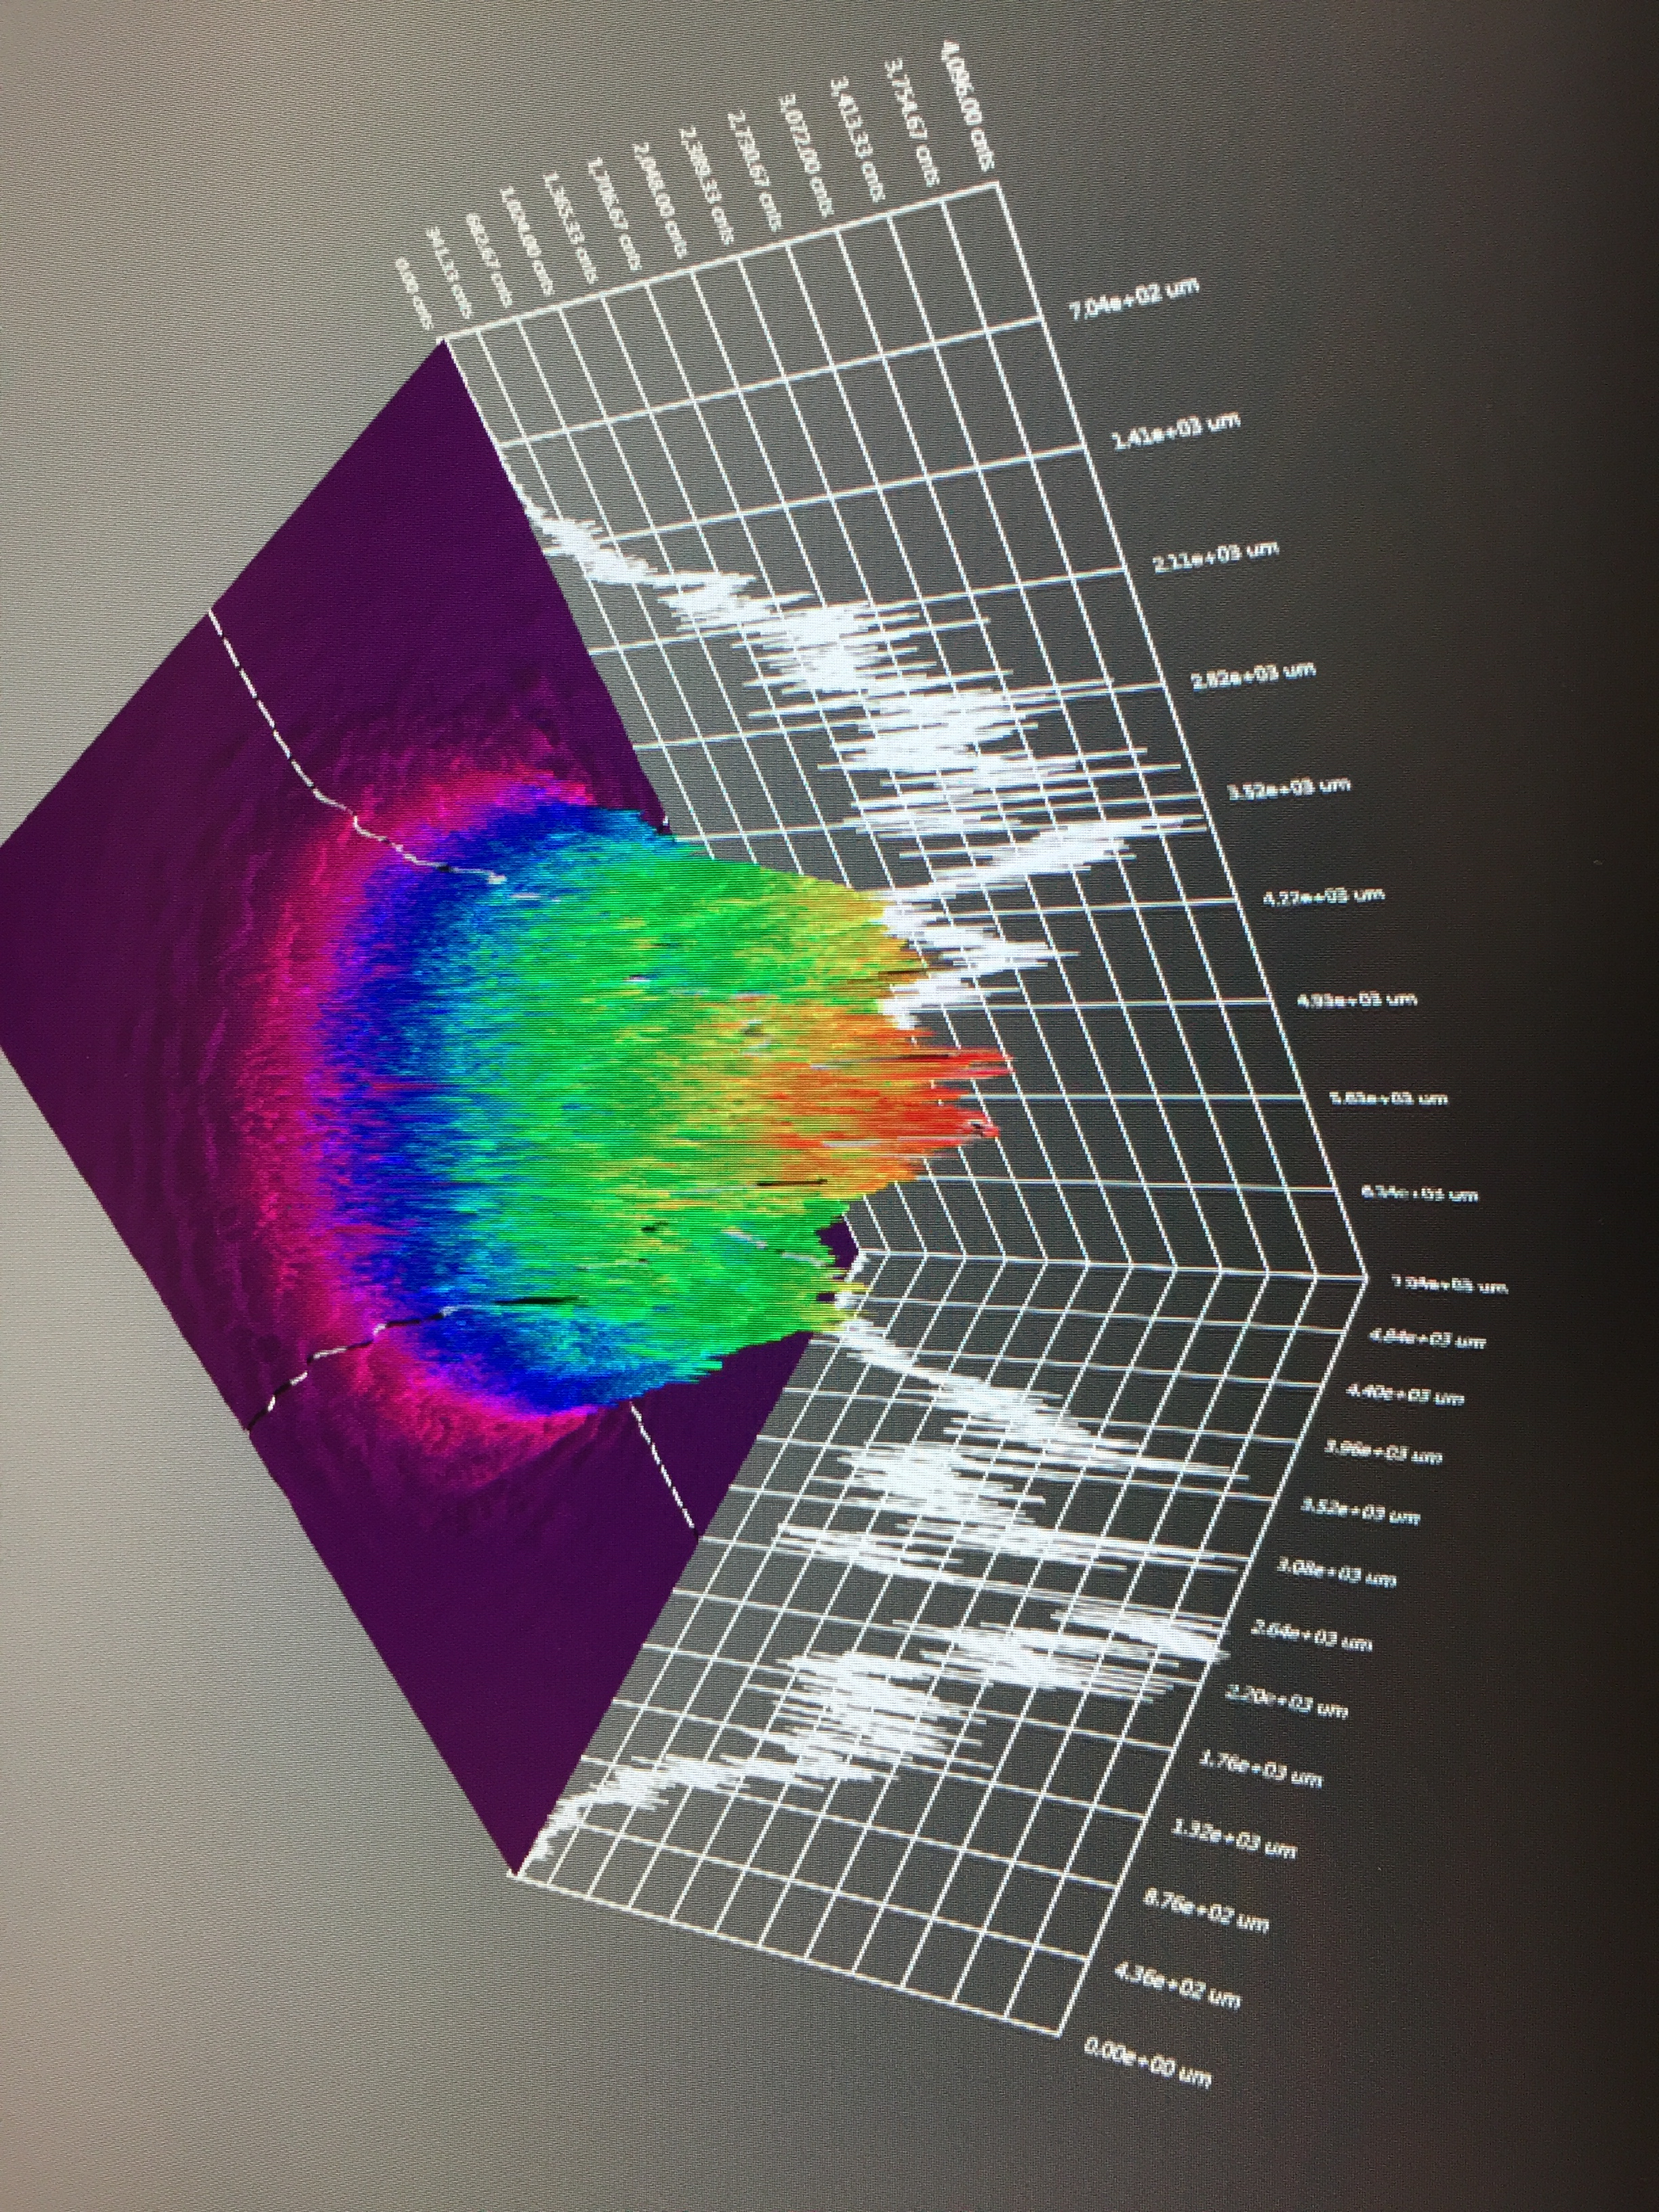
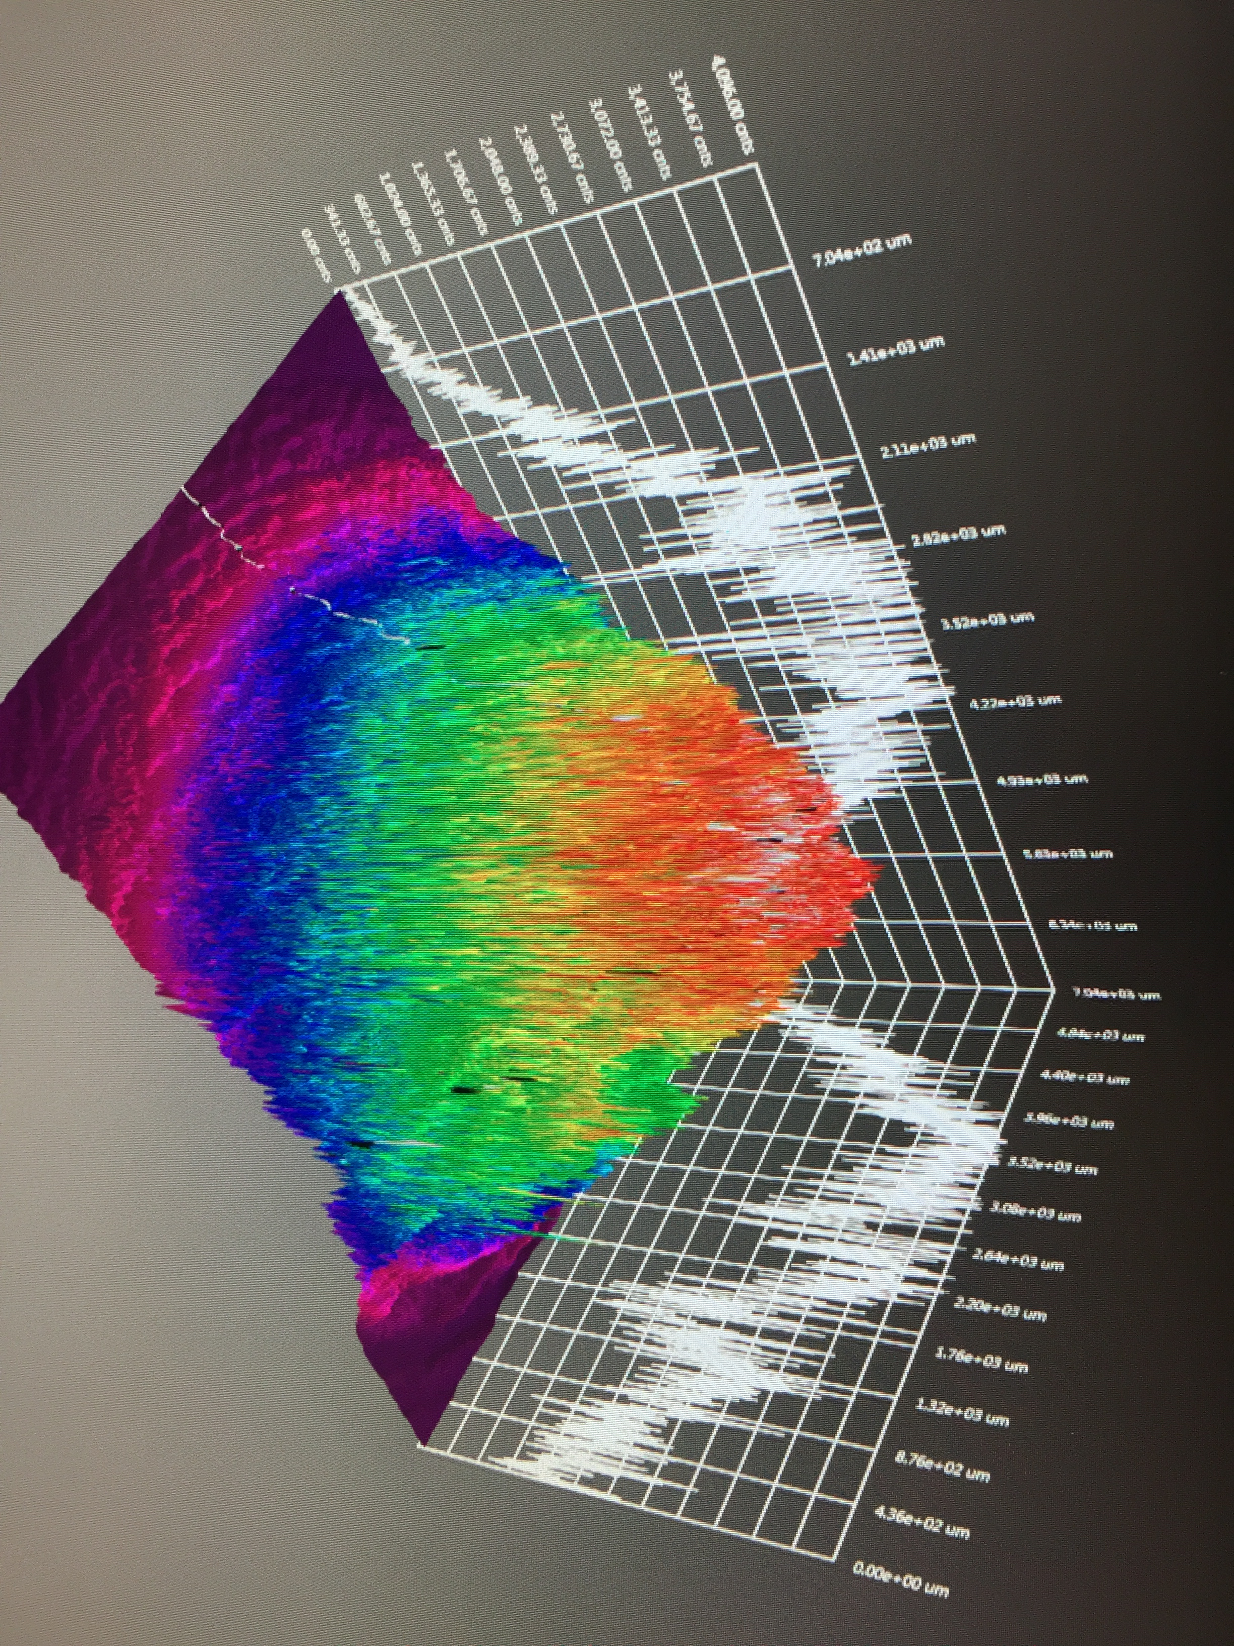
GaAs/GaAsP charge lifetime at milliamp current
Results from PSTP’17 suggests increasing laser spot size is viable to exceed >500 C lifetime; however we need to build another gun to test this assertion.
J. Grames, P. Adderley, J. Hansknecht, R. Kazimi, M. Poelker, D. Moser, M. Stutzman, S. Zhang, “Milliampere beam studies using high polarization photocathodes at the CEBAF Photoinjector” Polarized Sources, Targets and Polarimeters Workshop, Dajeon South Korea (2017)
Measurements were performed without anode biasing
Days
Trend we want to realize

Slide 18
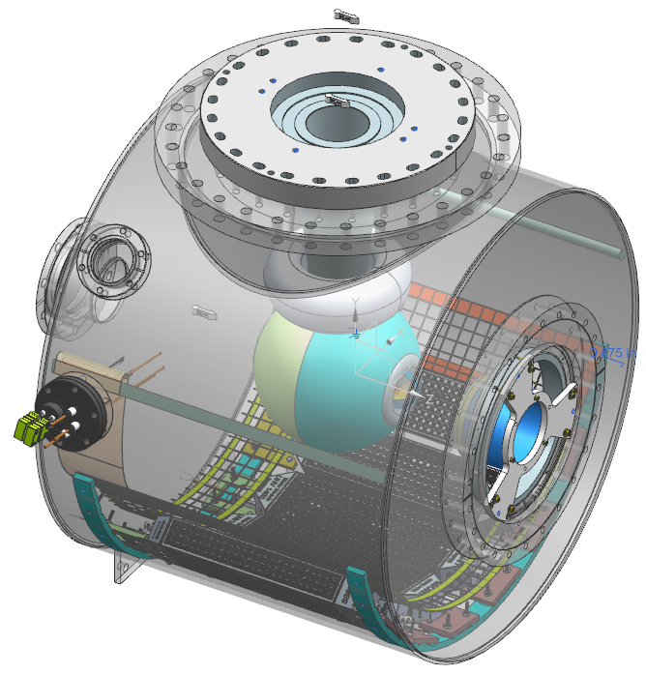
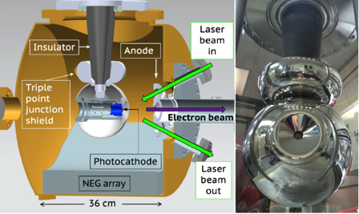
Build a mA polarized gun for e⁺
  Next, we want to combine our lessons learned and experience with the Magnetized 4mA/300 kV gun and new Polarized CEBAF 200 kV gun to build a new third gun optimized for positron generation…
300 kV Magnetized Beam Electron Source (CsKSb)
CEBAF 200 KV Polarized Gun (GaAs/GaAsP)
C. Hernandez-Garcia et al., Phys. Rev. Accel. Beams 22, 113401 (2019)
R30 inverted geometry ceramic insulator
Conditioned to 350 kV
Demonstrated 4.5 mA CW 300 keV
Operate at >200 kV without field emission
HV conditioning >350 kV (uses R30 inverted ceramic insulator)
Dynamic pressure (during beam delivery) ~ 1x10⁻¹² Torr

Slide 19
Summary and Outlook
SLSP GaAs photocathodes have been used to make mA intensity with polarization >85 %.
DBR photocathodes offer >10 mA/W, so cathode cooling may not always be necessary
Biasing anode has increased charge lifetime of GaAs/GaAsP in CEBAF 130 kV gun > 400 C
Increasing laser size affords gains up to ratio of increase – increasing area >5mm² (while managing all the beam) should achieve a charge lifetime > 1000 C in the CEBAF photo-gun.
Optimizing the gun voltage for lifetime remains an important parameter to consider.
It is not unreasonable to imagine sustainable mA beams soon.

