Slide 1
Molecular beam epitaxy of Cs-Sb thin films: structure-oriented growth of high efficiency photocathodes
Alice Galdi
Department of Industrial Engineering
Università degli Studi di Salerno (Italy)
CLASSE, Cornell University

Slide 2


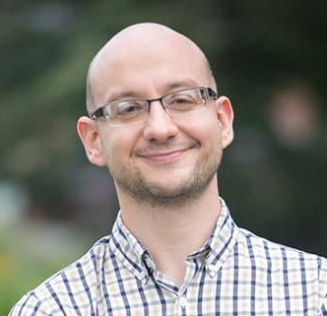
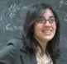
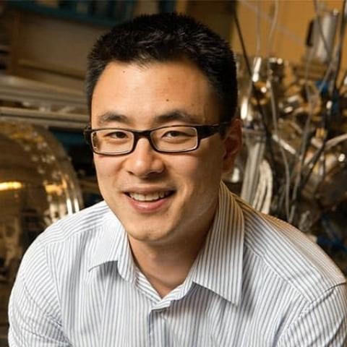
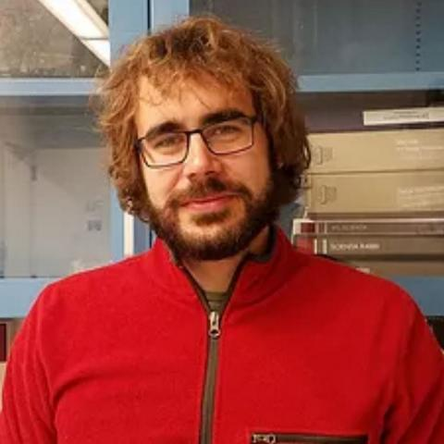

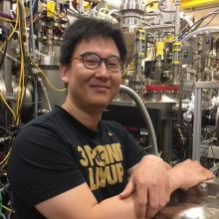

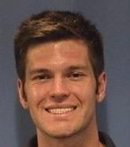


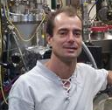

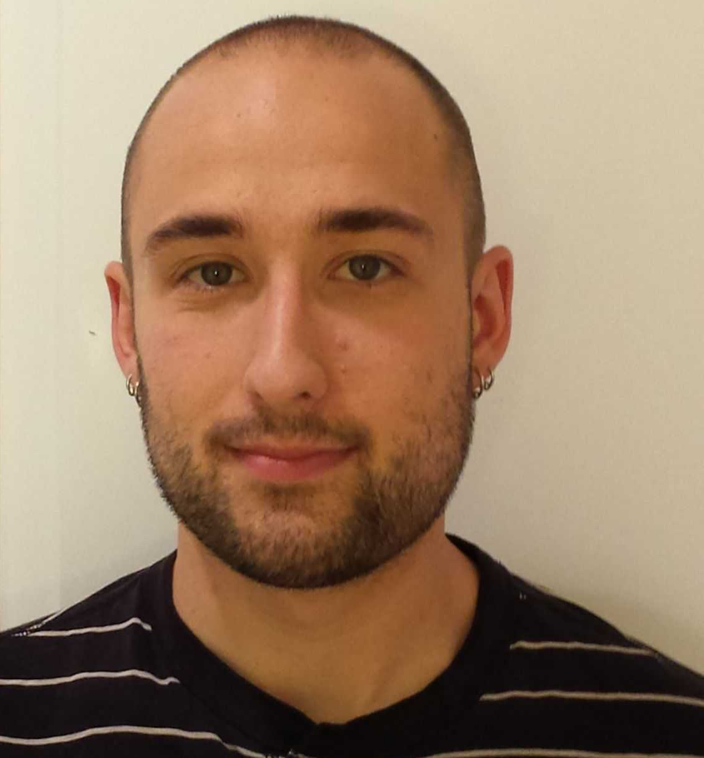
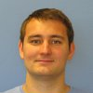
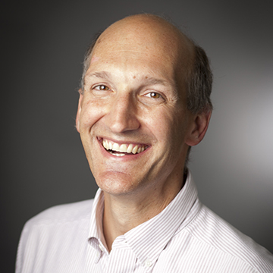

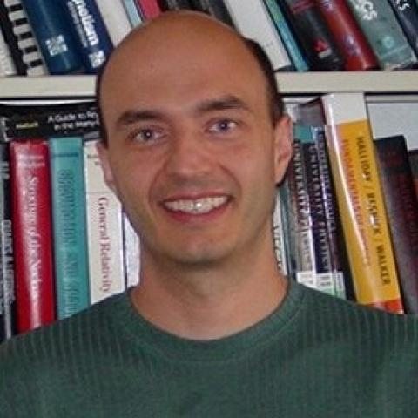
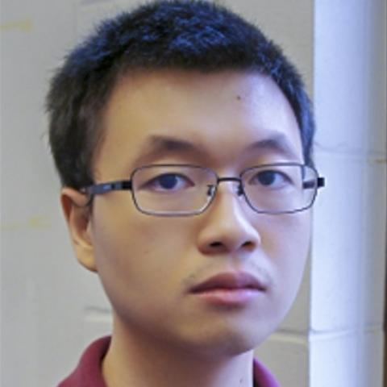
People
Maxson group
Shen group
Jared Maxson
Alice Galdi
Kyle Shen
Chris Parzyck
Vivek Anil
Hanjong Paik
Brendan Faeth
Hines group
Chad Pennington
Elena Echevarria
Cheng Hu
Luca Moreschini
Arias group
Mellissa Hines
Will DeBenedetti
Jan Balajka
Darrel Schlom
Tomàs Arias
J. Kevin Nangoi
https://cbb.cornell.edu/ https://www.paradim.org/

Slide 3
Outline
Motivation:
  Cs₃Sb for brighter electron beams
  Surface disorder and emittance degradation
Methods:
  RHEED monitored molecular beam epitaxy
Results: epitaxy of Cs₃Sb phase! (first time!)
  First band structure measurements of Cs₃Sb thin films
Results: new phase!
  Atomically smooth CsSb films: a visible light photoemitter with enhanced oxygen robustness
Future work and conclusions

Slide 4
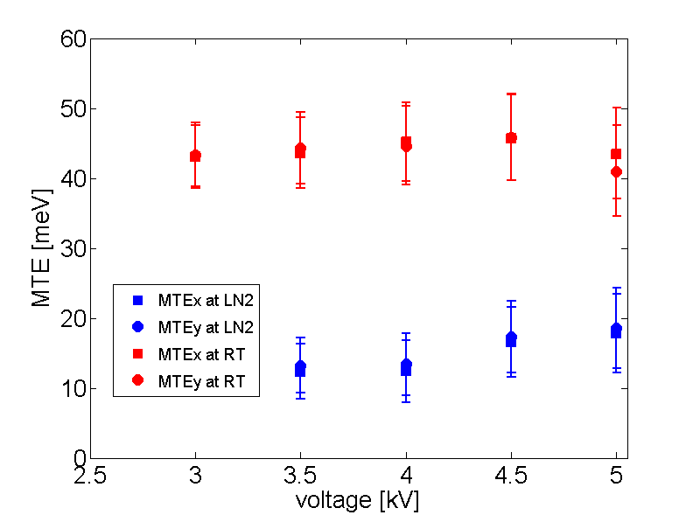
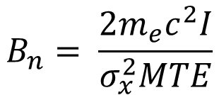
Cs₃Sb for low emittance, high current
Beam current: quantum efficiency, laser fluence, lifetime
$$B_{n}= \frac{2m_{e}c^{2}I}{σ_{x}^{2}MTE}$$
Mean transverse energy: Intrinsic momentum spread + roughness + laser heating + …
Cs₃Sb/Na₂KSb: next generation spin polarized photocathode?
λ=520 nm
λ=690 nm, QE=0.7e-4
~0.3 mm mrad
~25 meV at 300 K
~8 meV at 90 K
B. Dunham et al. APL 102, 034105 (2013)
L. Cultrera et al., Phys. Rev. STAB 18 (2015) 113401
V.S. Rusetsky et al, arXiv:2205.03693 [cond-mat.mtrl-sci]

Slide 5
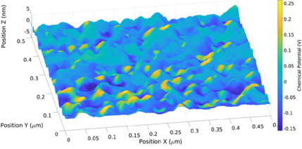
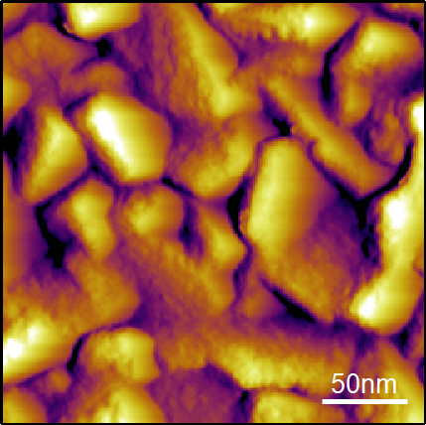
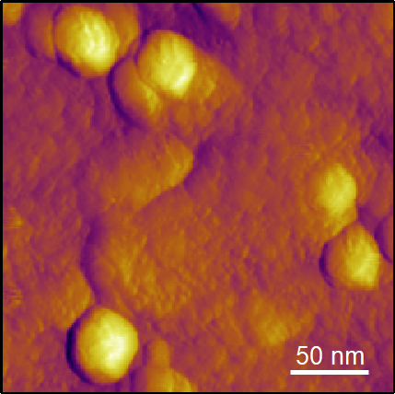
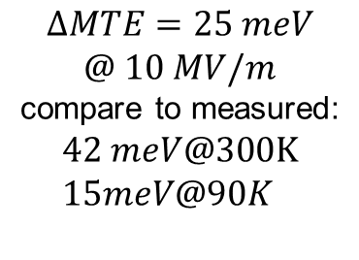
Drawbacks: reactive, disordered
λ=504 nm
Why does this matter for applications?
Because both heterogeneity enhaced by oxidation and roughness degrade MTE
(besides QE degradation in poor vacuum)
$$ΔMTE=25 meV$$
$$@ 10 MV/m$$
compare to measured:
$$42 meV@300K \\ 15meV@90K$$
σ=2.4 nm
σ=1.75 nm
Measured surface and surface potential of a Cs₃Sb photocathode
G. S. Gevorkyan, PRAB 21, 093401 (2018)
A. Galdi, et al. The Journal of Chemical Physics 153,144705 (2020)
A Galdi, et al. Applied Physics Letters 118 (24), 244101

Slide 6
Single crystalline photocathodes: epitaxy
Epitaxy is the growth of a crystal layer with one or more well-defined orientations with respect to an underlying crystal seed layer (usually a single crystal substrate)
Epitaxial single-oriented films would allow:
Roughness control
Orientation control → surface potential control
Measurements of intrinsic properties
(optical constants, band structure, intrinsic MTE…)
Cs
flux
Sb
flux
Choose the method: MBE
Select suitable substrates
Identify suitable growth conditions
Epitaxial
layer
adsorption
re-evaporation
diffusion
Substrate
nucleation
reaction-interdiffusion

Slide 7
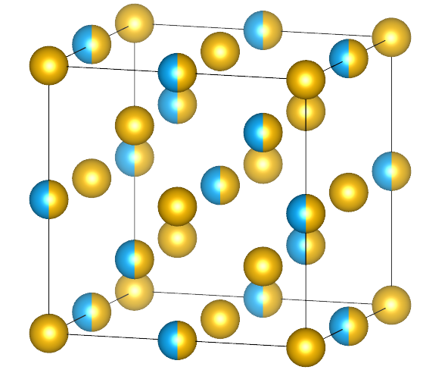

Cs₃Sb structure and possible epitaxial relations
Jack and Wachtel (1957)
$$Fd\overline{3}m$$
Based on previous studies, we selected 3C-SiC as substrate
(but also tested: TiO₂ , MgF₂)
A Galdi, et al. Applied Physics Letters 118 (24), 244101
1x Sb +3x Cs
<100>
1x Sb +3x Cs
1x Sb +3x Cs
≈5%
1x Sb +3x Cs
Sb³⁻
Cs⁺
Sb³⁻
Cs⁺
1 X Cs₃Sb (a=0.9165 nm)
4 X SiC (a=0.436 nm)
≈
≈-1%

Slide 8
Previous results
Our work builds on many experimental results obtained via in-operando characterization of the growth of alkali antimonide thin films with different techniques.

Slide 9
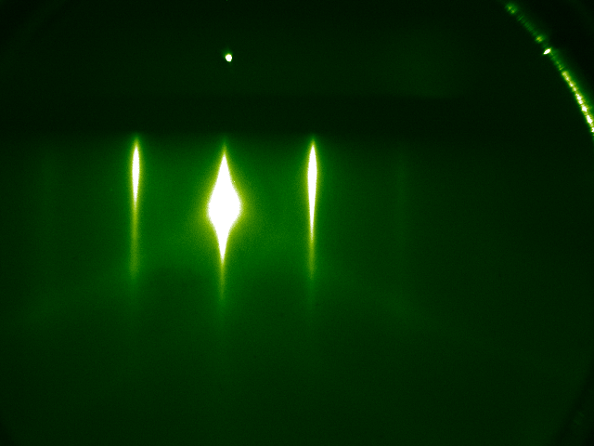
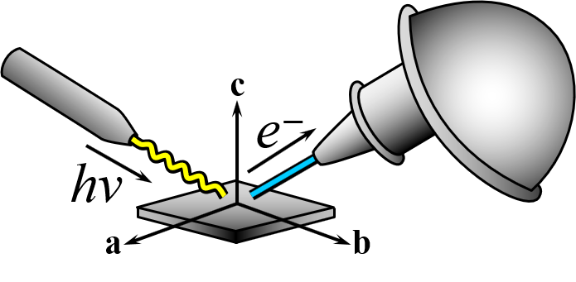

RHEED assisted MBE @ PARADIM
PARADIM Thin Film User Facility
Molecular Beam Epitaxy System
  In Operando high energy electron diffraction (RHEED)
  P_{base} = 2x10⁻⁹ torr
Sample Transfer System
  In Situ Quantum Efficiency Station (biased pickup coil)
  P_{base} = 1x10⁻⁹ torr
ARPES/XPS System
  Scientia DA30 electron analyzer
  Fermi Helium Plasma discharge lamp
  Specs XR50 Al/Mg X-ray source
  P_{base} = 7x10⁻¹¹ torr
Reflection High Energy Electron Diffraction
(RHEED)
Sample
15kV e⁻ gun
Detector
MBE loadlock
Angle Resolved Photoemission Spectroscopy
(ARPES)
ARPES
XPS
LEED
MBE
w. RHEED
STORAGE
Helium plasma discharge lamp
hv=21.22, 40.81 eV
(+X-ray tube
Mg/Al anode
1.254/1.487 keV)
Transfer chamber
Hemispherical electron analyzer
E_{pass} = 2-100 eV
QE measuring station
vacuum suitcase
to UHV STM/XPS
ARPES loadlock

Slide 10
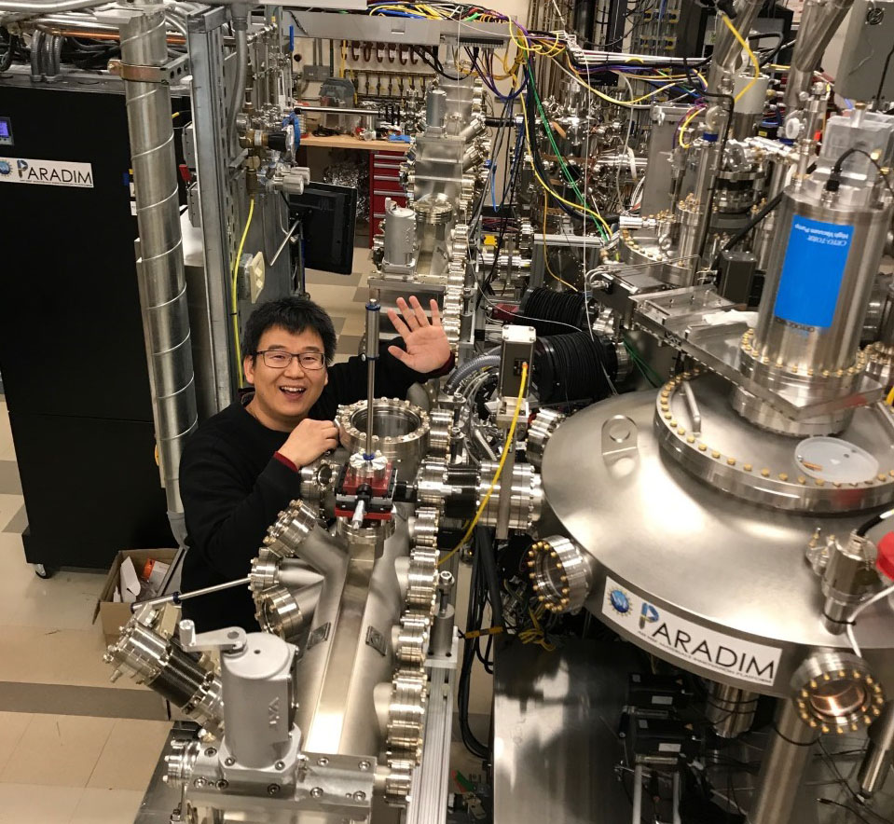
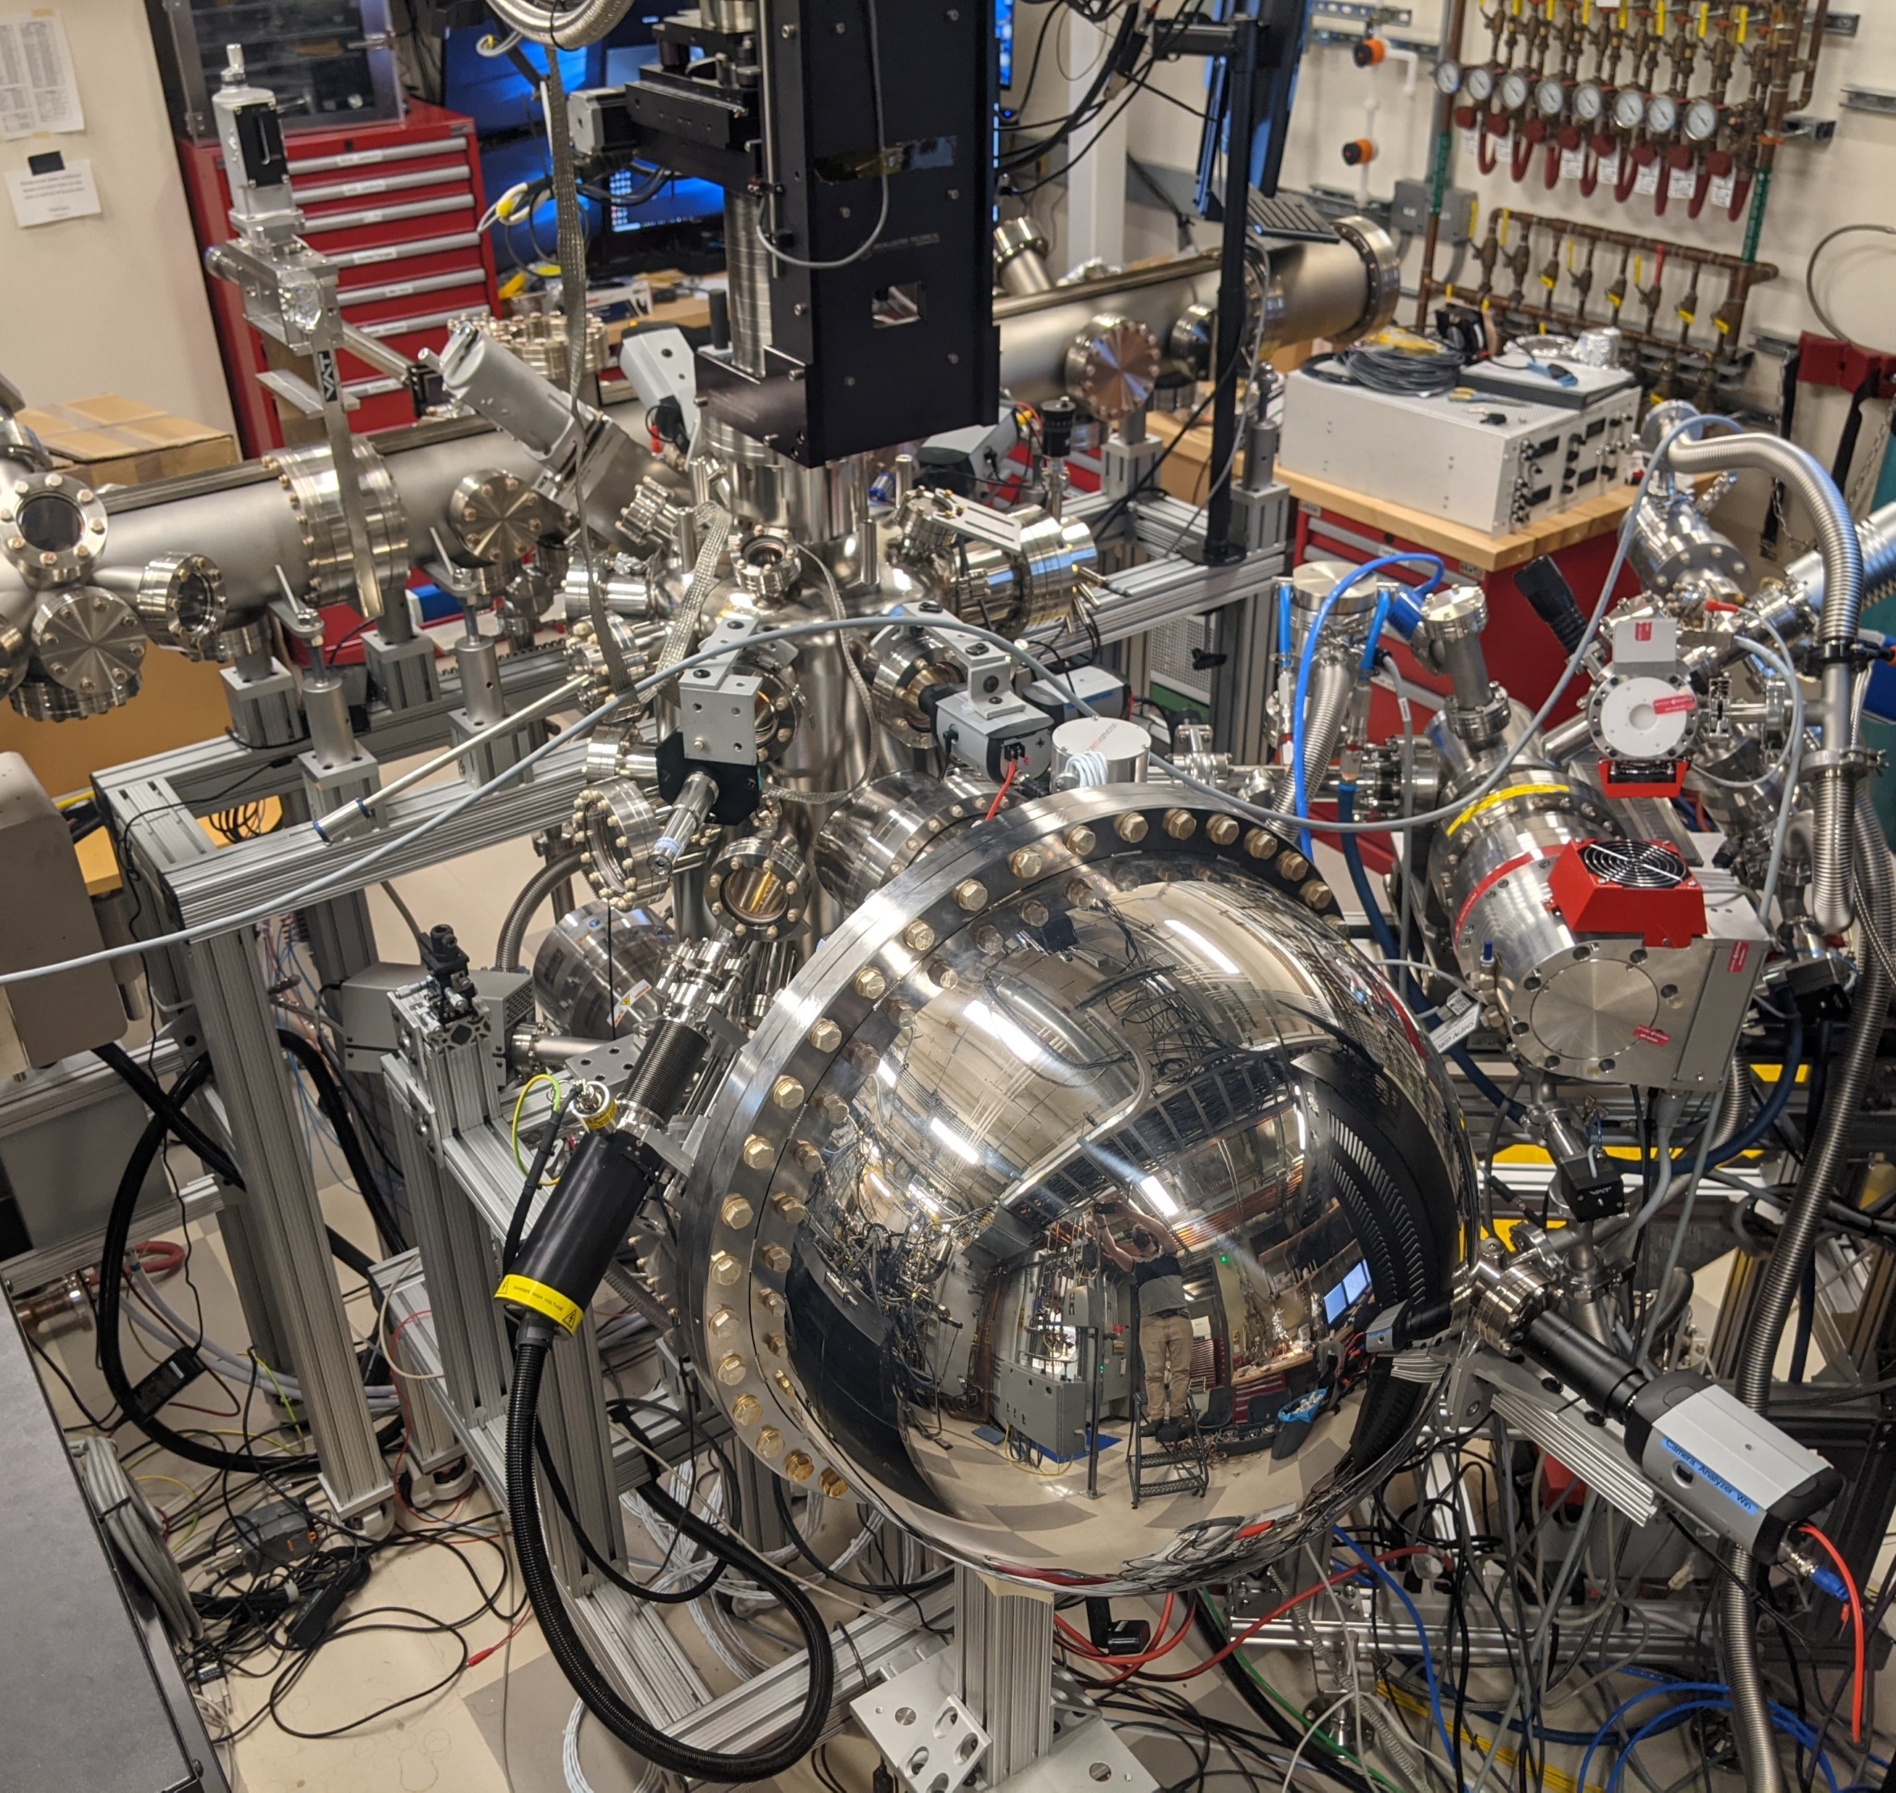
RHEED assisted MBE @ PARADIM
PARADIM Thin Film User Facility
Molecular Beam Epitaxy System
  In Operando high energy electron diffraction (RHEED)
  P_{base} = 2x10⁻⁹ torr
Sample Transfer System
  In Situ Quantum Efficiency Station (biased pickup coil)
  P_{base} = 1x10⁻⁹ torr
ARPES/XPS System
  Scientia DA30 electron analyzer
  Fermi Helium Plasma discharge lamp
  Specs XR50 Al/Mg X-ray source
  P_{base} = 7x10⁻¹¹ torr
Reflection High Energy Electron Diffraction
(RHEED)
Sample
15kV e⁻ gun
Detector
Angle Resolved Photoemission Spectroscopy
(ARPES)
Helium plasma discharge lamp
hv=21.22, 40.81 eV
(+X-ray tube
Mg/Al anode
1.254/1.487 keV)
Hemispherical electron analyzer
E_{pass} = 2-100 eV

Slide 11
The experiment
Typical photocathode growth: Photocurrent monitored
Quantum efficiency oriented
Our growth method:
RHEED monitored
Structure oriented
heater
heater
Substrate
Current
QMB
Substrate
QMB
RHEED
Cs
Sb
Cs/In
Sb
Light source

Slide 12
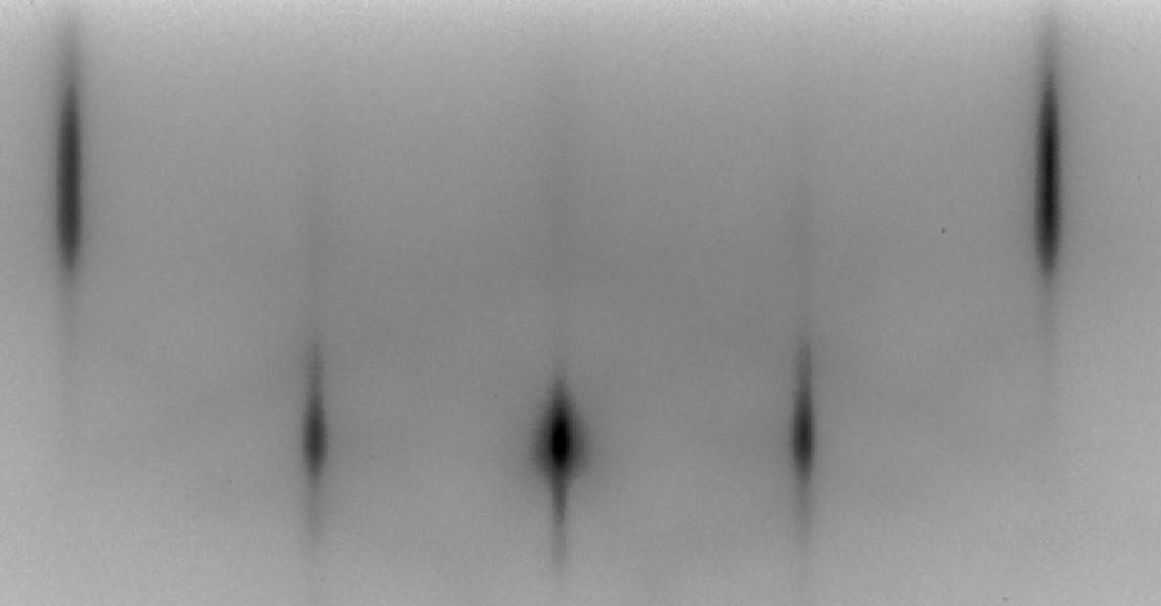
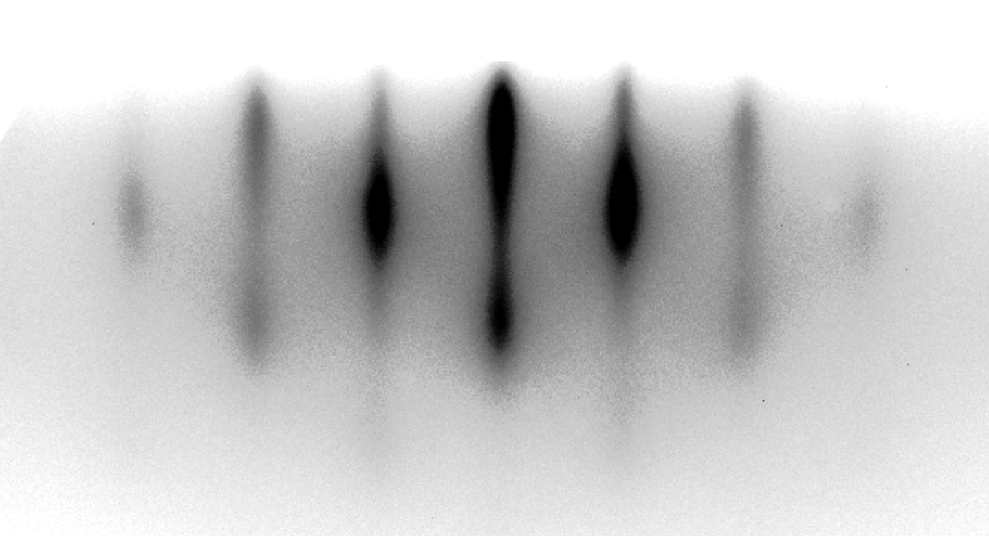
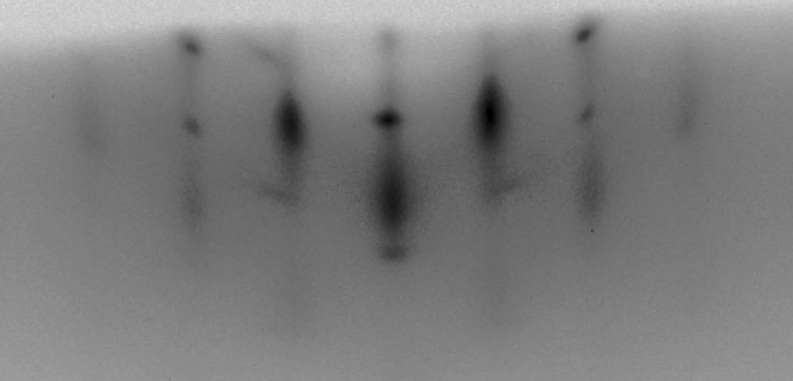
Information provided by RHEED
Φ=0°
Real-time
Sub-ML sensitivity
Qualitative probe of surface roughness and crystallinity
Single crystal
k_{in}
k_{out}
Single crystal
High coherence
Φ=45°
Film
Reduced coherence
Roughened surface
Fluorescent screen
By rotating the sample around its surface normal, we intersect different sets of reciprocal space rods
Film
Polycrystalline domains/impurities
Θ

Slide 13
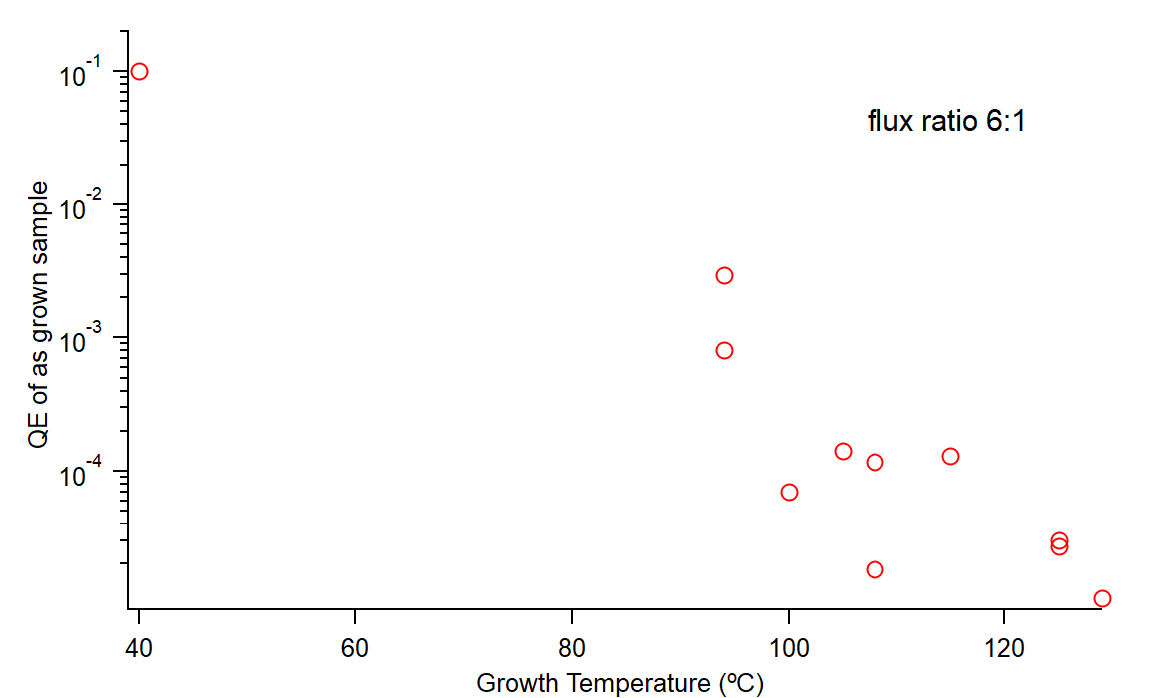
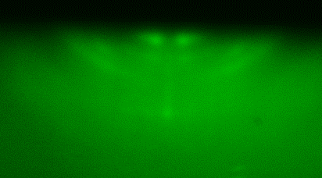
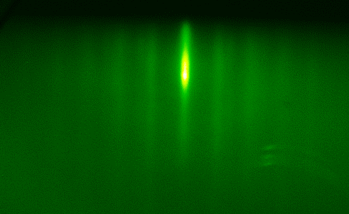
Temperature study: codeposition
Cs-Sb co-deposition on SiC substrates
  Cs:Sb ratio = 6:1 (as measured by Quartz Crystal Microbalance)
Lower Growth Temperature
λ=504 nm
Improved Quantum Efficiency
Polycrystalline Films
Polycrystalline
Rough
Fiber texture
Flat
Higher Growth Temperature
Improved Crystal Order
OOP Film Orientation
Reduced Surface Roughness
Reduced Quantum Efficiency
Low crystallinity
Rough
Notes:
We started the study by observing how the growth temperature affects the samples properties while we deposit at the same time Cs and Sb. The quantum efficiency decreases as we increase the temperature; however, if we look at the structure, we observe that the high quantum efficiency sample is polycrystalline and has a rough surface, the intermediate samples appear to have low crystallinity, but above a certain temperature the structure changes and becomes flat, so that we observe streaks in the rheed pattern. So how can we achieve at the same time a good, ordered crystalline structure and high quantum efficiency?

Slide 14
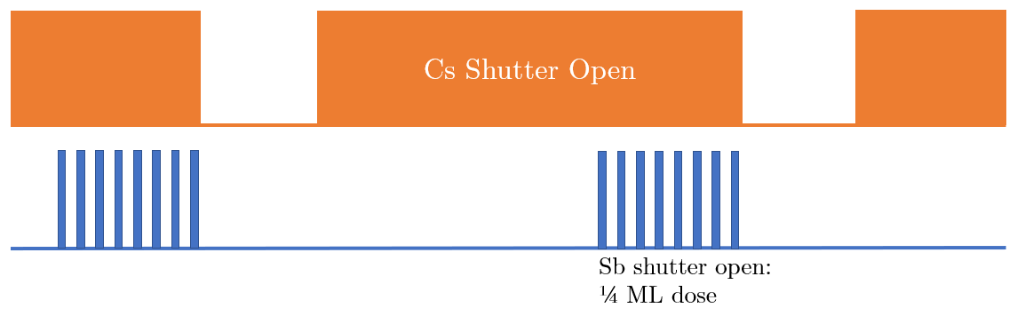

Solid Phase (Molecular Beam) Epitaxy
Low Deposition temperature to take advantage of improved Cs sticking coefficient
High temperature Cs anneal to improve crystallinity
T=85°C
T=40°C
Time

Slide 15
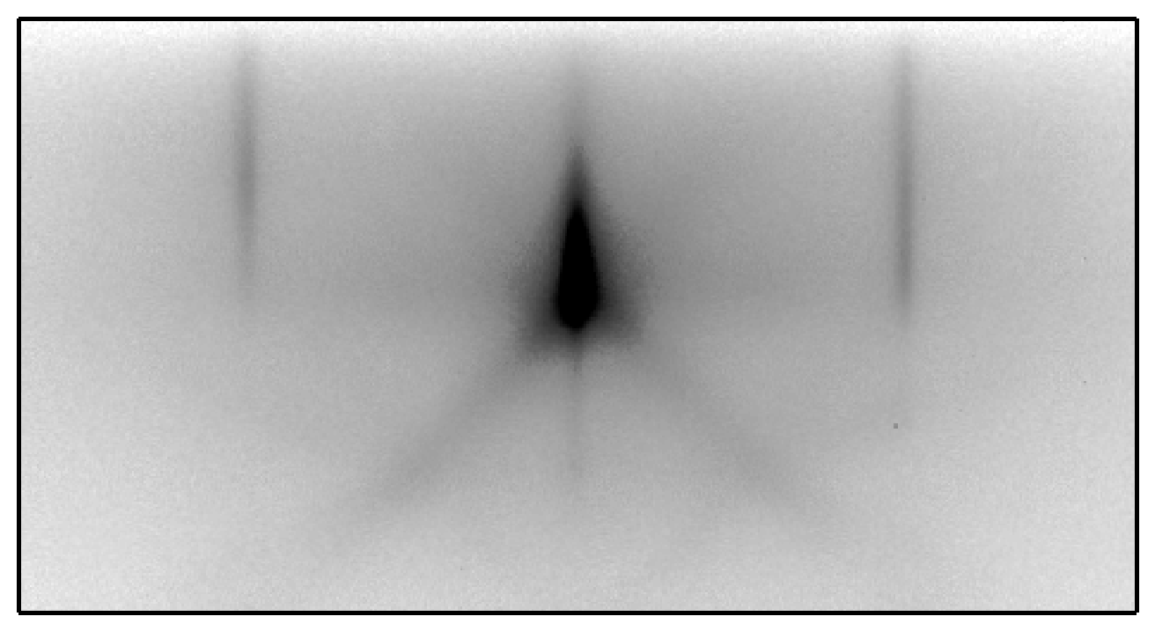
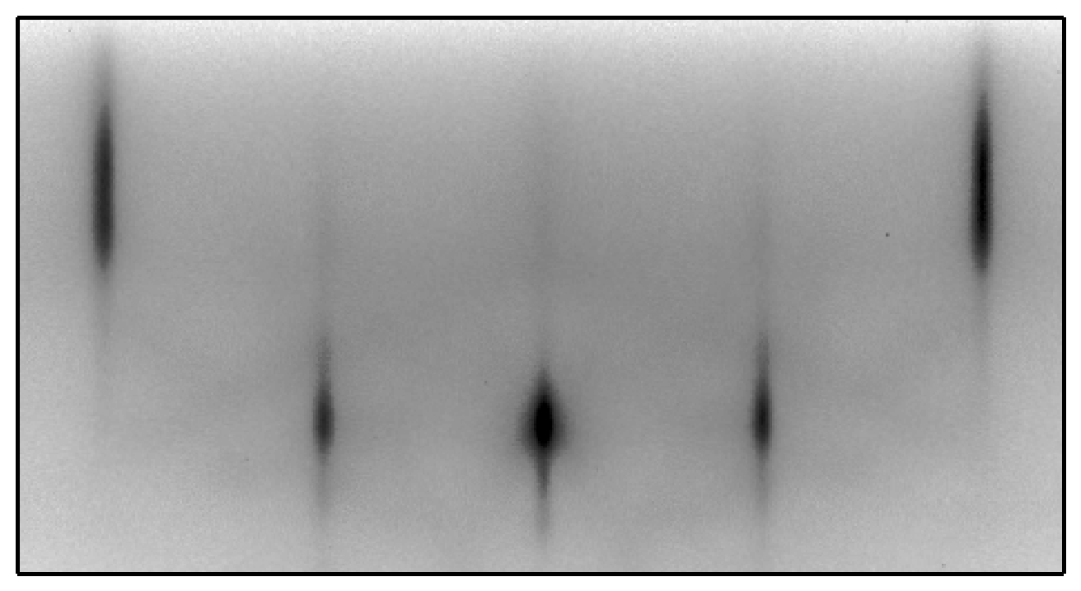
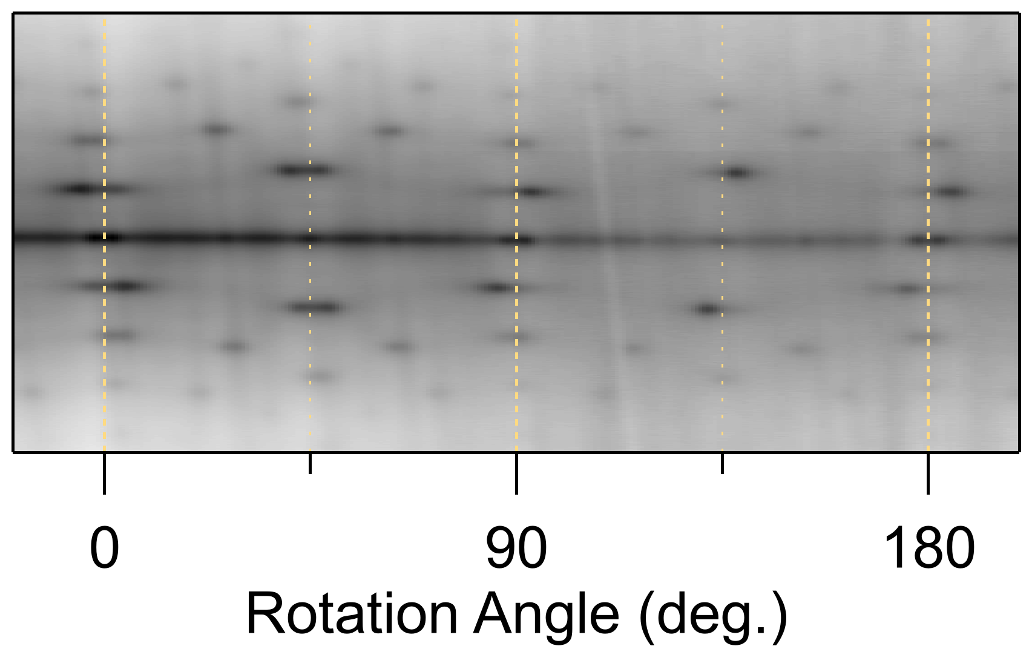
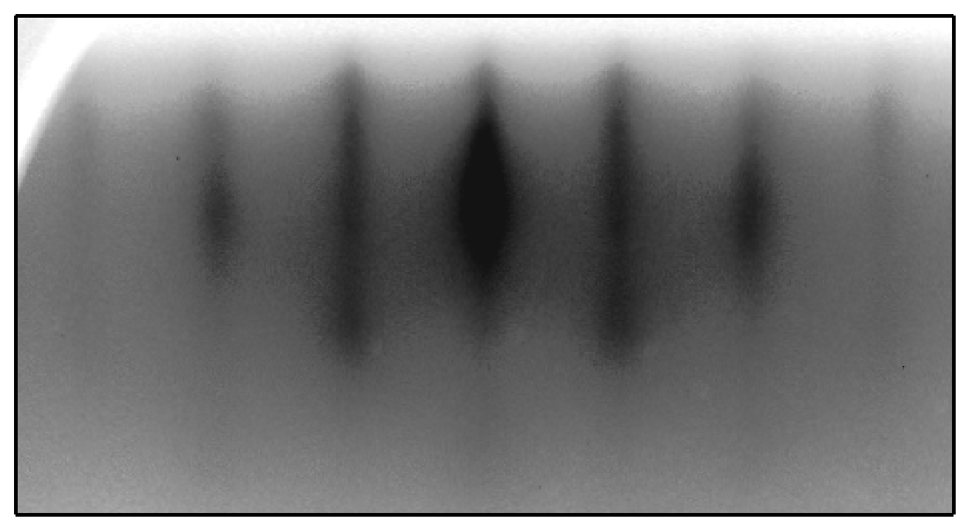
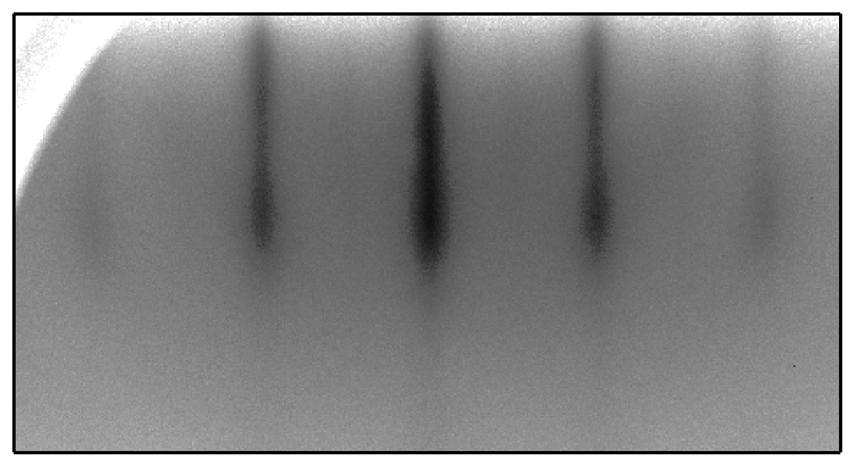
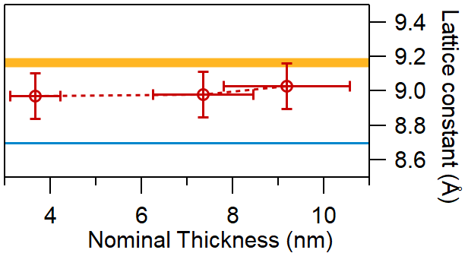
It is epitaxial!
SiC [10]
SiC [11]
Cs₃Sb [10]
Cs₃Sb [11]
Φ=0°
Φ=45°
e⁻
e⁻

Slide 16
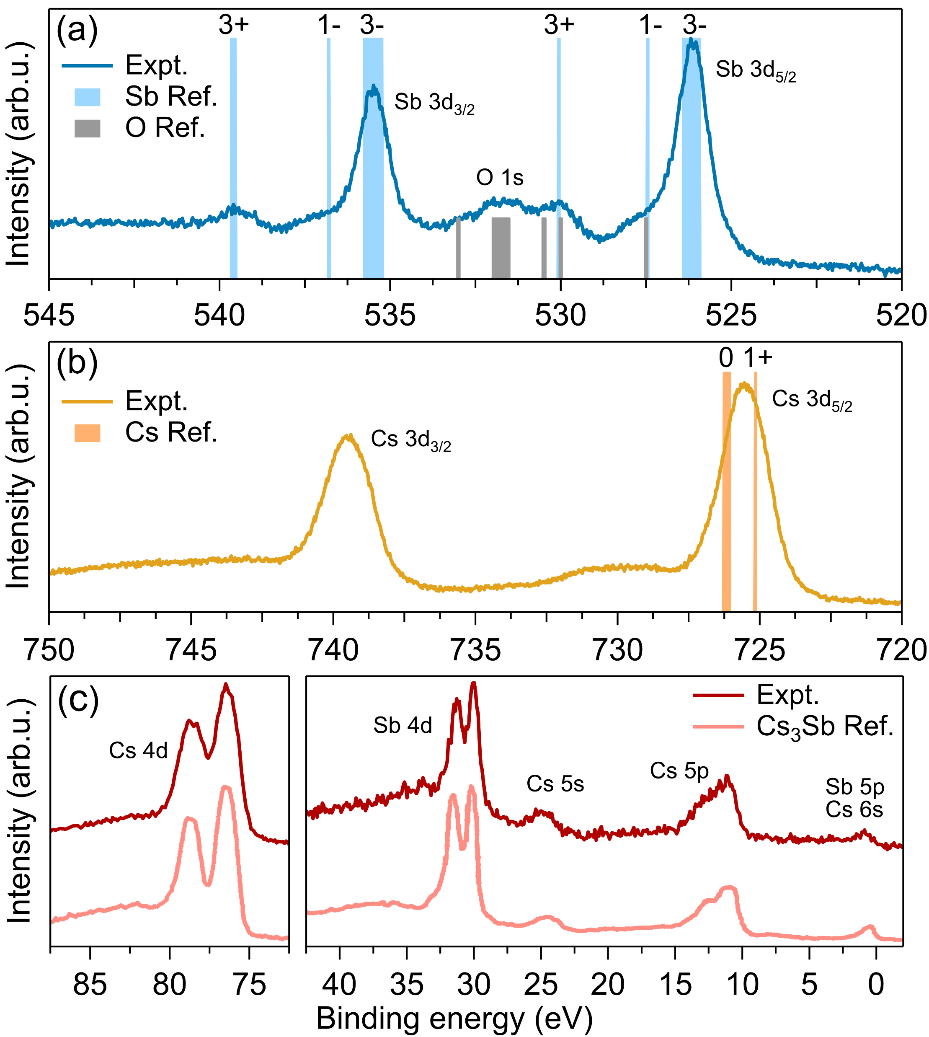
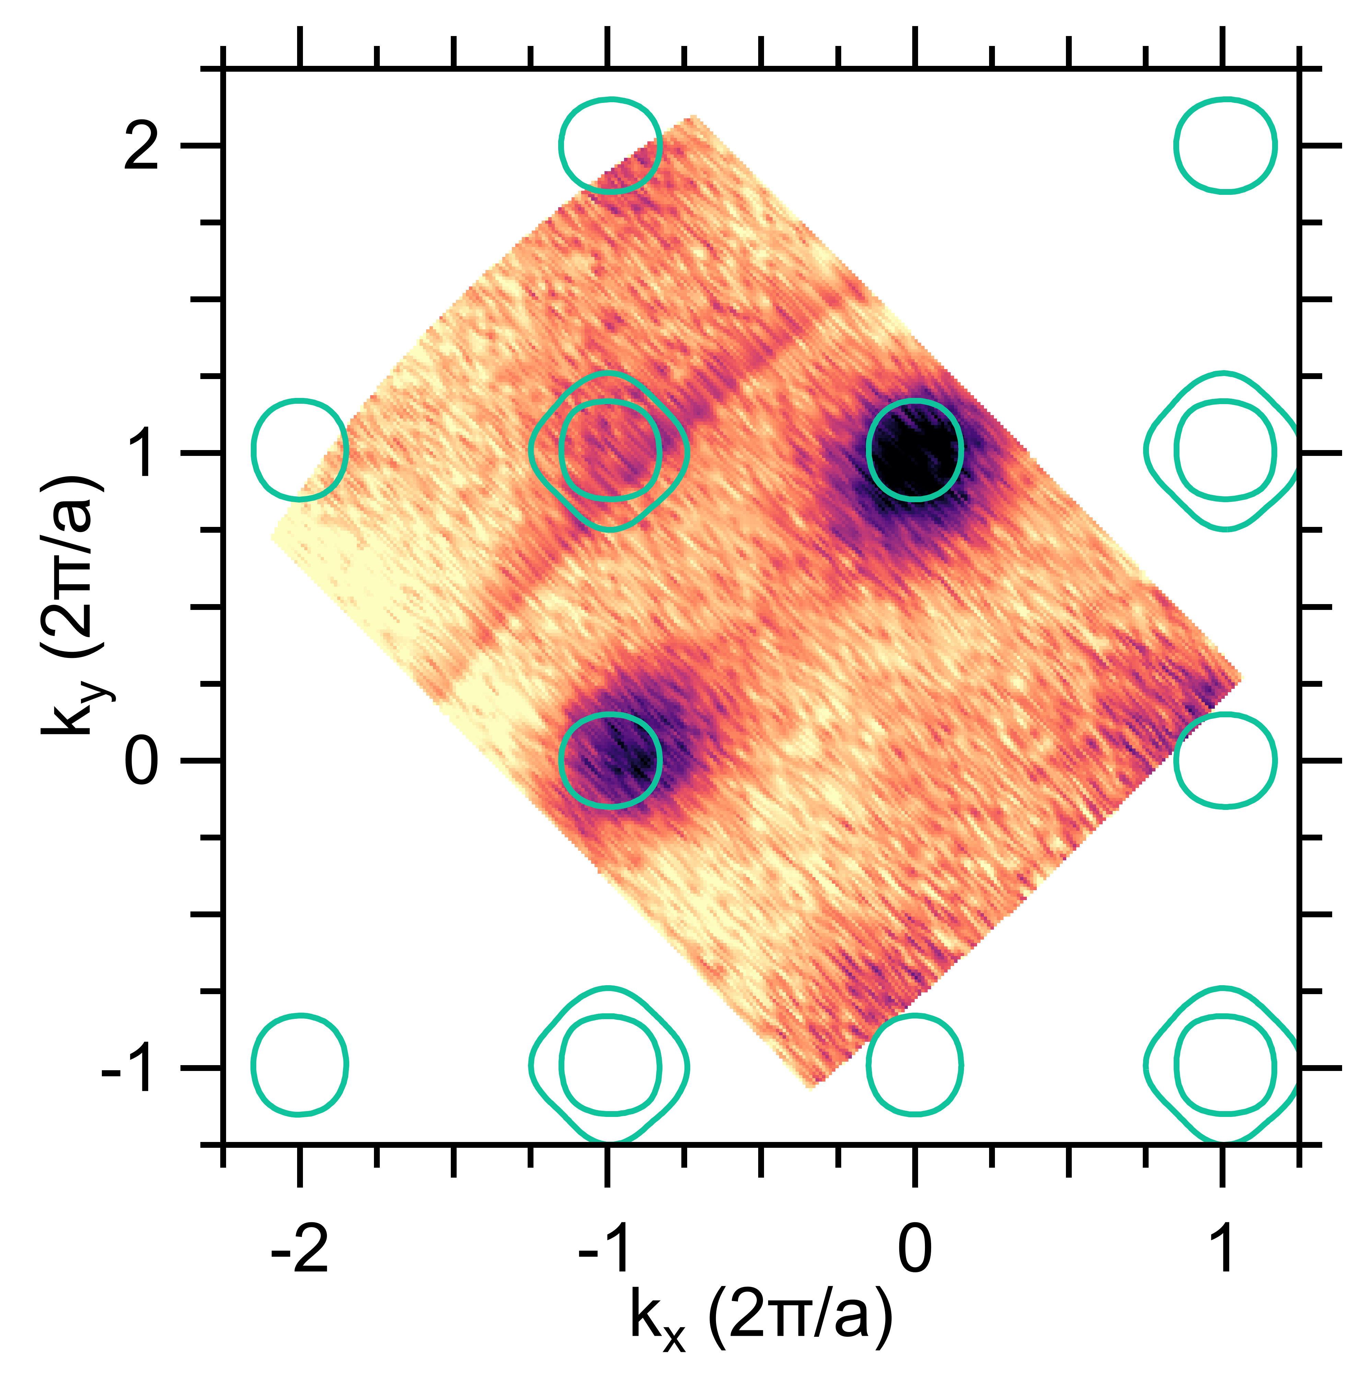
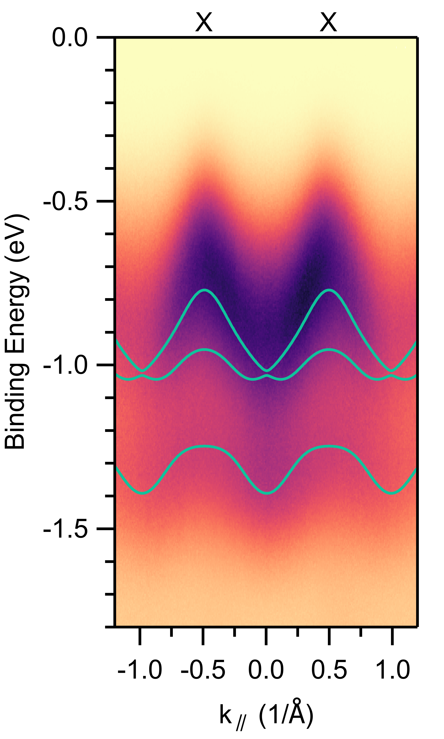
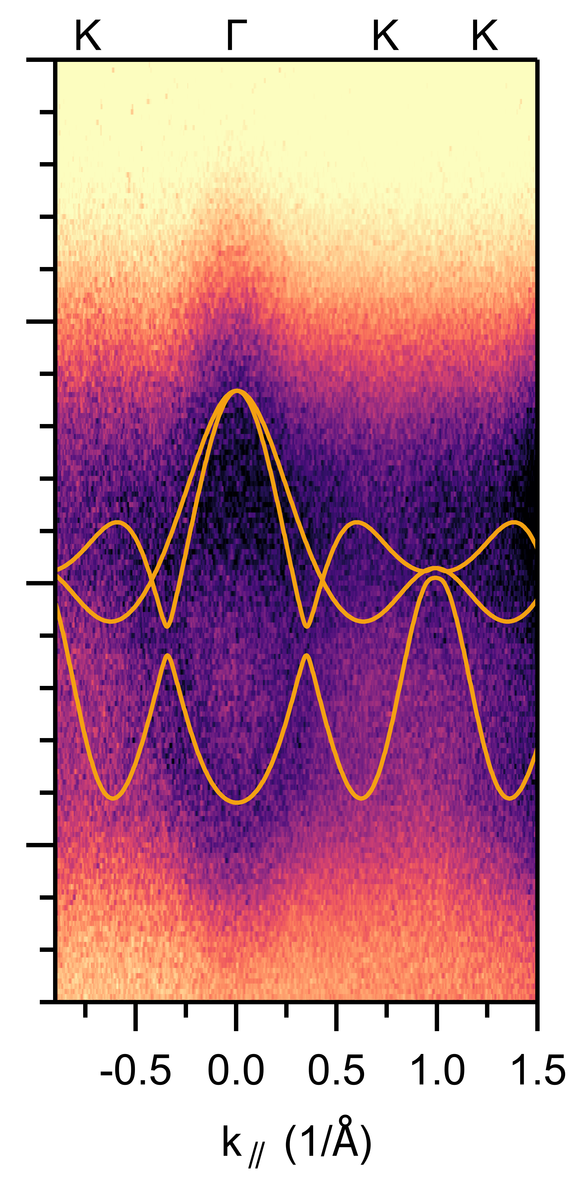

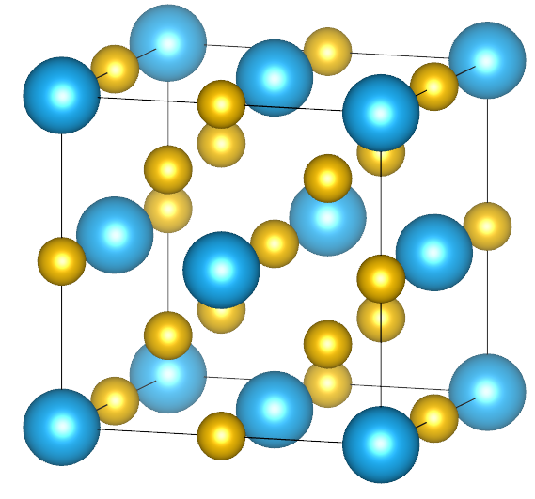
It really is Cs₃Sb: XPS and ARPES
XPS: perfect agreement
ARPES: larger bandwidth (Strain? Structure distortion?)
C. W. Bates, et al. Thin Solid Films 69, 175 (1980)

Slide 17
High efficiency in the ultrathin limit
Grey line and dots represent the data from a codeposited Cs₃Sb sample grown by photocurrent-monitored codeposition.
Enhanced QE:
At the photoemission threshold
At small thickness
C.T. Parzyck, A. Galdi et al.
Physical Review Letters 128, 114801

Slide 18
Temperature study: codeposition
Cs-Sb co-deposition on SiC substrates
  Cs:Sb ratio = 6:1 (as measured by Quartz Crystal Microbalance)
Lower Growth Temperature
λ=504 nm
Improved Quantum Efficiency
Polycrystalline Films
Polycrystalline
Rough
Fiber texture
Flat
Higher Growth Temperature
Improved Crystal Order
OOP Film Orientation
Reduced Surface Roughness
Reduced Quantum Efficiency
Low crystallinity
Rough

Slide 19
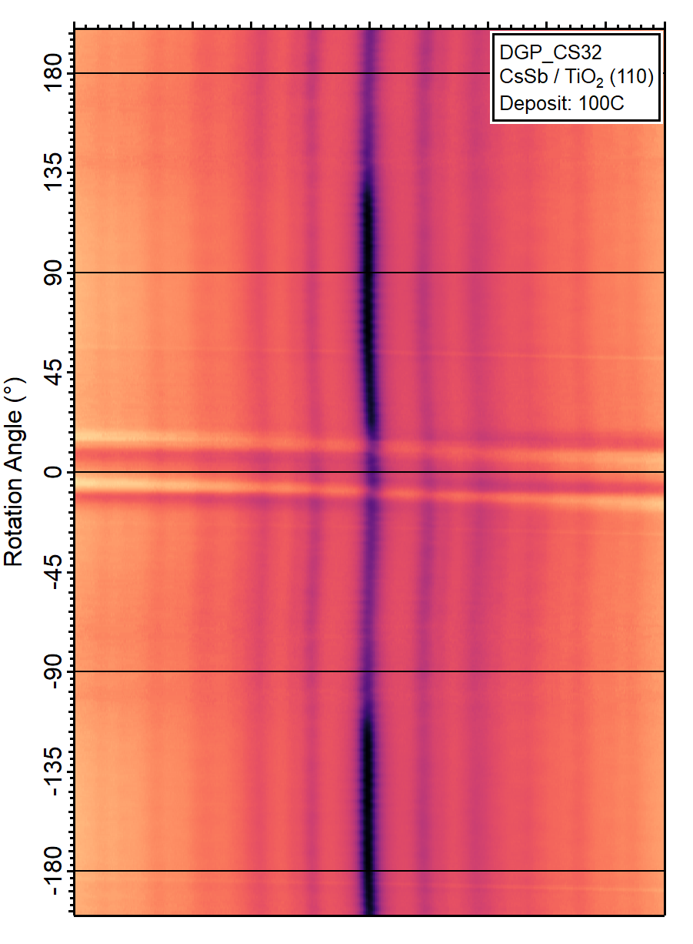
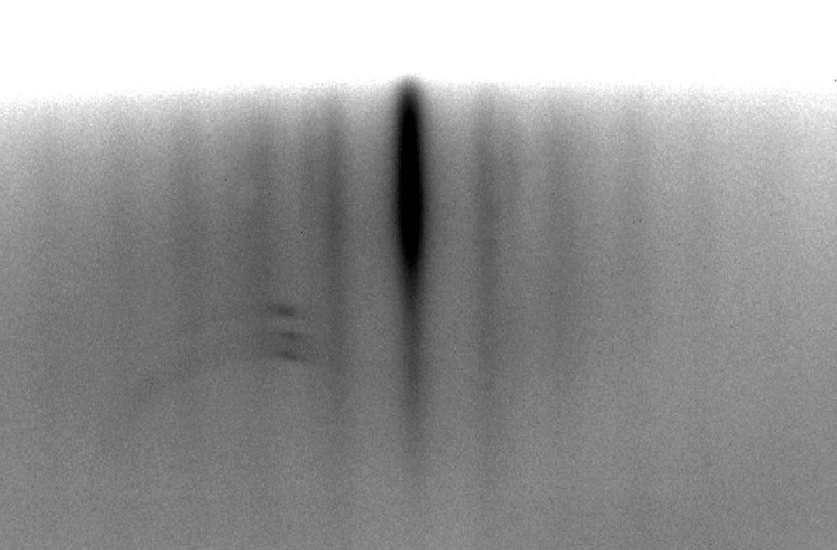
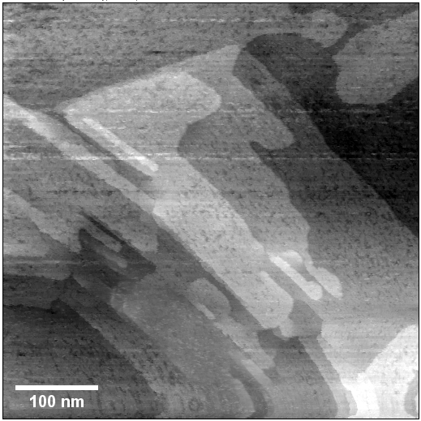
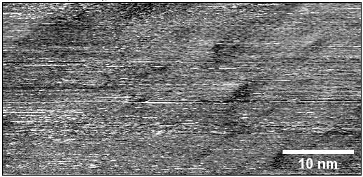
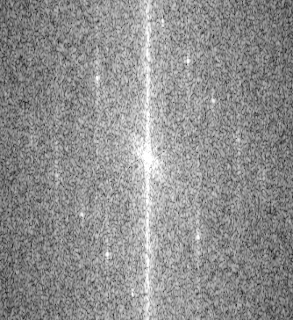
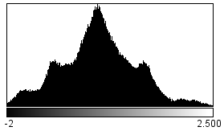
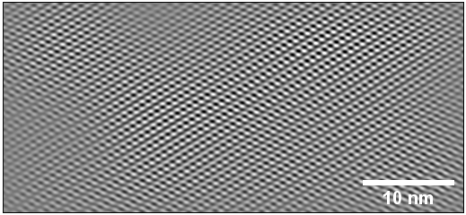
Flat co-deposited samples
k_{in}
k_{out}
Raw
FFT
In vacuum transfer to STM
Cs₃Sb
0.6 nm
FFT-filtered
Lattice:
0.76 nm x 1.42 nm

Slide 20
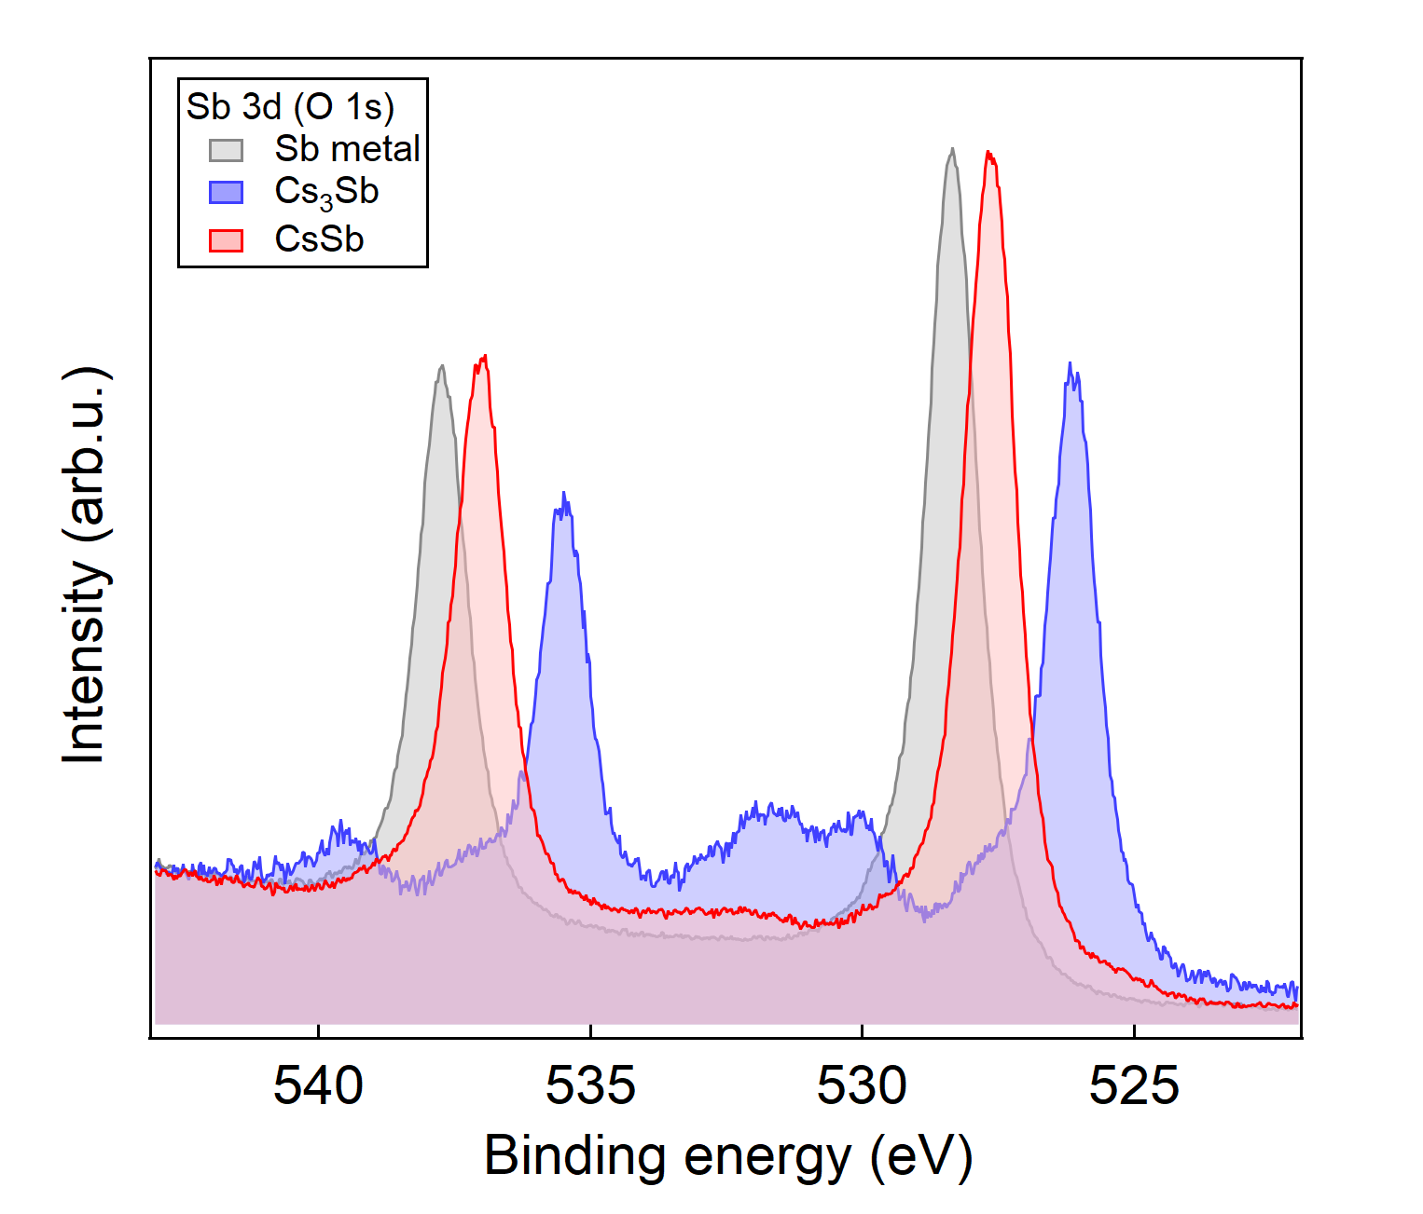
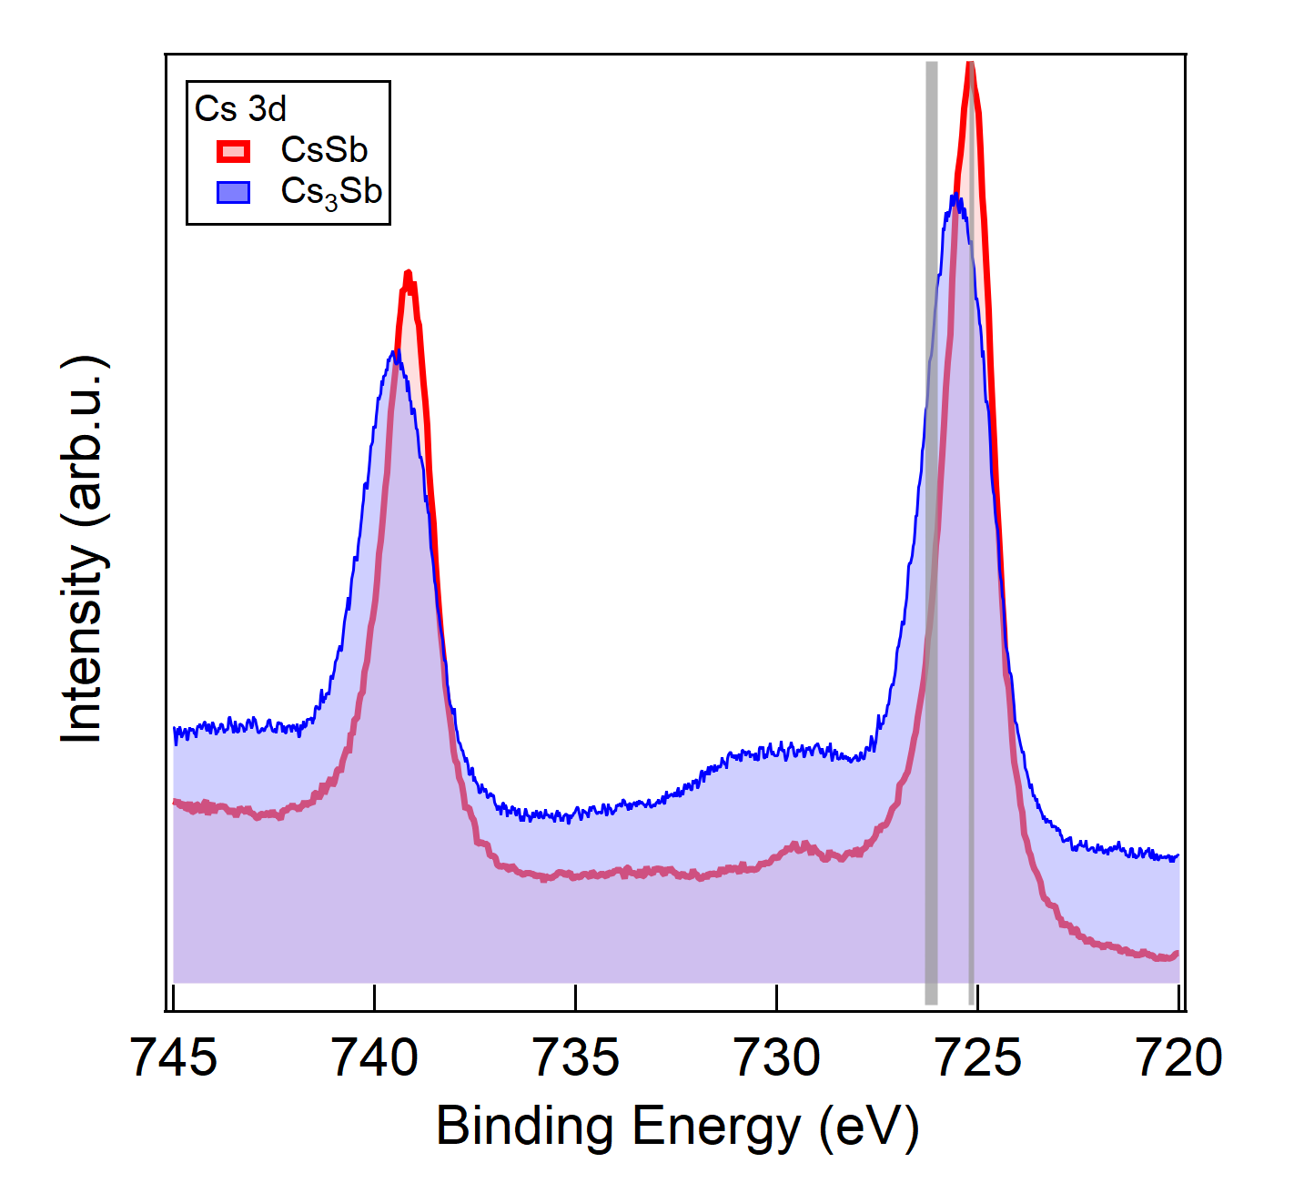

Flat co-deposited samples
CsSb parameters:
  a = 7.34 Å
  b = 7.57 Å
  c =13.27 Å
  P1 structure
$$Cs:Sb≈1:1$$
Structure and composition data suggest that the compound we are forming is closely related to CsSb

Slide 21




Current work in PHOEBE @ Cornell U.
PHOEBE: PHOtocathode Epitaxy and Beam Experiments laboratory
Clean hood
Vacuum suitcase
Sample preparation
TE-meter
Photocathode MBE
Study of epitaxial Cs₃Sb and CsSb samples: spectral response, lifetime, oxygen resistance, mean transverse energy
Chad Pennington
Elena Echevarria

Slide 22
Conclusions
Epitaxy of Cs₃Sb is achieved using molecular beam epitaxy via monitoring the sample structure with RHEED
State-of-the-art MBE machines and in-situ RHEED allow to explore various growth regimes and efficient optimization of the samples beyond quantum efficiency
High throughput:
  PARADIM experiments: 59 samples grown in 27 days (24h per day)
  PHOEBE: 75 Cs-Sb samples grown between 09/2021 and 08/2022
Structure-oriented growth identifies an interesting phase: CsSb
  Atomically smooth
  Easily achievable via codeposition
  QE ~1% at 400 nm
  Robust against oxidation

Slide 23
Information provided by RHEED
Polycrystalline islands
No texture
Epitaxial island growth
k_{in}
k_{out}
k_{in}
k_{out}
Textured film
Transmission pattern:
Streaks turn into spots
Fiber texture
No rotation dependence if the texture axis is out-of-plane (uniaxial)
Rotation dependence if the texture axis is in-plane (biaxial)

Slide 24



Epitaxial Relationship
Substrate
Fully Ordered
Fiber Textured Film
Only c-axis oriented
Partially Ordered Film
Epitaxial Film

