Slide 1
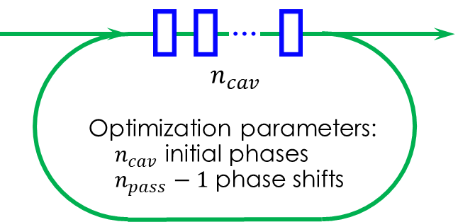
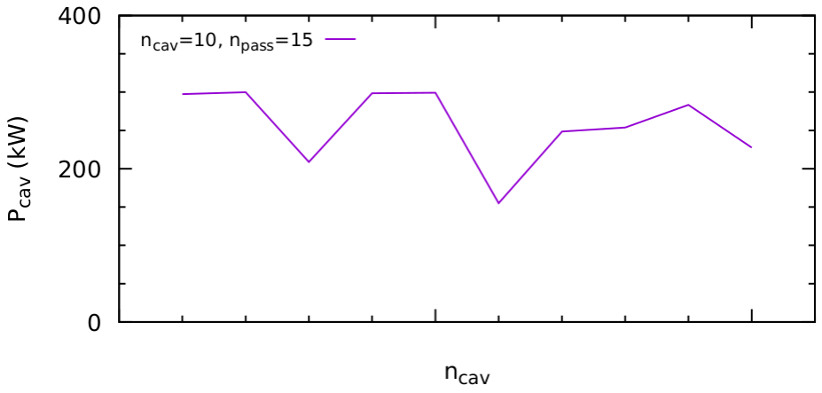
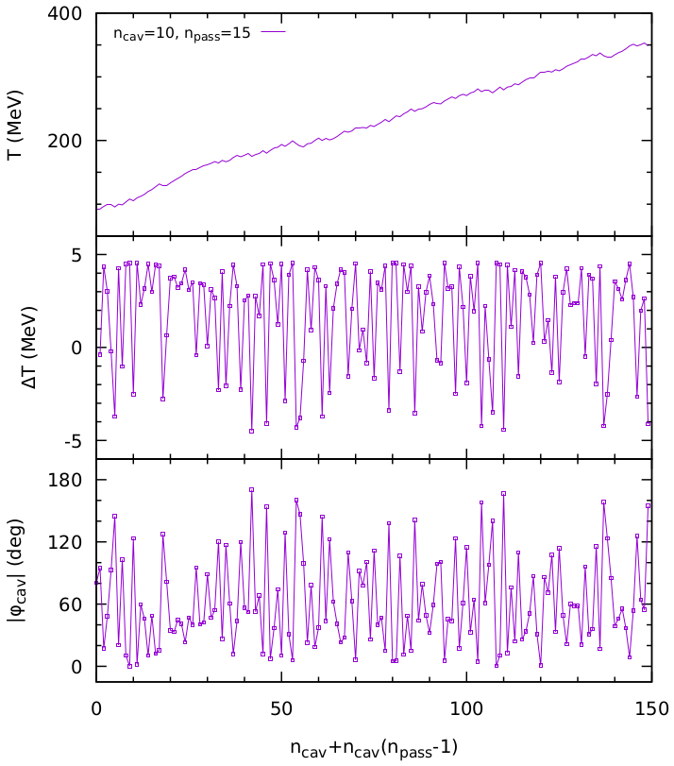
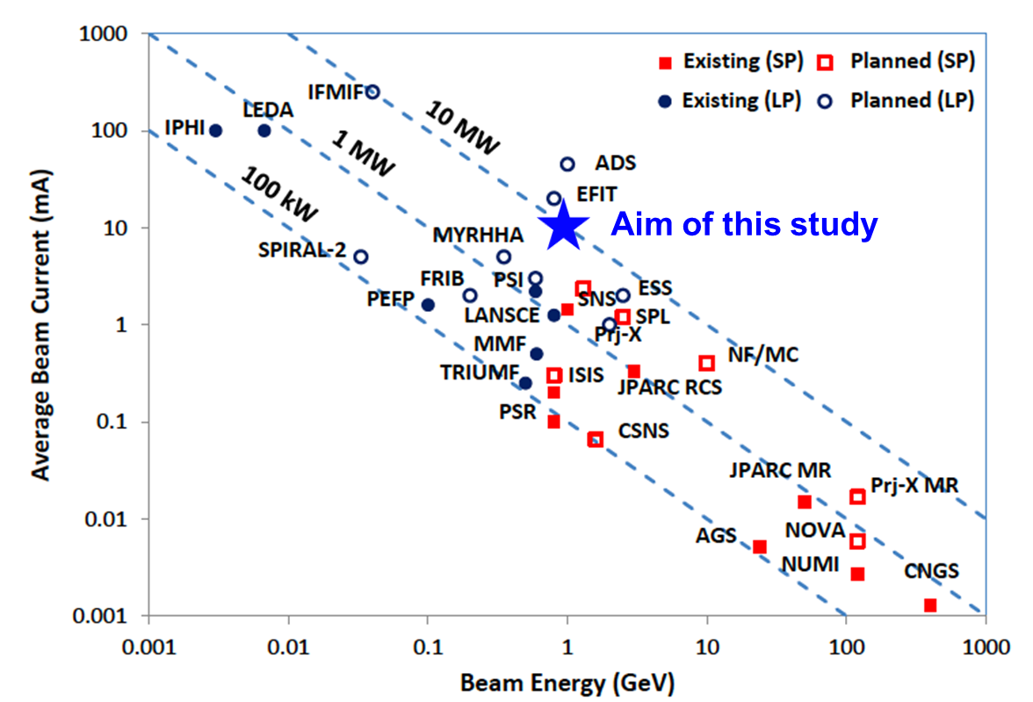
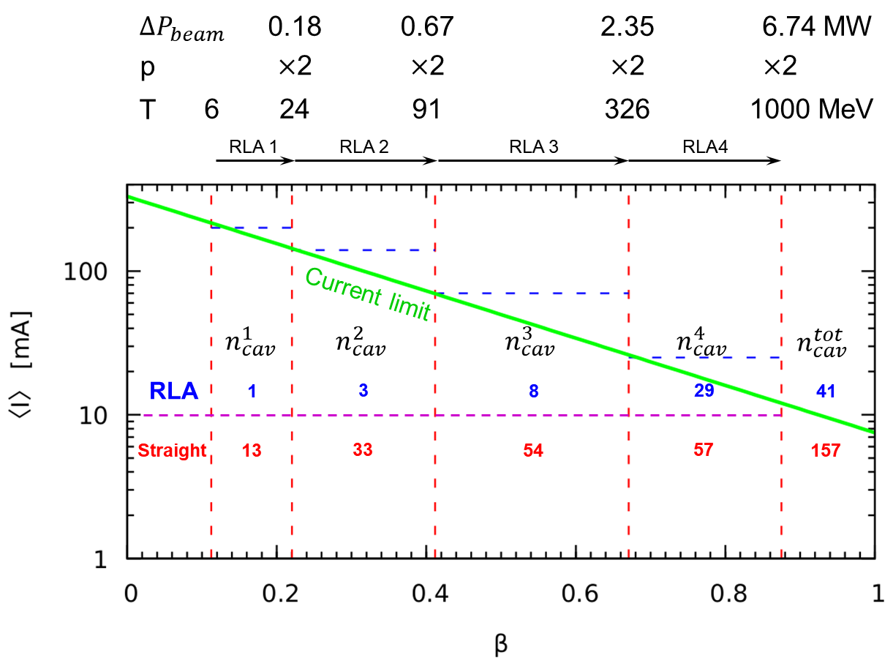
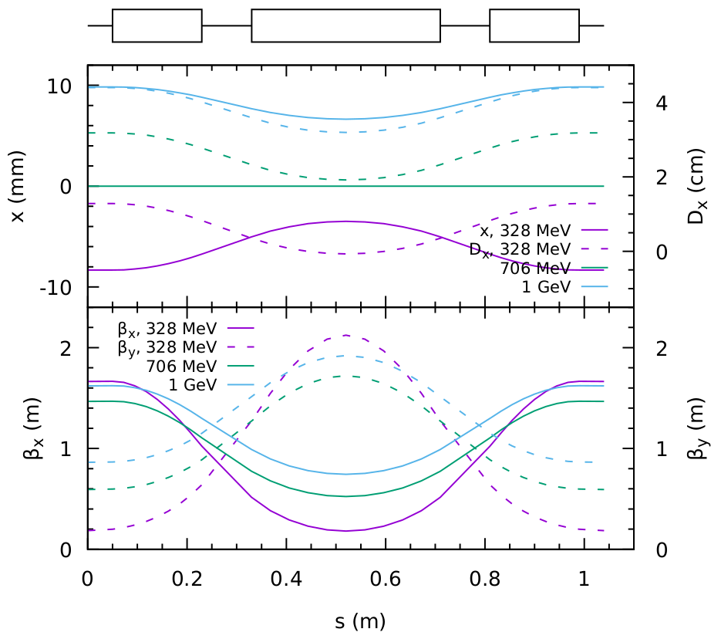
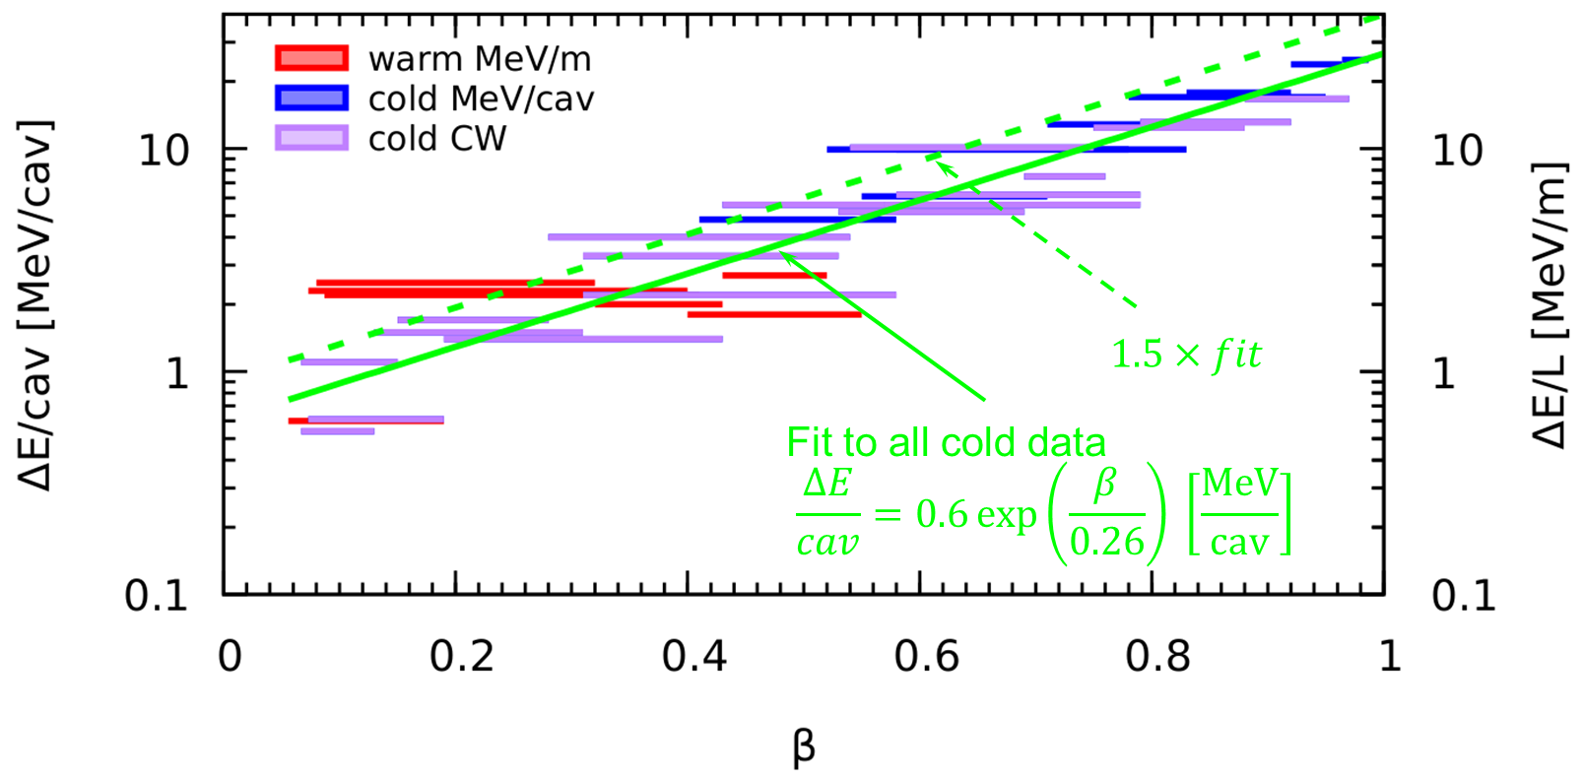
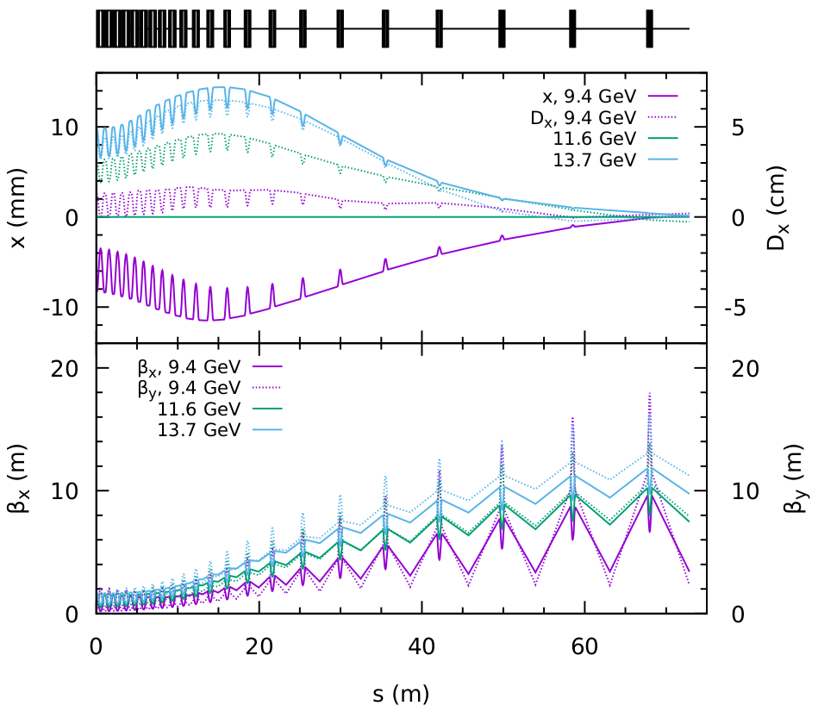
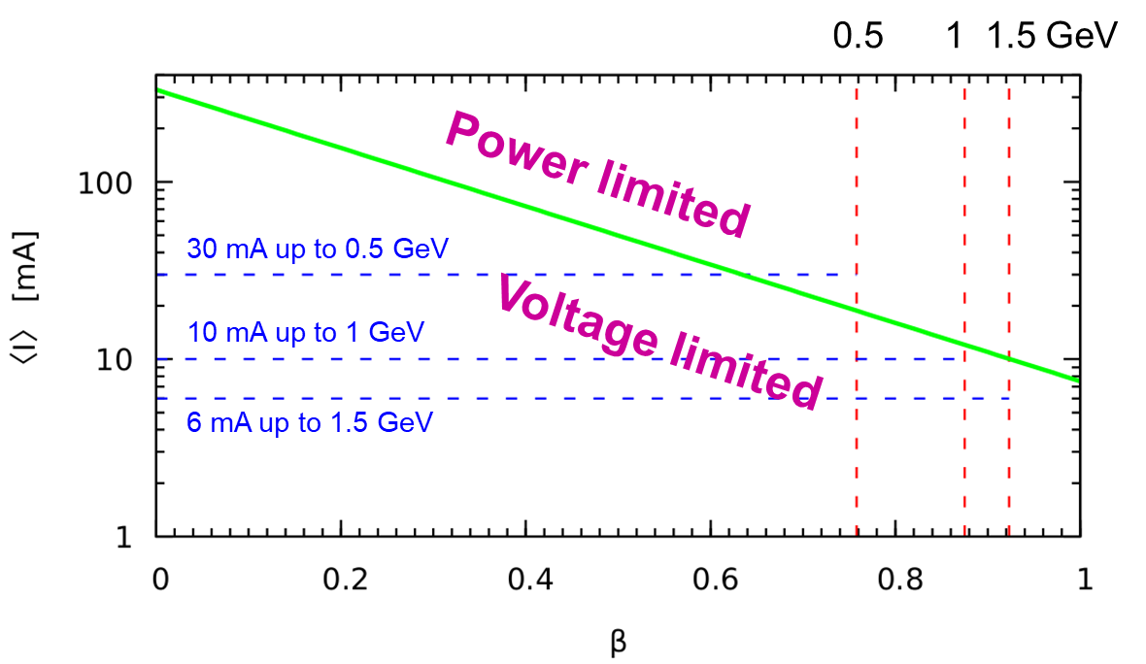
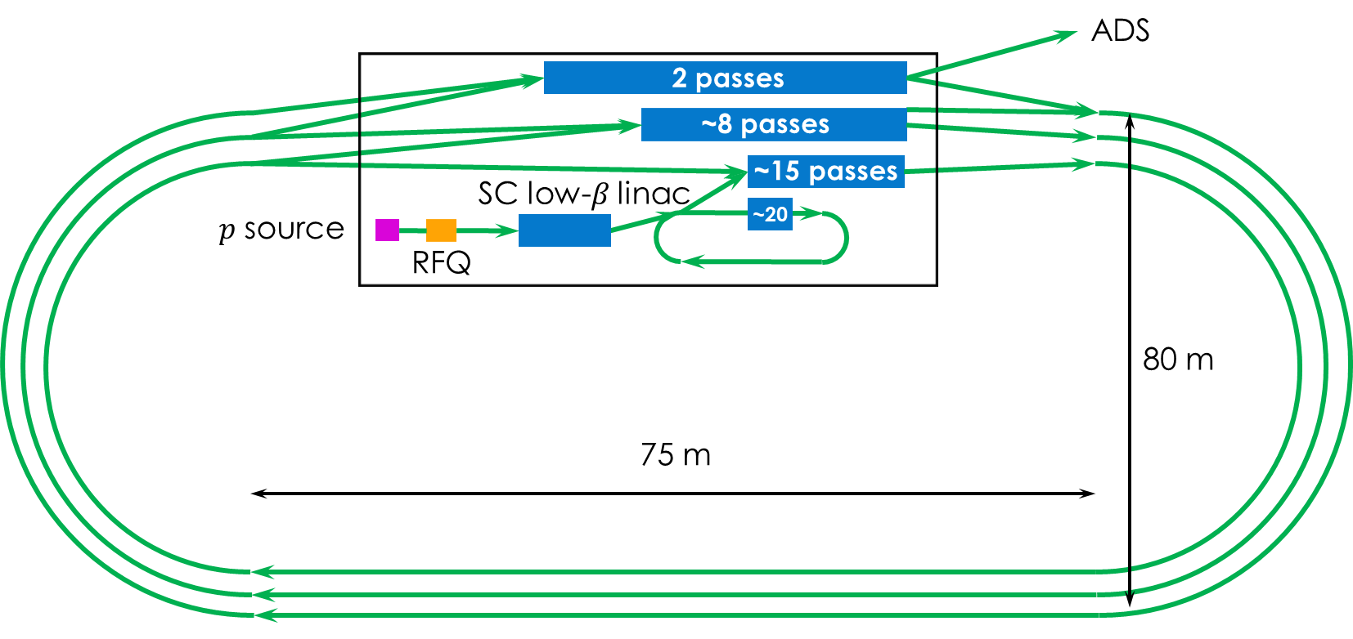
Concept of a High-Power Linear Proton Accelerator
V.S. Morozov, RAD, SNS, NScD, Oak Ridge National Laboratory, Oak Ridge, TN
Abstract
Optimization Concept
Linac Timing
We present a new concept of a compact high-power linear proton accelerator with an average power of 10 MW at a kinetic beam energy of 1 GeV. Acceleration is accomplished in several stages. In each stage, the beam is recirculated a few times through the same set of SRF cavities. To avoid the complexity of multiple recirculating arcs and especially of multi-pass beam spreaders and recombiners, we implement the Fixed-Field Alternating-gradient arc design and adiabatic matching approach where all beam passes are transported and matched to the accelerating sections in a single beam line.
Problem: incomplete use of available power by some of the cavities, the bottle neck is the current limit of the higher-energy linac section Solution: recirculate the beam through lower-energy sections up to their power limits
⇓
Problem: inefficient acceleration on the 2nd and subsequent passes due to loss of beam synchronization with the linac RF Solution: use larger number of passes to compensate for the loss of acceleration efficiency while staying under the cavity power limit
⇓
Problem: impractically large number of recirculation arcs Solution: use FFA arc optics
⇓
Problem: complicated arc to linac matching section Solution: adiabatic match
Consider RLA3: $T=91→328$ MeV, $V_{ampl}=4.6$ MV
2 m cavity spacing
Optimization problem with many local minima, use GA with population of 100k and 1k iterations
Motivation
$${P_{lim}}/{\text{cav}}=300 \text{kW}$$
Multiple applications
Fundamental research
Generation of high-flux neutron beams
Neutrino, muon and kaon physics
ADSR
Production of electricity and heat
Production of liquid fuels
Processing of spent nuclear fuel
Use of Pu and Th
Applied research
Nuclear medicine
Generation of radioisotopes
Material science
Natural follow up to the PPU and STS
Combined with ORNL’s reactor expertise, provides a path to ADSR
$T_{goal}=340$MeV
Acceleration Scheme
Utilize the maximum RF power that can be provided by a cavity by recirculating the beam
Assume each FFA arcs covers a momentum ratio of 2 (Transition energies approximately align with SRF technology change points)
Number of cavities
RLA: $n_{cav}^{i}={ΔP_{beam}^{i}}/{\left[300 \text{kW}\right]}$
Straight linac: $n_{cav}^{i}={ΔE_{beam}^{i}}/{[{V_{max}^{i}}/{\text{cav}}]}$
Potential reduction in cavity number from ~160 to ~40
Deceleration $↑$
Acceleration $↓$
Review of Existing Designs
Arc Optics
Arc FODO cell using combined function dipole magnets with quadrupole field components
Maximum field of 1 T at 20 mm radius
Consistent with permanent magnet technology
Adiabatic match of arcs to linacs using 22 cells
Cell parameters scale as
$f\left(i\right)=1−3{\left[i/{\left(n_{T}+1\right)}\right]}^{2}+2{\left[i/{\left(n_{T}+1\right)}\right]}^{3}$
$θ_{i}=f\left(i\right)θ_{a}$ , $l_{i}=l_{s}{\left[{l_{a}}/{l_{s}}\right]}^{f\left(i\right)}$, $k_{1}^{i}=k_{1}^{s}{\left[{k_{1}^{a}}/{k_{1}^{s}}\right]}^{f\left(i\right)}$
Energy gain per cavity as function of $β$ for SNS, ESS, MYRRHA, Project X, JAEA ADS, CiADS, and HC HP-SPL
All these and other explored projects are straight linacs
Assume maximum coupled cavity power of 300 kW
Accelerator Layout
Bend allows for efficient tunnel use
Short cryogenic and RF power lines
Total circumference of ~400 m
$$I_{max}\left(β\right)=300 kW/V_{max}\left(β\right)$$
Linac
Arc
Acknowledgements
Work supported by UT-Battelle, LLC, under contract DE-AC05-00OR22725 with the US DoE through LDRD project, LOIS 10908.

