Slide 1
I.FAST as ERL 2022 sponsor
Florian Hug
ERL Workshop 2022, Cornell, 4th October 2022

Slide 2
I.FAST in a nutshell
Innovation Fostering in Accelerator Science and Technology
New EC instrument called Innovation Pilot, to support super-advanced scientific communities developing and exploiting Research Infrastructures (RI), in their transition from Open Science to Open Innovation.
Open innovation = Sharing of ideas between scientific institutions and commercial companies, to improve high technology products and to identify new products and markets. Transition to an innovation ecosystem (Keywords: community, trust, openness, creativity, connection to industry)
48 beneficiaries – 8 large RI operators, 12 national research centres, 12 universities, 16 industrial partners (1/3, including 11 SMEs) - from 15 European Countries, supported by 12 partner organisations and >20 collaborating institutions, jointly developing technologies for the next generation of particle accelerators.
Timeline: 4 years, starting 1 May 2021.
Resources: 10 M€ EC contribution, out of a total project cost of about 19 M€.
Structured in 9 Thematic Areas (work Packages), each made of a “strategy group” and of one of more R&D activities at different TRL (Technology Readiness Level), with industry participation.

Slide 3
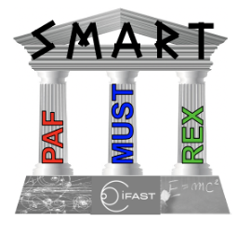
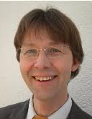
I.FAST Work Package 5
Strategies and Milestones for Accelerator Research and Technologies (SMART)
Peter Forck (GSI), Giuliano Franchetti (GSI), bb Nadia Pastrone (INFN),
Frank Zimmermann (CERN)
Participating Institutes:
INFN, CERN, CEA, CNRS, KIT, PSI, United Kingdom Research and Innovation, GSI, Bergoz Instrumentation, Barthel HF-Technik GmbH, HIT Heidelberg + JGU Mainz

Slide 4
Task 5.2 Pushing Accelerator Frontiers (PAF)
Main tools: topical workshops and dedicated prospective studies
Overriding goal: survey frontiers of classical accelerators and develop long-term strategies for boosting the performance of future facilities and for overcoming limitations
Within WP 5.2: Thrust 5: green accelerators, sustainable accelerator concepts, e.g. energy recovery, energy efficiency, and possibly particle (e.g. positron) recycling (CERN, GSI, CNRS, PSI, + JGU – Florian Hug)
→ PAF will develop a coherent landscape for future accelerators and issue targeted R&D recommendations

Slide 5
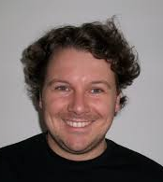
Task 5.2 Pushing Accelerator Frontiers (PAF) – cont’d
Thrust 5: green accelerators, sustainable accelerator concepts, e.g. energy recovery, energy efficiency, and possibly particle (e.g. positron) recycling (CERN, GSI, CNRS, PSI, + JGU – Florian Hug)
WP5 - Task 5.2 PAF synergies:
with Task 5.1 MUST: positron sources, ultimate limits, and particle recycling ..
with the Task 5.3 REX: dark sector fixed-target experiments and machine learning …
→ PAF will develop a coherent landscape for future accelerators and issue targeted R&D recommendations

Slide 6
ERL 2022 sponsoring through I.FAST
Covering full travel costs for two invited young speakers from Europe (G. Pérez Segurana (CERN) and C. Barbagallo (IJCLab))
Covering registration fees for a bunch of six local graduate students from Cornell University
Enabling young scientists to participate at ERL 22
We would be happy to offer this possibility at ERL 2024 again, if wanted

