Slide 1
Title Slide
2022 Company Overview
Stephen Coleman,
Sr. Project Scientist
coleman@radiasoft.net
RadiaSoft headquarters:
1790 38th St., Suite 306
Boulder, Colorado
Boulder, Colorado USA | radiasoft.net October 4, 2022
Notes:
15-20 minutes

Slide 2
Supporting US industry
RadiaSoft supports high-tech industry in the US, including applications in medicine, agriculture, energy and homeland security:
RadiaBeam – compact X-ray & γ-ray sources for homeland security
ProTom International – proton therapy beamlines & gantry design
Bartoszek Engineering – system integration of magnetic horn
Nusano – beamline design and radiation shielding for isotope production
Reveam – control system for irradiation of agricultural products
Modern Electron – thermionic converter modeling & design
Best Medical – design of proton & carbon ion therapy accelerator

Slide 3
Supporting US Industry
RadiaSoft supports high-tech industry in the US, including applications in medicine, agriculture, energy and homeland security:
Notes:
Reveam, formerly ScanTech

Slide 4
Supporting research labs around the world
LLNL – GUIs for codes supporting the $700M Scorpius project
NSLS II – integration of with X-ray beamline controls
ANL – ML detection of system anomalies; new concept for cooling high intensity ion beams; high-power e- beam melting of vacuum chamber walls
LBNL – ML-based FPGA controls for high rep rate, high power laser systems
Fermilab – radiation modeling & shielding design for proton accelerators
ORNL – ML-based controls & data visualization for neutron experiments
BNL & JLAB – ML-based data analysis and beamline control systems
SPring 8 – beamline design at Japanese X-ray facility via

Slide 5
Supporting research labs around the world

Slide 6
Education & Training
RadiaSoft collaborates with universities and training programs:
U.S. Particle Accelerator School
Korea University
UCLA
Strathclyde University
RadiaSoft personnel volunteer to teach at the
US Particle Accelerator School (USPAS)
supports the SAGE Summer Camp:
https://conf.slac.stanford.edu/sage
Notes:
I would suggest listing all of these items equally: giving them the same bullet point listing, instead of making USPAS and SAGE subordinate. I would also remove the words “several” (you don’t need to *say* several because you *list* several) and “volunteer” (we just teach at USPAS–no need to diminish the professionalism by saying it’s an unpaid gig).
This slide still has a lot of words on it. I would consider putting the small print behind each bullet point (“teaching the principles of particle accelerator…” etc) into spoken words instead of writing them out.

Slide 7
Core Software Competencies
RadiaSoft has several software development foci:
CAE gateway
Online user interfaces and simulator tools
Integrated simulation environment development
Control system interfaces (e.g., EPICS, bluesky)

Slide 8
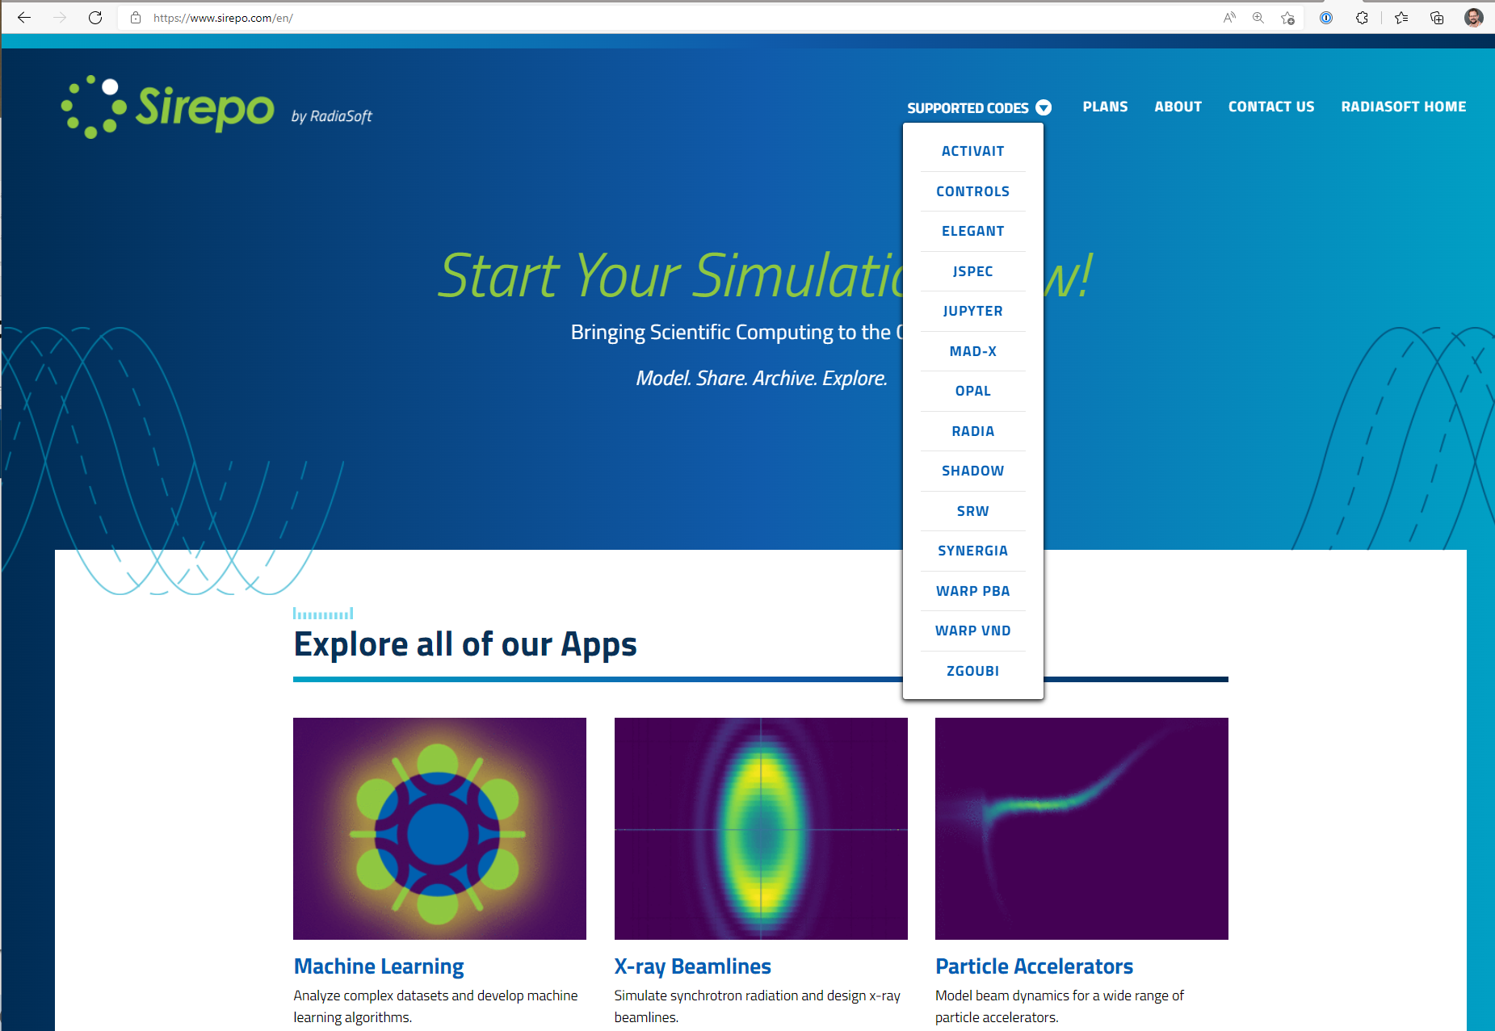
Sirepo.com: CAE gateway

Slide 9
Sirepo-supported codes & apps
JupyterHub
X-ray Beamlines
SRW (Synchrotron Radiation Workshop), Shadow3
Particle Accelerators
elegant, OPAL, MAD-X, Synergia, Zgoubi, Warp, JSPEC
Machine Learning
Magnets
Radia
Vacuum Nanoelectronics
Warp
Controls
EPICS
Plasmas
FLASH
Free Electron Lasers
GENESIS

Slide 10
Sirepo supported codes and apps
Command line & ML
Accelerators
elegant
Synergia
Activait
MAD-X
WARP
OPAL
Zgoubi
X-ray
optics
Plasmas
Controls
Magnets
EPICS
Shadow
FLASH
Radia
BLUESKY
SRW
Neutron
Transport
FELs
Cooling
GENESIS
JSPEC
OpenMC
Notes:
I would consider adding Activait’s glyph to the box, since JupyterHub gets a glyph. We don’t want Activait to feel lonely. Logos are located here.

Slide 11
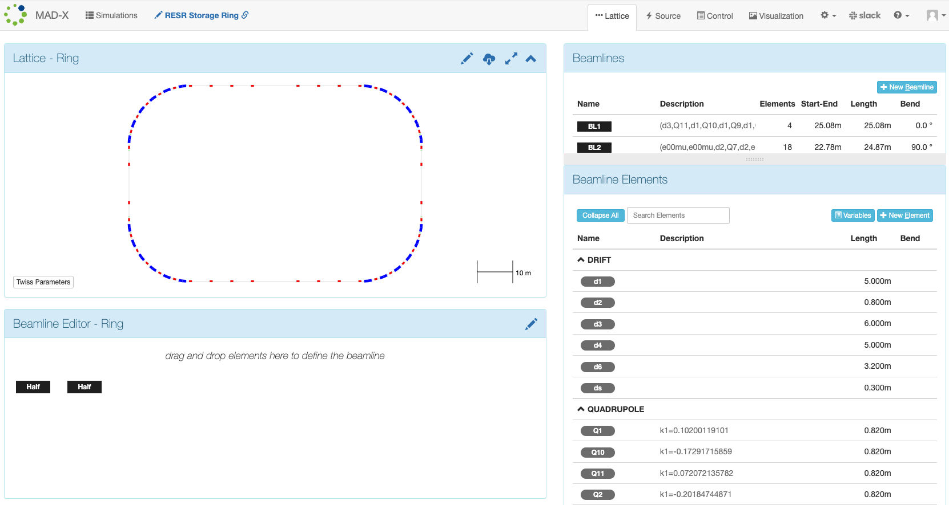
Example: MAD-X
Upload or design your lattice and visualize it!
Notes:
Consider changing to “Upload or design your own lattice and visualize it”

Slide 12
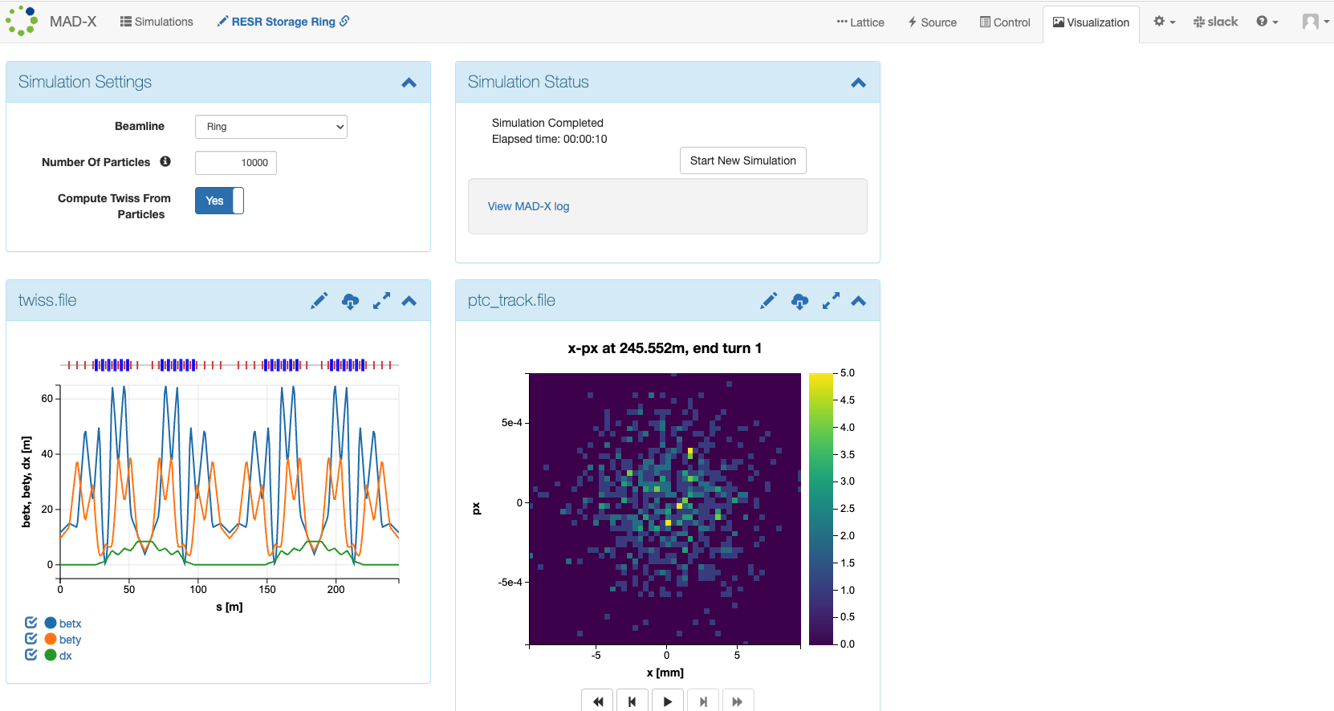
Example: MAD-X

Slide 13
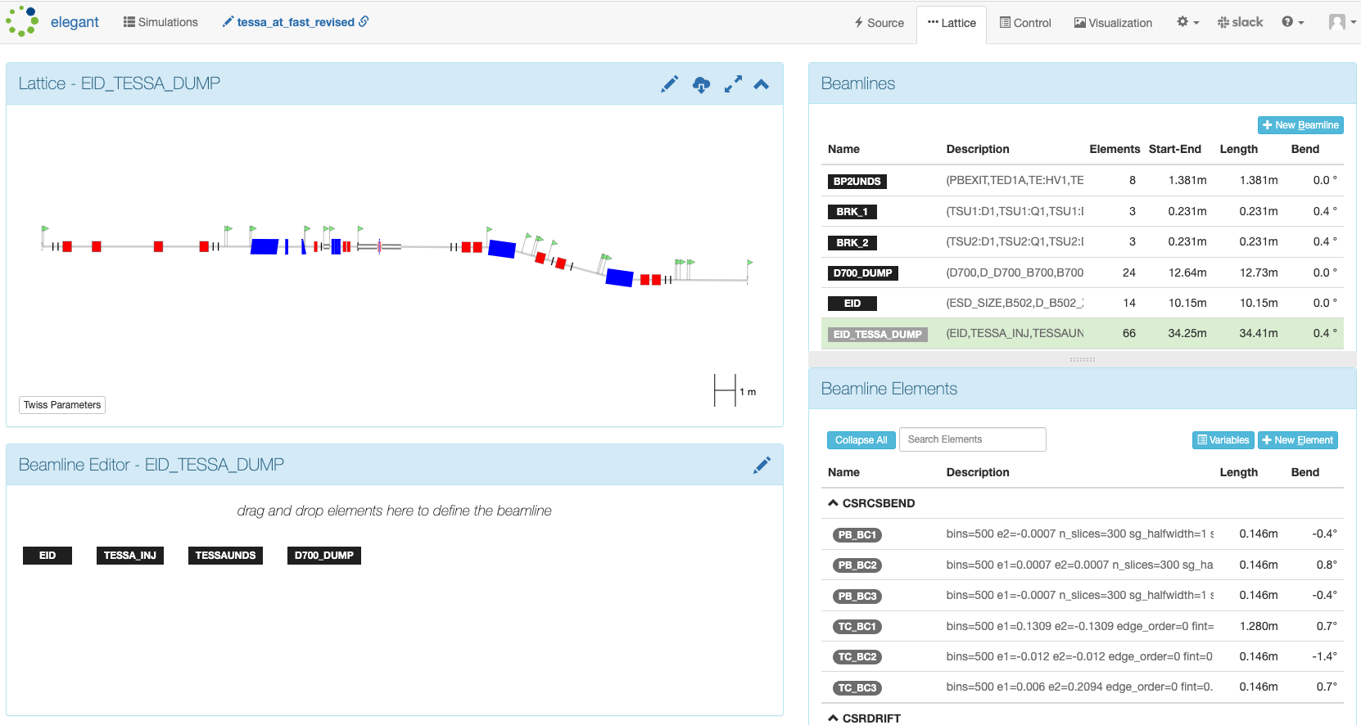
Example: elegant
Browser-based beamline optimization

Slide 14
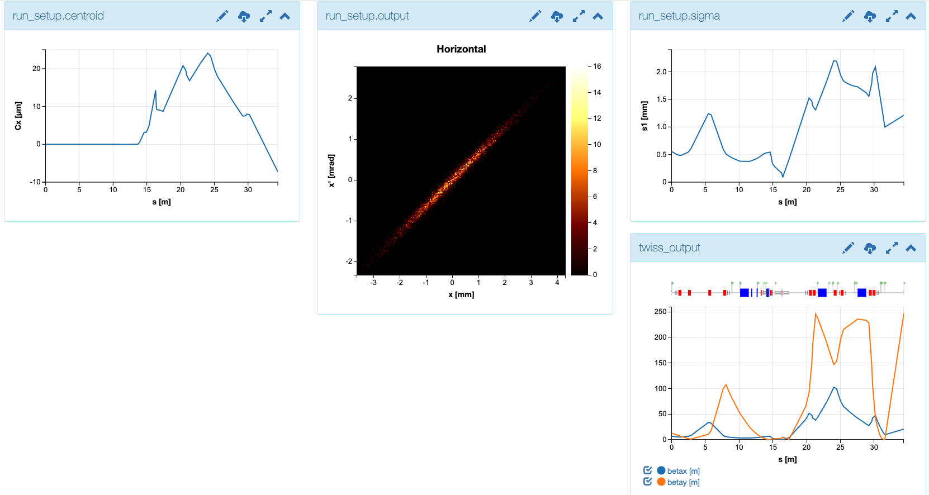
Example: elegant

Slide 15
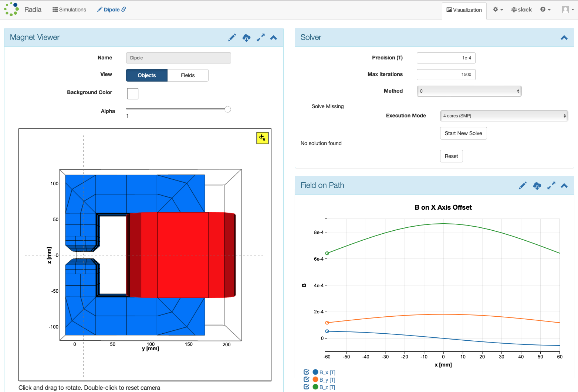
3d Model Visualization: Radia
Notes:
I would consider embedding a short video of the Radia visualization spinning around in 3D because that’s super sexy and cool! There’s a video here.

Slide 16
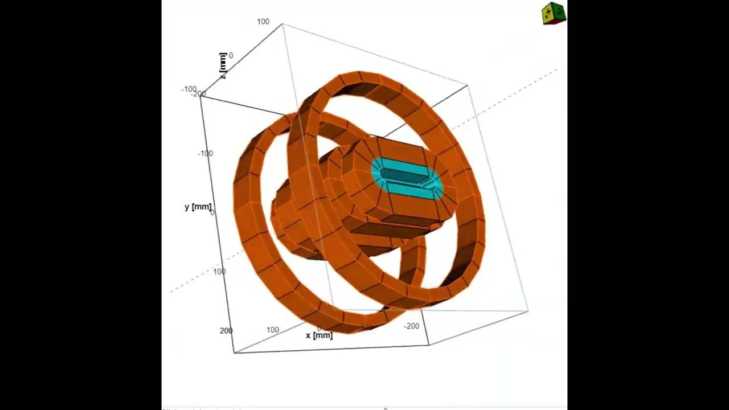
3d Model Visualization: Radia

Slide 17
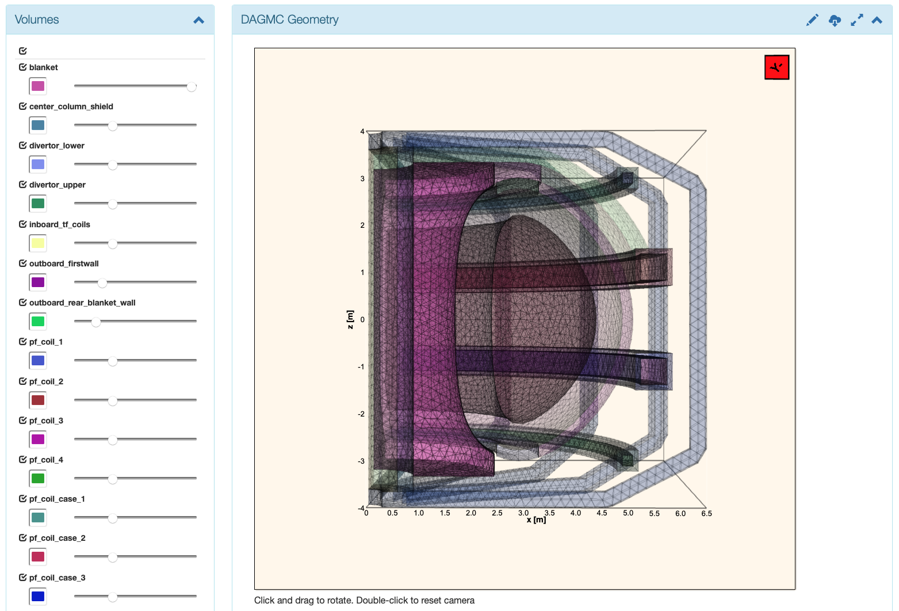
3d Model Visualization: OpenMC
Notes:
This image would also be super cool if we get to see it rotate. I don’t have a video clip of this one anywhere.

Slide 18
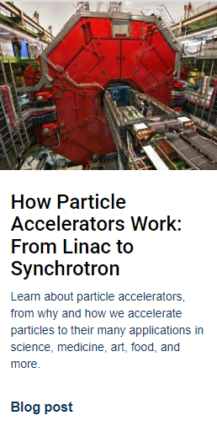
Community Outreach & Support
RadiaSoft’s educational blog is updated regularly, https://www.radiasoft.net/resources
Our monthly webinar series is available on YouTube, https://www.youtube.com/c/RadiaSoft

Slide 19
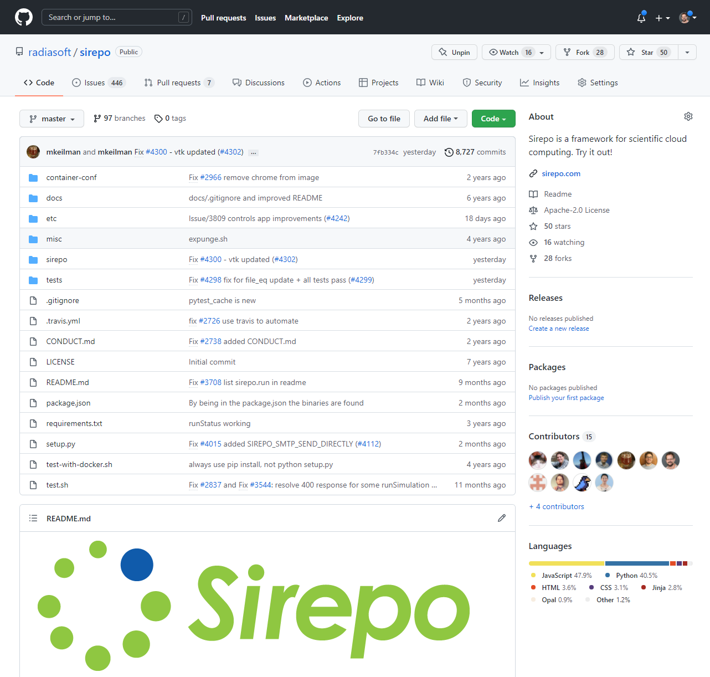
is an open source framework
developed on GitHub since 2015
https://github.com/radiasoft/sirepo
https://github.com/radiasoft/download

Slide 20
Sirepo is a resource management system
Sirepo is a custom job and resource management system
working with NSLS-II on automated X-ray beamline control for TES, ARI, and SXN
integration with Bluesky, EPICS and ML algorithms at CHX and CSX beamlines
integration with EPICS, MAD-X and ML algorithms for hadron transfer line at BNL
RadiaSoft facilities consist of:
HPC clusters and servers in a 365/24/7 data center:
760 core cluster
GPU server with 4 Tesla V100
Also supporting AWS and other cloud-based VMs
Support for running on NERSC systems

Slide 21
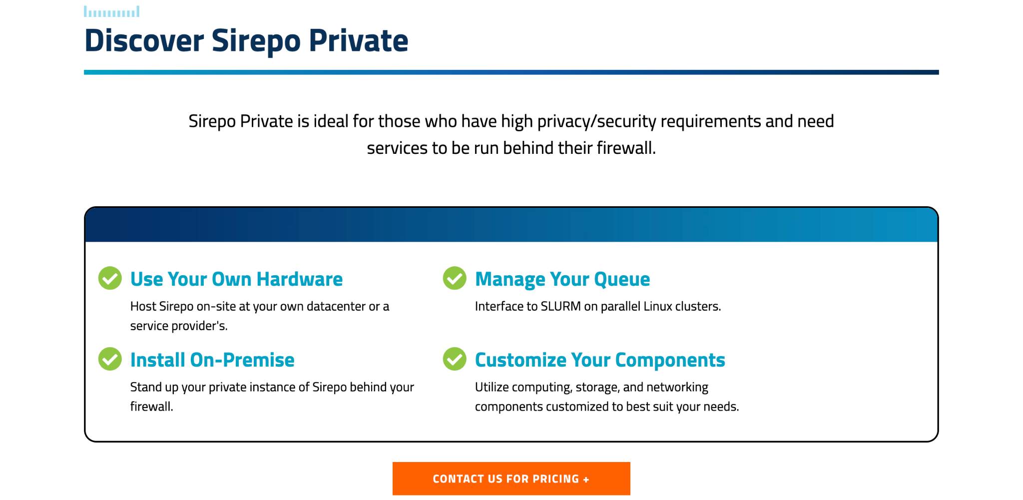
Use your own hardware

Slide 22
Use our software in class

Slide 23
Consulting Opportunities
RadiaSoft has 11 research scientists with expertise in:
Accelerator and beamline modeling
Machine learning
High energy plasma modeling and analysis
Control Systems
System design consulting
Programmable and embedded device development

Slide 24
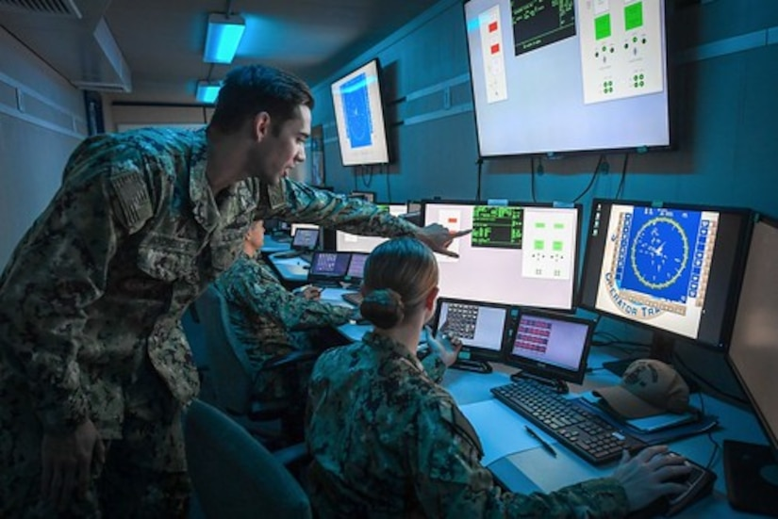
GUI Case Study: AFWERX
RadiaSoft delivering GUIs to the AF in a private customized M&S workspace
in which AF engineers can run, manage, share and optimize their legacy scientific/engineering model and simulation codes.
Transforming command-line codes into fully functional GUI* tools makes solutions instantly accessible to the entire lab
Wrapping CLI** code in a GUI enables knowledge reuse, freeing up valuable resources
New hires and scientists benefit from better accessibility, improving productivity and retaining valuable legacy knowledge
GUIs lower the expense and burden of documentation, managing obsolescence and succession planning
*GUI: Graphic User Interface **CLI: Command Line Interface

Slide 25
Wrap up
We are available to consult on your beamline, optimization, or machine learning project
You can tackle your modeling problems with our
Sirepo interface
Let us build a custom GUI for your code!
Check us out at
Radiasoft.com
and
Sirepo.com

